Slide 1
Cheat
Water Resources
Assessing Climatology and Land Cover Trends and Evaluating Flood Risk of the Cheat River
Sabine Nix, McKenna Brahler, Mary Everett Fuller, Alex Rowland
Alabama – Marshall
Notes:
Speaker Notes:
Hello! We are the Cheat Water Resources Team.

Slide 2
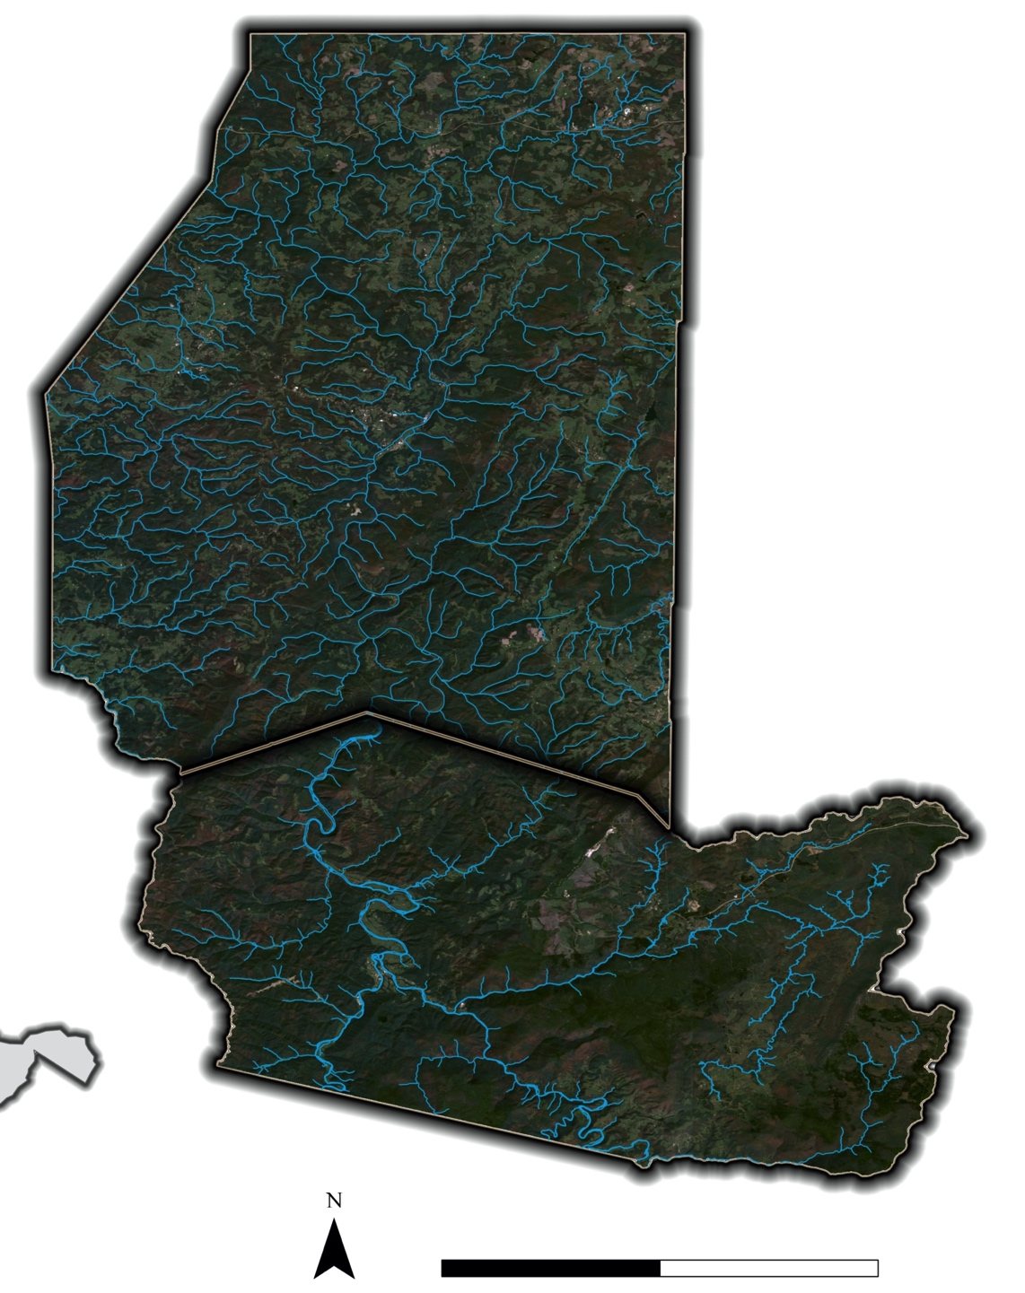
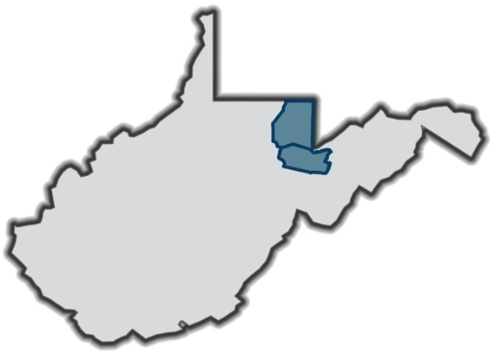
STUDY AREA
PRESTON COUNTY
Preston and Tucker County, West Virginia
January 1950 - December 2020
TUCKER COUNTY
West Virginia
N
0 20 miles
Notes:
Speaker: Mary Everett
Speaker Notes:
The study area for our DEVELOP project was located in Preston and Tucker counties in Northeast West Virginia.
In this project, we utilized data from January 1950 to December 2020

Slide 3
COMMUNITY CONCERNS
Flooding is one of the deadliest and most costly natural disasters
Cheat River flooding causes community and ecological damage in Preston and Tucker Counties
Changing climatic conditions could increase frequency of extreme precipitation in the region and worsen flooding
Image Credits: Friends of the Cheat
Notes:
Speaker: Mary Everett
Speaker Notes:
Flooding can be one of the most deadly and costly natural disasters because it can damage landcover and infrastructure, and worsen water quality. The Cheat River flows through the Preston and Tucker counties and because of its position within the Appalachian mountains as well as regional climate conditions, the Cheat River experiences frequent flooding. This has posed significant economic and ecological challenges for the surrounding communities. With the increasing changes in climate conditions, there is a growing threat of flood frequency and intensity. Because of this, there are mounting concerns about extreme flood damage in the future.
------------------------------Image Information Below ------------------------------
•Image Credit: Friends of the Cheat
•Image Source: Friends of the Cheat
•Image License: The team received written permission to use photographs.

Slide 4
PARTNERS
Friends of the Cheat (FOC) - founded in 1994 to mitigate contamination due to acid mine drainage
FOC aims to expand their focus to include proactive flood mitigation along Cheat River
Image Credits: Friends of the Cheat
Notes:
Speaker: Alex
Speaker Notes:
Friends of the Cheat (FOC) was founded in 1994 in response to severe river contamination due to acid mine drainage (AMD). Since 1994, FOC has been involved in a variety of monitoring and restoration projects aimed at reducing the ecological and community impacts of AMD and has succeeded in having the Cheat River removed from the national list of impaired waterways.
In recent years, FOC has expanded their work to proactively mitigate flood events in the watershed through activities such as riparian reforestation, dam removals, and community outreach.
We partnered with FOC for this project to provide information that can help them more effectively target their mitigation and restoration activities to prevent future flood damage.
------------------------------Image Information Below ------------------------------
•Image Credit: Friends of the Cheat
•Image Source: Friends of the Cheat
•Image License: The team received written permission to use photographs.

Slide 5
PROJECT OBJECTIVES
Identify long term trends in precipitation, temperature and river discharge
Quantify recent changes in land cover to better assess flood risk
Map flood risk and vulnerability to identify areas to target mitigation
Image Credits: Friends of the Cheat
Notes:
Speaker: Alex
Speaker Notes:
Changes in climate can have drastic impacts on precipitation and flood potential. To address the FOC’s concern about changing climatic conditions worsening flood severity or frequency, the team aimed to identify long term trends in precipitation, temperature and river discharge.
We also conducted supervised classifications of land cover from 1990 to 2020 to better understand whether land cover change trends could be exacerbating flood risk.
Lastly, we created a map of flood risk and flood vulnerability to help FOC and the communities along the Cheat River understand where to target flood mitigation efforts
------------------------------Image Information Below ------------------------------
•Image Credit: Friends of the Cheat
•Image Source: Friends of the Cheat
•Image License: The team received written permission to use photographs.

Slide 6
SATELLITES AND SENSORS
Landsat 5
Thematic Mapper (TM)
Landsat 8
Operational Land Imager (OLI)
Shuttle Radar Topography Mission
(SRTM)
Image Credits: NASA
Notes:
Speaker: McKenna
Speaker Notes:
To achieve our project objectives, we utilized several satellites and sensors.
We used Landsat 5 Thematic Mapper (TM) and Landsat 8 Operational Land Imager (OLI) to conduct a timeseries analysis of land cover between 1990 and 2020 and to calculate the Normalized Difference Water Index (NDWI), which was included in our flood risk map.
We also used elevation data from the Shuttle Radar Topography Mission in our flood risk map.
------------------------------Image Information Below ------------------------------
•Image Credits: NASA
•Image Sources: DEVELOPedia
•Image Licenses: Public Domain images.

Slide 7
FLOOD RISK & VULNERABILITY: ANCILLARY DATASETS
Data Source | End Product
National Climate Data Center (NCDC), National Oceanic and Atmospheric Administration (NOAA) | Climatology Timeseries
Stream Gauge Data, United States Geological Survey (USGS) | Climatology Timeseries
Multi-Resolution Land Characteristics (MRLC) National Land Cover Database (NLCD) | Land Cover Timeseries
Global 30m Height Above Nearest Drainage (HAND) | Flood Risk Map
Federal Emergency Management Agency (FEMA), Statewide Floodplain Polygons | Flood Risk Map
U.S. Census Bureau, Roads | Flood Vulnerability Map
Friends of the Cheat, Abandoned Mines | Flood Vulnerability Map
U.S. Census Bureau, TIGER, U.S. Census Blocks | Flood Vulnerability Map
Notes:
Speaker: Sabine
Speaker Notes:
Atmospheric Climate Data
To analyze climate trends, the team used data published by NOAA under the National Climate Data Center, which collects climate data for public access.
The team focused on monthly datasets so that climate trends over many years could be analyzed
The average range associated with monthly variables and the time range selected for the yearly variables was 1950 to 2020. This timeline was selected to compare climatic trends from the 20th Century to the climatic trends of the beginning of the 21st Century.
River Climate Trends and Variables:
The team used data from the United States Geological Survey (USGS) collected from the Cheat River gauge at Parsons, WV.
The team used the Multi-Resolution Land Characteristics (MRLC) National Land Cover Database (NLCD) to train our random forest classifier.
This trained classifier then classified the Landsat 5 TM and Landsat 8 OLI imagery previously mentioned to create our land cover timeseries.
To create our flood risk map, we utilized the classified land cover for 2020, the elevation data from SRTM, as well as the Global 30m Height Above Nearest Drainage available in Google Earth Engine, and the Federal Emergency Management Agency (FEMA) Statewide Floodplain Polygons.
For the Flood Vulnerability map, we also added roads and population from the Census Bureau and a dataset of abandoned mines from the Friends of the Cheat.

Slide 8
CLIMATOLOGY: METHODOLOGY
USGS River Gage Height
Timeseries Charts
NCDC Precipitation
USGS River Discharge
NCDC
Temperature
Statistical Analysis
USGS River Streamflow
Notes:
Speaker: Mary Everett
Speaker Notes:
To analyze our climatology data, we displayed atmospheric and river climate trends using statistical graphs to show if there are any consistently changing climate variables for the study area.
The atmospheric climate data was taken from a County-level (involving Preston and Tucker Counties separately) and we also used the Cheat river Gauge at Parsons, West Virginia for the River Climate data.
We then added trend lines to the statistical graphs to indicate if there were significant changes among climate variable averages.
For our Statistical Analysis timeseries, we found the mean for each monthly and yearly datasets then calculated the standard deviation for the datasets that’s were used to analyze change in climate trends.
The values that indicted greater than or equal to1 standard deviation above the mean were marked for significance and counted within the graphs.

Slide 9
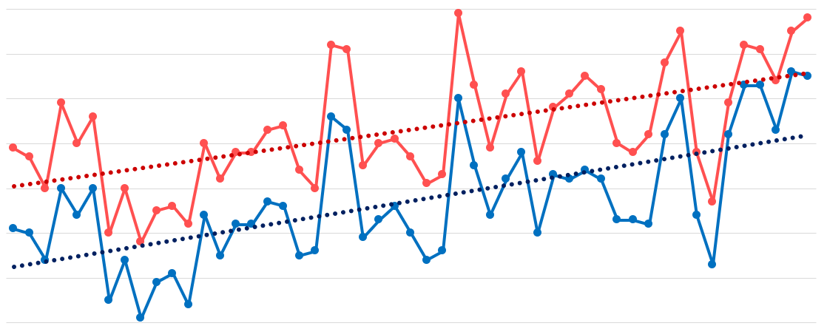
CLIMATOLOGY: RESULTS
Yearly Mean Temperature (1970 – 2020)
52
51
50
49
Temperature in °F
48
47
46
45
1970
1972
1974
1976
1978
1980
1982
1984
1986
1988
1990
1992
1994
1996
1998
2014
2016
2018
2000
2020
2002
2004
2006
2008
2010
2012
Year
Mean Temperature – Preston County
Trend Line – Preston County
Mean Temperature – Tucker County
Trend Line – Tucker County
Notes:
Speaker: McKenna
Mean Temperature is plotted using the solid line
The Trend Line of the Mean Temperature data is represented by the dotted line
The trend line is linear and suggests that the yearly average temperatures in Tucker County is increasing
Between 1970 and 2020, the trend of the yearly average temperature suggests that temperatures have increased
The change in temperatures is noticeable and should be noted, more significant than the changes in Preston County
This indicates that there is a significant trend of higher annual mean temperatures

Slide 10
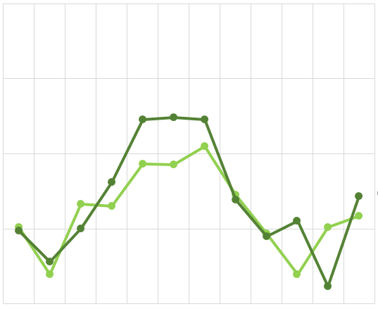
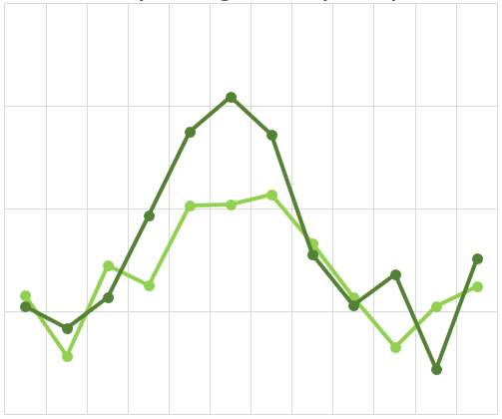
CLIMATOLOGY: RESULTS
Preston County Average Monthly Precipitation
Tucker County Average Monthly Precipitation
7
7
6
6
Precipitation Amount (inches)
5
5
Precipitation Amount (inches)
4
4
3
3
January
Month
Month
February
March
April
May
June
July
August
September
October
November
December
January
February
March
April
May
June
July
August
September
October
November
December
1970 - 1999
2000 - 2020
1970 - 1999
2000 - 2020
Notes:
Speaker: McKenna
Speaker Notes:
These graphs show the difference in the average amount of precipitation per month in each county
The light green lines are the mean between 1970 and 1999 for their respective county
The dark green lines are the mean between 2000 and 2019 for their respective county
As we can see in both county graphs, the means are different
There is an increase and/or decrease in the mean precipitation amount for each county, depending on the month
Both graphs show that the 2000-2019 mean is above the 1970-1999 mean, with the largest differences in the late spring and summer months.
Other times of the year show a precipitation average that is similar to past trends, while late fall is trending drier than normal.

Slide 11
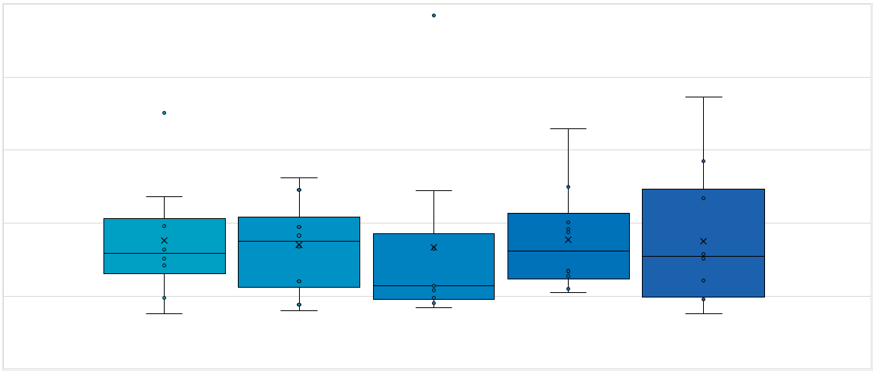
CLIMATOLOGY: RESULTS
Cheat River Discharge at the Parsons, WV Gauge
3500
3000
2500
Discharge (cubic feet per second)
2000
1500
1000
1970s
1980s
1990s
2000s
2010s
Notes:
Speaker: McKenna
Speaker Notes:
This is a box and whisker plot for the average river discharge per year, plotted by decade
The dots on the plot are the average yearly values
Any dot not plotted on the box or line for the decade is an outliner
The X in the plot is the mean for the decade
The line in the box is the median for the decade
Looking at the X’s (means) for the decades, we can see that there is a trend upward.
This indicates that the average discharge per decade is increasing.
Also looking at the range of values in discharge per decade is increasing in a positive direction slowly
The range extends higher up the graph for the 2000s and the 2010s than the first 3 decades plotted

Slide 12
LAND COVER: METHODOLOGY
NLCD Land Cover
Training Dataset
Remap land cover classes
Random Forest Classifier
Landsat 5 TM
Classified Imagery
Processed Imagery
Landsat 8 OLI
Filter June – August,
1985-2020
Cloud Masking
Reduce by median
Image Credits: NASA
Notes:
Speaker: Mary Everett
Speaker Notes:
To create our land cover timeseries, we trained a random forest classifier in Google Earth Engine using the NLCD Land Cover dataset previously mentioned with all the forest categories remapped into a single land cover class.
Then, to prepare the Landsat imagery to be classified, we filtered the imagery in Google Earth Engine to obtain images for the summer months using Landsat 5 data between the years 1990 and 2011 and Landsat 8 data between the years 2013-2020.
We chose to use summer months to avoid confusion with leaf off imagery.
Next, we cloud-masked all imagery and then reduced by median to obtain one image for each year.
Lastly, we used the trained classifier to classify the imagery into specific landcover classes.

Slide 13
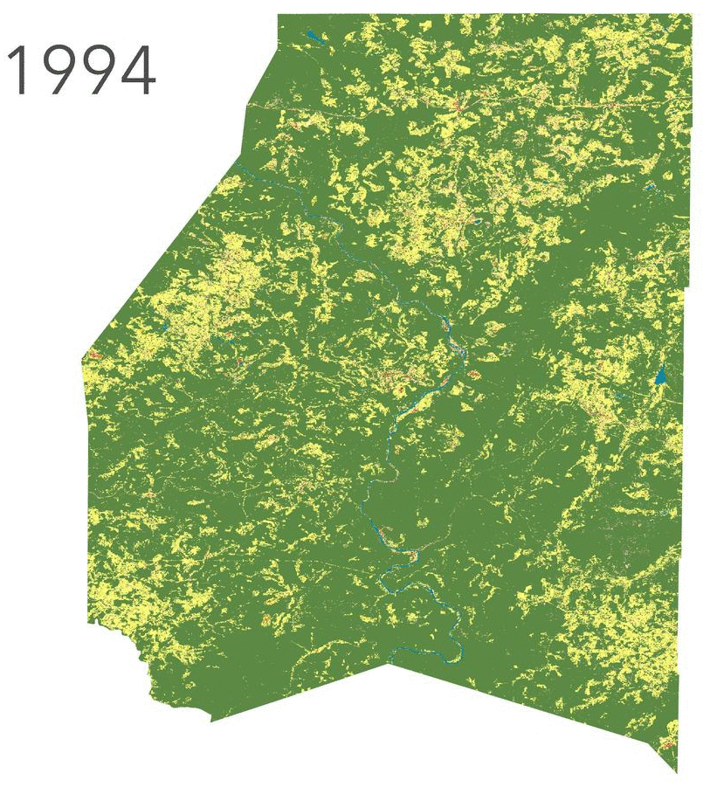
LAND COVER: RESULTS
Forest
Developed, Open Space
Developed, Low Intensity
Developed, Med. Intensity
Developed, High Intensity
Barren Land
Grassland/Herbaceous
Pasture/Hay
Cultivated Crops
Woody Wetlands
Emergent Herbaceous Wetlands
PRESTON COUNTY
Open Water
Notes:
Speaker: Sabine
Speaker Notes:
This gifs show the change in land cover classification for Preston county between 1990 and 2020.
We did not detect any substantial trends in land cover at the county level over this time period, however, smaller changes are likely occurring at the sub-county level that were too small to be picked up by our classifier.

Slide 14
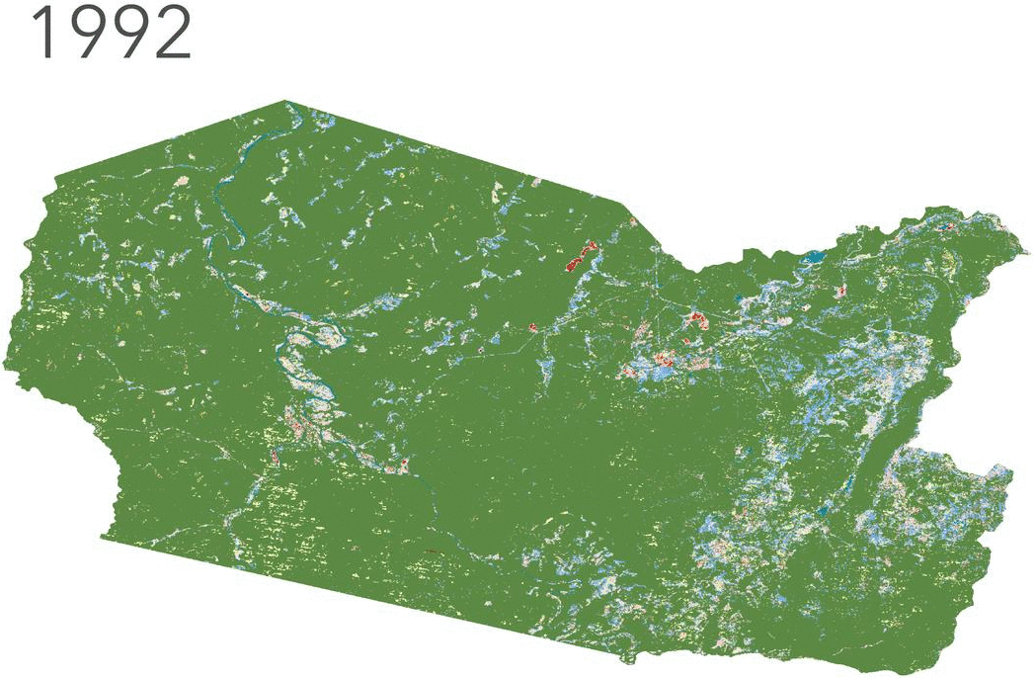
LAND COVER: RESULTS
Forest
Developed, Open Space
Developed, Low Intensity
Developed, Med. Intensity
Developed, High Intensity
Barren Land
Grassland/Herbaceous
Pasture/Hay
Cultivated Crops
Woody Wetlands
Emergent Herbaceous Wetlands
TUCKER COUNTY
Open Water
Notes:
Speaker: Sabine
Speaker Notes:
This gifs show the change in land cover classification for Tucker county between 1990 and 2020.
We did not detect any substantial trends in land cover at the county level over this time period, however, smaller changes are likely occurring at the sub-county level that were too small to be picked up by our classifier.

Slide 15
FLOOD RISK & VULNERABILITY: METHODOLOGY
Landsat 8 OLI (2013-2020)
NDWI (2013-2020)
Max Flood Extent
FEMA Floodplains
NDWI = (Green – Near-Infrared) / (Green + Near-Infrared)
Cloud Mask
Reduce by max pixel value
Water threshold
Total Flood Extent
Notes:
Speaker: Mary Everett
Speaker Notes:
The first step in calculating flood risk and flood vulnerability was determining the total extent of historical flooding.
To do this, we calculated NDWI (the Normalized Difference Water Index) for every Landsat 8 image between 2013 and 2020, which we then cloud masked and combined by taking the maximum pixel value for each pixel.
This functioned to give us the max flood extent because the NDWI equation gives higher values to pixels representing water, and lower values to dry pixels.
We then filtered the resulting image to get only the pixels above a certain threshold (which we used 0.1 as that value).
This worked to select only the pixels that had been flooded at some point 2013 and 2020. To get our final risk flood extent data, we combined the NDWI flood extent with the flood extent depicted in the FEMA 100 and 500 year floodplains. We incorporated this data set into our flood risk and vulnerability maps.

Slide 16
FLOOD RISK & VULNERABILITY: METHODOLOGY
Global HAND
Flood Extent
0-1 Raster
Flood Risk Map
0-1 Raster
Elevation
0-1 Raster
Fuzzy Membership
0-1 Rasters
Fuzzy Overlay
Land Cover Class
Fuzzy Overlay
Intersect
Reclassify land cover values
Population
Mines
Roads
Notes:
Speaker: Mary Everett
Speaker Notes:
For the purposes of this project, we defined flood risk to be the physical presence of flooding, while flood vulnerability specifically refers to vulnerability of human and human structures. To create the Flood Risk map, we downloaded all of our data and converted them to rasters with values from 0-1 using the Fuzzy Membership geoprocessing tool in ArcGIS Pro. By doing so, we were then able to combine and convert the Flood Extent, Elevation data, and the Global HAND values to 0-1 rasters directly using the Fuzzy Membership tool again. To incorporate the landcover data, we first reclassified the land cover classes so that the land cover categories that were most at-risk for flooding (such as developed areas and barren soil) received the lowest values, and the areas least at risk for flooding received the highest values. Then, we could convert this reclassified raster to a raster with 0-1 values with Fuzzy Membership tool once more. To finalize our Flood risk map, we used the Fuzzy Overlay tool to combine all the 0-1 rasters into a single flood risk map using both the overlay and option variables.
Lastly, to create the vulnerability maps, we combined the flood risk map and flood extent layer with several ancillary datasets such as roads, underground mines, and census population data. We found the intersection of these variables and used fuzzy overlay geoprocessing tool to combine the population dataset with the flood risk map to highlight areas of high vulnerability.

Slide 17
FLOOD RISK: RESULTS
High Flood Risk
Low Flood Risk
Image Credit: Google Earth Studio
Notes:
Speaker: Sabine
Speaker Notes:
This video depicts our flood risk map along sections of the Cheat River. The video highlights the varying topography in this region, which plays a large role in determining flood risk distribution.
In this map, the red areas are at higher risk for flooding, while the yellow and blue areas have less flood risk.
The video makes it clear that areas at lower elevation closer to the river are at substantially higher risk for flooding, which is also the area where many towns in these counties are located.

Slide 18
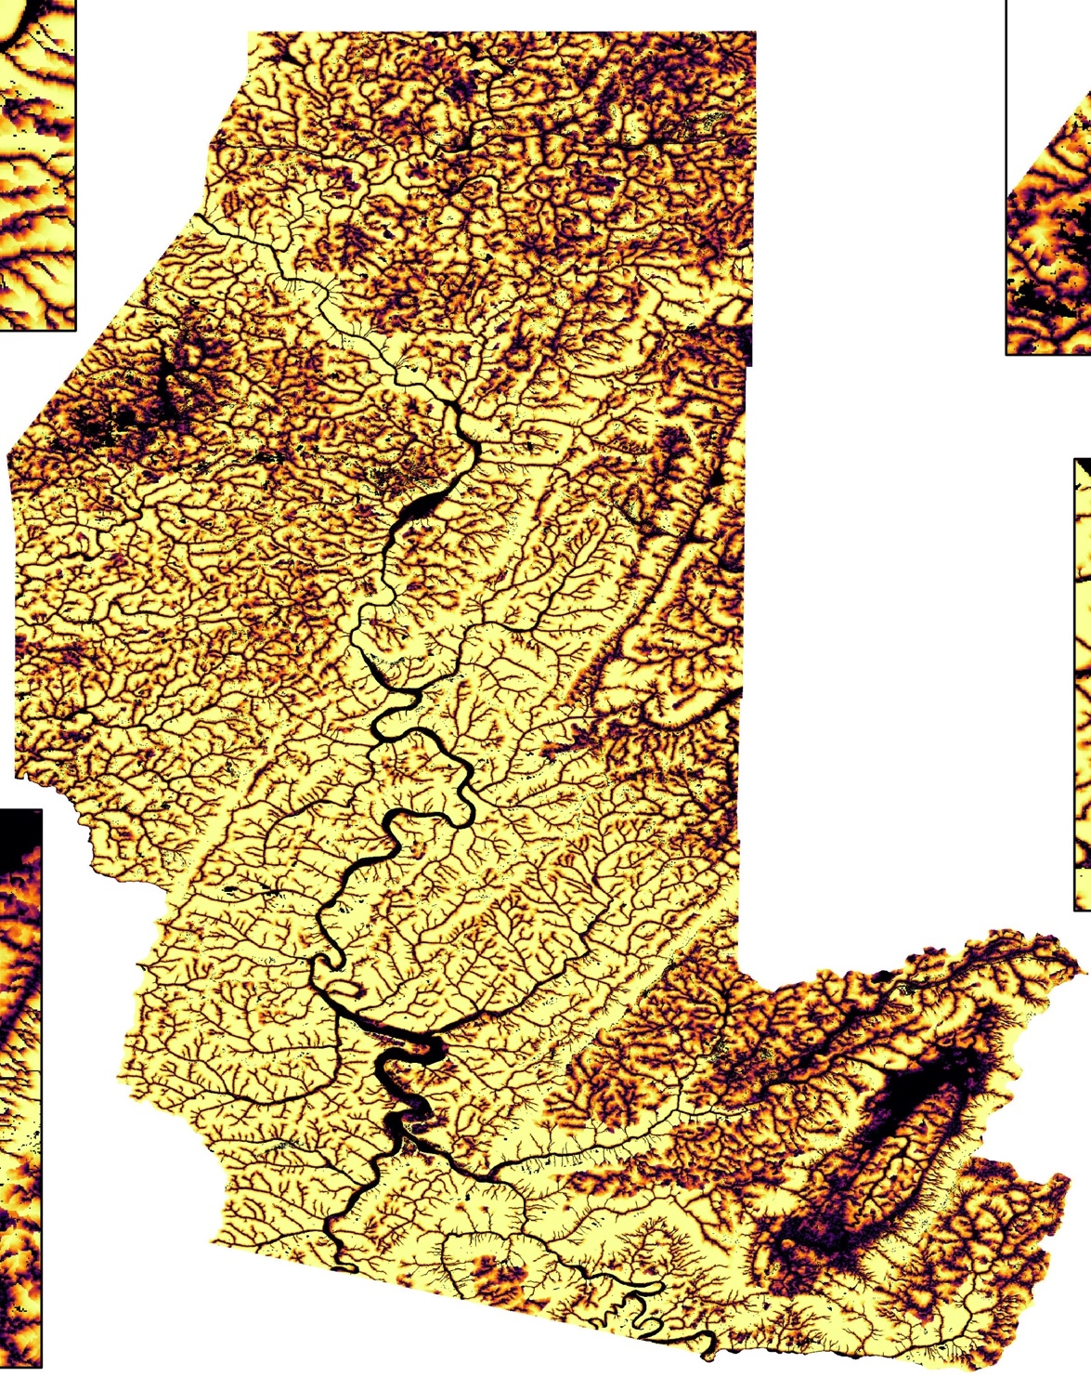
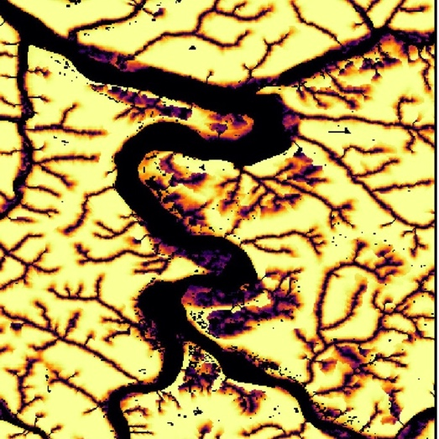
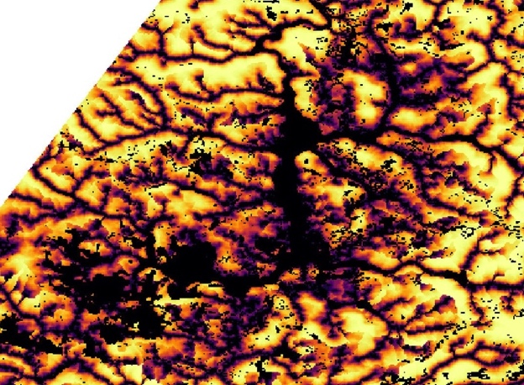
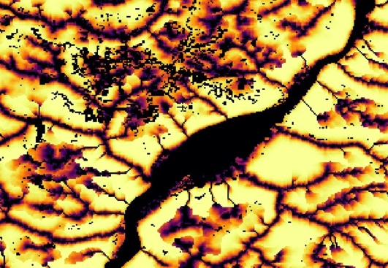
FLOOD RISK
Masontown
Arthurdale
Reedsville
Parsons
High Flood Risk
Low Flood Risk
Kingwood
0 20
miles
Notes:
Speaker: Alex
Speaker Notes:
This map depicts our flood risk map that incorporated 2020 land cover that we classified from Landsat 8 OLI imagery, FEMA Floodplains, NDWI Flood Extent, Height Above Nearest Drainage and Elevation.
In this map, the areas in dark purple and black are at higher risk for flooding, while the areas in lighter yellow are at lower risk for flooding.

Slide 19
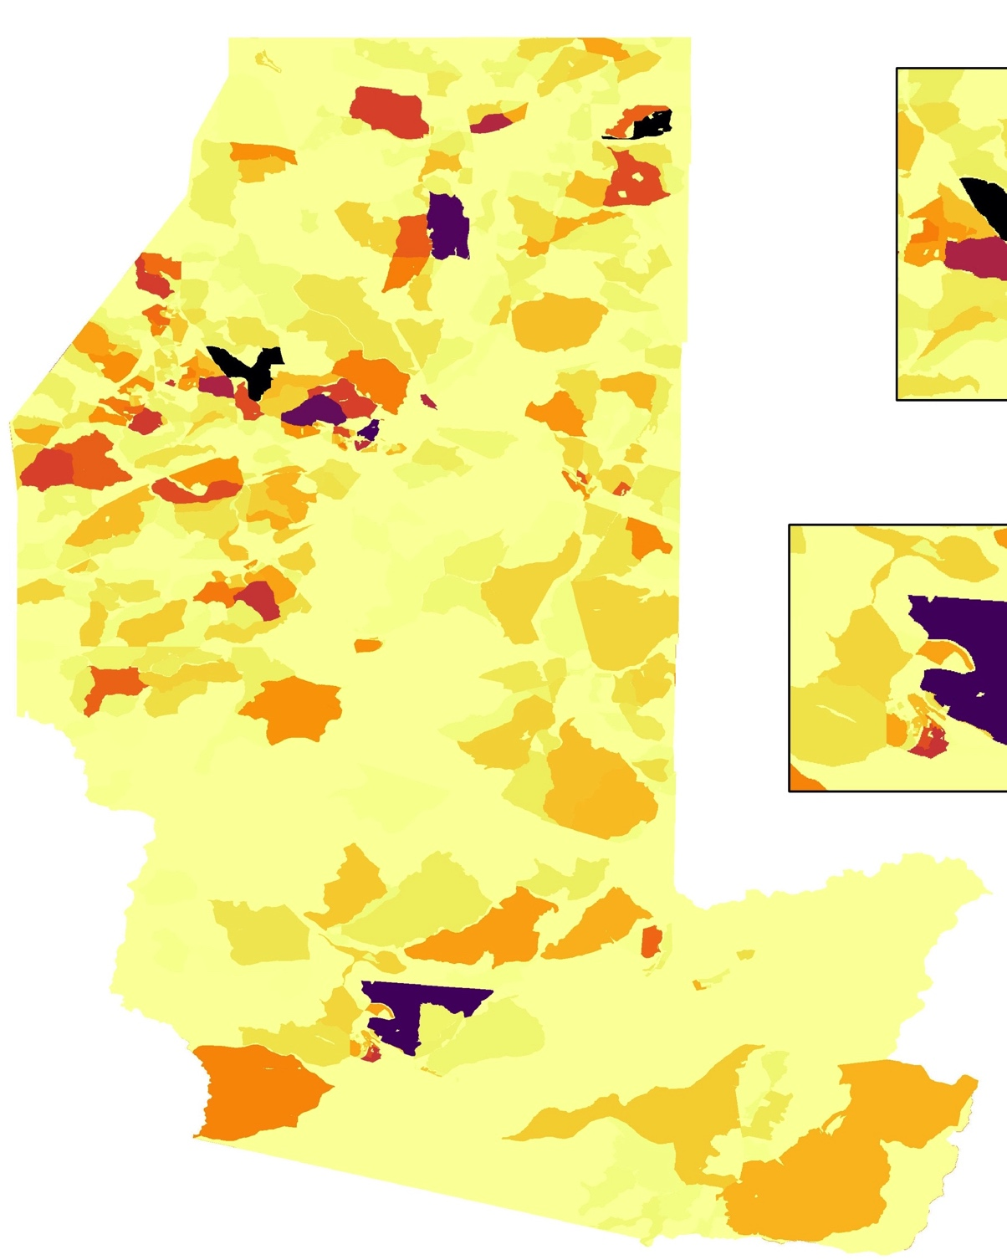
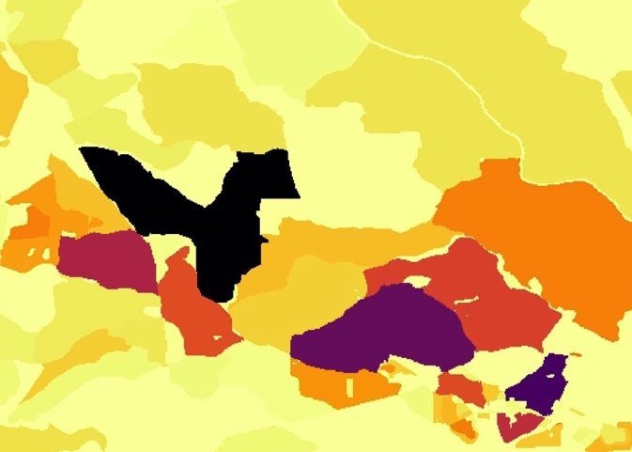
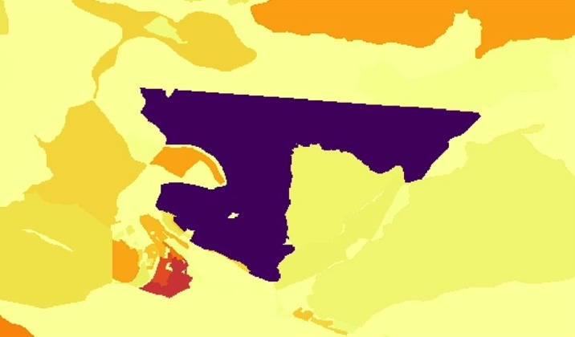
FLOOD VULNERABILITY - POPULATION
High Vulnerability
Low Vulnerability
Kingwood
Parsons
0 20
miles
Notes:
Speaker: Alex
Speaker Notes:
To better understand where people were most vulnerable to flooding, the team analyzed population vulnerability to flooding at the census block level. Using population numbers for each census block, the team was able to weight the average flood risk values by census block population. The final map on the right then shows flood vulnerability by census block, where darker purple and black census blocks had higher flood vulnerability (taking both high population and high flood risk into account), and lighter yellow has lower vulnerability ( taking lower population or lower flood risk into account).
Based on this analysis, some of the census blocks with the highest flood vulnerability are located near Parsons and Kingwood

Slide 20
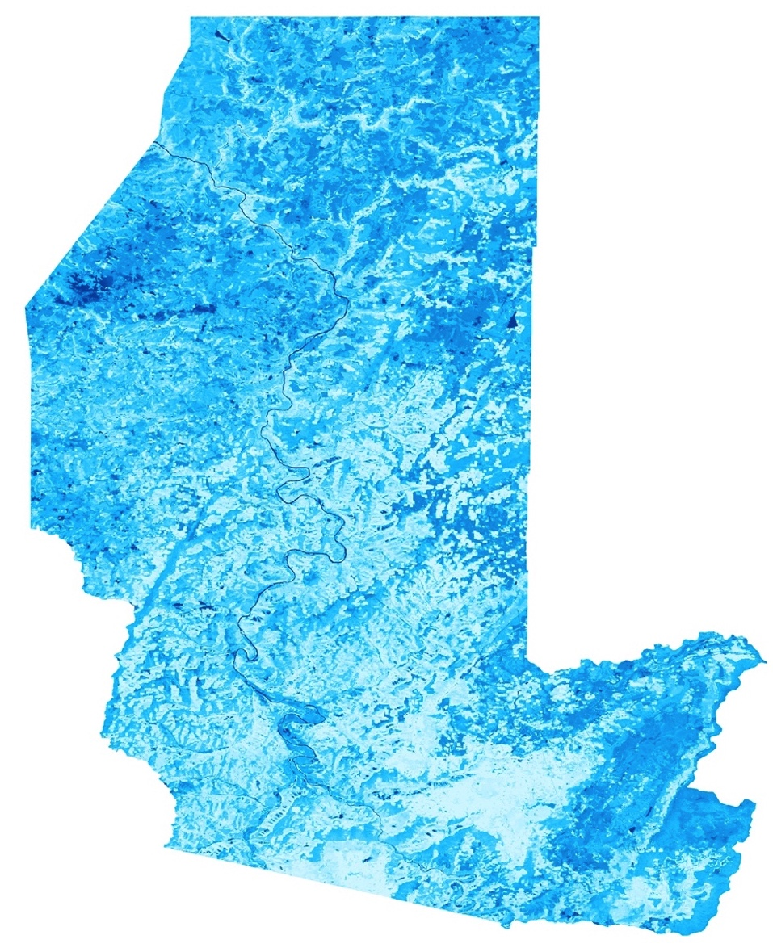
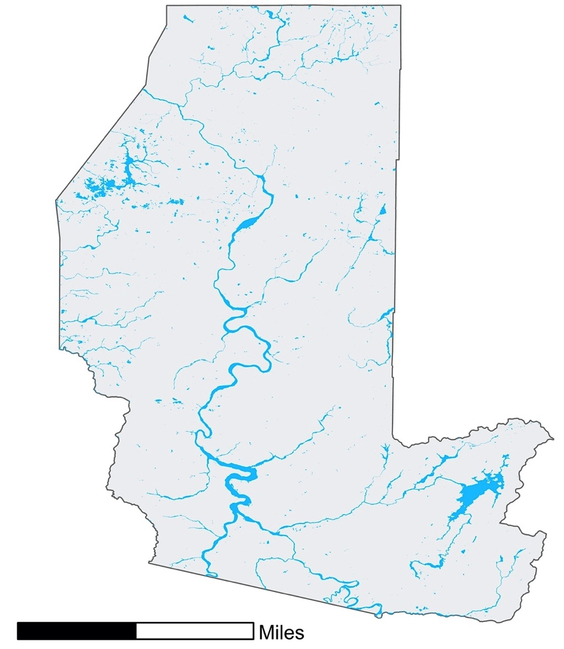
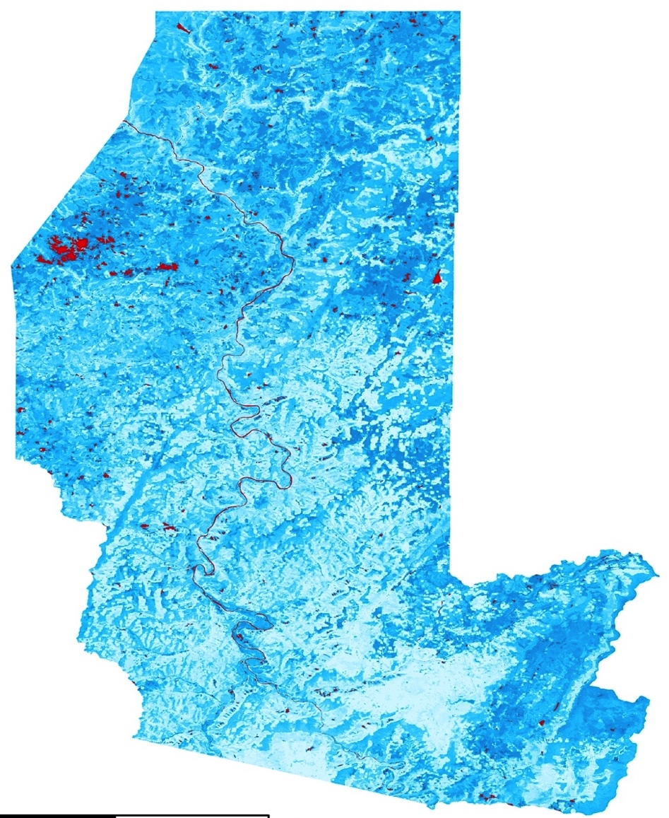
FLOOD RISK: FLOOD EXTENT
High NDWI (Water)
Low NDWI (Not Water)
Areas classified as flood extent
Total Flood Extent (Combined with FEMA Floodplains)
0 20
miles
Notes:
Speaker: Alex
Speaker Notes:
Given that FEMA Floodplain maps do not always show the full extent of flooding, we chose to combine the FEMA 100 and 500 year Floodplains with NDWI flood extents to get a map of the total area that has likely flooded between 2013 and 2020.
The image on the left shows NDWI calculated over the study area, with the areas in red representing the areas ultimately classified as water based on an NDWI threshold of 0.1.
The map on the right shows the full flood extent after combining NDWI with FEMA Floodplains, which was used in further vulnerability analyses.

Slide 21
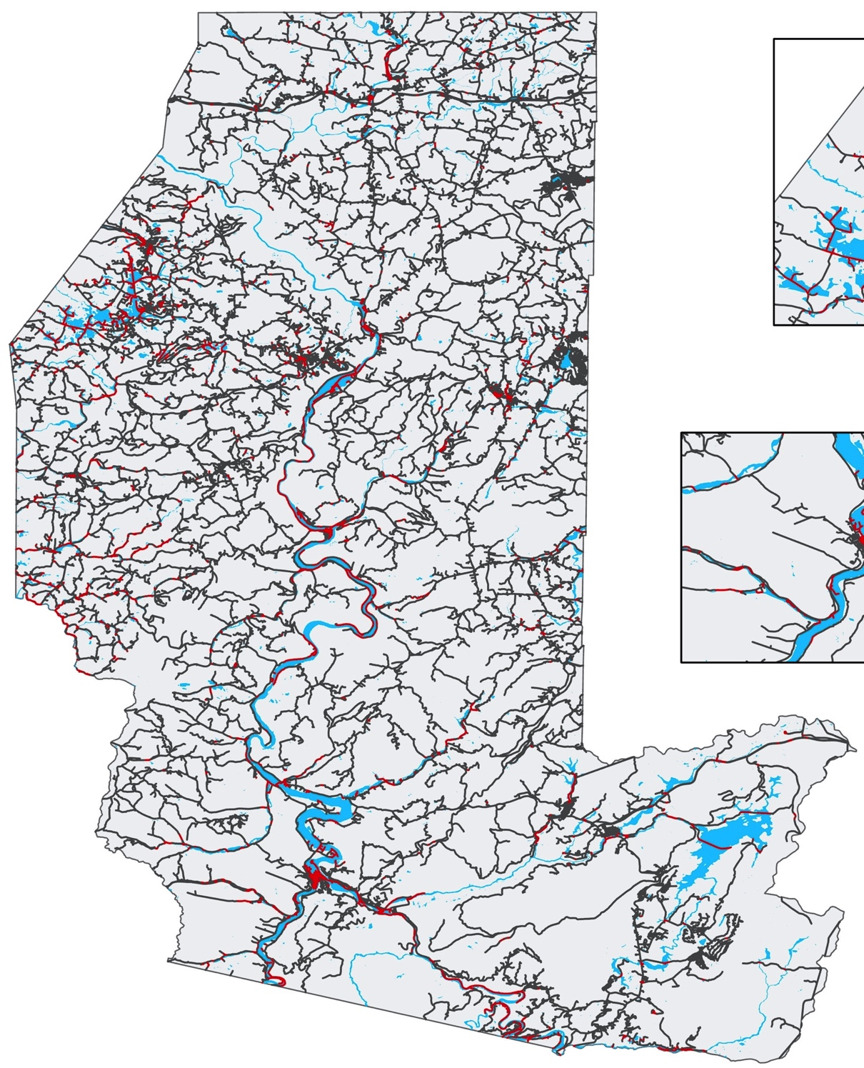
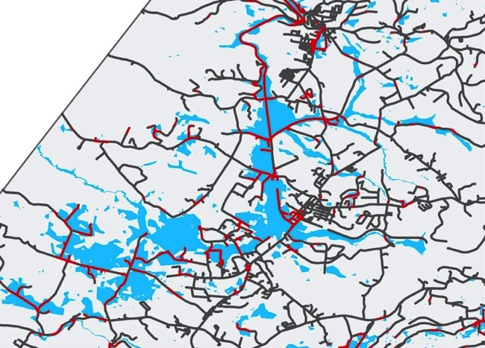
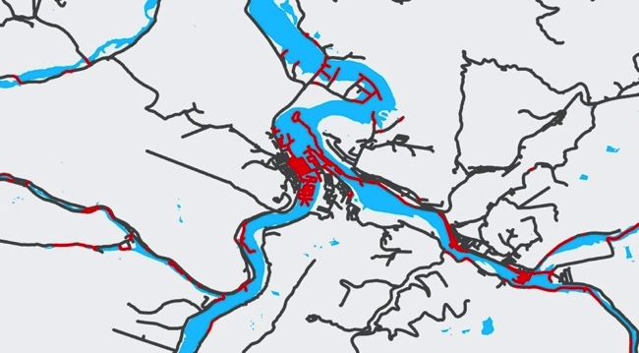
FLOOD VULNERABILITY - ROADS
Masontown
Roads
Vulnerable Roads
Arthurdale
Flood Extent
Parsons
0 20
miles
Notes:
Speaker: Mary Everett
Speaker Notes:
This map depicts the road network of Preston and Tucker Counties over the flood extent calculated from combining the NDWI flood extent and FEMA floodplains. On this map, the Roads within the flood extent were considered ”vulnerable roads”, and are highlighted in red.
The inset map shows regions with many vulnerable roads near Parsons, West Virginia and Mastontown, West Virginia.

Slide 22
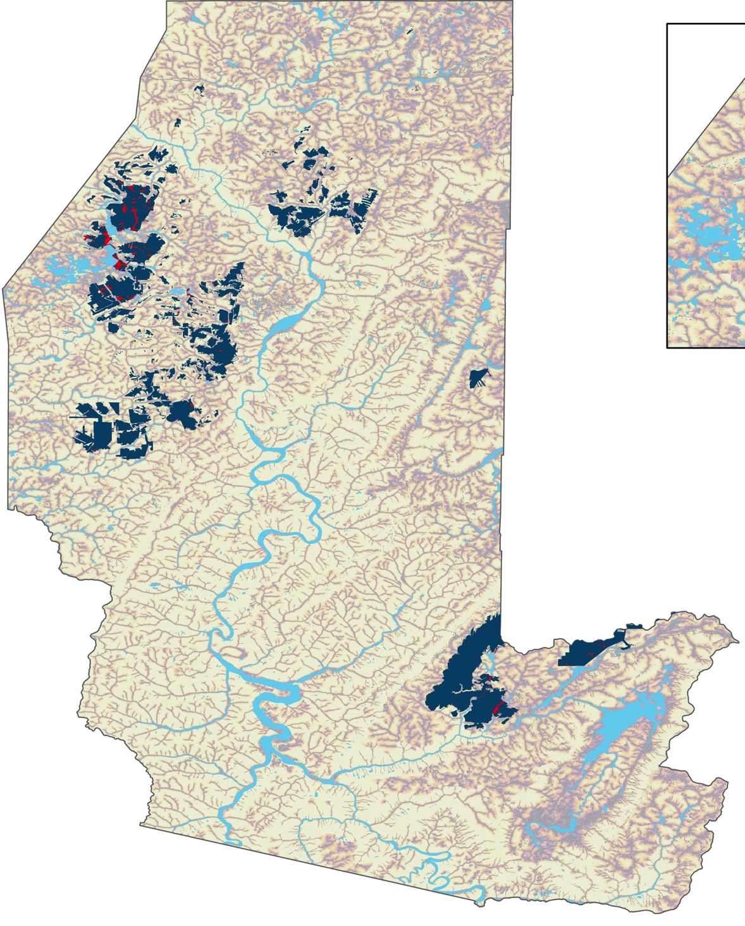
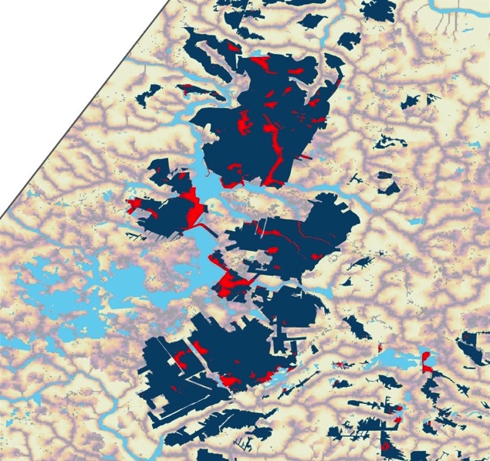
FLOOD VULNERABILITY - MINES
High Flood Risk
Low Flood Risk
Flood extent
Areas with mining
Mining areas within flood extent
0 20
miles
Notes:
Speaker: Mary Everett
Speaker Notes:
This map shows an overlay of mines within Preston and Tucker Counties, the flood risk map, and the flood extent. The mining areas highlighted in red are those that fall within the flood extent and are therefore considered vulnerable. Flooding near the mines can potentially intensify issues with Acid Mine Drainage, which can then worsen water quality and threaten human health and aquatic ecosystems.
The inset map shows one area with substantial parts of the mining area within the flood extent. This region could be vulnerable to flooding that lowers pH levels and increase toxins in the watershed.

Slide 23
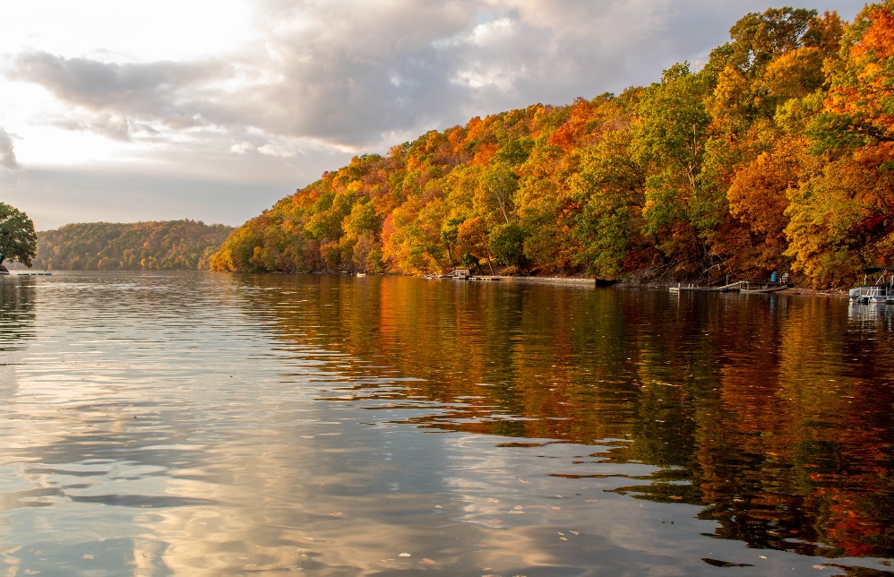
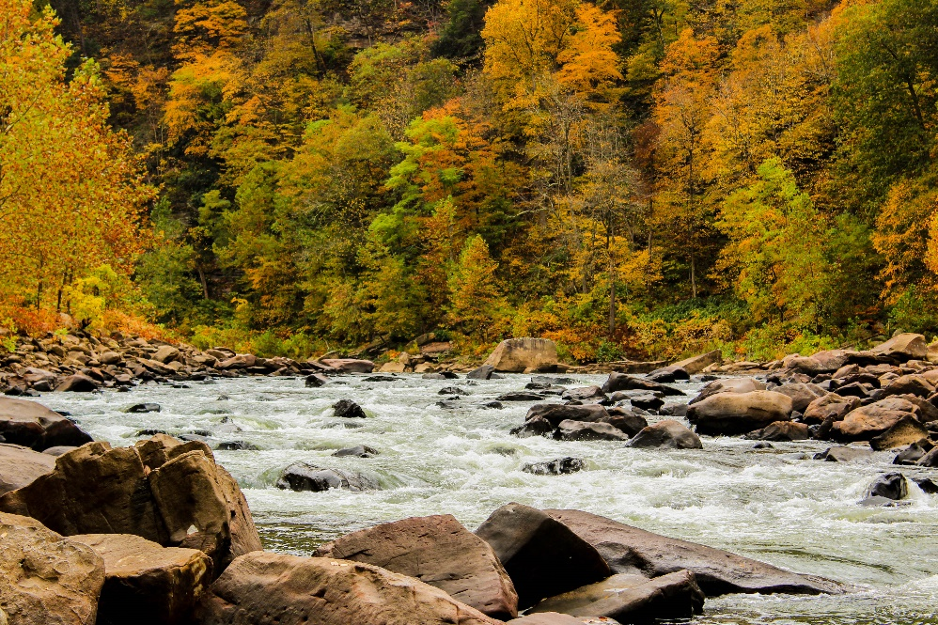
CONCLUSIONS
Precipitation has increased by 4.2 inches since 1970 while temperature has increased by about 2.75°F (1.5 °C)
No substantial changes in land cover at the county-level
Some of the most vulnerable areas include Parsons, Masontown, Reedsville, and Eglon
Image Credits: Friends of the Cheat
Notes:
Speaker: McKenna
Speaker Notes:
Overall, we found that average yearly precipitation has increased by 4.205 inches and temperature has increased 2.75°F.
There were no substantial changes in land cover at the county level, but it’s important to note that there could be smaller scale changes that were not picked up by the classifier.
Based on our flood risk and vulnerability map, some of the areas most susceptible to flooding include Parsons, Masontown, Reedsville, and Eglon.
------------------------------Image Information Below ------------------------------
•Image Credit: Friends of the Cheat
•Image Source: Friends of the Cheat
•Image License: The team received written permission to use photographs.

Slide 24
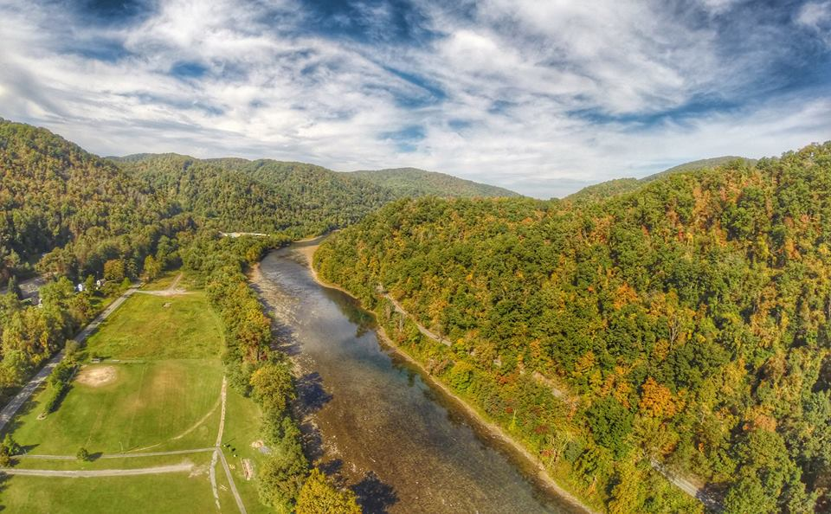
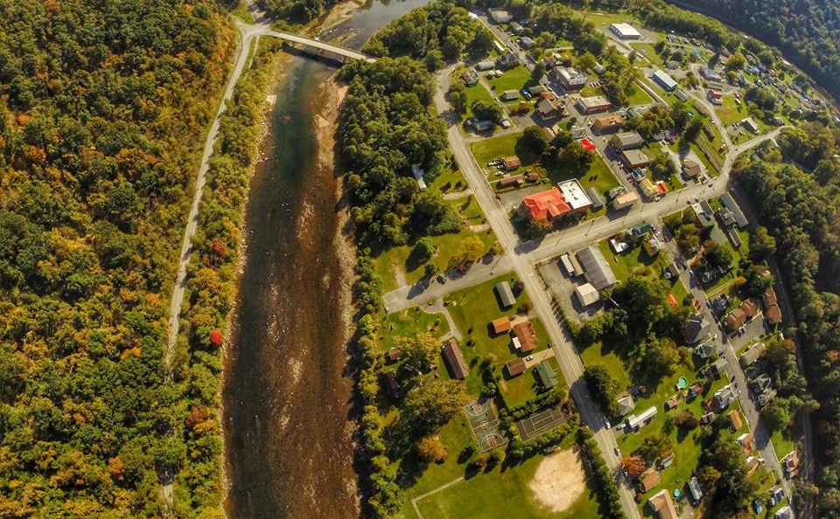
LIMITATIONS & FUTURE WORK
Limitations
Inconsistent stream gauge data
Limited spatial resolution in land cover change maps
Limited validation of NDWI flood extents
Future Work
Higher resolution and more accurate land cover classification
Increased validation of land cover classifications
Image Credits: Friends of the Cheat
Notes:
Speaker: Alex
Speaker Notes:
Inconsistent stream gauge data
A limited number of gauges along the Cheat River in the study area limited the scope of river climate data that team was able to collect. There were three “main” gauges that were available but two of these gauges had data that was not consistently collected, missing years of historical and current data.
Only one gauge in study area that had a large set of consistent and historical data, and this was the Cheat River Gauge in Parsons, WV.
Due to the limited spatial resolution of the land cover change maps, the team was not able to determine smaller scale land cover change trends
Due to time constraints, we were unable to validate the NDWI flood extents which leads to uncertainty in the flood risk and vulnerability maps
------------------------------Image Information Below ------------------------------
•Image Credit: Friends of the Cheat
•Image Source: Friends of the Cheat
•Image License: The team received written permission to use photographs.

Slide 25
Advisors:
Dr. Jeffrey Luvall, NASA Marshall Space Flight Center
Dr. Robert Griffin, University of Alabama in Huntsville
DEVELOP Fellow:
A. R. Williams, NASA DEVELOP Fellow
Partners:
Madison Ball, Friends of the Cheat
Beth Warnick, Friends of the Cheat
Notes:
Speaker: Alex
Speaker Notes:
We would like to thank everyone that made this project possible. Thank you to our science advisors, Dr. Jeffrey Luvall and Dr. Robert Griffin, and our DEVELOP Fellow, A.R. Williams.
Thank you also to our partners at Friends of the Cheat, Madison Ball and Beth Warnick.

Slide 26
SUPPLEMENTAL MATERIALS
Notes:
*Additional materials for partner handoff

Slide 27
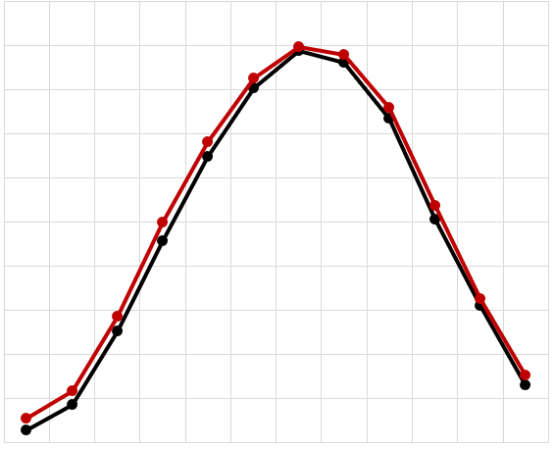
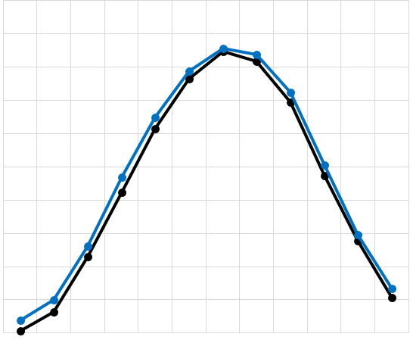
CLIMATOLOGY: RESULTS
Preston County Average Monthly Temperature
Tucker County Average Monthly Temperature
75
75
70
70
65
65
60
60
Temperature in °F
Temperature in °F
55
55
50
50
45
45
40
40
35
35
30
30
25
25
Month
Month
January
February
March
April
May
June
July
August
September
October
November
January
December
February
March
April
May
June
July
August
September
October
November
December
1970 - 1999
2000 - 2020
1970 - 1999
2000 - 2020
Notes:
*Additional materials for partner handoff
Speaker: McKenna
Tucker County
Monthly temperatures have increased since the start of the 21st century
The line representing 2000-2020 is above the line representing 1970-1999
Indicates that temperatures from 2000-2020 are measuring higher than those of 1970-1999
Preston County
Monthly temperatures have increased slightly since the start of the 21st century
While the line representing 2000-2020 is slightly higher than the line representing 1970-1999, the difference between them is not as significant as the difference in the Tucker County graph

Slide 28
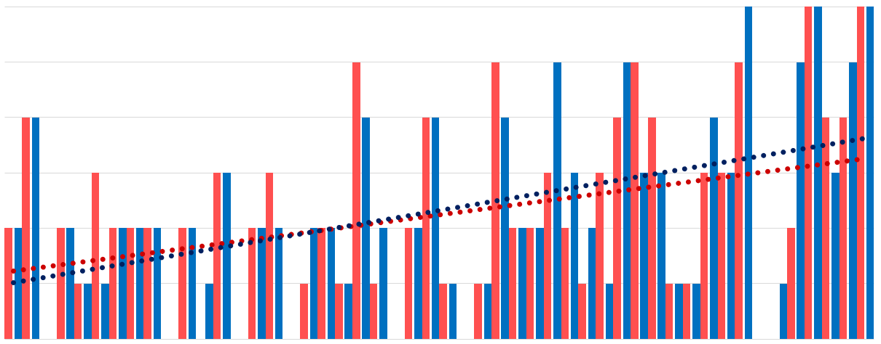
CLIMATOLOGY: RESULTS
Number of Months with Significantly Above Average Temperatures
6
5
4
3
Number of Months per Year
2
1
0
1970
1972
1974
1976
1978
1980
1982
1984
1986
1988
1990
1992
1994
1996
1998
2014
2016
2000
2018
2002
2004
2006
2008
2010
2012
Preston County
Trend Line – Preston County
Year
Tucker County
Trend Line – Tucker County
Notes:
*Additional materials for partner handoff
Speaker: McKenna
Using monthly precipitation data for Preston and Tucker Co. from each month from January 1950 to December 2019
Mean of each month was calculated
Standard deviation of each month was calculated
Values of the month that were 1 or more standard deviations higher than the mean were marked for significance
The number of months graphed per year in this graph, indicate the number of months that year that strayed 1 or more s.d. higher than the mean for that month
The two trend lines indicate the linear trend of Preston and Tucker Counties
As shown by the positive slopes of the trend lines, we can conclude that the number of months per year that are significantly above average is increasing.
But Preston County has a much smaller increase (slope) of months per year that are significantly above average precipitation

Slide 29
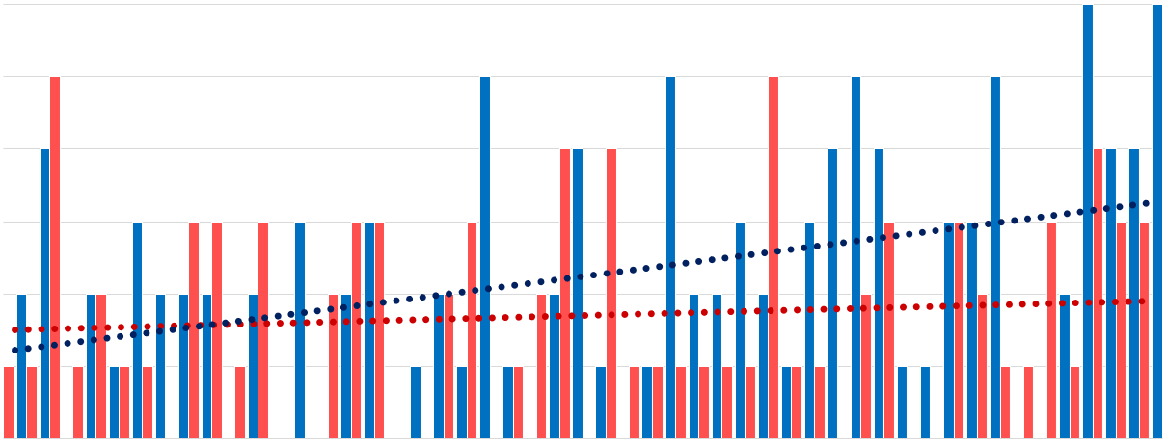
CLIMATOLOGY: RESULTS
Number of Months with Significantly Above Average Precipitation
6
5
4
3
Number of Months per Year
2
1
0
1970
1972
1974
1976
1978
1980
1982
1984
1986
1988
1990
1992
1994
1996
1998
2014
2016
2000
2018
2002
2004
2006
2008
2010
2012
Preston County
Trend Line – Preston County
Year
Tucker County
Trend Line – Tucker County
Notes:
*Additional materials for partner handoff
Speaker: McKenna
Using average monthly temperature data for Preston and Tucker Co. from each month from January 1950 to December 2019
Mean of each month was calculated
Standard deviation of each month was calculated
Values of the month that were 1 or more standard deviations higher than the mean were marked for significance
The number of months graphed per year in this graph, indicate the number of months that year that strayed 1 or more s.d. higher than the mean for that month, between the years of 1970 and 2019
The two trend lines indicate the linear trend of Preston and Tucker Counties
As shown by the positive slopes of the trend lines, we can conclude that the number of months per year that are significantly above average is increasing.

Slide 30
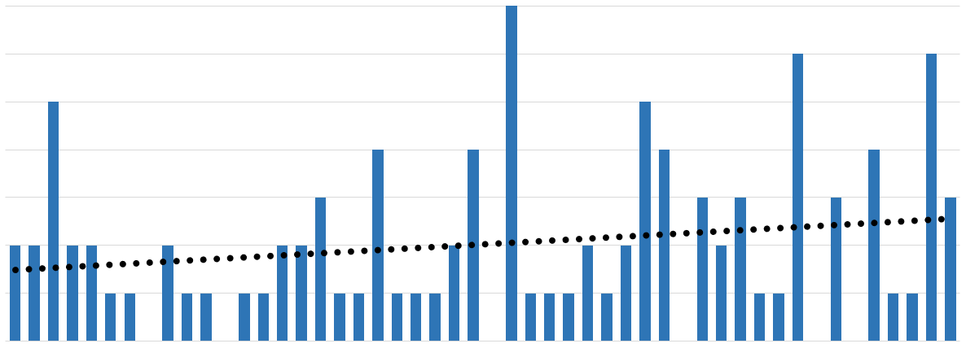
CLIMATOLOGY: RESULTS
Number of Month with Significantly Above Average River Discharge – Parsons, WV Gauge
7
6
5
4
Number of Months per Year
3
2
1
0
1970
2014
1972
1974
1976
1978
1980
1982
1984
1986
1988
1990
1992
1994
1996
1998
2016
2000
2018
2002
2004
2006
2008
2010
2012
Year
Number of Significant Months
Trend Line of Significant Months
Notes:
*Additional materials for partner handoff
Speaker: McKenna
Using monthly discharge data from January 1950 to December 2019 – Parsons Gauge
Mean of each month was calculated
Standard deviation of each month was calculated
Values of the month that were 1 or more standard deviations higher than the mean were marked for significance
The number of months graphed per year in this graph, indicate the number of months that year that strayed 1 or more s.d. higher than the mean for that month, between the years of 1970 and 2019
The linear trend line shows that the number of significant months per year for discharge, are increasing
Have increased from an average of 1 month per year to 2.5 months per year

Slide 31
LAND COVER: RESULTS
Notes:
*Additional materials for partner handoff
Speaker: Sabine
Speaker Notes:
This graph shows the change in land cover classification for Preston county between 1990 and 2020.
We did not detect any substantial trends in land cover at the county level over this time period, however, smaller changes are likely occurring at the sub-county level that were too small to be picked up by our classifier.
The reason the total area of land cover analyzed decreases over time is due to increased levels of cloudy imagery reducing the number of pixels available for analysis. NoData values (not shown here) increase as the other classes drop off.

Slide 32
LAND COVER: RESULTS
Notes:
*Additional materials for partner handoff
Speaker: Sabine
Speaker Notes:
This graph shows the change in land cover classification for Tucker county between 1990 and 2020.
As for Preston County, we did not detect any substantial trends in land cover at the county level over this time period, however, smaller changes are likely occurring at the sub-county level that were too small to be picked up by our classifier.
The reason the total area of land cover analyzed decreases over time is due to increased levels of cloudy imagery reducing the number of pixels available for analysis. NoData values (not shown here) increase as the other classes drop off.

Slide 33
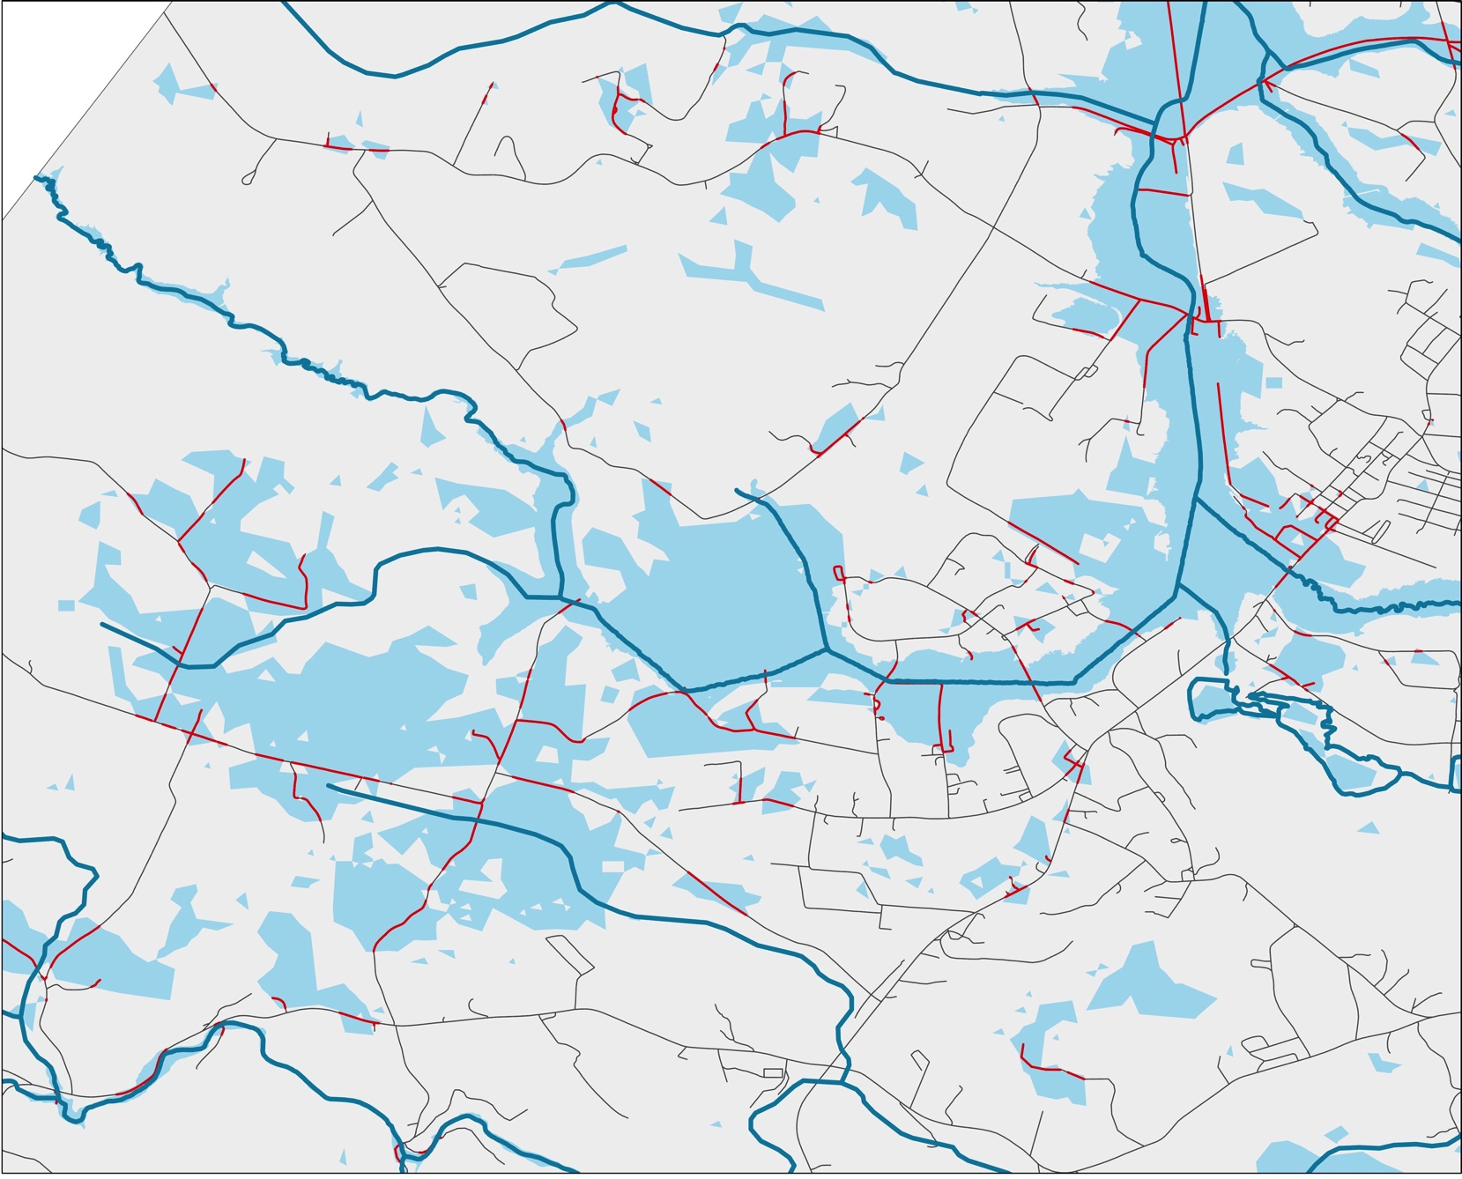
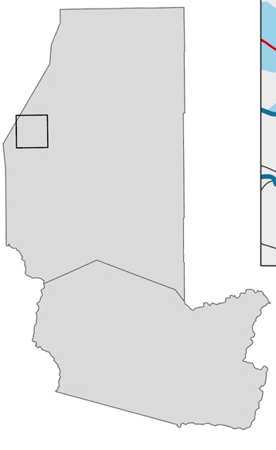
FLOOD VULNERABILITY
-ROADS
Dillan Creek
Laurel Run
Deckers Creek
Roads
Vulnerable Roads
Creek
Kanes
Streams & Tributaries
Deckers
Creek
Flood Extent
Masontown
Reedsville
Stony Run
Kingwood
Rowlesburg
Fields Creek
Parsons
0 3
miles
Notes:
*Additional materials for partner handoff
Speaker Notes:
This map shows the flood extent and vulnerable roads near Reedsville

Slide 34
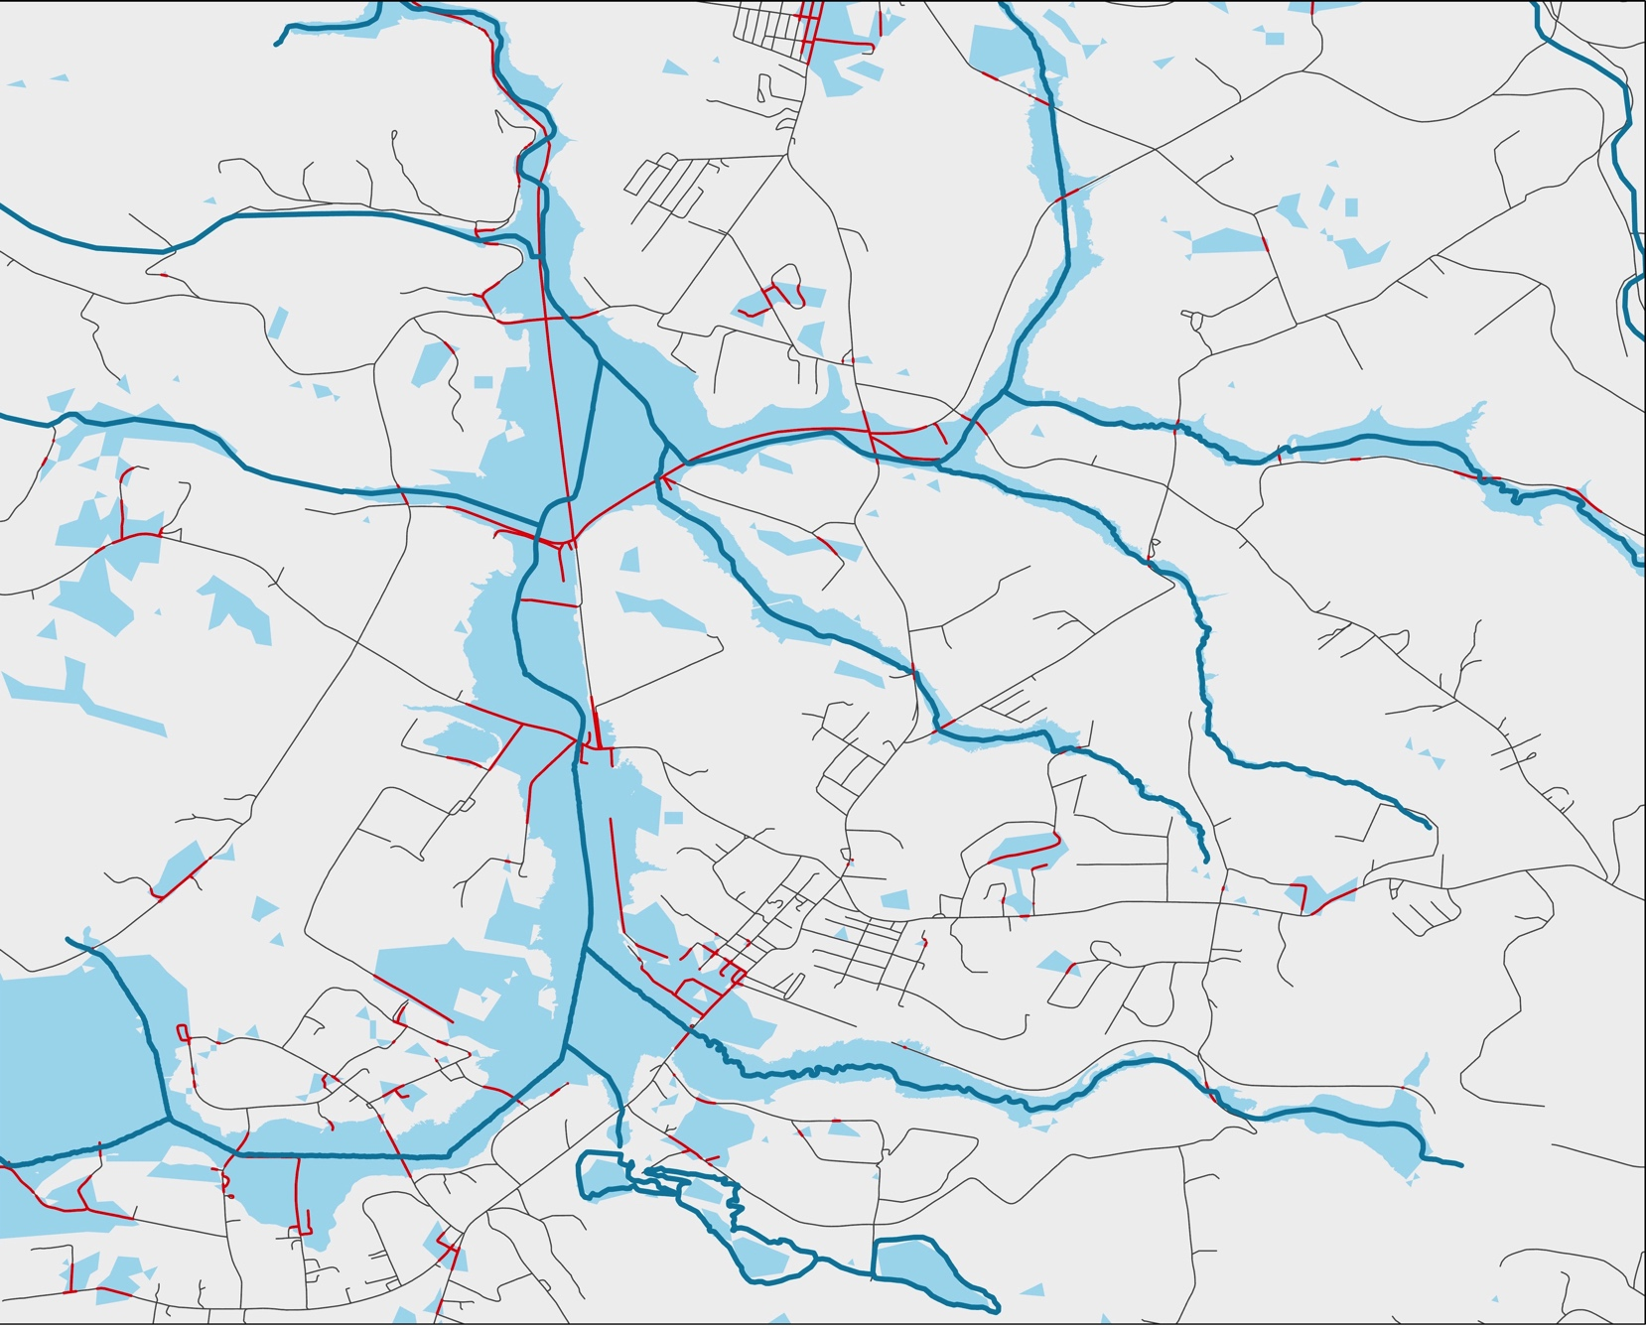
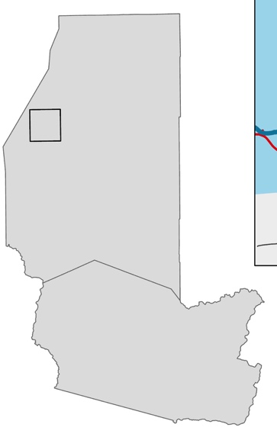
FLOOD VULNERABILITY
-ROADS
Swamp Run
Run
Slabcamp
Roads
Dillan Creek
Laurel Run
Vulnerable Roads
Streams & Tributaries
Flood Extent
Masontown
Reedsville
Kanes
Kingwood
Deckers
Creek
Creek
Rowlesburg
Parsons
0 3
miles
Notes:
*Additional materials for partner handoff
Speaker Notes:
This map shows the flood extent and vulnerable roads near Reedsville and Masontown

Slide 35
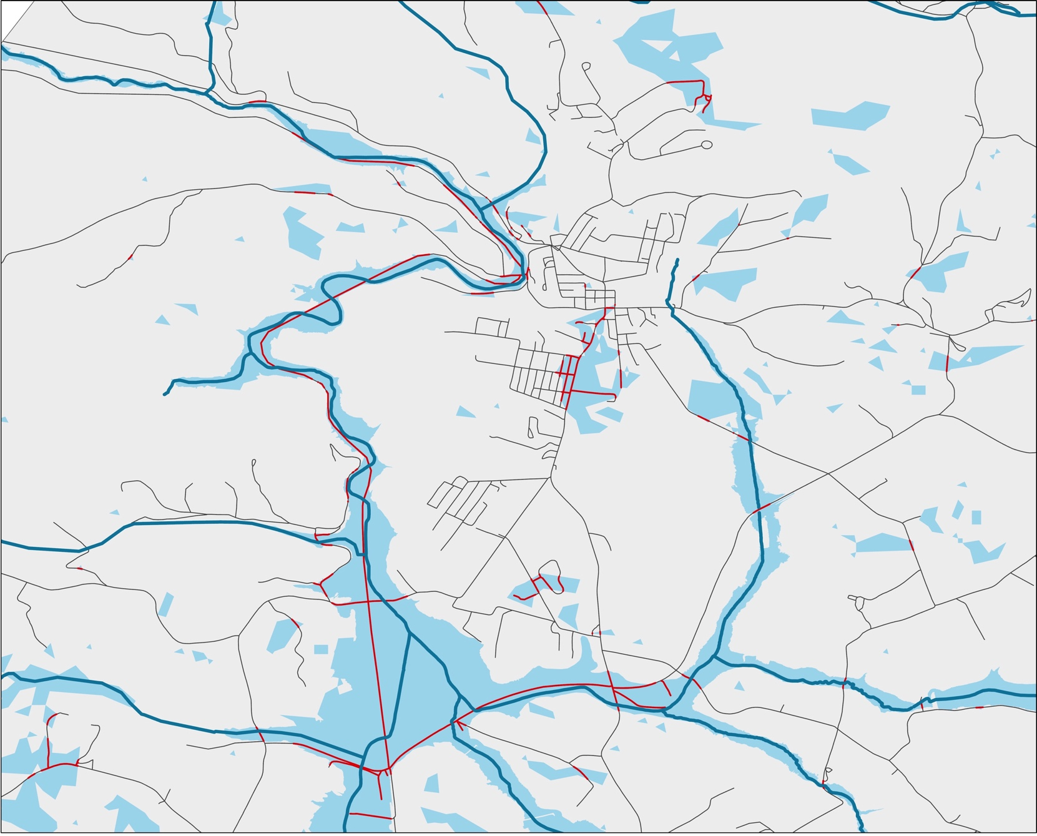
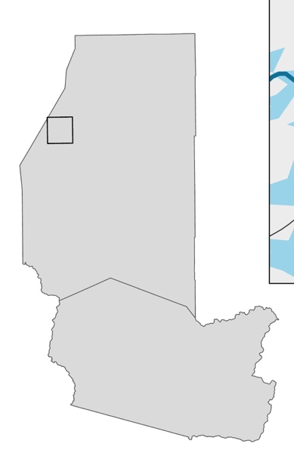
FLOOD VULNERABILITY
-ROADS
Glady Run
Roads
Deckers Creek
Vulnerable Roads
Swamp Run
Streams & Tributaries
Slabcamp Run
Flood Extent
Masontown
Reedsville
Kingwood
Dillan Creek
Dillan Creek
Rowlesburg
Laurel Run
Parsons
0 2
miles
Notes:
*Additional materials for partner handoff
Speaker Notes:
This map shows the flood extent and vulnerable roads near Masontown

Slide 36
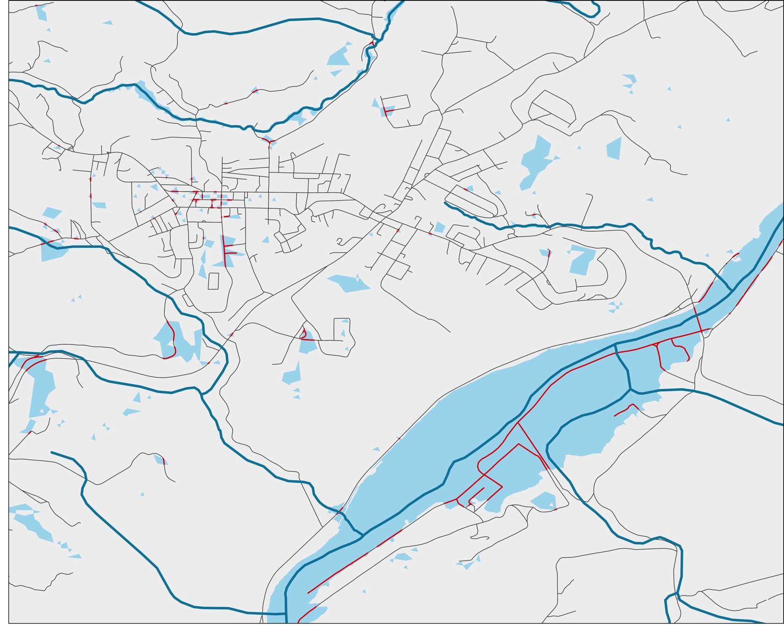
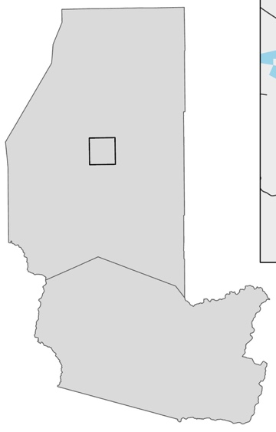
FLOOD VULNERABILITY
-ROADS
Run
South Fork
Greens
Roads
Vulnerable Roads
Streams & Tributaries
Flood Extent
Cheat River
Morgan Run
Masontown
Reedsville
Kingwood
Buffalo Run
Rowlesburg
Parsons
0 2
miles
Notes:
*Additional materials for partner handoff
Speaker Notes:
This map shows the flood extent and vulnerable roads near Kingwood

Slide 37
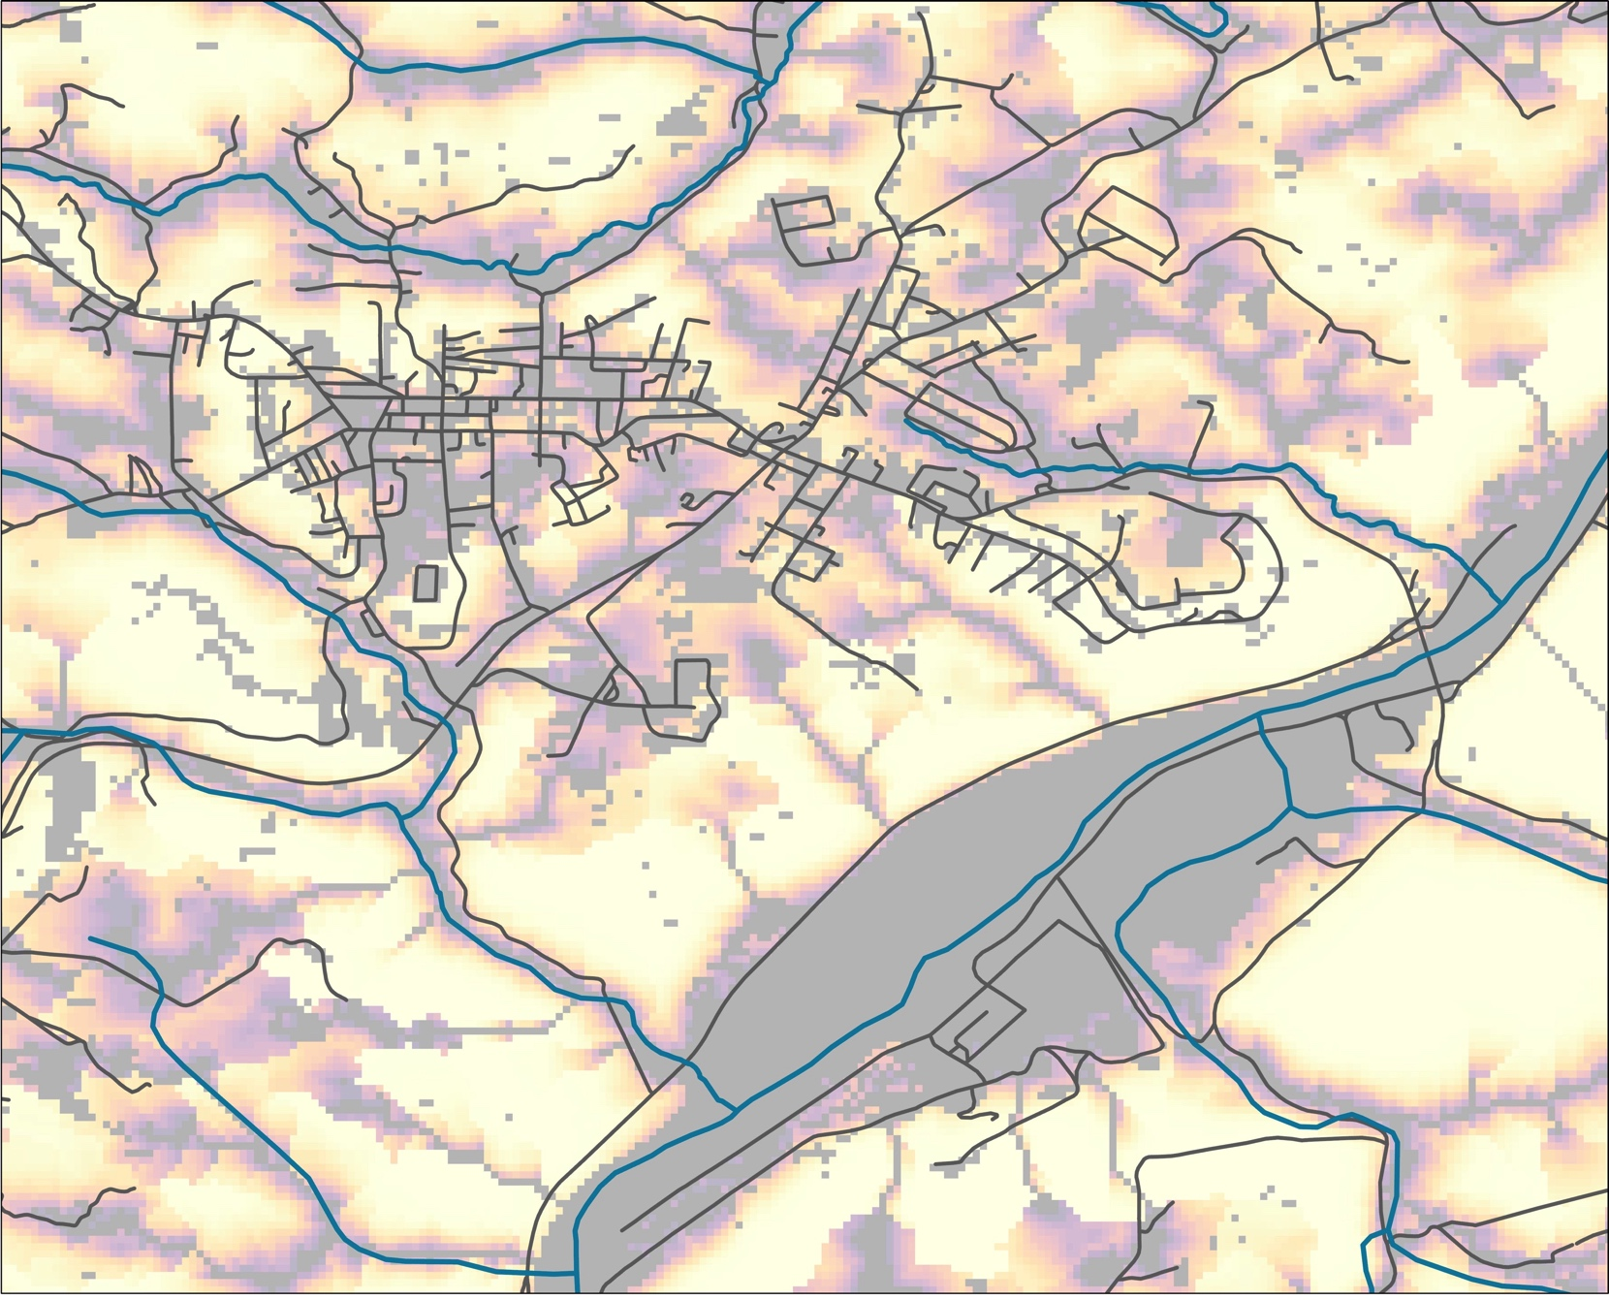
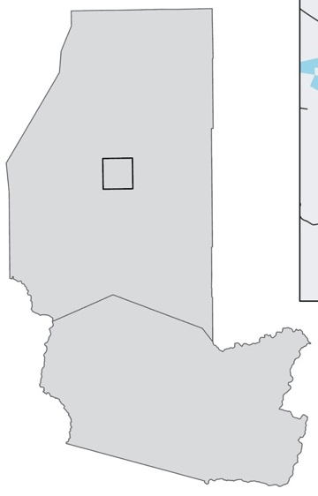
FLOOD VULNERABILITY
-ROADS
Run
South Fork
Greens
Roads
Streams & Tributaries
High Risk
Low Risk
Cheat River
Morgan Run
Masontown
Reedsville
Kingwood
Buffalo Run
Rowlesburg
Parsons
0 2
miles
Notes:
*Additional materials for partner handoff
Speaker Notes:
This map shows the flood risk map, roads and tributaries near Kingwood

Slide 38
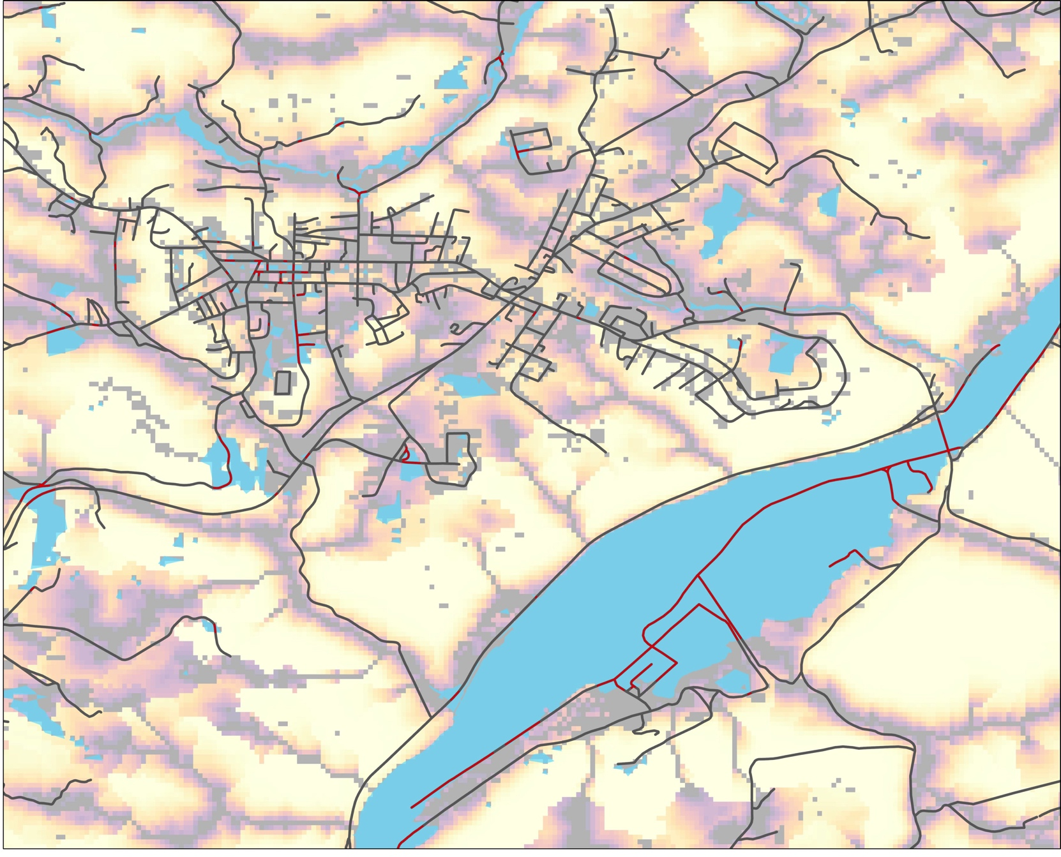
FLOOD VULNERABILITY
-ROADS
Roads
Vulnerable Roads
Flood Extent
High Risk
Low Risk
Masontown
Reedsville
Kingwood
Rowlesburg
Parsons
0 2
miles
Notes:
*Additional materials for partner handoff
Speaker Notes:
This map shows the flood risk map, roads and flood extent near Kingwood

Slide 39
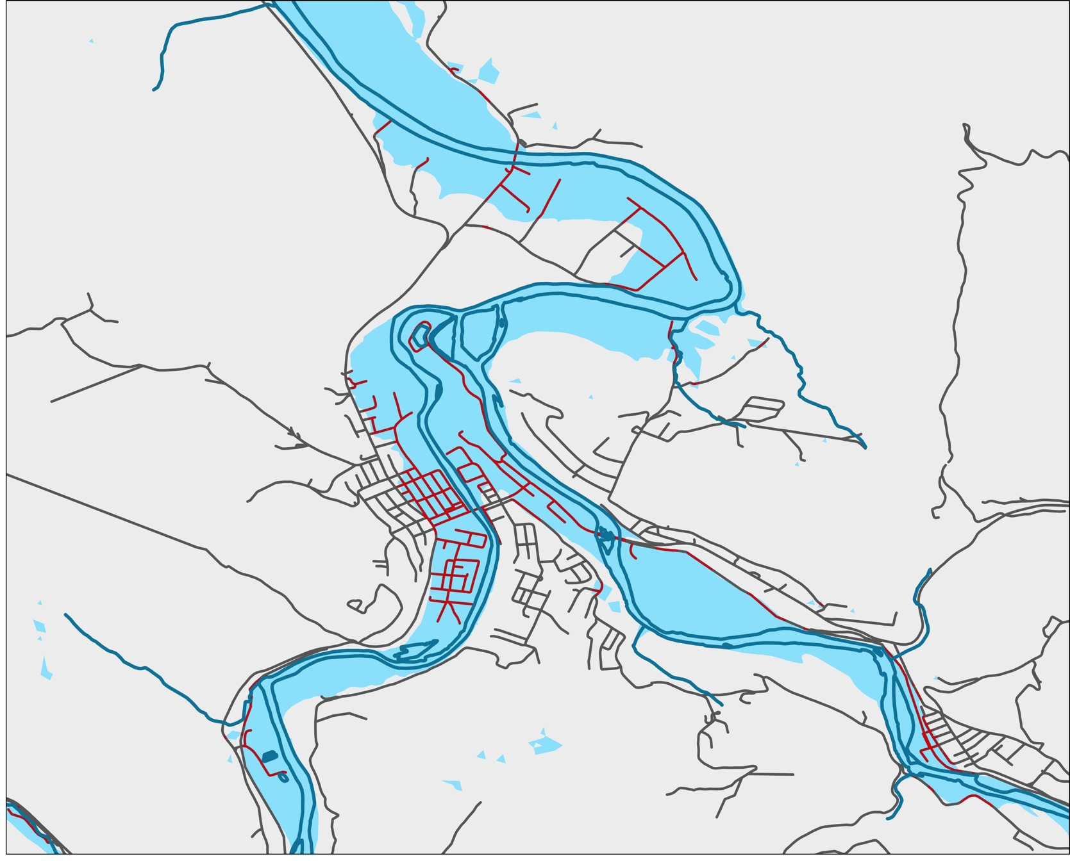
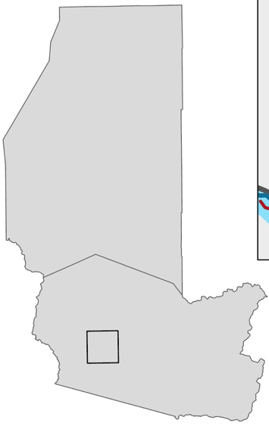
FLOOD VULNERABILITY
-ROADS
Cheat River
Roads
Vulnerable Roads
Flood Extent
Masontown
Black Fork
Reedsville
Shaves
Fork
Kingwood
Rowlesburg
Parsons
0 2
miles
Notes:
*Additional materials for partner handoff
Speaker Notes:
This map shows the flood extent and vulnerable roads near Parsons

Slide 40
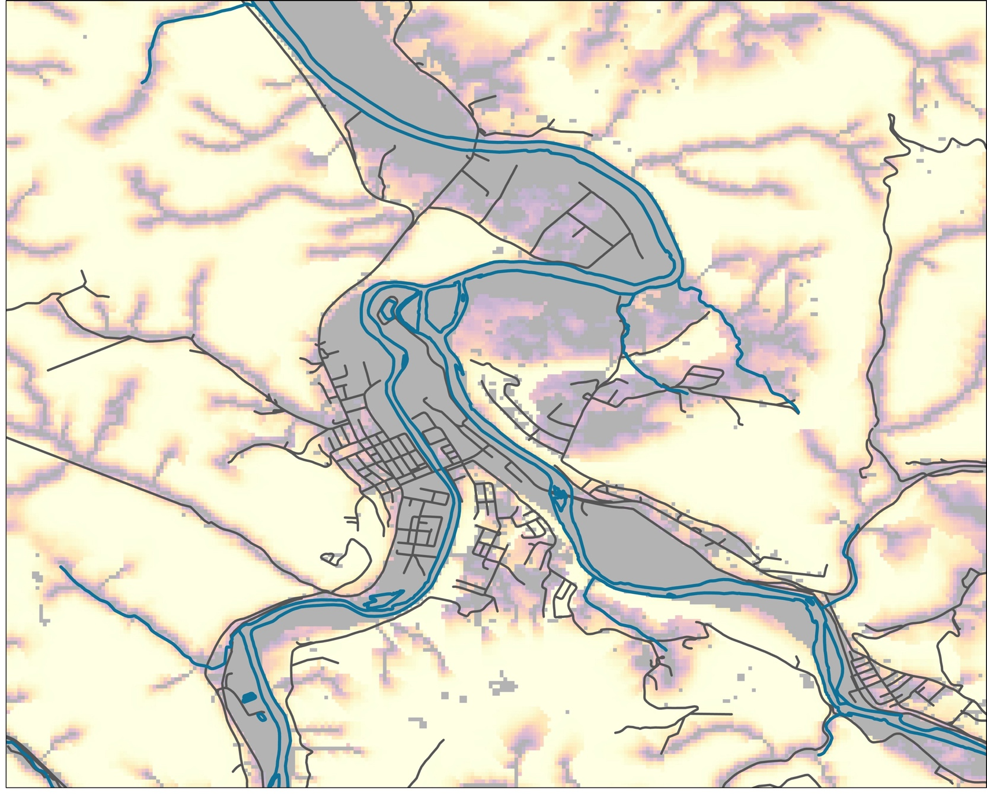
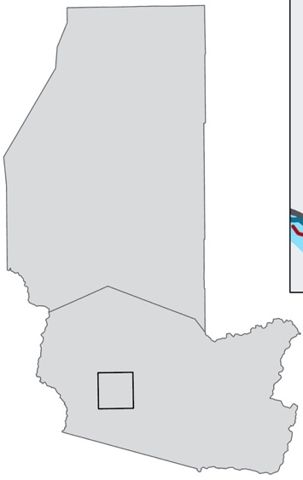
FLOOD VULNERABILITY
-ROADS
Cheat River
Roads
Streams & Tributaries
High Risk
Low Risk
Masontown
Black Fork
Reedsville
Shaves
Fork
Kingwood
Rowlesburg
Parsons
0 2
miles
Notes:
*Additional materials for partner handoff
Speaker Notes:
This map shows the flood risk map, roads and tributaries near Parsons

Slide 41
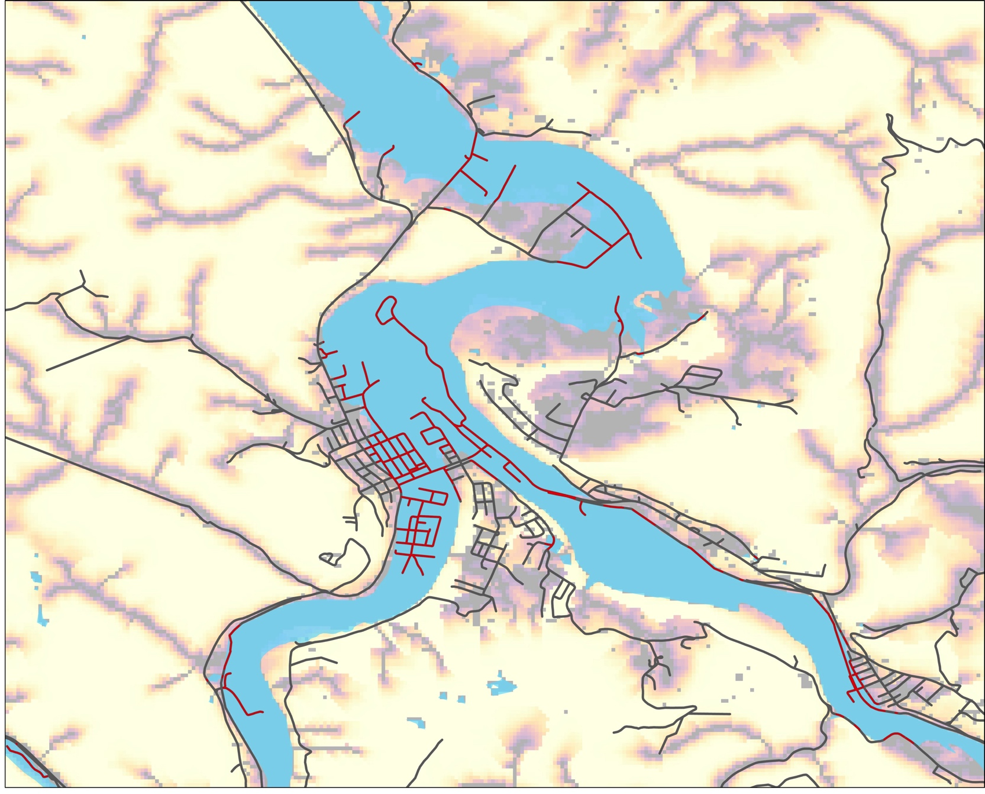
FLOOD VULNERABILITY
-ROADS
Roads
Vulnerable Roads
Flood Extent
High Risk
Low Risk
Masontown
Reedsville
Kingwood
Rowlesburg
Parsons
0 2
miles
Notes:
*Additional materials for partner handoff
Speaker Notes:
This map shows the flood risk map, roads and flood extent near Parsons

Slide 42
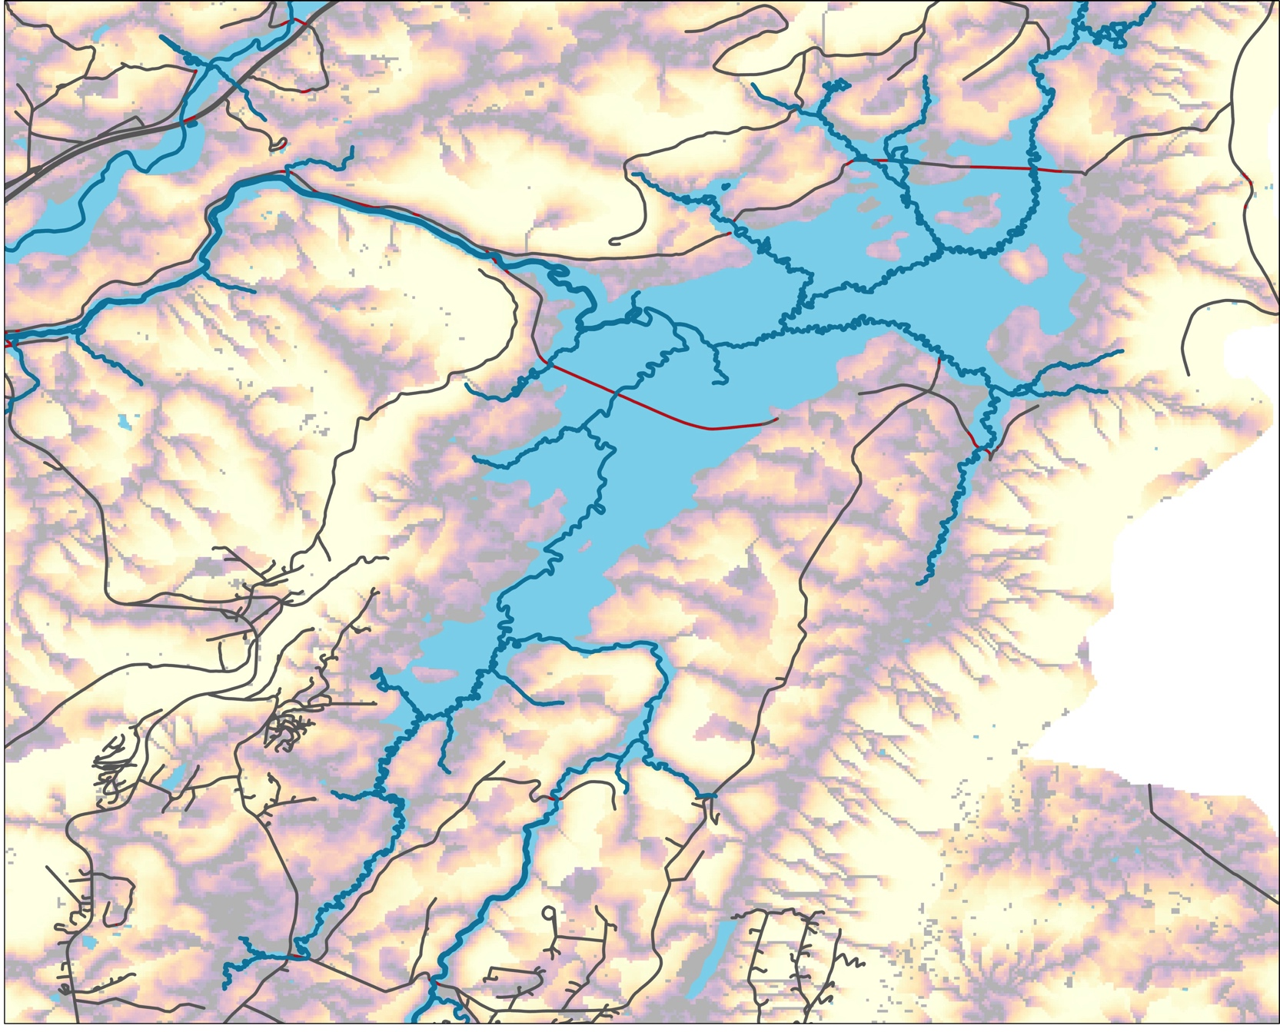
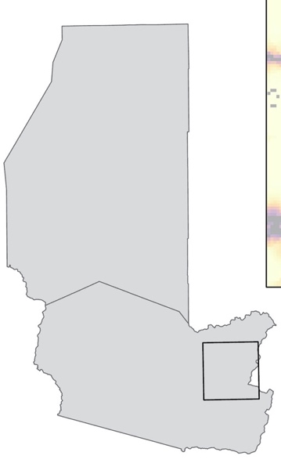
FLOOD VULNERABILITY
-ROADS
Roads
Vulnerable Roads
Blackwater River
Flood Extent
High Risk
Low Risk
Masontown
Reedsville
Kingwood
Rowlesburg
Parsons
0 2
miles
Notes:
*Additional materials for partner handoff
Speaker Notes:
This map shows the flood risk map, roads and flood extent in eastern Tucker County

