Slide 1
FIRE ISLAND
Water Resources
Assessing Sediment Dynamics and Turbidity Changes Along Fire Island National Seashore Using Satellite Data
Kelly Young (Project Lead), Tyler Albrethsen, Yuhe Chang, Lisa Tanh and Brenna Hatch
Massachusetts – Boston
Notes:
We are the Fire Island Water Resources Team, and we assessed sediment dynamics and turbidity changes along the Fire Island National Seashore using satellite data.

Slide 2
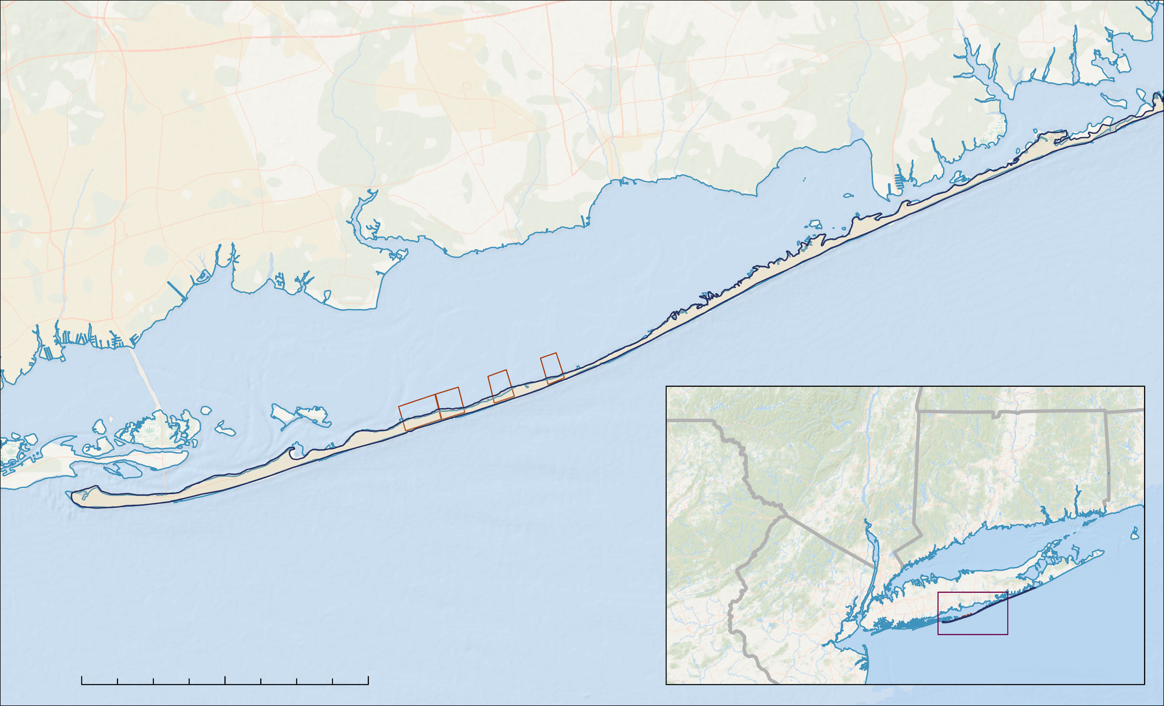
STUDY AREA
Long Island, NY
Great South Bay
Fire Island
Priority Areas
NY
CT
PA
Atlantic Ocean
N
NJ
0
2
4
8 miles
Study Area
Basemap: ESRI, DeLorme, NaturalVue
Notes:
Fire Island National Seashore is a 26-mile-long barrier island located off the southern coast of Long Island, New York. To the South, Fire Island borders the Atlantic Ocean, and to the north, it borders the Great South Bay, a stretch of water with a maximum depth of 20-feet that separates Fire Island from Long Island. The island is home to 17 residential communities, numerous bird species, wildlife habitats, and an ecologically-important holly maritime forest, an ocean coastal wooded habitat, called the Sunken Forest.

Slide 3
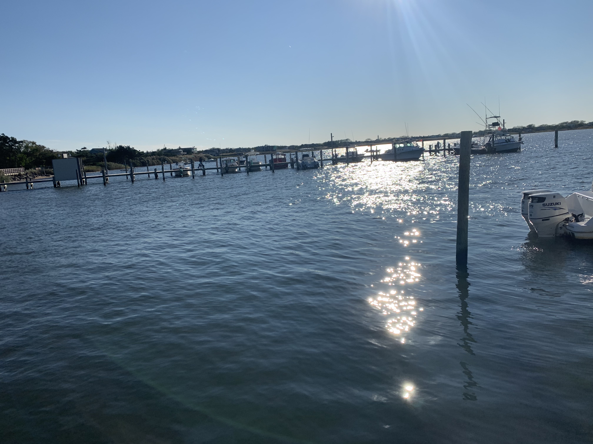
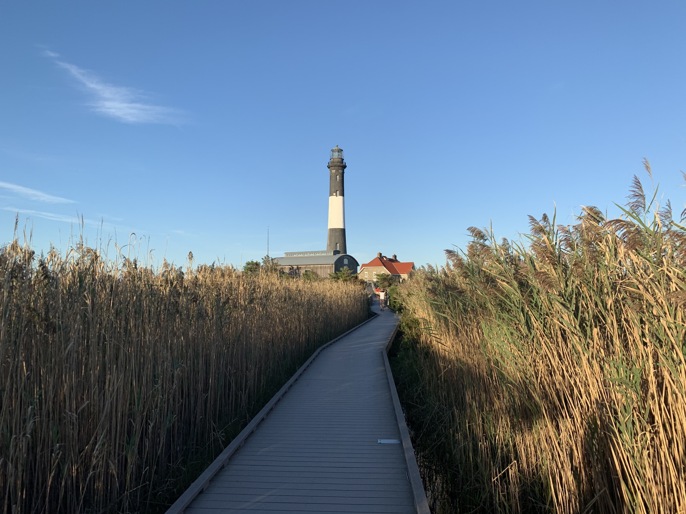
PROJECT PARTNERS
Our project partners with the National Park Service and Fire Island National Seashore Branch are responsible for:
Protecting critical wildlife habitat
Preserving the Sunken Forest
Combatting erosion via beach nourishment projects
Monitoring overall island health
Image Credits: John E. Gray.
Notes:
Our project partners are from the National Park Service Fire Island National Seashore branch. They are responsible for protecting critical wildlife habitats, preserving the Sunken Forest, implementing beach nourishment projects to combat erosion, and monitoring overall island health. A main concern for NPS to maintain the island is knowing where erosion is happening that lead to community concerns.
Image Credits: John E. Gray (media release form)

Slide 4
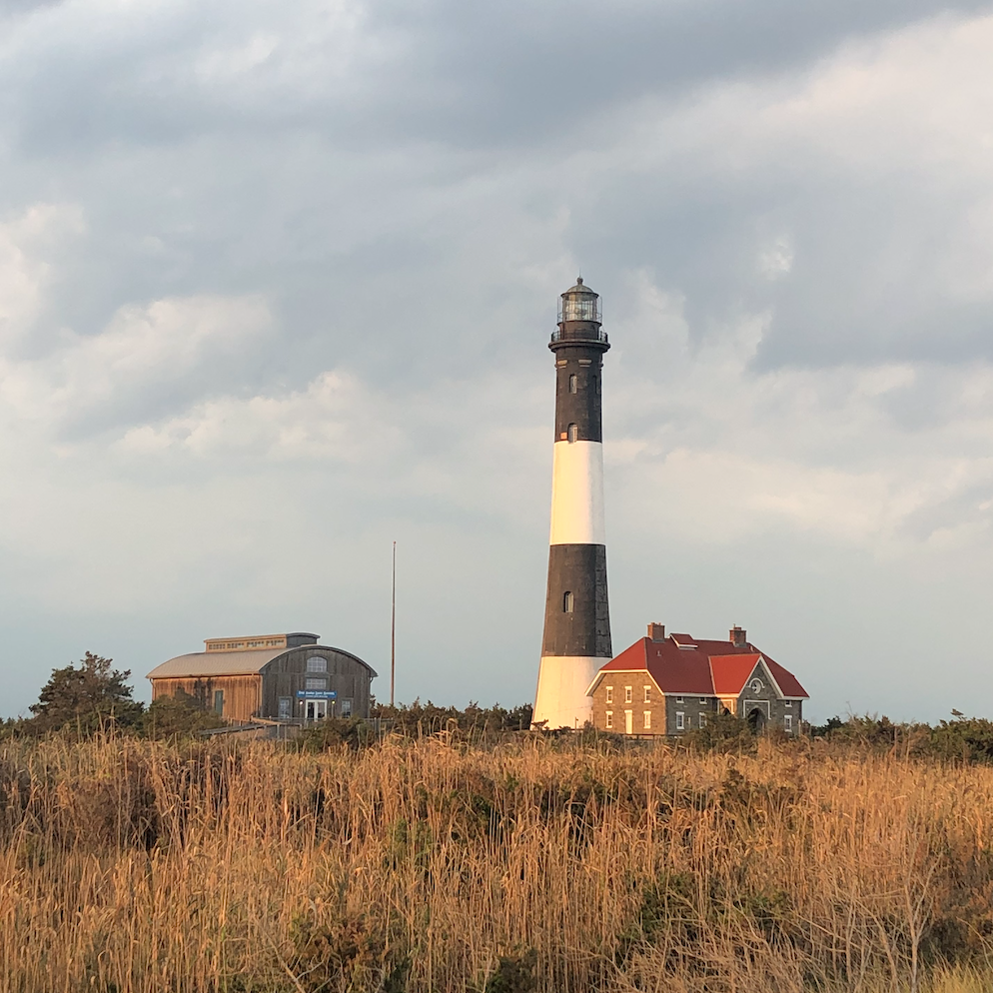
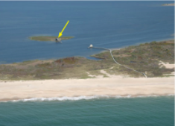
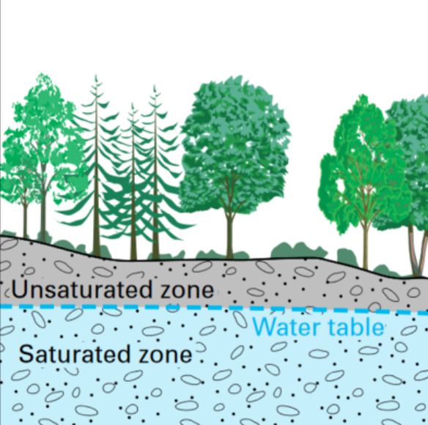
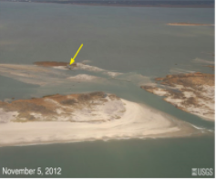
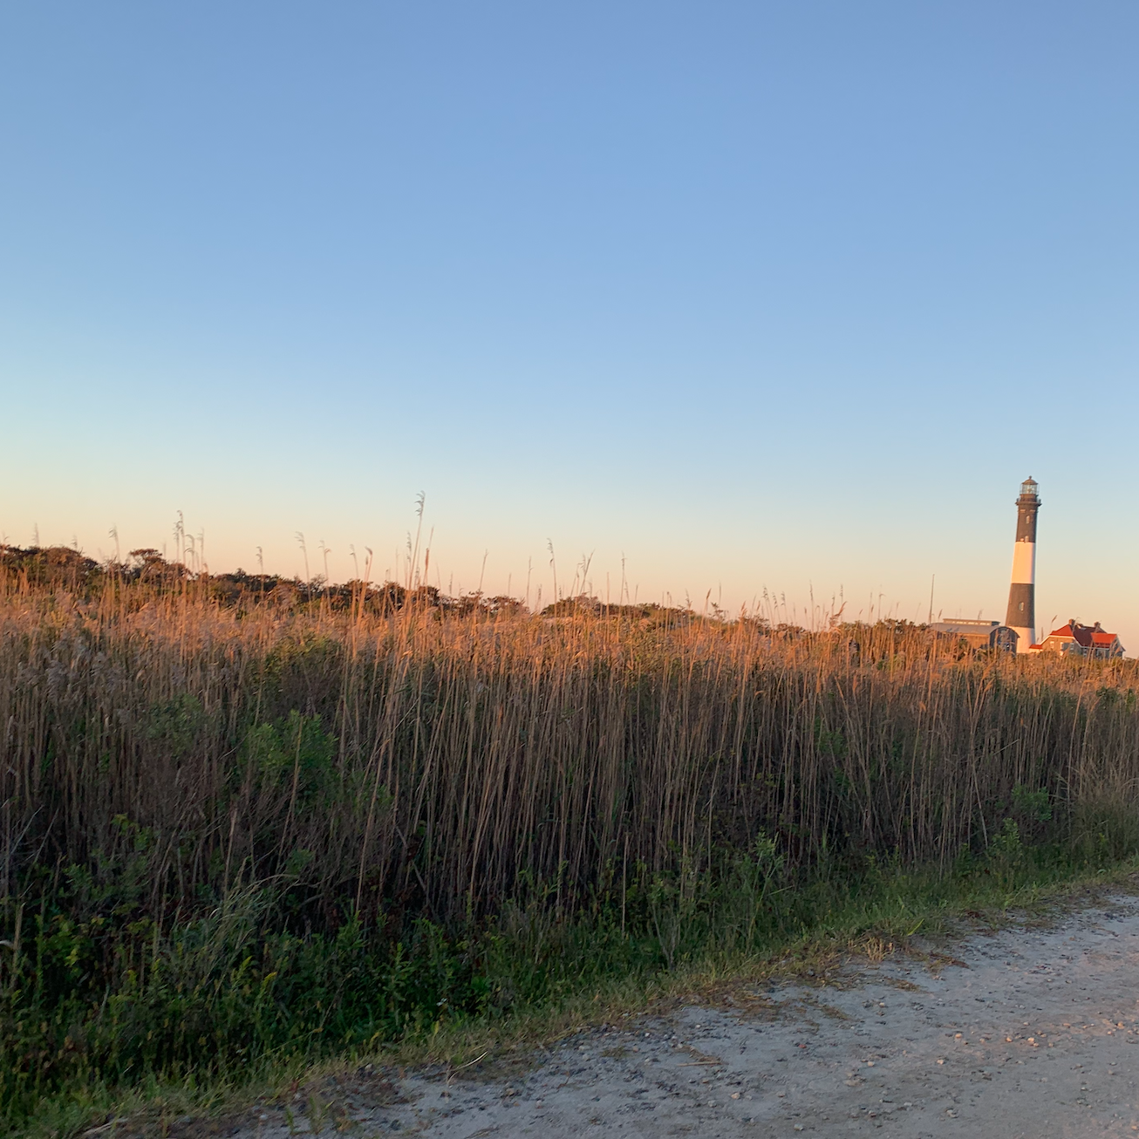
COMMUNITY CONCERNS
Erosion of the barrier Island and the Hurricane Sandy breach in 2012
Loss of homes
Ground water level rise
Loss of habitats
Image Credits: USGS, John E. Gray.
Notes:
Fire Island National Seashore is experiencing shoreline erosion because it is a dynamic barrier island. In 2012, it experienced a breach from Hurricane Sandy seen in the images in the left panel. Erosion causes loss of residential homes, the rise of groundwater levels, and loss of wildlife habitats like the holly maritime forest, known as the Sunken Forest. Restoration efforts have been completed every few years through beach nourishment projects from the National Park Services. The goal is to provide our partners at the National Park Service with more information about the local sediment dynamics and turbidity along Fire Island National Seashore to protect areas of higher erosion rates.
Image credits:
Left panel, from top to bottom: USGS https://ny.water.usgs.gov/archived_files/projects/hurr_sandy_2012/index5.html
Right panel, from top to bottom: John E. Gray (media release form), USGS (https://www.usgs.gov/mission-areas/water-resources/science/groundwater-basics?qt-science_center_objects=0#qt-science_center_objects); John E. Gray (media release form)

Slide 5
OBJECTIVES
Generate turbidity maps to visualize seasonal variability in suspended sediment
Assess patterns in sediment transport and turbidity over time
Analyze shoreline changes after Hurricane Sandy to better understand storm-induced erosion
Notes:
Our project had three major objectives. The first was to generate turbidity maps using SeaDAS to visualize suspended sediment. The second was to assess patterns in sediment transport and turbidity using in-situ data from three buoys located in the Great South Bay and along Fire Island. This would allow us to validate our data and gain a better understanding of conditions along the shoreline. Lastly, using high-resolution imagery purchased from MAXAR, our last goal was the analyze shoreline changes before and after Hurricane Sandy. Doing this will allow us to see the impacts of major storms and provide our partners with key areas that beach nourishment projects should target.

Slide 6
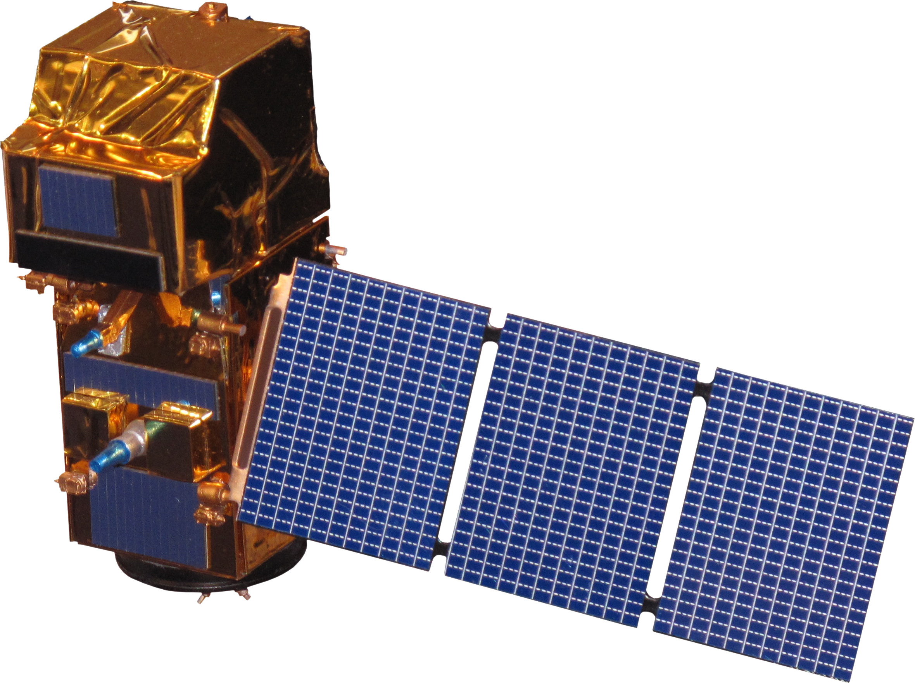
SATELLITE EARTH OBSERVATIONS
Landsat 5 TM
2000-2012
Landsat 8 OLI
2013-2021
Sentinel-2
2014-2021
2000
2021
2014
2021
Image Credit: NASA
Notes:
The team used Level-1 imagery from Landsat 5 Thematic Mapper imagery from 2000 to 2012, Landsat 8 Operational Land Imager imagery from 2013 to 2021, and Sentinel-2 Level2A imagery from 2014 to 2021. These data from the satellites were collected and atmospherically corrected in ACOLITE. This created turbidity data using the Dogliotti turbidity algorithm from the imagery and visualized in SeaDAS to create turbidity maps.
Image Credit: NASA (Public Domain)

Slide 7
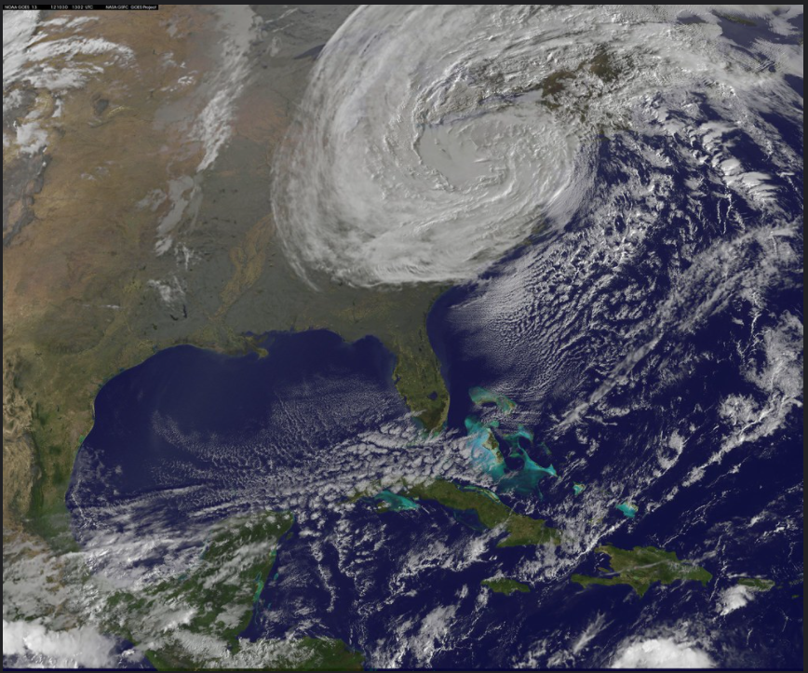
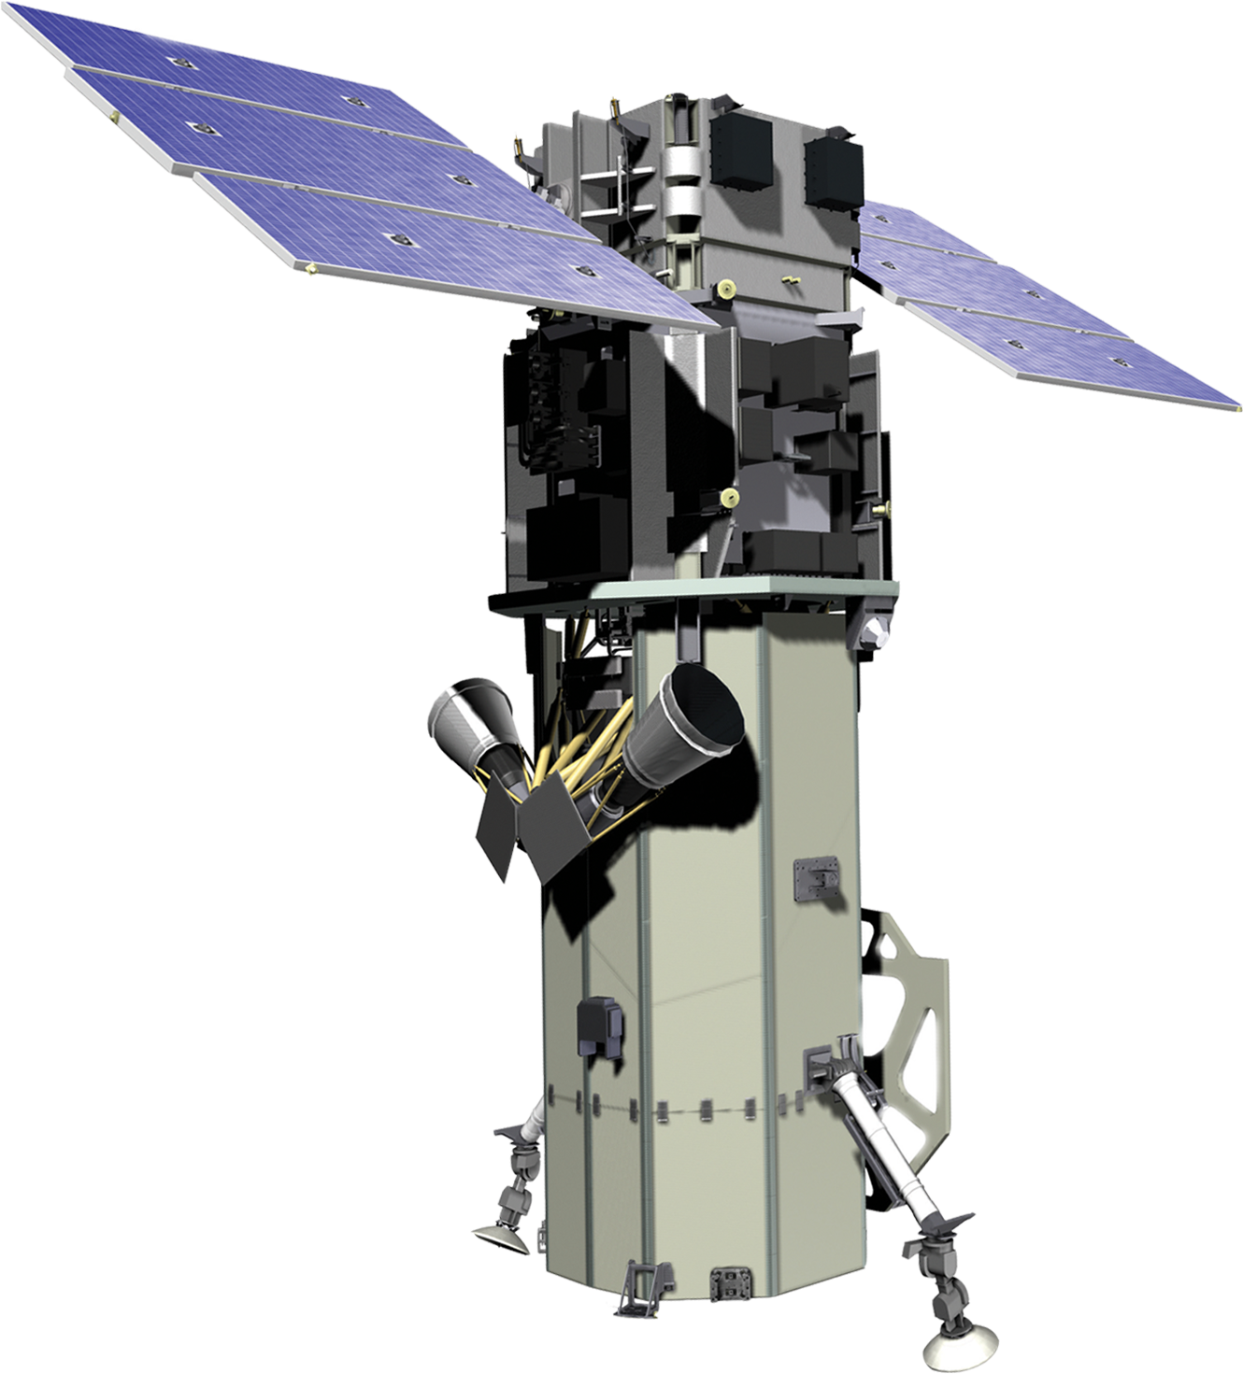
COMMERCIAL HIGH-RESOLUTION DATA
WorldView-2
WorldView-2
Hurricane Sandy
07/25/2010
10/22/2012
12/18/2019
2000
2021
Image Credit: DigitalGlobe, NOAA/NASA GOES Project
Notes:
The team used high resolution images from WorldView-2 for pre-Hurricane Sandy on July 25th 2010 and post Hurricane Sandy on December 18th 2019. This data was purchased from MAXAR and was used to analyze shoreline changes caused by Hurricane Sandy that happened on October 22nd 2012. This caused significant over washes and new breaches in Fire Island.
Image Credit: DigitalGlobe, © 2021 DigitalGlobe NextView License
NOAA/NASA GOES Project (Public Domain)

Slide 8
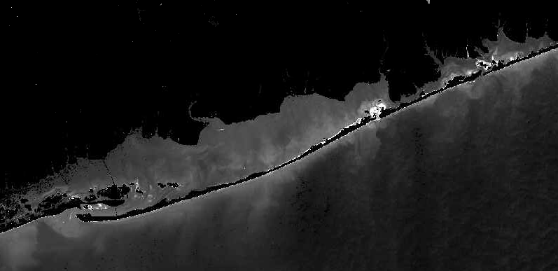
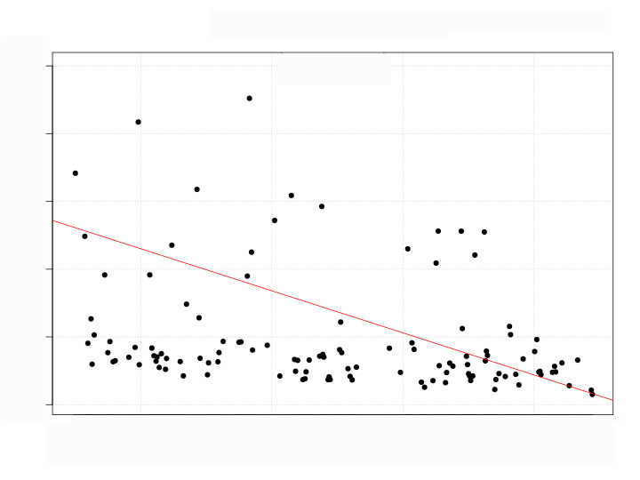
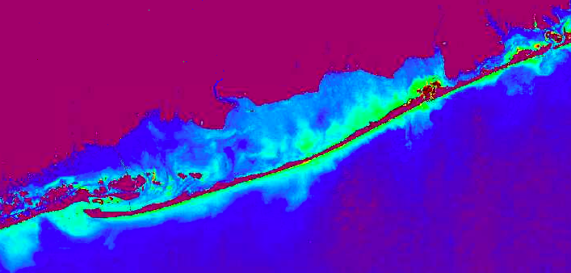
METHODS
Turbidity Time Series & Validation
Application of Dogliotti (2015) turbidity algorithm​
Extract turbidity values from processed imagery
Turbidity (FNU)
Match satellite imagery times to tidal buoy times
Date
Compare turbidity values and plot against time
Buoy Points
Notes:
The first of our major methods involved mapping turbidity. Utilizing the Landsat 5 TM, Landsat 8 OLI and Sentinel-2 imagery we compiled, the first step was atmospheric correction. We used the program ACOLITE to process our imagery and apply the atmospheric correction known as Dark Spectrum Fixing (DSF). From there, we utilized the Dogliotti equation for turbidity which is adapted for all satellites utilized in our study and available directly through ACOLITE to create a more streamlined and simple process. Then, we brought our imagery into SeaDAS to visualize turbidity. In-situ data from the local buoys was compared to our turbidity imagery for validation and correlated with wind and tidal data to determine patterns.

Slide 9
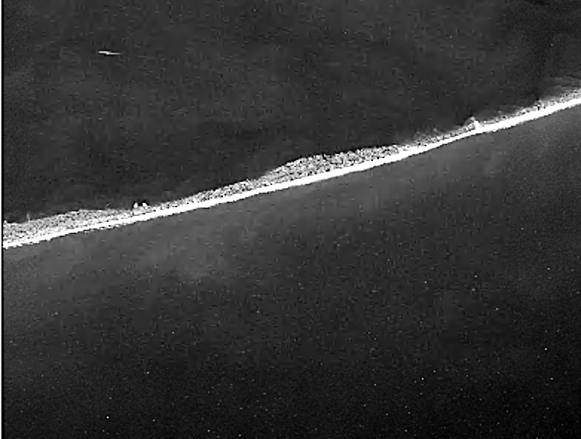
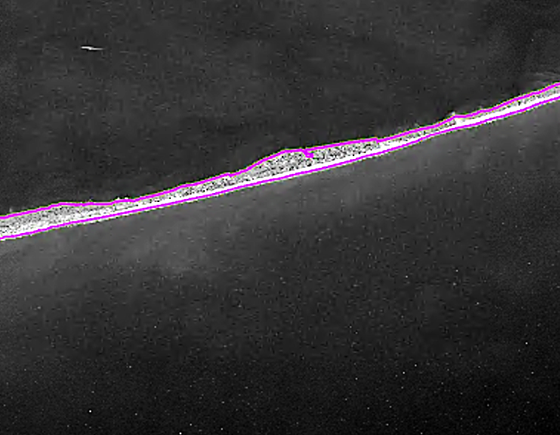
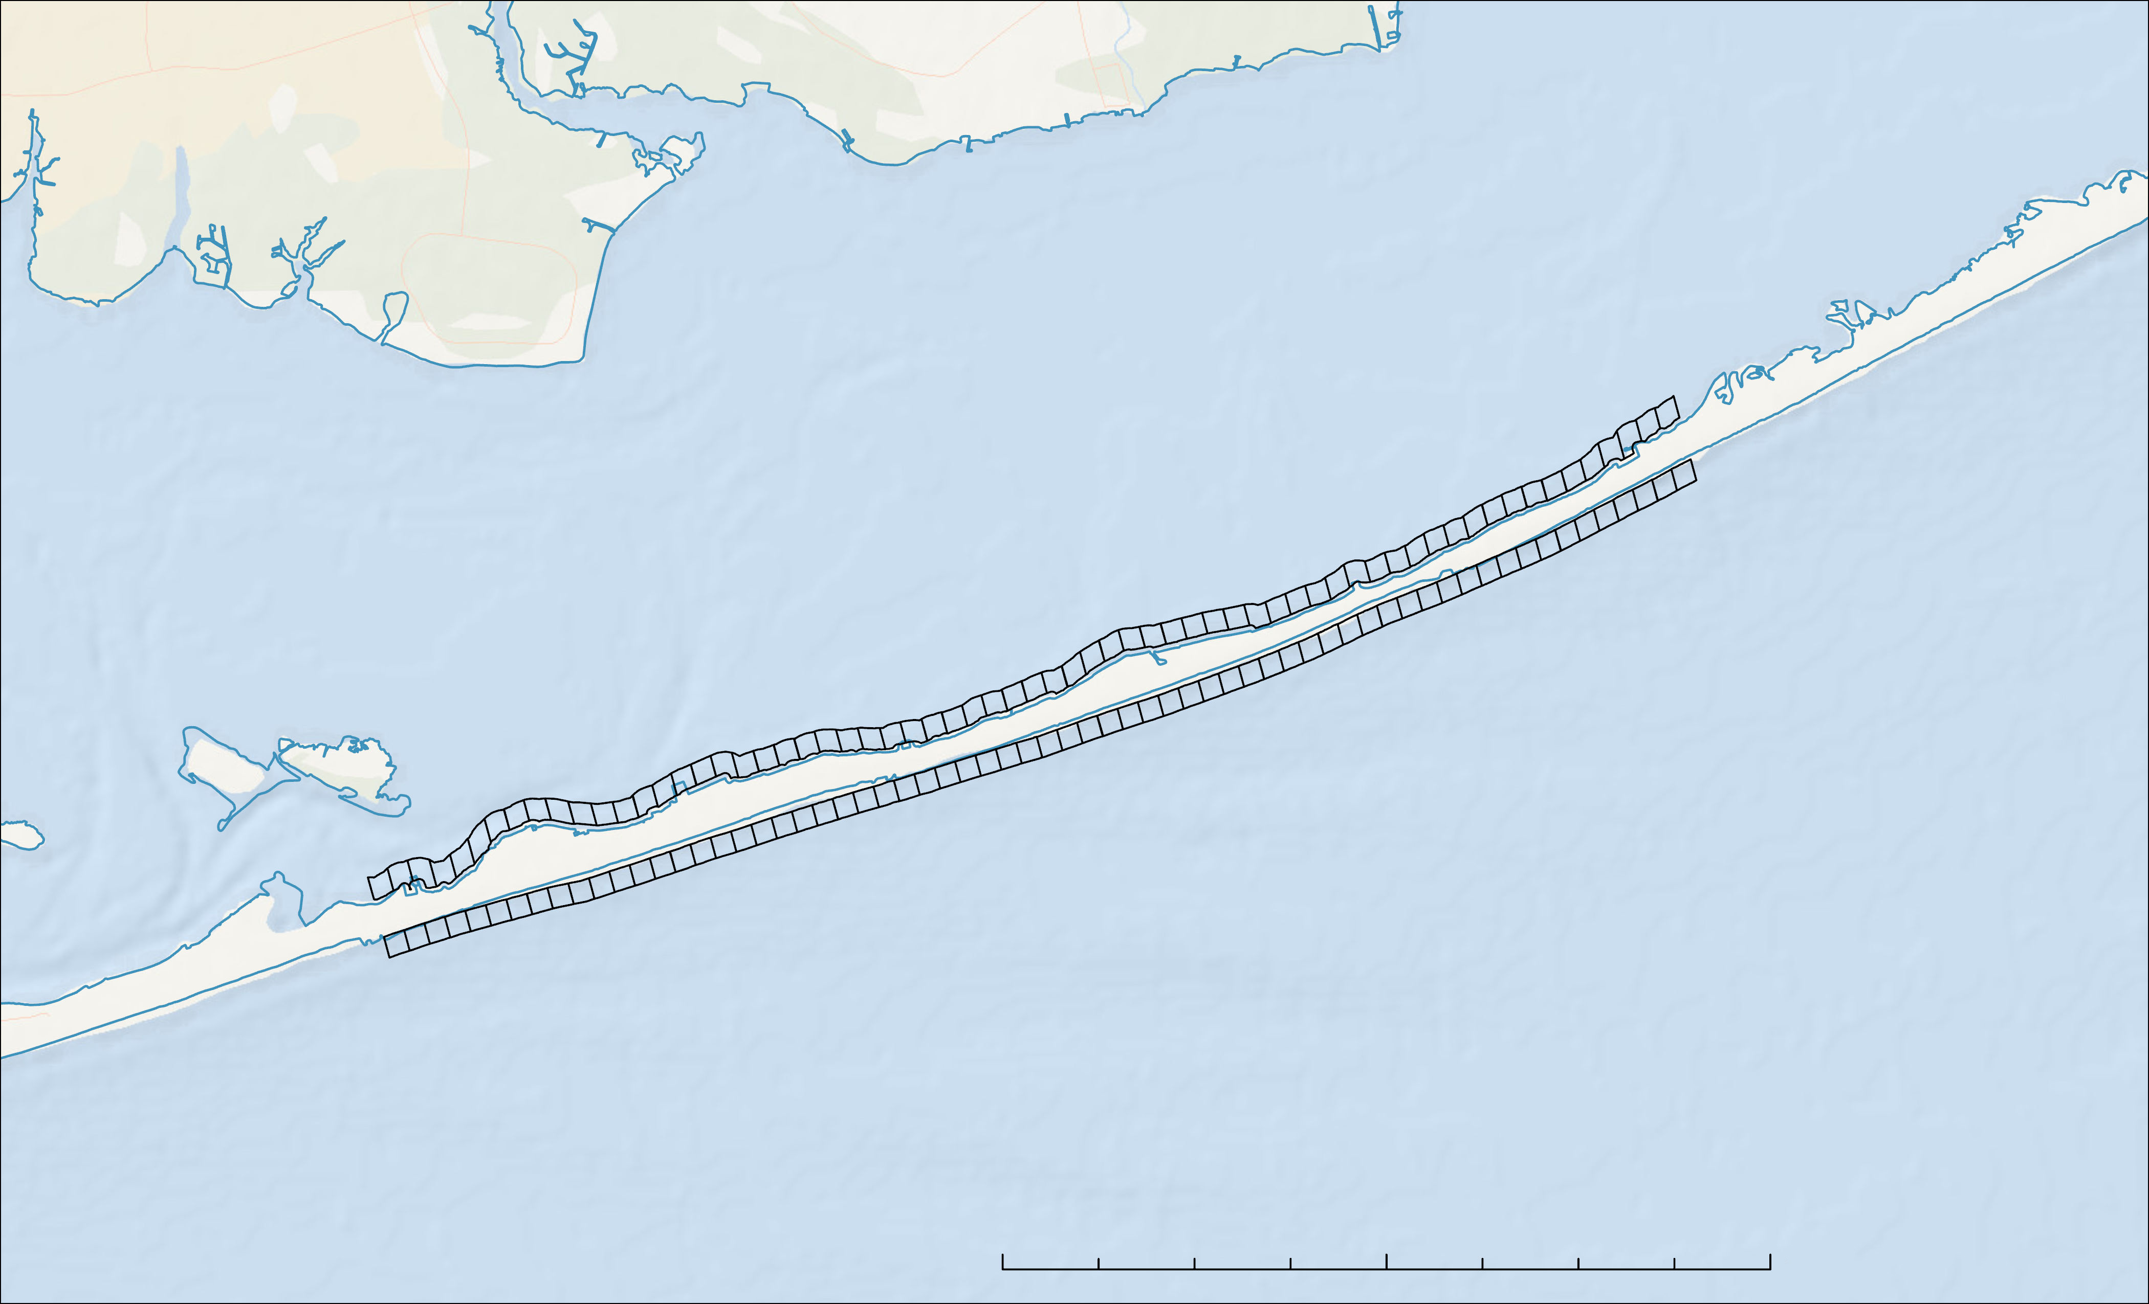
Methods
Shoreline Analysis
Digitize Shorelines using high-resolution imagery
BayBerry Dunes
Separate shorelines into paired 250-meter plots
Plot #65
Queen Beach
Study Plots
Measure differences in land area from before and after Hurricane Sandy
Cherry Grove
Plot #1
N
0 2 4 8 km
Basemap: ESRI, DeLorme, NaturalVue
Notes:
To measure shoreline change between 2010 to 2019, we digitally traced the bay side and coast side coastline using high-resolution images taken before and after Hurricane Sandy. Of the images available, we selected two that were most similar in tidal stage. The two images used were about 0.1 foot different in tidal stage. We took land area measurements on both sides of the island for both dates.
The digitized shorelines were divided into 65 paired plots by overlaying a 250-meter grid. Land area measurements for each plot were then used to assess shoreline loss or gain on both sides of the island as a result of Hurricane Sandy.
Basemap: ESRI, DeLorme, NaturalVue

Slide 10
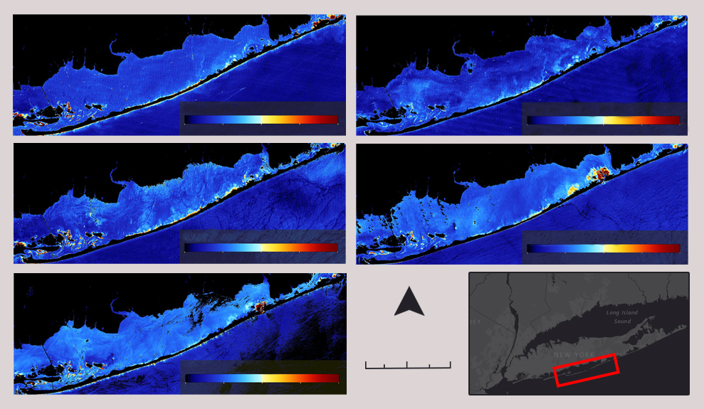
RESULTS
Summer Turbidity Map Series
8/25/2000
8/23/2005
Turbidity (NTU)
Turbidity (NTU)
0 5 10 15 20
0 5 10 15 20
6/18/2010
8/19/2015
Turbidity (NTU)
Turbidity (NTU)
0 5 10 15 20
0 5 10 15 20
7/29/2019
N
0 2.5 5 km
Turbidity (NTU)
0 5 10 15 20
Notes:
To analyze the seasonality of turbidity, time series static maps were created and compared. This figure shows a time series of turbidity during the summer season from 2000-2019 using Landsat 5 and Landsat 8 imagery processed in ACOLITE and SeaDAS. Summer seasons tend to have lower turbidity in the Great South Bay due to lower storm activity in comparison to winter seasons. Thus, there is not much sediment activity in the bay. Over time, turbidity appears to increase in the Great South Bay, likely exacerbated by Hurricane Sandy in 2012. Starting in 2015, you can see the impact of the massive storm in the form on an island breach on the far right side of the island. It shows up in the maps as an area of extremely high turbidity which may actually be bottom reflectance from shallow water, not turbidity.

Slide 11
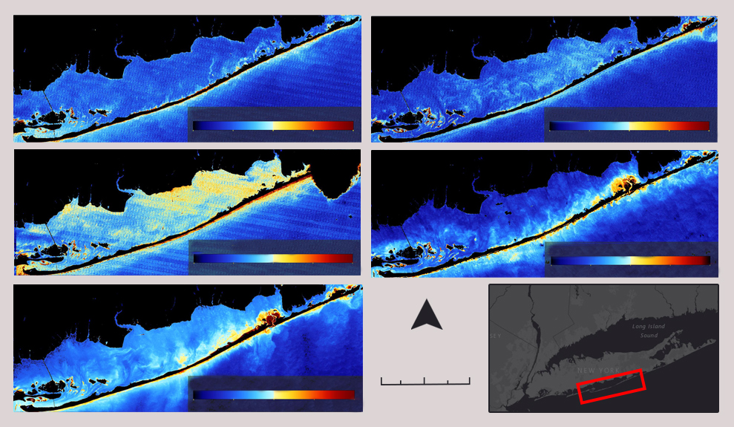
RESULTS
Winter Turbidity Map Series
11/29/2000
12/19/2006
Turbidity (NTU)
Turbidity (NTU)
0 5 10 15 20
0 5 10 15 20
11/12/2011
11/23/2015
Turbidity (NTU)
Turbidity (NTU)
0 5 10 15 20
0 5 10 15 20
1/21/2020
N
0 2.5 5 km
Turbidity (NTU)
0 5 10 15 20
Notes:
Shown here is a time series static map of turbidity in the winter. Compared to the summer, it is considerably higher for a number of reasons. Firstly, natural wave activity can impact turbidity. As waves crash into the seaward side of the island, sand is uplifted, which increases turbidity. The winter season often has stronger and more frequent storms, which increases turbidity in this season. With increased storm activity also comes higher levels of erosion which can increase sediment transport along the Great South Bay coast as well, creating the effect seen in the static map. Lastly, the National Park Service typically carries out any dredging activities in the winter season. Dredging, or the removal of excess sediment, occurs every couple years and would also increase turbidity in the winter season especially.
(Note: 2011 appears the have highest turbidity, likely because of wind)

Slide 12
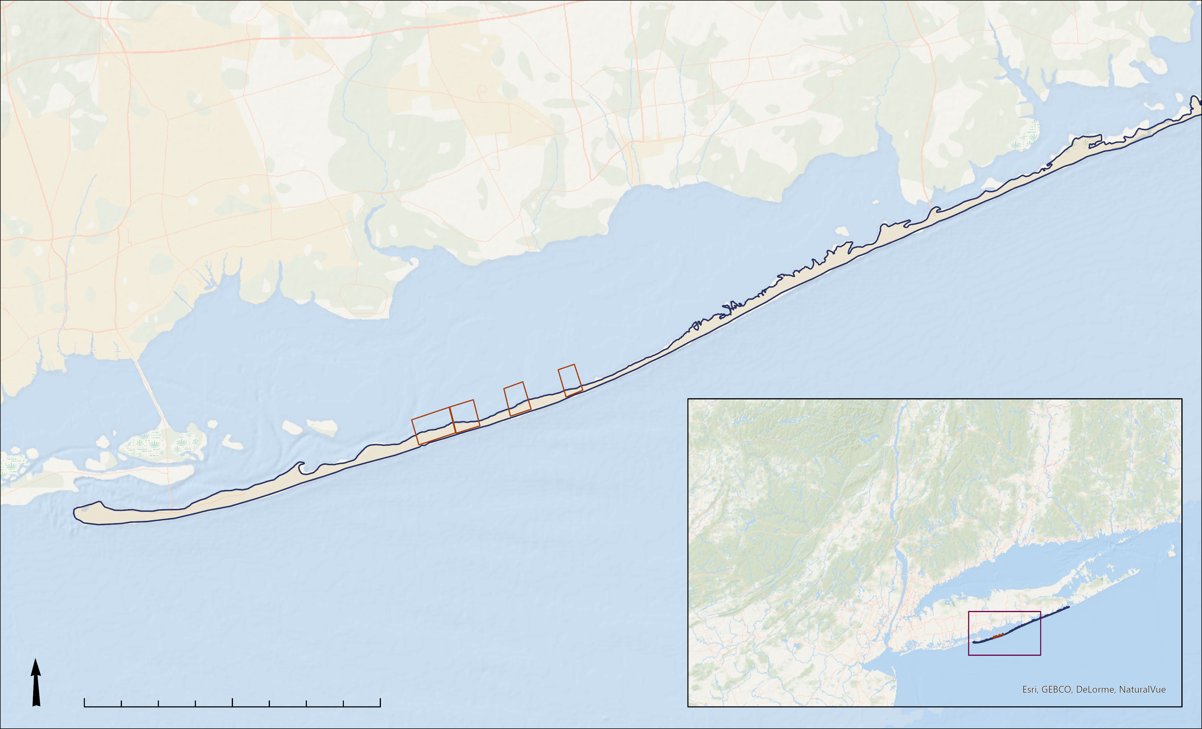
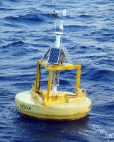
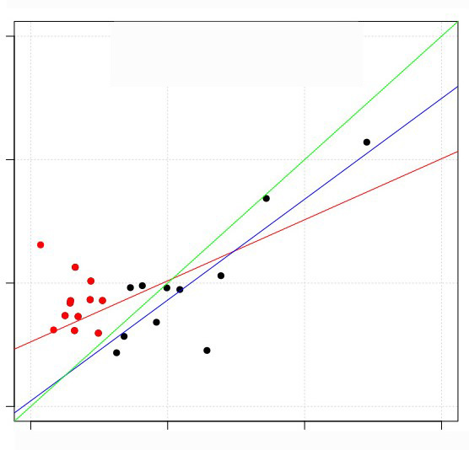
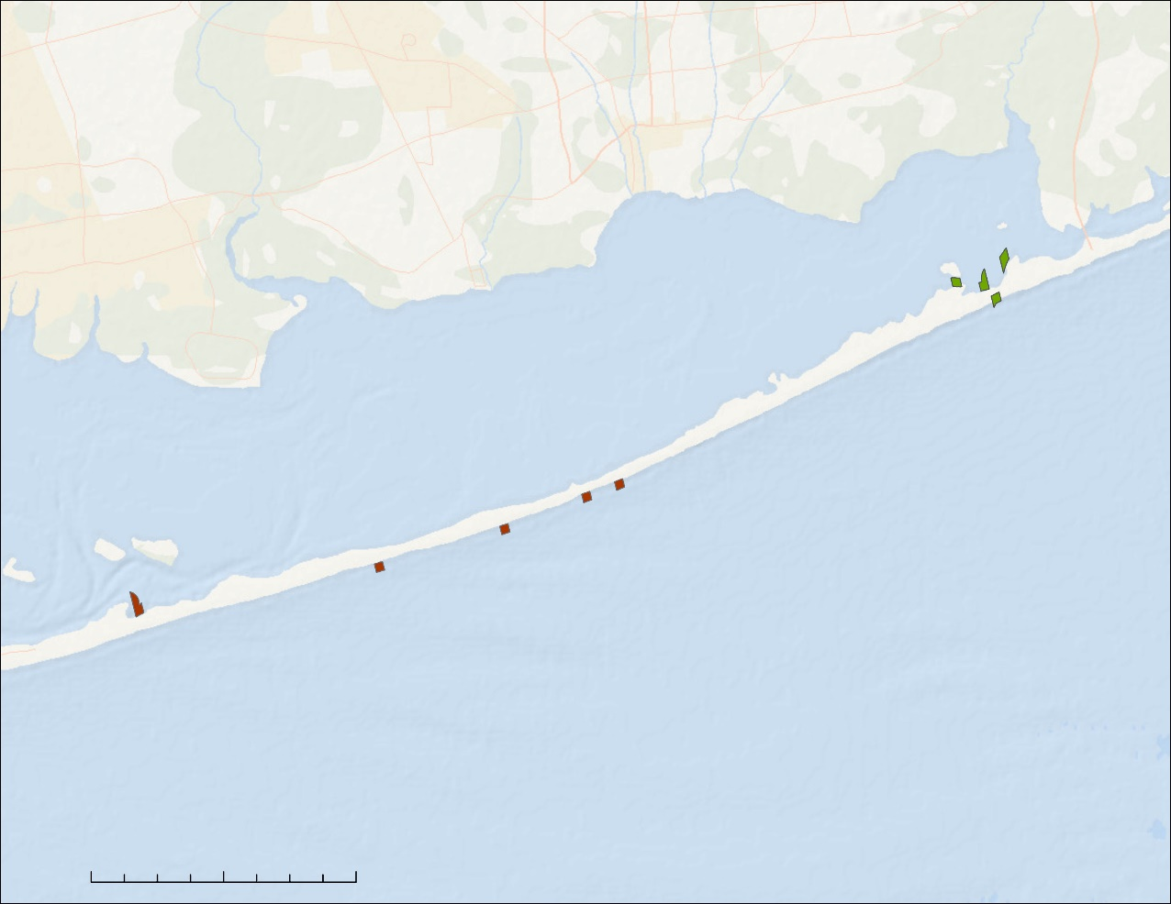
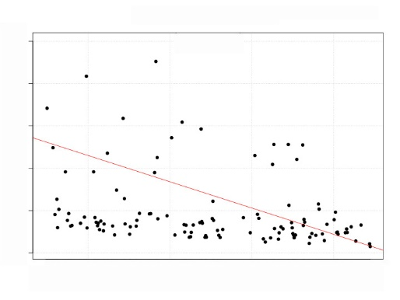
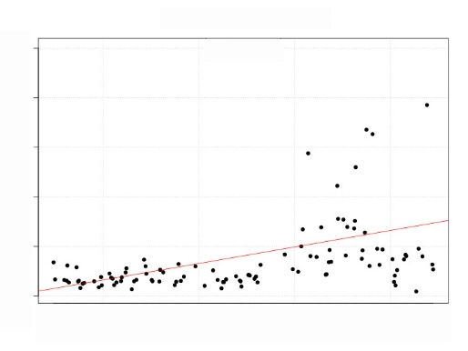
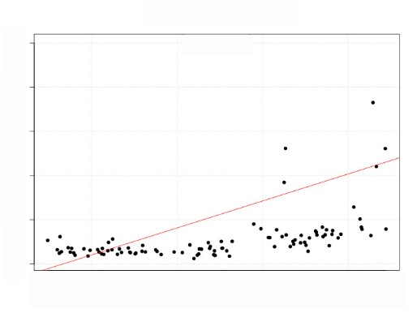
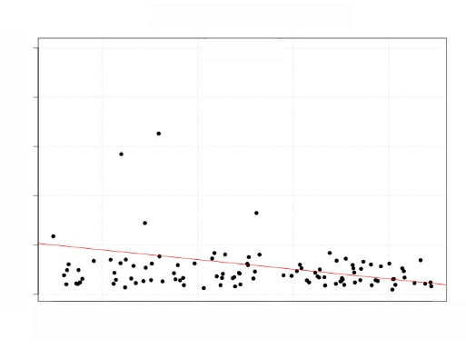
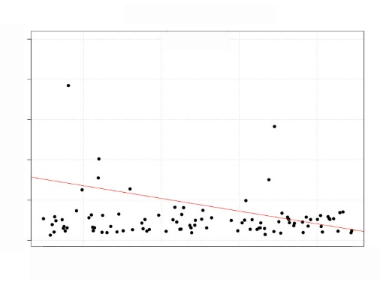
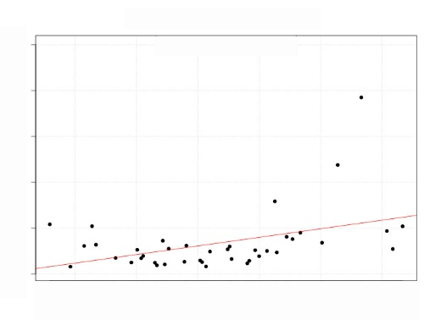
RESULTS
Data Validation
y = x
All points
Points > 3
Turbidity Time Series Point Analysis
Plots with Significant Change in Turbidity
Dogliotti Turbidity (FNU)
Bay-133
Buoys
Bay-127
In-situ Turbidity (NTU)
Bay-27
Bay-127
Bay-133
Turbidity (FNU)
Bay-27
Coast-131
Coast-70
2000
Date
2021
2000
Date
2021
2000
Date
2021
Coast-55
Coast-70
Coast-131
Coast-55
Significant Increase
Significant Decrease
Turbidity (FNU)
N
0 5 10 km
Basemap: ESRI, DeLorme, NaturalVue
2000
Date
2021
2000
Date
2021
2000
Date
2021
Notes:
For the turbidity time series analysis, we first conducted the index validation for retrieved turbidity values by comparing them with the in-situ measurements collected at the Great South Bay Buoy. We found a statistically significant relationship between retrieved turbidity and measured turbidity. That relationship was even stronger when removing values below 3 NTU. Since the study plots focus on turbid areas, removing low values more accurately represents the accuracy of our retrieved data.
Scatterplots are shown for six study areas with significant changes. In total, 9 study plots out of 139 showed significant changes in turbidity. On the coast side, all but one area experienced a decrease in turbidity. On the bay side, all but one area experienced an increase in turbidity. All increasing areas on both sides of the island occurred near the breach created by Hurricane Sandy in 2012.
Image credits:
Buoy image (Public domain): https://www.ndbc.noaa.gov/station_page.php?station=44025

Slide 13
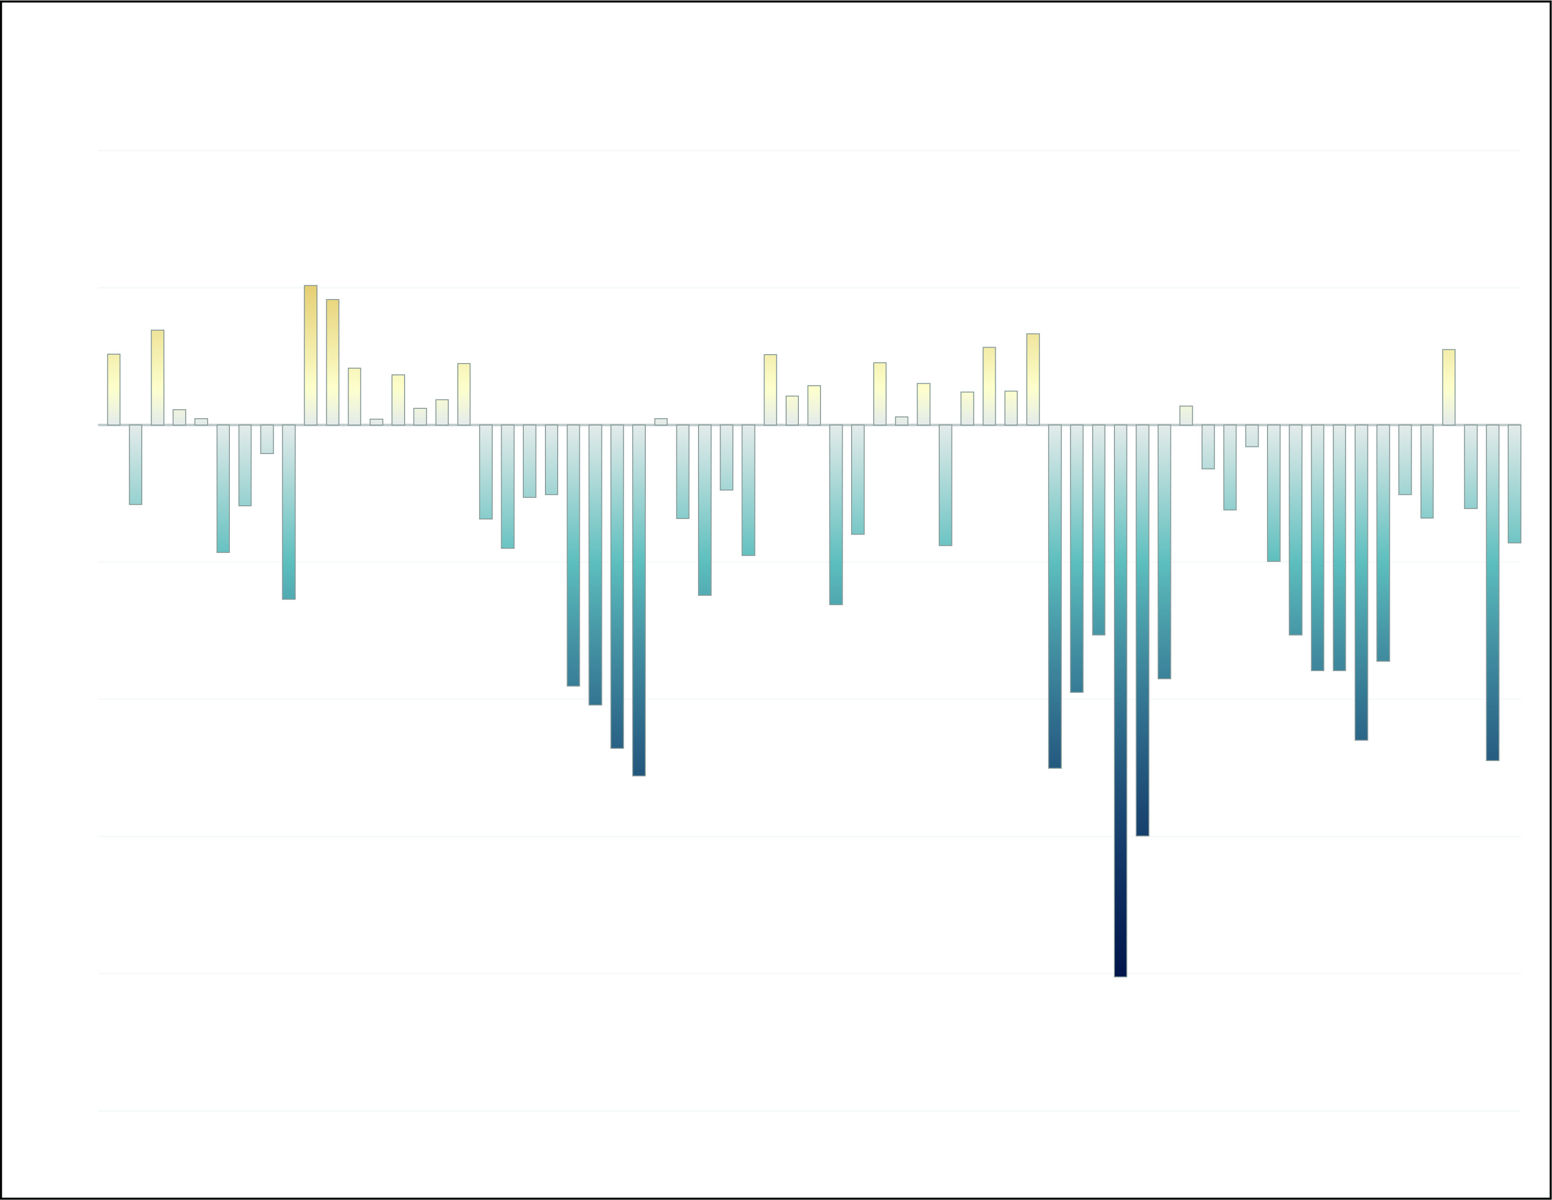
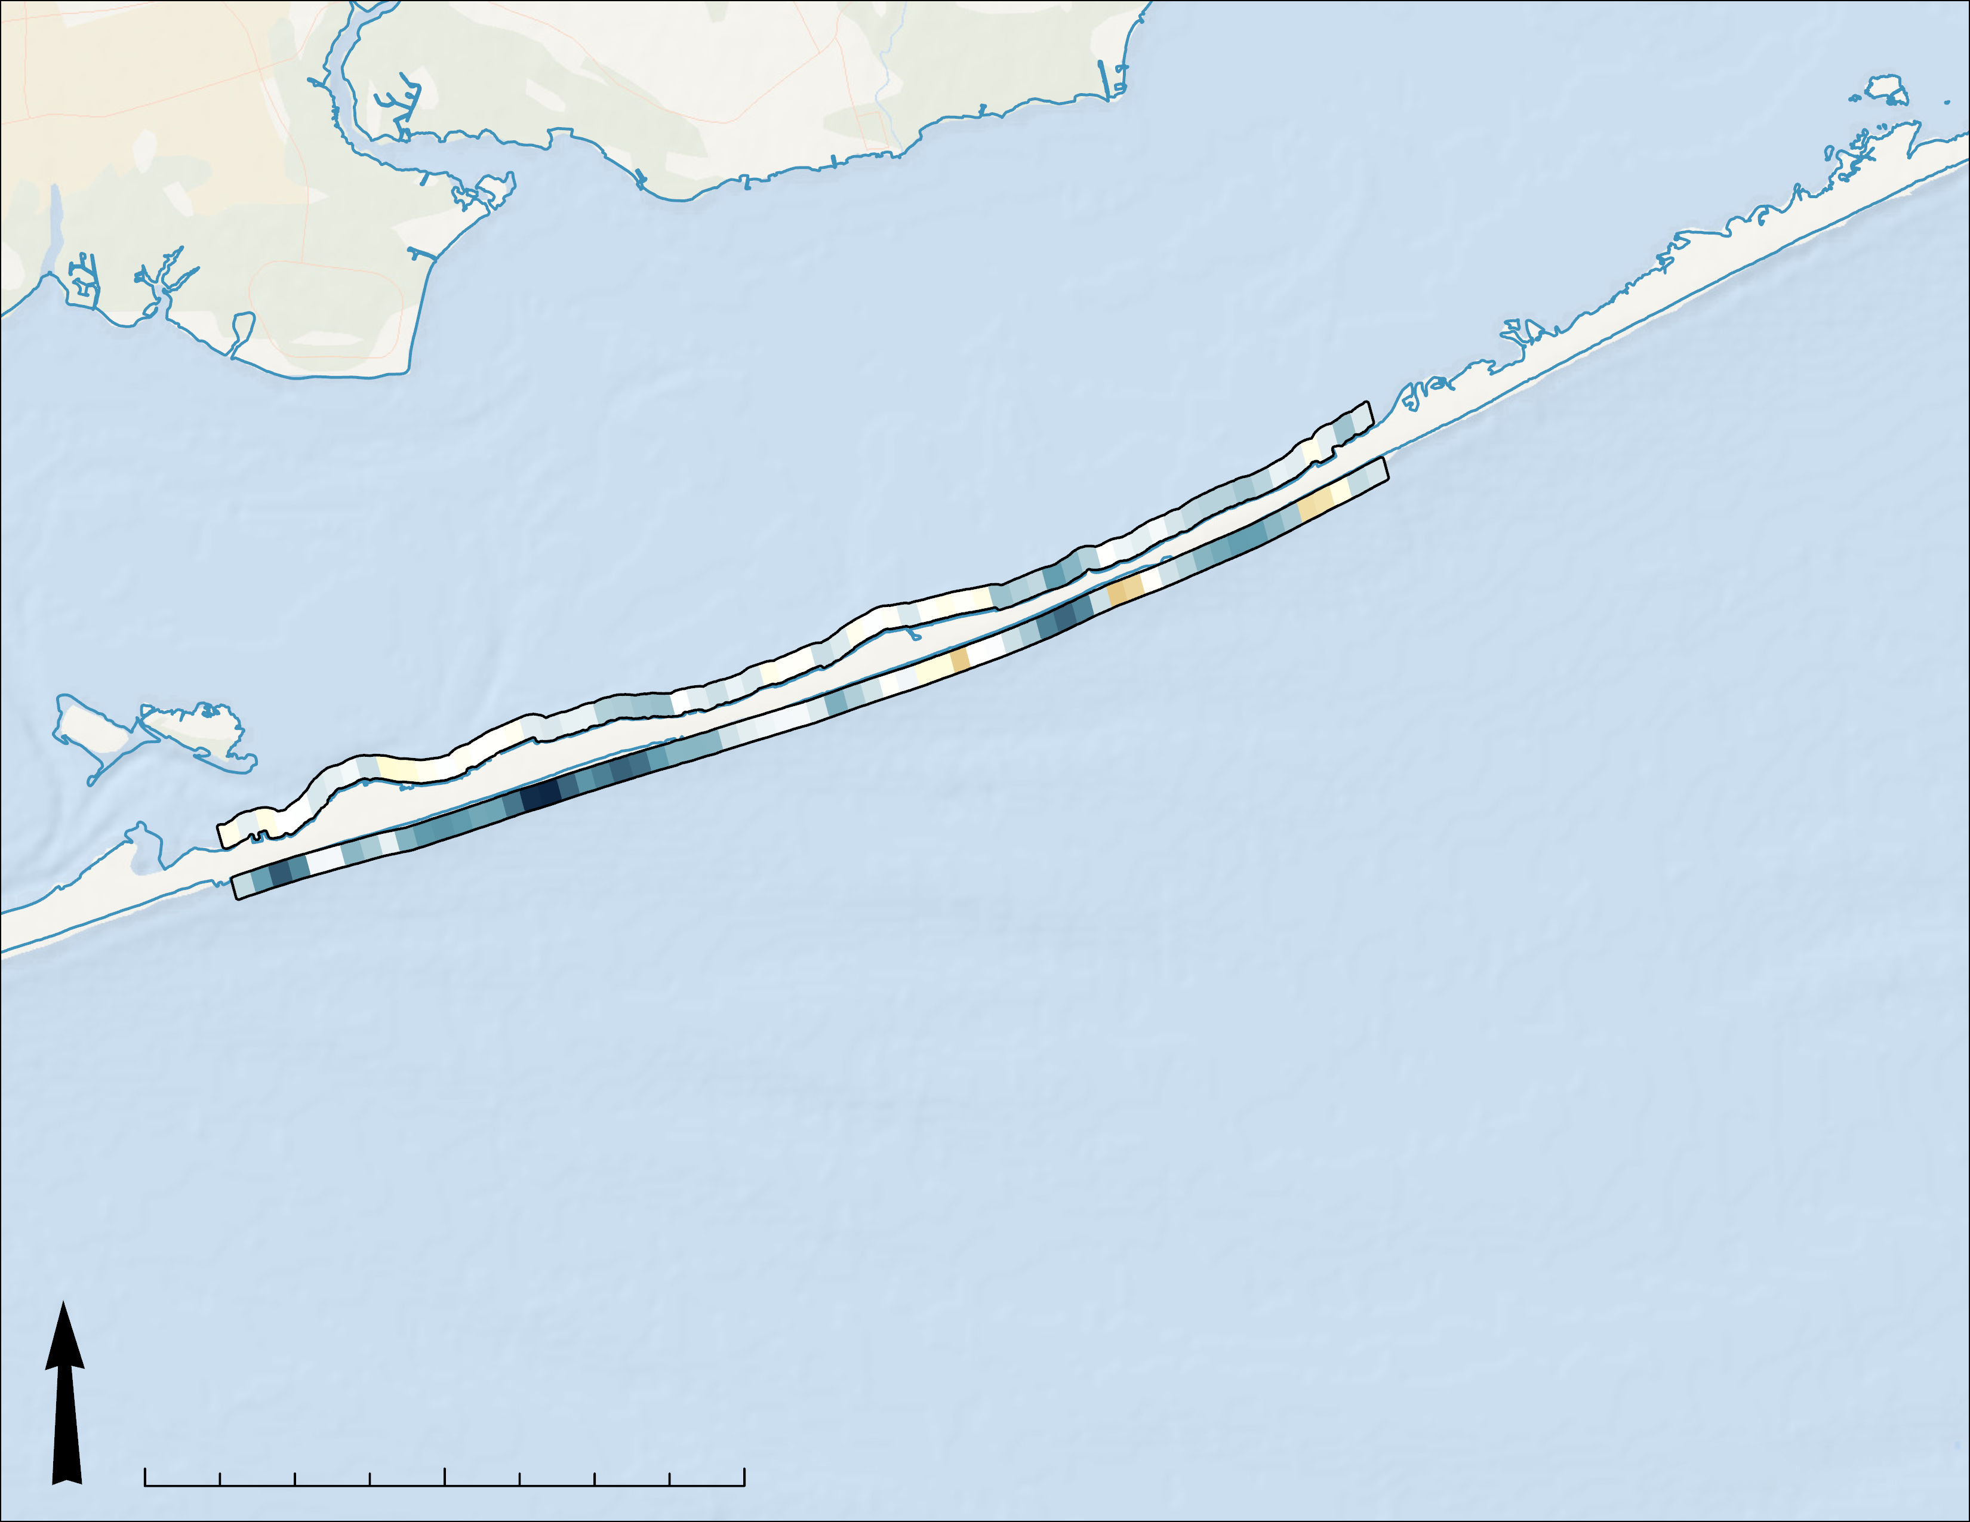
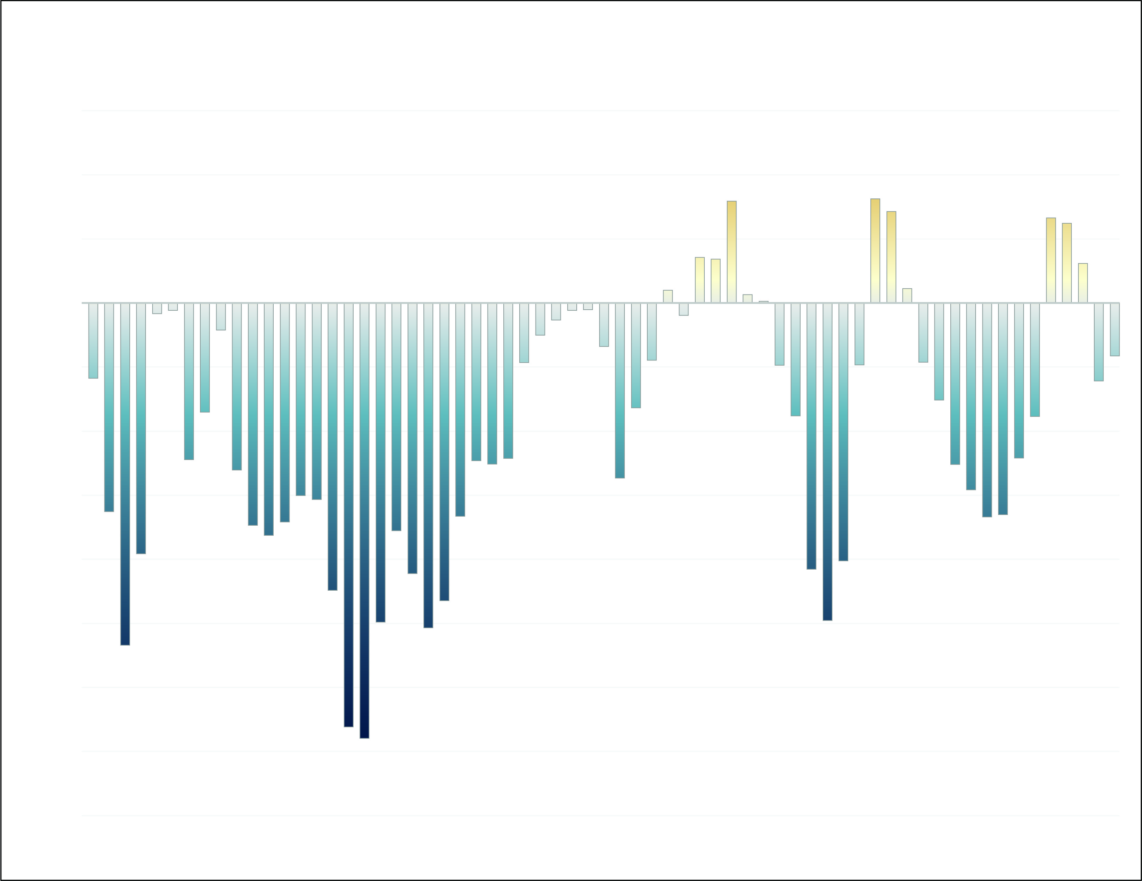
RESULTS
Area
(sq meters)
2000
1000
0
-1000
-2000
-3000
-4000
Change in Land Area
Before and After Hurricane Sandy – Shoreline Changes
Bay
BayBerry Dunes
Plot #65
Queen Beach
Coast
6000
4000
2000
0
-2000
-4000
-6000
-8000
-10,000
-12,000
-14,000
3,300
0
-14,000
Cherry Grove
Change in
Land Area
(sq meters)
Plot #1
N
0 2 4 8 km
Plot Number
Basemap: ESRI, DeLorme, NaturalVue
1 10 20 30 40 50 60 65
Notes:
Our shoreline analysis focused on the area where our imagery overlapped which was from just west of Queen Beach to BayBerry Dunes. In that space our analysis revealed a significant amount of coastline lost to erosion. In total, we estimated that about 62 acres of shoreline was lost on the coast side and about 11 acres was lost on the bay side. We chose two images that were closely matched in tidal stage, but our 2019 image was at a slightly lower tide. This means that shoreline loss is potentially greater than these results show.
Basemap: ESRI, DeLorme, NaturalVue

Slide 14
RESULTS
Area
(sq meters)
2000
1000
0
-1000
-2000
-3000
-4000
Change in Land Area
Shoreline Loss in Priority Areas
Bay
Carrington Tract
Point O'Woods
Plot #65
Coast
Talisman
6000
4000
2000
0
-2000
-4000
-6000
-8000
-10,000
-12,000
-14,000
3,300
0
-14,000
Plot #1
Sailor's Haven/ Sunken Forest
Change in
Land Area
(sq meters)
N
0 2 4 8 km
Plot Number
Basemap: ESRI, DeLorme, NaturalVue
1 10 20 30 40 50 60 65
Notes:
If we look through these results at the plot level, we can start to get a feel for what they mean for different parts of the island. In these areas, shoreline loss was experienced on both sides of the island.
Basemap: ESRI, DeLorme, NaturalVue

Slide 15
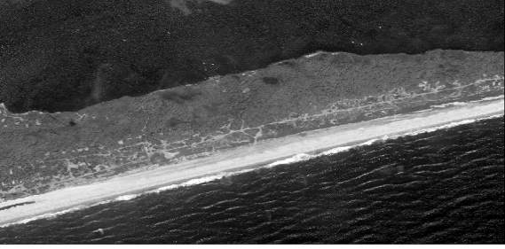
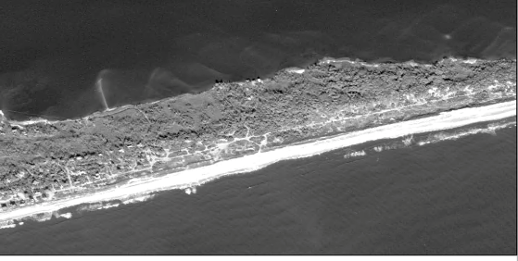
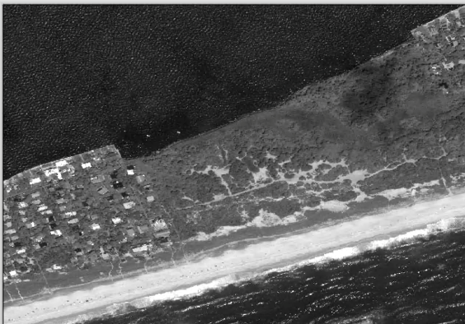
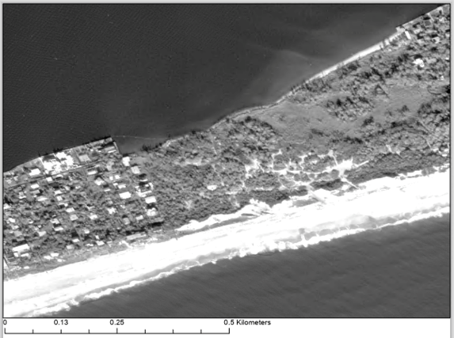
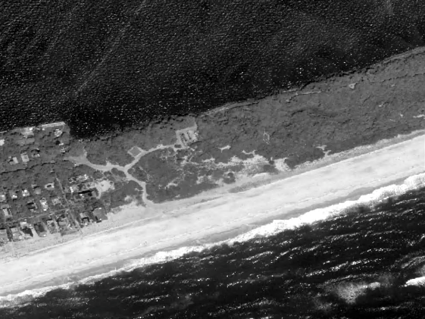
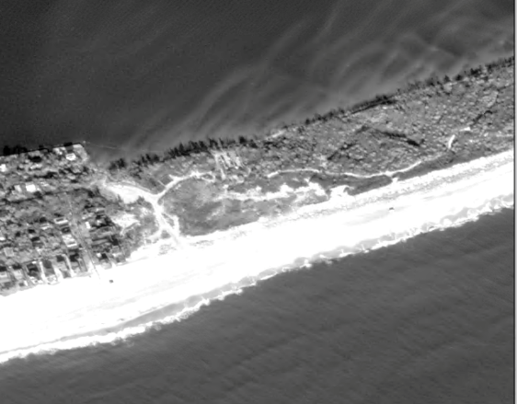
RESULTS
July 25, 2010
December 18, 2019
Point O'Woods and Sailor’s Haven/Sunken Forest
Shoreline Loss in Priority Areas
0.5 km
Carrington Tract
Carrington Tract
Point O'Woods
Plot #65
Talisman
0.5 km
3,300
0
-14,000
-13,734 sq. m
Talisman
Plot #1
Sailor's Haven/ Sunken Forest
Change in
Land Area
(sq meters)
N
0 2 4 8 km
0.5 km
Basemap: ESRI, DeLorme, NaturalVue
Notes:
There are four areas of interest chosen by our partners. Before and after high resolution images, spanning from 2010 to 2019, are shown for these areas. The first two areas, Point O’Woods and Sailor’s Haven were combined and are shown in the two top right images. Land area was lost on both the bay coastline and seaward coastline in all areas of interest.
At the Point O’Woods site, we observed a loss of about 71,500 sq meters on the coast side and about 3900 sq meters on the bay side. At the Sailor’s Haven/Sunken Forest site, we observed a loss of about 30,800 sq meters on the coast side and 7600 sq meters on the bay side. At the Carrington Tract site, we observed a loss of about 11,900 sq meters on the coast side and 1400 sq meters on the bay side. At the Talisman site, we observed a loss of about 13,700 sq meters on the coast side and 5300 sq meters on the bay side.
Basemap: ESRI, DeLorme, NaturalVue

Slide 16
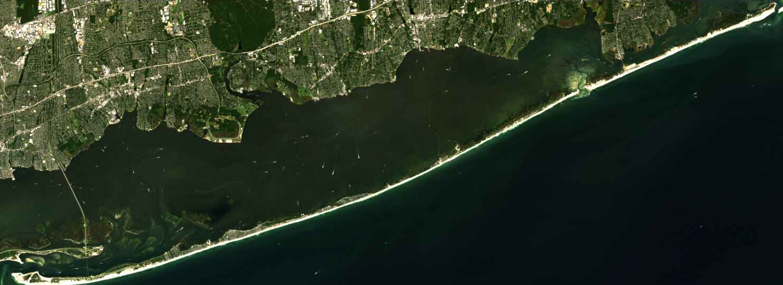
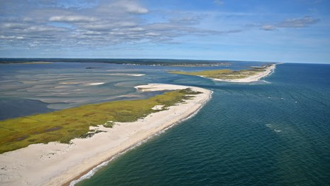
CONCLUSION
Turbidity is influenced by tidal stage, wind and seasonality
Relationship between retrieved and measured turbidity is statistically significant
Method of atmospheric correction and turbidity equation impacts output and results, especially in shallow water
Erosion has impacted Fire Island's shoreline, causing many regions to decrease in area
Image Credits: NASA, NPS
Notes:
In conclusion, our project focused on analyzing turbidity and shoreline change on Fire Island throughout time. Through static mapping and in situ validation, we saw that tidal stage, wind speed and seasonality influence turbidity values. The relationship between turbidity retrieved from satellite imagery and measured ground truth turbidity from buoys is statistically significant. Additionally, through digitizing the shoreline using hi-res imagery, we saw that erosion is causing many areas to decrease in side, particularly in the bay side where turbidity is highest. Lastly, our attempt at a Google Earth Engine analysis showed that the method of atmospheric correction and selected turbidity equation makes a large difference in the outputs.
Image Credits: NASA, NPS (Public Domain)

Slide 17
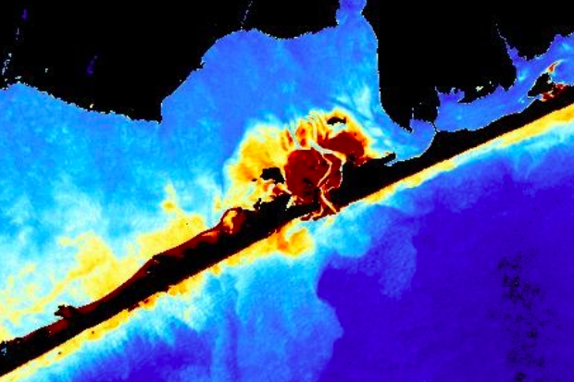
ERRORS & UNCERTAINTIES
Cloud cover
Bottom Reflectance
Sea Ice
Shoreline Digitization
Limited extent and seasonality of Worldview-2 images
Notes:
Our project has made errors and uncertainties. One of the major limitations was obstructed imagery. Cloudcover reduced the number of viable Landsat and Sentinel images we had to work with. Secondly, sea ice and shallow waters interfere with analysis and show up as high turbidity, when in reality it is not high turbidity. This reduces the accuracy of our data and shows the importance of bathymetry when working in shallow water environments. For shoreline analysis, hand digitization can result in slight differences between our two images and create errors in our end results. The limited extent of our Worldview-2 imagery reduced the effectiveness of our analysis by limiting our study area.

Slide 18
FUTURE WORK
Increase understanding of sediment transport by tracking sediment direction
Calculate sediment budget for Fire Island Shoreline
Address uncertainties in shoreline change and tidal stages
Notes:
In the future, we would like to increase understanding of sediment transport by tracking sediment direction. This will provide insight as to where the uplifted sand goes throughout the bay. Secondly, calculating a sediment budget would provide our partners more insight on whether the island is gaining or loosing sand, and what is needed to maintain key areas. Lastly, addressing uncertainties in shoreline change and improving how compounding factors are accounted for will improve our results. Tidal stages and wind can impact the digitization process and thus impact the analysis.

Slide 19
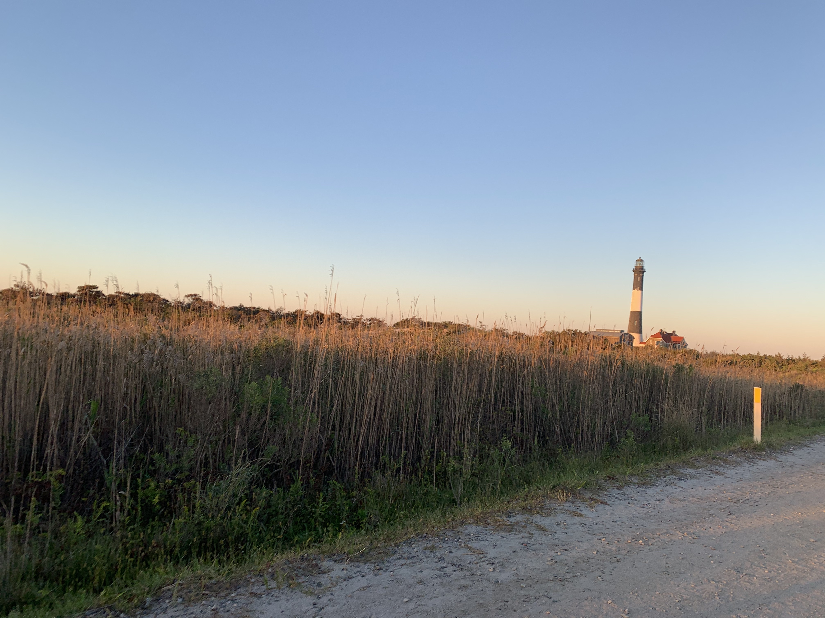
Partners:
National Park Service (NPS)
Michael Bilecki – Resource Chief for Fire Island National Seashore
Dr. Catherine Johnson – Northeast Ocean & Coastal Resource Program Coordinator
Dr. Monique Lafrance Bartley – Marine Ecologist
Science Advisor:
Dr. Cedric Fichot (Boston University)
NASA DEVELOP:
Tyler Pantle (NASA DEVELOP MA Fellow)
Image Credits: John E. Gray.
Notes:
We would like to thank everyone for the support and guidance in the Fire Island Water Resource project. A special thank you for our science advisor Dr. Cedric Fichot and partners at the National Park Service.
This material is based upon work supported by NASA through contract NNL16AA05C. Any mention of a commercial product, service, or activity in this material does not constitute NASA endorsement. Any opinions, findings, and conclusions or recommendations expressed in this material are those of the author(s) and do not necessarily reflect the views of the National Aeronautics and Space Administration and partner organizations.
DigitalGlobe/Maxar data were provided by NASA’s Commercial Archive Data for NASA investigators (cad4nasa.gsfc.nasa.gov) under the National Geospatial-Intelligence Agency’s NextView license agreement.
This material contains modified Copernicus Sentinel data (2014-2021), processed by ESA.

