Slide 1
YONKERS
Urban Development II
Leveraging NASA Earth Observations to Support Modeling Urban Cooling Interventions and Urban Heat Vulnerability in Yonkers, New York
Tamara Barbakova, Kyle Pecsok, Amanda Trakas, Akshay Agrawal, Lauren Mahoney
Arizona – Tempe
Notes:
This presentation will discuss the project that Yonkers Urban Development II of the Arizona node completed during the Fall 2021 term. The team members of this project include Tamara Barbakova, Akshay Agrawal, Lauren Mahoney, Kyle Pecsok, and Amanda Trakas.

Slide 2
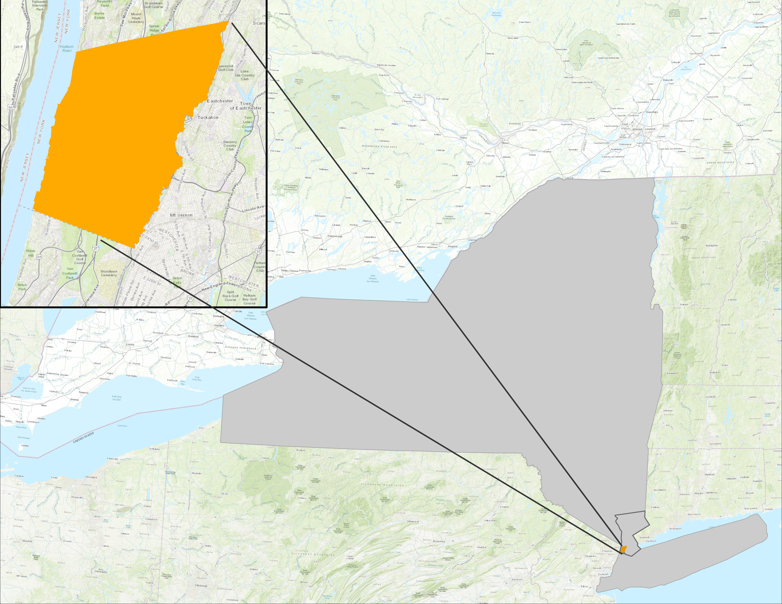
Project Location
Study Area
City of Yonkers, New York
Population: 201K
Climate: Humid continental hot summers
35% Hispanic/Latino
Founded in 1646, grew from farming village around Saw Mill River
N
Yonkers
0
1
2
3
Miles
New York
Study Period
2016 to 2021
Summer months: June 1st – August 31st
Westchester County
Basemap: County of Westchester, Esri, HERE, Garmin, INCREMENT P, USGS, METI/NASA, NGA, EPA, USDA, OpenStreetMap contributors, FAO, NPS, AAFC, NRCan
Notes:
Speaker Notes:
Yonkers, New York is located in Westchester County, just north of New York City's Bronx borough. With a diverse population of about 200,000 city residents, Yonkers, like many cities in the United States and around the globe, has found that rising temperatures are becoming a growing threat to the health and safety of its residents.
Study area map created by Yonkers UD I Spring 2021 team

Slide 3
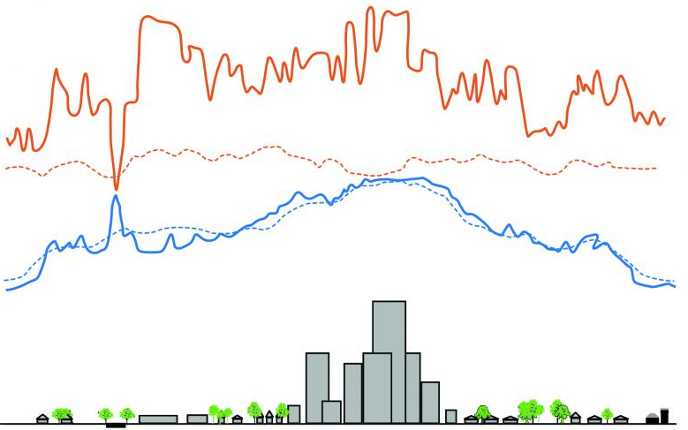
Background
Surface Temperature (Day)
Air Temperature (Day)
Surface Temperature (Night)
Air Temperature (Night)
The Urban Heat Island (UHI) effect
Thermal hotspots in urban canopies
Surface Heat Island Effects (SUHI) as proxy of air temperature
Day
(4 pm)
Temperature
Night
(2 am)
Rural
Suburban
Pond
Industry &
Warehouses
Urban
Residential
Downtown
Urban
Residential
Park
Suburban
Rural
Image Credit: Environmental Protection Agency
Notes:
Speaker notes:
Large concentrations of impervious surfaces found within cities store and radiate heat from the sun and make neighborhoods and cities hotter, even at night, creating what is known as an Urban Heat Island (UHI). (Phelan et al., 2015).
The impacts of UHIs can be addressed by increasing tree canopy in cities. Trees are especially effective at providing cooling by absorbing solar radiation and shading surfaces below their canopies.
More Info:
Trees are especially effective at offering cooling by absorbing solar radiation and shading impervious surfaces below their canopies during the day as well as releasing water vapor through their leaves to cool the air at night (Balany et al., 2020). Similarly, cooling infrastructure like parks, other public and private green spaces, and streetscapes along streets and sidewalks are some of the most effective strategies to keep impervious surfaces and the air cooler.
-------------------Image Credits------------------------------
https://www.epa.gov/heatislands/learn-about-heat-islands
* Part of image modified. Enlarged text, made editable

Slide 4
Community Concerns and Community Needs
Increasing Temperatures
Urban Greening
Social & Health Vulnerability
Future Interventions
Icon Credit: LA Great Streets, "Made by Made", Luis Prado, and Creative Mania​
Notes:
Speaker Notes:
The communities most vulnerable to rising temperatures are those that have not benefited from equitable investment and urban planning, which is the case in Yonkers due to historic government-sanctioned racist housing and lending practices.
Addressing these Environmental Justice concerns has been of particular interest to our community partner, Groundwork Hudson Valley.
-------------------Image Credits------------------------------
1. Vacant lot activation
Image Credit- LA Great Streets, US (Public Domain) from the Noun Project
Image Source- https://thenounproject.com/search/?q=urban+development&i=476745
2. Tree canopy
Image Credit- LA Great Streets, US (Public Domain) from the Noun Project
Image Source- https://thenounproject.com/term/tree-canopy/476740/
3.Heat Stroke
Image Credit- Luis Prado, US (Creative Commons) from the Noun Project
Image Source- https://thenounproject.com/search/?q=heat+stroke&i=924682
4. Global Warming
Image Credit- Creative Mania, IN (Creative Commons) from the Noun Project
Image Source- https://thenounproject.com/term/global-warming/1028784/
5. Offices
Image Credit- Made by Made, AU (Creative Commons) from the Noun Project
Image Source- https://thenounproject.com/term/offices/707660/

Slide 5
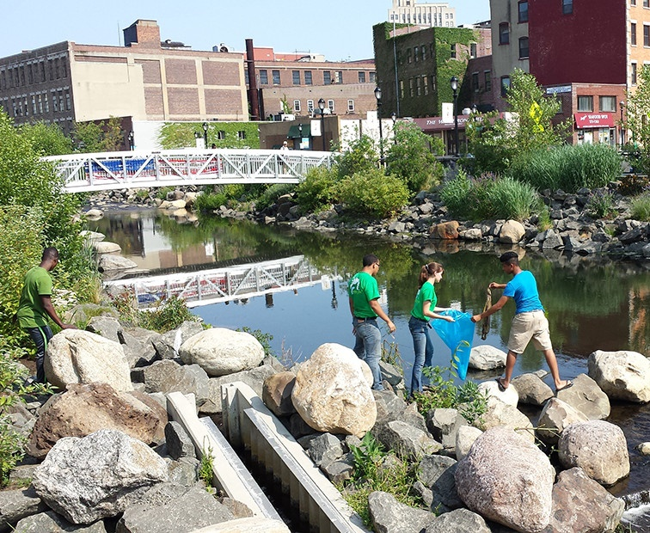
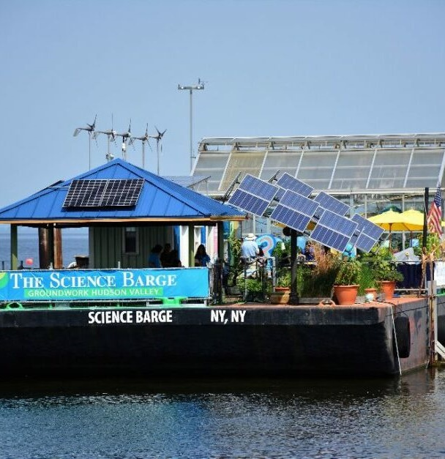
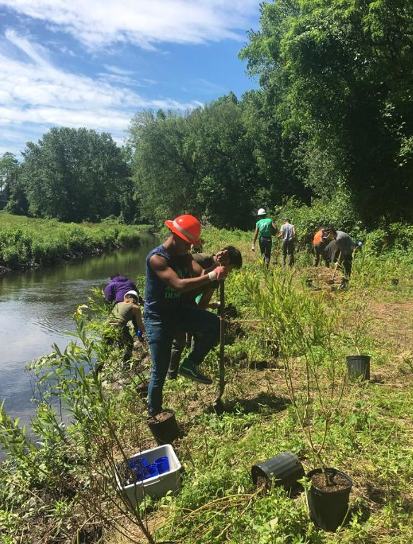
Project Partner
Groundwork USA, Groundwork Hudson Valley
Image Credit: Groundwork Hudson Valley
Notes:
Speaker Notes:
Groundwork Hudson Valley (GHV) is a social and environmental advocacy organization promoting equity, leadership, and economic opportunity in Yonkers.
This partnership between Groundwork Hudson Valley and NASA DEVELOP focuses on supporting Groundwork’s Climate Safe Neighborhoods initiative to foster equitable community-based climate change adaptation in Yonkers.
-Oded Holzinger, Climate Resilience Manager, served as the DEVELOP team's point of contact for the project
-------------------Image Credits------------------------------
Photo of volunteer tree planting by Groundwork Hudson Valley courtesy of Groundwork Hudson Valley, used with permission

Slide 6
Created Heat Vulnerability Maps of Yonkers
Updated Heat Vulnerability Classification
Analyzed Proximity to Yonkers Cooling Centers
Modeled Urban Cooling at a city-wide scale
Analyzed Distribution of Tree Canopy & Impervious surfaces
Modeled Neighborhood & Street Level Cooling
A Two Term Project
A Two-Term Project
Summer
2021
Fall
2021
Notes:
Speaker Notes:
Our project builds off of the Yonkers Urban Development I Summer 2021 project which assessed heat vulnerability and urban cooling interventions at a city-wide scale. This term we looked at data from the summer months between 2016 and 2021 and zoomed in to a neighborhood/street level to accomplish the following objectives. (listed on the next few slides)

Slide 7
Project Objectives
Heat Vulnerability Analysis
produce an updated heat vulnerability index based on vulnerability variables identified by the New York State Department of Health
Icon Credit: Luis Prado, Creative Mania​, LA Great Streets, and Microsoft PowerPoint Icons
Notes:
Speaker Notes:
Our first objective was to produce an updated heat vulnerability index based on vulnerability variables identified by the New York State Department of Health, referred to from this point on as the NYSDOH.
-------------------Image Credits------------------------------
1.Heat Stroke
Image Credit- Luis Prado, US (Creative Commons) from the Noun Project
Image Source- https://thenounproject.com/search/?q=heat+stroke&i=924682
2. Global Warming
Image Credit- Creative Mania, IN (Creative Commons) from the Noun Project
Image Source- https://thenounproject.com/term/global-warming/1028784/
3. Tree canopy
Image Credit- LA Great Streets, US (Public Domain) from the Noun Project
Image Source- https://thenounproject.com/term/tree-canopy/476740/
4. Teaching
Image Credit- Microsoft PowerPoint Icons

Slide 8
Project Objectives
Heat Vulnerability Analysis
Landcover Distribution Per Capita
quantified the distribution of impervious surface and natural areas per person
Icon Credit: Luis Prado, Creative Mania​, LA Great Streets, and Microsoft PowerPoint Icons
Notes:
Speaker Notes:
Our second objective was to calculate and compare the area of greenspace and impervious surface throughout Yonkers.
-------------------Image Credits------------------------------
1.Heat Stroke
Image Credit- Luis Prado, US (Creative Commons) from the Noun Project
Image Source- https://thenounproject.com/search/?q=heat+stroke&i=924682
2. Global Warming
Image Credit- Creative Mania, IN (Creative Commons) from the Noun Project
Image Source- https://thenounproject.com/term/global-warming/1028784/
3. Tree canopy
Image Credit- LA Great Streets, US (Public Domain) from the Noun Project
Image Source- https://thenounproject.com/term/tree-canopy/476740/
4. Teaching
Image Credit- Microsoft PowerPoint Icons

Slide 9
Project Objectives
Heat Vulnerability Analysis
Landcover Distribution Per Capita
Thermal Comfort Analysis
model outdoor thermal comfort benefits in identified high heat-vulnerability sites by simulating increased tree canopy interventions
Icon Credit: Luis Prado, Creative Mania​, LA Great Streets, and Microsoft PowerPoint Icons
Notes:
Speaker Notes:
Our third objective was to use the microclimate model ENVI-met to model outdoor thermal comfort benefits by simulating increased tree canopy interventions.
-------------------Image Credits------------------------------
1.Heat Stroke
Image Credit- Luis Prado, US (Creative Commons) from the Noun Project
Image Source- https://thenounproject.com/search/?q=heat+stroke&i=924682
2. Global Warming
Image Credit- Creative Mania, IN (Creative Commons) from the Noun Project
Image Source- https://thenounproject.com/term/global-warming/1028784/
3. Tree canopy
Image Credit- LA Great Streets, US (Public Domain) from the Noun Project
Image Source- https://thenounproject.com/term/tree-canopy/476740/
4. Teaching
Image Credit- Microsoft PowerPoint Icons

Slide 10
Project Objectives
Heat Vulnerability Analysis
Landcover Distribution Per Capita
model the temperature benefits of increasing tree canopy
Thermal Comfort Analysis
model outdoor thermal comfort in identified high heat-vulnerability sites
Heat Literacy
produce ArcGIS StoryMap to help with understanding of urban heat impacts
Icon Credit: Luis Prado, Creative Mania​, LA Great Streets, and Microsoft PowerPoint Icons
Notes:
Speaker Notes:
Our last objective was to have our analyses serve as a heat literacy tool to support GHV’s advocacy efforts. Which we actualized by creating an ArcGIS StoryMap
-------------------Image Credits------------------------------
1.Heat Stroke
Image Credit- Luis Prado, US (Creative Commons) from the Noun Project
Image Source- https://thenounproject.com/search/?q=heat+stroke&i=924682
2. Global Warming
Image Credit- Creative Mania, IN (Creative Commons) from the Noun Project
Image Source- https://thenounproject.com/term/global-warming/1028784/
3. Tree canopy
Image Credit- LA Great Streets, US (Public Domain) from the Noun Project
Image Source- https://thenounproject.com/term/tree-canopy/476740/
4. Teaching
Image Credit- Microsoft PowerPoint Icons

Slide 11
Heat Vulnerability Analysis
Notes:
Jumping right into our methodology and results, we will first talk about our updated heat vulnerability analysis.

Slide 12
Revised Heat Vulnerability Index
Incorporate
Add
Calculate
Social & biophysical variables used by the NYSDOH to calculate heat vulnerability
Heat vulnerability to prioritize areas in need of cooling interventions in Yonkers
An exposure component: temperature data
Icon Credit: Microsoft PowerPoint Icons
Notes:
This term we took a different approach by calculating heat vulnerability at the census tract level, and incorporated social and biophysical variables that the NYSDOH uses to calculate heat vulnerability. These variables were determined based on factors that impact the heat-health relationship within New York State and were intentionally selected because the New York Climate Smart initiative recommends looking at heat vulnerability as part of New York’s climate smart communities certification framework.
Beyond NYSDOH heat variables we also added an exposure component to our calculations, which was temperature.
Our calculations were then used to prioritize areas in need of cooling interventions across the city.

Slide 13
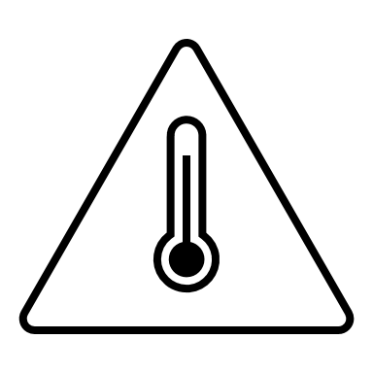
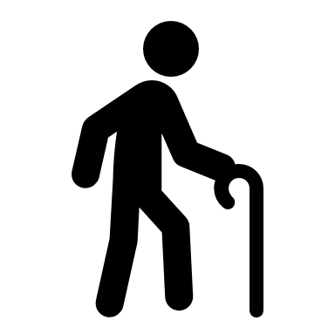
Heat Vulnerability Analysis Variables
NYSDOH Four Components of Heat Vulnerability
¡Si!
+
+
+
=
Да ну?
Socio-Economic
Language
Elderly / Elderly Isolation
Environmental
Heat Vulnerability
Icon Credit: Microsoft PowerPoint Icons
Notes:
Speaker Notes:
The variables we used fall under four different social and biophysical components that NYSDOH uses to help define vulnerability: socioeconomic vulnerability, language vulnerability, elderly vulnerability, and environmental vulnerability.
------------------------------Image Information Below ------------------------------
All images on this slide are sourced via Microsoft PowerPoint icons

Slide 14
Heat Vulnerability Social & Biophysical Data
% Hispanic
% Black
% Foreign born
% Speak English less than very well
% Income below poverty level
% Age 65 or older
% 65 years + Older living alone
% Ages 18-64: w/ disability
% Ages 18-64: unemployed
% Houses built before 1980
Density of Housing Units / Mile²
Census Tract: 2015 - 2019 (5-year interval)
% high building intensity areas​
% open undeveloped areas
National Landcover Database (NLCD) 2019
Image credit: ACS, MRLC
Notes:
Speaker Notes:
The four components of heat vulnerability are can be broken down into 13 social and biophysical variables:
All of the social variables were acquired from the ACS 2019, 5-year estimate data and the environmental variables were obtained from NLCD, based on 2019 landcovers that were defined as ‘Percentage land with high building intensity areas’ and ‘Percentage land that consists undeveloped areas.’
------------------------------Image Information Below ------------------------------
1. ACS Logo
Image Credit- U.S. Census Bureau, America Community Survey
Image Source- https://commons.wikimedia.org/wiki/File:US-Census-ACSLogo.svg
2. MRLC Logo
Image Credit- MRLC
Image Source- https://www.mrlc.gov/partners

Slide 15
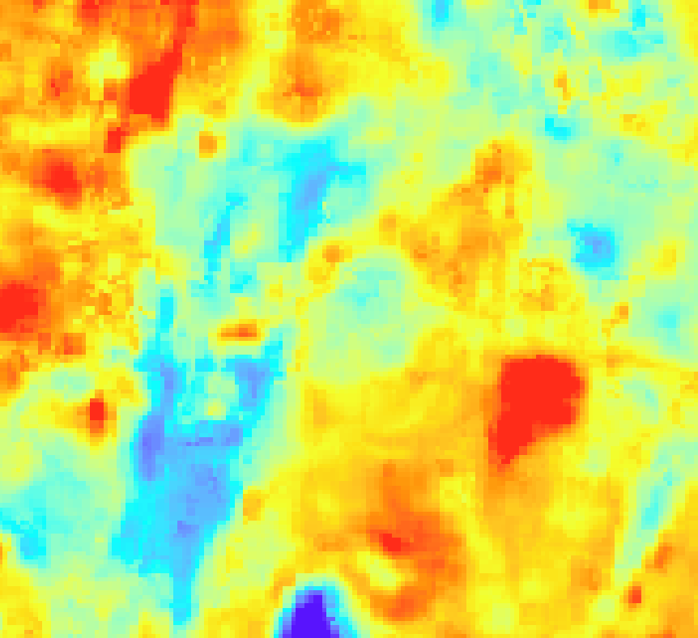
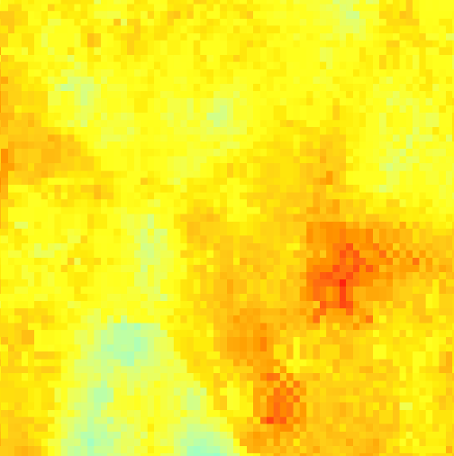
Heat Vulnerability Temperature Data
Collection Dates: June 1st- August 31st (2016-2021)
Landsat 8
TIRS
Land Surface Temperature (LST)
ISS
ECOSTRESS
Image credit: NASA, Microsoft PowerPoint Icons
Notes:
Speaker Notes:
Beyond the variables the NYSDOH used to calculate heat vulnerability, we added an exposure component by including temperature data into our analysis, by providing the median day and night time land surface temperature values for each census tract. We used the following NASA Earth observations to collect day and nighttime land surface temperatures over non-water surfaces. Also, it is important to note ECOSTRESS was not launched until 2018, so we had not night time land surface temperature collections in 2016 or 2017.
------------------------------Image Information Below ------------------------------
1. Landsat 8, ISS
Image Credit- NASA
Image Source- https://www.devpedia.developexchange.com/dp/index.php?title=List_of_Satellite_Pictures
2. Day time LST and Night time LST: sourced via Microsoft PowerPoint icons

Slide 16
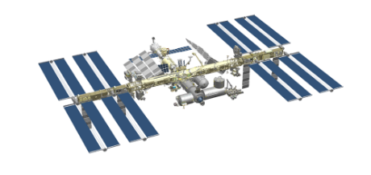
Earth Observations
Landsat 8
TIRS
ISS
ECOSTRESS
Thermal Infrared Sensor
The ECOsystem Spaceborne Thermal
Radiometer Experiment on Space Station
Spatial Resolution: 30 meters
Temporal Revisitation: 16 Days
Spatial Resolution: 70 meters​
Temporal Revisitation: 1-7 days
Image credit: NASA, Microsoft PowerPoint Icons
Notes:
Speaker Notes: These satellite/sensor products were used to collect our day and night time land surface temperature data for our heat vulnerability analysis which we will discuss in the next slides.
This slide depicts the temporal and spatial resolution for the analysis.
Landsat 8 Thermal Infrared Sensor (TIRS)
International Space Station (ISS) ECOsystem Spaceborne Thermal Radiometer Experiment on Space Station (ECOSTRESS)
Image Credit:
NASA Satellites- https://www.devpedia.developexchange.com/dp/index.php?title=List_of_Satellite_Pictures
Microsoft PowerPoint Clipart​

Slide 17
Heat Vulnerability Calculation
Input Data
Acquisition & Processing
Output
Data Spreadsheet for PCA analysis
ACS 2015-2019
R-Studio
Landsat 8-TIRS
Google Earth Engine
ISS ECOSTRESS
ArcGIS Pro
NLCD 2019
Icon Credit: Microsoft PowerPoint Icons
Notes:
Speaker Notes:
To get the data needed for our analysis we had to acquire data from various sources. We obtained and processed the ACS data through the tidycensus package in R Studio, and the Landsat 8-TIRS data through Google Earth Engine. We downloaded the ISS ECOSTRESS data through requesting it on APPEARS and downloading it to ArcGIS Pro. In addition, due to cloud cover issues and the lack of ISS ECOSTRESS data we were only able to retrieve nine images in total. Lastly, we downloaded our NLCD data from The Multi-Resolution Land Characteristics (MRLC) Consortium and also processed it through ArcGIS Pro. Once we had our relevant data we exported it all to a single spreadsheet for analysis.
We used these data to calculate heat vulnerability and a final heat vulnerability score downloading based on calculations made by the Philadelphia Health & Air Quality team in the Spring of 2020.
--------------------------------Image sources--------------------------------
All images on this slide are sourced via Microsoft PowerPoint icons

Slide 18
Principal Component Analysis
Spreadsheet
Variables
Select Components
Score by Census Tract
High
variables
components
Low
Notes:
Speaker notes: (short) To create the scores for heat vulnerability we used a Principal Component Analysis, which is also known as a PCA. In this case, the PCA takes our 15 previously discussed variables and combines them into principal components, PCs. We then selected the 4 components that explained approximately 75% of the data variation, after running the analysis with other numbers of components and examining what made sense with variables that made up each component. These components were then used to develop an overall heat vulnerability score for each census tract.
Speaker notes: (long)
To calculate heat vulnerability, we used a Principal Component Analysis, also known as a PCA. We did the PCA for all of Westchester County because it is generally recommended that there are 10-20 observations per variable. Since we had 15 variables, we wanted at least 150 observations (census tracts). Yonkers only has 52 census tracts, so we decided to analyze the whole county, which has 223 census tracts. The PCA took our previously discussed variables and combined them into principal components, PCs. We then selected the four components that explained approximately 75% of the data variation after running the analysis with other numbers of components and examining what made sense with variables that made up each component. These components were then used to develop an overall heat vulnerability index which we then converted to a score for each census tract.

Slide 19
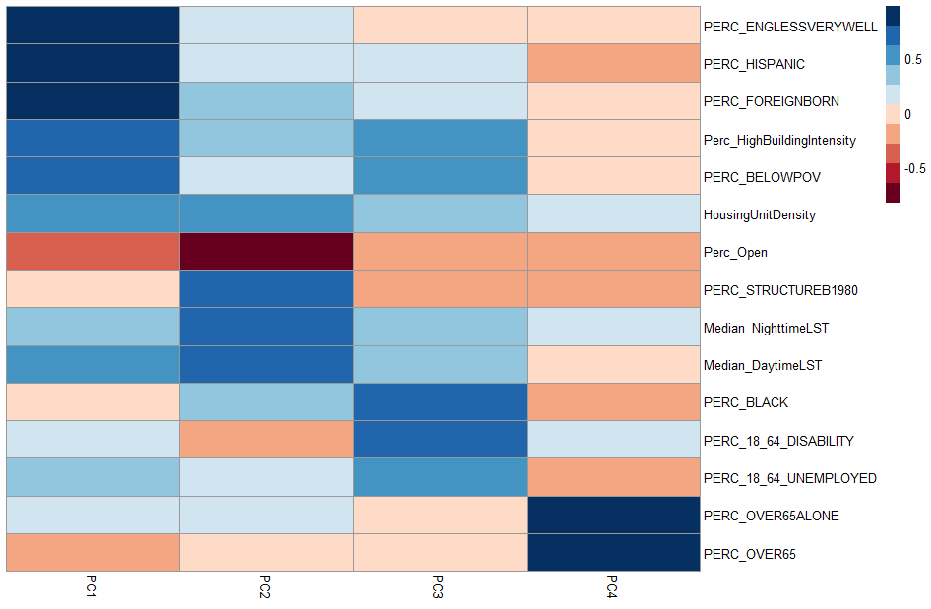
Heat Vulnerability Index Results
% Speak English less then very well
% Hispanic
% Foreign Born
% High Building Intensity
0.5
% Below Poverty
Housing Unit Density
% Open Space
0
% Built Before 1980
Median Night LST
-0.5
Median Day LST
% Black
% 18 – 64 w/ Disability
% 18 – 64 Unemployed
% Over 65 and Live Alone
% Over 65
PC 1
PC 2
PC 3
PC 4
Notes:
The results of running our four components shows this result. Many of these variables are commonly associated with vulnerability across the literature, and that many of these associations between race, class, and vulnerability are a product of racist governance and development. The first component shows populations and variables that tend to have financial constraints. The second component consists of variables that are related to environmental, and infrastructure exposure, and even urbanicity like NYSDOH initially had as a component as well. The third component consists of populations that may have greater difficulty in accessing medical care or essential services, while the fourth component consists of the two variables that make up elderly/elderly isolation vulnerability as defined by the NYSDOH.
More details:
Four Components:
First Component is % Hispanic, % Foreign Born, % High Building Intensity, % Below Poverty, Housing Unit Density, % Speak English less than very well
Second Component is: % Open Space, % Built Before 1980, Median Night LST, Median Day LST
Third Component is: % 18-64 w/ a disability, % Black, % 18-64 Unemployed.
Fourth Component: %Over 65 Live Alone, and % Over 65

Slide 20
Heat Vulnerability Score Results
Top 3:
Radford
Sunnyside Park
Glenwood
Nepera Park
Sprain Lake Knolls
Crestwood Lake
Glenwood
Neighborhoods in Yonkers
Radford
Heat Vulnerability
Bottom 3:
Crestwood Lake
Sprain Lake Knolls
Nepera Park
1
2
3
4
5
Sunnyside
Park
0 0.5 1 2 3 4
m
Notes:
This map shows Heat Vulnerability in Yonkers Census tracts given on a scale of 1-5, with each level split into fifths that indicate how vulnerable certain areas of the city are to heat events compared to others. A census tract with a value of one indicates that it is among one of the least vulnerable areas of Yonkers. In contrast, a census tract with a value of five indicates it is among one of the most heat-vulnerable areas of Yonkers. As the map shows, the most heat vulnerable census tracts are located in the southwestern portion of the city, particularly around the Old 7th Ward and areas surrounding it to the north and west. Areas with lower heat vulnerability tend to be scattered throughout the city, with the northeastern section of the city seeing the highest concentration of low heat vulnerable census tracts.
The most heat vulnerable census tract is in the Radford neighborhood and slightly bleeds into a part of Old 7th Ward.

Slide 21
Median Temperature Differences
Old 7th Ward
LST Differences (°F)
-6.60 – -4.00
-3.99 – -1.00
-0.99 – 1.00
1.00 – 4.00
4.01 – 8.00
Kimball
0 0.5 1 2 3 4
m
Notes:
Speaker Notes:
This map shows the difference between median land surface temperatures recorded from Landsat 8 – TIRS during the daytime during the summers from 2016-2021 in Yonkers census tracts, compared to the median temperature recorded for all of Yonkers. This map shows that some of the warmest land surface temperatures are located in parts of the city with the highest heat vulnerability and vice versa. This map also shows that some of the warmest land surface temperatures are in and around Kimball and Old 7th Ward, the neighborhoods in which we modeled tree canopy interventions.

Slide 22
Available Landcover Per Person
Notes:
Speaker Notes:
Next, we decided to take a closer look at landcover distribution to see how it could potentially have ties to areas of inequity and higher heat vulnerability.

Slide 23
Input data
Data Processing software
Data Processing
Outputs
USFS Tree Canopy Cover
(NLCD 2016)
Clip dataset to Yonkers study area
green space
#
Developed Imperviousness Dataset (NLCD 2016)
Calculate % of each census tract containing green spaces, impervious surface
ArcGIS Pro
impervious surface
#
Population (2019 ACS Data)
Extract
population data
R-Studio
Icon Credit: Microsoft PowerPoint Icons
Notes:
Speaker Notes:
For input data, we utilized two NLCD (National Land Cover Database) products, tree canopy cover and developed imperviousness released in 2016.
More details:
We compared these data products within census tracts through ArcGIS Pro, and then connected this with population data from the ACS 2019 survey. This process gave us mapping products for both tree canopy cover and impervious surface at the percent census tract and per Capita level.
To calculate the area of both landcover types, including both tree canopy cover and impervious surfaces, at a per person scale, the team downloaded two National Land Cover Database (NLCD) products, including percent Developed Imperviousness and percent Tree Canopy released in 2016. We downloaded these datasets released from the U.S. Geological Survey (USGS) and collected them from the Multi-Resolution Land Characteristics (MRLC) Consortium website at a 30-meter spatial resolution. We analyzed these data products at the census tract level, and then connected this with population data from the ACS 2019 survey, which provides a 5-year estimate.
--------------------------------Image sources--------------------------------
Image Credit: Microsoft PowerPoint icons

Slide 24
Calculating Landcover Per Person
Fraction tree
or
Impervious surface
Total census
tract area (ft²)
Area of tree
or
impervious surface
Total # of people per census tract
Icon Credit: Microsoft PowerPoint Icons
Notes:
Speaker Notes:
Next, the team performed a simple calculation within ArcGIS Pro's Field Calculator to determine the area of landcover, both tree canopy cover and impervious surface, per person. We multiplied the fraction of each census tract represented by tree canopy or impervious surface by the total area of each census tract, in square feet, and then divided this value by the total population of each census tract. This produced the estimated area of each landcover type in square feet per capita. The team then represented these values graphically, below.
--------------------------------Image sources--------------------------------
All images on this slide are sourced via Microsoft PowerPoint icons

Slide 25
Tree Canopy Per Capita Results
Top 3:
Sprain Lake Knolls
Beech Hill – Victory Heights
Nepera Park
Bottom 3:
Radford
Nodine Hill
Old 7th Ward
Old 7th Ward
TC(ft²) Per Capita
10 – 220
221 – 480
481 – 1330
1331 – 2800
2801 – 4878
Kimball
0 0.5 1 2 3 4
m
Notes:
Speaker Notes:
Our first result is for tree canopy coverage (in square feet) per Capita.
In the map pictured here, dark green areas represent the most tree canopy coverage in square feet per person. Overall, the north of Yonkers contains more tree canopy cover than the southwest and southeast/downtown areas of Yonkers, including the neighborhoods Kimball, and Old 7th Ward.
EXTRA:
Census tracts with the highest area of tree canopy per person include: Sprain Lake Knolls (North central), Beech Hill –Victory Heights (Northeast), and Nepera Park North central). Census tracts with the least area per person include: Radford (Southwest), Nodine Hill (center next to Old 7th), and Old 7th Ward (outlined above).

Slide 26
Tree Canopy Per Census Tract
Top 3:
Sunnyside Park
Park Hill
Woodstock Manor
Bottom 3:
Radford
LaMartine Heights
Old 7th Ward
Average % TC
per census tract
Old 7th Ward
0.4 – 10%
11 – 15%
16 – 20%
21 – 30%
31 – 46%
Kimball
0 0.5 1 2 3 4
m
Notes:
Speaker Notes:
Our next mapping result is also for tree canopy coverage, except instead of at the per person scale, it is taken as percentage of each census tract.
Dark green areas represent census tracts with a greater percentage of tree canopy cover making up their surface area. This includes mainly areas predominantly in the north of Yonkers, such as: Sunnyside Park, Park Hill, and Woodstock Manor. Areas with an overall lower percentage of tree canopy cover are predominantly located to the southeast and southwest, such as Radford, LaMartine Heights, and Old 7th Ward.
Later on in our analysis, we determined there to be a negative correlation/association between tree canopy cover and heat vulnerability, indicating that places we identified as more heat vulnerable do tend to have a lack of tree cover that might act as a cooling mechanism.

Slide 27
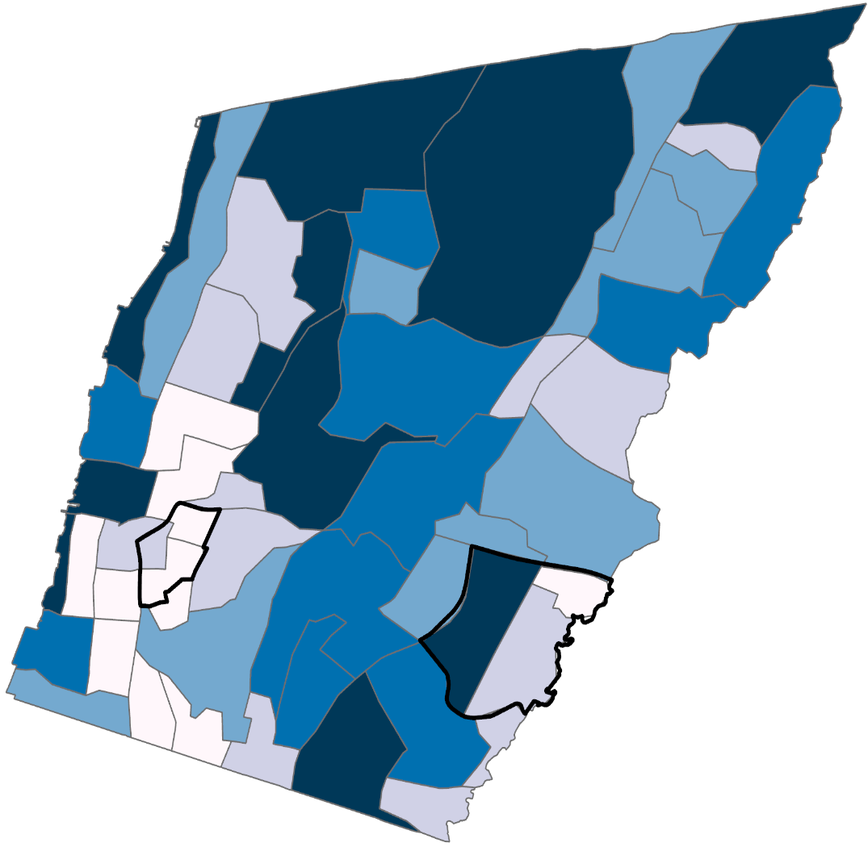
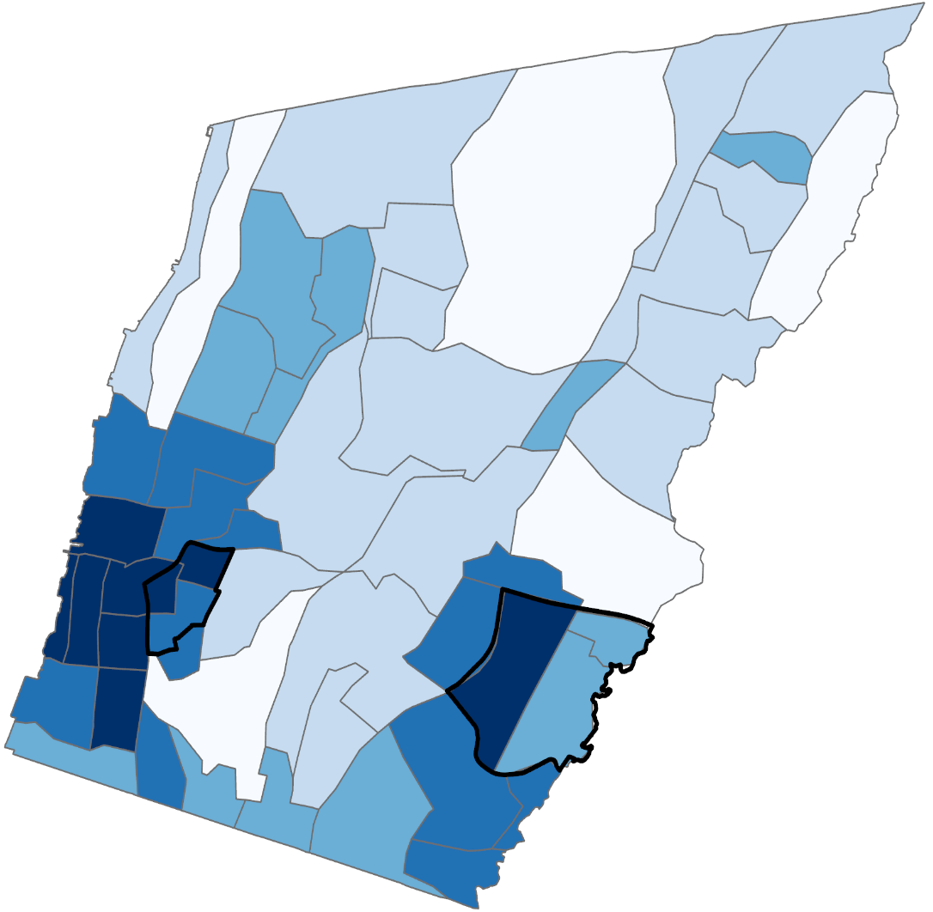
Impervious Surface Landcover Results
Average % IS
per census tract
IS (ft²) Per Capita
350 – 700
700 – 1100
1100 – 1440
1440 – 1835
1835 – 12645
29 – 35%
36 – 50%
51 – 60%
61 – 70%
71 – 86%
0 0.5 1 2 3 4
m
Notes:
Speaker Notes:
In this next figure, we compare the amount of impervious surface at the per capita and the per census tract level, which were of particular interest. We reproduced the same mapping outputs as described above for tree cover, except this time using the developed imperviousness dataset.
In both maps, dark blue areas represent the most impervious surface coverage.
The left map depicts more impervious surface per person to the north. In contrast, census tracts with less area of impervious surface per person are located towards the southeast and southwest, including our modeled neighborhoods Old 7th Ward, and Kimball.
These results, however, are misleading and not representative of which areas are actually in most need of green spaces. Neighborhoods such as Old 7th Ward and Kimball are ranked as having the least area of impervious surface per person, when in reality, the population is densely packed into a small surface area so that people have less area in general per person, illustrated in the slide to the right.

Slide 28
Calculating Landcover Assets
Assets
Liabilities
Area of tree cover
Area of
impervious surface
Area of net landcover assets per person
Notes:
Speaker Notes:
Since looking at landcover surfaces at a per capita scale can de-prioritize census tracts with large populations and small surface area, the team created a metric called landcover assets that would better take into account the equity at stake in different neighborhoods of Yonkers. Areas of tree canopy cover were reframed as assets, or a resource of positive value in terms of heat vulnerability, and areas of impervious surface were framed as liabilities, or a source of negative value in terms of worsening heat vulnerability. Liabilities were subtracted from assets to determine which census tracts have more assets, or positive resources to combat urban heat island, than liabilities and which census tracts have more liabilities making it more difficult to combat urban heat, than assets.

Slide 29
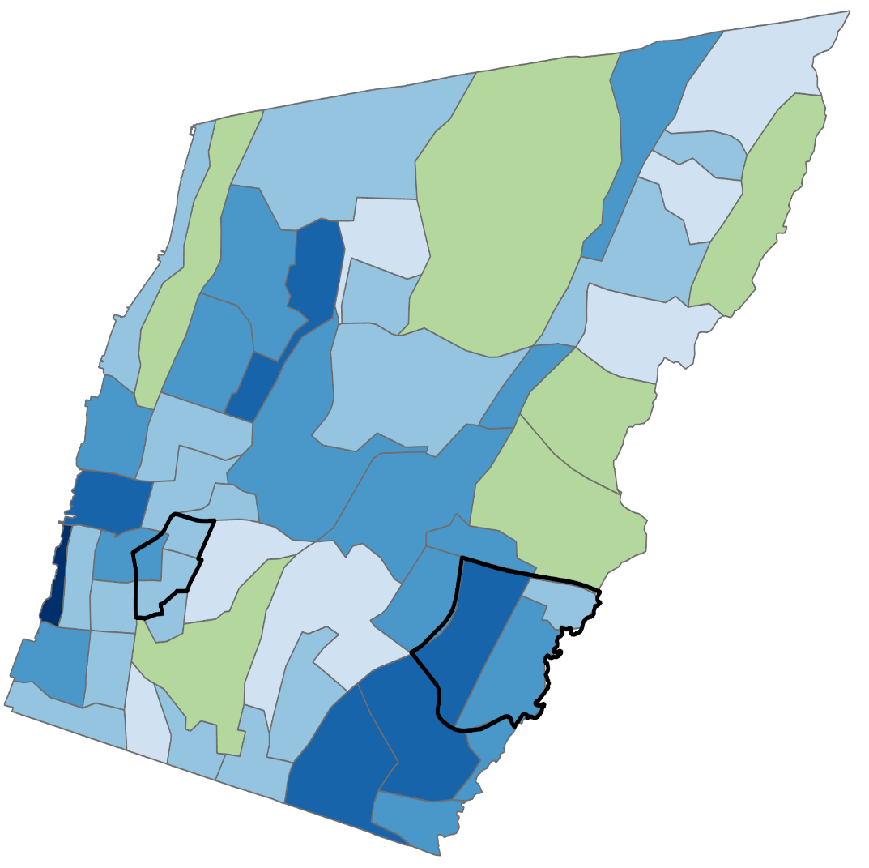
Landcover Assets
Area of Net
Landcover
Assets per Capita
IS (ft²) Per Capita
350 – 700
700 – 1100
1100 – 1440
1440 – 1835
1835 – 12645
-12586
-12585 – -1315
-1314 – -670
-669 – -350
-349 – 0
1 – 692
0 0.5 1 2 3 4
m
Notes:
Speaker Notes:
Looking at the map to the right, Blue areas represent census tract with more liabilities than assets, or in this case, greater area of impervious surface than tree canopy coverage. The green area represents census tracts with more assets than liabilities, in this case being more tree canopy coverage than impervious surfaces. Areas such as Sprain Knoll Hills and Park Hill, which earlier displayed as having more impervious surface per capita, actually have more tree canopy coverage than impervious surface coverage, and are thus more prepared to combat heat vulnerability.
Compared to the map to the left, which looks at impervious surface per person, it becomes that certain areas to the North, such as Sprain Lake Knolls and Park Hill, which were neighborhoods with the highest area of impervious surface per person, actually have more net assets (green space) than liabilities (impervious surface). This helps elucidates some of the equity issues with looking at impervious surface at a per person level when neighborhoods in need have small surface area and are densely populated.

Slide 30
Thermal Comfort
Notes:
Although surface temperature and meteorological information including air temperature and humidity can give a strong indication of what an outside environment feels like, there are additional factors within a microclimate or a location-specific heat experience that can affect human thermal comfort.
To gain a better understanding of microclimate on the streets in Yonkers and how adding street trees might work to improve thermal comfort for residents, a climate model called ENVI-met was used. This model allows for a close look at conditions that would affect thermal comfort including meteorological data along with detailed information on physical site conditions like the materials of the walls and roofs of the buildings along the street together with characteristics of the surrounding vegetation.
It is important to note that even taking into account meteorological information and their interaction with the varying characteristics of the physical environment, this information only tells half of the story. The other half is determined by personal, physical, and even behavioral dynamics of each person and their interaction with the environment which may include age, fitness level, previous exposure, expectations, adaptation to local conditions, and many other factors (Middel 2015) which makes true thermal comfort for diverse populations difficult to determine.

Slide 31
ENVI-met
Atmosphere
Soil
Vegetation
Buildings
Wind Speed + Direction
Temperature + Humidity
Turbulence
Radiative Fluxes
Gas + Particle Dispersion
Surface + Soil Temp.
Soil Water Content
Vegetation Water Supply
Water Bodies
3D Plant Geometry
Foliage Temperature
Heat + Vapor Exchange
3D Building Geometry
Building Materials
Building Physics
Air Temperature
Mean Radiant Temperature
Relative Humidity
Global Radiation
Notes:
Speaker Notes:
In order to understand what temperatures feel like in Yonkers, and how adding additional street trees might improve heat conditions for residents, a climate model called ENVI-met was used.
The interaction of atmosphere, soil, vegetation and building variables of the study locations were evaluated by modeling both the existing conditions as well as a simulated increase in street tree canopy cover.
The model outputs of air temperature, relative humidity, and radiation fluxes – the heat felt between the individual and their surroundings - were then used with BIOmet, a post data-processing application, to calculate thermal comfort. This was based on the Universal Thermal Climate Index, modeled on human thermo-regulation. The resulting temperatures reflect what a standard male at, 35 years of age, 5’8” in height, and 175 lbs in weight would feel in each location within the study areas.
The inputs shown in bold text were acquired from Real-Time Mesoscale Analysis (RTMA) through Google Earth Engine for the 30th of June 2021 at 2pm. The remaining inputs were acquired through a beginner level simulation completed using ENVI Guide.

Slide 32
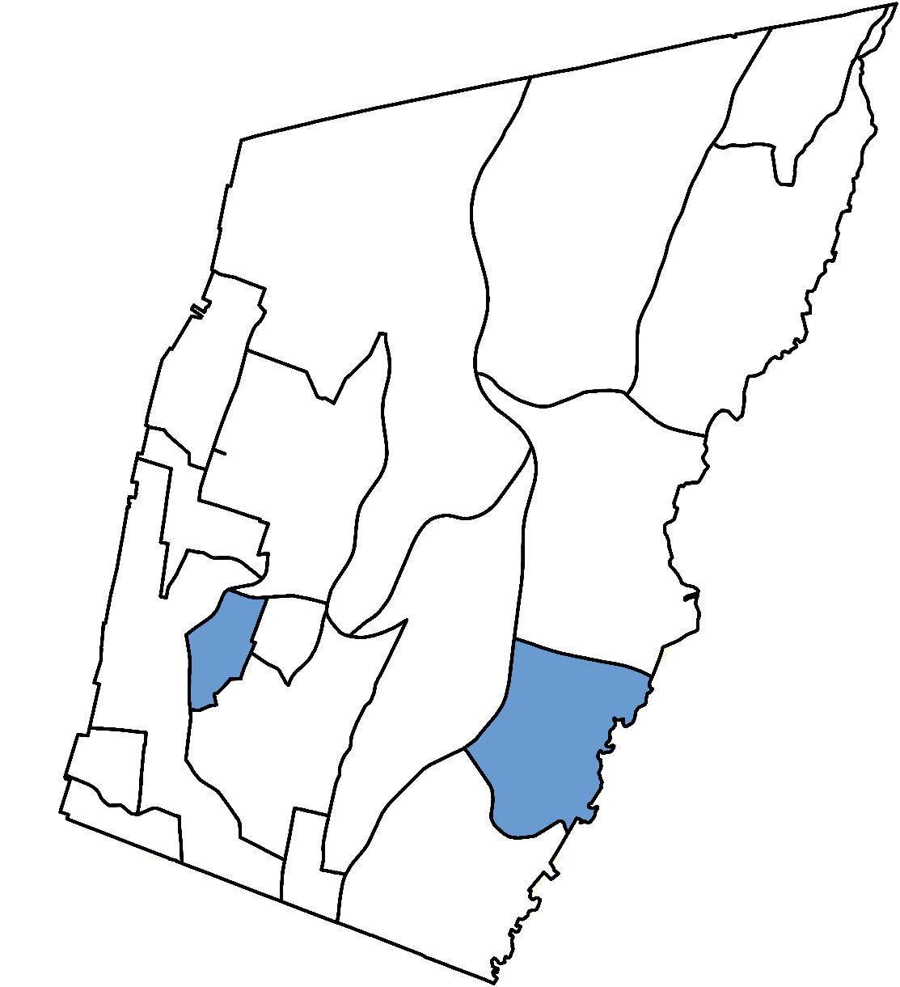
Simulation Locations
Old 7th Ward
Kimball
Notes:
Speaker Notes:
Based on the results of our vulnerability analysis and the feasibility of future cooling interventions, two study locations were chosen. These were located in the Kimball and Old 7th Ward neighborhoods, shown here on a map of Yonkers’ neighborhoods.

Slide 33
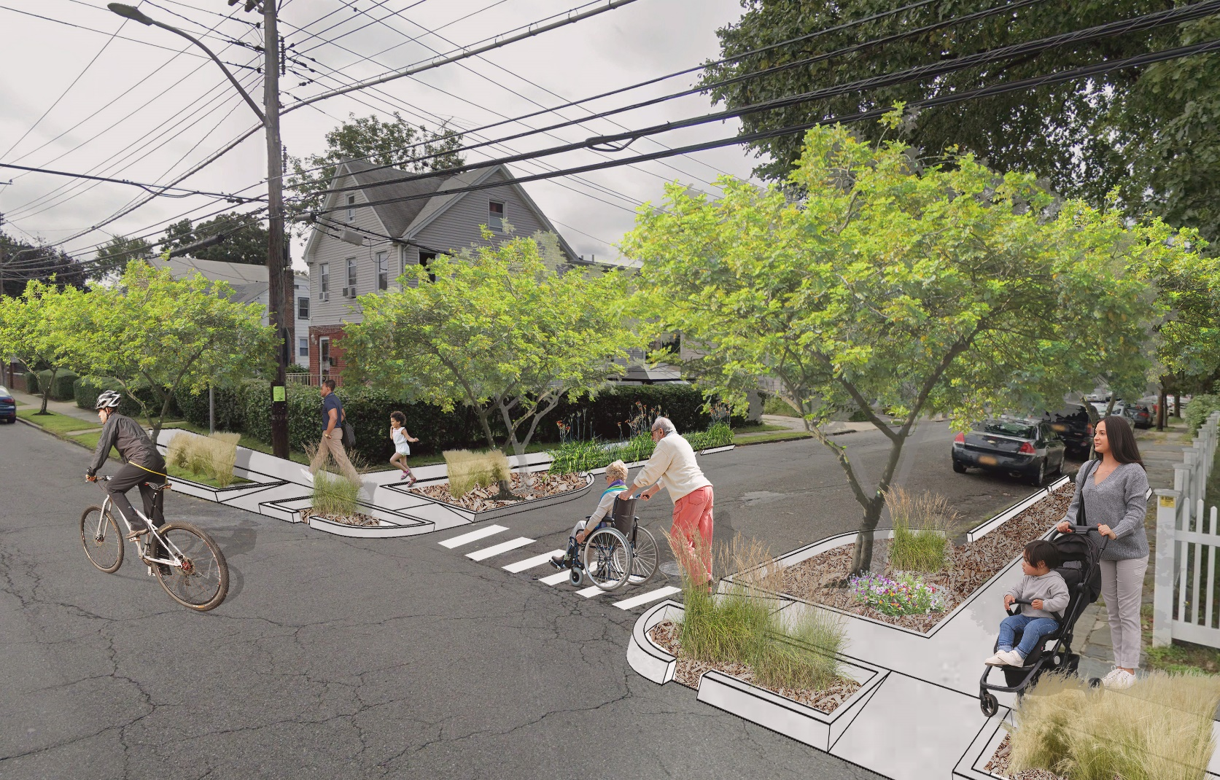
Intervention
Increasing street tree canopy
Placement at point heat source
European redbud (Ceris siliquastrum)
NYC approved street trees
Image Credit: Google Street View
Notes:
Speaker Notes:
The chosen intervention includes planting the Eastern redbud tree along residential and larger collector streets. This tree is native to the northeast and, with a maximum height of less than 35 ft, it is suitable for planting along roads and under existing powerlines.
Meteorological information necessary to run these simulations was acquired from the Real-Time Mesoscale Analysis through Google Earth Engine for the 30th of June 2021 at 2pm. The remaining inputs were acquired through a beginner-level simulation completed using ENVI Guide.
Image: Google street view

Slide 34
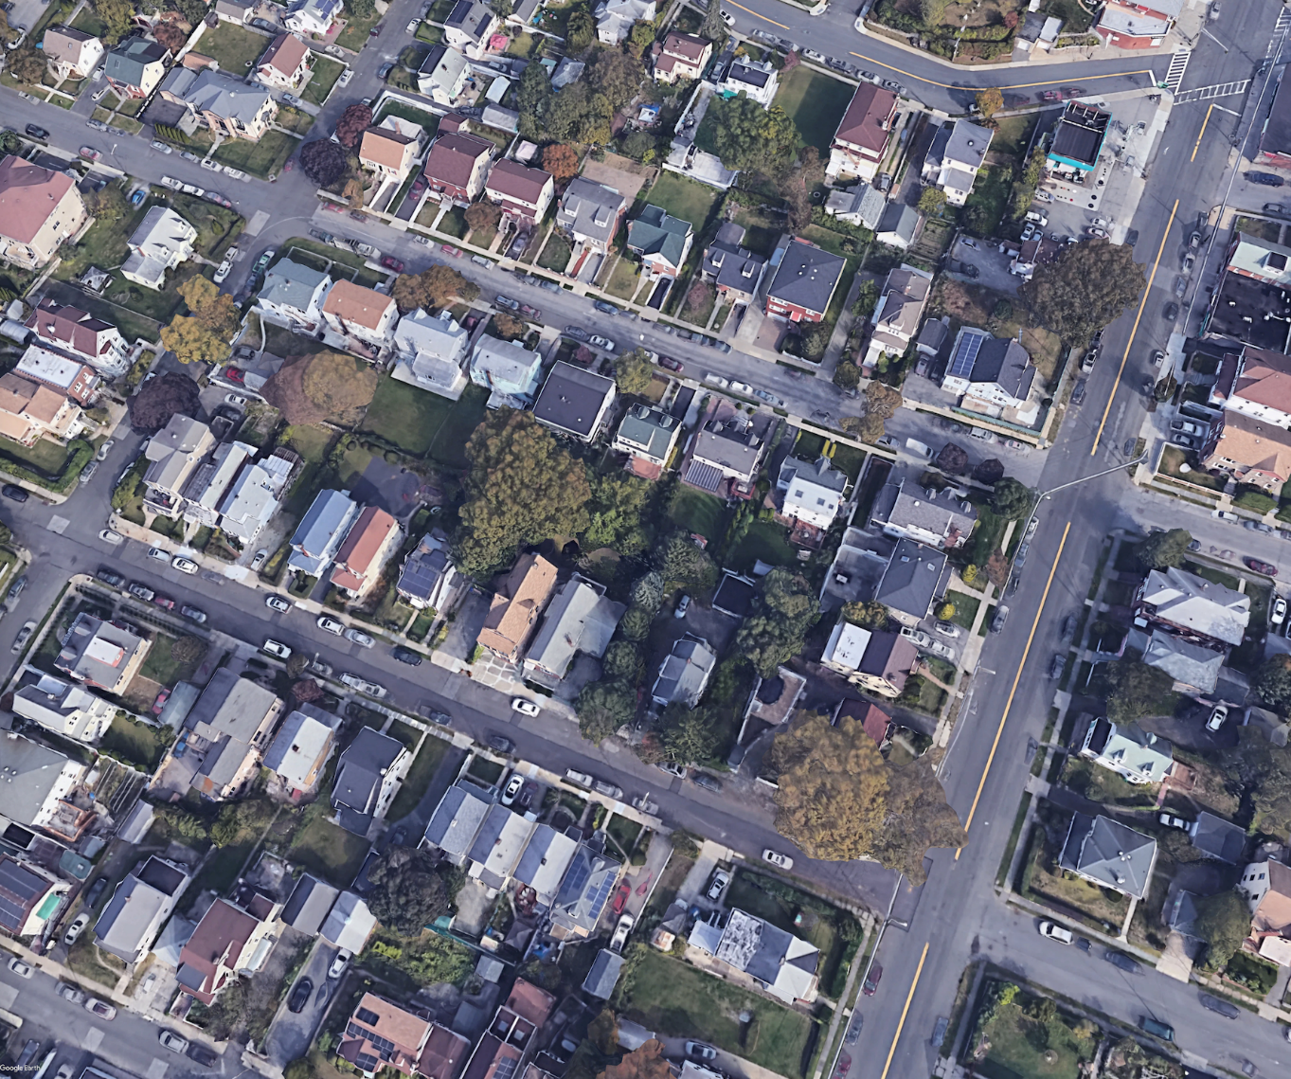
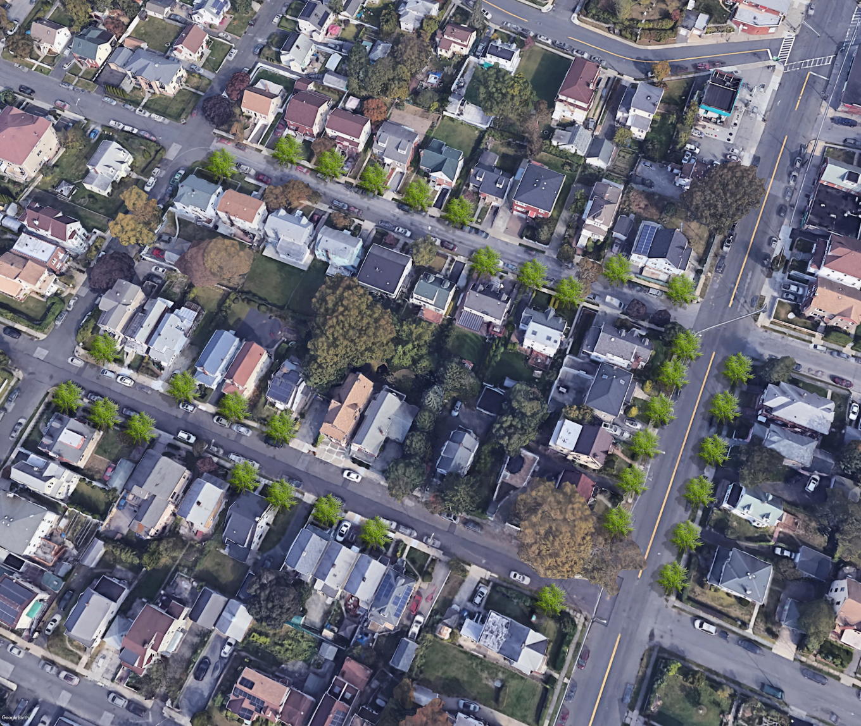
Intervention: Kimball
Existing Conditions
Modeled Intervention
Kimball Ave
Kimball Ave
Edgewood Ave
Edgewood Ave
Winifred Ave
Winifred Ave
Image Credit: Google Earth
Notes:
Speaker Notes:
The first simulation was run in the Kimball neighborhood. Kimball is an upper-middle class neighborhood that displayed only moderate heat vulnerability through our analysis but features existing wide landscaped easements along its streets, making a future cooling intervention in this area highly feasible.
The following are Google Earth imagery showing the existing conditions of a residential block along Kimball Ave on the left and a graphic representation of the modeled increase in street canopy coverage through ENVI-met on the right.
--------------------------------Image sources--------------------------------
Google Earth

Slide 35
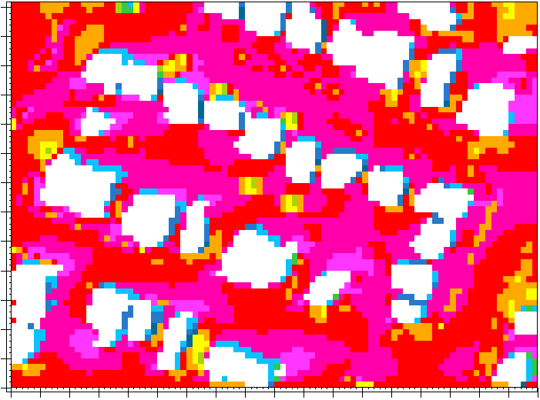
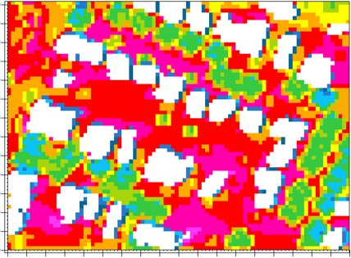
Thermal Comfort: Kimball
Existing Conditions
Modeled Intervention
120
Edgewood Ave
120
Edgewood Ave
100
100
80
80
(m)
(m)
60
60
Kimball Ave
Winifred Ave
Kimball Ave
Winifred Ave
40
40
20
20
0
0
0 20 40 60 80 100 120 140 160 180
0 20 40 60 80 100 120 140 160 180
(m)
UTCI
(m)
Min: 96.1 °F
Max: 111.3 °F
below 97.6 °F
97.6 - 99.1 °F
99.1 - 100.6 °F
100.6 - 102.2 °F
102.2 - 103.7 °F
103.7 - 105.2 °F
105.2 - 106.7 °F
106.7 - 108.2 °F
108.2 - 109.8 °F
above 109.8 °F
Min: 94.1 °F
Max: 110.8 °F
Notes:
Speaker Notes:
Shown here are the results of the thermal comfort analysis, temperatures that reflect what each specific location feels for the chosen study subject.
As shown here, the majority of the improvements were seen in the immediate vicinity of the planted trees, though additional cooling was felt at both the east and west ends of Edgewood and Winifred Ave's as well as off the street, between individual homes and even in private backyards.
The maximum thermal comfort temperature had an overall reduction of .5°F in the study area and the minimum decreased by 2°F.

Slide 36
Thermal Comfort: Kimball
Existing Conditions
Modeled Intervention
120
Edgewood Ave
120
1
1
5
Edgewood Ave
5
100
100
6
6
80
4
10
80
4
10
(m)
(m)
60
60
Kimball Ave
Winifred Ave
Kimball Ave
Winifred Ave
40
2
8
40
2
8
3
9
9
20
7
3
20
7
0
0
0 20 40 60 80 100 120 140 160 180
0 20 40 60 80 100 120 140 160 180
1. 105.2 °F - 100.6 °F = 4.6 °F
2. 108.2 °F - 100.6 °F = 7.6 °F
3. 109.8 °F - 102.2 °F = 7.6 °F
4. 108.2 °F - 106.7 °F = 1.5 °F
5. 106.7 °F - 103.7 °F = 3 °F
6. 108.2 °F - 102.2 °F = 6 °F
7. 106.7 °F - 108.2 °F = -1.5 °F
8. 109.8 °F - 108.2 °F = 1.6 °F
9. 106.7 °F - 102.2 °F = 4.5 °F
10. 105.2 °F - 99.1 °F = 6.1 °F
Min: 96.1 °F
Max: 111.3 °F
Min: 94.1 °F
Max: 110.8 °F
Notes:
Speaker Notes:
For a closer analysis of thermal comfort, temperatures were compared both before and after the simulated intervention at ten specific locations.
Improvements of 1.5°- 7.6°F were observed within the study area, with the highest numbers in the range within direct proximity to planted trees nearer to the street. Only one location was observed to lack a cooling improvement – location 7- which experienced a 1.5°F increase in thermal comfort.
Overall, an average of 4.1°F of cooling was experienced at all the points in this analysis.

Slide 37
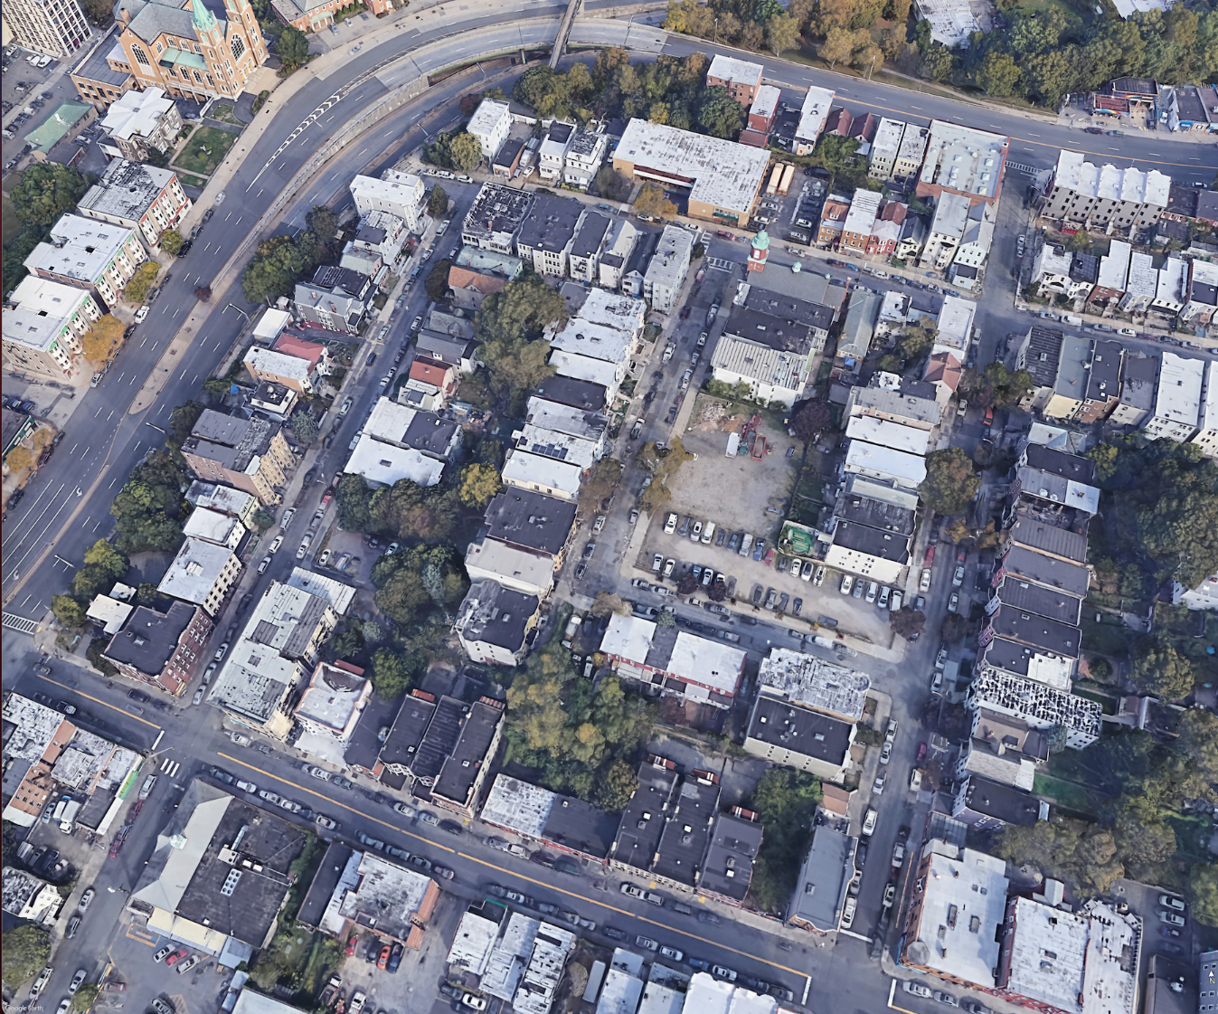
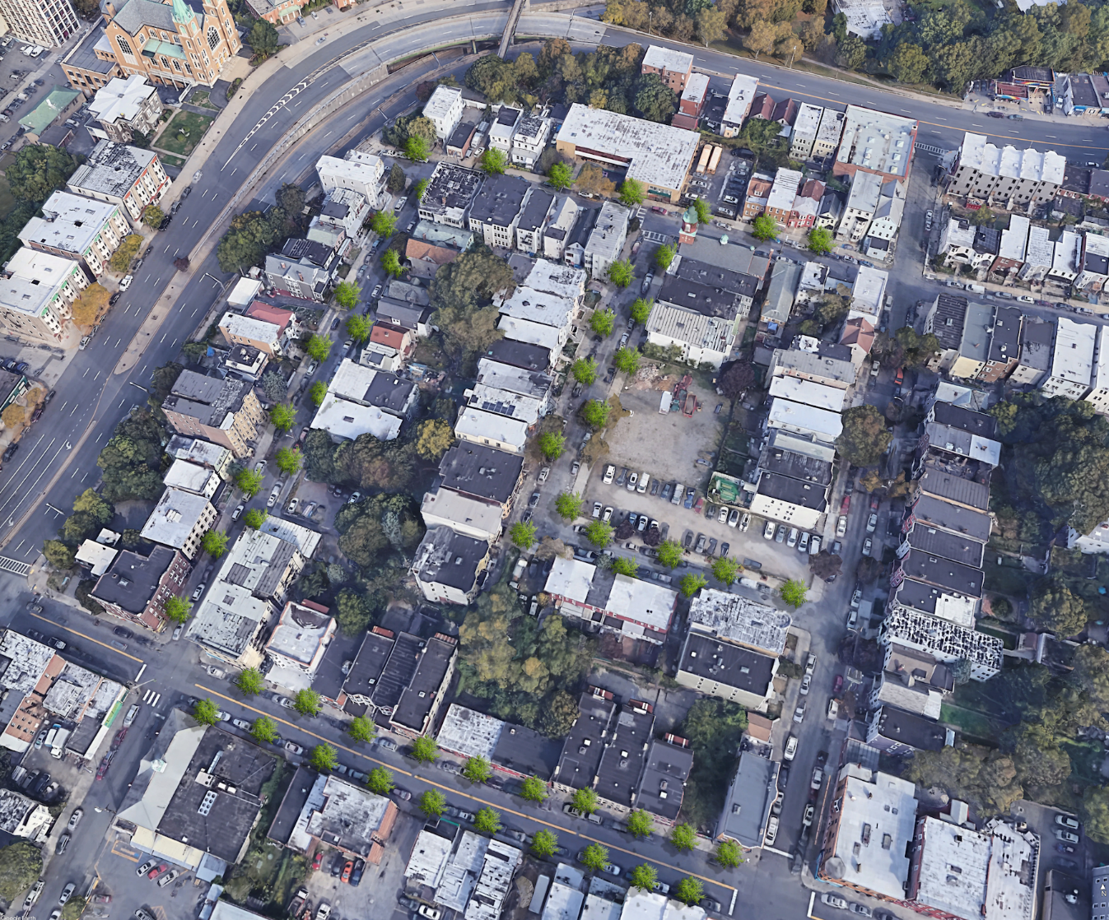
Intervention: Old 7th Ward
Existing Conditions
Modeled Intervention
Nepperhan Ave
Nepperhan Ave
Chestnut Ave
Chestnut Ave
Elm Street
Riverview Ave
Elm Street
Riverview Ave
Linden Ave
Linden Ave
Image Credit: Google Earth.
Notes:
Speaker Notes:
The Old 7th Ward neighborhood has a higher density urban form and demonstrates a high heat vulnerability due to factors related to both socioeconomic and surface temperature characteristics.
The existing prevalence of street trees is minimal along the public facing side of each street as is the infrastructure to plant additional trees along the sidewalks. Despite this, a similar simulated increase was modeled here as in Kimball to demonstrate how, if equitable investment was made, a cooling benefit might be experienced in this area for pedestrians, public transit users, and local residents.
--------------------------------Image sources--------------------------------
Image Credit: Google Earth

Slide 38
Thermal Comfort: Old 7th Ward
Existing Conditions
Modeled Intervention
200
Chestnut St.
200
Chestnut St.
180
180
160
160
UTCI
140
below 99.4 °F
99.4 - 101.0 °F
101.0 - 102.5 °F
102.5 - 104.1 °F
104.1 - 105.6 °F
105.6 - 107.2 °F
107.2 - 108.7 °F
108.7 - 110.3 °F
110.3 - 111.8 °F
above 111.8 °F
140
120
120
(m)
(m)
100
100
Linden St
Linden St
80
80
60
60
40
40
Elm Street
Elm Street
20
Min: 97.8 °F
Max: 113.4 °F
20
Min: 94.8 °F
Max: 112.9 °F
0
0
0 20 40 60 80 100 120 140
0 20 40 60 80 100 120 140
(m)
(m)
Notes:
Speaker Notes:
The results of the thermal comfort analysis demonstrate significant cooling along the streets that received the planting intervention along with adjacent spaces including residential backyards and even the vacant parcel within the study area.
The overall maximum temperature was reduced by 3°F relative to human thermal comfort, with more dramatic cooling felt in specific locations. The overall minimum temperature was also decreased by 0.5°F.

Slide 39
Thermal Comfort: Old 7th Ward
Existing Conditions
Modeled Intervention
200
Chestnut St.
200
Chestnut St.
6
6
180
1
180
1
1. 108.7 °F - 99.4 °F = 9.3 °F
2. 110.3 °F - 101.0 °F = 9.3 °F
3. 107.2 °F - 99.4 °F = 7.8 °F
4. 108.7 °F - 107.2 °F = 1.5 °F
5. 101.0 °F - 99.4 °F = 1.6 °F
6. 110.3 °F - 101.0 °F = 9.3 °F
7. 107.2 °F - 99.4 °F = 7.8 °F
8. 107.2 °F - 104.1 °F = 3.1 °F
9. 110.3 °F - 107.2 °F = 3.1 °F
10.108.7°F - 101.0 °F = 7.7 °F
160
7
160
7
140
140
5
5
120
120
(m)
(m)
2
2
100
8
100
8
Linden St
4
Linden St
4
80
80
60
60
3
9
3
9
40
40
Elm Street
Elm Street
20
Min: 97.8 °F
Max: 113.4 °F
20
Min: 94.8 °F
Max: 112.9 °F
10
10
0
0
0 20 40 60 80 100 120 140
0 20 40 60 80 100 120 140
(m)
(m)
Notes:
Speaker Notes:
The temperatures were again compared both before and after the simulated intervention at ten specific locations. Improvements ranged from just 1.5°F to 9.3°F relative to thermal comfort, an average of 6.1°F of cooling was experienced at all the locations of this analysis.
Overall, Old 7th Ward experienced a greater net benefit from the street tree intervention than Kimball, with higher temperatures noted within its existing conditions along with more significant cooling benefits noted after the intervention.

Slide 40
Limitations & Uncertainties
ACS data based on estimates
Coarse data resolution
LST is not experienced temperature
Spatial shifts
Icon Credit: Microsoft PowerPoint Icons, Hopkins, Adrien Coquet, FR
Notes:
Speaker Notes:
Limitations for our study include but are not limited to our land surface temperature variable for the heat vulnerability analysis not taking into account feels like temperature, the American Community Survey data being based on estimates, the coarse spatial resolution of our temperature and meteorological data inputs for the heat vulnerability calculation and ENVI-met and our ISS ECOSTRESS data initially georeferenced incorrectly.
In addition, only 9 ECOSTRESS images were used, as mentioned before, so the data is not necessarily the best representation of Yonkers nighttime temperatures, and ENVI-met is a time-consuming model with a steep learning curve with more complex simulations requiring a run time of a week or more.
More details and limitations:
Course Spatial Resolution: For the PCA the ECOSTRESS data had a spatial resolution of 70 meters. For ENVI-met the temperature and wind data also had a coarse resolution, with RTMA pixels larger than certain neighborhoods especially Old 7th Ward. For Old 7th Ward we had to create a buffer of 500 meters around the neighborhood to even just get data, since Old 7th Ward was too small.
Spatial shifts: In addition, the ECOSTRESS Data was not georeferenced correctly, so we had to shift the data to the best of our ability. Also only 9 ECOSTRESS images were used in the analysis between 2018 and 2021.
Additional notes: Only 9 ECOSTRESS images were used as mentioned before, even for Landsat data temperature data were not recorded every day so some days may not be representative of overall conditions of Yonkers
Additional Note: ENVI-met is a time-consuming model with a steep learning curve with more complex simulations requiring a run time of a week+
-------------------Image Credits------------------------------
1. Thermometer
Image Credit- Microsoft PowerPoint Icons
2. People
Image Credit- Hopkins, US (Public Domain) from the Noun Project
Image Source- https://thenounproject.com/search/?q=people&i=930476
3. Net
Image Credit- Adrien Coquet, FR , US (Public Domain) from the Noun Project
Image Source- https://thenounproject.com/search/?q=net&i=4311578
4. Satellite
Image Credit- Microsoft PowerPoint Icons

Slide 41
Conclusions
ENVI-met is a useful model for evaluating microclimate and possible interventions
In Yonkers, socio-demographics and physical properties are linked to urban heat and heat risk
Location specific interventions in high- risk areas would provide the most benefits
Increasing tree canopy along streets is an effective way of cooling Yonkers
Open spaces are an opportunity for impactful interventions
Icon Credit: Microsoft PowerPoint Icons
Notes:
Speaker Notes:
ENVI-met model outputs show that microclimate interventions in SW Yonkers could provide tangible cooling benefits and work to address the negative impacts associated with Urban Heat Islands. In Yonkers, there is a confirmed link between community socio-demographics, physical conditions and urban heat. Strategically locating cooling interventions in areas of high heat vulnerability has potential to provide the most benefits. While, increasing shade through tree cover overall would be an effective way of cooling Yonkers.
These results will serve as a heat literacy tools to help Groundwork Hudson Valley and the city of Yonkers prioritize urban cooling strategies to meet the goals of New York State’s Climate Smart Communities program— improving community public health, safety, and climate adaptation.
Image Credit- Microsoft PowerPoint Icons

Slide 42
Future Work
Model incremental tree canopy increases in heat vulnerable neighborhoods
Leverage TARGET and ENVI-met to examine the impacts of additional heat mitigating infrastructure implementation such as a cost benefits analysis of green roofs to support GHV"s partnership with a local municipal housing group
Mapping increased landslides in Yonkers in comparison to vulnerable neighborhoods
Further refine and add proximity analysis variables, such as public transportation
Icon Credit: Microsoft PowerPoint Icons
Notes:
Some possibilities of future work include implementing TARGET to examine the impacts of additional heat mitigating infrastructure implementation. One consideration could be a cost benefits analysis of green roofs to support GHV’s partnership with a local municipal housing group.
Our partner has also expressed considerable interest in looking at the increase of landslides in Yonkers, NY and how they relate to high-vulnerability neighborhoods.
Future teams can also perform more in-depth statistical analyses to look at the relationship between walkability to parks or areas of high tree cover, and examine more closely the relationship between heat, and socio-economic or health variables.
Icons: Microsoft powerpoint

Slide 43
A special thank you to our Science Advisors, Mentors and Fellow for their direction and support:
Dr. David Hondula (Arizona State University, Associate Professor)
Dr. Kenton Ross (NASA Langley Research Center)
Lauren Childs-Gleason (NASA Langley Research Center)
Ryan Hammock (NASA DEVELOP, Fellow/Lead)
We would also like to thank our wonderful project partner and collaborator at Groundwork USA, Groundwork Hudson Valley:
Oded Holzinger, Climate Resilience Manager of Groundwork Hudson Valley
A big thanks to Yonkers Urban Development I for their previous contributions:
Jillian Walechka, Tanya Bils, Kathryn Greenler, Samain Sabrin, Joseph Scarmuzza
Finally, we would like to thank Dr. Ariane Middel for providing us access to her support and providing the team with access to ENVI-Met
Notes:
Speaker Notes:
And that concludes our presentation.
We would like to extend a special thank you to our Science Advisors, Mentors and Node lead Fellow for their direction and support these include:
Dr. David Hondula
Dr. Kenton Ross
Lauren Childs-Gleason
Ryan Hammock
We would also like to thank our project partner and collaborator at Groundwork Hudson Valley: Oded Holzinger.
Also, a thanks to Yonkers Urban Development I for their previous contributions
Finally, we would like to thank Dr. Ariane Middel for providing access and support to ENVI-met.
And thanks to you all for your attention. We now welcome any comments or questions.

Slide 44
EXTRA/BACKUP SLIDES:
Notes:
Speaker Notes:

Slide 45
Environmental Justice
Historically Red
Lined
Old 7th
Ward
Higher Average
Temp.
Video & Image Credit: Groundwork Hudson Valley , Microsoft PowerPoint Icons
Notes:
Speaker Notes:
Unfortunately, the communities most vulnerable to rising temperatures are those that have not benefited from an equitable investment in essential cooling infrastructure. Most often communities vulnerable to heat include the highest percentages of impervious surfaces and lowest percentages of tree canopy coverage per capita when compared to other, less vulnerable communities which is the case in Yonkers.
Addressing this Environmental Justice concern has been of particular interest to our community partner, Groundwork Hudson Valley.
------------------Image Credits------------------------------
1. Photo of Old 7th Ward and -------- by Groundwork Hudson Valley courtesy of Groundwork Hudson Valley, used with permission
2. Heat Wave Icon
Image Credit- Creative Mania, IN US (Public Domain) from the Noun Project
Image Source-https://thenounproject.com/search/?q=heat+wave&i=1028786
3. Remainder of the icons are Microsoft Powerpoint Icons

Slide 46
Project Objectives
Heat Vulnerability Analysis
Thermal Comfort Analysis
model the temperature benefits of increasing tree canopy
Landcover Distribution Per Capita
model outdoor thermal comfort in identified high heat-vulnerability sites
Heat Literacy Graphics
Icon Credit: Luis Prado, Creative Mania​, LA Great Streets, and Microsoft PowerPoint Icons
Notes:
Lastly, we worked to produced heat literacy graphic for our ArcGIS StoryMap to help with understanding urban heat impacts.
-------------------Image Credits------------------------------
1.Heat Stroke
Image Credit- Luis Prado, US (Creative Commons) from the Noun Project
Image Source- https://thenounproject.com/search/?q=heat+stroke&i=924682
2. Global Warming
Image Credit- Creative Mania, IN (Creative Commons) from the Noun Project
Image Source- https://thenounproject.com/term/global-warming/1028784/
3. Tree canopy
Image Credit- LA Great Streets, US (Public Domain) from the Noun Project
Image Source- https://thenounproject.com/term/tree-canopy/476740/
4. Teaching
Image Credit- Microsoft PowerPoint Icons

Slide 47
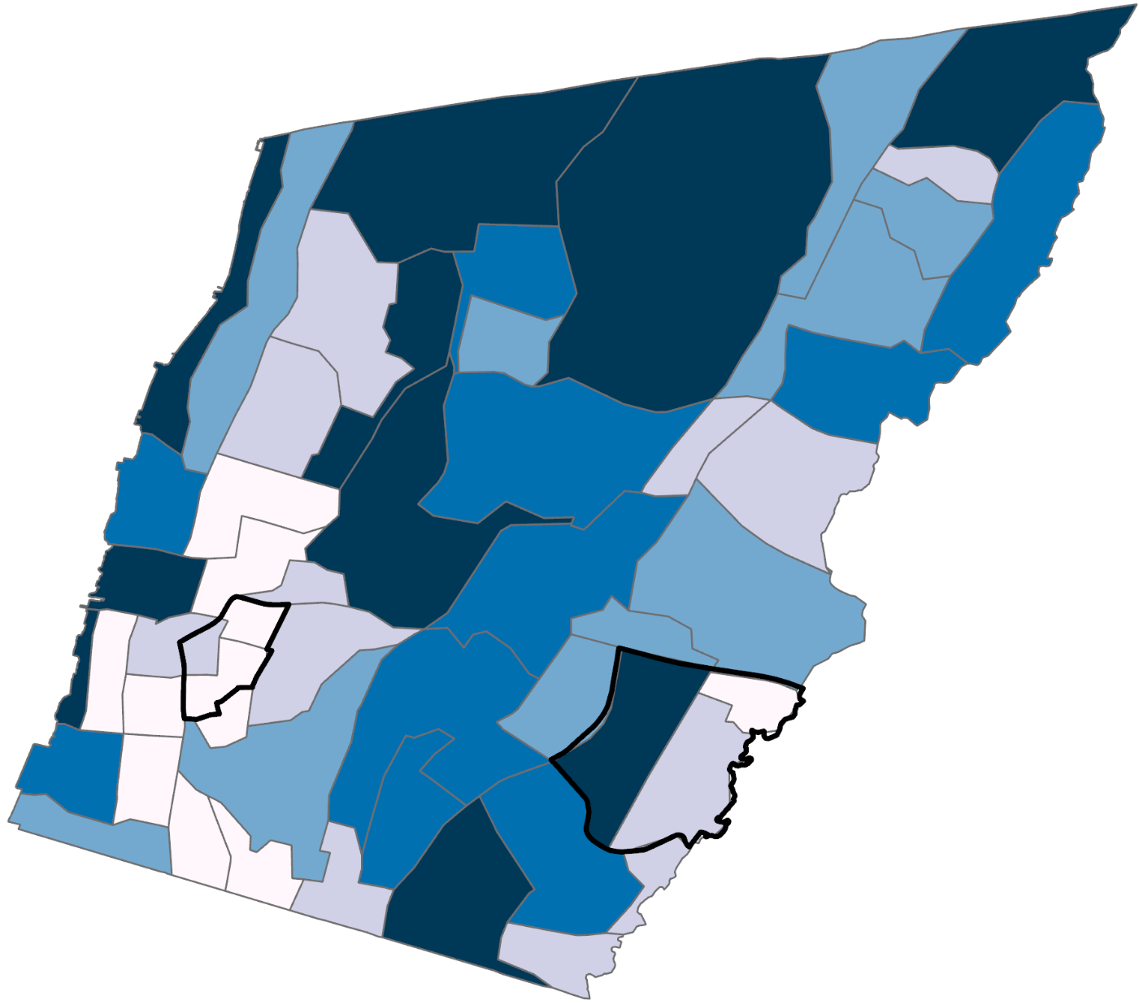
Impervious Surface Per Capita Results
Top 3:
Radford
Sprain Lake Knolls
Beech Hill- Victory Heights
Bottom 3:
Radford
Old 7th Ward
Kimball
Old 7th Ward
IS (ft2) Per Capita
350 – 700
700 – 1100
1100 – 1440
1440 – 1835
1835 – 12645
Kimball
0 0.5 1 2 3 4
m
Notes:
Speaker Notes:
Dark blue areas represent the most impervious surface coverage per person. This depicts more impervious surface per person to the north, such as in neighborhoods like: Radford, Sprain Lake Knolls, and Beech Hill- Victory Heights. On the contrast, areas with less area of impervious surface per person are towards the southeast and southwest, such as: Radford, Old 7th Ward, and Kimball (two of which are our study areas). These results, however, are not indicative of the true picture of areas in most need of green spaces. Neighborhoods such as Old 7th and Kimball are ranked as having the least area of impervious surface per person, when in reality, the population is densely packed into a small surface area that people have less area in general per person.

Slide 48
Impervious Surface Per Census Tract
Top 3:
Radford
Old 7th Ward
LaMartine Heights
Bottom 3:
Sunnyside Park
Crestwood Lake
Park Hill
Average % IS
per census tract
Old 7th Ward
29 – 35%
36 – 50%
51 – 60%
61 – 70%
71 – 86%
Kimball
0 0.5 1 2 3 4
m
Notes:
Speaker Notes:
Dark blue areas represent census tracts with a greater percentage of impervious surfaces making up their surface area. This includes mainly areas to the southeast and southwest, such as Radford, Old 7th Ward, and LaMartine Heights. Areas with an overall lower percentage of impervious surfaces include predominantly areas in the north of Yonkers, such as: Sunnyside Park, Crestwood Lake, and Park Hill.

Slide 49
Landcover Assets
Area of Net Landcover Assets per Capita
Old 7th Ward
-12586
-12585 – -1315
-1314 – -670
-669 – -350
-349 – 0
1 – 692
Kimball
0 0.5 1 2 3 4
m
Notes:
Speaker Notes:
Blue areas represent census tract with more liabilities than assets, or in this case, greater area of impervious surface than tree canopy coverage. The green area represents census tracts with more assets than liabilities, in this case being more tree canopy coverage than impervious surfaces. Areas such as Sprain Knoll Hills and Park Hill, which earlier displayed as having more impervious surface per capita, actually have more tree canopy coverage than impervious surface coverage, and are thus more prepared to combat heat vulnerability.

