Slide 1
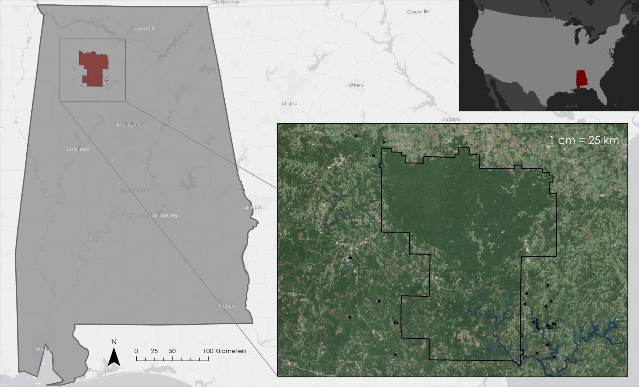
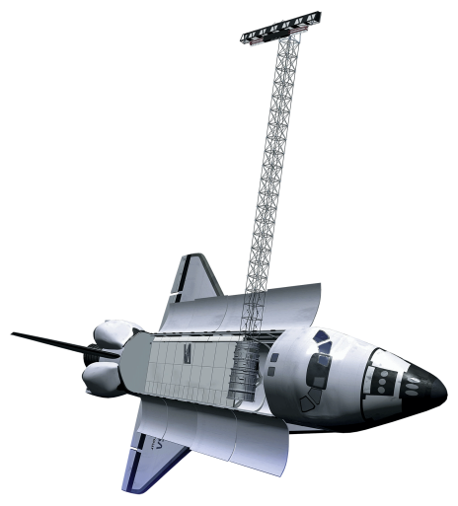
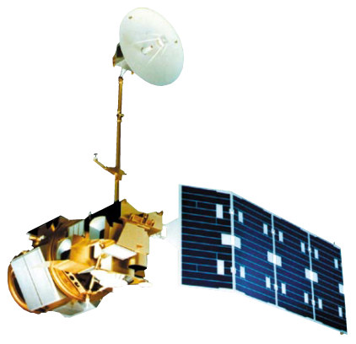
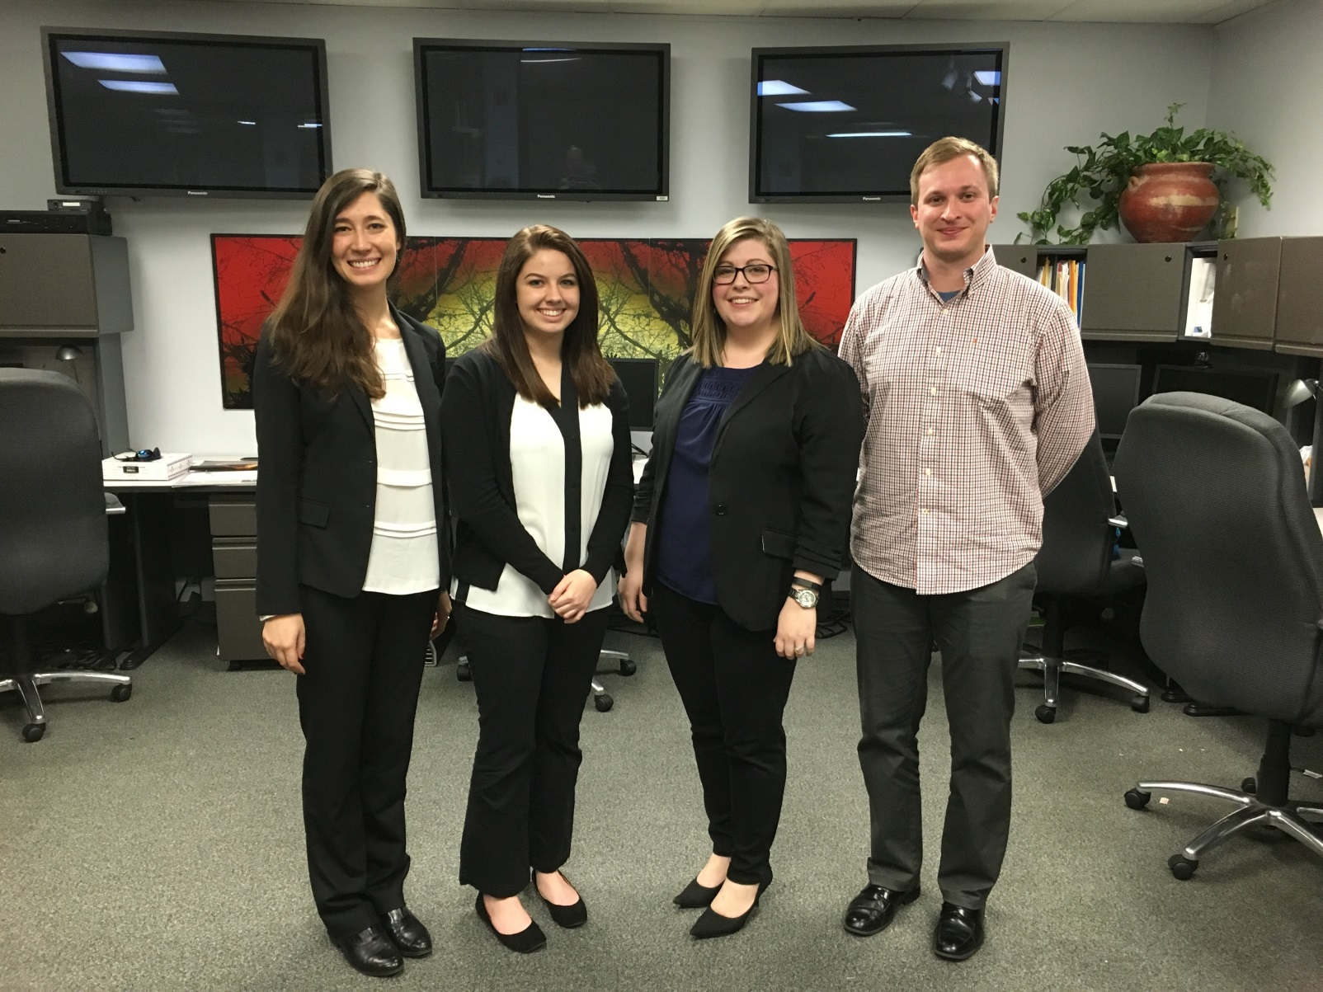
Alabama Ecological Forecasting
Assessing Southern Pine Beetle Epidemics in the Bankhead National Forest using NASA Earth Observations
Ryan Schick (Project Lead), Maggi Klug, Kelsey Herndon, Leigh Sinclair
DEVELOP National Program at NASA Marshall Space Flight Center
Abstract
Objectives
Map previous beetle infestations to determine areas affected by the Southern Pine Beetle (SPB)
Assess current and future forest susceptibility of SPB outbreaks to help determine where suppression efforts should be focused
Create a near real-time model to continually assess the ongoing risk of SPB outbreaks
Study Area
Methodology
1
Historical Pine Beetle Coverage Map
NAIP and in situ data [SPB locations]  Landsat 5 and 8 [Green Red Vegetation Index]  TRMM and GPM [Precipitation]  SRTM-v2 [Elevation and Slope]
2
Pine Beetle Prediction Map
In situ data [SPB locations]  SPB outbreak thresholds [Green Red Vegetation Index, Elevation, Slope, etc.]  Princeton University Maximum Entropy Model
3
Near Real-Time Pine Beetle Susceptibility Map
Earth Observations
Landsat 8 [Green Red Vegetation Index]  GPM [ precipitation]  SRTM-v2 [ Elevation and slope]  Python
Surface Temperature
Min. Temperature
Max. Temperature
Mean Temperature
NDVI
GRVI
Tree Species
Elevation
Slope
Aspect
Near Real-Time Southern Pine Beetle Susceptibility Model
Python
Landsat 8
Fuzzy Logic Model
STRM-V2
Landsat 5
Landsat 8
Conclusions
TBD
Results
TBD
Team Members
Acknowledgements
Dr. Jeffery Luvall - NASA at the National Space Science Technology Center
Dr. Robert Griffin - University of Alabama in Huntsville
Dave Casey – United States Forest Service
Dr. John Nowak – United States Forest Service
Dr. Chris Asaro – United States Forest Service
Tim Klug - University of Alabama in Huntsville Graduate Research Assistant
Daryl Ann Winstead - NASA DEVELOP National Program
Alabama Forestry Commission
Project Partners
United States Forest Service
Right to left: Kelsey Herndon, Maggi Klug, Leigh Sinclair, Ryan Schick
NASA Marshall Space Flight Center

