Slide 1
Southern Rockies Ecological Forecasting II
Tracking Mule Deer for Wildlife Corridors between Seasonal Habitats in the Southern Rockies
Tyler Rhodes (Project Lead)
Allison Chappell
Michael Sclater
Maggie Jenkins
Amanda Flake
Cody Walker
Notes:
Hi, my name is Tyler Rhodes, and I am the Project Lead for the Southern Rockies Ecological Forecasting Team, this is the second term for this project. I recently graduated from Old Dominion University with a BS in Geography.
Hi, my name is Mike Sclater, and I graduated from Virginia Tech with a BS in Geography
Hi, my name is Amanda Flake, and I am a senior at Old Dominion University, graduating with a BA in Geography.
Our project uses NASA Earth observations to study mule deer migration by looking at snow coverage and the impact of anthropogenic features on their migration.

Slide 2
Community Concerns
Economically important
Hunting
Tourism
Ecologically important
Keystone species
Diverse ecosystem
Where are the Mule deer going?
Image Credit: Creative Commons “Tracks In the Snow” Chris Goforth
Notes:
Mule deer are a large source of income in the Southern Rocky region. Hunters of mule deer contribute millions of dollars to the local economies through lodging, licenses, supplies, food, and gas purchases during each hunting season. The money in turn contributes to the overall economic growth of this region.
Ecologically, mule deer are important because they are a keystone species that promote a diverse ecosystem. Mule deer populations have been declining, and because of this many other Southern Rocky wildlife species have been affected.

Slide 3
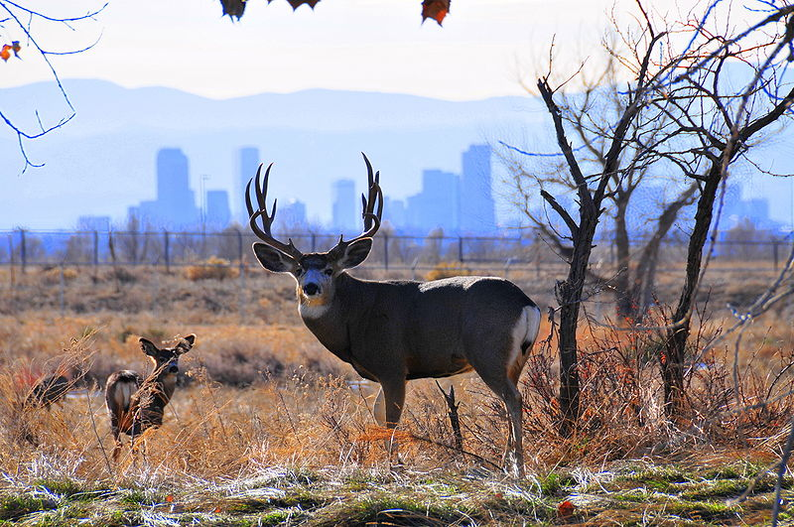
Community Concerns
Anthropogenic features
Buildings
Roads
Oil and Natural gas wells/pipelines
Fences
Image Credit: Oborseth
Notes:
The creation of oil and gas lines, along with urban sprawl, have caused indispensable migratory corridors to disappear, which in turn is causing a decline in mule deer. The increase in human features has caused these herds to migrate at different times.
Research shows that herds near more-developed areas are migrating earlier and moving faster. The reason is so that they can get around these areas and to lower elevations in time for the cold season.

Slide 4
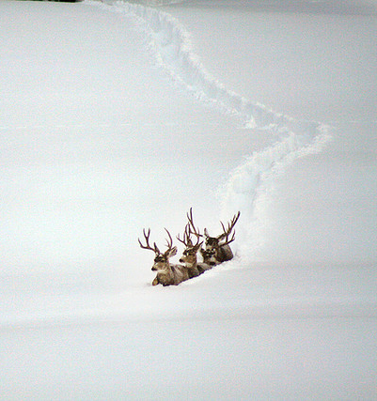
Snow’s Impact
Snow depth
Effects migration routes
Change Mule deer habitat
Image Credit: Creative Commons “Following the Leader” Laura Tidwell
Notes:
Areas that accumulate deep snow, have negative effects on migration routes.
Mule deer avoid routes and change their habitat during winter months of heavy snow.

Slide 5
Objectives
Improve understanding of mule deer migration
Determine how anthropogenic features affect migration
Document ideal conservation areas
Identify migratory corridors to maintain the current population
Image Credit: Oregon Dept. of Fish & Wildlife
Notes:
Our teams objective this term is to utilize NASA Earth observing satellites to improve knowledge and understanding of mule deer migration
Determine how human development such as roads, fences, buildings, oil and natural gas wells affect mule deer and their migration patterns
Document and identify conservation areas by running unsupervised classifications on Modis Phenology in ERDAS Imagine

Slide 6
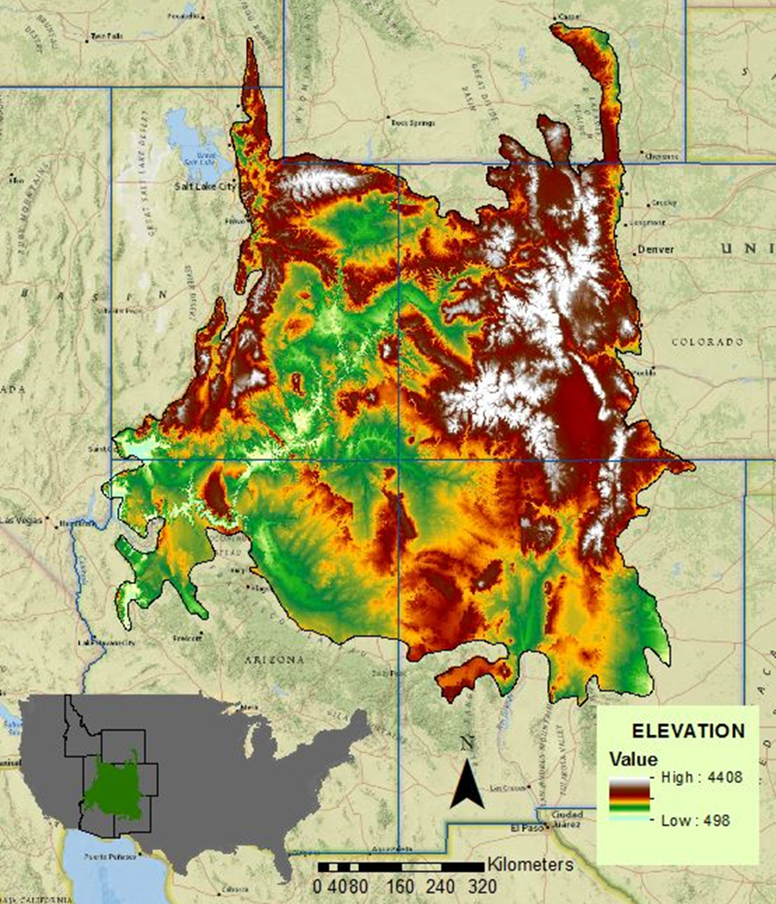
Study Area
Located in the Southern Rocky Mountains
Six states: Arizona, Colorado, Idaho, New Mexico, Utah, Wyoming
Encompasses approximately 516,754 km²
Study Period is from 2011- 2015
Notes:
The focus for our project was the Southern Rockies LLC which spans six states and encompasses approximately 516,754 km²
The study time period is from 2011- 2015

Slide 7
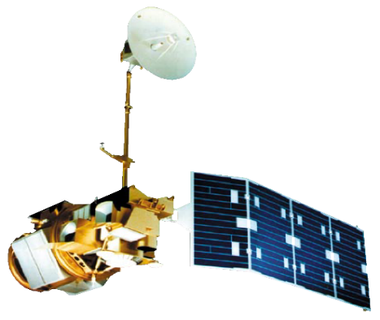
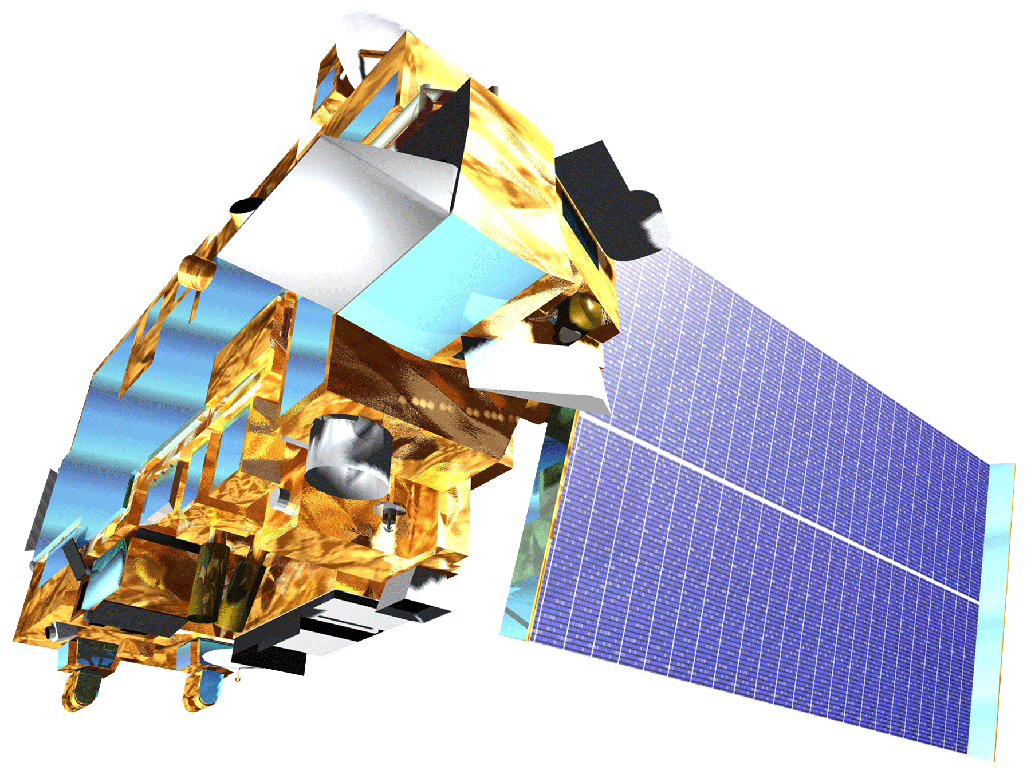
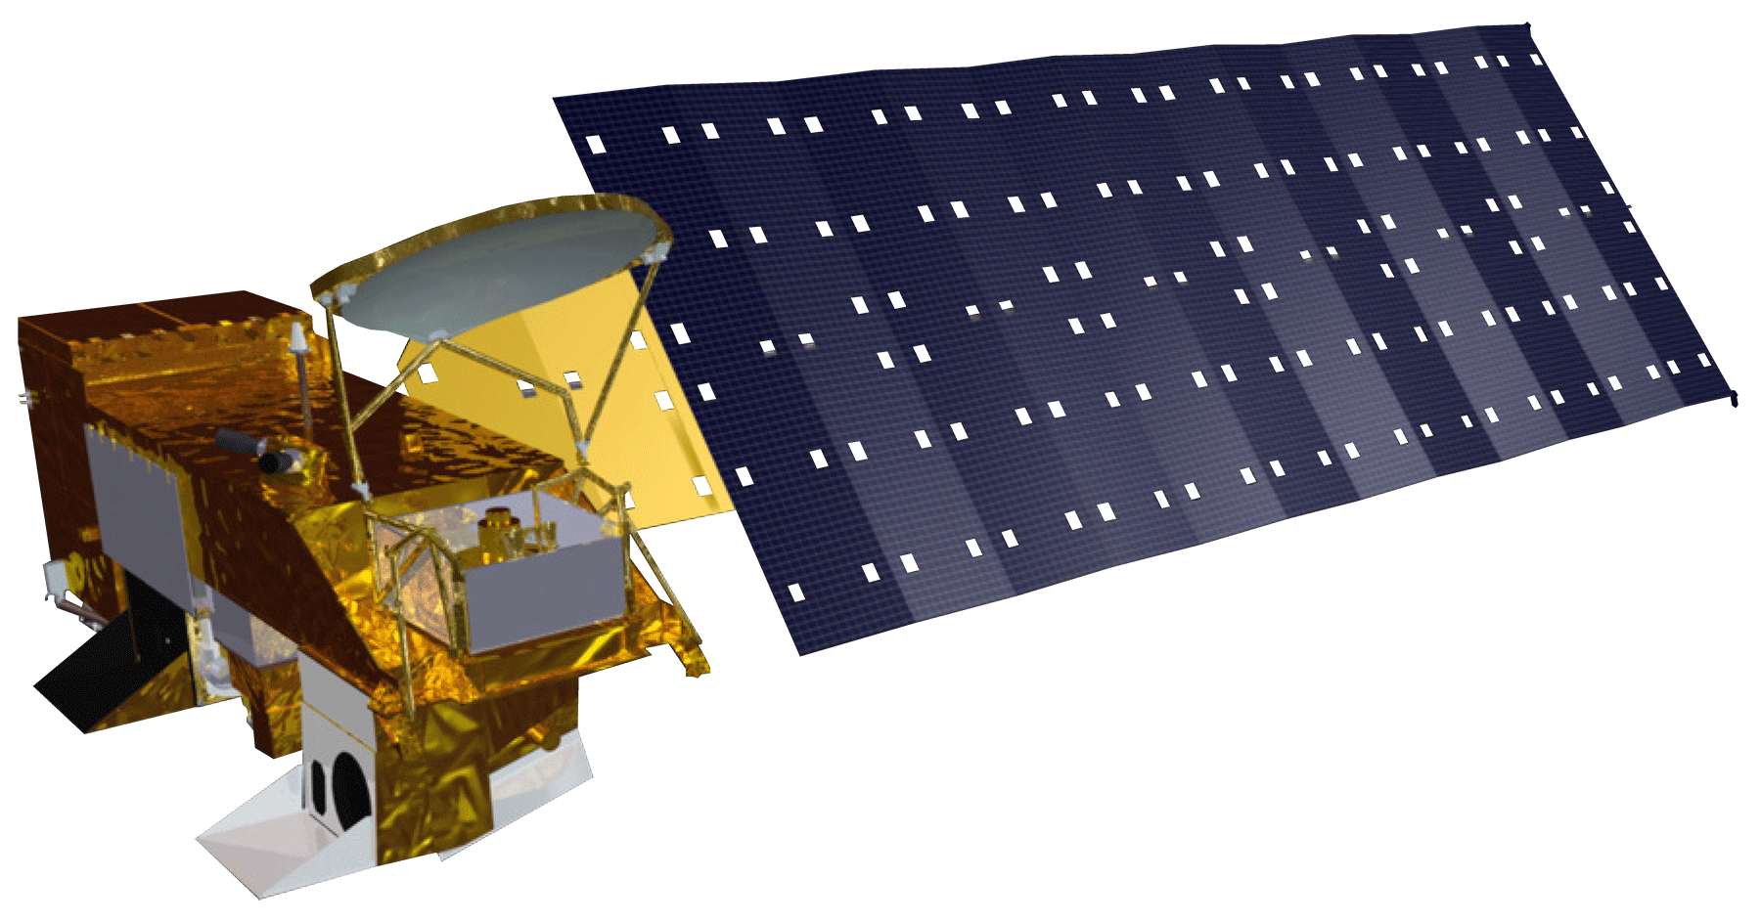
Earth Observations
Landsat 5 TM
Landsat 8 OLI
Terra
Aqua
Notes:
Landsat 5 TM (Thematic Mapper) and Landsat 8 OLI (Operational Land Imager), which has a 30m resolution was downloaded and used for land cover identification.
MODIS Moderatate-resolution imaging spectroradiometer sensors Aqua and Terra which have a 1km resolution were used to create the Forwarn climate data which we then clipped and ran unsupervised classifications on.

Slide 8
Methodology
NLCD
Landsat
Aster
Prism
Acquisition
Used ERDAS Imagine with MODIS images to create vegetation phenology
Created DEM/ slope using ArcGIS
Processing
Added NLCD, Vegetation phenology, climate data, DEM/slope, NDVI snow data and clipped to study area for the final mule deer corridor map.
Analysis
Notes:
Data that was downloaded and collected includes the 2011 NLCD (National Land Cover Dataset), Prism Climate data, Aster, Landsat 5 TM, and Landsat 8 OLI.
Utilizing ArcMap the team clipped the MODIS Phenology Data to a minimum bounding box around the SRLCC and then uploaded into ERDAS Imagine and an unsupervised classification was run to depict 30 distinct land classes.
The Aster was used to create a digital elevation model or DEM and a slope map for the study area
Prism temperature and precipitation data was collected and an average was then calculated for each month each year.
Finally, the NLCD, MODIS Vegetation phenology, Prism climate data, DEM/slope, and MODIS Snow cover data was clipped to our study area and added to our final mule deer corridor maps.

Slide 9
Results – Mule Deer Habitat Maps

Slide 10
Results – Snow’s Impact Maps

Slide 11
Conclusions

Slide 12
Errors and Limitations

Slide 13
Future Work

Slide 14
References

Slide 15
Advisor
Dr. Kenton Ross
NASA DEVELOP National Program Science Advisor
Partners
Southern Rockies Landscape Conservation Cooperative
John Rice
Mule Deer Western Association of Fish and Wildlife Agencies (WAFWA) Working Group
Jim Heffelfinger
Others
Emily Adams
NASA DEVELOP Langley Center Lead
Rebekke Muench
NASA DEVELOP Langley Assistant Center Lead
Past Contributors from Fall 2015
Ross Reahard (Project Lead), Teresa Fenn, Jeri Wisman

