Slide 1
Uruguay Agriculture III
Deconstructing A Drought Severity Index Based On NASA Earth Observations Into Its Principle Components For Better End-User Assessment Of The Driving Factors Behind Local Scale Drought
Jerrod Lessel (Project Lead)
Andrew Kruczkiewicz

Slide 2
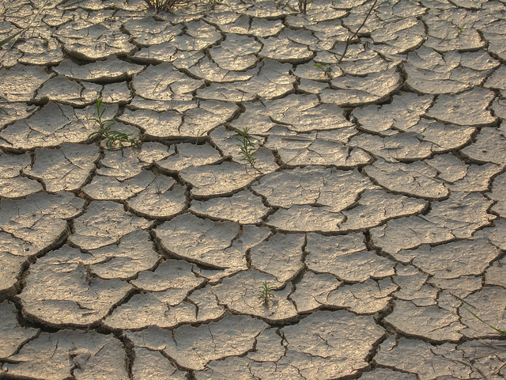
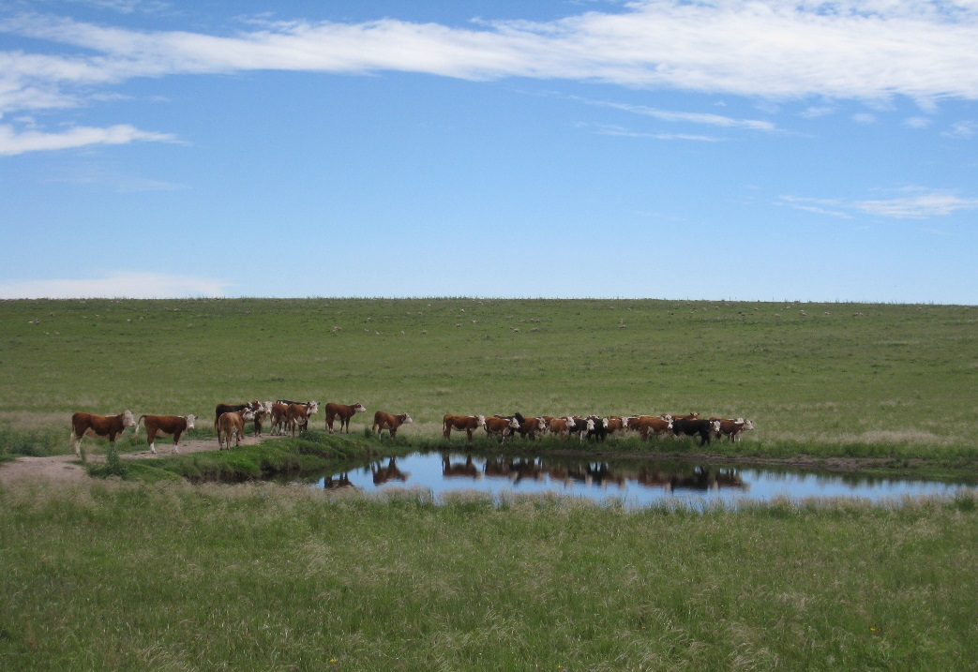
Introduction & Community Concerns
Drought is a major economic concern for Uruguay
  Much of their economy is based on agriculture
  Much of their power needs come from hydroelectric
There is need for decision support tools on a local scale
Source: Flickr CC, garycycles8
Source: Flickr CC, Anna
Notes:
Uruguay’s economy is closely tied to agriculture and as such drought is a major concern for the country.
Another aspect to of concern for the country is that much of their power comes from hydroelectric power, which itself is susceptible to conditions of drought.
These factors mean that there is need for decision support tools in the country that monitor drought so that end users in the country can make the most informed decisions when it comes to things like emergency resource allocation and drought mitigation practices.
Top image: garycycles8 on Flickr CC – link below
https://www.flickr.com/photos/garycycles8/9037772917/in/photolist-eLCX1Z-oX2xZg-eLQnXQ-socNri-6qui6L-D3uK8o-55hoDg-mWK1Tg-j655RL-buSS2C-qfmG7H-ffLJ6H-6qq9T6-D3uJ7f-9G5ado-E1dCa2-n5FcSR-efouTf-DXTXY1-opAHLU-fjBFXd-88y869-hissJ4-61tDry-9LR8mj-yYyu2-deoEvo-9LNnCM-5Xmaz1-9LNCJR-qG3vtK-dch4Mp-9MwZ1-9LNDPM-pKd7yj-dadmoZ-4baaux-5WuhpH-9LR95C-6HLdg-33TuUs-2cNr9g-eLQhMb-7c6P6J-Hwnr9-CvTNEk-7c6NZd-qLLAQ-bEPM6p-cJGsV
Bottom image: Anna on Flickr CC - link below
https://www.flickr.com/photos/iratxe/4130961746/in/photolist-7i3g1o-nBEYKz-nkbt9e-nkbzE1-nBENKd-7HZpET-nAQnER-9RHc84-65qgBq-ne35yt-nxiAkD-nebR9L-nebRuy-nec7Z3-nkcvVY-nebUFL-9c9YYv-njkJG9-562qWH-4zHGyd-qf7niv-mYz3Pa-mYypvc-ifH2cd-nAxAqa-9wVRat-nvdgS6-nebNWs-nvwRPw-ne2Utr-nebSys-nvHC29-nvoFyV-nxh8FP-nkcpsB-6Zg4j-nebE1c-nkbsgH-njkXr4-nyMVf3-njkZ5s-nCBogn-8yxRvG-nvvepF-94sbeH-87YR9Y-nebzcH-nttVho-nttWkq-nvwFGt

Slide 3
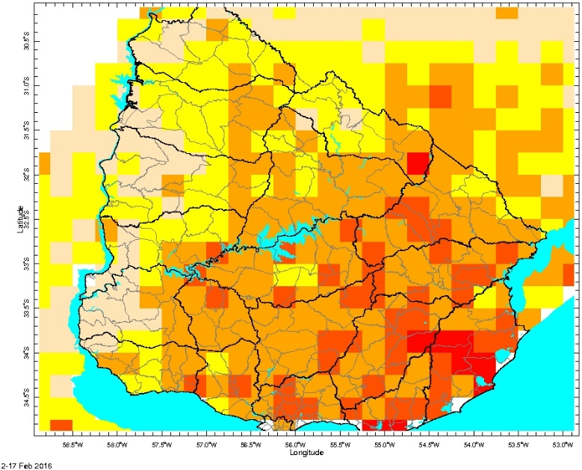
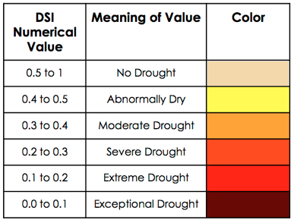
Background
Continuation from Fall 2013 and Spring 2015 terms working with the Instituto Nacional de Investigación Agropecuaria (INIA)
Created a drought severity index (DSI) based on work from Rhee et al. (2010)
  Incorporated the climatological anomalies of daytime land surface temperature (LST), precipitation (from CMORPH*), and normalized difference water index (NDWI)
(1/4) scaled LST + (1/2) scaled CMORPH + (1/4) scaled NDWI
*Climate Prediction Center Morphing Technique
Notes:
In previous terms the IRI has worked with INIA to create a drought severity index based on work from Rhee et al. 2010
This DSI from previous terms is based on three parameters precipitation from the climate prediction center using the their morphing technique, land surface temperature, and the vegetation index: normalized difference water index.
Previous terms determined that the best coefficient scheme for the DSI was the one presented in Rhee et al. 2010 as their C12 model which weighted LST with a 1/4, precipitation with a weight of ½, and NDWI with a weight of 1/4

Slide 4
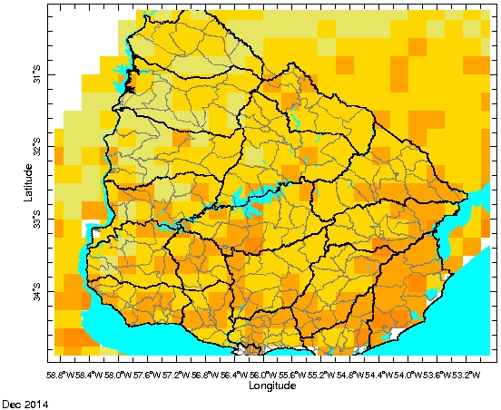
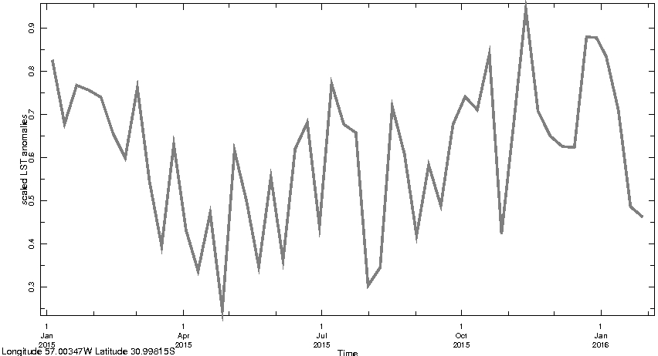
Objectives
Test and modify previous term’s drought severity index (DSI) to address end-users concerns of over estimation of drought severity
Create a way to inform end users of drivers for DSI results on a per pixel basis
Investigate the usefulness of knowing drought drivers on a per pixel basis
Notes:
This term we have three main objectives:
The first objective was to try and test whether a different scaling method changed the the end users concerns dealing with over estimation of the drought severity.
The second objective was to figure out the best way to convey the end users about each individual component within the DSI which could help present the drivers of drought on a local scale.
The third objective was to investigate the usefulness of breaking the DSI into its components and how it can better inform the end users in terms of local scale drought.

Slide 5
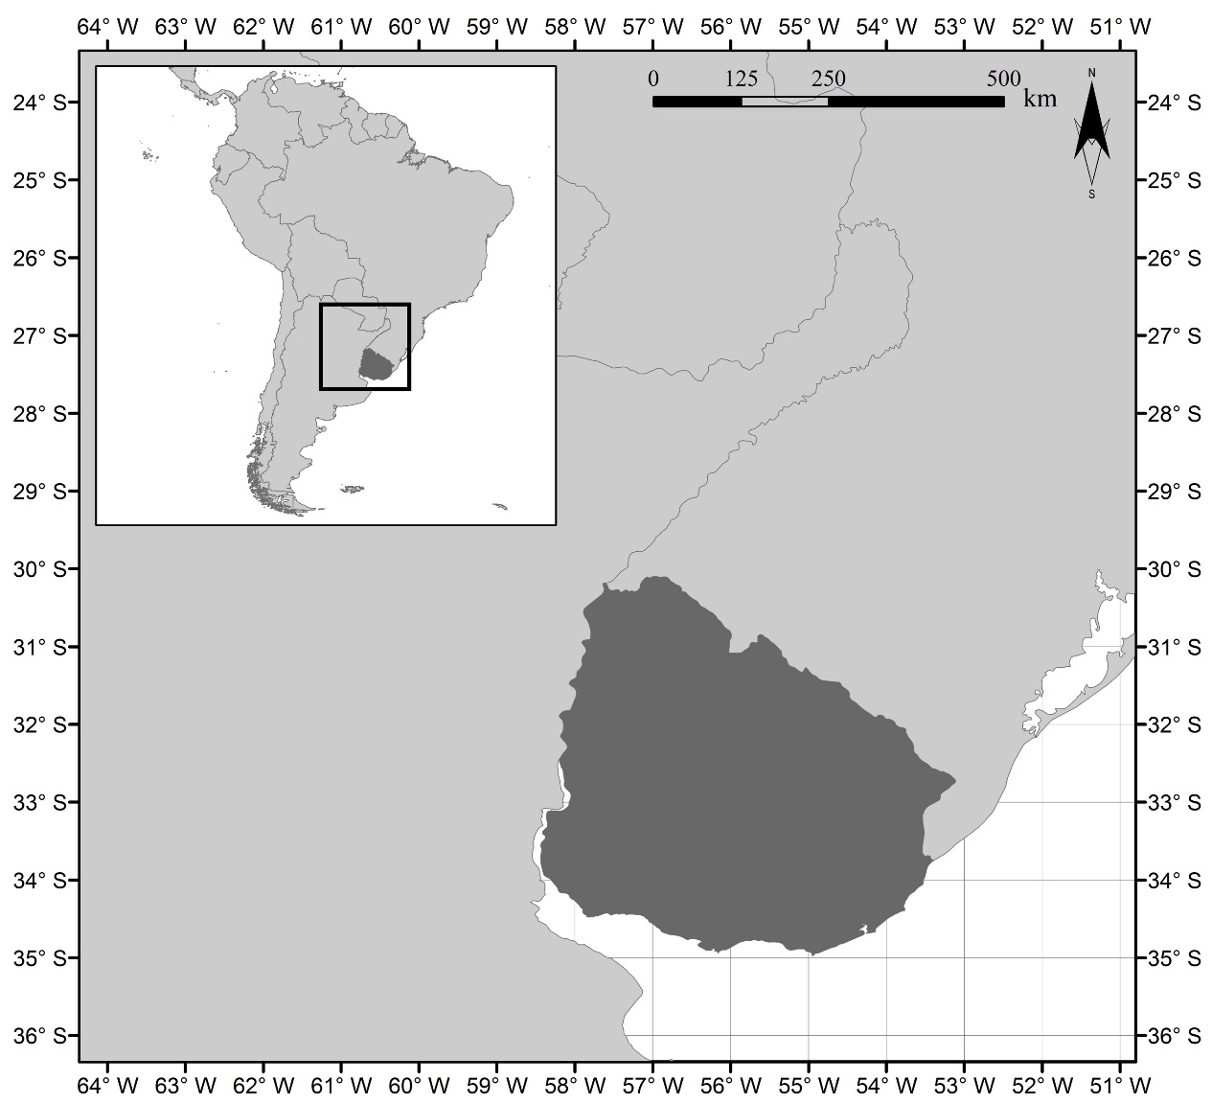
Study Area & Study Period
South America
Study Area: Uruguay
Study Period: January 2003 – December 2014
Brazil
Argentina
Uruguay
Notes:
This project’s study area encompasses the entire country of Uruguay.
We are studying the period between 2003 through 2014.
Those dates were chosen because that was when we were able to get the percent available water data for the country

Slide 6
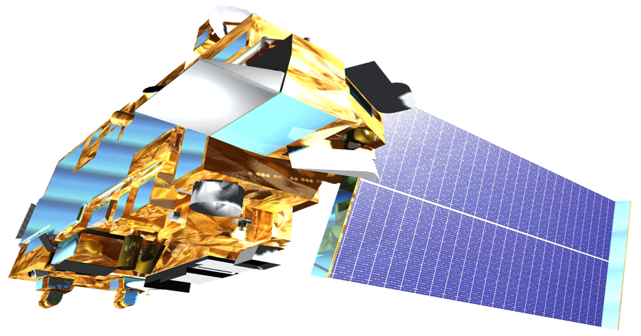


NASA Earth Observations
Aqua – MODIS*
Terra – MODIS
MODIS sensors used to obtain LST and NDWI
Precipitation data obtained from NOAA’s CMORPH
*Moderate-resolution imaging spectroradiometer
Notes:
We used Aqua and Terra MODIS in order to obtain the land surface temperature and normalized difference water index.
For the precipitation we changed from TRMM to NOAA’s CMORPH and tested that it was still as accurate as TRMM in the previous term.

Slide 7

Test
Vary the scaling method within the DSI
Create
Use different methods for visualizing the components of the DSI
Investigate
Research the benefits of the different visualization methods
Methodology
Test different scaling methods
Create various approaches of viewing the components
Investigate the most useful visualization method
Notes:
To test the concern from the end users that the DSI seems to over estimate the severity of the drought, we tested a different scaling method for the precipitation parameter. We tested a different scaling method because we found that the precipitation data was skewed towards zero as apposed to having a normal distribution. We found that it could be this skewed distribution could be driving down the overall value of the DSI and thereby giving a more extreme severity score from the DSI.
We then sought to create a new method for end users to view the drivers of drought on a per pixel local scale. To do this we testing a simple ternary diagram, then a bar graph with the three components, and also with a times series of the three components up to that point.
Finally we wanted to study the the outputs of these charts and diagrams and see what they would be able to tell us about the drivers of drought on a local scale and how they could better inform the end users decision making process.

Slide 8
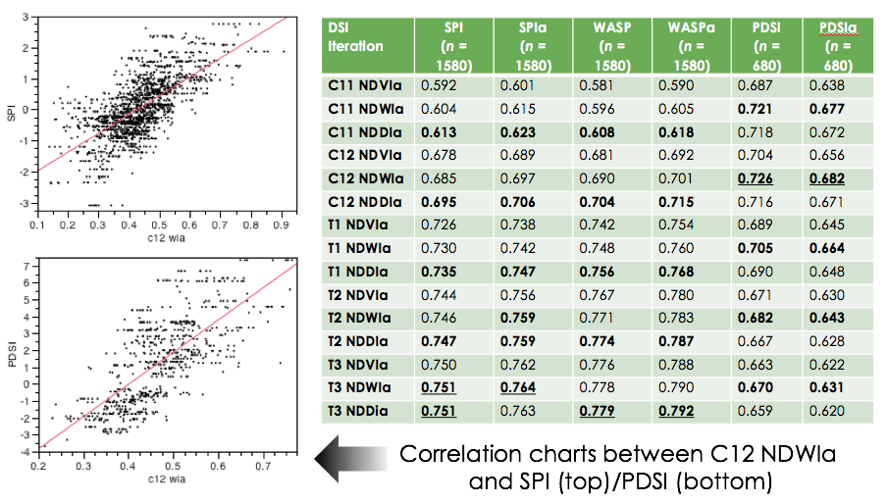
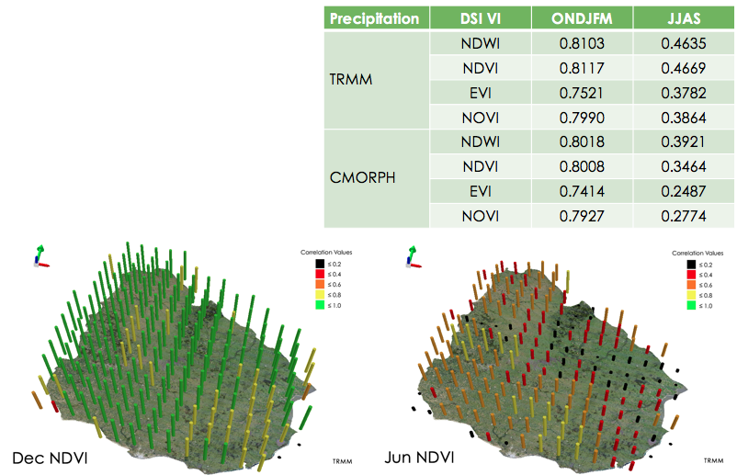
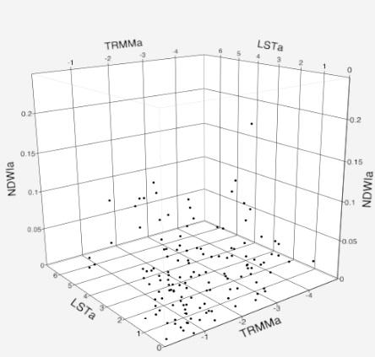
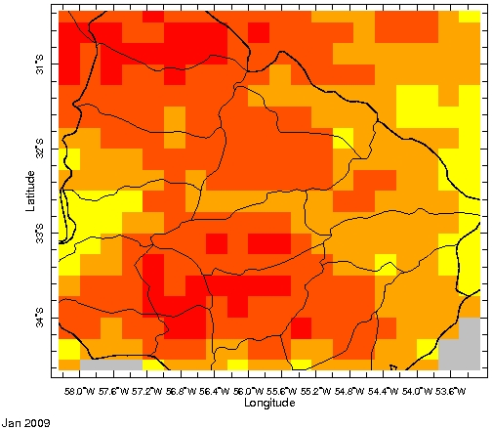
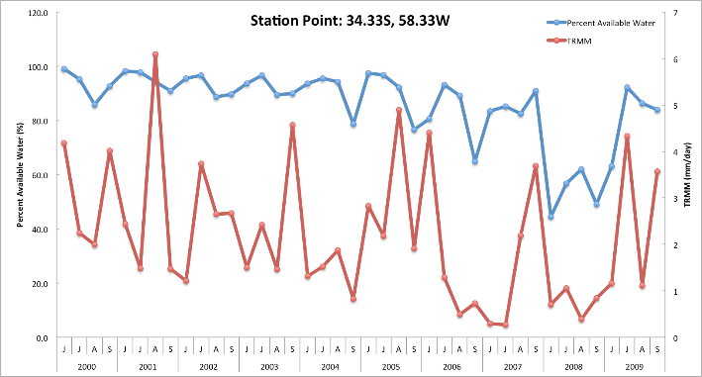
Uruguay Agriculture Overview
Fall 2013
Spring 2015

Slide 9
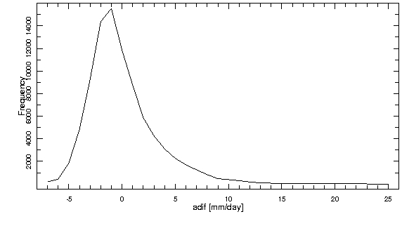
Results & Discussion
New Scaling Method
 | January | February | March | April | May | June | July | August | September | October | November | December
Using CMORPH (-min) | 0.711 | 0.793 | 0.736 | 0.610 | 0.647 | 0.245 | 0.489 | 0.392 | 0.426 | 0.729 | 0.753 | 0.838
Using CMORPH (max) | 0.780 | 0.817 | 0.792 | 0.723 | 0.723 | 0.264 | 0.456 | 0.404 | 0.444 | 0.749 | 0.798 | 0.875
CMORPH – CMORPH_{min} / CMORPH_{max} – CMORPH_{min}
CMORPH_{-min}
New method does not correlate as well with percent available water data

Slide 10
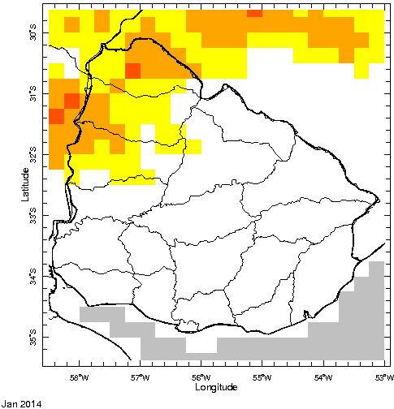
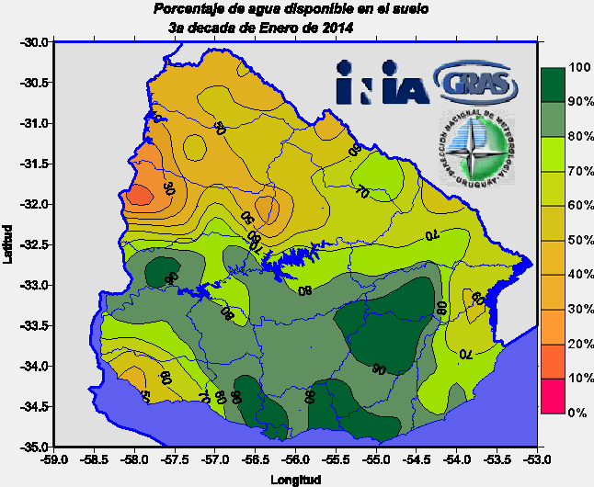
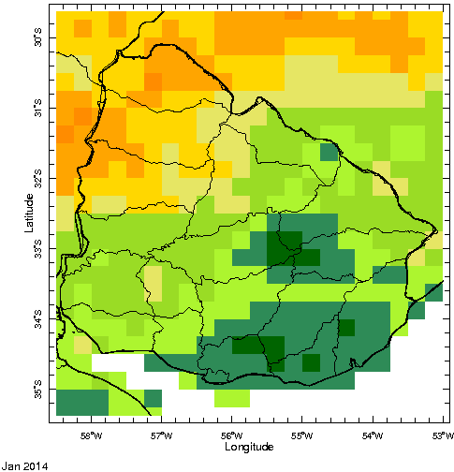
Results & Discussion
New Scaling Method
 | January | February | March | April | May | June | July | August | September | October | November | December
Using CMORPH (-min) | 0.711 | 0.793 | 0.736 | 0.610 | 0.647 | 0.245 | 0.489 | 0.392 | 0.426 | 0.729 | 0.753 | 0.838
Using CMORPH (max) | 0.780 | 0.817 | 0.792 | 0.723 | 0.723 | 0.264 | 0.456 | 0.404 | 0.444 | 0.749 | 0.798 | 0.875
A new color scheme may be a more practical solution

Slide 11
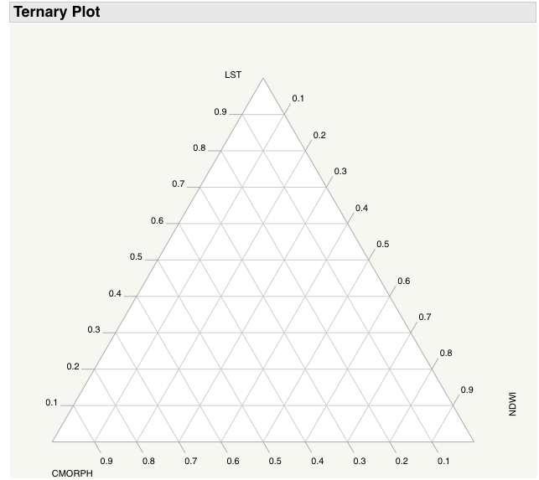
Results & Discussion
Component Visualization
Ternary Diagram
Ternary diagrams didn’t make the best visualization method

Slide 12
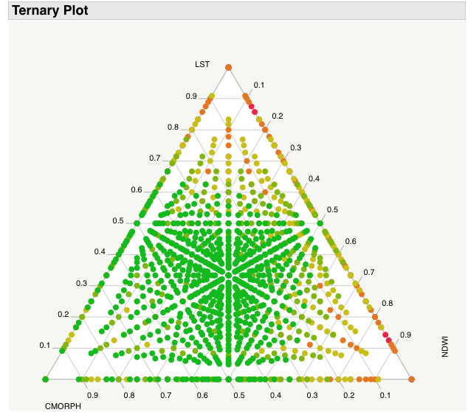
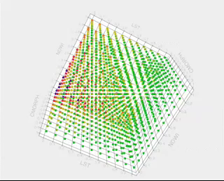
Results & Discussion
Component Visualization
Ternary Diagram
Ternary diagrams didn’t make the best visualization method

Slide 13
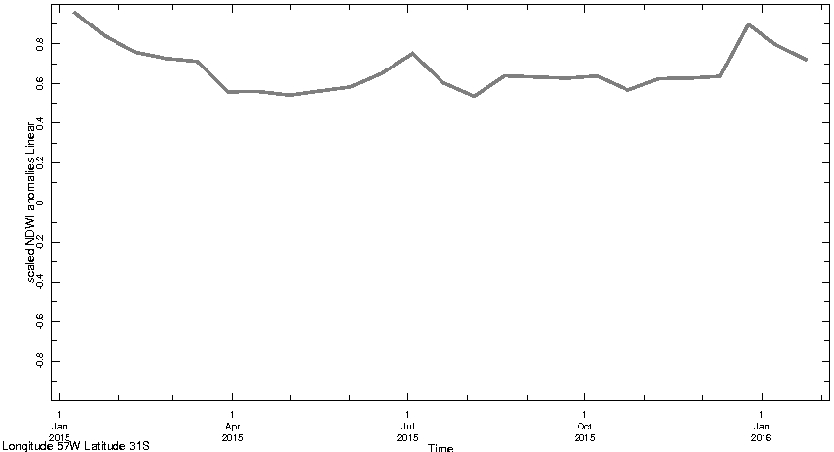
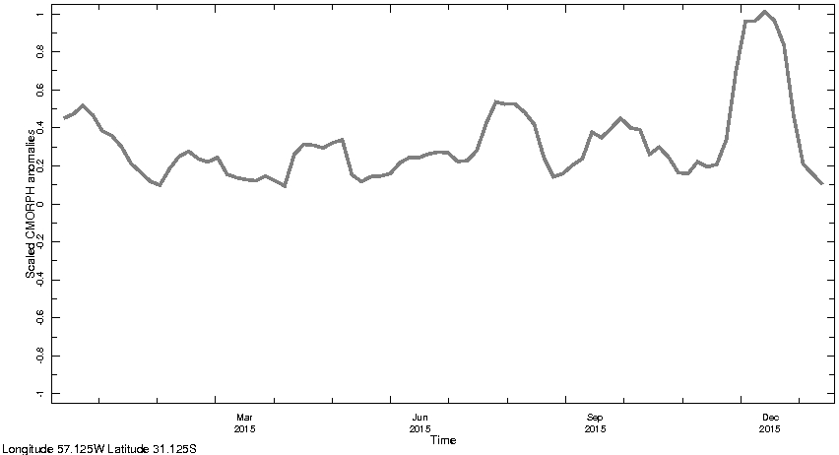
Results & Discussion
NDWI
Component Visualization
Time Series Charts
CMORPH
LST
Time series charts also have the added benefit of seeing how the component has changed for the past year

Slide 14
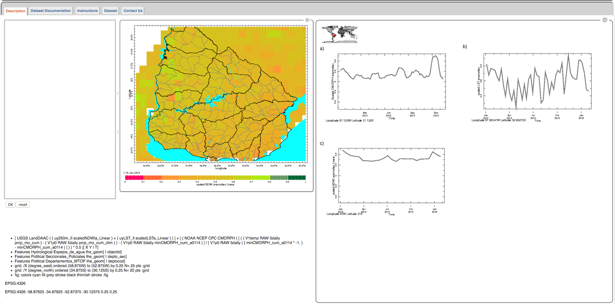
Results & Discussion
Component Visualization
Time Series Charts
Interactive map which displays component time series

Slide 15

Conclusions
Changed the color scheme to better match the percent available water data
Created an interactive map which displays the time series for each component for the DSI

Slide 16
Advisors
Dr. Pietro Ceccato, The International Research Institute for Climate and Society (IRI), The Earth Institute, Columbia University
Partners
Guadalupe Tiscornia, Instituto Nacional de Investigación Agropecuaria (INIA)
Others
Dr. Walter Baethgen, INIA and IRI
Alex Sweeney, IRI (Past Contributor)

