Slide 1
KENYA
Food Security & Agriculture II
Using NASA Earth Observations to Enhance Drought Warning Systems and Develop Capacity to Use the RHEAS Model in Kenya
Samuel Tatum, Caley Feemster, Jennifer Heeth, Sabine Nix
Alabama – Marshall

Slide 2
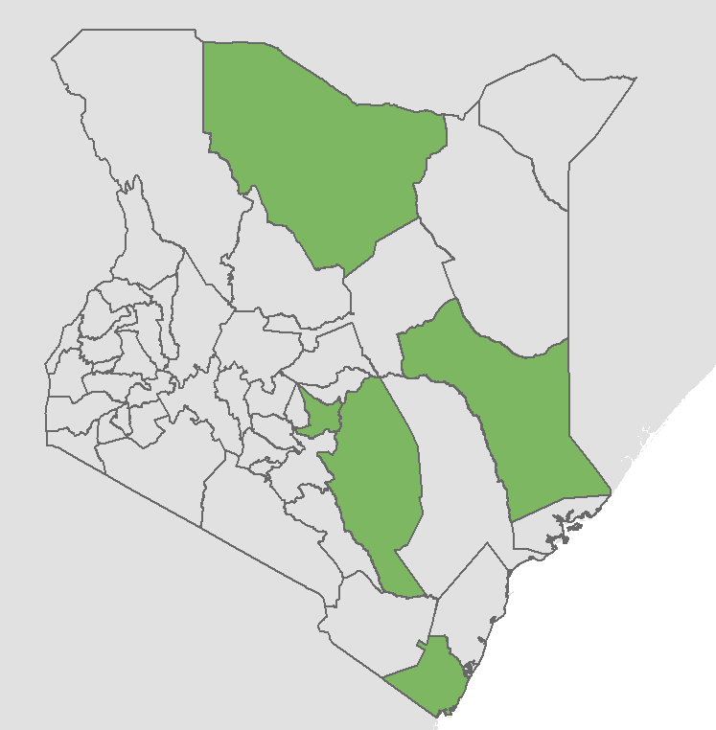
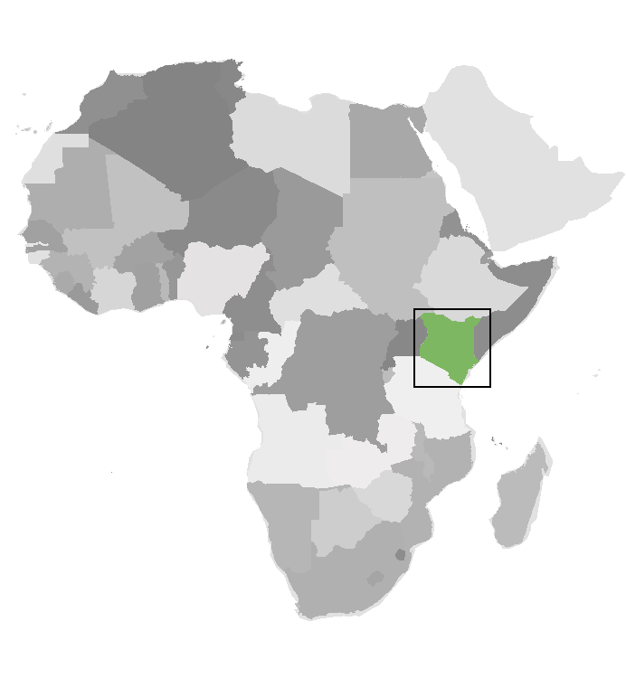
STUDY AREA & PERIOD
Study Area: Kenya
Case Study Counties:
Embu, Marsabit, Garissa, Kitui, Kwale
January 2016 – December 2019
Marsabit
Garissa
Kitui
Embu
N
Kwale
0 125 250 500 km
Image Credit: ArcGIS Online
Notes:
Our study area is Kenya during the period of 2016 to 2019.
Case Study Counties: We are focusing on five specific counties (Marsabit, Embu, Garissa, Kitui, Kwale). One of our partners suggested that we focus on these 5 counties because the current drought monitoring systems don’t function well in these counties. They also have a mix of land cover types, including agricultural land.
There is no universal definition of drought
There is meteorological drought, as measured by rainfall deficits
There is also agricultural drought as measured by plant stress
We will be looking at both of these.
------------------------------Image Information ------------------------------
•Image Credit: ArcGIS Online, map modified by Jennifer Heeth
•Image Source: ArcGIS Online
•Image License: Esri Master License Agreement

Slide 3
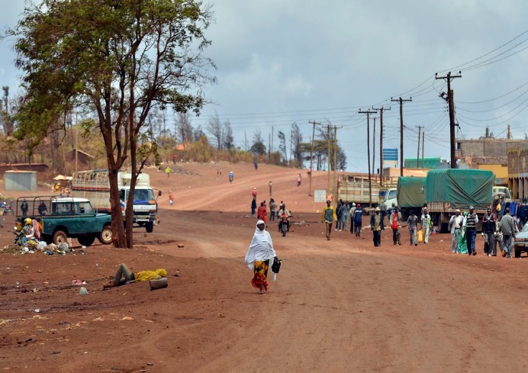
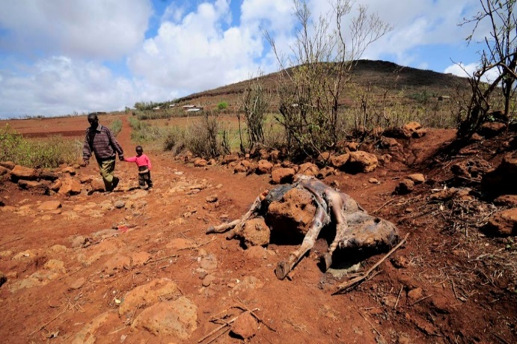
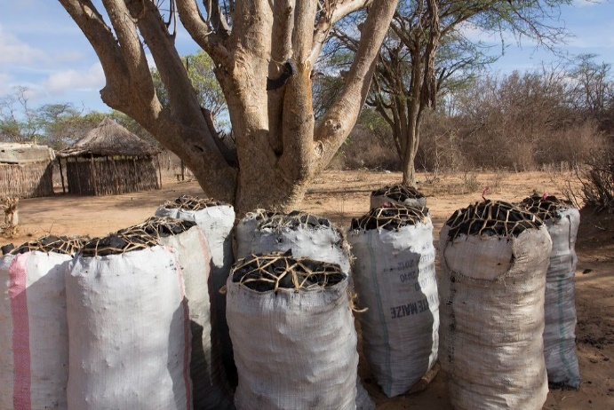
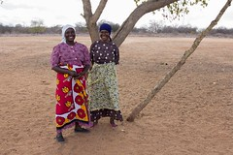
COMMUNITY CONCERNS
Economic dependence on agriculture and livestock
2016-2017 drought led to 3 million requiring food aid
Many crops are not drought resistant
Images (top to bottom): CIAT, CIAT, World Bank, World Bank
Notes:
Some of the community concerns that surround this project are Kenya’s population largely relies on rain-fed agriculture, many communities do not have access to irrigation systems and rely solely on rainfall for their crops to grow.
Many communities also rely on livestock for their subsistence and livelihood
Drought can affect livestock conditions and milk production, and other parts of day-to-day life such as distances to water sources.
In 2016-2017 a very severe drought led to 3 million people requiring food aid.
Furthermore, some of the crops that are commonly grown in the country and that contribute significantly to the economy and wellbeing of local populations are not drought tolerant, such as maize. There are some movements to increase cultivation of more drought resistant crops, such as cassava.
------------------------------Image Information ------------------------------
From Top to Bottom:
Image 1: CIAT International Center for Tropical Agriculture, https://search.creativecommons.org/photos/9590e841-4832-4b4f-ad75-537d7d5d11a2, Creative Commons: CC BY-SA 2.0
Image 2: CIAT International Center for Tropical Agriculture, https://search.creativecommons.org/photos/f51a86ca-ba67-436c-8281-5a2497a9340d, Creative Commons: CC BY-SA 2.0
Image 3: World Bank Photo Collection, https://search.creativecommons.org/photos/a58033a8-065e-4360-aee7-a1a880d54870, Creative Commons: CC BY-NC-ND 2.0
Image 4: World Bank Photo Collection, https://ccsearch.creativecommons.org/photos/c603b5de-9f01-4a53-80f2-cc4351a80b82, Creative Commons: CC BY-NC-ND 2.0

Slide 4
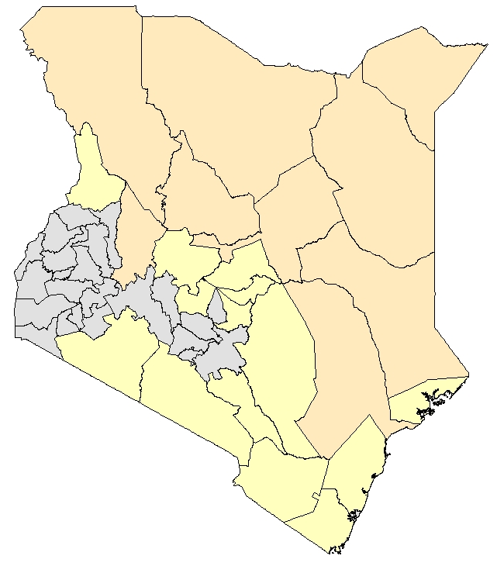
COMMUNITY CONCERNS
80% is Arid or Semi Arid (ASALS)
30% live in ASALS
Arid
N
Non-ASAL
Semi-Arid
0 50 100 200 Km
Image Credit: FEWS NET
Notes:
80% of Kenya is classified as Arid or Semi Arid, abbreviated as ASALs. These ASALs experience drought frequently, which means that droughts can cause more severe harm than in other regions
30% of Kenya’s population lives in these rural arid and semi-arid lands that are commonly plagued with drought.
Historically, large portions of the population of some arid counties were pastoralists rather than farmers, which meant that they were less affected by severe droughts. Recently, however, the populations have transitioned largely toward more sedentary agricultural lifestyles that are more threatened by drought.
------------------------------Image Information ------------------------------
•Image Credit: FEWS NET, map modified by Jennifer Heeth
•Image Source: FEWS NET

Slide 5
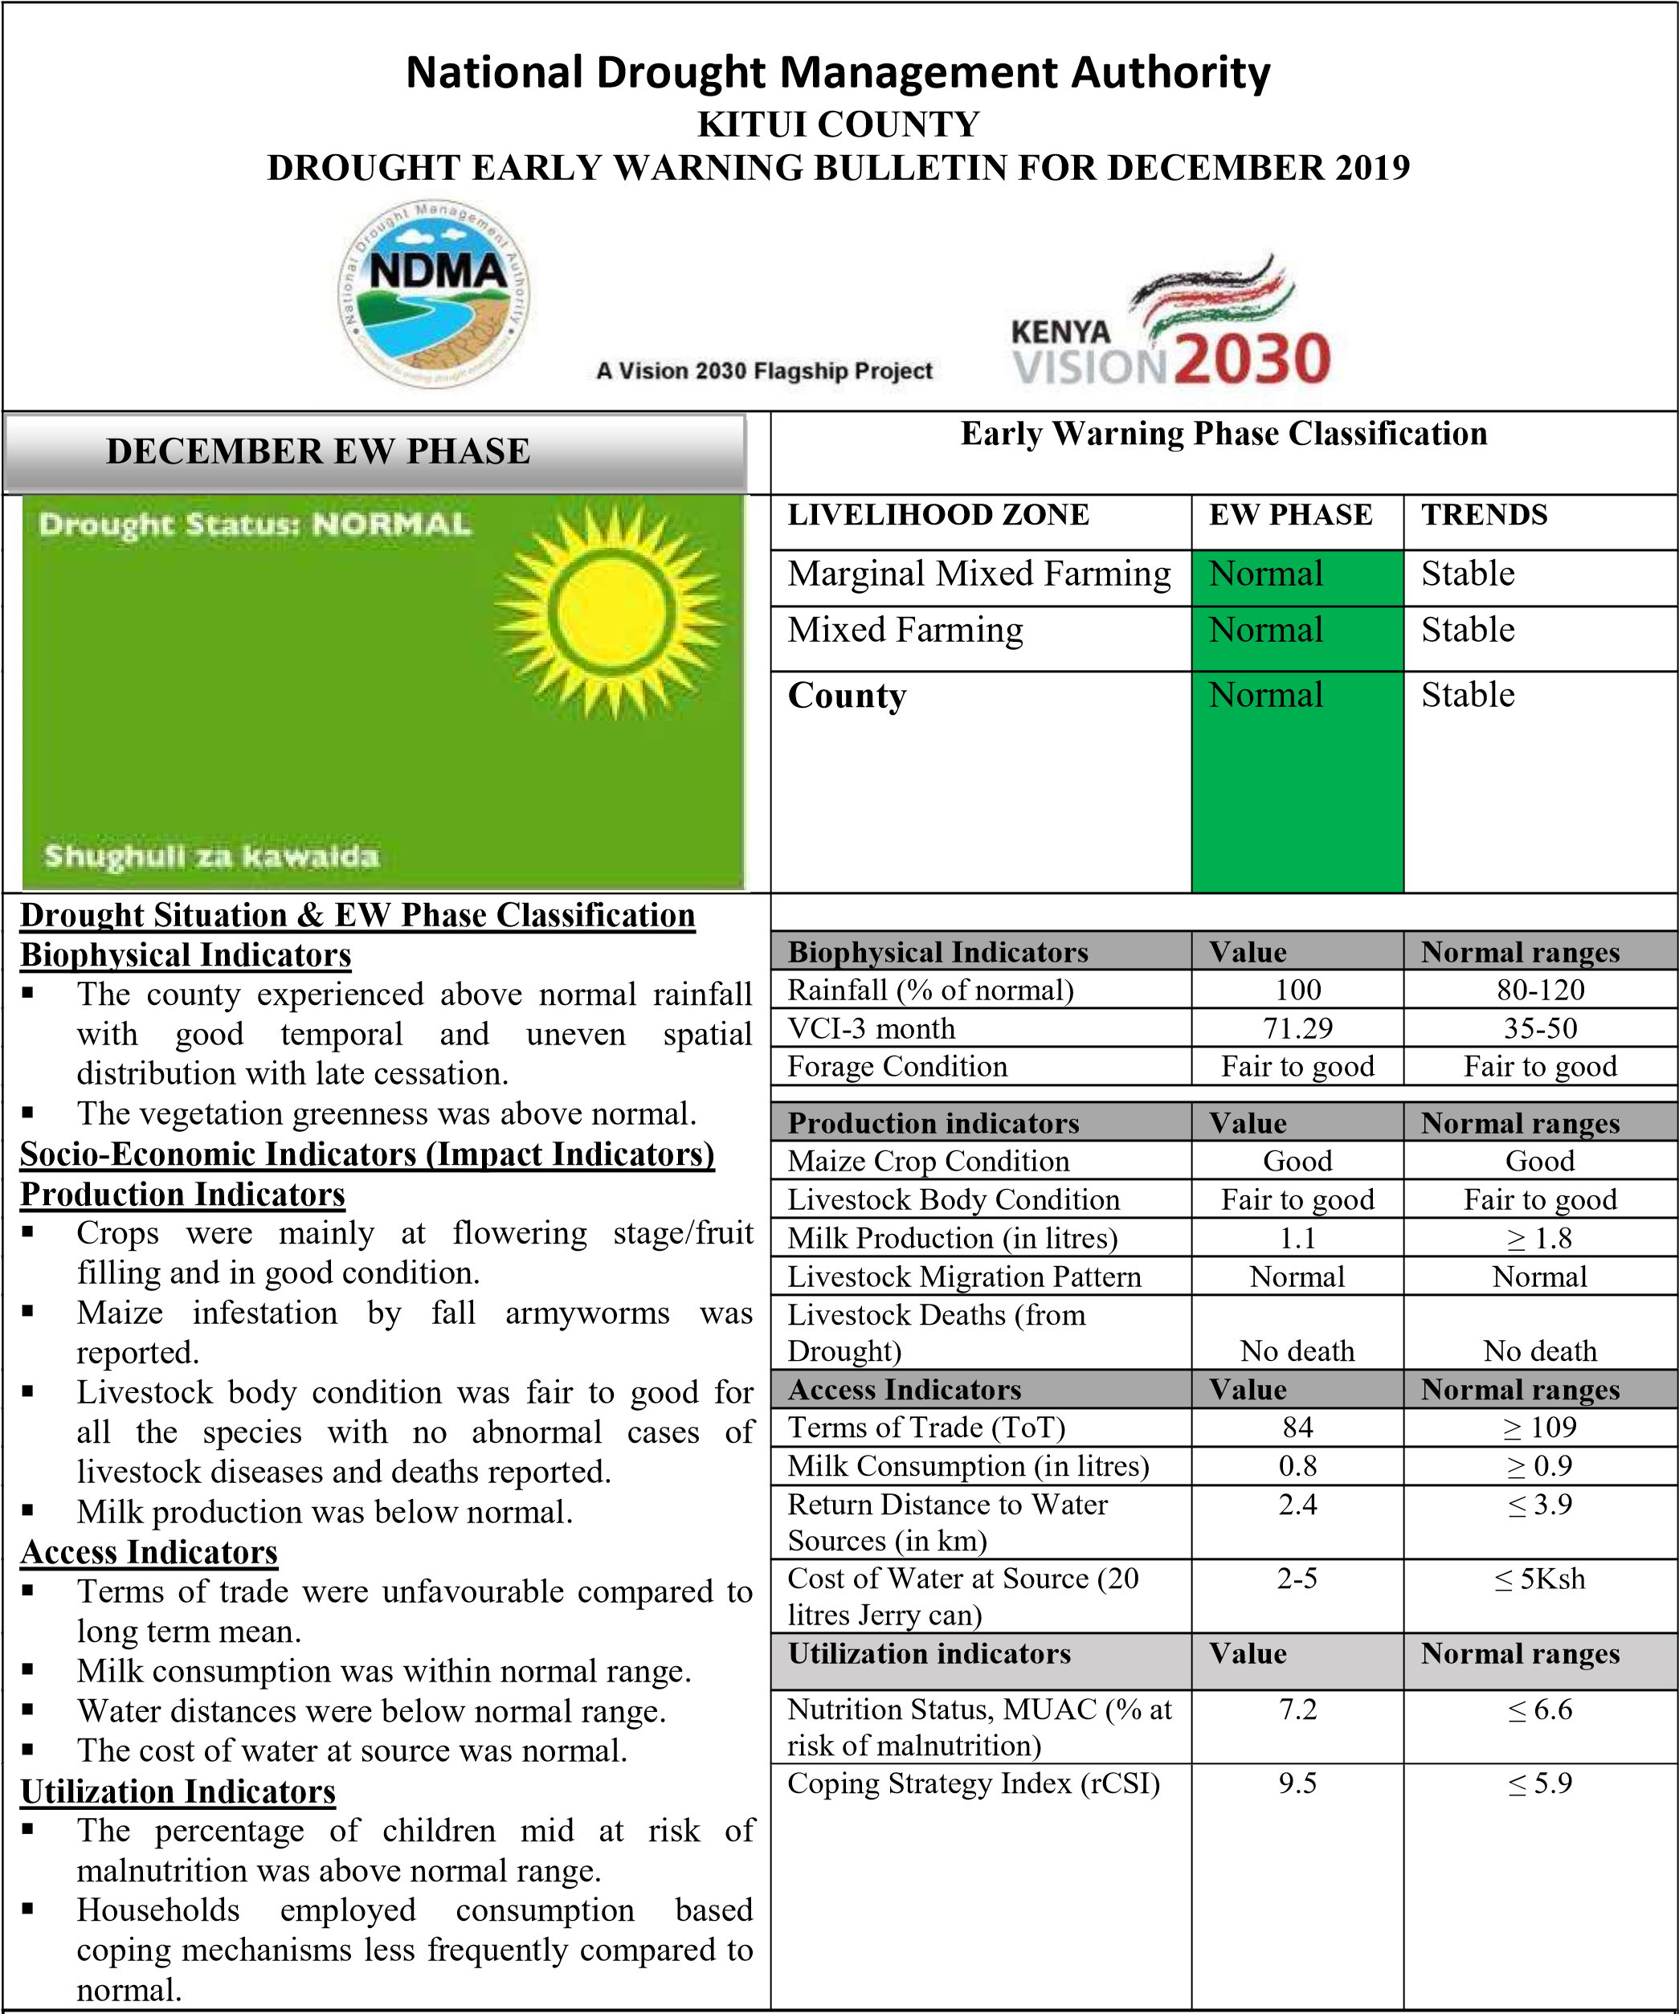
PARTNERS
National Drought Management Authority (NDMA) – End User
Operates Early Warning System
Provides ground observations from counties
NASA SERVIR – Collaborator
Regional Centre for Mapping of Resources for Development (RCMRD) – Collaborator
Rangeland Support Tool
Image Credit: NDMA
Notes:
Our project partner is the NDMA. One of the services they provide to the Kenyan people is a drought Early Warning System. Our work is aimed to improve this Early Warning System
Additionally, we are also collaborating with NASA SERVIR and the RCMRD. Through our collaboration we hope to improve the Rangeland Support Tool. This tool is utilized by the NDMA to create their monthly bulletins.
The table referenced in this slide comes from the drought warning phases published in the NDMA’s Early Warning Bulletins
------------------------------Image Information ------------------------------
National Drought Management Authority. (2020). County Early Warning Bulletins. https://www.ndma.go.ke/index.php/resource-center/send/26-kitui/5473-kitui-december-2019

Slide 6
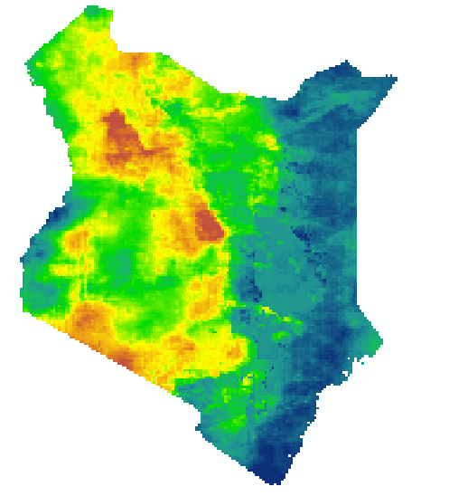
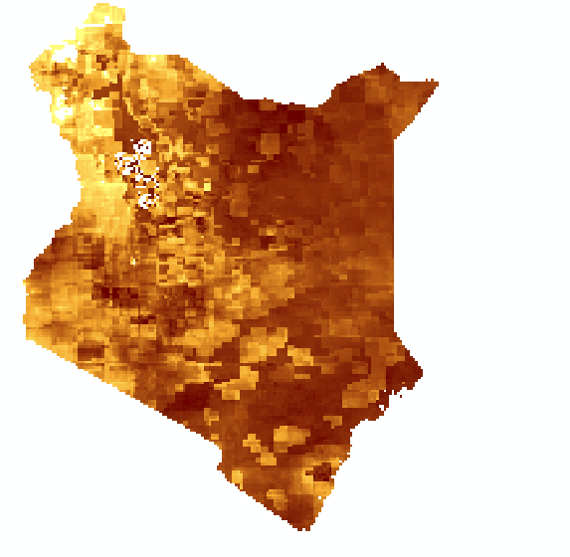
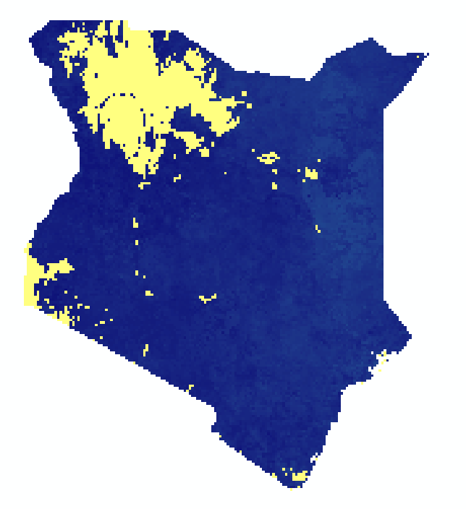
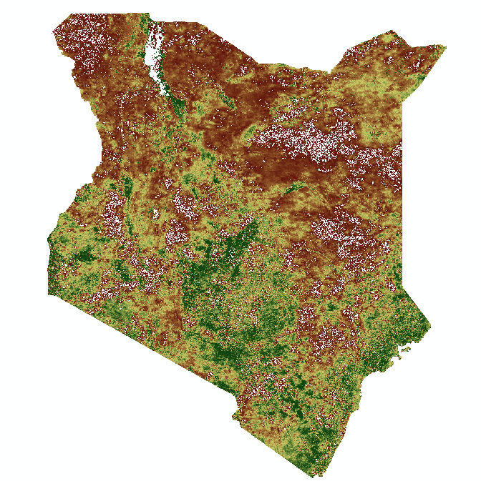
DROUGHT MONITORING
Standardized Precipitation Index (SPI)
Evaporative Stress Index (ESI)
Soil Moisture Anomalies (SMA)
Vegetative Condition Index (VCI)
Image Source: DEVELOP team
Notes:
Agricultural drought monitoring often uses indices that are based on precipitation, soil moisture, or vegetation stress.
Combined drought indicators are useful to management organizations because it has the potential to streamline decision-making. Rather than looking at several indices simultaneously, a Combined Drought Indicator can offer a more straightforward look at drought.
For our project, we calculated Standardized Precipitation Index (SPI), Evaporative Stress Index (ESI), Soil Moisture Anomalies (SMA), and Vegetation Condition Index (VCI).
We then looked at each of these indices and assessed which should be included in our Combined Drought Indicator. The combination of these indices takes into account the different factors that influence drought and combines them into a single indicator.
Currently, the NDMA uses VCI alone to assess drought. The CDI should outperform VCI due to the fact that it takes into account evaporative stress, precipitation, and soil moisture anomalies rather than just vegetative stress.

Slide 7
PROJECT OUTCOMES
Combined Drought Indicator (CDI)
Time Lag Assessment
Outreach and Training Materials
Image: Ex Pat
Notes:
One of our end products will be a Combined Drought Indicator, the goal is to create a CDI that can predict drought more accurately than the drought prediction system currently used by the NDMA, which is VCI alone.
This CDI also needs to be useable and reproducible by our partners
The CDI will be integrated into tools currently in use at the NDMA
We will also produce outreach materials, such as a story map and detailed analysis of how we calculated CDI.
The StoryMap will summarize results for public interest.
The technical paper will provide a well documented process for our collaborators.
This will help them integrate the CDI into current tools
We will also provide a user friendly guide for the NDMA to help them implement the CDI
We will also create a time lag analysis of our indices, explaining the time lag between when each of the indications of drought are first shown.
This can be used by the NDMA and other collaborators during future work
Image Information:
Image 1: project data
Image 2: project data
Image 3: Lions in the Masai Mara, Kenya, Ex Pat Flickr, https://www.flickr.com/photos/153313809@N08/33680277377, Creative Commons: CC0

Slide 8
METHODOLOGY
RHEAS MODEL
AppEEARS
AppEEARS
ClimateSERV
ClimateSERV
daily rasters to monthly
daily rasters to monthly
NDVI
NDVI
SMA
ESI
SMA
VCI
ESI
SPI
VCI
SPI
monthly
monthly
monthly
monthly
monthly
monthly
monthly
monthly
PCA Analysis
PCA Analysis
CDI
CDI
monthly
monthly
Notes:
Our end goal is to create a combined drought indicator for the NDMA to incorporate into their decision making
Our first step was to define which drought indices we would be incorporating into our CDI
We used RHEAS precipitation and soil moisture outputs to calculate SPI and SMA
RHEAS outputted 30 years of daily files, which we first converted to monthly files
Then we calculated SPI and SMA. The details for these calculations are included later in this presentation.
We downloaded NDVI data derived from Aqua and Terra MODIS from AppEEARS.
We ensured that all data was monthly, and then calculated Vegetation Condition Index from the NDVI data
Finally, we downloaded Evaporative Stress Index data from ClimateSERV.
Using all four indices, we conducted a Principal Component Analysis (PCA). This PCA allowed us to determine the best weights to assign to each of our indices when combining them into the final CDI.
Lastly, we evaluated our CDI using the early warning bulletins published by NDMA. The early warning bulletins have a drought status for each county for each month, which means that our validation was conducted only at the county level.

Slide 9
DATA ACQUISITION:
REGIONAL HYDROLOGIC EXTREMES ASSESSMENT SYSTEM
CHIRPS:
Climate Hazards Center InfraRed Precipitation with Station Data
NCEP:
National Centers for Environmental Prediction
The RHEAS Model:
30 years of daily climate data (tif files)
Standardized Precipitation Index (SPI) Soil Moisture Anomalies (SMA)
CHIRPS:
Climate Hazards Group InfraRed Precipitation with Station Data
NCEP:
National Centers for Environmental Prediction
The RHEAS Model:
30 years of daily climate rasters
Standardized Precipitation Index (SPI) Soil Moisture Anomalies (SMA)
Notes:
The first term of this project worked with the RHEAS model. The RHEAS model is a software framework for hydrologic modeling and data assimilation that automates the deployment of water resources nowcasting. The first term generated outputs from the model at a 25 km spatial resolution. Our team is not running the model, we are receiving pre-run outputs from NASA SERVIR that are generated at a 5 km spatial resolution.
Climate Hazards Center InfraRed Precipitation with Station Data (abbreviated as CHIRPS) precipitation data and National Centers for Environmental Prediction (NCEP) temperature and wind data are being ingested into the RHEAS model for our project.
The model was run by NASA SERVIR, and outputted 30 years of daily tiff files. These tiff files include climate variables such as precipitation, rainfall, soil moisture, and land surface temperature.
For this project, we used RHEAS’s precipitation data to calculate Standardized Precipitation Index (SPI), and soil moisture to calculate Soil Moisture Anomalies (SMA). These indices were combined with other indices from earth observations to create our Combined Drought Index

Slide 10
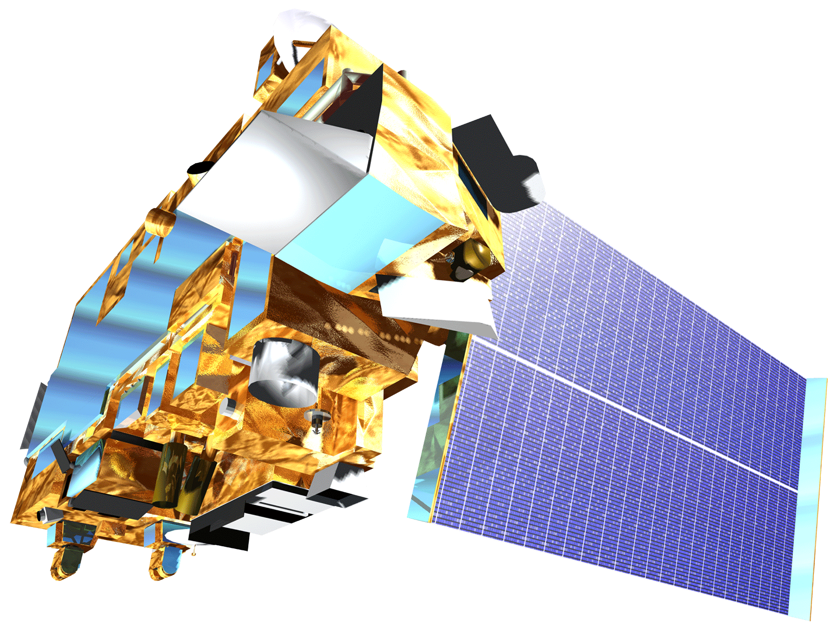
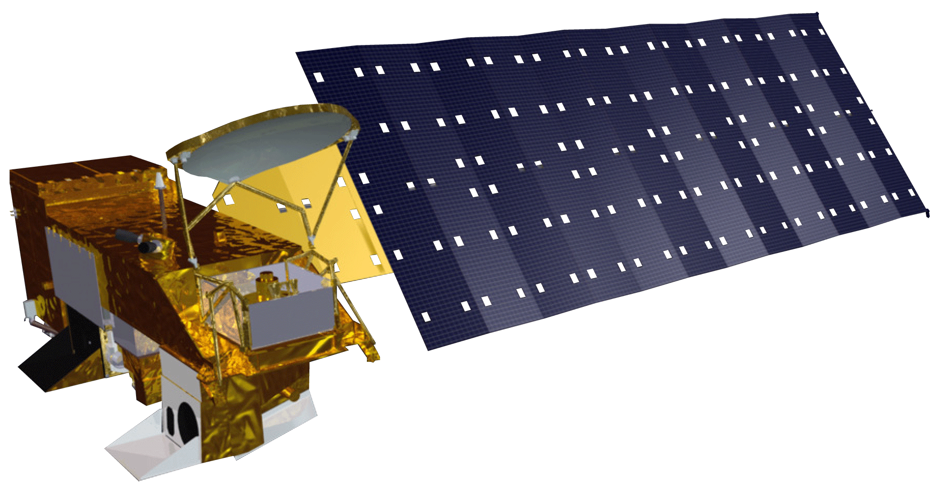
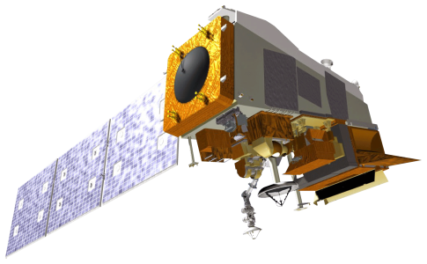
Aqua MODerate resolution Imaging Spectroradiometer (MODIS)
Terra
MODIS
Normalized Difference Vegetation Index (NDVI)
Evaporative Stress Index (ESI)
Vegetation Condition Index (VCI) Evaporative Stress Index (ESI)
Suomi National Polar-orbiting Partnership (NPP) Visible Infrared Imaging Radiometer Suite (VIIRS)
Aqua MODerate resolution Imaging Spectroradiometer (MODIS)
Terra
MODIS
Normalized Difference Vegetation Index (NDVI)
Evaporative Stress Index (ESI)
Vegetation Condition Index (VCI) Evaporative Stress Index (ESI)
Suomi National Polar-orbiting Partnership (NPP) Visible Infrared Imaging Radiometer Suite (VIIRS)
DATA ACQUISITION: EARTH OBSERVATIONS
Notes:
The Earth Observations used in this project were Aqua and Terra MODIS, and Suomi NPP VIIRS.
Normalized Difference Vegetation Index (NDVI) was derived from Aqua and Terra MODIS. The team used this NDVI to calculate Vegetation Condition Index (VCI).
Evaporative Stress Index was calculated using MODIS and Suomi NPP VIIRS derived LST and LAI.
The VCI and ESI from Earth Observations were combined with the SPI and SMA derived from RHEAS outputs in our final CDI.

Slide 11
DATA PROCESSING:
SOIL MOISTURE ANOMALIES (SMA)
Long-term mean
Long-term mean
Long-term mean
Long-term mean
Soil Moisture – Long-term Mean
Soil Moisture – Long-term Mean
Soil moisture
monthly
Soil Moisture – Long-term Mean
Soil moisture
monthly
Soil moisture
monthly
RHEAS soil moisture
Soil moisture
monthly
RHEAS soil moisture
RHEAS soil moisture
RHEAS soil moisture
SMA =
Long-term St. Dev.
Long-term St. Dev.
Long-term standard deviation
Long-term standard deviation
Long-term standard deviation
Long-term standard deviation
Notes:
To calculate SMA, we acquired soil moisture data from the RHEAS model. We then averaged the soil moisture data monthly, and then calculated long term mean and long term deviations for the data.
RHEAS outputs for soil moisture are calculated at three levels, with layer 1 representing the top layer of soil, and layer 2 and 3 representing deeper layers. These three soil layers were treated as separate indices, and were averaged and anomalies were calculated for each layer individually.
We then performed a calculation to find soil moisture anomalies, which is an index we used to calculate CDI. After the calculation, we ended up with monthly SMA from 2000 to 2018.

Slide 12
DATA PROCESSING:
STANDARDIZED PRECIPITATION INDEX (SPI)
Long-term mean
Long-term mean
Long-term mean
Long-term mean
Precipitation – Long-term Mean
Precipitation – Long-term Mean
Precip. summed monthly
Precipitation – Long-term Mean
Precip. summed monthly
RHEAS precip
Precip. summed monthly
RHEAS precip.
RHEAS precip.
Precip.
summed monthly
RHEAS precip.
SPI =
Long-term St. Dev.
Long-term St. Dev.
Long-term standard deviation
Long-term standard deviation
Long-term standard deviation
Long-term standard deviation
Notes:
To calculate SPI, we acquired RHEAS precipitation outputs. We then summed this data monthly and then calculated long-term mean and long-term standard deviation.
We then performed a calculation to find precipitation anomalies, which we used as an index to calculate CDI. After the calculation, we ended up with monthly SPI from 2000 to 2018.

Slide 13
DATA PROCESSING:
VEGETATION CONDITION INDEX (VCI)
Long-term minimum
Long-term minimum
Long-term minimum
Long-term minimum
Scaled NDVI
NDVI – long-term min
NDVI – long-term min
Scaled NDVI
NDVI – long-term min
MODIS NDVI
Scaled NDVI
MODIS NDVI
MODIS NDVI
Scaled NDVI
VCI =
MODIS NDVI
Long-term max – long-term min
Long-term max – long-term min
Long-term maximum
Long-term maximum
Long-term maximum
Long-term maximum
Notes:
To calculate VCI, we downloaded NDVI data from MODIS. We then scaled the NDVI data to match RHEAS outputs.
We then calculated long term minimums and maximums, and performed a calculation to find VCI. We used VCI as an index to calculate CDI. After the calculation, we ended up with monthly VCI from 2000 to 2019.

Slide 14
DATA PROCESSING:
EVAPORATIVE STRESS INDEX (ESI)
Climate-
SERV
ESI
Clipped ESI
Notes:
We did not need to perform any calculation on ESI. After downloading the data from ClimateSERV, the files were clipped to the same spatial extent as the other indices.
Finally, to complete the processing of our indices, we resampled each index to the same spatial resolution as the ESI data (5km resolution), and regridded the data to ensure that the pixels in each raster lined up before combining the indices into a CDI.

Slide 15
DATA ANALYSIS:
PRINCIPAL COMPONENT ANALYSIS (PCA)
County-Level
Covariance Matrices
Variable weights from eigenvectors
 | SPI | SMA_1 | SMA_2 | SMA_3 | VCI
Weights: | 0.20 | 0.21 | 0.23 | 0.15 | 0.20
Embu | 0.20 | 0.22 | 0.25 | 0.12 | 0.21
Garissa | 0.19 | 0.22 | 0.23 | 0.17 | 0.19
Kitui | 0.22 | 0.23 | 0.24 | 0.12 | 0.19
Kwale | 0.20 | 0.16 | 0.25 | 0.19 | 0.20
Marsabit | 0.20 | 0.22 | 0.19 | 0.17 | 0.22
Notes:
Principal Component Analysis (PCA) was used to calculate weights for each index based on the levels of variance in the data.
Some variables contain higher degrees of redundancy than others, and PCA aims to eliminate some of the redundancy in the data while assigning higher weights to variables with more variance.
For this project, we conducted a “partial” Principal Component Analysis, using only information from the linear principal component. Using only the linear component allowed us to translate the results of PCA directly back to information about our variables.
PCA was conducted using data for each index averaged over our five study counties. We conducted PCA for each of these 5 counties to determine whether the weights of each index differed greatly across the geography of the country. For example, we were interested to see if variables such as VCI would be weighted significantly higher in arid counties than semi-arid counties.
The results of the PCA showed that the weights of the indices did not change drastically depending on the county, so for the remainder of the project, we focused on using weights that were calculated for the country as a whole, rather than for specific counties.
Lastly, the PCA showed that most variables were weighted similarly

Slide 16
DATA ANALYSIS:
CORRELATION HEATMAPS
Garissa County:
County-Level
SPI and SMA Layer 1 strong correlation
ESI weak correlation
 | SPI | SMA1 | SMA2 | SMA3 | VCI | ESI
SPI | 1
SMA1 | 0.87 | 1
SMA2 | 0.44 | 0.51 | 1
SMA3 | 0.25 | 0.27 | 0.73 | 1
VCI | 0.38 | 0.5 | 0.59 | 0.58 | 1
ESI | 0.03 | 0.07 | 0.01 | 0.03 | -0.05 | 1
Notes:
To look at the relationships between individual indices before combining them into our final CDI, we created Correlation Heatmaps of our indices for each of our five counties.
The example shown on the slide is for Garissa County.
Overall, the correlation heatmaps consistently demonstrated that SPI and SMA-Layer 1 were strongly correlated, while ESI was very weakly correlated with the other five indices.

Slide 17
DATA ANALYSIS:
TIME LAG ASSESSMENT
Comparison | Time Lag | Average Pearson’s Correlation Coefficient
 |  | Arid | Semi-Arid | Non-ASAL
SPI vs SMA-1 | SMA-1 +0 months | 0.9 | 0.81 | 0.82
SPI vs SMA-2 | SMA-2 +1 months | 0.18 | 0.52 | 0.62
SPI vs SMA-3 | SMA-3 +2 months | 0.37 | 0.46 | 0.48
SPI vs ESI | ESI +1 month | 0.63 | 0.62 | 0.61
SPI vs VCI | VCI +1 month | 0.58 | 0.52 | 0.56
SMA-1 vs VCI | VCI +2 months | 0.61 | 0.49 | 0.59
SMA-2 vs VCI | VCI +0 months | 0.58 | 0.63 | 0.6
SMA-3 vs VCI | VCI -1 month | 0.6 | 0.61 | 0.49
ESI vs VCI | VCI +0 months | 0.78 | 0.77 | 0.7
Coefficient Values
Very Weak
Weak
Moderate
Strong
Very Strong
Notes:
This Table is a time lag comparison for all indices that were calculated by the team.
Time lag is an important for understanding how drought indices compare with each other temporally. The first signs of drought are a lack of rain. The lack of rain is accounted for by SPI. After a lack of rain, a lack of moisture is seen in the soil starting with the top layer. The layers of soil are represented by SMA-1, 2, and 3. Finally, after soil becomes dry, the plants start to wilt. VCI and ESI demonstrate this phenomenon.

Slide 18
DATA ANALYSIS:
TIME LAG ASSESSMENT
SPI vs VCI
- 1
+ 1
SPI
March
April
March
April
May
April
March
May
May
VCI
March
April
April
March
March
April
May
May
May
Notes:
In the time lag column, the time shift that corresponded with the highest Pearson’s Coefficient is given. For example, in the “SPI vs VCI” row, the strongest correlation was seen when SPI values were compared with the VCI values of the next month (+1 month).

Slide 19
DATA ANALYSIS:
TIME LAG ASSESSMENT
Comparison | Time Lag | Average Pearson’s Correlation Coefficient
 |  | Arid | Semi-Arid | Non-ASAL
SPI vs SMA-1 | SMA-1 +0 months | 0.9 | 0.81 | 0.82
SPI vs SMA-2 | SMA-2 +1 months | 0.18 | 0.52 | 0.62
SPI vs SMA-3 | SMA-3 +2 months | 0.37 | 0.46 | 0.48
SPI vs ESI | ESI +1 month | 0.63 | 0.62 | 0.61
SPI vs VCI | VCI +1 month | 0.58 | 0.52 | 0.56
SMA-1 vs VCI | VCI +2 months | 0.61 | 0.49 | 0.59
SMA-2 vs VCI | VCI +0 months | 0.58 | 0.63 | 0.6
SMA-3 vs VCI | VCI -1 month | 0.6 | 0.61 | 0.49
ESI vs VCI | VCI +0 months | 0.78 | 0.77 | 0.7
Coefficient Values
Very Weak
Weak
Moderate
Strong
Very Strong
Notes:
In land classifications, SPI and SMA-1 were strongly correlated at the same moment in time, which means there is little variation between the two indices, and one may substitute the other. However, SMA-2 and SMA-3 were weakly and moderately correlated to SPI in Arid and Semi-Arid regions. Additionally, there was moderate to strong correlation (0.4 – 0.79) for SPI, SMA-1, and SMA-2 values when compared with VCI values one month later. This was expected since a lack rain and soil moisture precede poor vegetation conditions. Unexpectedly, SMA-1 correlated with VCI one month before SPI; however, SMA-1 +1 and +2 month lag time Pearson’s Coefficients were comparable. Since ESI and VCI values were most related at the same moment in time for arid and semi-arid counties, ESI was omitted from the CDI calculation.

Slide 20
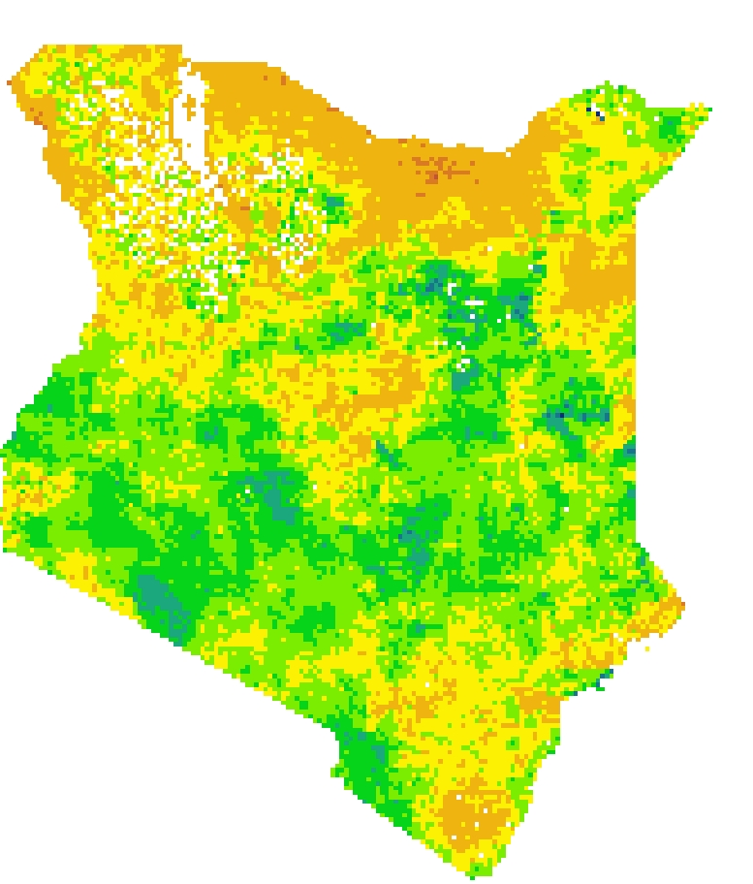
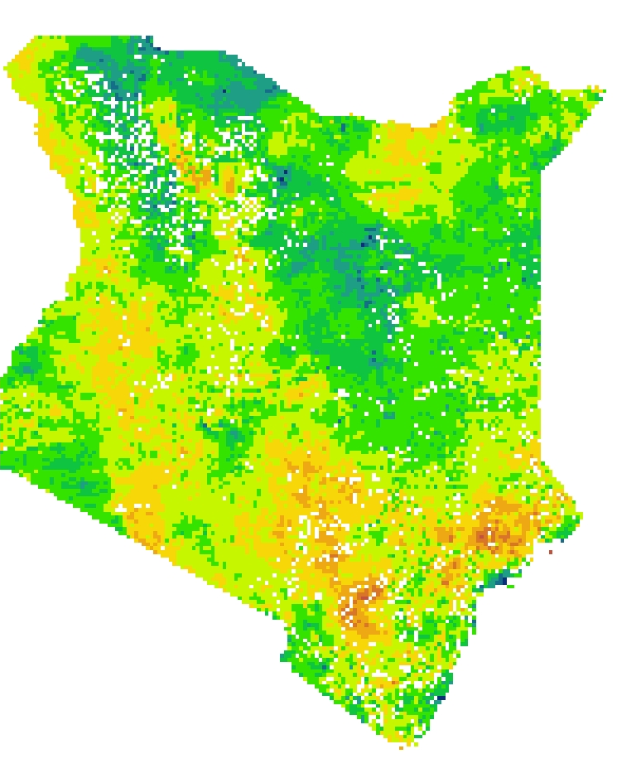
RESULTS:
COMBINED DROUGHT INDICATOR
January, 2016
March, 2017
dry wet
Image Source: DEVELOP team
Notes:
The final CDI was created at the monthly level by combining rasters of the individual indices using a weighted average technique.
The weights for the weighted average were derived from the Principal Component Analysis, which was previously discussed.
At the moment, the Combined Drought Indicator uses a single set of weights applied across the entire country for the whole period of time, but future work may look at applying different weights that vary with county or with season.
The following slides will look in more detail at the CDI timeseries, as well as evaluation of the CDI’s performance against historical records and the NDMA’s drought bulletins.
The first image was calculated during March of 2017, and the second image was taken during January of 2016
January 2016 had a high value of CDI overall for the country of Kenya, but drought in the northern regions of the country
March 2017 showed drought for much of the country, but showed flooding in some regions
Highlights importance of assessing drought per county instead of as an entire country

Slide 21
RESULTS: CDI TIMESERIES
Image Source: DEVELOP team
Notes:
We combined Soil Moisture Anomalies, Standard Precipitation Index, and Vegetation Stress Index to create our Combined Drought Indicator. We used a script that used weights from our Principal Component Analysis to create this CDI.
This graph demonstrates how the CDI changes over time, looking specifically at the CDI from January 2015 to December 2018. Lower values on the graph demonstrate drier periods (droughts) while higher values indicate wetter periods (not drought), which may indicate flood events.
The rainy seasons are depicted by the blue and gray bars, with the short rains (October through December) being represented by gray bars, and the long rains (March-May) being represented by blue bars. There is no significant pattern of CDI values across seasons, but visual interpretation suggests that CDI values tend to be lower between rainy seasons.
The yellow color on the graph depicts CDI averaged over Arid counties, while the blue line depicts CDI over semi-arid counties, and the red represents overall CDI. Interestingly, the CDI values for arid counties tend to be higher, indicating less drought, than the semi-arid or overall lines.

Slide 22
RESULTS: CDI & VCI WITH DROUGHT PHASE
Warning Phase
Marsabit
Normal
Alert
Alarm
Kitui
Emergency
No Value
km
2
5
Image Source: DEVELOP team
Notes:
This figure show CDI and VCI performance in comparison with the NDMA Early Warning Bulletins
CDI and VCI are graphed and the Early Warning Phase is the background color
Green is normal, alert is yellow, alarm is red, emergency is purple, and white spaces are where data was missing
We chose these two counties to compare because Garissa is an arid county whereas Kitui is semi-arid
The CDI performs better in semi-arid Kitui than it does in arid Garissa
In the Garissa figure from March 2018 to October 2018 the CDI diverged from the the NDMA
The NDMA Early Warning Phase is based on VCI, so VCI should better match the bulletin data
However in Garissa from March 2018 to October 2018 the VCI and Warning Phase better match historical drought data than our CDI

Slide 23
RESULTS: INDICES WITH DROUGHT PHASE
Garissa County
SMA Time Series and Early Warning Phase
ESI, SPI, and VCI Time Series and Early Warning Phase
Notes:
These graphs show SMA as well as ESI, SPI, and VCI for Garissa, which is a semi-arid county.
These indices are shown in comparison to NDMA’s drought warning phases to show how well our indices aligned with NDMA’s bulletin warnings.
We looked at whether the individual indices corresponded with the NDMA’s warning phases to ensure that the indices we included in our final CDI were related to the NDMA’s drought classifications

Slide 24
RESULTS:
HISTORICAL DROUGHT COMPARISON
Image Source: DEVELOP team
Notes:
This figure shows our overall CDI in comparison to historical drought events that we compiled into a database.
This shows how well our CDI picked up certain historical drought events.
Gray columns in the chart depict drought events noted for the entire country, while the yellow column is drought that was only recorded in northern regions.

Slide 25
RESULTS: CDI COMPARED TO VCI
km
2
5
Image Source: DEVELOP team
Notes:
This slide depicts the overall timeseries of our Combined Drought Indicator (CDI) compared to Vegetation Condition Index (VCI) averaged over semi-arid counties
The data for this graph was standardized in excel so that the datasets fell in the same range
Currently, the National Drought Management Authority (NDMA) only uses VCI to detect drought and publish their early warning bulletins, which means that they are unable to detect drought after vegetation begins to show stress
The time lag assessment suggested that several of the indices included in our CDI detect drought earlier than VCI, so we would expect that the overall CDI is able to perform ahead of VCI

Slide 26
RESULTS: CDI COMPARED TO VCI
Drought event of 2016-2017 begins in Kenya
km
2
5
Image Source: DEVELOP team
Notes:
The 2016-2017 drought in Kenya was severe, and led to millions requiring food aid
This graph depicts the results of our CDI over this time period, beginning in Jan. 2015 and ending in Dec. 2018.
The data on this slide has been smoothed to make the relationships between CDI and VCI more clear
To be most useful to our project partners, the final CDI should detect drought earlier than VCI
The drought event of 2016-2017 began with the loss of the OND (October, November, December) rains, which is consistent with our CDI picking up a drought event beginning around October
Based on visual interpretation of these results, we can see that the CDI detected several drought events before VCI, which suggests that it may be useful to the NDMA for their early warning bulletins, but more validation is needed to ensure that the CDI is consistently detecting drought earlier than VCI

Slide 27
RESULTS: CDI COMPARED TO VCI
Flooding: 2012 April – May
Insufficient rains: 2012 March – May
Flooding: 2011 Aug. – Nov.
insufficient rains: 2011 March – May
insufficient rains: 2010 Oct – Dec
km
2
5
Image Source: DEVELOP team
Notes:
The 2010 and 2011 drought in Kenya, and across the Horn of Africa was one of the most severe droughts in the past 60 years.
The data on this slide has been smoothed to make the relationships between CDI and VCI more clear.
This graph depicts the data between Jan. 2010 and Dec. 2013 to highlight the drought event of 2010-2012
The drought event in 2011 began in Kenya with the insufficient rains in March – May, which our CDI detects around March
Later in the year, the country experienced heavy rain and flash flooding, which would appear as higher values in our CDI.
beginning in August 2011 in the northwestern regions (counties Kisumu East, Nyando, and Turkana), heavy rains caused flash floods
Widespread flooding occurred around October – November 2011, during the rainy season (http://floodlist.com/africa/kenya-floods-and-landslides-leave-5-more-dead)
Particularly severe flooding reported in Garissa county, where the Tana River overflowed (http://floodlist.com/africa/kenya-floods-and-landslides-leave-5-more-dead)
These floods led to at least 25 deaths and almost 100,000 people were displaced from their homes (https://reliefweb.int/disaster/fl-2011-000115-ken)
In the beginning of 2012, the drought was exacerbated by the lack of rain and poor March-April-May rains, but beginning in April 2012, some counties also experienced heavy rains and flash floods
While our CDI may be detecting drought earlier than VCI in some cases, there are other situations in which the CDI does not function exactly as anticipated. Further work could be focused on identifying which indices perform best in different seasons and across different counties to best tailor the CDI to different scenarios.

Slide 28
CONCLUSIONS
1
Timing of Drought Indices: Time lag assessment suggests potential to detect drought much earlier than current systems based on VCI alone.
2
CDI across arid and semi-arid regions: Our CDI’s performance suggests that some drought indices function better in semi-arid counties than arid counties.
3
VCI and CDI function similarly: While there is room to improve current drought warning systems, the current CDI did not appear to detect drought significantly earlier than VCI.
km
2
5
Notes:
Timing of Drought Indices: The time lag assessment suggests that there is potential to detect drought much earlier than current systems based on VCI alone. Many indices functioned one full month ahead of VCI, which may significantly improve the response to drought and help prepare for severe consequences.
CDI across arid and semi-arid regions: Our CDI performs very differently in arid and semi-arid regions. Current systems have also been noted to struggle to detect drought consistently and accurately in arid regions, which suggests that certain indices may function better in different regions.
VCI and CDI: Our results show that while there is room to improve current drought warning systems, the current CDI did not appear to detect drought significantly earlier than VCI. While specific indices perform ahead of VCI, including indices at the same moment in time using a weighted average may not be the method best suited to take advantage of the early detection capabilities of certain indices.

Slide 29
FUTURE WORK:
1
Historical Database: Compile an extensive historical drought database on the county and monthly level that can validate the CDI.
2
Validate: Process and compile a quantitative data base that can be used to compare and validate the CDI.
3
Test other Drought Indicators: Compare other drought indicators to see which one is more accurate, perhaps using the threshold method.
km
2
5
Notes:
Future work that could be done would be to compile a more comprehensive historical drought and flood database, this would consist of more monthly events and more specific county drought events that could be used to validate CDI.
Work that could also be done would be to test other Drought Indicators and Compare other drought indicators to see which one is more accurate, perhaps using the threshold method
Other work that could be done would be to compile a data set of precipitation or drought data to validate our CDI with.

Slide 30
SERVIR: Dr. Lee Ellenburg, Emily Adams, Dr. Vikalp Mishra, and Sara Miller
RCMRD: Lilian Ndungu
NDMA: Nelson Mutanda
DEVELOP Fellow: A.R. Williams
Science Advisors: Dr. Jeffrey Luvall and Dr. Robert Griffin
Mentors: Helen Baldwin, Christine Evans, and Madison Murphy

