Slide 1
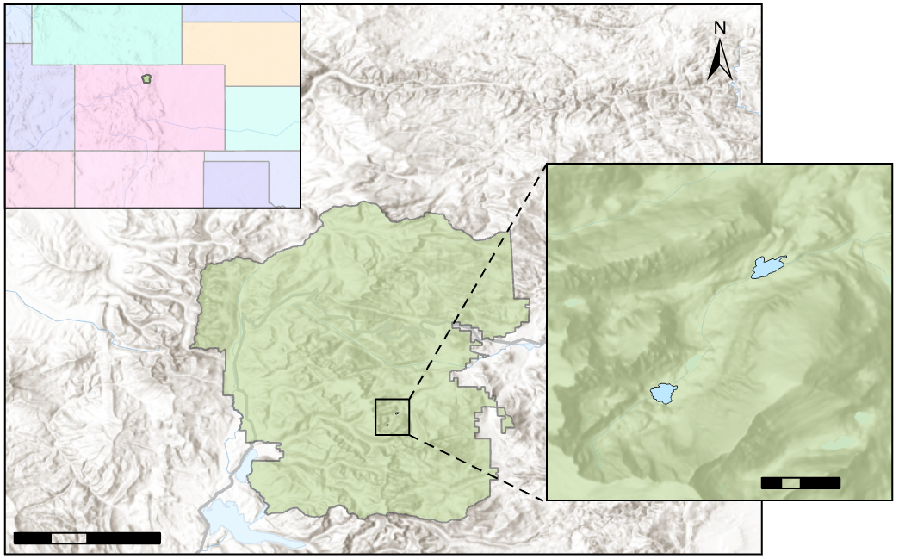
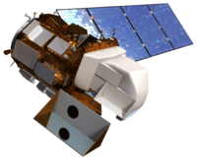
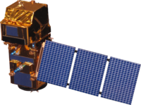
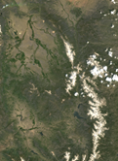
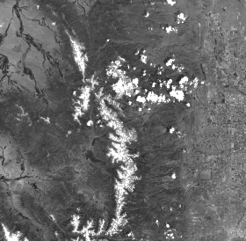
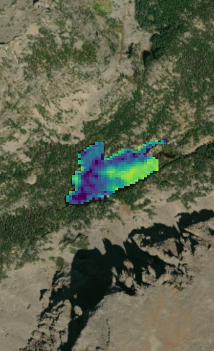
Employing NASA and ESA Earth Observations to Monitor Alpine Lake Algal Productivity in Rocky Mountain National Park
Abstract
Study Area
Alpine lakes in Rocky Mountain National Park (RMNP) serve as an important habitat and water source for wildlife and contribute to the overall aesthetic value of the park. However, since the 1960s, alpine lakes within RMNP have experienced intensified algal productivity as a result of rising temperatures and increased nitrogen and phosphorus deposition. This increased algal productivity may have negative impacts on water quality, ecological function, and park aesthetic. Due to the remote location of many of these lakes, continuous monitoring of algal productivity is difficult. In order to assist in the surveillance of these lakes, the Rocky Mountain Water Resources II team partnered with the United States Geological Survey’s Fort Collins Science Center and the National Park Service at RMNP to develop a methodology integrating satellite imagery for monitoring chlorophyll-a concentration as a proxy for algal productivity. In 2016, DEVELOP’s Rocky Mountain Climate team utilized Landsat 8 Operational Land Imager (OLI) to predict chlorophyll-a levels but were limited by the spatial and temporal resolution of the data. This feasibility analysis compared the efficacy of integrating higher resolution Sentinel-2 Multispectral Instrument (MSI) data with Landsat 8 OLI indices in detecting chlorophyll-a at two RMNP focal lakes, Sky Pond and The Loch. An increased understanding of the algal productivity of these lakes will allow our partners to promote best management practices in maintaining the resilience and preserve the beauty of these fragile ecosystems.
Figure 1. Study Period: May to September (ice-free season), 2016 to 2018
COLORADO
Rocky Mountain National Park
The Loch
Sky Pond
0
1
0
10
20
km
km
Results
Sentinel-2 Indices - August 30th 2018
Landsat 8 Indices - August 30th 2018
The Loch
Sky Pond
The Loch
Sky Pond
Objectives
(Red⁻¹-Red Edge1⁻¹)/(Red Edge2⁻¹-Red Edge1⁻¹)
ρ = 0.531
Green/Blue
ρ = -0.426
Assess the feasibility of incorporating Sentinel-2, Landsat 8, and in situ data for monitoring algal productivity in alpine lakes within RMNP
Determine the most effective index for remotely detecting chlorophyll-a
Create chlorophyll-a concentration maps for Sky Pond and Loch Lake in RMNP
Develop an ArcGIS tool for future remote monitoring of algal productivity
0.05 km
0.05 km
0.05 km
0.05 km
(Blue-Red)/Green
ρ = 0.437
(Blue - Red)/Green
ρ = 0.352
Earth Observations
0.05 km
Landsat 8 OLI
Sentinel-2 MSI
Rocky Mountain Water Resources II
NIR/Red
ρ = -0.271
1.67 - 3.94 * ln(Green) + 3.78 * ln(Red)
ρ = -0.182
Methodology
Process
Calculate
Correlate
Sentinel-2 MSI imagery was atmospherically corrected using ACOLITE software.
11 band indices were calculated for Sentinel-2 and 8 were calculated for Landsat 8 using ArcGIS.
The outputs of these indices were then correlated with field data using Spearman’s correlation coefficient in R.
Low Chl-a
High Chl-a
Field Sampling Points
Figure 2. Comparison of the best performing index for Sentinel-2 and Landsat 8 using imagery from August 30th 2018. Rasters were categorized by quantiles. A Spearman’s correlation coefficient was calculated for each index, with a higher ρ value indicating better correlation with field data.
Conclusions
Sentinel-2 enhances the ability to detect chlorophyll-a due to the 10 m spatial resolution and the red-edge band, which overlaps with chlorophyll-a absorption. Landsat 8 also showed promising ability to detect chlorophyll-a.
The highest performing indices were (Red⁻¹- Red Edge 1⁻¹)/(Red Edge 2⁻¹ - Red Edge 1⁻¹) (ρ = 0.531) for Sentinel-2 and Green/Blue for Landsat 8 (ρ = -0.426).
Using intersecting pixels rather than mean values within a 20 m buffer resulted in the greatest correlation between remotely sensed data and field data. Correlations were also improved by looking at lakes individually and within 3 days of field collection.
Including additional field data will increase confidence in correlations with remotely sensed data.
Mixed pixels along the lake edge may introduce error due to vegetation on land.
Although algal production is historically high, the oligotrophic to mesotrophic status of the Loch and Sky Pond present a challenge in detecting lower levels of chlorophyll-a.
Project Partners
Fort Collins Science Center
Rocky Mountain National Park
Team Members
Acknowledgements
The Rocky Mountain Water Resources II Team would like to thank our partners at the USGS and NPS for engaging with NASA DEVELOP to make this research possible. We would also like to give a special thanks to Kristen Dennis (CO and ID Node Center Lead), Peder Engelstad (Science Advisor), and Dr. Jill Baron (USGS) for working closely with our team throughout this research project.
This material contains modified Copernicus Sentinel data (2017-2018), processed by ESA.
Anastasia Kunz
Project Lead
Genevieve Clow
Natalie Schmer
Sarah Wingard
Colorado – Fort Collins | Summer 2019

