Slide 1
GILA WATER RESOURCES
Using Earth Observations to Track Watershed Recovery After Wildfires in the Gila National Forest
Abigail Barenblitt
Ariege Besson
Terra Edenhart-Pepe
Carli Merrick
Maryland – Goddard | Fall 2019
Notes:
I would like to thank you all, on behalf of our team and the National Develop Program, for joining us today.
I am joined today by my multi-talented teammates:
Abigail Barenblitt, I have a masters in Wildlife and Fisheries Science from Penn State University
Carli Merrick, I have a masters in Applied Remote Sensing from the University of Miami
Ariege Besson, I recently graduated with my bachelor’s in Geology & Geophysics and in Ethnicity, Race & Migration from Yale.
Terra E-P, LA, MES, GIS/Spatial Analytics
We worked along side our partners at the USFS & Gila National Forest to explore relevant data & appropriate methodologies for tracking watershed recovery after fire events.

Slide 2
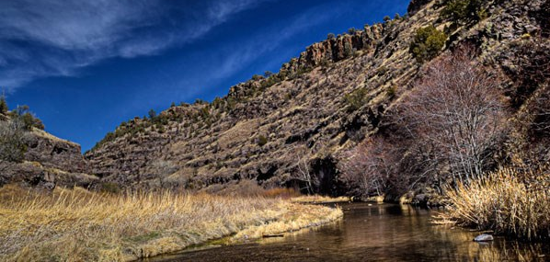
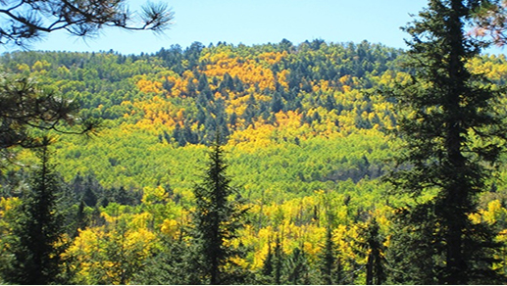
Gila National Forest
Located in southwestern New Mexico
Covers 3.3 million acres of land including ~793,000 acres of wilderness
Elevation ranges from 4,200 to 10,900 feet
Contains the headwaters of the Gila and San Francisco rivers
Image Credits: NPS Photo by Bruce Bloy, USDA-FS
Notes:
The Gila National Forest is a diverse landscape that covers more than 3 million acres of land in southwestern New Mexico.
This region has a semi-arid continental climate
four distinct seasons
very light precipitation
large temperature ranges annually and diurnally
Also of interest to our project is that it is home to a wide variety of land cover types, including evergreens, aspens, grasslands, and endangered species including the Mexican spotted owl.
The forest is also home to the headwaters of the San Francisco and Gila Rivers(Gila River flows westward for 500 miles before joining the Colorado River), which are important water sources for communities and habitats downstream in New Mexico and Arizona.
images:
nps.gov
NPS Photo by Bruce Bloy (Public Domain)
https://www.nps.gov/gicl/planyourvisit/gila-wilderness.htm
Gila National Forest on Flicr
https://www.flickr.com/photos/gilaforest/29557492327/

Slide 3
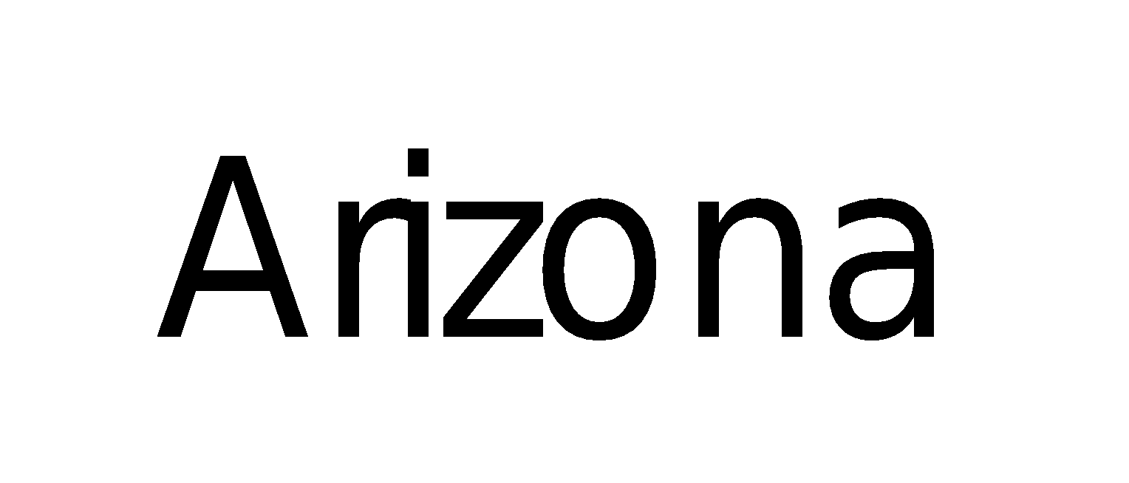
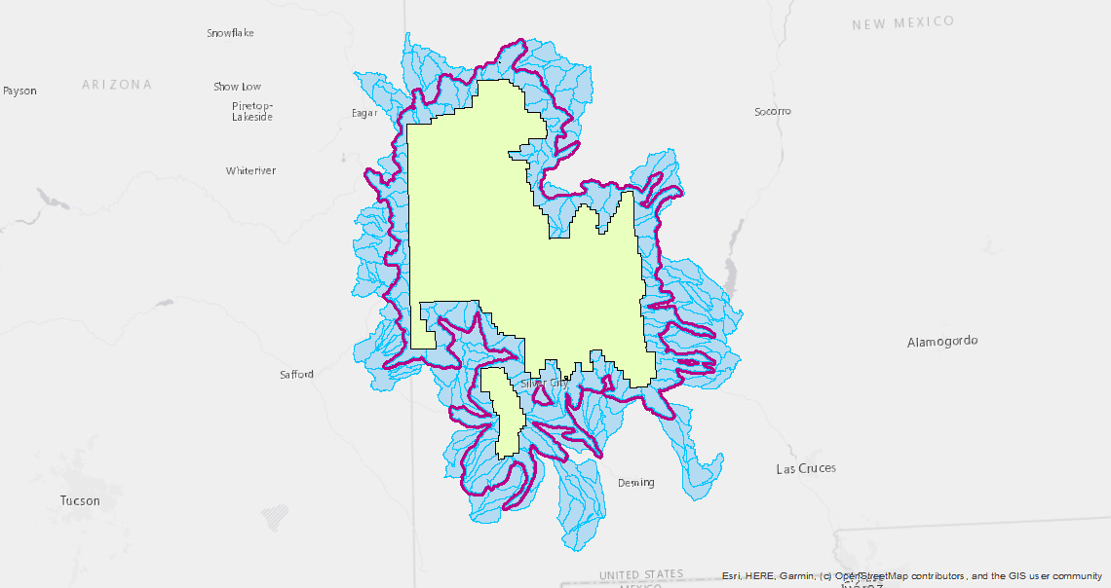
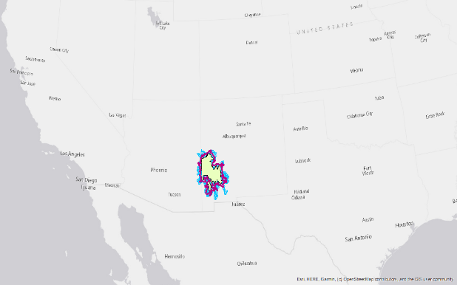
Study Area
N
N
United States
N
New Mexico
N
Arizona
Watershed Boundaries
Gila National Forest
Study period: 1998 - 2018
Project Study Area
Notes:
This is an image of our study area. our project partners were particularly interested in changes at the subwatershed level, so the study we chose area includes ((HUC-12 level)) subwatersheds that intersected the Gila’s administrative forest boundary, as our partners suggested. The study area also includes a 1 kilometer buffer to ensure that our entire study area would be covered when using raster data with a 30m resolution. Our study period covered 1998-2018, as suggested by our partners to ensure coverage of short, medium, and long term trends.

Slide 4
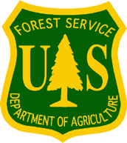
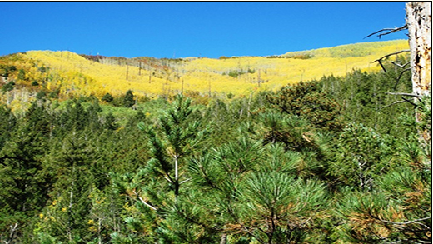
Project Partners
USDA Forest Service, Gila National Forest
USDA Forest Service, Region 3
Image Credits: USDA Forest Service, USDA Forest Service Gila National Forest
Notes:
We’re collaborating with partners include the USDA Forest Service Region 3, which includes all of Arizona and New Mexico, as well as the Gila National Forest.
They have been great partners because they’ve
gathered a lot of data
analyzed a lot of data
shared many observations and local knowledge
Our project has benefited from these additions.
Image: USDA Forest Service https://www.fs.fed.us

Slide 5
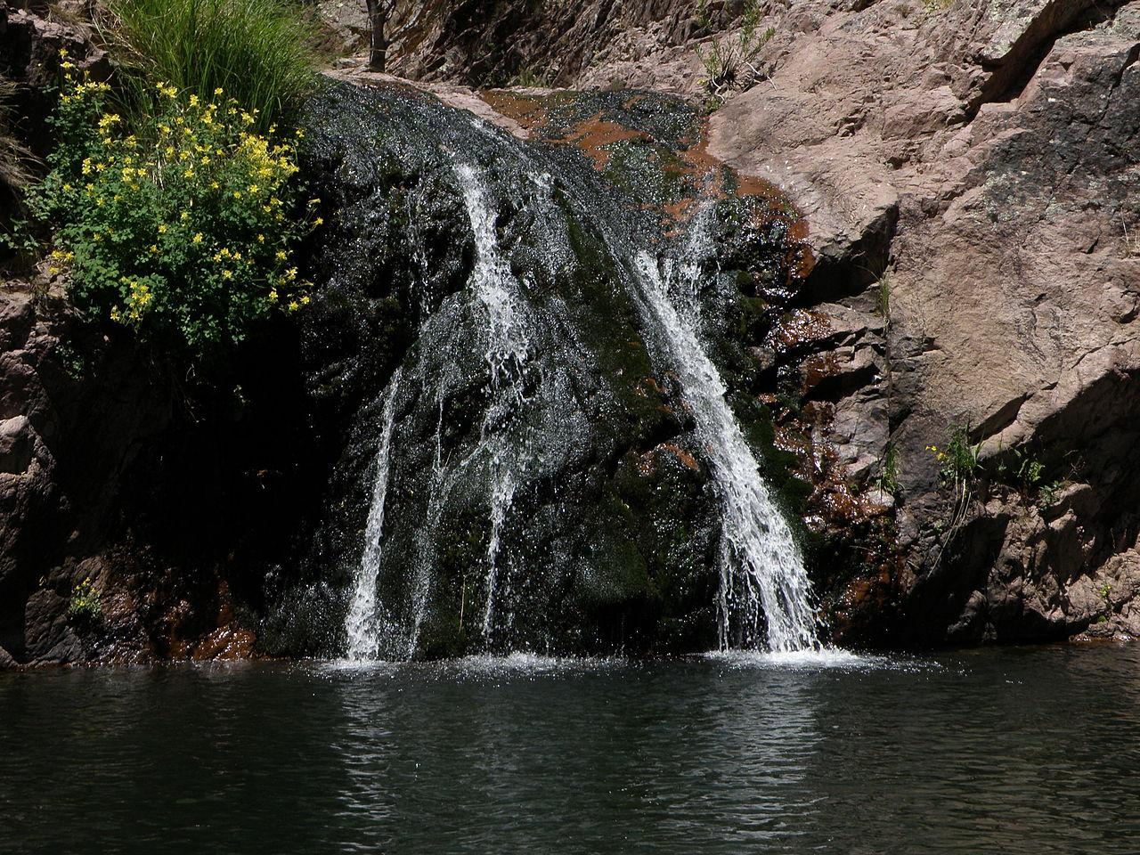
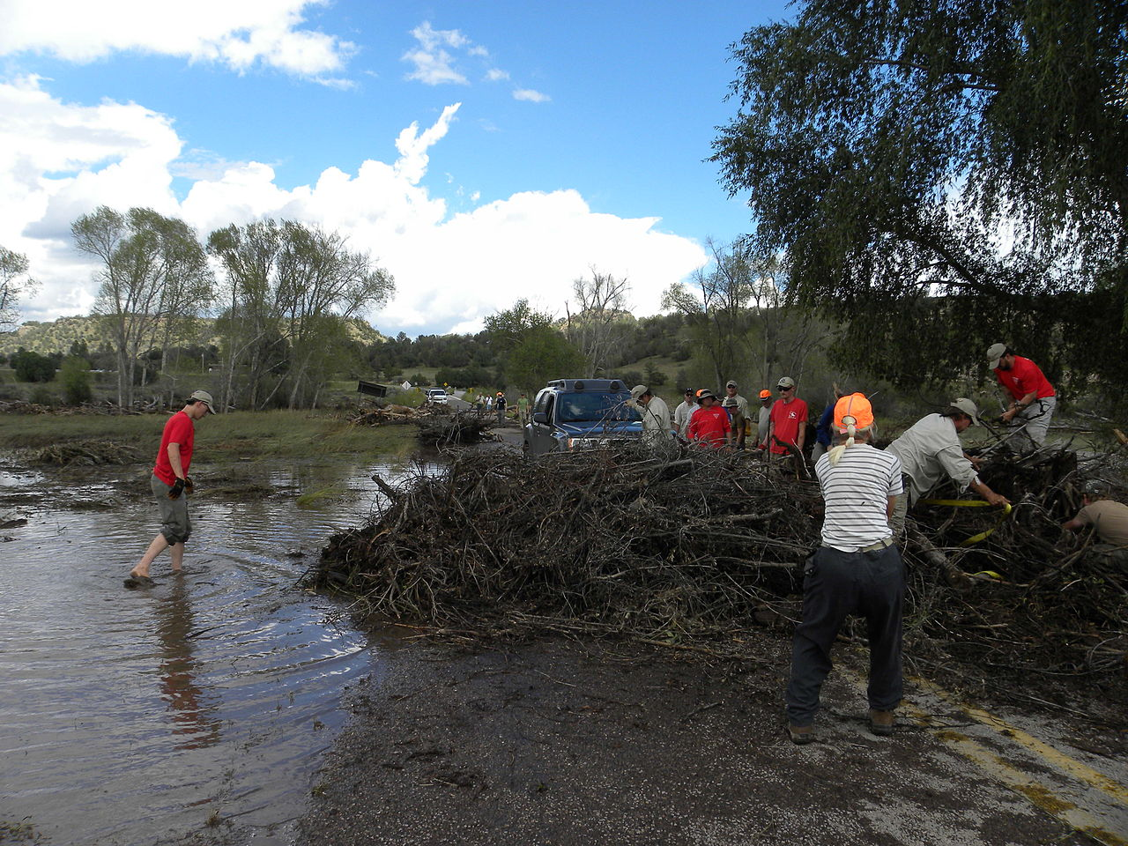
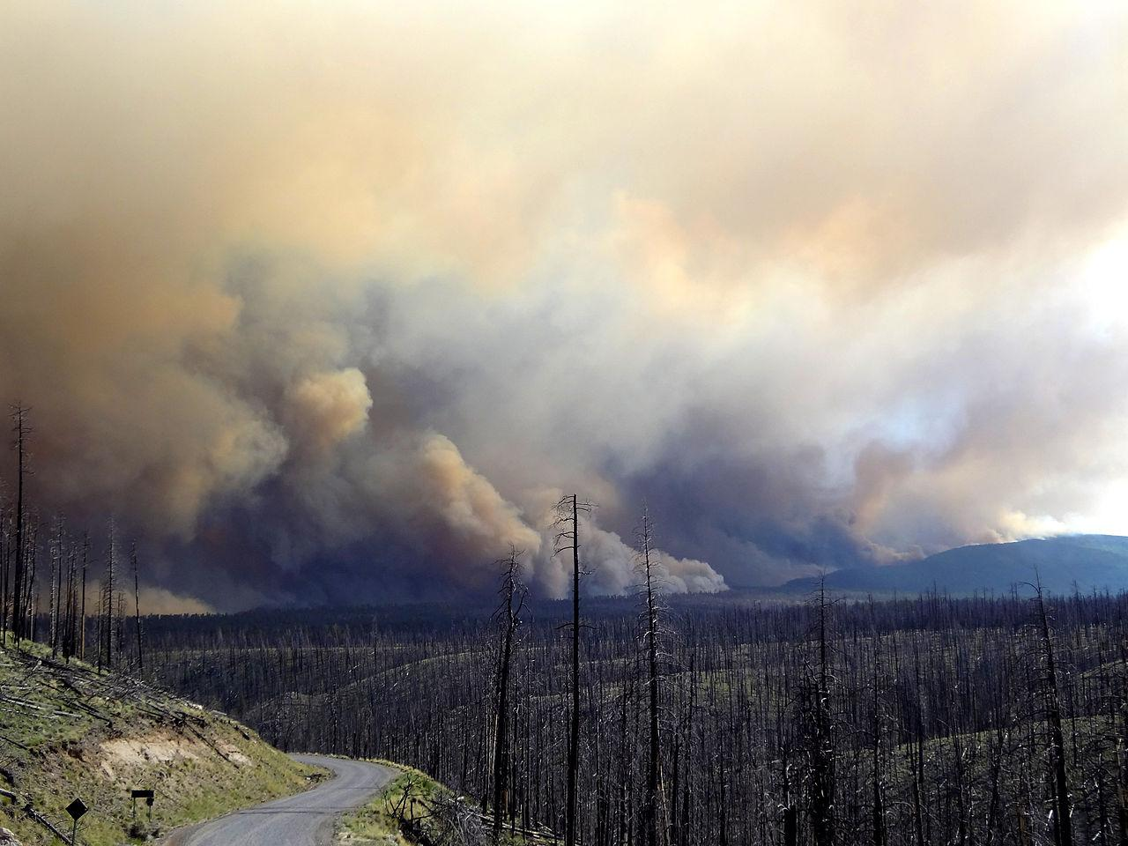
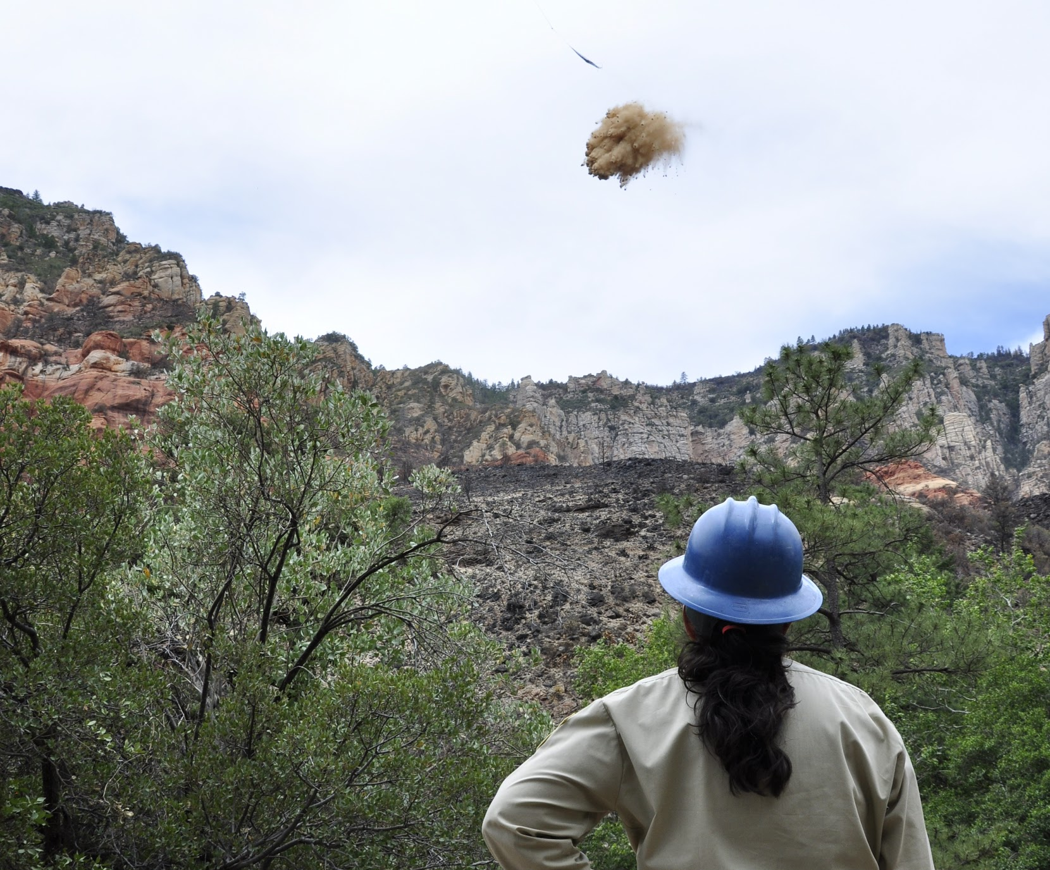
Community Concerns
2012: Whitewater-Baldy Fire Complex, ~290,000 acres burned
2013: Silver Fire, ~139,000 acres burned including 788 acres of private land
Fire Response
Management Priorities
Watershed Health
Post-Fire Flooding
Image Credits: US Forest Service, Gila National Forest; U.S. Forest Service, Coconino National Forest
Notes:
The Gila experienced severe fires in both 2012 and 2013, which broke records for acres burned and destruction of human property. Our partners have made observations that 1 - 2 years after fires, severe floods occur. With reduced vegetation cover, water is not held in root systems and soils and so runoff is higher, increasing streamflow and sometimes resulting in floods.
Community concerns include:
How to respond to fires and prioritize areas for post-fire recovery activities.
How to ensure well-being of downstream communities through examining watershed health.
Our partners are particularly interested in watershed recovery, and in better understanding the relationships between fire and post-fire flooding impacts that they observed in the years following 2012 and 2013.
Currently, Gila uses Landsat data and other datasets provided by USGS. However, our partners have not assessed long term impacts of disturbances, such as wildfires, using GIS and Remote Sensing, and that is a need this project is attempting to address.
(Stats on fires: In 2012, the Whitewater-Baldy Fire Complex burned approximately 290,000 acres of land and was the largest fire on record in New Mexico. The year afterwards, in 2013, the Silver fire burned an additional 139,000 acres of land. It was the most destructive fire to private property on record in New Mexico.)
Fire Response Image: US Forest Service Gila National Forest, https://commons.wikimedia.org/wiki/File:Gila_National_Forest_(7282037236).jpg
Watershed Health Image: Gila NF, https://commons.wikimedia.org/wiki/File:W._Fk_of_Mogollon_crk,_Jeanies_waterfall,_Gila_National_Forest_(8727134762).jpg
Management Priorities Image: U.S. Forest Service, Coconino National Forest https://commons.wikimedia.org/wiki/File:Heli-mulching_Slide_Fire_BAER_Work_C4_(14329711807).jpg
Post-Fire Flooding Image: Gila National Forest, https://commons.wikimedia.org/wiki/File:Gila_River_flooding_in_Gila_Hot_Springs_area_(9776418862).jpg

Slide 6
Objectives
Quantify recovery trends over time using NASA Earth observations
Evaluate the correlation between environmental factors and recovery
Explore relationships between hydrological processes and fire events
3
0
01
02
1
2
02
Notes:
With these things in mind, we had three objectives for our project:
As part of NASA’s Applied Sciences program, we wanted to explore the use NASA Earth observations to quantify trends in recovery over time
Second, we wanted to evaluate the correlation between environmental features’ and recovery
Finally, we wanted to explore the relationships between fire and hydrological processes, including flooding.
All of these objectives support the goal to help Gila make informed land management decisions about where to focus post-fire recovery activities within the park, such as seeding and mulching.

Slide 7
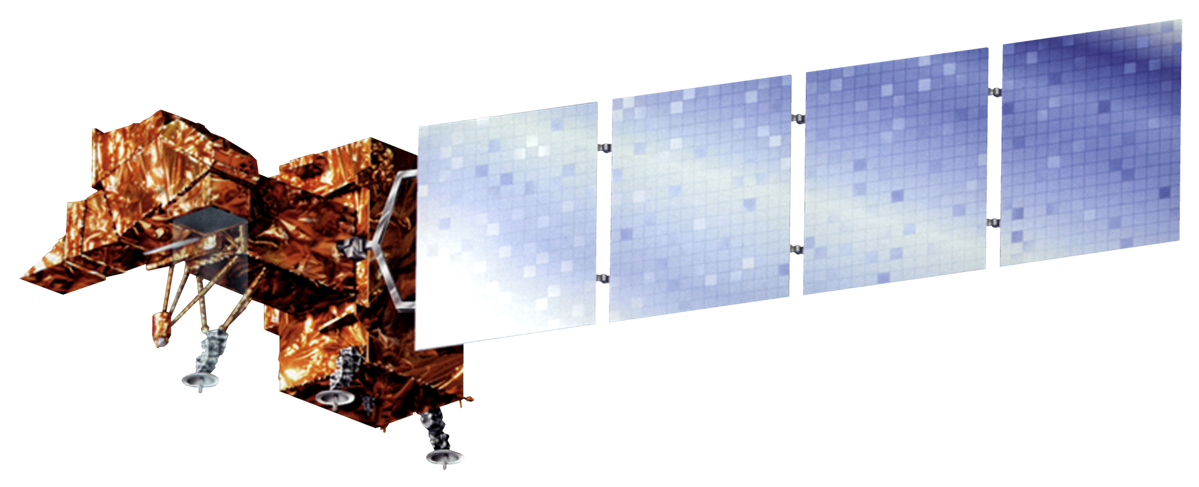
DATA: NASA Satellites & Sensors
Landsat 7 Enhanced Thematic Mapper Plus (ETM+)
Landsat 8 Operational Land Imager (OLI)
Notes:
We utilized surface reflectance data from the Landsat 7 and Landsat 8 satellites. Both were necessary in order to cover the entire time period of our study from 1998 to 2018.
Landsat instruments collect visible and near-infrared light at 30 m resolution every seven days.
Image Source (Landsat 7 ETM+): (http://www.devpedia.developexchange.com/dp/images/c/c2/02_Landsat7.png; DEVELOPedia)
Image Source (Landsat 8 OLI & TIRS): (http://www.devpedia.developexchange.com/dp/images/c/c2/03_Landsat8.png; DEVELOPedia)
Uses instruments to collect information in the

Slide 8
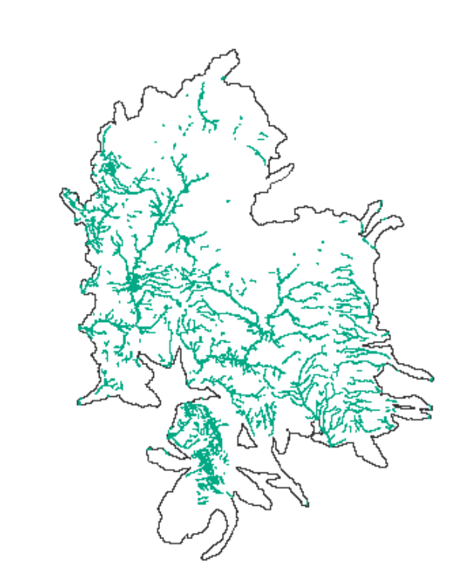
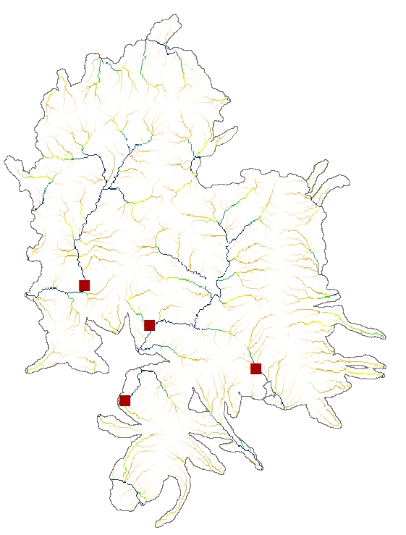
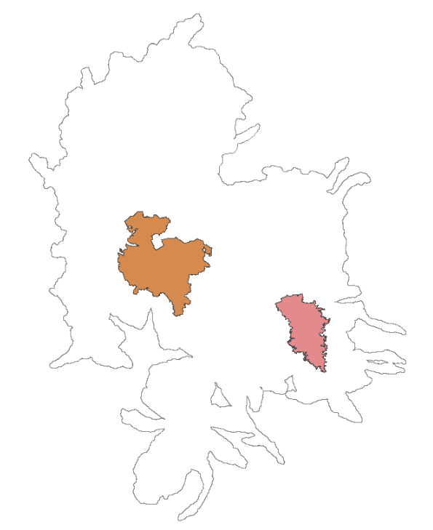
DATA: In situ USGS & USDA-FS
USGS Stream Gauges
Riparian Areas
Burned Areas
Notes:
We were also fortunate to use a wide range of data passed along to us by the USDA- Forest Service and partners. This is the data that we used to inform the direction of our project. This data included burned areas, fire severity, riparian regions, and streamflow data from USGS gauges.
On the far right you can see the outline of the two major fires we are considering in this study, whitewater (2012) in orange and Silver (2013) in pink.

Slide 9
Methodology
Evaluate
spatial relationships between recovery and landscape characteristics
03
03
03
03
03
3
Quantify
vegetation growth over time following fire events using satellite-based Normalized Burn Ratio
02
02
02
02
02
01
2
01
01
01
01
1
01
Explore
USGS Streamflow data as a metric for watershed recovery
Notes:
Our Methodology corresponds to our 3 objectives:
To Quantify recovery trends over time we used NASA EO to look at vegetation growth overtime using the Normalized Burn Ratio, which we will cover in subsequent slides.
We employed USGS streamflow data in our Exploration of relationships between recovery, hydrological processes and fire events.
To Evaluate the correlation between exogenous environmental factors and recovery we built a database spatially associating landscape characteristics, which can be used to run regressions.
A major challenge in this work is to develop a cohesive story around all 3 of these of project components.

Slide 10
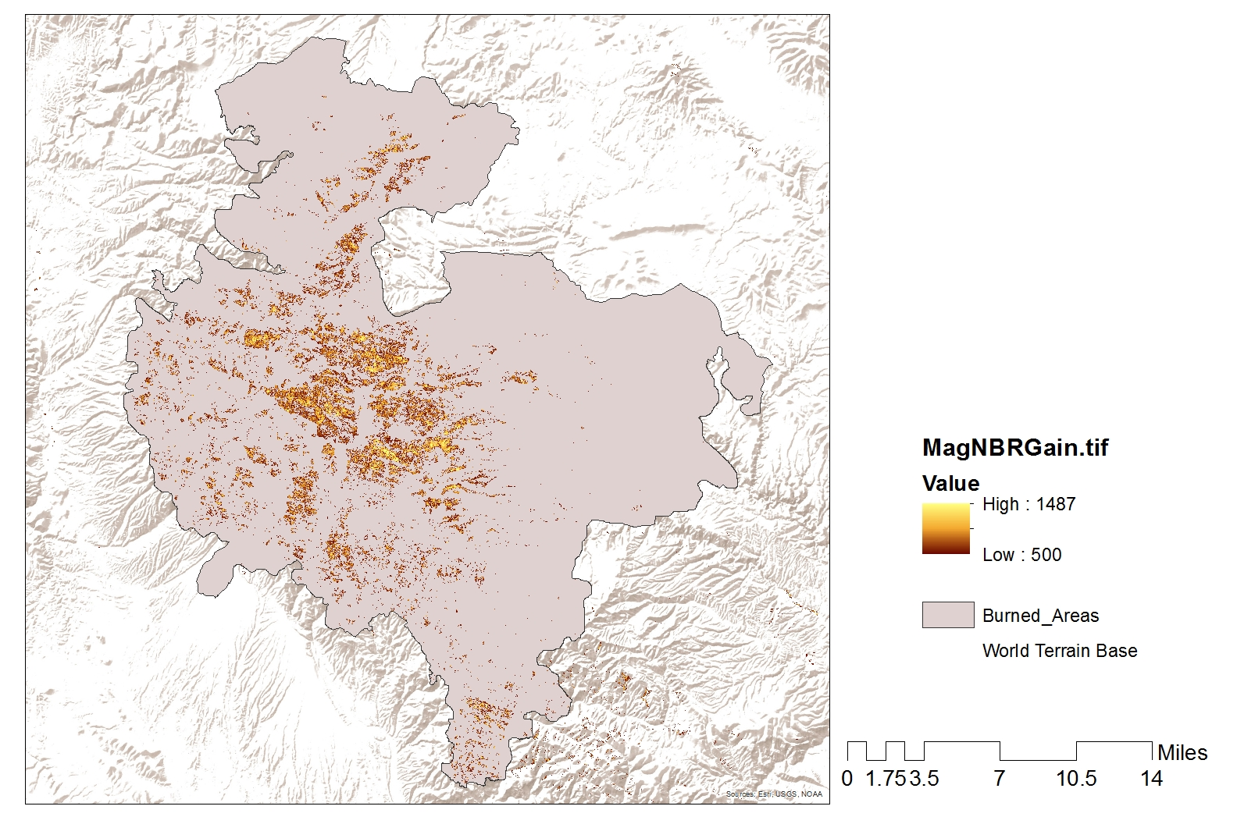
Quantify Change Over Time
Normalized Burn Ratio (NBR)
Used to spectrally compare healthy vegetation with burned areas
Values range from -1 to +1
Is calculated using near infrared (NIR) and shortwave infrared (SWIR) bands
High
Moderate
Low
Burned Areas
NBR = (NIR - SWIR) / (NIR + SWIR)
Notes:
Following our lit review, we chose to use normalized burn ratio as an index of recovery in the watershed .
NBR is measured using Near Infrared and Shortwave Infrared bands (shown in the equation here) & is similar to the gold standard NDVI (normalized difference vegetation index) both as a method to track landscape change & in the structure of the equation. However, NBR was preferred because it is:
it is sensitive to the capture of disturbance events (Kennedy et al., 2010, p. 2905) and
is less prone to saturation than NDVI when considering post-fire vegetation recovery (Bright et al., 2019).

Slide 11
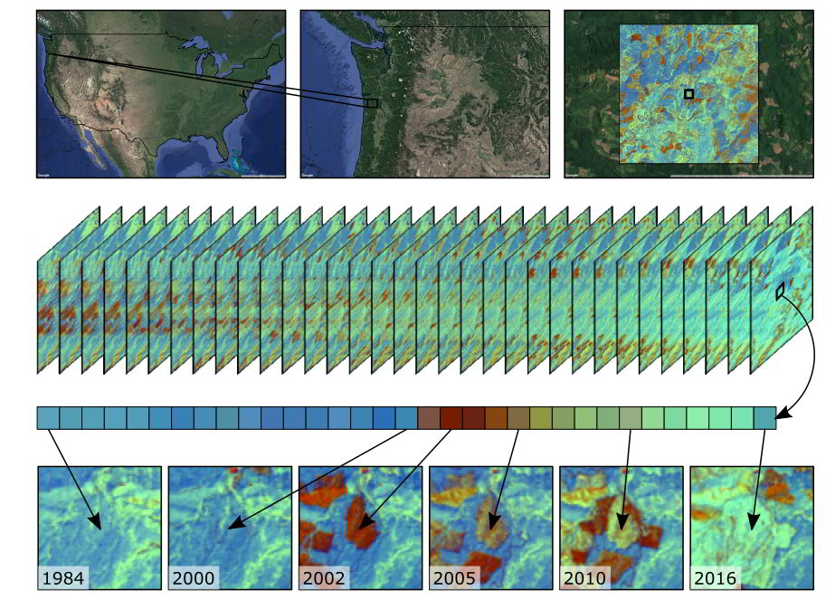
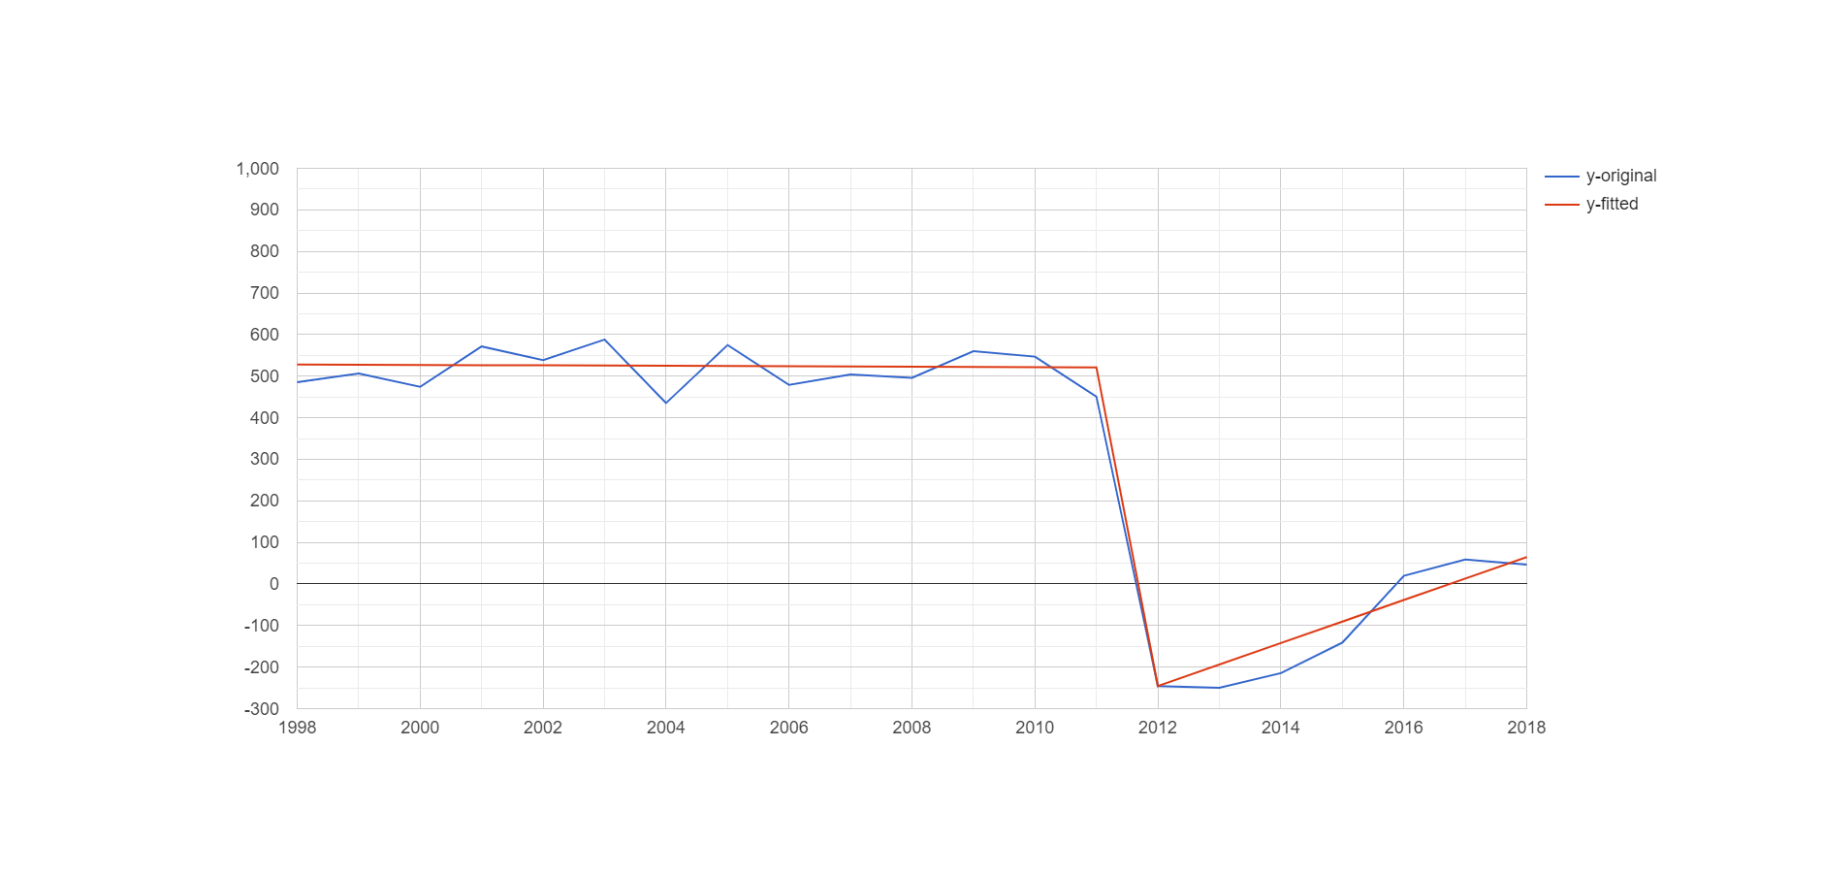
LandTrendr
Time Series graph of a pixel from a high-severity burn area
NBR
Image Credit: Oregon State University
Original
Fitted
Notes:
We used LANDTRENDR, a suite of functions and procedures developed at Oregon State University & based on the premise that “every pixel has a story to tell”.
Landsat provides historical record of landscape character and LT’s algorithms track changes in each pixel individually overtime.
FOR EXAMPLE, this plot shows the story of one pixel that lives in a deciduous forest for years before experiencing a wildfire event and a dramatic, rapid loss of vegetation. Then, in the subsequent 4 years after the disturbance, the pixel regenerates. LR calculates regeneration as magnitude of change based on the value of NBR prior to the disturbance.
Image: https://emapr.github.io/LT-GEE/introduction.html
Oregon State University provided us with written permission to use this graphic
((, and associating the recovery phenomenon with other phenomena or physical landscape and hydrological characteristics within the study area. ))

Slide 12
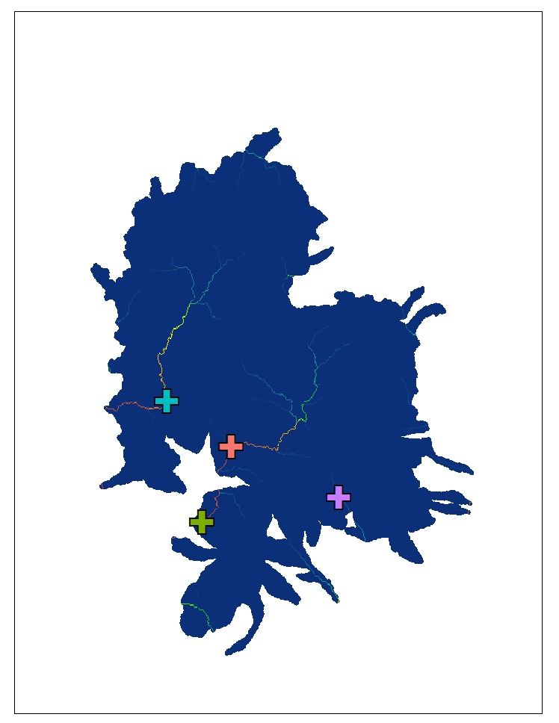
Exploring Streamflow
USGS Gauges:
Mimbres River at Mimbres, NM
San Francisco River near Glenwood, NM
Gila River near Gila, NM
Gila River near Redrock, NM
Metrics:
Annual Mean Streamflow
Daily Mean Streamflow
Q7 max
Notes:
USGS streamflow data was also used in our analysis of recovery.
We plotted 20 years worth of gauge data from 4 strategically selected stations:
- One downstream of Silver,
WW,
Both WWB & Silver fires
Neither - upstream of both fires.
The metrics we used in our analysis:
annual streamflow (or the amount (volume) of water carried by a stream past a point per second),
daily mean streamflow, and
Q 7 max (Q7 max is a measure of the mean of the highest 7 consecutive days of streamflow per each year).

Slide 13
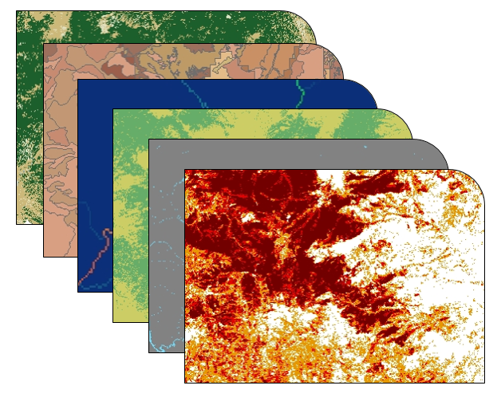
Evaluate Spatial Relationships
Which physical and environmental parameters are correlated with recovery?
Burn Severity
Distance to water
Elevation
Slope
Burned in the 2012/2013 fires or not
Land cover type
Soil type
Notes:
To evaluate spatial relationships, we looked at recovery metrics by way of a fishnet, which provides a sampling technique at a snapshot of time.
This technique allows us to wrangle together vector and raster data describing physical, landscape features.
These data are manually encoded, such as slope value & distance to stream etc. The result is a model-ready spatial database.
Since we are the first term of a multiple term project, part of our job was to examine various datasets and collect relevant data. The fishnet is a step in the direction of modeling of relationships between the recovery phenomenon with other phenomena or physical and hydrological characteristics within the study area.

Slide 14
Results: LandTrendr Time Series
Magnitude of Gain in NBR
High
Moderate
Low
Burned Areas
Notes:
This map is the result of LT’s NBR analysis & displays the magnitude of gain in NBR (gain of vegetation post disturbance- in this case the Whitewater-Baldy Fire).
Areas with a high magnitude of change indicate areas with high burn severity, and thus a large change in vegetation following fires. We noticed that these areas overlap with areas of high burn severity which helps us validate that our computed values reflect observed values.
This is the first part of our methodology for understanding recovery.
Present values NBR
Immediately after fire to determine recovery.

Slide 15
Results: LandTrendr Time Series
Percent Recovery NBR
High
Moderate
Low
Burned
Areas
Notes:
This map demonstrates result of LT’s NBR analysis.
Areas of green indicate high percent recovery.
Areas in purple indicate areas of low recovery.
Zoomed in image shows restoration plots, which overlapped with high burn severity.
High recovery was seen in treated areas.

Slide 16
Results: LandTrendr Time Series
Burn Severity | Whitewater Mean % Recovery | Silver Mean % Recovery
Low | 90.8% | 85.0%
Moderate | 88.5% | 86.5%
High | 77.5% | 84.9%
Landcover Type | Mean % Recovery
Forest | 92.3%
Shrub/ scrub | 80.0%
Herbaceous | 82.1%
Notes:
We have demonstrated the mean % recovery within our study area’s land cover types and areas of fire severity. It should be noted that we excluded restoration plots from this part of our analysis to reduce confusion in the signal cause by assisted growth.
Left: Percent recovery at different burn severity levels. Again, we expected to see greater variability here. However, there is only slightly more recovery in areas with low or moderate burn severity.
Right: LC type separated by forest, shrub/scrub, and herbaceous. We expected to see greater variability here. However, there is only slightly more recovery in areas with forested land cover types.

Slide 17
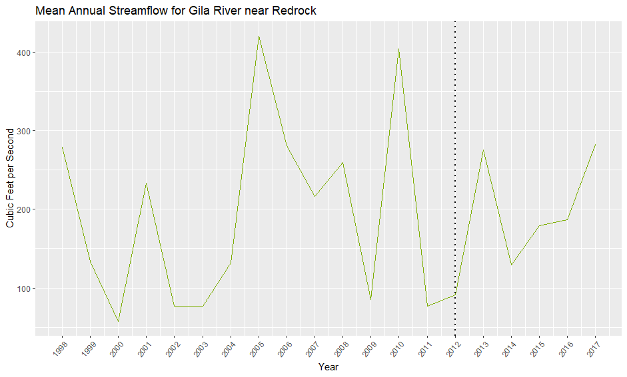
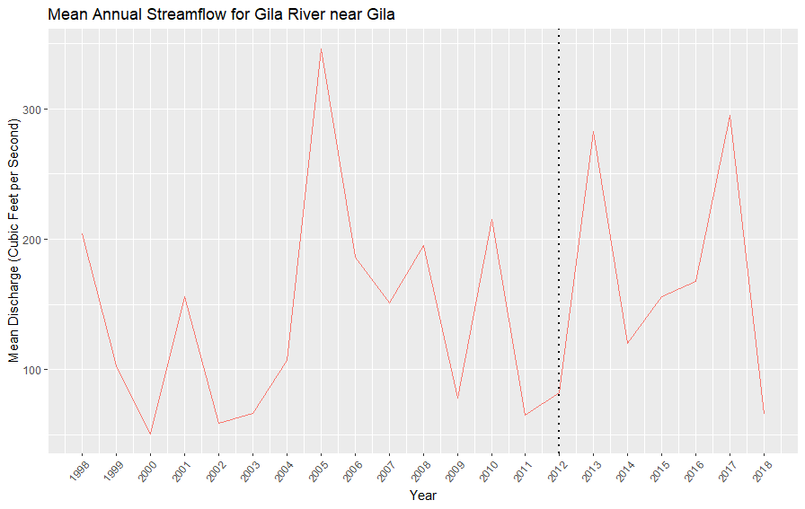
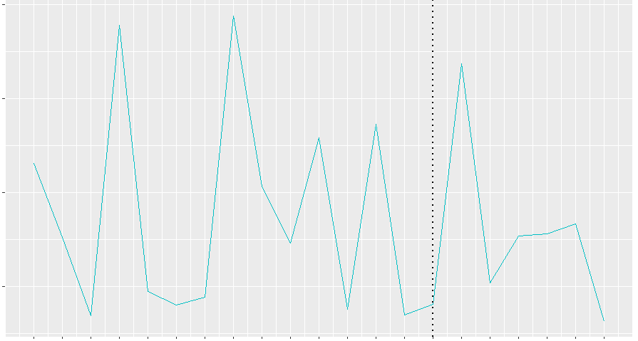
Results: Streamflow Gauges
400
300
Cubic Feet per Second
Cubic Feet per Second
0
0
98
99
00
01
02
03
04
05
06
07
08
09
10
11
12
13
14
15
16
17
98
99
00
01
02
03
04
05
06
07
08
09
10
11
12
13
14
15
16
17
18
160
Upstream
Downstream (Both)
Cubic Feet per Second
Downstream - Whitewater-Baldy
Whitewater-Baldy Fire Year
Q = P - E
0
98
99
00
01
02
03
04
05
06
07
08
09
10
11
12
13
14
15
16
17
18
Notes:
During our literature review for this project, we were able to confirm with at least two published studies that there is an impact on stream and river flow from wildfire (Hallema et al, 2018; Wine & Cadol, 2016). We are planning to quantify that correlation within our study in the future.
The equation at the bottom of the screen is the water budget equation where Q equals streamflow, which is what we have plotted here.
We are displaying the three gauges that had complete data sets for our study period.
In these plots, the vertical, dotted, black line represents the time of the Whitewater-Baldy Fire Complex in 2012. The colored lines show the mean annual streamflow from the gauge data.
These do show an increase in streamflow after the fire event, which is not to say we have confirmed a correlation between the two, but with the addition of precipitation and evapotranspiration (the P and E in the water budget equation), there is potential make more conclusive assessments about the relationships between fire and streamflow.

Slide 18
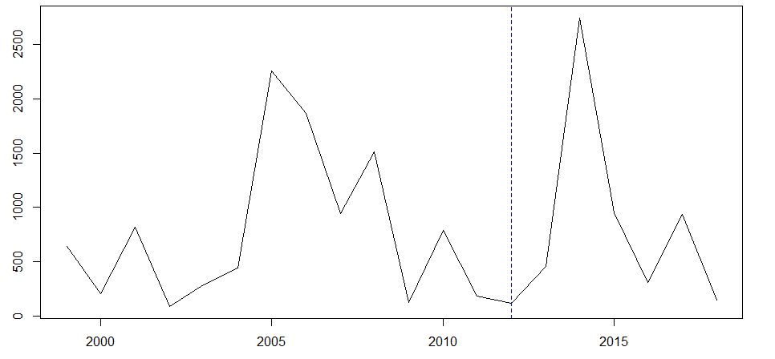
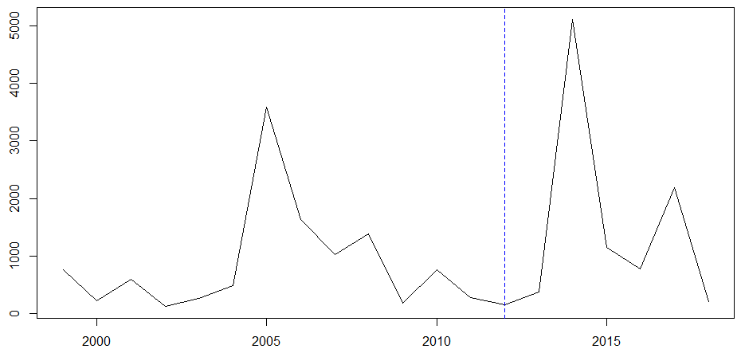
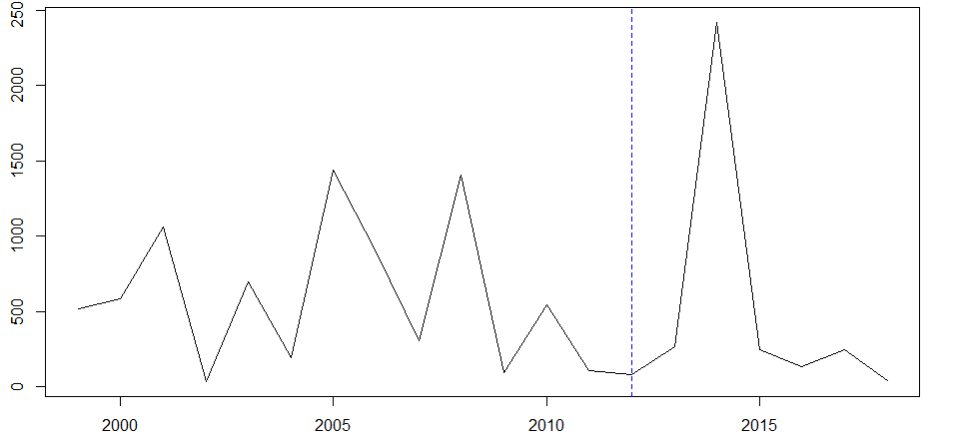
Results: Streamflow Gauges
Gila River near Redrock - Upstream
Gila River near Gila- Downstream (Both)
mm/Day
San Francisco River at Glenwood - Downstream (Whitewater-Baldy)
mm/Day
Q7Max
Whitewater-Baldy Fire Year
Notes:
These plots are Q7 MAX - the average of the highest 7 consecutive days of streamflow per year.
The difference between these results and the previous slide is that Q7Max is showing an increase between 2013 and 2014 where 2014 is more than 10 times the value of 2013. The annual mean shows the opposite, with a decrease between the two years, which tells us that Q7Max may better represent flooding events rather than an average of the entire year, which is more susceptible to things such as precipitation anomalies.
Based on our end user’s interest in flood events and their relationship with fire events, it may be that Q7Max is a preferred metric between the two that we have explored.
Our next steps will be to analyze and plot the variance of the daily streamflow from the annual mean. This will show how far and how often the flow deviates from the average value for each year.
There have been over 100 fires since 1982 so it would be interesting to look at the relationships between older fires and flood events.

Slide 19
Conclusions
NBR and Q7Max are viable metrics for evaluating watershed recovery.
There is an inverse relationship between percent recovery and burn severity within the Whitewater-Baldy fire perimeter; low burn severity areas display a 17% increase in recovery from high burn severity areas.
From 2013 to 2014, there was an increase of more than 10 times the Q7Max at all gauges. Conversely, the annual mean streamflow decreased between the same years, suggesting the need for additional data and metrics.
Notes:
Much of this project was exploratory.
Our focus was on what data and methods are appropriate to study watershed recovery.
You can see quantifiable conclusions here…
We think NBR is a useful metric of recovery within a watershed because the magnitude of change picked up in LT appears to align with managed areas.
We know hydrologic patterns are effected by burn events. We are still exploring how to operationalize streamflow as a metric for recovery.

Slide 20
Possible Future Work
Validating results using high-res imagery or local knowledge
Modeling hydrology using WLDAS, assembled USGS Stream Gauge information, and Earth observations tool for assessing recovery
Running logistic regressions with the assembled data to determine the statistical significance of physical features to recovery
Notes:
Going forward, validation will be important. We have acquired high resolution imagery for 2018 and 2019 during peak growing and fire seasons. This information can be used as a means of validation for future modeling.
In future, it would be interesting to use NASA’s hydrological model optimized for the western United States, WLDAS.
In future terms, the Fishnet database can model correlations bt dependent variable (recovery) against physical features

Slide 21
Partners
Gila National Forest
Carolyn Koury, Hydrologist
Mike Natharius, Soil Scientist
Nessa Netharius, Soil Scientist/Ecologist
USDA Forest Service, Region 3
Jack Triepke, Regional Ecologist
Bart Matthews, Photogrammetry Program Specialist
Anna Jaramillo, Regional Watershed Improvement Program
Advisors
Dr. John Bolten
Dr. Raha Hakimdavar
Dr. Sebastian Martinuzzi
Dr. Sinan Abood
Dr. Ibrahim Mohammed
Special Thanks
Oregon State University
Notes:
We’d like to thank our great team of partners and advisors.

Slide 22
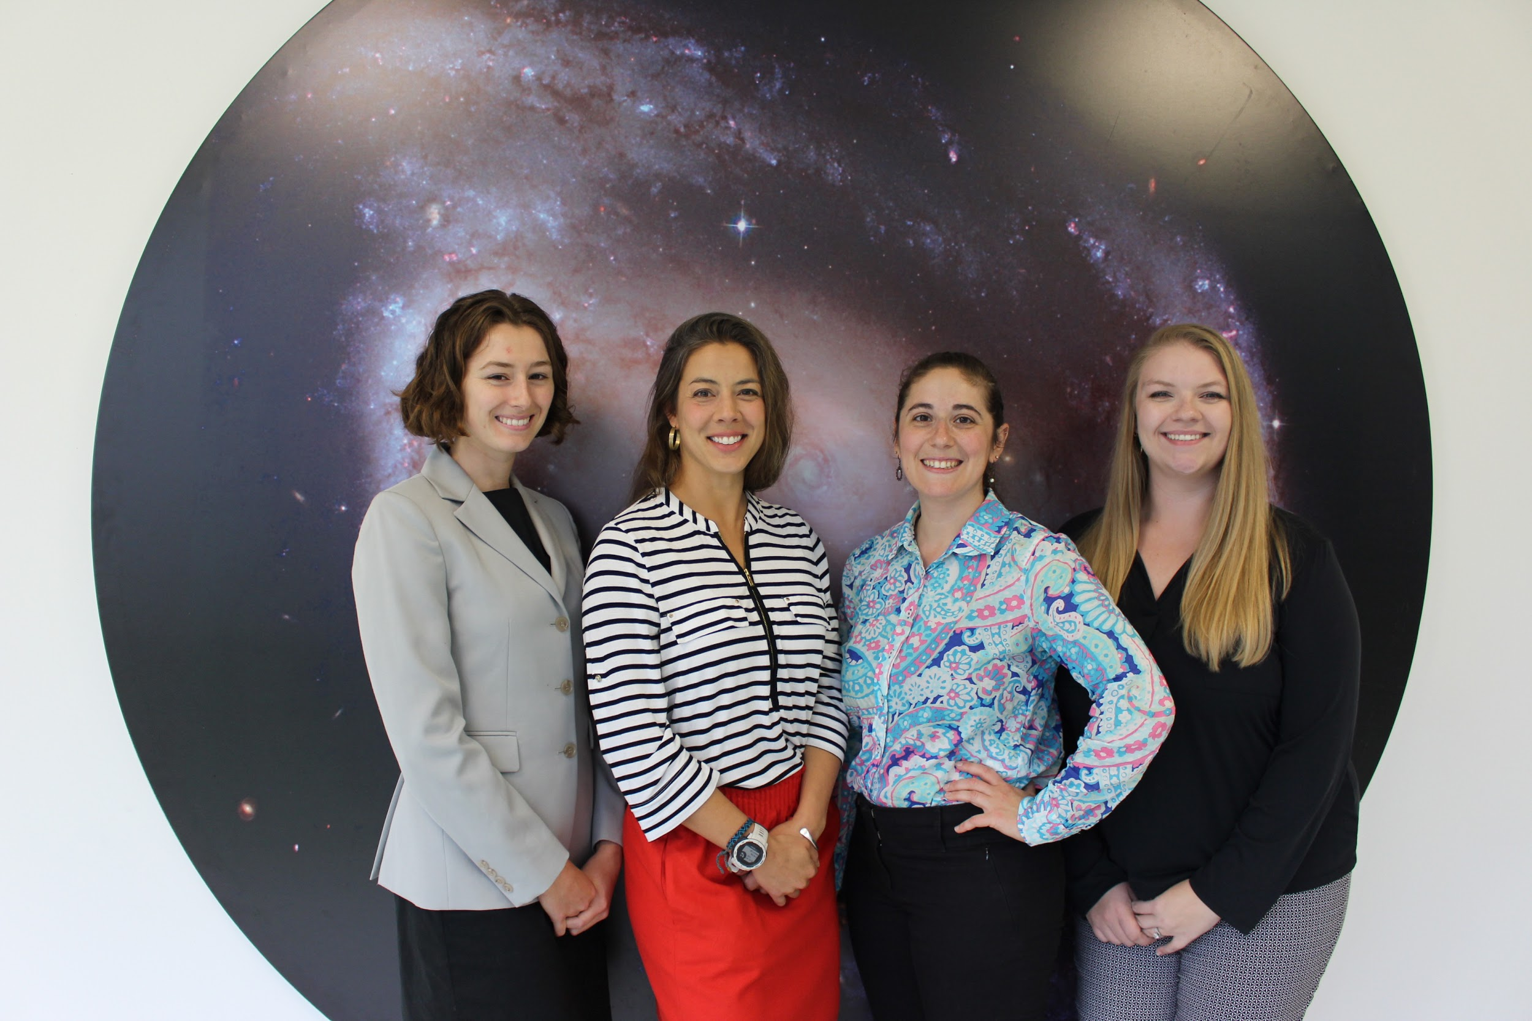
Thank You!
Notes:
Thank you.
//end

