Slide 1
Great Lakes Climate II
Impact of Decreasing Lake Water Levels on Great Lakes Wetlands
Emily Adams (Project Lead)
Idamis Del Valle Martínez
Miriam Harris
Rodney Meyer
Stephen Zimmerman

Slide 2
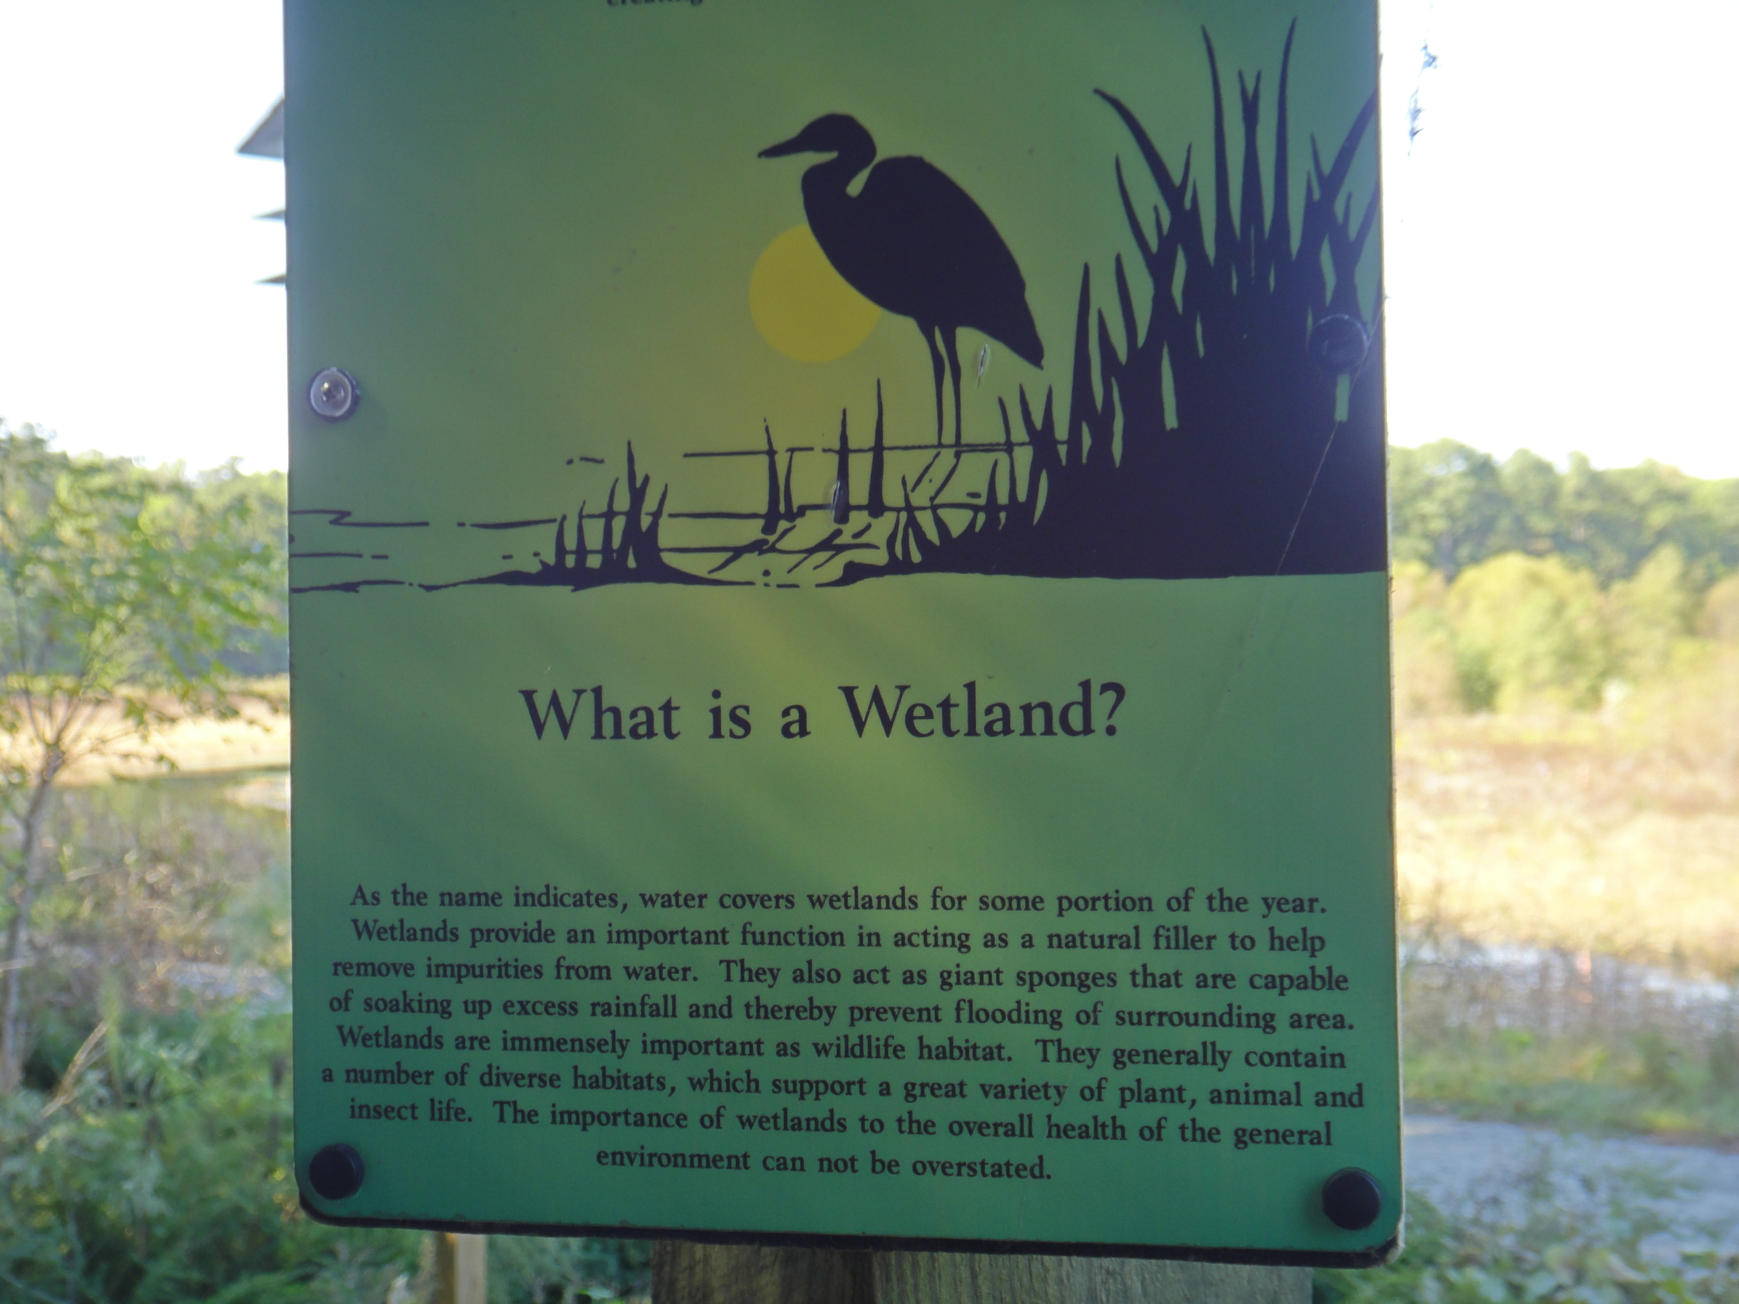
Wetlands
Link between terrestrial and aquatic ecosystems
Wetland extent decreased up to 90%
Ecological and economic benefits:
  Filtration
  Ground water recharge
  Biological diversity
  Tourism
Source: Miriam Harris
Notes:
Wetland extent decreased up to 90% due to human activities

Slide 3
Wetlands
Link between terrestrial and aquatic ecosystems
Wetland extent decreased up to 90%
Ecological and economic benefits:
  Filtration
  Ground water recharge
  Biological diversity
  Tourism
Photo
Notes:
Wetland extent decreased up to 90% due to human activities

Slide 4
Wetlands
Link between terrestrial and aquatic ecosystems
Wetland extent decreased up to 90%
Ecological and economic benefits:
  Filtration
  Ground water recharge
  Biological diversity
  Tourism
Photo
Source: Miriam Harris, Sandy Bottom State Park, Hampton, VA
Notes:
Wetland extent decreased up to 90% due to human activities

Slide 5
Wetlands
Link between terrestrial and aquatic ecosystems
Wetland extent decreased up to 90%
Ecological and economic benefits:
  Filtration
  Ground water recharge
  Biological diversity
  Tourism
Photo
Photo by Miriam Harris, Sandy Bottom State Park, Hampton, VA
Notes:
Wetland extent decreased up to 90% due to human activities

Slide 6
Wetlands
Link between terrestrial and aquatic ecosystems
Wetland extent decreased up to 90%
Ecological and economic benefits:
  Filtration
  Ground water recharge
  Biological diversity
  Tourism
Photo
Photo by Miriam Harris, Sandy Bottom State Park, Hampton, VA
Notes:
Wetland extent decreased up to 90% due to human activities

Slide 7
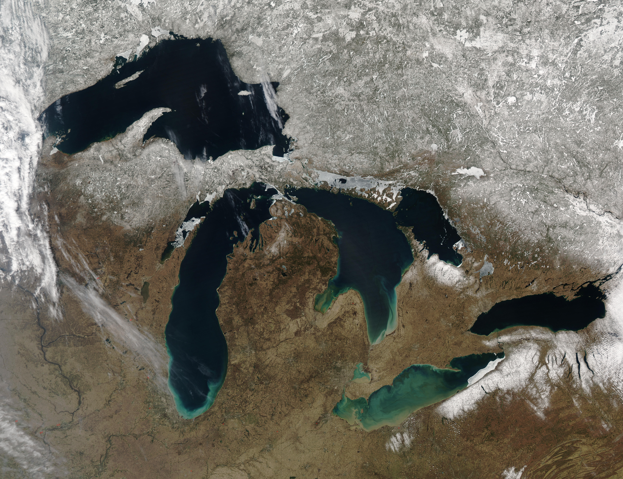
Great Lakes
Largest source of fresh water
Wetlands cover an area of 1700 km²
  Georgian Bay – wetlands are well preserved
  Lake Ontario – wetland extent has decreased
Lake Superior
Georgian Bay
Lake Huron
Lake Michigan
Lake Ontario
Lake Erie
Source: Jeff Schmaltz, MODIS Rapid Response Team, NASA/GSFC

Slide 8
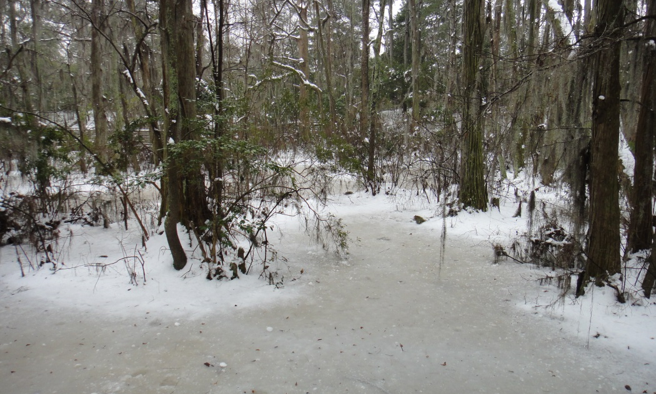
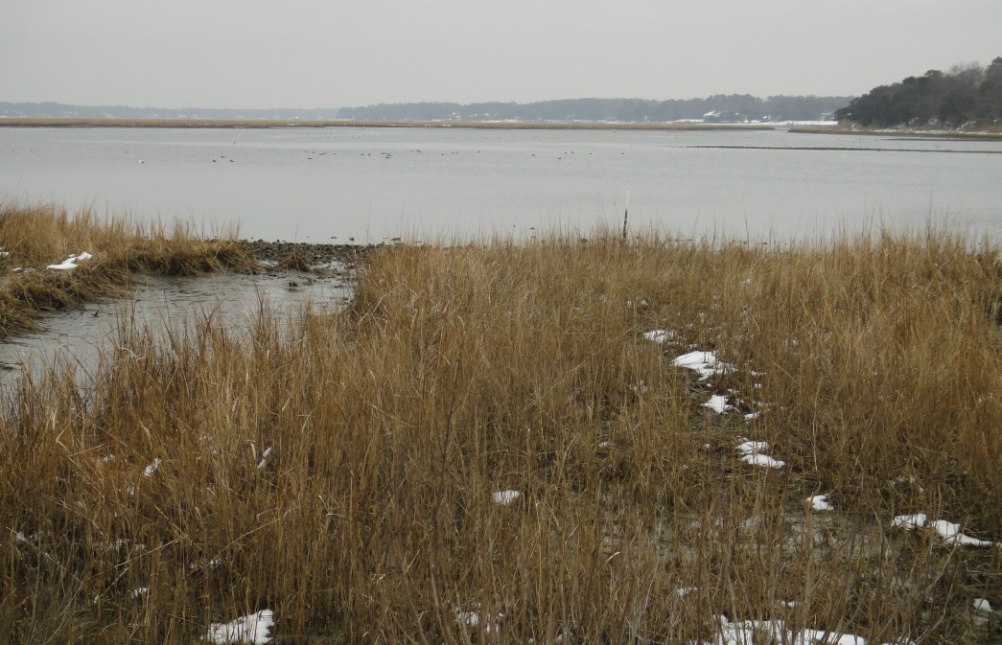
Community Concerns
Decreasing lake levels
Wetland degradation and loss
Climate change may impact wetland’s:
  Hydrologic cycle
  Biological diversity and tourism
Photo by Miriam Harris, Sandy Bottom State Park, Hampton, VA
Source: Miriam Harris
Source: Miriam Harris

Slide 9
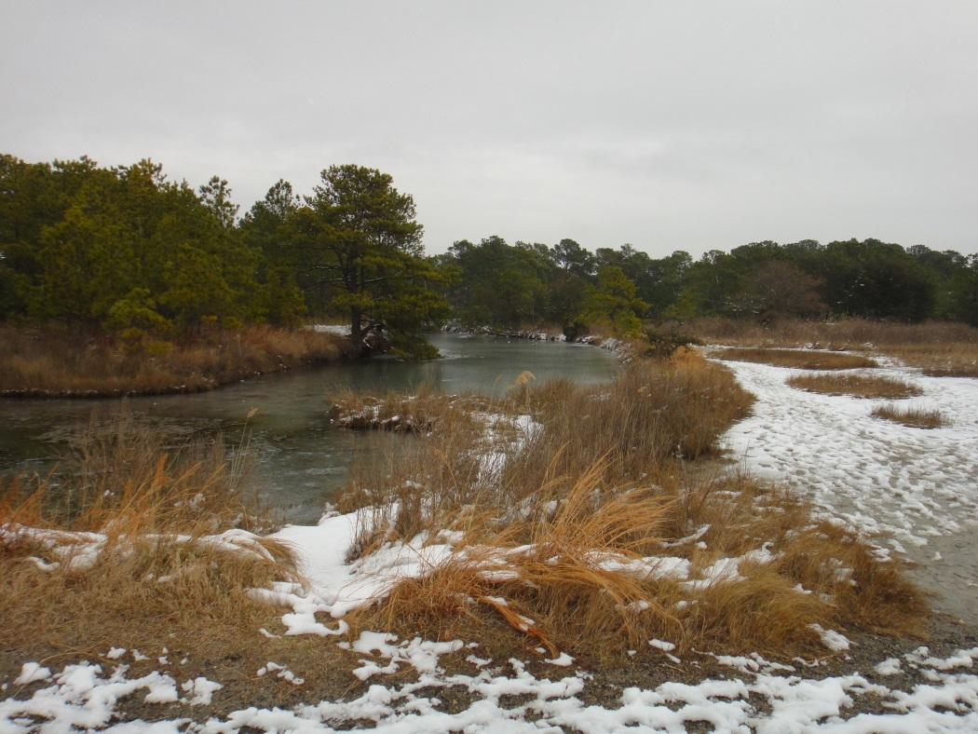
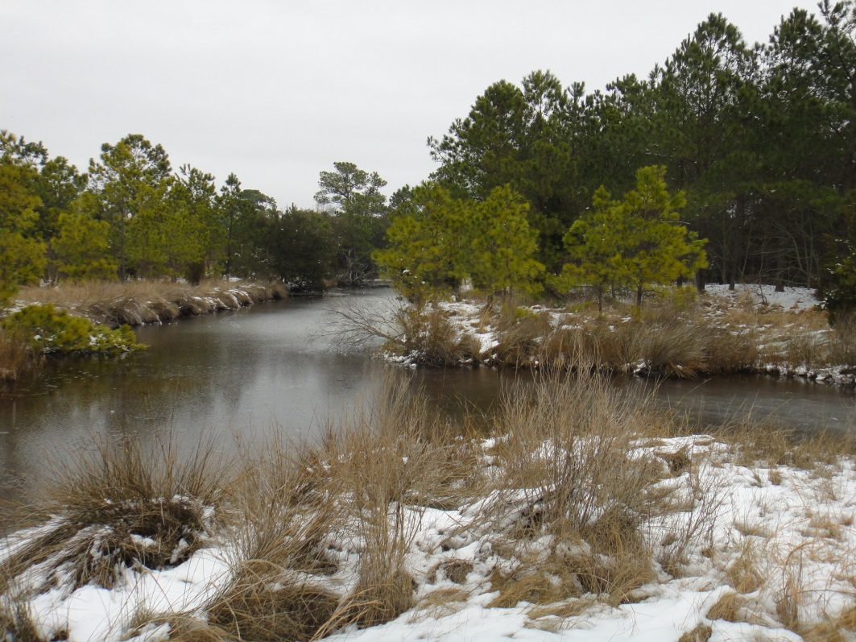
Project Partners
Source: Miriam Harris
David Ullrich
Executive Director
Great Lakes and St. Lawrence Cities Initiative
David Sweetnam
Executive Director
Georgian Bay Forever
Source: Miriam Harris
Mike Robertson
Imagery Project Manager
Ontario Ministry of Natural Resources

Slide 10
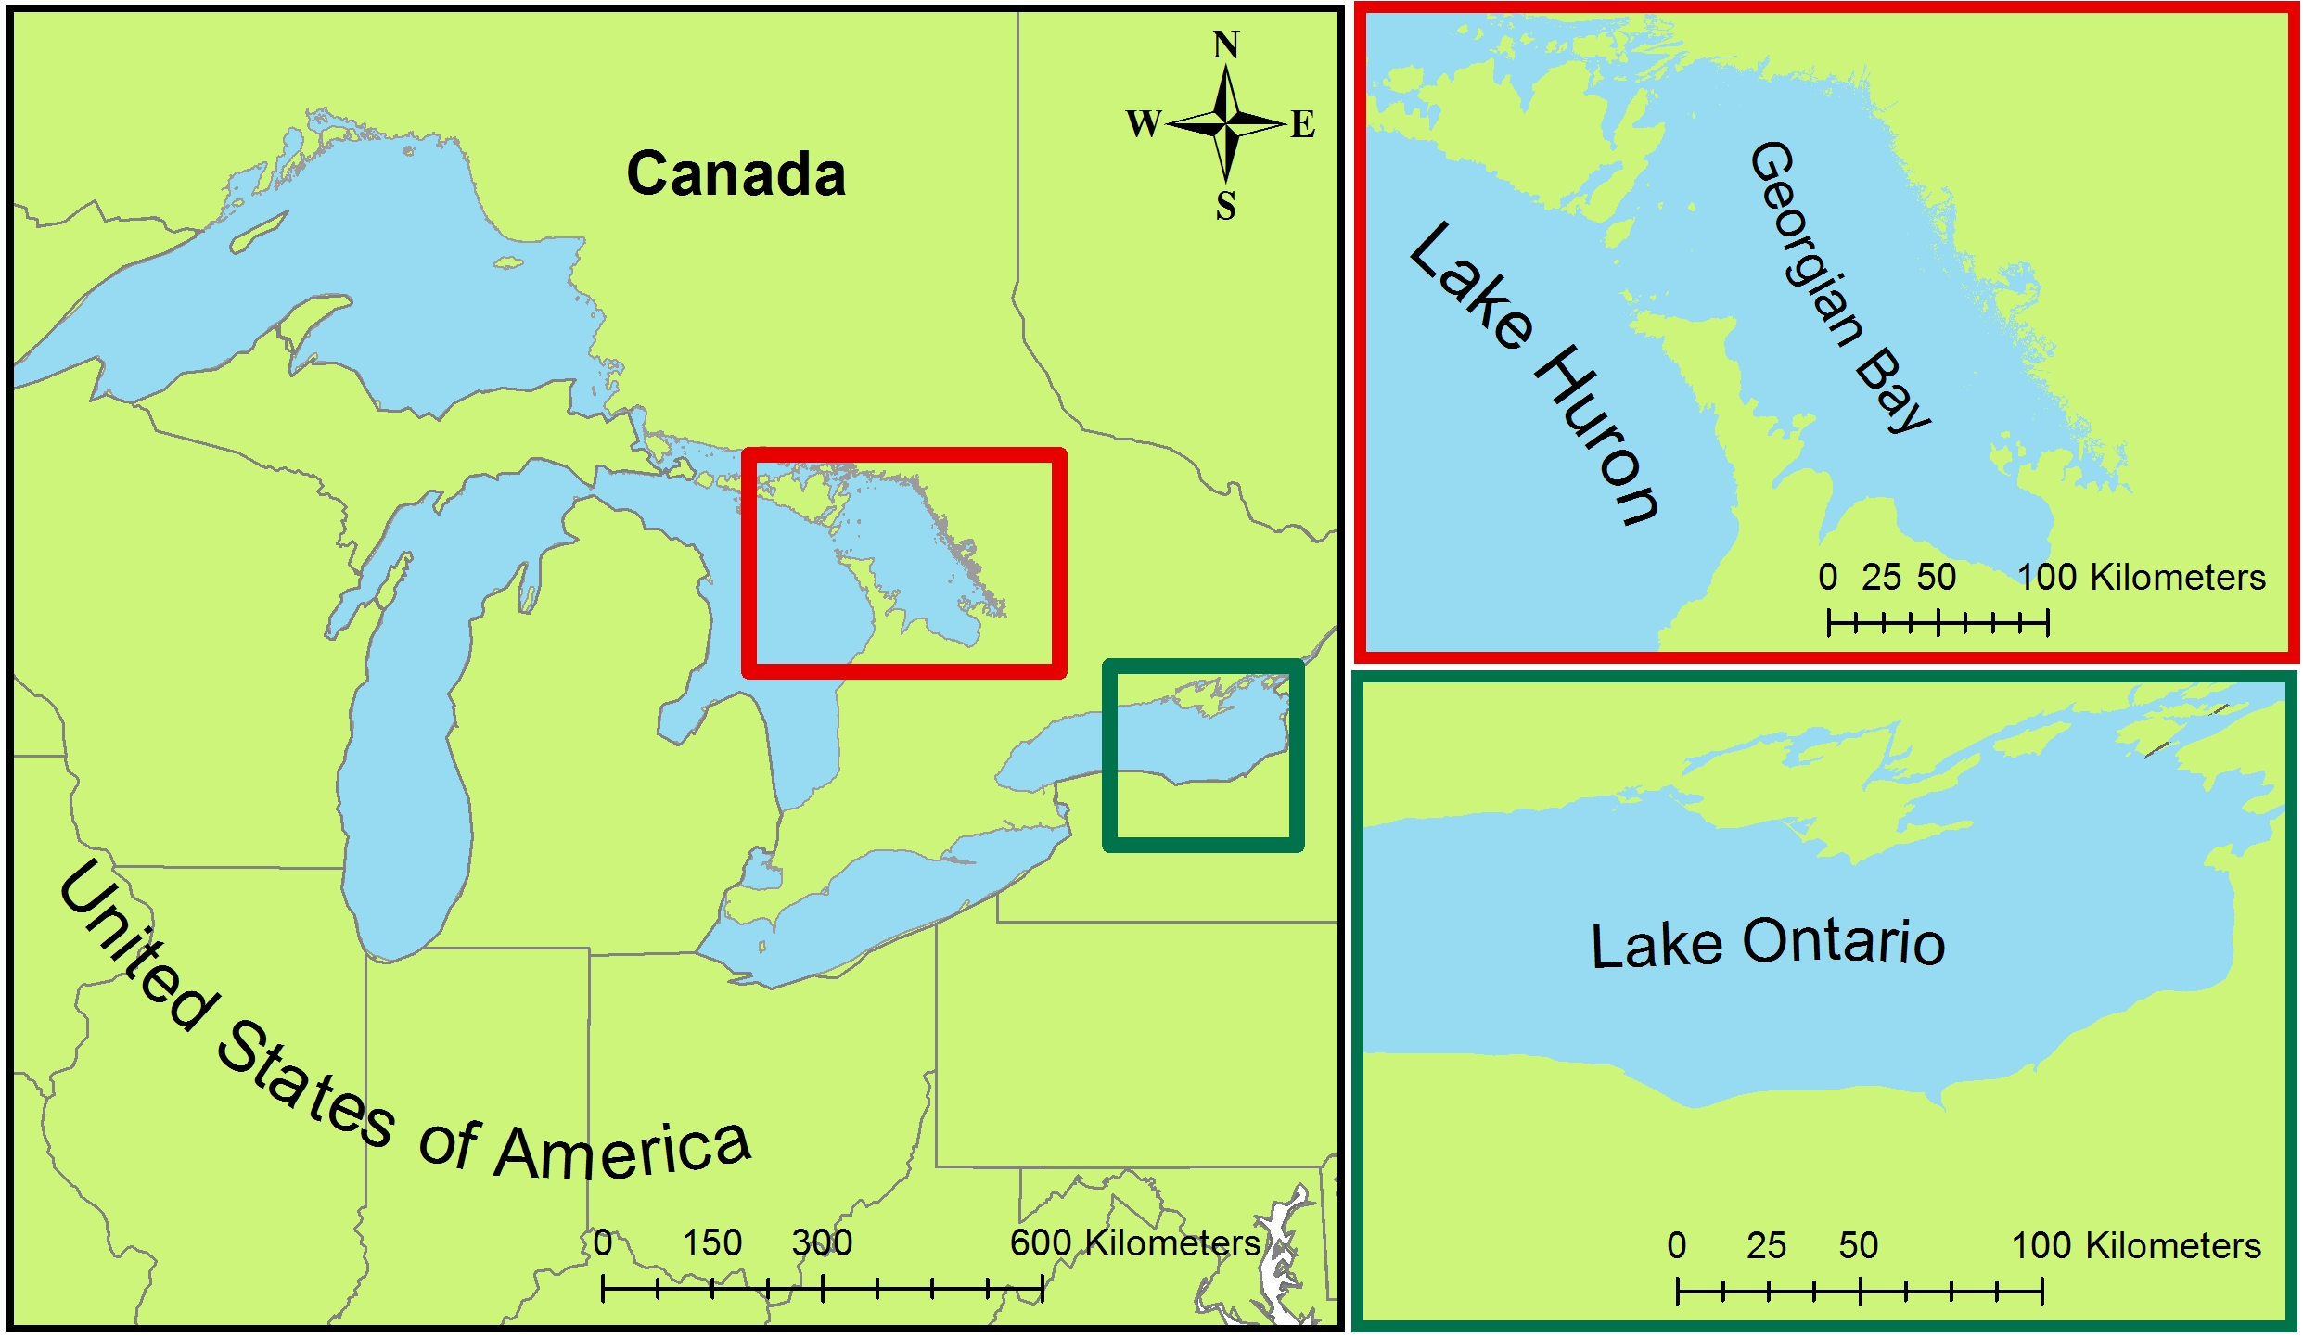
Study Area & Study Period
Georgian Bay (1987 -2013)
Southern Lake Ontario (2006 -2014)

Slide 11
Objectives
Land cover classification maps
Wetlands extent change maps
Time series of wetland health and extent

Slide 12
Methodology
Data Acquisition
Data Processing
Data Analysis
Georgian Bay
Landsat 5 (July 1987)
Landsat 8 (June 2013)
ASTER DEM
Top of Atmosphere Corrected
Training Site Selection
Lake Ontario
Landsat 5 (August 2007)
Landsat 8(June 2014)
ASTER DEM
Mosaicked Landsat Scenes
Random Forest Land Cover Classification Script (R)
Water Levels
TOPEX/Jason-1
OSTM/Jason-2
In situ water level gauges
Study area defined by 10 km buffer around shoreline
Validation and Accuracy Assessment

Slide 13
Methodology
Data Acquisition
Data Processing
Data Analysis
Georgian Bay
Landsat 5 (July 1987)
Landsat 8 (June 2013)
ASTER DEM
Top of Atmosphere Corrected
Training Site Selection
Lake Ontario
Landsat 5 (August 2007)
Landsat 8(June 2014)
ASTER DEM
Mosaicked Landsat Scenes
Random Forest Land Cover Classification Script (R)
Water Levels
TOPEX/Jason-1
OSTM/Jason-2
In situ water level gauges
Study area defined by 10 km buffer around shoreline
Validation and Accuracy Assessment

Slide 14
Methodology
Data Acquisition
Data Processing
Data Analysis
Georgian Bay
Landsat 5 (July 1987)
Landsat 8 (June 2013)
ASTER DEM
Top of Atmosphere Corrected
Training Site Selection
Lake Ontario
Landsat 5 (August 2007)
Landsat 8(June 2014)
ASTER DEM
Mosaicked Landsat Scenes
Random Forest Land Cover Classification Script (R)
Water Levels
TOPEX/Jason-1
OSTM/Jason-2
In situ water level gauges
Study area defined by 10 km buffer around shoreline
Validation and Accuracy Assessment

Slide 15
Water Levels in the Great Lakes
Fluctuations due to climate variability
  Vegetation adapts to these changes
Water Levels in Parry Sound, Georgian Bay, Ontario, CA

Slide 16
Water Levels in the Great Lakes
Fluctuations less variable in Lake Ontario
  Water levels regulated
Water Levels in Lake Ontario (US/Canada)

Slide 17
Results: Classified Maps Georgian Bay
TBD

Slide 18
Results: Wetlands Extent Change Maps
Georgian Bay

Slide 19
Results: Accuracy Assessment
Georgian Bay

Slide 20
Results: Classified Maps Southern Lake Ontario
TBD

Slide 21
Results: Wetlands Extent Change Maps
Southern Lake Ontario

Slide 22
Results: Accuracy Assessment
Southern Lake Ontario

Slide 23
Conclusions
TBD

Slide 24
Conclusions
TBD

Slide 25
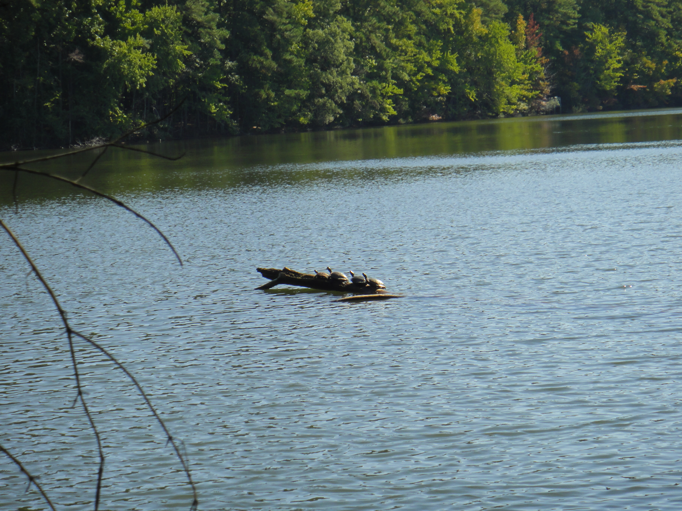
Benefits of Research
More cost effective methodology for land classification maps
Facilitate comparison of wetlands extent over time
Insights on impact of climate change to wetlands health
Source: Miriam Harris

Slide 26
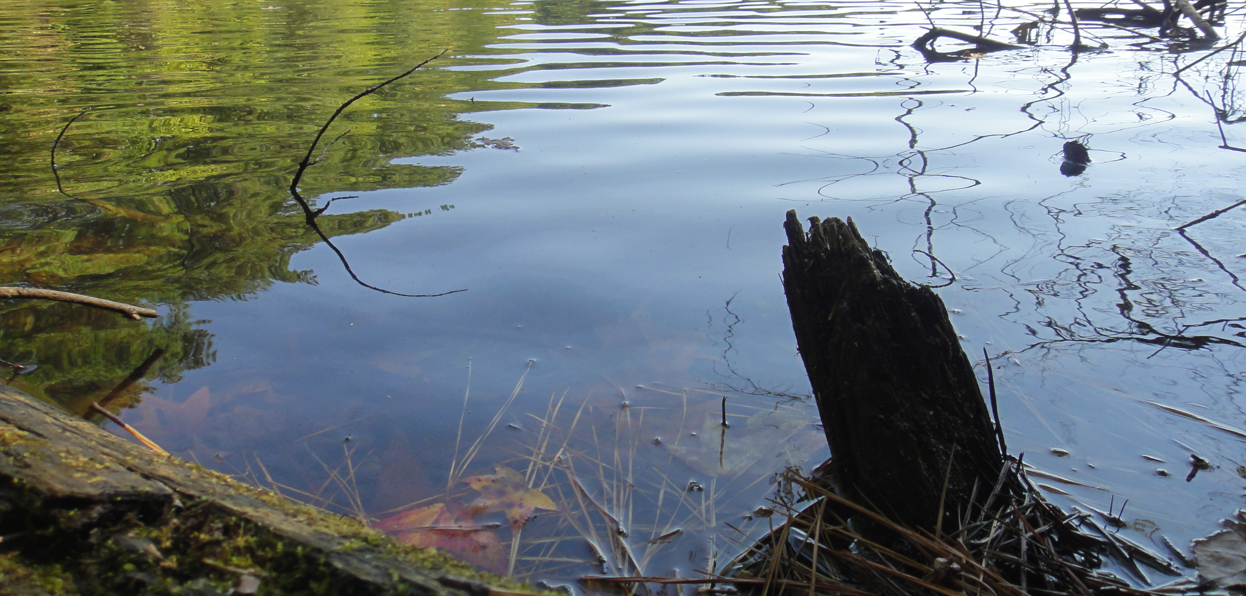
Future Work
Expand geographic scope
Create educational aids based on study results
Source: Miriam Harris

Slide 27
Acknowledgements
David Sweetnam
Georgian Bay Forever
David Ullrich
Great Lakes and St. Lawrence Cities Initiative
Mike Robertson
Ontario Ministry of Natural Resources
Dr. Kenton Ross
NASA DEVELOP National Program- Science Advisor
James Favors
NASA DEVELOP National Program- International Lead
Nathan Owen
NASA DEVELOP - Langley Center Lead
Chad Smith
NASA DEVELOP – Langley Assistant Center Lead

Slide 28
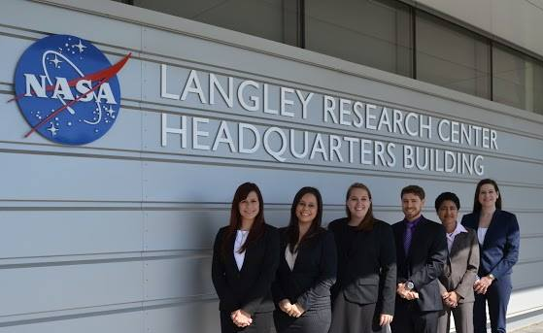
Acknowledgements
Previous Contributors
Fall 2014 Great Lakes Climate I
Janice M. Maldonado Jaime
Emily Adams
Lydia Cuker
Kathy Currie
Miriam Harris
Daniel Marx
This material is based upon work supported by NASA through contract NNL11AA00B and cooperative agreement NNX14AB60A.

Slide 29
References
Assel, R. A., F. H. Quinn, and C. E. Sellinger (2004), Hydroclimatic factors of the recent record drop in Laurentian Great Lakes water levels. Bull. Amer. Meteor. Soc., 85, 1143-1151.
Breiman, L. (2001), Random forests. Mach. Learn., 45, 5-32.
Bardecki, M. J. (1991), Wetlands and climate change: a speculative review. Can. Water Resour. J., 16, 9-22.
Canada Department of Fisheries and Oceans (2014), Historical monthly and yearly mean water level graphs 1918-2013 [Available online at http://waterlevels.gc.ca/C&A/netgraphs-eng.html].
Chow-Fraser, P. (1998), A conceptual ecological model to aid restoration of Cootes Paradise Marsh, a degraded coastal wetland of Lake Ontario, Canada. Wetl. Ecol. Manag. , 6, 43-57.
Chow-Fraser, P., V. Lougheed, V. Le Thiec, B. Crosbie, L. Simser, and J. Lord (1998). Long-term response of the biotic community to fluctuating water levels and changes in water quality in Cootes Paradise Marsh, a degraded coastal wetland of Lake Ontario. Wetl. Ecol. Manag., 6, 19-42.
Cvetkovic, M., and P. Chow-Fraser (2011), Use of ecological indicators to assess the quality of Great Lakes coastal wetlands. Ecol. Indic., 11, 1609-1622.
Herdendorf, C.E. (2004), Morphometric factors in the formation of Great Lakes coastal wetlands. Aquat. Ecosyst. Health & Manage., 7, 179-197.
Keddy PA, and AA. Reznicek (1986), Great lakes vegetation dynamics: the role of fluctuating water levels and buried seeds. J. Gt. Lakes Res.,12, 25-36.
Li J., and W. Chen (2005), A rule-based method for mapping Canada’s wetlands using optical, radar and DEM data. Int. J. Remote. Sens. 26, 5051-5069.
Mcleod, E., G.L. Chmura, S. Bouillon, R. Salm, M. Bjork, C.M. Duarte, C.E. Lovelock, W.H. Schlesinger, and B.R. Silliman (2011), A blueprint for blue carbon: toward an improved understanding of the role of vegetated coastal habitats in sequestering CO2. Front. Ecol. Environ., 9, 552-560.
Midwood, J., D. Rokitnicki-Wojcik, and P. Chow-Fraser (2012), Development of an inventory of coastal wetlands for eastern Georgian Bay, Lake Huron. ISRN Ecology 2012, 1-13.
Mortsch, L.D. (1998), Assessing the impact of climate change on The Great lakes shoreline wetlands. Climatic Change, 40, 391-416.
——, and F.H. Quinn (1996), Climate change scenarios for Great Lakes Basin ecosystem studies. Limnol. Oceanogr., 41, 903-911.
——, H. Hengeveld, M. Lister, L. Wenger, B. Lofgren, F. Quinn, and M. Slivitzky (2000), Climate change impacts on the hydrology of the Great Lakes-St. Lawrence system. Can. Water Resour. J., 25, 153-179.
Sellinger, C.E., C.A. Stow, E.C Lamon, and S.S. Qian (2008), Recent water level declines in the Lake Michigan-Huron System. Environ. Sci. Technol., 42, 367-373.
Whillans, T. (1982), Changes in marsh area along the Canadian shore of Lake Ontario. J. Gt. Lakes Res., 8, 570-577.
Whillans, T. (1996), Historic and comparative perspectives on rehabilitation of marshes as habitat for fish in the lower Great Lakes basin. Can. J. Fish. Aquat. Sci., 53, 58-66.
Wilcox, D. A. and Y. Xie, (2007), Predicting wetland plant community responses to proposed water-level-regulation plans for Lake Ontario: GIS-based modeling. J. Gt. Lakes Res., 33, 751-773.

