Slide 1
WASHINGTON
Health & Air Quality
Quantifying Air Quality Parameters and Air Pollution Sources Impacting the Health of Puget Sound Residents Through the Use of NASA and ESA Remote Sensing Data
Amiya Kalra, Rachel Earwood, Ray Deininger, & Richard Murray
Alabama – Marshall
Notes:
Speaking: Ray
Hello! We are the Washington Health and Air Quality team.
[individual introductions]

Slide 2
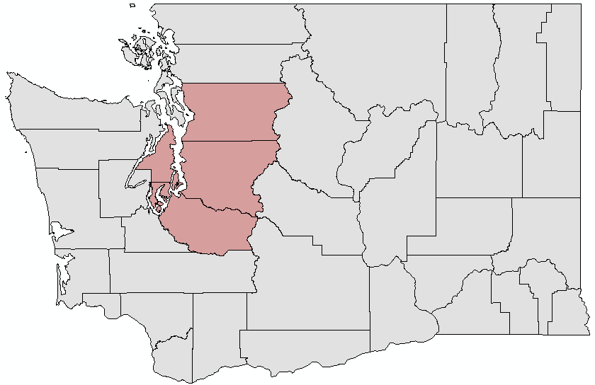
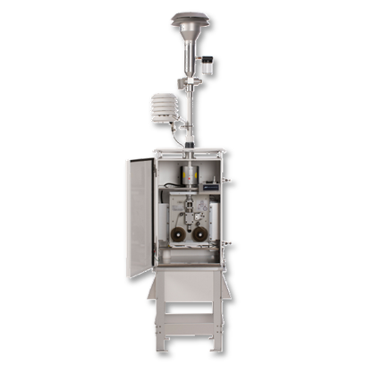
STUDY AREA & PARTNTER
Puget Sound
Snohomish
Puget Sound Clean Air Agency
Seattle
●
Kitsap
King
Pacific
Ocean
Pierce
N
0 100 200 400 Miles
Image Credit: PSCAA
Notes:
Speaking: Ray
Our study area is the Pacific Northwest, focusing on the Puget Sound, as shown in these maps.
Our partner is the Puget Sound Clean Air Agency, or PSCAA, which is a regional governmental agency covering four counties around Puget Sound (Strategic Plan 2014-2020 Clean Healthy Air for Everyone, Everywhere, All the Time, n.d.). They’ve been working since 1967 to monitor air pollution, enforce air quality standards, and educate people about the air quality in their neighborhoods.
Their primary goals for the last few years, is to improve air quality thereby decreasing health risks from exposure and economic disparities.
------------Image Information Below------------
Map of Washington State:
Image Credit: Produced In ArcGIS Esri
Base Map: Light Gray Canvas
North Arrow: available through CC0 1.0 Universal (CC0 1.0 (https://publicdomainvectors.org/en/free-clipart/North-arrow/58771.html)
Puget Sound Ground Sensor:
Image Credit: PSCAA WildfiresmokePP Slide 30
Image Source: https://linkprotect.cudasvc.com/url?a=http%3a%2f%2fdl.pscleanair.org%2fwildfiresmoke.pptx&c=E,1,f-YiHv_8SG5hebv5xxOyGCbtx7MEhxGhlPRES-UHoWXC_shj_D3d5zmlcI_2ov16oWHNn9Tq6-xit0SvOBGetm0HjP-m3hUj1hOMjAi-QEh3J69i65gI&typo=1

Slide 3
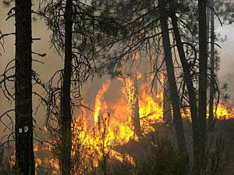
COMMUNITY CONCERNS
Air Pollution-related Health Risks
Cardiovascular disease
Severe respiratory inflammation
Worsened asthma attacks
Increased mortality rates
PM_{2.5}
< 2.5μm in diameter
PM₁₀
< 10μm in
diameter
Fine Beach Sand
90μm average diameter
Human Hair
~ 70μm average diameter
Image Credit: Washington State Department of Ecology
Image Credit: pxhere
Image Credit: Washington DNR
Notes:
Speaking: Ray
Our partners have expressed concern over air quality in Puget Sound – they say that over 1,100 people die each year from air pollution-related illnesses in the Puget Sound region (Air Pollution & Your Health: Puget Sound Clean Air Agency, n.d.). The pollutants they’re most concerned with are aerosols, nitrogen dioxide, and carbon monoxide, which mostly originate in wildfire smoke and diesel exhaust from cargo ships in the Sound.
The PSCAA has raised concerns about the health effects of air pollution, which can include cardiovascular disease, severe respiratory inflammation, worsened asthma attacks, and increased mortality rates. Some populations are at a higher risk for various reasons – including children, elderly people, pregnant women, and people with pre-existing respiratory conditions. The PSCAA has also noted a pattern of disproportionate health effects on low-income communities (PSCAA, 2014).
------------Image Information Below------------
Infographic:
Image Credit: Washington State Department of Ecology
Image Source: https://fortress.wa.gov/ecy/publications/publications/91br023.pdf; Image Copyrighted by the Washington State Department of Ecology
Link to Copyright Information: https://ecology.wa.gov/About-us/Accountability-transparency/Our-website/Copyright-information
Fire image:
Image Credit: Washington DNR, Flickr
Image Source: https://www.flickr.com/photos/wastatednr/6264472650 (available under CC BY-NC-ND 2.0)
Boat image:
Image Credit: pxhere
Image Source: https://pxhere.com/en/photo/1229244 (available under CC0 public domain)

Slide 4
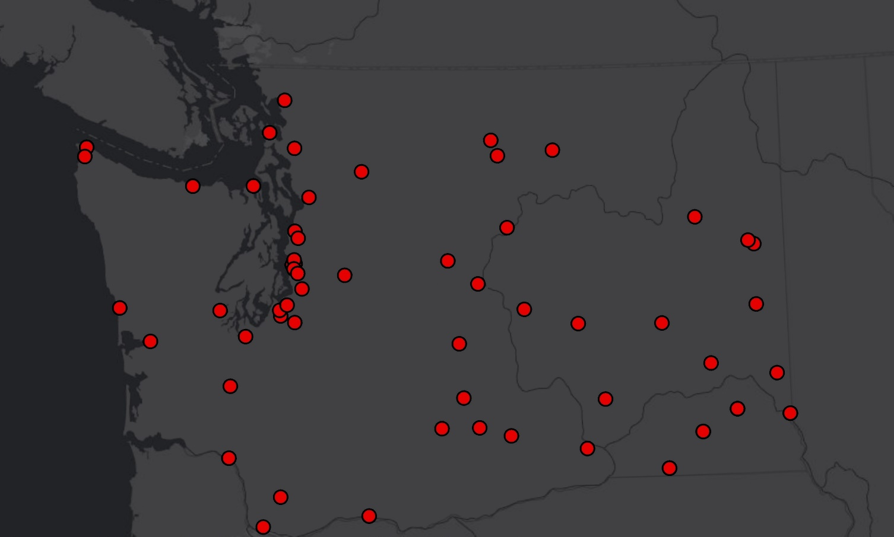
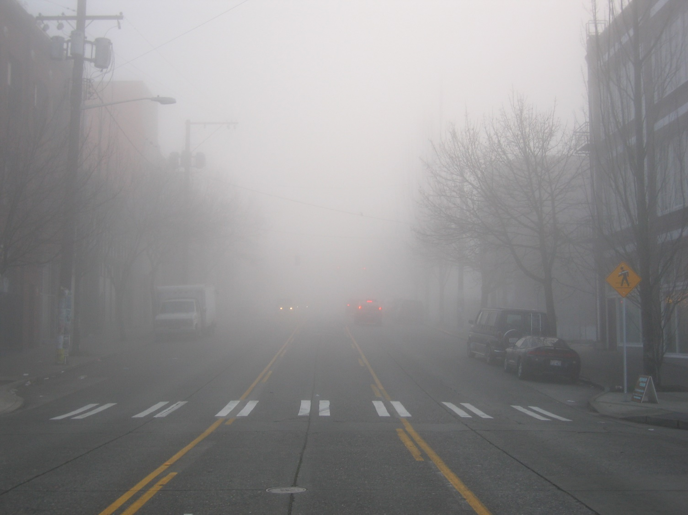
OBJECTIVES
Identify sources and dispersion patterns of air pollutants
PM_{2.5}, NO_{x}, CO, O₃, SO_{x}
Estimate Aerosol Optical Depth (AOD) to PM_{2.5} relationship
Validate with in situ data
Sensors
N
N
0 75 150 300 Kilometers
Image Credit: Tom Harpel
Notes:
Speaking: Ray
Our project objectives are:
Identify sources and dispersion patterns of air pollutants increasing health risks to vulnerable communities by creating a web-based tool identifying current trends in spatial distribution of air pollutants
Estimate a relationship between AOD and PM2.5 using a two-variable, linear regression approach
Validate the data produced by the web-based tool using in situ data provided by the PSCAA’s ground sensors
------------Image Information Below------------
Fog image:
Image Credit: Tom Harpel, Wikimedia Commons, originally Flickr
Image Source: https://commons.wikimedia.org/wiki/File:Dense_Seattle_Fog.jpg (available under CC BY 2.0)

Slide 5
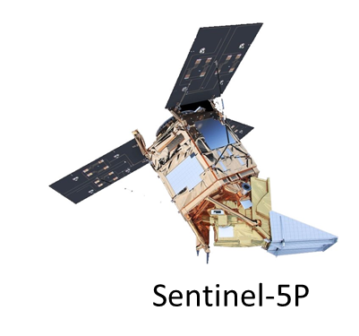
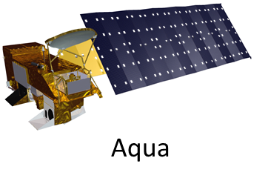
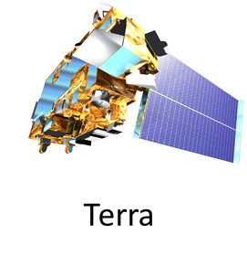
SATELLITES & SENSORS
Aqua
(MODIS)
Sentinel-5P (TROPOMI)
(MAIAC)
Terra (MODIS)
(MAIAC)
Sentinel Image Credit: ESA/ATG medialab
Image Credit: NASA
Notes:
Speaking: Richard
We used data from three separate satellites for this project. We used the Moderate Resolution Imaging Spectroradiometer (MODIS) sensor on both Aqua and Terra. There’s an algorithm called the Multi-Angle Implementation of Atmospheric Correction (MAIAC) – there are datasets available on GEE that used MAIAC on MODIS data to show aerosols with finer spatial resolution than is otherwise available from MODIS (Google Earth Engine, MCD19A2.006). We relied primarily on MAIAC for our project, and we supplemented that with Sentinel-5P data, which is also available on GEE. Sentinel provided data on other pollutants, including nitrogen dioxide and carbon monoxide (Google Earth Engine, Sentinel-5P OFFL NO2).
-----------Image Information Below------------
Aqua and Terra:
Image Credit: NASA DEVELOP
Image Source: http://www.devpedia.developexchange.com/dp/index.php?title=List_of_Satellite_Pictures
Sentinel:
Image Credit: ESA
Image Source: http://www.esa.int/ESA_Multimedia/Search/(sortBy)/view_count?result_type=images&SearchText=Sentinel+5p

Slide 6
METHODOLOGY
Data Acquisition
Data Processing
End Products
Sentinel-5P
TROPOMI
Google Earth Engine
AirPIT
Aqua/Terra MODIS
Statistical Approach
Two Variable
ArcGIS Story Map
MAIAC
ALGO
AirData
Validation Map
Notes:
Speaking: Richard
We used the MAIAC algorithm to access our data on aerosols. MAIAC data (processed from Terra and Aqua MODIS as a gridded Level 3 product) is available on Google Earth Engine. It provided us with daily AOD data at 1 km resolution, which we then used to estimate concentrations of particulate matter (PM2.5) using linear regression (Google Earth Engine, MCD19A2.006).
We accessed data on nitrogen oxides, sulfur dioxide, ozone, and carbon monoxide from Sentinel-5P through the Tropospheric Monitoring Instrument, or TROPOMI. Google Earth Engine provides concentration data in the form of atmospheric column density at a resolution of 0.01 arc degree for each of those pollutants (Google Earth Engine, Sentinel-5P OFFL NO2).
Our primary goal for this project was to create a tool in Google Earth Engine showing recent/current concentrations of air pollutants over the Pacific Northwest for the PSCAA to use when prescribing policy and educating the public. In GEE, we were able to calculate our PM2.5 estimates from MAIAC and incorporate the concentration data from Sentinel to create imagery showing those concentrations.
------------Image Information Below------------
Infographic:
Image Credit: Washington State Department of Ecology
Image Source: https://fortress.wa.gov/ecy/publications/publications/91br023.pdf (Image Copyrighted by the Washington State Department of Ecology)
Link to Copyright Information: https://ecology.wa.gov/About-us/Accountability-transparency/Our-website/Copyright-information

Slide 7
Converting AOD into PM2.5 Estimation
Two Variable Method
Model Surface Concentrations
_{Multivariable Method}
Artificial Intelligence
$$Y=mX+b$$
Notes:
Speaking: Richard
AOD does not measure concentrations of PM2.5, but there are multiple statistical approaches to use it to estimate those calculations, as you can see here (N.a., 2016). We chose to use the two-variable (*click*) statistical approach (Schaap, et al. 2009) (highlight relevant equation), using methodology shared by NASA ARSET (2016) and beginning with data from EPA on-the-ground air sensors. In this equation, Y is the AOD and X is the measured PM2.5 value.
In order to do that, we performed a linear regression between PM2.5 concentration data from a number of ground sensors and the AOD data from the same latitude and longitude point as those sensors. We then used the equation of the line from that regression to predict PM2.5 values for every MAIAC pixel.
The relationship between AOD and PM2.5 varies depending on the time of year and the region, so to make our PM2.5 concentration estimates as accurate as possible, we performed separate regressions for each month between June and September and for different regions of Washington State.
-----------Image Information Below------------
Artificial Intelligence: NASA ARSET Theoretical Basis for Converting Satellite Observations to Ground-Level PM2.5 Concentrations PowerPoint
Image Source: https://arset.gsfc.nasa.gov/sites/default/files/airquality/workshops/BAQ16/P8.pdf

Slide 8
RESULTS: Particulate Matter 2.5
R² = 0.1512
140
120
100
80
PM_{2.5} Concentration Derived from AOD
60
40
20
0
0
20
40
60
80
100
120
140
160
180
PM_{2.5} Concentration from EPA Sensors
Notes:
Speaking: Amiya
This is an example of what our validations looked like. For this example, we looked at particulate matter on August 14, 2018, which was recorded as having especially bad air quality around the Puget Sound due to an atmospheric inversion, which trapped pollutants closer to the surface. The scatterplot shows more of a cloud of points than points focused around a line. The r-squared value is only 0.15, which is very low, and indicates that the predicted PM2.5 values don't come near the actual measured PM2.5 values.

Slide 9
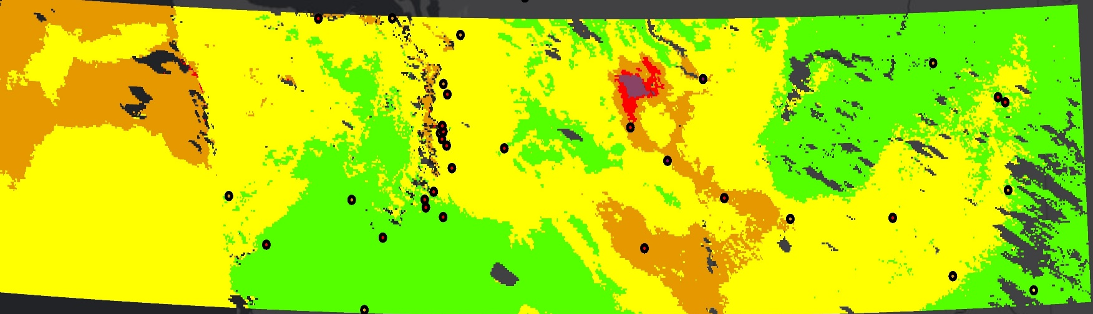
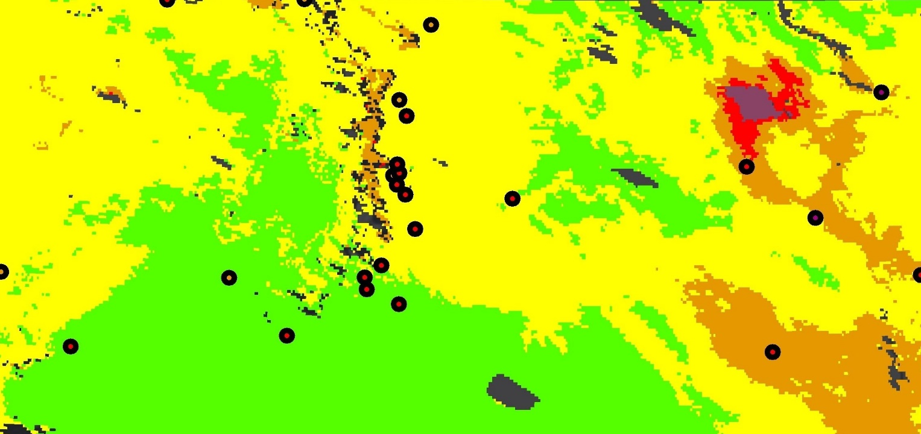
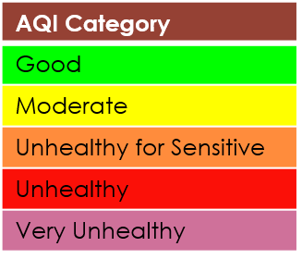
RESULTS: Particulate Matter 2.5
0 75 150 300 Miles
Sensors:
0 75 150 300 Miles
Sensors:
Notes:
Speaking: Amiya
The map here shows both sensor and satellite measurements of particulate matter concentrations. The points represent the ground sensors and are colored according to the concentrations they recorded, following the EPA Air Quality Index colors. Green points recorded lower particulate matter concentrations, while red points recorded higher concentrations. The color outside the sensor points shows the PM2.5 estimates from satellite aerosol optical depth data, and it does not match the sensor readings well. There are many places where the satellite data does not match the nearby sensor data. This kind of discrepancy is why we made sure to validate the data produced by our tool - after finding this error, we could try to find more accurate estimates of particulate matter from aerosol optical depth. These results also indicated that our tool and our methods for estimating particulate matter concentrations are not the best ways to examine particulate matter in this region.

Slide 10
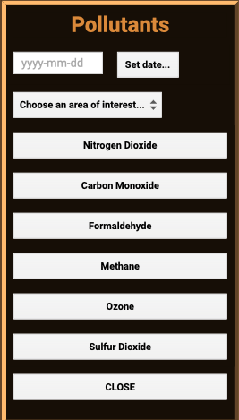
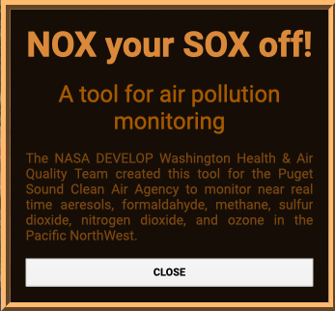
Air Pollutant Identification Tool (AirPIT)
Notes:
Speaking: Amiya
Once we had PM2.5 concentration estimates for our study region, we integrated them into AirPIT, our Google Earth Engine tool. We also included Sentinel-5P concentration data on nitrogen oxides, sulfur dioxide, ozone, formaldehyde, methane, and carbon monoxide. The tool allows users to select a time period, region, and pollutants to visualize, and colors the pollutants in the display according to their concentration and their rating according to the EPA's Air Quality Index.
One important part of our process for making this tool was checking that the satellite data were an accurate representation of the actual on-the-ground conditions. In order to do that, we picked several days with known atmospheric conditions and performed linear regressions to compare ground sensor measurements and satellite measurements for each pollutant. If the r-squared value from each regression was high enough, we considered the tool to be an accurate representation of air quality. As of this time, AirPIT is not completed.
-----------Image Information Below------------
Widget Screenshots:
Image Credit: NASA DEVELOP, Google Earth Engine; map data copyright 2020 by Google
Monitor Outline:
Image Credit: Pixabay
Image Source: https://pixabay.com/vectors/screen-monitor-tv-internet-1065137/ (available under Pixabay license)

Slide 11
LIMITATIONS
Methods
Linear regression accuracy
Location
Data
CALIPSO
Image Credit: Google Earth Engine
Notes:
Speaking: Rachel
Most of our project’s limitations stemmed from time constraints. In terms of our methodology, linear regression accuracy was compromised because of the relatively quick two-variable method that we went with. We also did not have enough time to validate outside of the Puget Sound region.
In terms of data, although we worked toward it, we were ultimately not successful with uploading a dataset from CALIPSO CALIOP (Caliopi) onto Google Earth Engine, which would have displayed vertical stratification imagery. However, the team will instruct our partner how to do this so they can obtain this vertical depth data for a time period of their interest.
*Sentinel-5P SI units
-----------Image Information Below------------
Error message:
Image Credit: Google Earth Engine; copyright 2020 by Google

Slide 12
CONCLUSIONS
MAIAC provides high-quality, high-resolution aerosol optical depth data
Two-variable Method is not the most accurate for the Puget Sound region
Image Credit: Sheila Sund
Notes:
Speaking: Rachel
We feel that there are two main conclusions to our study. First, MAIAC provides high-quality high-resolution aerosol data which is useful for remote sensing air quality studies. Second, the two-variable method is viable for estimating PM2.5 from AOD but not as accurate as the multi-variable or modelling methods, which affects the accuracy and usefulness of remote sensing air quality studies using that method.
-----------Image Information Below------------
Puget Sound Landscape:
Image Credit: Sheila Sund
Image Source: https://www.flickr.com/photos/sheila_sund/28314436166/in/photolist-K93TpU-75BCrB-21sLsM4-5dMMho-paBSX8-ovDTXE-C69csy-LR9f8T-56frkk-WvMPru-5ZMZTB-5ZMUF2-5ZMZDZ-k1rS-LGNUwW-5ZS7uE-2djCSb3-5ZS7rC-3yjLC-2p5qTr-qnn3D-2i1xLWj-eCRQP-YQ5s1J-8BqZEN-75BCNF-7eWfEv-5AsvcN-4Nw7Dk-avaTAV-29m83A-dTx74H-873zxZ-9qetQv-4JBhnf-R1hrJ-5EbVY1-8BBNCm-74x5Sf-BFF7Kb-gVdmLv-8Bozn1-LPBWC1-dhki73-smHguy-5EbWaL-5fZ17P-5aZC3g-9dGLZ5-af8qN7 (CC BY 2.0

Slide 13
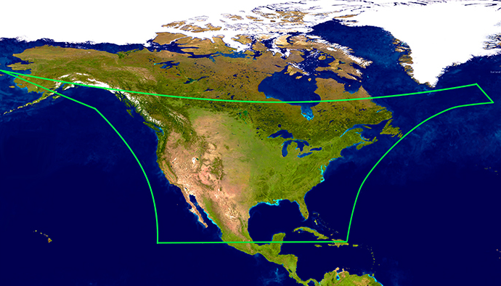
FUTURE WORK
Sensors Set to Launch in 2022
Multi-Angle Imager for Aerosols
will differentiate PM sizes, composition of PM_{2.5}
Tropospheric Emissions: Monitoring Pollution
improved spatial & temporal resolution over North American continent
Projects
OWLETS1
FIREX-AQ
Image Credit: TEMPO 2015
Image Credit: NASA/USGS/SAO
Notes:
Speaking: Rachel
As previously mentioned, using a multi-variable method would have yielded more accurate results in terms of the linear regressions for AOD-PM2.5. Updating the teams’ GEE tool to display the trajectories of air pollutants, rather than their most recently recorded locations and concentrations, would make it possible for the PSCAA to better track the movement of air pollutants during poor air quality events.
Also, on the horizon are the Multi-Angle Imager for Aerosols (MAIA) and Tropospheric Emissions: Monitoring Pollution (TEMPO), both set to launch in 2022. These sensors are expected to advance the ability to sense aerosols remotely. Looking at diesel emissions plumes coming from cargo ships will become more feasible with the high resolution and frequently-updated data the sensors will provide.
We believe that related NASA projects could offer insight into this study. In 2017, the Ozone Water-Land Environmental Transition Study (OWLETS) used LIDAR to examine the Chesapeake Bay air-shed with respect to ozone (Aknan, 2019). In 2018, OWLETS-2 provided a follow-on study to better understand the behavior of ozone and related trace gases across the water land transition zone in the upper portion of the Chesapeake Bay. Because of the similar geography and patterns of cargo ship nitrogen oxide emissions shared by the Bay and the Sound, it would be useful to incorporate the OWLETS projects’ findings to the air quality of the Puget Sound. Finally, a NASA and NOAA joint venture called Fire Influence on Regional to Global Environments Experiment – Air Quality, or FIRE-AX, investigates natural and prescribed fires and could be helpful with assessing the accuracy of satellite detections in general (Murphy 2020).
------------------------------Image Information Below ------------------------------
TEMPO Logo:
Image Credit: TEMPO 2015
Image Source: http://tempo.si.edu/index.html (NASA Image)
North America Swath:
Image Credit: NASA/USGS/SAO
Image Source: http://tempo.si.edu/gallery.html (NASA Image)

Slide 14
Dr. Jeffrey Luvall (NASA Marshall Space Flight Center)
Dr. Robert Griffin (University of Alabama in Huntsville)
Dr. Mike Newchurch (University of Alabama in Huntsville)
Dr. Mohammad Al-Hamdan (NASA Marshall Space Flight Center)
Erik Saganić (Puget Sound Clean Air Agency)
A. R. Williams (NASA DEVELOP)
Helen Baldwin (NASA SERVIR)
Christine Evans (University of Alabama in Huntsville)
Madison Murphy (Optimal GEO)
Tim Mayer (NASA SERVIR)
Dr. Manil Maskey (NASA Marshall Space Flight Center)
Dr. Sundar Christopher (University of Alabama in Huntsville)
This material contains modified Copernicus Sentinel data (insert year), processed by ESA.
Notes:
Speaking: Rachel
We’d like to thank the scientific advisors, mentors, and other individuals who made this project possible, including Dr. Luvall, Dr. Griffin, Dr. Newchurch, Dr. Al-Hamdan, Dr. Maskey, Dr. Christopher, our fellow Rochelle Williams, Helen Baldwin and Tim Mayer (Mayor) with NASA SERVIR, Christine Evans with UAH, and Madison Murphy with Optimal GEO. We are so appreciative of all of your time and help. Thank you!
Are there any questions or comments?

