Slide 1
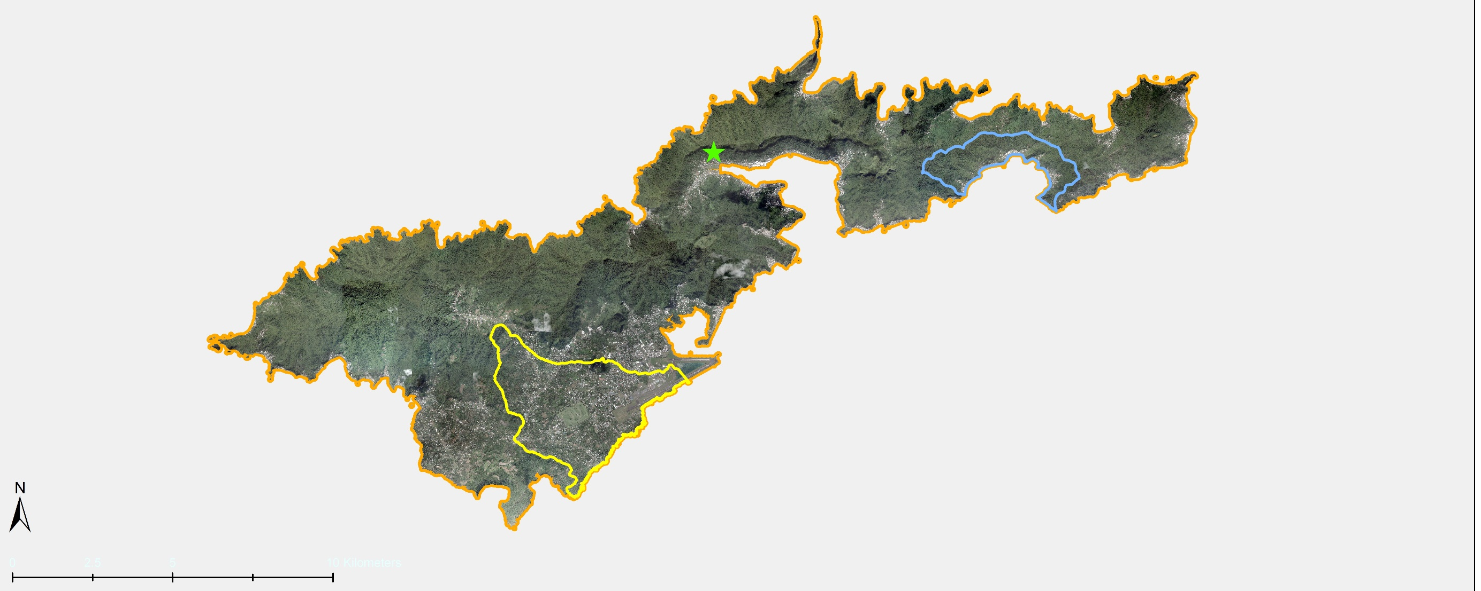
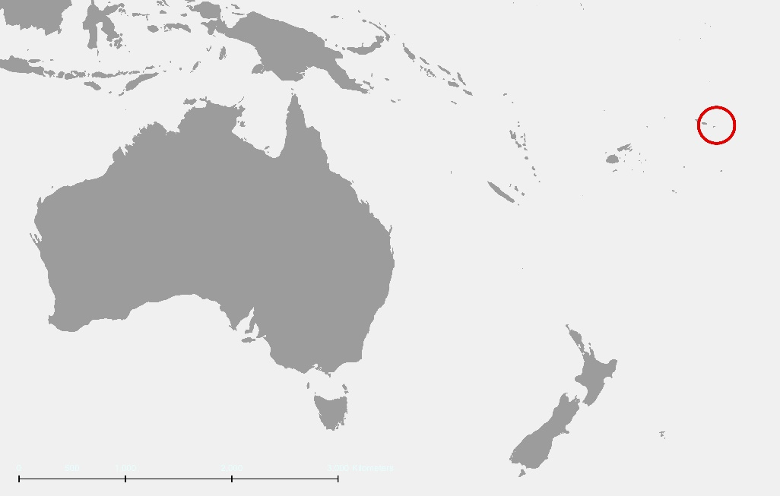
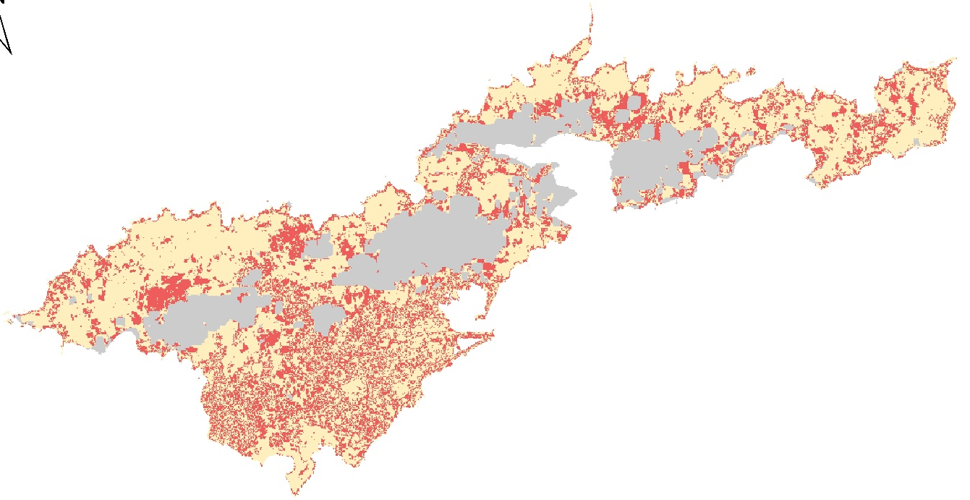
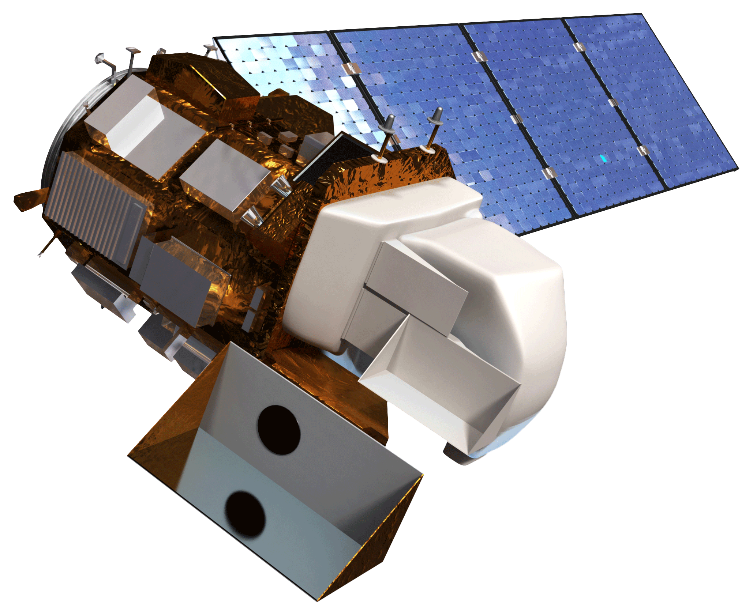
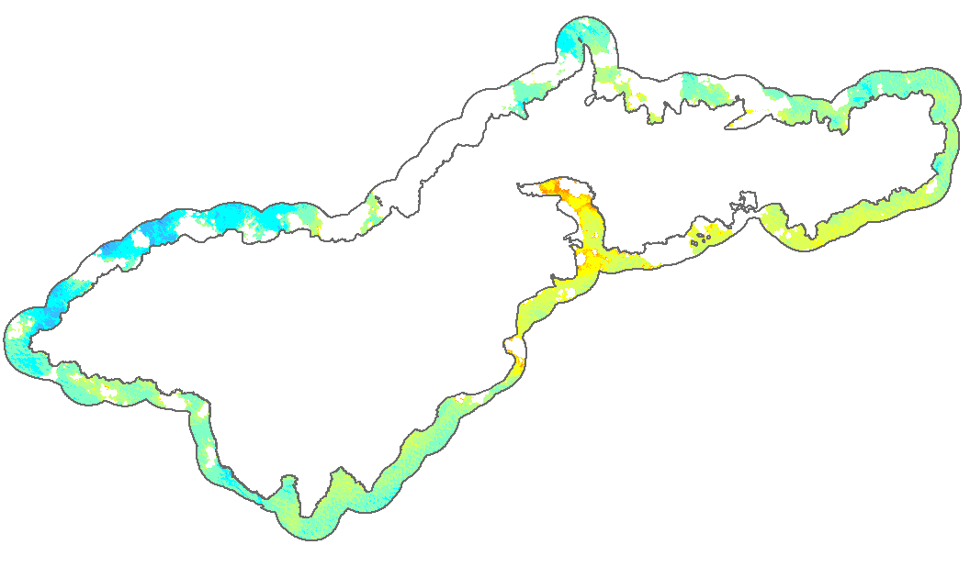
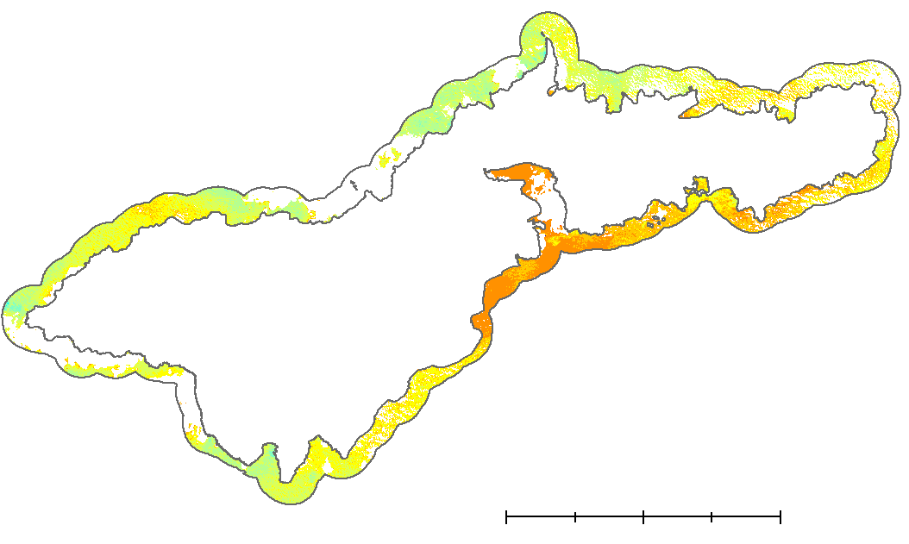
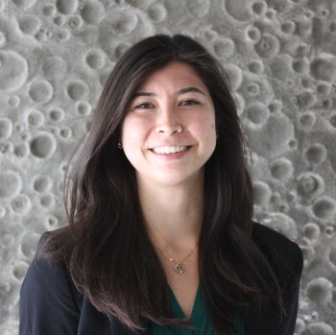
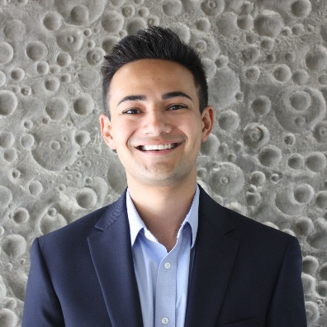
Evaluating the Impacts of Land Cover and Water Quality Changes in American Samoa to Improve Watershed Management
Abstract
Study Area
American Samoa Water Resources
For at least the past two decades, the coral reefs and coastal ecosystems of the American Samoan island of Tutuila have experienced deteriorating water quality. Increased levels of sedimentation, nutrients, and other land-based sources of pollution (LBSP) have negatively impacted these systems and the local fishery-based economy. Traditional efforts to monitor these systems, such as in situ water quality sampling studies and field surveys of piggery operations, have proven insufficient, prompting the US Coral Reef Task Force (CRTF) Watershed Partnership Initiative (WPI) and the American Samoa Department of Marine and Wildlife Resources (DMWR) Coral Reef Advisory Group (CRAG) to seek new strategies. This project provided the partners with maps and geospatial data products to support management interventions designed to mitigate the impacts of land use and land cover change. A time series analysis deployed Earth observations from Landsat 8 Operational Land Imager (OLI) to analyze changes in land cover and chlorophyll-a (Chl-a) concentrations—a proxy for water quality—from 2013 to 2019 at an island-wide scale. Ancillary data products from the United States Department of Agriculture Natural Resources Conservation Service were used to depict change patterns in land cover at a more granular scale, using the Tafuna Plain, Nu’uuli watershed, and Faga’itua watershed as sample sites because of the biodiversity and vulnerability of their marine ecosystems. The end products supplied project partners with knowledge and tangible decision-support tools to maintain the structure and function of vital coastal ecosystems.
Faga’itua Watershed
Tafuna Watershed
Nu’uuli Watershed
Tutuila Island
Pago Pago (capital)
American
Samoa
Australia
10 km
3000 km
New
Zealand
Results
TUTUILA ISLAND LULCC — 2013 to 2018
80
Objectives & Earth Observations
60
Quantify the magnitude of LULCC on Tutuila and identify “hotspot” areas of most significant change
Discern trends in water quality and analyze their relationships with LULCC in adjacent watersheds
Produce maps and geospatial analyses to enable partners to optimize watershed management strategies and protect coastal ecosystems in the future
Provide end users with effective outreach materials to better inform community-based conservation efforts
40
Clouds
No Change (67.6%)
Change (32.4%)
20
10 km
0
Canopy Impervious Bare/Ag Clouds
Landsat 8 OLI
2013 to 2019
FAGA’ITUA WATERSHED LULCC — 2012 to 2017
4
Methodology
3
LANDSAT 8 OLI
EARTH OBSERVATIONS
NRCS ORTHOIMAGES
2
Shade
No Change (87.5%)
Change (12.5%)
1
PREPROCESSING
1 km
Canopy Impervious Grass/Ag Shade
CLOUD MASK
CLIP
SR CORRECTION
TUTUILA ISLAND NEAR-SHORE CHLOROPHYLL-A — 2013 to 2019
WATER QUALITY EVALUATION
WATERSHED - SCALE LAND CLASSIFICATION
2013
0.95
0.85
0.75
0.65
0.55
0.45
0.35
0.25
Mean Observed Chlorophyll-a Concentrations
IMAGE COMPOSITES
ISLAND - SCALE LAND CLASSIFICATION
2019
Chl-a (mg m⁻³)
TIME - SERIES ANALYSIS
0.00-0.10
0.10-0.20
0.20-0.30
0.30-0.40
0.40-0.50
0.50-0.60
0.60-0.70
0.70-0.80
0.80-0.90
0.90-1.00
1.00-2.00
2.00-3.00
>3.00
RANDOM FOREST MODELING
ZONAL STATISTICS
10 km
2013 2014 2015 2016 2017 2018 2019
MODEL OUTPUTS
Conclusions
Project Partners
Although Earth-observing satellites can monitor LULCC, current instruments are limited in their capacity to detect change at the island scale.
By masking and compositing Landsat 8 images across a season, cloud coverage can be removed to facilitate analysis of surface reflectance data.
Island-scale classifications indicate a net change in land cover from canopy to impervious surfaces scale.
Chlorophyll-a concentrations showed an increasing trend, although the inference is limited by the low frequency of observations.
The analysis offers a reproducible method that can be used to monitor LULCC and water quality, given more frequent observations.
United States Coral Reef Task Force, Watershed Partnership Initiative
American Samoa Department of Marine and Wildlife Resources, Coral Reef Advisory Group
Acknowledgements
Va’amua Henry Sesepasara (US Coral Reef Task Force, Watershed Partnership Initiative); Fa’asalafa Diana Kitiona & Alice Lawrence (American Samoa Department of Marine and Wildlife Resources, Coral Reef Advisory Group); Dr. Juan Torres-Pérez (Bay Area Environmental Research Institute, NASA Ames Research Center); Tomoko Acoba (Joint Institute for Marine and Atmospheric Research, University of Hawai’i at Manoa); Dr. John Olson (California State University Monterey Bay); Dr. Kenton Ross (DEVELOP National Program, NASA Langley Research Center); Fa’amao Asalele (American Samoa Environmental Protection Agency); Tony Kimmet (US Department of Agriculture, Natural Resources Conservation Service, National Geospatial Center of Excellence); Antonina Teo (American Samoa Environmental Protection Agency); Farnaz Bayat & Jerrold Acdan (DEVELOP National Program, NASA Ames Research Center)
Team Members
Marshall Worsham
Project Lead
Melissa Collin
Eric Davis
Arev Markarian
California - Ames| Summer 2019

