Slide 1
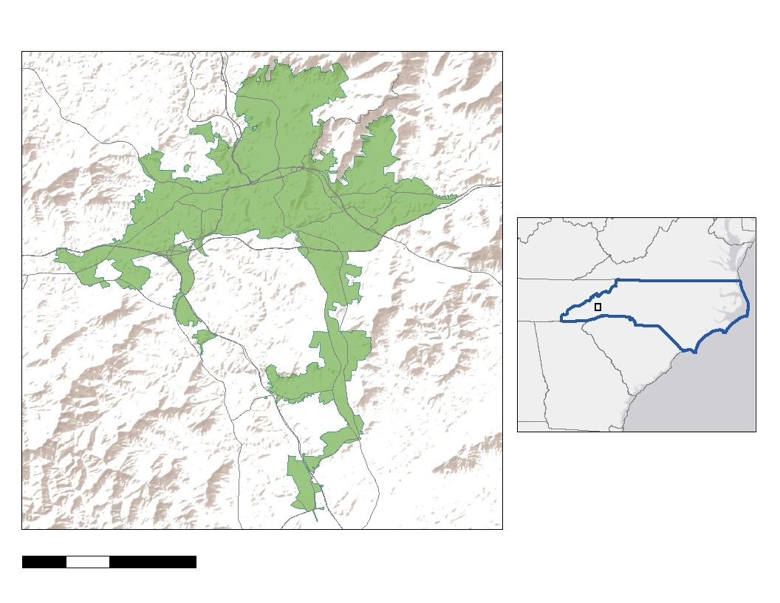

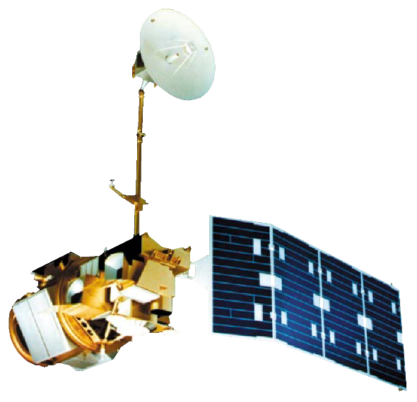
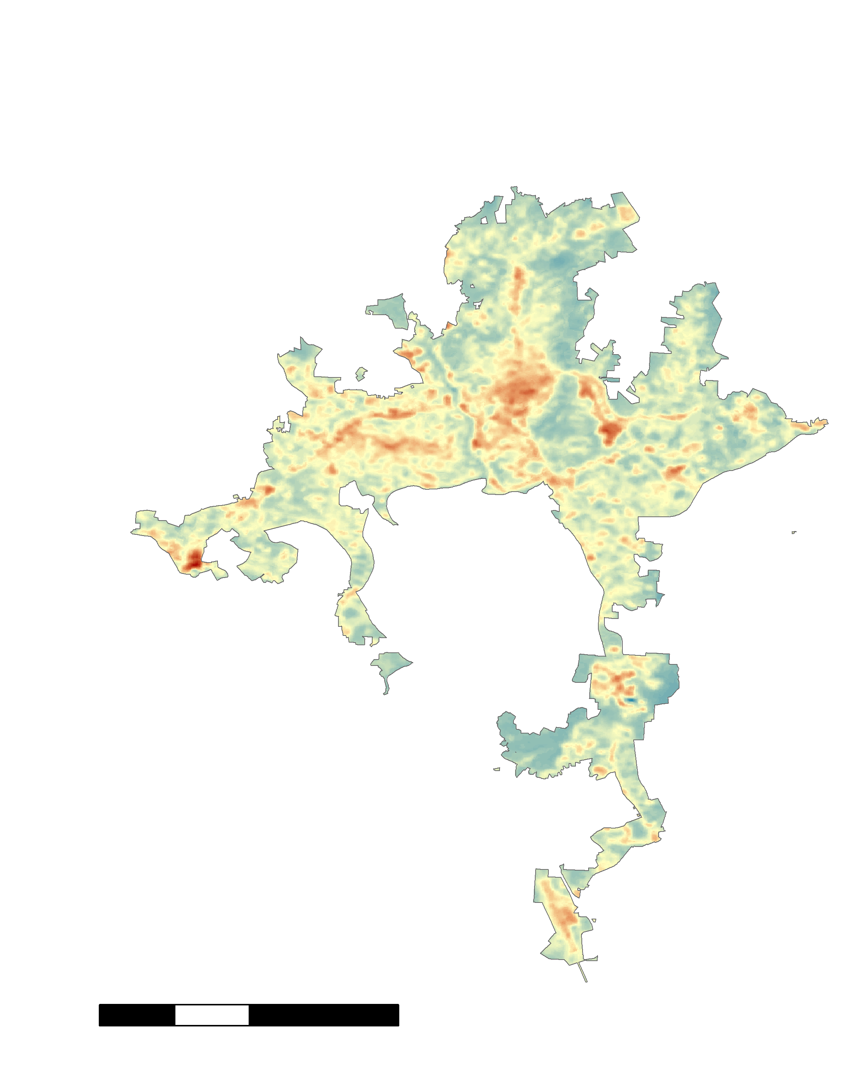
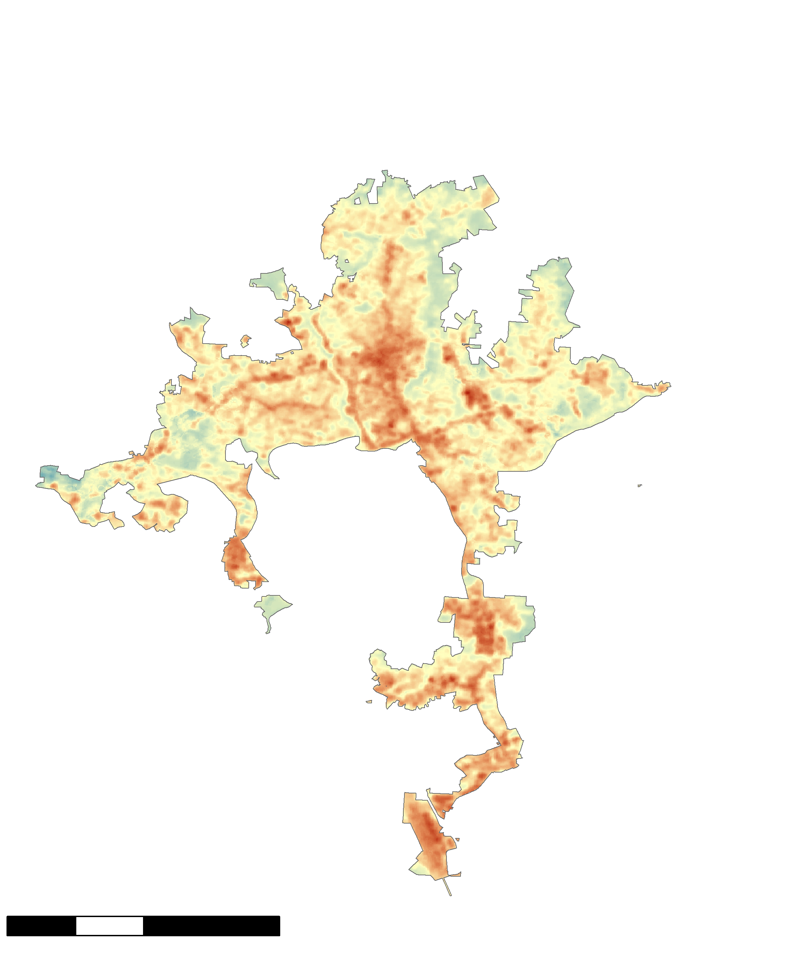
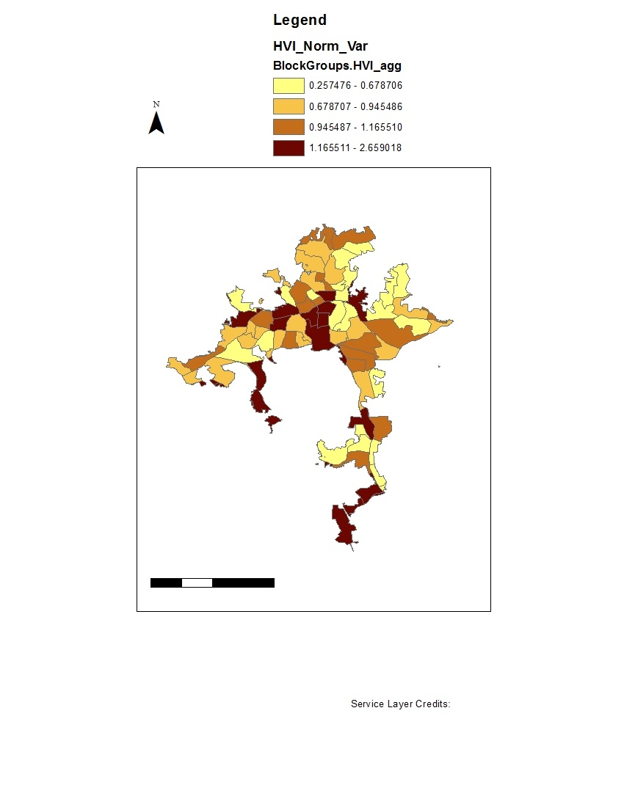

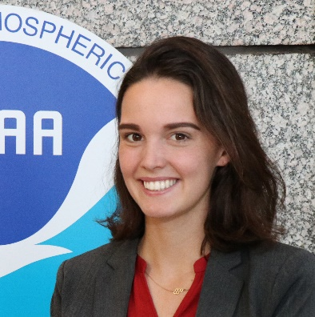
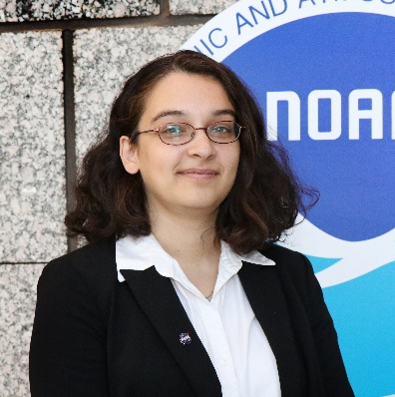
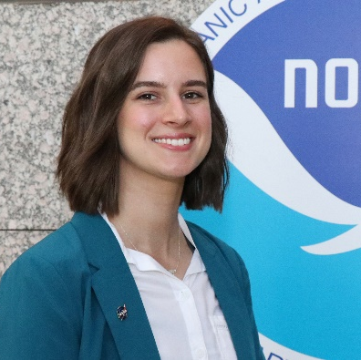

Using NASA Earth Observations to Quantify the Impact of Urban Tree Canopy Cover on Urban Heat and Identify Community Vulnerability in Asheville, North Carolina
Abstract
Study Area
Earth
Observations
Asheville Urban Development
Asheville, North Carolina has had a population growth of approximately 10 percent over the past decade, while the city’s tree canopy cover has simultaneously decreased by 6.4 percent. A well-known benefit of urban tree cover is the mitigation of the effects of urban heat islands through factors including shade and evapotranspiration. Thus, as Asheville’s population grows, the presence of trees and their cooling effects is crucial. The Asheville Urban Forestry Commission advises the City Council on issues pertaining to urban development with policies centered on tree cover preservation and growth. The Asheville Urban Development team partnered with the Urban Forestry Commission to complete a study using NASA Earth observations and ancillary datasets to explore relationships between changes in land surface temperature and tree cover over the last 10 years. The team used Landsat 5 Thematic Mapper (TM) and Landsat 8 Operational Land Imager (OLI) to calculate Land Surface Temperature (LST) changes from 1984 to 2018. The team also used socioeconomic data on the census block group level to create a heat vulnerability index in order to identify communities at risk. The team included tree cover and LST data in this index to represent exposure and adaptive capacity as factors in heat vulnerability. The end products illustrated a significant correlation between tree cover and LST in Asheville and identified vulnerable communities to support the Urban Forestry Commission’s decisions about tree planting and preservation.
N
Asheville
Landsat 8 OLI
VA
Methodology
NC
Data Acquisition
Processing
Analysis
End Products
0 2.5 5 10
Kilometers
SC
Temperature & Tree Cover Analyses
Objectives
GA
Landsat 5 TM
Landsat 5 and 8
Tree cover data
Derive LST
LST change analysis
Difference maps
Analyze how land surface temperature and tree cover in Asheville have changed long-term by comparing data from the 1980s to present-day to quantify changes and identify areas that have changed the most
Explore the statistical relationship between tree cover and land surface temperature in Asheville
Identify areas particularly vulnerable to heat in Asheville by generating a heat vulnerability index that incorporates temperature, tree cover, and socioeconomic data
Calculate means
Linear regression
Scatter plots
per block group
Census data
Heat Vulnerability Index
Map of heat
Clip to Asheville
Aggregate variables
Normalize all
vulnerability by
Results
variables
census block group
35-Year Change in LST for Warm Months
Present Day
Tree Cover vs. LST
Heat Vulnerability by
Census Block Group
Median LST 1984 to 1986
Median LST 2017 to 2019
86
1.0
Gorman Bridge
84
0.5
N
N
82
80
Land Surface Temperature (ºF)
0.0
78
LST
Social
Lack of Tree Cover
76
N
74
72
20
40
60
80
Tree Cover Percentage
R² = 0.5374
Y = - 0.1225x + 82.785
LST
High: 95° F
Low: 56° F
0 2.5 5 10
Kilometers
0 2.5 5 10
Kilometers
Asheville School
1.0
Downtown
Conclusions
0.5
1.0
0.0
LST
Social
Lack of
Tree Cover
Heat Vulnerability
0.5
Median LST for warm months has increased by up to 31°F in parts of Asheville over the last 30 years.
The presence of tree cover in Asheville has a cooling effect which can mitigate the urban heat island effect.
Heat vulnerability varies drastically between neighborhoods based on LST, tree cover, age, and poverty.
NASA Earth observations can be used to supplement urban heat vulnerability indices based on US Census data and high resolution tree cover data.
Highest
0.0
LST
Social
Lack of Tree Cover
Lowest
0 2.5 5 10
Kilometers
Project Partner
Team Members
Asheville Urban Forestry Commission
Acknowledgements
We would like to thank our science advisor Scott Stevens and our fellow Andrew Shannon for their knowledge and guidance throughout this project. We would also like to thank our partners from the Asheville Urban Forestry Commission, including Ed Macie, Dawn Chavez, Stephen Hendricks, Amy Smith, and others. We further recognize representatives from NEMAC, NCEI, the City of Asheville, and others for their assistance in the completion of this project.
Darcy Gray
Project Lead
Amiya Kalra
Amy Kennedy
North Carolina – NCEI | Fall 2019

