Slide 1
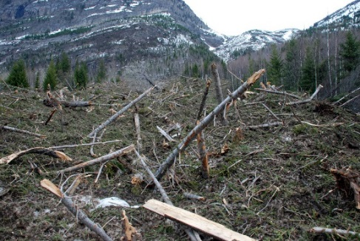
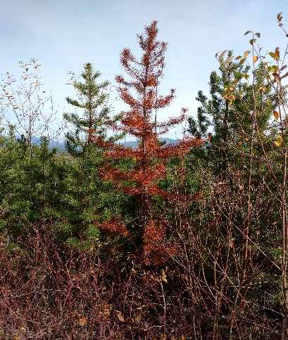
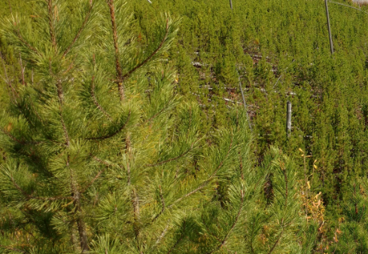
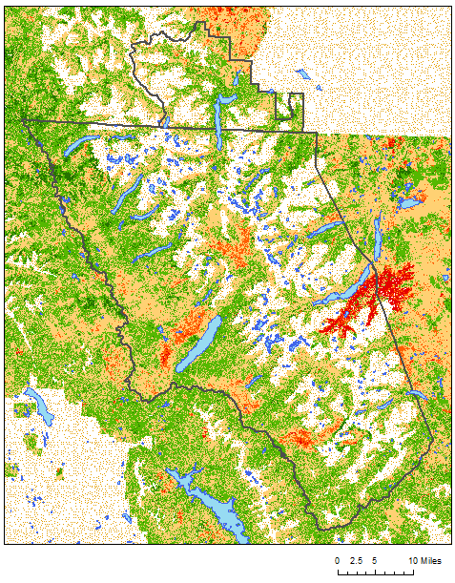
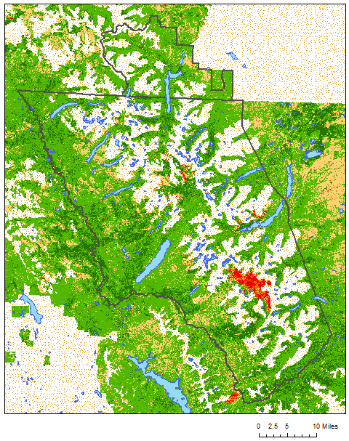
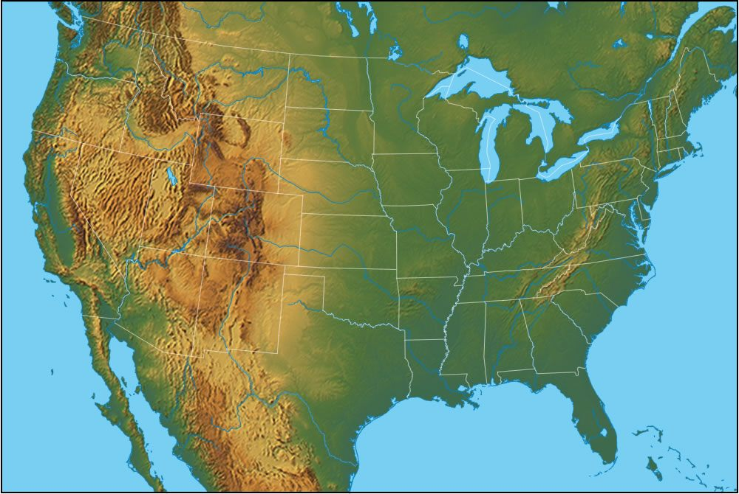
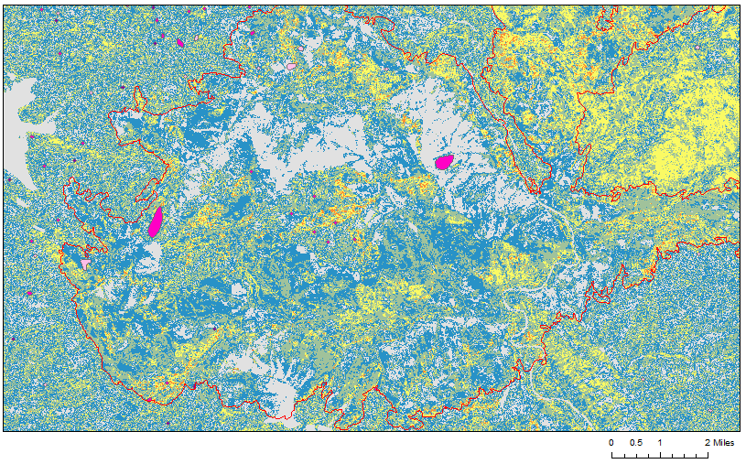
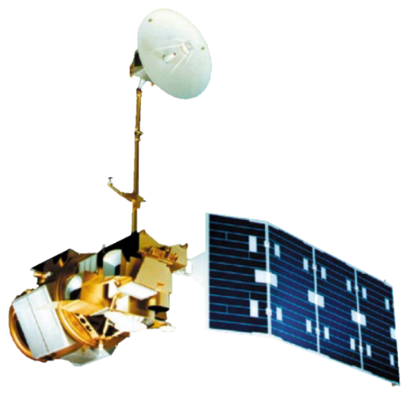
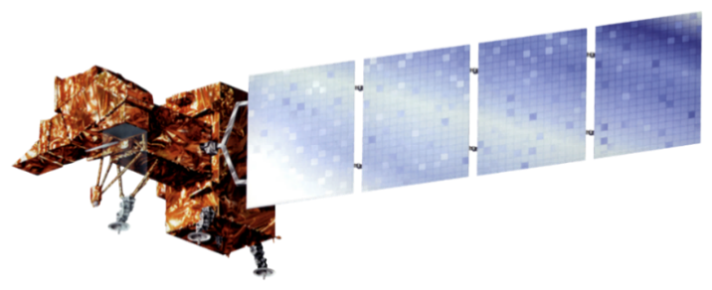
A Threshold-Based Decision Tree Approach to Mapping Landscape Disturbance in Glacier National Park
Abstract
Methodology
Abrupt Disturbance Threshold
Insects and pathogens cause extensive damage to pine forests in the northwestern United States. Bark beetles in particular cause mortality in pine stands that can impact the timber industry and national parks. Previously, studies have used spectral indices derived from Landsat time series to identify insect disturbance. The team mapped landscape disturbance in Glacier National Park and Waterton Lakes National Park in Alberta, Canada from 1999-2016 using a time series of Normalized Difference Moisture Index (NDMI) and red-green index (RGI) computed from cloud-free Landsat composites. Aerial Detection Survey (ADS) polygons were used to fine tune thresholds, targeting the classification of moderate disturbance toward insect disturbance. Insects and pathogens were the primary focus of this classification scheme, however, due to the level of ambiguity in the ADS data and because NDMI is sensitive to various disturbance types, the study opted to map all moderate disturbance. To determine the thresholds for these categories, we analyzed spatial subsets of our spectral indices within ADS polygons, fire data from the National Park Service, and polygons representing healthy forest as digitized from high resolution NAIP imagery. RGI was then incorporated to further target the red stage of bark beetle attack in the moderate disturbance category. Maps of persistent disturbance over a time series of five inter-annual periods were created from the resulting maps of interannual disturbance. The study programmatically generated all maps and histograms with Python for efficiency and modularity, so that the methodology may be applied to map future outbreaks.
Establish ∆NDMI Thresholds
Calculate ∆NDMI
Cloud Mask/Target Date Mosaics
Moderate Disturbance Threshold (Potentially Insect)
Potential Red-Stage Disturbances
Other Disturbances
Healthy Vegetation
Results
Credit: Richard Menicke
Landscape Disturbance
Glacier National Park (2005 – 2006)
Landscape Disturbance
Glacier National Park (2015 – 2016)
Landcover Classification
Cardston
Abrupt Disturbance
Cardston
High Disturbance
Moderate Disturbance
Low Disturbance
Healthy/Regenerating Vegetation
Water Bodies
Park Boundaries
Masked Areas
Study Area
Study Period:
1999-2016
June - September
WhiteFish
WhiteFish
Columbia Falls
Columbia Falls
Glacier National Park Climate II
Number of Interannual Periods Showing Persistence
1
2
3
4
Boundary outline of Waterton-Glacier International Peace Park
5
2001 Fire Outline
Credit: geology.com
ADS Top 15% DTPA 2004
ADS Top 15% DTPA 2005
Earth Observations
ADS Top 15% DTPA 2006
Landsat 5 TM
Landsat 7 ETM+
Landsat 8 OLI
Persistence of Moderate Disturbance from Interannual Periods
2001- 2002 to 2005-2006
Objectives
Conclusions
Classify landscape disturbance within Glacier National Park (GNP) utilizing a threshold-based decision tree approach
Develop an automated Python program utilizing NASA Earth observations that expedites disturbance mapping within GNP
Educate students in Whitefish and Columbia Falls High School through interaction with NASA Earth observation tools
Persistence of inter-annual moderate disturbance coincides with higher activity of bark beetle disturbance 3-5 years after forest fire encounters.
Multi-spectral indices from Landsat can be valuable in locating areas that are at risk or currently impacted by drought, insect, and other moderate disturbances in GNP.
While it is not possible to exclusively detect bark beetle disturbance, the use of threshold-based classification schemes can provide an efficient and accurate approach for identifying and mapping canopies experiencing significant stress.
Team Members
Project Partners
Acknowledgements
We would like to thank the following individuals and groups for their contributions to this project:
Dr. Kenton Ross: NASA Langley Research Center
Whitefish High School: Whitefish, Montana
Columbia Falls High School: Columbia Falls, Montana
Previous Term Participants:
Jordan Lubbers
Dr. Sunita Yadav-Pauletti
Joe Harris
Zachary Wardle
Charlotte Mays
Team Lead
Antonio Alvarado
Ryan Avery
Richard Menicke:
National Park Service, Glacier National Park
Dr. Christopher Potter:
NASA Ames Research Center
Dr. Jeffrey Hicke:
University of Idaho, Department of Geography
Suzannah Richards
Jemiris Gonzalez- deJesus
NASA Langley Research Center – Spring 2017

