Slide 1

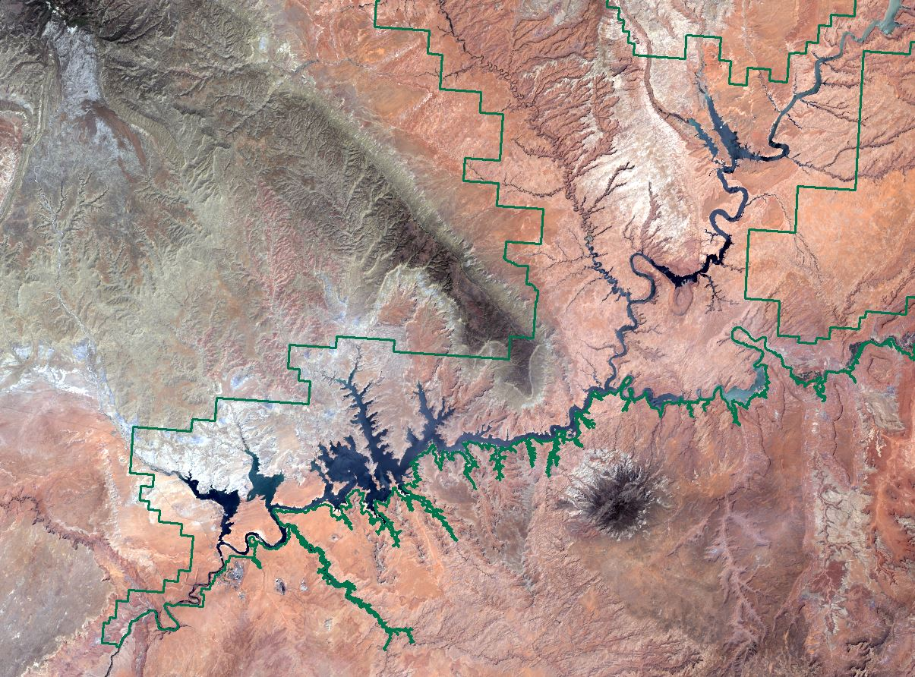
Southwest US Ecological Forecasting
Ryan Avery (Project Lead)
Mapping Invasive Species to
Efficiently Monitor Southwestern
National Park Areas
Katherine Landesman
Timmera Whaley
Jordan Vaa
Dakoyta Greenman
Notes:
Your project VPS Image should be placed behind the top aperture shape. An example shape has been placed in this position for your reference. Delete the example VPS image, insert your image, right click your image and select the “Send to Back” option. Position and adjust the size of your image so that it lines up with the provided margin rulers.

Slide 2
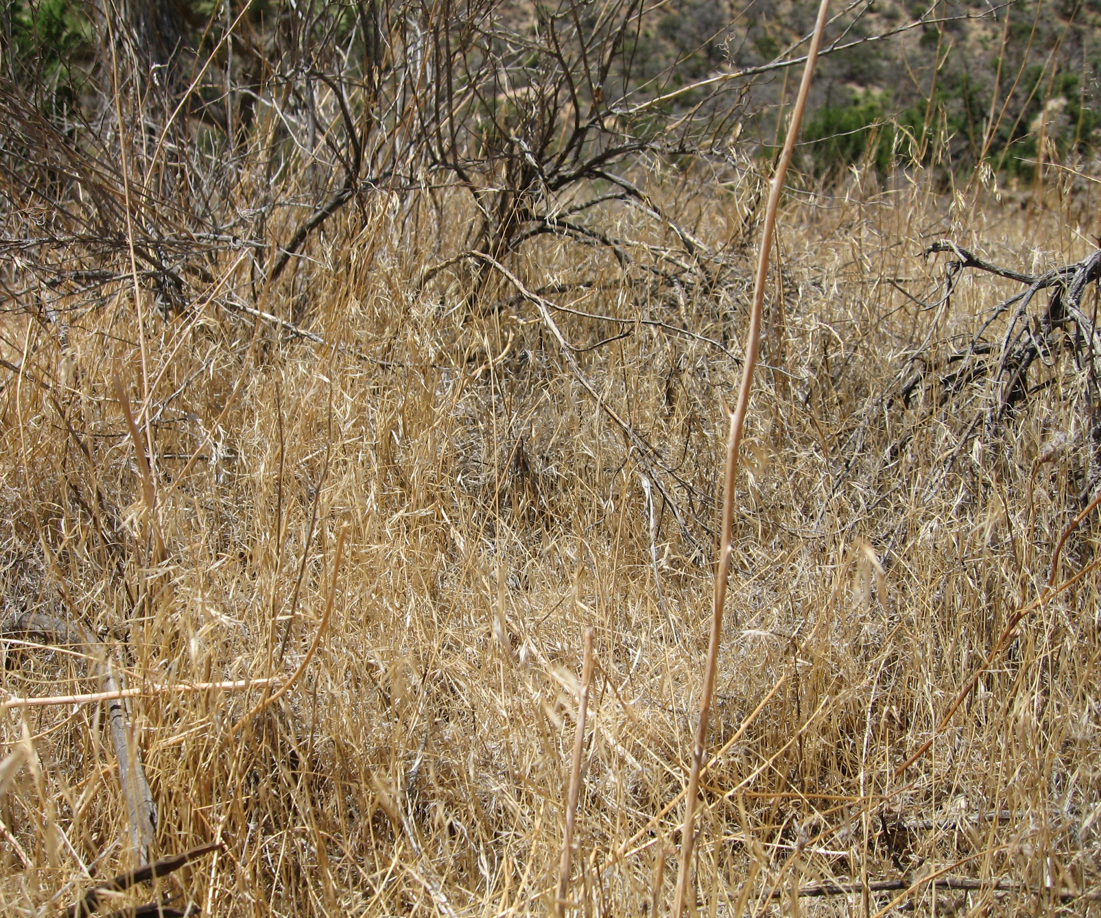
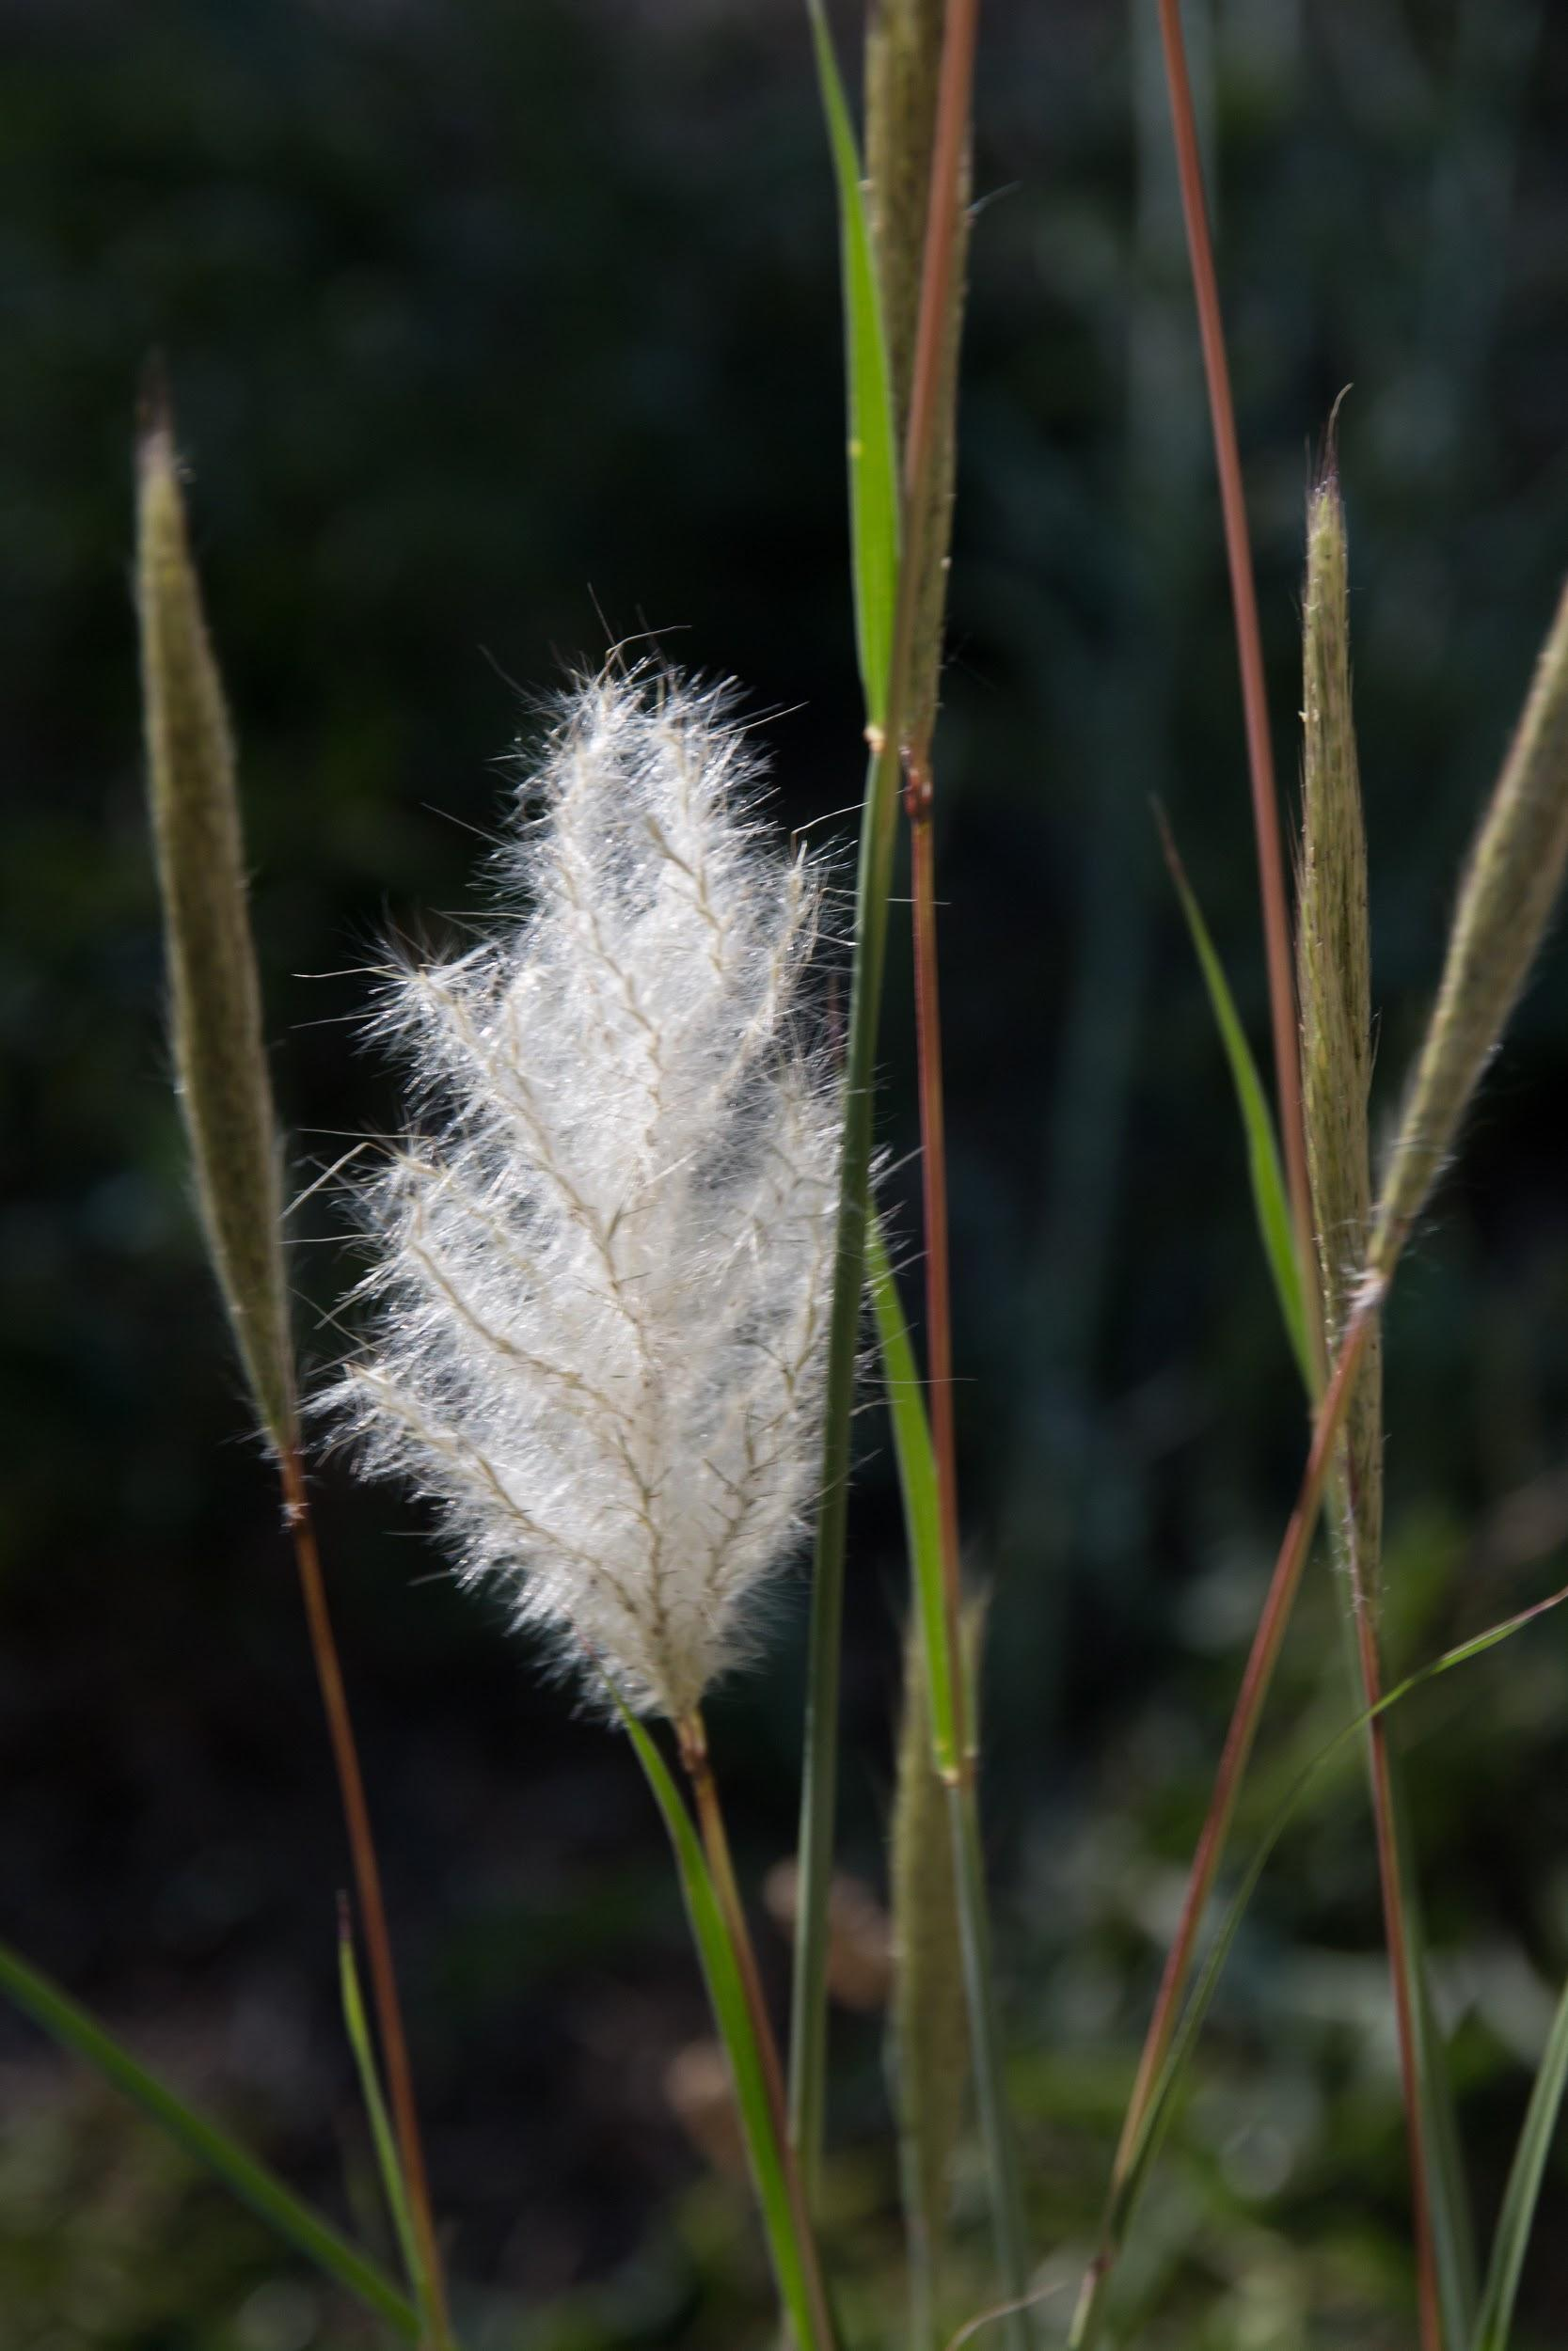
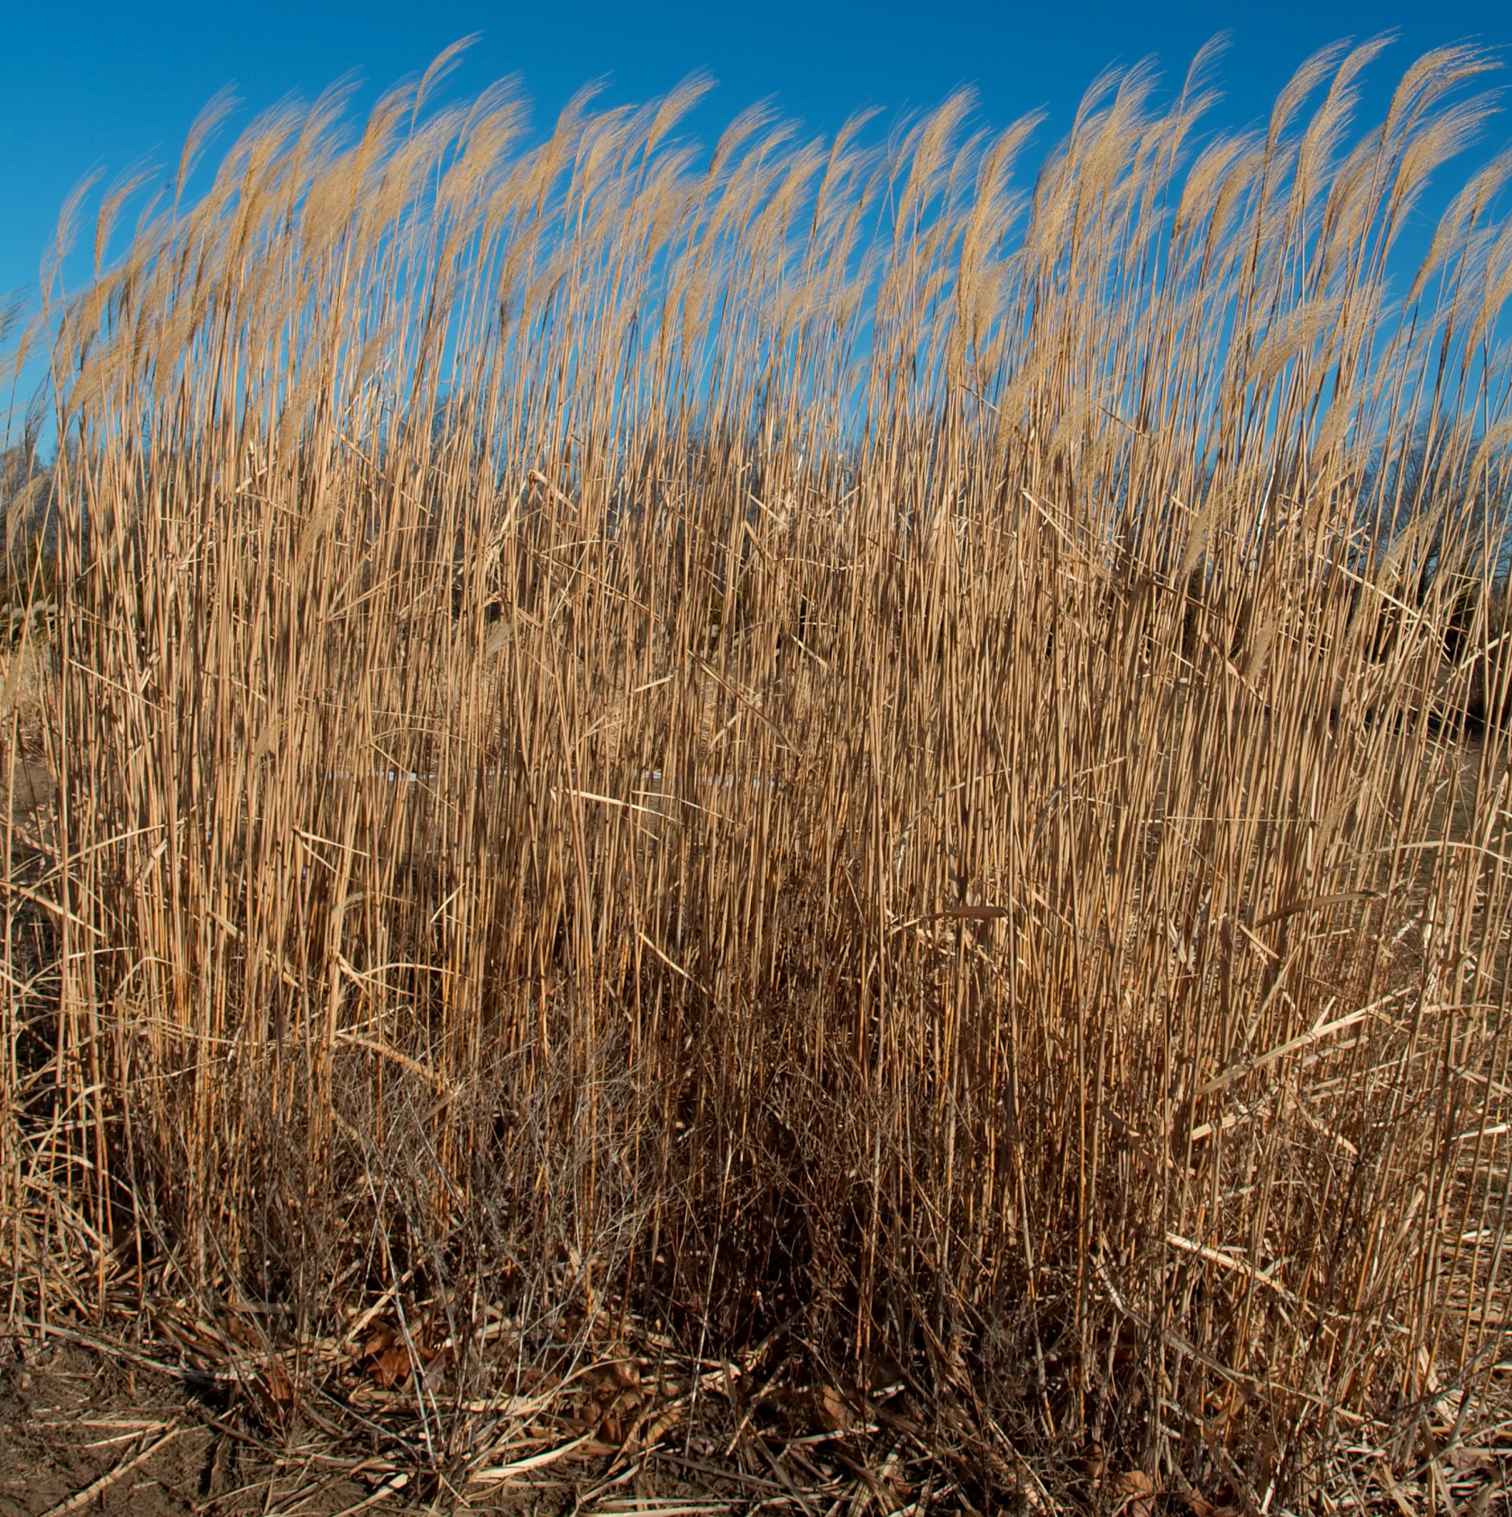
Objectives
Cheatgrass
Classify cheatgrass, giant reed, and ravenna grass in Southwest National Parks
Map habitats of invasive species to predict distribution
Provide National Park Service with management alternative using Earth observations
Ravenna grass
Photo Credit: Robb Hannawacker
Giant Reed
Photo Credit: Daniel Villafruela
Photo Credit: Dori
Notes:
1) Objectives:
The National Park Service (NPS) requires accurate information about the location of invasive species.
The objective of the Southwest Ecological Forecasting project is to provide an alternative to time intensive, on-the-ground surveys through the use of Earth observation tools by creating distribution maps and predictive models of invasive species.
Our study examined four national park locations in the Southwestern United States and three invasive species currently of interests to our project partners: cheatgrass *click*, giant reed *click*, and ravenna grass *click*.

Slide 3
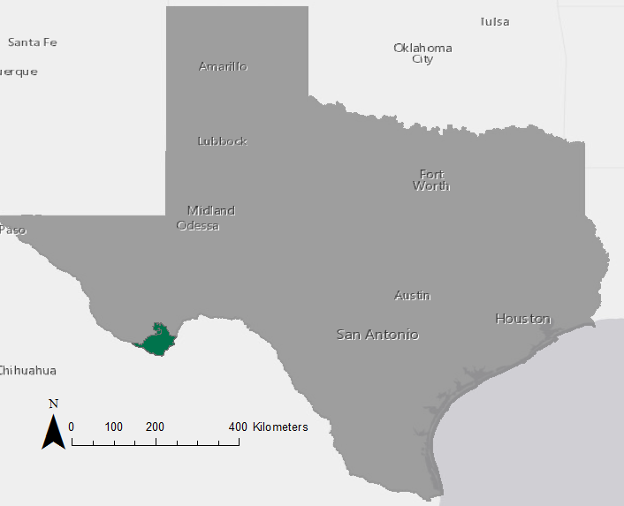
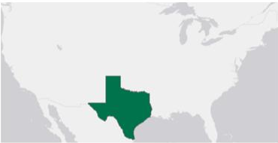
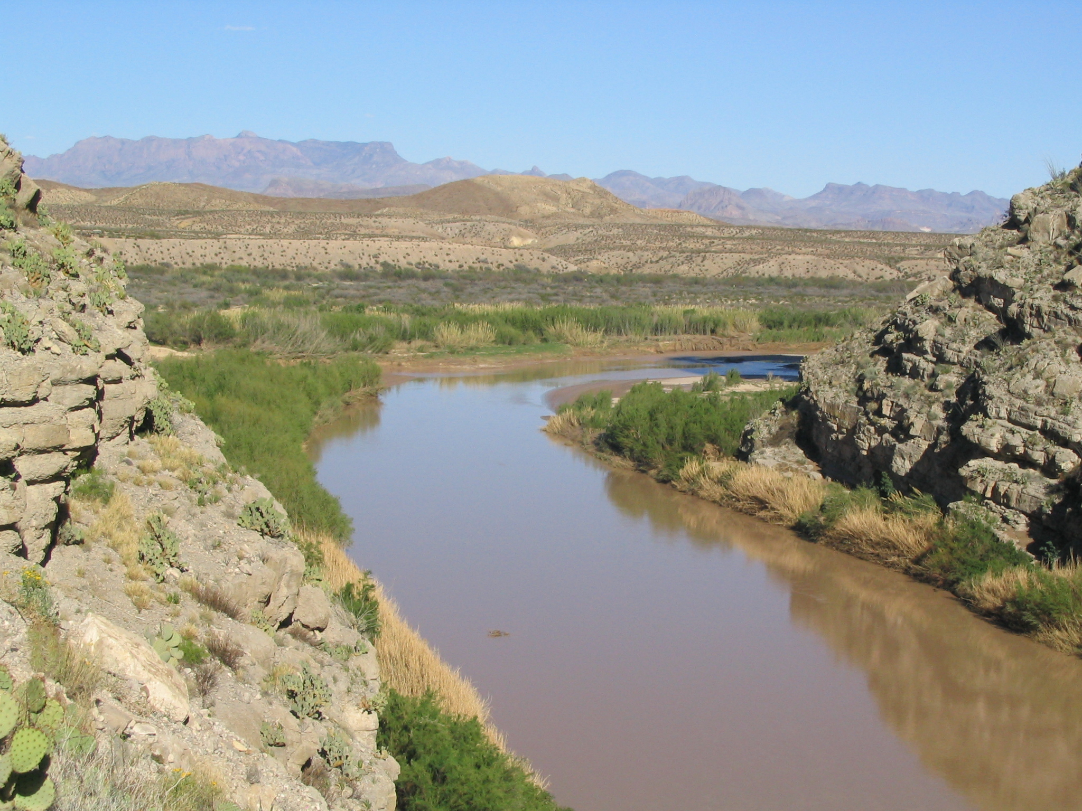
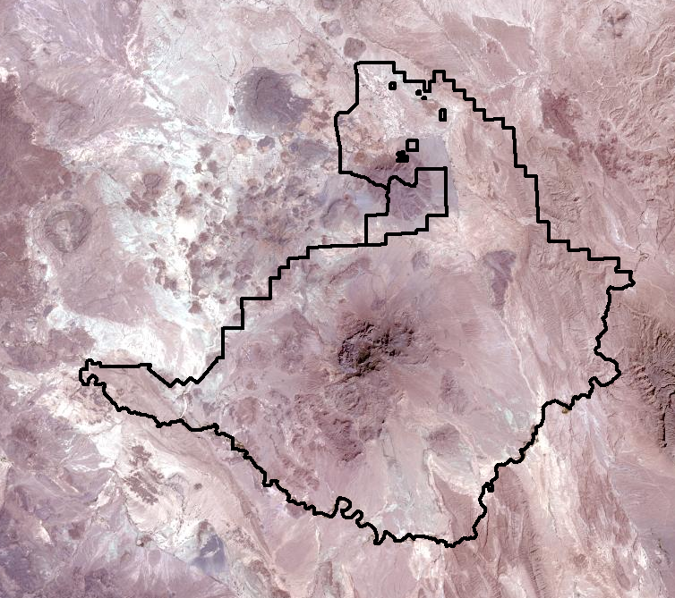
Big Bend National Park
Tulsa
Santa Fe
Oklahoma
City
Amarillo
Lubbock
Fort Worth
Photo Credit: ESRI Online, World Light Grey Canvas Base
Midland
Paso
Odessa
Texas
Austin
Houston
San Antonio
Chihuahua
Credit: Ken Lund
Photo Credit: ESRI Online, World Light Grey Canvas Base
Photo Credit: ESRI Online, Landsat 8 PanSharpened
Notes:
In Big Bend National Park in TX, giant reed was originally introduced as an erosion-control agent in the 1820s *click* and has since colonized riparian corridors along the Rio Grande.

Slide 4

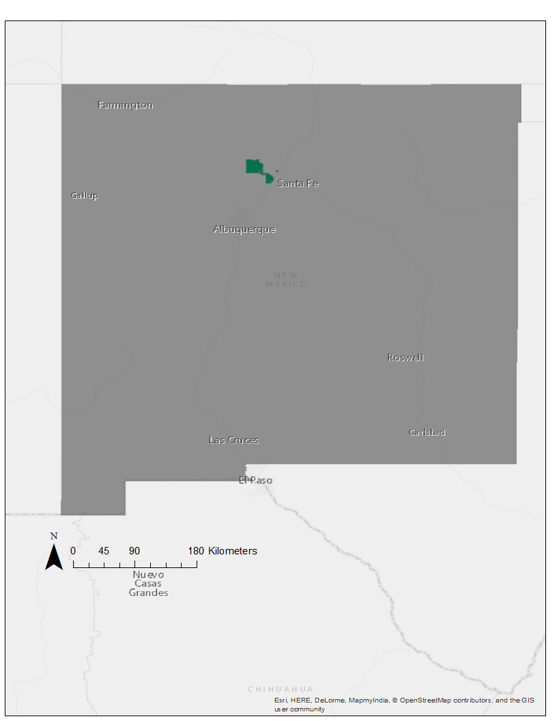
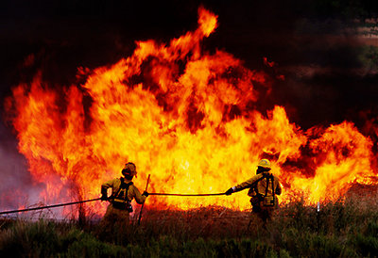
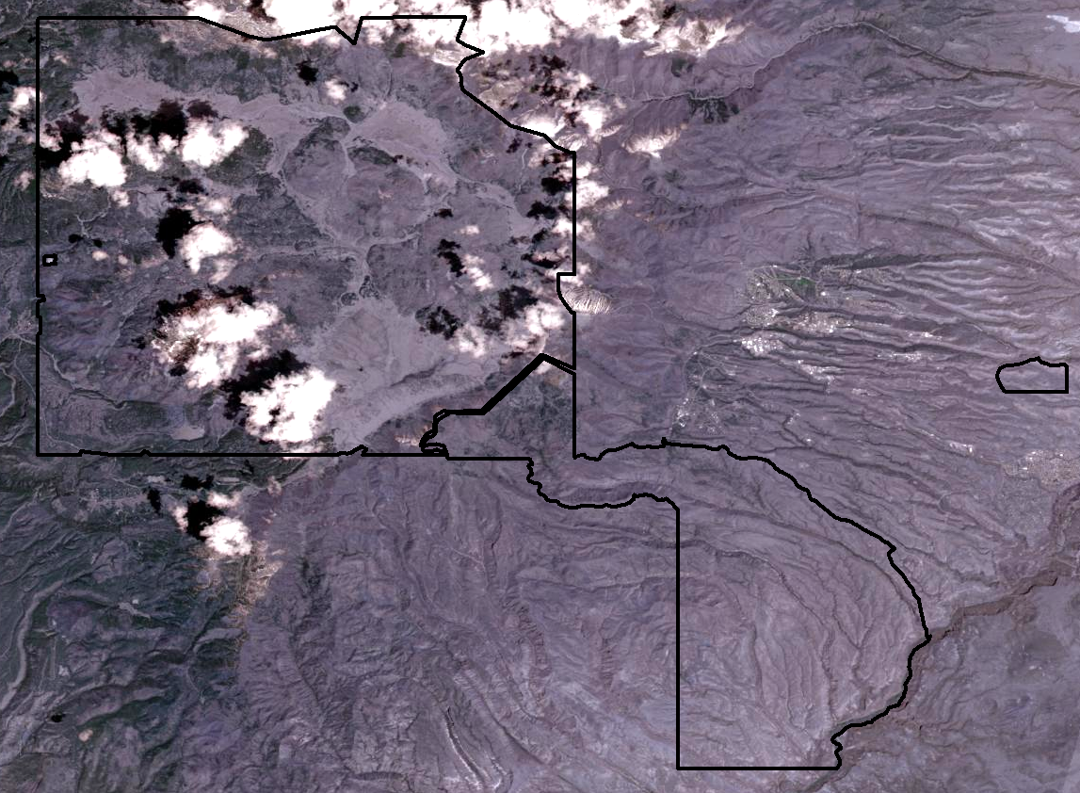
Valles Caldera & Bandelier
Farmington
Santa Fe
Gallup
Albuquerque
Photo Credit: ESRI Online, World Light Grey Canvas Base
New Mexico
Roswell
Las Cruces
Carlsbad
El Paso
Credit: Sparks Tribune
Photo Credit: ESRI Online, Landsat 8 PanSharpened
Photo Credit: ESRI Online, World Light Grey Canvas Base
Notes:
In Valles Caldera National Preserve and Bandelier National Monument in New Mexico, cheatgrass is problematic because of its early phenology, *click* which causes it to be a fire hazard and allows it to outcompete native species.

Slide 5
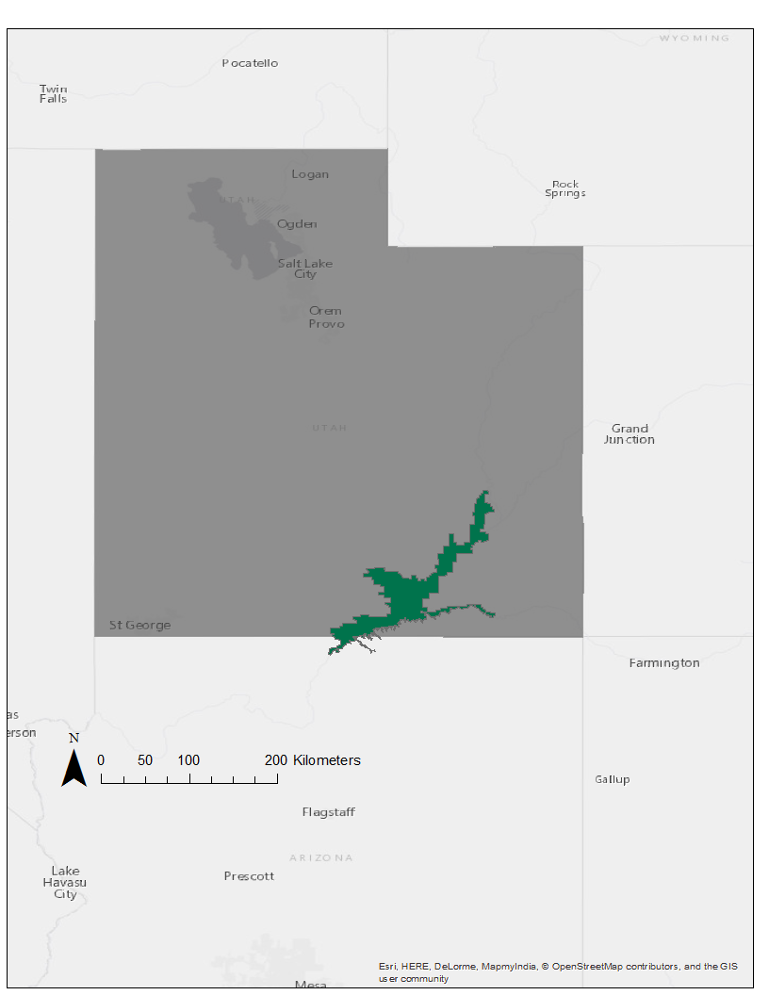
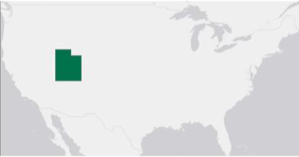
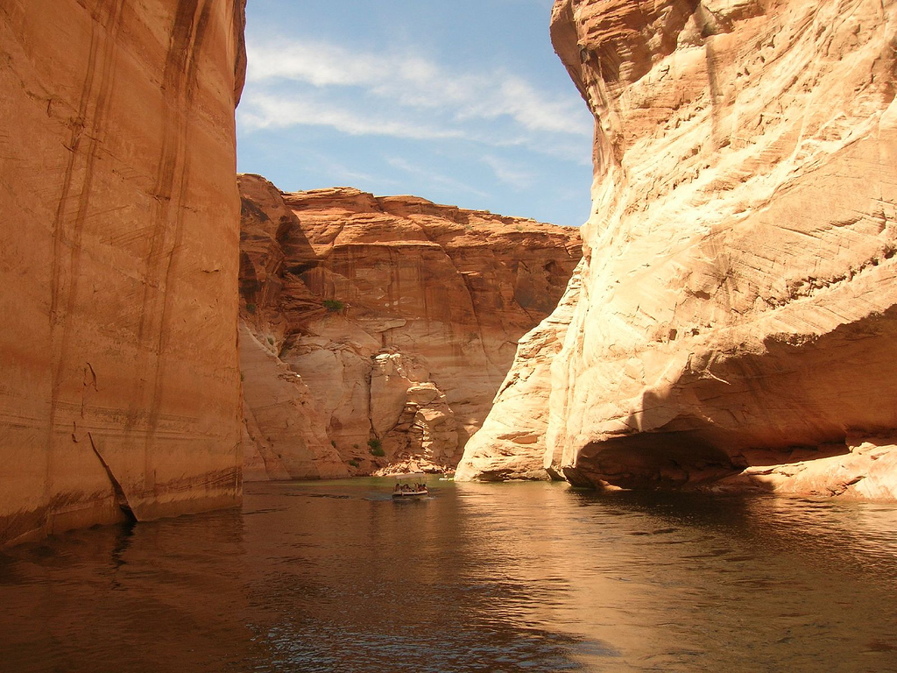
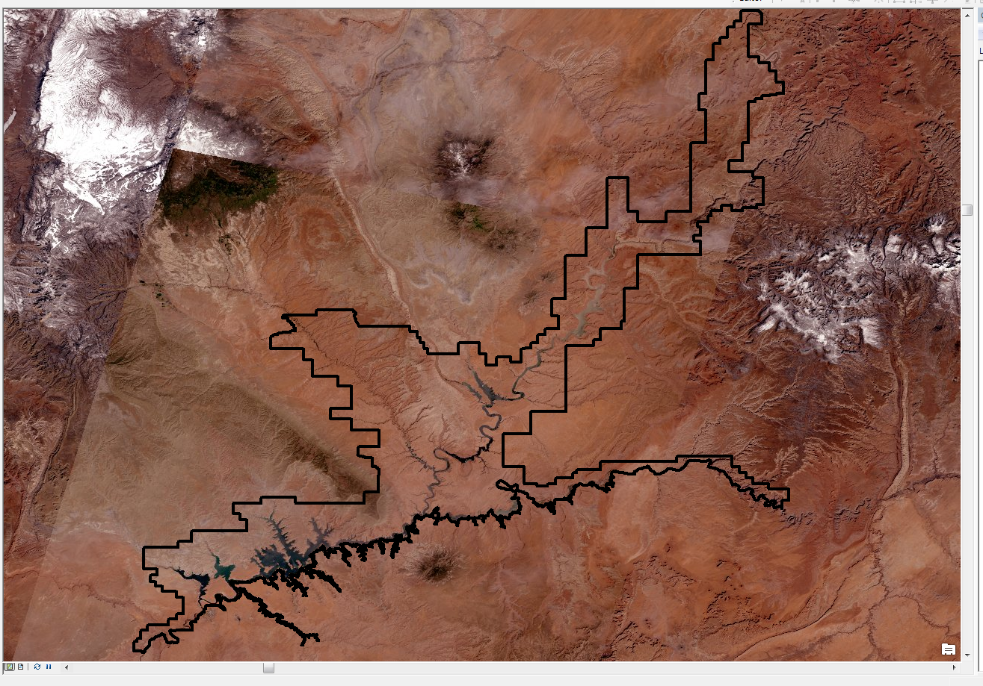
Glen Canyon National Recreation Area
Logan
Salt Lake
City
Orem
Provo
Utah
Photo Credit: ESRI Online, World Light Grey Canvas Base
St. George
Arizona
Credit: Justin Brockie
Photo Credit: ESRI Online, World Light Grey Canvas Base
Photo Credit: ESRI Online, Landsat 8 PanSharpened
Notes:
In Glen Canyon National Recreation located in Utah, ravenna grass threatens a unique vegetation cover called hanging gardens which is found around Lake Powell.

Slide 6
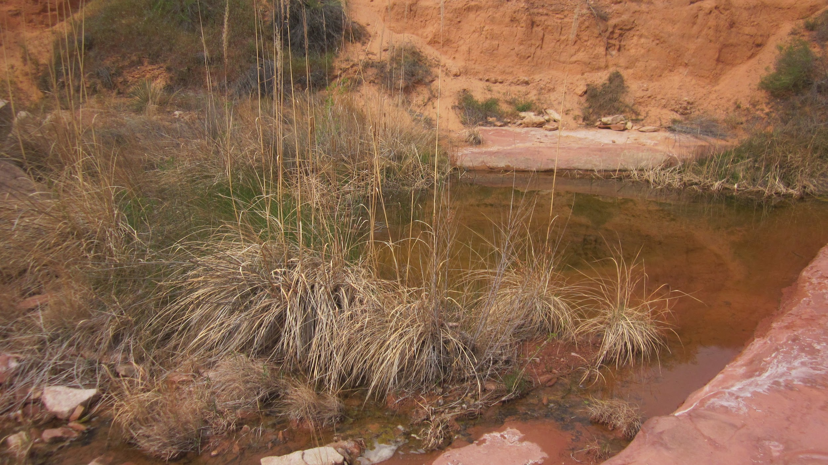
Community Concerns
Invasive species are a threat to ecosystems
Monitoring invasive species in the field is resource intensive
Treating threats requires accurate maps of invasive species
Photo Credit: Lonnie Pilkington, Natural Resource Program Manager of GLCA
Notes:
Invasive species are an issue for the national park service because these non-native plants tend to out compete local vegetation, which can severely impact biodiversity and alter fire regimes. To combat their introduction and propagation, the park service monitors, inventories, and treats invasive species

Slide 7


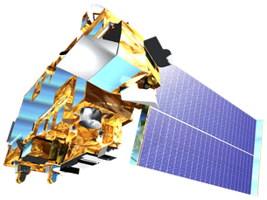
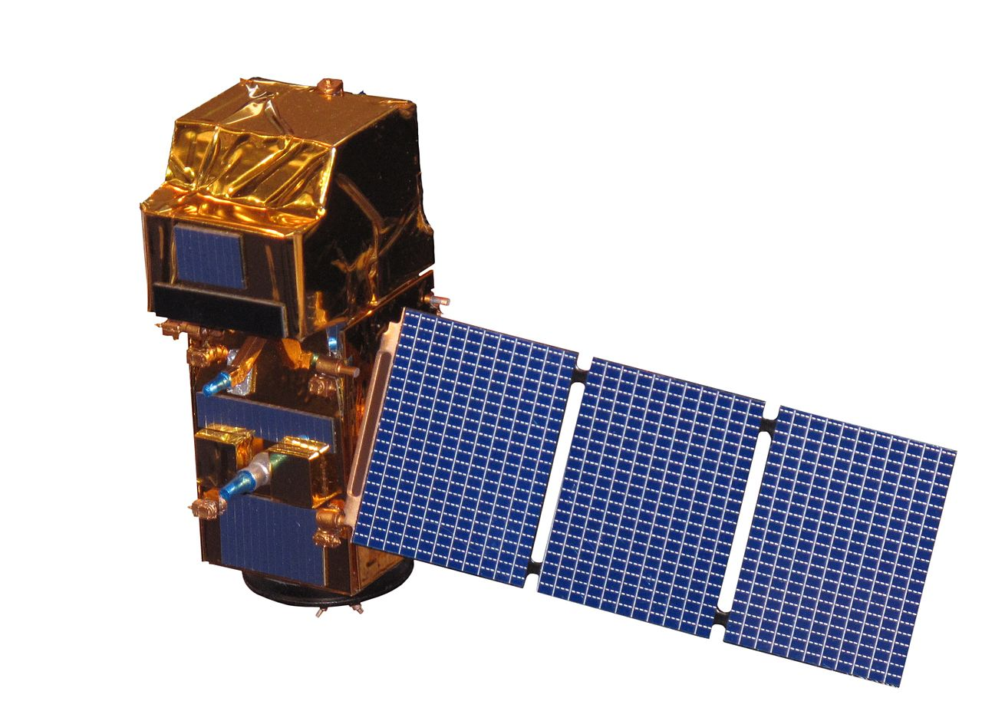
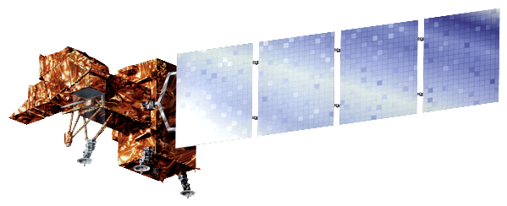
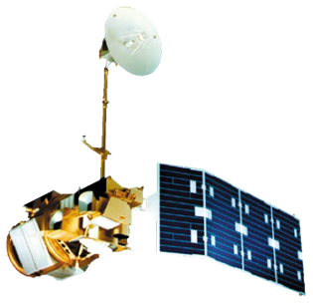


Earth Observations
Landsat 8 OLI
Credit: USGS/NASA Landsat
Landsat 5 TM
Credit: USGS/NASA Landsat
Terra MODIS
Credit: NASA
Landsat 7 ETM+
Credit: USGS/NASA Landsat
Sentinel - 2a
Credit: Rama
National Elevation Dataset
Landsat 5 TM
Landsat 8 OLI
Terra MODIS
Notes:
We utilized several earth observations in order to get the best "recipe" for mapping vegetation distribution across our study area. We applied different band combinations of multispectral data from Landsat's 5, 7 & 8 as well as Sentinel II to classify our focal species. We also used phenology data from the US Forest Service's Forwarn dataset, which is derived from Terra MODIS imagery. Additionally, topographic indices were derived from the National Elevation dataset (NED).

Slide 8
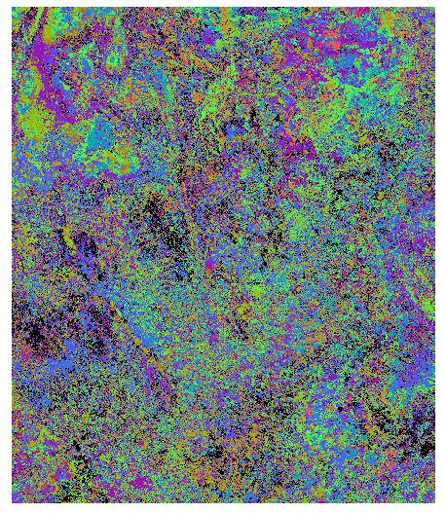
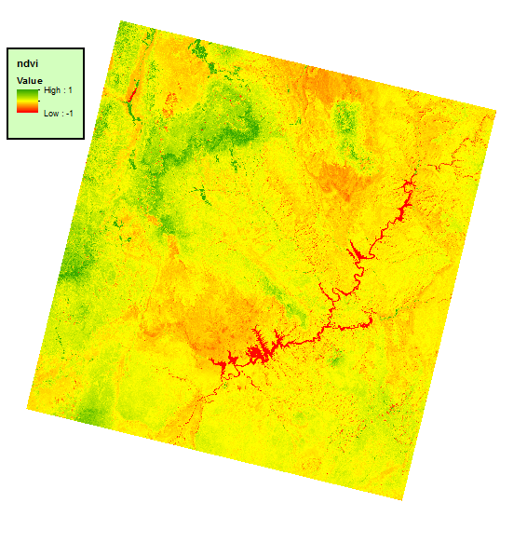
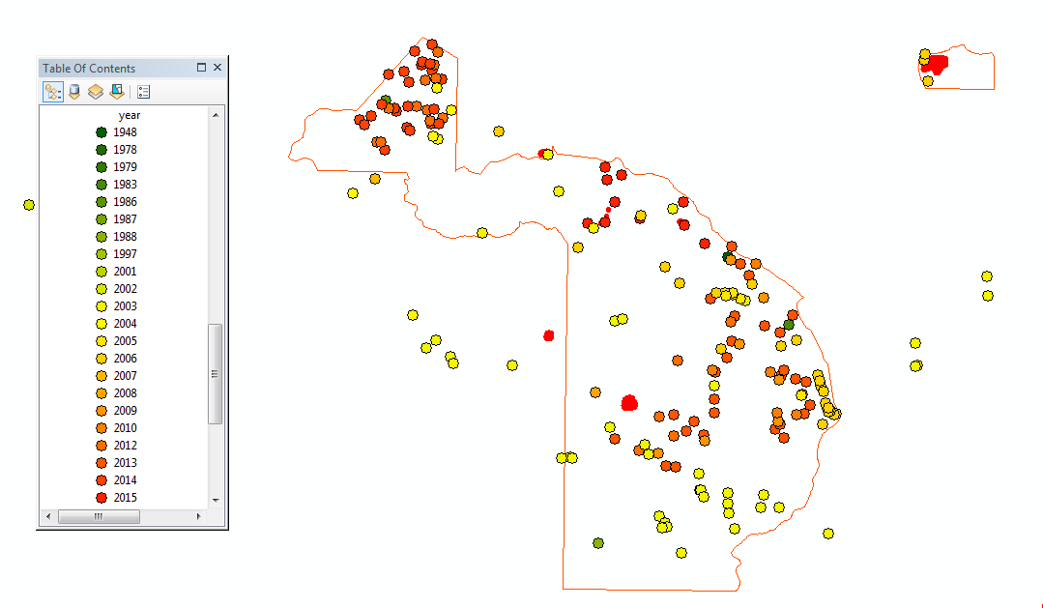
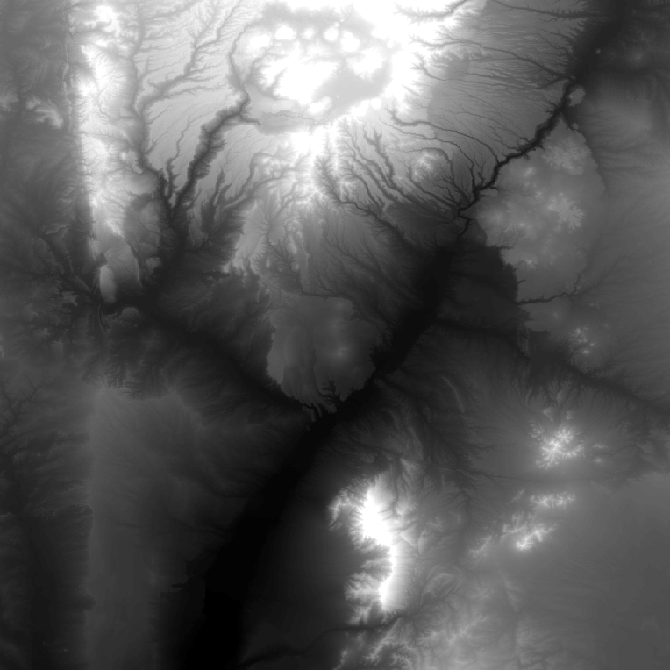
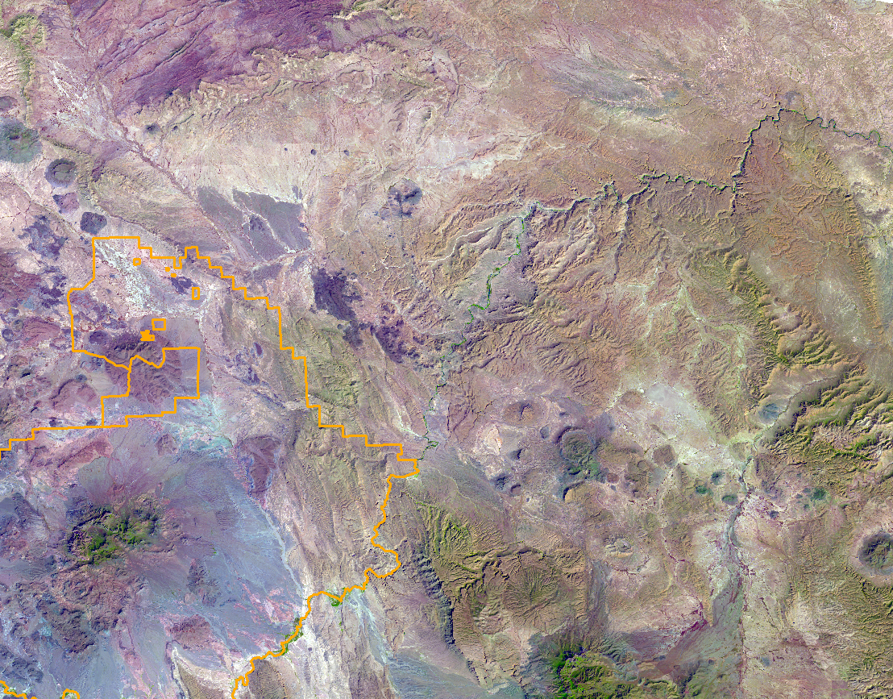
Methods Overview
Determine Vegetation Greenup Dates
Variable Selection
In Situ Selection
Conduct K-means or Random Forest Classification Method
Validate Classification and assess accuracy with in situ data
Notes:
We assembled Landsat and Sentinel-2 imagery for each year where we obtained cloud free images. We classified these multispectral data using both unsupervised and supervised methods. In BAND and VALL, classification maps were validated using in situ data and the 2002-2003 GAP landcover study. In Big Bend, class labeling and error estimation is done within the Random Forest algorithm.
We repeated this process for various unique combinations of topographic and spectral variables, differing study area extents, and algorithm parameters. We qualitatively compared map outputs and quantitatively compared summary statistics to determine the most accurate map product.

Slide 9

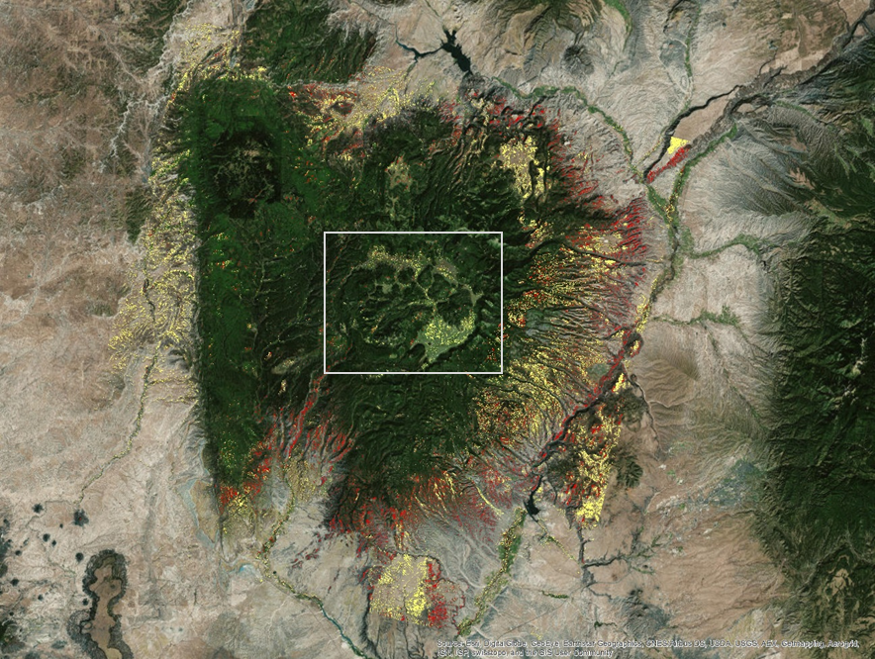
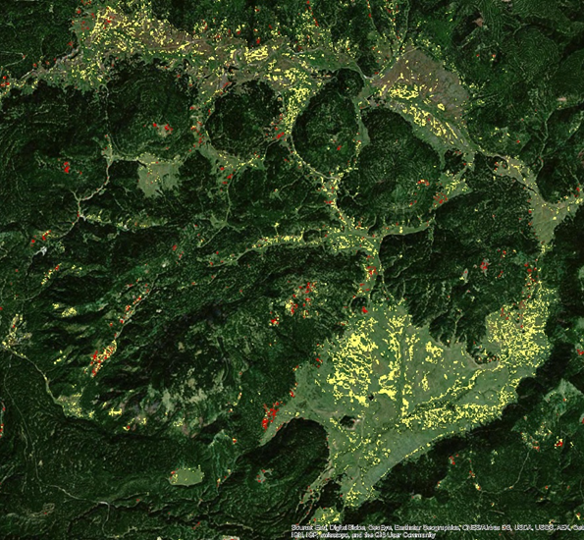


Results: Unsupervised Classification
Valles Caldera and Bandelier
2002 potential cheatgrass areas
2016 potential cheatgrass areas
Notes:
These are our most successful classifications of the BAND and Valles Caldera Area. The classes which captured the highest percentage of cheatgrass in situ points are labeled as areas with potential susceptibility to cheatgrass invasion. Since we did not have enough situ data to determine if patches of cheatgrass could be directly sensed by Landsat, we instead sought to classify the more general case: grasslands susceptible to cheatgrass invasion.
We see from the map that our 2016 classification does not capture the majority of the grassland or thin open canopy areas around the caldera. This is because we clipped out forested areas using GAP landcover data into classifiable regions and because of the lack of in situ data.

Slide 10
Results: Unsupervised Validation
Count
Valles Caldera and Bandelier in situ point distribution, 2002
Class Label
Notes:
This graph shows how classes were labeled for the 2002 image as well as the spatial distribution of the 2002-2003 in situ data that was used to validate our map. The graph shows that a majority of points fell within a single class. However, most of these points have percent coverage ranging from 0-10. Even then, the fact that our classification captured most of these points could be related to sampling bias or over-classification

Slide 11
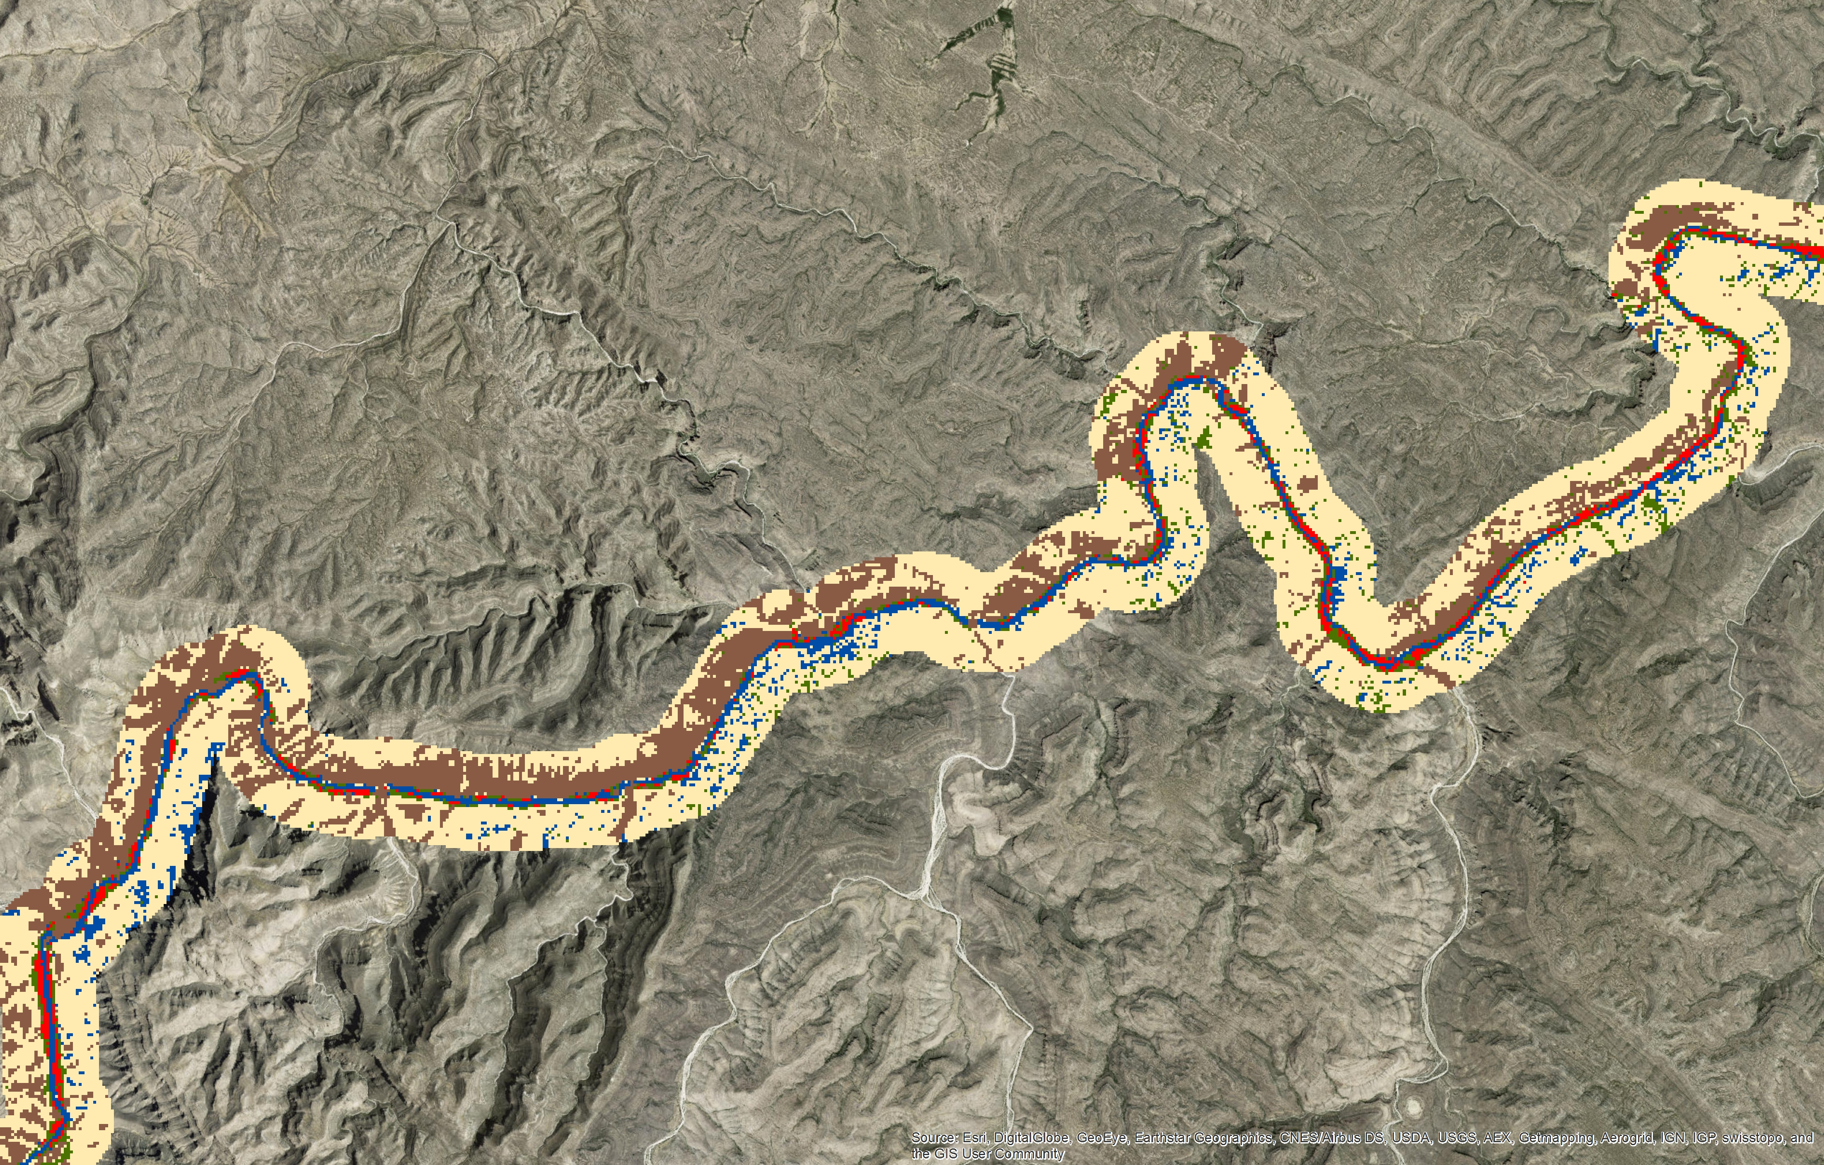
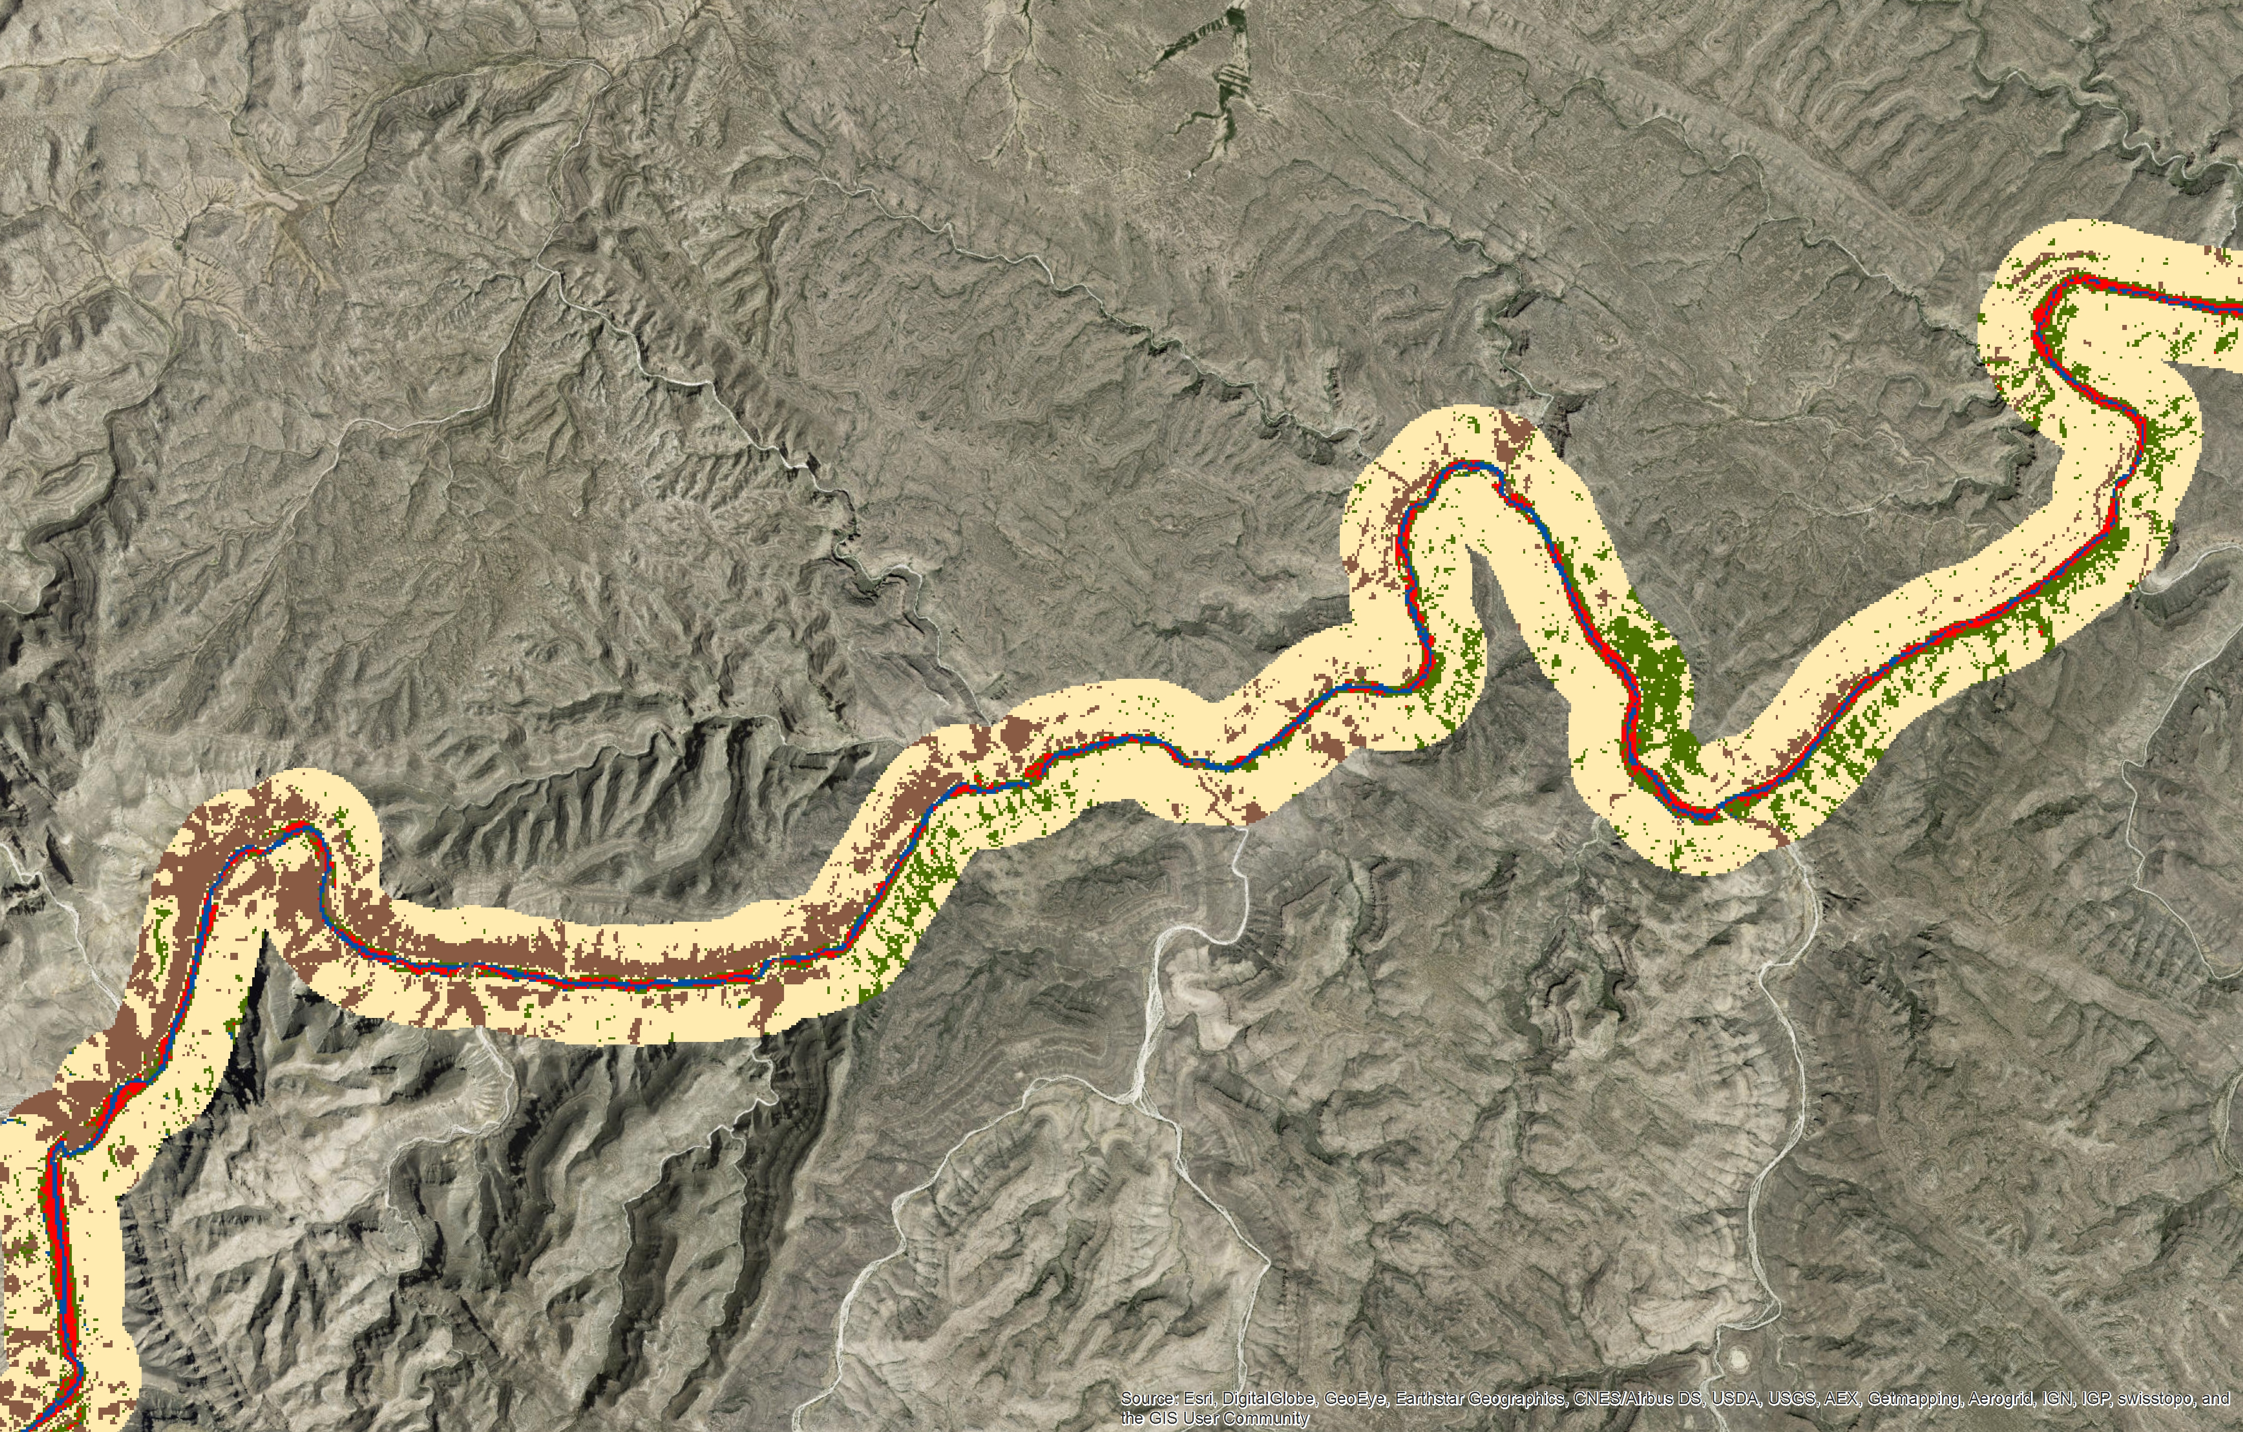
Results: Random Forest
Landsat vs. Sentinel - 2a
Giant Reed
Bare Soil
Other Vegetation
Water
Shrubland
Notes:
We compared the two Random Forest classifications and found Sentinel-2 performed better than Landsat. Both results over classify Giant Reed but Sentinel does a better job in most of the other classes and has a smaller error rate overall. Aside from the error matrix output, (Transition:) this can be validated several different ways.

Slide 12
Results: Random Forest
Notes:
Random Forest also creates an output image that shows the probability of each pixel having been classified correctly. These histograms show how many pixels in our classified image had a high probability of being correct. The Sentinel-2 image clearly has a higher probability of more pixels being classified correctly.

Slide 13
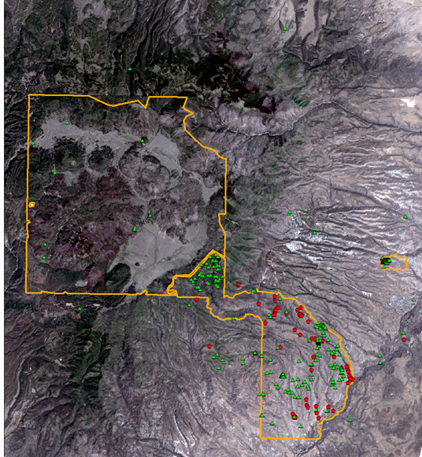

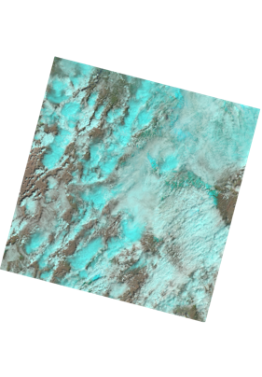
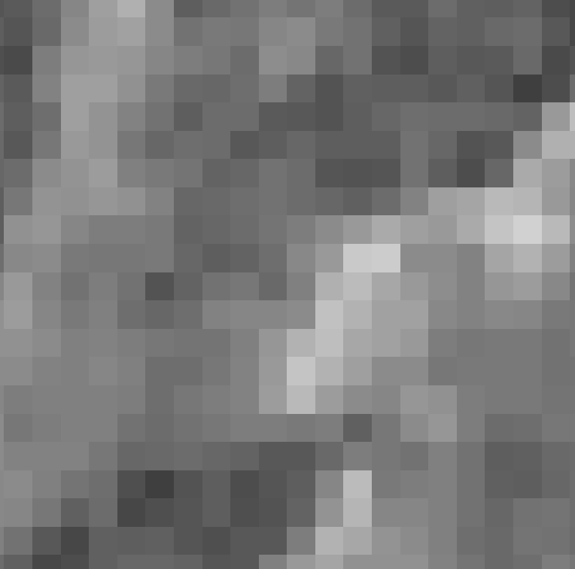

Error and Uncertainties
MODIS
250 m
Landsat8
30 m
Sentinel – 2a
10 m
All Cheatgrass Points
In Situ
Percent Coverage
Notes:
One of the reasons for this disparity is because of the different spatial resolutions of Landsat and Sentinel-2. In the middle here we have examples of a MODIS band which is 250m, Landsat 8, which is 30m, and Sentinel 2, which is 10m. We tested MODIS ForWarn data as a variable in our classifications for cheatgrass but it’s coarse resolution did not improve our results.
Another challenge was that only a sixth of our in situ points had percentage cover information and none of these points fell within Valles Caldera. Additionally, the in situ data we had for Giant Reed along the Rio Grande was sparse and making the training data for the other classes was difficult. Thus Giant Reed was over classified, since most riparian vegetation was classified as giant reed, due to similar spectral signatures.

Slide 14
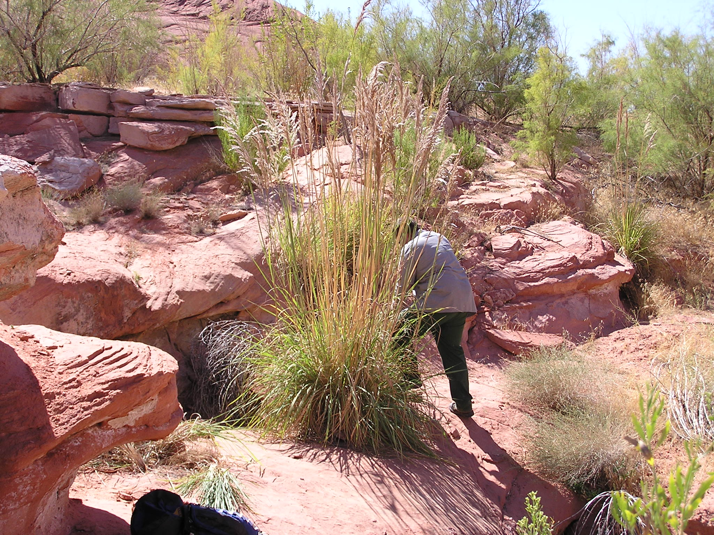
Conclusions
Valles Caldera’s increase in field observations for 2016 improved classification of potentially invaded grasslands
Ravenna grass could not be accurately classified based on current field observations
Sentinel – 2a performed better than Landsat along the Rio Grande
Credit: NPS
Notes:
In conclusion, having more field observations significantly improved the ability to validate and label our unsupervised classifications in the Caldera, and we expect that a richer distribution of in situ observations across the preserve could significantly improve future classifications.
Likewise, in Glen Canyon, due to the lack of field observations, ravenna grass was unable to be accurately modeled or predicted.
Our results for Big Bend determined that Landsat’s 30m pixels are too large to classify giant reed along the Rio Grande. With the public release of the Sentinel-2 archive, we expect that there will be further improvements to be made in classifying vegetation along the Rio Grande and elsewhere.

Slide 15
Dr. Kenton Ross, NASA DEVELOP National Program Science Advisor
Emily Gotschalk, NASA DEVELOP Langley Center Lead
Tyler Rhodes, NASA DEVELOP Langley Center Lead
Kathleen Moore, NASA DEVELOP Langley Assistant Center Lead
Carrie Kelly, NASA DEVELOP Langley Assistant Center Lead
Charles Schelz, Southwest Exotic Plant Management Team, Ecologist/Program Manager
Todd Chaudhry, Colorado Plateau Cooperative Ecosystem Studies Unit, Research Coordinator
Steven Buckley, Southwest Exotic Plant Management Team, Ecologist
Notes:
We’d like to thank the Langley Leadership team and Dr. Ross for all of their help and hard work. We also thank our project partners for the opportunity to work and learn alongside the National Park Service.
Our next presentation is Western U.S. Water.

