Slide 1
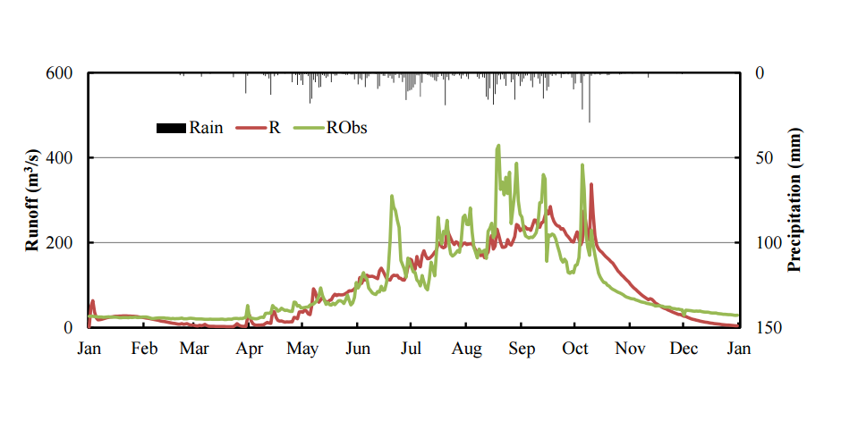
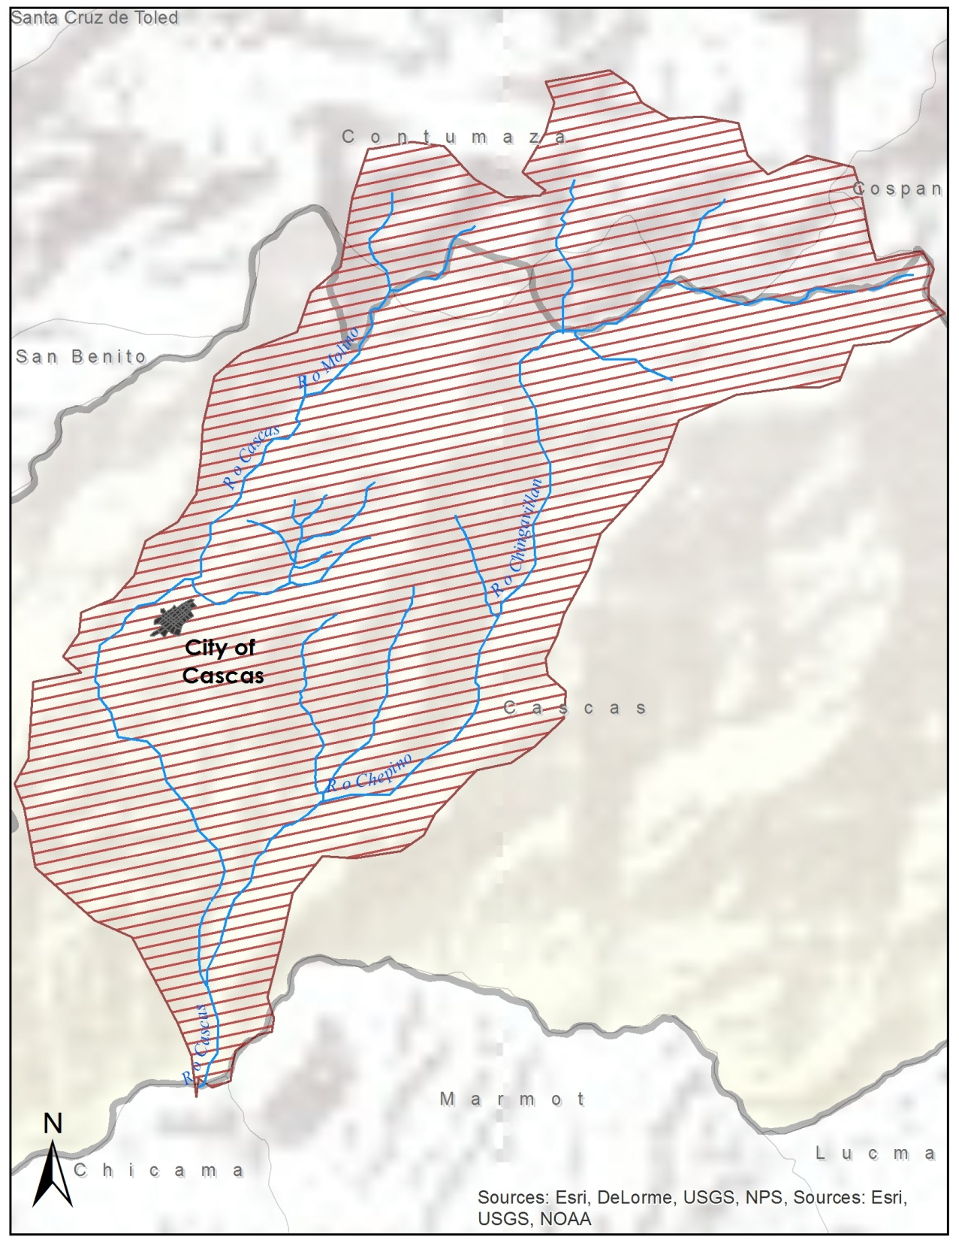
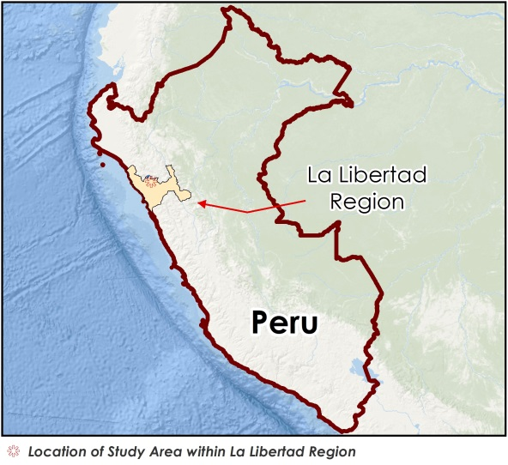
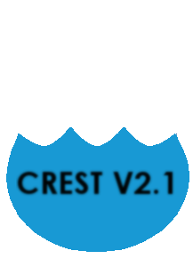
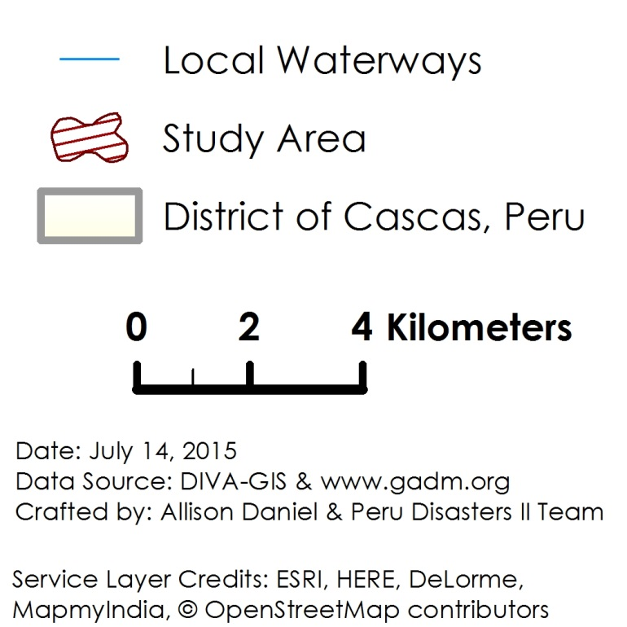
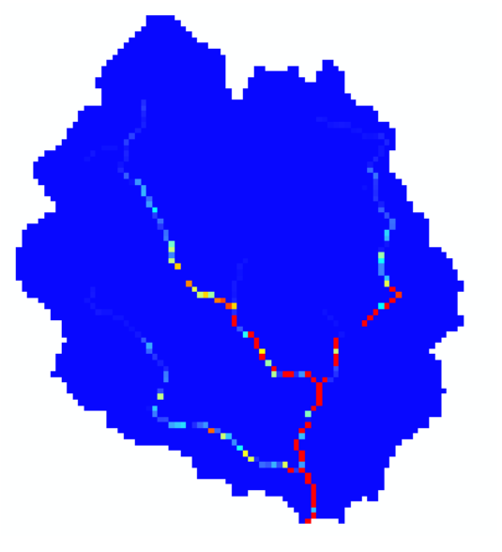
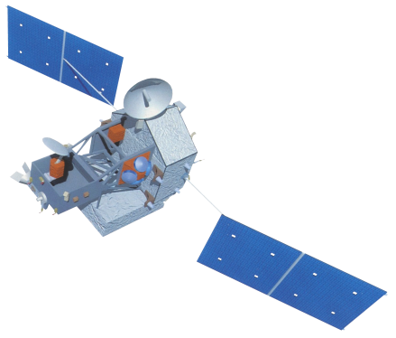
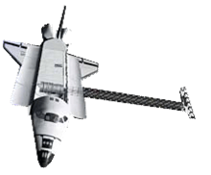
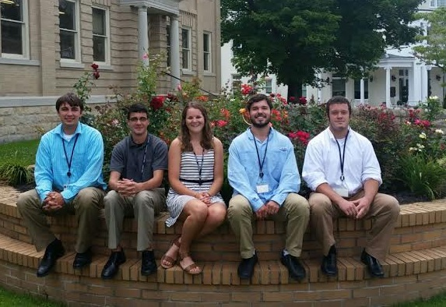
Peru Disasters II
Identifying and mapping flood prone regions in the La Libertad Region of Peru using NASA's Earth Observation Systems
William Wilson (Project Lead), Grant Bloomer, Allison Daniel, Anthony Donzella, Josh Hammes
NASA DEVELOP National Program at Wise County Clerk of Court’s Office
Abstract
Objectives
In recent years, natural disasters have devastated the rural regions of Peru. Large flooding events in 2008, 2013, and 2014 disrupted central highlands districts, including the Cascas district of the Gran Chimu province about 110 km inland from the coastal city of Trujillo. The primary study area for this project was the Ochape river sub-basin near the city of Cascas, the capital of the Gran Chimu province. In partnership with Water for People and the Instituto Nacional de Defensa Civil Del Peru (INDECI), this project aimed to create resources and tools necessary for flood risk assessment projects in the Cascas district of Peru. NASA Earth observations were used in this project to provide input datasets for the Coupled Routing and Excess Storage (CREST) distributed hydrological model, which was developed by the University of Oklahoma in collaboration with NASA SERVIR. These inputs included Digital Elevation Models (DEMs) and related data from the HydroSHEDS portfolio of NASA’s Shuttle Radar Topography Mission (SRTM), rainfall data collected by Tropical Rainfall Measuring Mission (TRMM), and Landsat 8 imagery. All final maps, models, datasets, and tutorials developed in this project will enable Water For People and local authorities to better prepare for flooding based on historical examples.
Improve upon the resources necessary to provide a preliminary flood risk analysis
Produce historic and predictive flood maps utilizing NASA’ s Earth observation satellites and mathematical models for requested area within the La Libertad Region of Peru
Obtain a successful calibration of the CREST 2.0 model
Study Area
Methodology
Shapefile of Study Area
DIVA-GIS
Digital Elevation Model
Flow Direction Map
HydroSHEDS
Flow Accumulation Map
Rainfall Data
Evapotranspiration Data
HydroSHEDS
HydroSHEDS
MOD16
Giovanni
Time Series Data
Earth Observations
TRMM
SRTM
Distributed Outputs
Terra
.
Conclusions & Outlook
Results & Limitations
Results from this project have yet to be compiled at the time of this presentation. We continue working towards simulating the rainfall-runoff cycle in our study area using the CREST model.
Deactivated functionality with 2014 MATLAB version, → 2015 update (CREST v2.1.3) was released mid July.
Late switch to FORTRAN version for compatibility with partner resources and NASA SERVIR.
CREST code still in development and not widely used, v 3.0 to be released later this year.
Dialogue between partners, CREST developers, and SEVIR to continue into interim. Goal is to:
Perform trial runs of basin data over selected time intervals to produce results.
Have forcing inputs formatted for availability with model. Allows partners flexible incorporation with years of data on hand.
Provide manual for obtaining data for other basins.
Team Members
Project Partners
Acknowledgements
Water For People
Instituto Nacional de
Defensa Civil del Peru (INDECI)
Dr. Kenton Ross, Science Advisor (NASA DEVELOP)
Dr. DeWayne Cecil, Science Advisor (Global Science and Technology Inc. )
Jordan Bates, Wise Center Lead (NASA DEVELOP)
Jack Kennedy, Clerk of Circuit Court for Wise County and City of Norton.
Dr. Xinyi Shen, Hydrometeorology and Remote Sensing Laboratory (University of Oklahoma)
Ashutosh S. Limaye, NASA SERVIR
Lance Watkins, Geoinformatics Team (NASA DEVELOP)
Ms. Melanie Salyer, NASA DEVELOP Wise Principal Investigator
(from left to right) Grant Bloomer, Anthony Donzella,
Allison Daniel, Josh Hammes, William Hunter Wilson
Wise County Clerk of Court’s Office

