Slide 1
VERMONT WILDLAND FIRES
Quantifying the Role of Antecedent Conditions and Recent Environmental Trends in Exacerbating Fire Potential and Risk in Vermont
Aline Maybank
Lucas Barr
Isabela Suaza Sierra
Rebecca Economides
North Carolina – NCEI | Summer 2024
Notes:
Hello, thank you for coming to our presentation today! Our NASA DEVELOP project is focused on the Vermont wildland fires, where we worked to quantify the role of drought conditions in exacerbating fire potential and risk across forested lands in Vermont.

Slide 2
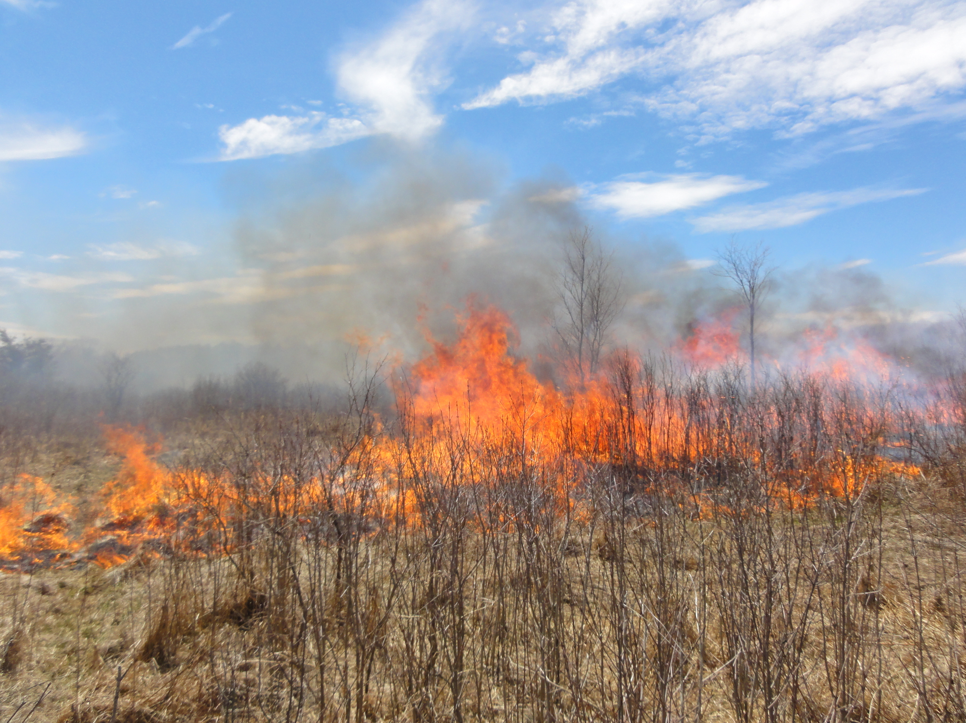
BACKGROUND
Wildfire risk is projected to rise in the northeastern U.S.
Wildfire climatology in Vermont is under-studied.
Patterns that contribute to greater fire risk in moist climates are not well understood.
Image Credit: NWS Burlington
Notes:
Wildfire risk is projected to rise in the Northeastern U.S. Vermont is experiencing increases in annual precipitation and temperature, which are projected to continue under a changing climate. Despite the increase in precipitation, higher temperatures and the influence of other environmental parameters put the state at a greater risk for flash drought conditions, and potentially wildland fires. Also, the majority of literature on fire ecology is concentrated on Western United States, presenting a research gap on how changing environmental conditions impact wildfire risk in the Northeast. So, the patterns that contribute to greater fire risk in moist climates, such as Vermont, are not well understood.
----------Image Information Below----------
Image Credit: National Weather Service Burlington, VT Forecast Office
Image Source: (Obtained from partner, Peter Banacos)

Slide 3
BACKGROUND
Observed Vermont Climate Trends*
Parameter | Trend | Projection
Annual Temperature | Increase | 3.7-5.8°F higher by 2050
Temperature Variability | Increase | Less stable; seasonal variability
Annual Precipitation | Increase | 10% increase by 2100
Snow | Decrease | Fewer days with snowpack; earlier snowmelt
Soil Moisture | Decrease | Higher summer evapotranspiration
Short-Term Droughts | Increase | Potential for annual recurrence in areas
Fire | Increase | Fire events more likely
*Adapted from Vermont Dept. of Forests, Parks, and Recreations (2017)
Notes:
Under a changing climate, Vermont is becoming both wetter and warmer, and is projected to continue to do so (VT Forest Action Plan). Despite the increase in precipitation, higher temperatures and the influence of other parameters put the state at a higher risk for flash drought conditions, which increases fire risk (VT Forest Action Plan).
An overall increase in precipitation could spell a misleading narrative that fires should be less likely, but this is not true. Increased climate variability poses challenges to fire forecasting and communicating risk to the public. For example, winter will bring less snow and more rain, while less change in precipitation is expected for summers. However, even projections themselves are highly variable for summers (VT Forest Action Plan). Flash droughts can occur even after periods of above-average precipitation. Prediction is key to addressing potential damages.
----------Information Citation Below----------
Source: Vermont Dept. of Forests, Parks, and Recreations. (2017). 2017 Vermont Forest Action Plan. https://fpr.vermont.gov/sites/fpr/files/Forest_and_Forestry/Vermont_Forests/Library/2017_VT_ForestActionPlan.pdf

Slide 4
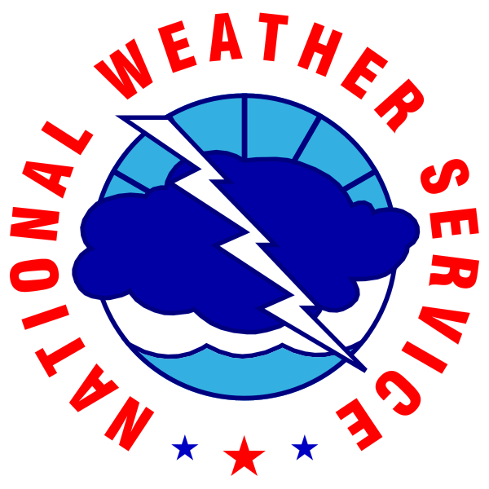
PARTNERS
• National Weather Service (NWS), Burlington, VT Weather Forecast Office
• Vermont Agency of Natural Resources, Department of Forests, Parks and Recreation – Division of Forests
University of Vermont
NOAA National Integrated Drought Information System (NIDIS)
NASA Goddard Space Flight Center
Image Credit: NASA
Image Credit: NOAA
Image Credit: NOAA/NIDIS
Notes:
Partners of our projects include the National Weather Service, Burlington Vermont Weather Forecast Office and the Vermont Agency of Natural Resources, Department of Forests, Parks, and Recreation, Division of Forests. Collaborators include the University of Vermont, the National Integrated Drought Information System from NOAA, and Goddard Space Flight Center from Goddard.
----------Image Information Below----------
NWS logo, bottom center
Image Credit: National Oceanic and Atmospheric Administration
Image Source: https://commons.wikimedia.org/wiki/File:US-NationalWeatherService-Logo.svg
NASA logo, bottom left
Image Credit: National Aeronautics and Space Administration
Image Source: https://gpm.nasa.gov/science-team/resources/nasa-logo
National Integrated Drought Information System (NIDIS) logo, bottom right
mage Credit: NOAA/National Integrated Drought Information System (NIDIS) Image Source: https://commons.wikimedia.org/wiki/File:NOAA-NIDIS-logo.png?uselang=en#Licensing
About logo licensing: "Creative Commons licenses are typically used for works that are copyrighted but licensed for certain permissions beyond traditional copyright law. Since government logos like those of NOAA and NWS are not copyrighted, they do not require a Creative Commons license for use. However, any use should still comply with the guidelines and policies set forth by NOAA and NWS to ensure proper usage."

Slide 5
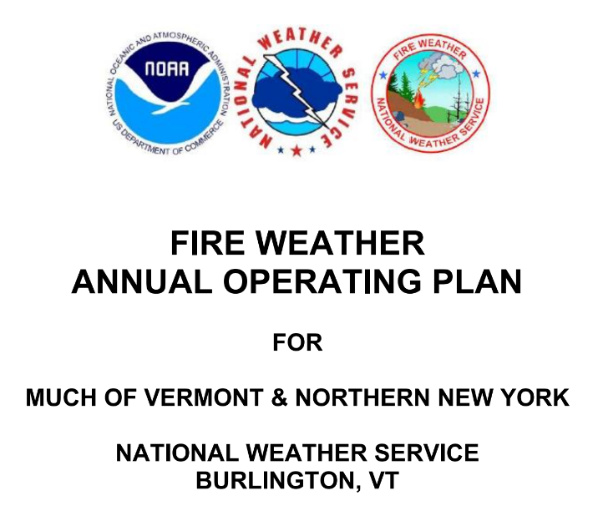
COMMUNITY CONCERNS
Future Fire and Flash Drought Forecasting
Fire and Environmental Hazard Mitigation Plans
Changing Long-Term Phenological Tends
Complex Environmental Interactions
Image Credit: NWS Burlington
Notes:
Community decision makers are interested in accurate short-term indicators for wildland fire and flash droughts to better inform their forecasting and operations. In order to make effective hazard mitigation plans, municipalities need evidence-informed long-term environmental analyses. A better understanding of the changing springtime dynamics of snowmelt and greenup allows community members to incorporate these phenological trends into planning, budgeting, and operations. Also, this work will inform others who are studying the complex interplay between a changing climate and other known issues in Vermont such as invasive species impacts.
----------Image Information Below----------
Fire Weather Annual Operating Plan
Image Credit: National Weather Service Burlington, VT Forecast Office
Image Source: Fire Weather Annual Operating Plan, NWS Burlington, 2022 (Obtained from partner, Peter Banacos)

Slide 6
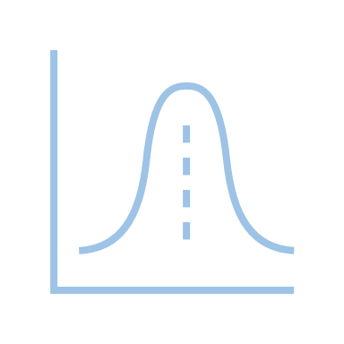
OBJECTIVES
Investigate the Role of Antecedent Conditions and Long-Term Phenology in Exacerbating Fire Risk and Potential in Vermont
Examine Vermont Wildland Fire Climatology
Statistical Analyses of Antecedent Conditions
Phenological
Trend Analyses
Informational
Flyer
Notes:
The goal of our project is to investigate the role of antecedent conditions and long-term environmental trends in exacerbating fire risk and potential in Vermont
We investigated the influence of environmental parameters, such as relative humidity, precipitation, and wind conditions, prior to fire case studies. Results from this study can be used to inform the National Weather Service’s preparation of fire forecasts before prescribed burns and support outreach by the Vermont Division of Forests about fire risk to communities in Vermont.
Our end-products from this project are an examination of Vermont wildland fire climatology, statistical analyses of antecedent conditions, phenological trend analyses, and an informational flyer.
----------Icon Citing Below----------
Icon Credits: PowerPoint

Slide 7
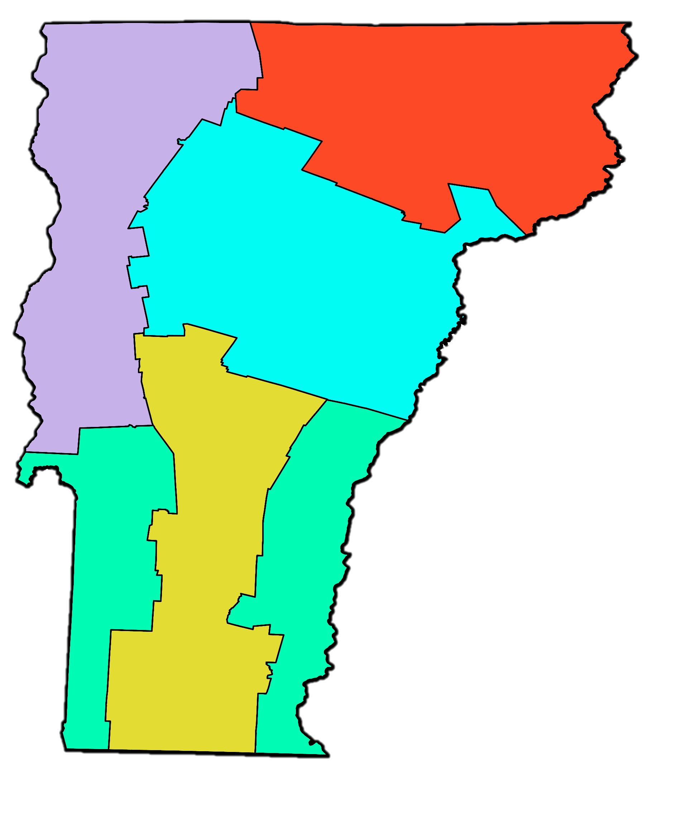
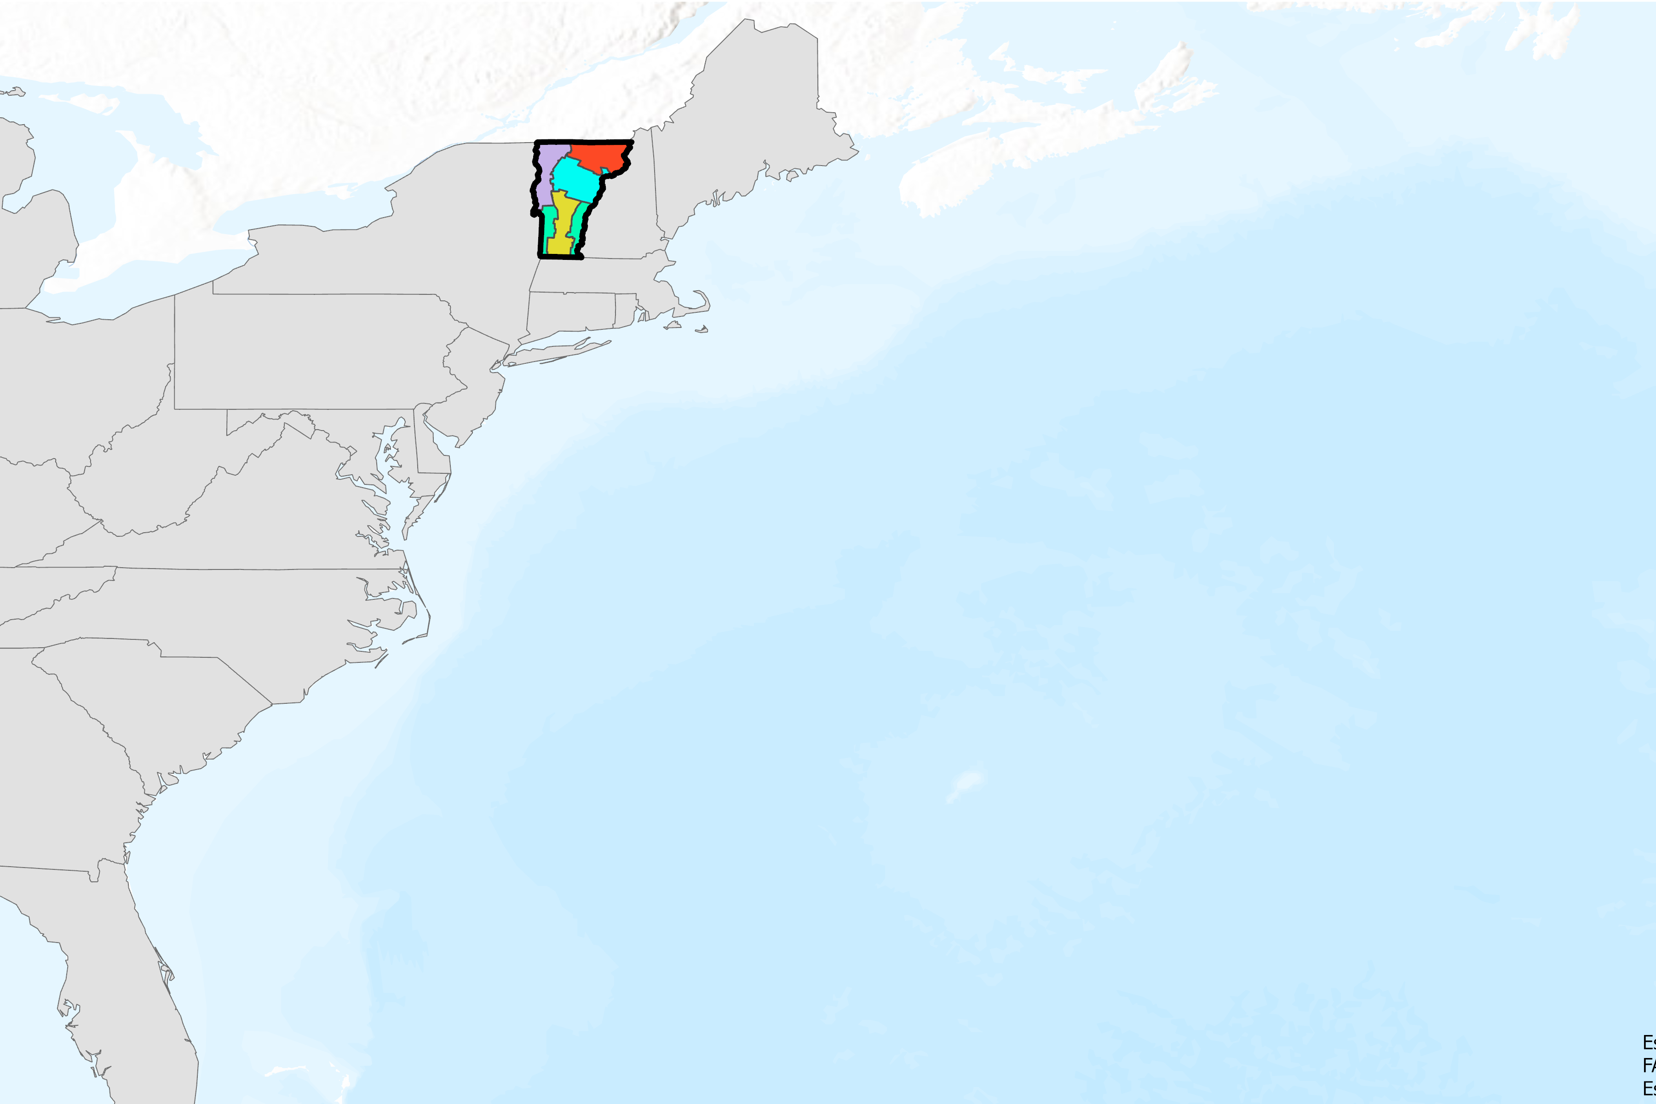
STUDY AREA
FDRA 3
Maine
FDRA 5
New Hampshire
New York
Michigan
Massachusetts
Pennsylvania
Connecticut
Rhode Island
Ohio
FDRA 4
N
Maryland
New Jersey
Study Location:
Vermont, US (VT)
Delineated into Fire Danger Rating Areas 1-5
West Virginia
Delaware
Kentucky
Virginia
Tennessee
North Carolina
FDRA
1
Vermont Boundary
South Carolina
VT Fire Danger Rating Areas
FDRA
1
Georgia
North Atlantic Ocean
FDRA 1
FDRA 2
FDRA 2
FDRA 3
Florida
FDRA 4
0
25
50
100
FDRA 5
Basemap credits: VCGI, Esri, TomTom, Garmin, FAO, NOAA, USGS, EPA, USFWS
km
Notes:
Under a changing climate, increases in dry conditions coupled with more extreme heat events are projected to heighten wildfire risk in the northeastern United States. However, recent trends in wildfire risk in Vermont—and the mechanisms through which environmental factors contribute to increased fire risk in humid environments—are not well understood. So, our study's location is the state of Vermont, which is delineated into its five Fire Danger Rating Areas (FDRA). Our analyses are conducted at the scale of Vermont’s FDRAs.
----------Image Information Below----------
Image Credit: DEVELOP TEAM
Service Layer Credits: VCGI, Esri, TomTom, Garmin, FAO, NOAA, USGS, EPA, USFWS

Slide 8
STUDY PERIOD
Long-term environmental trend analyses
January 1st – December 31st, 2001–2023
2001
2008
2023
For antecedent condition analyses for fire case studies
March 1st – November 30th, 2008 – 2023
Notes:
Our study has two periods of interest. First, to analyze trends in environmental parameters related to fire risk in each of Vermont’s five Fire Danger Rating Areas, we first reviewed phenology data from January 1st, 2001, to December 31st, 2023. Second, to examine links between antecedent conditions preceding fire events in Vermont, we evaluated environmental variables from March 1st to November 30th, from 2008 and 2023.

Slide 9
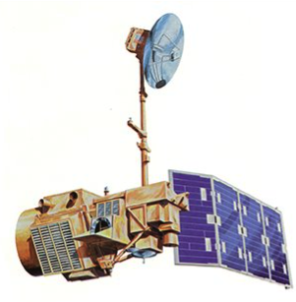
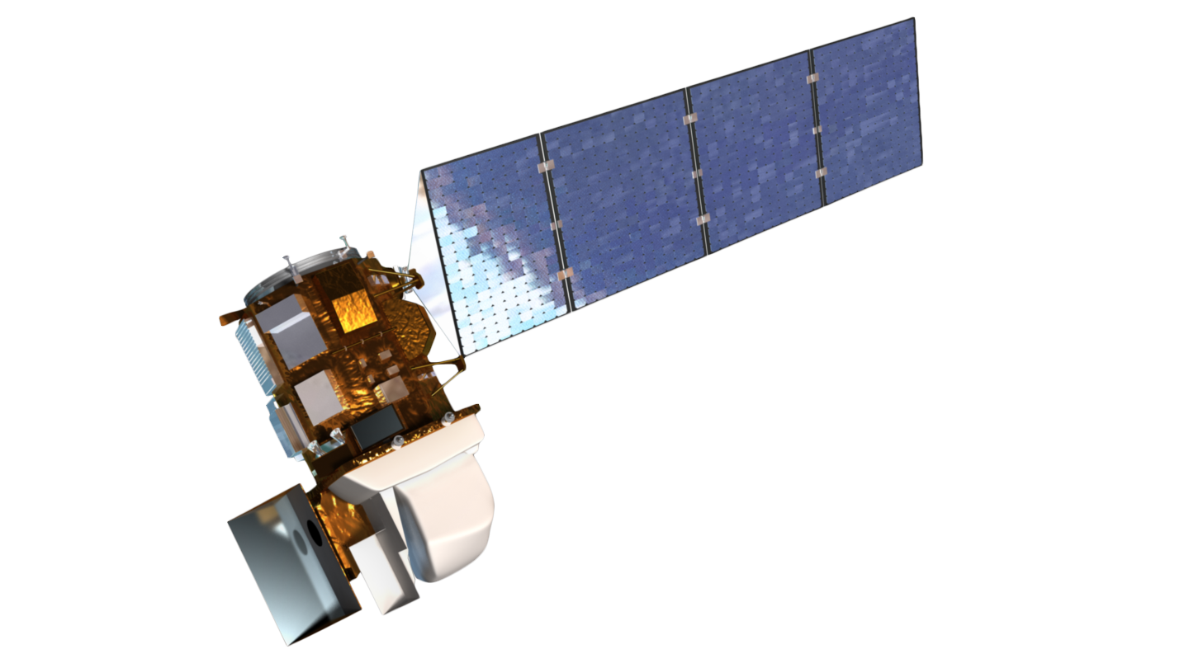
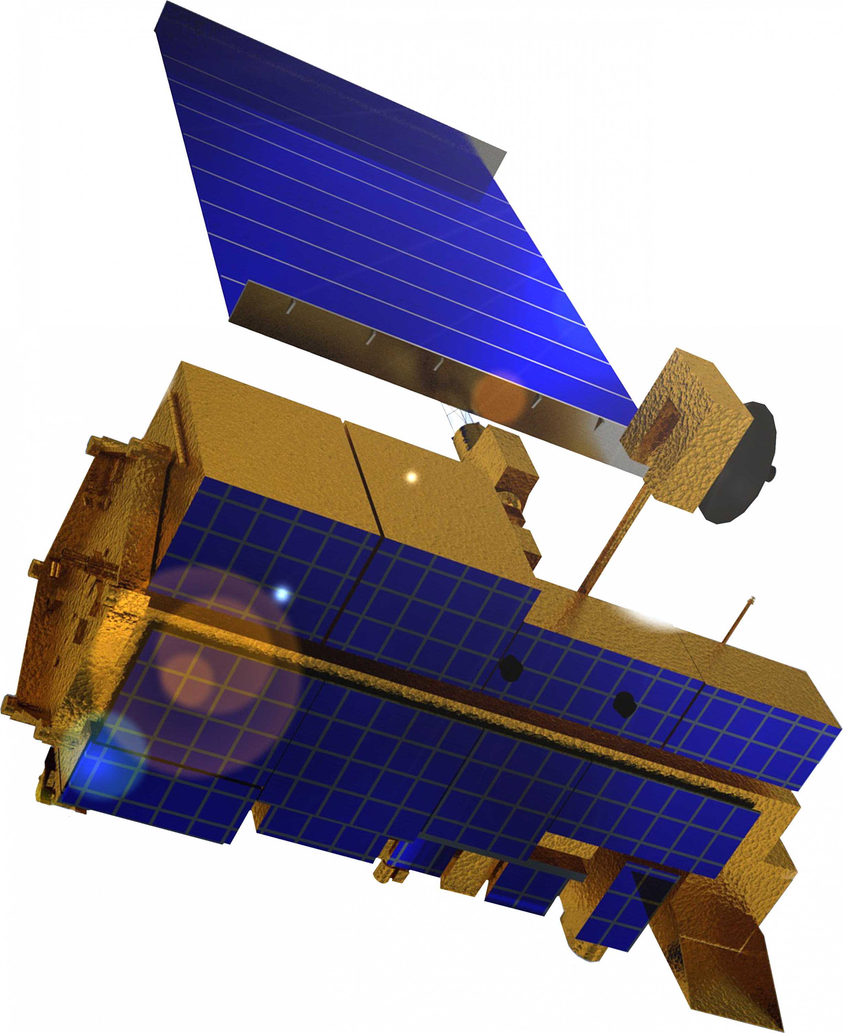
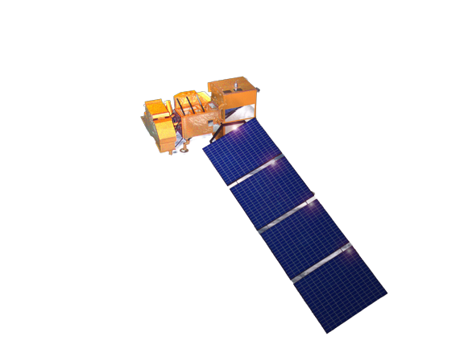
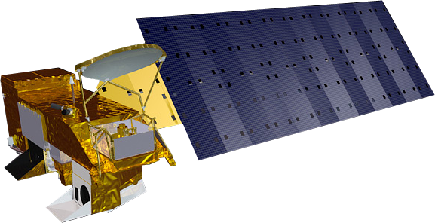
EARTH OBSERVATIONS: SATELLITES & SENSORS
Terra MODIS
Landsat 8 OLI & TIRS​
Landsat 5 TM​
Landsat 7 ETM+
Aqua MODIS
Landsat 9 OLI & TIRS
Image Credits: NASA Landsat Science & Jet Propulsion Laboratory
Notes:
To retrieve our environmental parameter data, we used a variety of satellites. While in the data selection phase of our project, we retrieved normalized difference vegetation index (NDVI) data from Landsat 5 Thematic Mapper, Landsat 7 Enhanced Thematic Mapper Plus, and Landsat 8 and 9 Operational Land Images and Thermal Infrared Sensor. We also retrieved vegetation (MODIS dataset) and soil moisture data from the Terra and Aqua satellites.
----------Image and Icon Information Below----------
Landsat 5 TM: https://landsat.gsfc.nasa.gov/satellites/landsat-5/
Landsat 7 ETM+: https://landsat.gsfc.nasa.gov/article/landsat-7/
Landsat 8 OLI & TIRS: https://landsat.gsfc.nasa.gov/article/landsat-data-continuity-mission/
Landsat 9 OLI & TIRS: https://landsat.gsfc.nasa.gov/satellites/landsat-9/landsat-9-overview/
Terra: https://science.nasa.gov/wp-content/uploads/2023/05/Terra.png
Aqua: https://science.nasa.gov/wp-content/uploads/2023/05/Terra.png
Icon Credit: Powerpoint

Slide 10
METHODOLOGY: LONG-TERM PHENOLOGICAL ANALYSIS
2001
January 1st – December 31st, 2001–2023
2023
Variables
Processing
Analysis
Classified data per FDRA
Extracted dates of green-up
Calculated dates of snowmelt
Summary statistics and visualizations per FDRA
Trend analysis
within study period
MCD12Q2 Land Cover Phenology
Snow Water Equivalent
Notes:
For the long-term phenological analysis, we accessed the Normalized Difference Vegetation Index (NDVI) data and Snow Water Equivalent (SWE) between 2001 and 2023. All data was pulled from Climate Engine via Google Colab. For vegetation data, land surface phenology was retrieved from the Terra and Aqua combined Moderate Resolution Imaging Spectroradiometer (MODIS) Land Cover Dynamics (MCD12Q2) data product between January 1, 2001 and December 31, 2022. SWE data was pulled in from the National Operational Hydrologic Remote Sensing Center (NOHRSC) as part of their Snow Data Assimilation System (SNODAS) dataset between January 1, 2004 and December 31, 2023.
For NDVI, we extracted from MODIS's Land Cover Dynamics 'Green-Up layer. This layer indicates an early green-up date per 500 m pixel. For processing, we averaged these early green-up dates at the FEDRA level per year, arriving at twenty dates of green-up per FDRA. For SWE, we created a calculation which determined the maximum value of SWE per winter season -- a date which indicates maximum snowpack – and found the date following this event at which the snowpack first decreased to half the maximum value. This value became the 'melt timing' date and was used for analysis. From here, we took at the distributions of these dates and calculated appropriate summary statistics for each set of dates. We relied heavily on the median value for this. Last, we analyzed trends within this 20-year time span for both green-up dates as well as melt dates.

Slide 11
METHODOLOGY: ANTECEDENT CONDITION ANALYSIS
2008
March 1st – November 30th, 2008 – 2023
2023
Variables
Processing
Analysis
Relative Humidity
Precipitation
Soil Moisture
Evaporative Stress Index
Wind Speed
Seasonal linear regressions
Pearson linear correlations
Random Forest models
Maps of environmental condition trends
Retrieved data per FDRA and compute 7 and 30-day moving averages
Divided data into seasons based on phenological processes
Notes:
For the antecedent condition analysis, we accessed relative humidity, precipitation, soil moisture, evaporative stress index, and wind speed datasets. We used 4 km relative humidity data from the University of California’s GridMET database. Daily precipitation data at 4.6 km resolution was pulled from NOAA’s NClimGrid-Daily archival database. We accessed the NASA Global Land Data Assimilation System (GLDAS) version 2.1 root zone soil moisture at 24 km resolution for daily soil moisture. Four-week Evaporative Stress Index (ESI) data from the SERVIR program at NASA jointly with the Hydrology and Remote Sensing Laboratory at the United States Department of Agriculture - Agricultural Research Service (USDA-ARS) was accessed, which provides a new 30-day update every seven days at a 5 km resolution. Finally, wind speed was retrieved from Gridmet.
To process the data we computed 7 and 30-day moving averages and divided the data into seasons based on phenological trends. Our outputs from the analysis include seasonal linear regressions, Pearson linear correlations, random forest models, and maps of environmental condition trends.

Slide 12
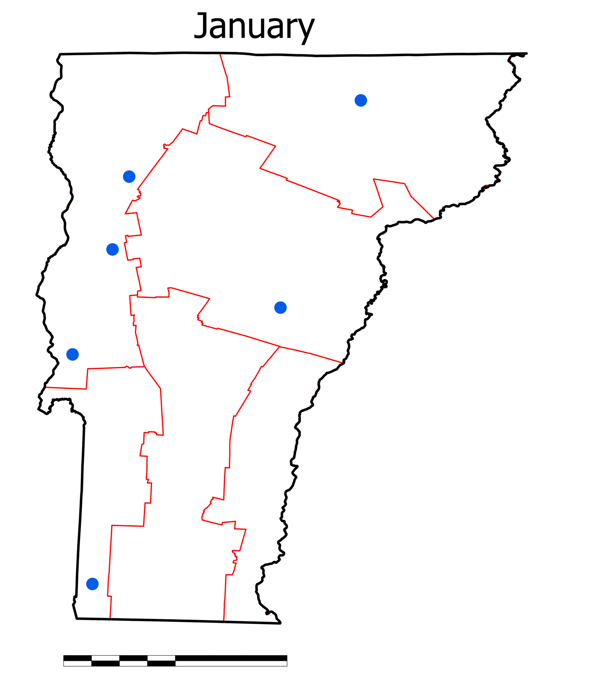
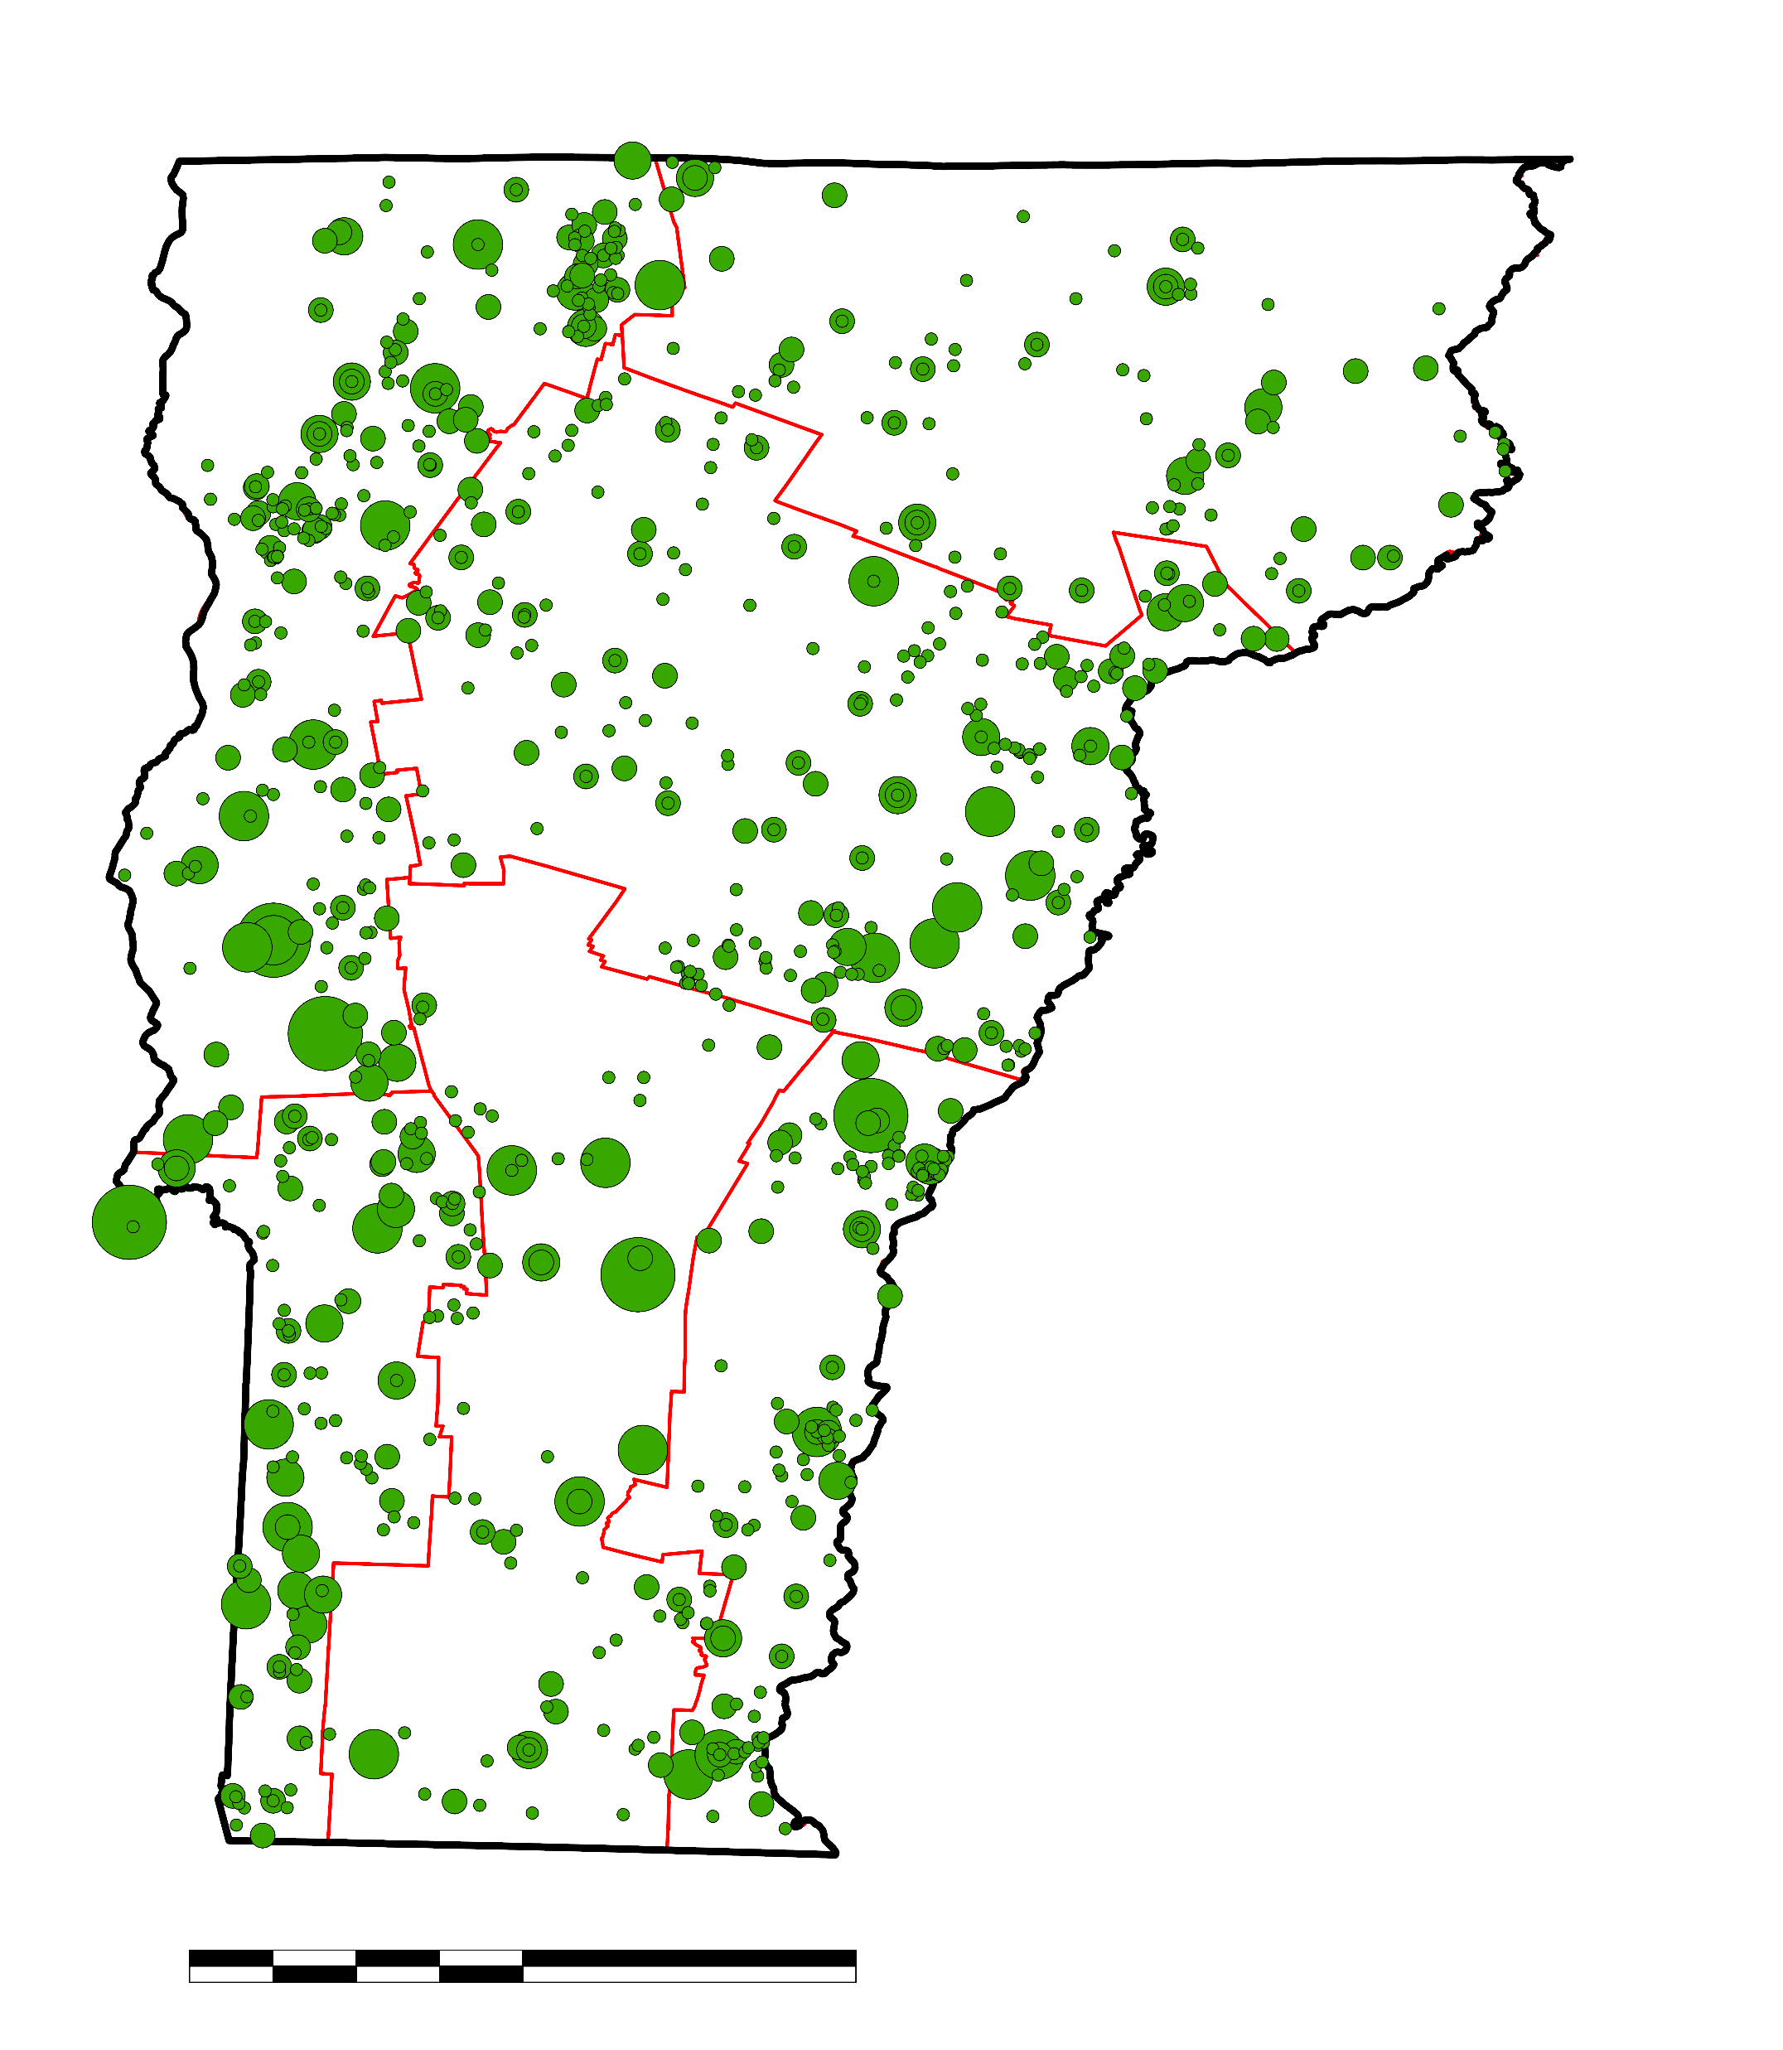
VERMONT FIRE OCCURRENCE (2008-2023)
Monthly Fire Occurrence
Fire by Area
N
5
N
3
3
5
4
4
2
Area Burned (Acres)
1
1
1
2
1
1
5
Location of fires
10
50
100
0
25
50
100
0
25
50
100
km
km
Credits: ESRI, CGIAR, USGS
Notes:
Vermont's largest fire season is from April to May each year. These maps serve to visualize the distribution of fires within each year and across each FDRA. The map to the left, depicting monthly fire occurrence, show the number and placement of all the wildland fires that occurred between 2008 and 2023 in each month of the year. You can easily see visually that April has experience the largest number of fires. It should be noted that the proportional symbols in the area map do not reflect the actual area burned in individual fire events. The scale of actual area burned would not be visible on the scale of Vermont in this presentation.

Slide 13
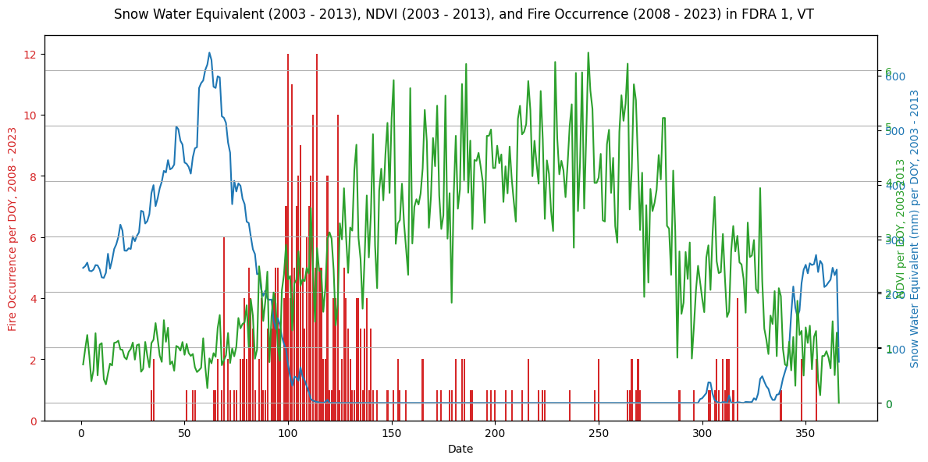
LONG-TERM PHENOLOGICAL ANALYSIS
Snow Water Equivalent, NDVI, and Fire Occurrence in FDRA 1, Vermont
Fire Occurrence by Day of Year, 2008 - 2023
Snow Water Equivalent (mm)
by Day of Year, 2003 - 2012
NDVI by Day of Year, 2003 - 2012
0
50
100
150
200
250
300
350
Day of Year
Notes:
This graph shows three variables by day of year: snow water equivalent in blue, NDVI values in green, and fire occurrence in red. All variables are from FDRA 1 in Vermont; SWE and NDVI data are combined from a period of about 10 years, while the bar graph represents summed fire occurrence over 15 years. Together, these trends depict key environmental processes surrounding fire season in Vermont. As you can see, SWE decreases quickly in the spring, followed by a sharp uptick in fire occurrence. We notice that NDVI starts to increase, indicating the onset of green-up, as fire occurrence decreases in late May. We can see here how greenup and snowmelt frame Vermont's fire season; between these two events is when dry fuels in the landscape are susceptible to fire-conducive conditions. Since most fires in Vermont are humans, this means that the environment during these two events is primed to allow a wildland fire to occur. We can see here that wildland fires do, in fact, occur in numbers during this time, and so the timing of these two events becomes very important.
This image is for visualization only.

Slide 14
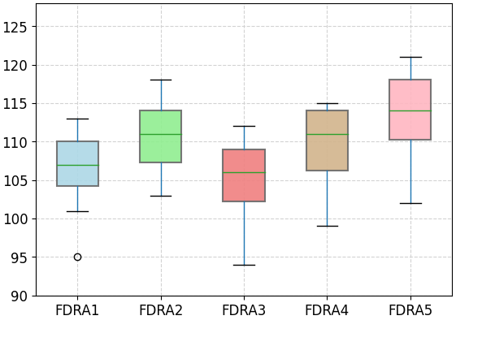
LONG-TERM PHENOLOGICAL ANALYSIS
Temporal Distribution of Green Up Day (2001-2022) by FDRA
125
120
115
Day of Year
110
105
100
95
90
FDRA1
FDRA2
FDRA3
FDRA4
FDRA5
Notes:
After retrieving all 100 green-up dates from MODIS Land Cover Phenology MCD12Q2 (20 per 5 FDRA's), we examined these distributions per FDRA. This helped us get an idea of the best way to analyze trends within this period, if there were any. Spring green-up dates represent the beginning of the green-up period. As shown in this boxplot, there is no (significant) difference between the five FDRA's green-up dates from 2001 and 2022. However, they are not the exact same either. FDRA5 has the latest and FDRA3 has the earliest median green-up day compared to the other FDRAs.

Slide 15
LONG-TERM PHENOLOGICAL ANALYSIS
Representative Start and End Dates of Fire Season
as determined by annual environmental events
FDRA | Spring Melt Date | Spring Early Green-Up Date
FDRA 1 | March 10 | April 17
FDRA 2 | April 5 | April 21
FDRA 3 | March 7 | April 16
FDRA 4 | March 29 | April 21
FDRA 5 | April 2 | April 24
Method | Implemented peer-reviewed method for melt timing | Extracted dates from pre-processed MODIS imagery
Notes:
These dates are determined from two datasets: MODIS Land Cover Phenology and SNODAS Snow Water Equivalent data and represent the median dates of the study period per FDRA. SWE data is from an archival reanalysis dataset which contains daily SWE data, which allowed for precise and straightforward calculation of spring melt dates. The early green-up dates were extracted from the 'Green-Up' layer in MODIS land cover phenology data, which has a temporal resolution fine enough to pinpoint this vegetative phenomenon during the spring. The spring melt dates are defined as the first date in the spring at which the snowpack SWE arrives at half the maximum value achieved during the previous winter. While these dates are a subjective way to arrive at an idea of when the snowpack is melting, and represent an approach in timing of the upcoming fire season. The spring green-up dates shown here represent the beginning of green-up period, and as you can see, are more consistent than the spring melt dates.

Slide 16
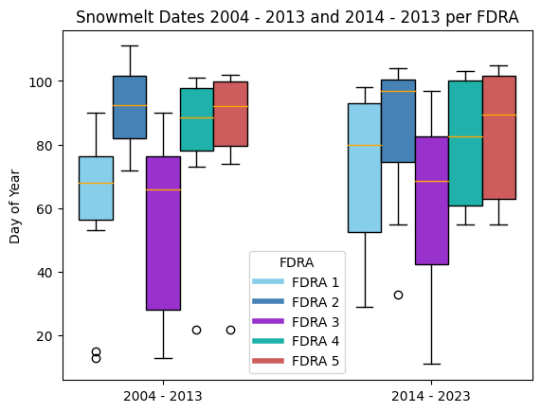
LONG-TERM PHENOLOGICAL ANALYSIS
Snowmelt Dates 2004 - 2013 and 2014 – 2023 by FDRA
100
IQR of first ten years of calculated snowmelt dates is smaller
80
IQR of second half of calculated snowmelt dates is increased from IQR of the first half of dates
Day of Year
60
40
FDRA
FDRA 1
FDRA 2
20
FDRA 3
FDRA 4
FDRA 5
2004 - 2013
2014 - 2023
Notes:
This analysis depicts how climate variations and changes in environmental conditions have potentially impacted snowmelt patterns over the past 20 years. The box plot represents snowmelt dates categorized by the five FDRAs. When comparing the two periods, we can observe that snowmelt dates have generally shifted later in the year in the 2014-2023 period for most FDRAs. Over the first ten years (2004-2013), the variability is quite pronounced, with some FDRAs showing wide interquartile ranges and several outliers. In the second decade, (2014-2023), while the variability persists, the trend towards later snowmelt dates becomes more evident. This increased consistency in later snowmelt dates could indicate a broader regional climatic trend affecting all FDRAs to some extent.

Slide 17
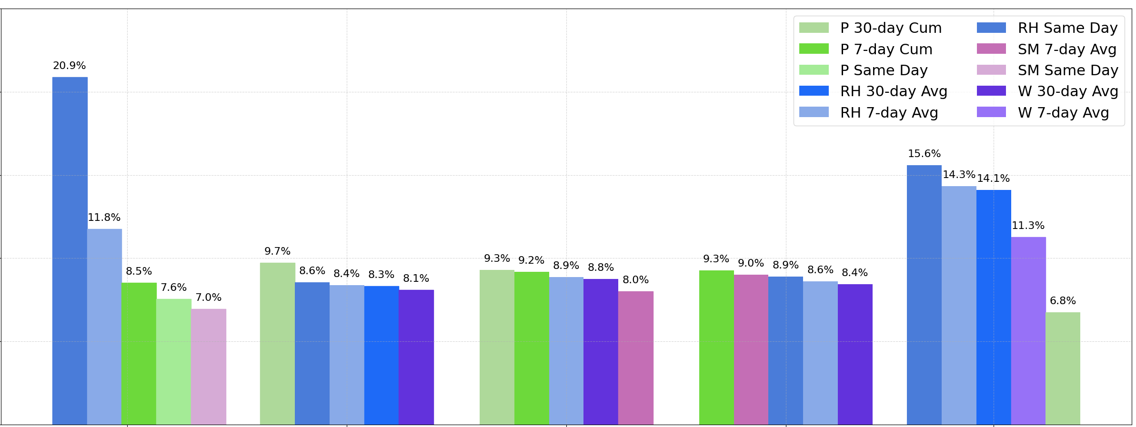
ANTECEDENT CONDITION ANALYSIS
Feature Importance Analysis of Random Forest Models for Fire Occurrence Prediction by Season (2008-2023) for All FDRA
25
P 30-day Avg
RH Same Day
P 7-day Cum
SM 7-Day Avg
20.9%
P Same Day
SM Same Day
20
RH 30-day Avg
W 30-Day Avg
RH 7-day Avg
W 7-Day Avg
15.6%
15
14.3% 14.1%
Importance (%)
11.8%
11.3%
10
9.7%
9.3% 9.2%
9.3% 9.0%
8.5%
8.6% 8.4%
8.3%
8.1%
8.9% 8.8%
8.9% 8.6%
8.4%
7.6%
7%
8.0%
6.8%
5
0
Pre-green up period
Summer and early fall
Fall
Additional fall
Winter
Notes:
We also conducted a feature importance analysis using Random Forest models for predicting fire occurrence by season across all FDRAs from 2008 to 2023. For the seasonal analyses, starting with the pre-green up period, precipitation for the 30-day cumulative period (P 30-day Cum) is the most critical feature, with an importance of 20.5%. For the summer and early fall time period, precipitation for the 7-day cumulative period (P 7-day Cum) and same-day precipitation (P Same Day) are the most influential, each with an importance of around 8.9% and 9.7%, respectively. Feature importance is more evenly distributed in the fall and Additional fall periods, with precipitation and relative humidity showing similar levels of importance. Winter shows a distinct pattern where relative humidity for the same day (RH Same Day) is highly significant, with an importance of 15.4%. Overall, precipitation and relative humidity are consistently significant features across all seasons, indicating their strong influence on fire occurrence. This analysis underscores the complexity of predicting fire occurrences and the necessity of considering multiple environmental factors.

Slide 18
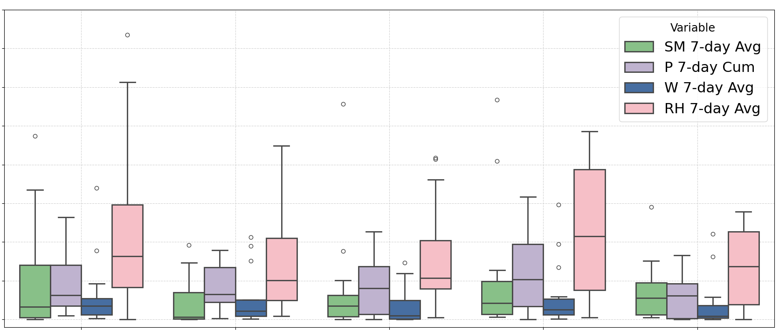
ANTECEDENT CONDITION ANALYSIS
R-squared Values for Climatological Variables (7-day Avg) and Fire Occurrence by FDRA in Spring (2008-2023)
0.40
Variable
0.35
The maximum R-squared value across all variables analyzed by FDRA is less than 0.4, indicating no significant correlation.
SM 7-day Avg
P 7-day Cum
0.30
W 7-day Avg
RH 7-day Avg
0.25
R-squared (fire, regressor)
0.20
0.15
0.10
0.05
0
FDRA1
FDRA2
FDRA3
FDRA4
FDRA5
Notes:
In addition, we calculated seasonal correlations using linear regression between antecedent variables (e.g., soil moisture by FDRA) and the response variable (aggregated fire occurrences by FDRA) for each unique season, such as Spring from 2008 to 2023. This analysis aimed to determine whether correlations exist between fire occurrences and antecedent variables during specific seasons. Since, this graph is a boxplot of R-squared values in each FDRA, a value of 1 indicates a perfect correlation between the variable and fire occurrences, while a value of 0 indicates no correlation.
The analysis included same-day, antecedent 7-day moving average, and antecedent 30-day moving average WS and RH. And same-day P, 7-day cumulative P, and 30-day cumulative P
Across all FDRAs, the maximum R-squared value for any variable is less than 0.4, indicating no significant correlation. This suggests that none of the antecedent climatological variables (SM, P, W, RH) are strong predictors of fire occurrences in spring within the studied period. Specifically, for FDRAs 1-3, the R-squared values for all variables are generally low, with no variable exceeding an R-squared value of 0.2; thus, there are very weak correlations between the antecedent variables and fire occurrences. For FDRA 4 and 5, there are slightly higher R-squared values are observed compared to FDRA1 to FDRA3, but still below 0.4, and relative humidity and precipitation show marginally higher importance in these regions, yet not significant enough for predictive power.
Overall, this boxplot analysis highlights the complexity of fire occurrence prediction and suggests that other factors beyond the antecedent climatological variables considered here might play a more crucial role.

Slide 19
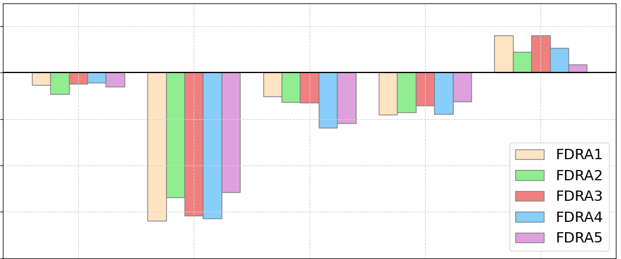
ANTECEDENT CONDITION ANALYSIS
Linear Correlation Between Fire Occurrence and Climatological Variables (30-Day Moving Average) by FDRA (2008-2023)
0.2
0.0
-0.2
Correlation coefficient
-0.4
FDRA1
FDRA2
FDRA3
FDRA4
FDRA5
Moderate/Weak negative correlation
-0.6
-0.8
ESI
RH
SM
P
W
Notes:
In addition, we calculated the Pearson (linear) correlation between fire occurrences and climatological variables using a 30-day moving average. This analysis covered all dates from 2008 to 2023, utilizing a weekly resolution (Tol include ESI data) by FDRA A correlation coefficient of 1 indicates a perfect positive correlation, meaning that as one variable increases, the other also increases proportionally. Conversely, a coefficient of -1 signifies a perfect negative correlation, indicating that as one variable increases, the other decreases proportionally. A coefficient of 0 suggests no linear relationship.
ESI shows a weak negative correlation with fire occurrences across most FDRAs, implying that higher evaporative stress slightly increases fire risk. Across all FDRAs, RH shows the highest negative correlation with fire occurrences, which means that lower RH values are associated with an increase in fire occurrences, indicating drier conditions promote fire activity. Both soil moisture and precipitation show generally negative correlations with fire occurrences, although less pronounced than RH, suggesting that drier conditions are linked to higher fire occurrences. Wind Speed exhibits a mix of weak positive and negative correlations across FDRAs, indicating that wind speed has a less consistent impact on fire occurrences compared to other variables. Overall, this analysis demonstrates that relative humidity is a significant predictor of fire occurrences, with lower RH values leading to higher fire risk.

Slide 20
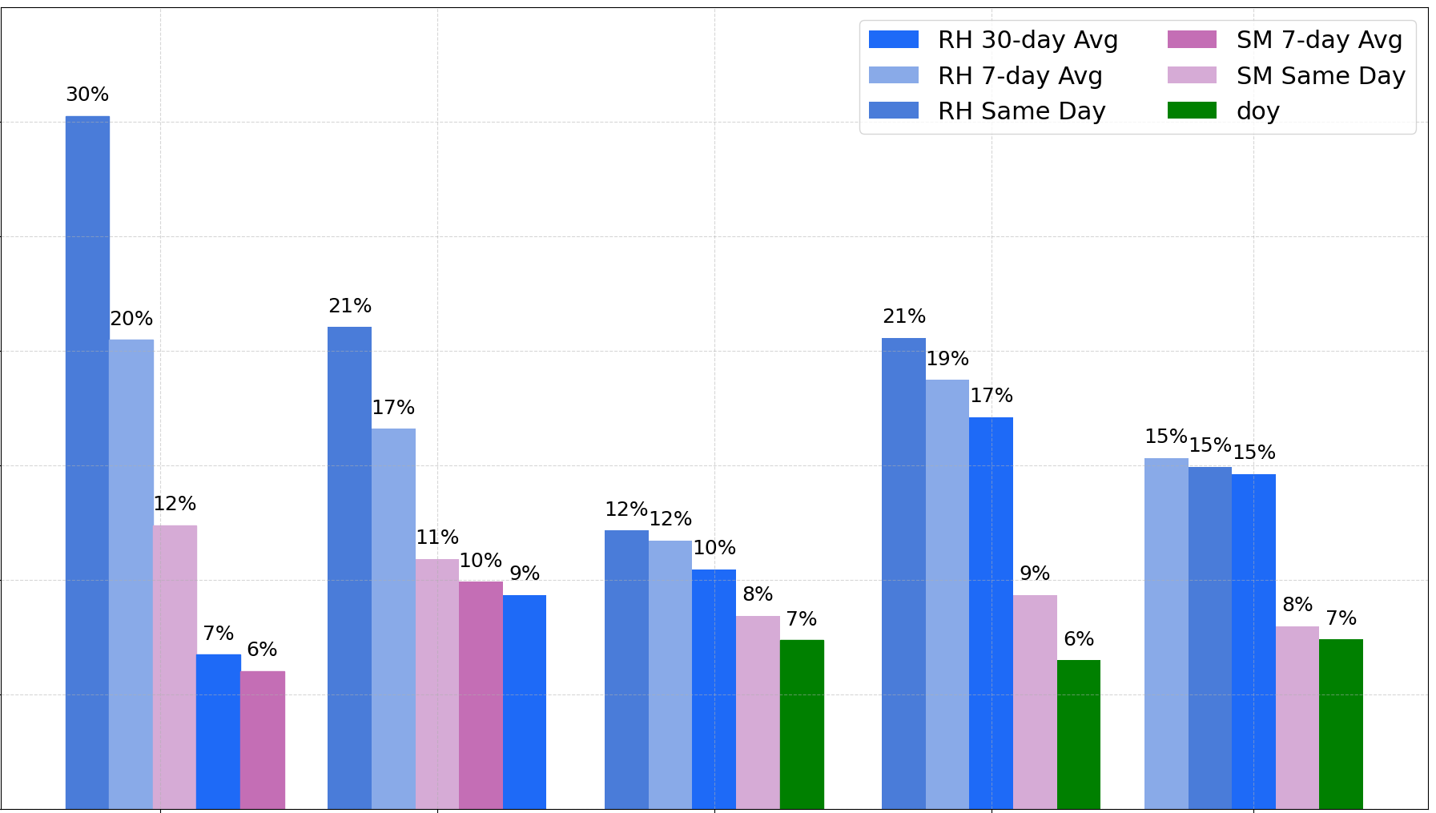
ANTECEDENT CONDITION ANALYSIS
Minimum relative humidity (same day, 7-day avg, and 30-day avg) is the most influential factor in determining fire occurrences during each FDRA
RH 30-day Avg
SM 7-day Avg
30%
RH 7-day Avg
SM Same Day
30
RH Same Day
Day of Year
Feature Importance Analysis of Random Forest Models for Fire Occurrence Prediction by FDRA (2008-2023)
25
20%
21%
21.6%
20
19.7%
Importance (%)
17.2%
17.1%
15
15.7% 15.4% 15.2%
12.4%
11.8%
12.5% 12.3%
10
10.6%
10.7%
9.5%
8.1%
9.6%
8.6%
7.1%
7.4%
6.1%
7%
5
6%
0
FDRA1
FDRA2
FDRA3
FDRA4
FDRA5
Notes:
Given that the results from our regression models and Pearson correlations were weak—mostly around 0—we sought to employ more advanced methods like Random forest to better understand the antecedent conditions influencing fire occurrences. Random Forest is a type of machine learning algorithm that builds multiple decision trees to make predictions, offering a more robust analysis compared to traditional regression models. Feature importance refers to the contribution of each variable (e.g., Soil Moisture, Precipitation) to the model's predictive power, and the importance is expressed as a percentage, showing the relative significance of each feature in predicting fire occurrences. Here, we present the feature importance analysis from Random Forest models for fire occurrence prediction by FDRA over the period from 2008 to 2023.
Across all FDRAs, minimum relative humidity for same day, 7-day average, and 30-day average consistently appears as the most influential factor. For example, in FDRA1, RH (same day) has the highest feature importance at 30%, indicating that RH is crucial in determining fire occurrences. Soil Moisture (SM) and Precipitation (P) also contribute to the models but with lower importance compared to RH; for instance, in FDRA5, Soil Moisture 7-day average (SM 7) shows a feature importance of 15%, which, while significant, is still less than that of RH.
This analysis highlights that minimum relative humidity is the most influential factor in predicting fire occurrences across all FDRAs and other variables like soil moisture and precipitation also play roles but to a lesser extent.

Slide 21
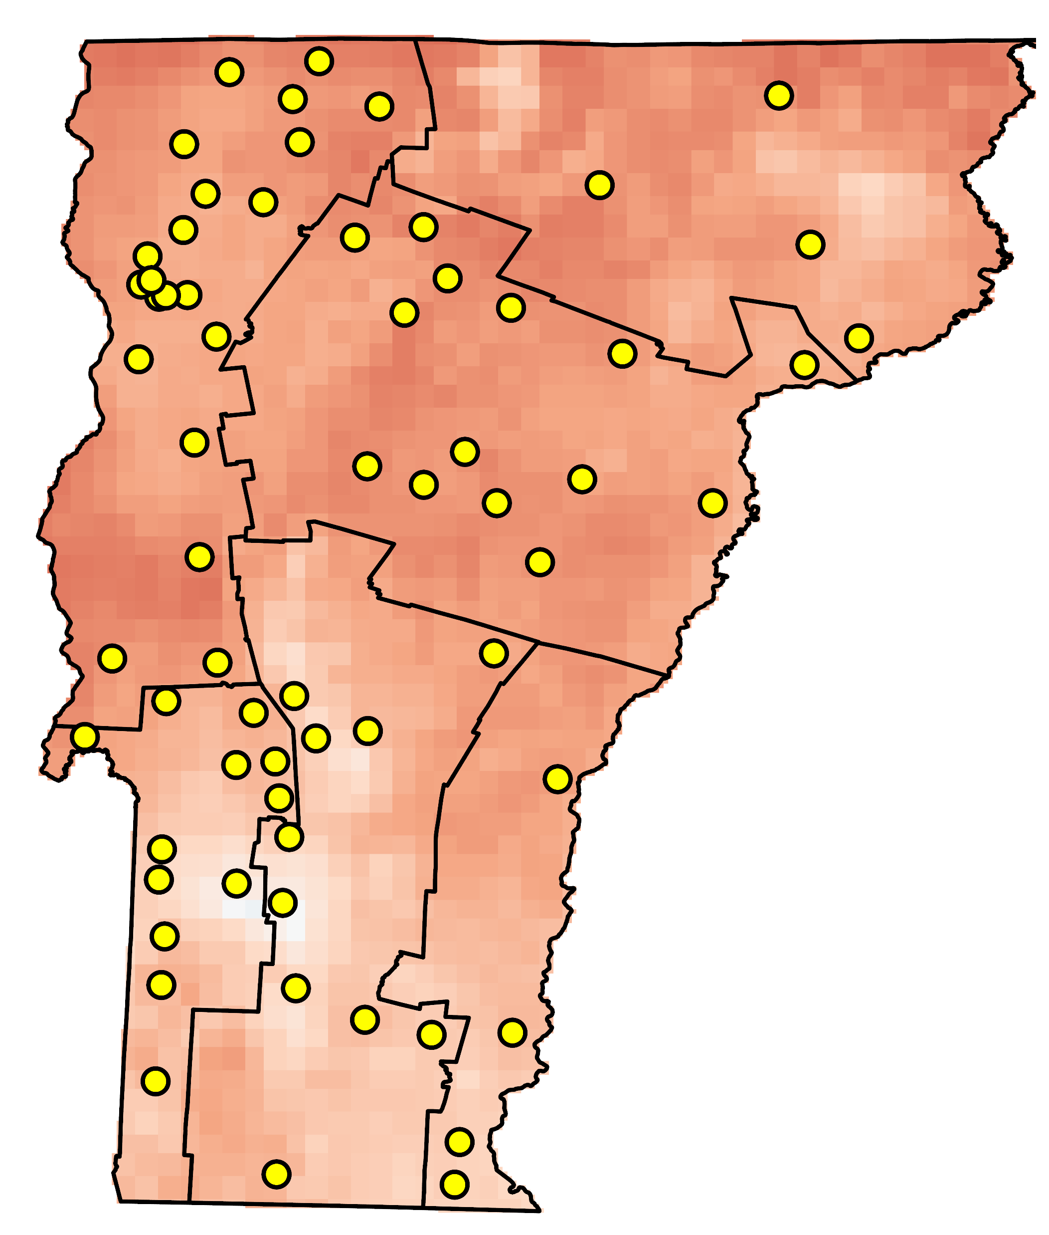
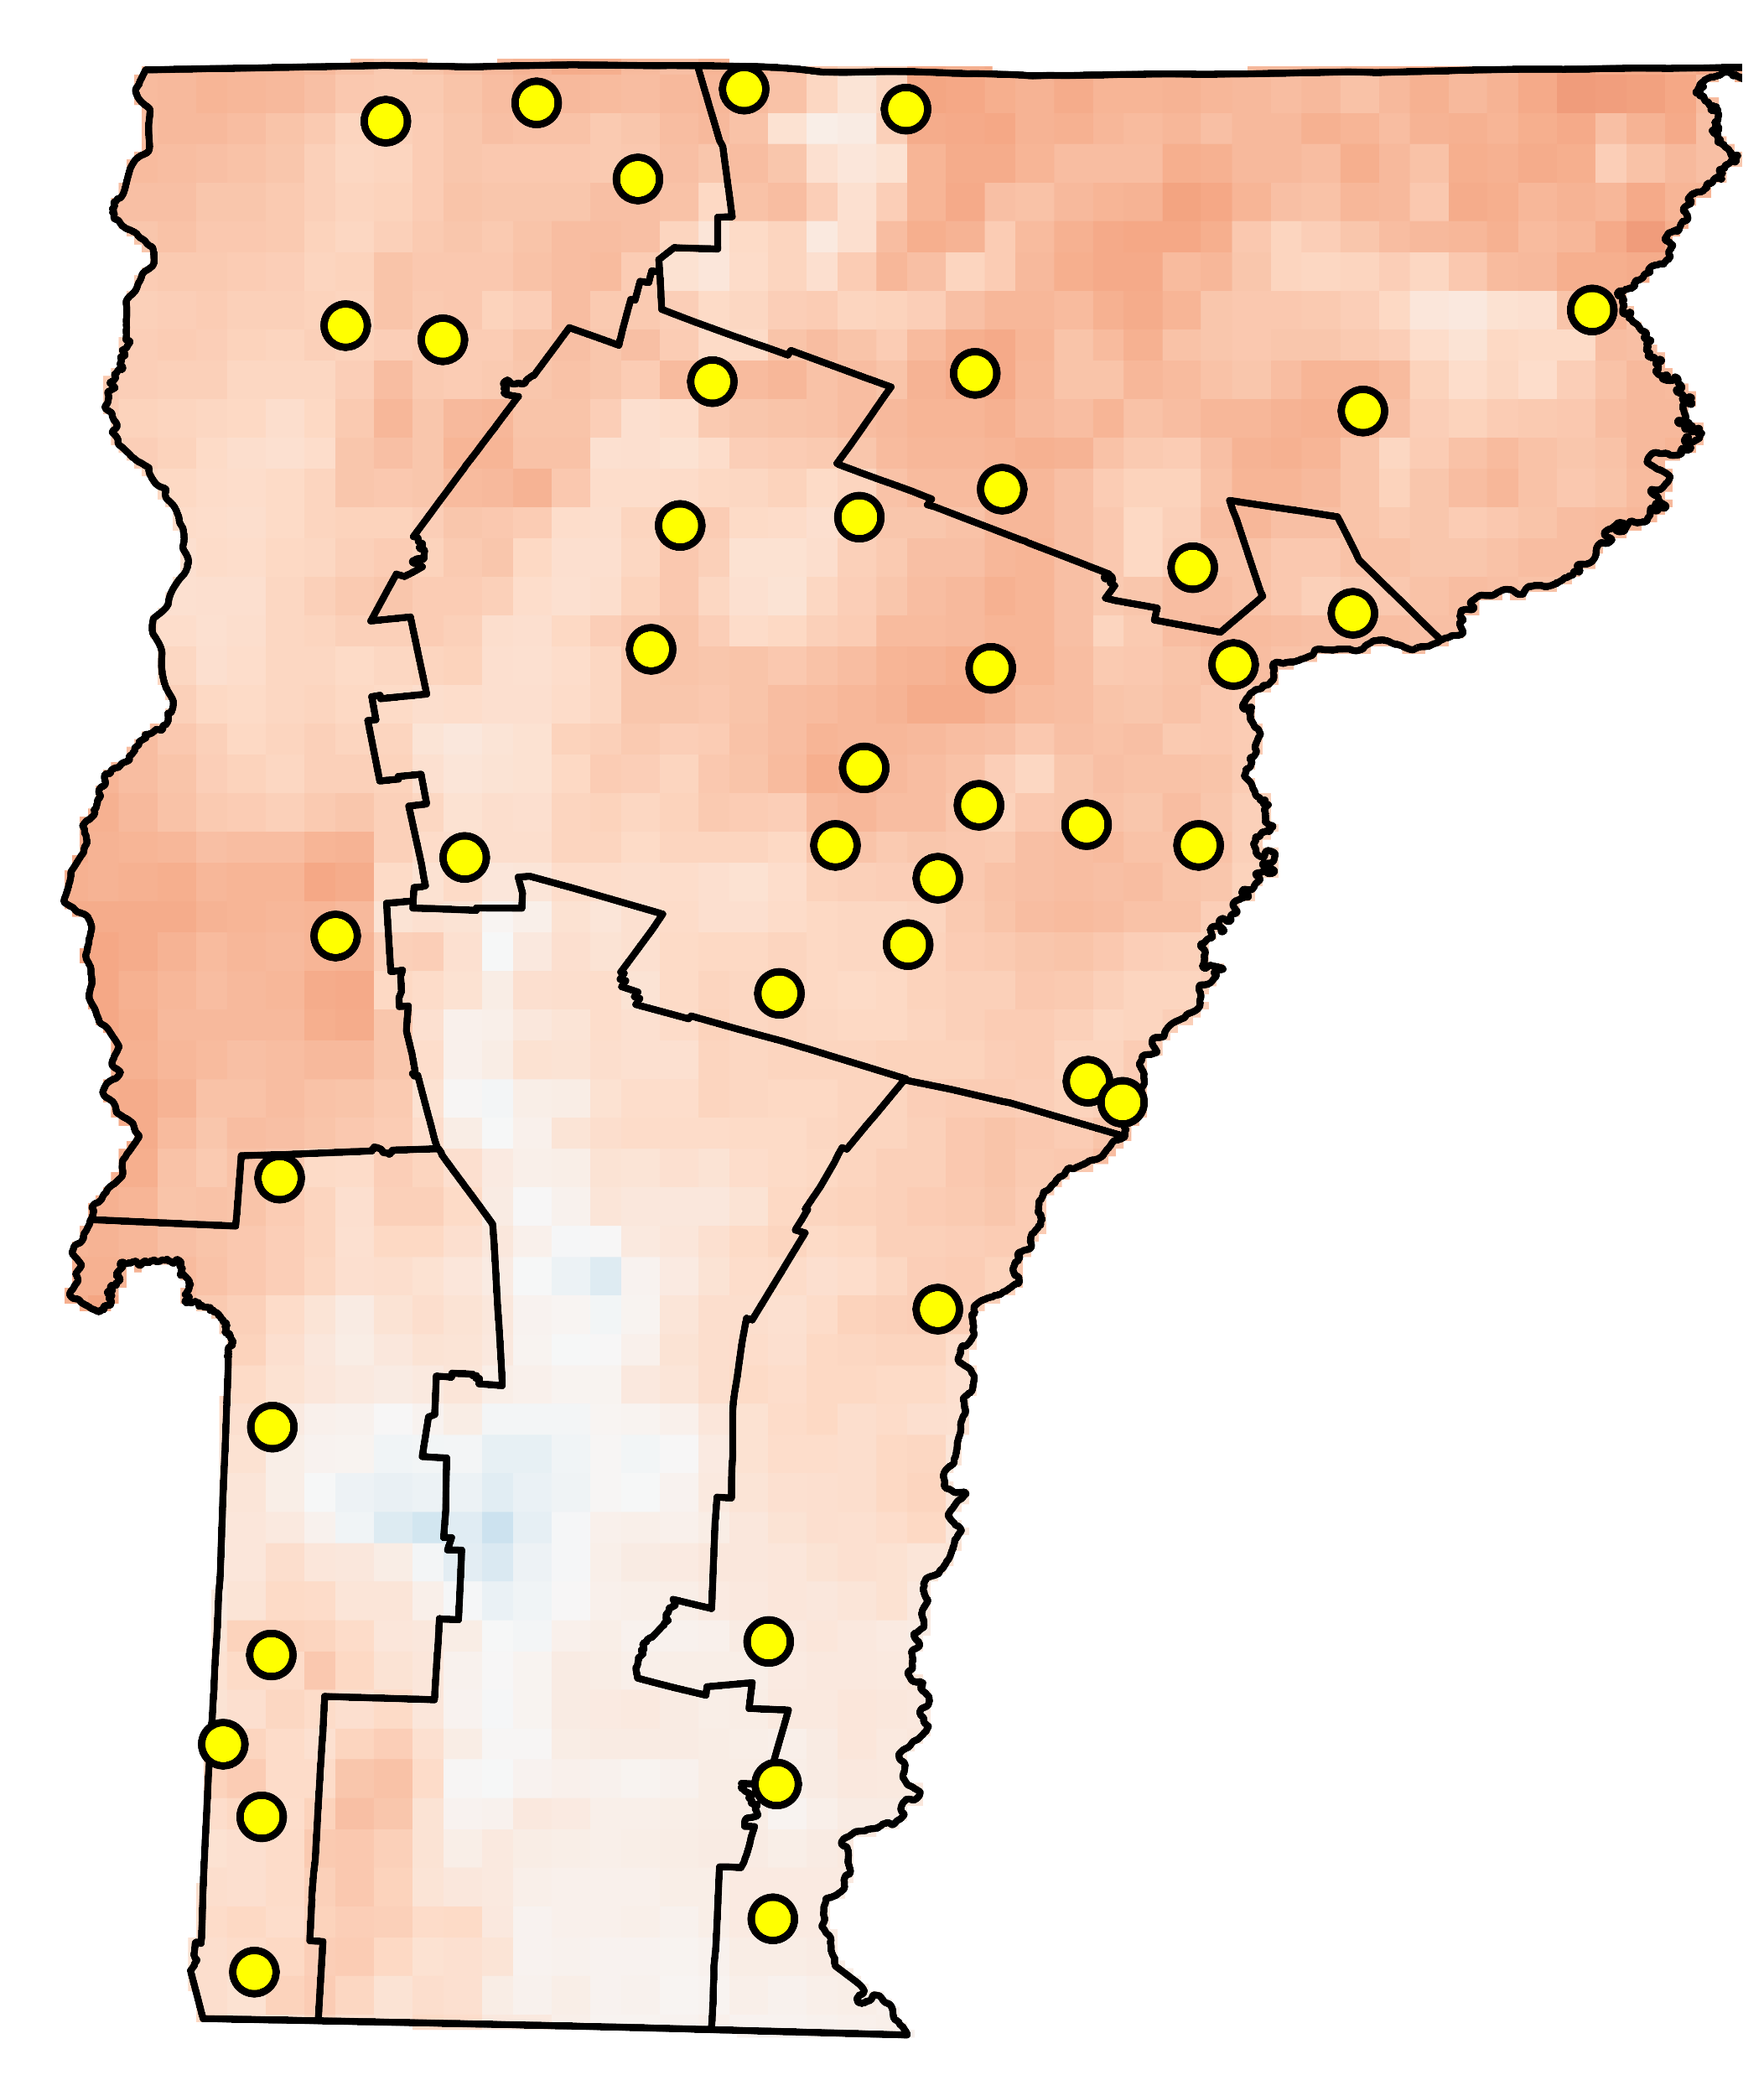
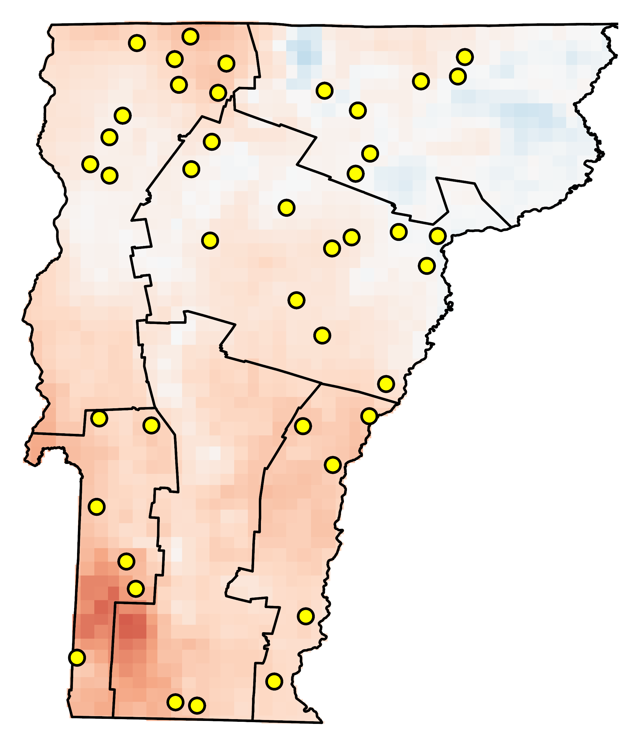
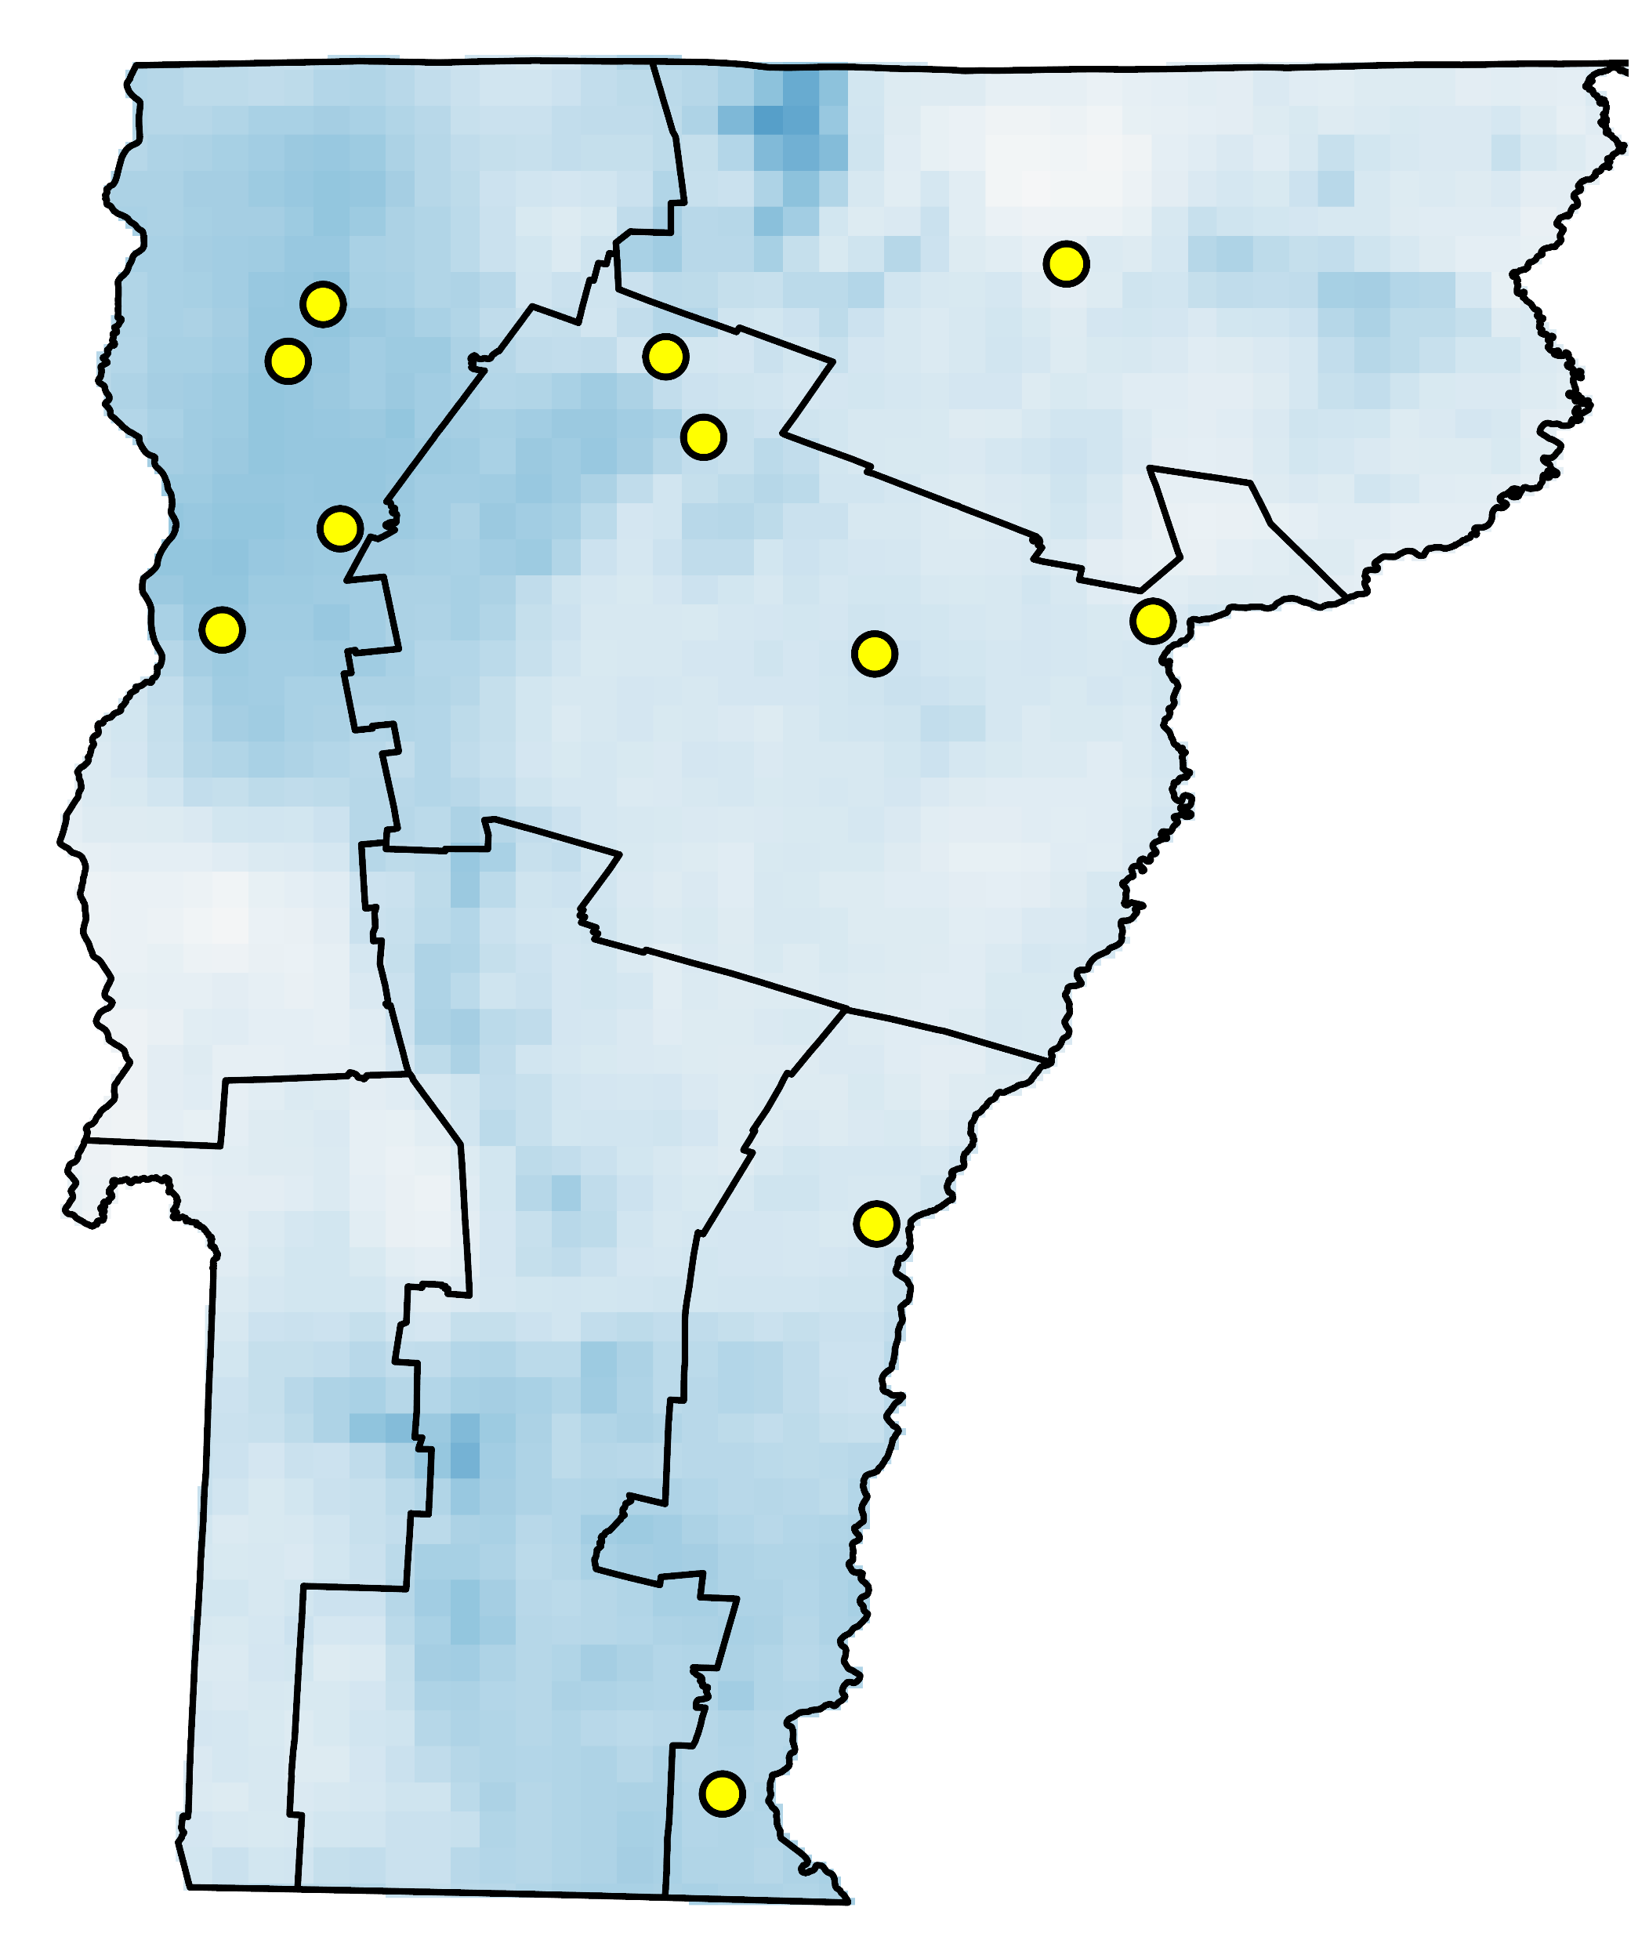
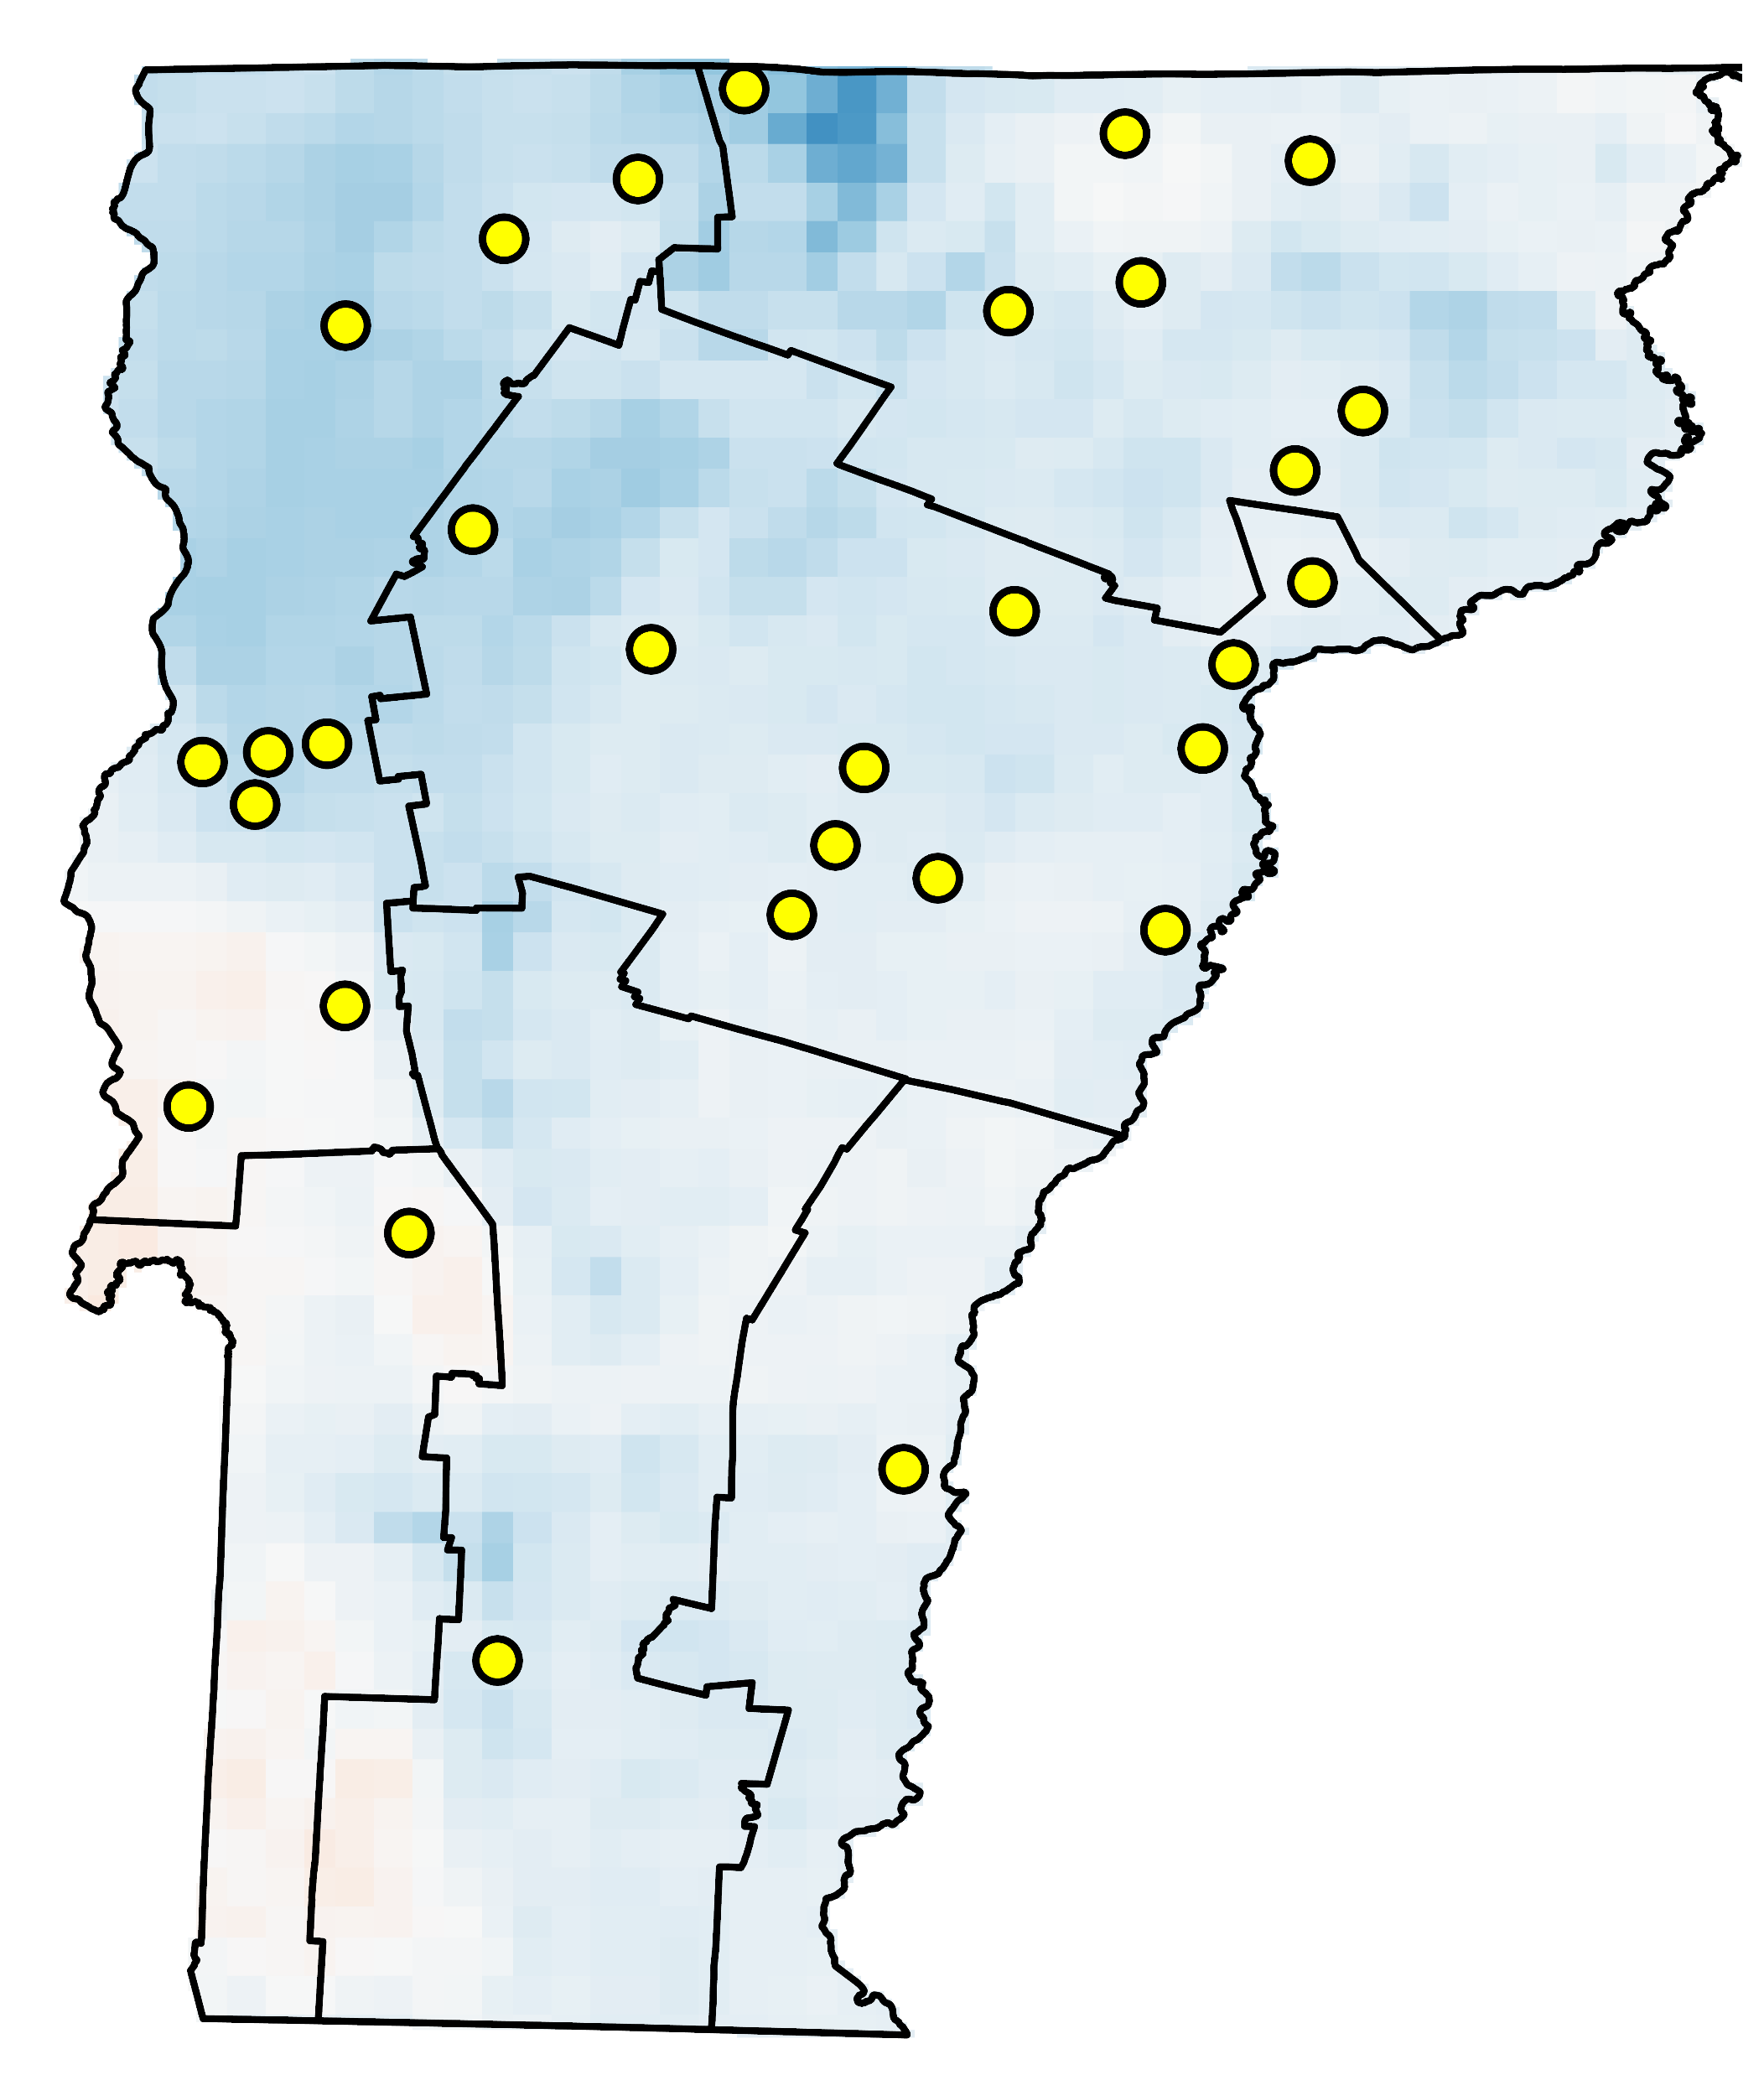
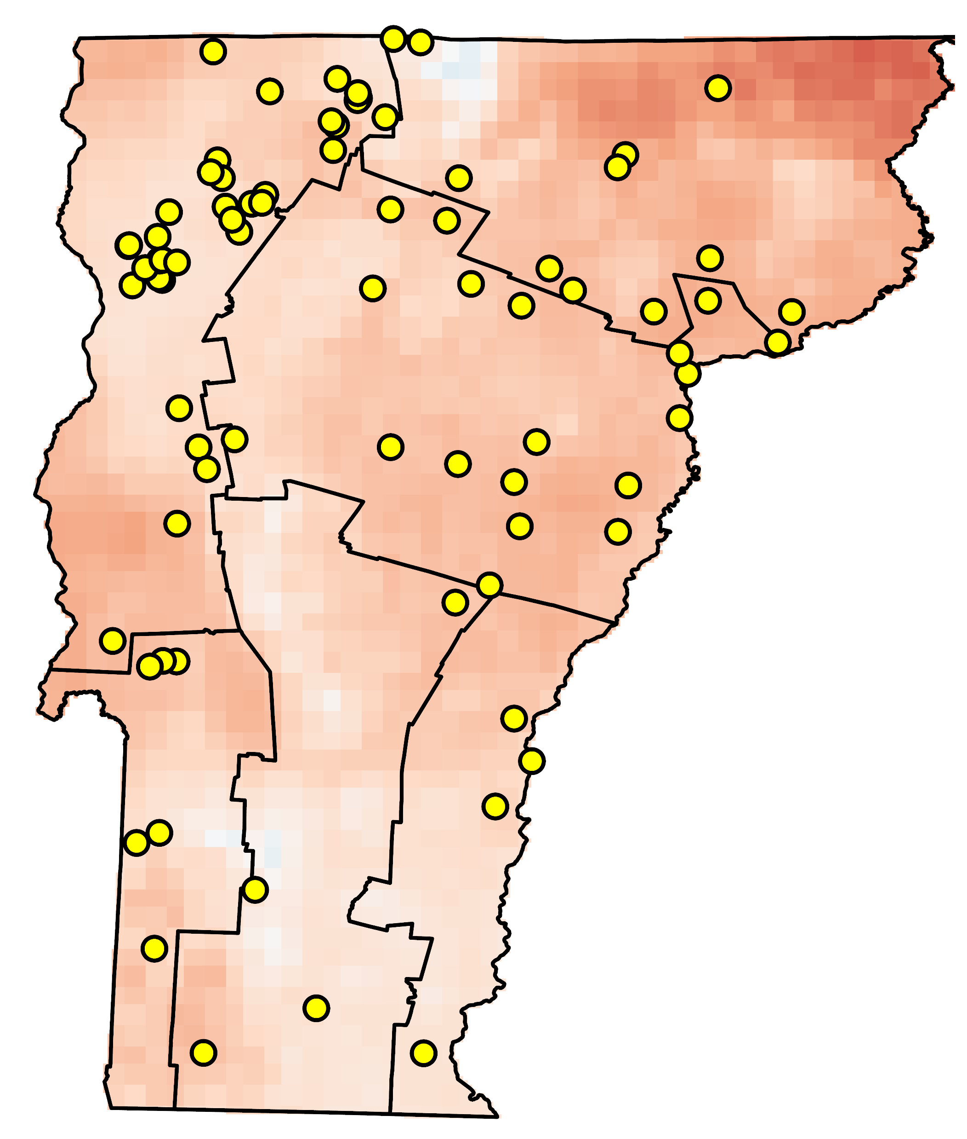
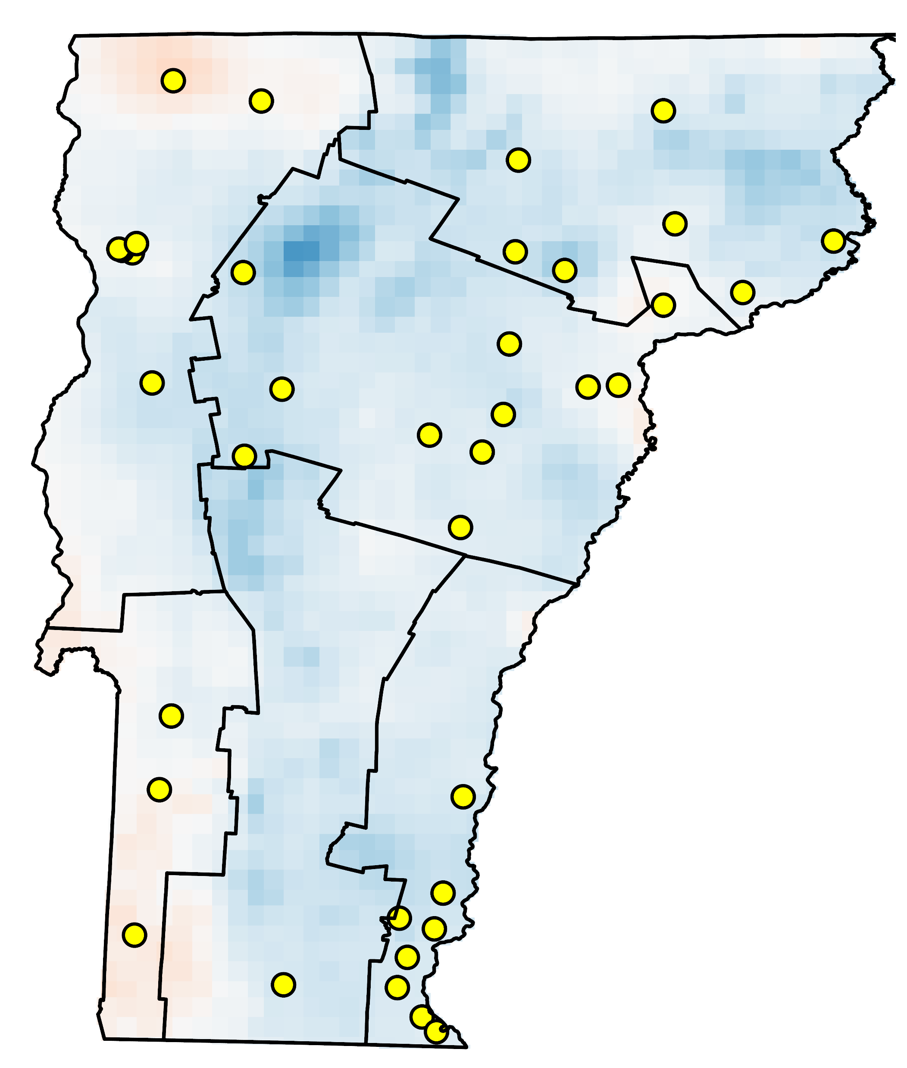
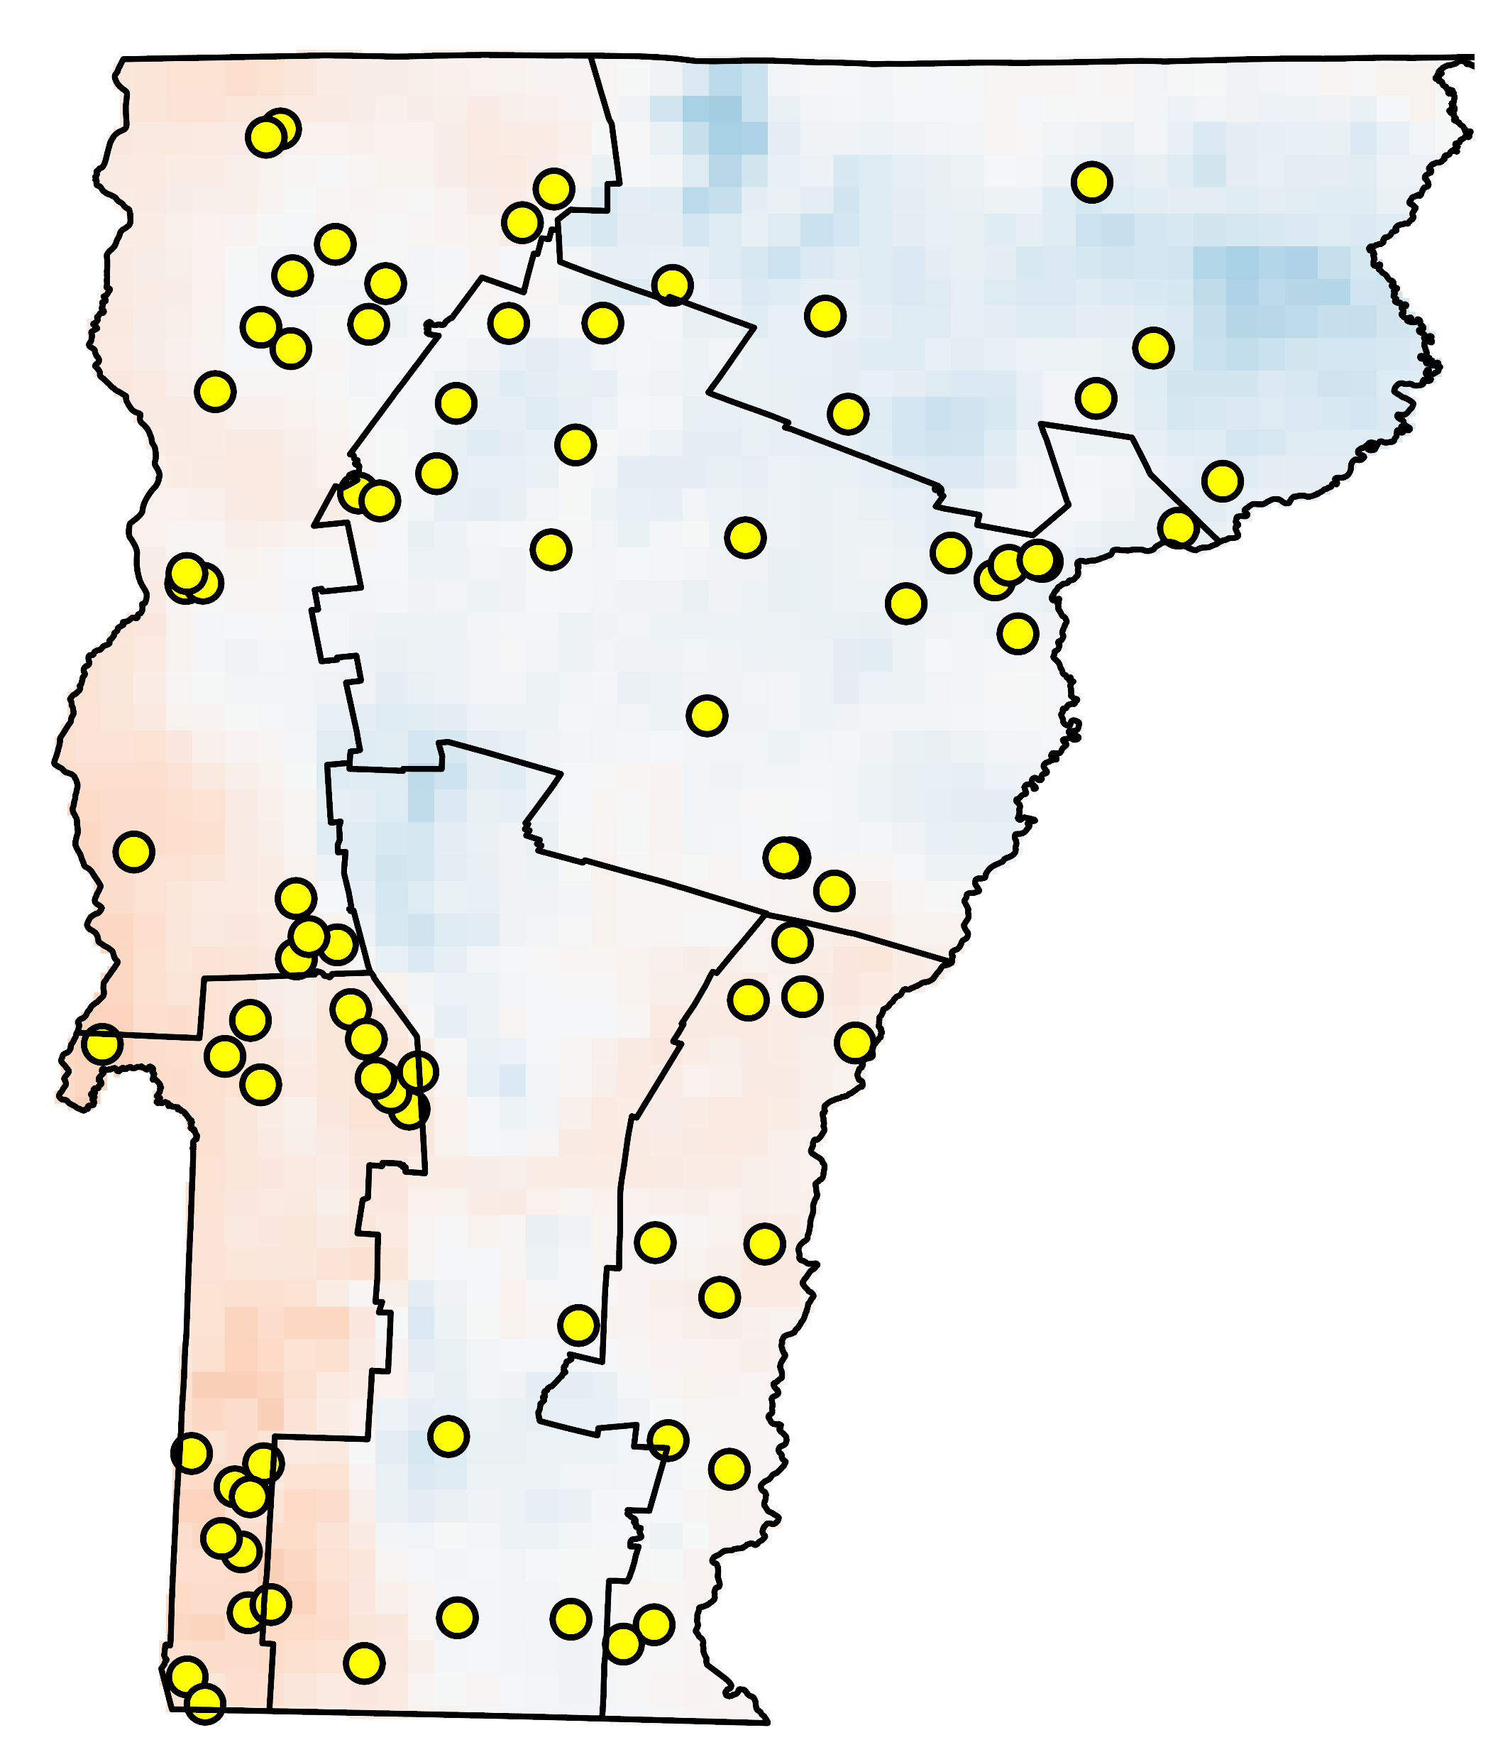
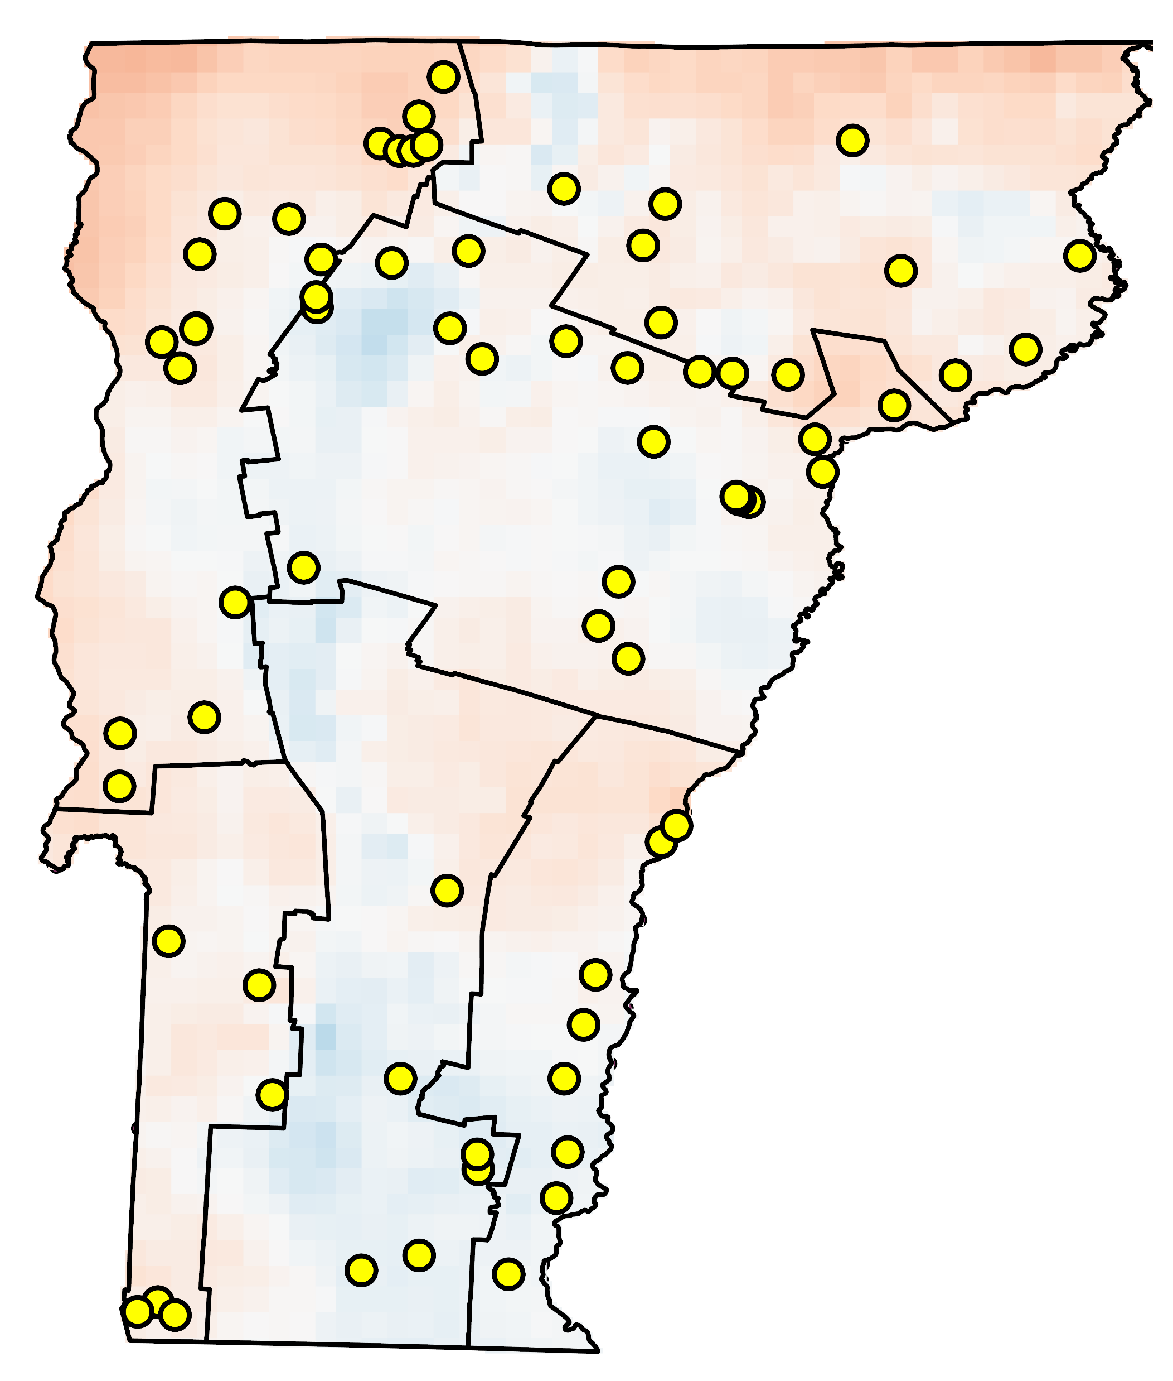
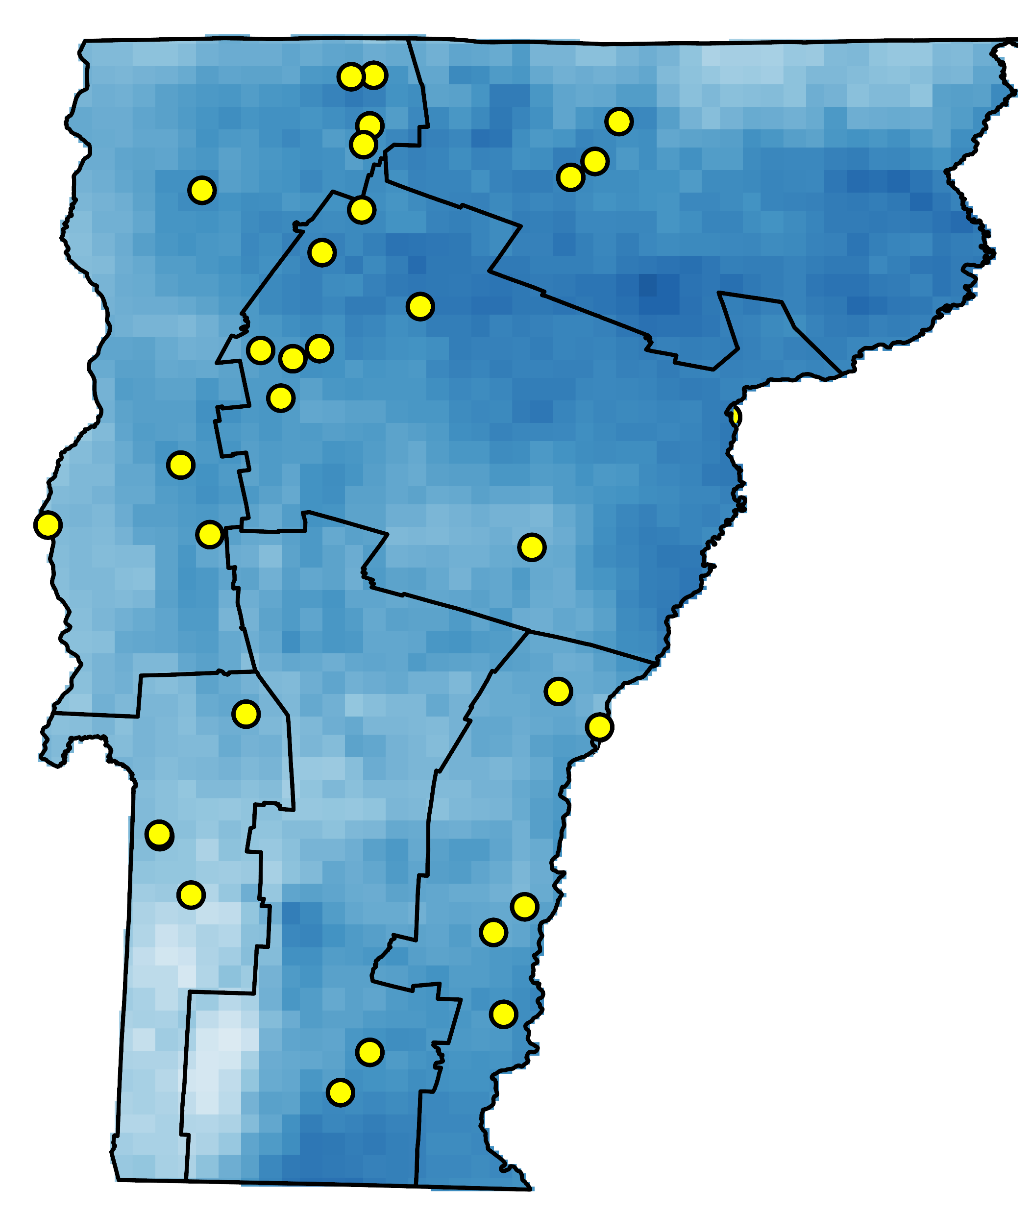
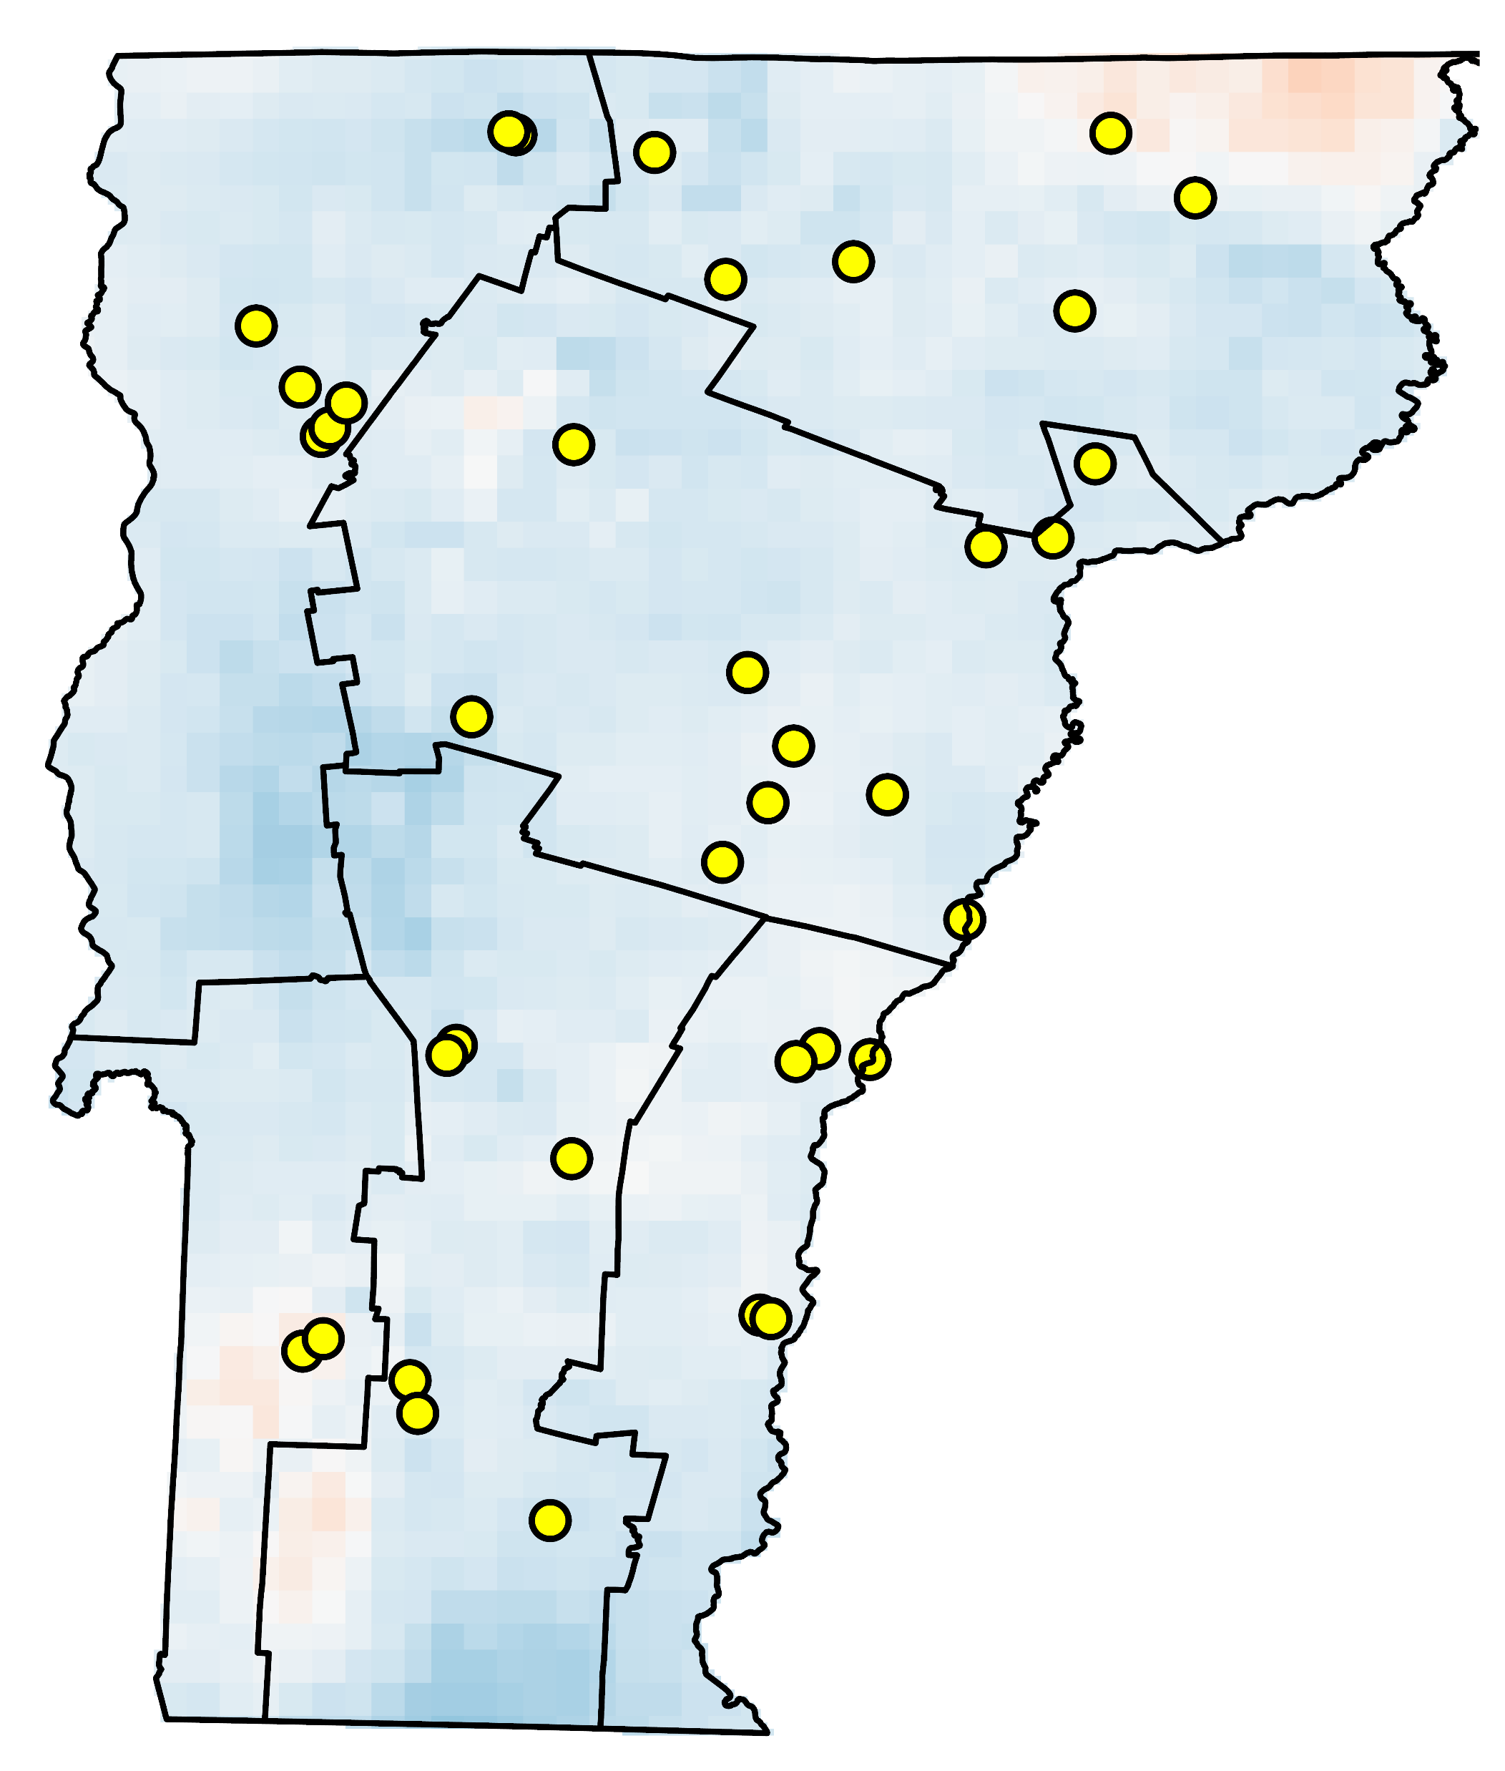
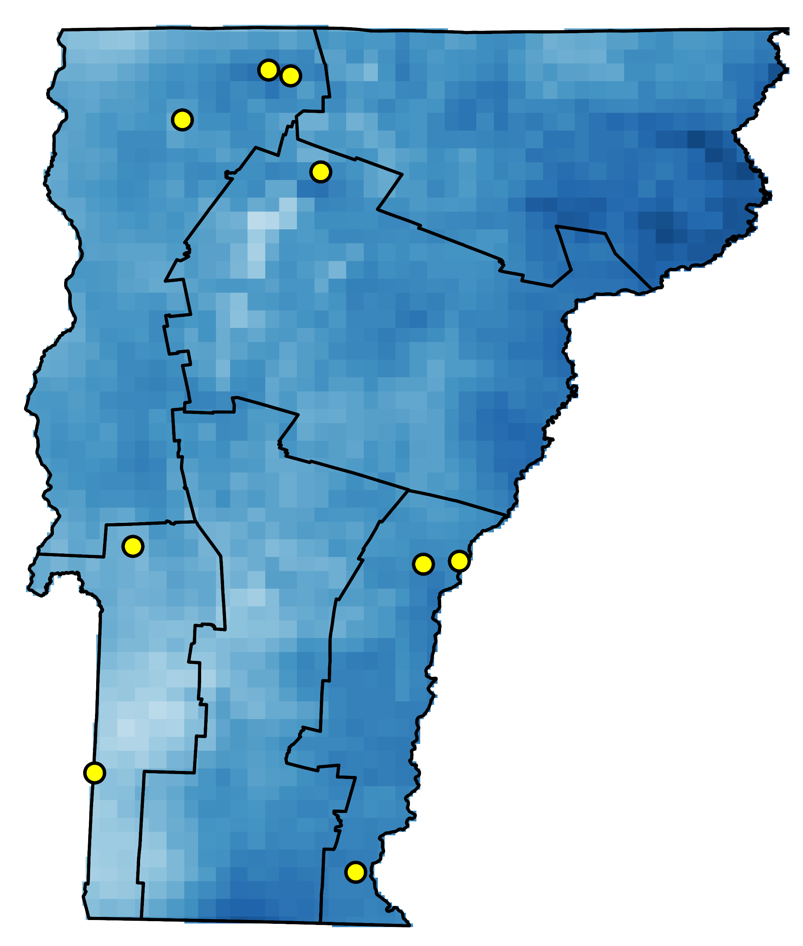
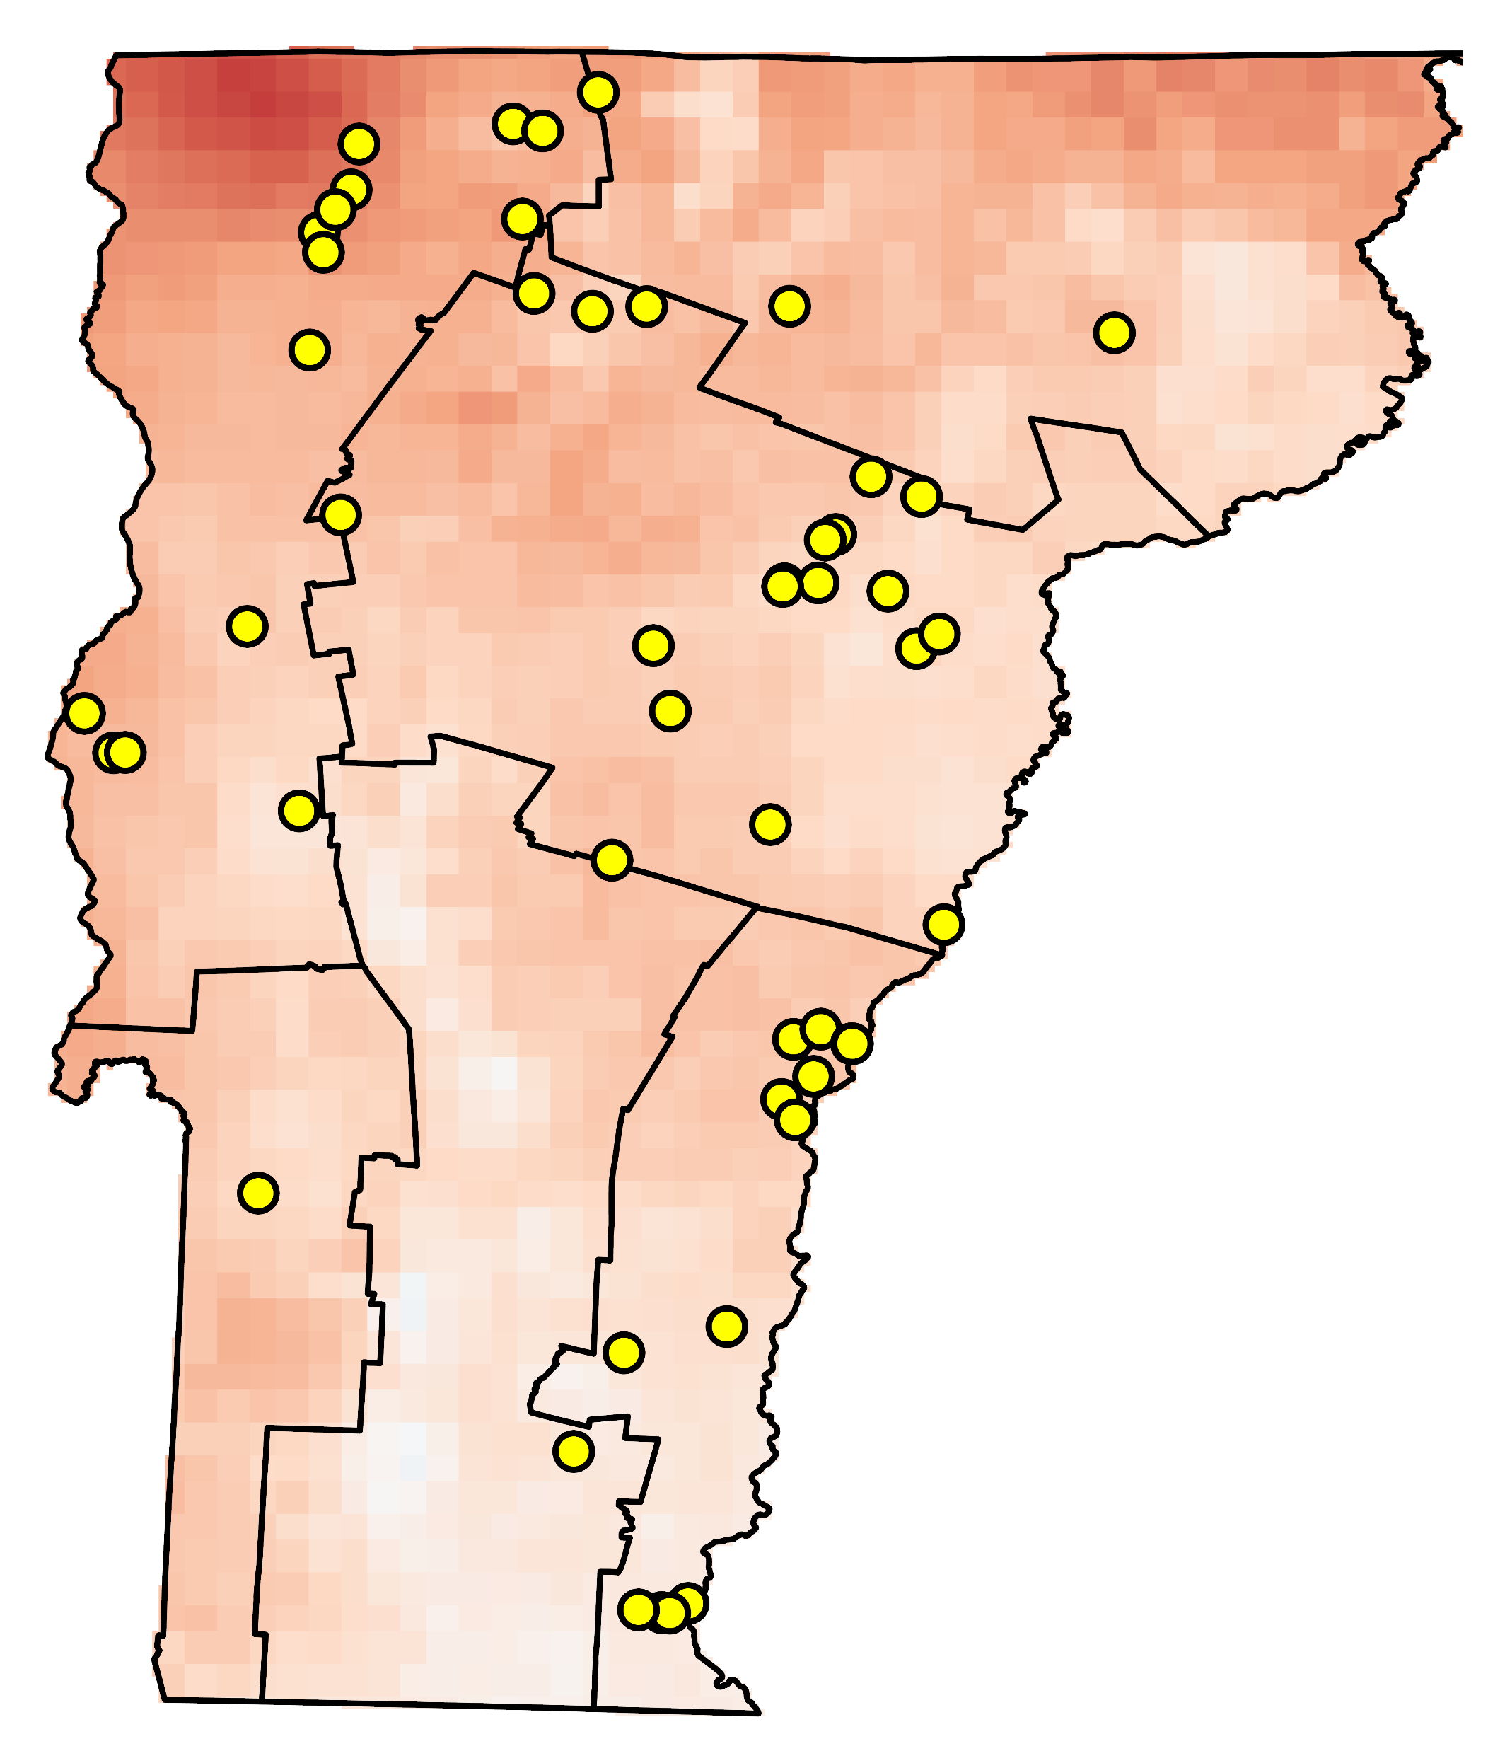
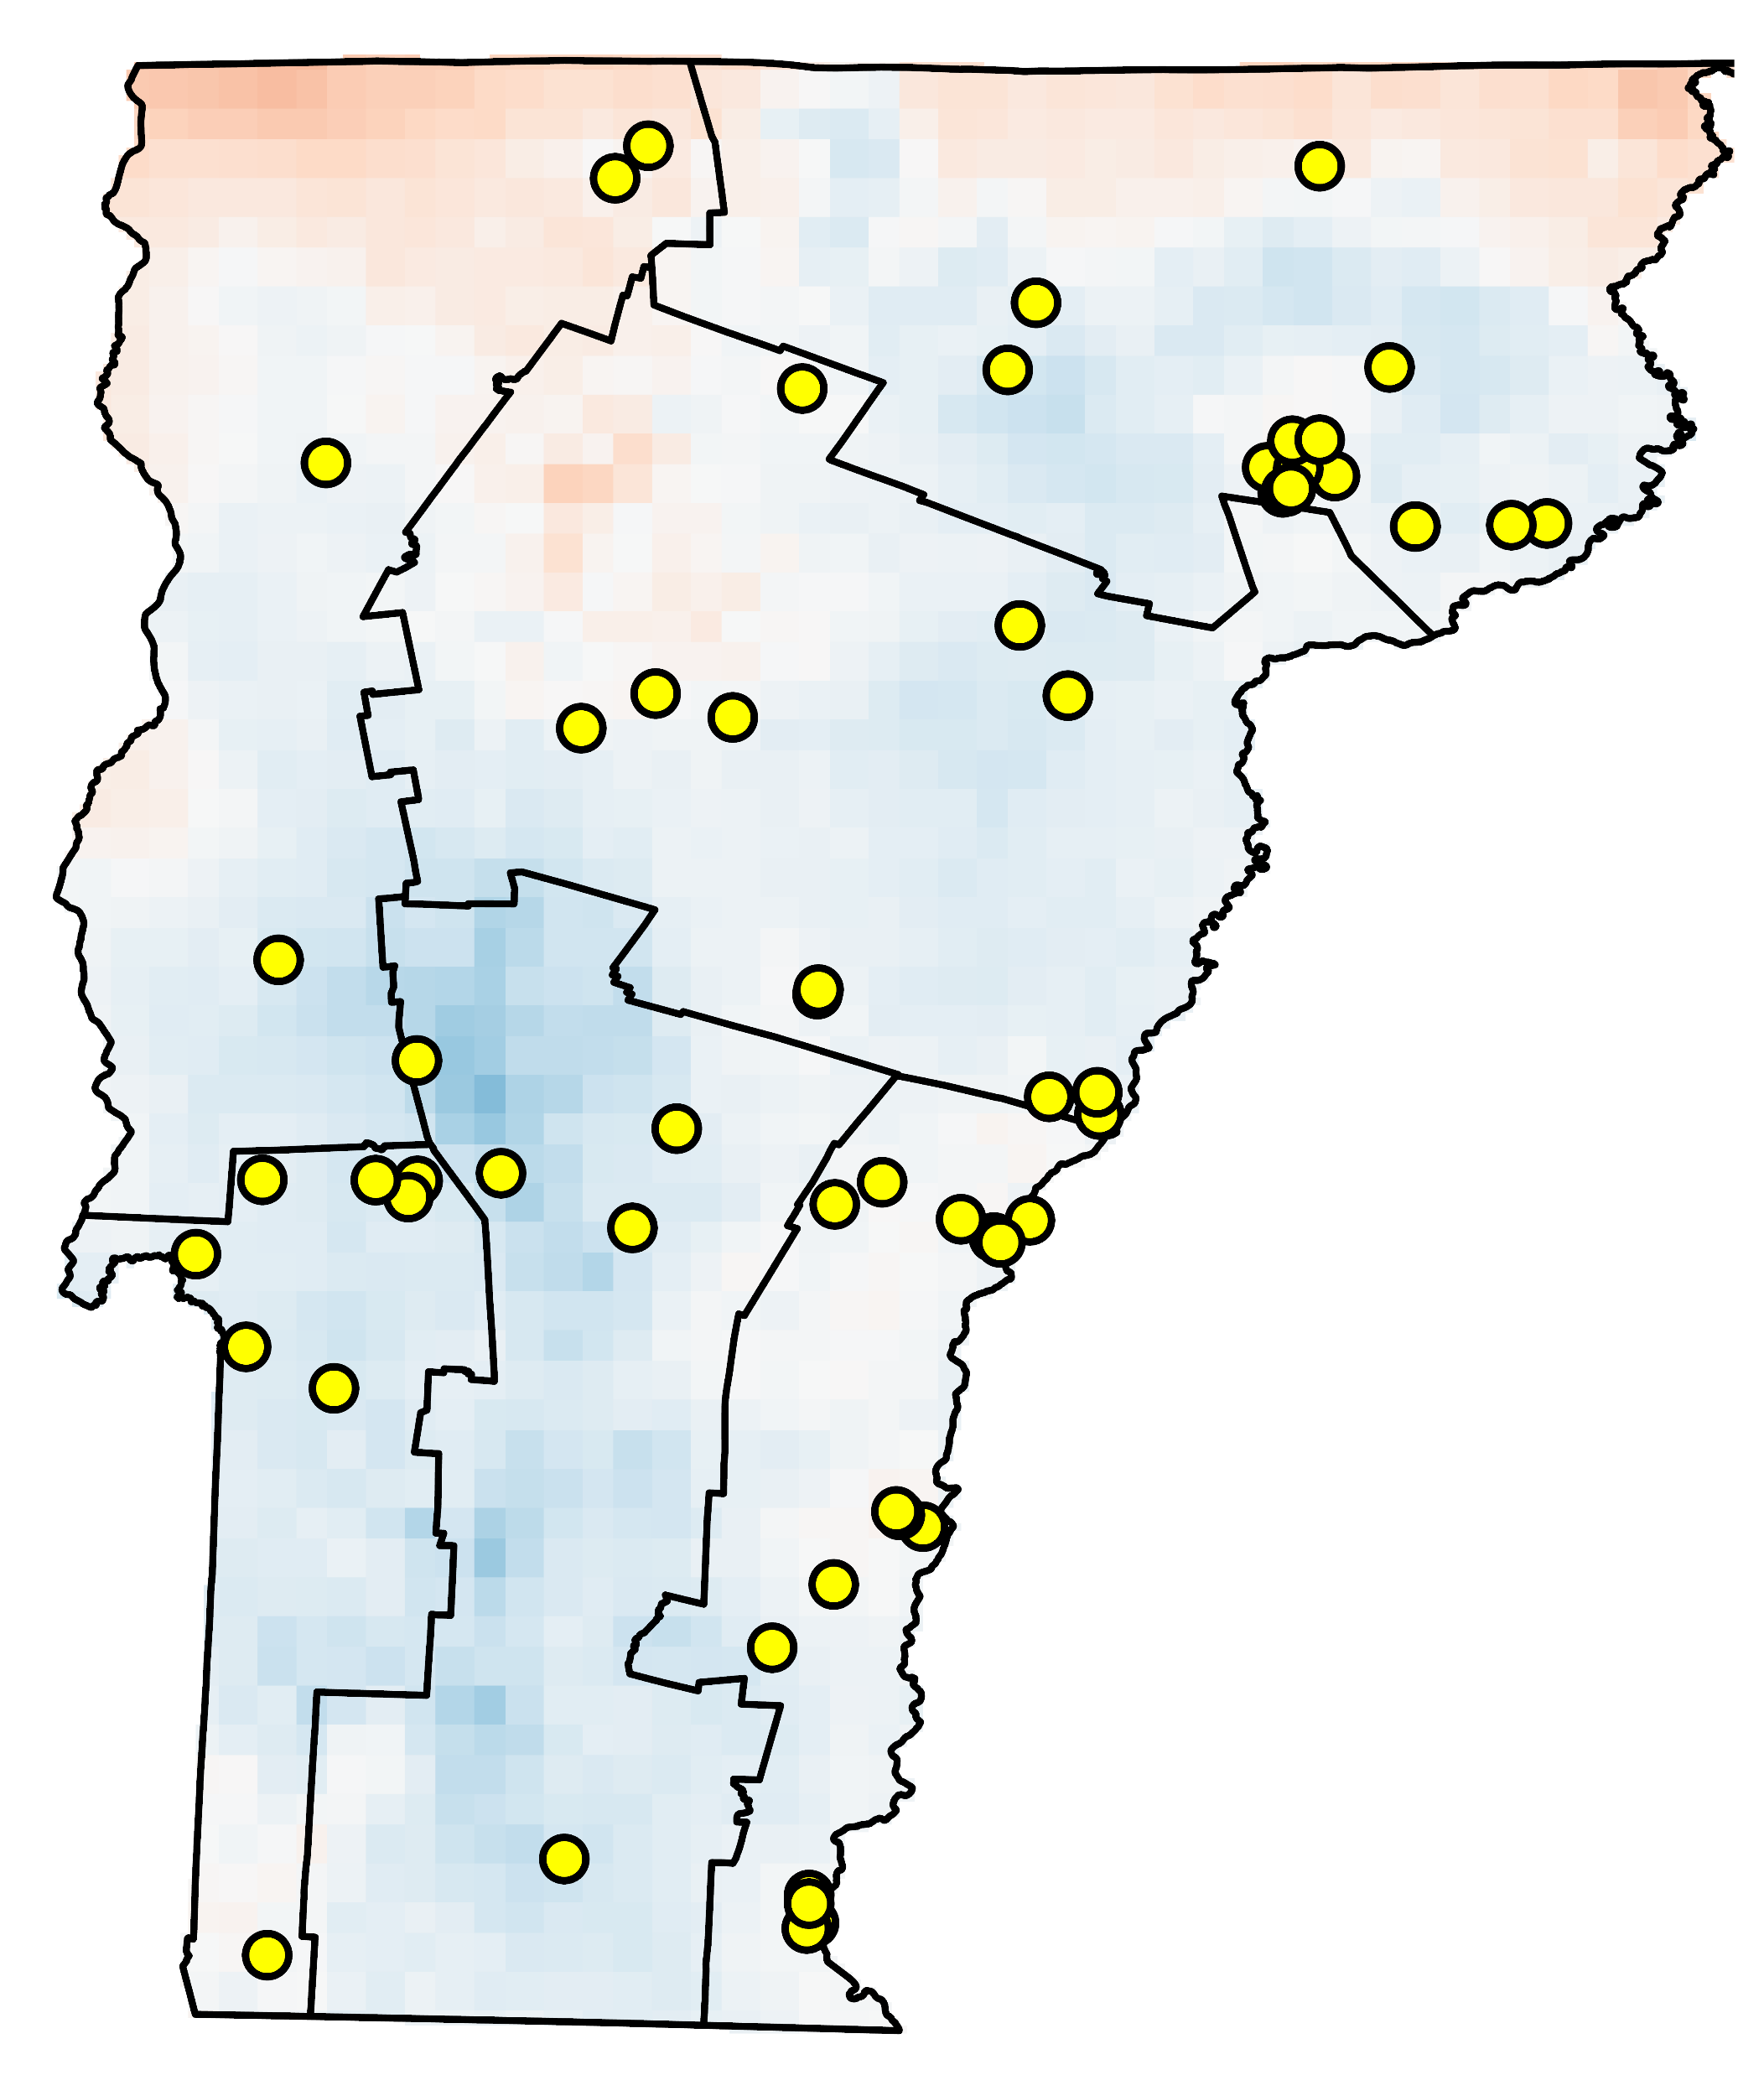
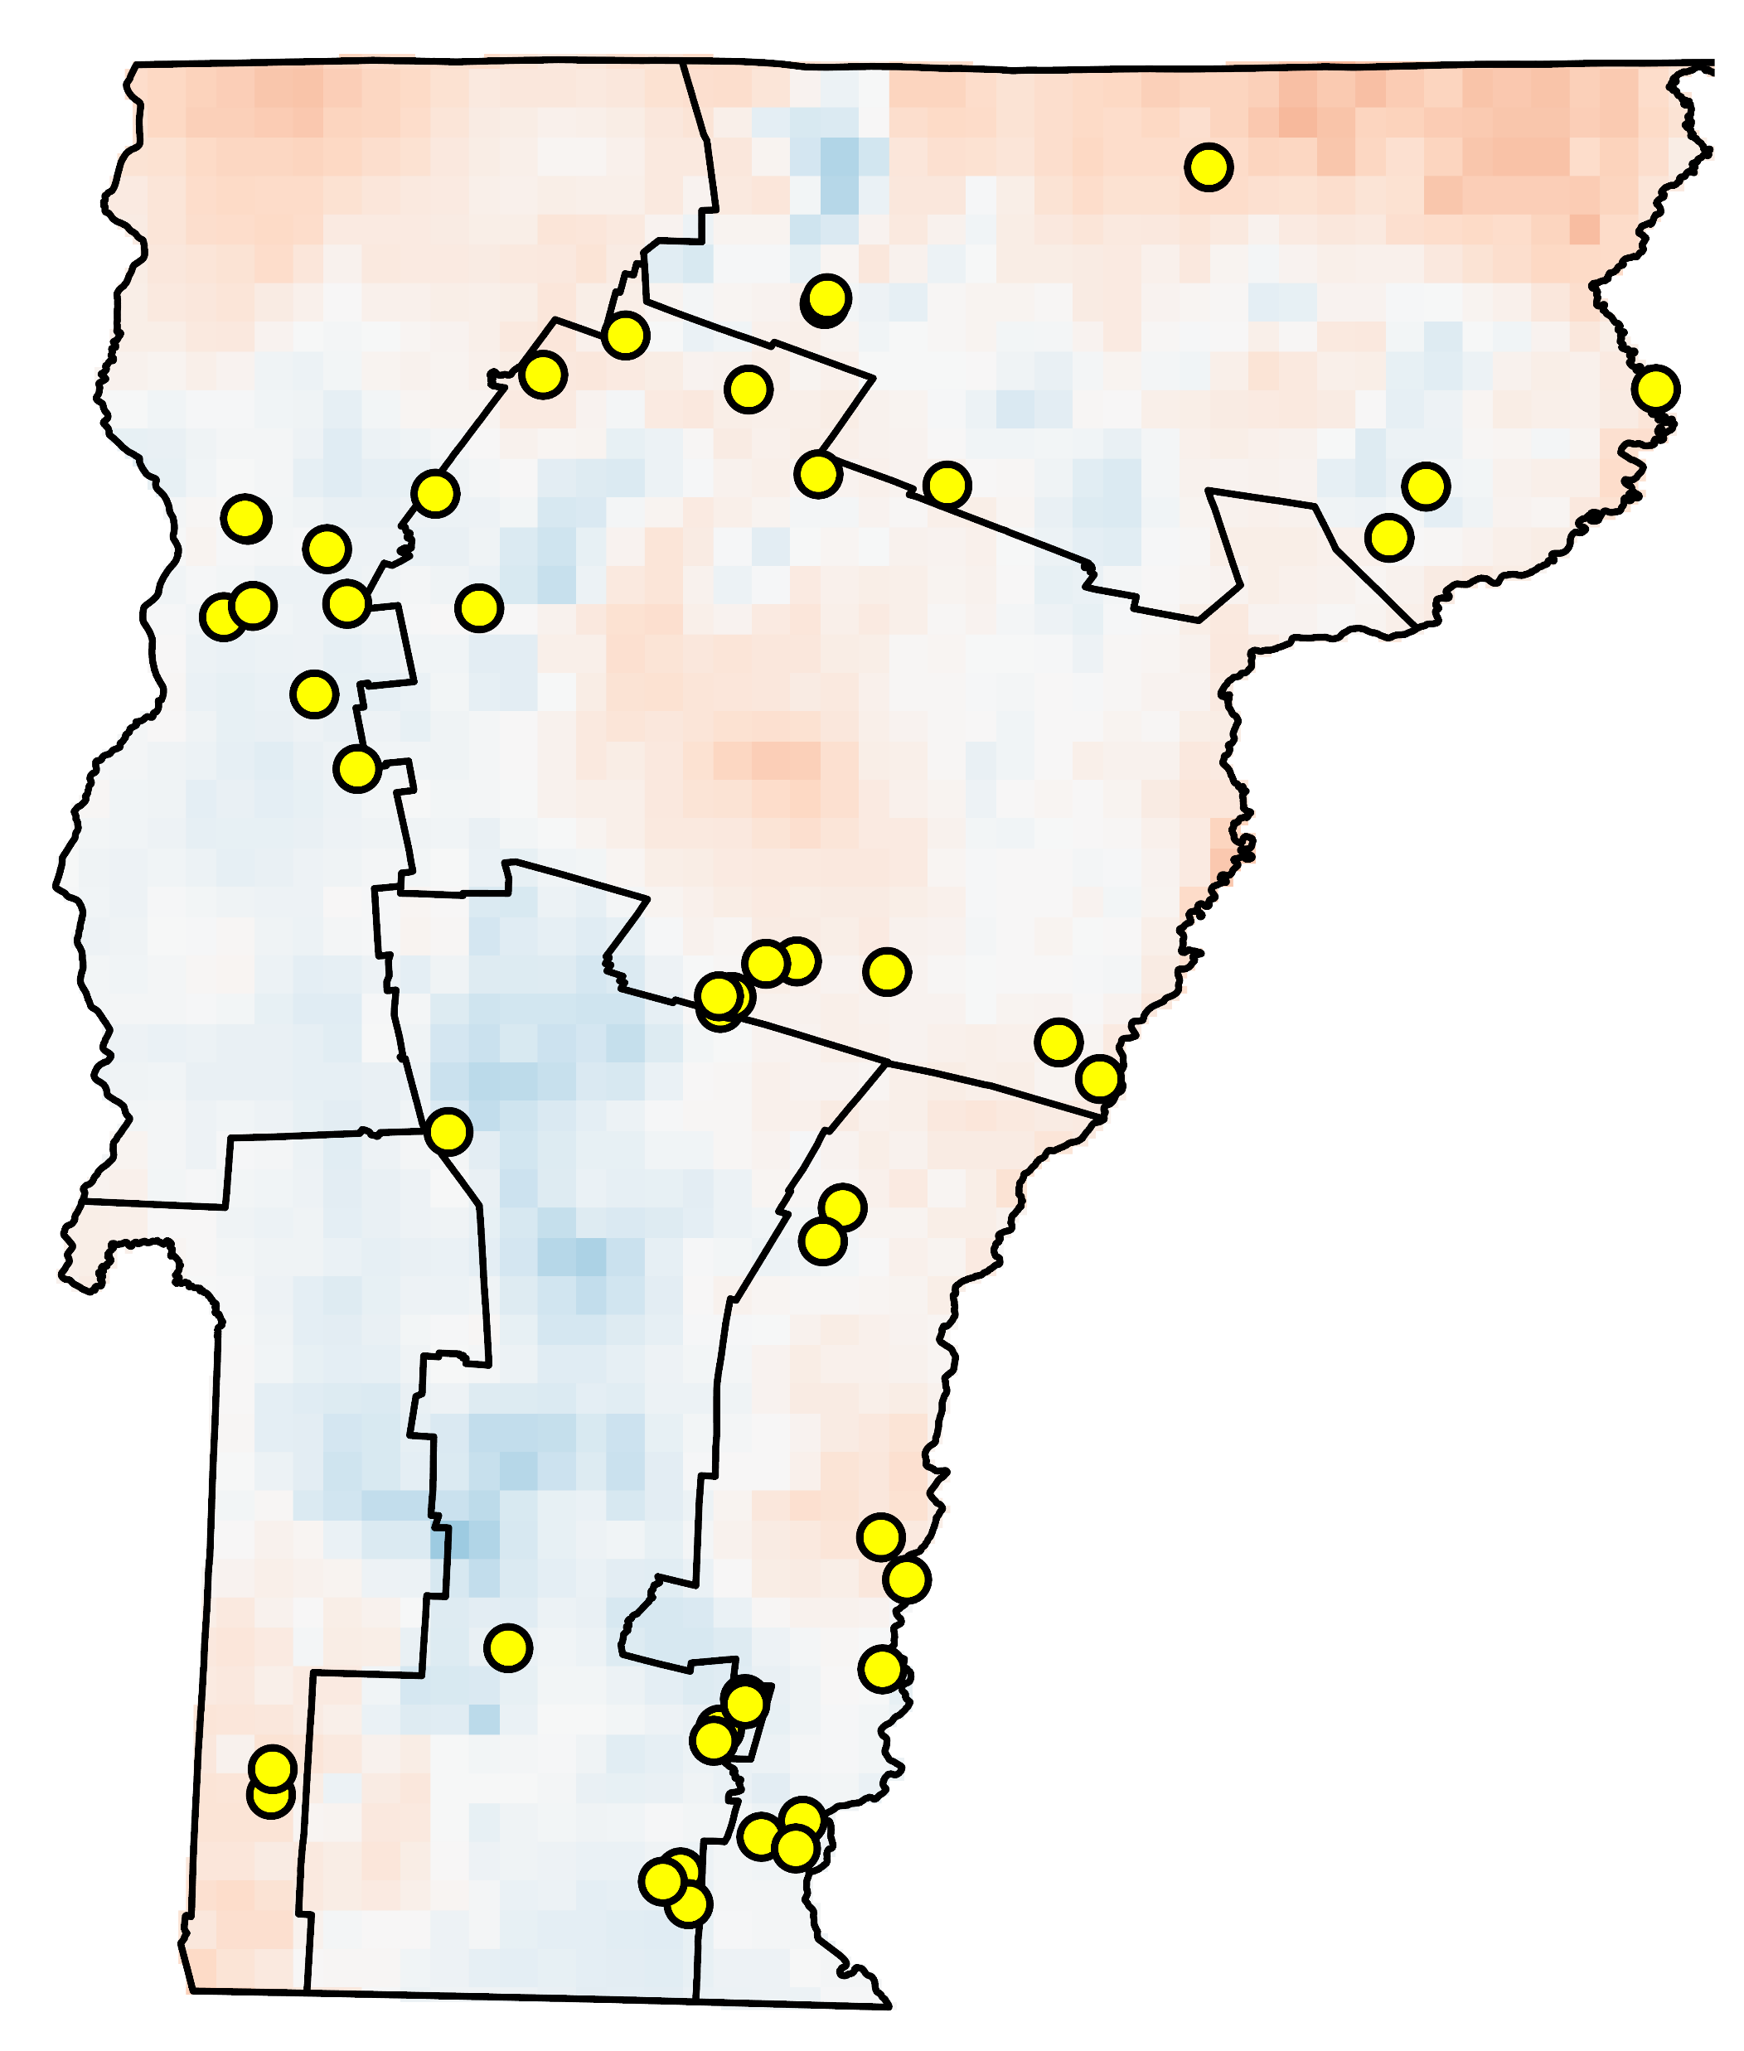
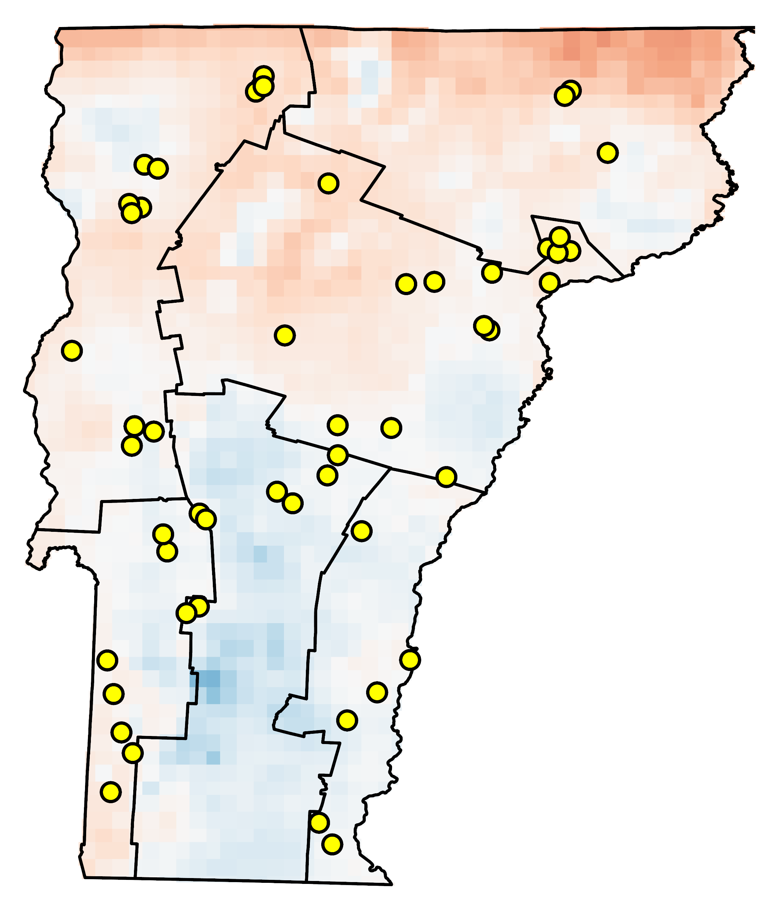
ANTECEDENT CONDITION ANALYSIS
Minimum relative humidity departure from average and fire occurrence (April 1- May 30)
(with respect to a 2001-2023 base period)
2008
2009
2010
2011
2012
2013
2014
2015
2016
2017
2018
2019
2020
2021
2022
2023
0
100
Location of fires (April and May, respective year)
-20
5
N
km
Minimum Relative Humidity Anomaly (%)
Notes:
This series of maps depict the spatial pattern between minimum relative humidity, for spring, and fire occurrence for a given year between the period of 2008 to 2023. The color scale indicates the RH anomaly: red areas represent lower-than-average RH, white areas are near normal, and blue areas represent higher-than-average RH. The yellow points on the maps indicate the locations of fire occurrences during the respective spring season.
The most significant take-aways from these maps are that 2008 to 2010, show predominantly red areas, indicating lower-than-average RH, especially in 2008 and 2009. Fire occurrences, marked by yellow points, appear more frequent in these drier regions. Also, 2011 to 2015 have more balanced RH anomolies, with a mix of red and blue areas, and 2013 and 2014 showing significant red regions that appear to have higher fire occurrences. Between 2016 and 2019, there are predominantly blue areas, indicating higher-than-average RH and there appears to be fewer fire occurrences, supporting the impact of elevated minimum relative humidity on reducing fire risk. Between 2020 and 2023 there is a return to more red areas, especially in 2020 and 2022, where lower RH coincides with increased fire occurrences.
The apparent visual relationship between lower RH and increased fires across different years supports incorporating RH monitoring into future fire prediction models.

Slide 22
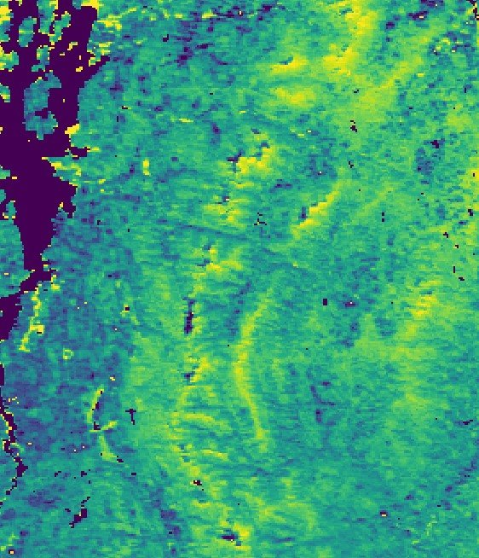
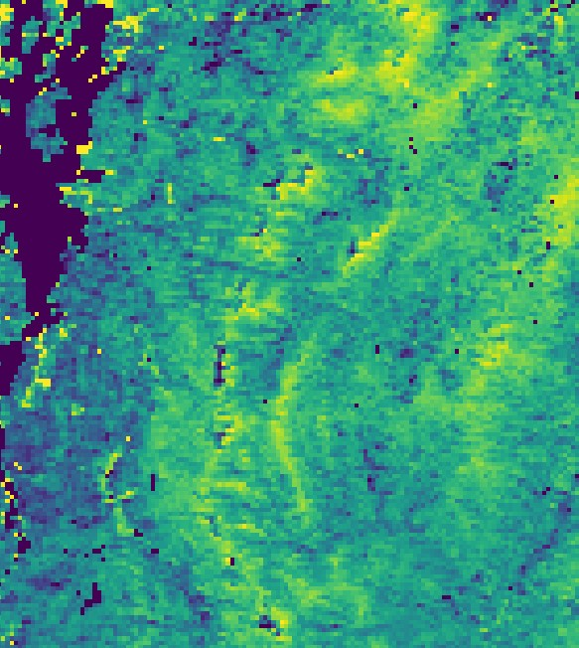
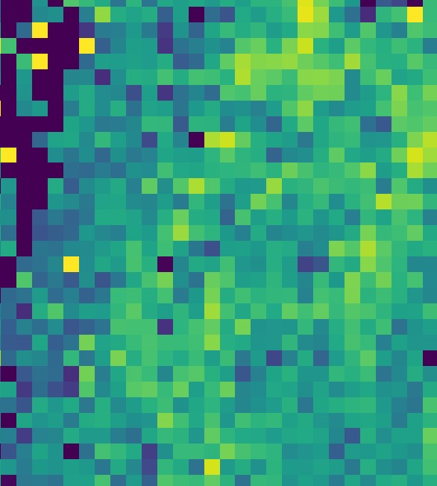
ERRORS AND UNCERTAINTY
Validation
Spatiotemporal Resolution
Timeline
MODIS
500 m, 8 days
SNODAS
1 km, Daily
ESI
5 km, 4-week daily
GLDAS
24 km, daily
Notes:
Sources of error in this project are defined by consolidating variables across multiple datasets with key differences in spatial and temporal resolution. The data sets in this study vary spatially from a resolution of 500 meters to 24 kilometers on a time scale from daily data to 8 days. The NClimGrid and GridMET datasets were not included on this slide, but both have unique resolutions.
The record of fire events utilized in this project came in the form of point data. The inclusion of all possible fire events could not be validated due to a very low average size and the possibility of underreporting at certain fire stations. The largest fire event reflected in the data is a 200 acre fire in April 2005. The vast majority of fires are below 5 acres, resulting in an area where individual fires cannot be meaningfully analyzed in the context of the resolution available. This informed our decision to analyze the datasets by fire event frequency within each FDRA. Variables with coarse temporal resolution inhibits analysis of conditions proceeding fire events as there might not be data available in the crucial days before fire events. This led the team to implement analysis on seven and 30-day moving windows of variables.
Given the extent of variables and datasets posed in the work plan, the team was limited by the project timeline in developing a sufficiently comprehensive analysis. Coordinating across 13 partners and science advisors also contributed to the speed of analysis.
More recent datasets offering higher spatiotemporal resolution such as SMAP for soil moisture or MODIS for NDVI could not be utilized uniformly across the two timescales of analysis. This is because of the amount of data that the team had to process and that these datasets were not available by 1984 or 2008 for the antecedent and long term condition analyses respectively.
Imagery in this slide does not represent actual data obtained from each data source, but rather serves to visualize the spatial resolution of each dataset. This helps the public to visualize the limitations of spatial resolution. Raster data from the team's website image was used, depicting the average day of the year in which an area reaches green up from the MODIS MCD12Q2 land cover phenology product.
----------Image and Icon Information Below----------
Images: MODIS, SNODAS, ESI, and GLDAS datasets retrieved and edited by the DEVELOP team Icon Credits: PowerPoint

Slide 23
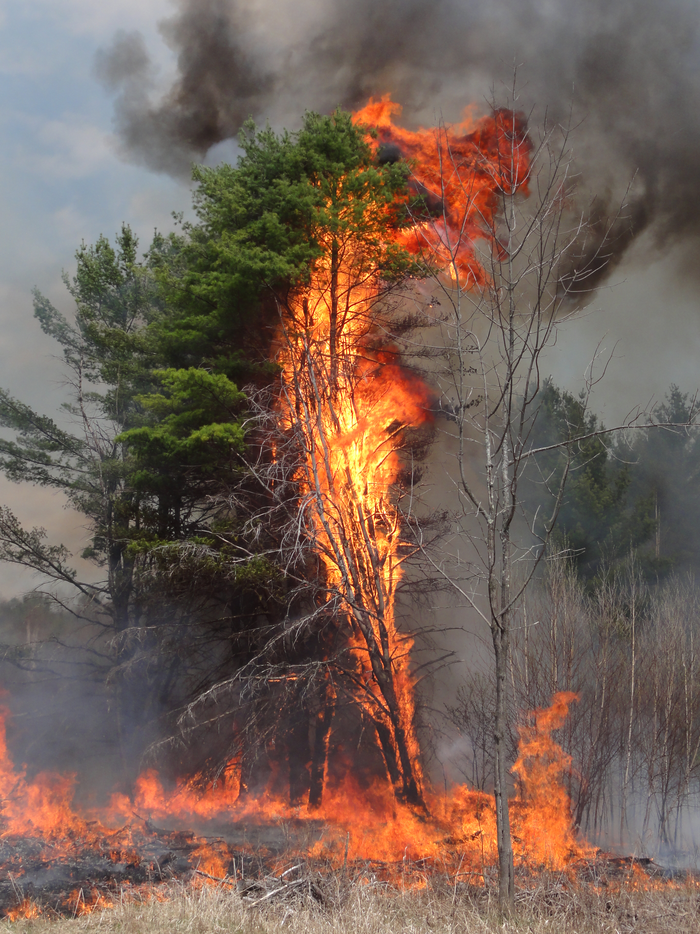
Feasibility & Partner Implementation
Use of Landsat data is not feasible
(higher spatiotemporal
resolution datasets is needed)
Finalized data layers and methodology framework were shared with partners to investigate future Vermont fires and changing environmental conditions
Analysis of flash drought conditions before fire events should be examined at a
finer scale than FDRAs
Image Credit: NWS Burlington
Notes:
Landsat was not an effective dataset to use for the environmental condition (vegetation data) analysis portion of our project due to the restricted temporal scale of the dataset (every 16 days). The long-term phenological analysis was initially intended to span from 1984-2023. Landsat data was retrieved and processed for this time period to determine annual green up/down dates. Dates were to be extracted based on a method of analyzing the span of NDVI curves. Due to the low temporal resolution, combined with existing error of high cloud cover dates, it was determined that dates of phenological processes could not be meaningfully identified with confidence. This informed the use of MODIS land cover phenology product MCD12Q2, in which dates of phenological processes were derived from data with considerably higher temporal resolution.
Partners expressed interest in understanding how environmental conditions related to fire risk are changing as Vermont's climate changes. The relationships of these variables in context with documented fire events were quantified through coefficients and random forest models at the FDRA level. The distribution of phenological dates over time was also quantified per FDRA. The code for this analysis can be adapted by partners to introduce new variables or to study different areas.
Flash droughts were a notable element of the work plan that was not feasible to incorporate into analysis this term. Resources were focused on examining other environmental variables and phenology. Datasets initially prescribed were not feasible for examining flash drought conditions before and after fire events. This is because fire events were too small to analyze precisely with remote sensing data, and the spatiotemporal resolution of variables related to drought were not sufficient to study this element fully. Increased climate variability mean that conditions can shift rapidly from droughts to floods. The methodology and datasets for studying this phenomenon should be revisited.
----------Image Information Below----------
Image Credit: National Weather Service Burlington, VT Forecast Office
Image Source: (Obtained from partner, Peter Banacos)

Slide 24
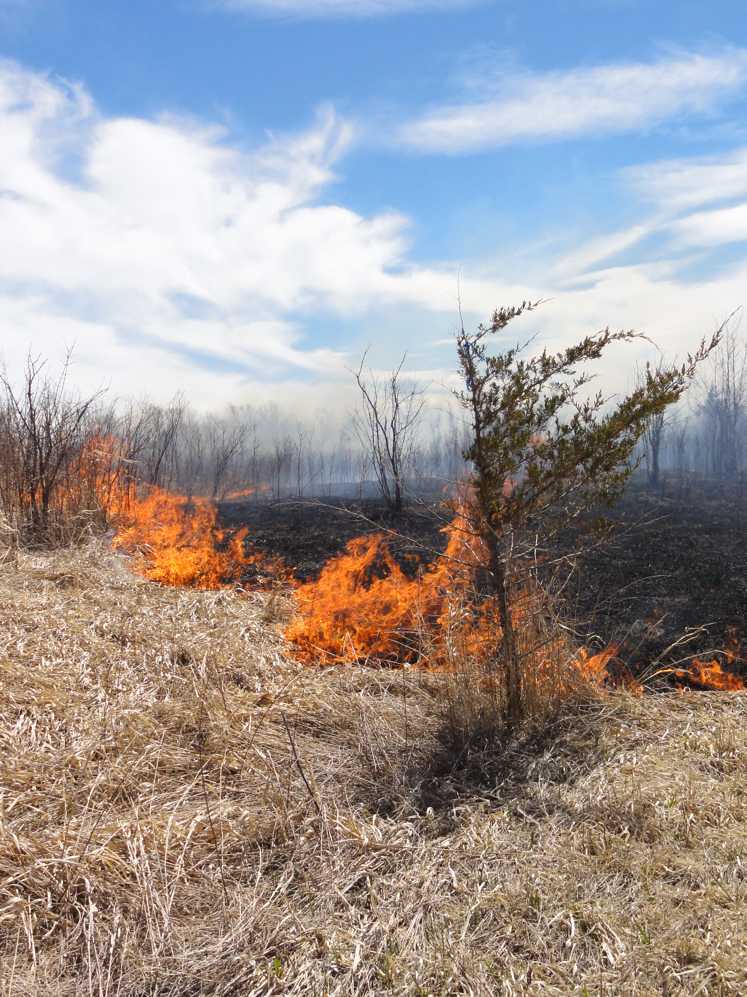
CONCLUSIONS
Minimum relative humidity was the most significant environmental variable associated with wildfire occurrence in Vermont.
Green-up dates over the study period remain stable, while snowmelt dates appear to be increasing in variability.
Datasets with fine spatial and temporal characteristics are critical for analyzing regional trends in environmental conditions indicative of flash droughts and wildland fires.
Image Credit: NWS Burlington
Notes:
In conclusion, our project successful analyzed long-term phenological trends and antecedent conditions to wildland fires in Vermont.
The three most important take-home messages from our DEVELOP project are that, one, minimum relative humidity was the most significant environmental variable leading to wildfire risk in Vermont, at the daily, seven-day, and 30-day timescale. Two, green-up dates over our study period remain relatively stable while snowmelt dates appear to be becoming increasingly variable. This may be indicative of the influence of a changing climate on the transition from the winter to spring seasons. Three, we learned throughout the project that fine spatial and temporal data are essential for analyzing short-term events, such as wildland fires and the conditions that preceded them. Statistical techniques such as machine learning and were critical in our successful analysis of phenological trends and antecedent conditions of wildland fire risk in Vermont; however, those do not replace valid, accurate data. We hope that future DEVELOP and partner projects use our study as a foundational stepping stone to support their research methodology, data sourcing, and results of the impact of a changing climate on the world around us. Thank you!
----------Image Information Below----------
Image Credit: National Weather Service Burlington, VT Forecast Office
Image Source: (Obtained from partner, Peter Banacos)

Slide 25
NASA DEVELOP Program
Tallis Monteiro (Center Lead, North Carolina – NCEI)
Special Thanks
Kristen O'Shea (Desert Research Institute, Climate Engine)
Dr. Kenton Ross (NASA DEVELOP National Program)
Kathryn Caruso (Former Center Lead, North Carolina – NCEI)
Science Advisors
Dr. Lesley-Ann L. Dupigny-Giroux (University of Vermont)
Dr. Vanessa Escobar (NESDIS)
Ryan Goodale (Colorado University in Denver)
Tamara Houston (NCEI)
Dr. David J. Meyer (NASA, Goddard Space Flight Center)
Molly Woloszyn (NIDIS, Midwest DEWS)
Partners
Kim A. Locke (NASA, Goddard Space Flight Center)
Pete Banacos, Gabriel Langbauer, & Brooke Tabor (National Weather Service)
Sylvia Reeves (NIDIS, Northwest DEWS)
Dan Dillner (Vermont Agency of Natural Resources)
Notes:
We would like to acknowledge the large team of individuals who have supported us throughout the Summer 2024 term. First, from the NASA DEVELOP Program, thank you Tallis, our Center Lead, for your endless support and compassion during stressful (and happy) times. Thank you to our special helpers, Kristen O'Shea, Dr. Kenton Ross, and Kathryn Caruso, who answered our many questions about data sourcing and coding. A big thank you to our various science advisors and partners who attended our weekly meetings and provided input on all elements of our study. We truly could not have done it without you all.

