Slide 1
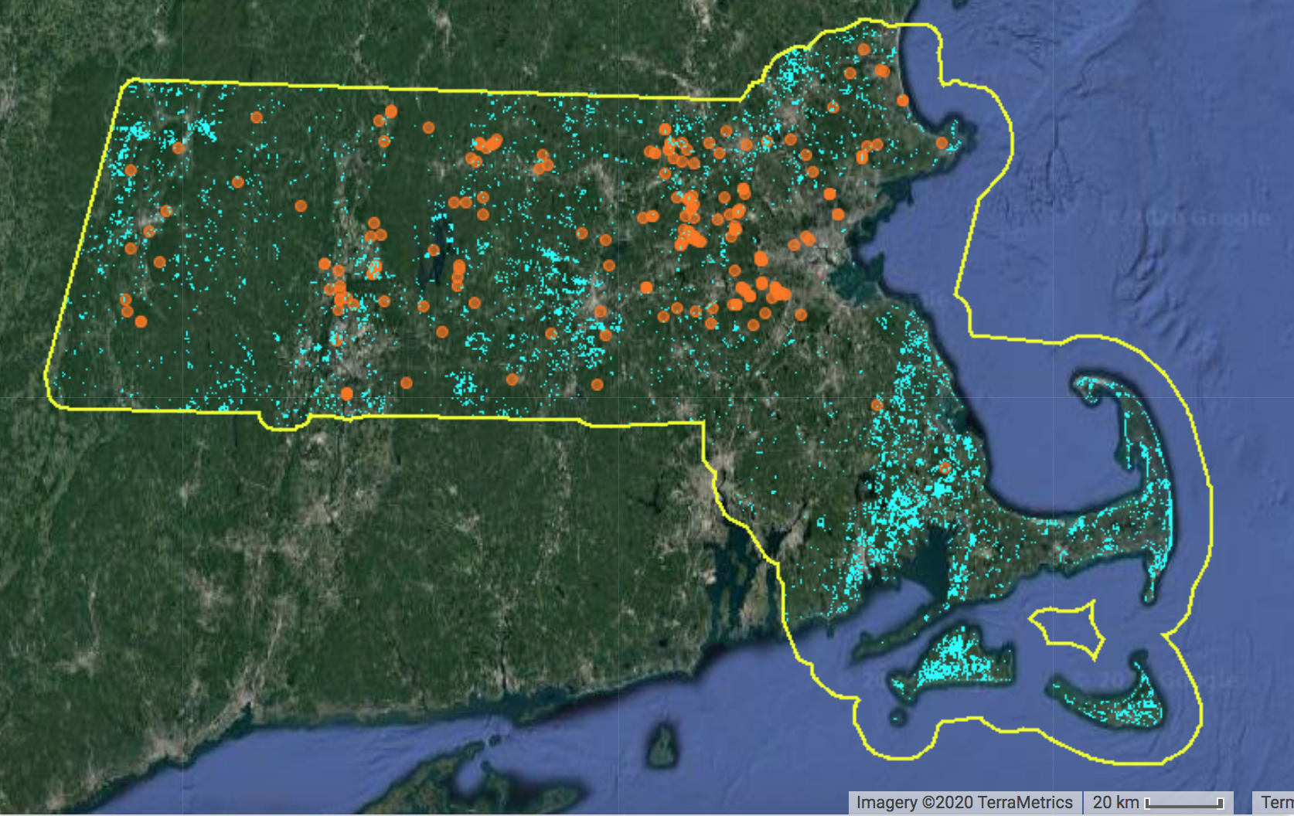
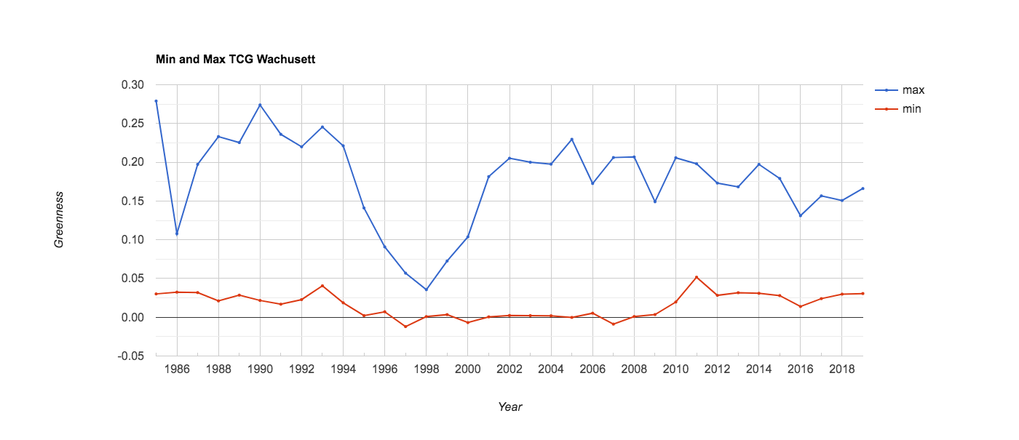
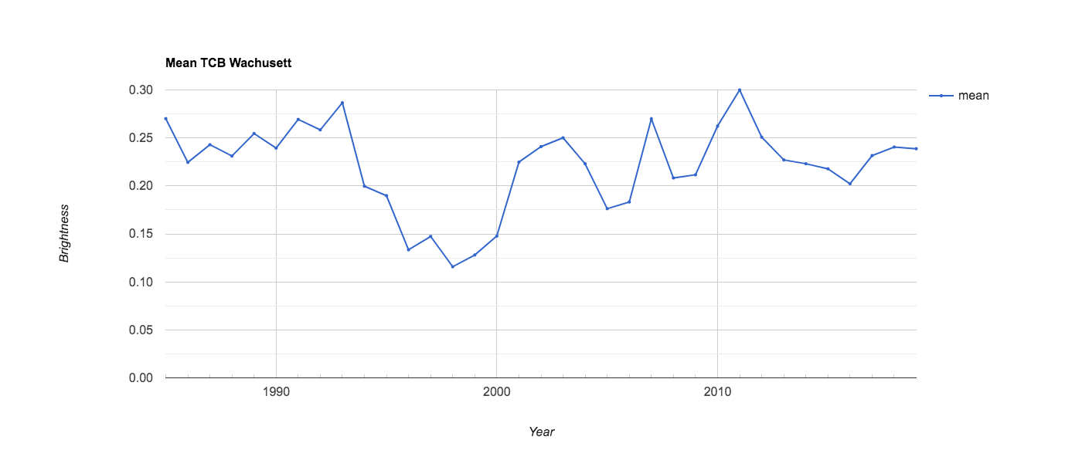

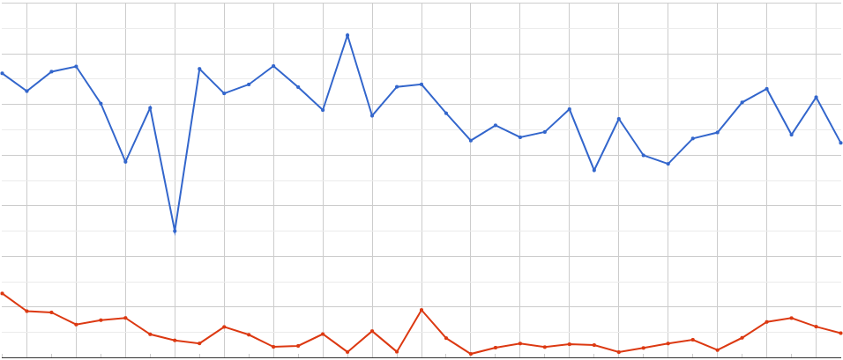
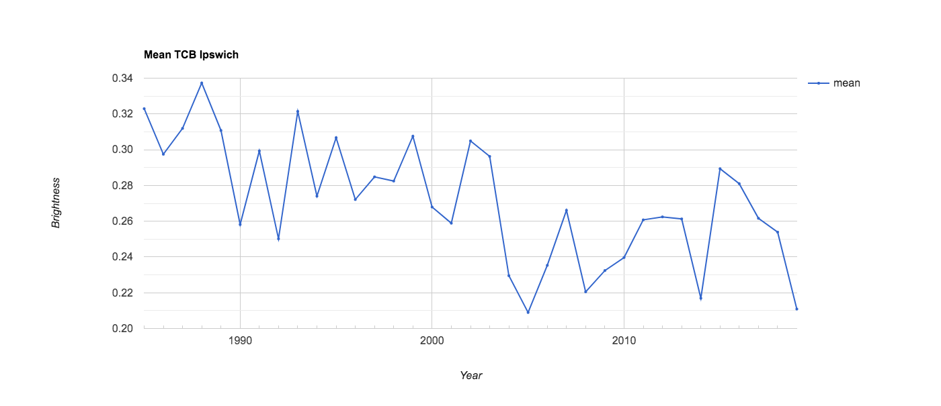

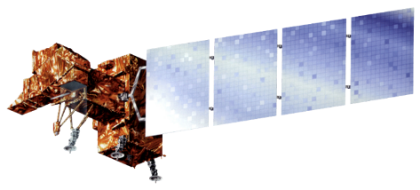

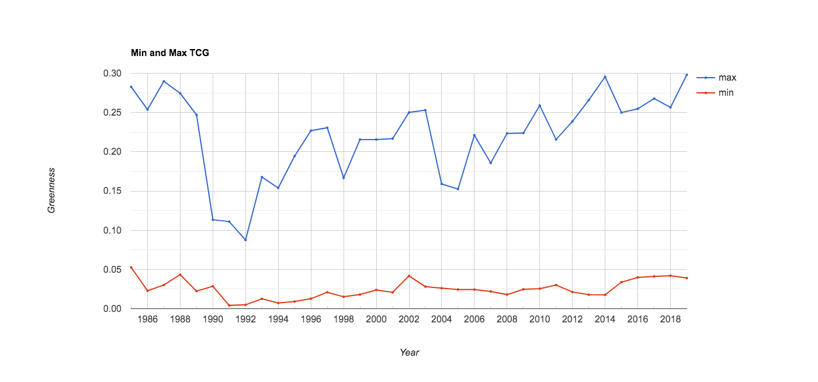
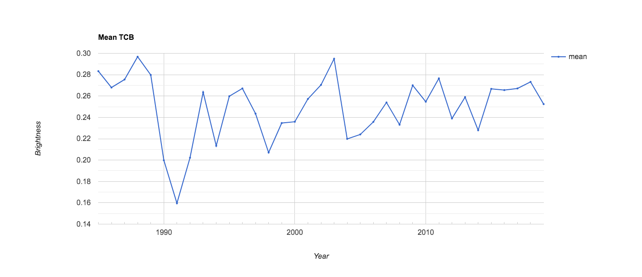

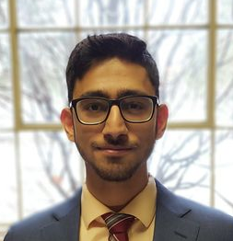
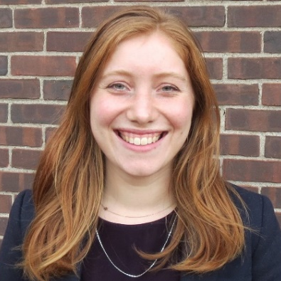

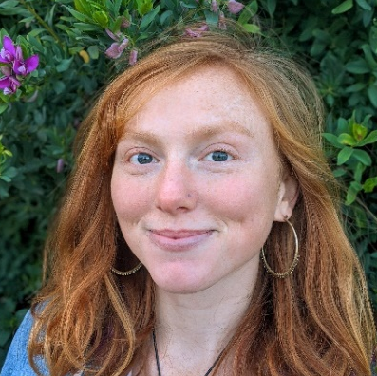
Assessing Flood Events Resulting from North American Beaver Reintroduction with NASA Earth Observations to Inform Biodiversity and Infrastructure Management
Abstract
Objectives
Massachusetts Water Resources
North American beavers (Castor canadensis) are returning to Massachusetts after overhunting decimated their populations in the 1700s. Current regulations have allowed this species to recolonize, resulting in increasingly prevalent human-beaver conflicts. These ecosystem engineers can quickly change their environment through the creation of dams, leading to floods that can adversely affect human infrastructures, such as basements, roads, or septic systems. Conversely, beaver dams can positively influence their environment, modifying the physical and chemical properties of streams and providing crucial habitats to a variety of wildlife. The 2020 Spring Boston NASA DEVELOP team collaborated with the Massachusetts Audubon Society to support their efforts in monitoring beaver impacts and managing human-beaver conflicts. The project-utilized data from Landsat 5 Thematic Mapper, Landsat 7 Enhanced Thematic Mapper Plus, and Landsat 8 Operational Land Imager to map the spectral signature created from beaver-induced flooding. The team created a tool called Beaver-Flood Event Detector (B-FED) in Google Earth Engine using imagery from 1985 to 2019. Ancillary datasets were incorporated into B-FED that allow the tool to highlight flood events in wetland areas and in situ observations of beaver presence. Beaver observations in or near flooded areas indicated likelihood that the flood was beaver induced. Time series and animations were also produced to display key regions of landscape change across Massachusetts. B-FED will allow the partner to identify and assess potential ecosystem changes and infrastructural impacts from beavers across Massachusetts and inform future management practices.
Create a user-friendly Google Earth Engine flood detection tool to detect flooding events likely caused by the North American beaver
Correlate direct beaver observations from a citizen science platform to remotely sensed flood events
Produce flood extent time series, maps, and animations to show how beavers have impacted the Massachusetts landscape through time
Project Partners
Massachusetts Audubon Society
Results
Figure 3. Displays B-FED detected flooding and reported beaver observations from 1985 to 2019. A 5km buffer was added to the border of Massachusetts to include any flooding that crossed state lines.
Study Area
Massachusetts Border
(5km buffer)
Beaver Observations
0
10
20
40
Miles
Detected Flooding
0.30
a) Wachusetts Meadow Wildlife Sanctuary
0.20
0.30
TCG Value
0.20
1064
0.10
0.10
0.00
1985 1990 2000 2010 2019
0.00
1985 1990 2000 2010 2019
-52
0.30
Year
b) Ipswich River Wildlife Sanctuary
Year
Elevation (ft)
0
10
20
40
0.34
Miles
0.20
0.28
Figure 1. Bottom Left: A map of the United States, with the study area of highlighted in red. Top Right: The study area, Massachusetts, with elevation.
TCG Value
Earth Observations
0.10
0.24
0.00
1985 1990 2000 2010 2019
0.20
1985 1990 2000 2010 2019
0.30
Year
c) Broadmoor Wildlife Sanctuary
Year
0.30
0.20
0.26
TCG Value
Landsat 5 TM
Landsat 7 ETM+
Landsat 8 OLI
0.10
0.18
Methodology
0.00
1985 1990 2000 2010 2019
0.14
1985 1990 2000 2010 2019
DATA PROCESSING
FLOOD ALGORITHM
CITIZEN SCIENCE
VALIDATION
FINAL PRODUCTS
Maximum TCG
Year
Minimum TCG
Beaver Introduction
Year
Mean TCB
Figure 4. TCG minimum and maximum (left) and TCB mean (right) for three case study locations: a) Wachusett Meadow, b) Ipswich River, and c) Broadmoor Wildlife Sanctuaries. Maximum and minimum greenness values represent the highest and lowest amount of TCG detected in an aggregate of pixels each year and collectively give the range of TCG. Mean TCB is the average reflectance of infrared light for an aggregate of pixels for a given year. A steep drop in TCG range and a steep or steady drop in mean TCB together indicate flooding for a given year. The dotted line in each graph highlights the year that beavers were introduced to each sanctuary according to management records. a) There is a major drop in TCB Mean and TCG range around 1995. Management records indicate that beavers were introduced to the sanctuary in 1993. The lagged response may indicate flood-resistant vegetation’s delayed die off in response to inundated conditions. b) There is a major drop in TCB Mean and TCG range around 1992, with management records indicating that beavers make their first dams in 1991, indicating B-FED successfully tagging the first beaver-induced flood. c) There is a major drop in TCB Mean and TCG range in 1990, validating beaver reintroduction in 1990, indicated in management records.
Filter to region of interest
Mask clouds and snow/ice pixels
Calculate Tasseled Cap (TC) values
Beaver-Flood Event Detector
(B-FED)
Filter by parameters
Utilize Global Biodiversity Information Facility (GBIF) in-situ observations
Create maps,
time series, and animations of historical flooding
Conclusions
Tasseled Cap components and citizen science data were successfully combined to identify beaver induced flooding for all of Massachusetts.
The flood detection tool confirmed beaver identified flooding with historical data at all three case study locations.
B-FED can visualize wetland patch creation and conversion across Massachusetts.
This tool can inform land management by connecting beaver population distribution and subsequent landscape change.
Figure 2. The essential components of B-FED’s algorithm are derived from TC transformations. TC transformations involve the application of pre-defined coefficients to radiance data, allowing the team to maximize the difference in spectral variance for analysis. The two TC components used here are: TC Brightness (TCB) and TC Greenness (TCG).
Team Members
Acknowledgements
Joshua Rapp, The Massachusetts Audubon Society
Cameron Piper, The Massachusetts Audubon Society
Elissa Landre, The Massachusetts Audubon Society
Jeff Collins, The Massachusetts Audubon Society
Dr. Cedric Fichot, Boston University
Dr. Valerie Pasquarella, Boston University
Celeste Gambino, Massachusetts – Boston DEVELOP Fellow
Ahmed Baqai
Project Lead
Rebecca Composto
Adelaide Gonzalez
Liana
Stachowicz
Massachusetts – Boston

