Slide 1
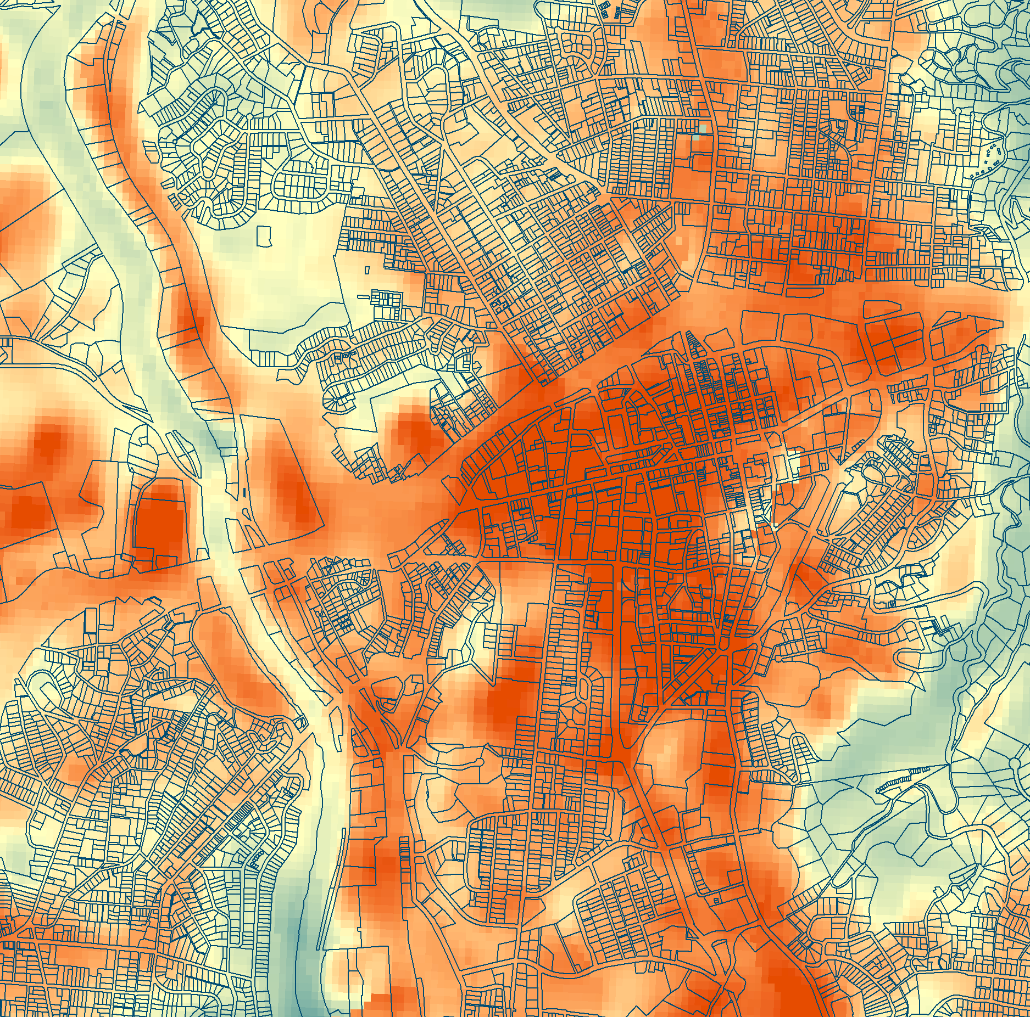
ASHEVILLE URBAN DEVELOPMENT
Using NASA Earth Observations to Quantify the Impact of Urban Tree Canopy Cover on Urban Heat and Identify Community Vulnerability in Asheville, North Carolina
Darcy Gray
Amiya Kalra
Amy Kennedy
North Carolina – NCEI | Fall 2019
Notes:
Hi everyone, we’ve been working with the Asheville Urban Forestry Commission on this project about urban heat island and tree cover in Asheville. Today, we’ll be talking through our project and describing some of our methodology and results.
------------------------------Image Information Below ------------------------------
Landsat Land Surface Temperature (LST) for 2018 summer months derived using a Google Earth Engine Code. A section of Asheville is displayed. Red indicates areas with higher LST, blue represents lower LST and the pale yellow is in the middle of the color scale. Displayed over the LST are US census parcels outlines, available from http://us-city.census.okfn.org/dataset/parcels .

Slide 2
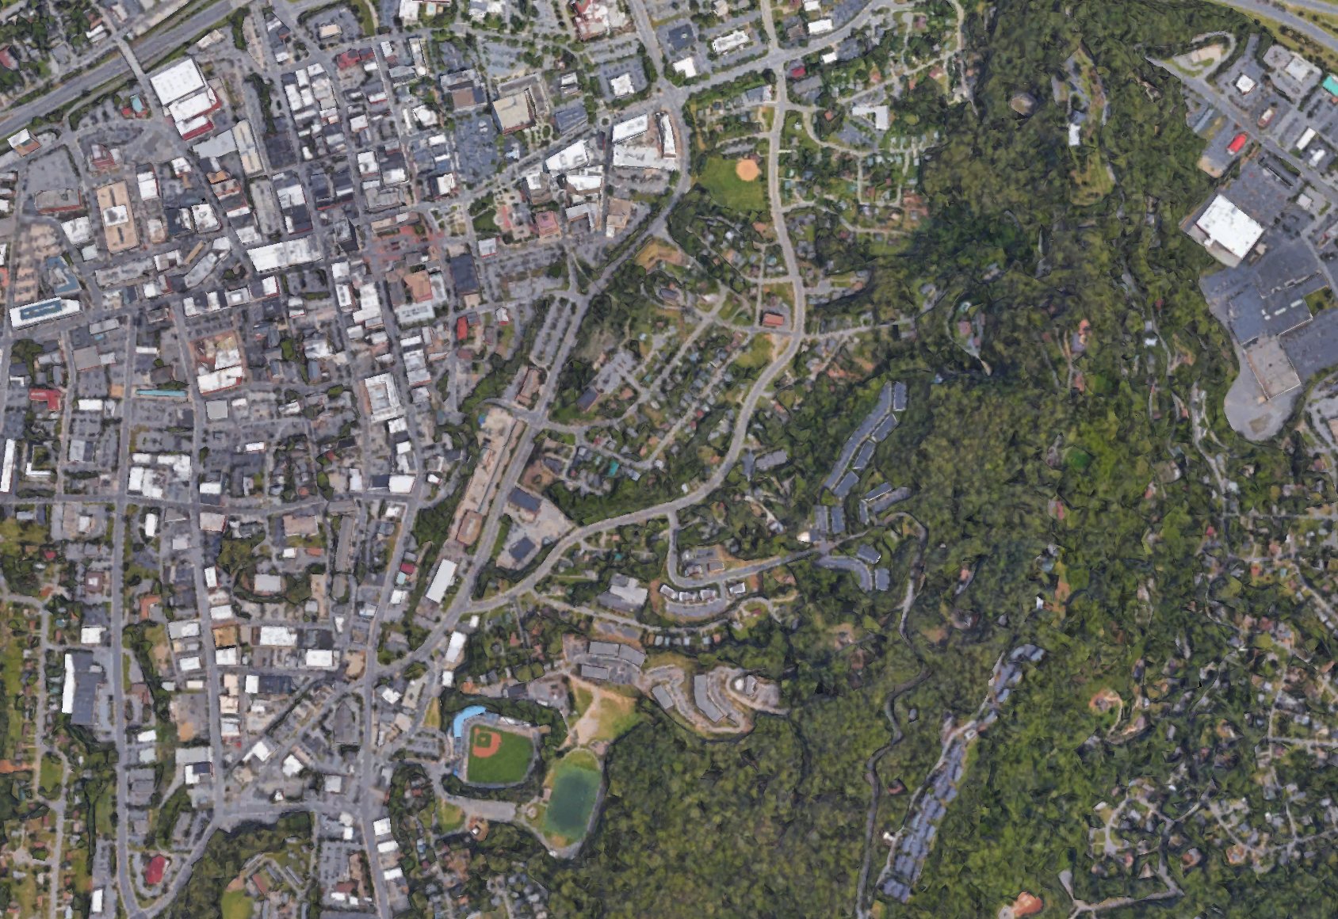
URBAN HEAT ISLANDS (UHI)
Separate from climate change
Using satellite imagery to see fine-scale temperature differences
Image Credit: Google Earth
Notes:
As some of you may already know, the Urban Heat Island effect is when an urban area experiences higher temperatures than its surroundings, typically due to things like increased amounts of impervious surfaces in cities and often, decreased tree cover. Something we want to clarify is that the urban heat island effect is a phenomenon which exists separately from climate change, and is not caused by climate change or greenhouse gas emissions but by changes in land cover and land use. However, the UHI can be exacerbated by climate change, and as temperatures increase globally, the high temperatures experienced in a city will only be higher. You can think of it as a bit of a “one-two punch.”
------------------------------Image Information Below ------------------------------
Image Credit: : Google Earth screenshot (approximately over downtown Asheville and Wind Oaks Town Homes)
Image Source: https://earth.google.com/web/@35.59317146,-82.54845159,643.32599604a,5286.66059396d,35y,-0h,0t,0r

Slide 3
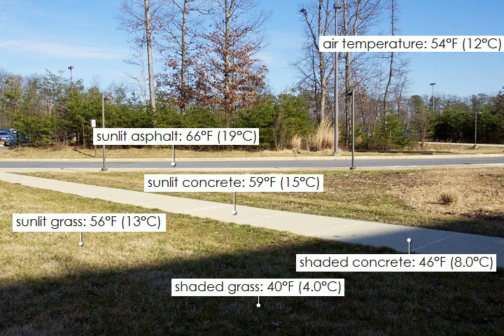
LAND SURFACE TEMPERATURE (LST)
Image Credit: Robert Simmon, NASA
Notes:
To look at the UHI in Asheville, we didn’t have thermometers to take the temperature on every street, so we used the next best thing – satellite imagery. The data that we’ll present is based off of NASA satellite-derived land surface temperature, and thats not the air temperature you're used to hearing about it, so it reflects the actual skin temperature of the earth and not the air, which means that the median temperature our data reflects for a black paved parking lot will be really high, maybe higher than you’d expect. As shown in this imagery, because land surface temperature is more extreme, it can also vary greatly even within a small space. Here we can see that the shady spot in the grass is 40 degrees, that sunny asphalt is 66 degrees, but the air temperature across the space is 54 degrees. This is something we want to keep in mind as we look at our temperature data.
------------------------------Image Information Below ------------------------------
Image Credit: Robert Simmon, NASA (text enlarged by NASA DEVELOP)
Image Source: https://earthobservatory.nasa.gov/features/HottestSpot/page2.php

Slide 4
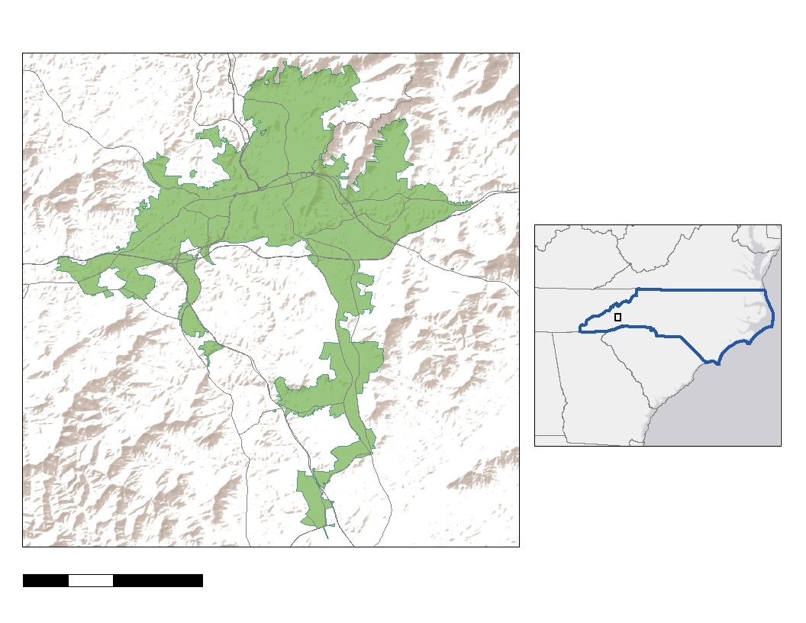
ASHEVILLE, NORTH CAROLINA
N
VA
NC
Asheville
SC
GA
Area: 117.2 km²
Study period: 1984 to 2019
Project Partner: City of Asheville Urban Forestry Commission
0 2.5 5 10
Kilometers
Notes:
As many of you may know, urbanization is increasing around the world. Following this pattern, Asheville is experiencing rapid population growth, which is expected to continue. Eighty-two percent of people in the US live in an urban area; following these patterns, Asheville is experiencing a rapid population growth which is expected to continue. Population here has increased 50% in the last 30 years. Since just 2008, there has been a population growth of 10%, but at the same time, there has been a tree cover loss of roughly 6.4% in the city. A well-known benefit of urban tree canopy cover is that it offsets the effects of urban heat islands (UHIs) through shade, reflectance rates, and evapotranspiration, which is a combined process of evaporation from water sources and soil and transpiration through plant leaves. With a growing population demanding more buildings and other impervious surfaces like parking lots, which absorb heat and contribute to UHIs, the presence of trees and their cooling effects is crucial to offset this heat.
For this project, we partnered with the City of Asheville Urban Forestry Commission. The Commission is a volunteer group that works with the city and other nonprofit environmental groups to protect Asheville’s urban forest following the city’s Comprehensive Plan (City of Asheville Tree Commission, 2019). They advise the City Council on issues pertaining to urban development with policies centered on tree cover preservation and growth (City of Asheville, 2019). They recently worked with an outside contractor, the Davey Resource Group, to acquire sub-meter resolution data on the urban tree canopy in Asheville, which we were able to include in this project.
------------------------------Image Information Below ------------------------------
Service Layer Credits: Esri, HERE, Garmin, (c) OpenStreetMap contributors, and the GIS user community
Sources: Esri, USGS, NOAA
-----------References-----------
City of Asheville Tree Commission. (2019). Asheville Tree Commission Annual Report [PDF file]. Asheville, NC. Retrieved on September 26, 2019 from https://drive.google.com/file/d/1A9v72lCHXgKbzzlm27gIeFC1BvWYP4W1/view
Davey Resource Group. (2019, Oct 23). Urban Tree Canopy Study, Asheville, North Carolina [PDF file]. Retrieved on October 28, 2019 from https://drive.google.com/drive/folders/183EXsfkstrpvvgmW9L3xbIPzjPLQunzH
U.S. Environmental Protection Agency. (2017). Healthy Benefits of Green Infrastructure in Communities. Healthy Benefits of Green Infrastructure in Communities. Retrieved on November 14, 2019 from https://www.epa.gov/sites/production/files/2017-11/documents/greeninfrastructure_healthy_communities_factsheet.pdf
Huang, Y. J., Akbari, H., Taha, H., & Rosenfeld, A. H. (1987). The Potential of Vegetation in Reducing Summer Cooling Loads in Residential Buildings. Journal of Climate and Applied Meteorology, 26(9), 1103–1116. doi: 10.1175/1520-0450(1987)026<1103:tpovir>2.0.co;2. Retrieved on November 14, 2019 from https://journals.ametsoc.org/doi/pdf/10.1175/1520-0450%281987%29026%3C1103%3ATPOVIR%3E2.0.CO%3B2
Qiu, G.-Y., Li, H.-Y., Zhang, Q.-T., Chen, W., Liang, X.-J., & Li, X.-Z. (2013). Effects of Evapotranspiration on Mitigation of Urban Temperature by Vegetation and Urban Agriculture. Journal of Integrative Agriculture, 12(8), 1307–1315. doi: 10.1016/s2095-3119(13)60543-2. Retrieved on November 14, 2019 from https://www.sciencedirect.com/science/article/pii/S2095311913605432
United Nations, Department of Economic and Social Affairs. (2018). 2018 Revision of World Urbanization Prospects. 2018 Revision of World Urbanization Prospects. Retrieved on November 8, 2019 from https://www.un.org/development/desa/publications/2018-revision-of-world-urbanization-prospects.html

Slide 5
PROJECT OBJECTIVES
Assess how LST has changed in Asheville over 35 years and over the last 10 years
Explore the statistical relationship between tree cover and LST in Asheville.
Construct an index based on socioeconomic factors, LST, and tree cover to identify heat vulnerable communities in Asheville
Notes:
Our partner’s concerns led us to three goals with our project:
To assess how Land Surface Temperature has changed in Asheville over the last 35 years, as well as over the last 10 years.
To explore the potential statistical relationship between tree cover and land surface temperature in Asheville.
To use the data on LST, tree cover, and other socioeconomic factors to construct a heat vulnerability index to identify heat vulnerable communities in Asheville.
------------------------------Image Information Below ------------------------------
The images are from maps generated in ArcMap by the Asheville Urban Development Team using Landsat 8, Davey Resource Group UTC analysis, and US Census Tracts, respectively.

Slide 6
METHODOLOGY
Temperature & Tree Cover Analyses
Data Acquisition
Processing
Analysis
End Products
Heat Vulnerability Index
Notes:
To answer these three objectives, our workflow ended up split in two: the temperature change analysis with the tree cover analysis, and the heat vulnerability index. For each of these, we had to source the data, process it, analyze it and display the end products. So we’ll walk you through that now.

Slide 7
METHODOLOGY – LST Analysis
Data Acquisition
Data Processing
Data Analysis
Data Acquisition
Notes:
First, we’ll go through our process for the temperature analysis. The first step in this process was data acquisition.

Slide 8


LST: NASA SATELLITES AND SENSORS
Landsat 5 Thematic Mapper (TM)
Landsat 8 Operational Land Imager (OLI)
Image Credit: NASA DEVELOP
Notes:
The temperature data we used was Satellite- derived Land Surface Temperature from Landsat 5 for the years 1984 to 2011 and Landsat 8 for years 2013 to 2018. We used Google Earth Engine, which is both a catalog of extensive data and an API using javascript where we could do some filtering and analysis. Many projects use MODIS for Land Surface Temperature, since this is a readily available product, but MODIS is only available at a 250 meter resolution, and since we wanted to investigate fine scale differences within the city, we chose to use Landsat to calculate temperature since this is at a 30 meter resolution.
------------------------------Image Information Below ------------------------------
Landsat 5 Image
Image Source: http://www.devpedia.developexchange.com/dp/images/thumb/6/69/01_Landsat5.png/200px-01_Landsat5.png
Landsat 8 Image
Image Source: http://www.devpedia.developexchange.com/dp/images/thumb/c/c2/03_Landsat8.png/200px-03_Landsat8.png

Slide 9
METHODOLOGY – LST Analysis
Data Acquisition
Data Processing
Data Analysis
Data Processing
Notes:
Next, we had to process this temperature data so it could be used in our analysis.

Slide 10
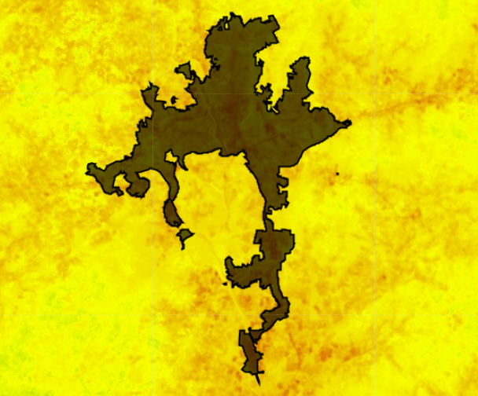
DATA PROCESSING
DERIVE LST FROM LANDSAT
MASK CLOUDS
CALCULATE MEDIAN LST
CLIP TO ASHEVILLE
ZONAL STATISTICS
Notes:
Some of the data processing we did happened within Google Earth Engine. First, we calculated land surface temperature from the Landsat imagery using the code, then we masked the clouds. Next, we had a stack of images for the time period, with each one showing the LST. So we calculated median temperature, clipped it to our Asheville shapefile and exported it.
For the final step in data processing, was to bring this temperature data into ArcMap. There we applied a tool called zonal statistics by table. This tool allowed us to calculate different statistics for a file based on the boundaries of another. For our purposes, we found average LST for each block group in the city. The tool took all the pixels within each block group boundary and calculated the mean, so one LST number was assigned to each block group. We then put these numbers with the high-resolution tree canopy data from Davey Resource Group in a table to be used for analysis later.
------------------------------Image Information Below ------------------------------
Image Credit: Darcy Gray, DEVELOPer
This image is a screen capture from Google Earth Engine. It shows our calculated Land surface temperature, set to a red to yellow scale, and overtop of it is the shapefile for Asheville which we used to clip the imagery.

Slide 11
METHODOLOGY – LST Analysis
Data Acquisition
Data Processing
Data Analysis
Data Analysis
Notes:
Next, we conducted data analysis for temperature and tree cover. This includes maps for the current temperature and the past, as well as a linear regression analysis between temperature and tree cover. Now we can show you some of our results:

Slide 12
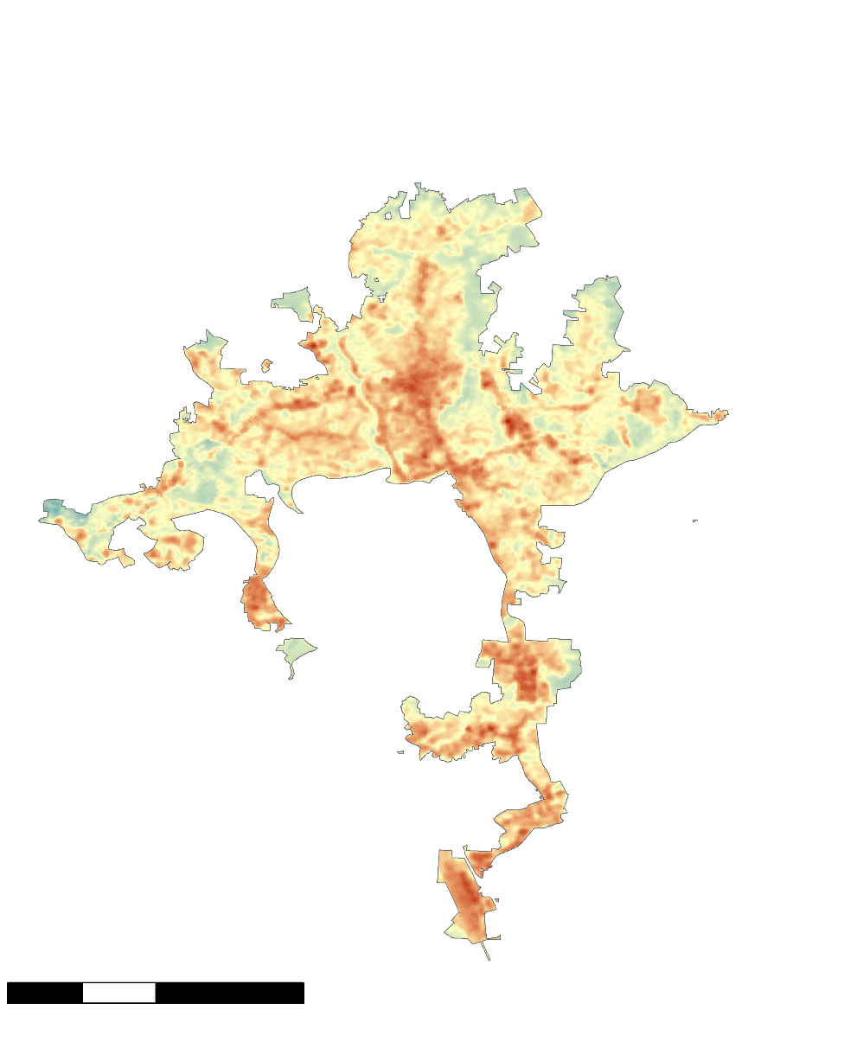
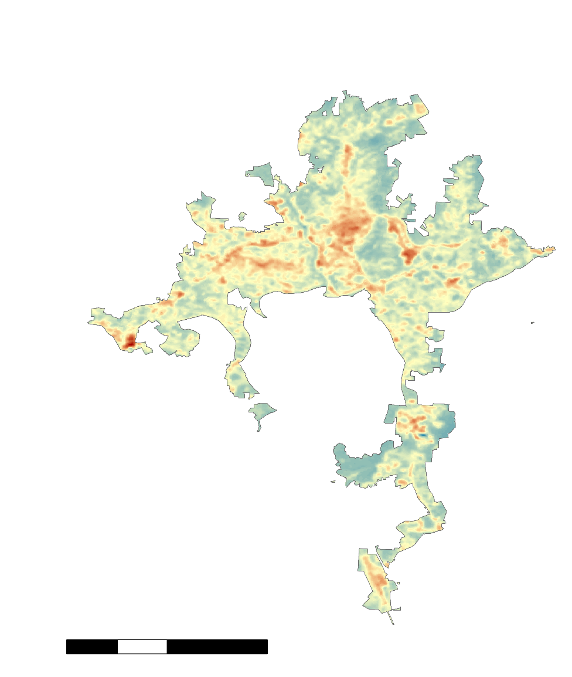
35-YEAR LAND SURFACE TEMPERATURE
CHANGE IN ASHEVILLE
Median LST 1984 to 1986
Median LST 2017 to 2019
LST
High: 95° F
Low: 56° F
0 2.5 5 10
km
0 2.5 5 10
km
Notes:
This first map shows median day time land surface temperatures for Asheville from the warm months, so May through September of 1984-1986. You can see that there’s tremendous variation across the city, with the lowest surface temperatures being in the 50s and 60s, and some spots in the 90s. The second map shows the same thing for 2017-2019. We used these 3 year ranges to have a larger sample size. This map is set to the same color scale and you can start to see where things are heating up, with some spots experiencing as much as an increase of 31 degrees F.
From this map, you can see that areas like the outlet mall and some areas south of town in the airport area really experiencing a lot more heat when it comes to LST. These extreme shifts in heat are likely related to land use, and are especially visible in places where there has been a lot of development.
Now that we had seen how much temperature was increasing within Asheville, we wanted to see specifically, what role are trees playing in this?

Slide 13
CORRELATION BETWEEN TREES AND LST
R²= 0.5374
Mean LST by Block Group, 2017-2019
( ℉ )
Percent Tree Cover by Block Group, 2018
Notes:
R squared value = 0.5374
Y = -0.1225x + 82.785
As we said before, trees provide cooling effects that mitigate heat. We wanted to see how trees and LST in Asheville correlated. Later on, we’ll be looking at population data, so we decided to do the bulk of our analyses based on census block groups. We used high-resolution tree data given to us by Davey Resource Group and the NASA satellite-derived LST that Darcy showed before. You can see that in the block group with the least tree cover – around 10% - the LST is highest in the city, and for those block groups with extremely high canopy cover, there are lower land surface temperature values. Between these values, you can see the points fall on a pretty tight line, representing a strong correlation between these two variables.
Having found a significant correlation between temperature and tree cover, we wanted to see how that information might specifically affect people living in Asheville.
-----------Sources-----------
U.S. Environmental Protection Agency. (2017). Healthy Benefits of Green Infrastructure in Communities. Healthy Benefits of Green Infrastructure in Communities. Retrieved November 15, 2019 from https://www.epa.gov/sites/production/files/2017-11/documents/greeninfrastructure_healthy_communities_factsheet.pdf
Huang, Y. J., Akbari, H., Taha, H., & Rosenfeld, A. H. (1987). The Potential of Vegetation in Reducing Summer Cooling Loads in Residential Buildings. Journal of Climate and Applied Meteorology, 26(9), 1103–1116. doi: 10.1175/1520-0450(1987)026<1103:tpovir>2.0.co;2. Retrieved November 15, 2019 from https://journals.ametsoc.org/doi/pdf/10.1175/1520-0450%281987%29026%3C1103%3ATPOVIR%3E2.0.CO%3B2
Qiu, G.-Y., Li, H.-Y., Zhang, Q.-T., Chen, W., Liang, X.-J., & Li, X.-Z. (2013). Effects of Evapotranspiration on Mitigation of Urban Temperature by Vegetation and Urban Agriculture. Journal of Integrative Agriculture, 12(8), 1307–1315. doi: 10.1016/s2095-3119(13)60543-2. Retrieved on November 15, 2019 from https://www.sciencedirect.com/science/article/pii/S2095311913605432

Slide 14
METHODOLOGY – Heat Vulnerability Index
Data Acquisition
Data Processing
Data Analysis
Data Acquisition
Notes:
The second part of our project workflow dealt with creating a heat vulnerability index to answer the question of how land surface temperature and tree cover affect people living in Asheville. To start with, we needed to collect the relevant data.

Slide 15
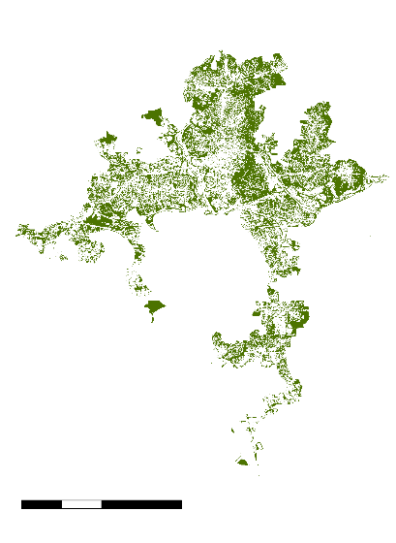
ANCILLARY DATASETS
Davey Resource Group Urban Tree Canopy Analysis
American Community Survey
0 2.5 5 10
km
Notes:
In addition to Satellite data, we used some other data sets in our analysis. Recently, the city of Asheville commissioned an urban tree canopy assessment to look at how tree cover has changed in the city of Asheville. The data was collected by the USDA’s national agricultural imagery program which is sub-meter resolution imagery, and Davey then backed this with ground data to generate a data set indicating where there are and are not trees in Asheville. This data was given to us by the forestry commission and is available at the census block group scale in addition to other scales.
The American community survey is run by the US census bureau to supplement the data they collect each decade. We used the 5-year estimates, which include information about a plethora of socioeconomic variables.
City of Asheville Tree Commission. (2019). Asheville Tree Commission Annual Report [PDF file]. Asheville, NC. Retrieved on September 26, 2019 from https://drive.google.com/file/d/1A9v72lCHXgKbzzlm27gIeFC1BvWYP4W1/view

Slide 16
METHODOLOGY – Heat Vulnerability Index
Data Acquisition
Data Processing
Data Analysis
Data Processing
Notes:
Once we had that data, we moved on to data processing.

Slide 17
METHODOLOGY: HEAT VULNERABILITY INDEX
Vulnerability
Exposure
Ability to Adapt
Sensitivity
Land Surface Temperature
Tree Cover
Age
Poverty
Notes:
Other studies that involved vulnerability indices like this one have defined vulnerability as the combination of exposure, sensitivity, and ability to adapt to a situation. We did the same thing with ours – each factor we included in the index represented one of those three things. We used land surface temperature for exposure, tree cover for ability to adapt, and age and poverty as sensitivity. In the next few slides we’ll go through and explain each one more thoroughly.
-----------References-----------
Bao et al. (2015) The construction and validation of the heat vulnerability index, a review. International Journal of Environmental Research and Public Health, 12, 7220-7234. doi:10.3390/ijerph120707220

Slide 18

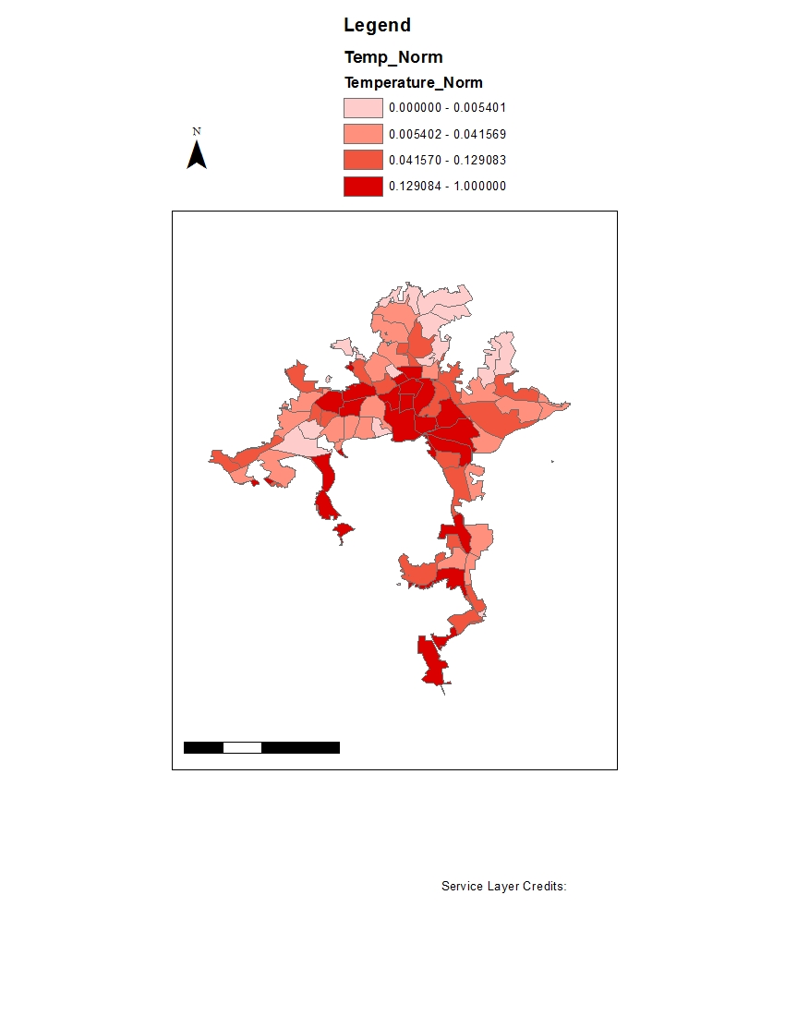
EXPOSURE: LAND SURFACE TEMPERATURE
Heat Exposure
Highest
Lowest
0 2.5 5 10
km
Notes:
So for the first component of our index, we took that satellite-derived land surface temperature, found a value per block group, and input that into our index. This map shows the 85 census block groups in Asheville color coded by land surface temperature. So the dark red are the hottest block groups and the lightest are the coolest. This is based off of the same data we looked at before, so again you’re seeing patterns around downtown and parts of south and west Asheville it’s particularly hot .
Since the index is concerned about heat risk, instead of median temperatures, we used percent of pixels in each block group whose max temperatures fall above a specific threshold. We set the threshold at the 90th percentile of the data.

Slide 19

ADAPTIVE CAPACITY: TREE COVER
Tree Cover
Highest
0 2.5 5 10
km
Lowest
Notes:
We then took percent tree cover by block group, provided to us by Davey Resource Group, and used this as one of the variables in the index. We included tree cover as an adaptive capacity variable because of the ways trees provide cooling effects through shade and evapotranspiration, which is a combined process of evaporation from water surfaces and soil and transpiration through plant leaves. On this map, the lighter colors represent the least amount of tree cover in the city, and the darker colors correlate with highest percent of tree cover. You can see that the northeast parts of the city are more wooded, and areas close to the airport at the bottom of the map and downtown in the center of the map have the least tree cover, which makes sense because there is a lot of development in those areas.
Image Credit: Amiya Kalra, DEVELOPer

Slide 20

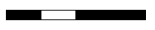
SENSITIVITY: SOCIOECONOMIC FACTORS
Social Vulnerability
Highest
0 2.5 5 10
km
Lowest
Notes:
The socioeconomic variables we included in this index are age and poverty. As people get older, they’re more likely to have health issues that can be caused or exacerbated by extreme heat, so areas with a lot of older people are more sensitive to heat. And people with lower incomes don’t necessarily have the resources that other people have to help them escape heat or make it more bearable, which can also lead to health problems because of the heat.
So on this map of Asheville block groups, the block groups that are marked with a darker blue are the areas with higher percentages of people who are above the age of 65 or living below the poverty line, which represents our definition of social vulnerability. This variable is different from the temperature and tree cover variables – there isn’t any clear pattern showing which areas are more or less vulnerable.

Slide 21
METHODOLOGY – Heat Vulnerability Index
Data Acquisition
Data Processing
Data Analysis
Data Analysis
Notes:
Once we had all three components of the index, it was time to put them together to create the index itself.

Slide 22
Overall Heat Vulnerability
Overall Heat
Vulnerability
Tree Cover
Land Surface Temperature
Highest
Lowest
0 2.5 5 10
km
0 2.5 5 10
km
Socioeconomic Factors
Notes:
To make the overall heat vulnerability index, we combined all three factors – we took temperature, tree cover, and social vulnerability and combined them to get this final map. To do that, we normalized the values for each census block group in Asheville, so that we ended up with values between 0 and 1 for each block group for each factor. The closer a value is to 1, the more vulnerable it is; the closer it is to 0, the less vulnerable it is. To create the overall heat vulnerability index, we aggregated the three factors – we added their normalized values together. That led us to a value between 0 and 3 for every census block group, where 3 is the most vulnerable and 0 is the least vulnerable. So our overall heat vulnerability index takes into account all three of those individual factors to show which parts of Asheville are most vulnerable to extreme heat from urban heat islands.
This final map shows the city of Asheville, divided into census block groups, and each block group is assigned one of four colors – the darker the color, the more vulnerable the people living there are to extreme heat from urban heat islands. For context –
This is the downtown area.
This is the outlet mall.
This is the Asheville airport.
This is UNCA.

Slide 23
IMPLICATIONS
Overall Heat
Vulnerability
Highest
Lowest
0 2.5 5 10
km
Notes:
As we said before, Asheville is a growing city. Because a growing population demands more buildings and other impervious surfaces, which absorb heat and contribute to UHIs, trees can help offset that heat, which we’ve seen from our results is true in Asheville.
It’s important to keep in mind that climate change is its own global phenomenon, and that the results from our research are hyper-localized and focus on the microclimate of Asheville directly related to UHI. However, while we would see these changes in land surface temperature even in a stable climate, climate change will make the effects of UHIs even more drastic.
Walton, D. (2019, March 9). Urban forestry proposals aim to save Asheville’s trees. Mountain XPress. Retrieved on October 28, 2019 from https://mountainx.com/
Davey Resource Group. (2019, Oct 23). Urban Tree Canopy Study, Asheville, North Carolina [PDF file]. Retrieved on October 28, 2019 from https://drive.google.com/drive/folders/183EXsfkstrpvvgmW9L3xbIPzjPLQunzH

Slide 24
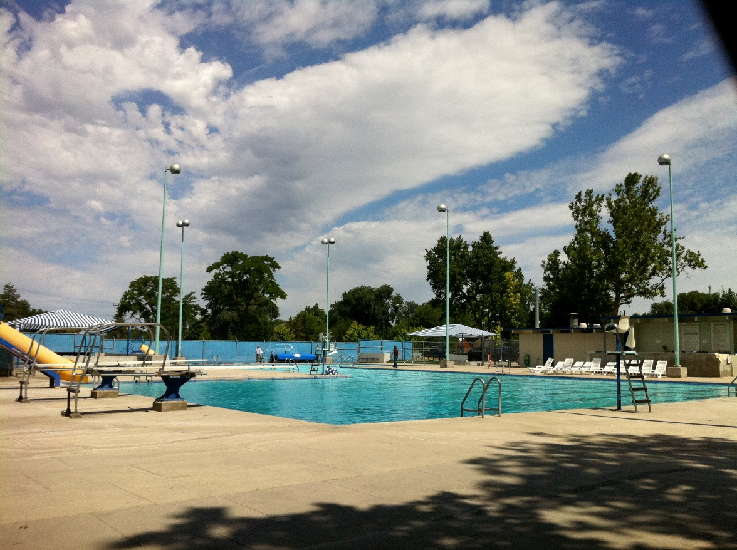
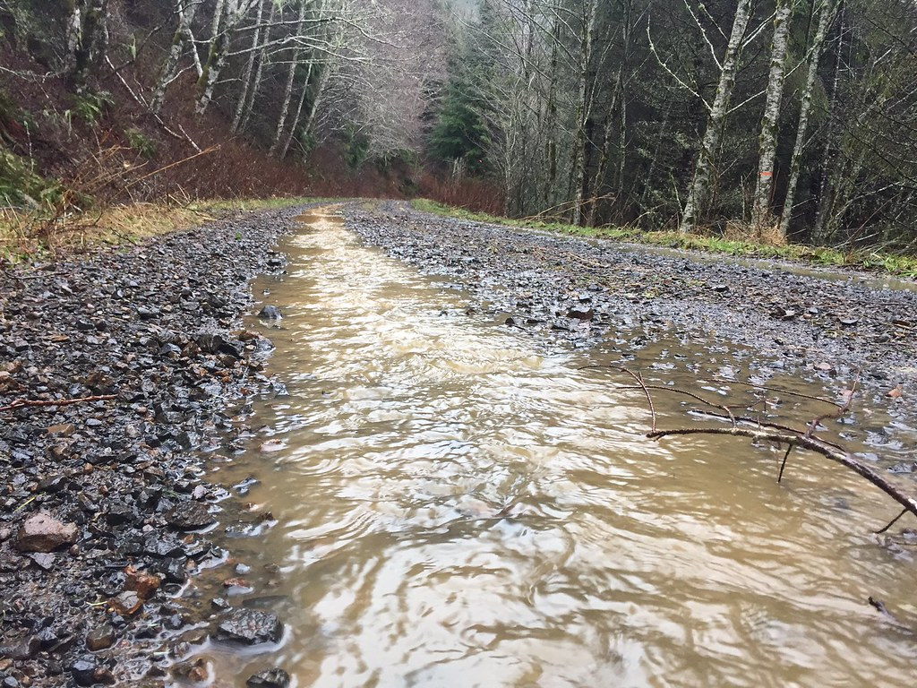

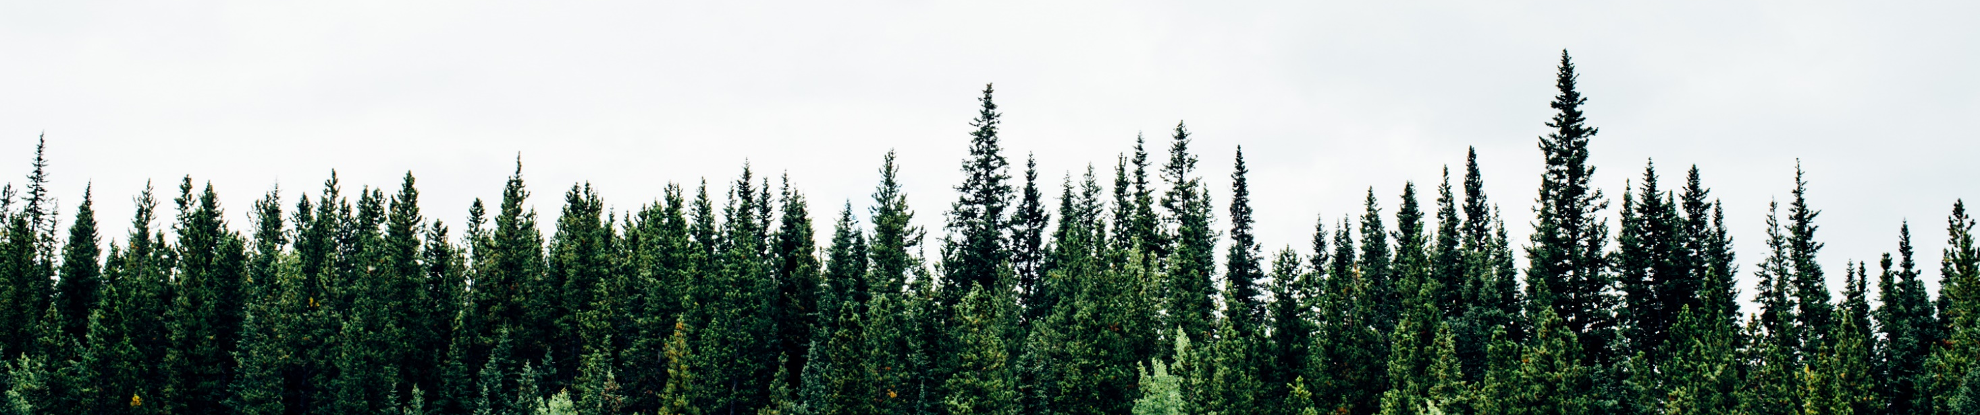
FUTURE WORK
Image credit: WildEarth Guardians
Image credit: Mordecharm, Wikimedia Commons
Image credit: Tdferro, Wikimedia Commons
Image credit: Michael Benz
Notes:
This research opens the door to a lot of great questions and potential project ideas. A few ideas that have been generated through our meetings with the Urban Forestry Commission and others include:
How has the implementation of various cooling centers and other resources in Asheville affected people’s exposure to heat in vulnerable areas over time?
Can we further investigate how tree cover relates to stormwater runoff in the city? Where can we plant trees to maximize savings in this area?
Look at changes in tree cover on public vs. private land over time
Does an increase in tree canopy lead to an increase in crime in that area?
Deeper look into the effects trees have on temperature in Asheville. What effect do new trees have on temperature? What proportion of new trees cause what change in temperature?
Can we do a similar analyses using ambient temperature (air temperature)?
These don’t necessarily fall within our scope since we are nearing the end of our 10 weeks with this project, but these ideas are something that can be investigated by others in the future.
------------------------------Image Information Below ------------------------------
Water runoff image:
Image Credit: WildEarth Guardians
Image Source: https://www.flickr.com/photos/wildearth_guardians/31715326874 (available under CC BY-NC-ND 2.0)
Crime watch image:
Image Credit: Mordecharm, Wikimedia Commons
Image Source: https://en.wikipedia.org/wiki/File:EvilEyeCrimeWatch.jpg (available under CC BY-SA 4.0)
Pool image:
Image Credit: Tdferro, Wikimedia Commons
Image Source: https://commons.wikimedia.org/wiki/File:Caldwell,_Idaho_public_pool.jpg (available under CC BY 3.0)
Tree image:
Image Credit: Michael Benz, Wikimedia Commons
Image Source: https://commons.wikimedia.org/wiki/File:Canadian_Treeline_(Unsplash).jpg (available under CC0 1.0)
Image has been cropped to fit slide.

Slide 25
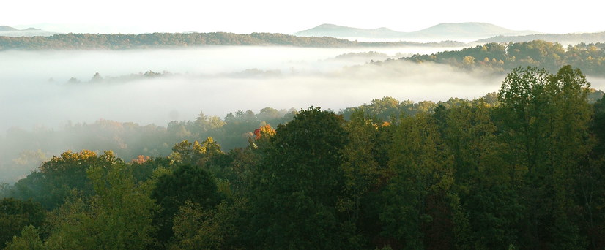

UNCERTAINTIES
Asheville Census Block Groups
Asheville City Limits
Census Block Groups
0 3 6 9 12 Kilometers
Notes:
Some census block groups only partially lie within city limits; sociodemographic data is assigned to entire census block groups, regardless of whether they are inside or outside the city. Because the team only examined data within the city limits for the heat vulnerability index but needed to use socioeconomic data based on census tract, they assumed that the data for entire tracts was representative of the data for the portion of the tract within city limits. It is possible that that was an inaccurate assumption and made the results of the heat vulnerability index less accurate.
Much of the data available from Landsat 5 and 8 for Asheville during the times in question was obscured by clouds. Cout data containing clouds severely limited the size of the dataset used in this project. That limitation may have affected the accuracy of the results of the project.
As the third image shows, and as was mentioned earlier, air temperature – the temperature people can feel when standing in a certain spot – differs from land surface temperature, which is the temperature of the skin of the earth. The land surface temperature data the team used included temperatures above 100 degrees Fahrenheit quite frequently because it measured the temperature of blacktop in the sun, rather than the temperature of the air above the blacktop. Land surface temperature is the best proxy for air temperature available from satellites, but because it is not the same as air temperature, there is a possibility that the team’s use of land surface temperature made some areas of Asheville seem hotter than they actually are.
------------------------------Image Information Below ------------------------------
Land Surface Temperature Image:
Image Credit: Robert Simmon, NASA (text enlarged by NASA DEVELOP)
Image Source: https://earthobservatory.nasa.gov/features/HottestSpot/page2.php
Cloud Image:
Image Credit: Jim Liestman
Image Source: https://www.flickr.com/photos/gods-art/3027680851/ (available under CC BY-NC-ND 2.0)

Slide 26
NASA DEVELOP
  Andrew Shannon
  Summer 2018 Washoe County Urban Development DEVELOP team
NOAA NCEI NCICS
  Scott Stevens
  Kate Johnson
  Jonathan Brannock
NEMAC
  Josh Wilson
Asheville Urban Forestry Commission and Tree Protection Task Force
  Ed Macie
  Steve Hendricks
  Amy Smith
  Dawn Chávez
  Allison Ormsby
  Dave Martin
  Steve Rasmussen
Notes:
Thank you for your time and for being here today! We want to say a special thank you to our fellow, Andrew Shannon, our science advisor Scott Stevens, and our partners at the Urban Forestry Commission. We also want to thank everyone in the NCEI building for all of their help along the way. You have made this such a supportive workspace, and we’ve really enjoyed our time here. Thank you again!
We can open the floor to questions now.

