Slide 1
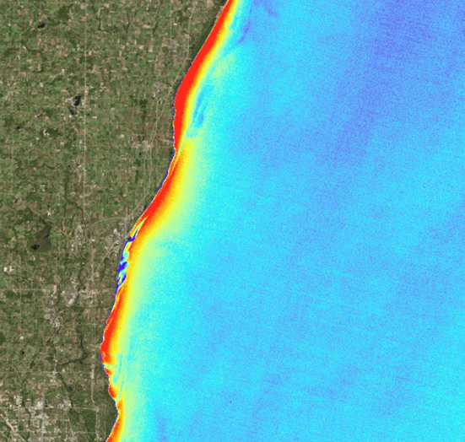
2018 Fall | California – Ames
LAKE MICHIGAN WATER RESOURCES II
Utilizing Multispectral Satellite Imagery to Monitor and Predict the Displacement of Cladophora Along the Milwaukee County Shoreline
Jashvina Devadoss
Catherine Breen
Genevieve Clow
Elizabeth Looby
Notes:
Hi Everyone, my name is Elizabeth Looby.
My name is Genevieve Clow.
My name is Catherine Breen.
And my name is Jashvina Devadoss. Our talk today will cover our 10 weeks of research on Lake Michigan Water Resources. Our project utilized multispectral satellite imagery to monitor and predict the displacement of Cladophora along the Milwaukee County shoreline.
Image Caption: Floating Algae Index derived from Landsat 8 OLI (2017) in Lake Michigan. Higher concentrations of algae are shown in red and lower concentrations are in blue.
Metadata Tags: Floating Algae Index, Cladophora, Lake Michigan, Landsat 8

Slide 2
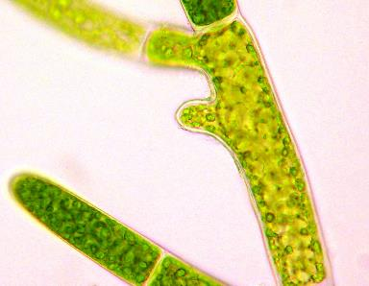
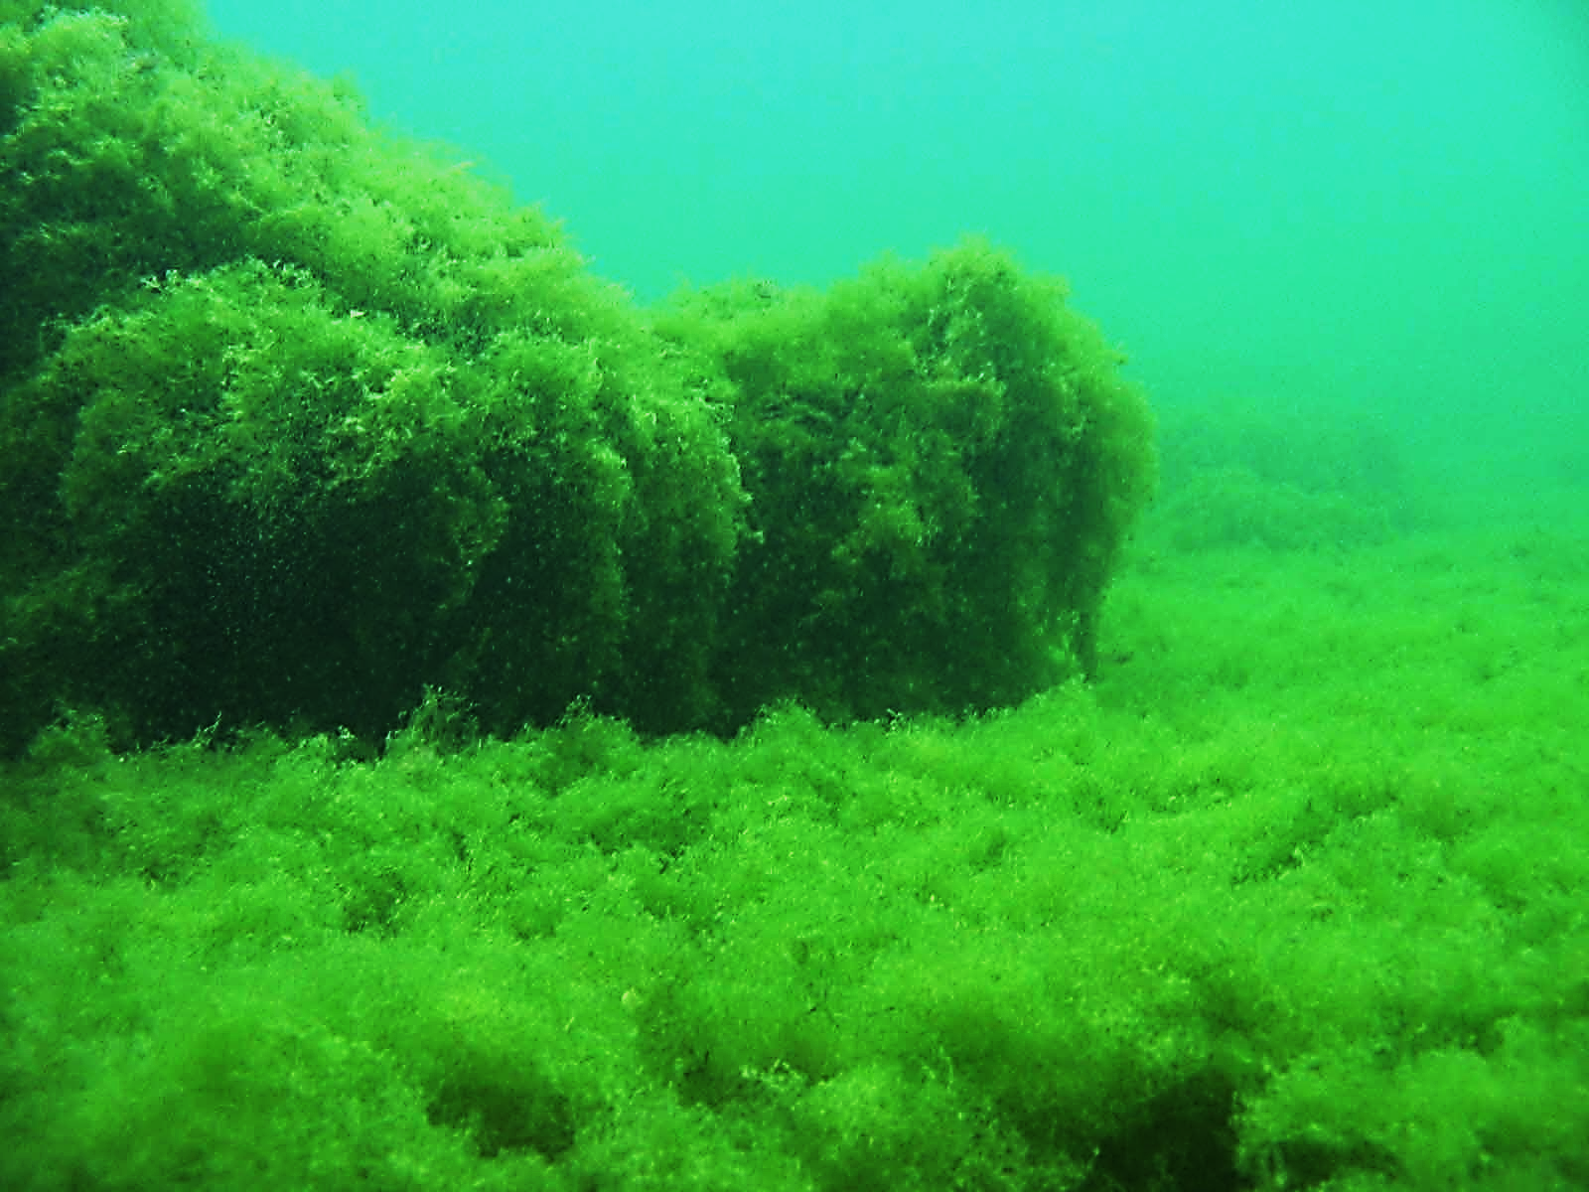
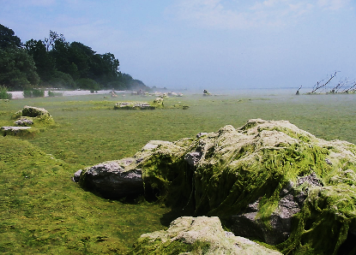
Cladophora glomerata
Green macroalgae that grows on hard surfaces at the bottom of freshwater lakes
Wind and water currents cause the algae to detach and float onshore
Peak sloughing occurs from June to September
Image Source: John, Flickr
Image Source: Scott Higgins, University of Waterloo
Image Source: Scott Higgins, University of Waterloo
Notes:
Our team analyzed Cladophora glomerata, a green macroalgae, that, unless you’re from the Great Lakes, may be unfamiliar to you. Cladophora is an algae that grows on hard surfaces at the bottom of freshwater lakes. Wind and water cause the algae to detach from hard surfaces, float to the water surface, then wash up on the shore, a process known as “sloughing.” Peak sloughing occurs between June and September.
Photo Credit: John (Flickr, Creative Commons: Attribution-NonCommerical 2.0 Generic (CC BY-NC 2.0), https://www.flickr.com/photos/johngiez-/4465267369/in/photolist-Zk79WQ-7NzEqr-4iP5bB-857PYX-gp9RmK-gp9wNf-4iTyPG-hFJvm-24MCZSq-6co9aH-24MCZrL-d6awBQ-rc7qQm-N9hE6o-7dbPeb-7dwncj-ejuTUY-bZuDHG-85aXvb-24Ros7e-7wA9rU-rrBWYV-xcQWpj-xs894J-xcWGPn-bwNAUo-rRJpKE-vHnZg6-wnKWAk-rvi7UJ-rHqUJf-qLx8dy/) and Scott Higgins (University of Waterloo)

Slide 3
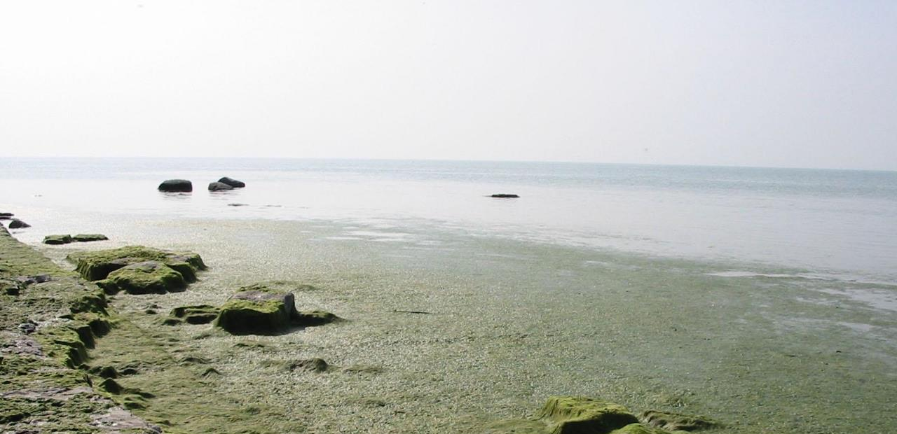
Community Concerns
Decay releases smelly, pungent odor
Promotes bacteria growth harmful to humans and wildlife if ingested
Thick mats deter beach visitors and lower real estate values
Current methods to remediate Cladophora are time-consuming and inefficient
Image Source: Scott Higgins, University of Waterloo
Notes:
For those from the Great Lakes region, Cladophora may already be a familiar sight. A recent surge in Cladophora growth has resulted in accumulation of algal mats on Lake Michigan’s western shores. When Cladophora washes up, it starts to decay, and this causes a pungent, sewage-like smell that deters beach visitors. Real estate values are lower in areas where Cladophora is frequent, and sometimes washup can be so dense that beaches and surrounding businesses lose money due to tourist not wanting to go to the beach. Additionally, the decaying Cladophora can serve as a habitat for bacteria that is toxic to humans and wildlife if ingested; for example, there have been cases of bird mortality from a disease known as avian botulism as a result of Cladophora.
Photo Credit: Scott Higgins, University of Waterloo

Slide 4
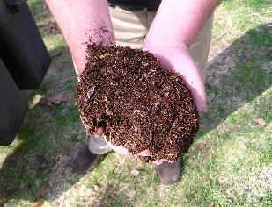
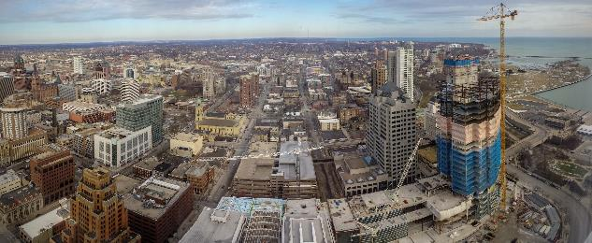
Project Partner
Groundwork Milwaukee
Implements volunteer days to promote environmental and social well-being, including Cladophora cleanup
Time-consuming cleanup process includes visually assessing each beach
Seek to make their cleanup efforts more efficient
Image Source (clockwise from top left): Groundwork Milwaukee, Jim Bauer (Flickr), Normanack (Flickr)
Notes:
Groundwork Milwaukee is a nonprofit organization that uses community efforts, such as volunteer days and educational programs, to promote environmental, economic, and social well-being within the Milwaukee area. Each year, the City of Milwaukee rewards an organization with a contract to carry out Cladophora cleanup, and Groundwork Milwaukee seeks to earn the contract to hire youth who can assist with the cleanup and compost the algae instead of transporting it to the landfill. Current cleanup efforts involve visiting each beach and visually inspecting whether Cladophora has washed ashore. To dispose of Cladophora, cleanup teams must rake the algae from the beaches, haul it out in large garbage bins, and transport it to the local landfill. The process is labor intensive, as Milwaukee’s beaches are often below steep bluffs. Groundwork Milwaukee seeks to make their cleanup efforts more efficient by eliminating the step where they must visit each beach to visually assess the amount of Cladophora that has washed up.
Photo Credit: Groundwork Milwaukee,
Jim Bauer (Flickr, Creative Commons: Attribution-NoDerivs 2.0 Generic (CC BY 2.0), https://www.flickr.com/photos/lens-cap/24589426570/in/photolist-DsTeQw-bEJiRV-5A2Lcy-dG7d1Q-2Zu5TB-z4uUg8-8LsXzD-bAQZUu-Y4Zin9-WAfM9V-c4EWaL-81Mji5-fpVjwT-u3Ak1T-c8dcBW-2uAQu2-9eK6SG-J5Xnam-9kGgqx-XEGxQX-71Ygox-XgrX73-u17C8G-9kGgir-oZjgrL-KT3ZLb-7seQpn-7seNW6-7sePgi-7seQv8-QEgNgB-6K5DpW-3LJMmJ-4uaCJ5-mTH7c-VvHMeb-5mvLaM-b6dERB-pwHoV5-4f9H3X-J2ux5P-Ci7RB3-71v32W-4fdLZ9-b6dPxX-QBBwQf-bbxCMv-HcZt7w-5gdH2D-9dP8pK),
Normanack (Flickr, Creative Commons: Attribution 2.0 Generic (CC BY 2.0), https://www.flickr.com/photos/29278394@N00/2457055952/in/photolist-4K848E-81GQik-iLiCux-UnpZuy-5voY7A-7YGdpv-vQX6g-5RgXx2-4LfZRU-t3dJL-5gFh2X-6hZGvG-29H6Jqu-6hZGrW-a23Lv3-28YRUY3-tkFfD-fnFGnV-4BuPYD-6EcyV2-6EgNHo-6WpJe2-79u6Nv-7rmL8X-ZXvNqo-4W9mBJ-9v9Y8H-5YDfiP-8a2vV9-LarxPy-pRdwLN-9fjy7N-psJwg-4W52wr-7mSfD2-9fgqN6-29H6J7U-dU3F9x-8ya2G5-jbo2W2-VEWxH1-93ifzc-5nH2if-583vNP-Vx3gNq-37mNJb-9wpMZR-6pgvVW-7Q843g-9h2fo1)

Slide 5
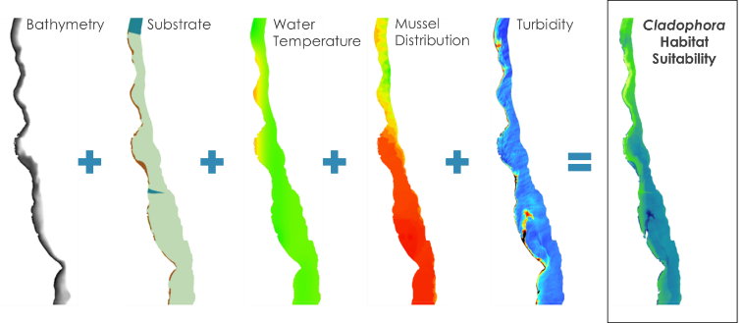
Previous Work
Habitat Suitability Map
Identified high quality habitat areas
Factors: bathymetry, substrate, water temperature, mussel distribution, turbidity
Predictive Washup Map
Identified areas suitable for Cladophora wash up
Factors: bathymetry, nearshore structures, population density, shoreline curvature
Image Source: NASA DEVELOP Lake Michigan Water Resources I
Notes:
Our project is a continuation of the Summer 2018 Lake Michigan Water Resources I project. In the summer, the team created a habitat suitability map that identified areas of high quality habitat for Cladophora using bathymetry, substrate, water temperature, mussel distribution, and turbidity, as shown in the graphic below.
They also made a predictive map to identify areas where Cladophora is likely to wash up, incorporating bathymetry, nearshore structures, population density, and shoreline curvature.
We added to the summer project’s work by incorporating surface water currents and chlorophyll-a into our analysis.
Image Source:
Lake Michigan Water Resources Team
Base Layer Source: Esri, DigitalGlobe, GeoEye, Earthstar Geographics, CNES/Airbus DS, USDA, USGS, AeroGRID, IGN, and the GIS User Community

Slide 6
Current Project

Slide 7
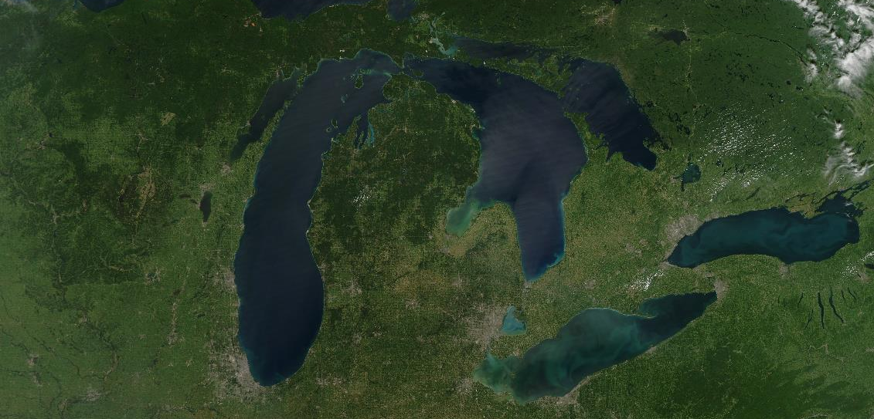
Objectives
Detect floating Cladophora from multispectral satellite imagery utilizing chlorophyll-a as an indicator
Compare the efficacy of two multispectral satellite sensors for chlorophyll-a detection
Provide decision-support to project partner by identifying areas where Cladophora is likely to wash ashore
Predict the trajectory of Cladophora transport by modeling seasonal surface water currents
Image Source: NASA Images
Notes:
We made a predictive washup tool in order to:
Detect floating Cladophora from multispectral satellite imagery
Compare the use of two multispectral satellite sensors for chlorophyll-a detection
Predict the trajectory of Cladophora transport by modeling seasonal surface water currents
Provide decision-support to our project partner by identifying areas where Cladophora is likely to wash ashore
Image Source: NASA Images, https://images.nasa.gov/details-GSFC_20171208_Archive_e001972.html

Slide 8
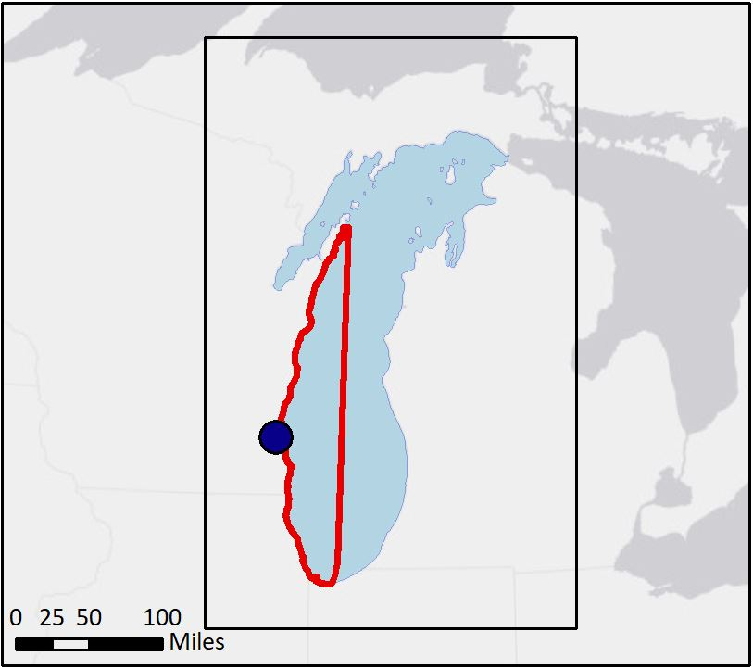
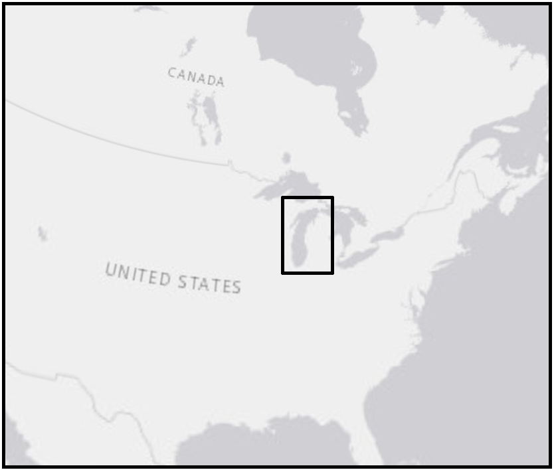
Study Design
Study period: June-September, 2016-2018 (Cladophora sloughing season)
Study area: Western shore of Lake Michigan
N
Milwaukee
Study Area
Lake Michigan
Map Source: NASA DEVELOP Lake Michigan Water Resources II
Notes:
Our partner is interested in Cladophora washup on beaches in Milwaukee County. We extended our study area along the western shore of Lake Michigan in order to generate a more comprehensive tool. Our study period was the Cladophora sloughing season, from June to September, 2016 to 2018.
Map Source: NASA DEVELOP ARC Lake Michigan Water Resources II
Base Layer Source: Esri, HERE, Garmin, OpenStreetMap contributors, and the GIS user community

Slide 9
Methodology

Slide 10
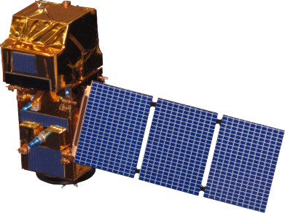
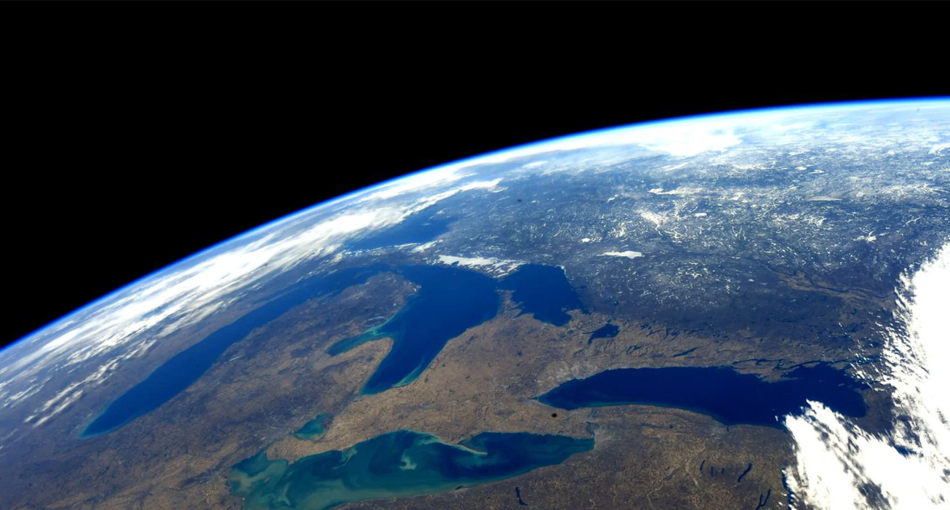
NASA and ESA Earth Observations
Sentinel-2 MSI
Landsat 8 OLI
Image Source: NASA; Wikimedia
Notes:
For our project we’ve used Landsat 8 Operational Land Imager and Sentinel-2 Multispectral Instrument. Landsat 8 has been used in previous studies for chlorophyll-a detection, but Sentinel-2 offers higher spatial resolution of 10-20m over Landsat 8’s 30m resolution. It also offers red-edge bands helpful with chlorophyll-a detection. So we have incorporated both and compared them for our purposes of detecting Cladophora.
Image Sources
DEVELOPedia
“Landsat 8” → Public Domain (NASA)
http://www.devpedia.developexchange.com/dp/index.php?title=List_of_Satellite_Pictures
“Sentinel-2” → Public Domain (NASA)
http://www.devpedia.developexchange.com/dp/index.php?title=List_of_Satellite_Pictures
Wikimedia Commons
“Great Lakes from space during early spring.webp” -> Public Domain
https://commons.wikimedia.org/wiki/File:Great_Lakes_from_space_during_early_spring.webp

Slide 11
Cladophora Detection
Chlorophyll-a as a proxy
Sentinel-2: Moses 3-Band Red Edge algorithm
Landsat 8: O’Reilly Band Ratio OC2 algorithm
$${\text{log}}_{\text{10}}\left(\text{chlor}\text{_}\text{a}\right)\text{=}{\text{a}}_{\text{0}}\text{+}\sum_{\text{i}\text{=1}}^{\text{4}}{{\text{a}}_{\text{i}}}{\left({\text{log}}_{\text{10}}\left(\frac{{\text{R}}_{\text{rs}\text{(}\text{λblue}\text{)}}}{{\text{R}}_{\text{rs}\text{(}\text{λgreen}\text{)}}}\right)\right)}^{\text{i}}$$
$$\text{Chl}\text{−}\text{a}\text{=232.29}\left[\left({\text{R}}_{\text{red}}^{\text{−1}}\text{−}{\text{R}}_{\text{red}\text{−}\text{edge} \text{B}\text{4}}^{\text{−1}}\right)\text{×}{\text{R}}_{\text{red}\text{−}\text{edge} \text{B}\text{7}}\right]\text{+23.174}$$
$a_{0}$ = 0.1977
$a_{1}$= -1.8117
$a_{2}$ = 1.9743
$a_{3}$ = -2.5635
$a_{4}$ = -0.7218
Coefficients:
Moses et al. (2012)
Werdell (2014); O’Reilly et al. (1998)
Notes:
Studies have shown that Cladophora is the most abundant algae in Lake Michigan so we used chlorophyll-a as a proxy for Cladophora.
1) These algorithms are specific to each sensor and take advantage of the available bands to detect chlorophyll-a, and each algorithm has been used for this purpose in other studies with some success
2) Sentinel-2 has chlorophyll-a sensitive red-edge bands which are incorporated into the 3-band algorithm we substituted in Sentinel-2’s bands (red, 2 red-edge) and used with the published coefficients which were adapted for MERIS but have still shown satisfactory results in simulations when used with this sensor. This algorithm uses that relationship between red absorption and the transition to NIR reflectance in the red edge to detect chlorophyll-a.
3) The Landsat 8 chlorophyll-a algorithm uses a ratio of the blue and green bands in a modified cubic polynomial, utilizing the updated published coefficients specifically adapted to Landsat 8. The updated coefficients help fit it to an in situ chlorophyll-a dataset and the 4th coefficient helps it to detect lower concentrations of chlorophyll-a without altering detection at higher concentrations.
*explain role of coefficients if needed*
The coefficients are sensor-specific, obtained after a number of iterations and correlations with in situ chlorophyll-a from different areas.
They also depend on:
- lifetime of the sensor
- its decay with time as they lose sensitivity
(that's why these coefficients are evaluated frequently)
Equation Sources
APA citation for Landsat 8 coefficient updates: Werdell, J. (2014). Chlorophyll a (chlor_a). Retrieved October 2, 2018, from https://oceancolor.gsfc.nasa.gov/atbd/chlor_a/
APA citation for Landsat 8 algorithm: O'Reilly, J. E., Maritorena, S., Mitchell, B. G., Siegel, D. A., Carder, K. L., Garver, S. A., . . . Mcclain, C. (1998). Ocean color chlorophyll algorithms for SeaWiFS. Journal of Geophysical Research: Oceans, 103(C11), 24937-24953. doi:10.1029/98jc02160
APA citation for Sentinel-2 algorithm: Moses, W. J., Gitelson, A. A., Berdnikov, S., Saprygin, V., & Povazhnyi, V. (2012). Operational MERIS-based NIR-red algorithms for estimating chlorophyll-a concentrations in coastal waters — The Azov Sea case study. Remote Sensing of Environment, 121, 118-124. doi:10.1016/j.rse.2012.01.024

Slide 12
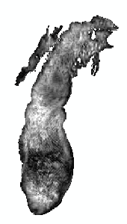
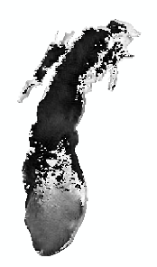
Surface Water Currents
Obtained modeled surface water currents from NOAA
Averaged U (eastward velocity) and V (northward velocity) over 10 day periods
Calculated direction and magnitude of currents from U and V
Used as Particle Track Tool inputs in ArcGIS Pro
Velocity
Direction
Particle Track Tool
Notes:
We incorporated surface current data into our model to improve the accuracy of the predictive washup map. The modeled surface current data were obtained from NOAA. The data included variables for U and V, which are eastward and northward velocity, respectively. This data was averaged over 10 day periods and then converted into raster datasets displaying the direction and magnitude of the currents. These two rasters were used as inputs into the Particle Track Tool in ArcGIS Pro to predict where the algae may wash ashore.
We also made the assumption that algae within the 2 meter bathymetry line would wash ashore due to wave forcing, so chlorophyll-a points within 2 meters of shore were excluded in the tool.
Map Source: NASA DEVELOP ARC Lake Michigan Water Resources II

Slide 13
Predictive Washup Tool
Inputs
Automated Steps in ArcGIS Pro
Output
Chlorophyll-a Algorithms
NASA Earth Observations: Landsat 8 OLI
O’Reilly Band Ratio OC2
Floating Algae Location
ArcGIS Pro Particle Track Tool
ESA Earth Observations:
Sentinel-2 MSI
Moses 3 Band Red Edge
Predictive Washup Map
NOAA Modeled Surface Current Data
Direction and Magnitude of Surface Currents
Current Averages Calculated
Chlorophyll-a algorithm sources: Werdell (2014); O’Reilly et al. (1998); Moses et al. (2012)
Notes:
This flowchart serves as a description of our final product. *Run-through of the chart*

Slide 14
Results

Slide 15
Results: Chlorophyll-a Detection
N
N
Landsat 8 Chlorophyll-a by Percentile
Sentinel Chlorophyll-a by Percentile
≤ 20%
≤ 20%
≤ 40%
≤ 40%
≤ 60%
≤ 60%
≤ 80%
≤ 80%
≤ 100%
≤ 100%
Notes:
Here we have a Sentinel-2 and Landsat 8 images processed with their respective chlorophyll-a algorithms. The red indicated higher chlorophyll-a concentration and we would expect it to be higher near shore like Landsat 8. The two outputs gave very different results due to an issue with the Sentinel-2 chlorophyll-a detection, making the Landsat 8 output the more accurate of the two.
Potential reasons why:
- The algorithm wasn’t designed for Sentinel and even though simulations pointed to good results with sentinel it might not work for our location.
- The algorithm used observed chlorophyll-a data from Russia that might NOT be comparable to our location, although creating a global algorithm was one of the objectives of Moses et al 2012

Slide 16
Results: Chlorophyll-a vs. FAI
FAI used to compare to chlorophyll-a algorithms as an alternative metric for Cladophora detection
Comparison of FAI results with the algorithm outputs show no correlation
Potential reason is that FAI detects floating algae and the algorithms are measuring the water column
Notes:
The floating algae index was used to compare with the results of both algorithms.
We found that there is no correlation between the two.
Could be because:
FAI is specifically designed to pick up algae floating on the water’s surface, whereas chlorophyll-a values are measured for the water column and include suspended phytoplankton, could be discrepancy between the two.

Slide 17
Results: Chlorophyll-a Change
Notes:
We’ve looked at change in chlorophyll-a detected by Landsat 8 over the course of 1 study year, 2017. On the Y axis we have just a count of chlorophyll-a classified pixels that fell between 3-100 micrograms/Liter, X is each month for the 2017 washup season. What we noticed was that we have 2 chlorophyll-a peaks, one in July and one in September, and the lowest levels in August which is on par with Cladophora washup behavior.
Due to the quality of results from Landsat 8 vs Sentinel-2, only the output from Landsat 8 was used as an input for the Predictive Washup Tool.
(FYI - Riley et al 2015, west beaches had higher cladophora except in aug when the southern shores get the most)

Slide 18
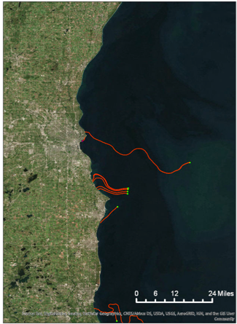
Results: Predictive Washup Tool
Predictive Washup Tool
Initial Cladophora locations*
Cladophora trajectory
*Note: High chlorophyll-a values were estimated to correspond to initial Cladophora locations
Notes:
This shows the particle track tool in action, using Landsat 8 data from August 2016. It depicts the trajectory of chlorophyll-a point movement with surface water currents, which are the orange lines. The green points represent detected chlorophyll-a.
Base Layer Source: Esri, DigitalGlobe, GeoEye, Earthstar Geographics, CNES/Airbus DS, USDA, USGS, AeroGRID, IGN, and the GIS User Community

Slide 19
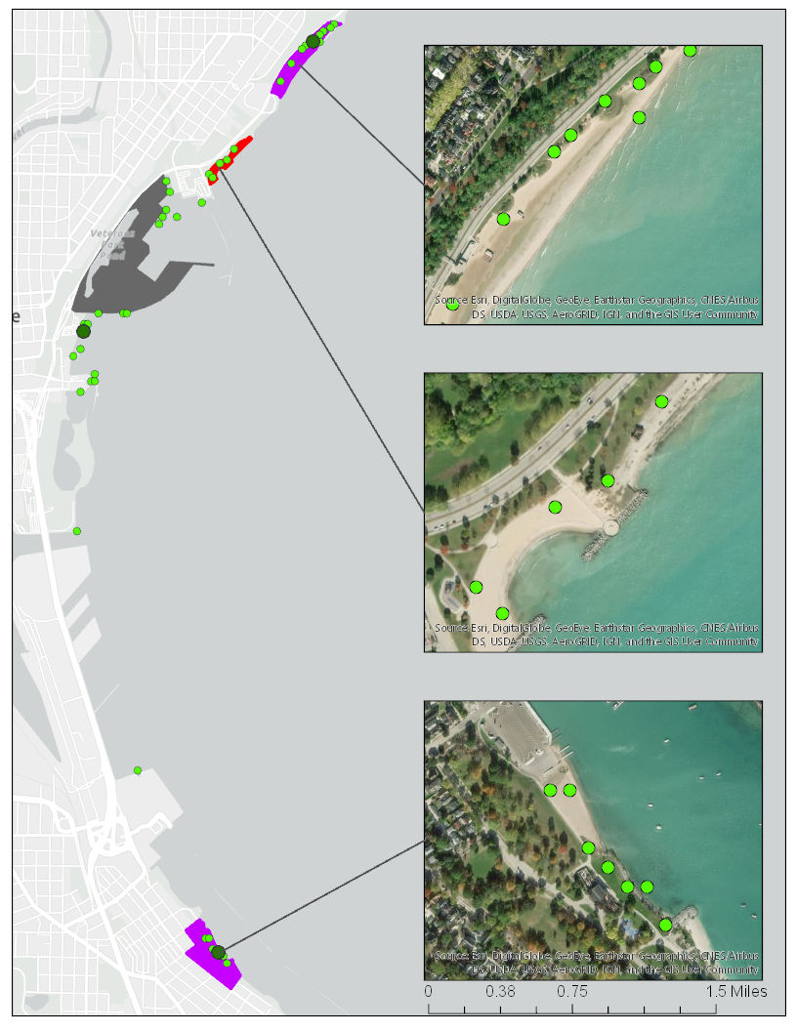
Results: Predictive Washup Tool
Bradford Beach
In Situ Observations
No Cladophora observed
Cladophora observed
No data
McKinley Beach
Tool Outputs
Highest chlorophyll-a values
Clustered points
South Shore Beach
Notes:
This is a comparison of our model outputs and in situ data collected by GWMKE that shows the predicted vs. actual Cladophora washup locations for June 30, 2018. The inset maps show that some points detected as Cladophora in our model may have been vegetation on the land. We clipped our input rasters based on NOAA cusp measurements of the extent of lake Michigan, but the extent predicted by NOAA may not have been accurate in all locations.
Map Source: NASA DEVELOP ARC Lake Michigan Water Resources II
Base Layer Source: Esri, HERE, Garmin, OpenStreetMap contributors, and the GIS user community

Slide 20
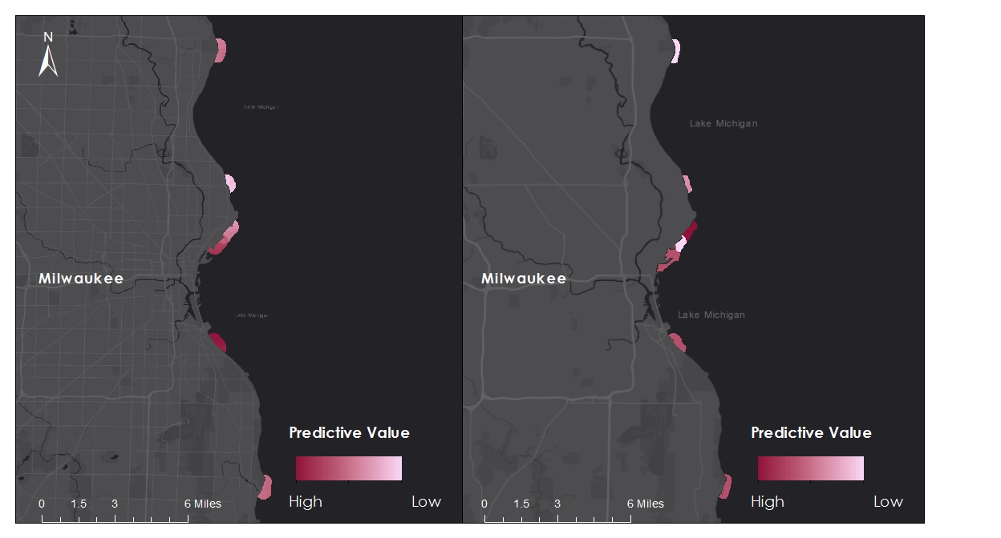
Results: Washup Predictive Map vs. Modeled Cladophora Washup
Phase 1
Doctors Park
Phase 2
Doctors Park
Atwater Beach
Atwater Beach
Bradford Beach
Bradford Beach
McKinley Beach
McKinley Beach
Veterans Park
Veterans Park
South Shore Beach
South Shore Beach
Grant Park Beach
Grant Park Beach
Notes:
These maps show the beaches predicted to experience the most Cladophora washup based upon data from 2016-2017, June through September. The first phase of this project (Phase 1) considered bathymetry, population density, shoreline curvature, and nearshore structures to create a general predictive map of washup. The map on the right (Phase 2) incorporated Cladophora detection using chlorophyll-a as an indicator, and modeled the movement of algal mats with surface water currents. The outputs of the predictive map and the model differ most notably in Bradford Beach (Phase 1, moderate; Phase 2, highest), South Shore Beach (Phase 1, highest; Phase 2, moderate), and Doctors Park (Phase 1, moderate; Phase 2, low).
Base Layer Source: Esri, HERE, Garmin, OpenStreetMap contributors, and the GIS user community

Slide 21
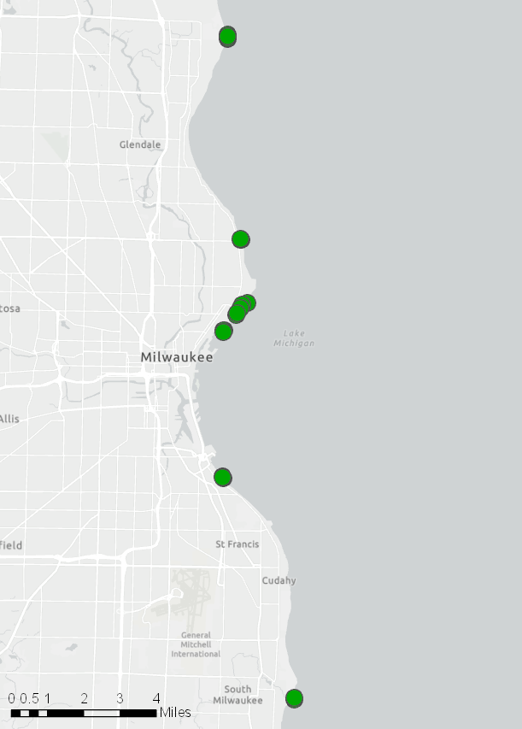
Uncertainties
N
Chlorophyll-a Indicator
Could also detect other phytoplankton
Lack of in situ data for floating Cladophora
Modeling Surface Current Data
Represents a highly simplified model
Robust particle tracking software not easily integrated into ArcGIS
Tool Validation
Need more in situ data of Cladophora washup
Cladophora Washup Mechanisms
Uncertainty about factors influencing Cladophora washup
Cladophora washup
Image Source: Lake Michigan Water Resources II
Notes:
Some uncertainties we faced were that, although Cladophora is the most abundant algae in Lake Michigan, chlorophyll-a can also detect other phytoplankton. We did not have in situ data for floating Cladophora to incorporate into our remote sensing analyses.
We made the model in ArcGIS because our partner organization can access that software and is familiar with using it, but we were not able to integrate a more complex model of currents or a robust particle tracking tool into ArcGIS.
We would need more in situ data of Cladophora washup to have more points to verify our tool. Data was collected on several satellite flyover dates in 2018, but little to no washup was found.
Furthermore, there is uncertainty about factors that influence Cladophora washup.
Map Source: NASA DEVELOP ARC Lake Michigan Water Resources II
Base Layer Source: Esri, HERE, Garmin, OpenStreetMap contributors, and the GIS user community

Slide 22
Conclusion

Slide 23
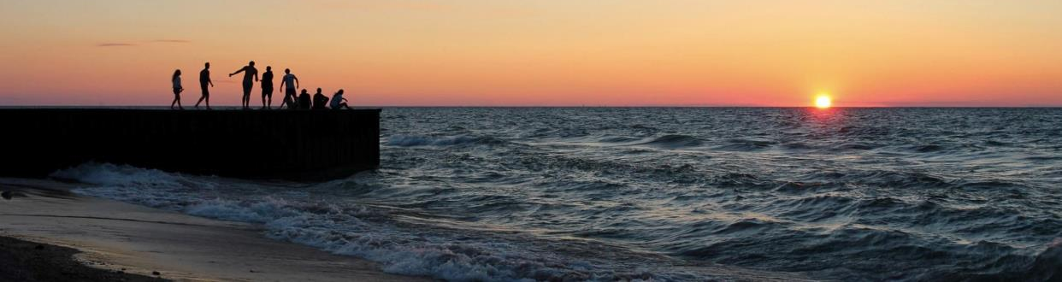
Conclusions
Landsat 8 with the O’Reilly band ratio was more successful in detecting chlorophyll-a than Sentinel-2 with the Moses 3 band red-edge algorithm.
Chlorophyll-a levels detected in Landsat 8 imagery followed Cladophora washup behavior, suggesting that what was detected could likely be Cladophora.
Incorporating chlorophyll-a and surface water currents generates new insights about Cladophora washup, expanding the predictive model developed by Phase 1 of this project.
Image Source: Cory Sitko, Flickr
Notes:
Landsat 8 data with the O’Reilly band ratio OC2 algorithm was more successful in detecting chlorophyll-a than Sentinel-2 with the Moses 3-band red-edge algorithm.
- This is potentially due to the Moses algorithm, having been fit to chlorophyll-a data elsewhere, not being compatible with Lake Michigan. It could also be that the Moses algorithm needs to be adapted more specifically to Sentinel-2
2) Chlorophyll-a levels detected in Landsat 8 imagery followed Cladophora washup behavior, suggesting that what was detected could likely be Cladophora.
3) Incorporating chlorophyll-a and surface water currents generates new insights about Cladophora washup, expanding the predictive model developed by Phase 1 of this project.
Photo Credit: Cory Sitko, Flickr, Creative Commons: Attribution 2.0 Generic (CC BY 2.0), https://www.flickr.com/photos/csitko/20494574482/in/photolist-xe33Ys-tzSTyS-x5zXVG-x6m2cg-tCoXcw-x5zYbS-XesmeD-w9otpv-Huz5f2-29L8R5Q-wNJzRL-wNDoe7-w9tyhX-XesiRx-x5uSoE-x6TEz6-XesmoM-ux7adP-x42sBq-Mpz5p2-wNDogm-8Cy7KC-dhFm5f-TYJuky-fFEUUd-cY7yt1-4ysxR9-nfQuL-aBHoHu-a29mbV-Hp6GTk-cyHpkL-52ktwp-fMDixY-4g8WT-29L8RdW-XnzDff-XrwaAZ-27FtbLJ-Wu7Zm5-29QqDZK-yXbss-WNDiyk-H2KHAP-Nf9z4P-XrwgKn-wpY7Pn-XesxmP-275B8Vo-MGP3mh)

Slide 24
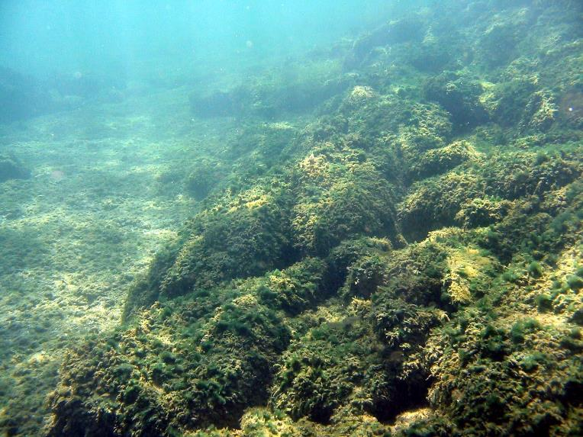
Future Work
In situ data for floating Cladophora to verify chlorophyll-a algorithm results
Higher resolution imagery
More in situ data for Cladophora washup
A tool for more complex, real-time modeling of surface water currents
Future studies focused on factors influencing Cladophora washup
Image Source: Scott Higgins, University of Waterloo
Notes:
Future efforts to predict Cladophora movement would benefit from incorporating in situ data for floating Cladophora in Lake Michigan, which could validate remote sensing analyses such as the O’Reilly and Moses chlorophyll-a algorithms and the Floating Algae Index. Higher resolution imagery would also aid the Cladophora detection, as some mats could be smaller than 30x30 resolution of Landsat 8 imagery.
Prediction efforts would also benefit from a tool that incorporates the complex, dynamic movement of surface water currents and waves.
Additionally, more field measurements of Cladophora washup would be helpful in order to calibrate predictions about its movement and develop a deeper understanding about which factors contribute most to washup.
Image source: Scott Higgins, University of Waterloo

Slide 25
Acknowledgements
Lawrence Hoffman, GIS Program Manager (Groundwork Milwaukee)
Deneine Christa Powell, Executive Director (Groundwork Milwaukee)
Dr. Juan Torres-Perez, Science Advisor (Bay Area Environmental Research Institute, NASA Ames Research Center)
Dr. Sherry Palacios, Science Advisor (Bay Area Environmental Research Institute, NASA Ames Research Center)
Dr. Kenton Ross (NASA Langley Research Center)
Joe Spruce (Science Systems and Applications, Inc.)
Farnaz Bayat, DEVELOP Center Lead (NASA Ames Research Center)
Jerrold Acdan, DEVELOP Project Coordination Fellow (NASA Ames Research Center), DEVELOP Summer 2018 Lake Michigan Water Resources Project Lead
Steven Chao, DEVELOP Summer 2018 Lake Michigan Water Resources Team
Lawrence Fujiwara, DEVELOP Summer 2018 Lake Michigan Water Resources Team
Ella Golovey, DEVELOP Summer 2018 Lake Michigan Water Resources Team
This material contains modified Copernicus Sentinel data (2016-2018), processed by ESA.

