Slide 1
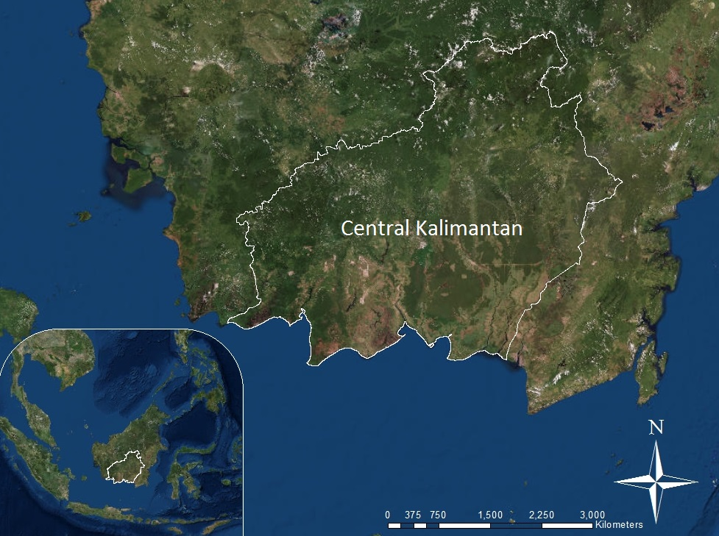
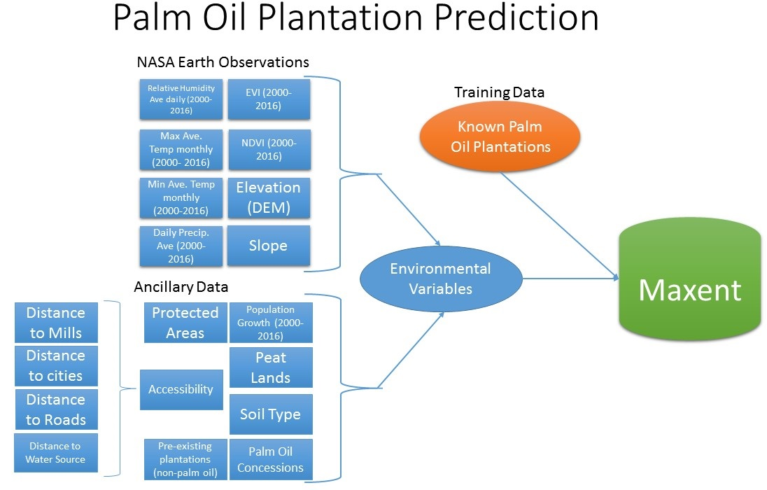
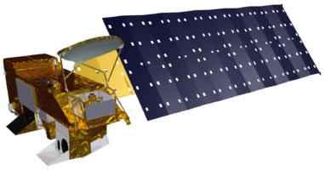
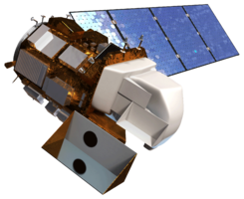
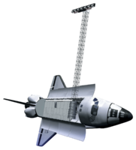
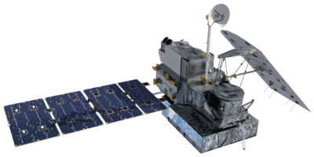
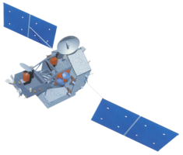
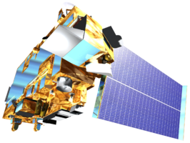
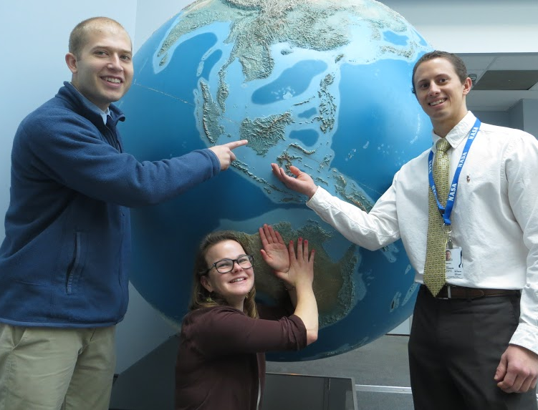
Indonesia Agriculture
Identifying Current Areas of Palm Oil Production and Modeling a Risk Map for Future Expansion in Central Kalimantan, Indonesia
Kyle T. Peterson (Project Lead), Abigail Childs, Michael Riedman
DEVELOP National Program at NASA Goddard Space Flight Center
Abstract
Objectives
Keep this blank for now.
Body text point size should be at least 24.
Caption text point size should be at least 16.
Feel free to rename, move, and resize sections as needed.
Identify current palm oil plantations in Central Kalimantan, Indonesia using Maxent
Generate a risk assessment map of future palm oil plantations based on identified plantations
Enhance World Wildlife Fund’s ability to combat deforestation using NASA Earth observations
Study Area
Methodology
Earth Observations
Aqua
Landsat 8 OLI
SRTM
GPM
TRMM
Terra
Results
Conclusions
Use images.
Make sure that it has some sort of flow, that it makes sense. Show your results in a logical order.
No bullets.
Use bullets.
Use complete sentences with periods.
Team Members
Project Partners
Acknowledgements
Left to Right: Michael Riedman, Abigail Child, Kyle Peterson (Team Lead)
World Wildlife Fund
Dr. Naikoa Aguilar-Amuchastegui, WWF (Science Advisor)
Aakash Ahamed, USRA/GSFC (Science Advisor)
Sean McCartney, SSAI/GSFC (DEVELOP Center Lead)
NASA Goddard Space Flight Center and World Wildlife Fund

