Slide 1
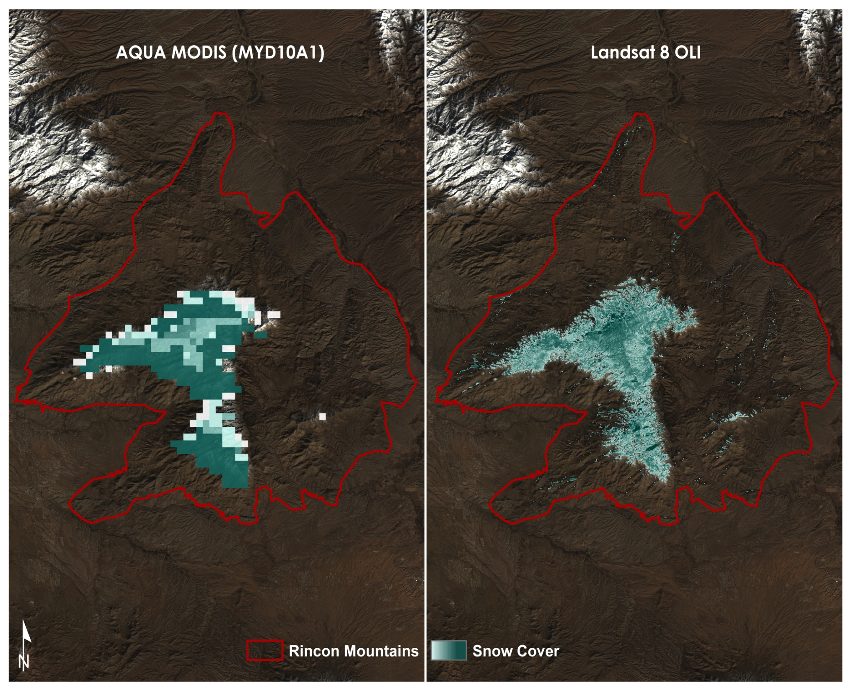

Saranee Dutta (Project Lead)
SOUTHEASTERN ARIZONA WATER RESOURCES
Using NASA Earth Observations to Assist the National Park Service in Assessing Snow Cover Distribution and Persistence Changes in the Sky Islands.
Farnaz Bayat
Elaina Gonsoroski
Katie Harville
Tyler Lynn
Notes:
We are the Southeastern Arizona Water Resources team.
Image Credit: Southeastern AZ Water Resources Team

Slide 2
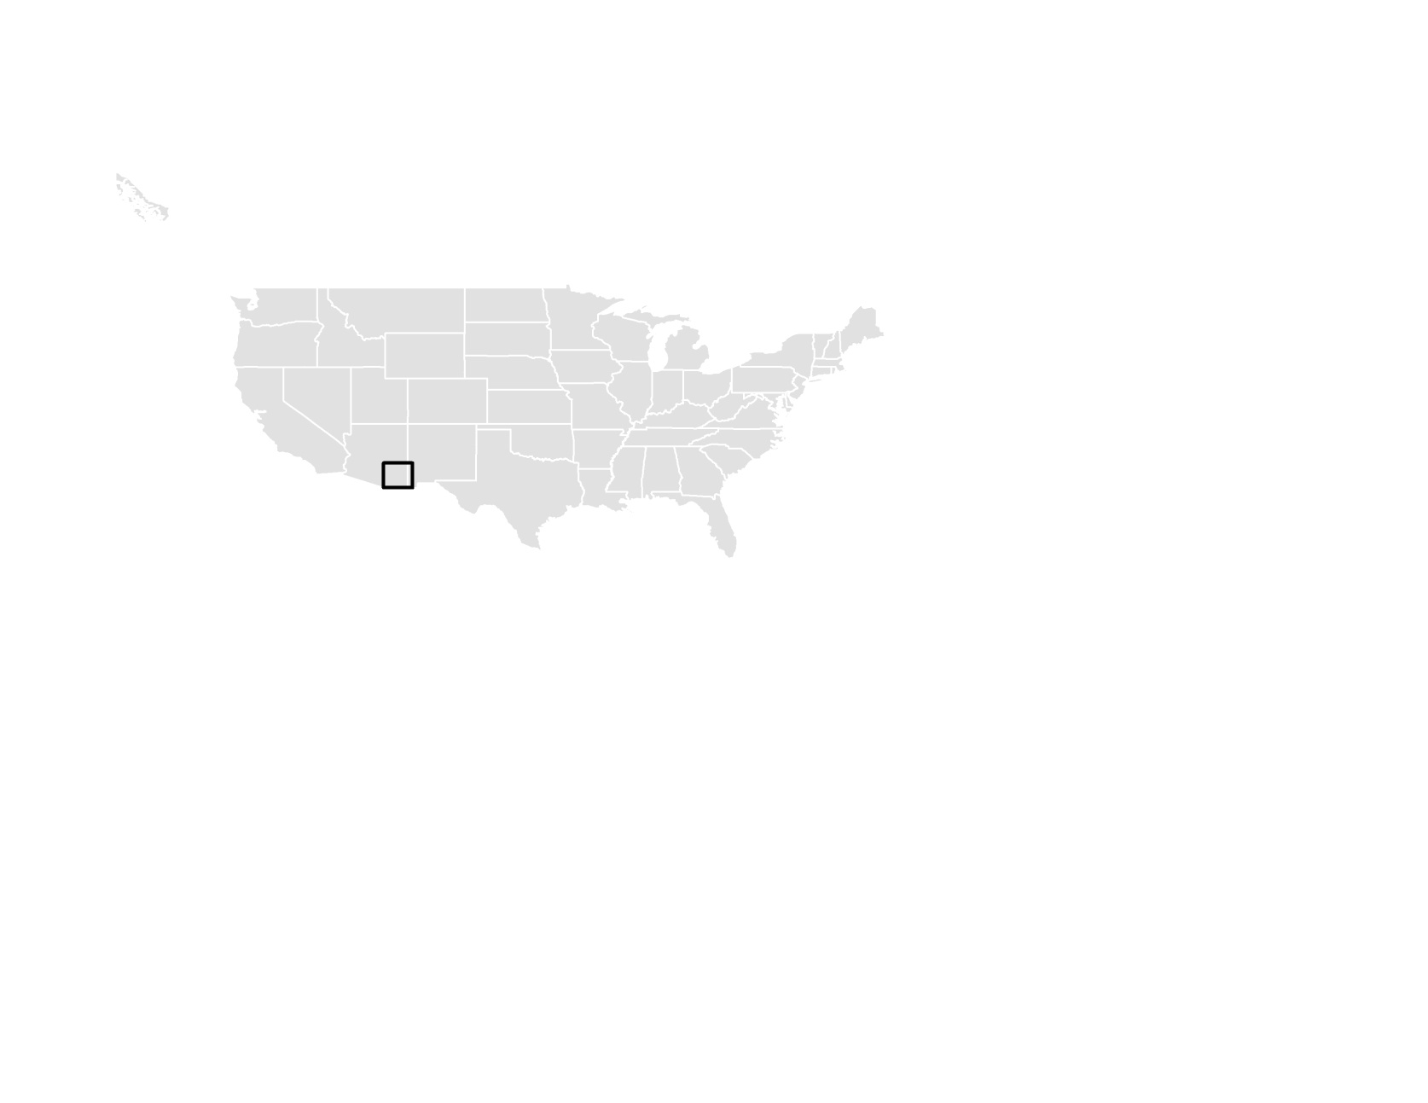
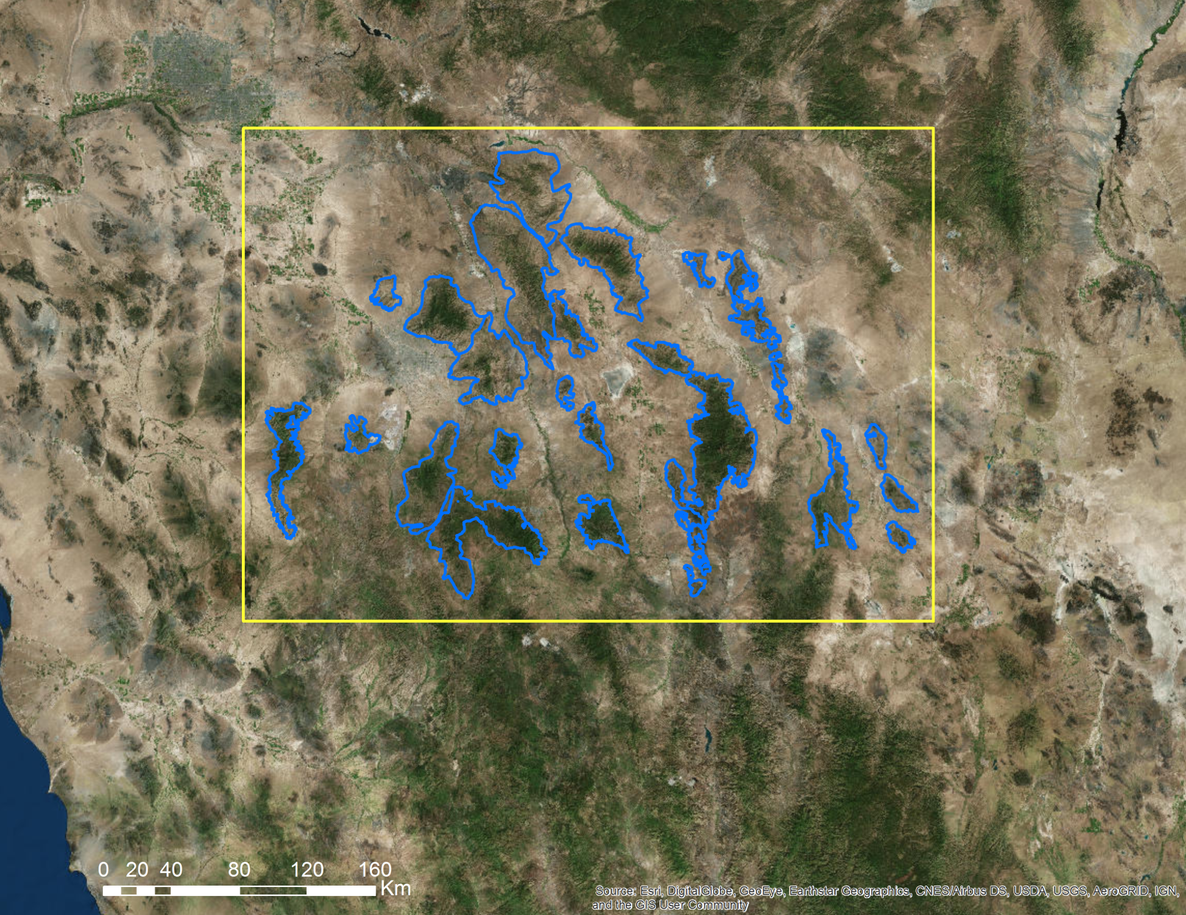
Area of Interest
Overall: Sky Islands (Madrean Archipelago)of Southeastern Arizona
Focus: Saguaro National Park East (East of Tucson, Arizona)
Study Period: 1985 - 2016
Image Credit: Southeastern AZ Water Resource Team
Notes:
The overall study area consists of Sky Islands located in southeastern Arizona (east of Tucson) and portions of Mexico covering roughly 45,156 sq. km of area with a focus on the islands within the Saguaro National Park boundaries. The study period for this project, 1985 – 2016, was chosen based on the lack of historical snow presence information and availability of remote sensing data.
Image Credit: Southeastern AZ Water Resources Team

Slide 3

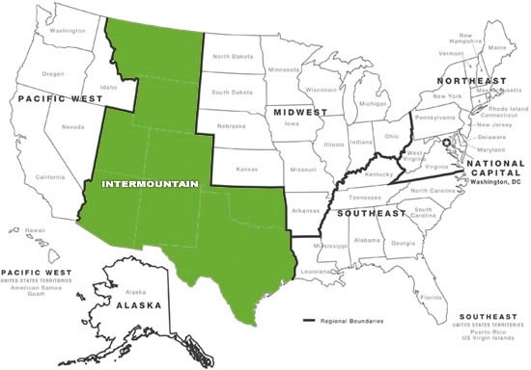
Community Concerns
Snowmelt runs into streams and water bodies, providing water resources to wildlife and vegetation even during the dry season.
Reduced annual snowpack has potential to negatively impact flora and fauna that inhabit the Sky Islands.
Understanding impacts of reduced snow pack in the Sky Islands will assist the NPS in developing adaptive land management strategies for the future.
Image Credit: National Park Service
Notes:
The Southeastern Arizona Water resource team collaborated with Partners from the National Park Service, Intermountain Region and the National Park Service at the Saguaro National Park to address the community concern of the potential impact of snow cover loss on water resources in the Sky Island region. With a more complete understanding of the impact of snow cover, the NPS will be able to analyze past snow cover changes to improve future land management decisions.
Image Source: https://www.nps.gov/nhl/contact/imro.htm

Slide 4
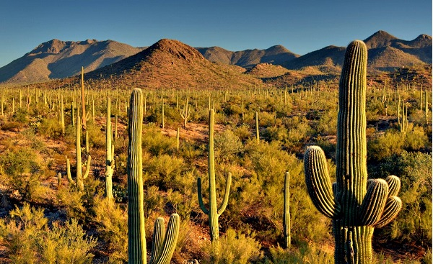
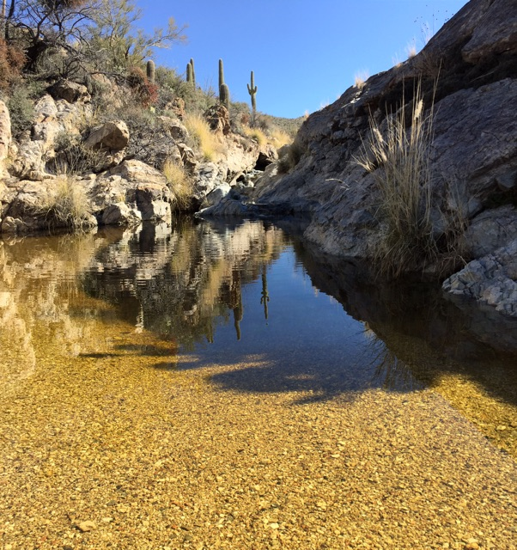
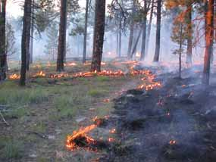
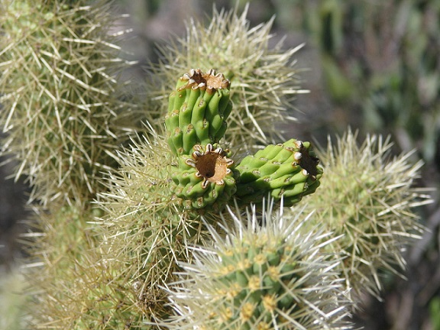
Community Concerns
Warming Temperatures =
More Rain and Less Snow
Snowpack decline results in less runoff during summer months.
  Potential Effects
  Water reduction
  Habitat change
  Wildfire outbreaks
Image Credit: National Park Service
Notes:
Noted climate change effects in the Southwestern United States include significant increases in temperature across the region. Warmer temperature causes shifts in the winter precipitation pattern e.g. precipitation is falling as rain rather than snow , shifts in the hydrological cycle - such as a decrease in winter precipitation, and earlier yearly snowmelt. Without the contributions from snowmelt runoff, the many streams, springs, seeps would exhibit extremely low water levels and in some cases dry out completely. This could lead to loss of habitat and an increase in wildfires.
Understanding how climate change has historically affected the region will assist the NPS in developing adaptive land management strategies for the future. These strategies might include where and how to apply prescribed fire, which species (aquatic and terrestrial) and critical habitats may become stressed, threatened, or endangered and what might be done to supplement water bodies or establish refugia, as well as how backcountry visitors may be impacted by water availability changes.
Image Source: (From Left to Right) http://www.national-park.com/wp-content/uploads/2016/04/Welcome-to-Saguaro-National-Park.jpg
https://www.nps.gov/sagu/learn/nature/water-in-saguaro-national-park.htm
https://www.nps.gov/sagu/learn/management/fire_natural_role.htm
https://www.nps.gov/sagu/planyourvisit/safety.htm

Slide 5
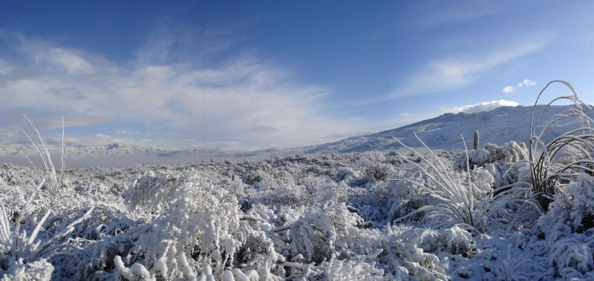
Image Credit: National Park Service
Objectives
  Assess historic snow cover distribution and persistence in the sky islands region.
  Analyze water availability trends in Saguaro National Park watersheds.
Notes:
The objective of this project is to – Assess historic snow cover distribution and persistence in the sky island region and analyze water availability in Saguaro National Park watersheds during dry season.
Image Source: https://www.nps.gov/media/photo/gallery.htm?id=D063AD9E-155D-451F-67481BE5A6A49824

Slide 6



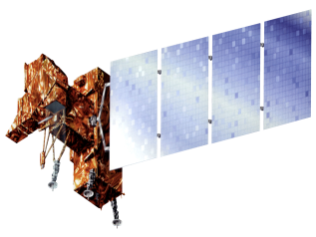

NASA Earth Observations
AQUA/MODIS (2002 – 2016)
TERRA/MODIS (2000 – 2016)
  Landsat 4/5 TM (1985 – 2011)
  Landsat 7 ETM +(2011-2013)
  Landsat 8 OLI (2013-2016)
Image Credit: NASA
Notes:
NASA Earth observing system comprises a series of satellite designed for long term global observation of the land surface, atmosphere, biosphere and oceans to monitor environmental changes.
For this project we used data from NASA’s Moderate Resolution Imaging Spectroradiometer (MODIS)boarded on Aqua and Terra satellite. MODIS standard snow cover products including the Normalized Difference Snow Index (NDSI) were obtained from NASA’s Land Processes Distributed Active Archive Center (LP DAAC) for the years 2002 through- 2016. Additionally, Landsat 5 (TM), Landsat 7 (ETM+), and Landsat 8 OLI & /TIRS data were obtained through the USGS Earth Explorer from 1985 to 2016 from November - March for all dates containing <30% cloud cover. We used both MODIS and LANDSAT data product in order to cover as wide a date range as possible. The goal of the fall 2016 term is to create an assessment of snow cover distribution in the Rincon Mountain, using NASA Earth observations (MODIS and Landsat) data products.
Image Source:
Aqua: http://www.devpedia.developexchange.com/dp/index.php?title=List_of_Satellite_Pictures
Terra: http://www.devpedia.developexchange.com/dp/index.php?title=List_of_Satellite_Pictures
Landsat 5: http://www.devpedia.developexchange.com/dp/index.php?title=List_of_Satellite_Pictures
Landsat 7: http://www.devpedia.developexchange.com/dp/index.php?title=List_of_Satellite_Pictures
Landsat 8: http://www.devpedia.developexchange.com/dp/index.php?title=List_of_Satellite_Pictures

Slide 7
Methodology
Data Acquisition
Data
Processing
Data
Analysis
Landsat 4/5 TM
Landsat 7 ETM +
Landsat 8 OLI
Scale to Top of Atmospheric Reflectance
NDSI Calculation
Snow cover distribution for focus area
Snow cover distribution for focus area
TERRA/MODIS
AQUA/MODIS
Extract Sub Dataset
Cloud Mask
Historical and current stream discharge, and stream flow
USGS Stream Gauge Data
Notes:
Landsat data were atmospherically corrected by using Develop National Program Python Packages (Dnppy) before calculating NDSI. NDSI was calculated using the reflectance value of band 2 and band 5.
ArcGIS model builder were used to process MODIS Terra and MODIS Aqua version of snow cover product. Snow cover is identified using Normalized Difference Snow Index (NDSI).
The NPS provided stream gauge data, dating from the Sky Island region dating back to1985 to compare with remotely sensed data. Additionally, spring-level data, dating back to the mid-1990s, from within Saguaro National Park were also available to compare to remotely sensed data. These correlations were used to create a clearer historical perspective on changes in snow cover and its effect on water resources. Additionally, individual watershed data was used to analyze changes in snow cover to identify watersheds experiencing a higher loss of snowpack.

Slide 8
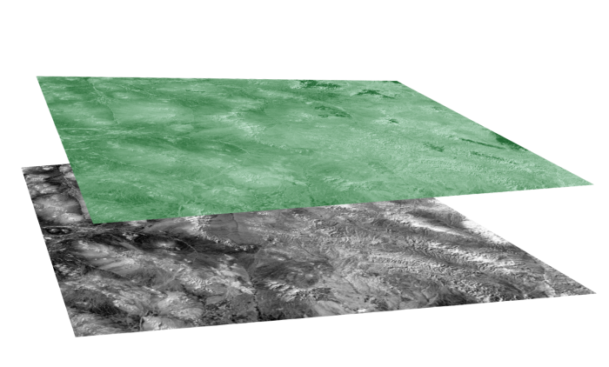
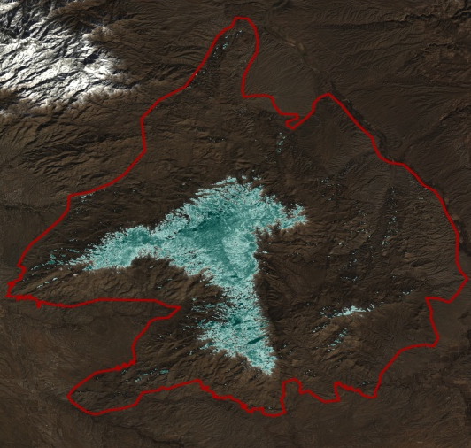

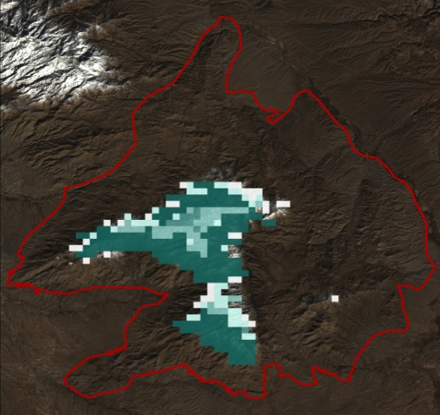
Methodology – NDSI
Green - SWIR
=
=
Green + SWIR
Landsat
NDSI
Top of Atmospherically Corrected Landsat image
 | Landsat 5 TM | Landsat 7 ETM+ | Landsat 8 OLI
Green | 0.52 – 0.60 µm | 0.52 – 0.60 µm | 0.53 – 0.59 µm
SWIR | 1.55 – 1.75 µm | 1.55 – 1.75 µm | 1.57 – 1.65 µm
AQUA/
MODIS NDSI
Wavelengths of Landsat bands used to calculate NDSI
MODIS NDSI scene
Image Credit: Southeastern AZ Water Resources Team
Notes:
MODIS and Landsat data were used to calculate the Normalized Difference Snow Index or NDSI. The NDSI uses reflectance off of the earth's surface in the Green and Short Wave Infrared spectral ranges in order to identify areas likely to be snow.
MODIS NDSI sub-datasets were processed by using model builder in Arc Map. This included reprojecting and clipping the MODIS tile to the study area.
Landsat data was scaled to Top of Atmosphere Reflectance. Then the NDSI was calculated using a ratio of the difference between the Green band and the Short Wave Infrared (SWIR) band over their sum. This index is used to identify reflectance values which are likely to be snow.
For Landsat 5 TM and 7 ETM+, bands 2 (Green) and 5 (SWIR) were used to calculate the NDSI and for Landsat 8 OLI bands 3 (Green) and 6 (SWIR) were used.
Image Credit: Southeastern AZ Water Resources team

Slide 9
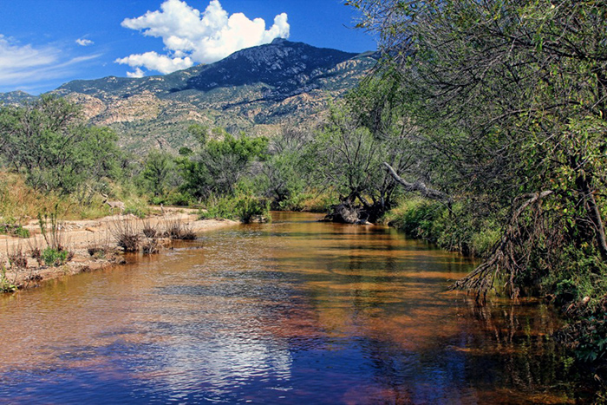
Methodology - In Situ Data
USGS Stream Gauge Data
Stream gauge water data was provided by the USGS.
For this term, the team focused on data from the Rincon Creek.
This stream flow data was then compared to snow data from Landsat and MODIS.
Image Credit: National Park Service
Notes:
The stream gauge data was obtained by the team from the United States Geological Survey (USGS). For this term the team specifically focused on the Rincon Creek stream gauge data and watersheds located on the Rincon Mountain as this is where the Saguaro National Park is located. The stream gauge data was then compared to NDSI data from Landsat and MODIS in order to gain an understanding of how snow may affect water resources in the park.
Image Source: National Park Service

Slide 10
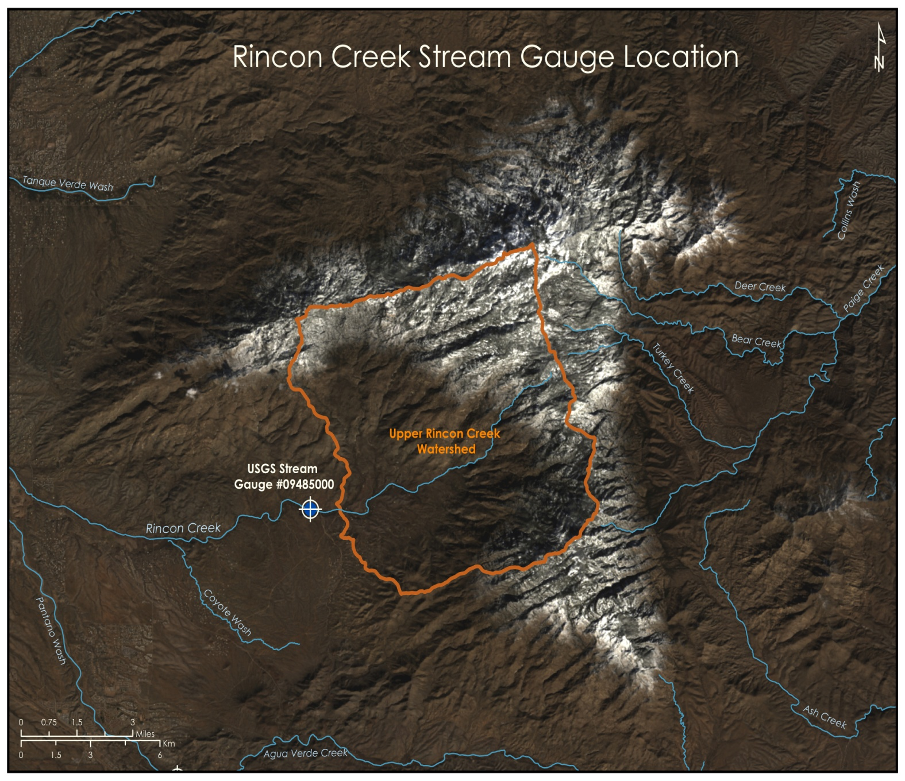
Analysis
NDSI images were computed for cloud free days over the Rincon Mountain.
The snow cover area extent was calculated for each date.
The percent of areal snow cover was calculated for each watershed.
Snow cover amounts were then compared to stream gauge data to analyze the relationship between snow cover area and water levels in streams.
Image Credit: Southeastern AZ Water Resources Team
Notes:
The NDSI data just for the Rincon Mountain was used when the data was cloud free over the mountain. The snow cover area was calculated by reclassifying rasters in ArcMap to show pixels as either snow or other (0.4 – 1.6 is snow, all other values are other). Then, using the zonal histogram tool in ArcMap, the number of pixels which fell into each value category within individual watersheds was compiled in spreadsheets by date. The percent of area indicated as snow within each watershed was then calculated. The team was then able to compare the snow cover area with stream gauge data in order to gain a better understanding of how snow is impacting water resources in the Sky Islands.
Image Credit: Southeastern AZ Water Resources team

Slide 11
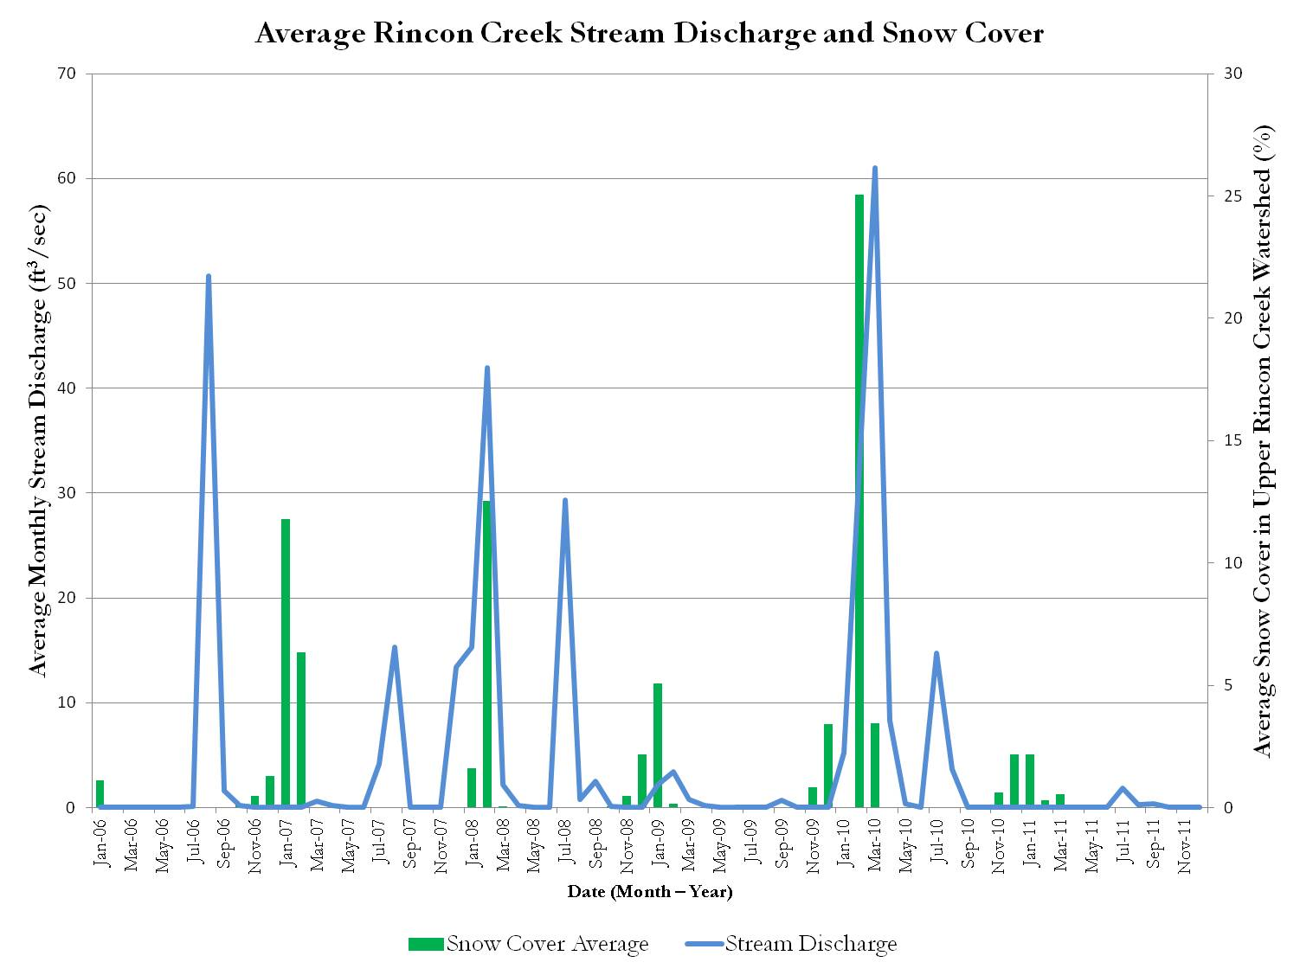
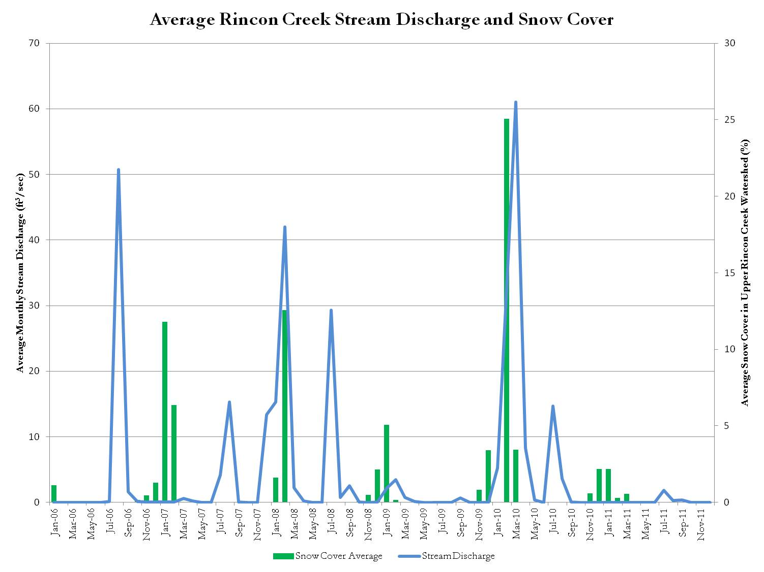
Results
Percentage of snow cover within each watershed was estimated using Landsat data.
This graph shows the comparison between stream discharge at Rincon Creek and the percent of the Upper Rincon Creek Watershed that was covered by snow.
Notes:
In order to better understand the role that snow cover plays in the streams and watersheds of the region, we calculated the snow cover area within individual watersheds. This analysis provided a preliminary view of the historical snow cover area. This data was then compared to the stream discharge data as a method for identifying trends and relationships between snow presence and streams in our study area.

Slide 12
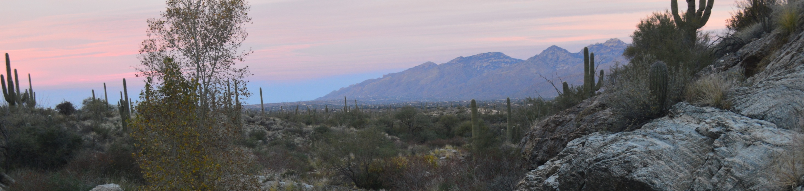
Conclusions
Snow cover area analyses were compared with stream discharge data in order to assess the effect of snow on water resources within the Rincon Mountain watersheds.
No long term trends have been identified but analyses will continue.
Continued analyses will provide a more complete understanding of the impact of snow cover. With this information the NPS will be able to analyze past snow cover changes , and establish well-informed water resource management strategies that can be adapted to the Southeastern Arizona Sky Islands region.
Image Credit: National Park Service
Notes:
Continuation of the project through the 2017 Spring term will involve more in-depth analyses of the acquired data as well as expansion of the study area to include additional Sky Islands. The objective of future work will be to provide the NPS with a comprehensive record of snow cover change by watershed within Saguaro National Park and synoptically across the region.
With this data, the National Park Service will be able to establish well-informed water resource management strategies that can be adapted to the changing climate of the Southeastern Arizona Sky Islands region.
Image Source: National Park Service

Slide 13
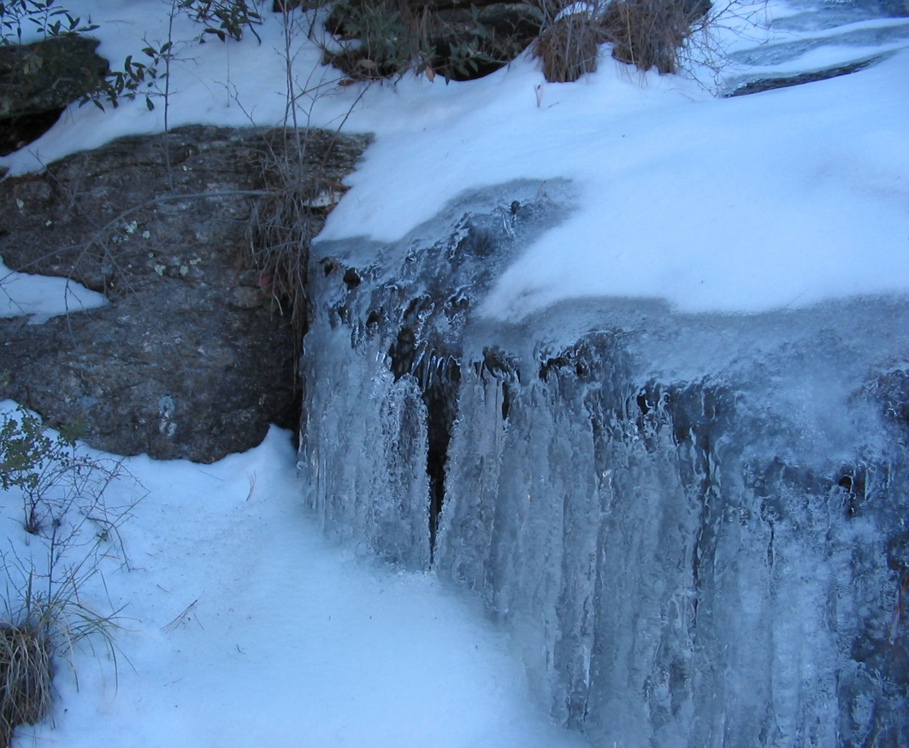
Errors and Uncertainties
Some snow maps had snow classification errors (commission and omission errors).
Topographic shadow obscured reflectance values of certain vegetation types with snow cover (e.g., forest).
Snow cover maps from Landsat or MODIS data can overestimate or underestimate snow cover in part due to spatial resolution.
Clouds and shadows obscured snow cover and non-snow covered areas for some of the observation dates particularly in the Landsat data.
Image Credit: National Park Service
Notes:
There may have been classification errors (Commission and omission errors) meaning some pixel values may have been placed in the incorrect category due to incorrect reflectance values caused by factors such as cloud cover. Shadow may have also obscured some of the reflectance values of certain vegetation types that had snow cover such as forest. In addition snow cover area was calculated using pixels identified as snow. This method may have over- or underestimated the area since an entire pixel may not be one land cover type. This is due to the spatial resolution of the data.
Image Source: National Park Service

Slide 14
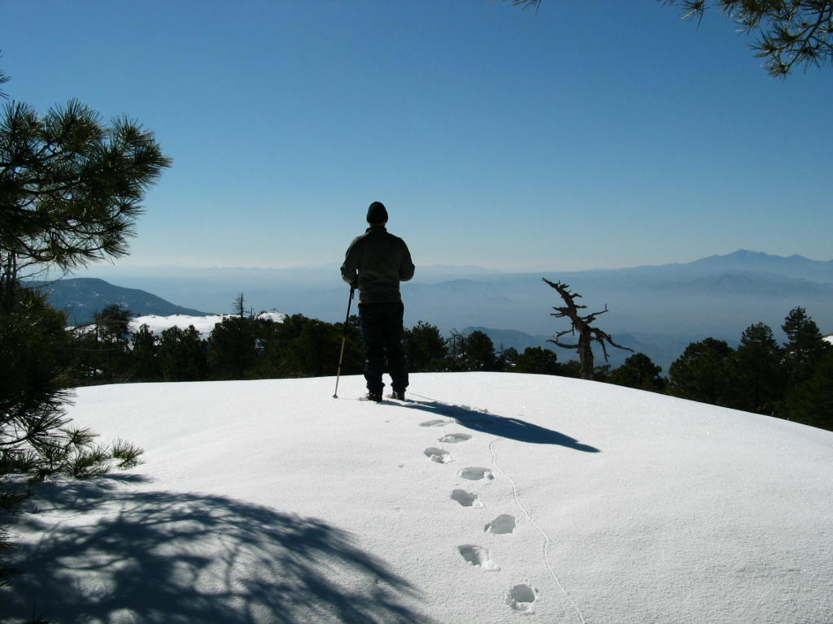
Future Work
Expand the area of analysis to include all of the Sky Islands.
Use Normalized Difference Vegetation Index (NDVI) and NDSI data to improve snow maps.
Apply corrections and masking for clouds, shadow and areas of water to improve accuracy of Landsat and MODIS snow cover maps.
Include temperature and precipitation data in future analyses of snow pack and surface water flow.
Image Credit: National Park Service
Notes:
Future work will involve expanding the focus area for analysis from just the Rincon Mountain, to all of the Sky Islands. Additionally, Normalized Difference Vegetation Index (NDVI) data will be used along with Normalized Difference Snow Index (NDSI) to improve snow maps. Lastly, efforts to mask out clouds, shadows, and areas of water will be done to improve the accuracy of areas identified as snow cover. An effort to include temperature and precipitation data will also be made in order to provide evidence of snow accuracy in our data. Additionally, the team can look at temperature trends when working to determine the persistence of snow in the area.
Image Source: National Park Service

Slide 15
Partners:
National Park Service (NPS), Intermountain Region
and Saguaro National Park
Advisors and Mentors:
Bernard Eichold, M.D., Dr. PH (Mobile County Health Department)
Joseph Spruce (NASA Langley Research Center)
Kenton Ross, PhD (NASA Langley Research Center)
Notes:
We would like to thank our project partners at the National Park Service.
Special thanks go out to our Science Advisors Joe Spruce and Dr. Kenton Ross and our Mentor Dr. Bernard Eichold.

