Slide 1
Southeast Ecological Forecasting
Utilizing NASA Earth Observations and Proximal Remote Sensing to Map the Spatio-temporal Distribution of Hydrilla verticillata
Shuvankar Ghosh (Project Lead)
Peter Hawman (Co-Project Lead)
Wuyang Cai
Pradeep Kumar Ragu Chanthar
Elizabeth Dyer
Notes:
From the University of Georgia NASA DEVELOP node.
Hello, we are the Southeast Ecological Forecasting Team from the University of Georgia. Our project is titled Utilizing NASA Earth Observations and Proximal Remote Sensing to Map the Spatio-temporal Distribution of Hydrilla verticillata

Slide 2
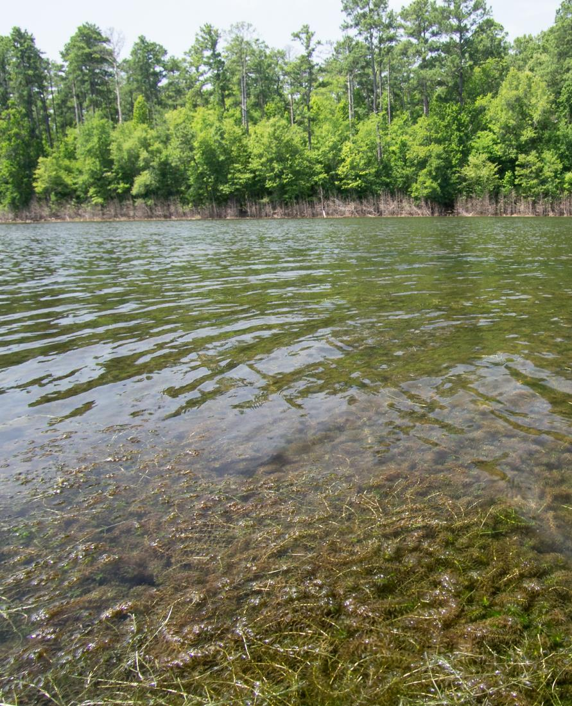
Hydrilla verticillata
Invasive aquatic plant
Native to Asia, Australia and Africa
Introduced in Florida in the 1950s
Spread to 25 states
Credit: Dr. Susan Wilde
Picture taken in : Lake Thurmond
Notes:
Hydrilla verticillata is an invasive aquatic plant in the southeastern US.
Native to Asia, Australia and Africa, hydrilla was introduced to the U.S. in the 1950s when it was sold in freshwater aquarium stores in Florida. Since then it has spread up the eastern seaboard and west to California and Washington State reaching 25 states.

Slide 3
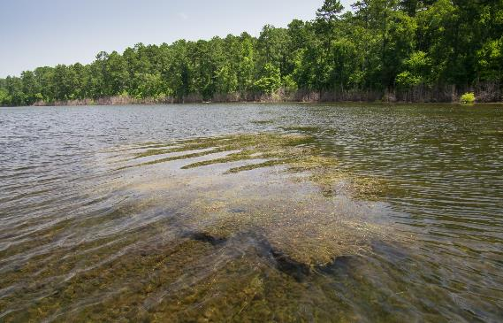
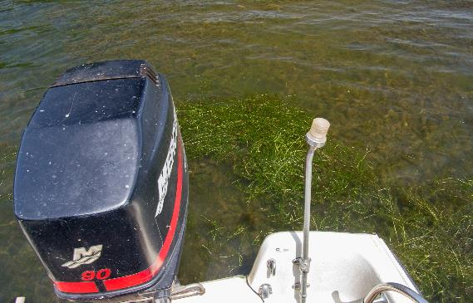
Community Concerns
Outcompetes native plants
Clogs boat motors disrupting transport and recreation
Creates hazardous swimming conditions
Obstructs water withdrawal
Picture of hydrilla from one of our field trips?
Notes:
Hydrilla outcompetes native plants creating a thick mat which blocks sunlight leading to anoxic conditions, as well as changing the nutrient balance in the water body.
These thick mats clog boat motors disrupting transport and recreation and cause hazardous swimming conditions.
Additionally, hydrilla obstructs water withdrawal for drinking water, irrigation, and power generation in reservoirs.

Slide 4
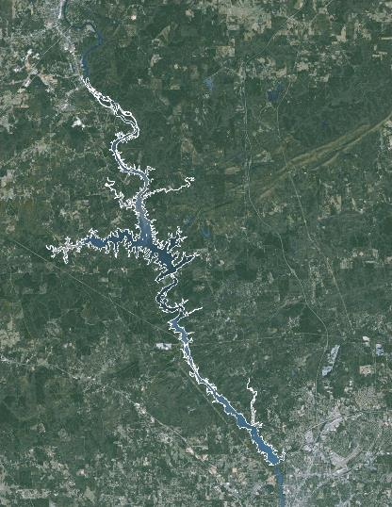
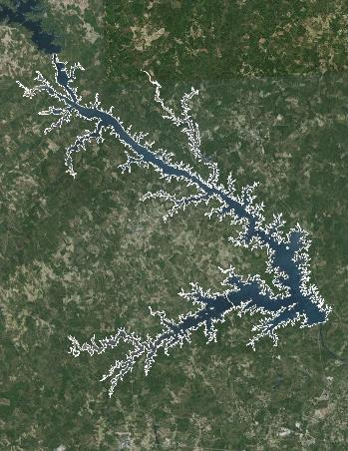
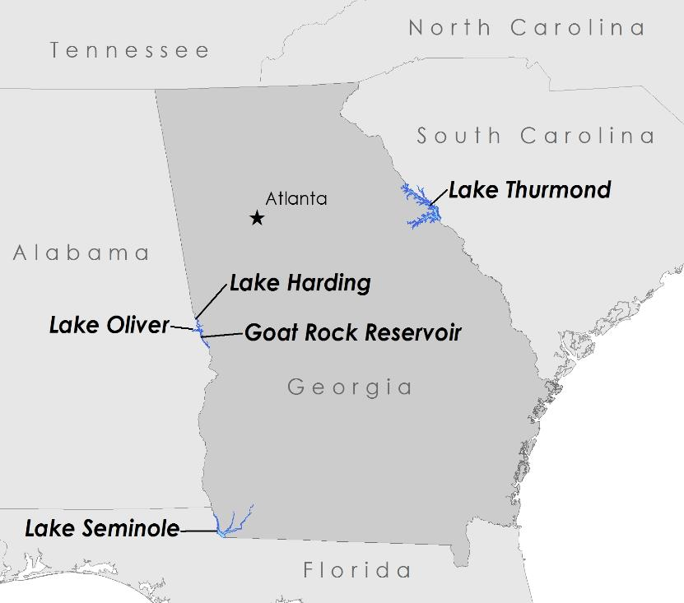
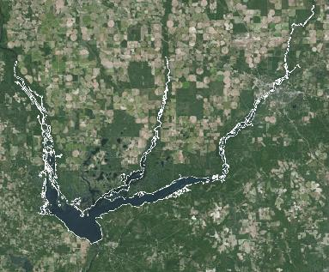
Study Areas
Lake Harding
Goat Rock
Lake Oliver
Lake Thurmond
Lake Seminole
Study Period: 2013 - present
Notes:
This study focused on five reservoirs located in Georgia and bordering Alabama, Florida, and South Carolina
Lake Seminole is a United States Army Corps of Engineers reservoir and they have been trying to control hydrilla in this location for over 50 years.
Lake Thurmond is another USACE reservoir that has been dealing with invasive hydrilla.
Lake Harding, Lake Oliver, and Goat Rock Reservoir are Georgia Power reservoirs along the Chattahoochee River. Recently in 2013, Georgia Power experienced a rapid development of hydrilla in Lake Harding and Lake Oliver, which spread to Goat Rock Reservoir in 2014.

Slide 5
Partners
Joseph W. Jones Ecological Research Center
Conduct studies on water quality in the lower Flint River and Lake Seminole, focusing on invasive species
Georgia Power Company
Responsible for protecting and restoring 17 reservoirs in GA
Henry County Water Authority
Hydrilla infestation was discovered in two of their newly constructed drinking water reservoirs
Notes:
This project partnered with 3 end-users.
The Joseph W. Jones Ecological Research Center is located in south Georgia north of Lake Seminole. One of their main focuses of study is water quality issues in the lower Flint River and Lake Seminole. Their research team was interested in incorporating remote sensing to better understand the phenological characteristics and seasonal distribution of hydrilla.
Georgia Power Company is responsible for protecting and restoring 17 reservoirs in Georgia. They are concerned with the spread of hydrilla in their lakes and the negative impacts it poses to water quality.
The Henry County Water Authority hydrilla in two of their reservoirs in 2010. They are concerned by the effects hydrilla recreation for fisherman and waterfowl hunters.

Slide 6
Objectives
Create
a time series hydrilla distribution map
Assess
the seasonal spatio-temporal distribution of hydrilla
Develop
a model partners can use to evaluate hydrilla distribution in the future
Notes:
We created hydrilla distribution maps through time of the study areas in the Southeastern United States by utilizing remote sensing data from multiple sources. Then we assessed the seasonal spatio-temporal distribution of hydrilla.
We developed a model using Landsat 8 OLI and in situ field data. Our partners will be able to use this model to determine hydrilla distribution in the future.

Slide 7

Data
Lake boundaries from National Hydrography Dataset
Landsat 8 OLI
In situ field data
Notes:
For our project we collected 3 data types.
We first retrieved lake boundaries for our 5 study lakes from the National Hydrography Dataset. We used these to subset our imagery.
We then downloaded Landsat 8 OLI data choosing scenes which were as cloud free as possible and spanded from 2013 to present.
We also collected in situ field data to help us calibrate our results.

Slide 8
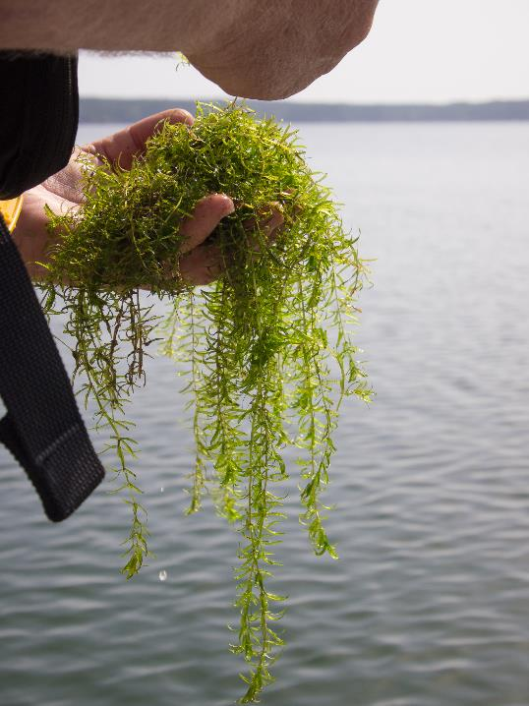
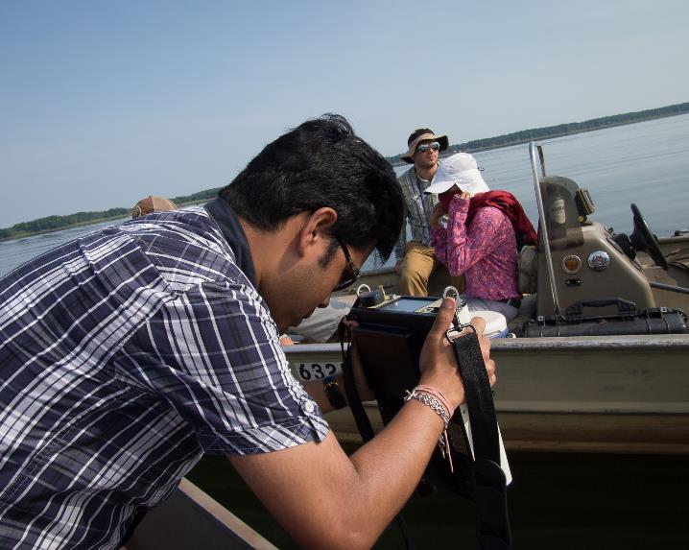
Field Data Collection
GPS point locations
Biomass samples
Hydrilla spectra
Depth from the surface
Notes:
Looking specifically at our in situ data collection, we visited two of our study lakes, Lake Thurmond along the GA SC border and Lake Seminole along the GA AL FL border. During our field work, at each location we collected GPS coordinates, biomass samples, hydrilla spectra using a spectroradiometer, and the depth of the hydrilla from the water’s surface.

Slide 9
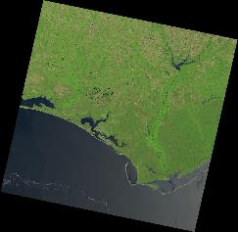
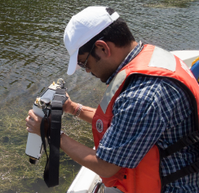
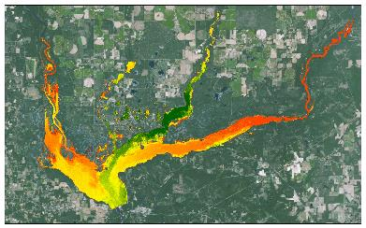
Methodology
Landsat 8
Vegetation Indices
Model
Calibration
Maps
Field Data
In situ measurements
Notes:
First we retrieved our data. Landsat 8 imagery was downloaded from USGS and atmospherically corrected. We then use our lake shapefiles to subset the images to our study lakes.
We also collected our field data.
We applied two vegetation indices to our imagery to map aquatic vegetation, NDVI and VARI.
We used our in situ measurements to calibrate our modeling and our output were distribution maps highlighting surface and submerged vegetation.

Slide 10
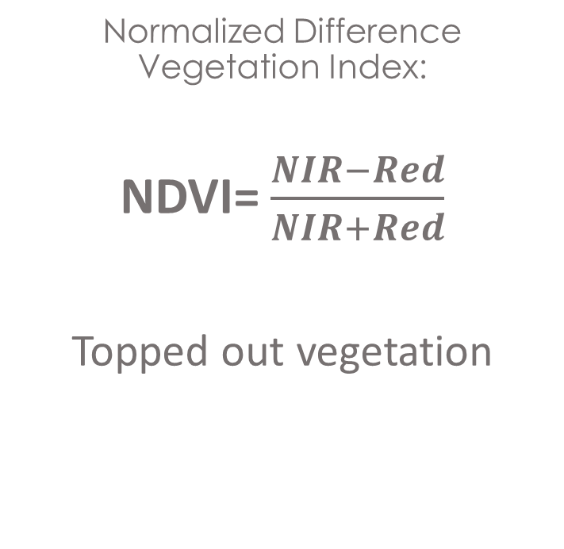
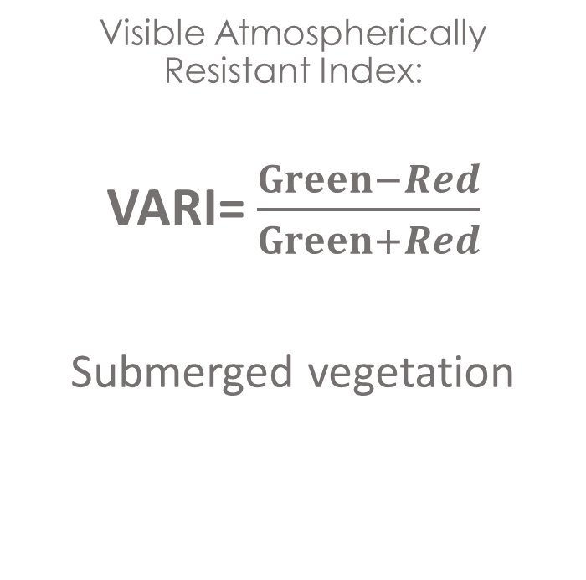
Data Analysis
NDVI
VARI
Normalized Difference Vegetation Index:
NDVI= $\frac{NIR−Red}{NIR+Red}$
Topped out vegetation
Visible Atmospherically Resistant Index:
VARI= $\frac{Green−Red}{Green+Red}$
Submerged vegetation
Notes:
We used two vegetation indices to analyze our landsat 8 imagery. To identify topped out vegetation we used the Normalized Difference Vegetation Index. This allowed us to locate the surface vegation and mask it out to perform our next vegetation index which looks at submerged vegetation witin the lake body, VARI or Visible Atmospherically Resistant Index.
Vegetation Indices
Visible Atmospherically Resistant Index (VARI)
VARI= $\frac{Green−Red}{Green+Red}$
Normalized Difference Vegetation Index (NDVI)
NDVI=$\frac{NIR−Red}{NIR+Red}$

Slide 11
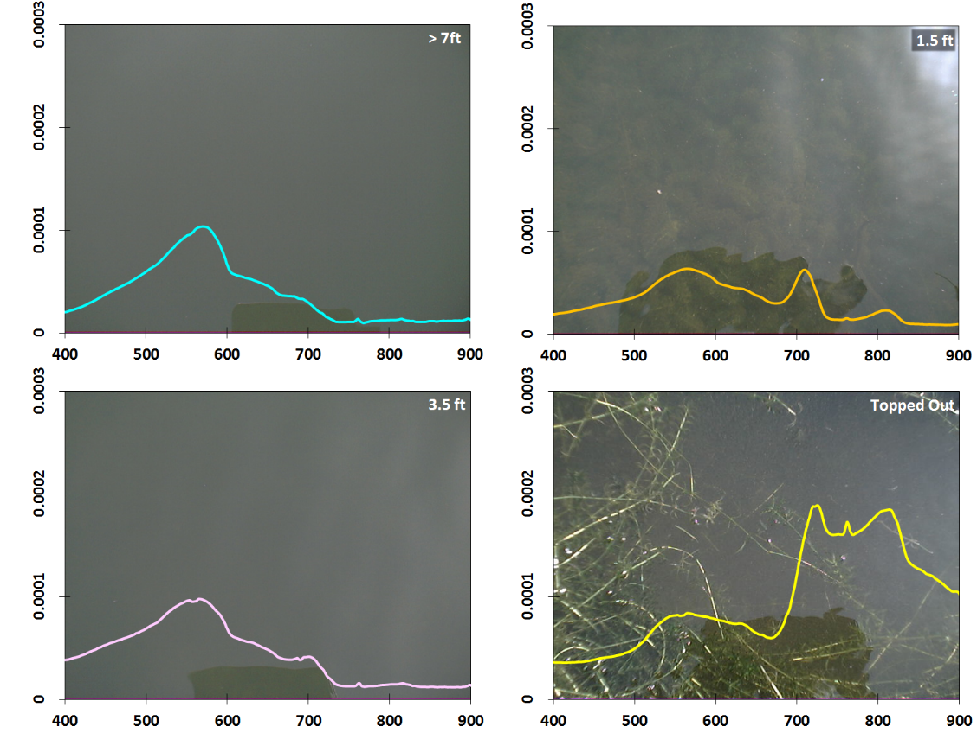
Results
1a
1c
Remote Sensing Reflectance (R_{rs})
1b
1d
Wavelength (nm)
Notes:
Figure 1a – d: Spectral signature of submerged Hydrilla across different water depths; reflectance at NIR becomes more prominent with decreasing depth

Slide 12
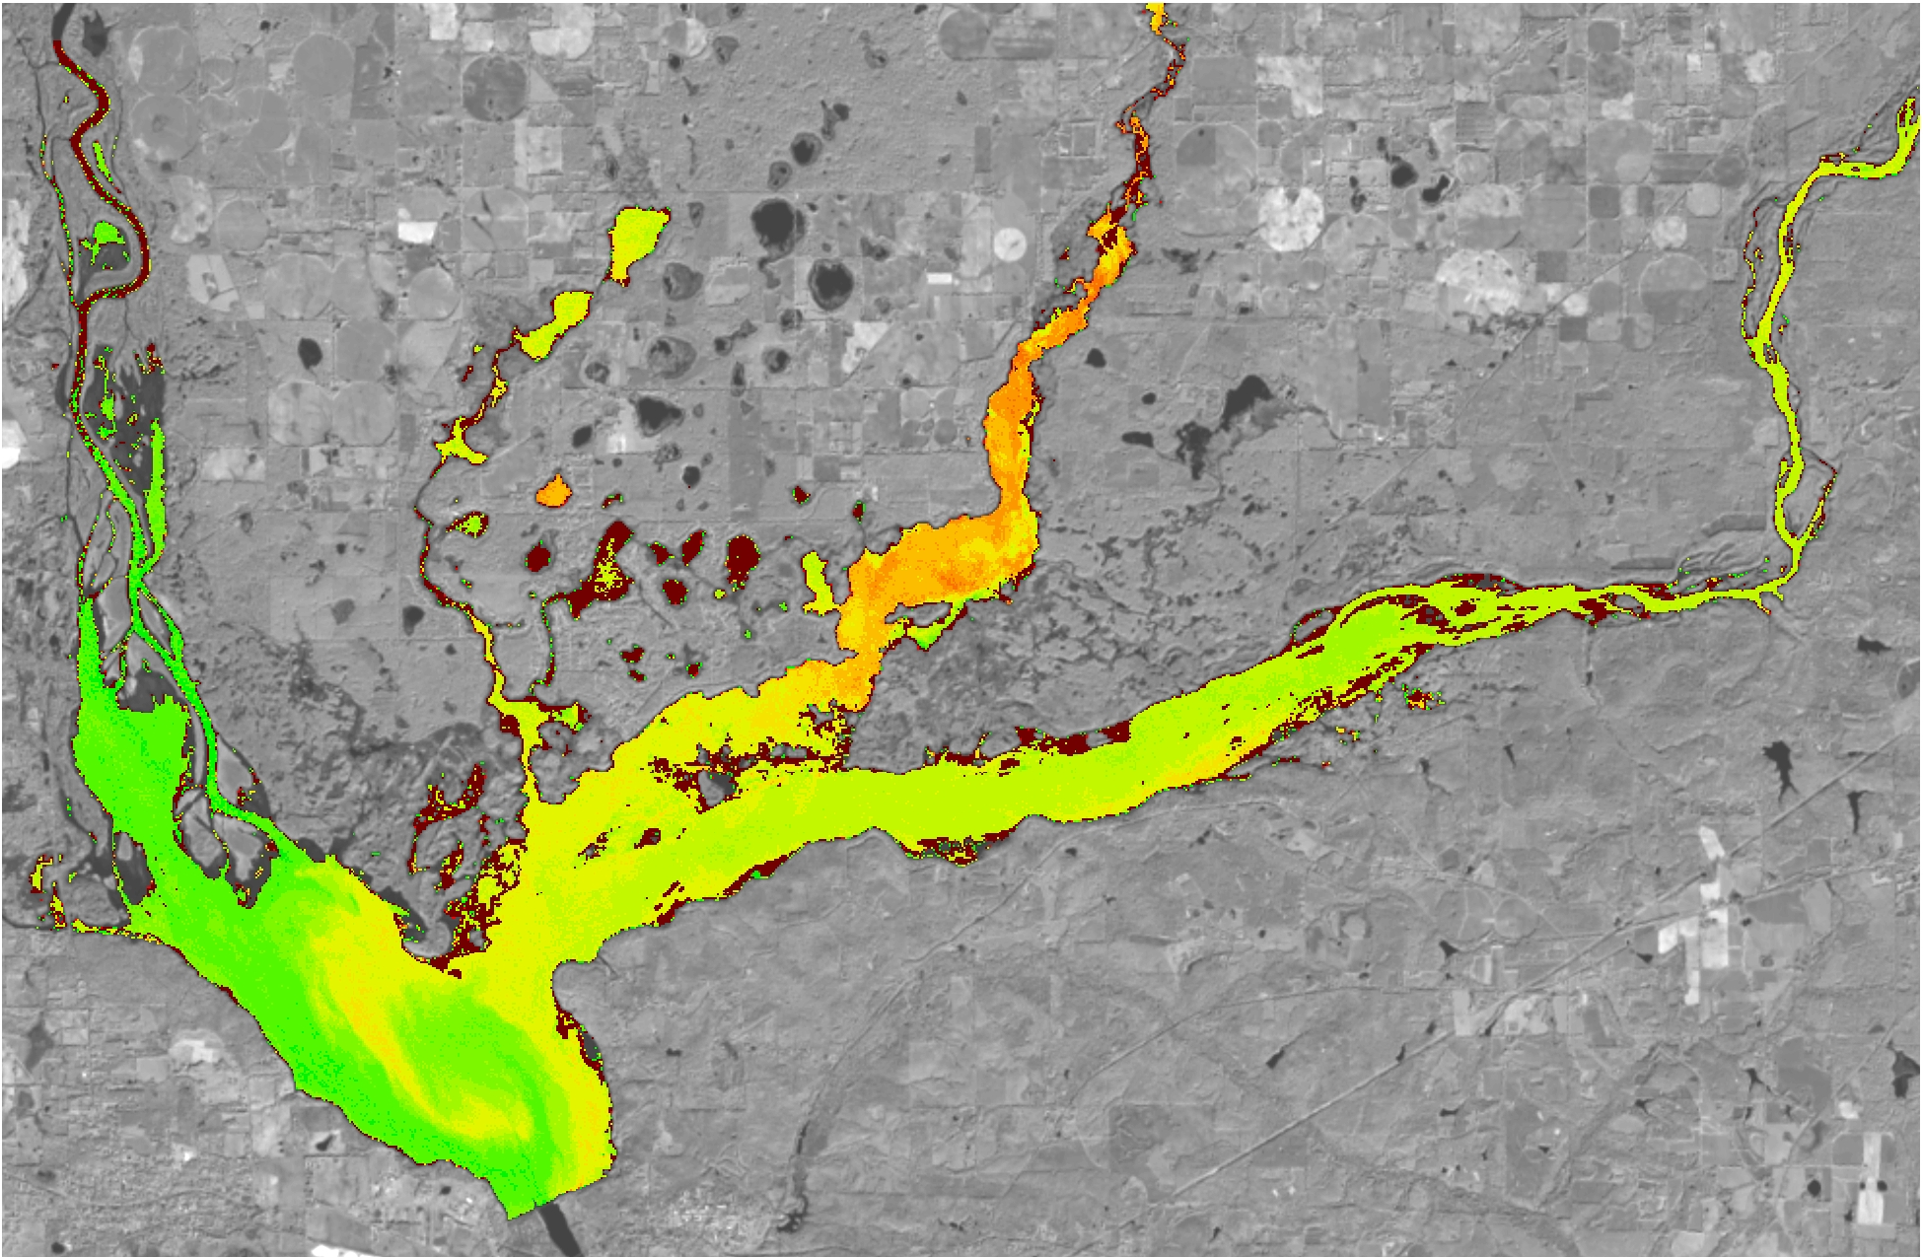
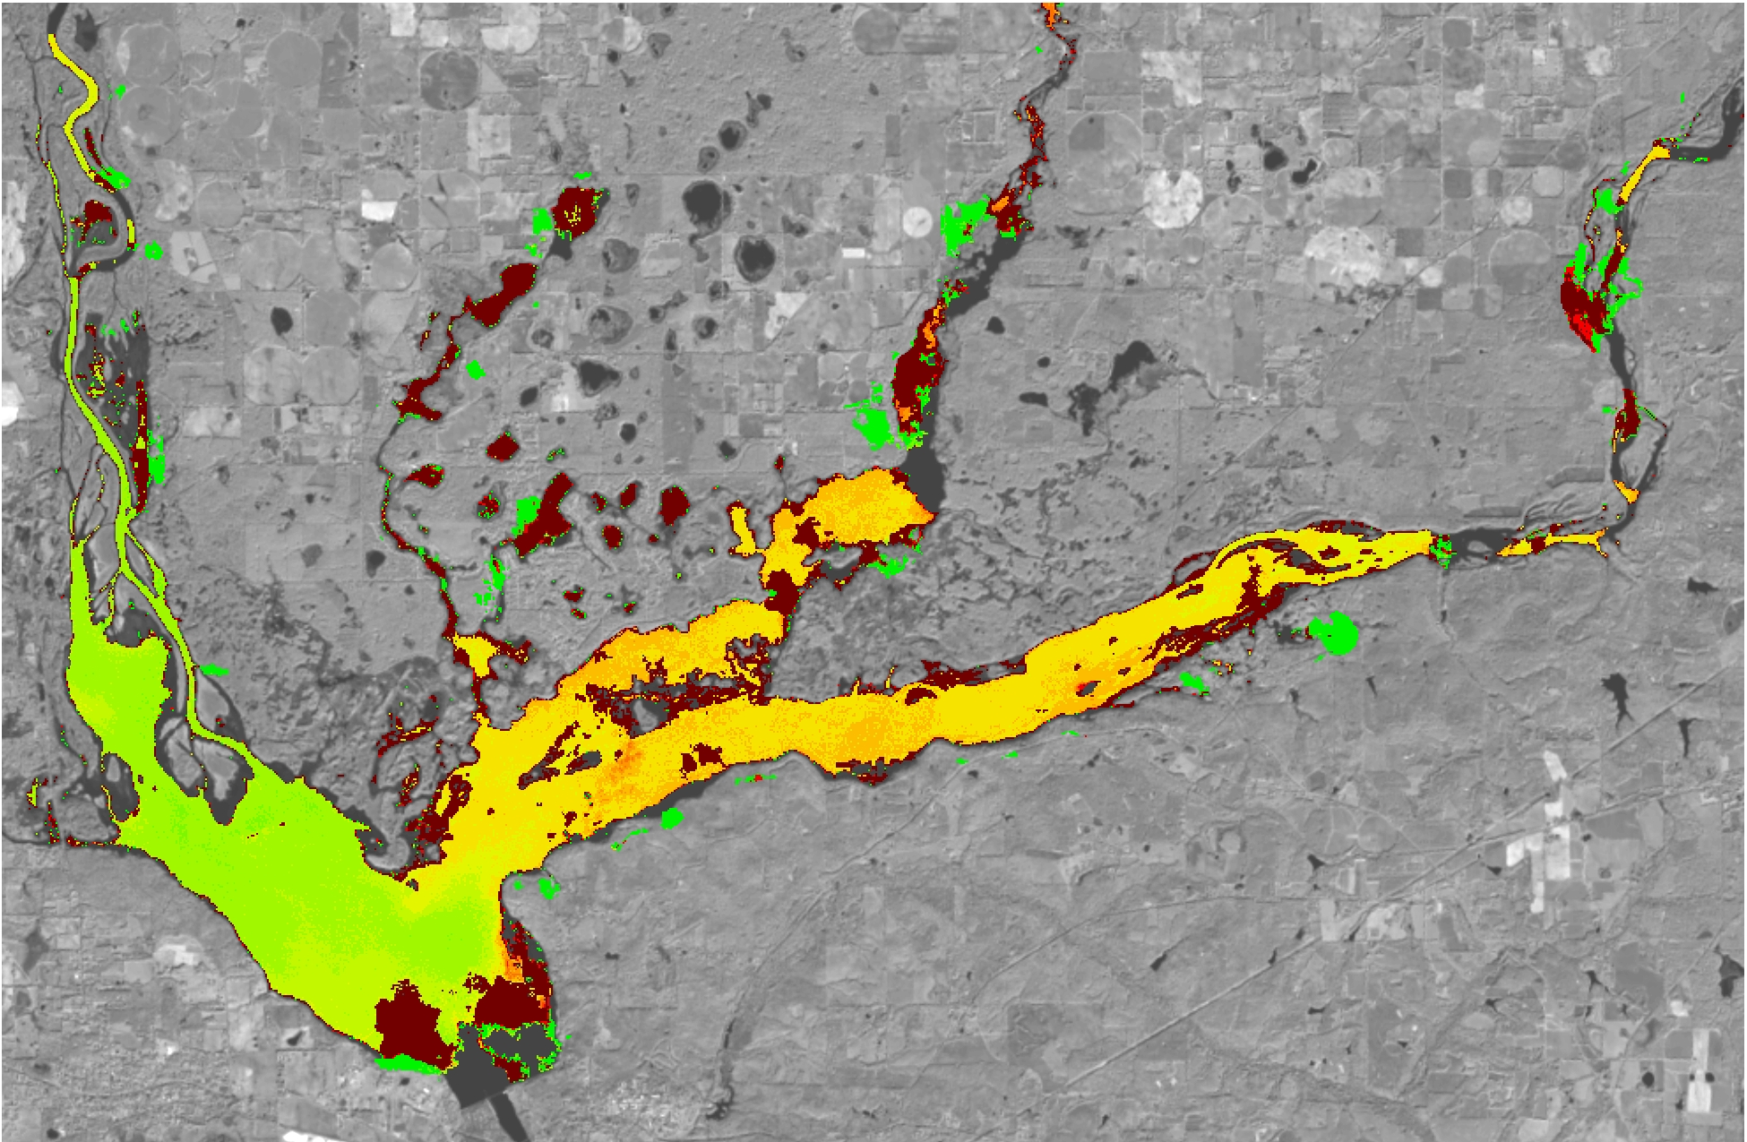
Results
May 22, 2014
presence of submerged hydrilla
September 11, 2014
Notes:
Figure 2a and 2b: Topped out and submerged vegetation maps prepared using Landsat 8 for May 22, 2014 and September 11, 2014. Submerged hydrilla presence is highlighted in the red box.

Slide 13
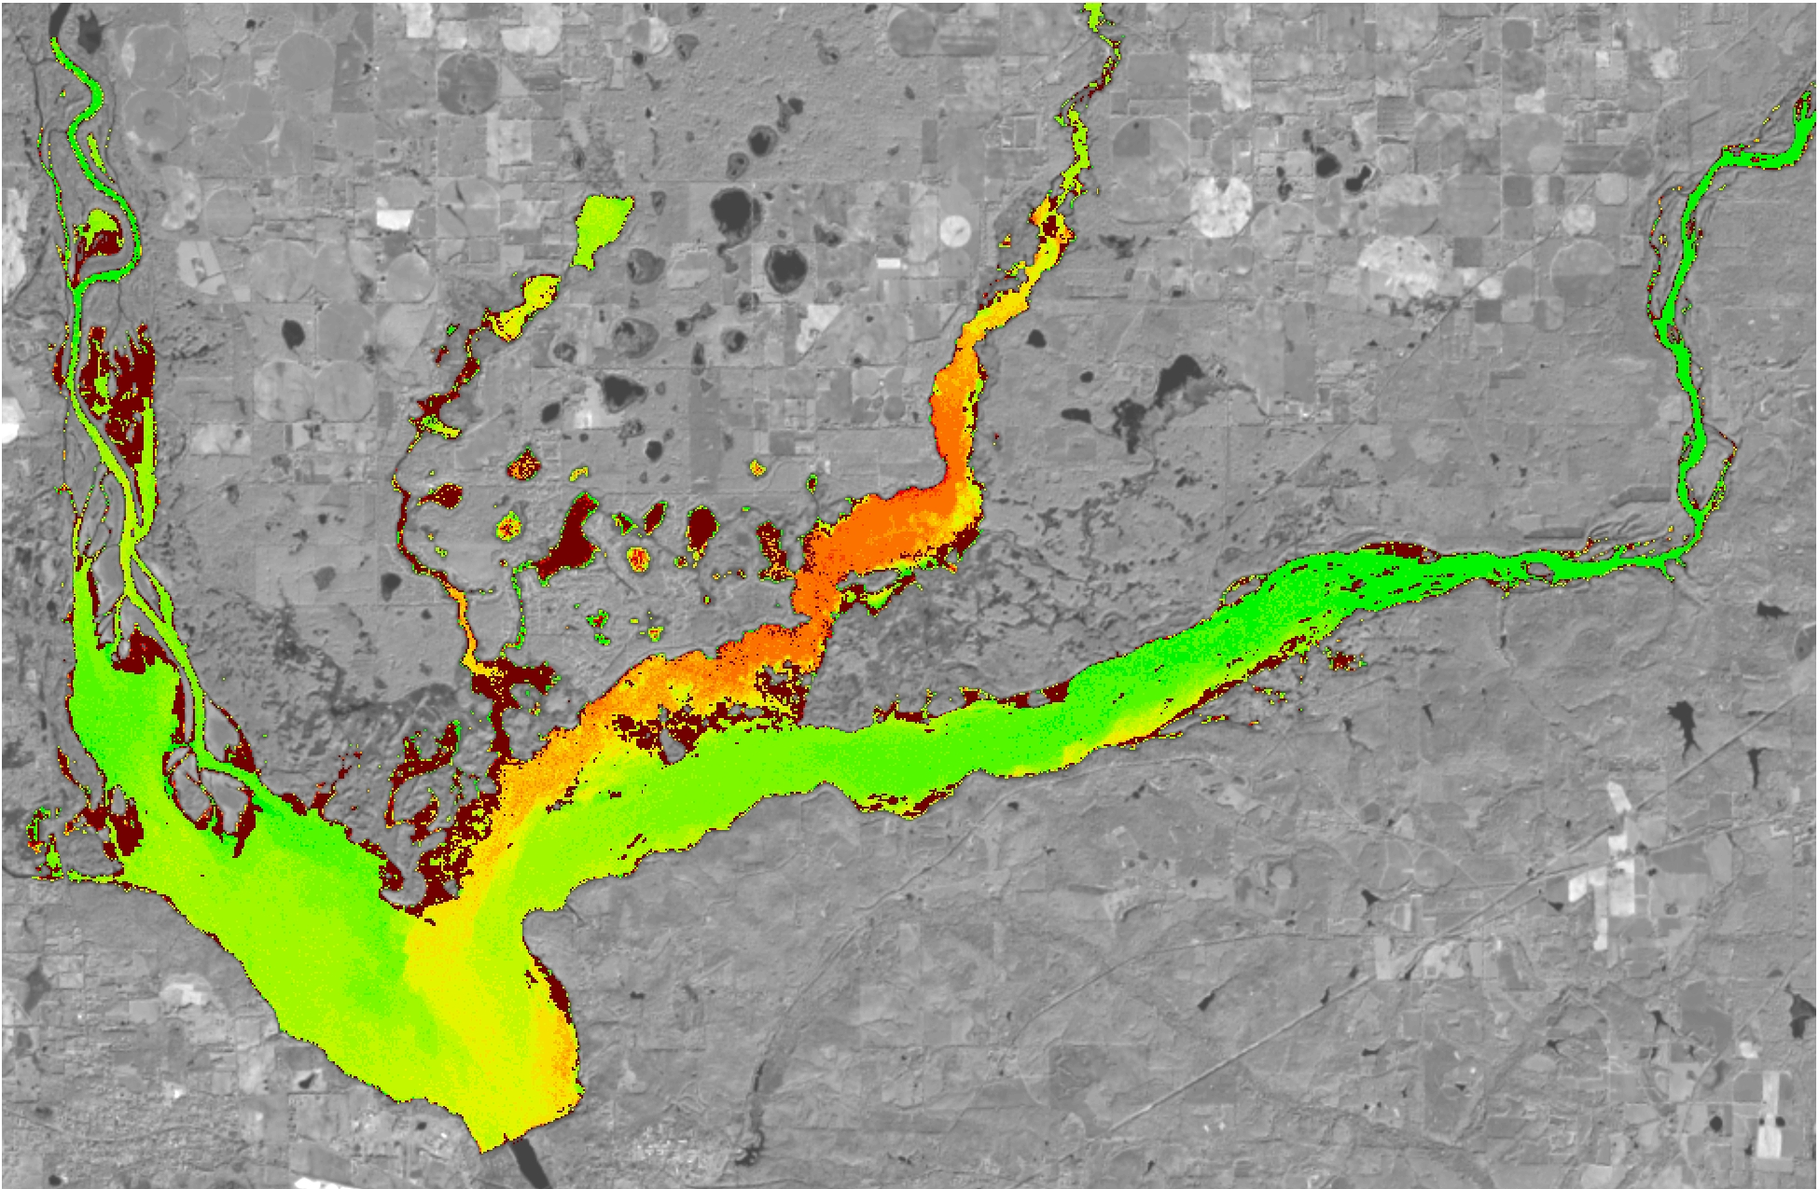
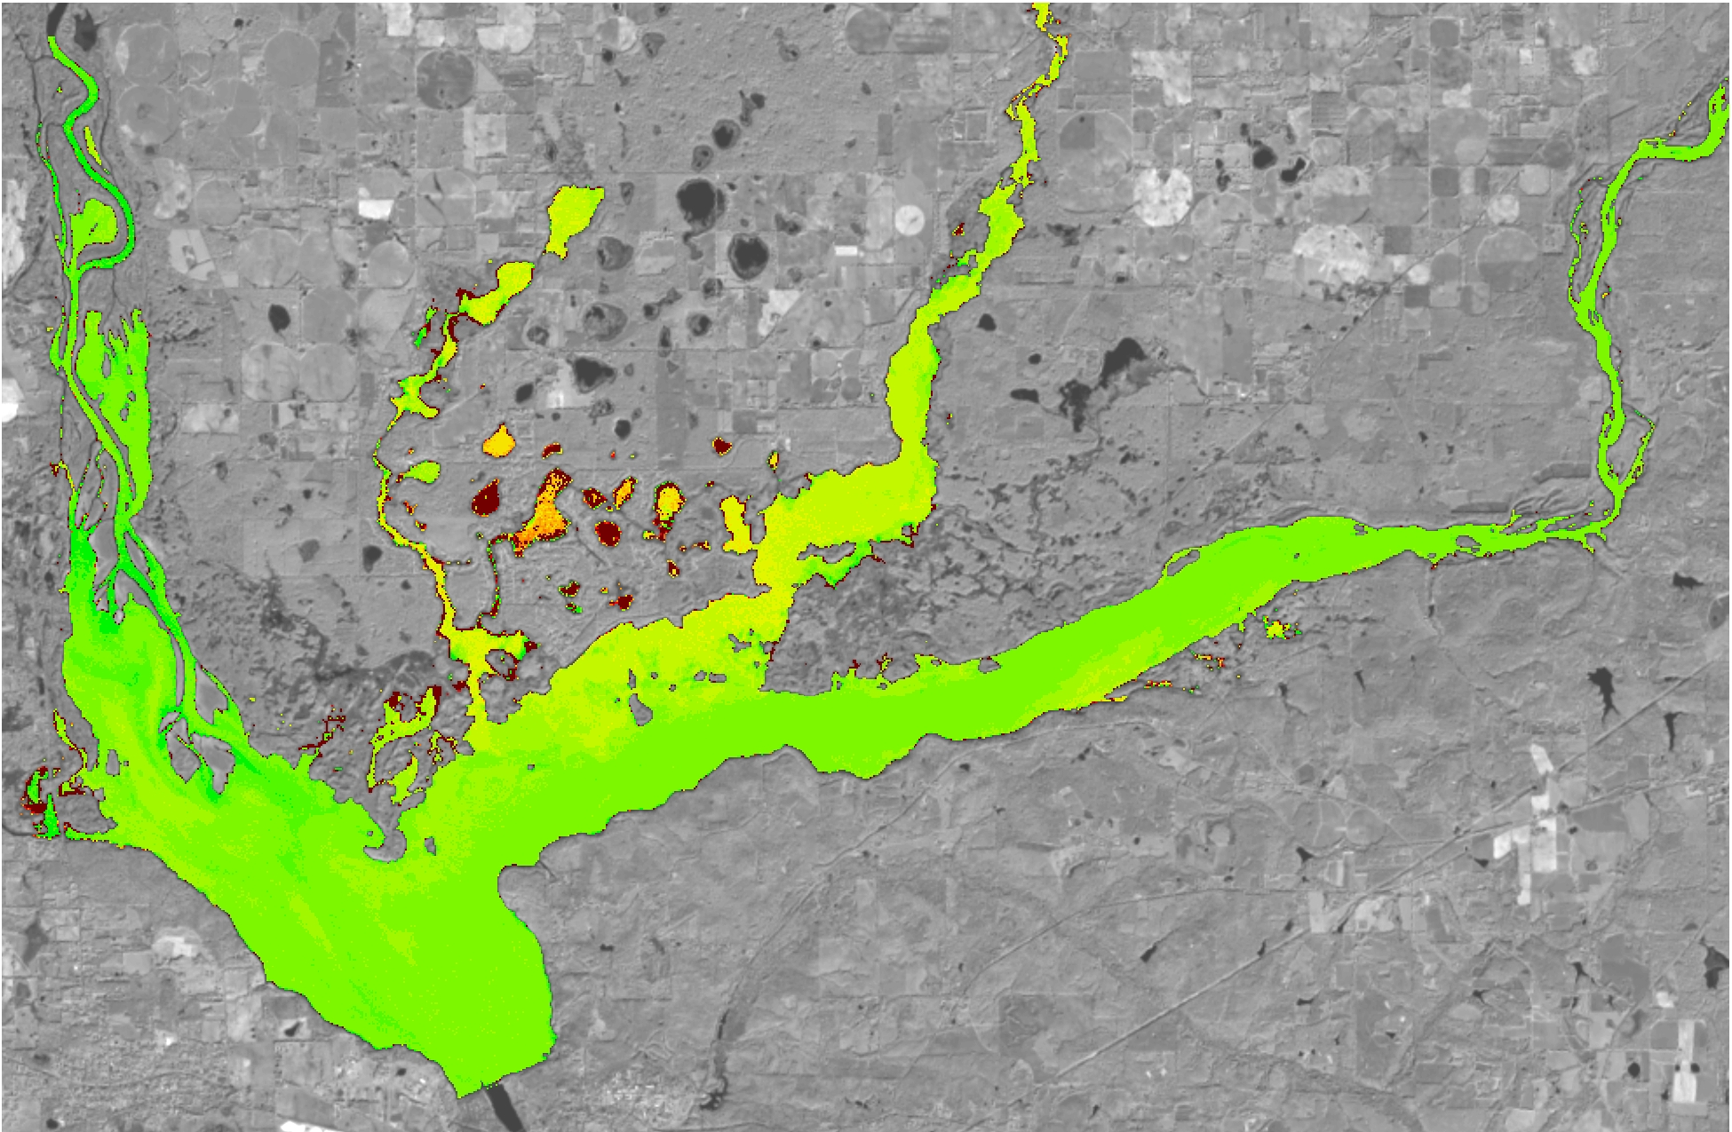
Results
November 30, 2014
presence of submerged hydrilla
February 18, 2015
Notes:
Figure 2a and 2b: Topped out and submerged vegetation maps prepared using Landsat 8 for November 30, 2014 and February 18, 2015. Submerged hydrilla presence is highlighted in the red box.

Slide 14
Conclusions
Potential to identify the presence of submerged aquatic vegetation
Additional in situ data collection is required
Accuracy
Detect the presence of hydrilla using low cost methods
Notes:
1. Landsat 8 OLI has the potential to identify the presence of submerged aquatic vegetation allowing the team to map the spatial-temporal variation of hydrilla within the study lakes.
2. Additional in situ data collection is required for refinement and validation of the hydrilla density distribution models developed so far.
3. Mapping accuracy depends on the depth of the submerged vegetation.
4. This methodology can help the project partners to detect the presence of hydrilla using low cost methods that provide up to date hydrilla distribution maps.

Slide 15
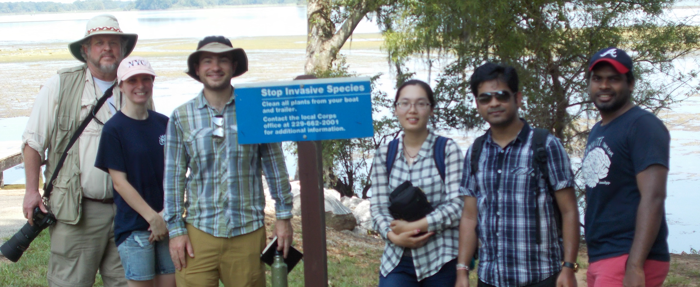
Future Work
Collect more field data to validate
Build models to forecast
Notes:
In order to improve our modeling we need to collect more field data for validation. During this term we only were able to visit two of our five study lakes. Visiting each lake and conducting repeated data collection trips, we will be able to more accurately verify our results.
This collection and modeling refinement will allow us to construct a forecasting tool which our partners will be able to use to understand the distribution and potential spread of this aggressive invasive species.

Slide 16
Advisors
Dr. Deepak Mishra, Department of Geography,
University of Georgia
Dr. Susan Wilde, Warnell School of Forestry and Natural Resources, University of Georgia
Partners
Dr. Stephen W. Golladay, Joseph W. Jones Ecological Research Center
Anthony Dodd, Georgia Power Company
Ken Presley, Henry County Water Authority
Others
Kenneth Boyd, U.S. Army Corps of Engineers
Benjamin Page, University of Georgia
Ike Sari Astuti, University of Georgia
Notes:
We would like to thank our science advisors, Dr. Mishra and Dr. Wilde, and our project partners.
A special thanks to Kenneth Boyd for taking us out on Lake Thurmond to collect samples on such short notice and to Ben and Ike for their technical support on processing imagery.

