Slide 1
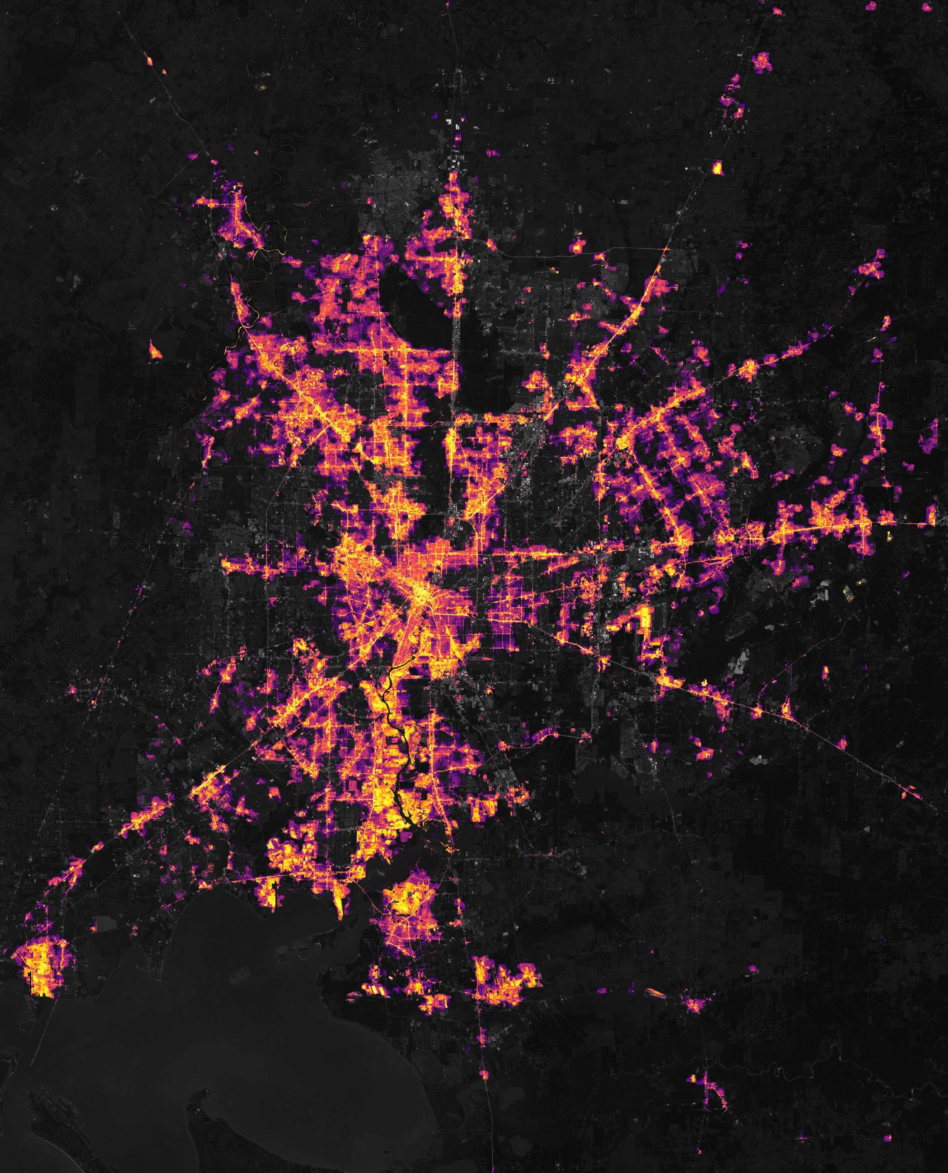
DEVELOP National Orientation (2022)
Module 2. About DEVELOP

Slide 2
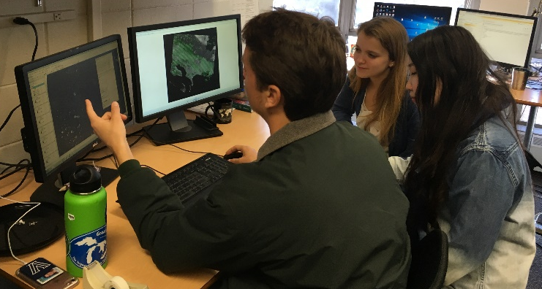
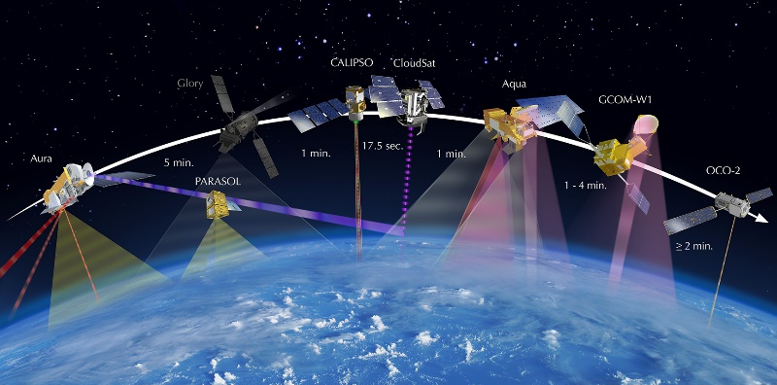
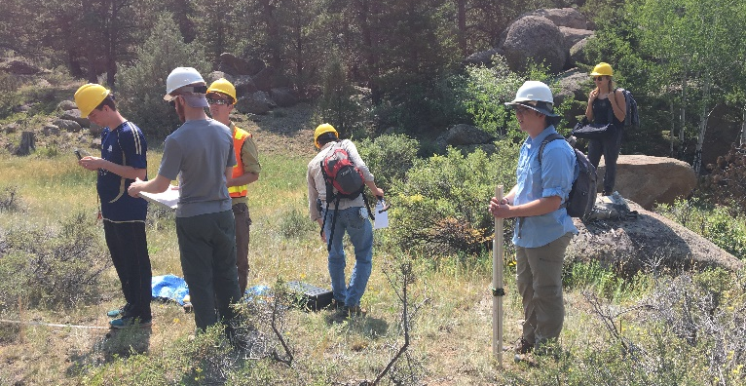
ABOUT DEVELOP
Empowered Participants + Earth Observations + Engaged Decision Makers
“Shaping the future by integrating Earth observations into global decision making”
DEVELOP bridges the gap between NASA Earth Science and society, building capacity in both its participants and end-user organizations to better prepare them to handle the environmental challenges that face society.
Elevator Speech: DEVELOP, part of NASA’s Applied Sciences’ Capacity Building Program, addresses environmental and public policy issues by conducting interdisciplinary feasibility projects that apply the lens of NASA Earth observations to community concerns around the globe. Bridging the gap between NASA Earth Science and society, DEVELOP builds capacity in both participants and partner organizations to better prepare them to address the challenges that face our society and future generations.

Slide 3
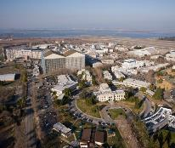
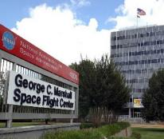
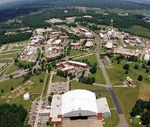
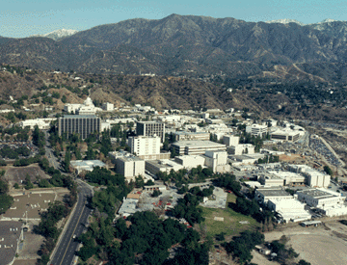
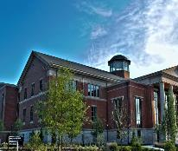
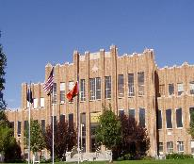
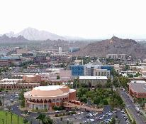
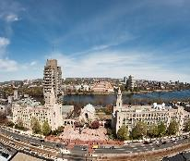
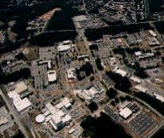
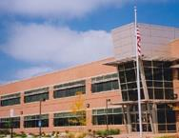
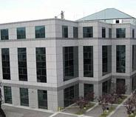
ABOUT DEVELOP
DEVELOP History
In 1998, three interns at NASA Langley Research Center co-authored the white paper “Practical Applications of Remote Sensing.”
A proposal combining NASA’s Digital Earth Initiative and the students’ paper advocated the formation of a program, and in 1999 DEVELOP was officially formed.
Expansion beyond Langley began in 2001 and continues today.
Ames
2003
JPL
2008
Marshall
2008
Pocatello, ID
2015
Boston, MA
2018
Athens, GA
2013
Langley
1998
2004
Goddard
2012
Fort Collins, CO
2014
Asheville, NC
2016
Tempe, AZ

Slide 4


ABOUT DEVELOP
DEVELOP’s Mission & Vision
Mission: Integrating NASA Earth observations with society to foster future innovation and cultivate the professionals of tomorrow by addressing diverse environmental issues today.
Vision: Shaping the future by integrating Earth observations into global decision making.
Core Values:
  Collaboration
  Discovery
  Service
  Passion
By The Way
NASA’s core values are:
Safety
Excellence
Teamwork
Integrity
Inclusion
DEVELOP shares these as well!

Slide 5


ABOUT DEVELOP
DEVELOP’s Culture
Our approach to teamwork is based on a philosophy that each team member brings unique experience and important expertise to tasks at hand. We encourage and reward vigorous, open flows of communication on all issues, in all directions.
We are committed to creating an environment that fosters teamwork and processes that support continuous learning, innovation, and an openness to new ideas.
We are adaptable, quick to respond, and go where others don’t, providing more service than is expected.
We pursue all endeavors with energy, excitement, and enthusiasm and are committed to maintaining an environment of trust, built upon honesty, ethical behavior, respect, and candor.
DEVELOP nurtures an organizational culture in which individuals make full use of their time, talent, and opportunities to pursue excellence in both the ordinary and the extraordinary.
Collaborative
Dynamic
Innovative
Professional
Service-Oriented
Passionate
Excellent

Slide 6
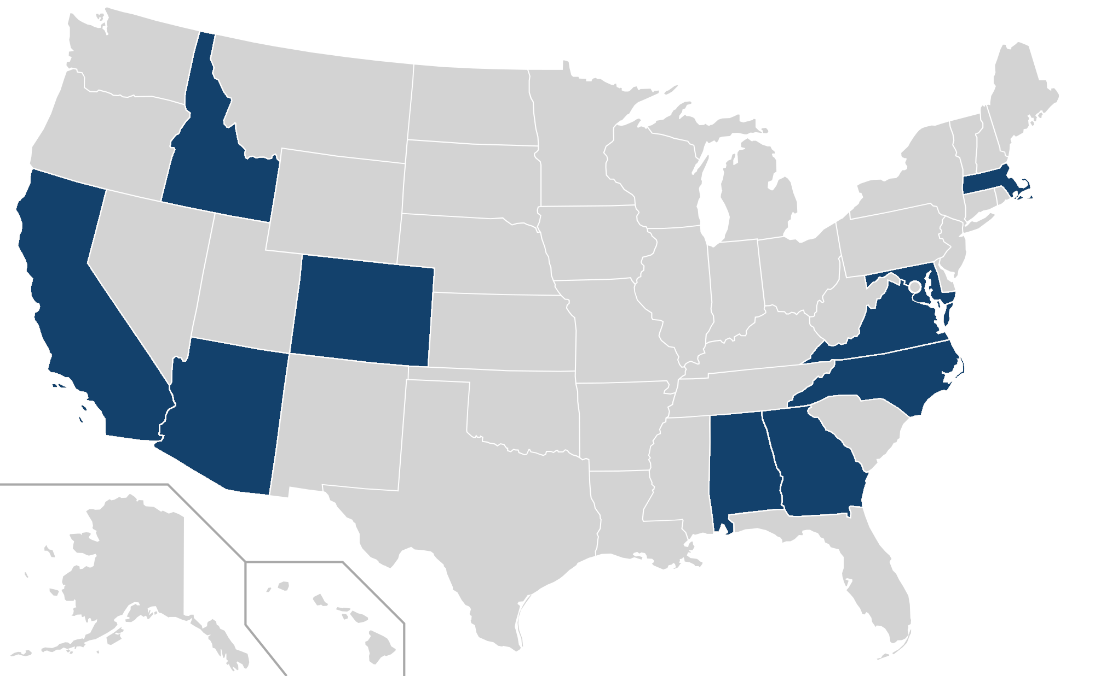
ABOUT DEVELOP
By The Way
DEVELOP locations are also known as “nodes,” but we’ve been operating virtually since March 2020. For the summer 2022 term, we have 4 projects not associated with an in-person location!
DEVELOP In-person Locations
9
7
Alabama – Marshall
Arizona – Tempe
California – Ames
California – JPL
Colorado – Fort Collins
Georgia – Athens
Idaho – Pocatello
Maryland – Goddard
Massachusetts – Boston
North Carolina – NCEI
Virginia – Langley
3
5
8
11
4
10
2
1
6

Slide 7
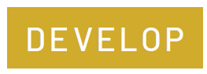
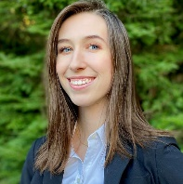
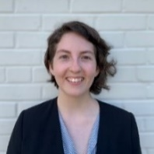
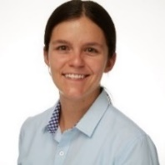

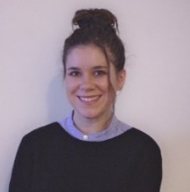
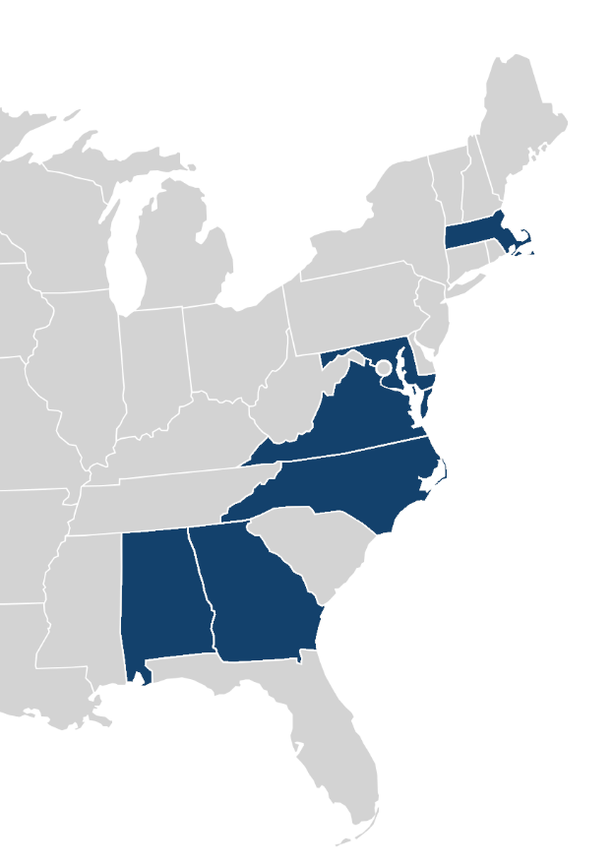
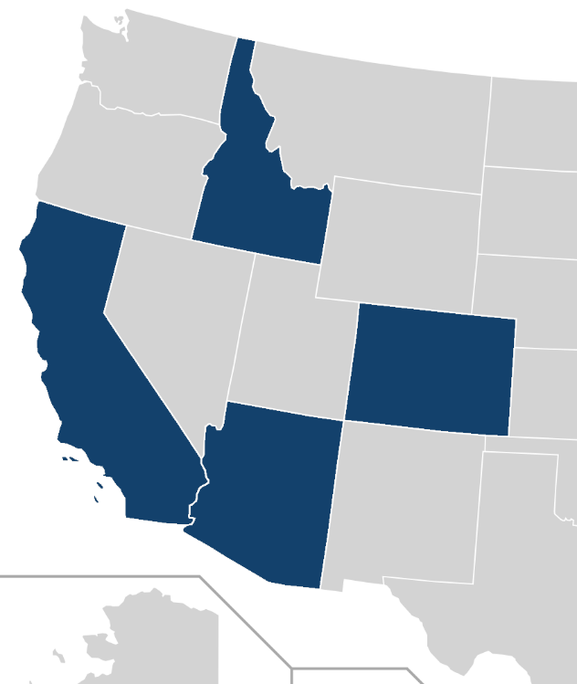
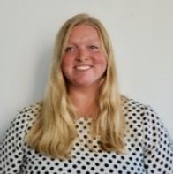

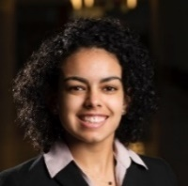
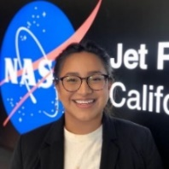
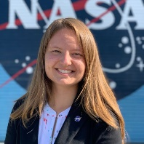

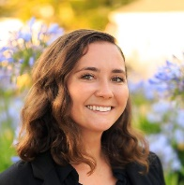

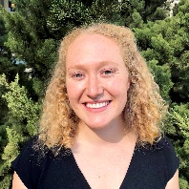



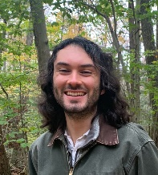
FELLOWS
Caroline
Pop-up Projects (PUP)
Project Coordination
Cecil (LaRC)
Sophia (LaRC)
Tamara (LaRC)
Impact Analysis
Katie (NC)
Sarah P. (GA)
Geoinformatics
Hayley (ARC)
Britnay (ARC)
Erica (JPL)
Adriana (LaRC)
Nicole (GSFC)
Brandy (ID)
Communications
Celeste (MA)
Ryan (AZ)
Paxton (MSFC)
Tyler (MA)
Node-only
Marco (VEJ)
Caroline (PUP)
Sarah H. (CO)
Celeste
Comm SF
Brandy
PC/Geo
Tyler
Comm
Britnay
Geo
Nicole
PC/Geo
Hayley
Geo SF
Adriana
PC/Geo
Erica
Geo
Sophia
*PC
Cecil
PC SF
Ryan
Comm
Sarah H.
Geo
Katie
IA
Tamara
*PC
Paxton
Comm
Sarah P.
IA
Marco
Virtual Environmental Justice (VEJ)

Slide 8
ABOUT DEVELOP
By The Way
A community of practice is a group of people who share a common concern, a set of problems, or an interest in a topic and who come together to fulfil both individual and group goals!
DEVELOP Structure
Community of Practice
Node Chain of Command
NPO
NPO
Fellows
Science Advisors & Mentors
Senior Fellows
Project Lead/POC
Fellows
Participants
Team Members

Slide 9
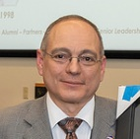
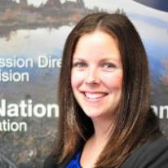
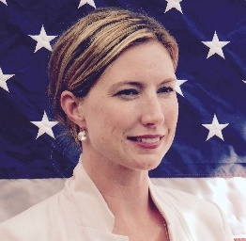

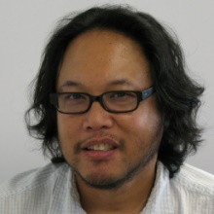
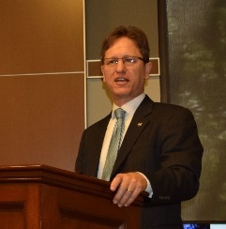
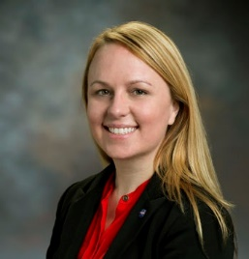
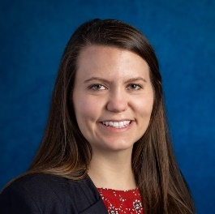
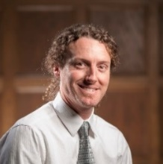
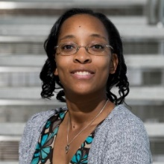
ABOUT DEVELOP
By The Way
They’re normal people too and you are welcome to reach out to them! You will have the opportunity to interact with them throughout the term!
National Program Office (NPO)
NPO is the core leadership and support team who manage and facilitate the various aspects of the program. The team is made up of NASA civil servants and SSAI contractors who implement DEVELOP.
NASA Management
SSAI
Management
NPO Support Team
Mike Ruiz
Program Manager
Karen Allsbrook
Business Manager
Stephanie Burke
Operations Lead
Jolana Davis
SSAI HR
Danny Mangosing
Web Developer &
Software Release
Science Island
Dr. Kent Ross
Chief
Scientist
Lauren Childs-Gleason
Science Manager
Amanda Clayton
Science
Lead
Sean McCartney
Software Carpentry & Bhutan
Shanise Hunter
Graphic Designer

Slide 10
ABOUT DEVELOP
National POCs
Mike Ruiz
Dr. Kenton Ross
Lauren Childs-Gleason
Karen Allsbrook
Amanda Clayton
Danny Mangosing
Stephanie Burke
Senior Fellows
Cecil Byles
Hayley Pippin
Celeste Gambino
DEVELOP
NPO
DEVELOP Fellows
Alabama – Marshall
Paxton LaJoie
Arizona – Tempe
Ryan Hammock
Idaho – Pocatello
Brandy Nisbet-Wilcox
Maryland – Goddard
Nicole Ramberg-Pihl
Massachusetts – Boston
Tyler Pantle
North Carolina – NCEI
Katie Lange
Virginia – Langley
Adriana Le Compte
Sophia Skoglund
Tamara Barbakova
California – Ames
Britnay Beaudry
Pop-up Projects
Caroline Williams
Virtual Environmental Justice
Marco Vallejos
Colorado – Fort Collins
Sarah Hettema
California – JPL
Erica Carcelen
Georgia – Athens
Sarah Payne

Slide 11
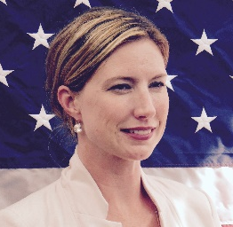
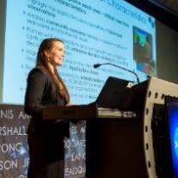
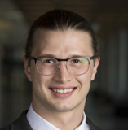


Note: for Virtual Machine questions, ask the Geoinformatics team or James Davis (SSAI) in the IT Support channel on Teams!
Questions? Contact…
Operational & SSAI Processes
Communications
Participant application system/process, outreach & recruitment, professional development, logistical support, SSAI processes, travel, Senior Fellow positions
Stephanie: 757-864-4498 Stephanie.Burke@ssaihq.com
Creative Communication deliverables, AGOL, project videos, social media, outreach
Celeste: celeste.gambino@ssaihq.com
Projects & Publications
Project Coordination
Deliverables, Export Control, DEVELOPedia
Impact analysis, personal growth assessments, surveys
Cecil: robert.byles@ssaihq.com
Projects, publications, presentations, conferences, deadlines, international work, webinars, partners, project hand-offs, proposals, Fellow positions
Amanda: 757-864-5552 Amanda.L.Clayton@nasa.gov
Human Resources
Geoinformatics
Technical help, code, Software Carpentry and software release
Hayley: hayley.pippin@ssaihq.com
Human resources, Employment status, offer letters, SSAI application, SSAI systems, employment verifications, payroll, schedule adjustments, paperwork, employment verifications
Jolona: 757-864-3762 jolona.davis@ssaihq.com

Slide 12




ABOUT DEVELOP
DEVELOP Social Media
DEVELOP National Program: features projects, node highlights & accomplishments, VPS announcements www.facebook.com/developnationalprogram
Once a DEVELOPer, Always a DEVELOPer: job posts
https://www.facebook.com/groups/387243741376125/
Articles & Important Events: Tweet @NASA_DEVELOP or #NASADEVELOP
http://twitter.com/#!/nasa_develop
NASA DEVELOP National Program:
VPS and promotional videos www.youtube.com/user/NASADEVELOP
NASA DEVELOP National Program: job posts, job skills & tips, and important events. This is a private group! Follow the link to join!
www.linkedin.com/groups/4343498
By The Way
Watch time spent on social media during work hours. If you are going to be on it, you should probably be on the DEVELOP pages liking and commenting on DEVELOP posts!

Slide 13
ABOUT DEVELOP
Things to Note
DEVELOP IS part of NASA’s Applied Sciences Program.
DEVELOP is NOT part of NASA’s Office of STEM Engagement.
DEVELOP is very different from NASA’s internship opportunities in the way we approach projects, focus on teamwork, the level of responsibility and authority given to participants, the opportunities we provide, and the individuals and organizations we network with. Enjoy it while you are here!
Earth observations and Earth science data are objective, transparent, and policy-neutral.
NASA Earth Science does NOT develop or prescribe policy. Other agencies and organizations use the data and scientific results in their policy analysis and development.
Travel is restricted and carefully managed, meaning that guidelines are in place to gain approval for travel. Travel is a privilege!

Slide 14
ABOUT DEVELOP
Quiz Time
How old is DEVELOP?
Who is the face of DEVELOP at your node?
Who should you contact if you have a project-related question?
Who should you contact if you have a schedule or payroll-related question?

Slide 15

Thank You.
You’re welcome for these DEVELOP knowledge bombs that just got dropped on you!

