Slide 1
PACIFIC NORTHWEST
Health & Air Quality
Utilizing NASA Earth Observations to Analyze Air Quality Impacts from Wildfires in the Pacific Northwest
Ani Matevosian, Taylor Orcutt, Danielle Ruffe, Liana Solis
California – Ames
Notes:
Speaker: Ani
Hello – we are the 2020 Summer NASA DEVELOP team and we are excited to share our 10 week journey where we utilized NASA Earth Observations to analyze air quality impacts from wildfires in the Pacific Northwest.
*Team introduces themselves*
I'm Ani...
I'm Dani...
I'm Liana...
I'm Taylor...

Slide 2
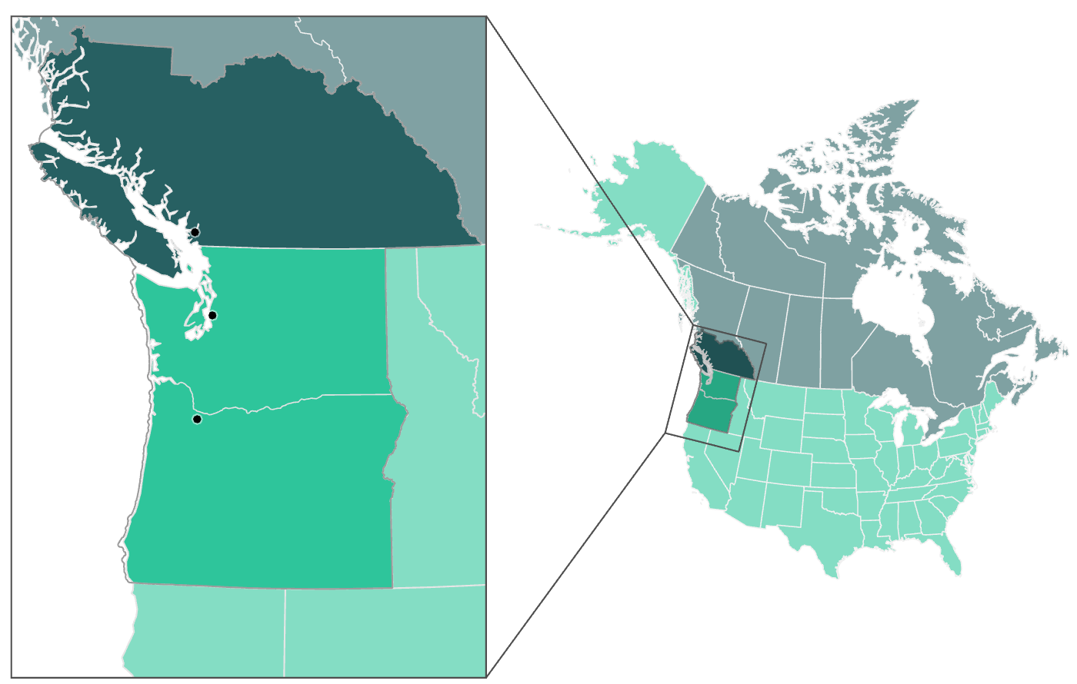
The Pacific Northwest
British Columbia
Vancouver
Seattle
Washington
Portland
Oregon
N
0
125
250
Miles
Notes:
Speaker: Ani
The project study area spans the Pacific Northwest, including Washington, Oregon, and Southern British Columbia. The study period spans from 2008-2020, covering around two decades of wildfire smoke emission data. With around 15 million people living in the region, health and air quality impacts from wildfire smoke are important topics of discussion among local and regional policy holders.
Although partners are both in Washington, we wanted to expand the study area because fires in British Columbia and Oregon, (among other places) do reach and impact the air quality in Washington.
Reference Credit: https://www.gonorthwest.com/Visitor/about/population.htm#:~:text=The%20Pacific%20Northwest,Population&text=The%20population%20of%20the%20Pacific,than%2015%20million%20and%20growing.

Slide 3
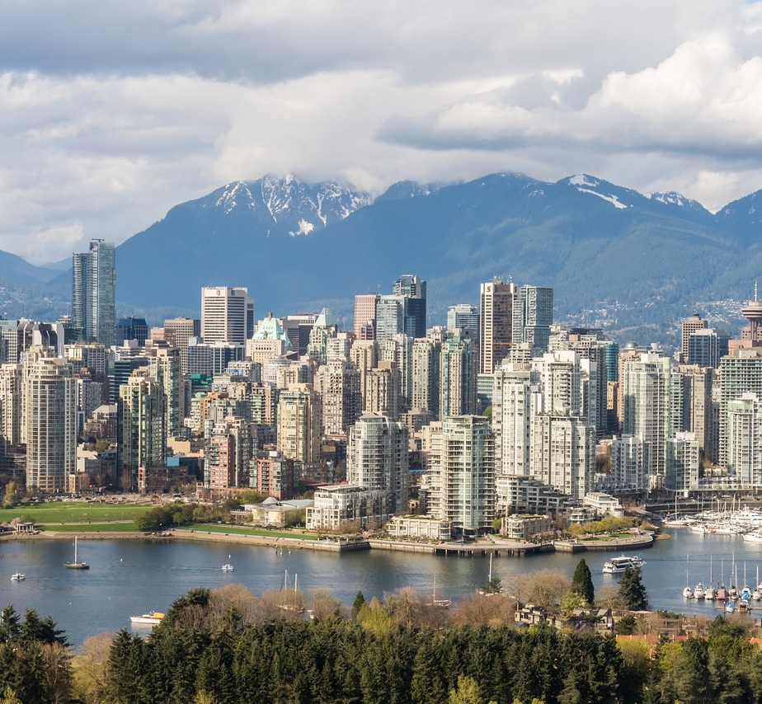
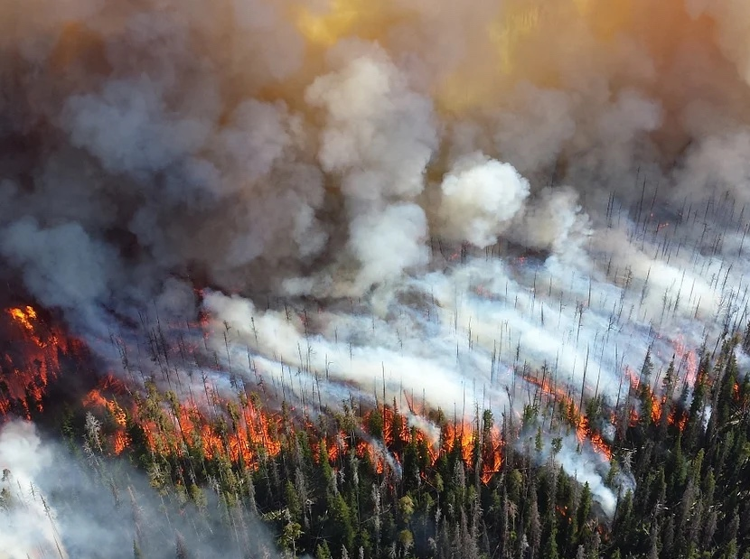
Community Concerns
Air quality
Human health
Economic impact
Geographic limitations of monitoring stations
PLACEHOLDER
Image source: Pixabay, Luke Lawreszuk
Notes:
Speaker Liana: (slide takes approx. 1 min, 10 sec)
Because of historic fire suppression and climate change, wildfires in the Pacific Northwest are increasing in scope and severity. Wildfires produce smoke which get injected into the atmosphere. This wildfire smoke is comprised of pollutants and trace gases such as nitrogen oxides, ozone, and carbon monoxide to name a few. These aerosol pollutants decrease air quality, reduce visibility, and are hazardous to human health. Exposure to the hazardous aerosols in smoke can aggravate symptoms of asthma and are associated with respiratory conditions, like Chronic Obstructive Pulmonary Disease, and in extreme cases, death. These health hazards can lead to economic loss from increased hospital admissions. Although wildfire smoke can impact any region of the Pacific Northwest, air quality monitoring stations are primarily located in urban areas, leaving rural communities, such as those east of the Cascade Mountains, with limited to no access to air quality monitoring. However, our team proposes that satellite data can be used to address the current regional gaps in air quality monitoring.
------------------------------Image Information Below (for both images) ------------------------------
Burning Forest:
Images Credit: Pixabay License
Images Source: https://pixabay.com/photos/forest-fire-blaze-smoke-trees-1161868/ , skeeze
Vancouver Skyline:
Images Credit: Pixabay License
Images Source https://pixabay.com/photos/vancouver-skyline-british-columbia-4585887/ , Luke Lawreszuk

Slide 4
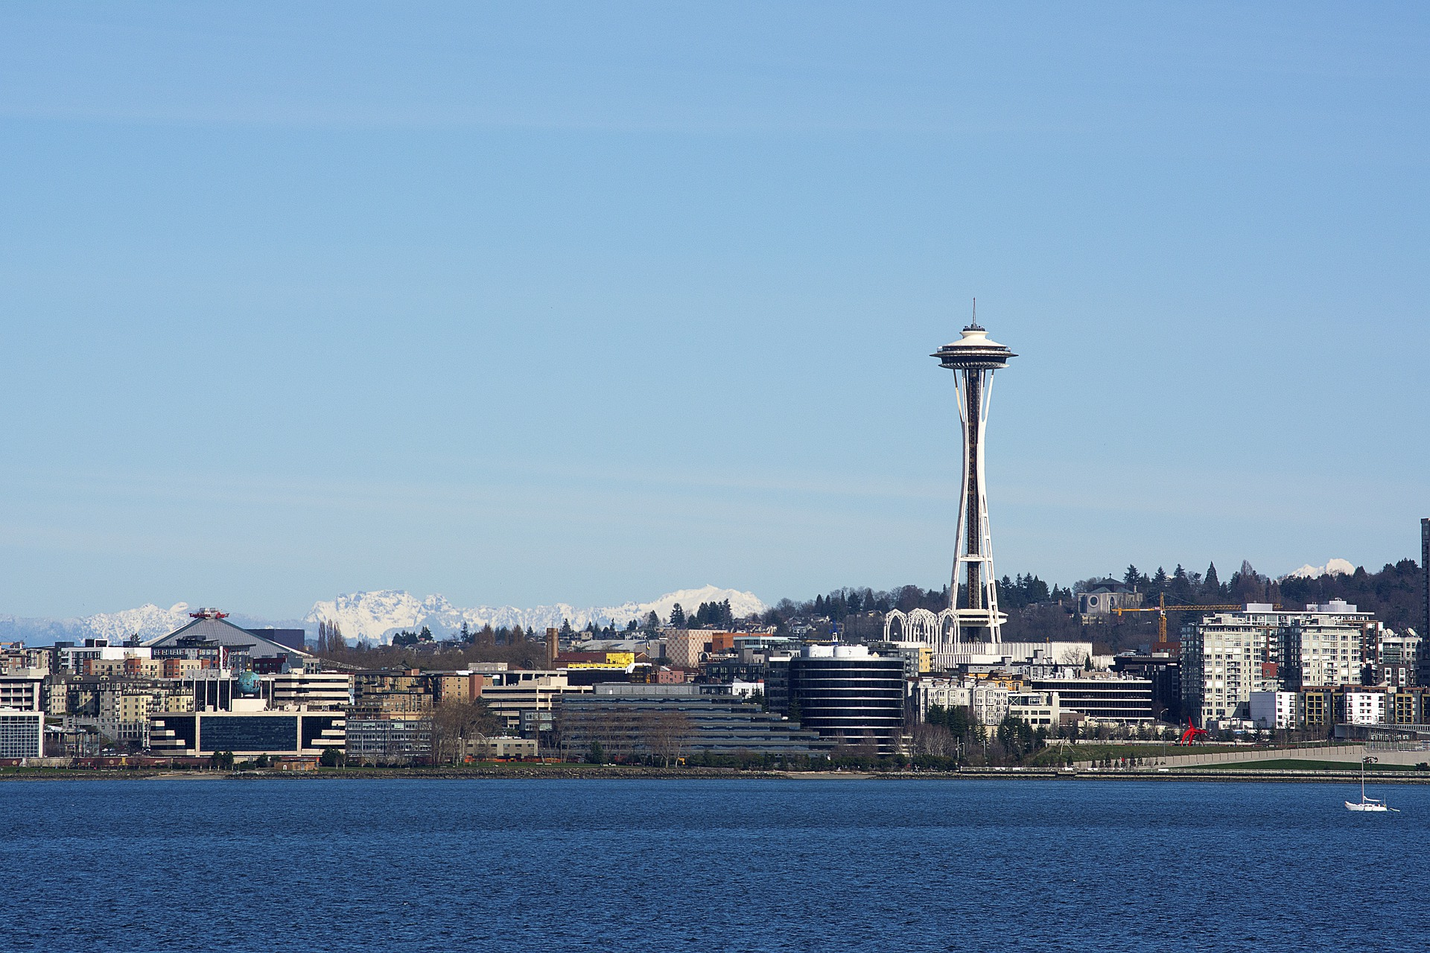
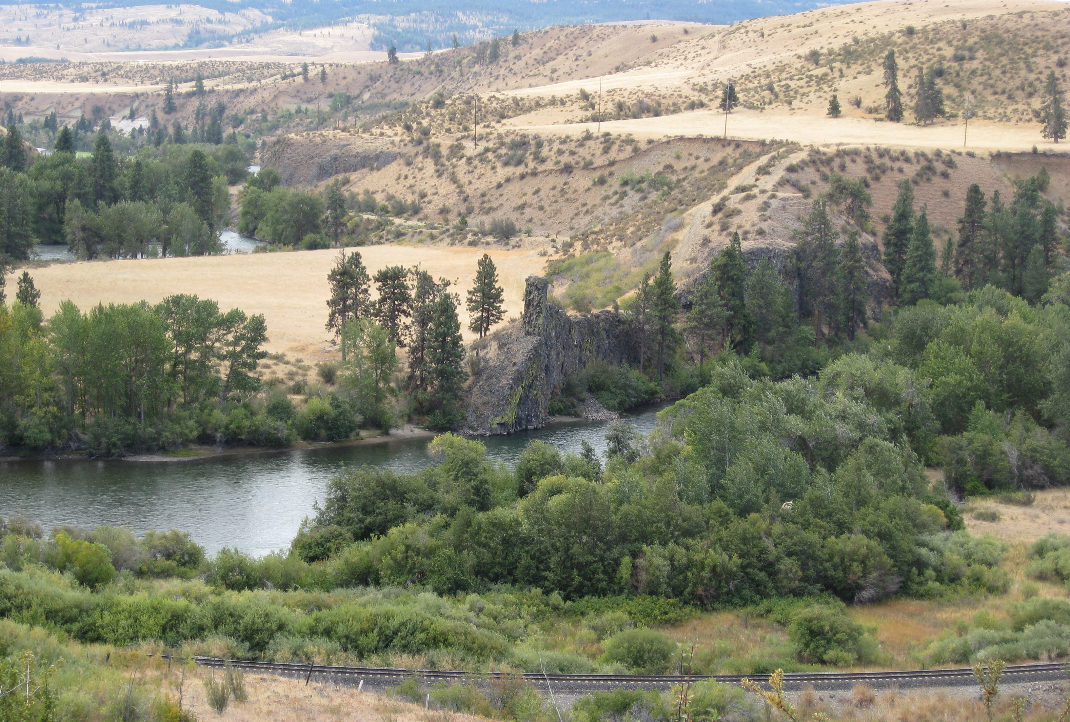
Partners
The Nature Conservancy – Washington Chapter
Puget Sound Clean Air Agency (PSCAA)
*possibly need new images, Erik is checking if he can legally share these for us to use
placeholder
placeholder
Photo credit: PSCAA
Photo credit: PSCAA
Image Sources: Pixabay, BrewBooks (Flickr)
Notes:
Speaker: Ani
We partnered with The Nature Conservancy Washington Chapter and the Puget Sound Clean Air Agency. Both partners are located in the state of Washington and provided us insight into how fire impacts air quality in their communities.
Image Credits:
Image 1 (left): Pixabay - Shoot_It_Raw, https://pixabay.com/photos/seattle-waterfront-washington-5364650/. (Pixabay Free Use License)
Image 2 (right): Flickr, BrewBooks - https://www.flickr.com/photos/brewbooks/2847634048 (Creative Commons)

Slide 5
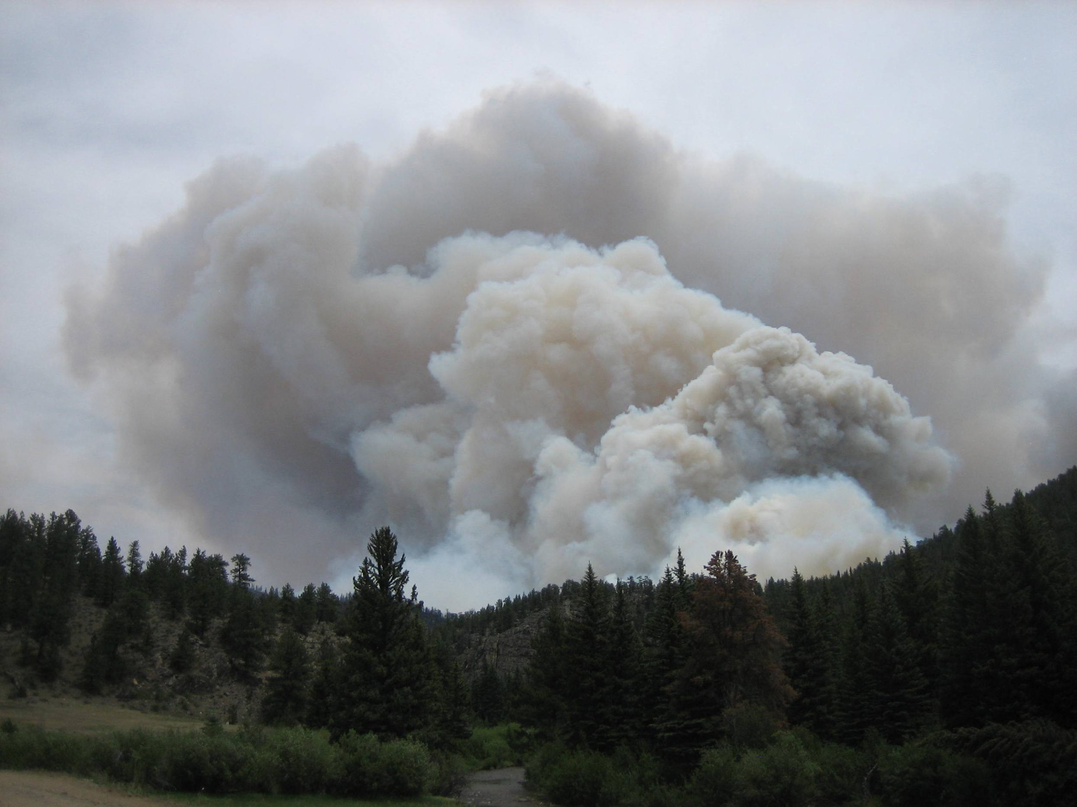
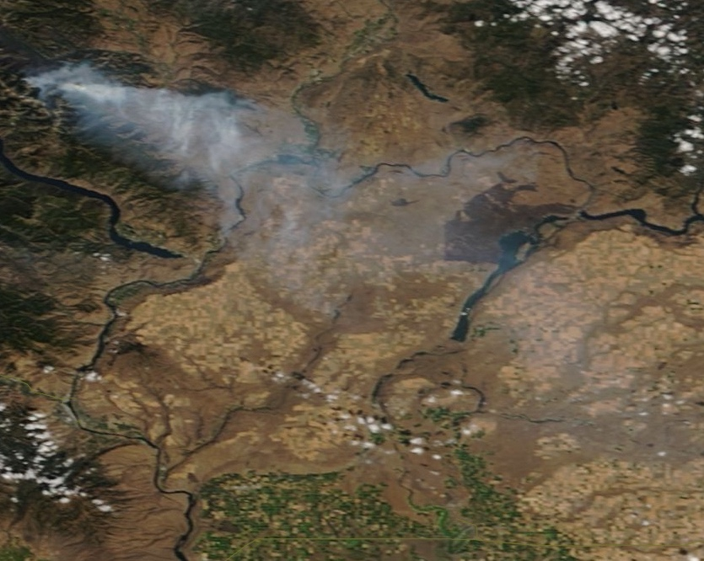
Objectives: How can we visualize & analyze smoke?
Create a methodology to assess plume height
Analyze distribution of smoke-caused pollutants
Image Sources: USDA via Wikimedia Commons, Worldview
Notes:
Speaker: Dani
For this project, we wanted to answer the question– “ How do you visualize and analyze smoke?” within our study area.
With limited ground-based sensors, we wanted to find a way for our partners to determine where air quality was compromised by smoke. We also sought to provide them with a way to determine how high smoke travels into the atmosphere, as there is not a current ground instrument method to measure plume height.
We set out to quantify plume height and analyze the distribution of smoke.
Visualizing where smoke and its pollutants are located, both three-dimensionally and geographically, provides insight to community partners for how to best respond in their wildfire management practices.
Image credit:
1. Source: Wikimedia Commons, https://commons.wikimedia.org/wiki/File:Smoke_column_-_High_Park_Wildfire.jpg (Creative Commons)
2. Source: World View (2018 Sept 1, WA) (Public Domain)

Slide 6
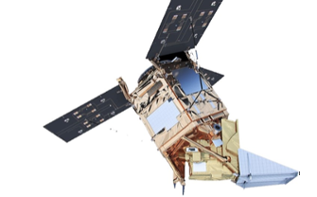
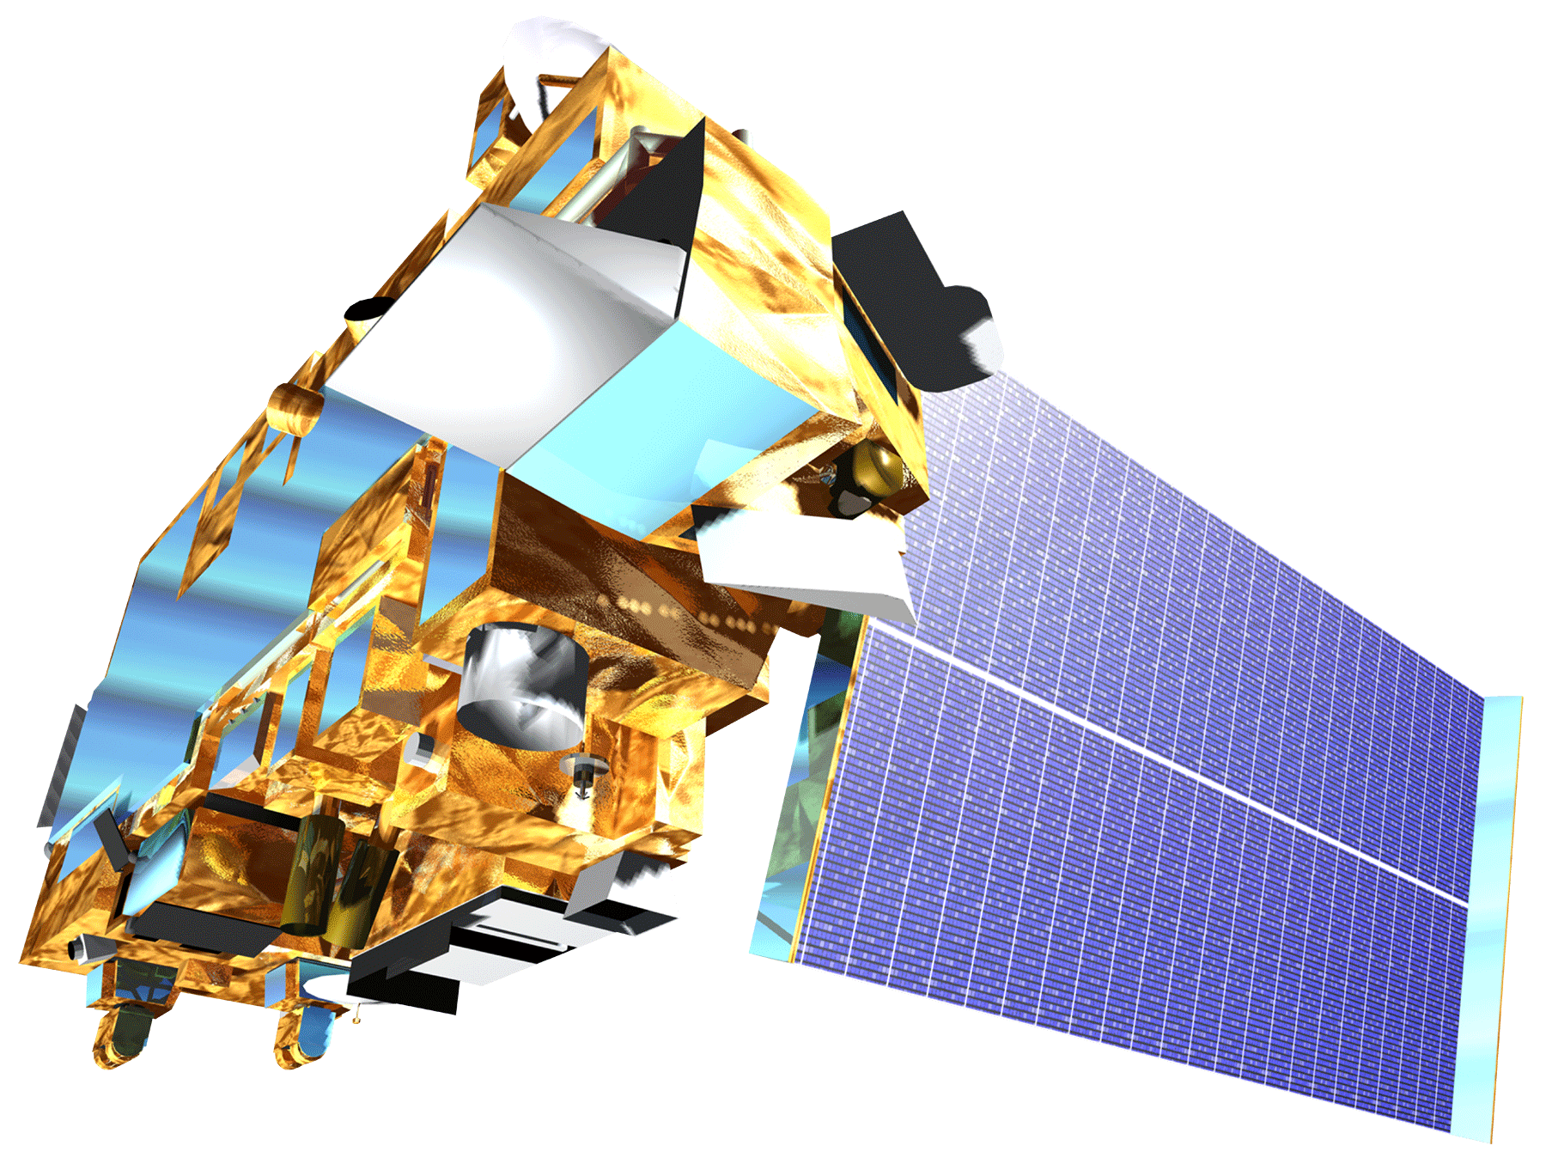
Satellites and Sensors
Aqua
Moderate Resolution Imaging Spectroradiometer (MODIS)
Sentinel-5P
TROPOspheric Monitoring Instrument (TROPOMI)
2008
2013
2018
2020
Terra
MODIS &
Multi-Angle Imaging Spectroradiometer (MISR)
Landsat 8
Operational Land Imager (OLI)
Notes:
Speaker: Ani
This project utilized a variety of satellites and sensors to gather Earth Observation data.
MODIS on Terra and Aqua provided Aerosol and fire products, and MISR on Terra provided plume height data.
We also used data from Sentinel-5P TROPOMI for measurements of pollutants including carbon monoxide, nitrogen dioxide, and formaldehyde for 2018-2020.
-----------Image Information Below------------
Aqua and Terra:
Image Credit: NASA
Image Source: http://www.devpedia.developexchange.com/dp/index.php?title=List_of_Satellite_Pictures
Landsat8
Image Credit: NASA
Image Source: http://www.devpedia.developexchange.com/dp/index.php?title=List_of_Satellite_Pictures
Sentinel:
Image Credit: ESA
Image Source: http://www.esa.int/ESA_Multimedia/Search/(sortBy)/view_count?result_type=images&SearchText=Sentinel+5p

Slide 7
Study Design: MINX and GEE Tool
How can we visualize & analyze smoke?
Vertical Extent
Geographic Extent
MINX Methodology
Plume Height
GEE Tool PHOENIX
Pollutants and Aerosols
km
2
5
Notes:
Speaker: Liana
We were able to use Earth Observations to help answer the question: How can you visualize and analyze smoke?
We separated this question two components: one being the vertical, 3D extent of smoke plumes and the other being the geographic extent of smoke.
We wanted to know the vertical extent because plume height influences how long the pollutants will stay in the atmosphere and how far of a distance the pollutants can travel. To achieve this, we used THE MISR INteractive eXplorer or MINX.
We also wanted to learn about where the smoke is. The closer to the Earth’s surface the pollutants are, the more it will have an impact on the population’s health. To identify where these wildfire-caused increases of aerosols occurred, we developed PHOENIX in Google Earth Engine. PHOENIX stands for “Plume Hazards and Observations of Emissions by Navigating an Interactive eXplorer”.

Slide 8
MISR INteractive eXplorer (MINX)
How can we visualize & analyze smoke?
Vertical Extent
Geographic Extent
MINX Methodology
Plume Height
GEE Tool PHOENIX
Pollutants and Aerosols
km
2
5
Notes:
First we will take a look at MINX

Slide 9
Digitizing Plume Height:
MINX
MISR INteractive eXplorer (MINX)
Notes:
*Transition Slide to MINX*
Why MINX?
MINX is a software built to determine smoke plume height. The team used MINX to understand the vertical extent of smoke in the Pacific Northwest region. In addition, we made a user-friendly tutorial for plume digitization to ensure replicability of the analysis.

Slide 10
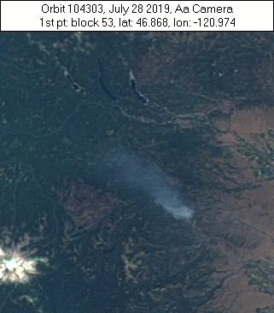
MISR in MINX
MINX uses data from MISR, a sensor flown aboard Terra
MISR has nine different camera angles
Using the different angles, helps show plume direction movement
Notes:
Speaker: Dani
MINX is a software developed by a team NASA JPL to help visualize and determine plume heights from wildfire smoke, volcanic eruptions, and other pollutants. MINX uses MISR data which is a multi-angle sensor flown aboard Terra, each MISR “capture” takes nine different images all with different views. This type of imaging creates stereoscopic models, see right, so that the plume movement and direction can be accurately assessed.
Image Credit: GIF Generated by DEVELOP Team

Slide 11
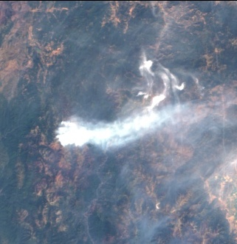
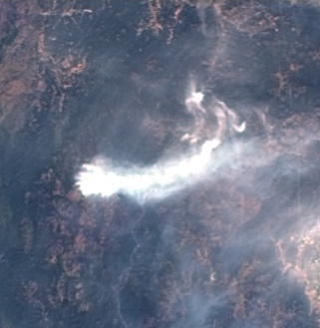
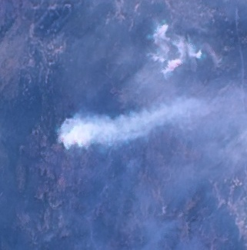
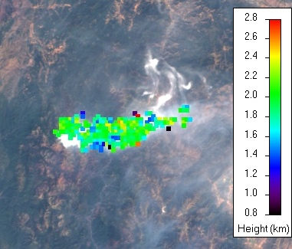
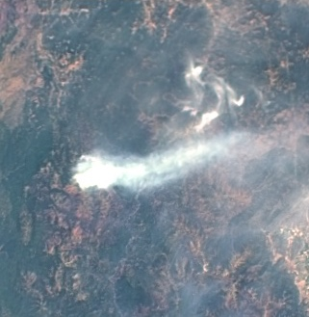
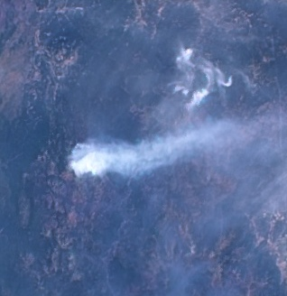
MINX Methodology
2.8
0.8
km
Load data into MINX
Manually Digitize the Smoke Plume
MINX-Derived Plume Height
Notes:
Speaker: Dani
The MINX methodology requires MISR data input and an optional MODIS fire pixel layer. After running the MINX program, the data files are loaded into the software where the user manually digitizes a polygon around the smoke plume. MINX then takes the digitized smoke plume and derives plume height from embedded algorithms (*further explanation below). The software outputs plume height and wind speed graphs, wind-corrected height calculations, and visualizations of the user-defined plume.
*A specialized MISR Interactive Explorer (MINX) program uses optical parallax along with the operator input of source location, wind direction, and plume area to derive Ha, e.g. [2]. Wind-corrected plume heights from MISR MINX have an accuracy of 250–500 m

Slide 12
Plume Height Analysis
All Plumes
Notes:
Speaker: Dani
The team analyzed MINX plume data from NASA JPL’s MISR Plume Height Project 2 database for the study area. Regionally, over 400 plumes were digitized and analyzed for a potential correlation between fire radiative power (“fire intensity”) from the MODIS MOD14 Fire Granules and maximum plume height from the MINX plume height project 2 database.
The team concluded that there was not enough of a significance to consider the positive correlation between fire radiative power and maximum plume height statistically significant.
We believe the values reflect the different meteorological patterns that evolve to change plume height for each fire event. For instance, high and low pressure systems would have different effects on plume height regardless of fire intensity. Future work could include additional analyses with meteorological data.

Slide 13
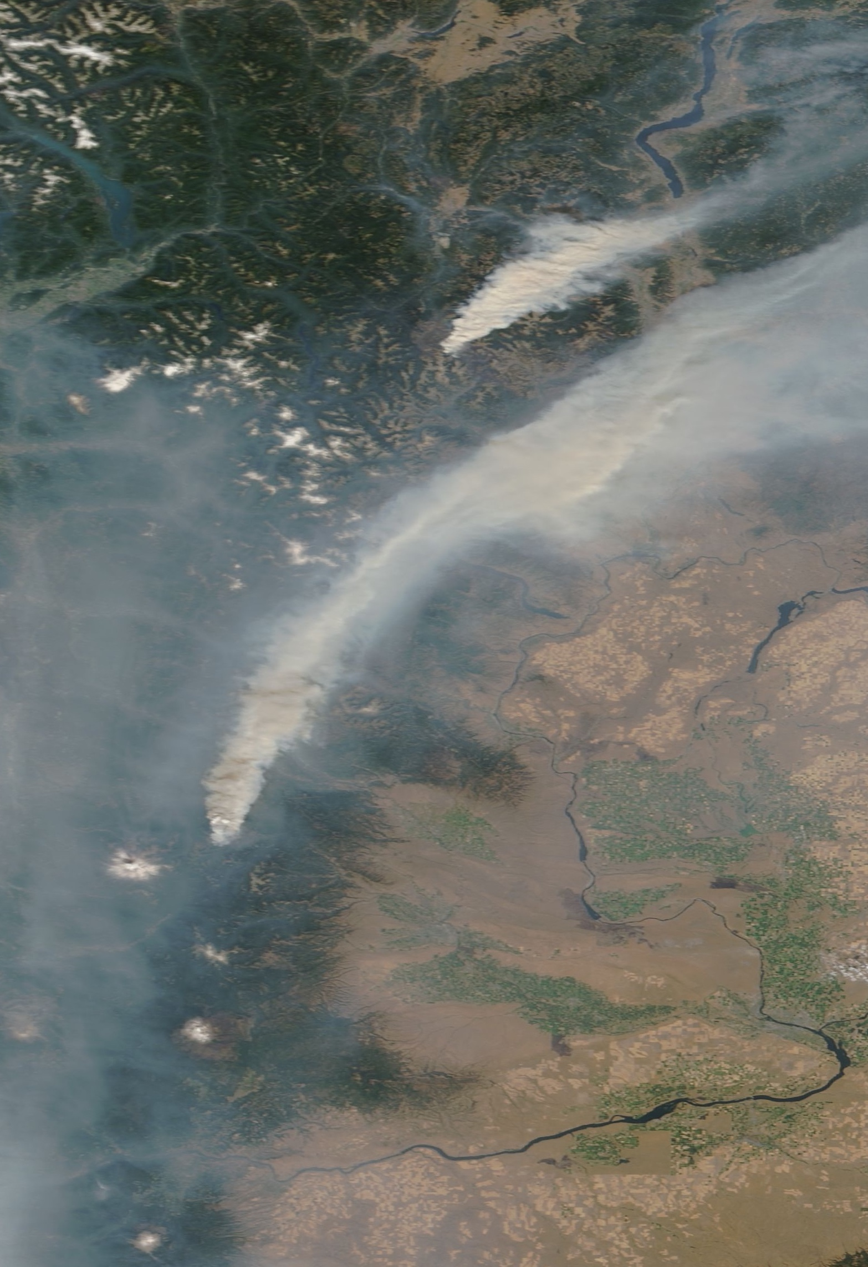
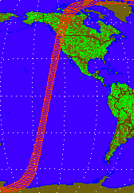
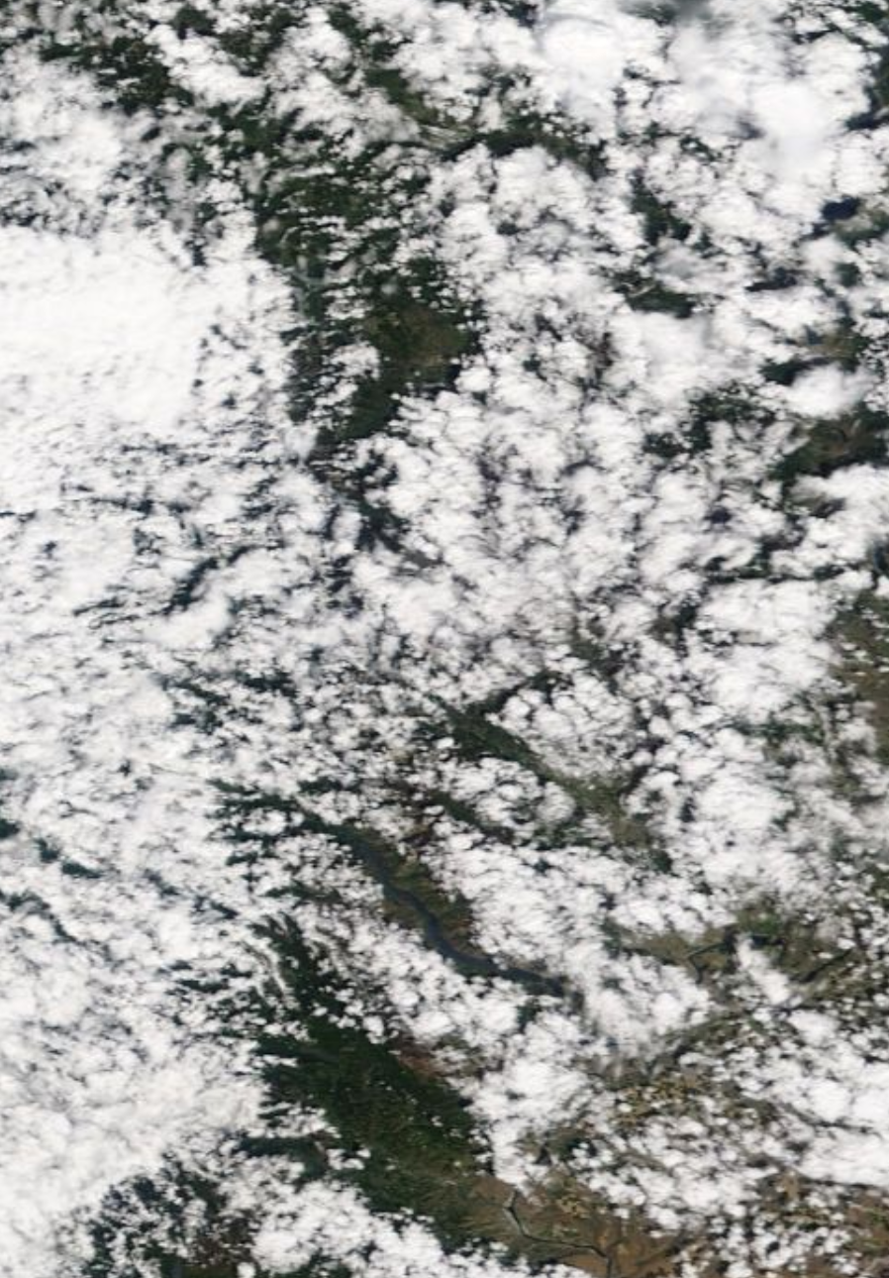
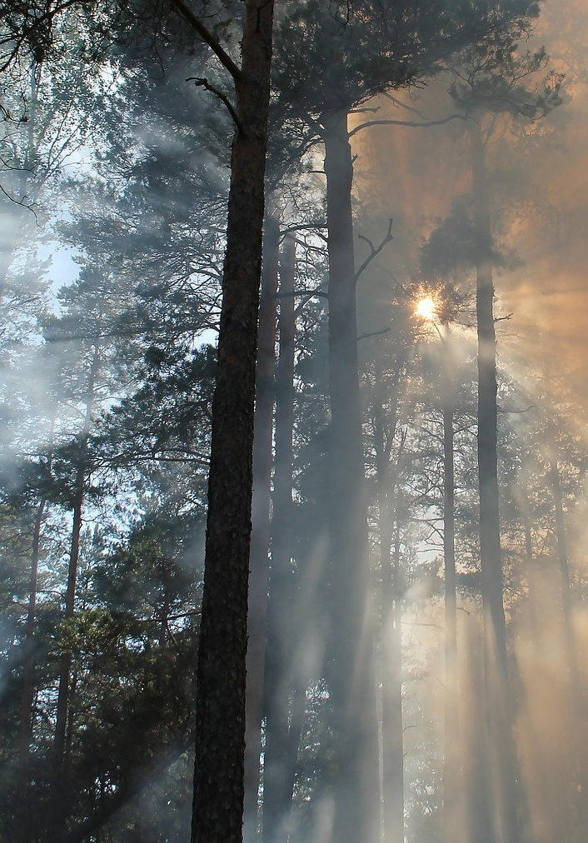
MINX Limitations
Plume Direction
Orbit
Clouds
Time of Day
Notes:
Speaker: Liana
Although MINX allows us to calculate plume height, it is not a perfect solution. MINX’s plume height algorithm takes Terra’s path into account when preforming calculations, however when a plume is aligned in the direction of the orbit the algorithm may result in height errors if it cannot distinguish the movement of the satellite from the wind direction.
Additionally, MISR have global coverage every 9 days at the equator and every 2 days at the poles, so shorter fire events can be missed.
Also, clouds can blocks the view of smoke, preventing us from measuring plume height.
Finally, the Terra overpass time in the late morning which does not coincide with the typical, late-afternoon peak of fire intensity, when the most smoke occurs.
------------------------Image Credit Below-----------------------------------
NASA, World View (2017 Aug 30, WA & CAN) (Public Domain)
NASA, MISR Browse Tool https://l0dup05.larc.nasa.gov/MISR_BROWSE/ (Public Domain)
NASA, World View (243 Compound Fire) (Public Domain)
Images Credit: Pixabay License
Images Sourcehttps://pixabay.com/photos/forest-fire-fire-burning-433683/

Slide 14
Study Design: MINX and GEE Tool
How can we visualize & analyze smoke?
Vertical Extent
Geographic Extent
MINX Methodology
Plume Height
GEE Tool PHOENIX
Pollutants and Aerosols
km
2
5
Notes:
*Transition Slide to GEE Tool *
While MINX gives in insight into the height of smoke, it give us no information about what it is composed of.

Slide 15
GEE Tool: PHOENIX
How can we visualize & analyze smoke?
Vertical Extent
Geographic Extent
MINX Methodology
Plume Height
GEE Tool PHOENIX
Pollutants and Aerosols
km
2
5
Notes:
*Transition Slide to GEE Tool*
To understand where the smoke is and what pollutants it is composed of, we created a google earth engine tool.

Slide 16
Google Earth Engine Tool:
PHOENIX
Plume Hazards and Observations of Emissions by Navigating an Interactive eXplorer
Notes:
*Transition Slide to GEE Tool*
Our GEE tool is called PHOENIX

Slide 17
PHOENIX Methodology
Data Acquisition & Inputs
Visualize Parameters
Analysis
Output
Aqua/Terra MODIS
Sentinel-5P TROPOMI
Landsat 8
Aerosol Optical Depth (AOD)
Nitrogen dioxide (NO₂)
Formaldehyde (HCHO)
Carbon Monoxide (CO)
Created stagnant 2-yr (‘18-’19) baseline map for each pollutant
Average a 7-day pollutant level on user chosen date
Calculate the difference between the two layers
The change in pollutant levels between the selected date and baseline map. This is used to display any pollutant level “anomalies” in the time frame
Notes:
Speaker: Taylor
*context - see overall effects of smoke in the study area in GEE*
The methodology for the GEE tool is displayed in this flowchart.
We began by acquiring the data in Google Earth Engine, this data included MODIS MAIAC, Sentinel, and Landsat datasets. Next, we set the tool to visualize by parameters of interest: Aerosol Optical depth (a proxy for PM 2.5), pollutants of NO2, Formaldehyde, and carbon monoxide. Then, for analysis we average the values over a 7 day range, and automate a difference operation between a selected date/fire event AND the historic 2 year averaged baseline map. The tool will also display LANDSAT 8 derived true color imagery to be able to see plumes.
Lastly, the output of the tool includes a map displaying the change in the selected pollutant for a selected date (aka fire event), as well as a graph displaying the health statistics for a selected point (point inspector).
*note on flow chart – figuring out how to simplify analysis/output parts*

Slide 18
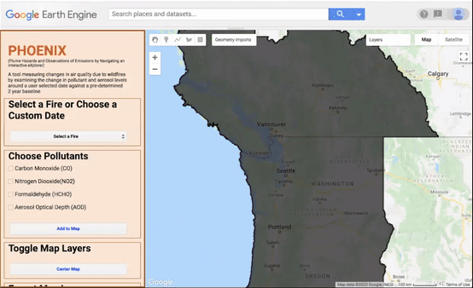
PHOENIX Interface
Notes:
Speaker: Taylor
*GIF of tool*
Here’s a snapshot of the tool! This map is displaying carbon monoxide levels within our study area difference against our two year baseline. We’ve selected the William Flats Fire, and so the map zooms in to that location. We then chose to show carbon monoxide. If we turn on the true color imagery only, you can see the plume, then the delta CO layer shows the change in CO levels surrounding the plume. Finally, that data can be exported as a tif.
::Slide contains a Google Earth Engine demo gif::

Slide 19
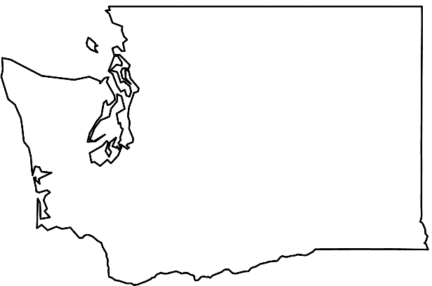
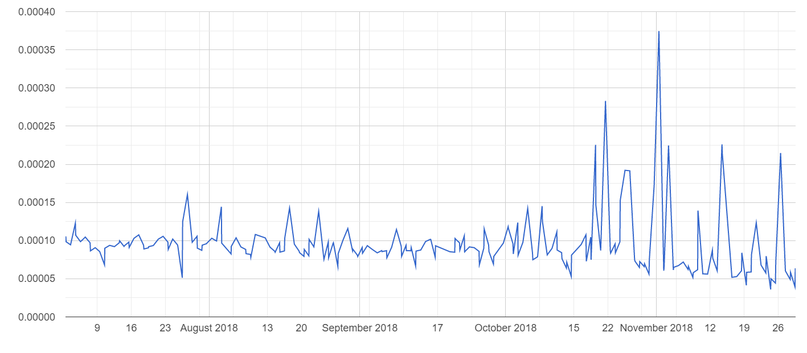
PHOENIX Case Study: 2018 Fire Season
WA
Nitrogen dioxide (NO₂) Levels for 2018 Fire Season
Unnamed Fire
NO₂ (mol/m²)
Time (days)
Notes:
Speaker:
Here we can see graphs output by the PHOENIX Tool that show NO2 levels in a selected geometry for a fire season of July-November, and within we can see pollutant level spikes that corelate to the time of a fire event in that year and selected region (in this case Colville Reservation, Washington). From visual analysis in the tool, we see that the FIRMS fire layer shows a fire on this date in November 2018.
Note: NO₂ levels are given in terms of the column abundances as indicated by the unit mol/unit squared

Slide 20
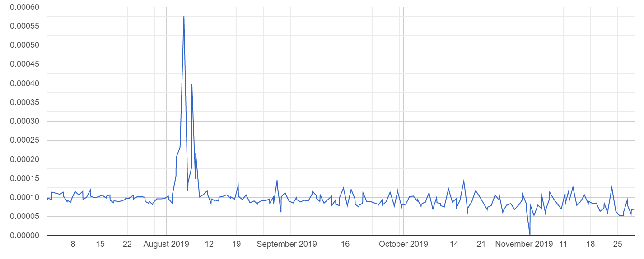
PHOENIX Case Study: 2019 Fire Season
WA
Nitrogen dioxide (NO₂) Levels for 2019 Fire Season
Williams Flats Fire
NO₂ (mol/m²)
Time (days)
Notes:
Speaker:
A second graph generated by the PHOENIX tool showing Nitrogen dioxide levels for the 2019 fire season (due to limited data availability was July – November).
We can see a spike in August, probably due to the William Flats fire that began August 2, 2019. The graph generated is also for the Colville Reservation region in Northeastern Washington (represented by the fire symbol).
Note: NO₂ levels are given in terms of the column abundances as indicated by the unit mol/unit squared

Slide 21
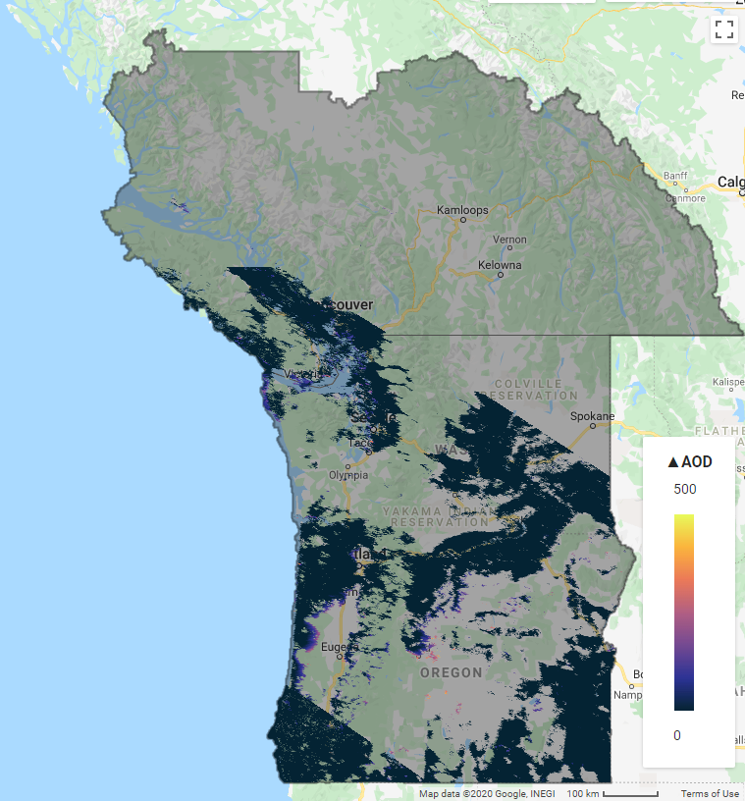
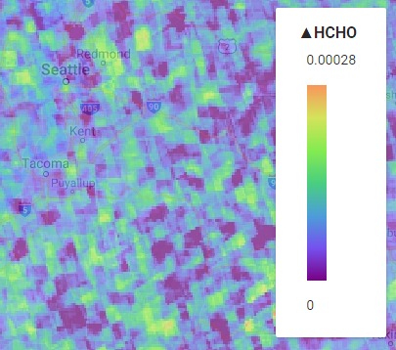
GEE PHOENIX Errors and Limitations
Sentinel 5-P TROPOMI is a new sensor and therefore temporally limited
Pollutant data does not date back more than 1.5 years
Baseline created over a short 2- year time frame
Some pollutant data are for the total vertical atmospheric column
Due to sensor paths there are spatial gaps in AOD data
Δ HCHO
0.00028
Δ AOD
50
0
Formaldehyde (HCHO)
0
Aerosol Optical Depth (AOD)
Notes:
Speaker: Taylor
The tool combines varying temporal resolutions: TROPOMI is a new sensor and therefore most pollutant data doesn’t date back more then 1.5 years, while the MODIS MAIAC dataset for AOD is 2000-present.
The Offline Sentinel datasets are also temporally limited, provided to the user between 5 days and 2 weeks after sensing (https://sentinel.esa.int/documents/247904/1848259/Sentinel-5P_Data_Access_and_Products). We opted for offline instead of Near-Real Time because NRT data has not gone through sufficient quality control.
Some of the pollutant data is for the total vertical atmospheric column, rather than the troposphere; when analyzing the impact on health, tropospheric and near surface levels are important.
The differencing operations on the pollutants may be a source of uncertainty as the tool picks a few days before and after the fire event.

Slide 22
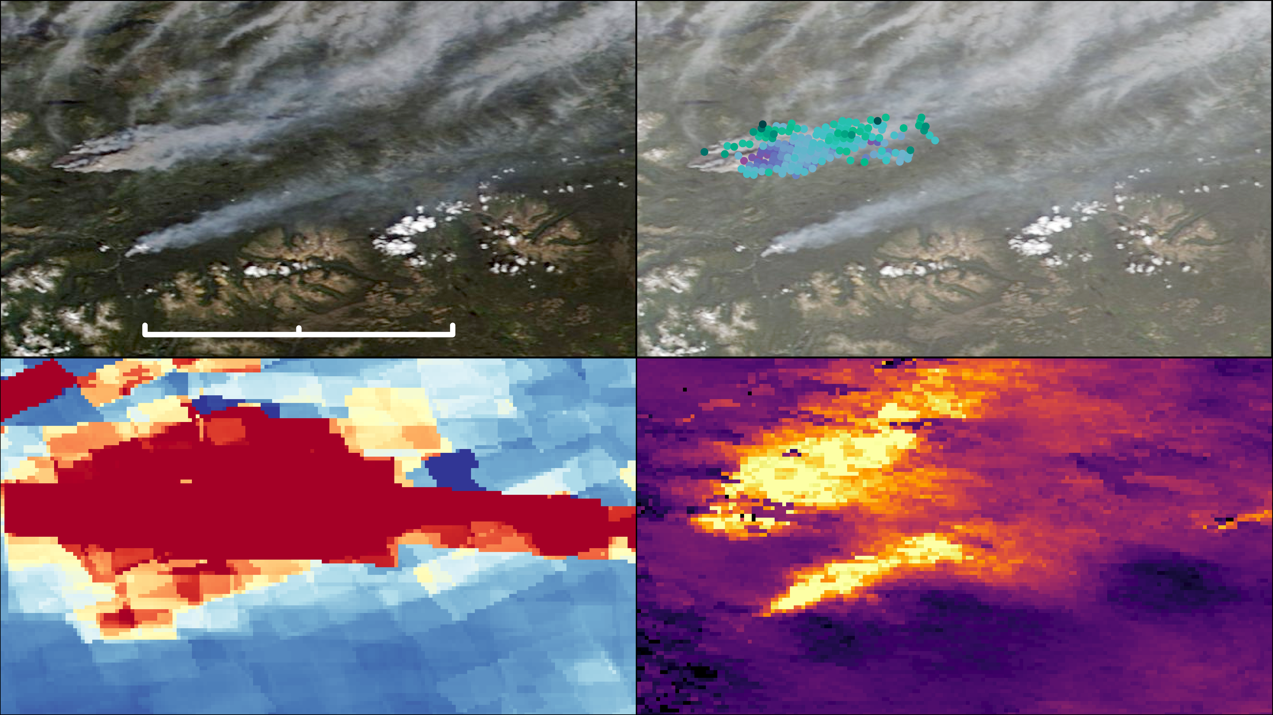
Case Study: August 6, 2018 Fire Event
Plume Height
3,674 m
N
N
0
25
50 miles
1,287 m
Change of CO from 2-year baseline
Change of AOD from 2-year baseline (unitless)
High
0.28 mol/m²
-0.02 mol/m²
Low
Notes:
Speaker: Liana
To tie everything together and get a complete picture of a smoke event, we looked at a case study in a remote part of British Columbia, during a fire event on August 6, 2018.
The smoke plume is relatively simple to spot/see in the true color MODIS imagery and is in a remote location where there is not many ground sensors.
We can see that PHOENIX detected an anomaly in both CO and AOD in the area where the smoke plume was located and we can see from MINX that this plume reaches over 3.5 kilometers in some areas, giving it potential to travel to other areas of the Pacific Northwest. The potential for smoke to travel is a reason we investigated a larger region instead of only the state in which our partners were located.
----notes------
*we looked at a fire event in our study area at this time*
*title: Case study: August 6, 2018 Fire Event*
British Columbia plume- August 6, 2018
*explain colors for AOD*
~smoke from british columbia had smoke impacts in WA~
*"anomaly in air pollution match up with the smoke*
*paints a full-er picture of the impact of fire/smoke*
*great example of how the tool is used to monitor fires in more remote areas*

Slide 23
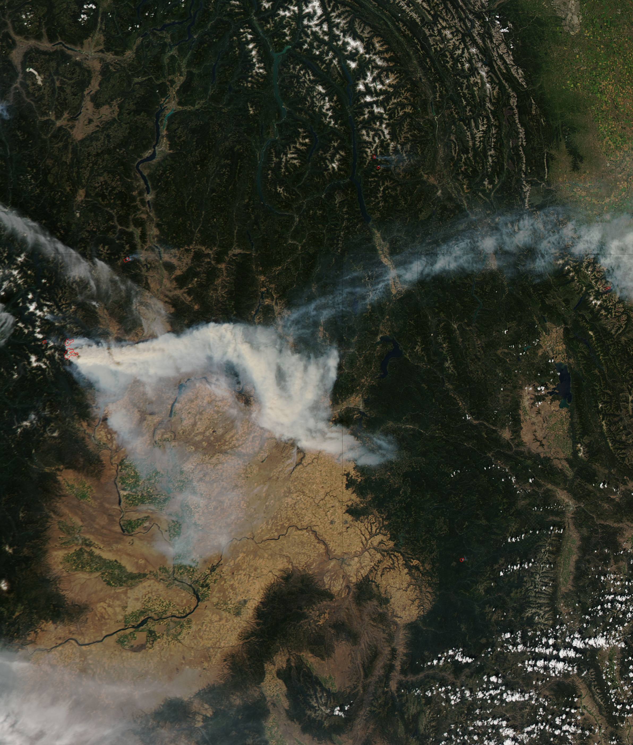
Conclusions
Satellite data can successfully visualize pollutants over remote regions that lack ground monitoring stations.
Changes in air quality surrounding fires is captured in the PHOENIX tool.
There is no regional, statistical correlation between fire radiative power and plume height.​
A combination of the PHOENIX tool and MINX methodology allows for a more effective and comprehensive evaluation of wildfire smoke.
Image Source: NASA
Notes:
Speaker: Taylor
The PHOENIX tool helps the user understand air quality in areas the were previous data-less due to the lack of ground sensors in certain areas.
We can see clear correlations between the location of fire event and the resultant level of pollutant in the air
Utilizing MISR data can now allow our partners to obtain data on plume height that they previously were unable to achieve. We also provided insight into the complexities of smoke and fire relationships with evidence that fire strength and plume height are not regionally correlated.
--------------------------Image Credit Below----------------------------------------------
Image: MODIS 2015-213 - Wolverine Fire and smoke over Washington and Idaho
Author: NASA
retrieved from Wikipedia Commons; https://commons.wikimedia.org/wiki/File:MODIS_2015-213_-_Wolverine_Fire_and_smoke_over_Washington_and_Idaho.jpg
________________
Previous text from slide:
Satellite data can successfully visualize pollutant distribution and changing levels over remote regions that lack ground monitoring stations.
Changes in air quality surrounding fires & plumes can be detected using the PHOENIX tool.
There is no regional, statistical correlation between fire radiative power and plume height.​
PHOENIX & MINX combination allows for a more effective and comprehensive understanding of wildfire smoke (captures both geographical and vertical dimensions)

Slide 24
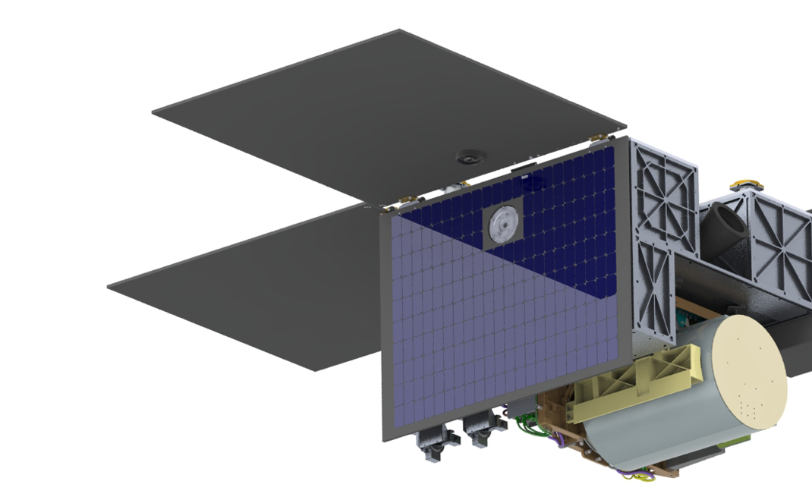
Future Work
NASA Multi-Angle Imager for Aerosols (MAIA) 2022 mission
Incorporate CALIOP (Cloud Aerosol Lidar and Infrared Pathfinder) CALIPSO vertical curtains
Investigate near-surface data
Include demographic data for an impact analysis
Ground sensor validation for all smoke pollutants
Notes:
Speaker: Ani
There are many studies that can build off of this project in the future. A new instrument called MAIA is set to launch in 2022 and will provide further research on aerosols, particulate matter, and their impact on human health (https://maia.jpl.nasa.gov/).
Similarly, CALIOP CALIPSO provides LiDAR data on the vertical profile of the atmosphere, as well as 3D visualizations of clouds and aerosols. This could enhance air quality and smoke plume studies.
In addition, the pollutant data in our PHOENIX tool used a combination of tropospheric and total column concentrations, however future work can investigate the near-surface concentrations for all pollutants, as that is where it has the greatest effect on population health.
Demographic data (such as race or income) for the study area could be incorporated to better understand the impact of these pollutants and their distribution.
Lastly, Ground sensor data could be used to validate the pollutant levels derived from satellite sensors.
Image Credit:
General Atomics Electromagnetic Systems, https://maia.jpl.nasa.gov/investigation/#host_satellite (Public Domain)

Slide 25
Puget Sound Clean Air Agency
Erik Saganić
The Nature Conservancy, Washington Chapter
Brian Straniti
Nikolaj Lasbo
Bay Area Environmental Research Institute
Dr. Juan Torres-Pérez
NASA Langley Research Center
Dr. Kenton Ross
NASA Goddard Space Flight Center
Dr. Ralph Kahn
NASA Jet Propulsion Lab
Abigail Nastan, M.S.
NASA Ames Research Center
Gina Cova
Zach Bengtsson
Britnay Beaudry
Atmospheric Science Data Center
Madison Broddle
Danielle Groenen
Sanjana Paul
This material contains modified Copernicus Sentinel data (2018-2020), processed by ESA.
Notes:
Speaker: Ani
We wanted acknowledge and thank all these individuals who contributed their time and knowledge! We could not have completed the project without them.

