Slide 1
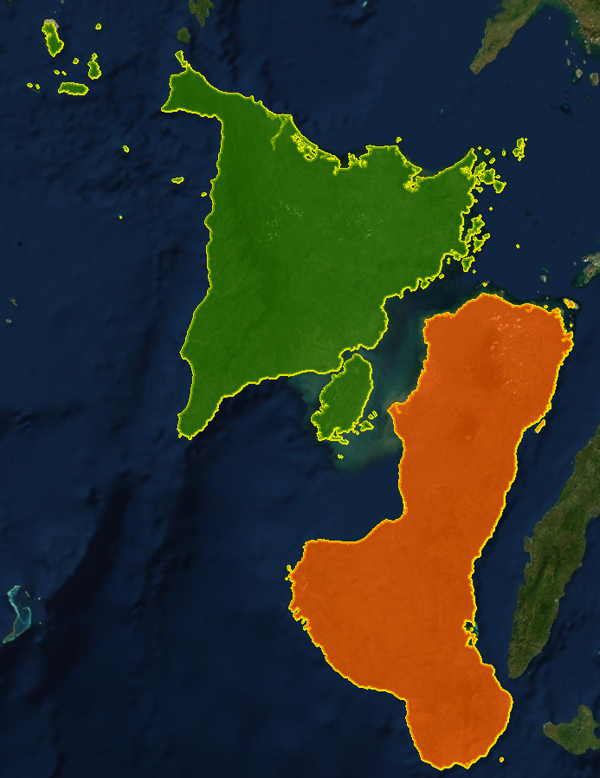
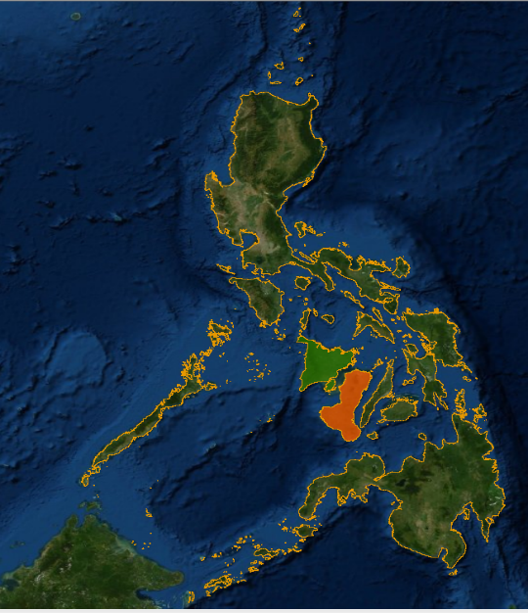
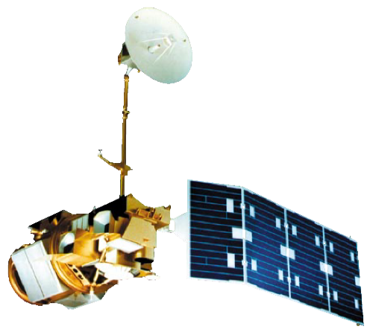
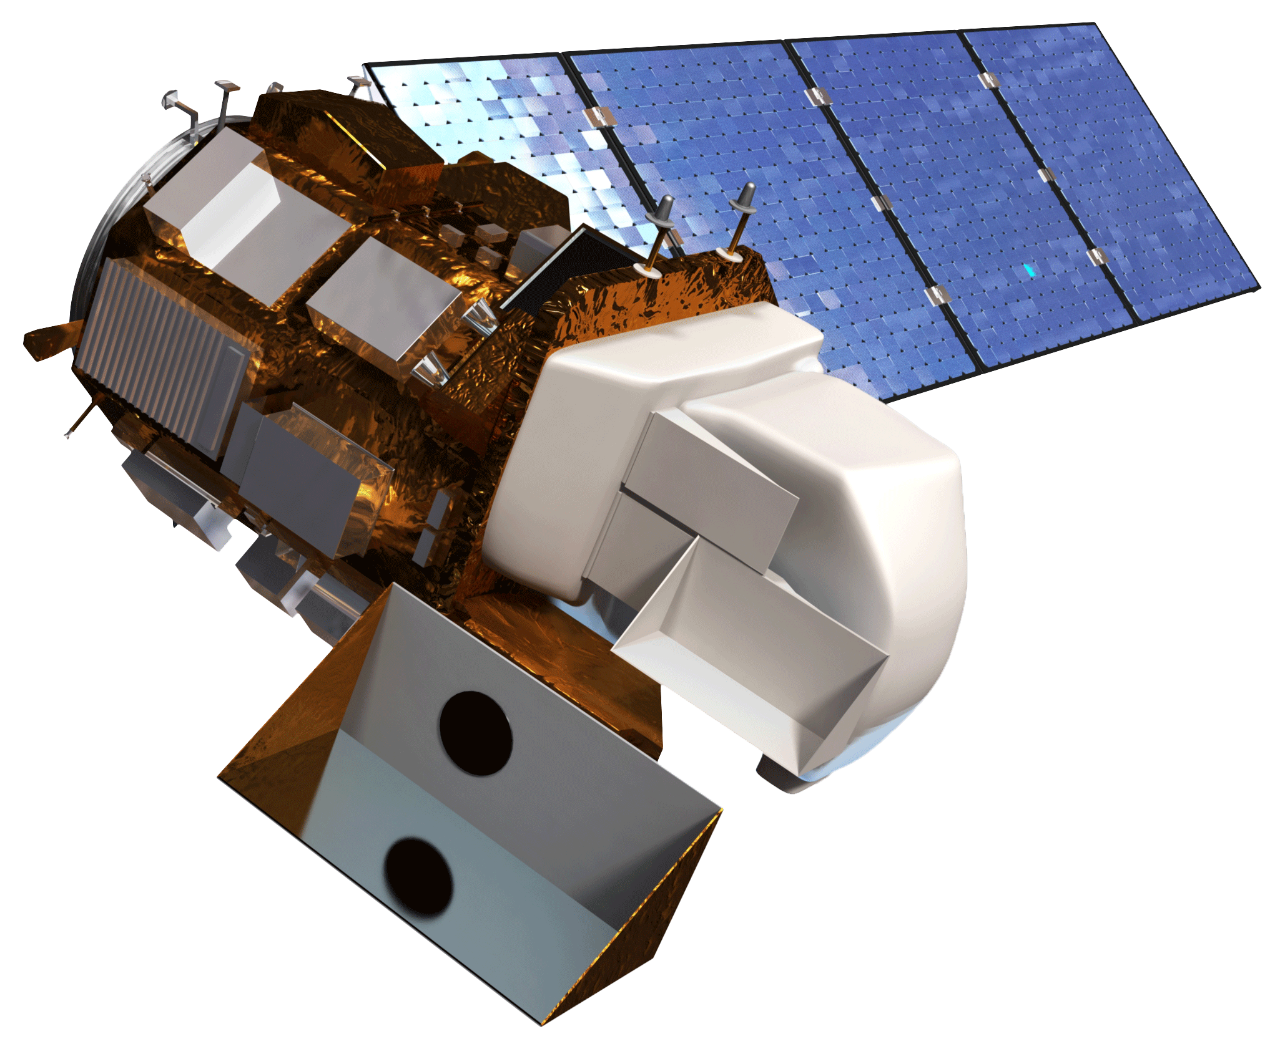
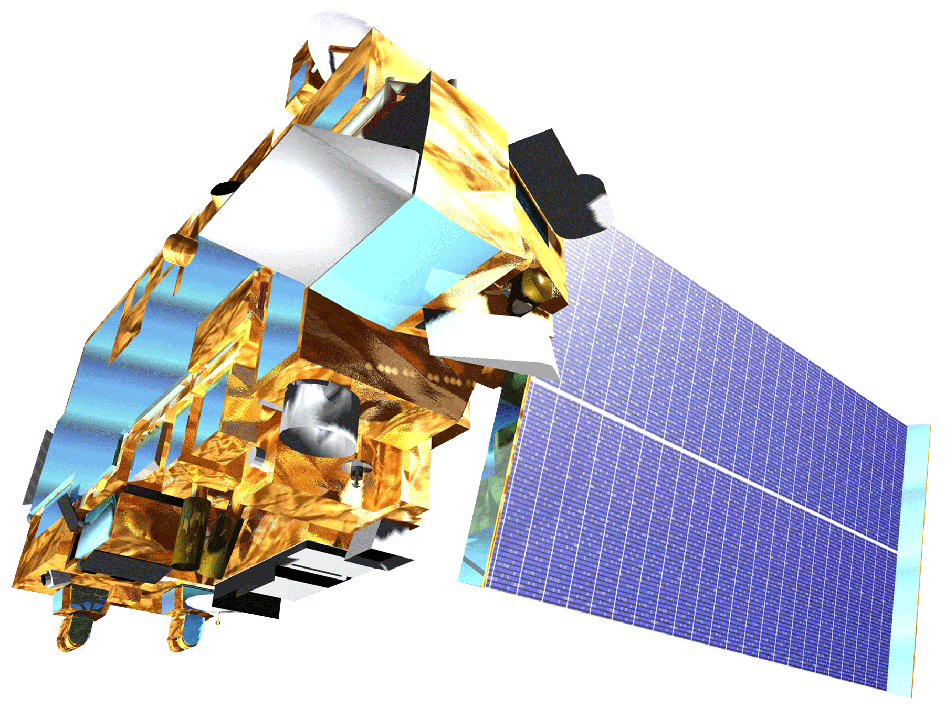
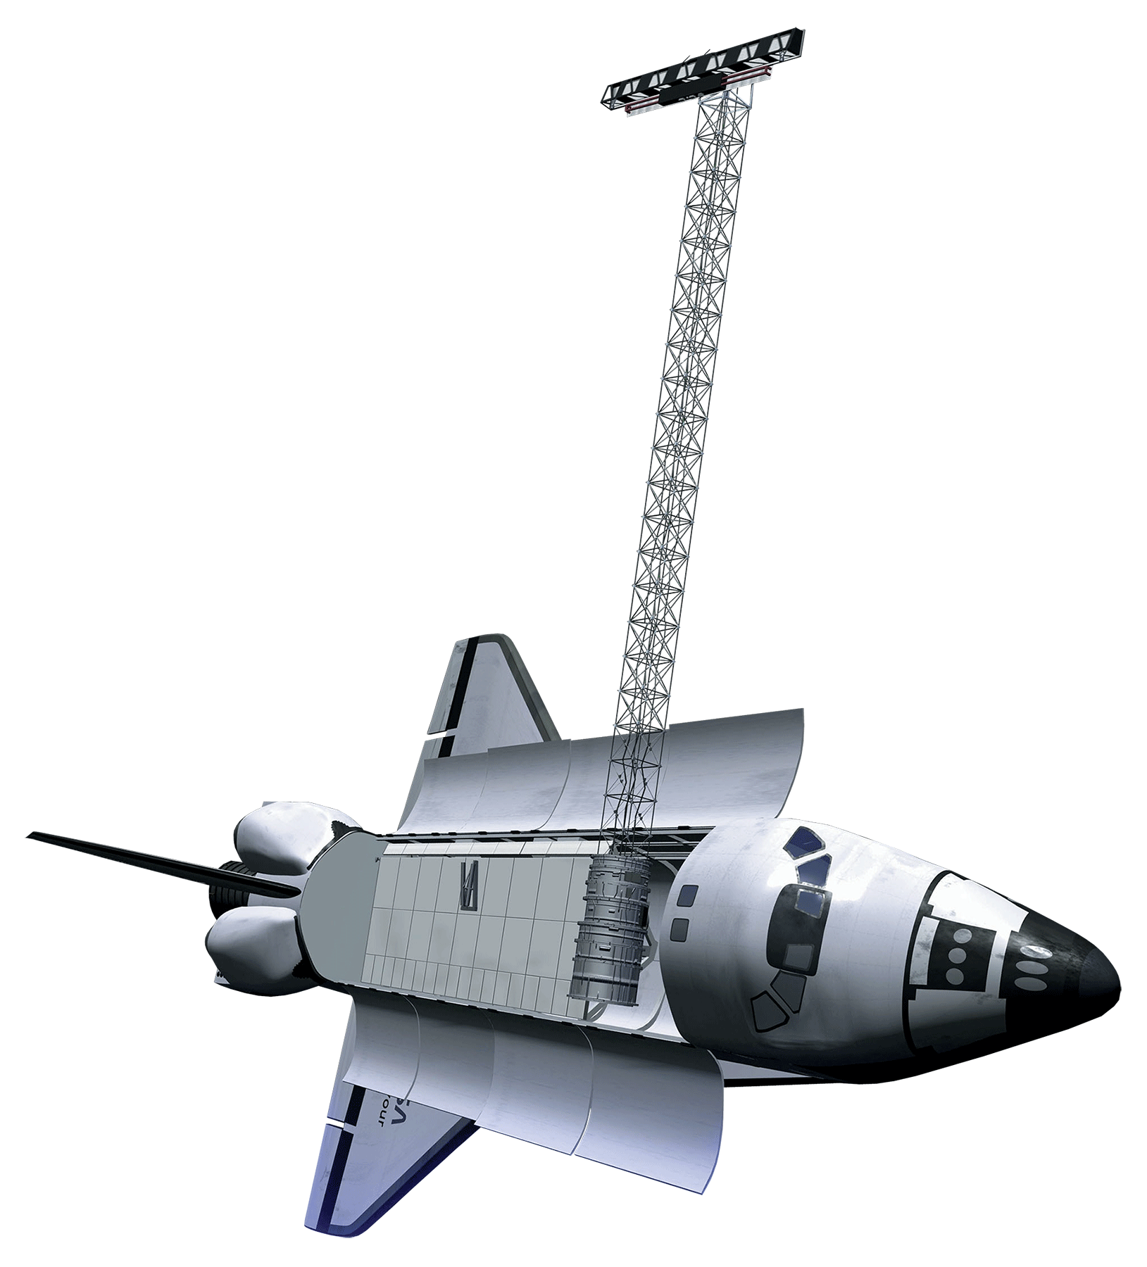
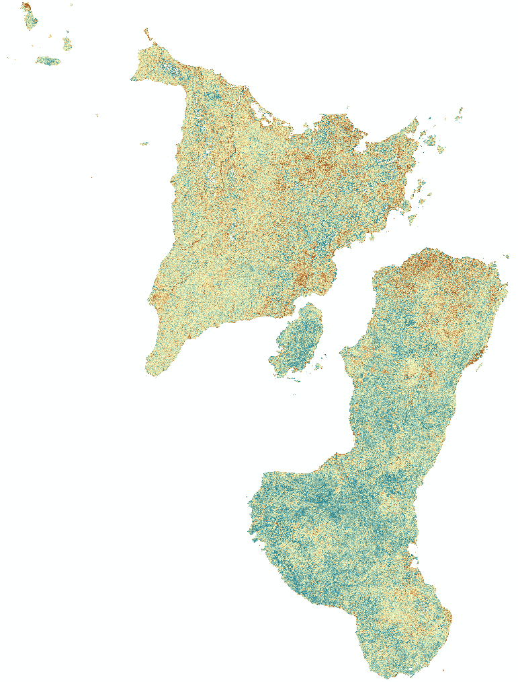
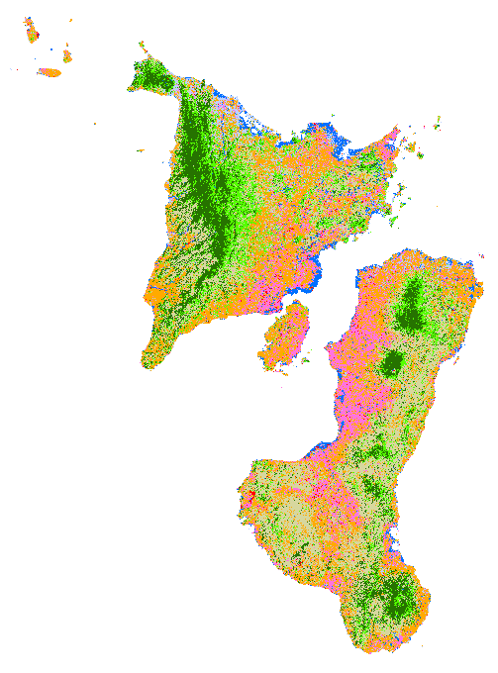
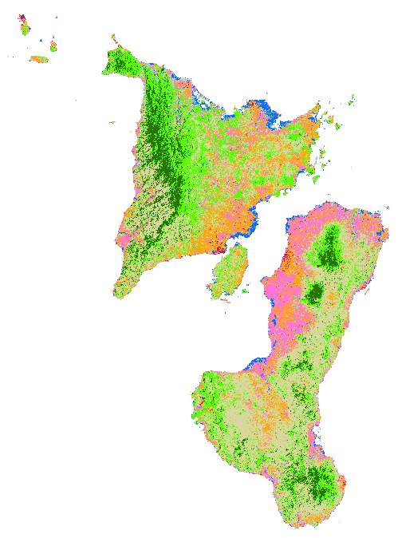
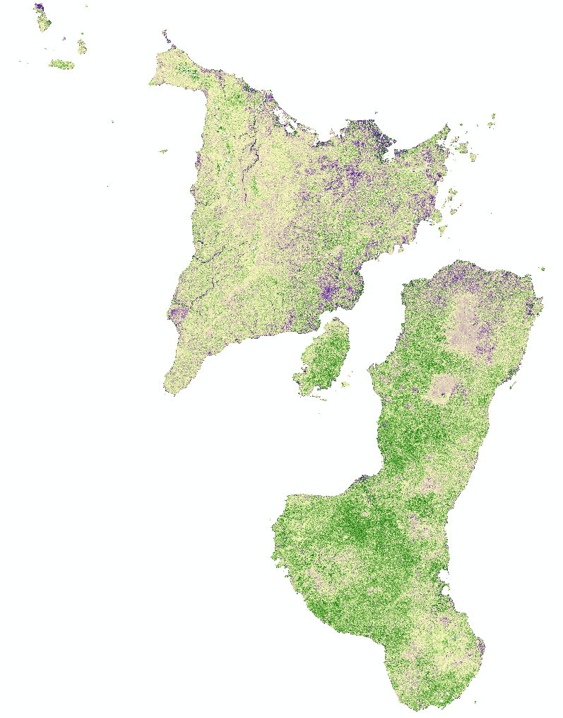
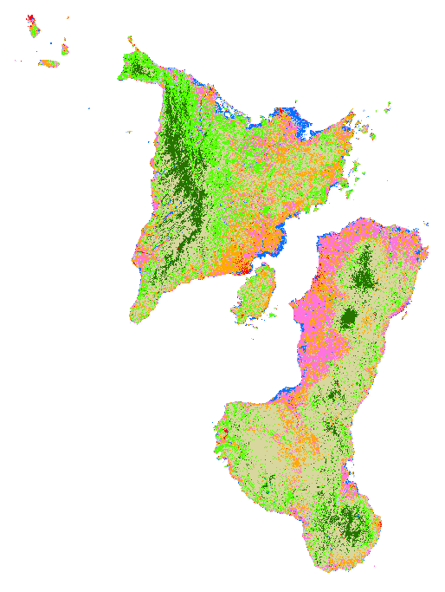
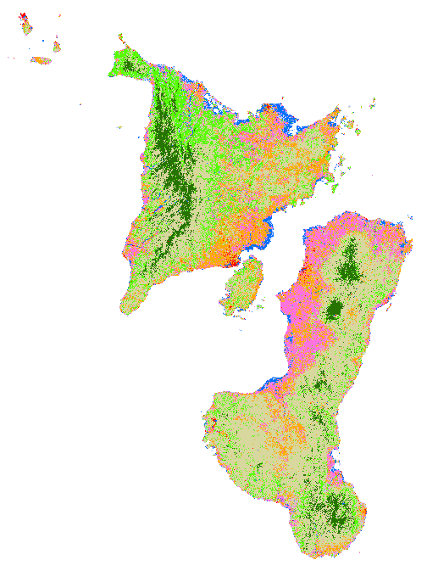
Identifying and Evaluating Changes in Land Use and Land Cover on the Visayan Islands over Time for Reintroduction of the Visayan Warty Pig (Sus cebrifons) and Visayan Spotted Deer (Rusa alfredi)
Abstract
Study Area
Visayan Islands Ecological Forecasting
The islands of Negros and Panay in the Philippines contain the last existing habitat for the critically endangered Visayan spotted deer (Rusa alfredi) and Visayan warty pig (Sus cebifrons). NASA DEVELOP partnered with the Arizona Center for Nature Conservation – Phoenix Zoo, International Union for Conservation of Nature Species Survival Commission, and Talarak Foundation Inc. for this study. The initiative was to analyze and map changes in vegetation health in order to identify potential habitat areas for the reintroduction of the warty pig and spotted deer species to the Visayan Islands. The study utilized Landsat 5 Thematic Mapper (TM), and Landsat 8 Operational Land Imager (OLI), Terra Moderate Resolution Imaging Spectroradiometer (MODIS) and Shuttle Radar Topography Mission (SRTM) Digital Elevation Model (DEM) data acquired from Google Earth Engine (GEE). GEE was used to perform historical Normalized Difference Vegetation Index (NDVI) and Enhanced Vegetation Index (EVI) analysis along with land classifications. RStudio was used for NDVI and EVI forecasting and supervised classification comparison. The team also used TerrSet Land Change Modeler and QGIS MOLUSCE to forecast land use and land cover (LULC) for the years 2030 and 2050. This methodology allowed the team to predict future land cover and potential habitat areas for the reintroduction of the two species. The LULC classification forecasts revealed a potential decrease in primary forests on the islands of Panay and Negros. Favorable habitats were also identified using buffer analysis based on habitat preferences for the Visayan warty pig and spotted deer.
Philippines
N
0
25
50
75
100
km
Negros Island
Panay Island
Visayan Islands
Earth Observations
Landsat 5 TM
Landsat 8 OLI
Terra MODIS
Shuttle Radar Topography Mission (SRTM)
Objectives
Results
Generate 1987 to 2019 NDVI and EVI time series maps to assess the status and trends of vegetation health
Produce LULC classification maps in 10-year intervals from 1987 through 2019 to evaluate the changes over time
Forecast LULC classifications to the years 2030 and 2050 to show the future landscape and habitat status
Provide partners with written materials detailing the application of LULC classification forecasts
Methodology
Urban
Primary Forest
Landsat 5
TM
Landsat 8
OLI
Terra
MODIS
Secondary Forest
EVI Increase
Sugarcane
Rice
Grassland
Mangroves
Cloud
Masking
NDVI and EVI Time Series Charts and Maps from 2000 to 2019
No Change
Fishpond/Water
Cloud Free Surface Reflectance Images
EVI Decrease
LULC classification for 1987 and 2019
1987 to 1989
Composite Image
1995 to 1997
Composite Image
2005 to 2007
Composite Image
2015 to 2017
Composite Image
2017 to 2019
Composite Image
Land use and Land Cover (LULC) Classification Using Random Forest Machine Learning Classifier
Ancillary Data (Gray Level Co-Occurrence Matrix, Vegetation Indices, and SRTM: DEM)
N
1987 to 1989 LULC
Classified Map
1995 to 1997 LULC
Classified Map
2005 to 2007 LULC
Classified Map
2015 to 2017 LULC
Classified Map
2017 to 2019 LULC
Classified Map
NDVI Increase
Accuracy
Assessments
QGIS MOLUSCE and
TerrSet Land Change Modeler
No Change
2030 to 2050 Forecast Maps
NDVI Decrease
Conclusions
0
10
20
30
40
LULC Forecasting for 2030 and 2050
The land use and land cover classifications show that there was a loss of primary forest by about 127,000 hectares, which accounted for a thirty-six percent decrease from 1987 to 2019.
Urban areas increased by 100 percent from 1987 to 2019.
The NDVI and EVI mean values showed a linear increasing trend which suggests a vegetation increase from 2000 to 2019.
The buffer analysis revealed there is approximately 1129 square miles of potentially favorable habitat for the Visayan Warty Pig.
km
EVI and NDVI Change from 1987 to 2019
Project Partners
 Arizona Center for Nature Conservation – Phoenix Zoo
 Talarak Foundation Inc.
 International Union for Conservation of Nature, Species Survival Commission
Team Members
Acknowledgements
The team would like to extend our gratitude to the following people in the NASA DEVELOP Program:
Dr. Marguerite Madden (Science Advisor, University of Georgia)
Dr. Sergio Bernardes (Science Advisor, University of Georgia)
Shelby Ingram (NASA DEVELOP Fellow, Georgia-Athens Node)
Ryan Slapikas
Project Lead
Lusitania Savio
Eze Amadi
Naomi Belle
Georgia – Athens | Fall 2019

