Slide 1
NASA DEVELOP National Program
Project Team Responsibilities:
Deliverables & Data Management Best Practices

Slide 2
Project Team Responsibilities
Set goals and work towards them.
Complete all mandatory deliverables and weekly updates, as well as any optional deliverables the team decides.
Please respect the chain of command within the team - project team members report to Project Leads, who report to Center Leads, who report to NPO. However, don’t feel bogged down by the chain of command - DEVELOP fosters open communication between all levels!
Leave organized documentation of all research and contacts so the project and/or communication with end users may be continued in following terms.
Look at what else needs to be done when you have completed the tasks your Project Lead(s) and Center Lead(s) have assigned. Take initiative!
Have an open mind & learn from each other!

Slide 3
Scientific Integrity
“The iconic success of NASA is planted firmly on three foundational elements: innovation, inspiration, and integrity. While innovation and inspiration are visible through our endeavors and successes, it is our integrity – how we work, and our commitment to excellence and openness – that earns us the trust of the public and ensures our continued ability to inspire and innovate. Integrity is woven throughout the fabric of NASA. It has always been there. And each and every day, we recommit ourselves to keeping it there.”
Dr. Waleed Abdalati
Former NASA
Chief Scientist
NASA SI Policy: http://www.nasa.gov/pdf/611201main_NASA_SI_Policy_12_15_11.pdf

Slide 4
Communication
The Project Lead is the main point of contact to NPO, science advisors and project end users/contacts
Emails
Telephone calls
Meetings
Emails relating to DEVELOP business or to NASA personnel must be approved by your Center Lead or DEVELOP NPO before they are sent outside of DEVELOP
CC your Center Lead when sending all project related emails – this ensures continuity of communication and knowledge after the project ends
Each team has access to a phone. If the phone rings, answer it nicely with something like: “DEVELOP Program, this is <name>. How may I help you?”
Take advantage of - and seek out - opportunities!
Remember, your experience is what YOU make of it!

Slide 5
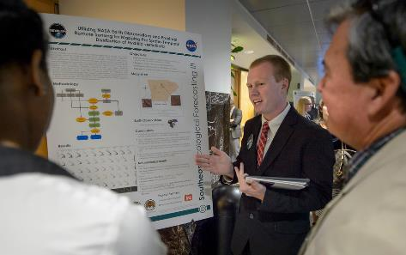
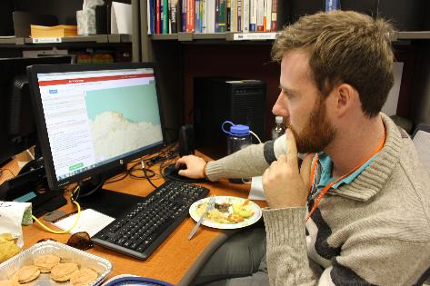
DEVELOP Deliverables
Deliverables are your opportunity to communicate your work.
Each deliverable is an example of your accomplishments. Use them to your advantage!
They provide multiple opportunities to build skills: technical writing, coding, science communication, effective visualizations, video editing, etc.
All deliverables are important and used by DEVELOP in a variety of ways.
Best Practices:
Tackle deliverables incrementally – start them early
Identify a POC within the team for each deliverable
Reuse content from one deliverable for another – while each demonstrates your project in a different method of communication, many have shared core elements
All deliverables must be reviewed by your Center Lead before submitting to NPO
Build in time for Science Advisors to review as well
Always review the deliverable checklist to ensure your deliverables are on point prior to submission to NPO
Questions about deliverables? Email the PC Team @ DEVELOP.ProjectCoordination@gmail.com

Slide 6
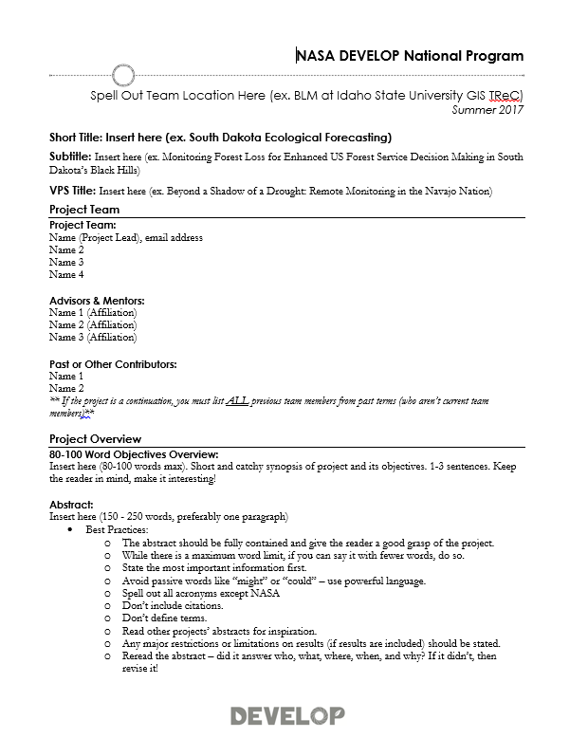
Deliverables: Project Summary
What it is: The Project Summary provides a short overview of project information in one place.
Why it matters:
The content in this document is compiled for reporting to NASA HQ –project indicators and tracking metrics, annual reports, quarterly program reviews, monthly status reports, etc.
Future teams will refer to this document.
In the summer term, the content from this document is what is used to populate the Project Booklet – a summary of the program’s portfolio and used throughout the year.
Project Summaries are commonly shared when project information is requested (ex. Legislative Affairs, Partners, etc.).
How to make it work for you:
This is where the abstract “lives” – you will iterate with NPO in this file. Don’t put the abstract on other deliverables until it’s finalized here.
Use the Project Summary content to fill in the sections of the DEVELOPedia page and poster.
Use this document in the future when you need to share information about the project you worked on.
Project Summary: http://www.devpedia.developexchange.com/dp/index.php?title=Project_Summary

Slide 7
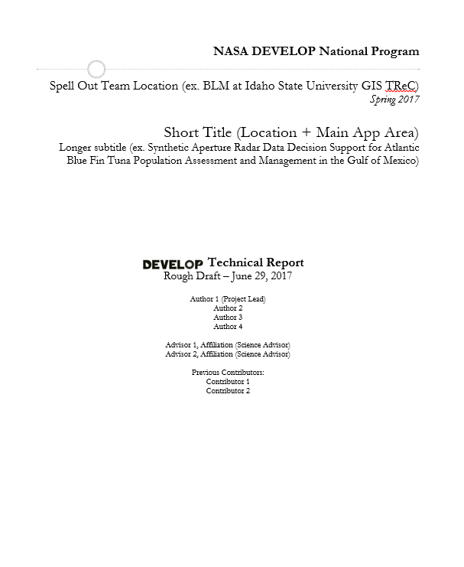
Deliverables: Tech Paper
What it is: The Tech Paper provides a synopsis of the project with technical details for partners and future DEVELOP teams to replicate and understand.
Why it matters:
Tech papers are the foundation for all future publications relating to the project.
Tech papers are commonly shared with project partners.
Methods are a large focus of the paper and should assist others in replicating your work.
How to make it work for you:
Develop your technical writing skills by working on the tech paper.
Use content from the tech paper in the video, poster, and presentation.
When you are applying to jobs and schools – this can be shared as a writing sample.
Important to Know:
Any external distribution or publications of this work must go through NASA Export Control. Just contact NPO and they can confirm it’s been approved.
Tech Paper: http://www.devpedia.developexchange.com/dp/index.php?title=Tech_Paper

Slide 8
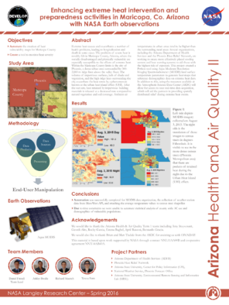
Deliverables: Poster
What it is: the visual demonstration of your project. It should layout the important aspects of your project in an appealing and easy to understand manner.
Why it matters:
All projects are represented at the Summer Showcase at NASA HQ.
Posters are commonly presented at node close out events at the end of the term.
Poster presentations at conferences and recruiting are extremely common within DEVELOP.
This deliverable will be shared with project partners.
How to make it work for you:
Content is often the same/similar to the presentation content – save yourself some time and reuse!
Effectively communicating your project visually can be hard, use the opportunity to create your poster to build your design skills.
Presenting your work at a conference is an excellent opportunity to engage with the scientific community and a strong poster is key.
Important to Know:
All teams will submit a HQ Final Draft. Due to the showcase falling in week 9, this comes in earlier than final results sometimes. A final draft at the end of the term can include more results/outcomes or a team can submit the HQ poster as the final poster draft again.
Interested in presenting your project at a conference? Talk to your Center Lead.
Poster: http://www.devpedia.developexchange.com/dp/index.php?title=Poster

Slide 9
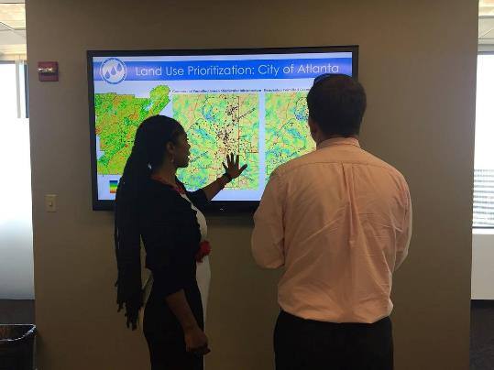
Deliverables: Presentation
What it is: the “story” of your project laid out in a slide by slide progression. It should speak to all aspects of your project.
Why it matters:
Presentation skills are fundamental to effective communication of science.
Presentations are commonly presented at the end-of-term node close out events.
Content from presentations are often repackaged for recruiting presentations, conference presentations.
This deliverable will be shared with project partners.
Presentation content is commonly used in recruiting presentations to inform potential partners and participants about the type of projects we conduct.
Presentations are used to report to NASA HQ in ASP Program Reviews and SMD Monthly Status Reviews.
How to make it work for you:
Presentation skills are critical – having good content to practice those skills helps!
The ability to craft a good PowerPoint presentation is important. Chartsmanship counts!
Content is often the same/similar to the poster content – save yourself some time and reuse!
Presenting your work at a conference, in a classroom, or other events is fun and builds your skills and network.
Important to Know:
Some teams will be selected to present a highlight or flash talk at NASA HQ. Those teams will also submit a HQ FD.
The template's layout is a guide, feel free to amend it to fit your project. A good practice is to have the presentation flow through the following: what was the problem, what did you do about it, and what is/will be the benefit and outcome.
Presentation: http://www.devpedia.developexchange.com/dp/index.php?title=Presentation

Slide 10
Deliverables: Video & Transcript
What it is: the “story” of your project in video. It highlights your project’s purpose to the project partners, scientific community, and the general public.
Why it matters:
It is the most external facing deliverable.
NASA HQ puts a strong emphasis on the power of these videos.
All project videos are hosted on DEVELOP’s YouTube channel. The video archive hosts over 500 project videos from 2011 to the present – it’s an amazing archive!
Many partner organizations will support your video creation by submitting clips and interviews – they then will highlight the video on their websites and social media because it brings attention to their needs.
How to make it work for you:
Video creation skills are a really unique skillset to add to your résumé and science communication tool belt.
You can link to your team’s video on LinkedIn, social media, résumés, job applications, etc.
Important to Know:
This an opportunity for the team to explore their creative sides.
We do have to represent NASA well – so keep it professional!
The transcript is mandatory, as the video must be compliant with Section 508 of the US Rehabilitation Act.
Requirements have changed over the years due to NASA Legal requirements – if you have any questions if something is alright, reach out to the Comm Team @ DEVELOP.Communications@gmail.com first.
Video: http://www.devpedia.developexchange.com/dp/index.php?title=Virtual_Poster_Session

Slide 11
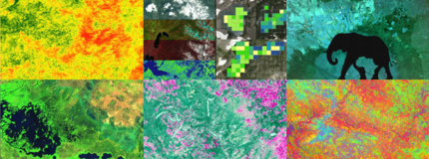
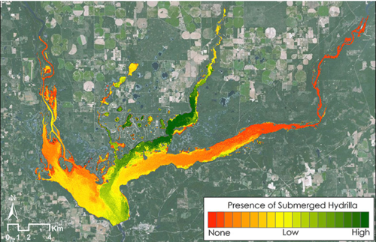
Deliverables: Imagery
What it is: There are two different images the team will submit, each serves a unique purpose and will be used for external communication.
Website Image: Used for the DEVELOP website project page gallery, summer booklet, and ASP website project portfolio. Week 6!
Technical Image: Also used on the DEVELOP website project page, and the interactive web mapper. Week 10.
Why it matters:
These images are used for website project pages, summer booklet, video thumbnails, and the ASP website.
How to make it work for you:
The ability to make effective visualizations of your work can increase the resonance of your project and attract viewers.
Important to Know:
The website/booklet image should not have any text on the image as it will be viewed at multiple scales and it would be distorted. You CAN submit a separate legend to be used in the booklet, just make sure to use proper file nomenclature.
The website/booklet image comes in very early in the term due to the fact NPO needs time to build web pages and design and print the summer booklet before the summer showcase in week 9!
The technical image can have legends and text, but be sparing and make sure it’s effective!
6 Website Image Examples
Technical Image Example
Imagery: http://www.devpedia.developexchange.com/dp/index.php?title=Website_and_Technical_Imagery

Slide 12
Deliverables: Study Area Shapefile
What it is: The shapefile outlines the study area and is used for the creation of impact maps and congressional district maps.
Why it matters:
This deliverable allows us to show how our program benefits the taxpayer, giving insight into where we are increasing workforce development and building capacity to use NASA Earth observations.
Maps will be used by NASA's Applied Sciences when reporting to members of Congress, and it is thus extremely important that these maps accurately reflect the extent of our projects’ impact.
This shapefile is used in the creation of impact maps and the new interactive web mapper to discern project study areas.
How to make it work for you:
The ability to package shapefiles and share is helpful and you can reuse this shapefile in the future.
Important to Know:
Your shapefile must match the study area listed on your project summary.
Create a polygon shapefile of your study area, containing only one feature.
Attribute table should contain a “project” field where your project short title is listed.
The shapefile must be zipped and saved using standard file nomenclature.
Coordinate system: GCS_WGS_1984
If through the course of the project, your study area changes to include additional states/countries not originally listed, ALL deliverables must be updated to reflect that change (even after a FD has been submitted).
Study Area Shapefile: http://www.devpedia.developexchange.com/dp/index.php?title=Study_Area_Shapefile

Slide 13
Deliverables: DEVELOPedia Project Page
What it is: Each project has a page on DEVELOPedia that is accessible to future DEVELOPers.
Why it matters:
DEVELOPedia serves as the most complete project archive available – this is a resource to everyone in the program.
How to make it work for you:
You can refer back to this page at anytime as DEVELOPers get to keep their accounts for eternity.
After a final NPO review, a final, archival set of deliverables are posted and you can access as needed.
DEVELOP Website Project Pages
Project pages are posted near the end of term on the NASA DEVELOP website. Feature your experiences and project pages on LinkedIn.

Slide 14
Deliverables: Feedback Form
What it is: The newest deliverable is in response to NASA Headquarter’s request that we increase our collection and reporting of feedback relating to three things: 1) NASA Earth observation data (accessibility, processing, and use), 2) research questions surfaced by application projects (what do the feasibility study results lead our partners to pursue next), and 3) partner engagement. Headquarters is also collecting information relating to answering the question “what is your success rate?” driving DEVELOP to increase its reflection on and assessment of projects and resources expended. With this in mind, DEVELOP has created a simple template that collects information regarding the above topics, along with team and advising relating to each project.
Why it matters:
Headquarters is looking for the wealth of knowledge rapidly gained in DEVELOP projects to feed into Science Teams
How to make it work for you:
Team discussion relating to the challenges and data use is a great exercise for the team to pursue. Follow up with project partners is also an important facet to the relationships built.
Important to Know:
This is the newest deliverable and we are looking for guidance on additional instructions we can provide.

Slide 15
Deliverables: Optional Deliverables
What they are: Your team may have extra time or decide that the creation of an optional deliverable will be of high-value. In this event, your team can utilize the resources and templates provided below to help create an excellent deliverable. Examples of optional deliverables are tutorials, one-pager/brochure, or image gallery, but really this is anything additional the team creates as part of a package for the partners.
Why it matters:
Often project partners can benefit most from a tutorial or additional materials that highlight the project’s methodology.
How to make it work for you:
Brochures can be used at conferences to hand out at poster presentations or given to partners to increase awareness of the project.
Tutorials can be referenced later on and you can submit as sample work when applying for a job or to graduate school.
Important to Know:
Before diving into this head-first, make sure the optional deliverables will not decrease the quality or timeliness of required deliverables.
Participants are paid by the submission of required deliverables and optional deliverables are completely optional. However, they can be extremely useful for your team, the end-user or boundary org, and for the community, so it’s generally a good idea to discuss this possibility earlier in the term.
Optional Deliverables: http://www.devpedia.developexchange.com/dp/index.php?title=Optional_Deliverables

Slide 16
Deliverables: Code
What it is: Teams are expected to turn in code that they developed for their projects. This can be any code that was used to help the project, such as batch processing imagery or converting files to a different format. Code is collected at the end of the term and will be put into a repository shared only among DEVELOP.
Why it matters:
Code can increase efficiency and speed up processing.
Many projects follow similar processing and analysis steps and can benefit from each others code.
How to make it work for you:
Code created at DEVELOP can be used in future work, although if it would be shared outside NASA and beyond your personal use, it must go through the software release process
Important to Know:
This deliverable applies to all code – code going through software release & internal code
Code that will shared externally must go through the software release process
Final code with README is submitted in week 10
Code with README: http://www.devpedia.developexchange.com/dp/index.php?title=Code_with_README

Slide 17
Deliverable Submission
Email
Amanda.L.Clayton@nasa.gov
DEVELOP.ProjectCoordination@gmail.com
Over 15MB and too large for email? Send through NASA LFT or Google Drive
NASA LFT
File Nomenclature
YearTerm_Node_Team_Deliverable_Draft
Ex. 2018Spring_GA_EasternIndiaEcoII_Poster_FD
Node Acronyms:
AL, ARC, AZ, CO, GA, GSFC, ID, JPL, LaRC, MA, MSFC, NC, VA
App Area Shorthand:
Ag, CC, Disasters, Eco, Energy, HealthAQ, TI, Urban, Water

Slide 18
Deliverables Deadlines to NPO
Week 1 – 6/7: Handbook Forms, Info Sheet, Personality Assessment, Entrance Personal Growth Assessment, DEVELOPedia Participant Page, Orientation Completed
Week 2 – No deliverables! (savor it)
Week 3 – 6/21: Project Summary RD
Week 4 – 6/28: Tech Paper RD, Video Outline
Week 5 – 7/5: Poster RD, Presentation RD, Software Release Definition Document (if applicable)
Week 6 – 7/12: Project Summary FD, Study Area Shapefiles, Website/Booklet Image, HQ Highlight & Flash Talk RD (if applicable)
Week 7 – 7/19: Poster FD, Project Video & Transcript, Software Release Master Document (if applicable)
Week 8 – 7/26: Software Release Draft Code (if applicable), HQ Highlight & Flash Talk FD (if applicable)
Week 9 – 8/2: Presentation FD, DEVELOPedia Project Page
Week 10 – 8/7: Exit PGA; 8/9: Tech Paper FD, Feedback Form, Technical Image, Archival Drafts of Poster & Presentation; 8/10: Exit Survey, Optional Deliverables, Software Release Code w/README (if applicable)
Note: Center Leads set a schedule for deliverables to be submitted to them for a first review prior to submission to NPO

Slide 19
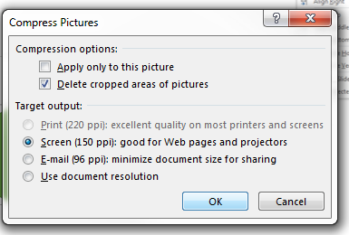
Deliverable Best Tips
Converting from Google Drive to Microsoft – this conversion always messes up the template, so instead of converting the file you should copy and paste your content into the Word/PPT template.
Citations – you should also include related remote sensing studies.
If you are a continuation project, you need to write all new content, not copy from the previous term.
Check the Style Guide – many other best tips and common mistakes are included here. Read it! Know it!
Use the Align Tool – it is your best friend when creating presentations and posters
Put effort into writing the conclusions for your poster!
For your PowerPoint Presentation - when using a lot of imagery, the file size will grow excessively – use the “Compress Pictures” tool in PowerPoint to delete cropped areas of pictures. Target output should be Print (220 ppi) or Screen (150 ppi).
Note: Do not compress pictures on your Poster smaller than Print 220ppi – when printing a gigantic poster we need the highest resolution! Use “Use document resolution” to keep resolution.

Slide 20
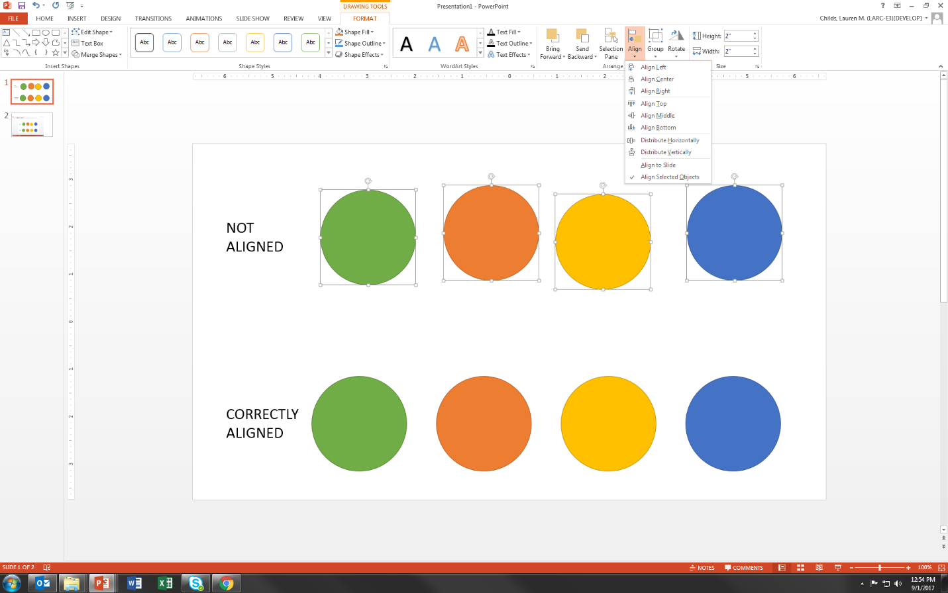
PowerPoint’s Align Tool: Know it, Use it
#2. Select which alignment you need. In this case you could use Align Top and Align Horizontally
#1. Highlight the items that need to be aligned

Slide 21
Writing Effective Poster Conclusions
Effective poster conclusions should be designed around two or three key findings that relate to the accompanying results and encourage dialog with poster viewers.
Take into consideration your results – what do they tell you and why does it matter?
Conclusions should include an analysis and interpretation of the results, including why they are important
Conclusions should not just be a statement of what was done
Strong conclusion examples:
“Preliminary historical analysis shows hotspots of both positive and negative NDVI change throughout Maryland’s Chesapeake Bay. Blackwater National Wildlife Refuge, one of the largest contiguous blocks of salt marsh along the Northeast Atlantic Coast, has experienced dramatic loss in vegetation over the study period.”
“Maryland’s marshes are trending towards degradation and, if all contributing factors persist, will continue to degrade over time.”
“Despite conservation efforts, the current extent of dense mangrove in Bhitarkanika Wildlife Sanctuary is projected to decrease up to 10% by the year 2050.”
Weak conclusion examples:
“Harmonic analysis was used to determine the seasonal trends in each agricultural zone.”
“An interactive map of environmental and socio-economic layers was generated to dynamically query and visualize weekly data.”

Slide 22
Why Use Best Practices?
Image Source: J. Cham. (2014, March 12). Comic number 1869. Piled Higher and Deeper . Retrieved from http://phdcomics.com/comics/archive_print.php?comicid=1689

Slide 23
Why Do Best Practices Matter to DEVELOP?
Terms are only ten weeks long. Good data management practices allows center leads or second term teams to answer questions about methods and results.
DEVELOP may present your past project at a conference. Good data management practices allows presenters to create graphics and slides and to answer questions.
Teams often want to publish. Good data management practices are necessary for teams to write a materials and methods section.
Future DEVELOP project teams may want to build on your data and methods.
Best practices enhance the likelihood that your work will be reproducible.

Slide 24
Reasons We Don’t Always Use Best Practices
We haven’t learned best practices.
We are in a hurry. Projects are just ten weeks long.
We want to provide our partners with results.
We document our work at the end of the term when we may leave out important steps.
We only document what worked. But, science is also about what doesn’t work.

Slide 25
What is Data Management?
"Data management is the development, execution and supervision of plans, policies, programs and practices that control, protect, deliver and enhance the value of data and information assets.“
Answers the questions:
Where did the original data come from?
What was done to the data?
Can I find the data again if needed?
Data should be well and consistently organized
Directory (folder) Structure
File Nomenclature
Analysis–Friendly Data
Documentation
Notes:
Image source: https://pixabay.com/en/combine-research-data-information-229114/

Slide 26
Tip 1: Organize Data Using a Directory Structure
Segregate materials for a project into one directory
Folders: data, methods, results, deliverables
Keep Raw Data Separate
Include README files
README files describe the contents of a folder, list the files in that folder, and provide metadata. They can be very useful in helping a new user navigate your directory.
This organizational approach applies equally to PCs, portable drives, or Google Drives

Slide 27
Directory Structure Example

Slide 28
Tip 2: Standardize File Nomenclature
File names should be:
Machine Readable:
Do not include special characters (%, $, &, etc.)
Use underscores instead of spaces
Example: 20171107_average_ndvi_by_census_tract.csv
Human Readable:
File names should briefly, but adequately, describe the contents of the file
It can be useful to note the version of the file by adding v1, v2 etc. in the file name
Bad Example: landcover_test2.tif
Good Example: 2016_Phoenix_landcover_v2.tif
If you are testing a process it’s easy to accumulate many different files that are essentially the same thing. Using a marker like “v2” can be helpful. However, once you figured out the correct process and produced the final version of file consider removing the “v2” tag and previous versions of the data.

Slide 29
File Nomenclature
File names should:
Work Well with Default Ordering
Example: Folder with daily land surface temperature files. Name the files so that they default in chronological order
Maintain Consistent Nomenclature
Use Open File Formats
CSV not XLSX

Slide 30
Tip 3: Data Should be Analysis-Friendly
Data Tables can be either Wide or Long formats.
Each row is a unique observation
Each column is variable
DO NOT combine multiple variables in one column
A common exception: Date. It’s common to have multiple columns for Day, Month, Year or a Date column with consistent date information (i.e. Year-month-day: 1999-06-01
Census_TractID | Date | Year | Month | Metric | Value
51043 | 2012-06 | 2012 | 6 | Avg_LST | 38.20
51043 | 2012-06 | 2012 | 6 | Avg_NDVI | -0.16928
51043 | 2012-07 | 2012 | 7 | Avg_LST | 36.84
51043 | 2012-07 | 2012 | 7 | Avg_NDVI | 0.359118
51043 | 2012-09 | 2012 | 9 | Avg_LST | 33.65
51043 | 2012-09 | 2012 | 9 | Avg_NDVI | 0.693757
51045 | 2012-06 | 2012 | 6 | Avg_LST | 37.03
51045 | 2012-06 | 2012 | 6 | Avg_NDVI | 0.619561
51045 | 2012-07 | 2012 | 7 | Avg_LST | 44.04
51045 | 2012-07 | 2012 | 7 | Avg_NDVI | -0.93069
51045 | 2012-09 | 2012 | 9 | Avg_LST | 37.58
51045 | 2012-09 | 2012 | 9 | Avg_NDVI | 0.974952
Census_TractID | Date | Year | Month | Avg_LST | Avg_NDVI
51043 | 2012-06 | 2012 | 6 | 38.20 | -0.16928
51043 | 2012-07 | 2012 | 7 | 36.84 | 0.359118
51043 | 2012-09 | 2012 | 9 | 33.65 | 0.693757
51045 | 2012-06 | 2012 | 6 | 37.03 | 0.619561
51045 | 2012-07 | 2012 | 7 | 44.04 | -0.93069
51045 | 2012-09 | 2012 | 9 | 37.58 | 0.974952
Wide
Long

Slide 31
Tip 4: Document your Data
Will it be possible for the reader of your tech paper to find the exact data used by your team?
Document the source of your data.
Keep a copy of all data used for analysis, results, images and tables.
Don’t just store the data on a drive. Add a document explaining what the data is, where it was obtained, and how it was used.
Document why you chose your data. Be specific.
Instead of “We used the least cloudy scene for each year in the study period”, try “We used the least cloudy scene for each year in the study period (Table A).”
Document any processing and/or modification of your data.
This includes clipping, reprojecting, cloud removal, etc.
DOCUMENT EVERYTHING! Documentation is the key to scientific reproducibility.
More info https://gigascience.biomedcentral.com/articles/10.1186/s13742-016-0135-4

Slide 32
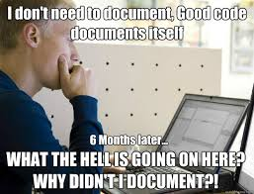
Tip 5: Document your Code
Computational reproducibility is the ability to exactly reproduce results given the same data. This is why DEVELOP requires comments on code for software release.
Best Practices for Comment Code
Leave your self notes as you are working on your code.
Example. ## Code below extracts files from the hdf. Running into an issue at line 43. Start there tomorrow.
Remove personal notes and clean up your comments once your code is finalized.
A reader should understand exactly what your code does, even if they aren’t familiar with your coding language. Every step should be explained.
Suggestion: Have another team read your code.
Things to consider:
Is your code well-commented?
Is your code stored in a way that it is available to future teams? https://github.com/NASA-DEVELOP or local node repository
Have you indicated your operating system(s), software dependencies, and the analytical software (and versions) that were used?
Did you use any unusual computer configurations or non-default parameters?
Is your data documented?
Need help? Contact Geoinformatics at DEVELOP.Geoinformatics@gmail.com

Slide 33
Tip 5: Document Your Methods
Documentation is vital in ensuring your work can be reproduced.
Document your decisions.
Why did you choose your methods? Are there better methods?
Keep a list of all equations or formulas.
Keep track of both failures and successes.
Document exact steps of final methods.
Example: Once you’ve figured out land cover classification in ENVI write down the exact steps and tools you used to complete the classification.
Think of this as a tutorial. Someone should be able to replicate your methods with this document. This can be an optional deliverable for your partner.
Teams can keep shared notes on Google Drive.
This will become the “Methods” section of the tech paper.

Slide 34
Overview
Tip 1: Organize Data Using a Directory Structure
Tip 2: Standardize File Nomenclature
Tip 3: Data Should be Analysis-Friendly
Tip 4: Document your Data
Tip 5: Document your Code
Tip 5: Document Your Methods
None of these processes are something you do once. It’s a continuous effort that should be discussed with your team multiple times during the term.
Project Success === Project Reproducibility

Slide 35
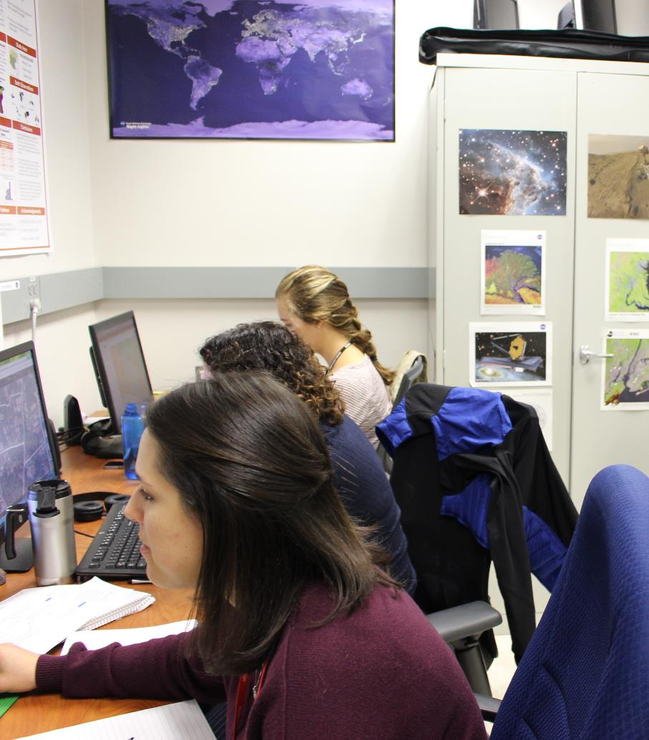
Thank You!
Each DEVELOP team and what they create is unique.
What’s special about your project and team members?
What will you create that is most useful to your partners?

