Slide 1
Lake Victoria Water Resources II
Developing an Automated, Near Real-Time System to Monitor Eichhornia Crassipes over the Winam Gulf in Lake Victoria
Jeanné le Roux (Project Lead)
Dwight Tigner
Daryl Ann Winstead
Christina Fischer
Sara Amirazodi

Slide 2
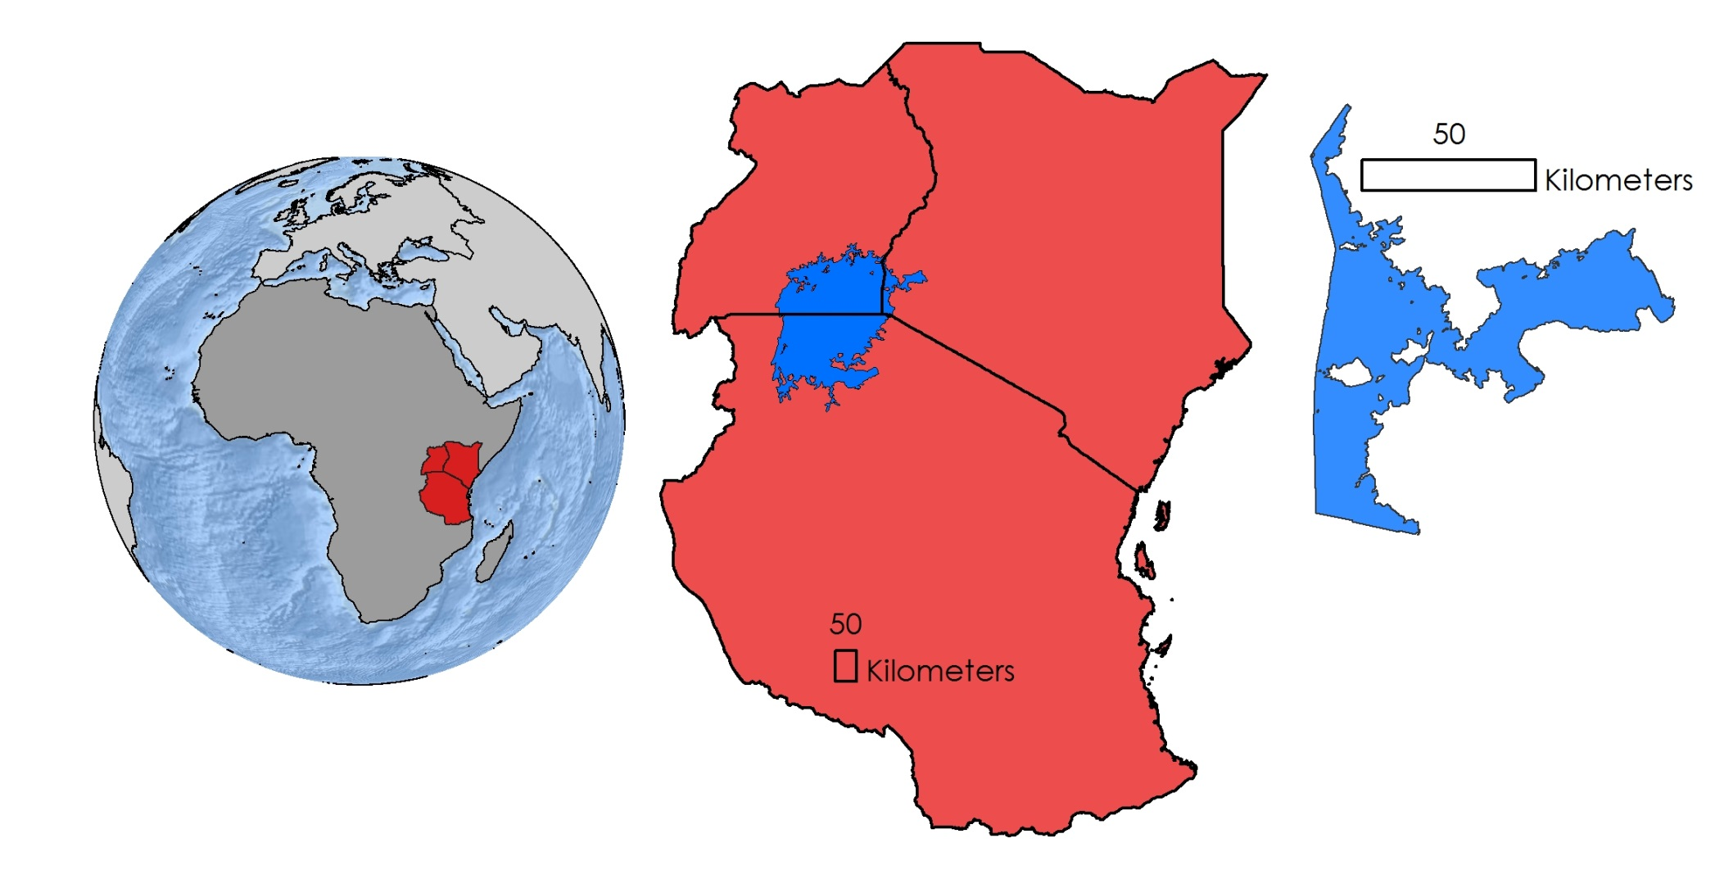
Study Area & Study Period
Winam Gulf, Lake Victoria
January 2013 to February 2016
Uganda
Kenya
Lake
Victoria
Tanzania
Winam Gulf,
Kenya
Notes:
This study focused on the Winam Gulf, which is located in the Kenyan portion of Lake Victoria in Africa.
Our project partners have identified this as a region of focus for the study of the invasive water hyacinth. The gulf’s isolated nature and close proximity to highly populated cities has degraded the water quality over time which has fueled outbreaks of algae and water hyacinth.

Slide 3
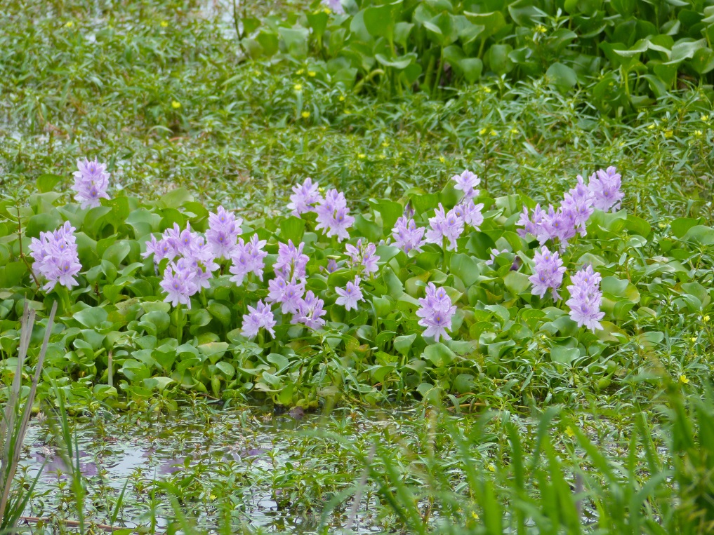
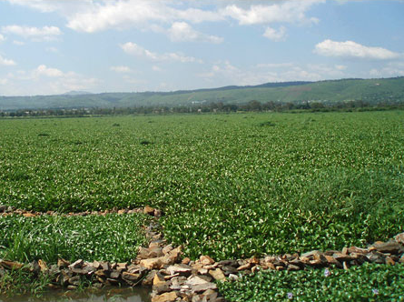
What is Water Hyacinth?
Scientific name: Eichhornia crassipes
Free-floating aquatic plant
Fast-growing and dense with prominent roots
Can double area within 2 weeks
Dead zones
Removal efforts unsuccessful
Image Credit: Bernard DUPONT
Image Credit: NASA
Notes:
-Water hyacinth is one of the worst aquatic weeds in the world.
-As much as 50% of a single water hyacinth can be roots, which are fibrous and can range from 10-300 cm in length.
-Hyacinths grow rapidly in nutrient rich water, and can withstand extremes of nutrient supply, pH level, temperature, and even grow in toxic water.
-Water hyacinth grows best in still or slow moving water, making isolated areas such as inlets and bays prone to outbreaks.
-Thick mats crowd the lake, block sunlight and oxygen from reaching the lake’s aquatic life, and reduce the lake’s biodiversity.
-Efforts have been made to fix the problem: Weevils that eat hyacinths were released, which helped manage growth for a little while.
-People have developed ways to harvest water hyacinth for making paper, cattle feed, and briquettes for cook stoves.
-The bottom right image of Winam Gulf shows the hyacinth’s reappearance in 2006.
Image Credit: https://upload.wikimedia.org/wikipedia/commons/7/77/Lake_Victoria_Hyacinth.jpg
Image Credit: https://upload.wikimedia.org/wikipedia/commons/1/11/Water_Hyacinths_%28Eichhornia_crassipes%29_%2813739218794%29.jpg

Slide 4
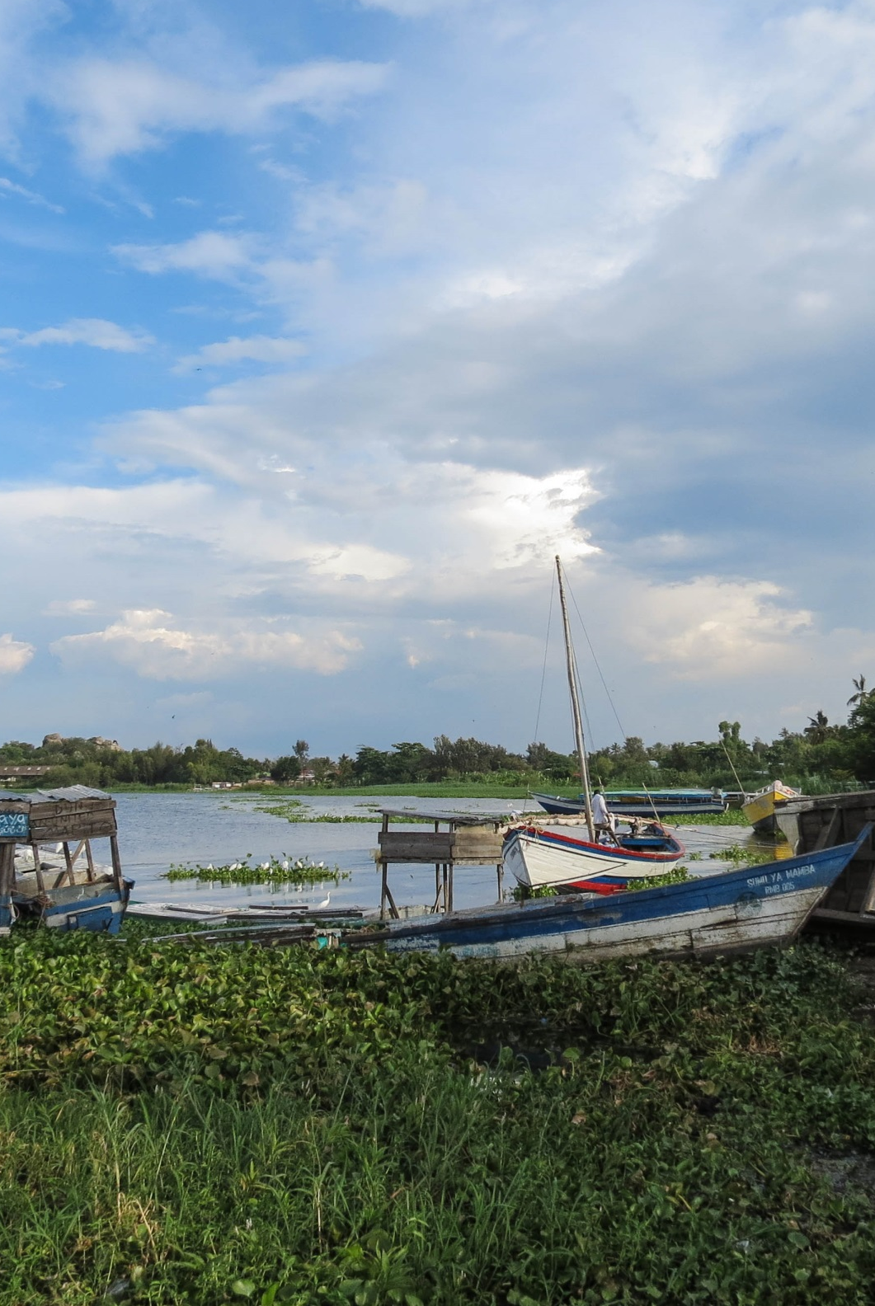
Community Concerns
Degradation of water quality
Restricted access to water extraction and boating
Decreased oxygen and nutrient levels
Vector for disease carrying snails
Image Credit: Ronald Woan
Notes:
Eutrophication due to runoff causes water hyacinth to spread rapidly and results in the degradation of water quality in Lake Victoria, which in turn directly affects everyday water usage.
Water hyacinth growth restricts access to boating docks used for transportation, water extractors for clean drinking water and irrigation use, and fishing, which the locals depend on daily.
Due to its nature of growth, water hyacinth blocks sunlight from the water column resulting in decreased oxygen and nutrient levels, which negatively affect biodiversity throughout the lake.
Schistosomiasis is a devastating tropical parasitic disease. The infectious form of the parasite is secreted by snails living in fresh water, resulting in contamination. Water hyacinth serves as a breeding ground for these snails as it provides physical attachment surfaces, shade, reduced temperature fluctuations, and food for snails carrying the parasite. Water hyacinth has a tendency to flourish in shallower waters near the lake shore, significantly increasing the human population exposure and infection risk of schistosomiasis due to activities such as boat launching and fishing. As a result, schistosomiasis poses a severe threat to populations living near water hyacinth infested waters.
Image Credit: https://www.flickr.com/photos/rwoan/8237176439/in/photolist-dxTFzr-oCdDW2-RxuFC-4uCqco-4MXBPm-dxTGfr-cXN3Wo-4tWwJf-dxYWDN-dxYX3A-867mJZ-86aw9u-4xZMYB-4tWvKA-fjEFq1-86avou-4tWyAA-4tSvuM-dxZccd-9UgPn3-fAdui8-4tSv2K-bAi9Gv-8jdY4Z-2iaYc-oCbXMC-dxZbxd-4tStJt-dxYYQo-dxTJKD-dxTKci-6zbJr2-4xecB-P4TdH-99Wqqa-cAkreq-dNH1Ar-dxTGGe-dxZd7L-4tSvVP-8jdYUD-4tSygn-9fXKcU-oUFtZ3-dxZ7Uf-oCdYP3-4tWpns-4zAQ4h-4tSmKH-4tSo7Z

Slide 5

Project Partners
NASA SERVIR Coordination Office at MSFC
NASA SERVIR-Eastern and Southern Africa Hub
Regional Centre for Mapping of Resources for Development (RCMRD)
Makerere University Department of Geomatics and Land Management
Image Credit: NASA
Notes:
We partnered with the SERVIR Coordination Office at MSFC, the NASA SERVIR-Eastern and Southern Africa Hub, the Regional Centre for Mapping of Resources for Development (RCMRD), and the Makerere University Department of Geomatics and Land Management for this project to assist with their current practices.
*Note: We plan on updating this image to better reflect our project partner locations, and are only using this image as a placeholder
Image source: http://www.nasa.gov/mission_pages/servir/overview.html

Slide 6
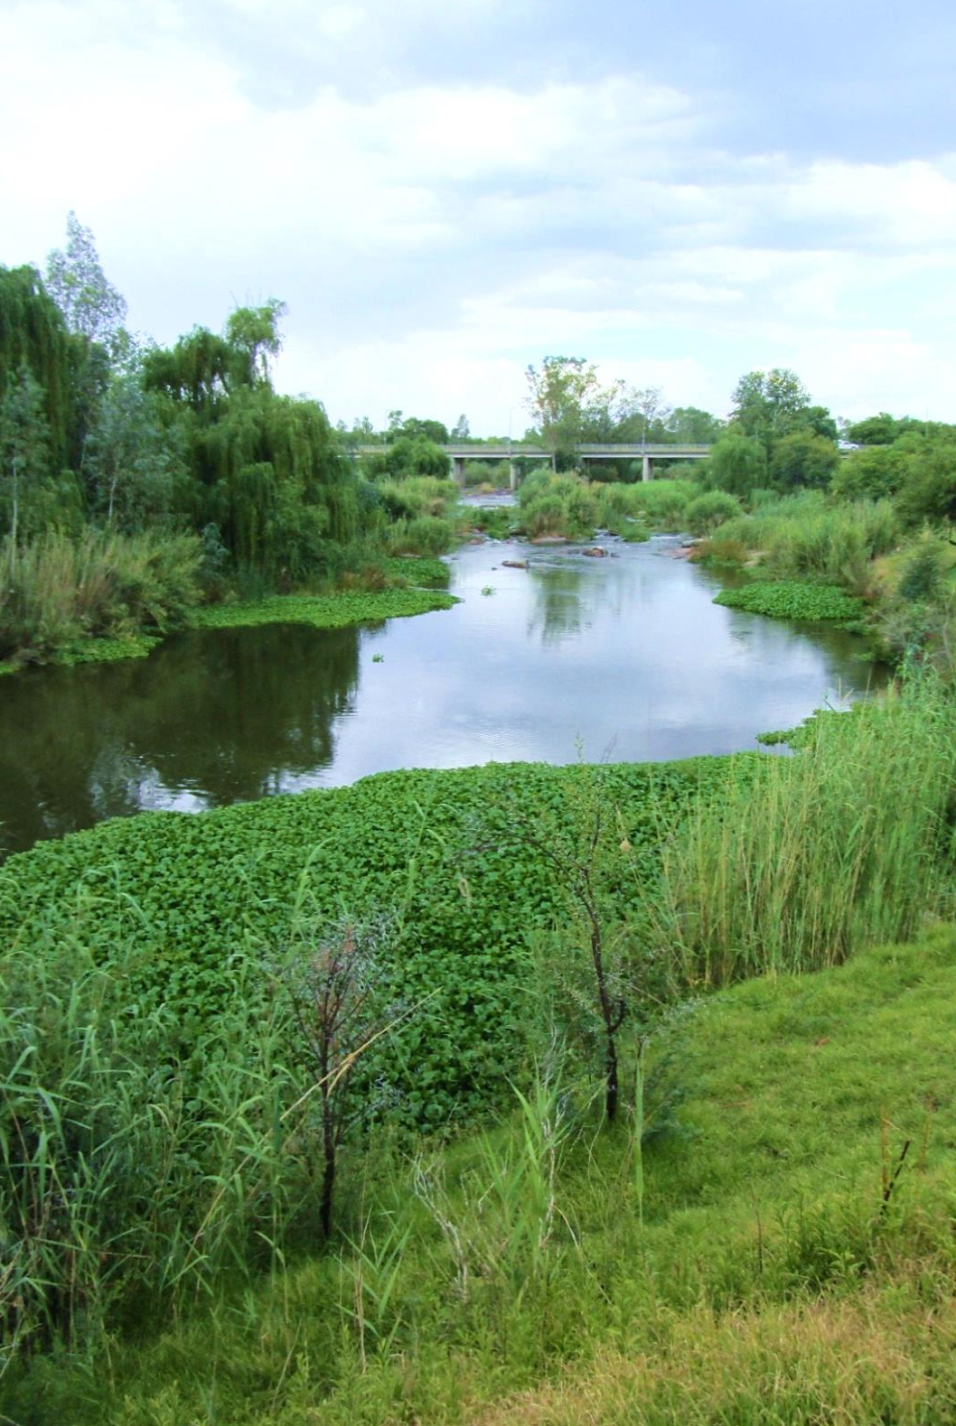
Objectives
Develop Surface Aquatic Vegetation Detection Tool (SAVDT)
Implement Sentinel-2 data
Accuracy assessment on data from SAVDT outputs
Image Credit: Jeanné le Roux
Notes:
This term’s objectives were to develop the Surface Aquatic Vegetation Detection Tool (SAVDT) using the methodologies created from the previous term and converting them to a python script that will automate the retrieval and processing of the data. Those methodologies include using Landsat imagery and running a Normalized Difference Water Index (NDWI) and Normalized Difference in Vegetation Index (NDVI), which will be talked about more in the upcoming methodology section. In addition to using Landsat, the team implemented Sentinel-2 data in order to have a larger range of images for accuracy assessment which will result in better accuracy assessment outputs.
Image Credit: Team lead Jeanne’ le Roux

Slide 7

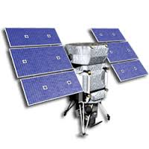
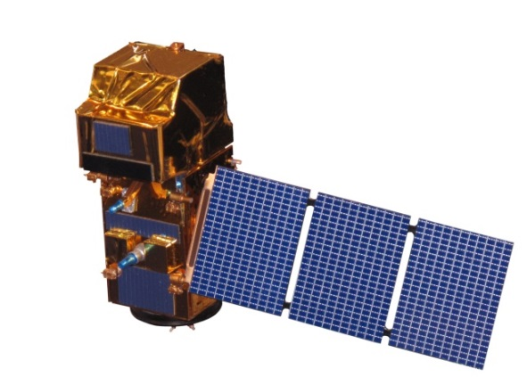
NASA Satellites & Sensors
Landsat 8 OLI
Landsat 8 Operational Land Imager (OLI)
Auxiliary Data
WorldView-1
European Space Agency’s Sentinel-2 MultiSpectral Instrument (MSI)
DigitalGlobe’s WorldView-1
Sentinel-2 MSI
Notes:
NASA’s Landsat 8 data, as well as the ESA’s Sentinel-2 data, were used for this project.

Slide 8
Methodology
Data Download
Dnppy python package to download Landsat 8
Data Processing
ArcPy module to apply MNDWI methodology
Repeat
Task the script to run every 2 weeks
Landsat 8 Script
text
text
text
Notes:
Our basic methodology was to develop a Python script to download recent Landsat 8 imagery, calculate MNDWI, and then generate a shapefile representing possible locations of water hyacinth based on a threshold of MNDWI values less than 1.
The script would then automatically re-run at set time intervals, most likely every 15 days.
Also a second script was included to apply MNDWI to Sentinel-2 data, except this one doesn’t automatically download so it’s still up to the user to provide inputs.

Slide 9
Methodology
Data Download
End user download Sentinel-2 from ESA’s scihub website
Data Processing
ArcPy module to apply MNDWI methodology
Repeat
End user may run the script whenever new Sentinel-2 data becomes available
Sentinel-2 Script
text
text
text
Notes:
The sentinel-2 script is not yet equipped to automatically download data, therefore the end user must download the data themselves
Used ArcPy to calculate the MNDWI, and then generated a shapefile representing possible locations of water hyacinth based on the threshold of MNDWI < 0
End user can decide when to run the script (for example, whenever new sentinel-2 data becomes available)
Link to download Sentinel-2: https://scihub.copernicus.eu/s2/#/home
MNDWI = (green - SWIR)/(green + SWIR)

Slide 10
Methodology
Surface Aquatic Vegetation Detection Tool (SADVT)
Sentinel-2
Landsat 8
Notes:
These two scripts combined make up the “Surface Aquatic Vegetation Detection Tool” which will be available on DEVELOP’s GitHub page once paperwork is processed.

Slide 11
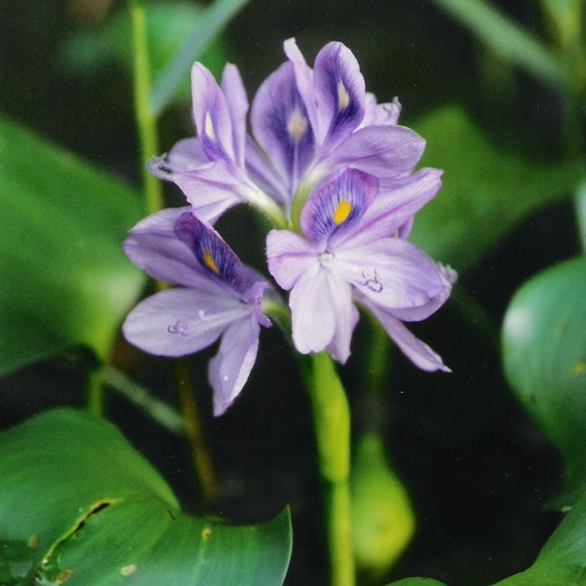
Methodology
Data Analysis
High resolution WorldView imagery to validate detection of water hyacinth and other macrophytes
Confusion Matrix
  Two classes tested:
    1. Water Hyacinth/ Macrophytes
    2. Other (water)
Image Credit: USDA
Notes:
Due to lack of in situ data, high resolution imagery from WorldView was used to validate the presence of algae and water hyacinth.
Imagery on a matching date (November 29, 2013) taken 45 minutes apart was used to test accuracy with a confusion matrix. (Landsat)
200 random points were generated for each class.
2 classes were tested (water hyacinth/ macrophytes and other) for the outputs from the Landsat 8 script
Due to large difference in spatial resolution of Landsat and WorldView (30m and Xm, respectively) any point within 30m of water hyacinth was counted as water hyacinth.
Image Source: http://www.ars.usda.gov/Main/docs.htm?docid=14222

Slide 12
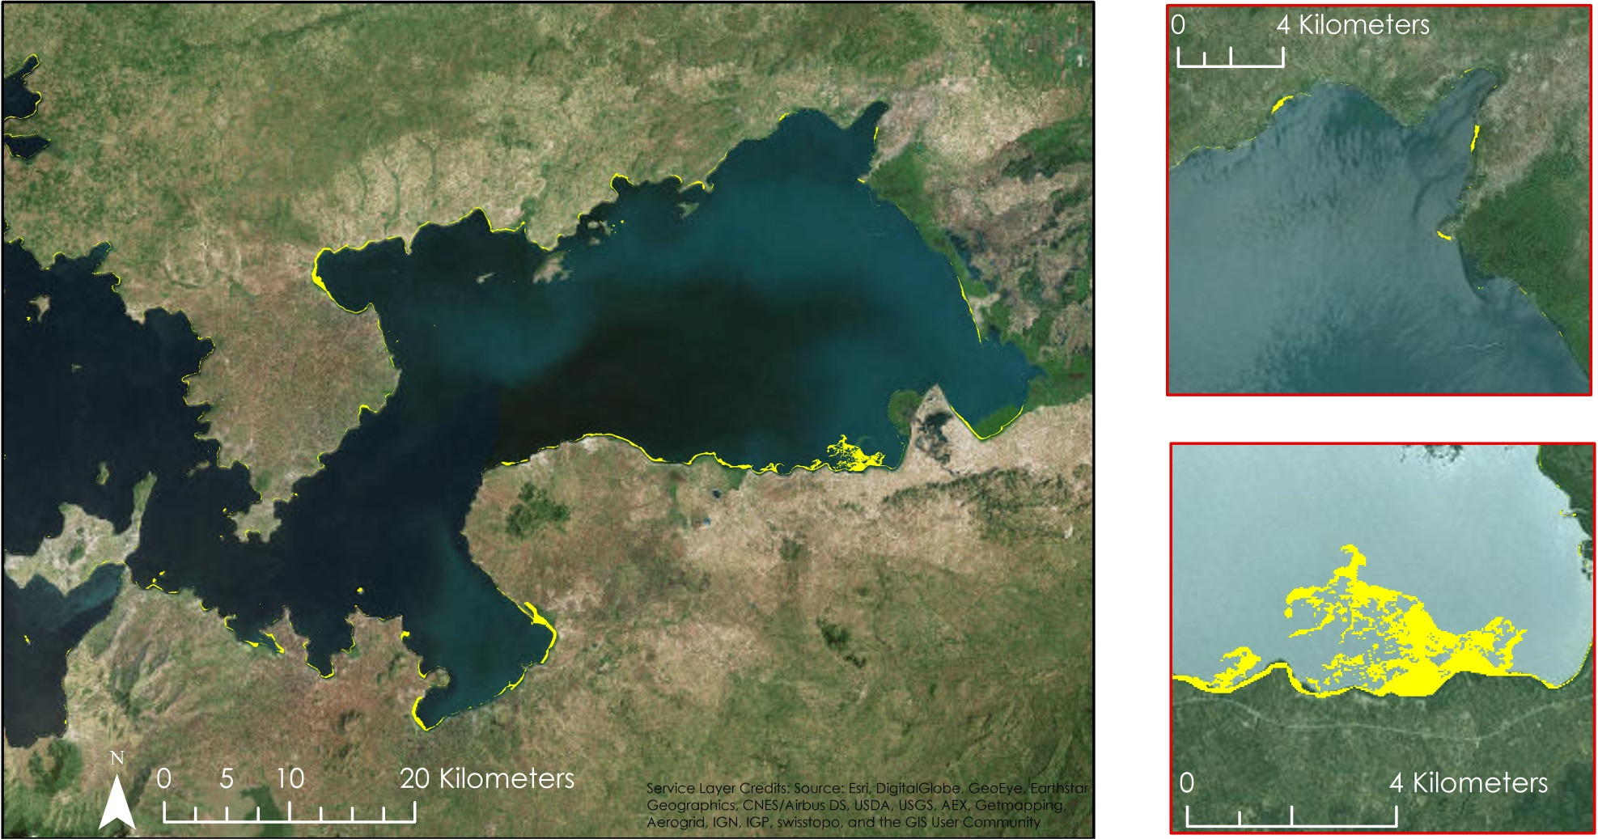

Results: Landsat Data
MNDWI < 0
MNDWI < 0
Image: Landsat 8
November 29, 2013
Image: Landsat
November 29, 2013
Non-Water Features
Notes:
Non-water features as specified by MNDWI values of 0 or less are highlighted in yellow.

Slide 13
Results: Landsat Accuracy
Predicted water hyacinth presence vs actual presence
n = 200 | Predicted NO | Predicted YES
Actual NO | TN = 94 | FP = 20
Actual YES | FN = 6 | TP = 80
Accuracy = 87%
Notes:
Accuracy results for the NDWI method:
True Positive (TP) = 80, True Negative (TN) = 94, False Positive (FP) = 20, False Negative (FN) = 6
Accuracy = 86.5 %

Slide 14
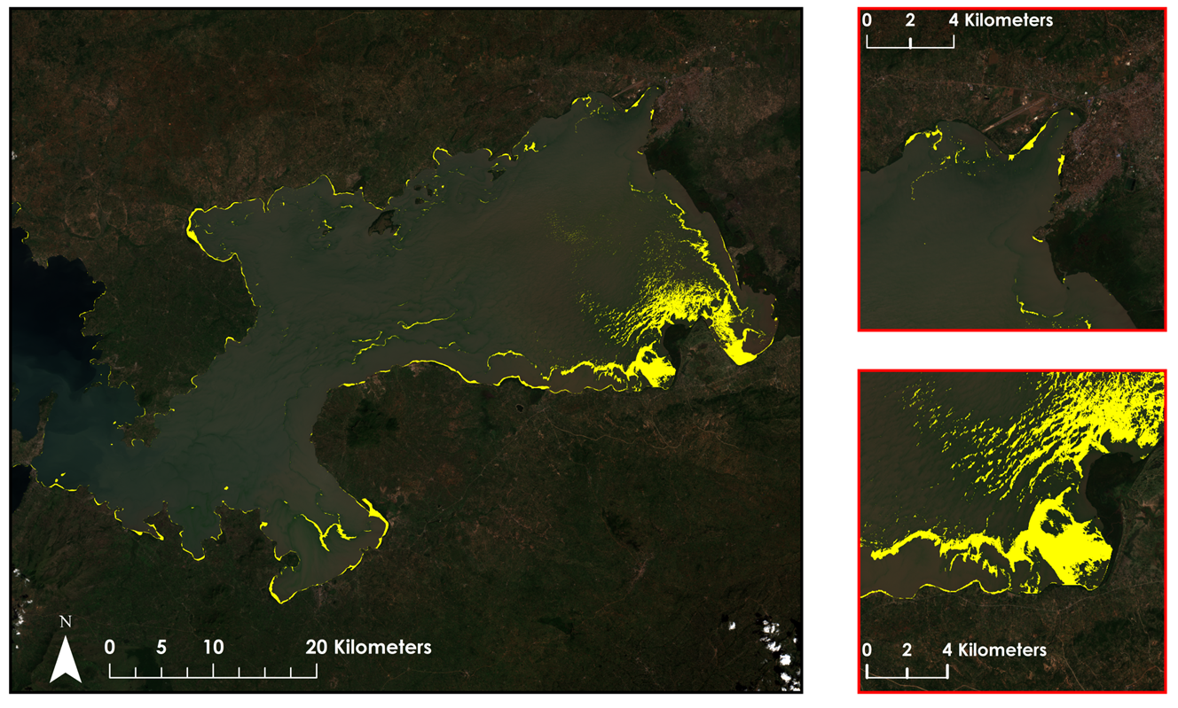
Results: Sentinel-2 Data
MNDWI < 0
MNDWI < 0
Image: Landsat 8
November 29, 2013
Image: Sentinel-2
December 19, 2015
Non-Water Features
Notes:
Non-water features as specified by MNDWI values of 0 or less are highlighted in yellow.

Slide 15
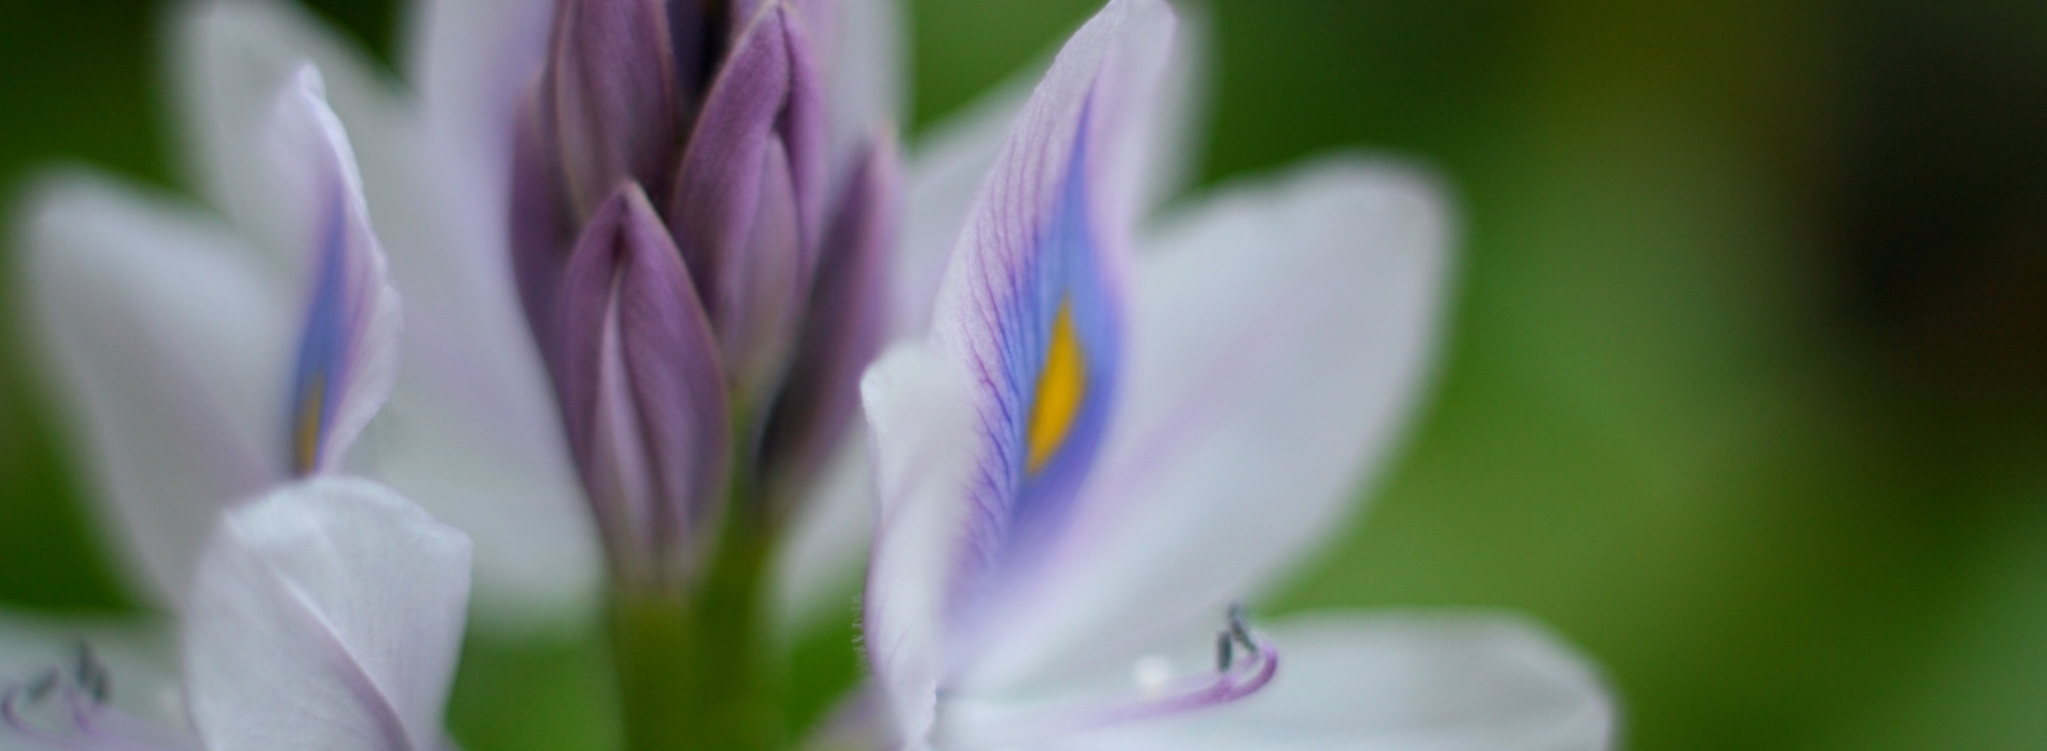
Conclusions
Automated script allows for almost real-time water hyacinth monitoring
The inclusion of Sentinel-2 increased temporal resolution of model
Image Credit: Mike Spasoff
Notes:
The main goal of our project was to create a python script to automate the methodology created last term. The inclusion of Sentinel-2 data helped this project by also increasing the temporal resolution of water hyacinth monitoring.
Image source: https://www.flickr.com/photos/clownfish/201316695/in/photolist-iMNrv-dVXsAd-FqPHh-iMNhx-c9cdhG-r8dDUB-c9c6Ys-EPyQ5-6rXhjS-c9c7Ko-BQSU6-5yNzB-4zfYJt-vA1QgC-4zR8rL-4zSDqk-pUeoqF-gDXUf-mBcowr-4zqSe6-mBe4GY-iW3FWz-mBcNRM-pUpAUT-d3upKm-5X6rGP-rxUnSJ-CmA96g-7MWGty-vRhsGU-6AisFt-ejDDES-6AnAF7-8auhg7-SGV2R-4ZQ5tR-iMNJU-4jLnM-6tTpwY-5oNTov-8xeLVx-8xeLVz-gmZ1UX-4wNA6M-4ygsLi-7mRbRM-duxkci-duxkdH-jSy77-jSy9f

Slide 16
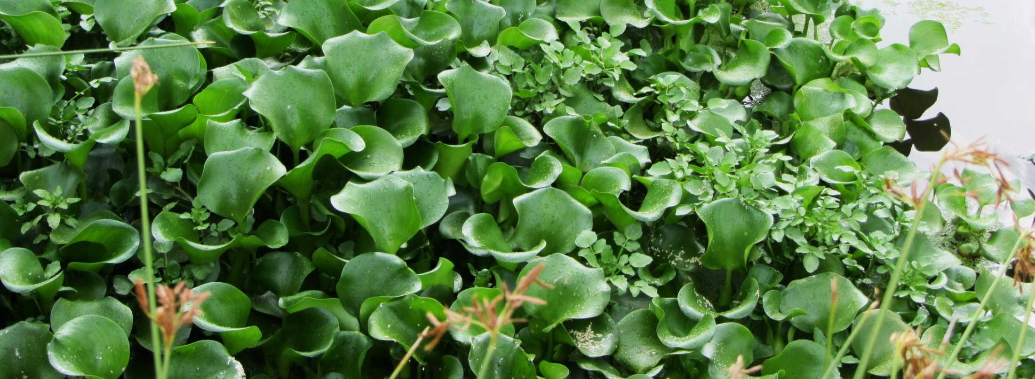
Errors and Uncertainties
Cloud cover in satellite imagery
Difficult to automate Sentinel-2 data download due to large file size
Inaccuracies along the coastline in study area shapefile
Amount of in situ data for validation
Image Credit: Jeanné le Roux
Notes:
Our errors and uncertainties consisted of cloud cover in our Landsat images, inaccuracies of coastline shapefiles, amount of in situ data validation, and difficulty downloading Sentinel-2 data due to its large file size. We also had issues with converting our data into python codes and scripts.

Slide 17
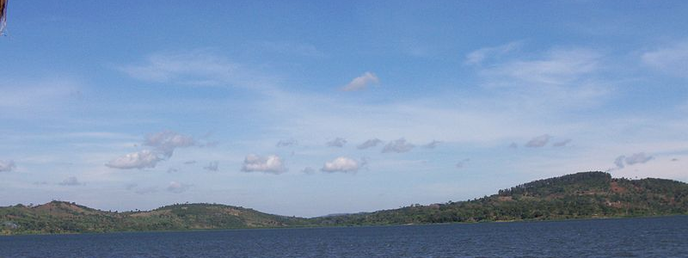
Source: Google Images
Image Credit: Michael Shade
Future Work
Revise the script to be completely open source
Find a way to automate Sentinel-2 download
Improve the quality of the study area shapefile
Include in situ observations
Notes:
For future work, we would like to develop a version of the SADVT which will be open source and not rely on arcMap
Figure out a way to automate Sentinel-2 download
Create a more accurate water mask to prevent misclassification errors
Schedule in situ observations which correlate with satellite passes
Image Source: https://commons.wikimedia.org/wiki/File:Africa_Lake_Victoria_10_006.jpg

Slide 18
Advisors
Dr. Jeffrey Luvall, NASA at NSSTC
Dr. Robert Griffin, University of Alabama in Huntsville
Africa Flores, NASA SERVIR Coordination Office at MSFC
Dr. Joe Ortiz & Dulci Avouris, Kent State University
Partners
James Wanjohi Nyaga, RCMRD
Dr. Robinson Mugo, NASA SERVIR-Eastern and Southern Africa Hub
Dr. Anthony Gidudu, Makerere University Department of Geomatics and Land Management
Others
Leigh Sinclair, NASA DEVELOP
Timothy Klug & Austin Vacek, University of Alabama in Huntsville

Slide 19
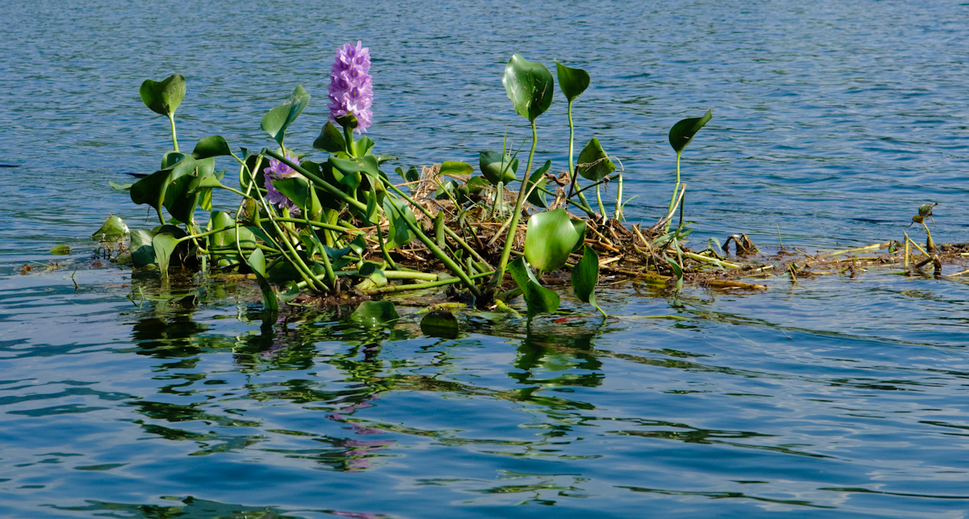
Questions?
Image Credit: happy.apple/Flickr
Notes:
We partnered with the SERVIR Coordination Office at MSFC, the SERVIR-Eastern and Southern Africa Hub, the Regional Centre for Mapping of Resources for Development (RCMRD), and the Makerere University Department of Geomatics and Land Management for this project to assist with their current practices.
Image source: https://www.flickr.com/photos/29022619@N03/4408894133/in/photolist-7HAJC6-mjAnq-DGDWHc-RcXkR-F9V9s-53cU2A-k35y2-Hx9U1-3NrwYJ-DLji8T-3jpJHq-roRwyL-7PpRuV-74eEkq-8nngSw-eaTbBb-ddRKJX-a5FMNo-cTiqJj-rxUnSJ-deHHgP-nMZZee-dhTcgx-5kCsz4-bCKBZY-8nHjAT-4iUM8R-9DksdN-4JqXyA-8xNa2f-5ffY3j-Dtubd1-cNbj1E-5X6rGP-CXb5WP-9zT5hV-6m94JM-iMNAb-CmA96g-6rXhjS-DUyS1z-73TFgu-85Dmsz-mW665E-85iFnp-4KaGTz-g4G6Cb-bWJTgV-bQS4Fk-4LKKrP

