Slide 1
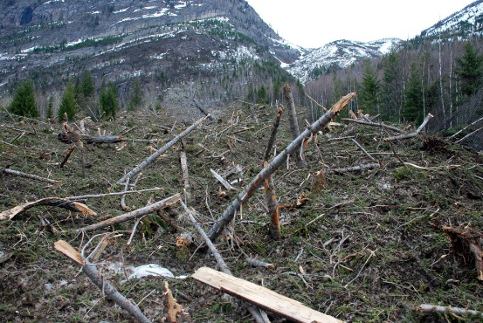
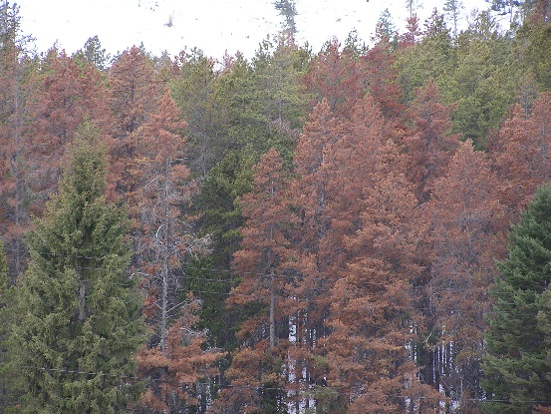
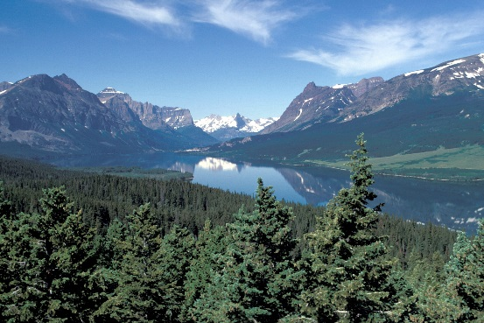
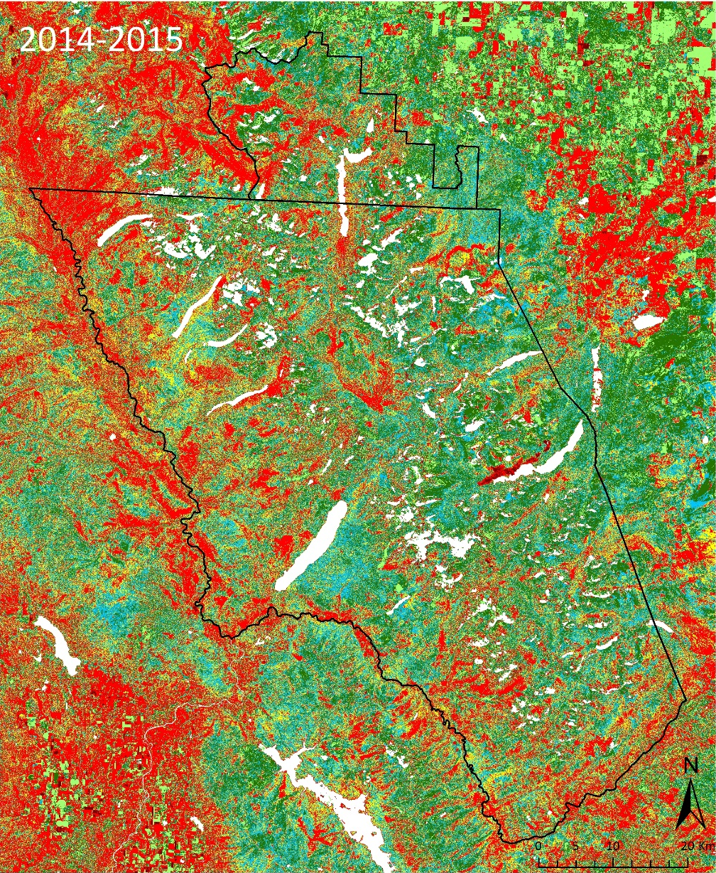
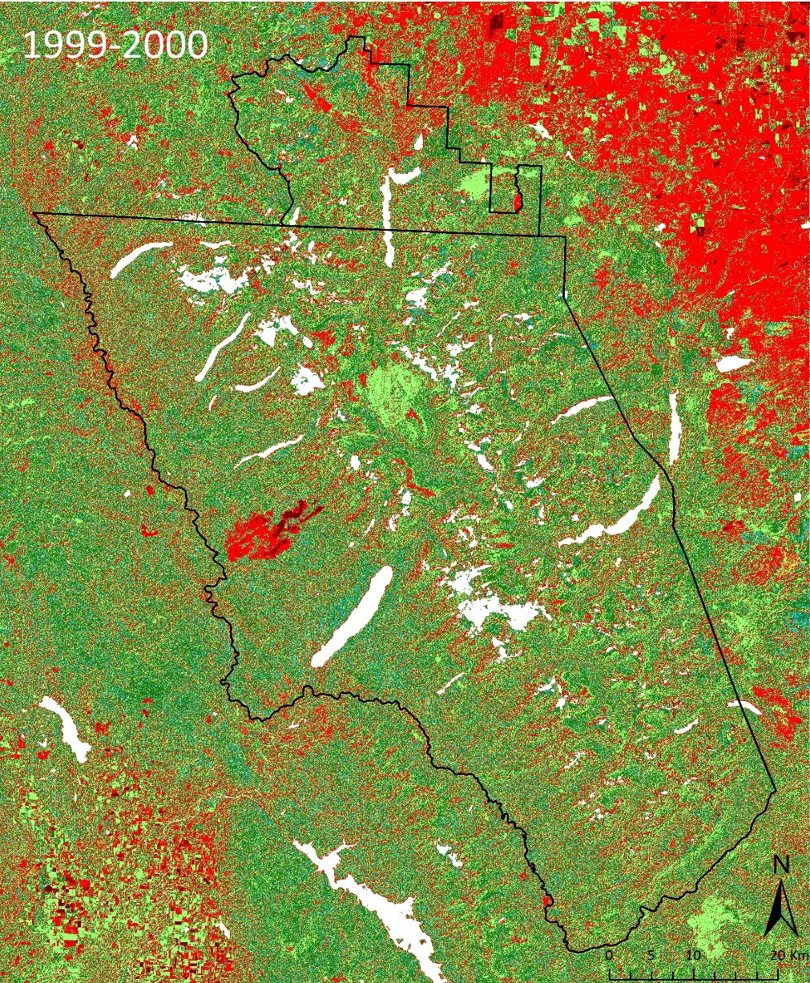
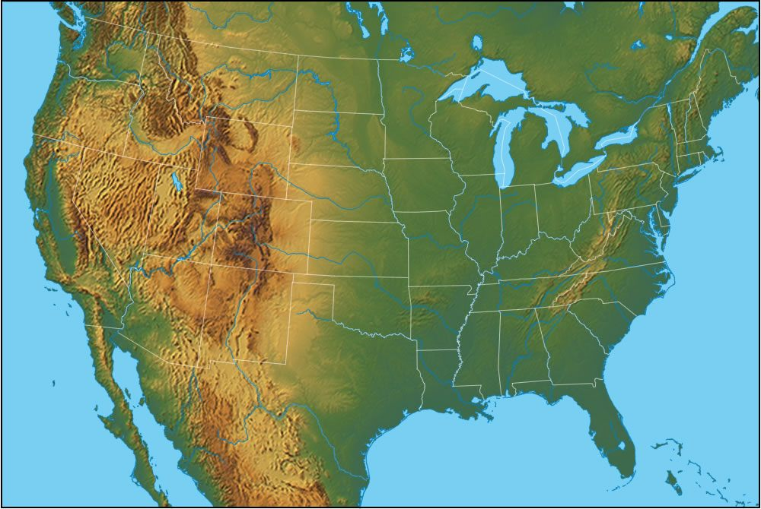
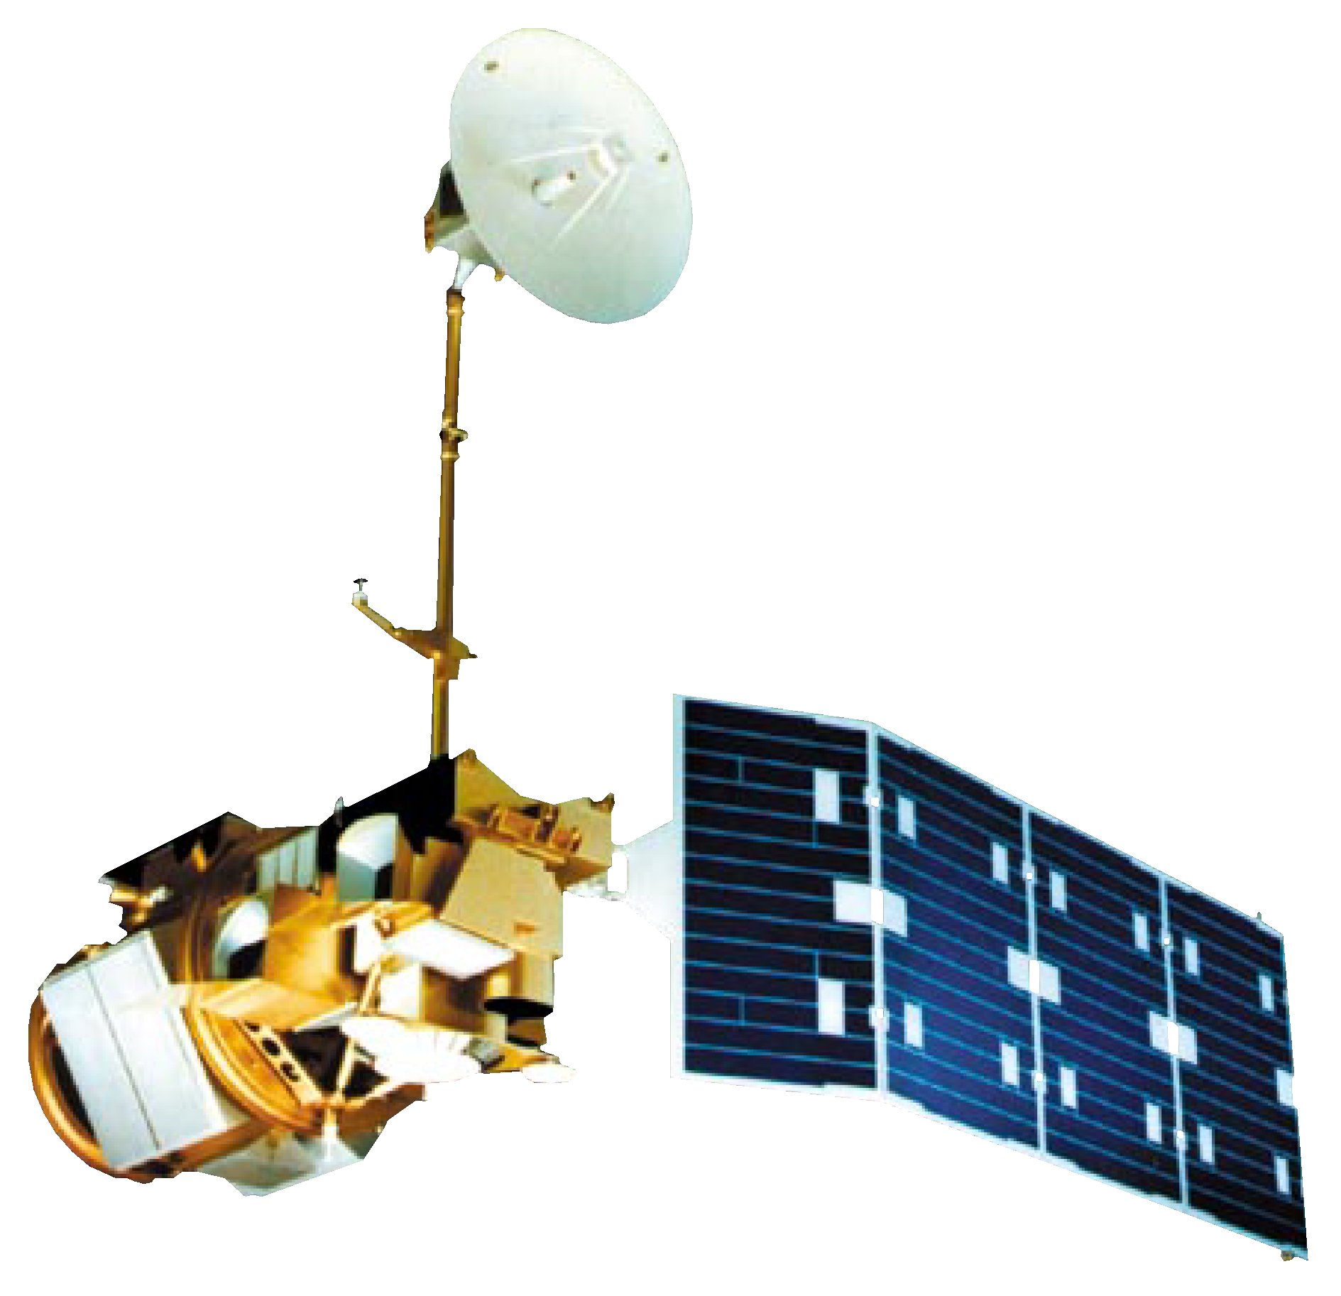
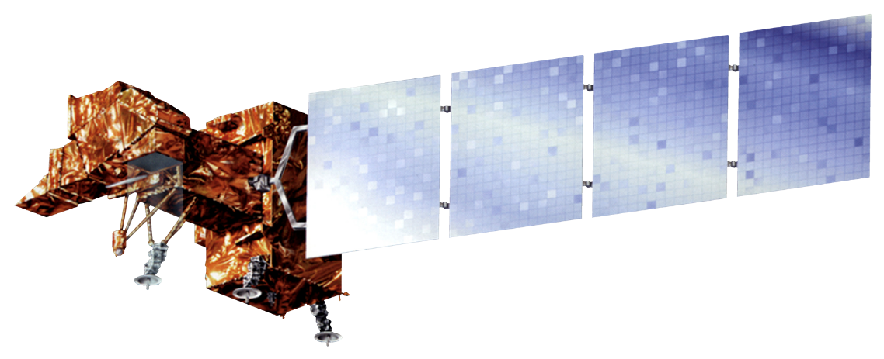
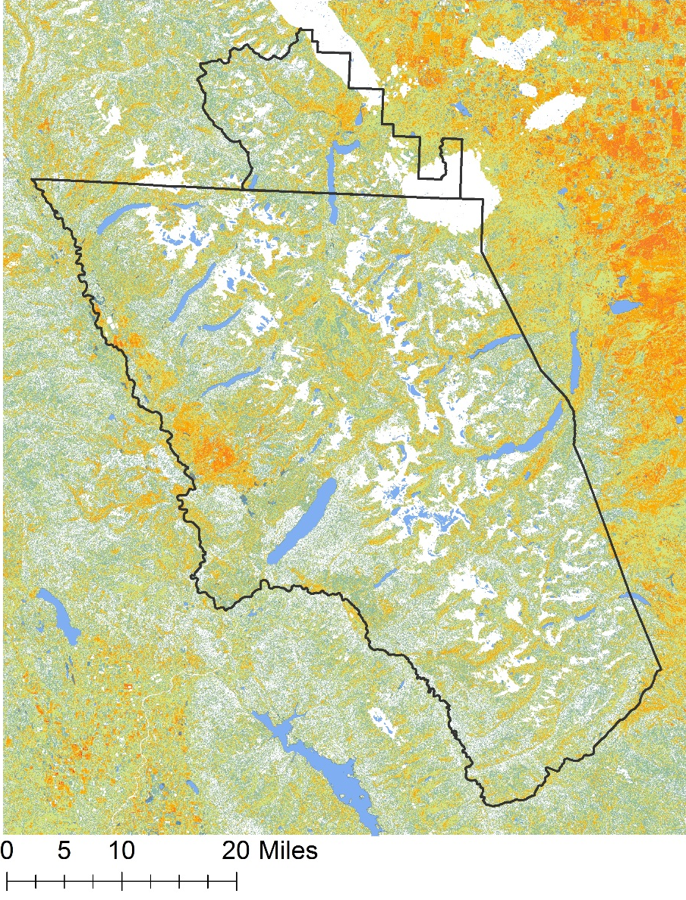
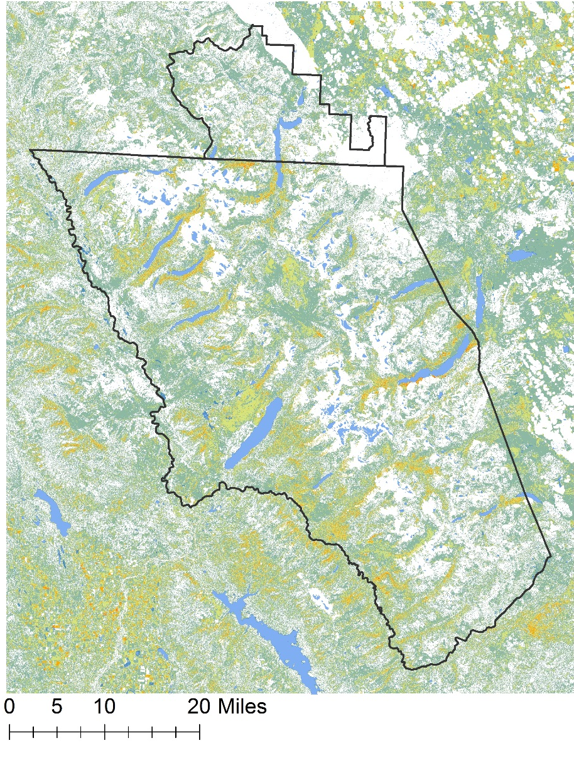
Utilizing NASA Earth Observations to Quantify Landscape Disturbances Related to a Changing Climate in Glacier National Park
Abstract
Methodology
National parks face an increasing number of threats from climate and biotic stressors, which lead to both major and minor landscape disturbances. The effects of disturbance are wide-ranging (e.g., changing species composition, altering nutrient flow and biodiversity, and landscape alterations) and impact numerous ecosystems within the park. While disturbance is part of the ecological history of a region, the major drivers and magnitude of disturbance change over time. In this project, the team quantified and mapped landscape disturbances in Glacier National Park from 1999 to 2016 (for the months of June – September). Landsat data were used to detect and map biotic stress from pathogens (such as the mountain pine beetle), fires, avalanche tracks, and landslides by using a threshold-based decision tree classification scheme similar to the work of Goodwin and others. Based on this methodology, and cross referencing results with insect Aerial Detection Surveys from the US Forest Service, it was observed that pathogen presence is represented by a negative change in NDMI of 600-4,000, with potential “green attack” phases of pathogen attack being represented by negative changes in NDMI of 250-600. Abrupt disturbances such as landslides, floods, and avalanches are represented by changes in NDMI of greater than 4,000. These results will aid the National Park Service in natural resource management by predicting a multitude of landscape disturbances in response to climate change.
∆NDMI ≥ Abrupt Threshold
Establish ∆NDMI Thresholds
Fire Removal
Cloud Removal
Abrupt Threshold ≥
∆NDMI ≥ Pathogen Threshold
Study Area
∆NDMI ≤ Pathogen Threshold
Study Period:
1999-2016
June - September
Results
Outline of Waterton-Glacier International Peace Park
Land Cover Classification
Vegetation Disturbance in Glacier National Park
Abrupt Disturbance
High Disturbance
Moderate Disturbance
Low Disturbance
Healthy Forest
Regeneration
Park Boundaries
Earth Observations
geology.com
Landsat 5 TM
Landsat 7 ETM+
Disturbance Frequency in Glacier National Park
1999-2004
2010-2016
Glacier National Park Climate
Landsat 8 OLI
Number of Inter-annual Periods
0
1
2
3
4
5
Park Boundaries
Objectives
Conclusions
Lakes
Utilize NASA Earth observations to identify, quantify, and map landscape disturbances related to a changing climate within Glacier National Park
Aid Glacier National Park staff in managing park resources by providing them with maps of disturbance within the park
Guide the direction of future research projects and educational outreach by exposing park staff to new datasets and processing methodology
Threshold based classification schemes can provide a quick, accurate way of identifying and mapping landscape disturbances.
∆NDMI threshold classification is best used with years following average or above average precipitation years.
Glacier National Park is becoming increasingly disturbed from 1999-2015 with respect to pathogens.
Team Members
Project Partners
Acknowledgements
We would like to thank the following individuals/groups for their contributions to this project:
Dr. Kenton Ross – NASA Langley Research Center
Whitefish High School – Whitefish, Montana
Columbia Falls High School – Columbia Falls, Montana
This material is based upon work supported by NASA through contract NNL11AA00B and cooperative agreement NNX14AB60A. Any mention of a commercial product, service, or activity in this material does not constitute NASA endorsement. Any opinions, findings, and conclusions or recommendations expressed in this material are those of the author(s) and do not necessarily reflect the views of the National Aeronautics and Space Administration and partner organizations.
Jordan Lubbers
Team Lead
Dr. Sunita Yadav-Pauletti
Ryan Avery
Richard Menicke – National Park Service, Glacier National Park
Dr. Christopher Potter – NASA Ames Research Center
Joe Harris
Zachary Wardle
Suzannah Richards
NASA Langley Research Center– Fall 2016

