Slide 1

DEVELOP Orientation
Module 2. The Ins & Outs of Projects & Partnering at DEVELOP
EARTH
ACTION

Slide 2

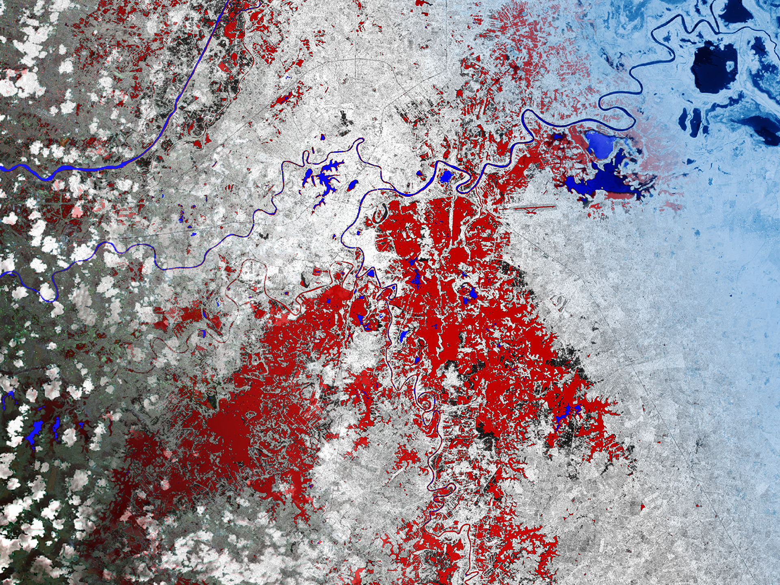
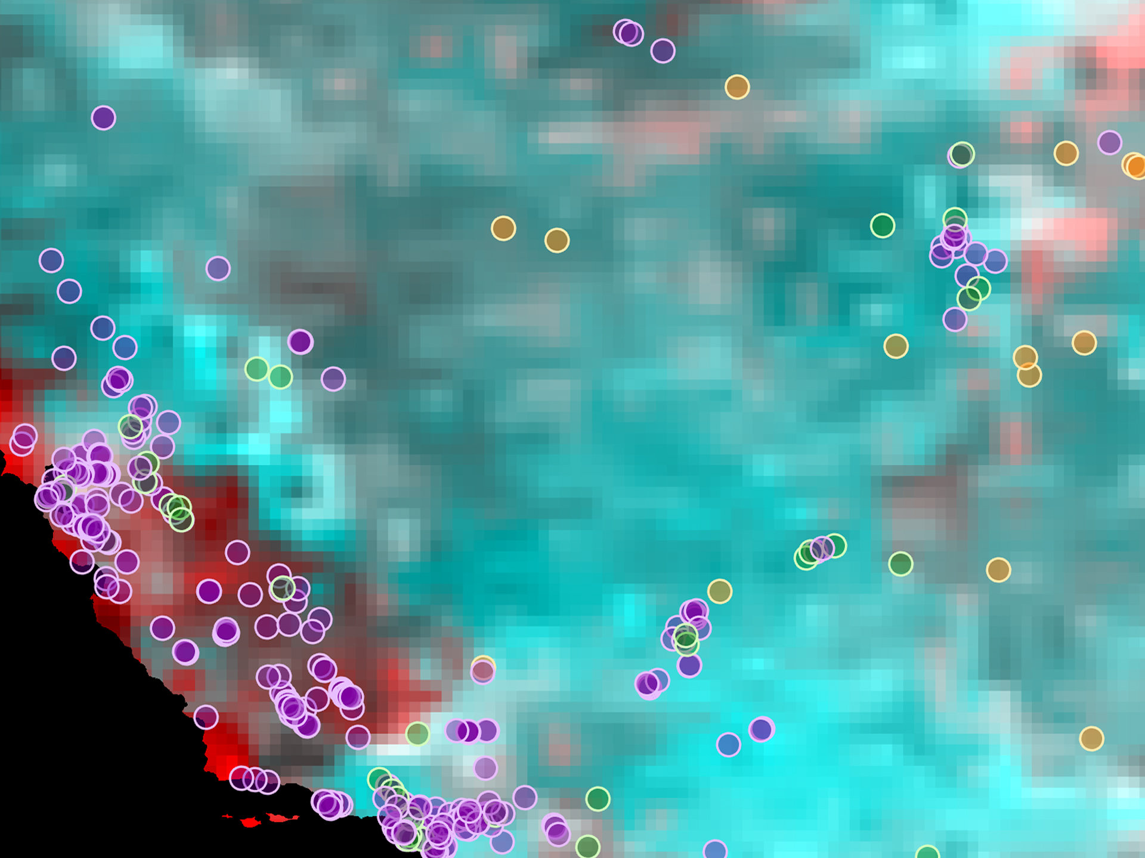
PROJECTS & PARTNERING
Types of DEVELOP Projects
Most DEVELOP Projects are…
Partner with end user organizations to assess feasibility of using specific EO to address issues and create end products tailored to the end user’s decision-making needs.
Feasibility
Some DEVELOP Projects are…
Tech & Innovation
Increase usability of EO data through tool improvement, EO cloud usage, AI and machine learning, future EO proxy data usage, etc.
Needs Assessment
Conduct in-depth needs assessments and landscape analysis of organizations and communities working in specific areas, identify key organizations to engage, and synthesizing findings and next steps.
Notes:
There are three types of projects: feasibility (majority of DEVELOP projects), tech & innovation, and listening projects.
Feasibility Projects: Typical DEVELOP projects that partner with at least one end user organization, focus on the assessment and feasibility of using specific EO to address issues faced by that end user, and tailor end products to the end user’s decision-making needs. Partners are involved from the beginning in the design of the project.
Tech & Innovation Projects: Aim to increase usability and accessibility of EO data and products through exploration of one or more of the following…
Improvement of previous DEVELOP tools
Assessments of EO cloud usage (Jupyter notebooks, Google colab, datacubes)
AI and machine learning
Future EO instrument usage
These projects are typically heavy in coding and/or modeling and do not typically have end-user partners involved.
Listening Projects: These projects conduct in-depth needs assessments that pursue a landscape analysis of organizations and communities working in specific areas, identify key groups for the program to engage, can include interviews / a listening tour, and synthesizing findings and next steps for the program. Ex. Two listening projects were conducted in sprig 2022 to explore opportunities relating to EJ in the disasters and health & air quality thematic areas.

Slide 3









PROJECTS & PARTNERING
Feasibility Project Characteristics
50+ feasibility projects take place each year – at their core they share these characteristics:
Highlight the applications and assess capabilities of NASA Earth observations
Address environmental management concerns relating to decision-making for real-world issues
Partner with “end user” organizations who can benefit from using NASA Earth observations to enhance decision making by providing decision support products
Align with at least one of the DEVELOP’s 10 Thematic Application Areas
Create a consistent set of deliverables to communicate the science
Conducted by teams with diverse backgrounds under the scientific guidance of Science Advisors and mentors from NASA and partner organizations

Slide 4
PROJECTS & PARTNERING
By The Way
Ideas can come from anywhere as long as they connect to a decision-making end user! Have an idea? Tell your Lead!
Project Lifecycle
Identify Needs Surrounding Partners’ Decision-Making Processes
NPO Collects Project Ideas
Proposal Process – Reviewed by NPO and NASA HQ
Project Execution
Hand Off to Partners & Conference Presentations
All DEVELOP projects center around a decision.
DEVELOP connects with potential partners through: project request forms submitted through the website, boundary organizations, past partners, DEVELOP alumni, science advisors & their networks, conferences, NASA HQ (ex. Program Managers and their teams), NASA Center reps, CEOS & GEO, and beyond!
DEVELOP identifies the information that would be helpful to the partner when making this decision. This is the partner’s need aka the “community concern”.
Project end products are designed to fit into the partner’s decision-making process.
The end deliverable package is handed off for partners to explore further and assess integration into their decision-making process.

Slide 5

TEAM RESPONSIBILITIES
Scientific Integrity
“The iconic success of NASA is planted firmly on three foundational elements: innovation, inspiration, and integrity. While innovation and inspiration are visible through our endeavors and successes, it is our integrity – how we work, and our commitment to excellence and openness – that earns us the trust of the public and ensures our continued ability to inspire and innovate. Integrity is woven throughout the fabric of NASA. It has always been there. And each and every day, we recommit ourselves to keeping it there.”
Dr. Waleed Abdalati
Former NASA
Chief Scientist
NASA SI Policy: http://www.nasa.gov/pdf/611201main_NASA_SI_Policy_12_15_11.pdf

Slide 6
PROJECTS & PARTNERING
Reproducibility & Replicability
As DEVELOP projects set out to assess the feasibility of applying EO to address a variety of environmental challenges, the ability to reproduce or replicate results and methods is central to the success of partners and future DEVELOP teams.
Here are some foundational tips to support the adoption of your project:
Good data management: "Data management is the development, execution and supervision of plans, policies, programs and practices that control, protect, deliver and enhance the value of data and information assets.” Answers the questions: 1) Where did the original data come from? 2) What was done to the data? 3) Can I find the data again if needed?
Strong organization: Organize your team’s data using a directory structure, segregate materials for a project into one directory with folders (data, methods, results, deliverables), keep raw data separate from processed data, include README files, have your README files describe the contents of a folder, list the files in that folder, and provide metadata.
File nomenclature matters: File names should be… 1) Machine Readable (do not include special characters (%, $, &, etc.), use underscores instead of spaces), and 2) Human Readable (file names should briefly, but adequately, describe the contents of the file, use versions as needed), and 3) Work well with default ordering (i.e., name the files so that they default in chronological order)
Document everything: Document your decisions - why did you choose your methods? Keep a list of all equations or formulas. Keep track of both failures and successes. Document exact steps of final methods.

Slide 7
PROJECTS & PARTNERING
DEVELOP Partners
Any organization can partner with DEVELOP. “Partner” is the umbrella term for any outside organization DEVELOP engages with through projects, nodes, or other activities. Each feasibility project tailors to a specific end user that is making an environmental decision.
Partner Types
End User: Organization that receives results and methodologies from DEVELOP (either directly from a DEVELOP project team or through a collaborator/boundary organization) and can use the project’s products or methodologies to make a decision or policy or take action; they may also provide some kind of resources (advising, data, model, software, funding, etc.), but it is not required.
Collaborator: Organization or individual that works directly with a DEVELOP project team and provides some kind of leveraged resource (advising, data, model, software, funding, etc.), but are not actually using the project’s products or methodologies to make a decision or policy.
Partner Sectors
ACADEMIC
CONSORTIUM
LOCAL GOVERNMENT
2024 SUMMER PARTNER INSTITUTIONAL SECTOR
STATE GOVERNMENT
FEDERAL GOVERNMENT
FOR-PROFIT
NON-PROFIT
TRIBAL
INTERNATIONAL

Slide 8
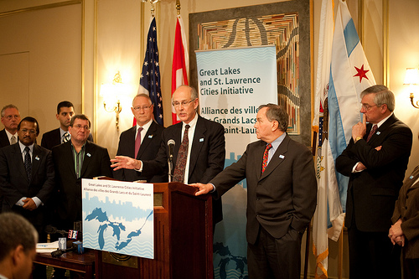
PROJECTS & PARTNERING
Partner Engagement & Communication Plan
A cornerstone of DEVELOP projects is the engagement of organizations who can benefit from the integration of NASA Earth observations in their decision-making processes. All DEVELOP feasibility projects engage at least one end user organization to hand off project results and methodologies to.
Communication Plan:
Team-partner meet & greet in week 1 or 2 – purpose: introductions and foundation setting for the team to understand the partner’s work, priorities, environmental challenge at hand, and interests
Weekly or Bi-Weekly Partner Meetings – purpose: team share status updates, share preliminary results, gain partners insights and “quality checks” on maps, etc.
Hand-off event at the end of the term – purpose: package up and inform the partners of the team’s final results, feasibility assessment of using EO to address their environmental concerns, share insights on methodologies, answer questions the partner may have, etc.

Slide 9
PROJECTS & PARTNERING
Checklist: Working with Partners
Ensure professionalism in all interactions - you are representing yourself, your team, your advisors, your node, DEVELOP, Earth Action, and NASA!
Have a plan and schedule. Sharing an agenda and questions ahead of partner meetings is helpful.
Be realistic in what you promise and the expectations of the partner. In fact, don’t “promise” anything, but ensure the plan you are working towards is clear and that there is a healthy understanding of challenges and potential obstacles/risks.
Keep in mind the limitations of resolution (spatial and temporal) of NASA data and work within them.
Understand the partner’s needs and interests and let that help guide the team’s work.
Keep communication lines open and ensure the team follows through. Generally speaking, the Project Lead should be the POC for communicating with a partner unless it is specifically delegated to another team member.
Make sure to CC your lead on emails between the team and any partners to keep them in the loop!
Include your project’s Science Advisor in partner communication as much as is possible, per your advisor’s availability.

Slide 10

PROJECTS & PARTNERING
First Partner Meeting Prep
Review the proposal/work plan and any other supporting documentation as exists (project request forms, email correspondence, etc.)
Review the partner’s website and learn about their organization
Brief lit review on the environmental challenge at hand
As a team, prepare a list of questions you’d like to ask the partners – anything not covered or addressed in the work plan, insights relating to their decision-making process, the environmental challenge at hand, etc.
  We’ve read the proposal, but can you talk us through the issue at hand and your decision-making process?
  Does your organization currently use GIS or any spatial analysis?
  What software programs do you typically use?
  What types of data formats do you typically work with?
  What are your expectations of our project?
  What format should end products be in to be useful?

Slide 11
PROJECTS & PARTNERING
By The Way
DEVELOP projects often include international participants who may have contacts in a foreign country where the study area lies. Be mindful that any communication with others outside the US relating to the project is pre-approved by your Lead and NPO.
International Projects
DEVELOP can and does work internationally. The program has a domestic focus with metrics to reach 35 states a year and all 50 states on a rolling three-year basis. Ensuring these domestic metrics are met, the program can pursue international projects.
When working with international partners, care must be taken that appropriate approvals and communication lines are followed due to complexities relating to export control, federal regulations, and designated country classifications.
What is a ‘Designated Country’? NASA maintains a list of “Designated Countries,” countries with which the U.S. has no diplomatic relations, determined by Department of State to support terrorism, are under Sanction or Embargo by the U.S., and/or countries of Missile Technology Concern.
  www.nasa.gov/sites/default/files/atoms/files/designated_country_list_6.10.2022.pdf
  Any engagement with individuals or organizations in these countries is NOT allowed unless specifically approved by NASA’s Office of International and Interagency Relations (OIIR), for example the NASA engagement with Bhutan.
OIIR supports DEVELOP when interacting with international organizations and must be included and aware of all international engagement. NPO coordinates with and involves OIIR reps.

Slide 12





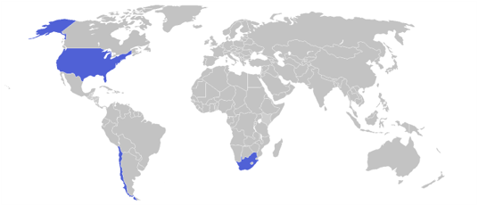
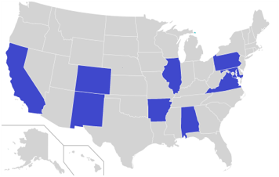
2024 Fall Portfolio
DISASTERS
ENGAGEMENT:
WILDLAND FIRES
48
23
12
AGRICULTURE
ENERGY
PARTICIPANTS
PARTNER ORGS
PROJECTS
ECOLOGICAL CONSERVATION
THEMATIC AREA
IMPACT:
TERM I: 10
WATER RESOURCES
9
3
TERM II: 2
URBAN DEVELOPMENT
U.S. STATES
COUNTRIES
CLIMATE
HEALTH & AIR QUALITY
Moffat County Agriculture
Santa Ana Pueblo Agriculture
Northern Alabama Agriculture
Illinois Eco Conservation
Santa Clarita Valley Eco Conservation
South Africa Eco Conservation II
Pennsylvania Water Resources
Chesapeake Bay Water Resources
Chile Water Resources?
Buffalo National River Water Resources
San Jose Urban Development
Hampton Roads Health & Air Quality II

Slide 13
PROJECTS & PARTNERING
Feasibility Project Considerations
DEVELOP projects are 10-week feasibility studies – we do these projects to see if the methods work! In 10 weeks, validation efforts are limited at best.
Be mindful in how you communicate with partners – do not overpromise or oversell your products and results.
NASA does not develop or prescribe policy, thus DEVELOP projects do not either – they simply demonstrate the feasibility of integrating NASA Earth observations into decision-making processes.
Other agencies and organizations may use the data and scientific results in their policy analysis and development.
NASA funds DEVELOP, thus DEVELOP projects are focused on the application of freely-available NASA Earth observations.
The North Carolina node receives NOAA funds, so they have an additional directive to highlight NOAA CDRs.
An increasing number of projects are using commercial datasets, these are generally only included in the proposal when a partner would have access to the data to replicate on their own in the future OR if a one-time static product is created by the team. NASA data must be involved meaningfully in the projects.

Slide 14
PROJECTS & PARTNERING
10-Week Timeline
Although your project will last 10 weeks, note that only a subset of that is used for conducting analysis. Communicating the results is just as, if not more, important to working with partners effectively.
General schedule to compare progress against…
Week 1 2 3 4 5 6 7 8 9 10
Orientation
Data Processing & Analysis
Literature Review
Draw & Finalize Results
Methodology Creation
Finalize Deliverables
Data Acquisition
Project Handoff
Code Workshops
All data acquired by end of week 3/early week 4
Processing & Analysis Completed
Presentation & Posters Submitted

Slide 15
PROJECTS & PARTNERING
Supporting Project Teams’ Coding: Workshops (Week 2, 3, & 4)
DEVELOP offers multiple coding workshops that participants are encouraged to attend if they would like to improve their programming skills! These are introductory and (mostly) optional!
Participants sign up for a subset of the following workshops:
  Python – covers the basics of Python programming and introduces geospatial Python topics including the use of ArcPy for ArcGIS Pro. Good for participants who have never programmed or never used Python before. Cannot enroll in R if enrolled in Python. 10/1-10/3
  R – covers the basics of R programming and introduces geospatial R topics. Good for participants who have never programmed or never used R before. Cannot enroll in Python if enrolled in R. 10/1-10/3
  Advanced Topics – covers advances geospatial methods for using R, Python, and ArcPy to retrieve and process imagery. Good for all Participants regardless of skill level 10/8-10/10.
Times and dates for all workshops available on the Summer 2024 Events calendar.

Slide 16
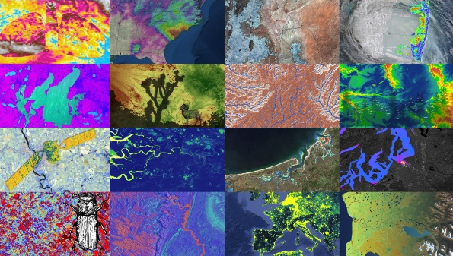
PROJECTS & PARTNERING
Project Deliverables
DEVELOP places equal emphasis on research & analysis and communicating your results.
Substantial efforts are put forth in developing deliverables that not only communicate the work done at DEVELOP, but enhance participants’ skills: technical writing, coding, science communication, effective visualizations, video editing, etc.
Deliverables are your opportunity to communicate your project work. Each deliverable is an example of your accomplishments. Use them to your advantage!
All deliverables are important and used by DEVELOP in a variety of ways which are laid out on following slides.
View details for each deliverable on DEVELOPedia and download the deliverable calendar for deadlines!
All Projects Create… a Project Summary, Study Area Shapefile, Presentation, Poster, Tech Paper, DEVELOPedia Page, Website Image, and a Project Feedback Form
Some Projects Create… a Tutorial, Video & Transcript, Code, Social Media Campaigns, Flyers and Brochures, One Pagers, etc.

Slide 17
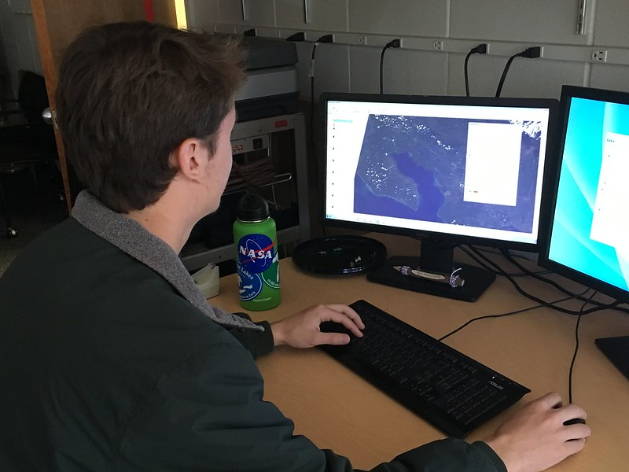
PROJECTS & PARTNERING
Project Deliverables
Best Practices
Tackle deliverables incrementally – start them early
Reuse content from one deliverable for another – while each demonstrates your project in a different method of communication, many have shared core elements
Always review the deliverable templates and checklists to ensure your deliverables are on point prior to submission to NPO. If it’s evident the checklist was not followed, we may ask you to resubmit!
All deliverables submitted will be reviewed by your Lead and your Project Coordination point of contact
Build in time for Science Advisors to review as well, if available
Identify a POC within the team for each deliverable, but ensure that all team members contribute

Slide 18
PROJECTS & PARTNERING
By The Way
Export Control only controls what deliverables can be shared externally. You are not only allowed to, but are encouraged to, discuss the details of your project with friends, family, colleagues, etc!
Export Control
Export Control is NASA’s program to ensure that scientific material being shared externally abides by federal regulations. All STI (Scientific & Technical Information) is submitted and reviewed. Once approved it can be shared externally to DEVELOP.
What does this mean to me?
BEFORE sharing any materials outside DEVELOP, check with your Lead and NPO.
Some project materials can be shared without going through export control (map products, preliminary results, imagery, videos), others must gain NASA approval first (tech paper, poster, presentation).
All external publications (ex. peer-review publications) and conference presentations must also gain these approvals.
The PC team (Brent, Marisa, Laramie, & Maya) are your primary Export Control points of contact.
NASA Export Control: “As a U.S. Government Agency on the forefront of technological development and international cooperation in the fields of space, aeronautics, and science, the National Aeronautics and Space Administration will strive to fulfill its mission for cooperative international research and civil space development in harmony with the export control laws and regulations of the United States. Due to heightened proliferation challenges facing the United States and the world, including risks posed by the spread of missile technologies and weapons of mass destruction, and in view of the significant criminal, civil, and administrative penalties that may affect the Agency and its employees as a result of a failure to comply with U.S. export control laws and regulations, it is the responsibility of every NASA official and employee to ensure that the export control policies of the United States, including nonproliferation objectives, are fully observed in the pursuit of NASA's international mission.”

Slide 19
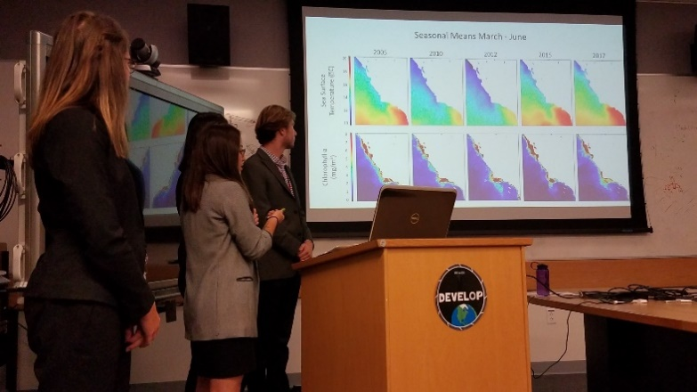
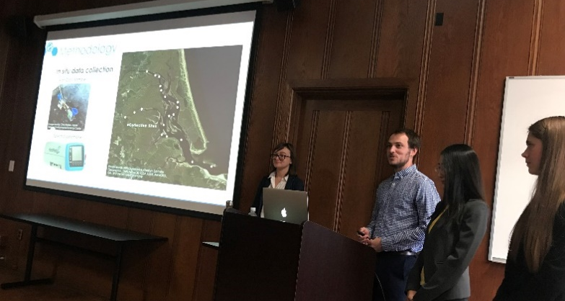
PROJECTS & PARTNERING
Project Handoff
Handoffs are where the team begins the transitioning of results and methodologies to partners in support of end users potentially integrating NASA Earth observations into their decision-making processes.
Depending on what you are handing off, be cognizant that you must get materials approved by NASA prior to handoff.
Handoff Plan:
Typical: 1-2 hour videoconference presenting the results and methodologies
Other ideas: In-person presentation of results and methodologies (when local), virtual workshop and/or demo session
During interim, the node Lead emails final deliverables (Tech Paper, Tutorials, Presentation, etc.) after they’ve been approved by export control
By The Way
Handoff vs. Closeout
Confusing? The handoff is where you “hand” your partner the results and methods, tailored for your audience, it is generally more in depth. A closeout event is a public presentation of information, partners may attend but the audience is broader.

Slide 20
PROJECTS & PARTNERING
PSI Assessment Questions
Is the project reproducible by others? Did it include a “recipe” for partners to access & analyze EO data?
Does the project find it is feasible to use its remote sensing methodology to inform action?
Was the project end user engaged with the Lead and team from the beginning to handoff?
Did the project highlight the application of NASA EO, and if so, did it include any underutilized sensors?
Did the project have a robust and/or novel methodology for applying EO to project objectives?
Did the project have high quality deliverables, particularly when compared to other projects in the term?
Did the project fill any programmatic portfolio gaps (geographic or partner sector), support a NASA HQ request, and/or support CEOS/GEO efforts?
Did the project create any standout end products, deliverables, or other materials worth noting?
Did the project tailor end products and deliverables meaningfully to the end user’s interests and needs? (comparison of the proposed end products/deliverables and the actuals)
Did the project's participants report growth of technical skills on their exit PGA?
Project Goals & the Project Strength Index (PSI)
DEVELOP’s Project assessment tool that considers the goals of DEVELOP projects and assigns a score for standardized tracking overtime and identification of projects to highlight. It includes 10 questions with a scoring rubric that aligns with DEVELOP’s goals for its projects, which are:
Create a reproducible ‘recipe’ for accessing and analyzing EO data
Assess the feasibility of using NASA EO to inform action
Build capacity to use EO in end users and participants
Inform a decision or action
Benefit NASA and communicate benefits of the investment in EO to taxpayers

Slide 21
PROJECTS & PARTNERING
Quiz Time
How many projects does DEVELOP conduct a year?
What do all DEVELOP projects center around?
Does NASA prescribe policy?
How many types of partners are there?
If you have international partners, what NASA organization needs to be aware of the project?
Can teams pursuing similar projects reach out to other nodes?
Notes:
50+
A decision ☺
No
International and Interagency Relations (OIIR)
Yes!
2

Slide 22

Thank You.
“A place for everything and everything in its place.”
-- Benjamin Franklin --

