Slide 1
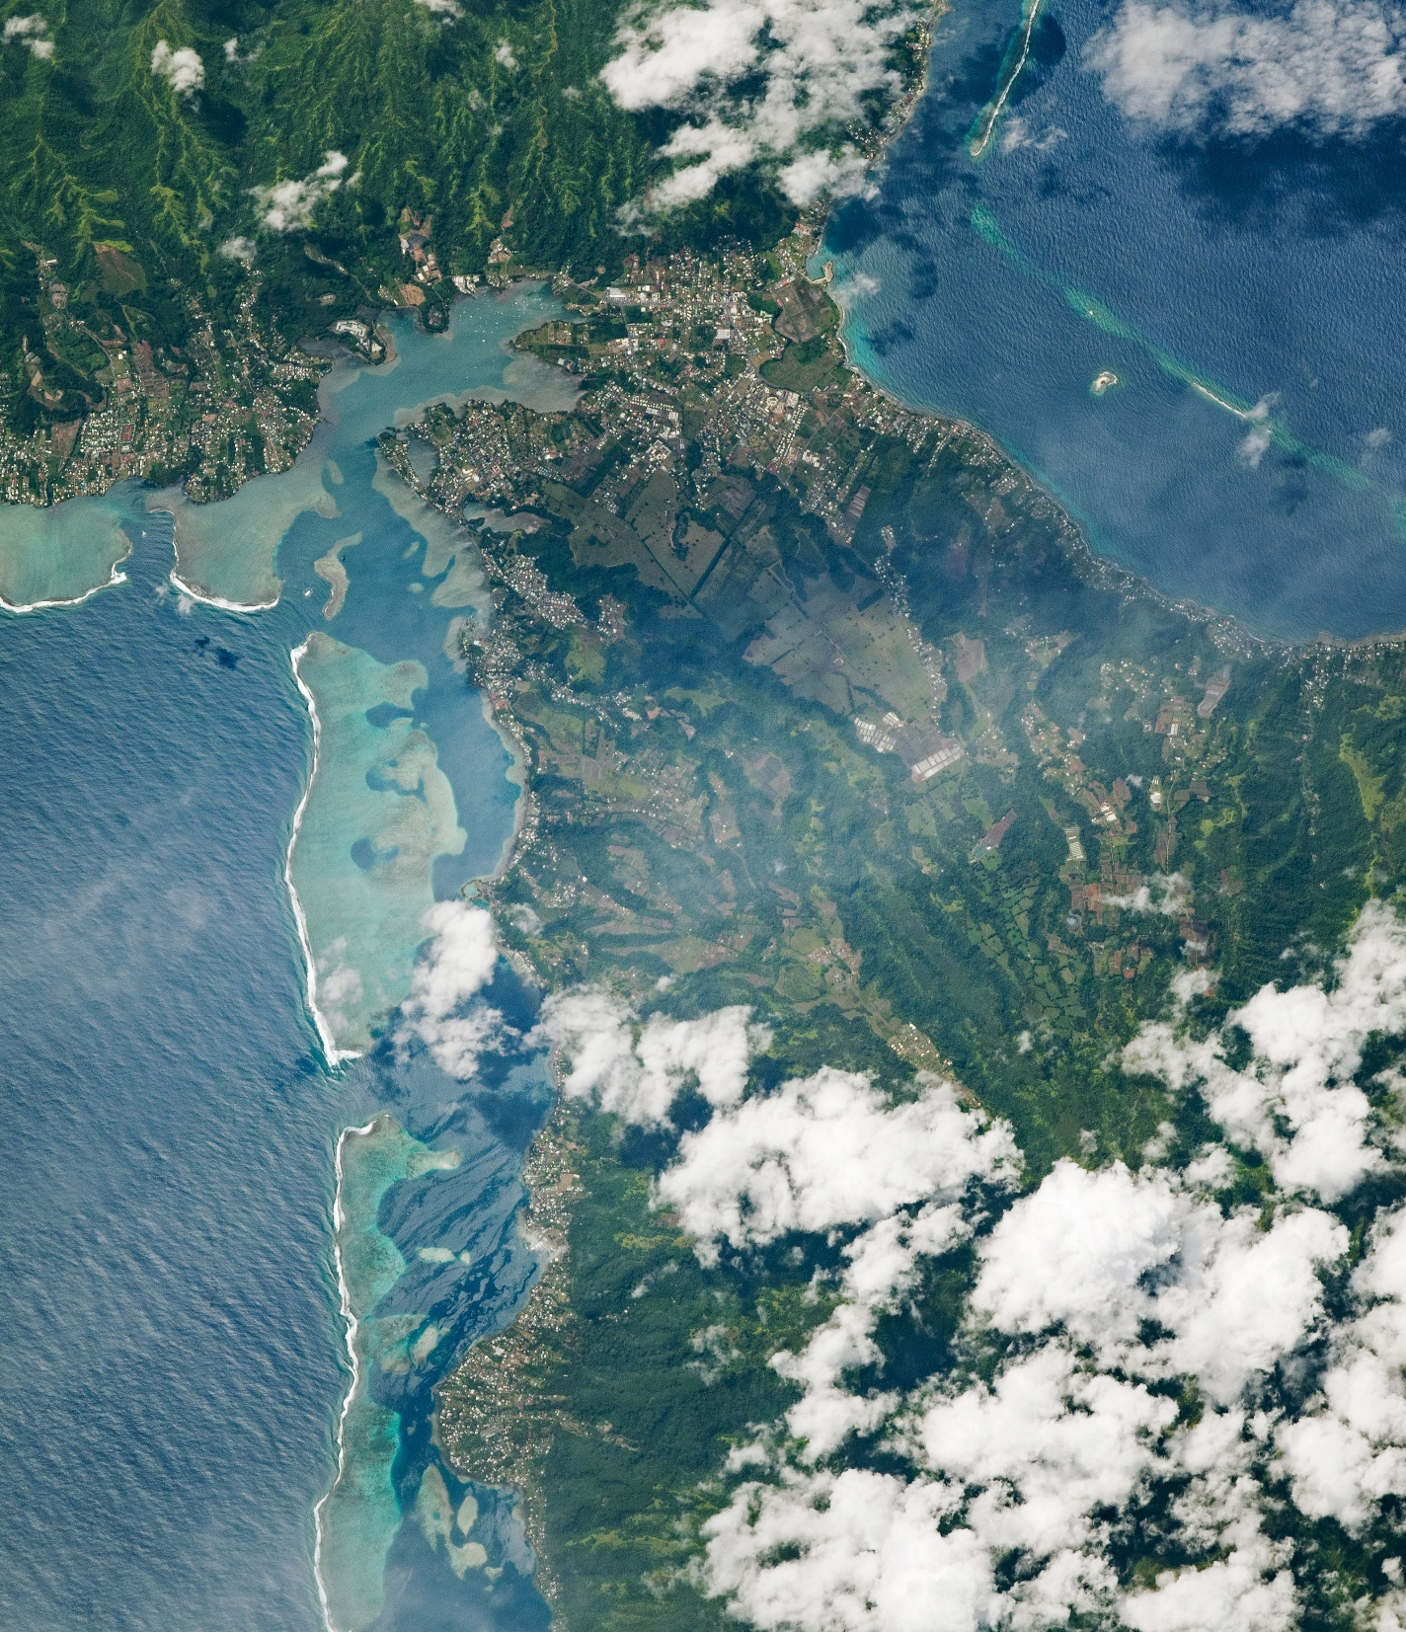
DEVELOP National Orientation (2023)
Module 5. Team Responsibilities

Slide 2
Responsibilities and Considerations

Slide 3


TEAM RESPONSIBILITIES
Project Team Responsibilities
Set goals and work towards them.
Complete all mandatory deliverables as well as any optional deliverables the team decides.
Support Project Leads in submission of deliverables and reporting to Lead/Fellows, who report to NPO.
Leave organized documentation of all research and contacts so the project and/or communication with end users may be continued in following terms.
Take initiative! Look at what else needs to be done when you have completed your assigned tasks.
Don’t feel bogged down by the chain of command – DEVELOP fosters open communication between all levels!
Network with other teams. Help other teams. Get help from other teams.
Have an open mind & learn from each other!

Slide 4

TEAM RESPONSIBILITIES
Scientific Integrity
“The iconic success of NASA is planted firmly on three foundational elements: innovation, inspiration, and integrity. While innovation and inspiration are visible through our endeavors and successes, it is our integrity – how we work, and our commitment to excellence and openness – that earns us the trust of the public and ensures our continued ability to inspire and innovate. Integrity is woven throughout the fabric of NASA. It has always been there. And each and every day, we recommit ourselves to keeping it there.”
Dr. Waleed Abdalati
Former NASA
Chief Scientist
NASA SI Policy: http://www.nasa.gov/pdf/611201main_NASA_SI_Policy_12_15_11.pdf

Slide 5
TEAM RESPONSIBILITIES
Research Misconduct
“fabrication, falsification, or plagiarism in proposing, performing, or reviewing research, or in reporting research results”
Federal definition of research misconduct:
Fabrication: Making up data or results and recording or reporting them.
Plagiarism: The appropriation of another person’s ideas, processes, results, or words without giving appropriate credit.
Falsification: Manipulating research materials, equipment, or processes, or changing or omitting data or results such that the research is not accurately represented in the research report.

Slide 6


TEAM RESPONSIBILITIES
Researcher Responsibilities
Researchers (all personnel involved in conceiving, designing, conducting and supervising research) have the responsibility to:
Uphold and embody the professional standards of the research community.
Exercise personal and professional honesty in proposing, designing, performing, and reporting research.
Maintain mutual respect with all members of the research team and accurately represent the contributions of each member’s work.
Not allow outside influence or pressure (e.g., political consideration, ideology, financial conflicts of interest, peer pressure, or individual opinion) to affect the results of research, input to or from advisory committees, or the dissemination of research and analysis.
Uphold all of NASA’s core values of ethical conduct and integrity.

Slide 7
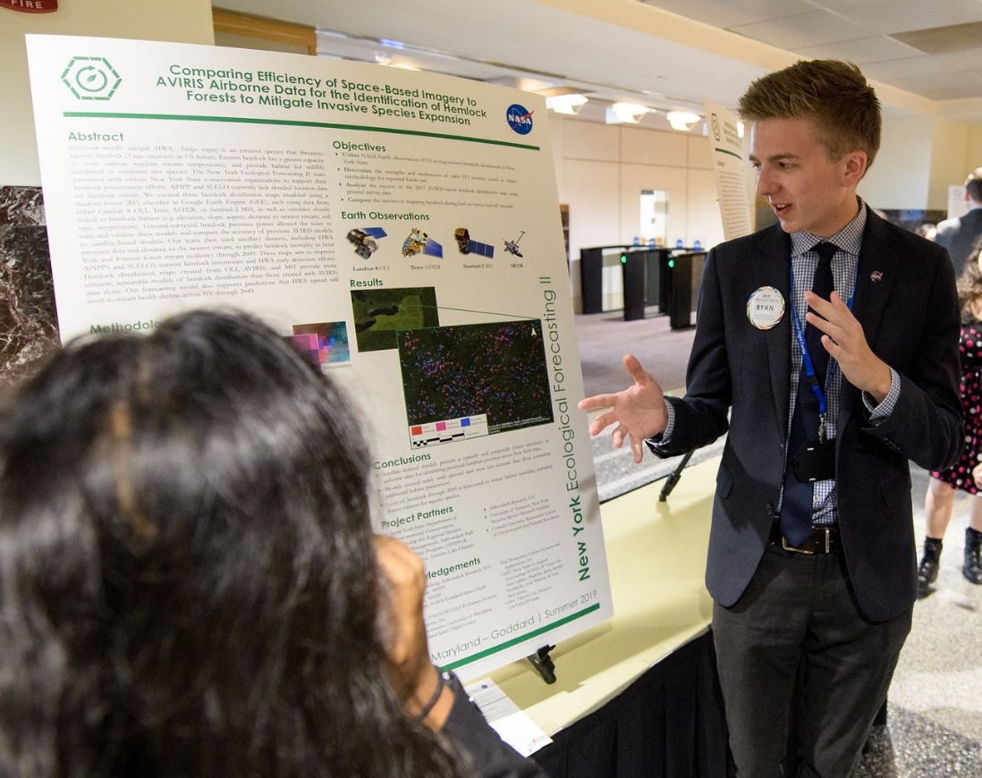
TEAM RESPONSIBILITIES
External Communications
A single DEVELOPer per team (usually the Project Lead) typically serves as the main point of contact to NPO, science advisors, and partners through email communication, leading project-related telecons, and coordination of team meetings.
Emails relating to your DEVELOP projects and being sent to international recipients should be reviewed by your Lead/Fellow & NPO, if necessary, before they are sent outside of DEVELOP.
CC your Lead/Fellow when sending ALL project-related emails – this ensures continuity of communication and knowledge after the project ends.
All participants should check their Space Systems-provided email each workday.

Slide 8
Deliverables

Slide 9
TEAM RESPONSIBILITIES
Project Deliverables
DEVELOP places equal emphasis on research & analysis and communicating your results.
Substantial efforts are put forth in developing deliverables that not only communicate the work done at DEVELOP, but enhance participants’ skills: technical writing, coding, science communication, effective visualizations, video editing, etc.
Deliverables are your opportunity to communicate your project work. Each deliverable is an example of your accomplishments. Use them to your advantage!
All deliverables are important and used by DEVELOP in a variety of ways which are laid out on following slides.
Download the deliverable calendar and pay attention to deadlines!

Slide 10
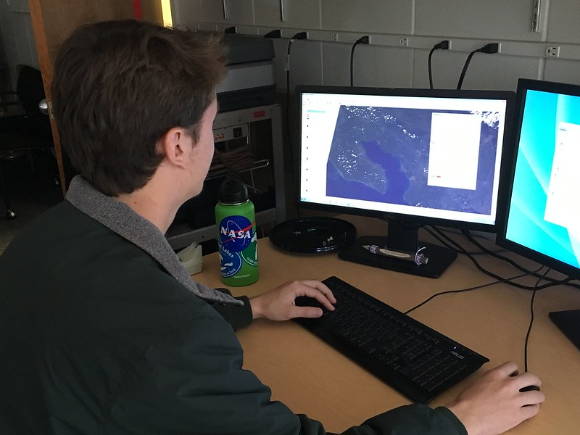
TEAM RESPONSIBILITIES
Project Deliverables
Best Practices
Tackle deliverables incrementally – start them early
Identify a POC within the team for each deliverable
Reuse content from one deliverable for another – while each demonstrates your project in a different method of communication, many have shared core elements
All deliverables must be reviewed by your Fellow before submitting to NPO
Build in time for Science Advisors to review as well, if available
Always review the deliverable checklist to ensure your deliverables are on point prior to submission to NPO. If it’s evident the checklist was not followed, we may ask you to resubmit!

Slide 11
TEAM RESPONSIBILITIES
Deliverable Submission
The Fellows supporting project coordination will work with you throughout the deliverable creation and submission process.
Each team has a designated Fellow to correspond with, as well as a set team of editors, throughout the whole term for continuity.
Any deliverable questions can be asked using the @Project Coordination tag in Teams or sent to your Project Coordination point of contact
To submit: All non-code deliverables will be uploaded to the respective folder in the DEVELOP Spring 2023 Teams channel.
YearTerm_Node_Team_Deliverable_Draft
Ex. 2021Sum_GA_EasternIndiaEcoII_Poster_FD
File Nomenclature
Node Acronyms:
ARC, CO, GA, GSFC, ID, JPL, LaRC, MA, MSFC, NC, VEJ, PUP
App Area Shorthand:
Ag, Disasters, Eco, Energy, HAQ, TI, Urban, Water, WildlandFires

Slide 12
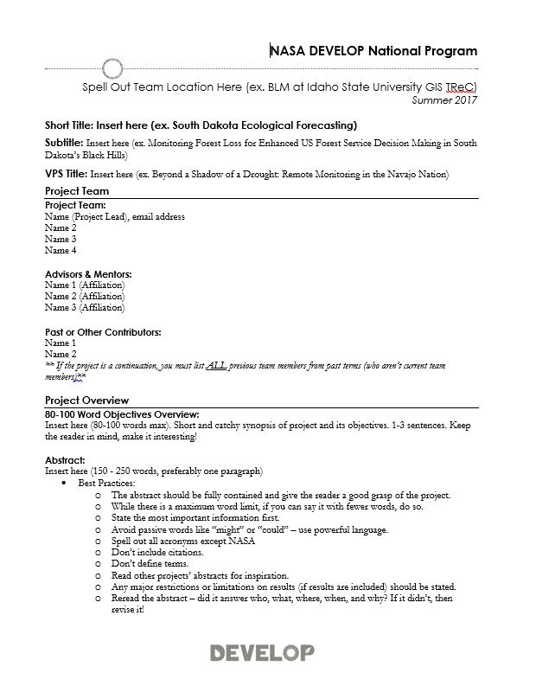
TEAM RESPONSIBILITIES
Project Deliverables
You’ll learn more about deliverables from the Project Coordination team’s Deliverables Tips & Tricks Webinars throughout the term, but it’s never too early to start thinking about deliverables!
Things to start thinking about now:
Communication Deliverable: If your team and partners are interested in creative ways to inform the public about your project, familiarize yourself with the optional Creative Communication deliverable. You can choose between a videos, one-page flyer, trifold brochure, or social media series! Consider what fits best for your project, consult with your partners, and submit your Creative Communication selection form in Week 4.
Code or Tutorial: You will work with the Geoinformatics team if you are developing any internal code or are creating a tutorial for your partners. Note, not all projects do this!

Slide 13
TEAM RESPONSIBILITIES
By The Way
Teams submit deliverables to the Fellow for a first review prior to submission to NPO! Take note of internal deadlines.
Deliverable Deadlines to NPO
Check out DEVELOPedia’s Deliverable Calendar
Week 1 – 1/26: Personality Assessment, DEVELOPedia Participant Page
Week 2 – 2/2: Entrance Personal Growth Assessment
Week 3 – 2/9: No deliverables due this week (savor it!)
Week 4 – 2/16: Creative Communications Selection Form
Week 5 – 2/23: No deliverables due this week
Week 6 – 3/2: No deliverables due this week
Week 7 – 3/9: Study Area Shapefile, Website Image, Creative Communication FD (Video Only)
Week 8 – 3/16: Presentation FD, Poster FD
Week 9 – 3/23: Creative Communication FD; Project Summary FD, DEVELOPedia Project Page
Week 10 – 3/27: Exit Personal Growth Assessment; 3/29: Anonymous Program feedback; 3/30: Tech Paper FD, Tutorial FD, GitLab Code Submission
New for Spring 2023
Rough drafts are out, checkpoints are in! See the detailed deliverable calendar on DEVELOPedia.

Slide 14
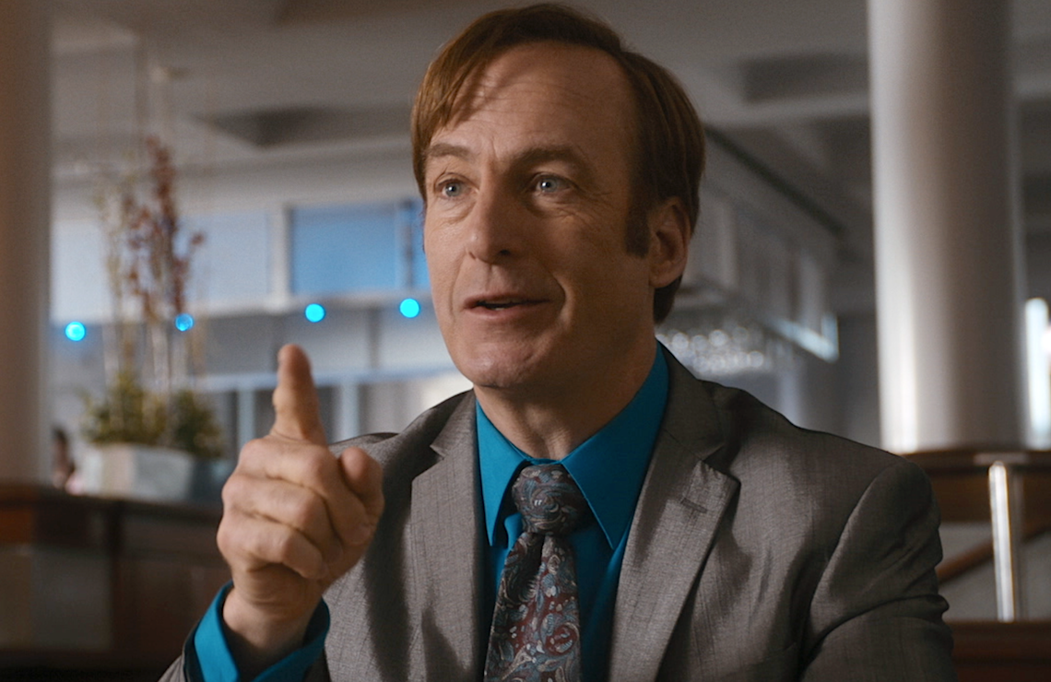

TEAM RESPONSIBILITIES
These statements are on all premade deliverable templates, but you’ll have to add it to your optional deliverables and custom templates!
Take it from me – I’m a lawyer!
Required Legal Statements
ALL deliverables and products created
by teams need to include this short
paragraph of legal statements:
“This material is based upon work supported by NASA through contract NNL16AA05C. Any mention of a commercial product, service, or activity in this material does not constitute NASA endorsement. Any opinions, findings, and conclusions or recommendations expressed in this material are those of the author(s) and do not necessarily reflect the views of the National Aeronautics and Space Administration and partner organizations.”

Slide 15
TEAM RESPONSIBILITIES
By The Way
Export Control only controls what deliverables can be shared externally. You are not only allowed to, but are encouraged to, discuss the details of your project with friends, family, colleagues, etc!
Export Control
Export Control is NASA’s program to ensure that scientific material being shared externally abides by federal regulations.
What does this mean to me?
BEFORE sharing any materials outside DEVELOP, check with NPO.
Some project materials can be shared without going through export control (map products, preliminary results, imagery, videos), others must gain NASA approval first (tech paper, poster, presentation).
All external publications (ex. peer-review publications) and conference presentations must also gain these approvals.
The PC team (Sophia, Tamara, and Cecil) are your Export Control points of contact.

Slide 16
TEAM RESPONSIBILITIES
Export Control
What is Export Control?
The NASA Export Control Program is based on the philosophy: “We want to maximize the benefits of our international efforts while ensuring that we comply with U.S. export control laws and regulations”. It is the personal responsibility of each employee or contractor to pursue appropriate international activities involving transfers of technologies, software, and commodities. The Agency’s Export Control Program is the mechanism that provides checks and safeguards at key steps to help manage international activities and ensures that NASA works within Export Administration Regulations (Department of Commerce) and the International Traffic in Arms Regulations (Department of State), which could result in criminal, civil, or administrative enforcement actions against NASA, individual employees, and/or private contractors.
NASA Administrator’s Export Control Policy:
"As a U.S. Government Agency on the forefront of technological development and international cooperation in the fields of space, aeronautics, and science, the National Aeronautics and Space Administration will strive to fulfill its mission for cooperative international research and civil space development in harmony with the export control laws and regulations of the United States. Due to heightened proliferation challenges facing the United States and the world, including risks posed by the spread of missile technologies and weapons of mass destruction, and in view of the significant criminal, civil, and administrative penalties that may affect the Agency and its employees as a result of a failure to comply with U.S. export control laws and regulations, it is the responsibility of every NASA official and employee to ensure that the export control policies of the United States, including nonproliferation objectives, are fully observed in the pursuit of NASA's international mission.“
Notes:
Fellows – skip if needed (participants can refer back later)

Slide 17
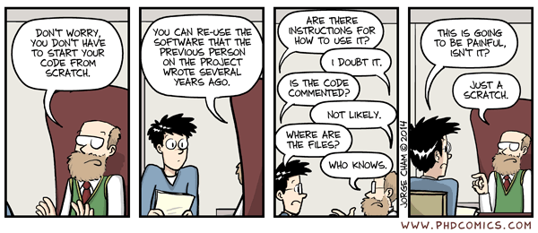
TEAM RESPONSIBILITIES
Why Use Best Practices?
Image Source: J. Cham. (2014, March 12). Comic number 1869. Piled Higher and Deeper . Retrieved from http://phdcomics.com/comics/archive_print.php?comicid=1689

Slide 18

TEAM RESPONSIBILITIES
Best Practices Summary
Project Success = Project Reproducibility
Tip 1: Organize Data Using a Directory Structure
Tip 2: Standardize File Nomenclature
Tip 3: Data Should be Analysis-Friendly
Tip 4: Document your Data
Tip 5: Document your Code
Tip 6: Document Your Methods
None of these processes are something you do once. It’s a continuous effort that should be discussed with your team multiple times during the term.

Slide 19
TEAM RESPONSIBILITIES
Quiz Time
Who should you cc on all project-related emails?
How do you submit deliverables?
Does each team have a designated PC support Fellow and consistent editors throughout the term?
Are the NASA legal statements required on ALL deliverables?
If you want to present or publish DEVELOP project materials in the future, would they have to go through export control?

Slide 20

Thank You.
Teamwork is dream work!

Slide 21
TEAM RESPONSIBILITIES
Why Do Best Practices Matter?
Terms are only 10 weeks long. Good data management practices allows Fellows or second term teams to answer questions about methods and results.
Best practices are important because…
DEVELOP may present your past project at a conference.
Teams often want to publish, which requires good organization. Future DEVELOP project teams may want to build on your data and methods.
Increase reproducibility of your methods
Reasons why we don’t always follow best practices:
We haven’t learned best practices.
We are in a hurry. Projects are just ten weeks long.
We want to provide our partners with results.
We document our work at the end of the term when we may leave out important steps.
We only document what worked. However, science is also about what doesn’t work.

Slide 22
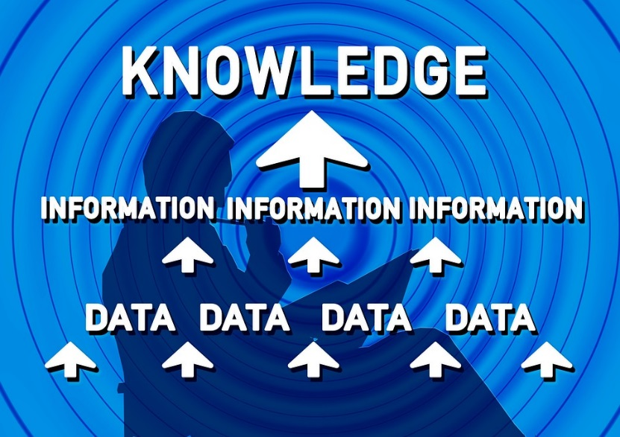
TEAM RESPONSIBILITIES
Data Management
"Data management is the development, execution and supervision of plans, policies, programs and practices that control, protect, deliver and enhance the value of data and information assets.”
Answers the questions:
Where did the original data come from?
What was done to the data?
Can I find the data again if needed?
Data should be well and consistently organized
Directory (folder) structure
File nomenclature
Analysis–friendly data
Documentation

Slide 23
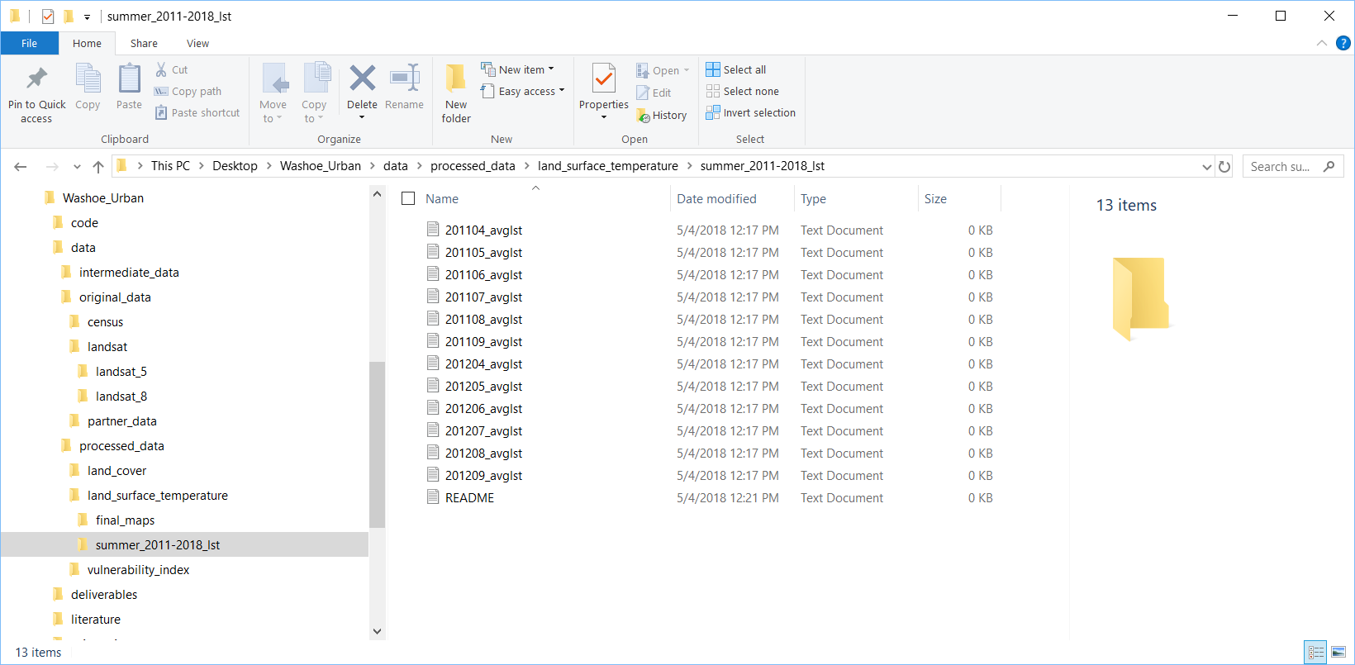
TEAM RESPONSIBILITIES
Tip 1. Organize Files
Directory Structure Example
Organize your team’s data using a directory structure
Segregate materials for a project into one directory:
Folders: data, methods, results, deliverables
Keep raw data separate from processed data
Include README files
README files describe the contents of a folder, list the files in that folder, and provide metadata
By The Way
This organizational approach applies equally to PCs, portable drives, or your SharePoint drive.

Slide 24
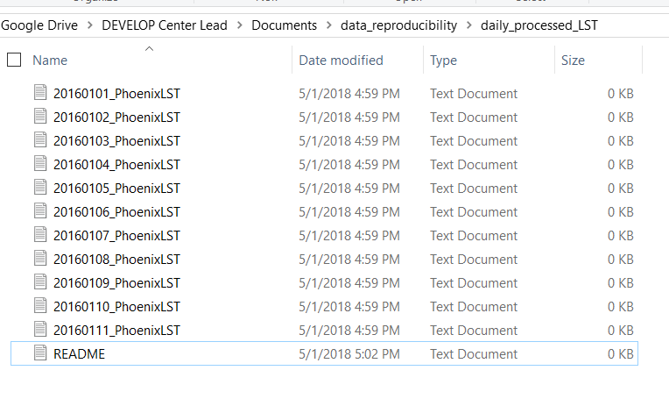
TEAM RESPONSIBILITIES
Tip 2. Standardize Nomenclature
File names should be:
  Machine Readable:
    Do not include special characters (%, $, &, etc.)
    Use underscores instead of spaces
    Example: 20171107_average_ndvi_by_census_tract.csv
  Human Readable:
    File names should briefly, but adequately, describe the contents of the file
    It can be useful to note the version of the file by adding v1, v2 etc. in the file name
    Bad Example: landcover_test2.tif
    Good Example: 2016_Phoenix_landcover_v2.tif
File names should work well with default ordering
  Name the files so that they default in chronological order

Slide 25
TEAM RESPONSIBILITIES
Tip 3. Analysis-Friendly Data
Data Tables should be either Wide or Long formats
Each row is a unique observation
Each column is a variable
DO NOT combine multiple variables in one column
Census_TractID | Date | Year | Month | Metric | Value
51043 | 2012-06 | 2012 | 6 | Avg_LST | 38.20
51043 | 2012-06 | 2012 | 6 | Avg_NDVI | -0.16928
51043 | 2012-07 | 2012 | 7 | Avg_LST | 36.84
51043 | 2012-07 | 2012 | 7 | Avg_NDVI | 0.359118
51043 | 2012-09 | 2012 | 9 | Avg_LST | 33.65
51043 | 2012-09 | 2012 | 9 | Avg_NDVI | 0.693757
51045 | 2012-06 | 2012 | 6 | Avg_LST | 37.03
51045 | 2012-06 | 2012 | 6 | Avg_NDVI | 0.619561
51045 | 2012-07 | 2012 | 7 | Avg_LST | 44.04
51045 | 2012-07 | 2012 | 7 | Avg_NDVI | -0.93069
51045 | 2012-09 | 2012 | 9 | Avg_LST | 37.58
51045 | 2012-09 | 2012 | 9 | Avg_NDVI | 0.974952
Long
Wide
Census_TractID | Date | Year | Month | Avg_LST | Avg_NDVI
51043 | 2012-06 | 2012 | 6 | 38.20 | -0.16928
51043 | 2012-07 | 2012 | 7 | 36.84 | 0.359118
51043 | 2012-09 | 2012 | 9 | 33.65 | 0.693757
51045 | 2012-06 | 2012 | 6 | 37.03 | 0.619561
51045 | 2012-07 | 2012 | 7 | 44.04 | -0.93069
51045 | 2012-09 | 2012 | 9 | 37.58 | 0.974952

Slide 26
TEAM RESPONSIBILITIES
Tip 4. Document Data
Document EVERYTHING!
The audience of your tech paper should be able to find the exact data used by your team!
Document the sources of your data – explain what the data is, where it was obtained, and how it was used.
Keep a copy of all data used for analysis, results, images and tables.
Document why you chose your data. Be specific.
  “We used the least cloudy scene for each year in the study period (Table A).”
Document any processing and/or modification of your data.
  This includes clipping, reprojecting, cloud removal, etc.
More info: https://gigascience.biomedcentral.com/articles/10.1186/s13742-016-0135-4

Slide 27
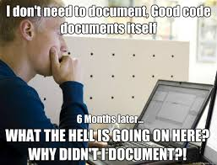
TEAM RESPONSIBILITIES
Tip 5. Document Code
Computational reproducibility is the ability to exactly reproduce results given the same data. This is why DEVELOP requires comments on code for software release.
Best Practices for Comment Code
  Leave your self notes as you are working on your code.
  Remove personal notes and clean up your comments once your code is finalized.
  A reader should understand exactly what your code does, even if they aren’t familiar with your coding language. Every step should be explained.
    Suggestion: Have another team read your code.
Things to consider:
Is your code well-commented?
Is your code stored in a way that it is available to future teams? https://github.com/NASA-DEVELOP or local node repository
Have you indicated your operating system(s), software dependencies, and the analytical software (and versions) that were used?
Did you use any unusual computer configurations or non-default parameters?
Is your data documented?
Need help? Contact Geoinformatics at DEVELOP.Geoinformatics@gmail.com

Slide 28
TEAM RESPONSIBILITIES
Tip 6. Document Methods
Document, Document, Document!
Document your decisions.
Why did you choose your methods? Are there better methods?
Keep a list of all equations or formulas.
Keep track of both failures and successes.
Document exact steps of final methods.
Think of this as a tutorial. Someone should be able to replicate your methods with this document. This can be an optional deliverable for your partner.
This will become the “Methods” section of the tech paper.

