Slide 1
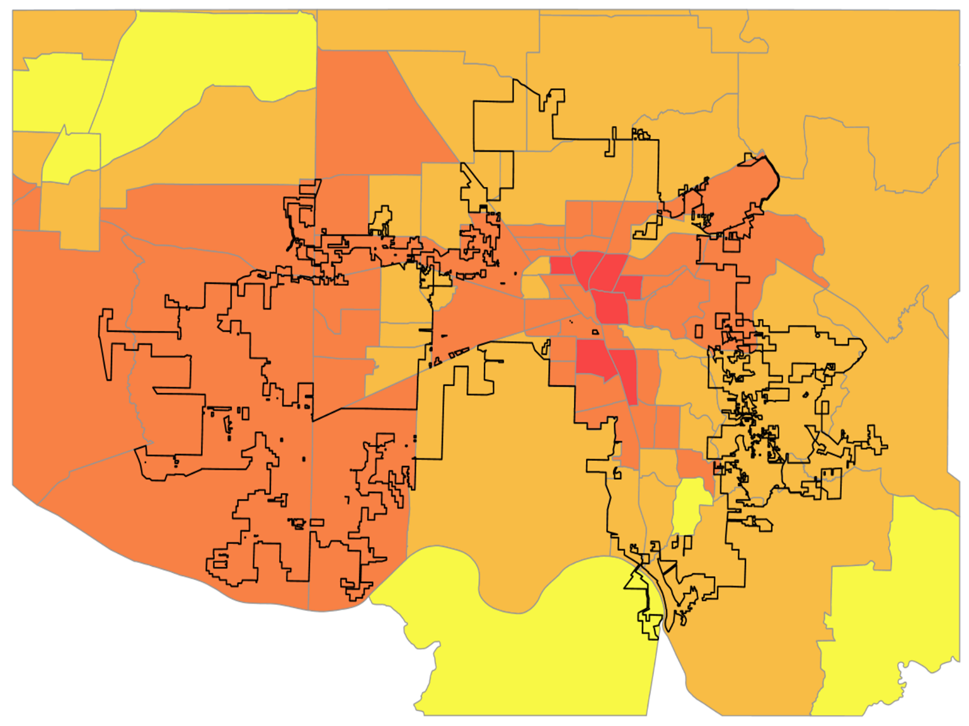
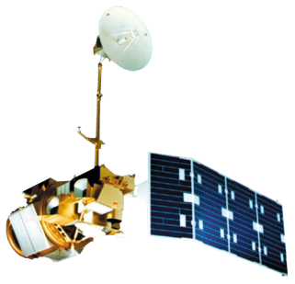
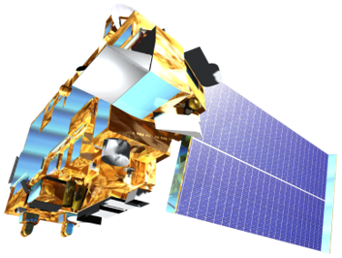
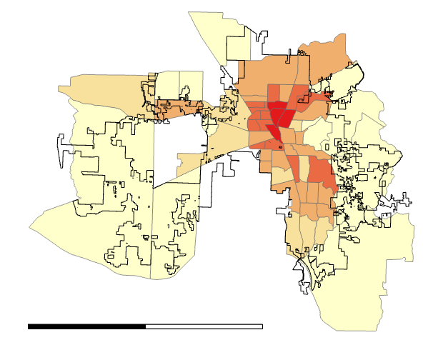
Utilizing NASA Earth Observations to Evaluate Urban Tree Canopy and Land Surface Temperature for Green Infrastructure Development and Urban Heat Mitigation in Huntsville, AL
Abstract
Project Partners
Study Area
Huntsville Urban Development
Huntsville, Alabama’s population has grown by approximately 11% since 2010, due in part to the city’s advancing engineering industry. Rapid urban growth negatively impacts the environment by decreasing tree canopy cover and increasing impervious surface cover, which can intensify the urban heat island effect. To examine the impacts of this urban growth on the environment, the team partnered with the City of Huntsville to utilize Landsat 5 Thematic Mapper (TM), Landsat 8 Operational Land Imager (OLI) and Thermal Infrared Sensor (TIRS), Terra Moderate Resolution Imaging Spectroradiometer (MODIS) and the International Space Station’s Global Ecosystems Dynamic Investigation (GEDI) and ECOsystem Spaceborne Thermal Radiometer Experiment on Space Station (ECOSTRESS). The team utilized these Earth observations in combination with ancillary datasets to create a suite of end products to assist in mitigating the effects of extreme heat due to urban expansion and tree canopy loss. Annual land surface temperature (LST) was calculated and land cover classes were derived through supervised and threshold classification methods to distinguish trees, other vegetation types, impervious surfaces, and water. From 2010 to 2019, LST increased approximately 4 °F for all census tracts within the city and the total amount of tree cover increased by approximately 3%. The findings will aid the city in future decision-making processes by indicating areas that would benefit from increased green infrastructure.
The City of Huntsville: Urban and Economic Development, Geographic Information Systems (GIS), Urban and Long-Range Planning, City Planning, Landscape Management, and City Engineering
Huntsville
0 20
MS
AL
GA
Miles
FL
Results
0 200
Miles
LST Change from 2010 to 2019
Change in LST (°F)
+ 0 – 2 °F
+ 2 - 4 °F
+ 4 – 6 °F
Objectives
+ 6 - 8 °F
City of Huntsville
Quantify the impact of Huntsville’s urban expansion on tree canopy cover, impervious surfaces, and land surface temperature
Assess the relationship between factors of social vulnerability, tree canopy cover, expansion of impervious surfaces, and land surface temperature
Provide tree canopy and heat vulnerability analysis to allow end users to incorporate this information into future decision-making
Census Tracts
0
10
N
20 miles
Earth Observations
Landsat 5 TM
ISS ECOSTRESS
and GEDI
Landsat 8​
OLI and TIRS
Terra MODIS
Methodology
LST
2019-
2020
End Products
Urban Heat Health Risk Map
ArcMap
UHI Identification
Overall Heat Vulnerability
Huntsville City Limits
Land Cover
2010 -2019
Census Tracts
NASA EOs
Google Earth
Engine
Health Data
LST/ Land Cover Timeseries
Lowest vulnerability
LST
2010 - 2019
HVI
Highest vulnerability
Urban Heat Health Risk
0
20 miles
No data
PCA with
R Studio
Conclusions
R Studio
and ArcPro
GEDI
Tree Survey
Tree Canopy Cover Survey
LST has increased by approximately 4 ̊ F while tree cover has increased by 3% across the city from 2010 to 2019.
Urban expansion in Huntsville has not substantially impacted tree canopy cover from 2010-2019.
GEDI data revealed that average tree height was 82 feet and mean plant area index was 3.
Team Members
Acknowledgements
Advisors: ​Dr. Jeffery Luvall (NASA Marshall Space Flight Center), Dr. Robert Griffin (University of Alabama in Huntsville), and​ A. R. Williams (NASA DEVELOP)​
DEVELOP Mentors: ​Helen Baldwin (NASA SERVIR), ​Christine Evans (University of Alabama in Huntsville), and ​Madison Murphy (Optimal GEO​)
Partners: Shane Davis, Frances Akridge, Lady Kassama, Amy Kenum, Nicholas Haney, Dennis Madsen, Ken Newberry, Kathy Martin, Gary Gleason, and Marc Byers
Greta Paris
Project Lead
Sabine Nix
Thomas Quintero
Amanda Tomlinson
Alabama – Marshall

