Slide 1
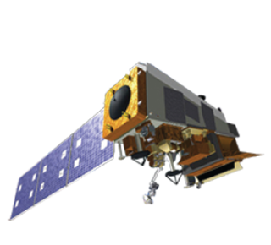
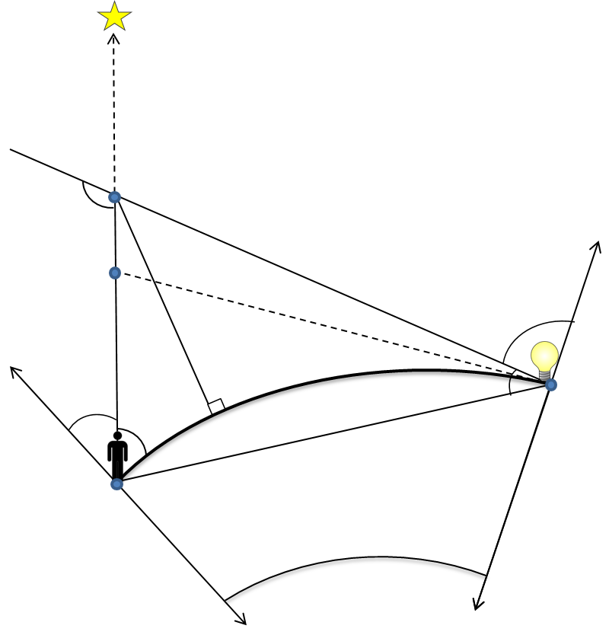
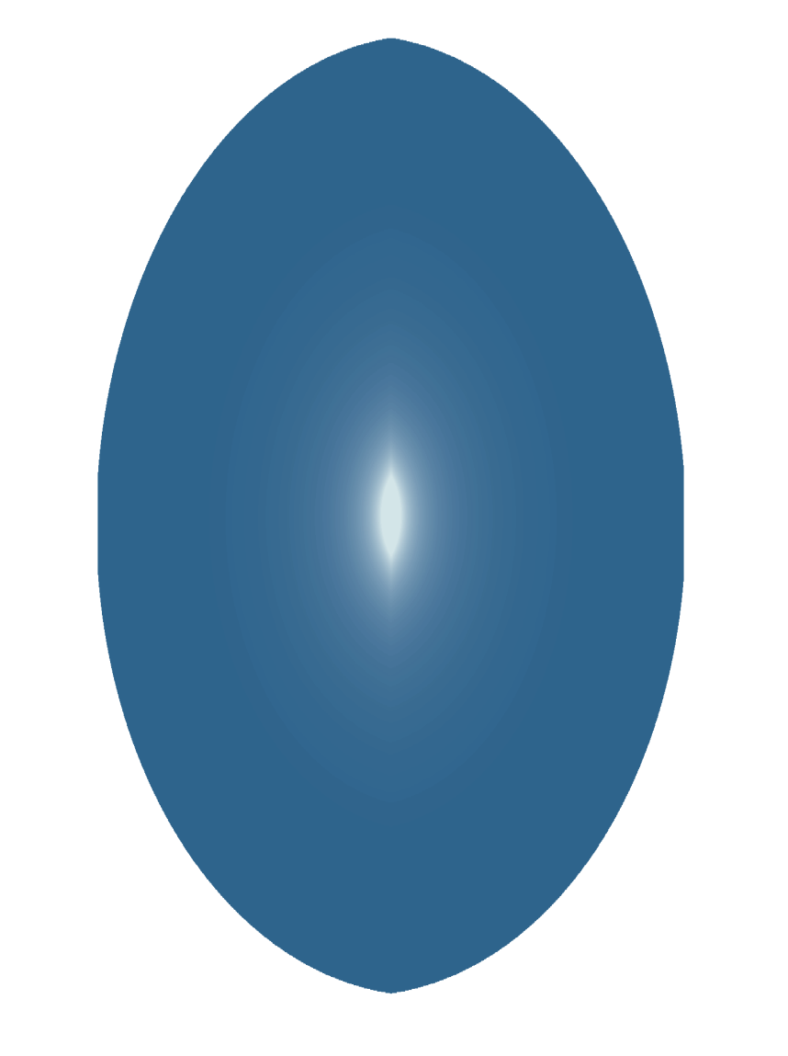
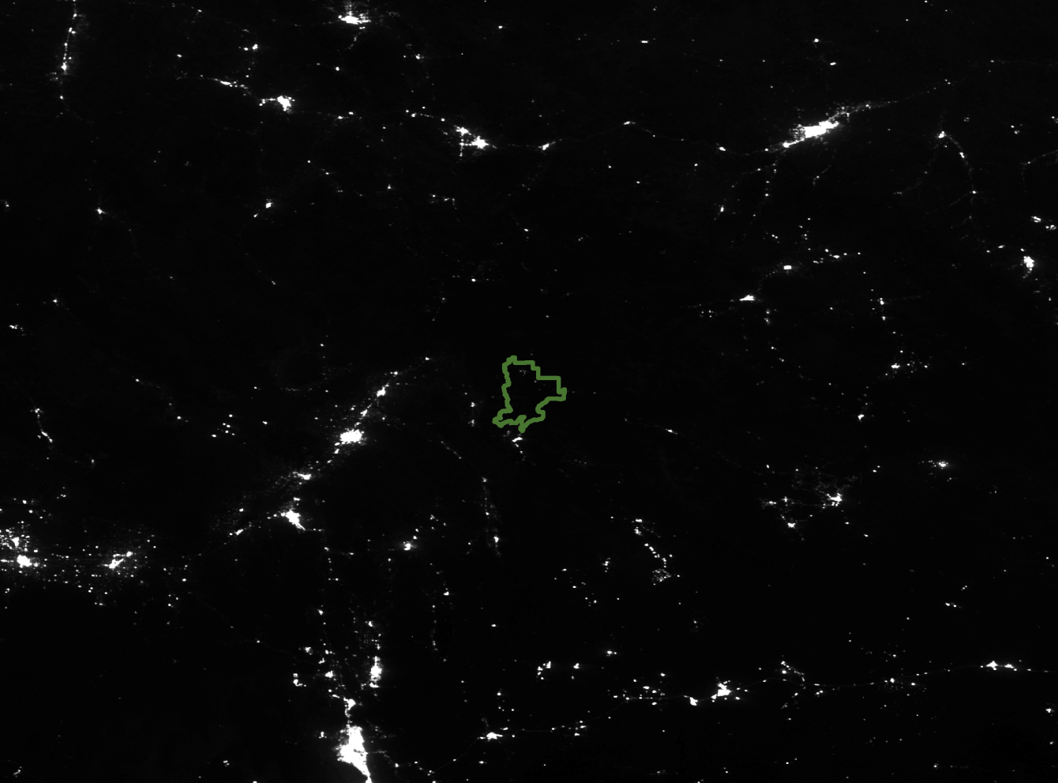
Utilizing NASA Earth Observations to Detect Changes in Nighttime Sky Brightness in Grand Teton National Park
Abstract
Objectives
Light pollution causes measurable damage to natural wildlife behaviors and human health, as well as decreases the ability for humans to view the night sky. The artificial brightening of the night sky, or sky glow, created by light pollution subjects nearly 100% of Americans to light-polluted skies with only three percent able to see the Milky Way from their homes. Historically, Grand Teton National Park has been a refuge for those seeking dark night skies; however, the quality of these skies is threatened by the spread of light pollution from nearby towns. The NASA DEVELOP Wyoming Cross-Cutting team partnered with Grand Teton National Park, the International Dark-Sky Association, and Wyoming Stargazing to utilize NASA Earth observations to identify sources of light pollution within the park, and the surrounding states up to a 300 km buffer. Utilizing Suomi NPP VIIRS Day/Night Band data and equations derived from Falchi et al.’s (2016) model of light emission, the team developed a convolution matrix to be used in the summer term to calculate sky glow levels and estimate light pollution within the park. The products will allow partners to assess areas where changes in lighting practices were effective, and suggest where mitigation is needed to reduce light pollution.
Quantify sources of anthropogenic sky brightness and its impact on recreational night sky viewing within Grand Teton National Park
Evaluate and inform anthropogenic light mitigation practices in the neighboring communities of Teton Village, WY and Idaho Falls, ID
Derive an equation to mathematically model scattered light in and around Grand Teton National Park
Study Area
Methodology
Earth
Observation
Model point-to-point scattering
Create propagation function script
Define light scatter geometry
MT
Mathematical Model Creation
Grand Teton National Park
Collect VIIRS DNB Data
Remove IR anomalies and outliers
Produce composite images
ID
Image Processing
Suomi NPP Visible Infrared Imaging Radiometer Suite (VIIRS)
WY
N
0 30 60 120 240 360 480
Kilometers
UT
Preliminary Results
Wyoming Cross-Cutting
$$ω$$
$$s$$
$$u_{0}$$
$$Ψ$$
$$u$$
$$h$$
$$D$$
$$Φ$$
$$z$$
$$θ$$
l
$$R_{T}$$
χ
$$R_{T}$$
This diagram depicts the geometry of light as it scatters through the atmosphere. Adapted from Falchi et al., 2016.
This image is a visual representation of the propagation function that will run over the VIIRS DNB imagery.
The above image displays a VIIRS Day/Night Band monthly composite corrected for infrared anomalies.
Conclusions
Limitations of VIIRS DNB data, such as infrared sensitivity and blue-blindness, indicate a need for further investigation and statistical correction.
A mathematical model calculating the atmospheric scattering of light and use of a light-propagation function will assist in creating a map of sky-glow.
The model will be used in future terms of this project to provide end-users a better understanding of the health of the local night skies.
Acknowledgements
Project Partners
Team Members
-Science Advisors-
Dr. L Dewayne Cecil NOAA NCEI, Global Science & Technology, Inc.
Dr. Kenton Ross NASA Langley Research Center
Bob VanGundy The University of Virginia’s College at Wise
-Project Partners-
Randy Stanley National Park Service, Intermountain Region
Dan Greenblatt National Park Service, Grand Teton National Park
John Barentine International Dark-Sky Association
Samuel Singer Wyoming Stargazing
-Other-
Ryan Avery NASA DEVELOP National Program
Michael Brooke Center Lead, Wise County Clerk of Circuit Court’s Office
International Dark-Sky Association
&
Wyoming Star Gazing
Ben Marcovitz
Co-team Lead
Veronica Warda
Co-team Lead
Eric White
Aubrey Hilte
Christine Stevens
Wise County Clerk of Circuit Court’s Office – Spring 2017

