Slide 1
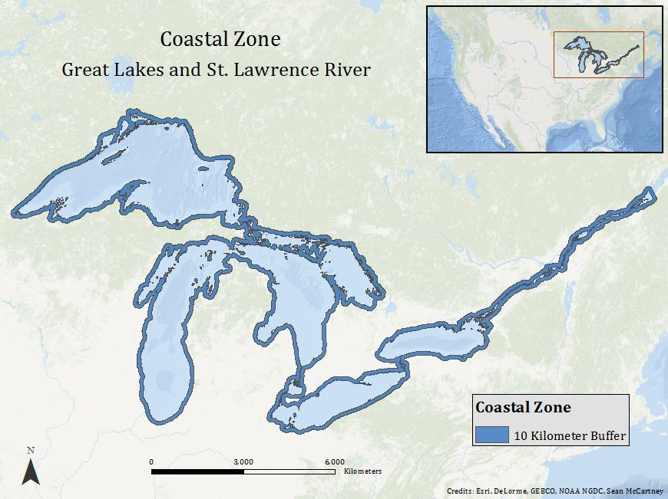
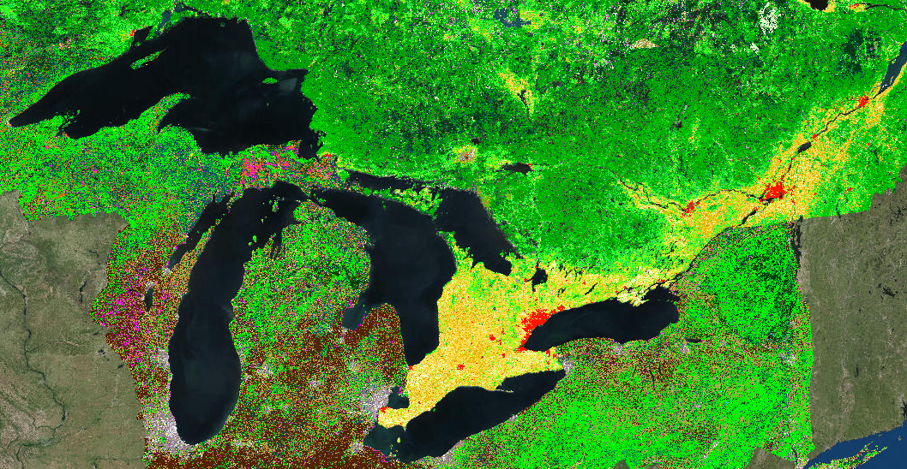
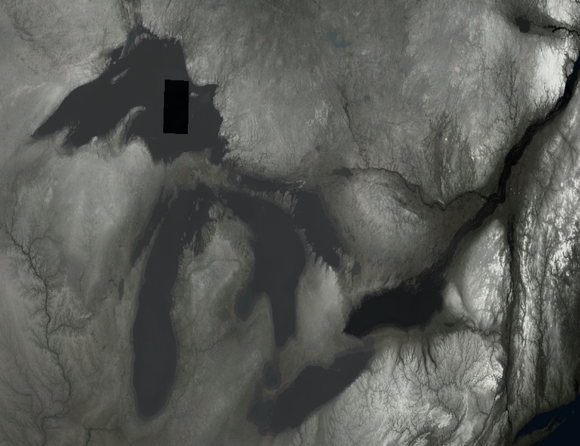
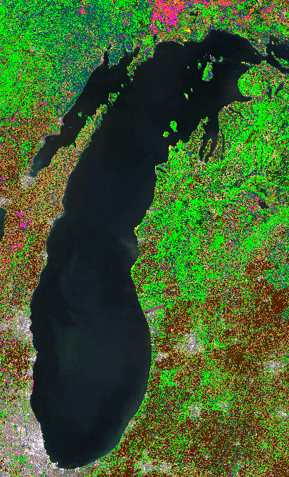
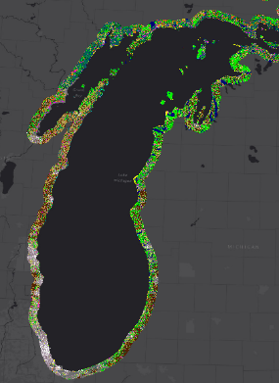
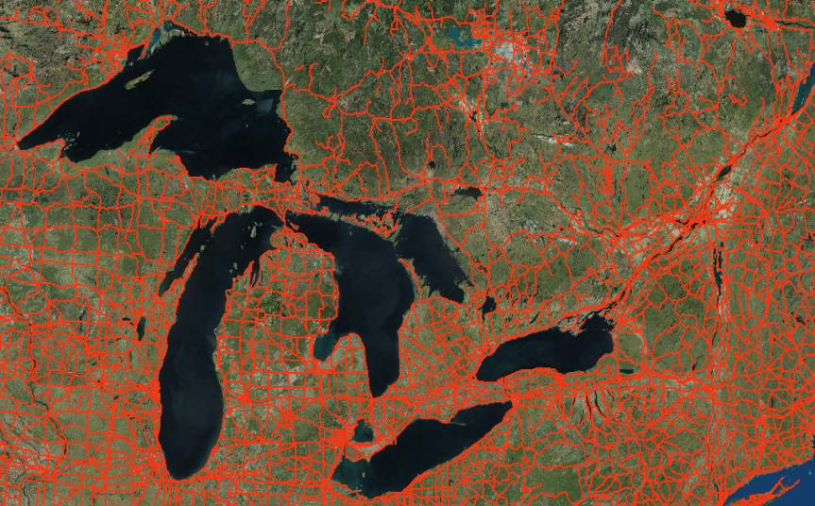
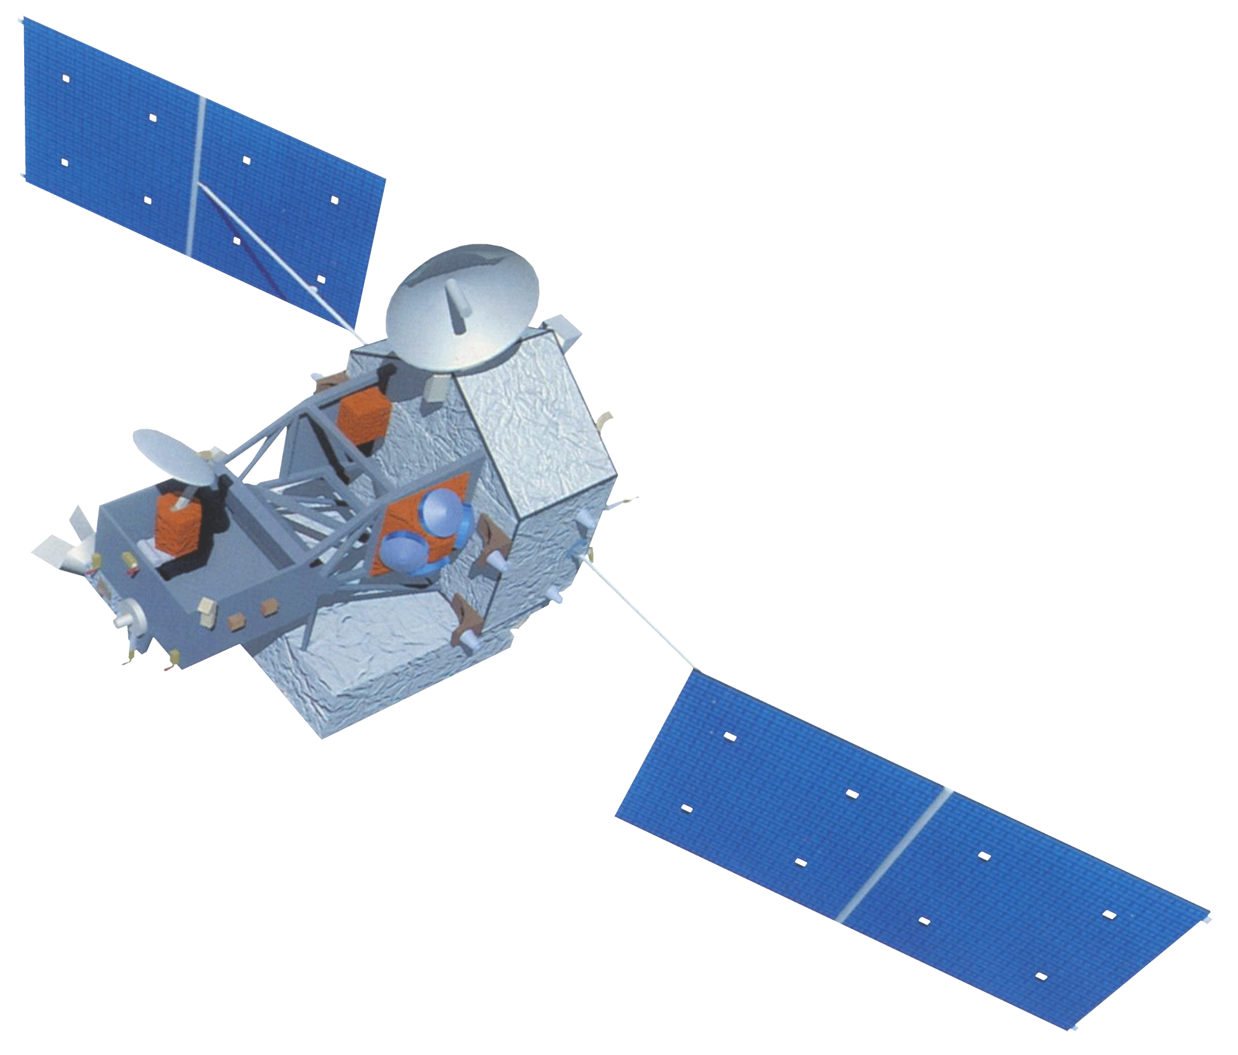
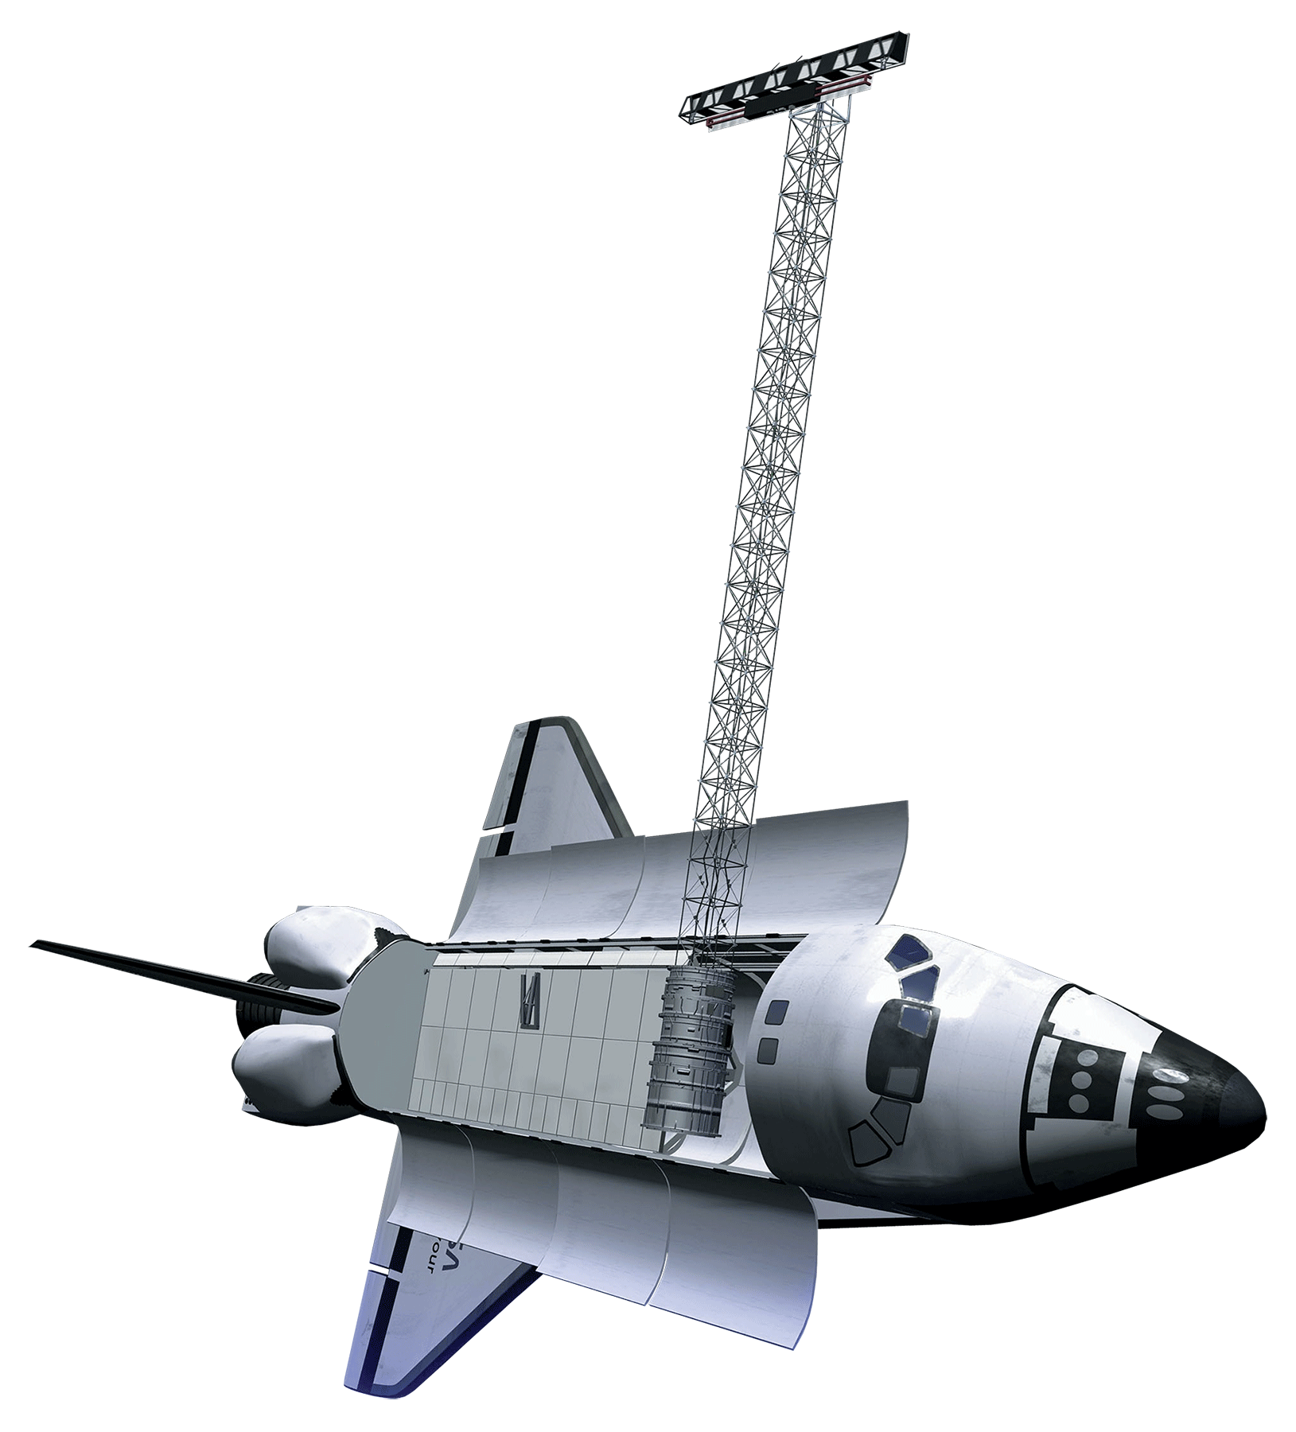
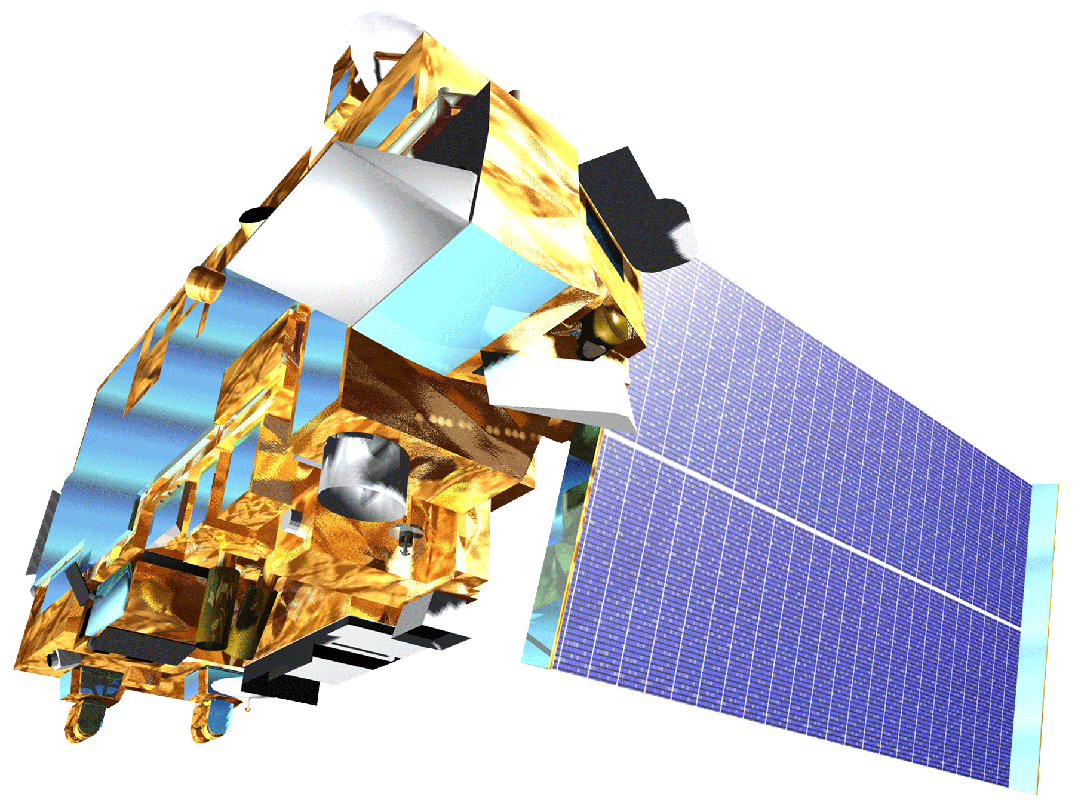
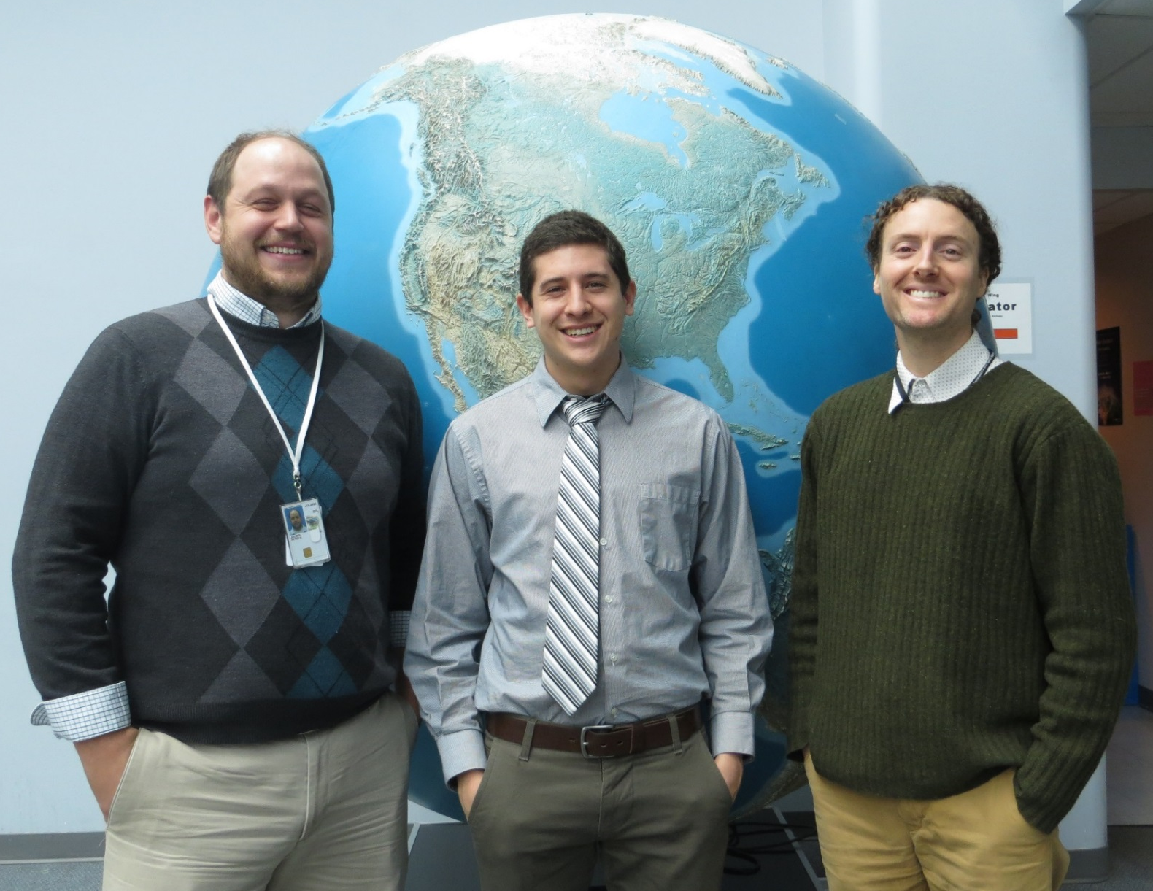
Great Lakes Ecological Forecasting
Utilizing NASA Earth Observations to Monitor and Forecast the Spread of Phragmites australis in the Great Lakes Basin
Issac Kinton (Project Lead), Sean McCartney, Peter Jacobs
DEVELOP National Program at NASA Goddard Space Flight Center
Abstract
Objectives
Keep this blank for now.
Body text point size should be at least 24.
Caption text point size should be at least 16.
Feel free to rename, move, and resize sections as needed.
Assess the value of Earth observations, and ancillary data, in creating environmental variables as inputs for habitat modeling
Model a current risk map of Phragmites australis for the 10 kilometer coastal zone within the Great Lakes and St. Lawrence River Basin
Model land change in the study area and use as driver variables for ecological forecasting
Forecast a risk map of Phragmites australis for 2020 for the 10 kilometer coastal zone within the Great Lakes and St. Lawrence River Basin
Methodology
Study Area
Datasets
Project
Reclassify
Resample
Clip
Mosaic
Analysis
Land Use & Land Cover (LULC)
DEM
Roads
Soils
Precipitation
Temperature
Presence locations of Phragmites australis
Maximum Entropy for Habitat Suitability Modeling (MaxEnt)
Risk Modeling
Forecasting
Current Risk Map (MaxEnt)
Land Change Modeler (TerrSet)
Future Risk Map (MaxEnt)
Earth Observations
TRMM
SRTM
Results
Terra
Use images.
Make sure that it has some sort of flow, that it makes sense. Show your results in a logical order.
No bullets.
Project Partners
Laura Bretheim (Great Lakes and St. Lawrence Cities Initiative)
Dr. Laura Bourgeau-Chavez (Michigan Tech Research Institute)
Acknowledgements
Simon Belisle (Great Lakes and St. Lawrence Cities Initiative)
David Ullrich (Great Lakes and St. Lawrence Cities Initiative)
Dr. Kurt P. Kowalski (United States Geological Survey)
Dr. Patricia Chow-Fraser (McMaster University)
Emily Adams (DEVELOP)
Team Members
Conclusions
Use bullets.
Use complete sentences with periods.
Left to Right: Peter Jacobs, Issac Kinton, Sean McCartney
NASA Goddard Space Flight Center

