Slide 1

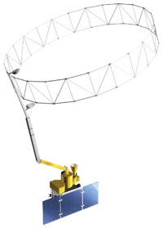
Texas Water Resources II
Using NASA earth observations to assess soil moisture in Texas for wildfire prediction and mitigation
Greggory Hoobchaak (Project Lead), Jessica Jozwik, Alyx Riebeling
Abstract
Objectives
Validate SMAP satellite data with in situ data.
Develop an error correction model to situate SMAP data within existing predictive models
Communicate lessons learned working with SMAP data
Study Area
Study Area:
Texas
Study Period:
2015
Methodology
.
Validate
Make grid polygon
Visualize
Find the average soil moisture volume with optimized SCAN/Mesonet Data
Apply
Index SCAN and Mesonet Data
Compare to SMAP data
Geostatistical interpolation with SCAN/Mesonet Data
Compare to SMAP data
Use ModelBuilder to iterate through available data
View Rolling Three Day Minimum
Earth Observations
Soil Moisture Active Passive (SMAP)
Conclusions
Results
Team Members
Project Partners
Acknowledgements
Greggory Hoobchaak, Jessica Jozwik, Alyx Riebeling
Texas Forest Service
Curt Stripling, Geospatial System Coordinator
Tom Spencer, Department Head of Predictive Services
We would like to thank the following people for their assistance and guidance:
Emily Adams, Center Lead at DEVELOP Langley Research Center
Dr. Kenton Ross, Science Advisor
NASA DEVELOP Texas Water Resources I Team:
Megan Buzanowicz
Laura Lykens
Zacary Richards
Jeff Close
NASA Langley Research Center

