Slide 1
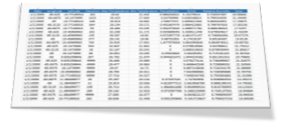
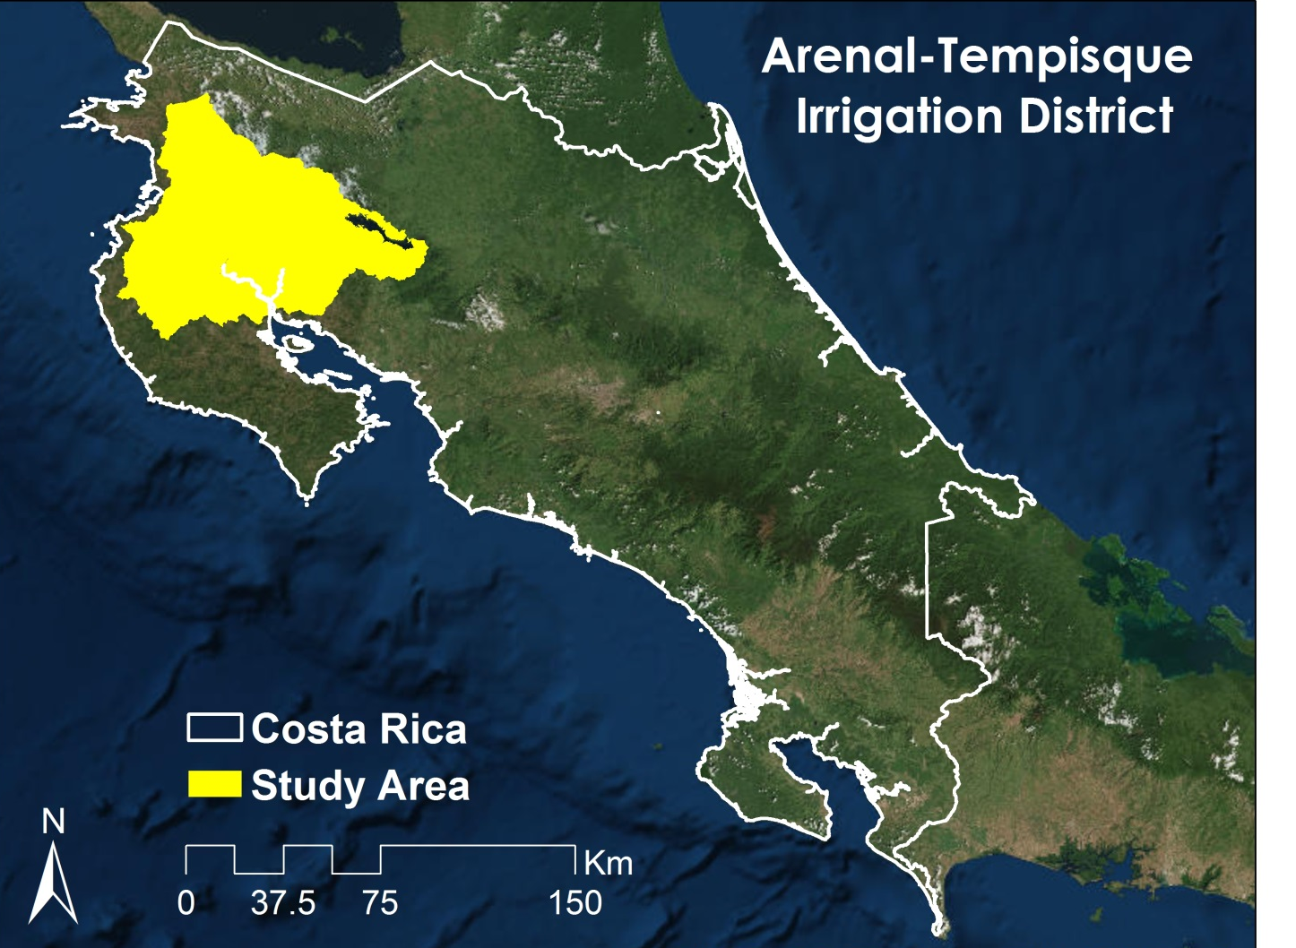
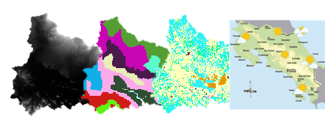
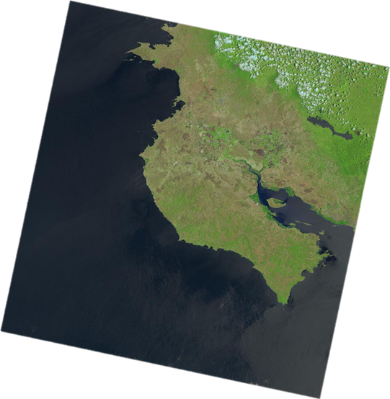
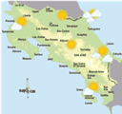
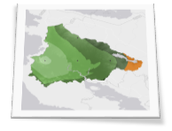
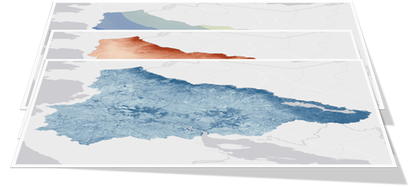
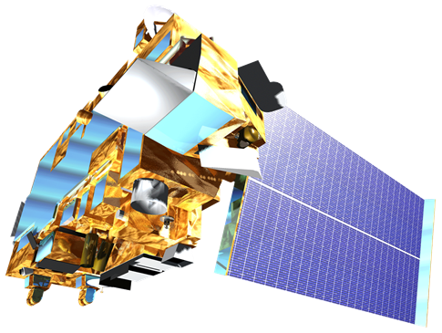
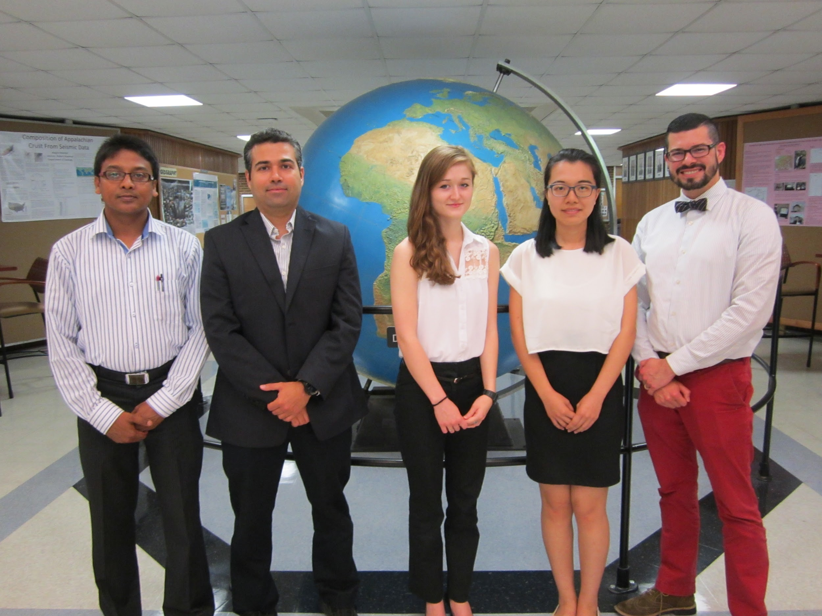
Costa Rica Water Resources II
Utilizing NASA Earth Observations to Develop a Comprehensive Water Budget for the Arenal-Tempisque Irrigation District of Costa Rica
Veronica Fay (Project Lead), Steve Padgett-Vasquez, Caren Remillard, Eduardo Rendon, Kamala Kanta Sahoo, Xuan Zhang
NASA DEVELOP University of Georgia
Abstract
Objectives
Keep this blank for now.
Body text point size should be at least 24.
Caption text point size should be at least 16.
Feel free to rename, move, and resize sections as needed.
Create a SWAT (Soil and Water Assessment Tool) model to simulate and assess the local hydrological processes
Utilize METRIC (Mapping Evapotranspiration at high Resolution and with Internalized Calibration) model to supplement SWAT’s evapotranspiration (ET) values
Update water inventory using the model’s final outputs to facilitate future water management policies
Develop tutorials for SWAT, SWAT Calibration Uncertainty Procedures (SWAT-CUP), and METRIC models allowing partners to replicate methods and update their water budget
Methodology
Study Area
Literature Review
Data Acquisition
GIS & Remote Sensing Processing
DEM Soil Land Use Weather
In situ stream gage data
Landsat 8 OLI image Weather
S W A T
SWAT CUP
METRIC
Earth Observations
Landsat 8 - OLI Terra - ASTER
Comprehensive Water Budget for the Arenal-Tempisque Irrigation District
Video Tutorial for End-User
Results
Conclusions
Use images.
Make sure that it has some sort of flow, that it makes sense. Show your results in a logical order.
No bullets.
Use bullets.
Use complete sentences with periods.
Team Members
Project Partners
Acknowledgements
SENARA (Costa Rica’s National Service of Underground Water, Irrigation, and Drainage)
University of Georgia Costa Rica
Costa Rican Embassy to the United States
Dr. Adam Milewski -- Department of Geology, University of Georgia
Dr. Kenton Ross -- NASA DEVELOP National Program
Dr. Marguerite Madden -- Department of Geography, University of Georgia
Javier Artiñano Guzmán -- SENARA
Other Contributors: Rachel Will, Benjamin Page, Grant Bloomer, Sarah Medley, Wondwosen Seyoum
Kamala Kanta Sahoo, Eduardo Rendon, Veronica Fay, Xuan Zhang, Steve Padgett-Vasquez
University of Georgia

