Slide 1
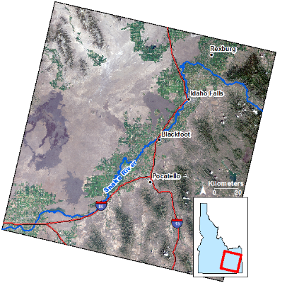
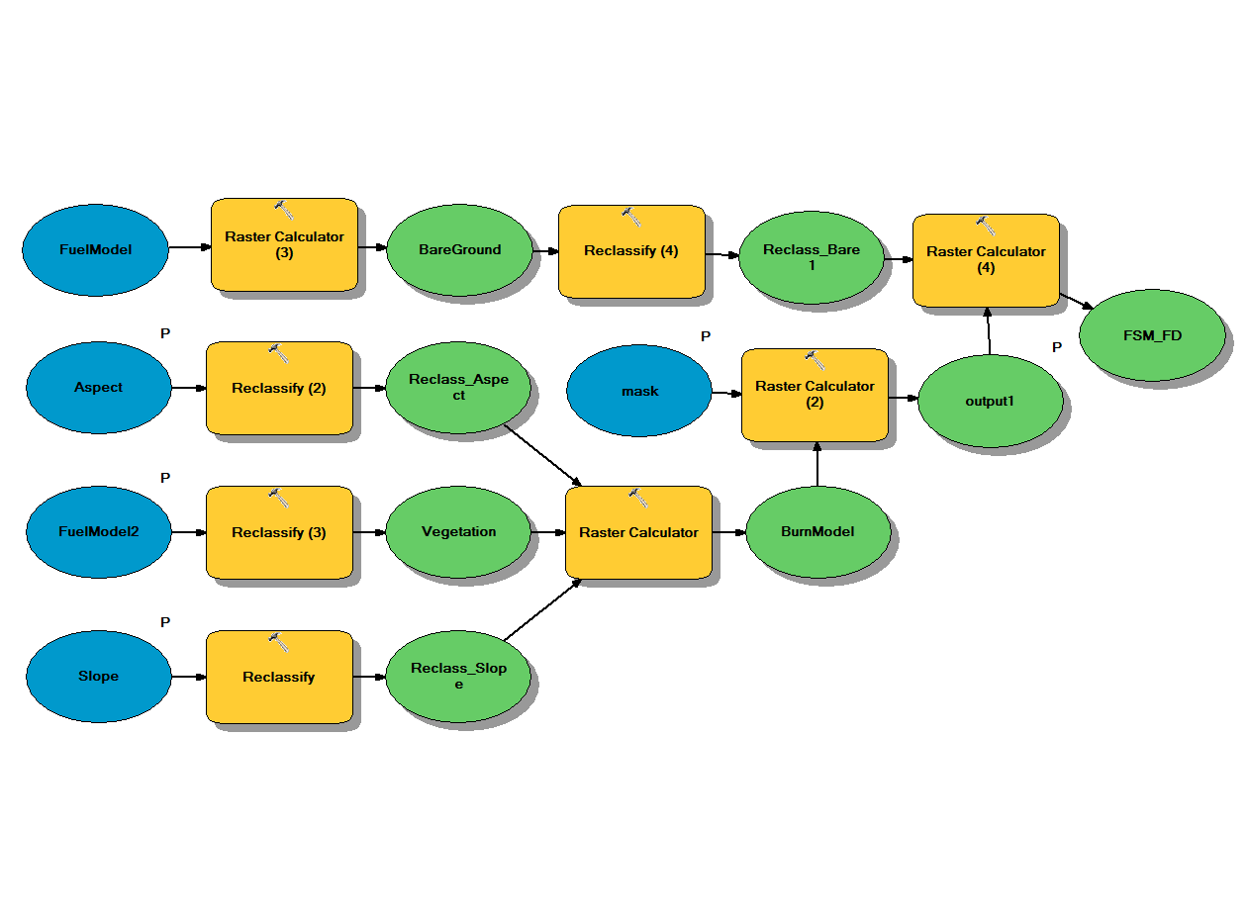
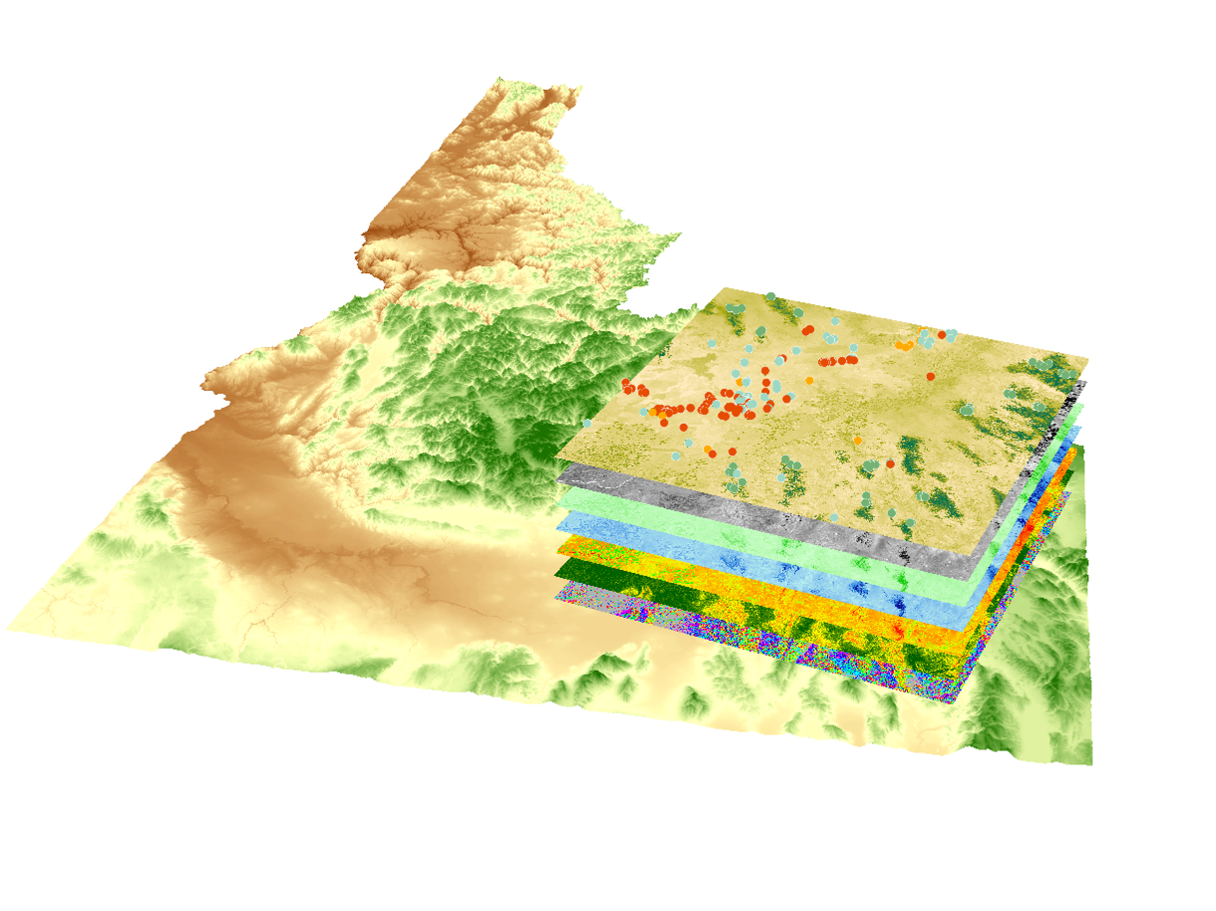
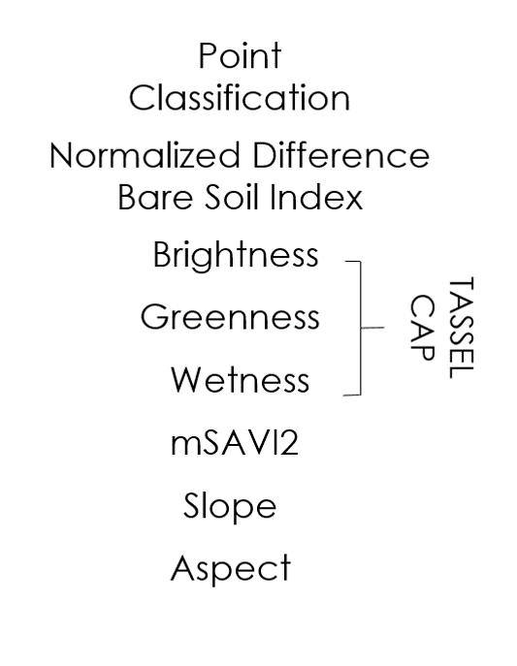
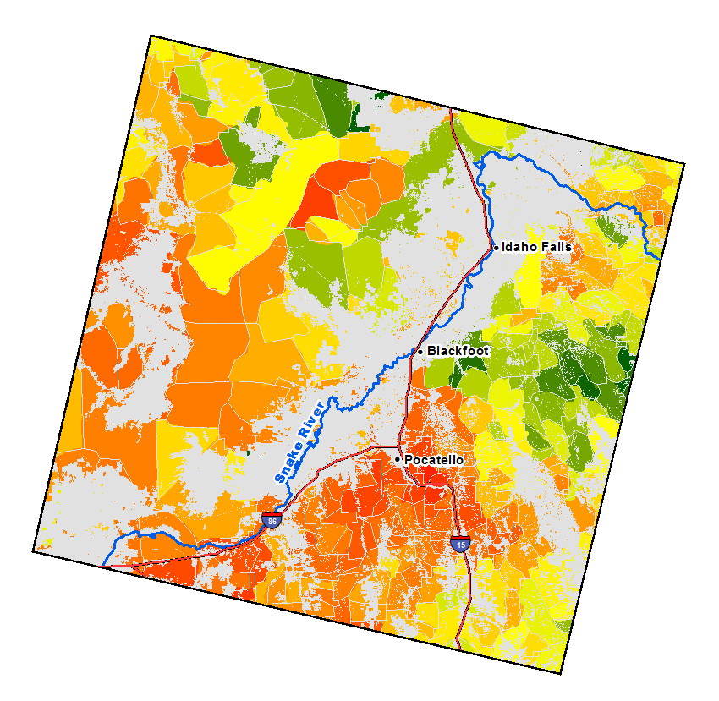
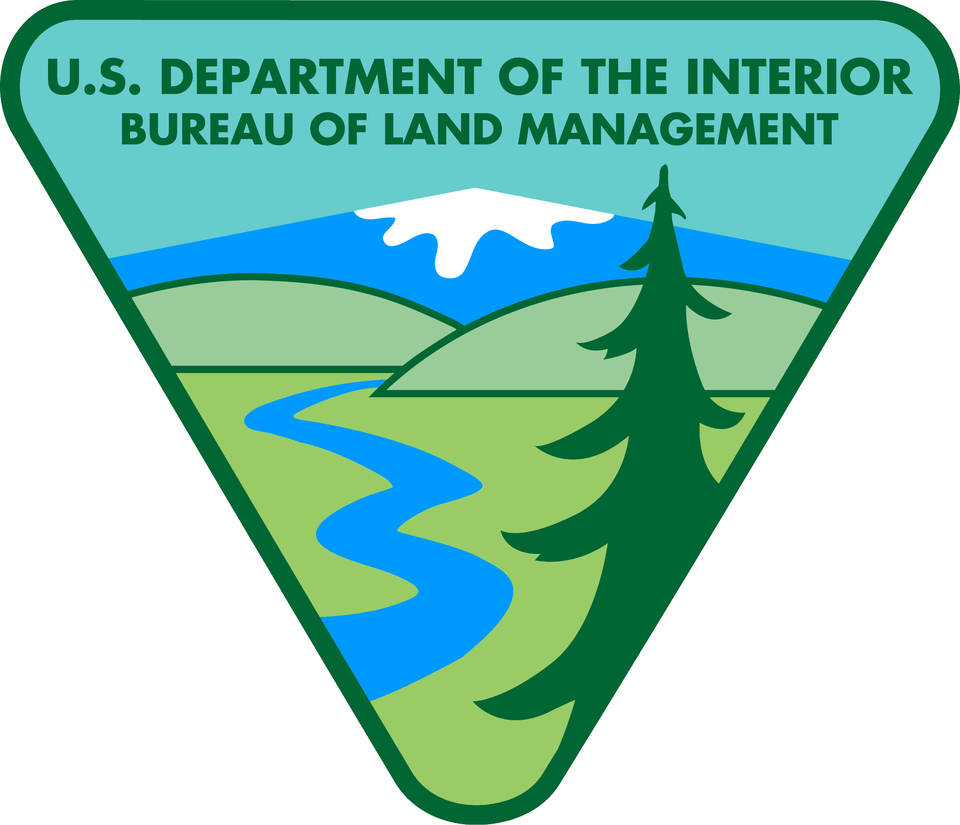
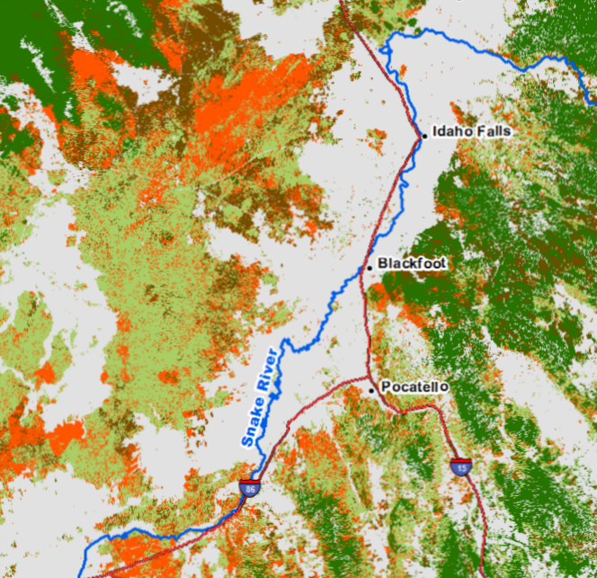
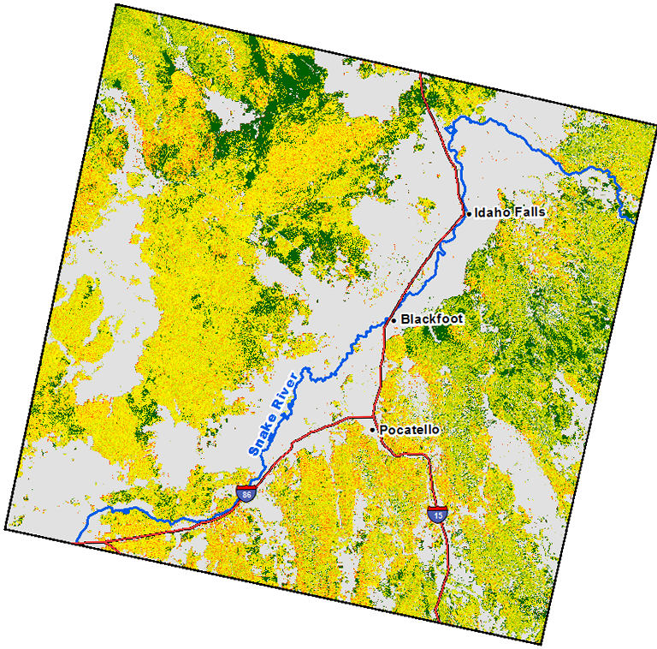
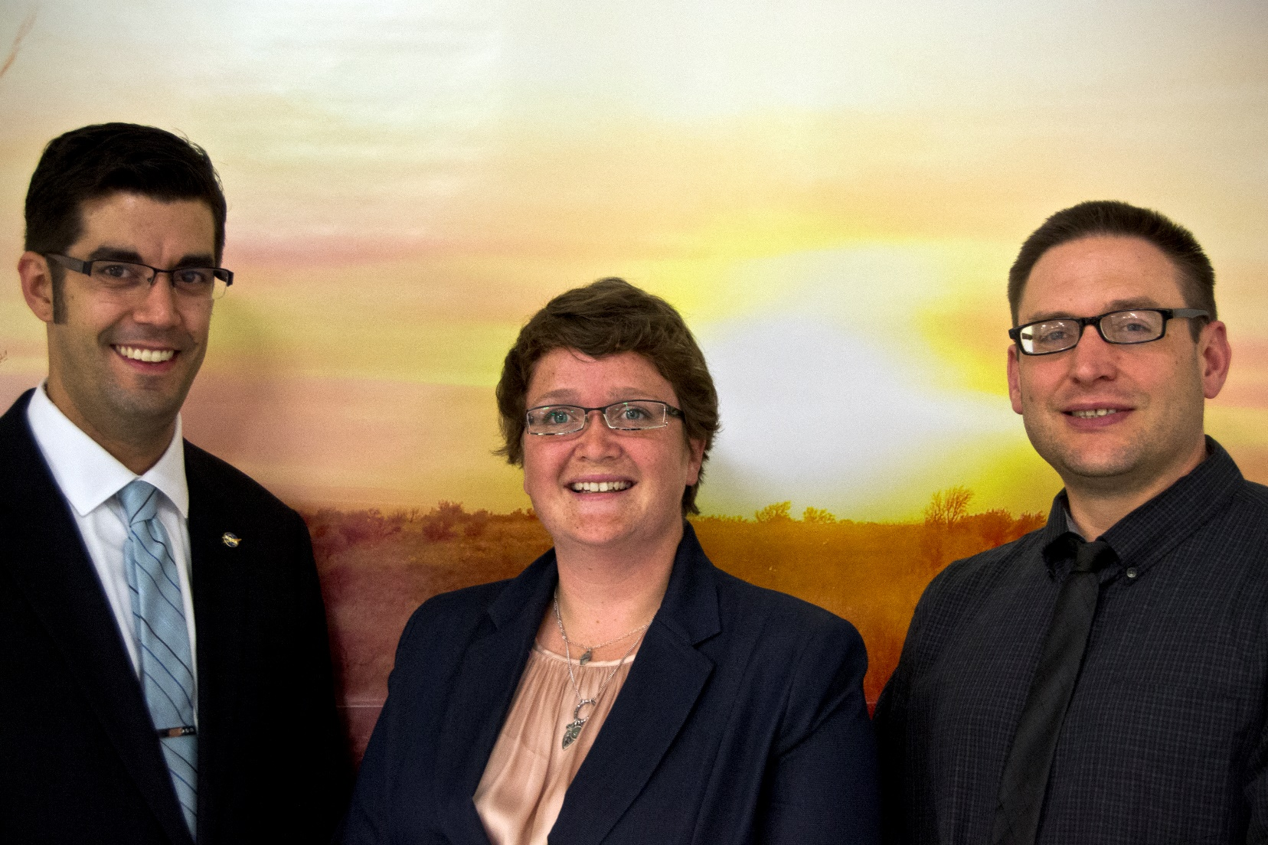
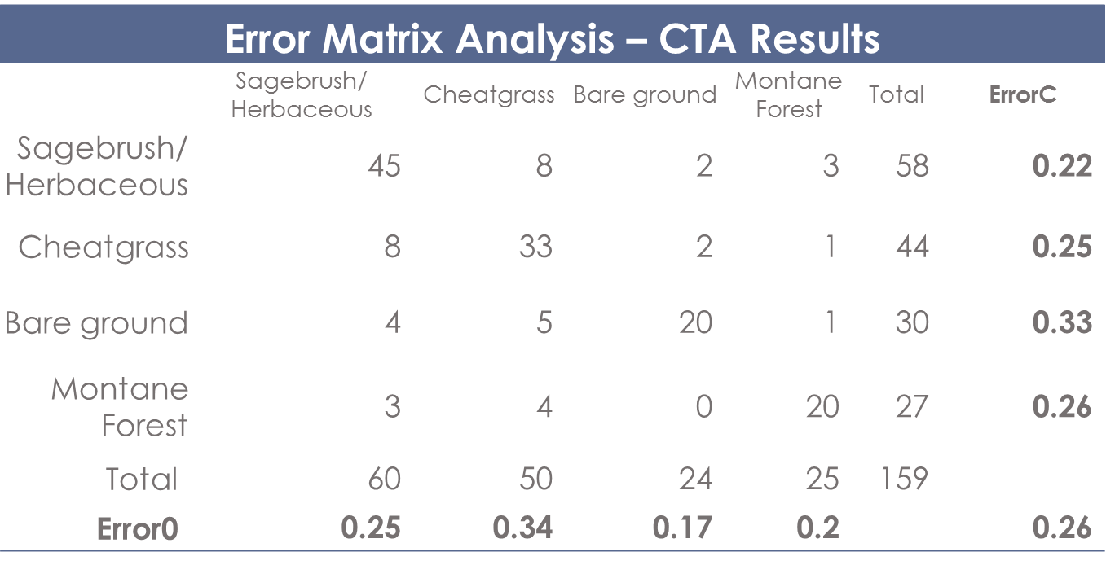
Idaho Disasters III
Using Landsat earth observations to identify increased fire susceptibility due to invasion by cheatgrass (Bromus tectorum)
Jeff May(Project Lead), Jenna Williams, Zachary Simpson
NASA DEVELOP National Program BLM at Idaho State University.
Abstract
Objectives
Wildfires, coupled with the presence of invasive plant species, are primary drivers of change in semi-arid savanna ecosystems. These wildfires disrupt ecosystems, human localities, critical habitats and create opportunities for invasive species to expand their populations. Wildland fire regimes have changed dramatically due to Bromus tectorum (cheatgrass), an invasive annual grass, which has effectively lengthened the wildfire season and increased fire frequency. Cheatgrass’ ability to quickly establish in disturbed areas creates a positive feedback cycle with wildland fire, resulting in landscapes that burn more frequently and become increasingly dominated by this invasive plant. This creates a need for more advanced landscape and wildfire monitoring tools that can identify the prominence of invasive plants in order to provide better information regarding fire susceptibility. Currently, there are no active cheatgrass management plans in Idaho due to the overwhelming capabilities of the plant to dominate landscapes. However, effective management of this species requires knowledge of its distribution in order to evaluate wildfire regimes and prevent cheatgrass expansion in recently disturbed landscapes. This study used spring/summer 2013, 2014, and 2015 imagery from Landsat 8 Operational Land Imagery (OLI) and decision-tree-based classification to create a vegetation distribution map of SE Idaho that identified cheatgrass and was subsequently used to create a fire susceptibility map for the study area. These results enhance the Bureau of Land Management’s and Idaho Department of Land’s decision making with respect to resource allocations and supports post-fire rehabilitation planning and fuel reduction programs.
Create a vegetation map that can be incorporated into fire susceptibility and hazard model
Provide benefit to End-users regarding resource allocation and identifying high fire susceptibility areas
Understand the relationship between the distribution of Bromus tectorum and other vegetation types with wildfire regimes in Southeast Idaho
Produce a fire susceptibility map using the resultant vegetation map and topographic information
Study Area
Methodology
Southeast Idaho
Landsat WRS-2 Path 39 Row 30
The Modified Soil-adjusted index (mSAVI2), Tasseled Cap Transformation (TCT), and the Normalized
Differenced Bare Soil Index (NDBSI) were derived from atmospherically corrected, cloud-masked, Landsat 8
WRS-2 path 39 row 30 imagery for May 15th, 2013,
April 16th, 2014, and April 19th, 2015. These images
were selected for analysis after determining that
prerequisites of being phenologically similar and
conducive with active cheatgrass growth and
dormant native vegetation were met.
Earth Observations
The data, along with topographic information,
was input into Classification Tree Analysis
in IDRISI TerrSet to produce the final
fuel model which discriminates four
classes; cheatgrass, sagebrush/herbaceous,
bare ground, and montane forest, to which mask was
applied to eliminate areas not relevant for this study.
Classification sites used to train and validate the classification model were obtained
from various sources including in-situ data from the Bureau of Land Management and Idaho State University GIS Training and Research Center collected during the early 2014 and 2015 growing season.
Landsat 8 Operational Land Imager (OLI)
Conclusions
Species specific classification can be successful when the target species is phenologically distinct from surrounding vegetation types.
Reliable regional land cover classification does not directly translate into reliable local scale analysis.
Reflectance from bare ground and sub-pixel mixing continues to be problematic for medium resolution land cover classification.
In total 397 classification points were created, of which 60% were used for training the classification model and 40% were reserved for independent validation. The resultant fuel model was combined with topographic data to estimate fire susceptibility across the study region on a per pixel basis
as well as within level 6 hydrologic unit boundaries. The ability of the fire susceptibility map to identify areas that are more susceptible to fire was assessed using historic fire data that identifies which areas
have higher fire frequency rates.
Project Partners
Idaho Department
of Lands
NASA RECOVER
Fuel Model
Acknowledgements
Mask
Cheatgrass
Keith Weber (ISU), Mark Carroll (GSFC), John Schnase(GSFC), Mike Kuyper (BLM) Michelle Mavers (BLM) Collin Homer (USGS), Ryan Howerton (ISU), Kiersten Newtoff (DEVELOP), Kyle Sowder (DEVELOP), Andrea Boddenberg (DEVELOP), Katherine Bradford (DEVELOP), Eric Smith (DEVELOP)
Bare ground
Montane Forest
Sagebrush/
Herbaceous
Team Members
Fire Susceptibility
Model
High
Low
Kappa: 0.67
Left to right: Jeff May, Jenna Williams and Zachary Simpson
BLM at Idaho State University GIS Training and Research Center

