Slide 1
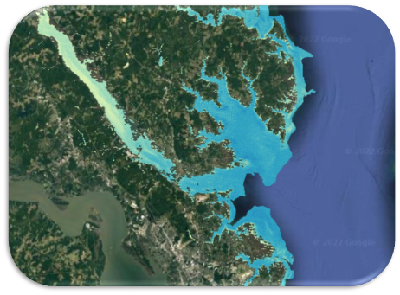
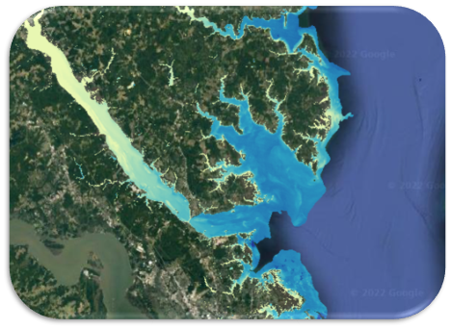
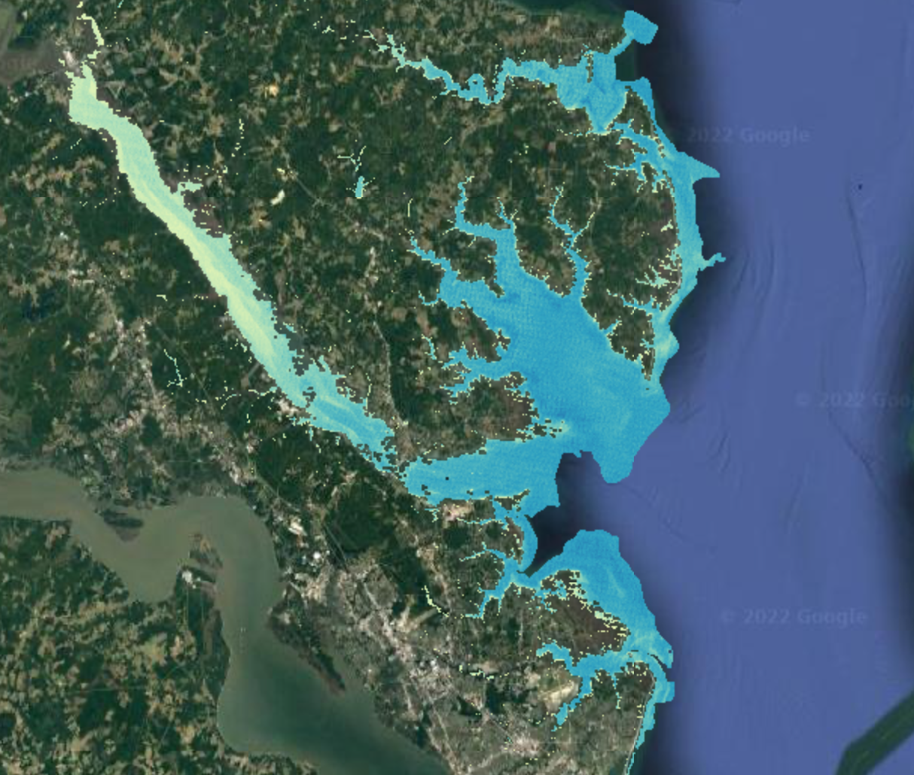
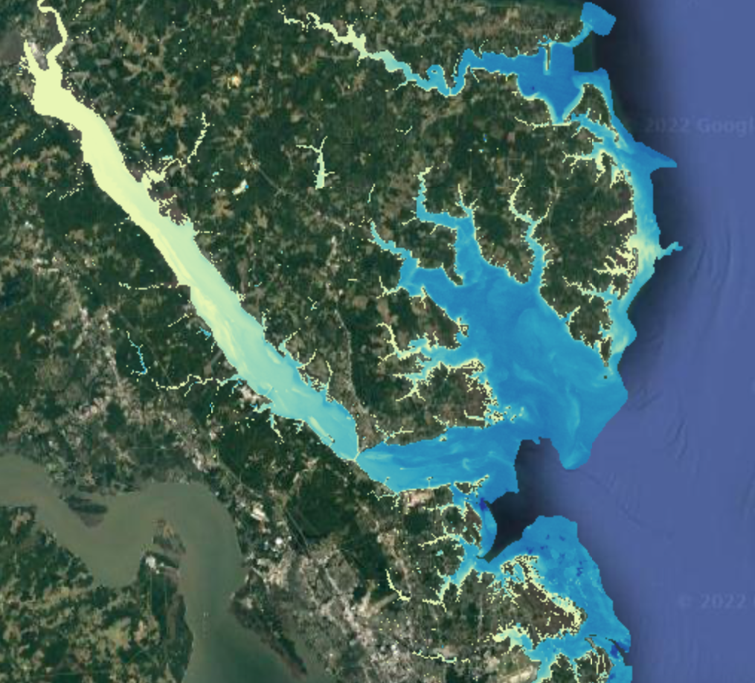
Chesapeake Bay Water Resources
January 2009
January 2019
Characterization of Sediment Dynamics for Enhanced Water Quality Monitoring
The Chesapeake Bay (CB) is the largest estuary in the United States and supports high biodiversity and economic resources. An increase in Total Suspended Sediment (TSS) concentrations has contributed to poor water quality in the CB since researchers began monitoring it in the 1970s. The team analyzed the intensity of turbidity in the York watershed from 2009 to 2019. The Soil and Water Assessment Tool and NASA DEVELOP's Optical Reef Coastal Area Assessment tool were used to model sediment dynamics and turbidity extent respectively in the watershed.
Lower turbidity
Higher turbidity
The team found that the TSS tends to peak in the spring and decrease in the fall, with a general trend of increased sediment and turbidity in recent years. The results suggest that despite the extensive efforts conducted to improve water quality in the CB watershed, additional projects such as implementing riparian buffer zones are needed. The team's findings will supplement current in situ monitoring efforts by partners and inform future management decisions.
Project end user: Virginia Department of Environmental Quality
Collaborators: CB National Estuarine Research Reserve, Group on Earth Observations AquaWatch,
the Committee on Earth Observations Satellites Coastal Observations Applications Services and Tools
Normalized Difference Turbidity Index
-0.5
0

