Slide 1
CALI URBAN DEVELOPMENT II
Investigating the Impacts of Land Use Change on Urban Heat and Social Vulnerability in Cali, Colombia
Gabi Davidson-Gomez
Deya Rodríguez
Isabelle Solórzano
Brenna Bruffey
California – Ames | Summer 2024
Notes:
GABI:
Hello everyone, and thank you for joining our presentation on Term II of the Cali, Colombia Urban Development project. My name is Gabi Davidson-Gomez, I am the Project Lead, and I'll pass it off to the rest of the team to introduce themselves. _____ This was a 10-week feasibility project based virtually out of the California Ames Research Center, during which the team utilized NASA earth observations to assess land use change and its relationship with urban heat and social vulnerability in Cali, Colombia.

Slide 2
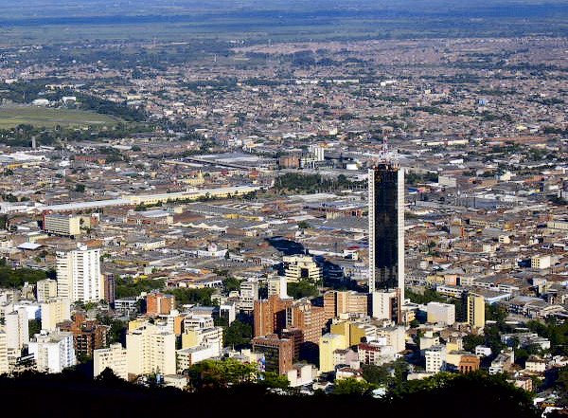
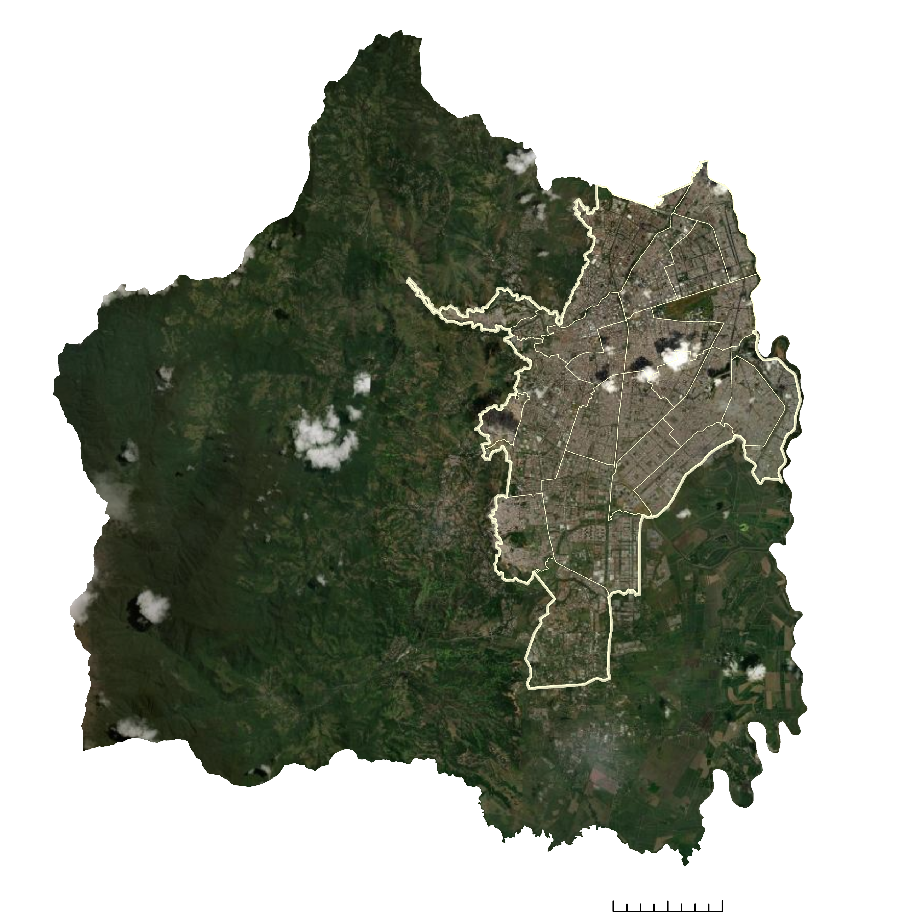
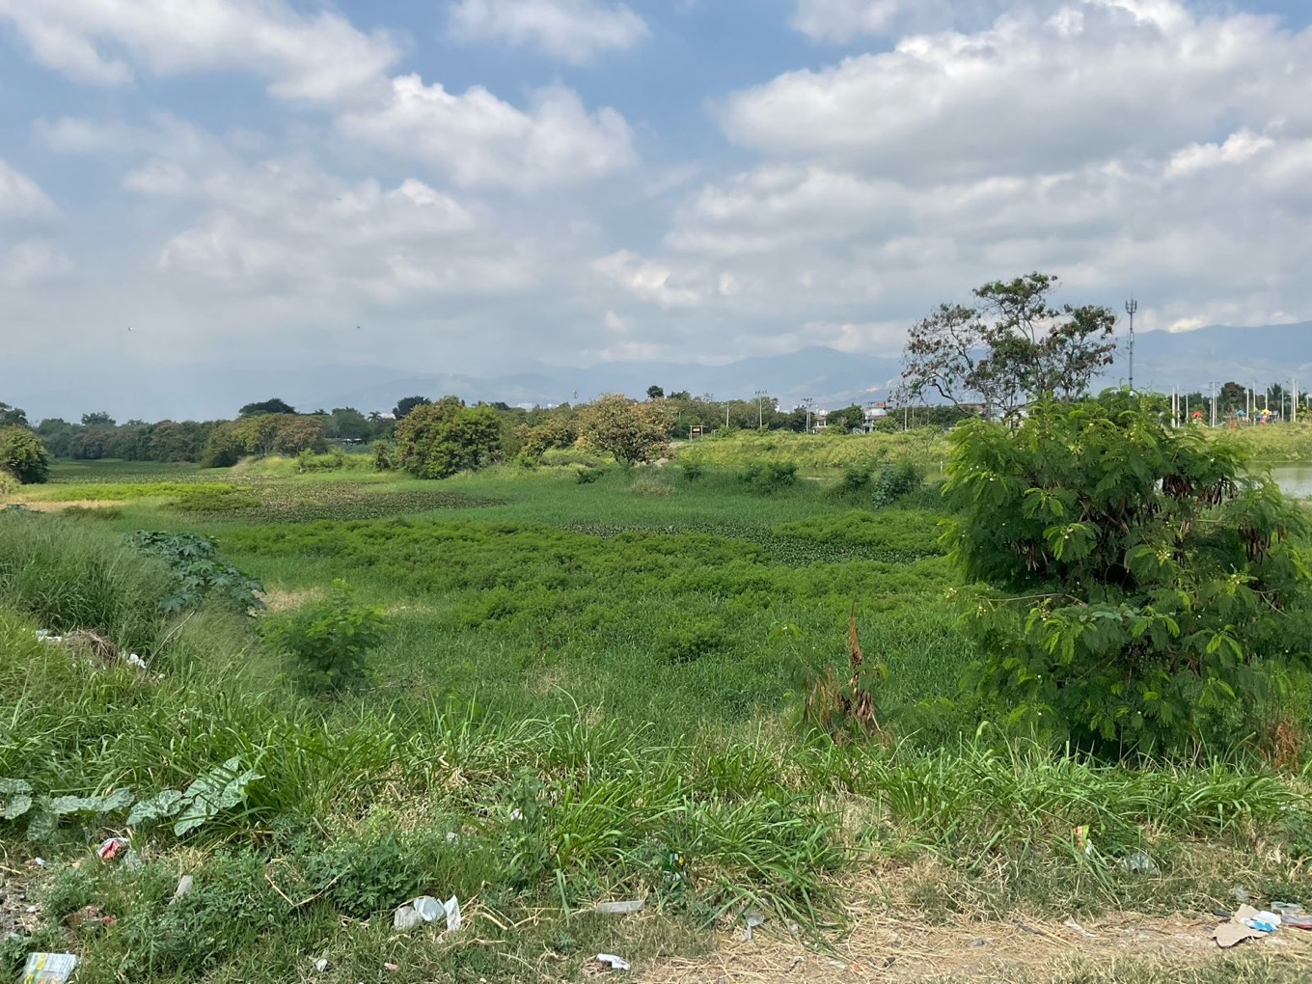
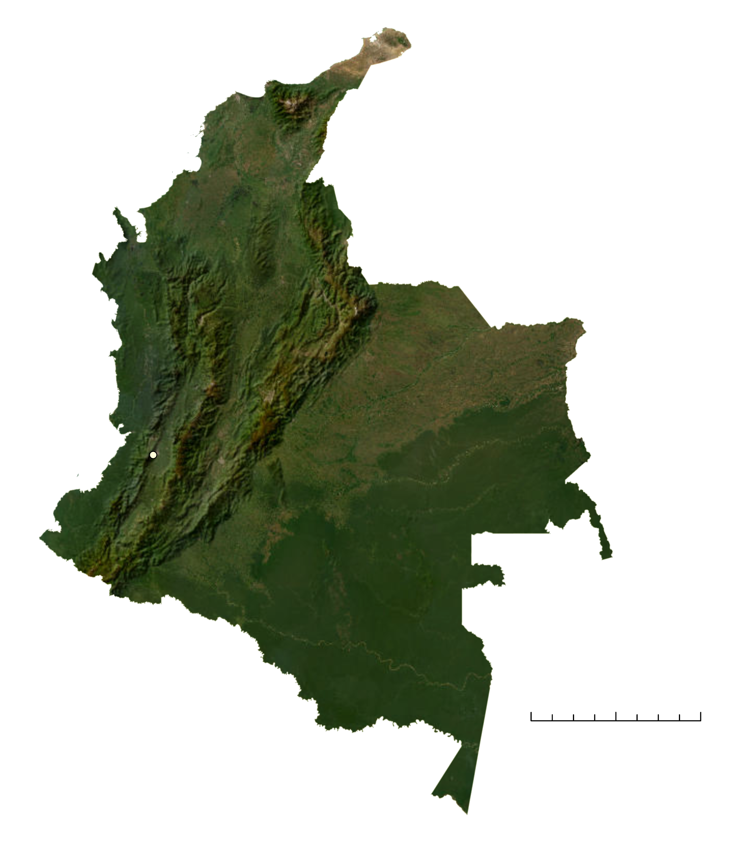
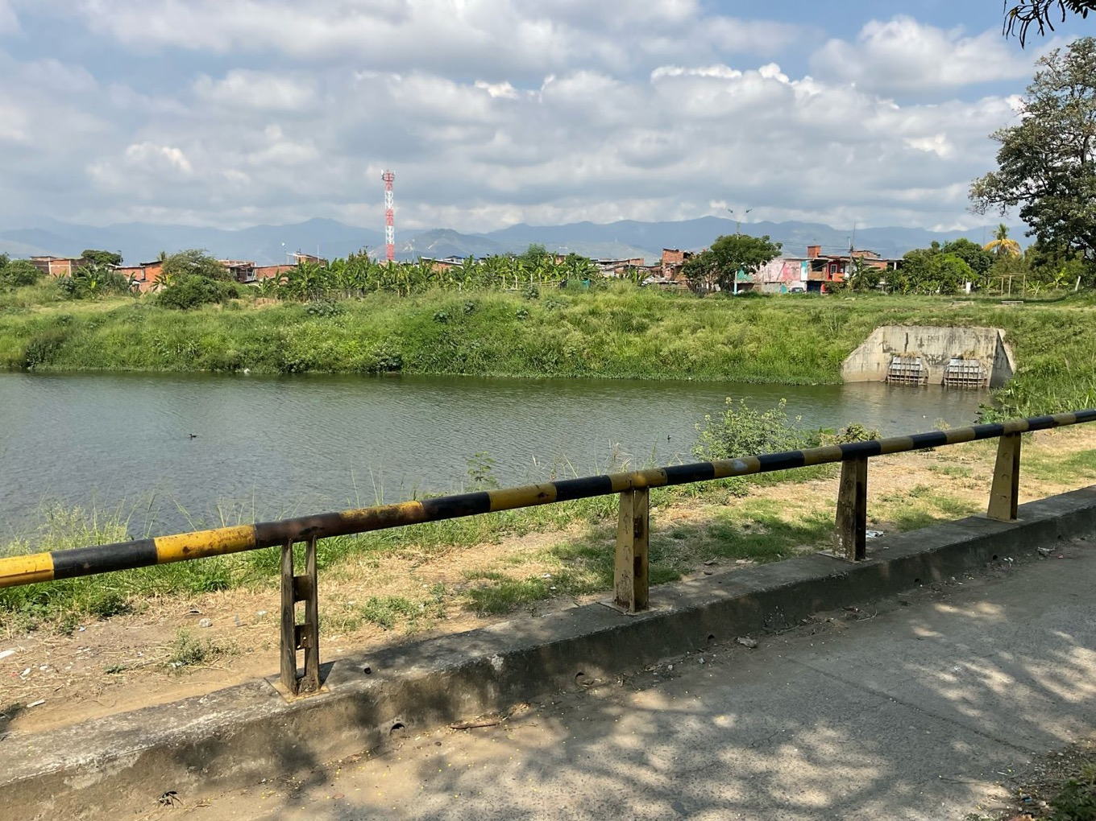
STUDY AREA & PERIOD
Study Area
Cali, Colombia
N
Study Period
Start - January 1st, 2013
End - December 31st, 2023
Cali within Colombia
Cali
0
200
400 km
Urban Perimeter of Cali
0
1
2
4 km
Image Credit: Viviana Maria Sanchez Escobar, Worldwide Wandering
Service Layer Credits: Earthstar Geographics
Notes:
[Deya] As mentioned, our project sought to assess the impacts of development within the urban perimeter of the city of Santiago de Cali in the Valle del Cauca department, in southwestern Colombia. This urban area is divided up into 22 different comunas, or administrative subdivisions, which served as the base unit for part of our analysis. Additionally, as a means to build upon previous research, the study period's start date was set for January 1st, 2013, and its end date for December 31st, 2023.
----------Image Information Below----------
Image Credit: DEVELOP Team generated map
Image Source: ArcGIS Pro
Service Layer Credits: Earthstar Geographics
Image Credit: Worldwide Wandering (View of Cali from Cerro de las Tres Cruces)
Image Source: https://www.flickr.com/photos/worldwidewandering/1343447776 licensed under CC BY-SA 2.0 Deed
Image Credit: Viviana Maria Sánchez Escobar, Leader of Climate Change Group at DAGMA (View of Cali's Wetlands)
Image Source: Used with permission, partner provided
Image Credit: Viviana Maria Sánchez Escobar (View of Cali's Wetlands)
Image Source: Used with permission, partner provided

Slide 3
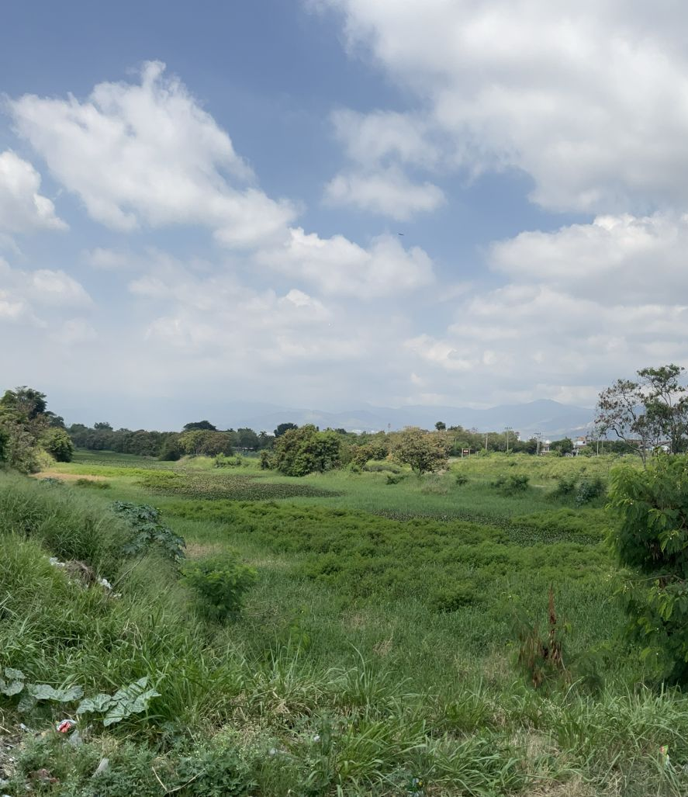
PARTNERS
Departamento Administrativo de Gestión del Medio Ambiente (DAGMA)
Fundación Dinamizadores Ambientales
Image Credit: Viviana María Sánchez Escobar
Notes:
[Isabelle] This project was done in partnership with the Departamento Administrativo de Gestión del Medio Ambiente (DAGMA), an international government entity dedicated to serving the public in Cali. Among its various responsibilities, DAGMA develops programs that encourage citizen participation and environmental stewardship. We also collaborated with Fundación Dinamizadores Ambientales, an international non-profit organization based in Cali that provides educational resources and practical tools for natural resource conservation, leading projects focused on environmental justice and community science. These two organizations have sought to strengthen their existing partnership by collaborating on the second term of this NASA DEVELOP project, which addresses land use change in Cali and its relationship to urban heat and social vulnerability.
----------Image Information Below----------
Image Credit: Viviana María Sánchez Escobar, Leader of Climate Change Group at DAGMA, Feb. 12 2024 (Used with Permission)
Image Source: Used with permission, partner provided

Slide 4
COMMUNITY CONCERNS
Rising temperatures, especially in urban zones
Heat exacerbated with social vulnerability
Determine locations for cooling interventions
Deforestation and wetland declination
Notes:
GABI: Our partners noted that the history of deforestation and wetland declination that has accompanied Cali's urban and agricultural development has, in recent decades, brought an increase in temperature in the city, especially in the highly urbanized areas. Previous studies on urban heat tell us that socially vulnerable populations, including the very old and very young, people with health conditions, and people living in areas with less vegetation, tend to experience greater effects from these rising temperatures. In Cali, some of the most socially and economically vulnerable communities are located in neighborhoods with more degraded ecosystems, which contributes to an inequitable distribution of how urban heat is felt by the population. Our partners hope to use the findings from this feasibility study to determine exactly how and where heat is concentrated in Cali, and to plan policy and action in response, for example, planting trees in areas that experience the most heat.
----------Image Information Below----------
Image Credit: Microsoft Office 365 PowerPoint Icons

Slide 5
URBAN HEAT ISLAND EFFECT
Temperature varies with land use because building materials and paved surfaces retain more heat, resulting in cities that are hotter than their surrounding rural counterparts
Rural farmland
Water body
Industrial
Urban
residential
Suburban residential
Urban core
Park
Rural
Land Use
Notes:
[Isabelle] The Urban Heat Island Effect is a specific concern regarding the temperature in cities, which is usually warmer than rural areas. Cities are built from dark materials which absorb heat from the sun and release it back into the environment, whereas trees and water reflect the sun so the area is cooler. Urban temperatures are concerning because air and water quality degrade as temperatures rise, which has a negative impact on human health, and increases the risk of heat related illnesses (Li et al., 2021). The Urban Heat Island Effect can be reduced by establishing green spaces, such as parks, trees, and gardens, in high temperature areas.
----------Image Information Below----------
Image Credit: Microsoft Office 365 Icons & Shapes
References:
Li, X., Stringer, L. C., Chapman, S., & Dallimer, M. (2021). How urbanisation alters the intensity of the urban heat island in a tropical African city. PloS One, 16(7). https://doi.org/10.1371/journal.pone.0254371

Slide 6
OBJECTIVES
Identify temperature hot spots within the city
Generate landcover maps to determine land use patterns
Compare the relationship between land use, temperature, and social factors
Notes:
Brenna: In order to better understand how the urban heat island effect is influenced by land use in Cali, we determined three main goals for our project. The first objective was to identify areas of the city that experience the highest temperatures, forming hot spots. The second was to generate landcover maps to evaluate how the land was used and how land use has changed over the study period. Finally, we explored the relationship between temperatures, the land use, and social factors in order to determine regions of high vulnerability to urban heat.
----------Image Information Below----------
Icon Credits: Microsoft Office

Slide 7
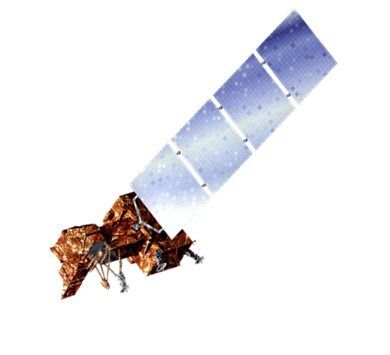
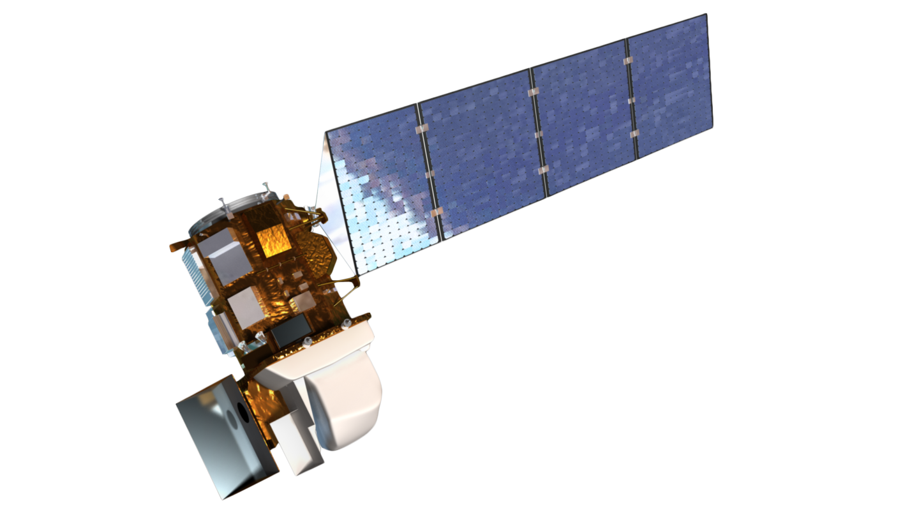
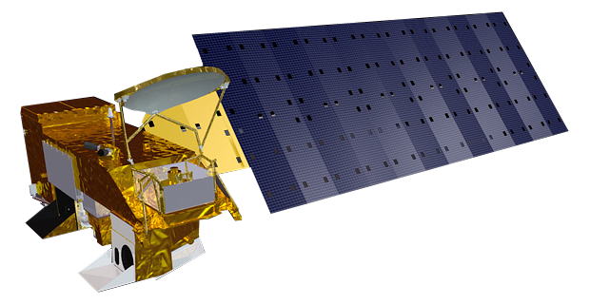
EARTH OBSERVATIONS
Landsat 7 ETM+
Landsat 8
OLI/TIRS
Landsat 9
OLI-2/TIRS-2
Aqua
MODIS
Image Credit: NASA
Notes:
[Isabelle] The team made use of NASA's Landsat 7 ETM+ and Landsat 8 and 9 satellites and their OLI/TIRS sensors, as well as NASA's Aqua MODIS satellite, to derive the land surface temperature, or LST, values. In addition, Landsat 8 OLI was also used to generate the land use/land cover values.
----------Image Information Below----------
Image 1 Credit: NASA (Landsat 7 satellite)
Image Source: https://landsat.gsfc.nasa.gov/article/landsat-7/
Image 2 Credit: NASA (Landsat 8 Satellite)
Image Source: https://landsat.gsfc.nasa.gov/article/landsat-data-continuity-mission/
Image 3 Credit: NASA (Landsat 9 Satellite)
Image Source: https://landsat.gsfc.nasa.gov/satellites/landsat-9/landsat-9-overview/
Image 4 Credit: NASA (Aqua Satellite)
Image Source: https://commons.wikimedia.org/wiki/File:Aqua_spacecraft_model.png

Slide 8
METHODOLOGY: Urban Heat
Acquisition
Processing
Analysis
UHEAT 2.0 Code
Transformed Code from Python to
GEE syntax
Zonal Statistics by Comuna
Landsat 7, 8 and 9 Imagery
Validity Check Using MODIS and
Temperature
Quality Assessment
Combine Image Collections in GEE
MODIS Imagery
Applied Cloud Mask in GEE
Notes:
[Isabelle] As an outline for our Google Earth Engine, or GEE, code we used the Tempe Urban Heat Exposure Assessment (UHEAT) 2.0 tool created by a spring 2022 DEVELOP team, which uses census data, Earth observations, and other open-source data to generate maps. We extracted the geoprocessing portion of the code from the UHEAT tool and modified it from its original Python syntax to function within GEE, where we combined data from Landsats 7, 8, and 9 and QA bits for a cloud mask to select a median image of LST from each selected year. We clipped all outputs to the urban study area. The Landsat images were then exported to ArcGIS Pro, where we ran zonal statistics on LST maps to generate the mean temperature, as well as the change over the study period, by comuna, or the 22 units in which Cali's urban zone is divided. We also checked the validity of our results by comparing our Landsat-derived LST results to LST results we derived using the MODIS Aqua satellite and also by mapping temperature uncertainty using Landsat's temperature quality assessment band.

Slide 9
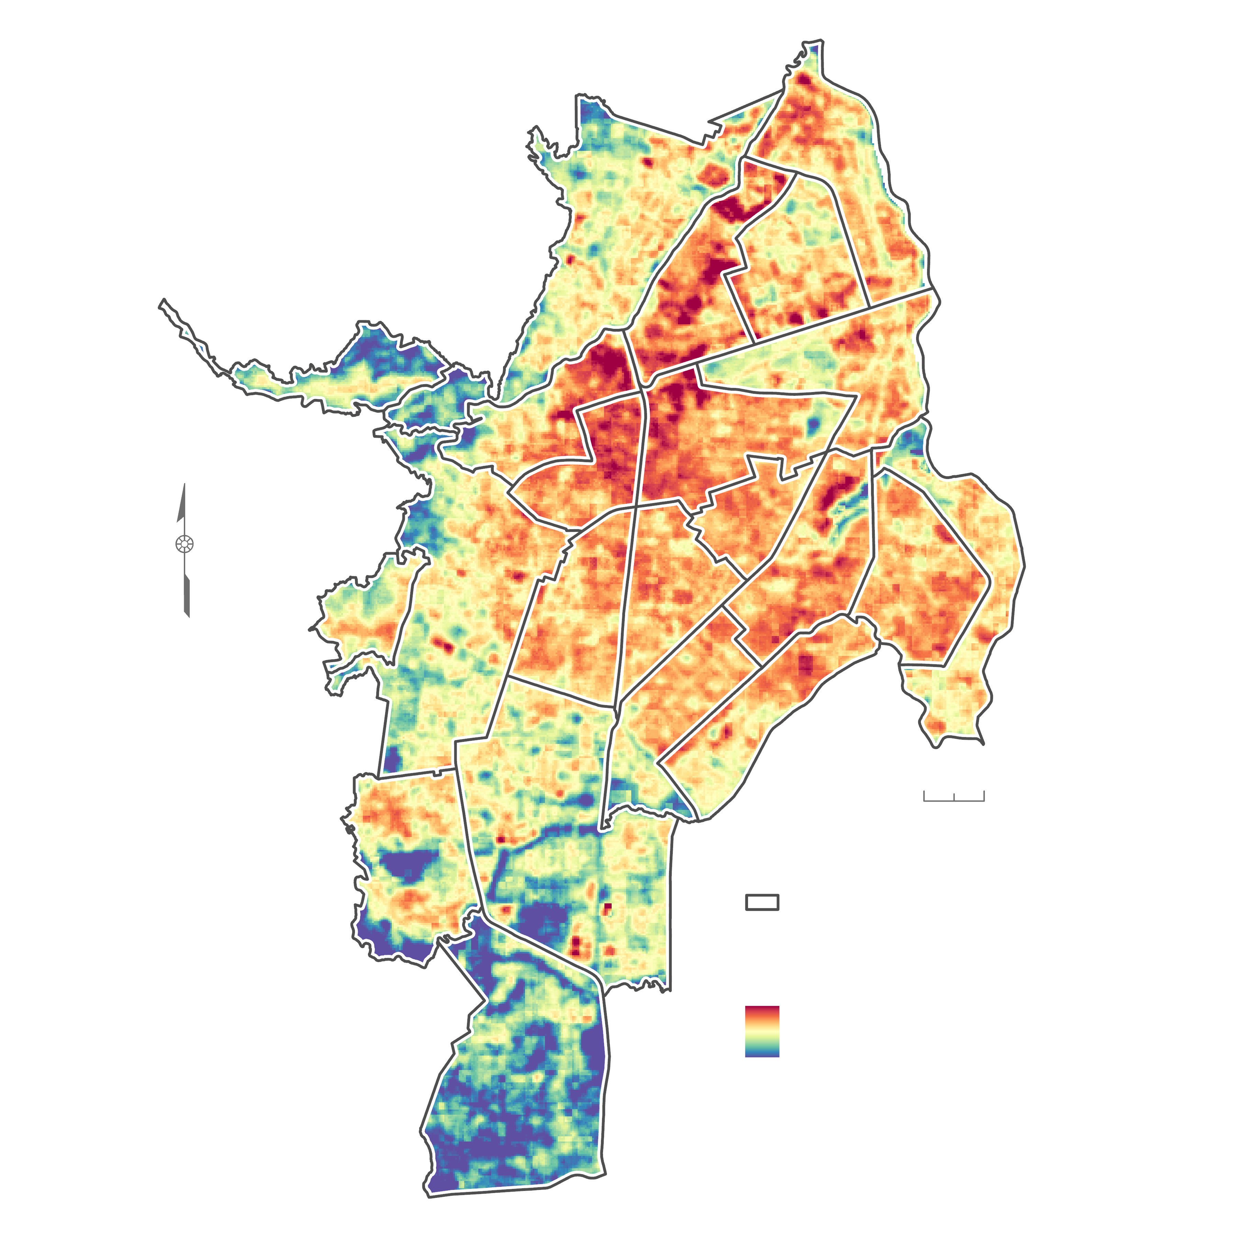
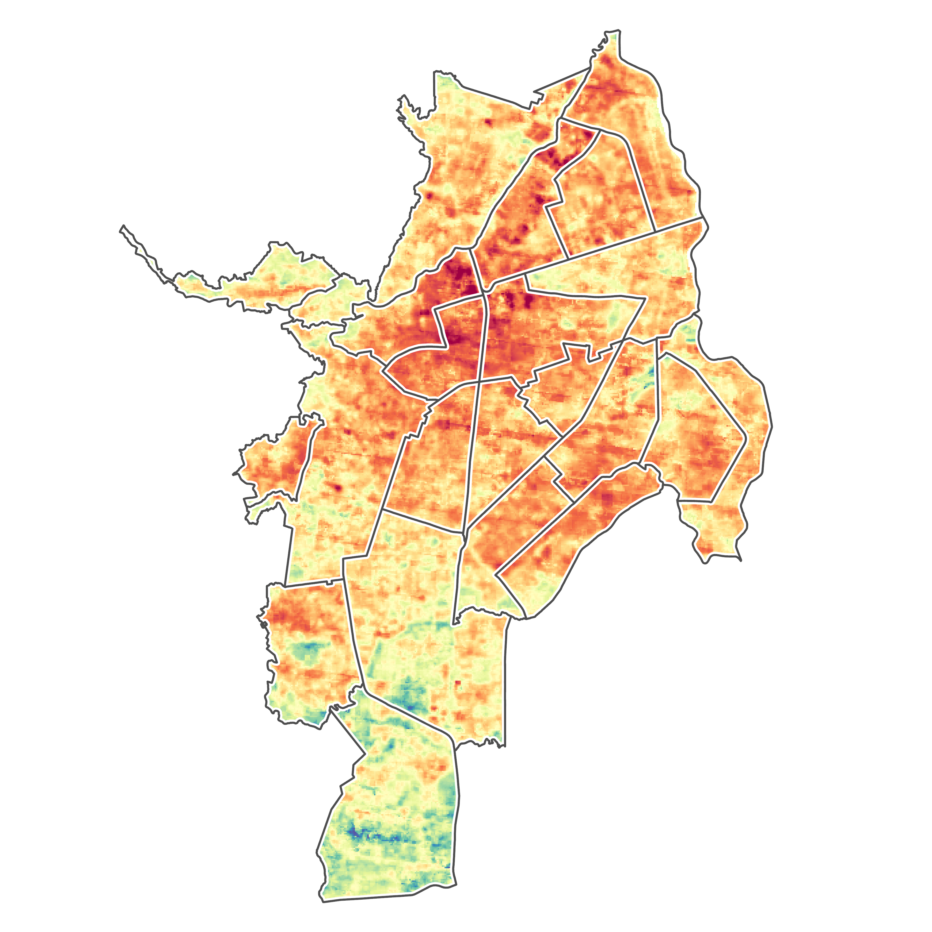
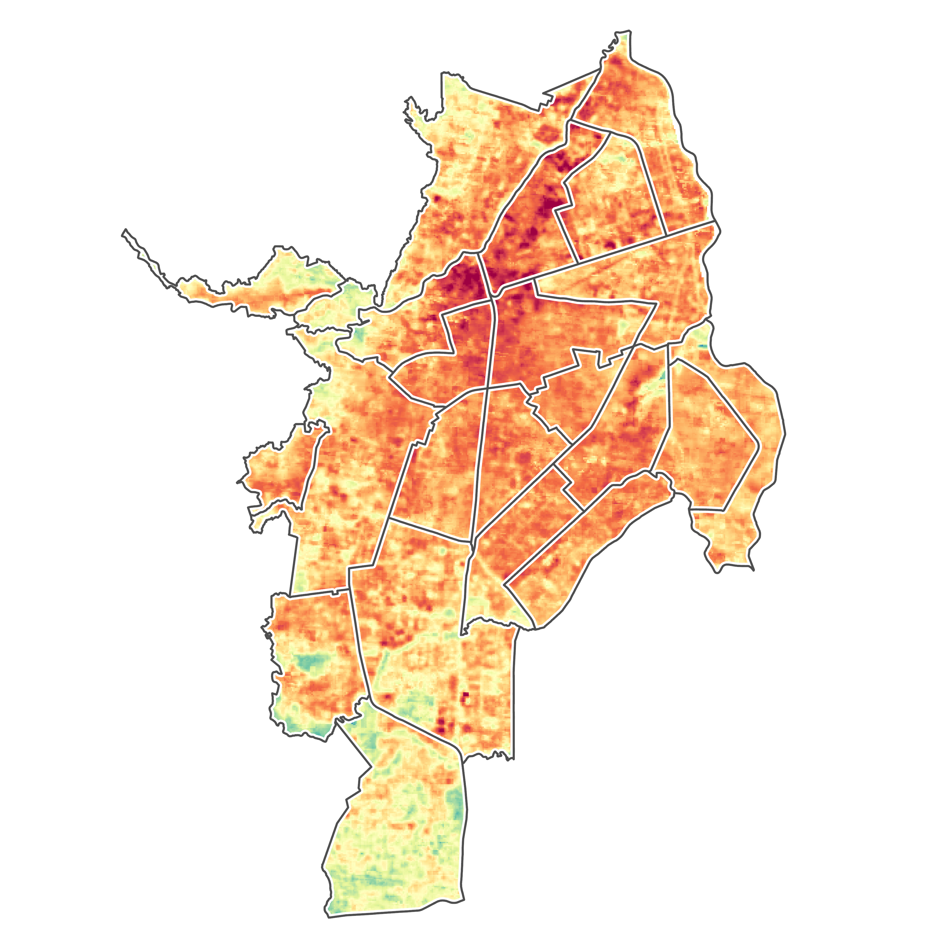
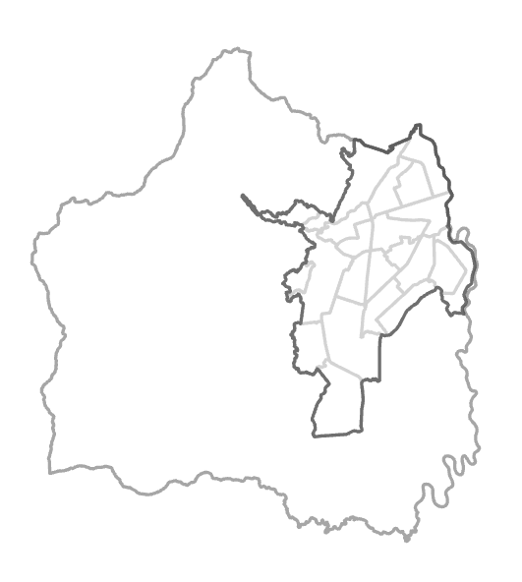
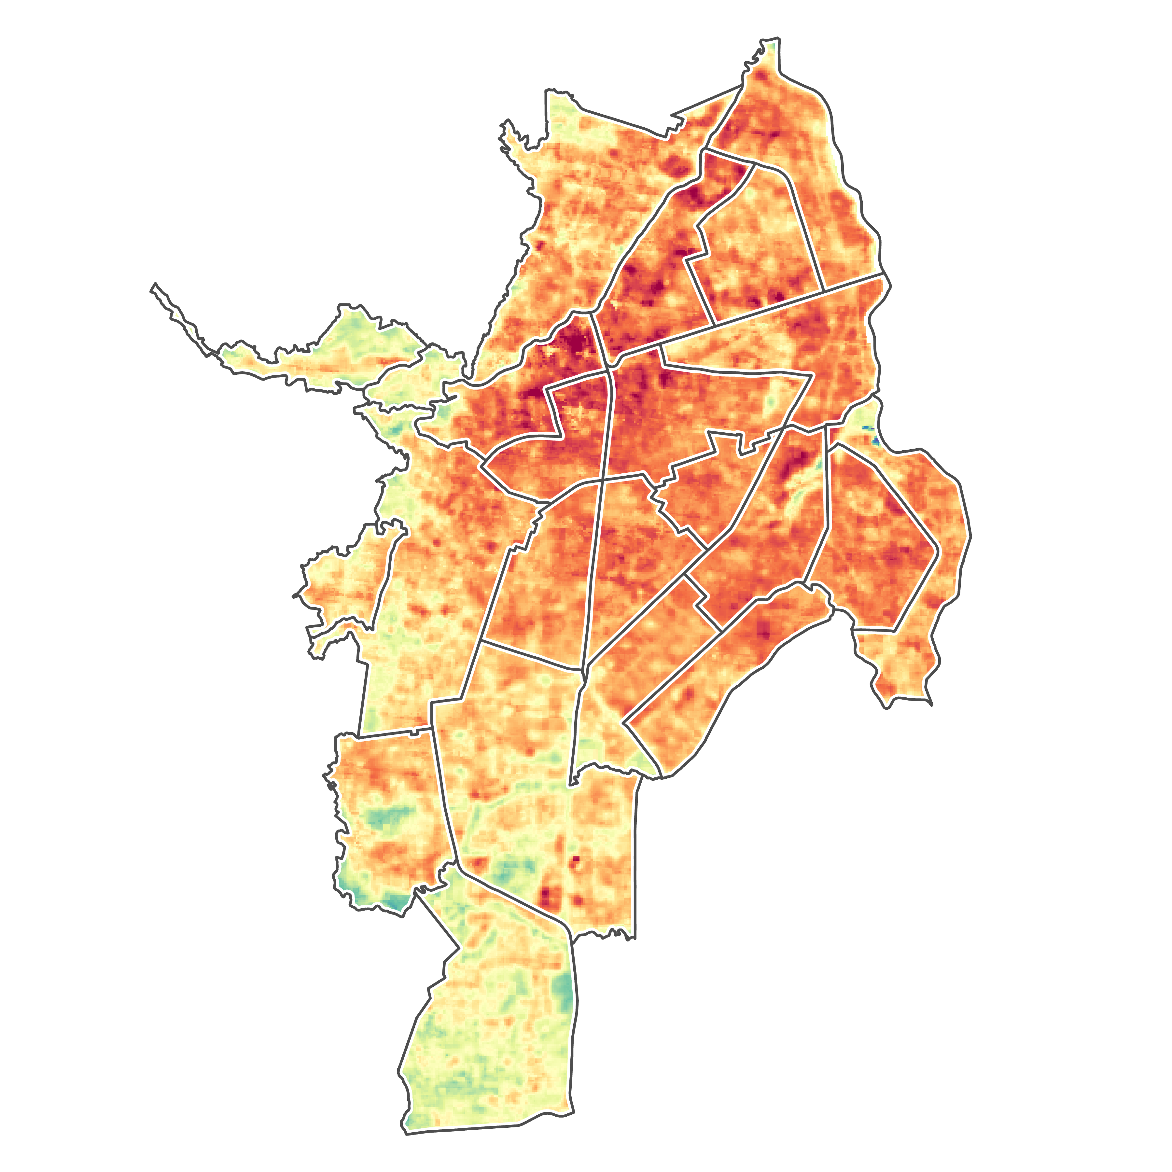
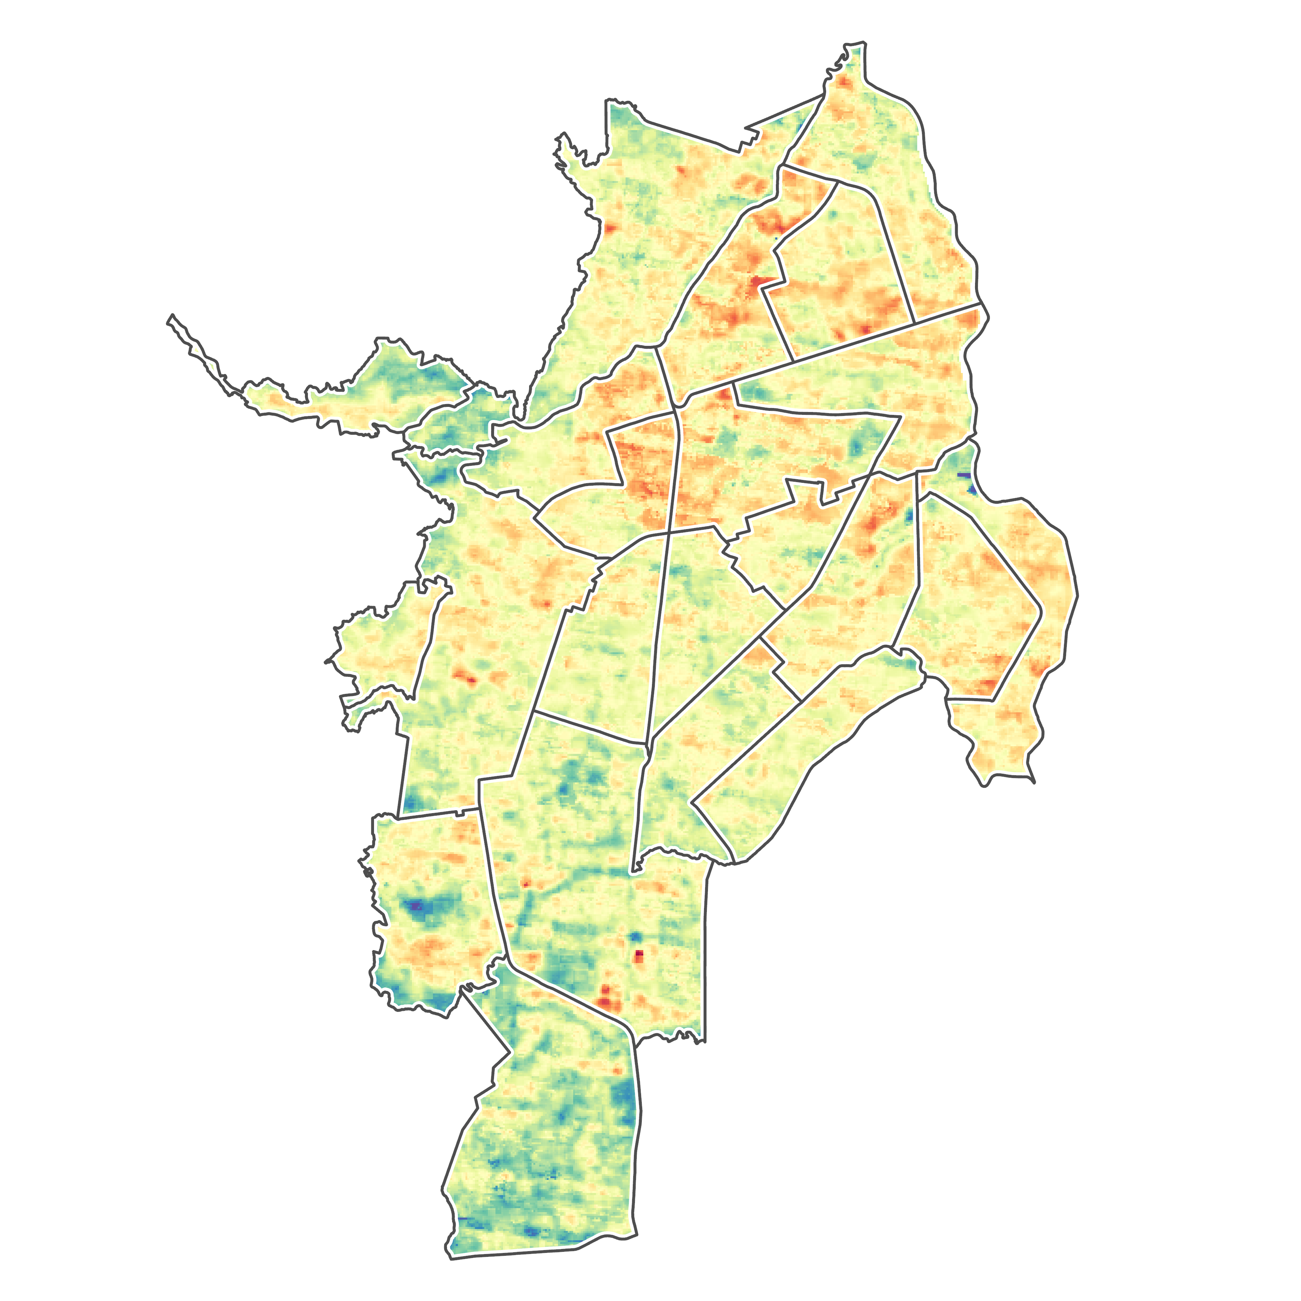
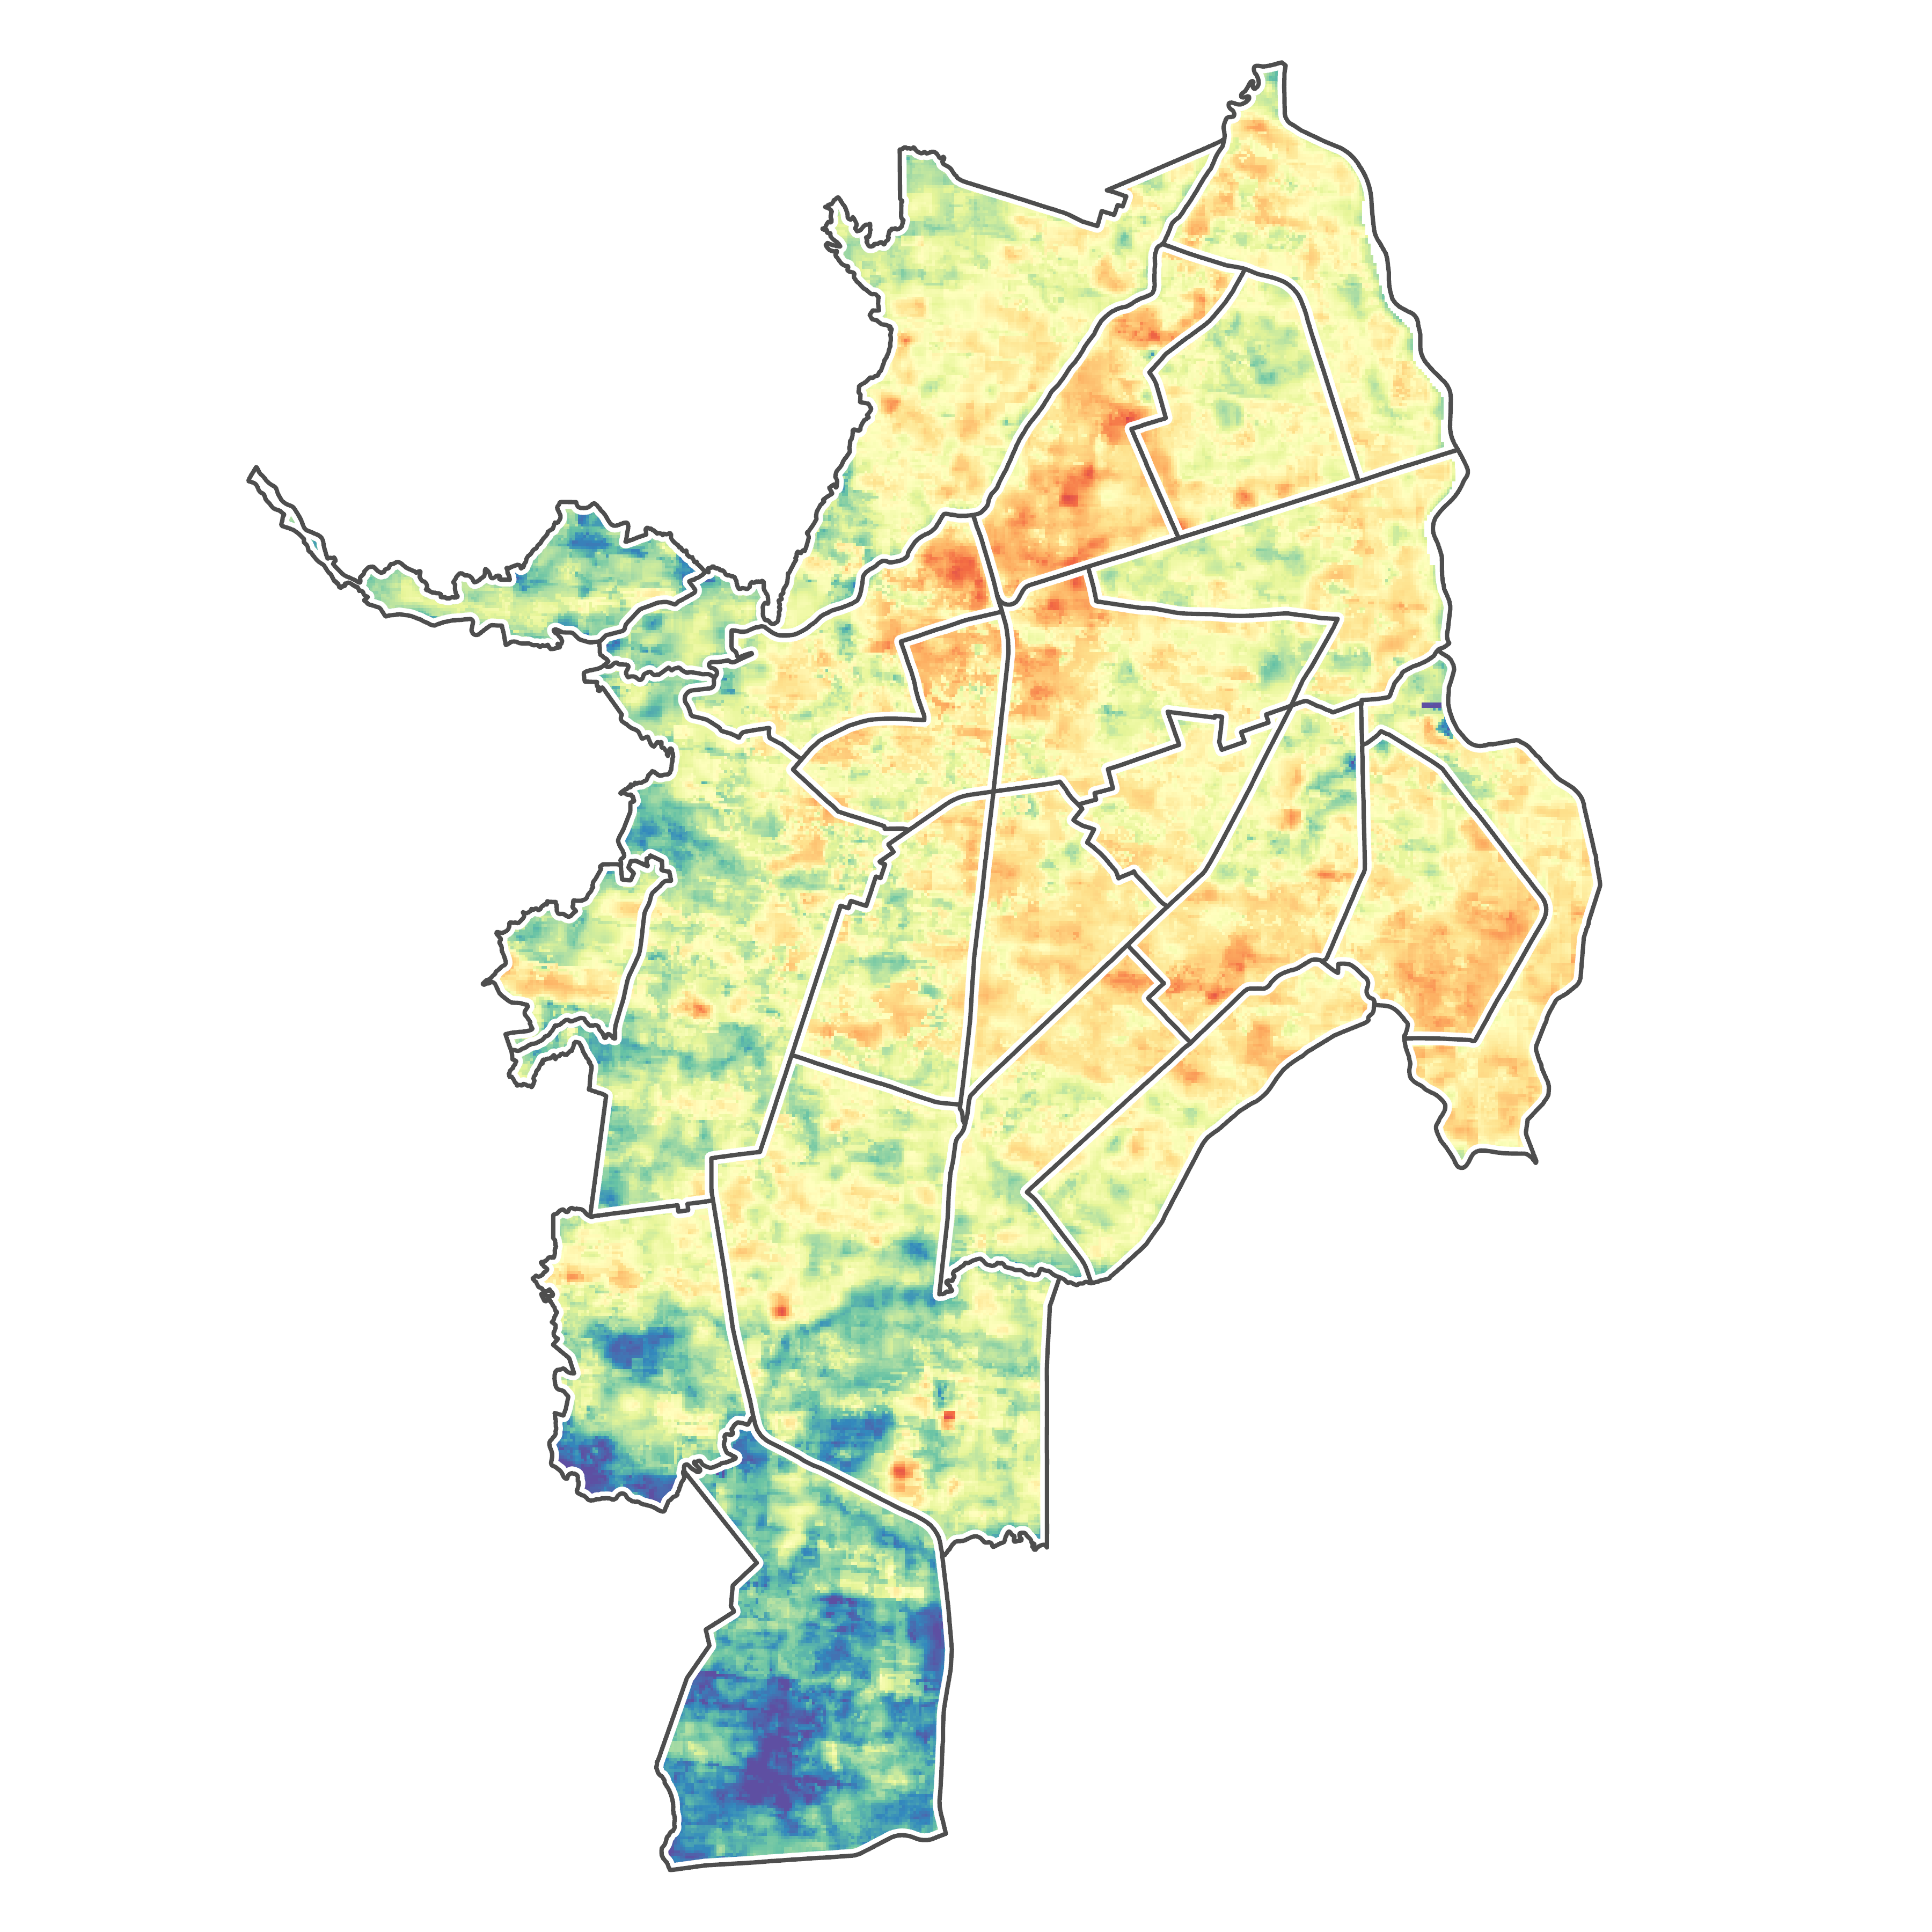
RESULTS: Urban Heat
2013
2015
Colombia
2013 - 2023
Cali
0
5 km
0
5 km
2018
N
39.6ºC
40.8ºC
0
5 km
2020
2023
0
1 km
Land Surface Temperature (ºC)
40.6ºC
48.1
0
5 km
0
5 km
25.2
36.1ºC
35.7ºC
Median: 39.0ºC
Notes:
QUESTION: Should we show the mean or median temperature for each year on this slide?
[Deya] This series of maps on the left show the median temperatures experienced throughout the urban core of Cali during each critical year in our study period. As can be observed, temperatures appear to have peaked around 2015-2018 before decreasing in the subsequent years, though there are some key limitations to this finding which will be discussed in a later section.
The map on the right depicts the median temperatures across our entire study period which varied from 25 to 48ºC. As can be observed central areas trended hotter, whereas southern and northwesterly areas trended cooler.

Slide 10
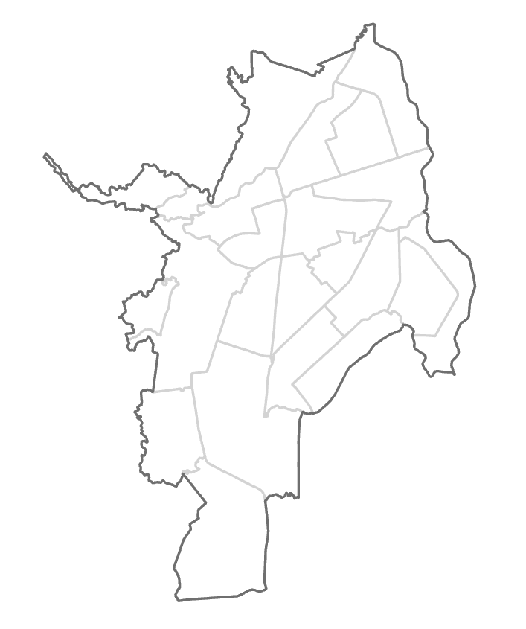
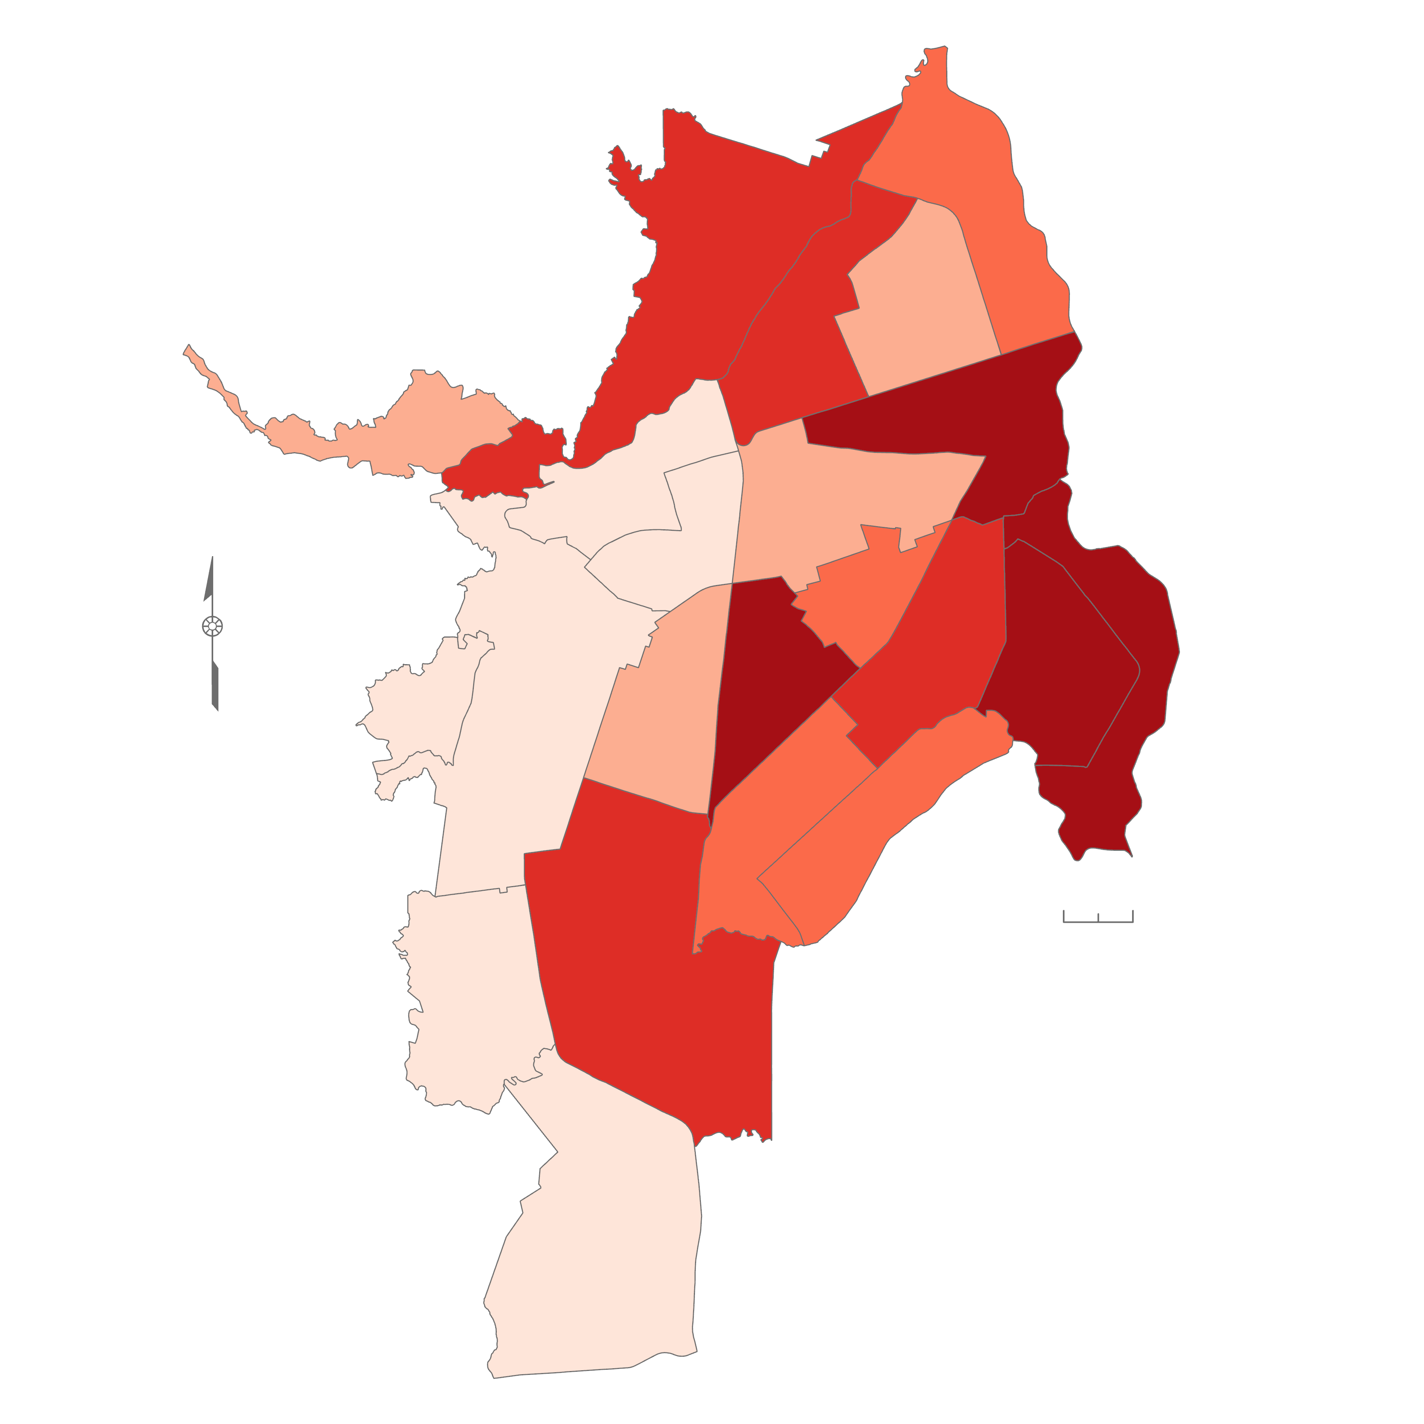
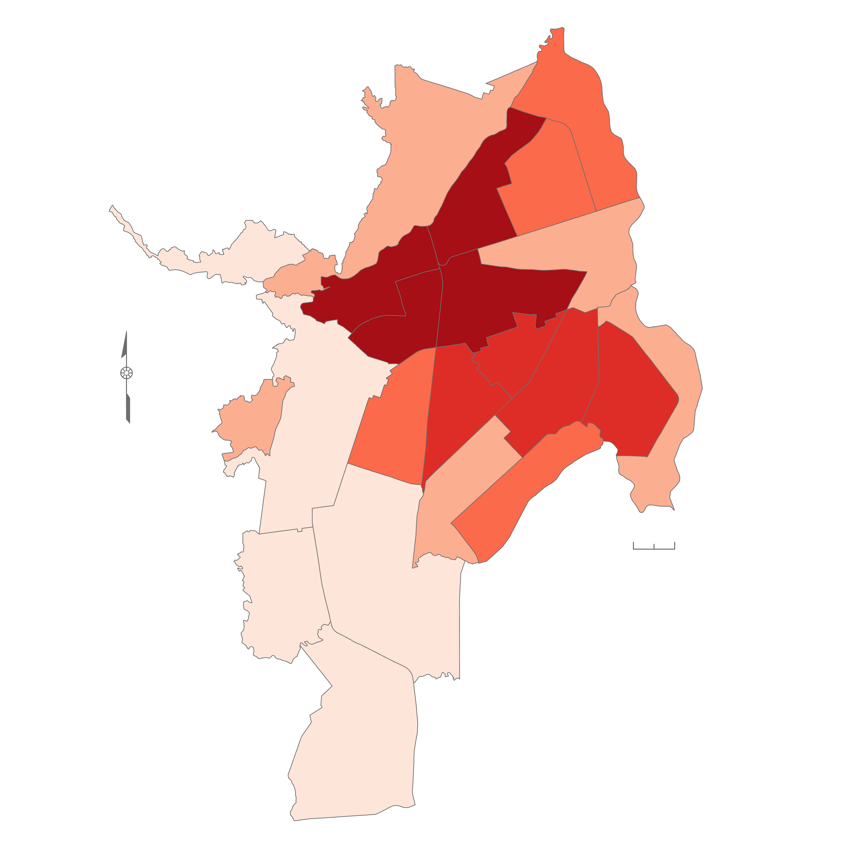
RESULTS: Mean Urban Heat
6
Change Between
2013 and 2023
Mean Across
2013 through 2023
1
2
5
-4.1
39.1
4
7
37.6
3
8
21
-3.5
9
12
20
11
14
10
13
-4.5
39.4
19
-2.9
41.2
16
15
-2.7
38.9
18
-4.8
35.1
17
-5.4
-4.7
N
40.0
40.4
22
N
-5.8
41.1
-4.0
-1.9
39.8
38.7
-2.6
-3.3
-2.0
39.7
39.8
39.8
-6.1
-5.4
38.1
-4.6
37.6
39.2
-3.9
38.5
-4.2
39.1
0
1 km
0
1 km
-5.7
Change in Land Surface Temp. (ºC)
36.7
36.8
Mean Land Surface Temp. (ºC)
-3.4
-1.9 -- -2.9
41.2 -- 39.8
-2.9 -- -3.9
39.8 -- 39.4
-3.9 -- -4.5
39.4 -- 38.9
-5.2
-4.5 -- -5.2
33.9
38.9 -- 37.6
-5.2 -- -6.1
37.6 -- 33.9
Notes:
[Deya] To facilitate further comparison between comunas, the team conducted a zonal analysis.
The map on the left depicts the change in LST over the start and end years of the study period. Overall, the team found that there has been a decrease in LST with eastern comunas experiencing the smallest decrease.
The map on the right depicts the mean LST, where central Cali has the highest mean LST.
Image Credit: Cali II Team
Image Source: ArcGIS Pro

Slide 11
METHODOLOGY: Land Use/Land Cover
Acquisition
Processing
Analysis
Landsat 8 Imagery from USGS Earth Explorer
Applied Cloud Mask in ArcGIS Pro
Zonal Statistics by Comuna
Deep Learning Land Classification Model
Change Detection
Wizard for 5- and 10-year Periods
Notes:
[Brenna] Using the USGS Earth Explorer database, we filtered Landsat 8 images by year, cloud cover less than 47%, and by the study area to select the best image from each year. The Surface reflectance bands were compiled into a composite band raster in ArcGIS Pro and run through a deep learning land classification model. We applied a cloud mask using the QA band processed through raster functions and clipped from the landcover maps. We then ran zonal statistics on landcover maps to generate the land use breakdown by comuna. Furthermore, we ran the Change Detection Wizard tool for the entire study period and for two five-year periods.

Slide 12
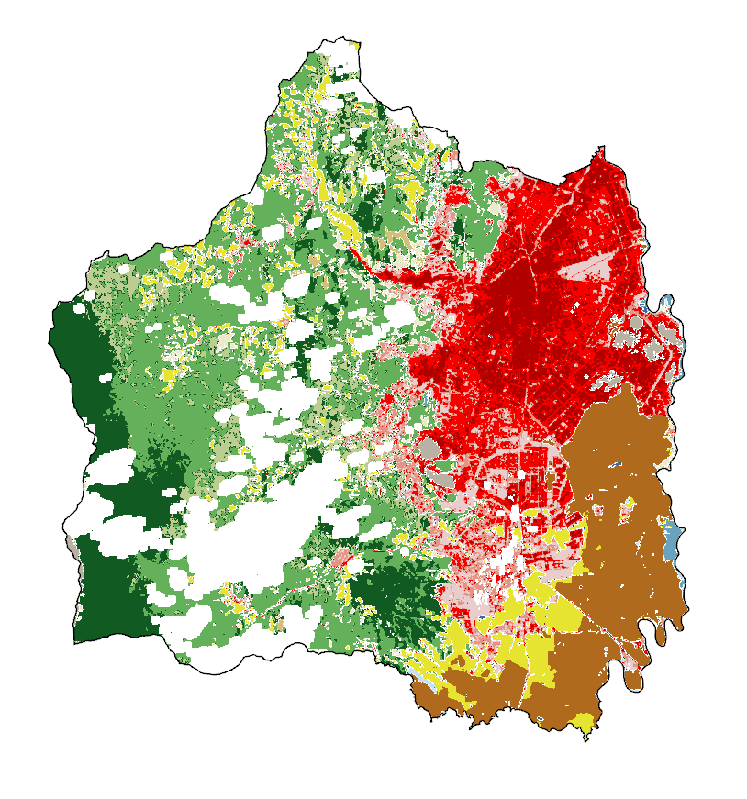
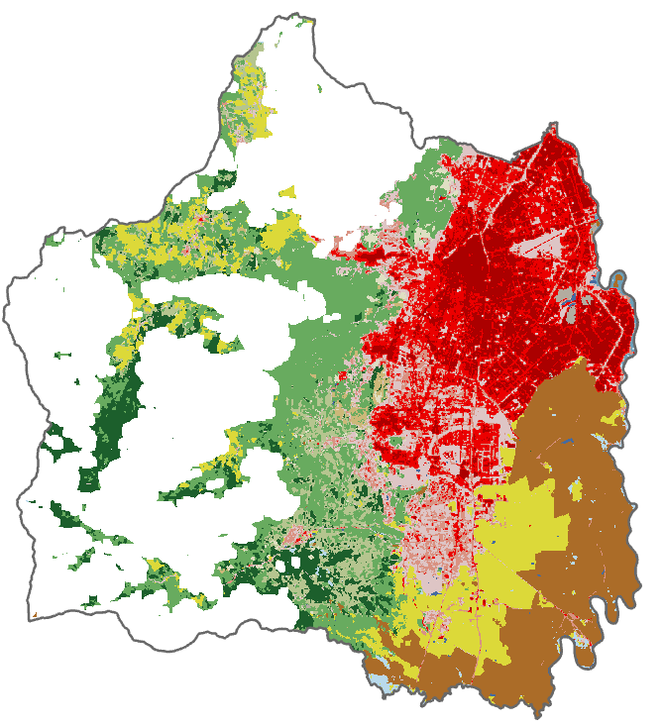
RESULTS: Land Cover
2013
N
2023
Open Water
Developed, Open Space
Developed, Low Intensity
Developed, Medium Intensity
Developed, High Intensity
Barren
Deciduous
Evergreen
Mixed
Shrub
Herbaceous
Pastures
Agriculture
Woody Wetlands
Emergent Wetlands
0
2.5
5
kilometers
Notes:
[Brenna] Here is the land cover classification from 2013 and 2023. Cloud cover was a major challenge for the tool, which can be noted by the large white areas missing from the 2013 image. The model was generally accurate at identifying different land types and was able to identify 81% of the known wetlands in 2023. It is important to note that there were some errors and some frequently misidentified land types. For example, wetlands were classified as woody, emergent, or open water. The other major misclassification is some urban areas as barren lands, likely due to the construction materials.
----------Data Layer Citation------------
Esri. (2023). Deep learning model to perform land cover classification on Landsat 8 imagery. https://www.arcgis.com/home/item.html?id=e732ee81a9c14c238a14df554a8e3225

Slide 13
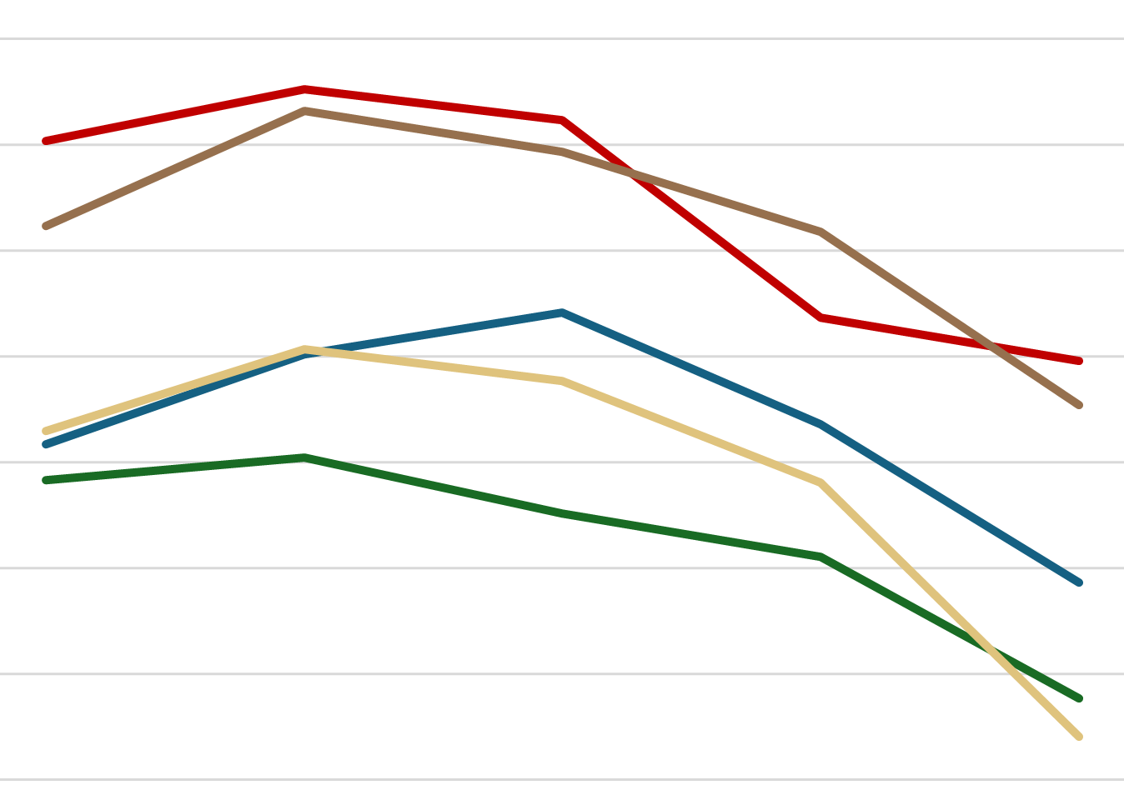
RESULTS: Urban Heat and Land Use
41
39
37
Urban
35
Temperature in ◦C
Crops
Wetlands
33
Pastures
Forests
31
29
27
2013
2015
2018
2020
2023
Year
Notes:
[Brenna] How the land is used influences the temperature of that area. We combined similar land cover types to calculate the average temperature each year of the five categories. While the actual temperature values differ between years, the annual temperature differences between land types remain the same. We found that urban land had the highest temperatures in all years. Conversely, the forested lands, including deciduous, evergreen, and mixed forests, consistently had the lowest temperatures at approximately 31 ºC on average. The wetlands, which include woody, emergent, and open water, also had cooler temperatures with an average of 33 ºC. It is interesting to note that the hottest land cover, developed urban areas or croplands, are the result of human modifications to the land.

Slide 14
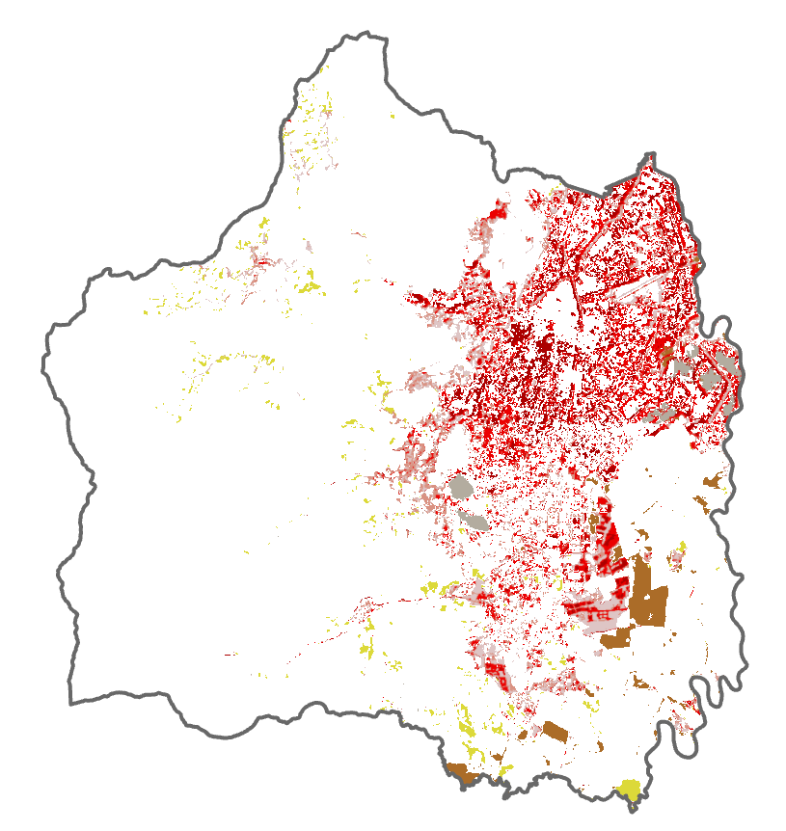
RESULTS: Land Cover Change
2013 – 2023
N
52.8 km² experienced an increase in developed cover
8.4 km² of deciduous forests were converted for human use
Developed, Open Space
Developed, Low Intensity
Developed, Medium Intensity
Developed, High Intensity
Barren Land
Pasture
Cultivated Crops
kilometers
0
1
2
0
2.5
5
kilometers
Notes:
[Brenna] This is the change in land use from 2013 to 2023. The urban areas in Cali have expanded and in many areas, the intensity of development has increased accounting for 52.8 km². The change from medium to high developed intensity was the largest, mostly within the center of the city as shown by the darkest red patches. Additionally, 39% of the pasture land in 2013 is crops in 2023, likely due to an increased need to feed people as the population within the city grows. Similarly, 8.4 km² of deciduous forests were converted, with 34% of the forest lost becoming pasture land and 31% becoming developed open space. These areas are likely to be developed more in the future based on the trends from 2013-2023 where open spaces became low, medium, or high intensity developed land. It is important to note that while intensity is increasing within the city, the deforestation and rural to urban land conversion is mainly at the south end of the city, which now exceeds the acknowledged city boundaries.

Slide 15
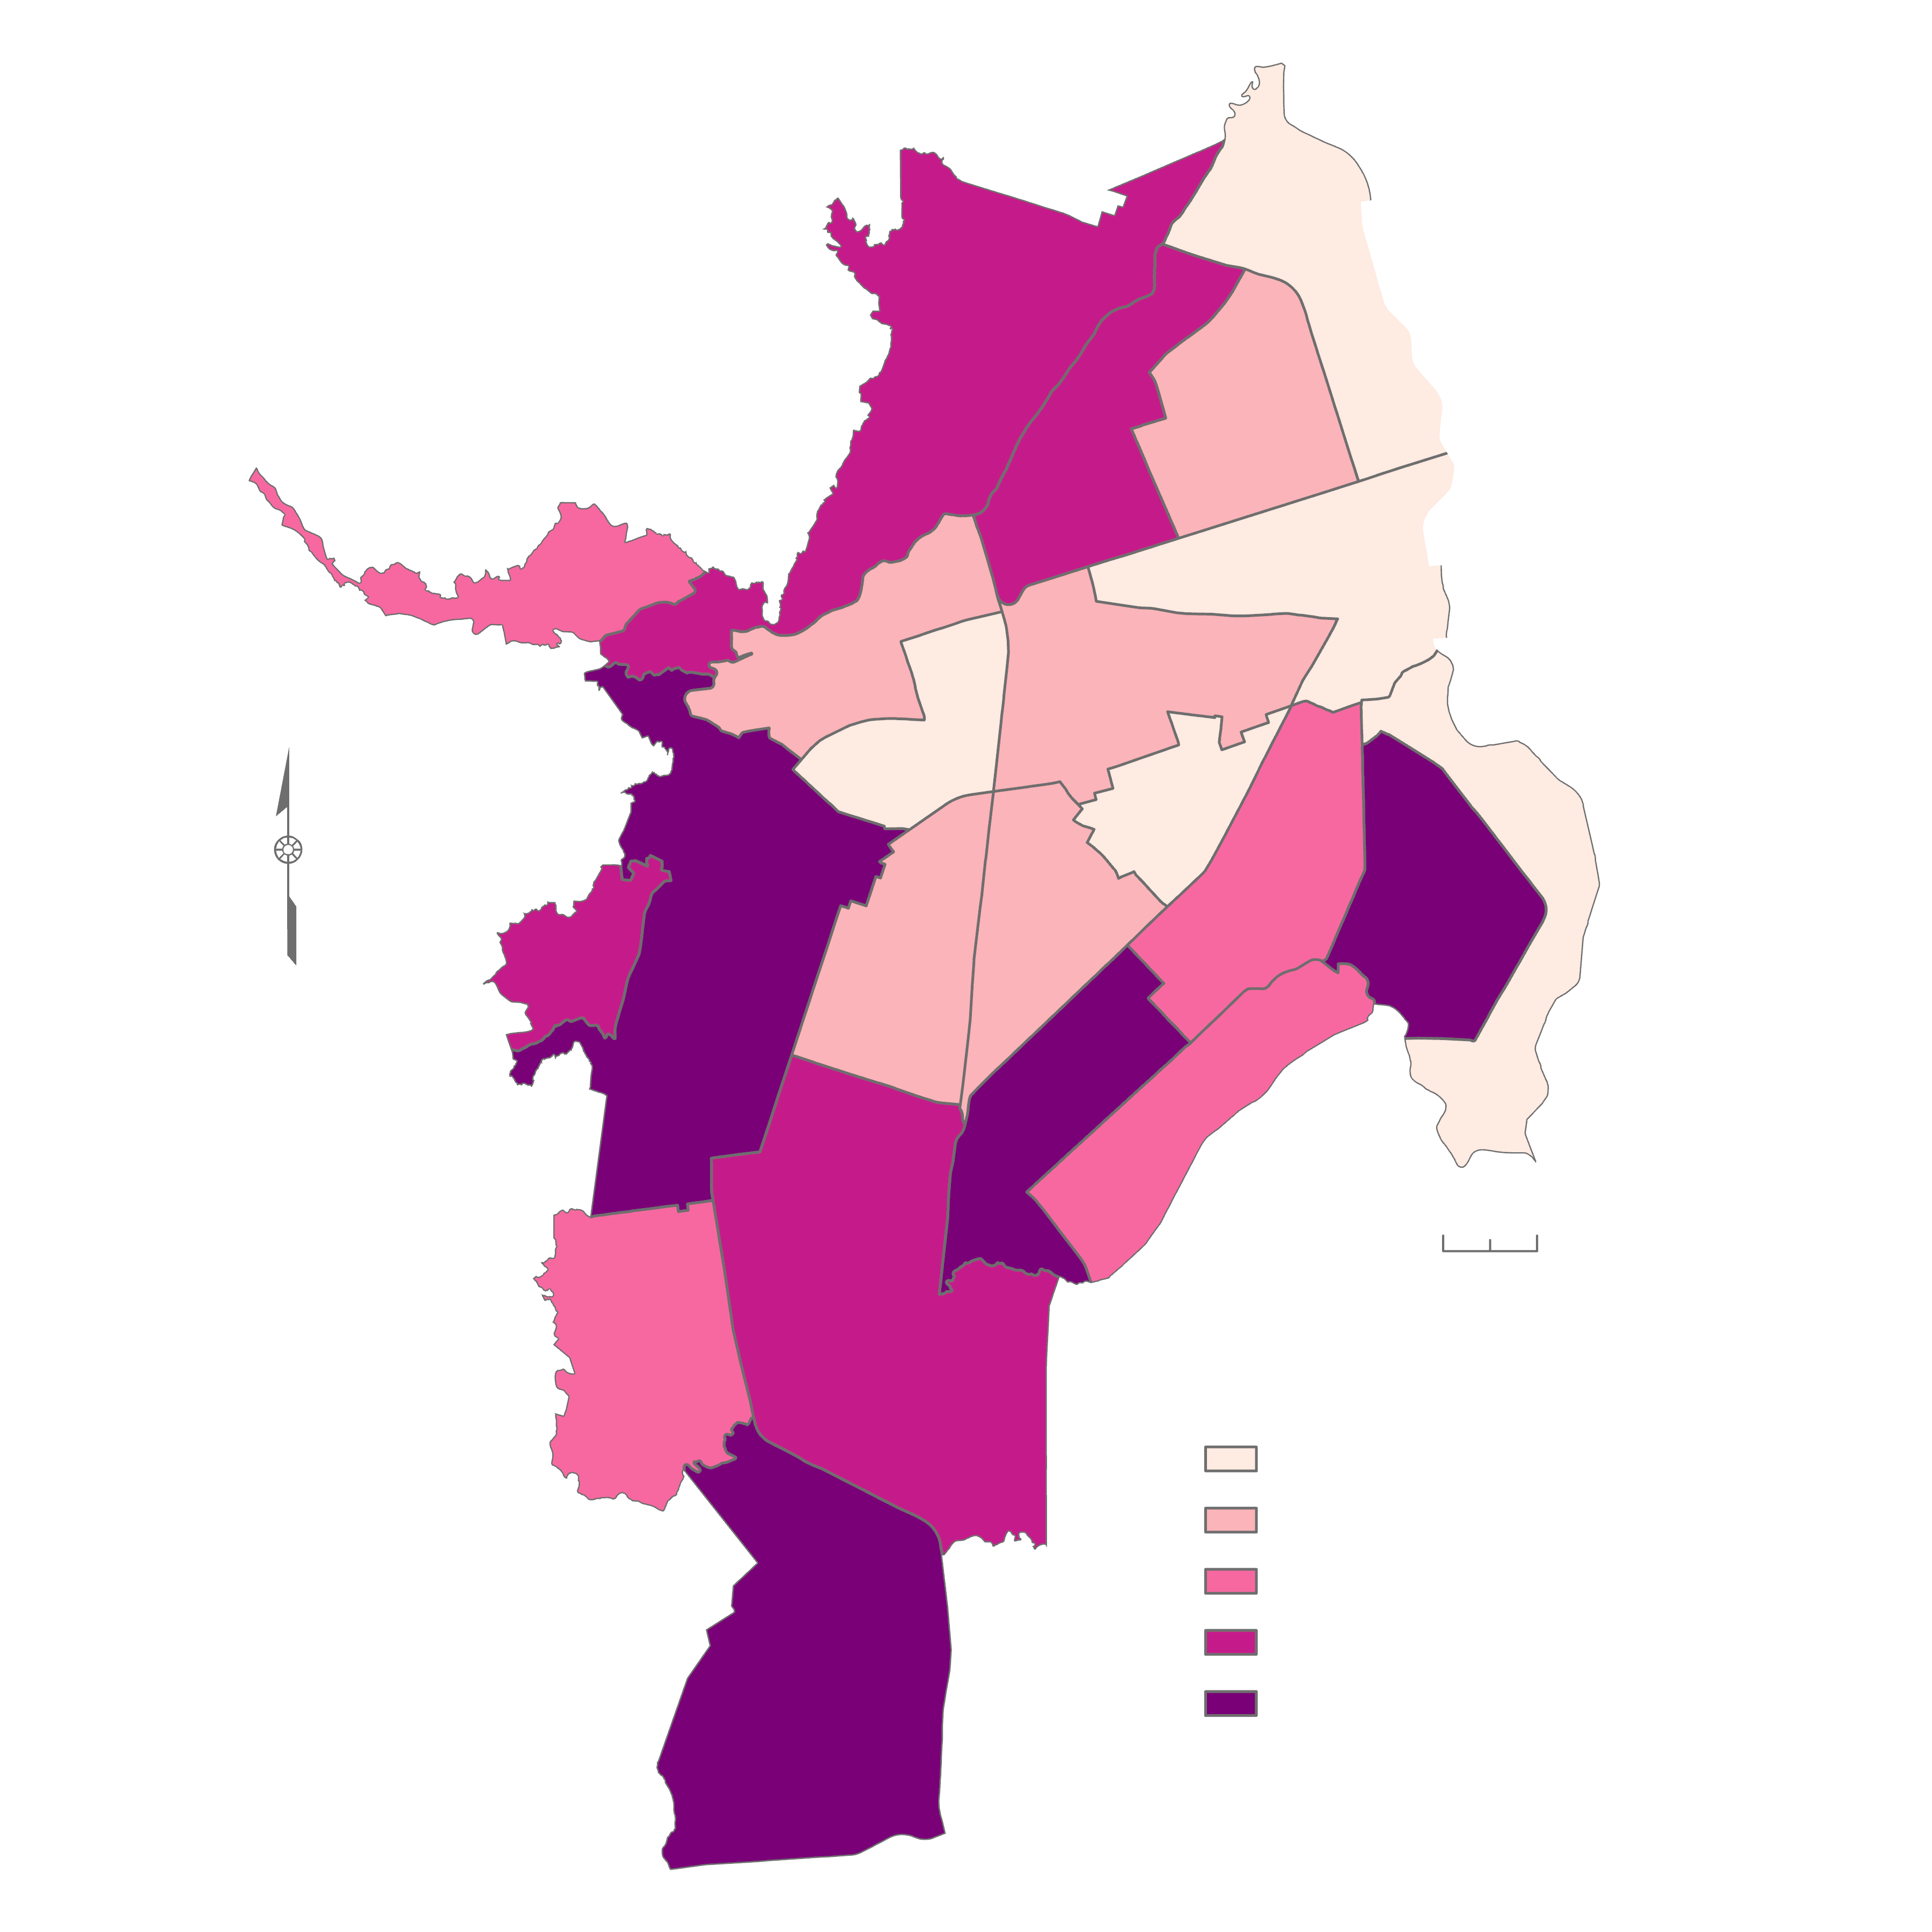
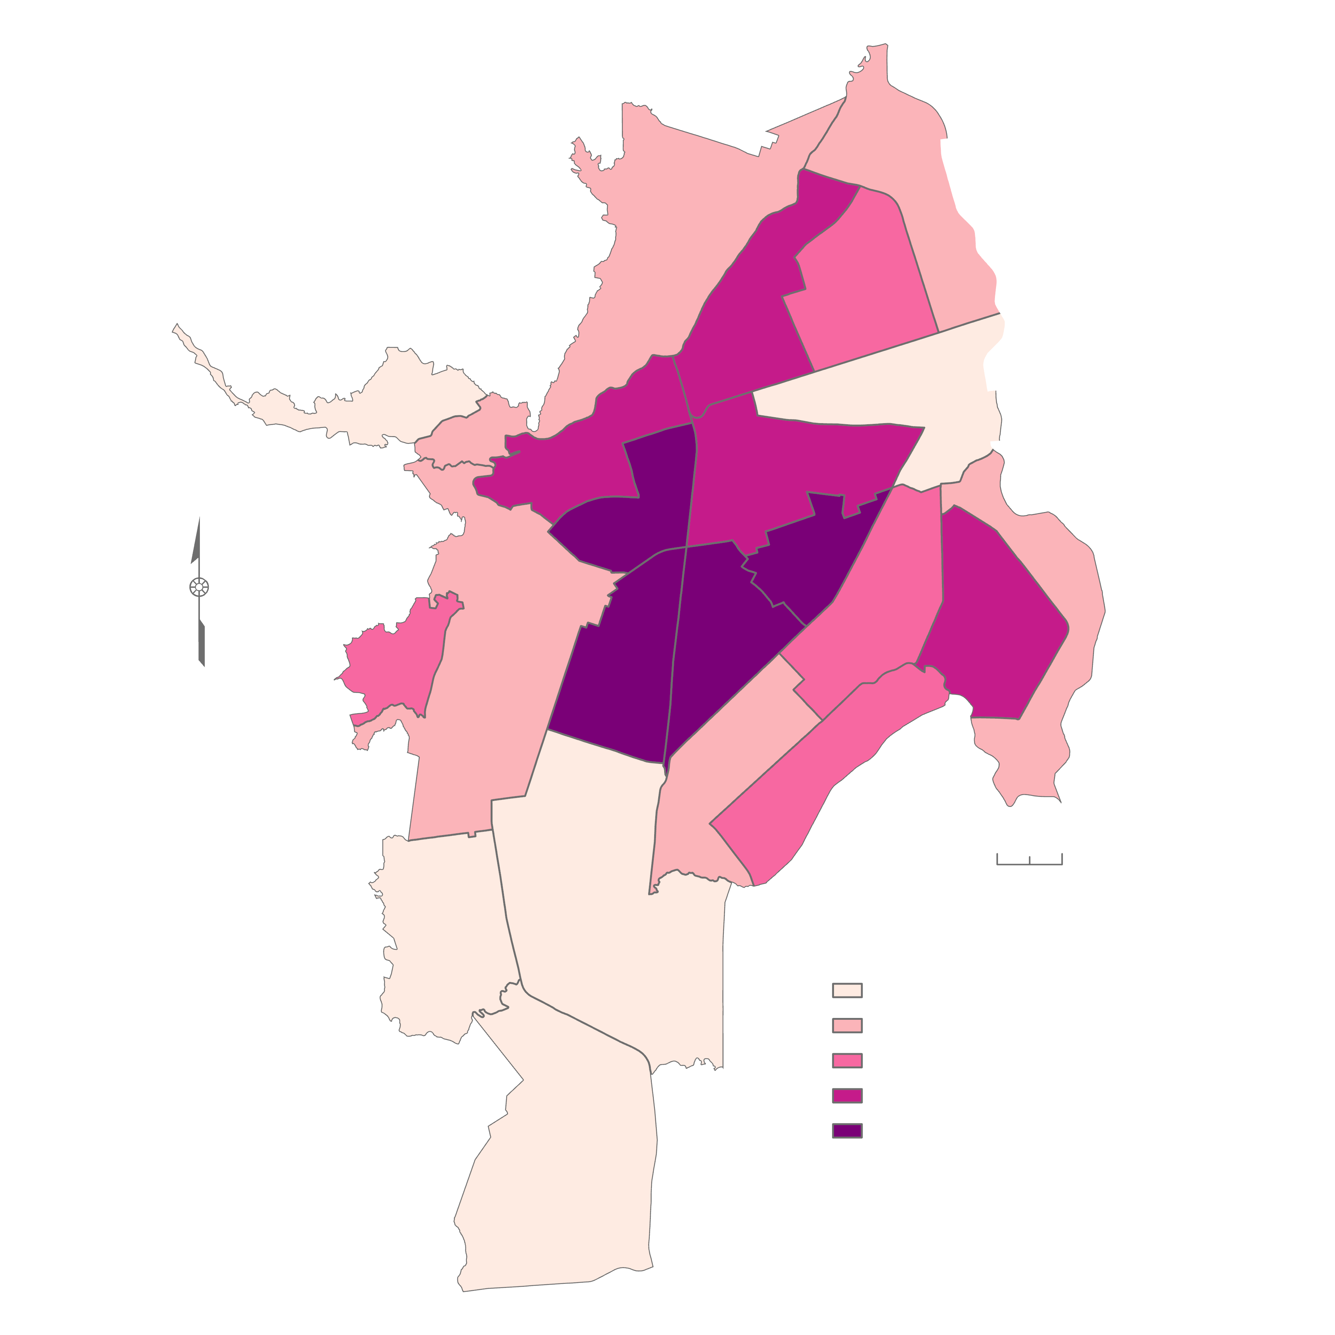
RESULTS: Urban Land Use Change
6
Change Between
2013 and 2023
Mean Across
2013 through 2023
1
2
5
-4.1
91.8
4
7
90.2
3
8
21
3.9
9
12
20
11
14
10
13
1.1
95
19
4
97.3
16
15
-0.8
68.8
18
3.5
73.4
17
0.8
0.2
N
95.3
97.4
22
N
0
99.4
0.1
-1.3
99.4
85.5
0.4
1.6
7
97.7
92.5
95.9
3.9
7.5
93.5
0.7
87.2
98.2
6.1
85.6
1.8
93.1
0
1 km
0
1 km
3
Urban Development Change (%)
75.3
81.5
Mean Urban Development (%)
5.9
99.4 -- 97.4
7.5 -- 5.9
97.4 -- 95.0
5.9 -- 3.5
95.0 -- 91.8
3.5 -- 1.1
91.8 -- 81.5
6
1.1 -- 0.1
60.5
0.1 -- -4.1
81.5 -- 60.5
Notes:
[Deya] To facilitate the comparison between the land use changes across our study period, the team also calculated urban development at the comuna level by grouping pixels classes as developed low to high intensity and calculating the percentage of these over the total number of pixels in each comuna.
The map on the left depicts the change in development over the study period. Overall, there has been an increase in urban development with significant increases in peripheral comunas.
In contrast, the map on the right depicts the mean urban development in Cali, calculated as previously described, where central Cali is the most urbanized.

Slide 16
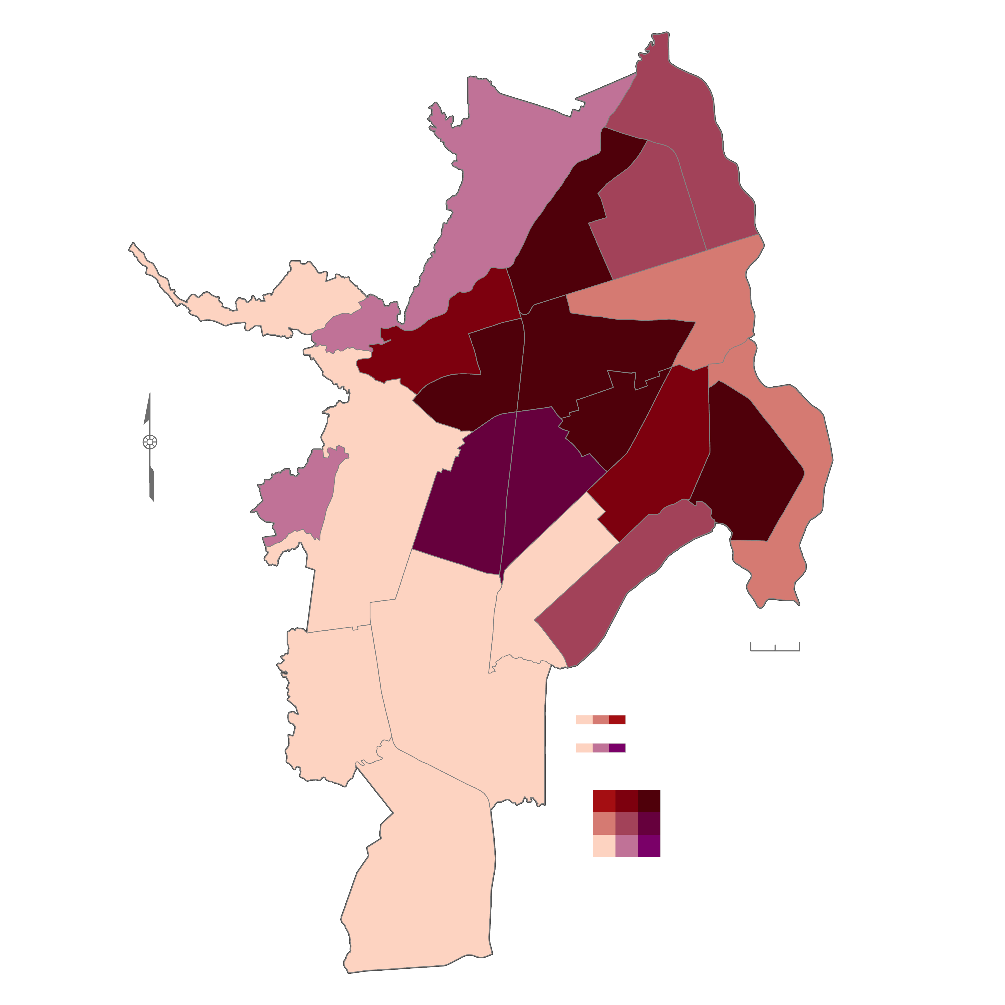
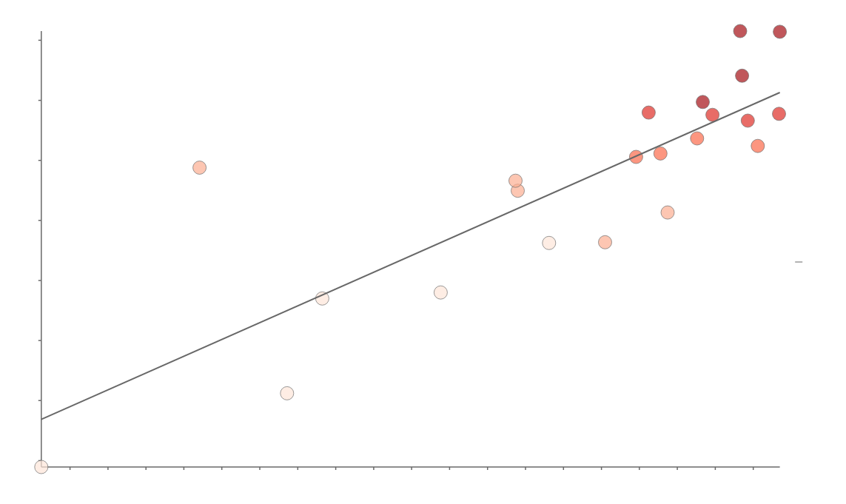
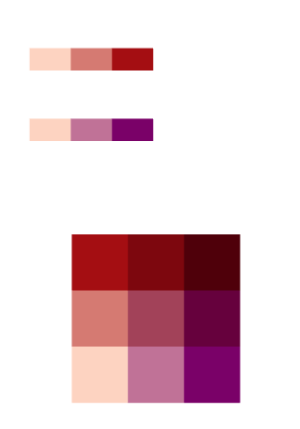
RESULTS: Urban Development vs Heat
Mean Across
2013 through 2023
6
2
41
5
4
40
1
7
39
N
3
8
9
38
12
21
Mean Land Surface Temp. (ºC)
11
13
14
37
20
19
10
16
36
R² = 0.7
15
0
1 km
35
18
17
Mean Land Surface Temp. (ºC)
34
62
66
70
74
78
82
86
90
94
98
Mean Urban Development (%)
H
Mean Urban Development (%)
22
L
H
Notes:
[Deya] To compare urban development and land surface temperature per comuna, the following graph plotting the two variables was made. As can be observed, there is a relatively strong positive correlation between the variables: as development increases, so does LST.
Another way to visualize the relationship between these two variables is through the following bivariate choropleth map. Comunas shown in darker colors (such as 4, 8, 9, 12, and 14) have both high temperatures and high urbanization, whereas the beige comunas (1, 16-19, as well as 22), have both lower temperatures and low urbanization.

Slide 17
METHODOLOGY: Social Vulnerability
Acquisition
Processing
Analysis
Demographic Data From "Cali en Cifras" and Other Municipal Datasets
Converted Numerical Population Shares Data to Percentages
Normalized Data and Ran PCA in R Studio
Visualized PCA Results in R Studio
Calculated Green Space Access in QGIS
Notes:
[Gabi] The team first searched for and downloaded relevant demographic data from the "Cali en Cifras" web portal and PDF document, both of which detail statistical data for the city of Cali. To determine how different indicators of vulnerability are distributed spatially across Cali, the team ensured that all data downloaded was organized by comunas, the 22 units in which Cali's urban zone is divided. Second, team members adjusted how some of the demographic indicators were presented to enable more effective comparison. For example, the team converted numerical data describing shares of the population, such as the number of Afro-Colombians residing in each comuna, to percentages of the population corresponding to the year each figure was collected, in order to account for demographic data being collected during different years. Team members also decided to quantify access to green space by calculating the area of green space in each comuna in QGIS, then calculating area of green space in meters squared per capita for each comuna. Finally, the team utilized R Studio to normalize the data, run a Principal Component Analysis, and visualize the results with graphs and charts.

Slide 18
RESULTS: Social Vulnerability
Social stratum 2
Adult illiteracy
% social benefits
# health facilities
% w/o garbage
% Afro-Colombian
% age 65 and over
Social stratum 1
Green space acc.
% w/o sec. edu.
% with disabilities
% w/o E/W/S
% w/o nat. gas
% Indigenous
% < age 5
Correlation Plot
-
-
-
-
-
-
-
-
-
-
-
-
-
-
-
1
% households in social stratum 1 -
% households in social stratum 2 -
0.8
% lacks secondary education -
0.6
Positive Correlation
Adult illiteracy rate -
% pop. with disabilities -
0.4
% with low-income social benefits -
0.2
# of health facilities -
% w/o electric, water, sewer coverage -
0
% w/o natural gas coverage -
-0.2
% w/o garbage pickup coverage -
Afro-Colombian % pop. -
-0.4
Negative Correlation
Indigenous % pop. -
-0.6
% pop. < age 5 -
% pop. age 65 and over -
-0.8
Access to green space -
-1
Notes:
[Gabi] This correlation plot shows how strongly each pair of socioeconomic variables is correlated. The numbers on the right are the correlation coefficients, which show the positive or negative linear relationships between the variables. Examples of variables that show strong positive relationships with multiple other variables are the adult illiteracy rate, percentage of households in the most socioeconomically disadvantaged social stratum, and the percentage of households receiving social and health benefits designed to serve low-income residents. This likely indicates that the populations in Cali that experience barriers to education are also less economically stable and are enrolled in programs to assist them in accessing healthcare. Meanwhile, variables that show strong negative relationships with other variables are the percentage of the population age 65 and over, and the area of green space accessible to each person. One variable with mostly weak negative correlations to the others is the number of health facilities, which indicates that the more health facilities are available per comuna, the less those residents tend to be socially vulnerable in other ways.

Slide 19
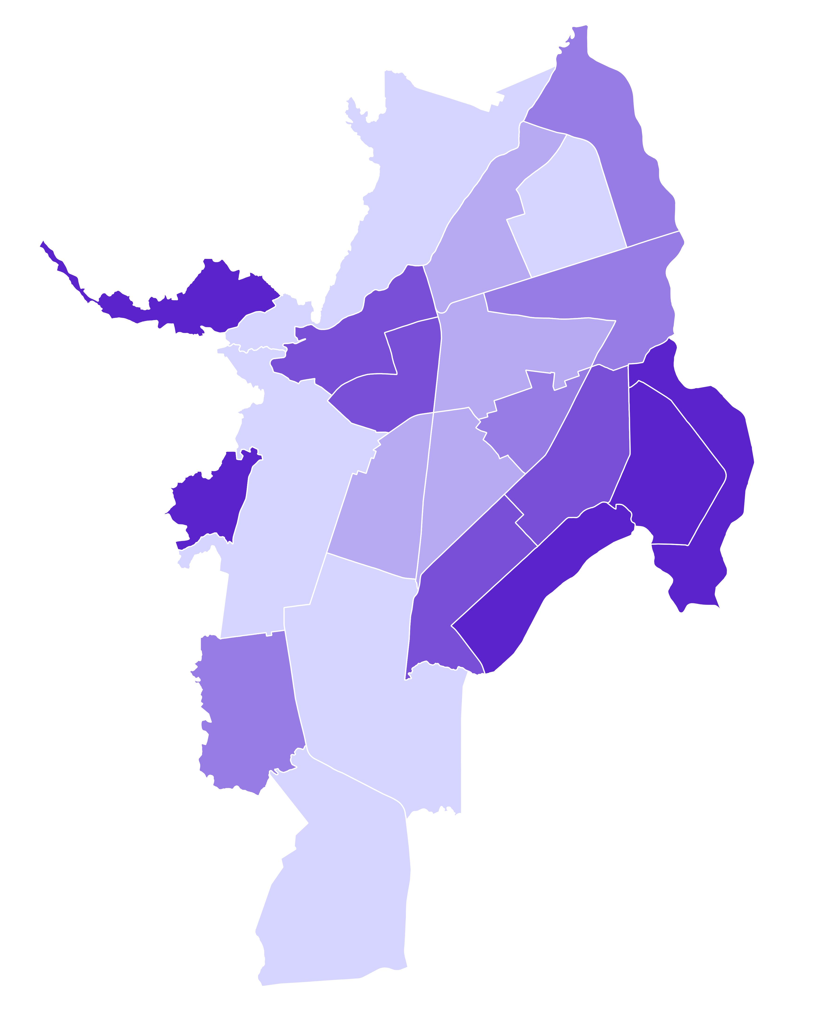
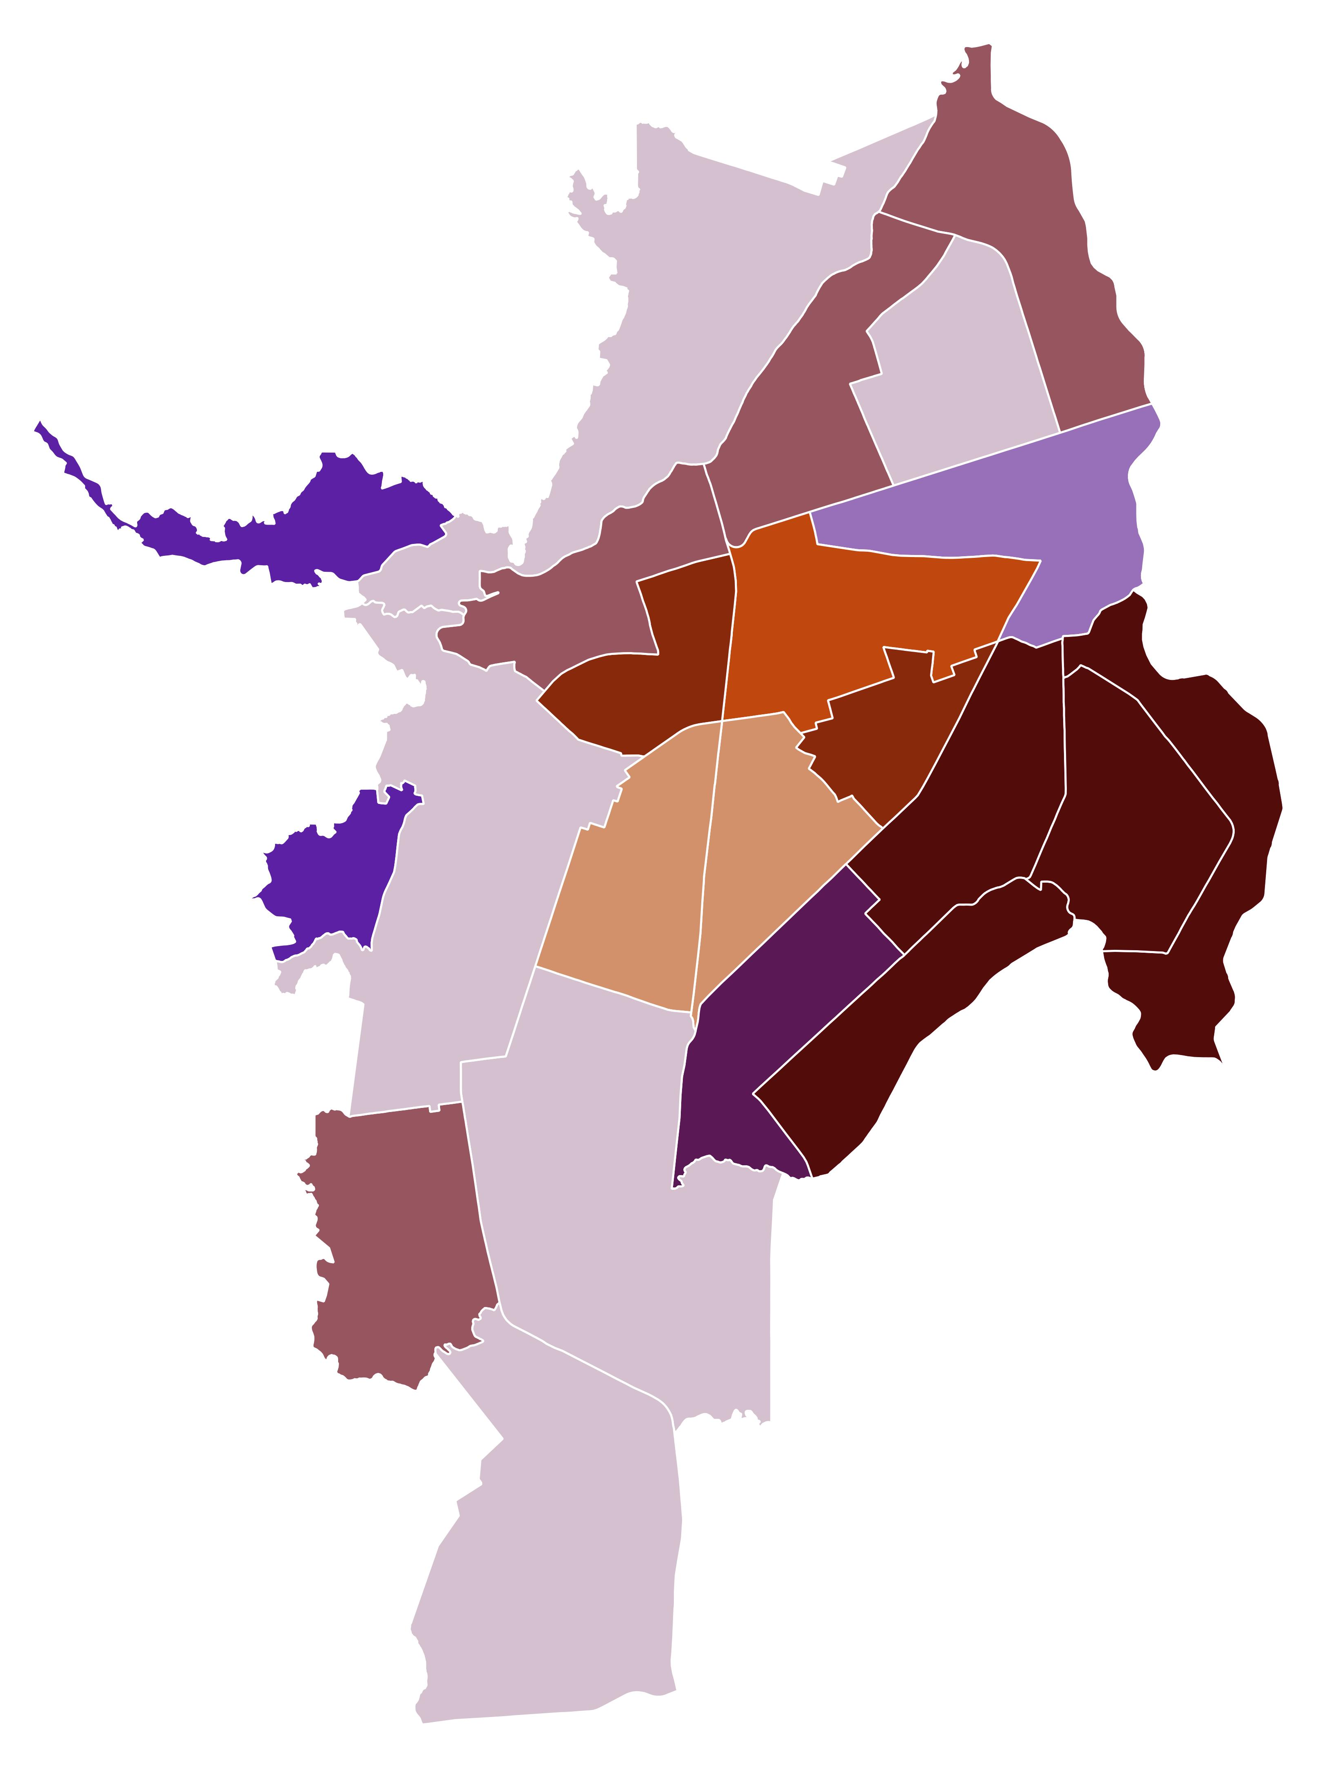
RESULTS: Social Vulnerability and Urban Heat
Social Vulnerability and Land Surface Temperature by Comuna, 2023
Social Vulnerability by Comuna
6
6
2
2
5
5
4
4
1
7
1
7
3
8
3
8
9
9
N
12
21
N
12
21
13
14
13
20
11
20
11
14
19
10
19
10
16
16
15
15
High Social
Vulnerability
Land Surface
Temperature
18
17
18
17
Social
Vulnerability Score
22
Low Social
Vulnerability
22
0
1 km
0
1 km
Notes:
[Gabi] Social vulnerability scores were calculated for each comuna by aggregating the socioeconomic variables shown on the previous slide. The comunas with the highest vulnerability were comunas demonstrated by the darkest purple color (1, 14, 15, 20, and 21). When comparing social vulnerability with land surface temperature, we found that comunas demonstrated by the dark brown color (13, 14, 15, and 21) experienced the most urban heat as well as high social vulnerability. Running the Principal Component Analysis with land surface temperature as an additional variable yielded further findings, showing that the areas with the hottest temperatures correlated to higher Afro-Colombian populations (correlation coefficient = 0.57) and less access to green space (correlation coefficient = -0.39).

Slide 20
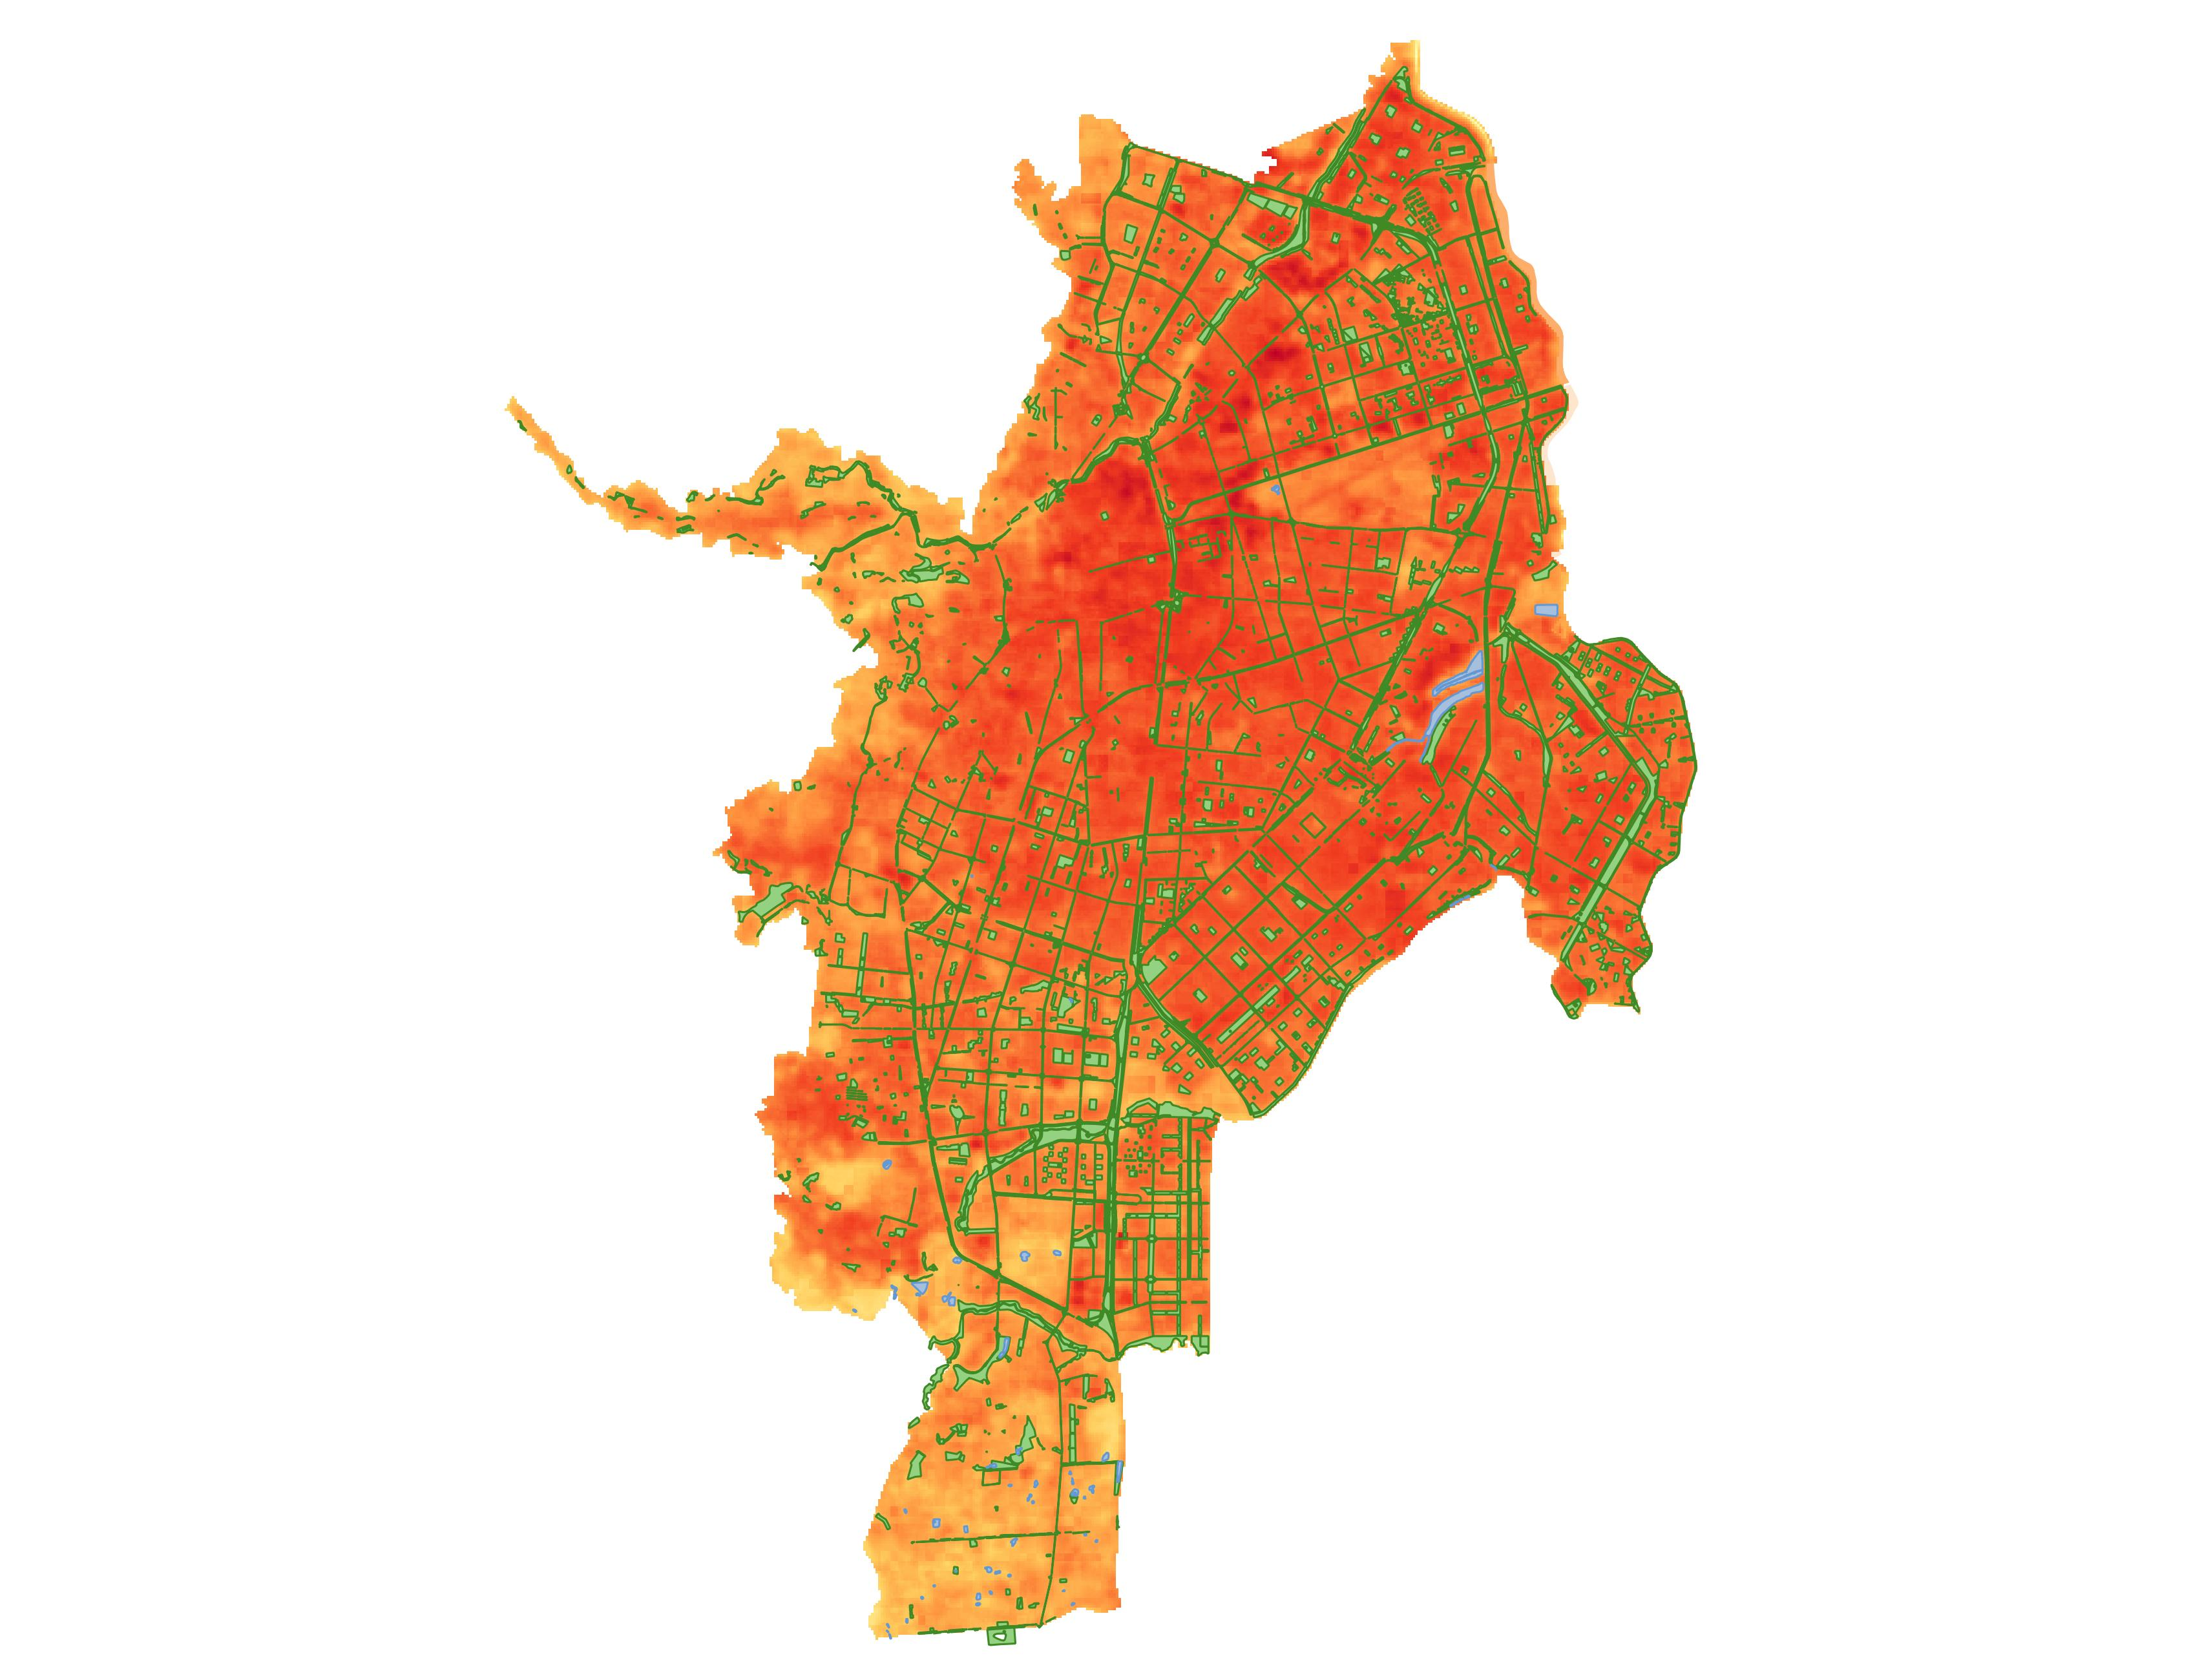
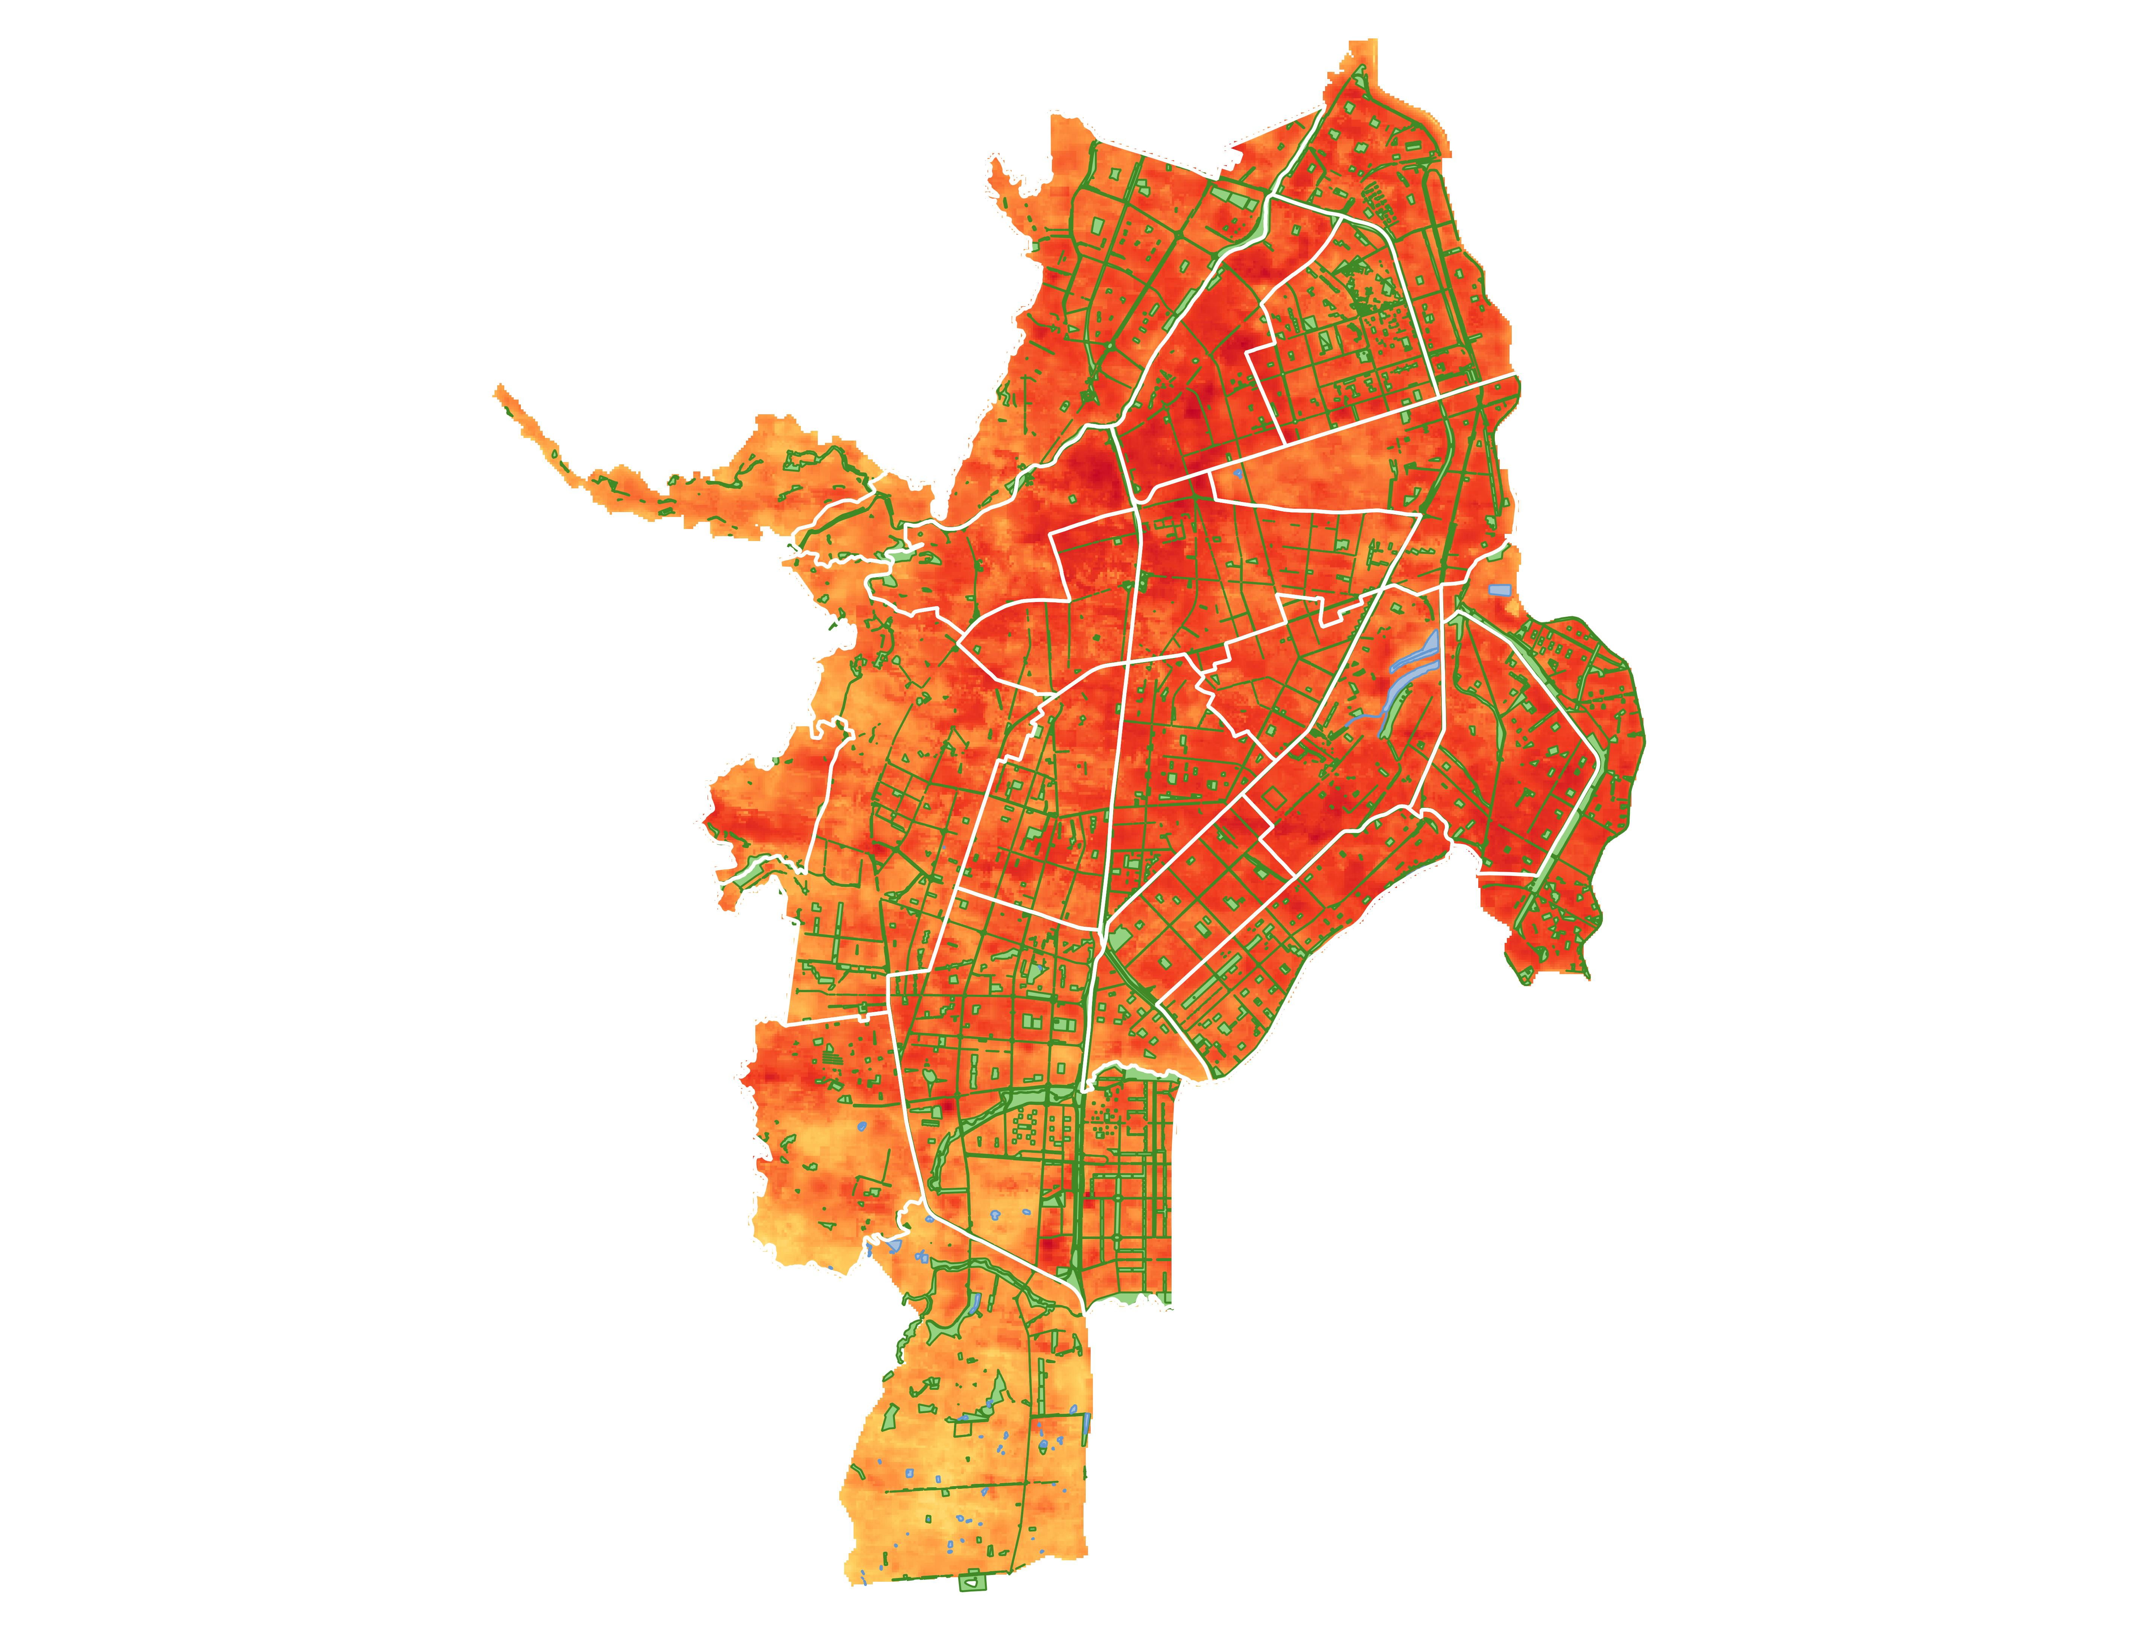
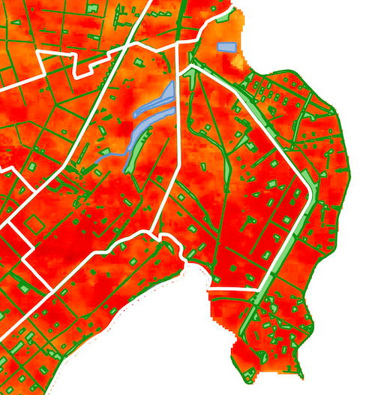
RESULTS: Social Vulnerability and Urban Heat
Land Surface Temperature, Urban Wetlands, and Green Spaces
N
6
2
5
4
1
7
Land Cover
3
8
Close-up of Eastern Comunas
Green Spaces
9
Wetlands
12
21
13
20
11
14
Land Surface Temperature
19
10
16
12
21
17
15
0
1 km
25.2 °C
13
14
18
15
48.1 °C
22
Comunas
Notes:
[Gabi] This map depicts the land surface temperature for Cali in 2023, using the tif image the team generated with UHEAT 2.0, overlaid with partner-provided shapefiles of urban green spaces and urban wetlands. We can see that urban wetlands and green spaces are present in comunas with high variation in temperature, prompting an interest in further investigation of the role of green and blue spaces in mitigating urban heat in Cali.

Slide 21
LIMITATIONS
Cloud cover in satellite data
Deep Learning Model trained with US data
Years of availability for some education and health data
Notes:
[Isabelle] Several limitations warrant further discussion. The most prominent is cloud cover which posed a challenge to landcover classification, along with the LST outputs which relied on imagery from Landsats 7, 8, and 9. Originally, we were planning to use only Landsat 8 to generate our LST data, however, the clouds limited the number of satellite images available to use in our analysis, which encouraged us to incorporate all of the currently operational Landsat satellites. Still, as a result of the clouds, the number of images generated for years relying on 2-3 Landsat satellites was between 34-63 images. The cloud mask was able to remove the clouds but left large areas of no data in some datasets, which heavily affected the landcover maps.
The deep learning model used in the landcover classification maps is another source of limitation. The model classified pixels based on the National Land Cover Database by the USGS which only uses U.S. data. Some of Colombia's construction materials for buildings and roads are different than in the U.S. and could influence the model’s classification, leading to errors.
Finally, some of the education and health data used in the social vulnerability analysis was outdated, as the only data available for download for some of the team's chosen indicators was from 2013, the first year of our study period.
Image Credit: Microsoft Office 365 Icons & Shapes

Slide 22
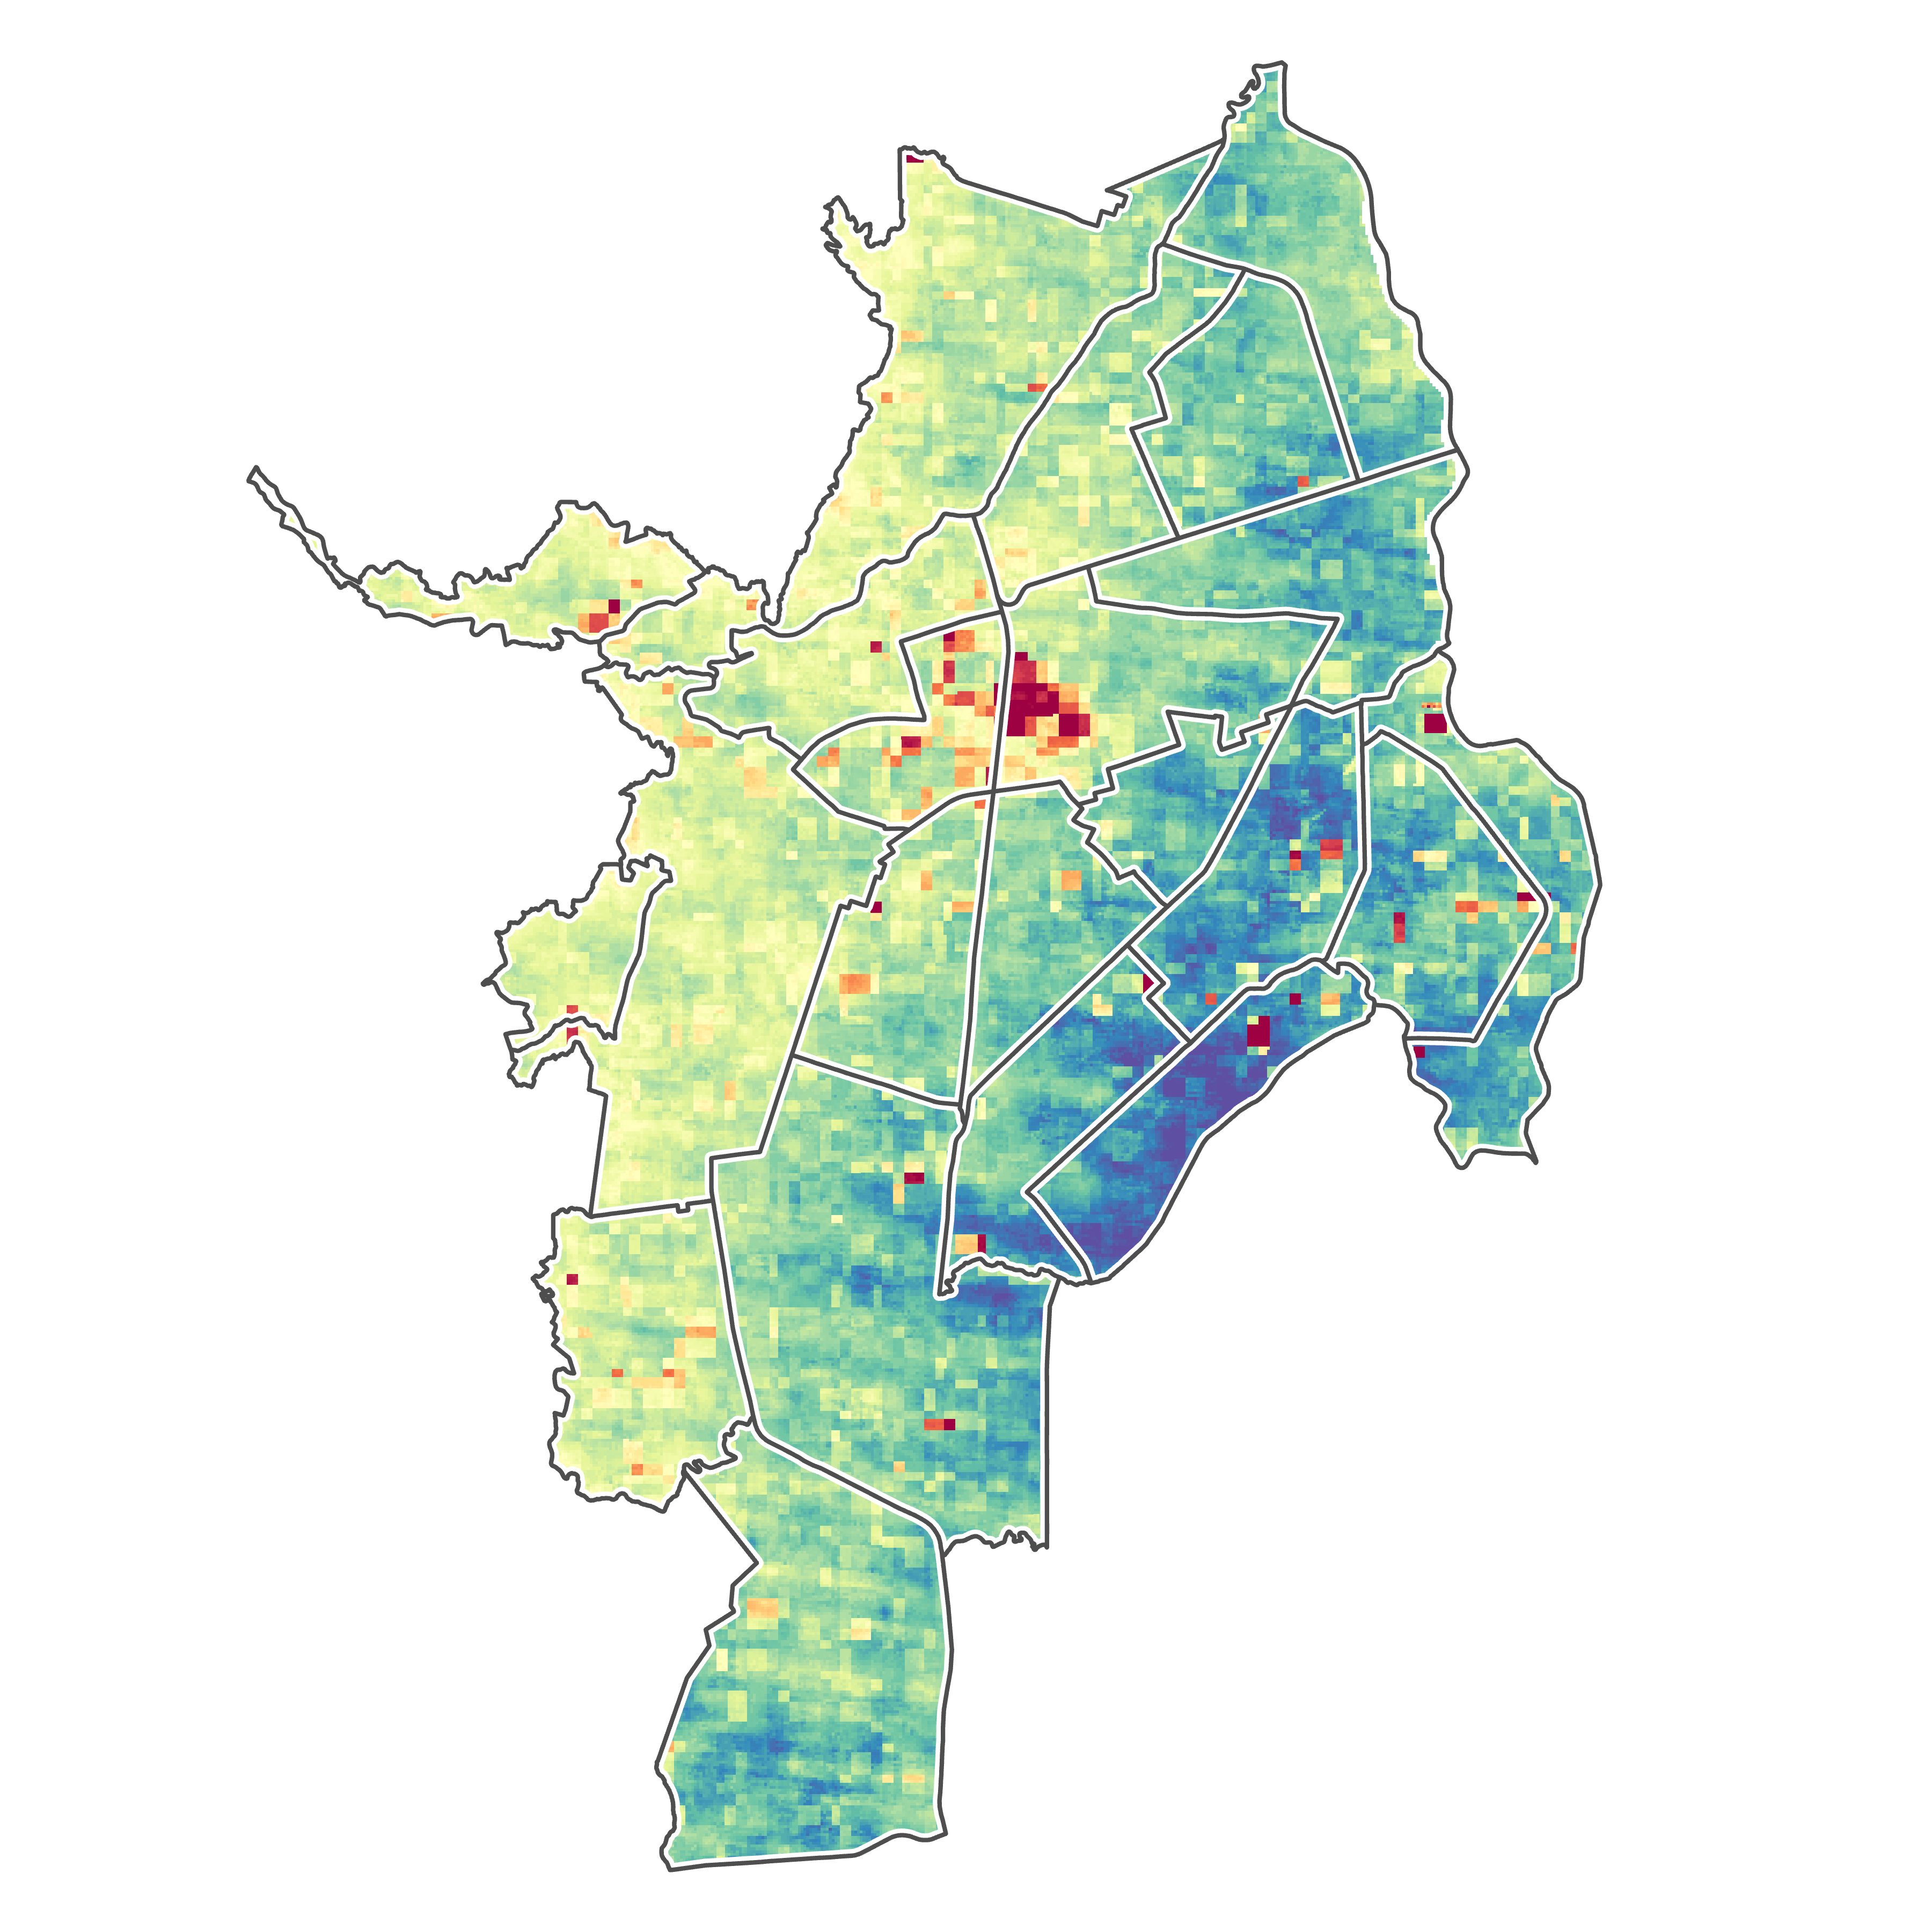
FEASIBILITY
6
2
Using NASA Earth observations in equatorial zones is limited by two major factors:
Minimal images to meet accuracy requirements
Temperature uncertainty
5
4
1
7
3
8
N
9
12
13
21
14
20
19
10
11
16
15
0
1 km
18
17
Temperature Uncertainty (ºC)
5.58
3.55
22
Notes:
[Deya] The feasibility of this study heavily relies on the team’s ability to meet the image requirements of 30 images or more used for accurate calculations, such as for land surface temperature. For 2022 and 2023, when we were able to use imagery from three satellites, the requirements were easily met. For earlier years, however, it was more difficult to acquire enough images since Landsat 9 was not launched until 2021.
Another major limiting factor was the uncertainty in the surface temperature bands from Landsat ETM+/TIRS. Previous research made use of a quality assessment mask that excluded pixels where the uncertainty was above 4 ºC. However, as can be seen in the map provided, a sizable percentage of our study area was above this threshold with an uncertainty ranging from 3.5 - 5.5 ºC

Slide 23
CONCLUSIONS
Surface temperature varies according to land cover
Amount of development significantly increases temperature
Areas with less green space experience hotter temperatures and higher social vulnerability
Highest need for expansion of green spaces and health facilities in Comunas 13-15 and 21
Continued development exposes more individuals to high temperatures
Charco Azul
Image Credit: Viviana María Sánchez Escobar
Notes:
[Brenna] Overall there are five main take-aways from this feasibility study. We found that temperature varies significantly between urban and forested lands which shows that landcover strongly impacts surface temperatures. It also means that the developed land area per comuna significantly increases the temperatures residents experience. The temperatures are hottest in the center of the city where there is less green space, and therefore less cooling from vegetation. We also saw less green space in areas of high social vulnerability. Implementing green spaces and health facilities should be prioritized in Comunas 13-15 and 21 to reduce heat vulnerability. Reducing heat risk is critical because more comunas will be at risk as development continues to increase.
----------Image Information Below----------
Image credit: Viviana María Sánchez Escobar, Leader of Climate Change Group at DAGMA, Feb. 12 2024 (Used with Permission)

Slide 24
The team would like to thank:
Partners: Fundación Dinamizadores Ambientales and Departamento Administrativo de Gestión del Medio Ambiente (DAGMA)
Advisors: Dr. Morgan Gilmour (NASA – ARC), Dr. Alexandra Christensen (NASA – JPL), Dr. Juan Torres-Pérez (NASA – ARC), Dr. Xia Cai (NASA – LaRC), Lisa Tanh (Esri)
Lead: Lauren Webster (California – Ames)
Fellow: Maya Hall (California – Ames)
Special thanks to the Spring 2024 Cali Urban Development I Team for their previous work on this project and the UHEAT Urban Development (Spring 2022) DEVELOP team for developing the UHEAT 2.0 Tool.
Notes:
[Gabi] We would like extend our sincere appreciation for the organizations and individuals who made this project possible through their exceptional commitment and dedication. Thank you to our partner organizations in Cali, Colombia, Fundación Dinamizadores Ambientales and DAGMA, for sharing their local knowledge and experience. Thank you to our science advisors who assisted us with the technical aspects of this project. We would also like to thank fellow Maya Hall for her valuable feedback and our Center Lead at Ames Research Center, Lauren Webster for her continuous support and guidance. Lastly we would like to extend a special thanks to the team who worked on the previous term of this project. We appreciate the time you all have taken to listen to our presentation today, thank you!

Slide 25
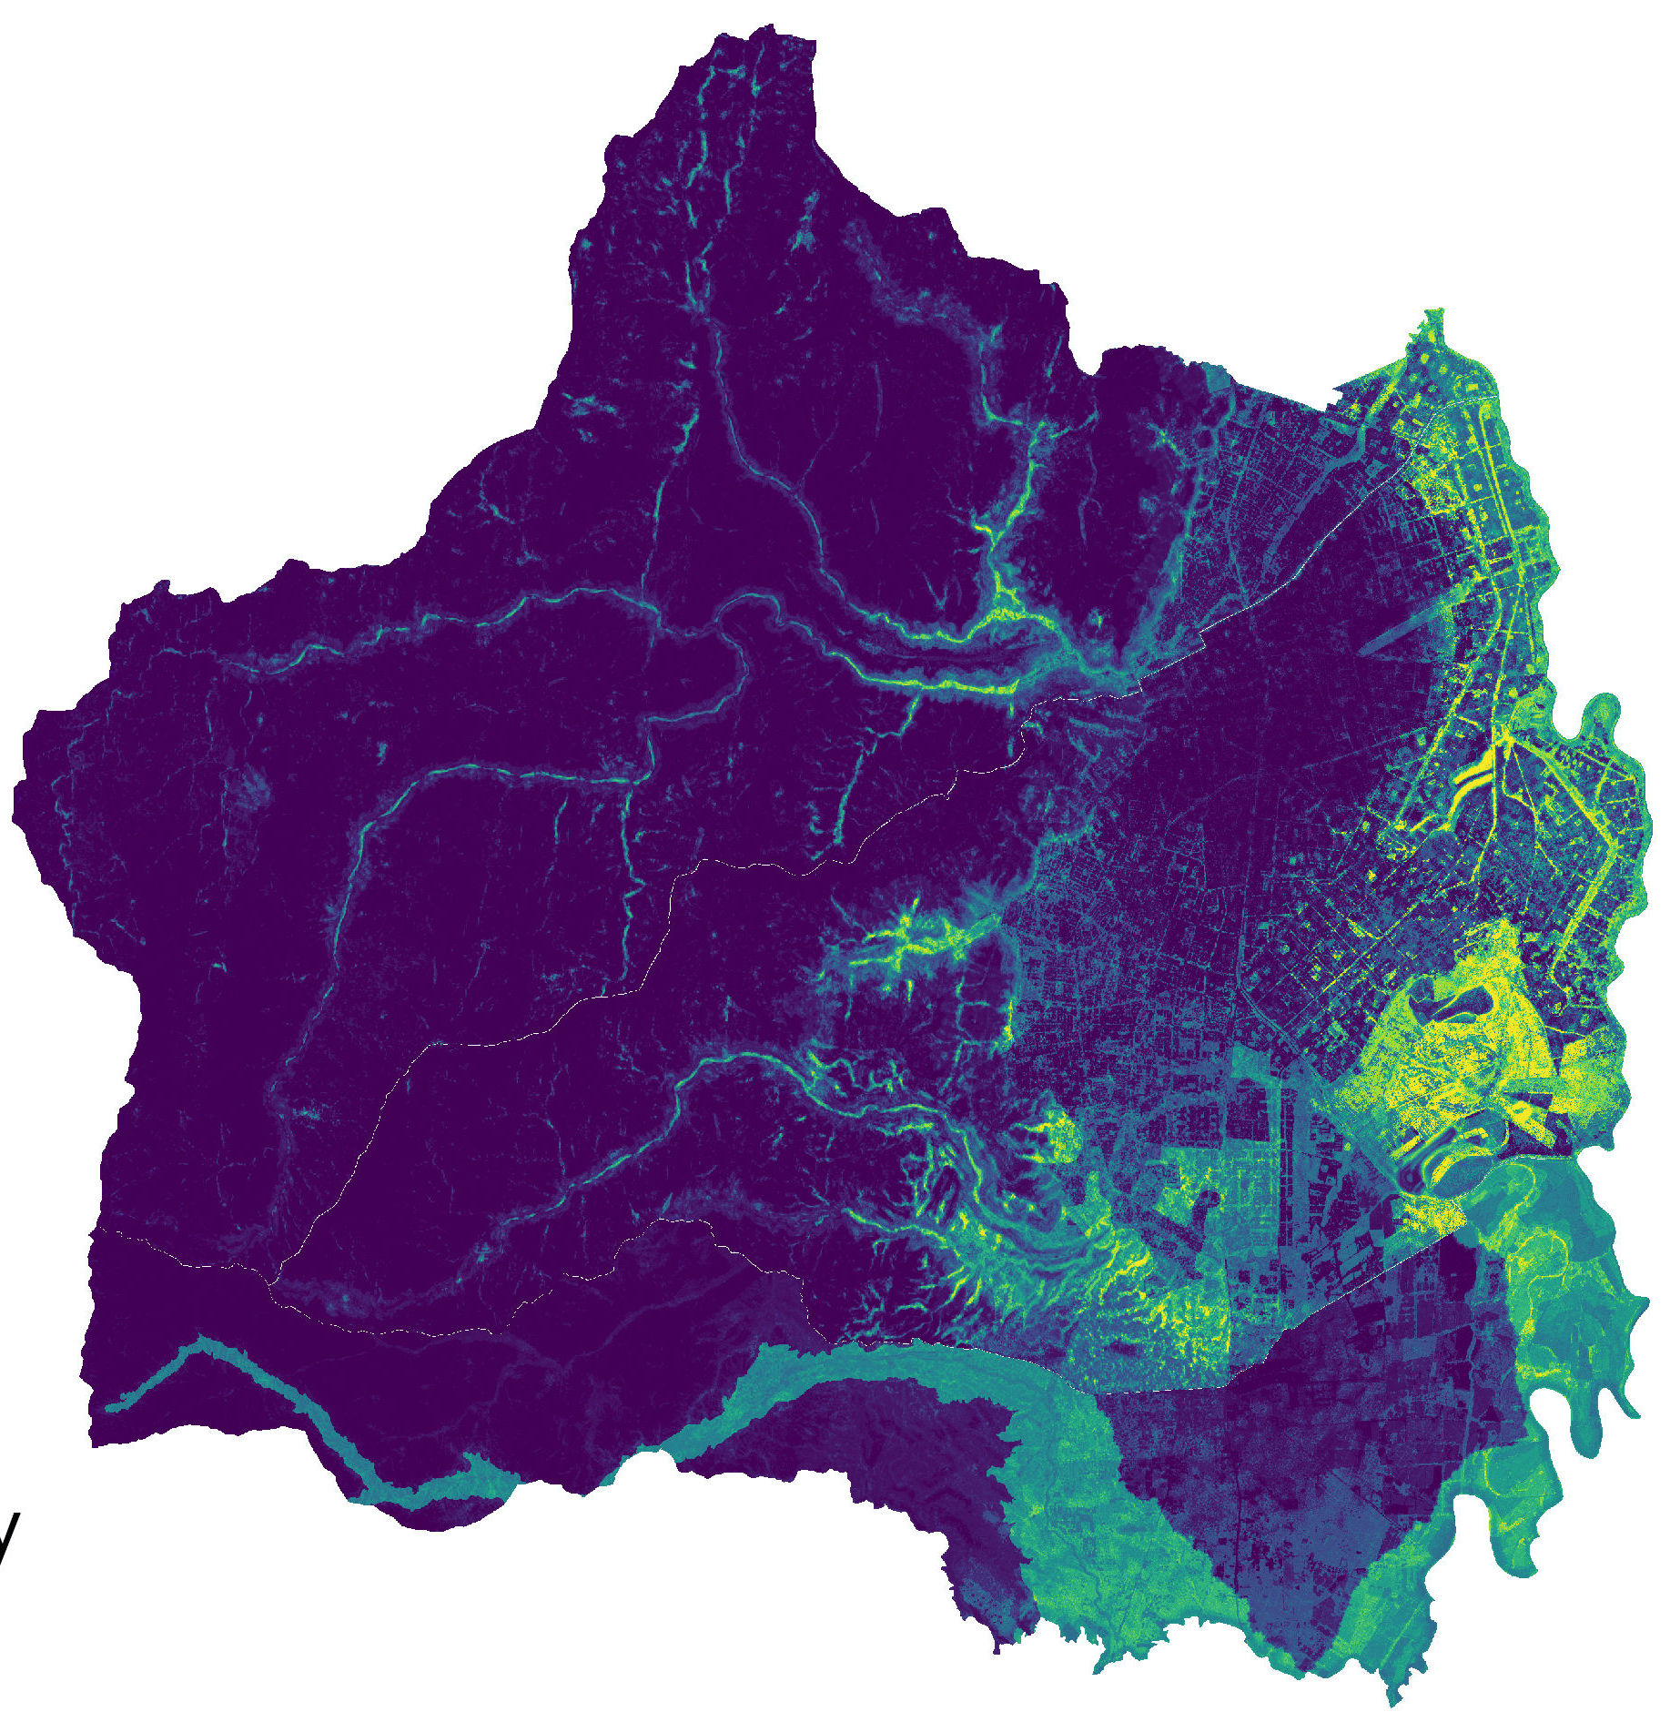
METHODOLOGY: Wetland Intrinsic Potential
0%
100%
The team modified the potential wetlands map from the first term by adding breaks at 10% intervals
N
Notes:
[Isabelle] For our last set of methods we have the Wetland Intrinsic Potential tool, a public ArcGIS toolbox developed by the University of Washington Remote Sensing and Geospatial Analysis Lab and watershed mapping company Seattle TerrainWorks to map small, ephemeral wetlands which are difficult to identify using traditional wetland mapping methods (Halabisky et al., 2023). This tool incorporates several DEM-derived topographical indicators, as well as NDVI, NDWI, and in situ soil data. This term, we modified the potential wetlands map from the first project to create a new map of potential wetlands by adding breaks at 10% intervals. This made it easier to visualize the probability of the wetlands by better showing certain bodies of water that were not clearly depicted on the map from term one.

