Slide 1
Southeastern Idaho Ecological Conservation
Investigating the Impact of Targeted Grazing to Improve Wetland Habitat in the Sterling Wildlife Management Area
Preethi Malur Balaji • Talissa Cota • Kangsan Lee • Melissa McNally
Idaho – Pocatello | Spring 2023
Notes:
We are the NASA DEVELOP Southern Idaho Ecological Conservation team and have spent the past ten weeks investigating the effect of targeted grazing as a method to improve wetland habitat in Idaho’s Sterling Wildlife Management Area.

Slide 2
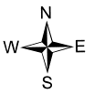
Study Area &
Pre-Grazing
2013 – 2020
Post-Grazing
2021 – 2022
Study Period:
Coeur
D’Alene
American Reservoir
Sterling Wildlife Management Area
American Game Unit
01/27/21 – 03/04/21
400 AUMs
01/14/22 – 03/01/22
400 AUMs
12/31/22 – 02/24/23
Wildlife Management
Area
Lewiston
Thompson Unit
01/14/22 – 03/01/22
400 AUMs
Control: Orth & Johnson Units
Wetlands
Boise
Idaho Falls
150
Sterling Wildlife Management Area
Twin Falls
Miles
Notes:
The wetlands study area is located within the Sterling Wildlife Management Area (SWMA) – a unique environment encompassing 4,106 acres of diverse vegetation and water cooperatively managed by Idaho Fish and Game, the Bureau of Reclamation, the Bureau of Land Management, and private land managed by IDFG.
SWMA was established in 1968. It is the most extensively accessed Wildlife Management Area in southeast Idaho, particularly for hunting ring-necked pheasant and waterfowl, but also popular for wildlife viewing and hiking. The region has a biomass issue of senesced vegetation and accumulated growth encroaching on the wetlands, decreasing the water surface area for wildlife habitat, and inhibiting walking space for SWMA visitors. To help combat the biomass issue, IDFG has collaborated with local ranchers to utilize cattle for high-intensity short-duration targeted grazing, by containing the livestock in specified areas using hot solar wire fencing.

Slide 3
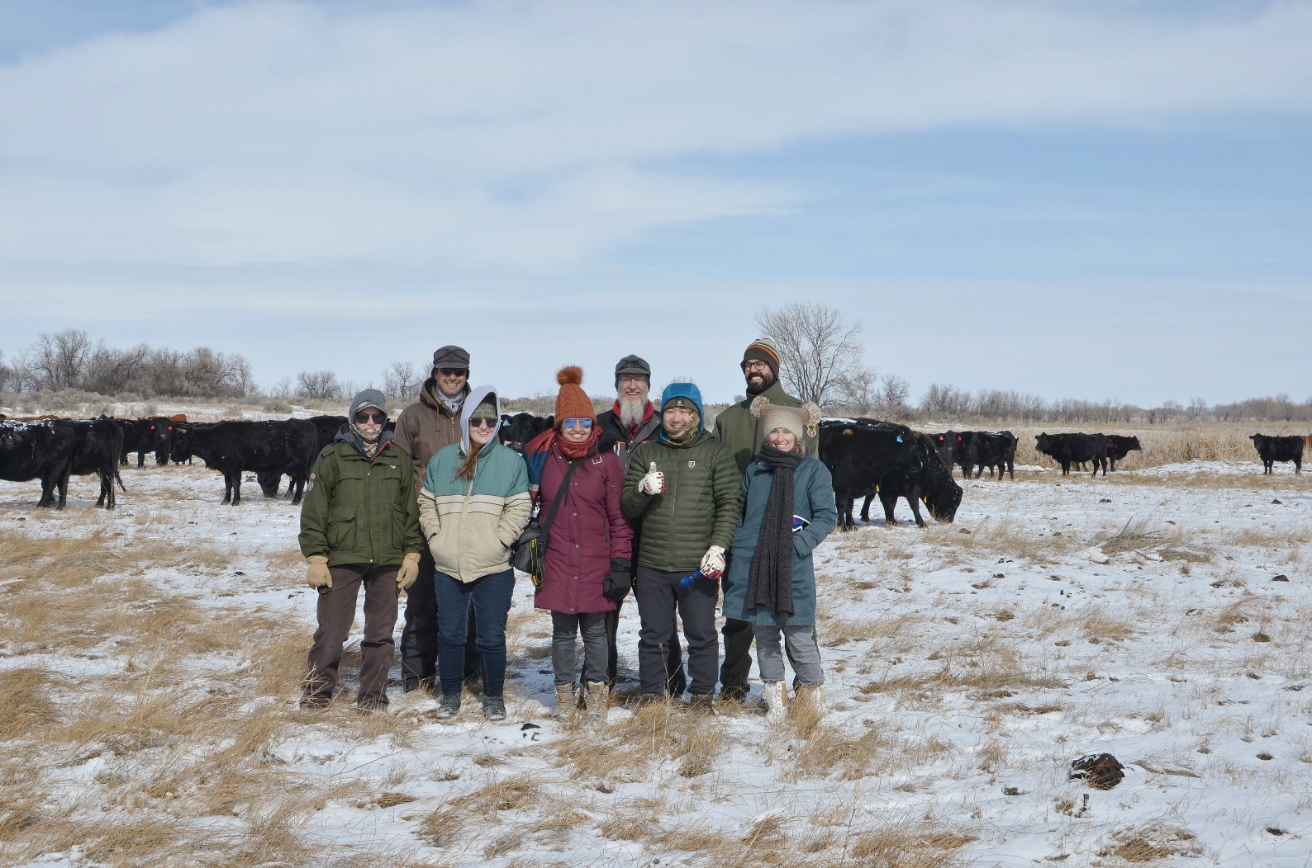
Partners
Idaho Department of Fish and Game (IDFG)
Jeff May, Software Engineer III
Maria Pacioretty, Regional Habitat Biologist
Image Credit: Ryan Healey
Notes:
Our IDFG partners are Maria Pacioretty, a regional habitat biologist and manager of the Sterling Wildlife Management Area, and Jeff May, an IT software engineer based in the Pocatello IDFG office, who is also a former DEVELOPer. Included in the photograph are (left to right) Maria Pacioretty, Talissa Cota (DEVELOP Team member), Preethi Balaji (DEVELOP Team Lead), Kangsan Lee (DEVELOP Team member), Melissa McNally (DEVELOP Team member); (right to left) Jeff May, Keith Weber (Pocatello DEVELOP Science Advisor) and Chase Carter, one of the collaborating cattle ranchers.
IDFG's statewide mission is to preserve, protect, perpetuate, and manage the wildlife in Idaho. The SWMA's specific vision is to protect upland and wetland habitats for the benefit of diverse wildlife, and to provide wildlife-based recreation to the public, with a special focus on the demand for hunting.
------------------------------Image Information Below------------------------------
Image credit: Ryan Healey
Image source: Provided by Fellow, Ryan Healey with permission

Slide 4
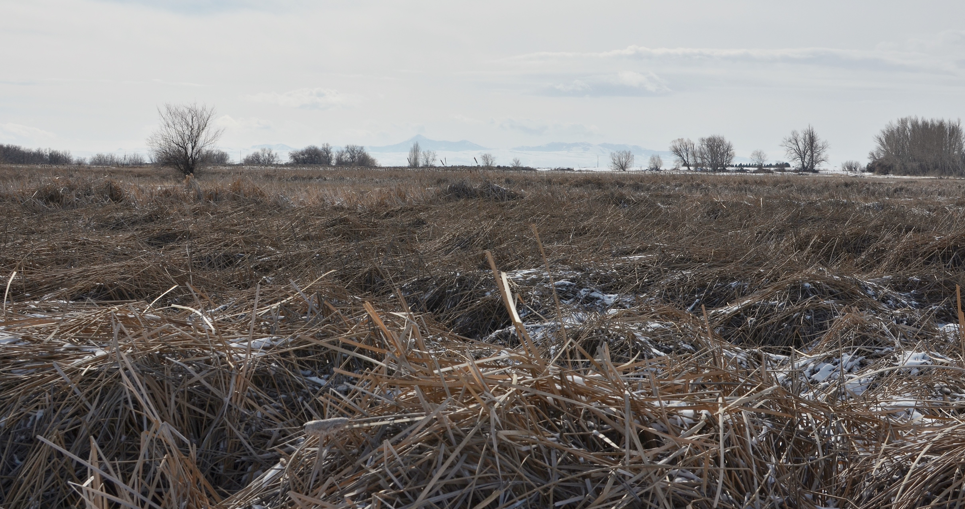
Project Objectives
Generate
Quantitative results showing the effects of grazing
Quantify
Change in vegetation density and surface water cover
Compare
Vegetation density and surface water cover pre- and post-grazing
Non-grazed area; Image Credit: Kangsan Lee
Develop
Step-by-step tutorial to provide IDFG with tools for future monitoring
Grazed area; Image Credit: Ryan Healey
Image Credit: Bernardo62
Notes:
The main objectives of this project were to investigate and compare the changes in biomass and surface water cover pre- and post-grazing, and to increase capacity by providing IDFG with tools to continue monitoring the region. Through this approach, the impacts of grazing on the area and the suitability of the area for wetland wildlife were assessed.
------------------------------Image Information Below------------------------------
•Image Credit: Ryan Healey and Kangsan Lee
•Image Source: Provided by Ryan Healey (fellow) and Kangsan Lee (participant) with permission

Slide 5
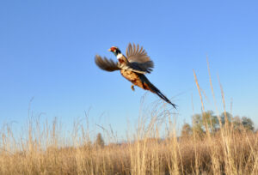
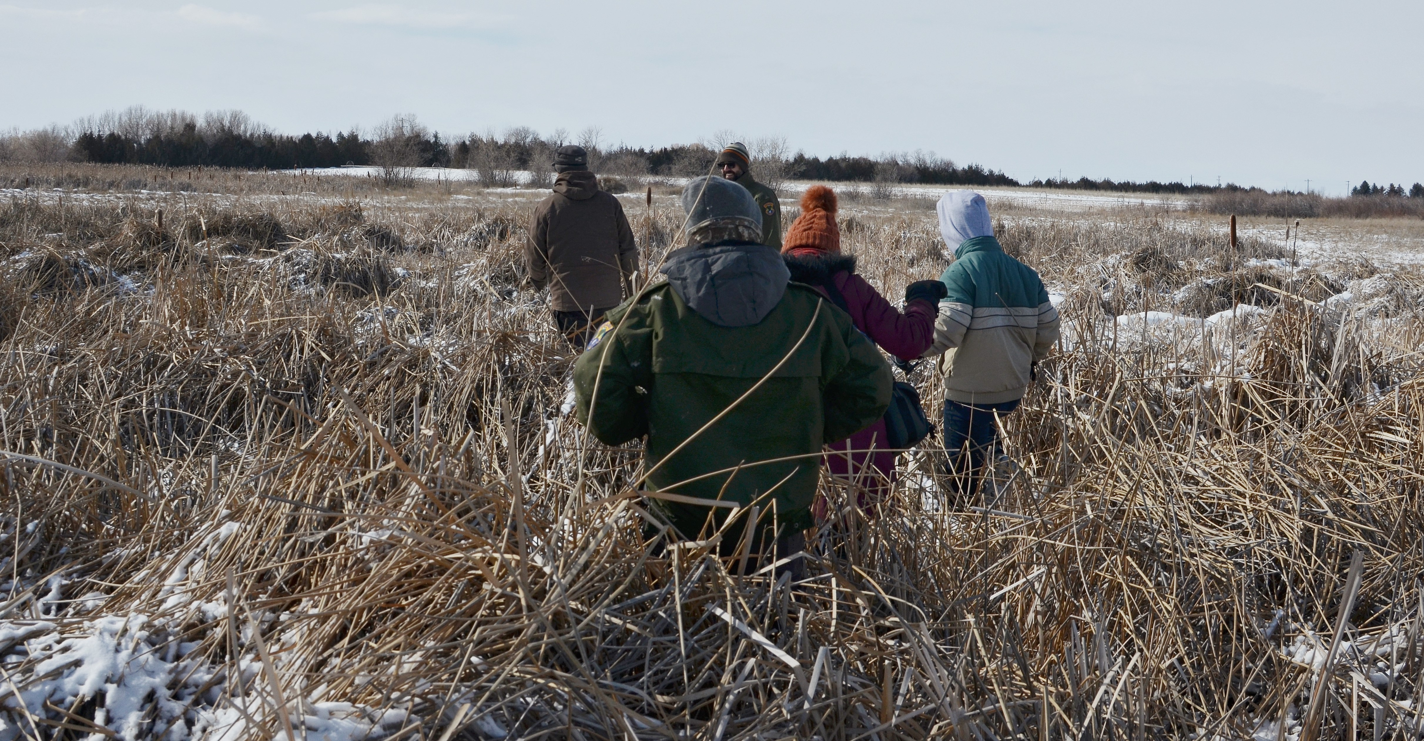
Community Concerns
Reduction of public access
Image Credit: Idaho Dept of Fish and Game
Decline in wildlife populations
Loss of biodiversity
Image Credit: Ryan Healey
Notes:
The biomass issue at the Sterling WMA makes it difficult for visitors to move through and use the land. It also degrades the wetland habitat, which negatively impacts the wildlife population in both numbers and in biodiversity.
------------------------------Image Information Below------------------------------
Image Credit: Idaho Fish and Game; (https://idfg.idaho.gov/d7/wma/sterling) and Ryan Healey
Image Source: Provided by partners at IDFG and Ryan Healey with permission

Slide 6
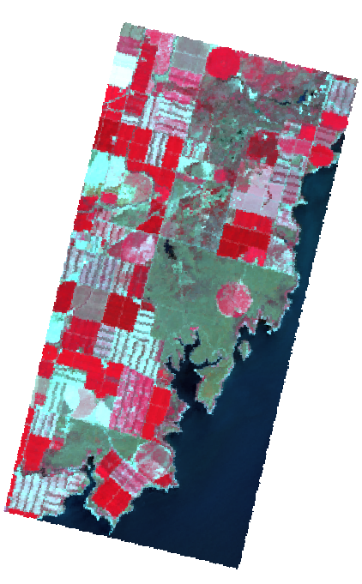
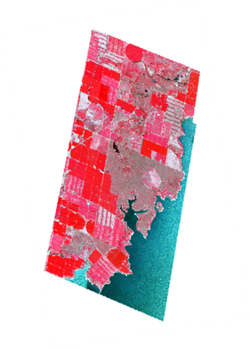
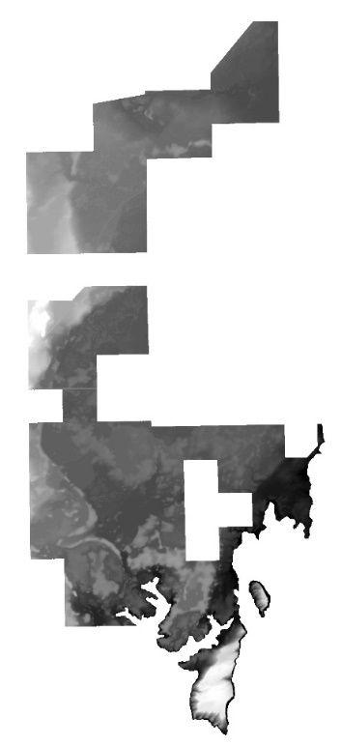
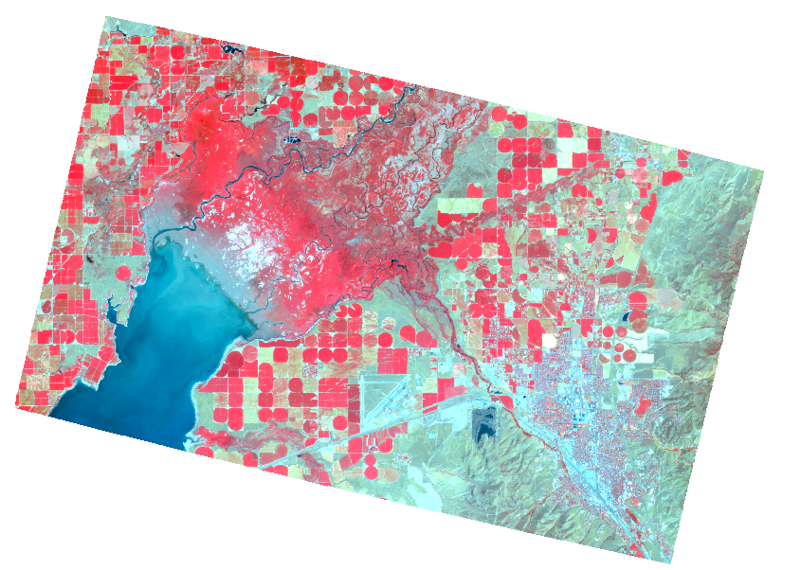
Earth Observations
NAIP
LiDAR
Landsat 8
PlanetScope SuperDove
Notes:
The NASA Earth observations were acquired from Landsat 8 Operational Land Imager and were used to analyze vegetation and surface water on SWMA. We used Landsat 8 images to generate Normalized Difference Vegetation Index (NDVI) and Normalized Difference Water Index (NDWI) to assess vegetation density and surface water on SWMA. We also acquired PlanetScope imagery which has higher resolution than Landsat (3m vs. 30m) to generate NDVI and compare the two types of imagery. 1-m resolution LiDAR layers were used to generate topographic elements, such as elevation and aspect, for use in the land change modeler. We also used the National Agriculture Imagery Program (NAIP) to georeference.
------------------------------Image Information Below------------------------------
Planetscope Instrument Credit: Planet Labs PBC Planet Team (2017). Planet Application Program Interface: In Space for Life on Earth. San Francisco, CA. https://api.planet.com.

Slide 7
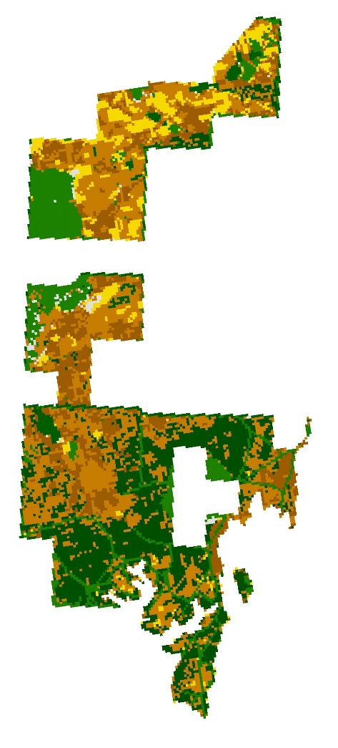
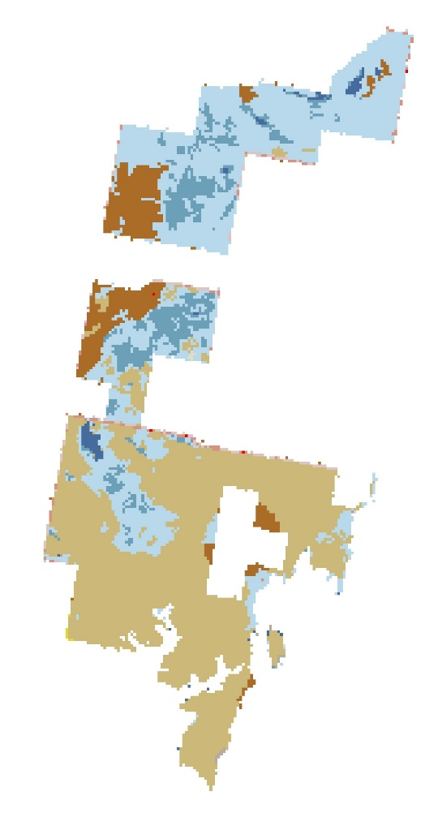
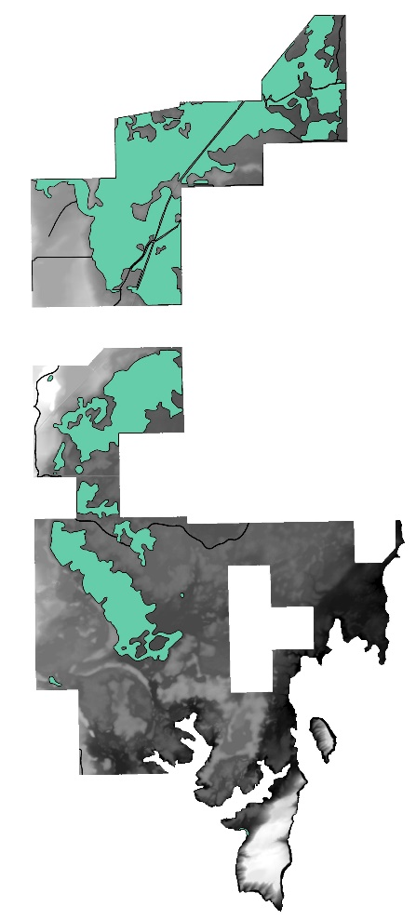
Other Datasets
LANDFIRE
NLCD Database
Idaho Wetlands Layer
Notes:
Ancillary datasets used to support this project were LANDFIRE and the National Landcover Database which were used to investigate the vegetation and landcover on the Sterling WMA. Additionally, we used an Idaho Wetlands layer to target our investigation and analyses to classified wetlands in the Sterling WMA.
More datasets included
(1) AgriMet weather data (Min. Daily temperature, Max. Daily temperature, Daily precipitation and Growing Degree Days (GDD)) from AgriMet Historical Archive Weather (Bureau of Reclamation), Aberdeen station
(2) Drought conditions (percent area) from the US drought monitor
(3) Boundary shapefile for grazing and non-grazing allotments from IDFG

Slide 8
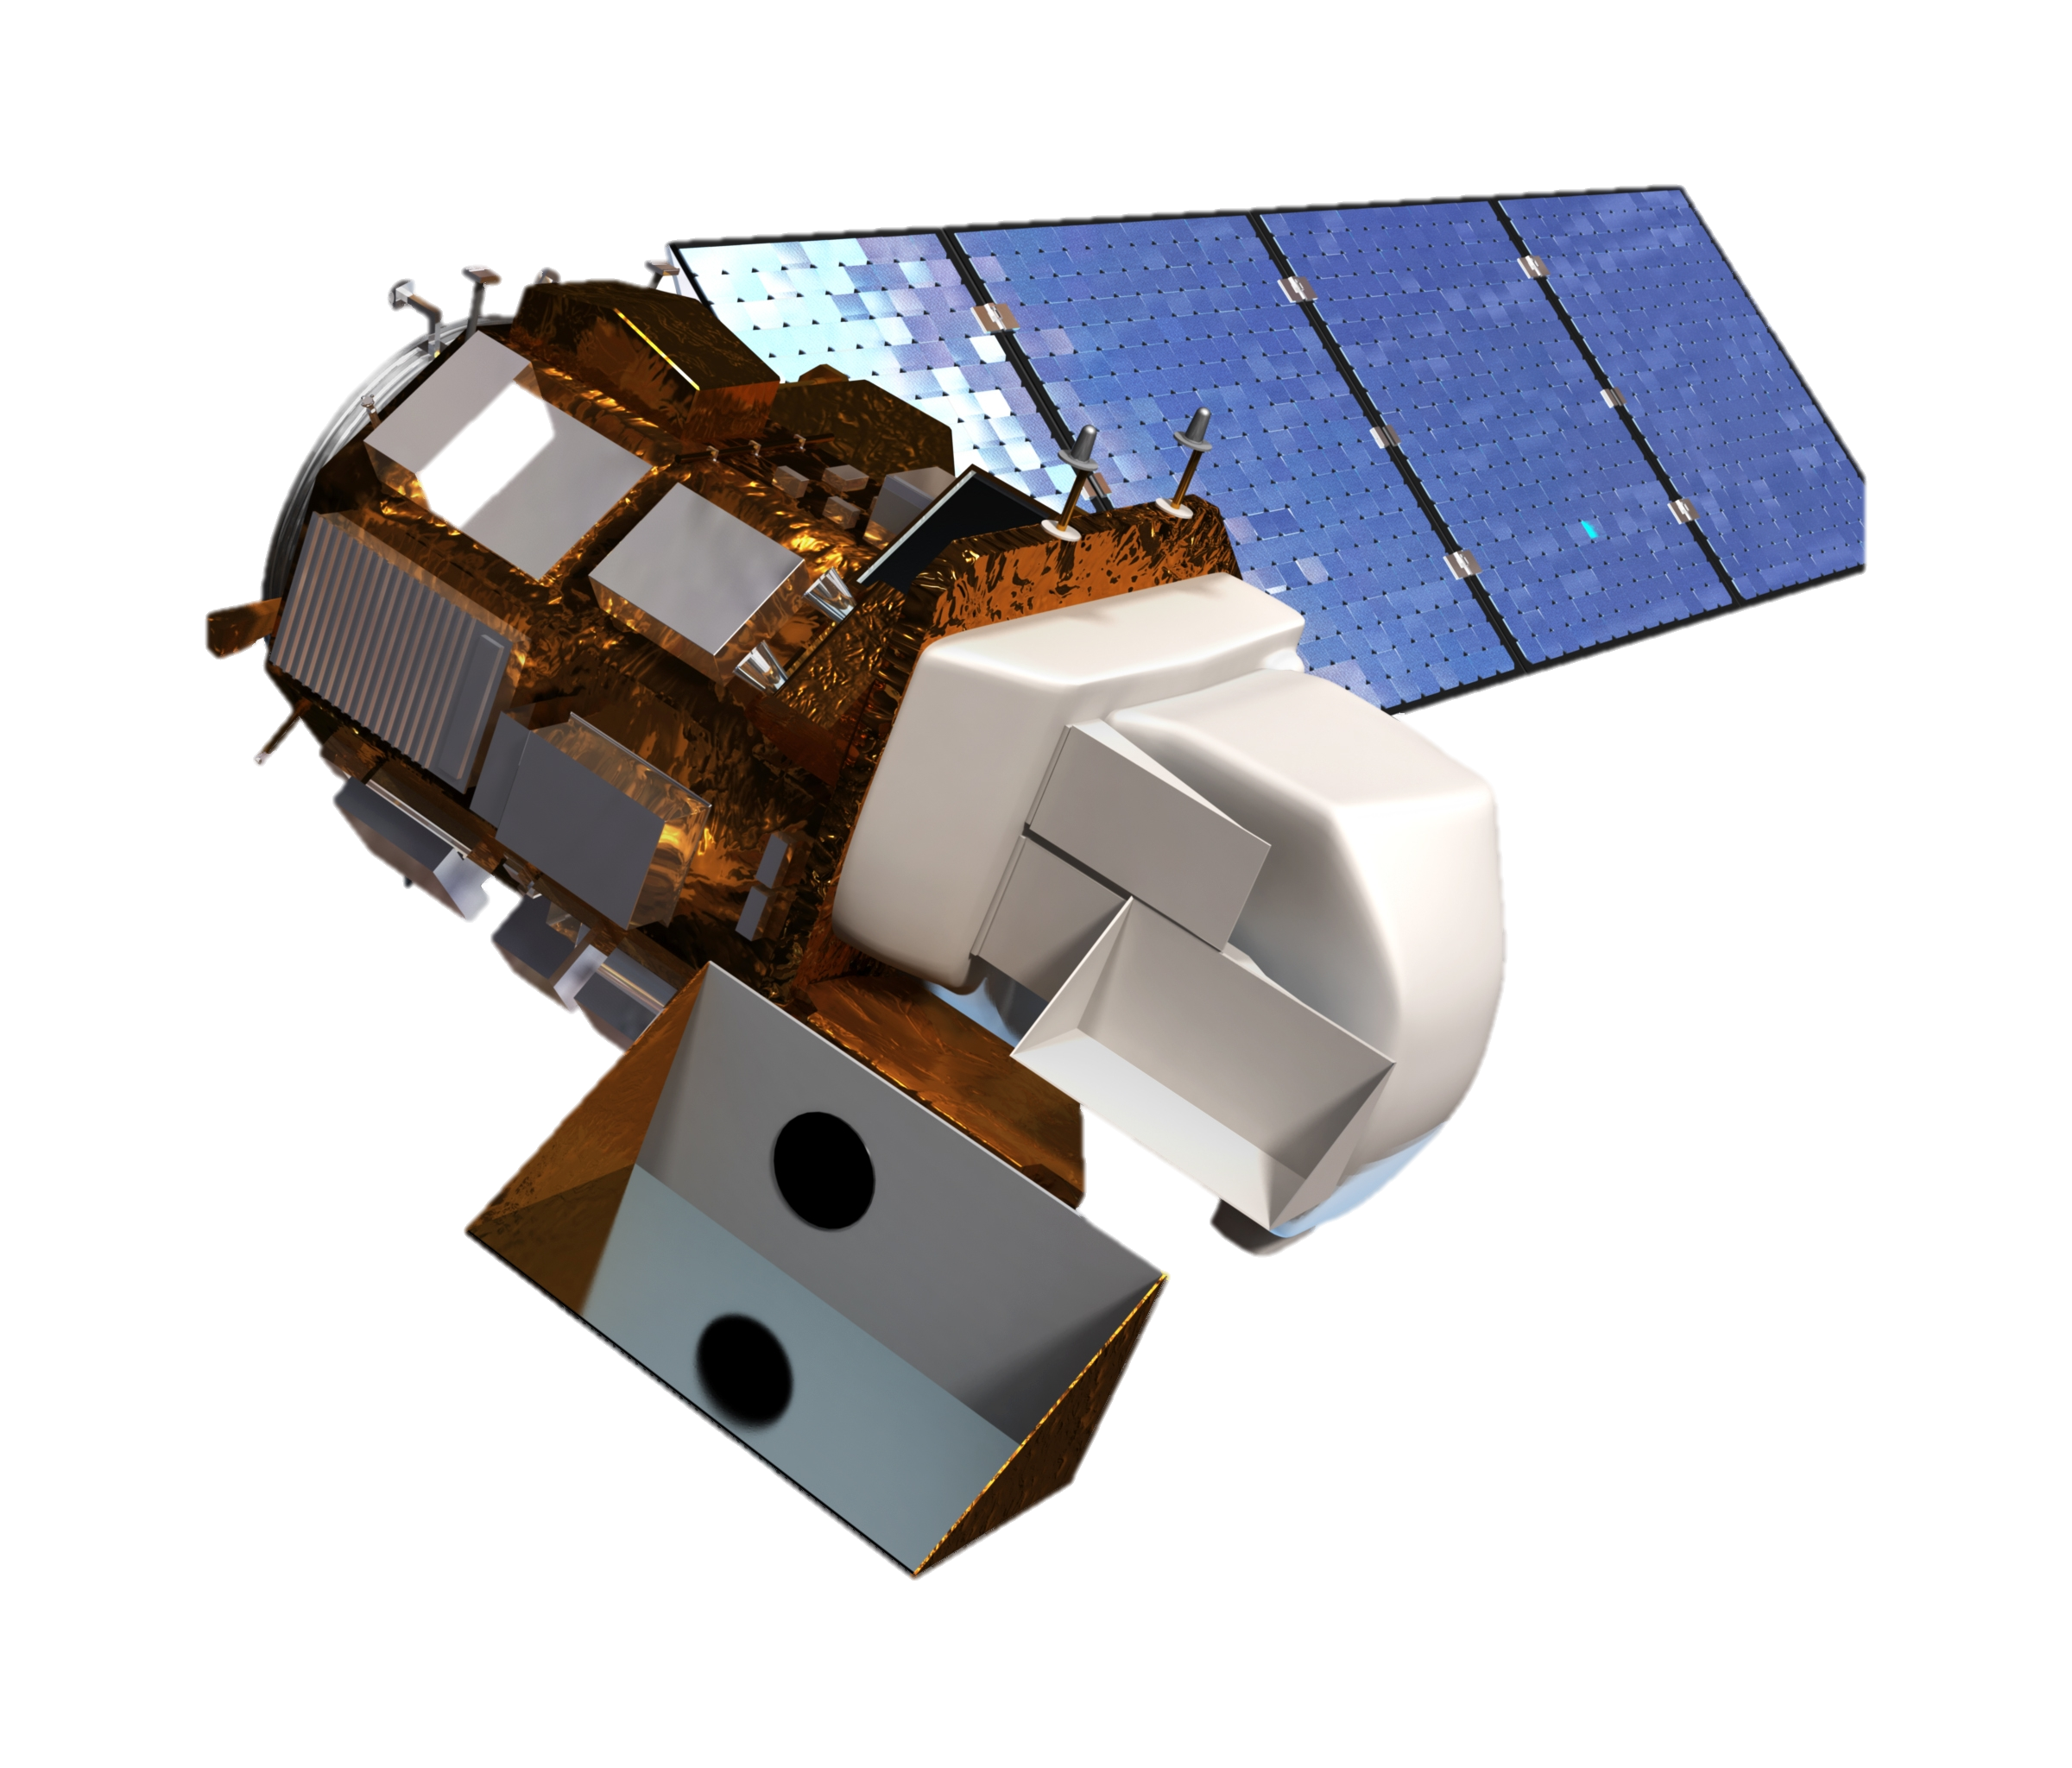
Methodology Workflow
Suitability Analysis
Preprocessing
Ecological Forecasting
Land Change
Modeler
(IDRISI TerrSet)
Water Area
Landsat 8 OLI
(Google
Earth Engine)
Surface Reflectance
Vegetation Area
Grazing Area
Boundary
Prediction Image
(NDVI 2022)
Clip Raster
NAIP
(Reference)
Georeference Check
Change Detection
(ArcGIS Pro)
Change Detection
(ArcGIS Pro)
Normalized Difference
Water Index (NDWI)
Rectified Images
Prediction – Observed
NDVI
Normalized Difference
Vegetation Index (NDVI)
Calculate
Year-Max NDVI
Quantifying
Vegetation Changes
Quantifying the Effect of Grazing on Ecosystem
*The image acquisition period was chosen using Pheno-Calc – software designed at Idaho State University to determine the most comparable dates between years based on phenological changes in the vegetation
Notes:
The methodology involved three main processes: Preprocessing the satellite images, Ecological Forecasting to predict the pre-grazing effects on 2022 Landsat image using the NDVI input and compare it with post-grazing NDVI image and Suitability Analysis to investigate the suitability of the area for wetland wildlife habitat.
Image acquisition dates were selected once we gained an understanding the phenological dates of the vegetation on the study area – this was performed with the use of a software Pheno-Calc (designed at the ISU GIS TReC by Keith Weber) which takes temperature and precipitation data as input to calculate cumulative precipitation and growing degree dates. Based on these, images between March and July were selected and images were acquired from Landsat-8.
Pre-processing was performed using Google Earth Engine (GEE) in which NDVI and NDWI images were generated needed for ecological forecasting and suitability analysis processes. The National Agriculture Imagery Program data was used with a high resolution of 1 meter to validate the georeferencing of Landsat data. A baseline was set (Maximum NDVI between 2013 and 2019 excluding two wet years 2016 and 2017). This baseline was based on pre-grazing years.
Ecological forecasting included Land Change Modeler with 2013 NDVI Maximum and 2018 NDVI Maximum images were given as input and set to forecast to 2022. This was then compared with the NDVI 2022 image derived from Landsat data from GEE.
For the suitability analysis, NDWI and NDVI were analyzed. The changes in water index and vegetation productivity were analyzed to assess the impacts of grazing on the area suitability for wildlife habitat.

Slide 9
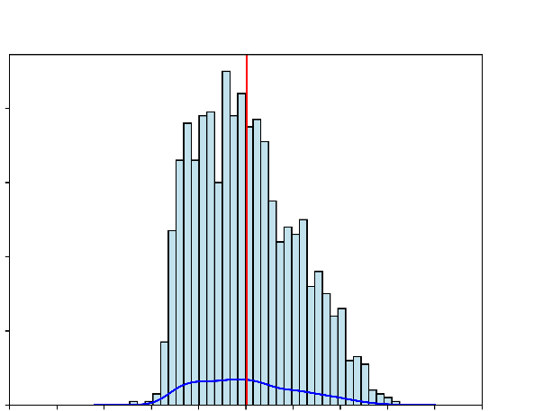
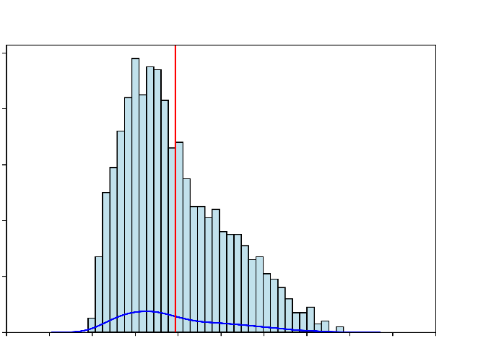
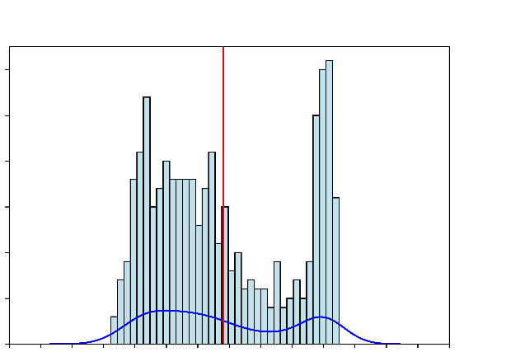
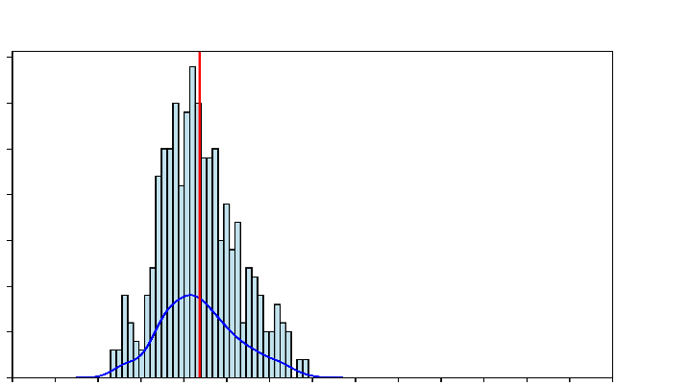
Results: Baseline NDVI Comparison
American Wetland Game Unit Histogram Comparison Between the Baseline and Max NDVI 2022 values
Mean, Median, and Standard Deviation Comparison Between NDVI of Baseline and Maximum NDVI from 2022
80
100
0.35
0.30
0.30
80
0.30
0.25
0.23
Count
60
0.25
60
NDVI
NDVI
0.20
40
40
0.15
20
0.10
0.05
0.06
20
0.05
0
0
0.00
0.05
0.15
0.25
0.35
0.45
0.55
0.05
0.15
0.25
0.35
0.45
0.55
Mean
Median
Std. Dev
Thompson Unit Histogram Comparison Between the Baseline and Max NDVI 2022 values
NDVI Baseline
NDVI MAX 2022
30
35
0.45
0.39
25
30
0.40
20
25
0.35
Count
20
0.30
0.27
15
15
NDVI
10
0.25
5
10
0.20
0
5
0.15
0.11
0.05
0.25
0.45
0.65
0
0.05
0.25
0.45
0.65
0.10
0.05
0.05
Maximum NDVI Values
Maximum NDVI Values
0.00
Baseline
MAX NDVI 2022
Mean
Median
Std. Dev
Notes:
The NDVI baseline image was compared with the Maximum NDVI derived for 2022 for each of the units. The histogram showed a change in the distribution of pixels between the pre-grazing baseline and post-grazing data.
In the American Unit, The histogram is skewed to the left in the MAX NDVI 2022 image indicating that there is a change in the biomass after grazing. In the Thompson Unit, there is a shift in the distribution and the mean indicating changes.

Slide 10
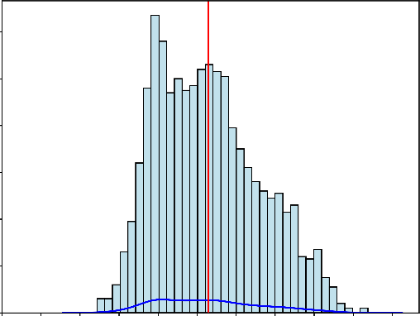
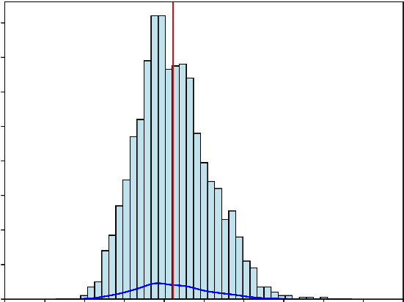
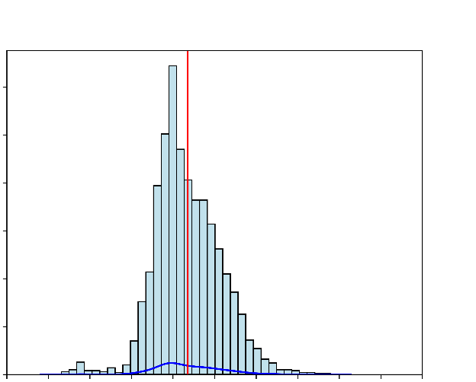
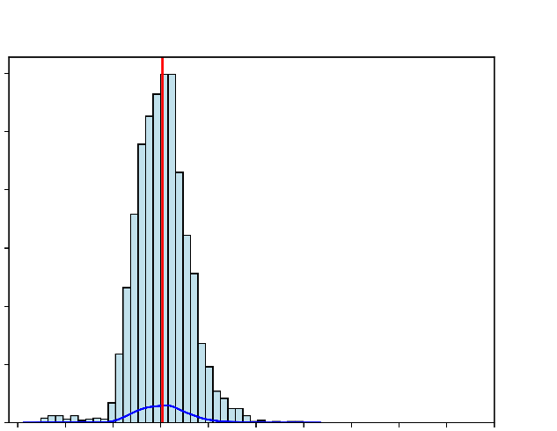
Control: Orth Unit Histogram Comparison Between the Baseline and Max NDVI 2022 values
Mean, Median and Standard Deviation Comparison Between NDVI of Baseline and Maximum NDVI from 2022
120
160
100
140
120
0.35
0.31
80
100
0.30
0.26
60
80
0.25
40
60
NDVI
0.20
20
40
0.15
20
0.10
0
0.10
0.20
0.30
0.40
0.50
0
0.30
0.05
0.05
0.10
0.20
0.40
0.50
0.01
0.00
Control: Johnson Unit Histogram Comparison Between the Baseline and Max NDVI 2022 values
Mean
Median
Std.Dev
NDVI Baseline
NDVI MAX 2022
300
300
250
250
200
200
150
0.35
150
0.30
0.26
100
100
0.25
0.20
50
50
NDVI
0.20
0
0.15
0.05
0.15
0.25
0.35
0
0.45
0.55
0.10
0.45
0.55
0.05
0.15
0.25
0.35
0.05
0.04
0.03
Maximum NDVI Values
Maximum NDVI Values
0.00
Mean
Median
Std.Dev
BASELINE
MAX NDVI 2022
Notes:
In the control units, the pixel distributions are not skewed pre- and post-grazing and the data are comparable. Since no treatment has occurred within these areas, no significant change can be seen in the histograms.

Slide 11
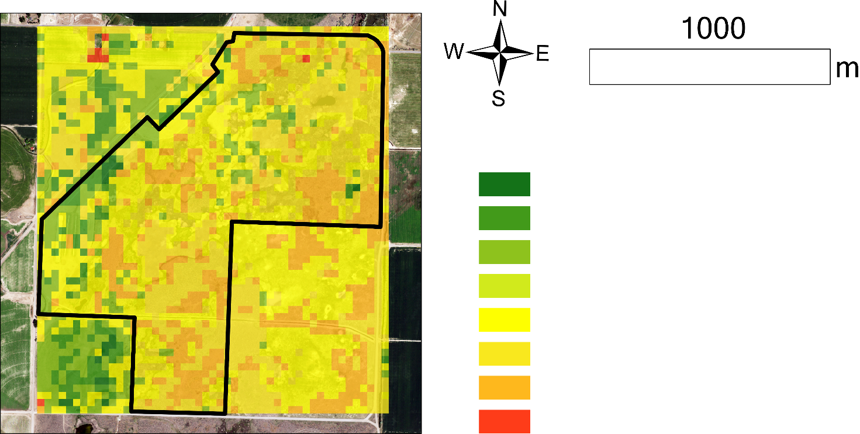
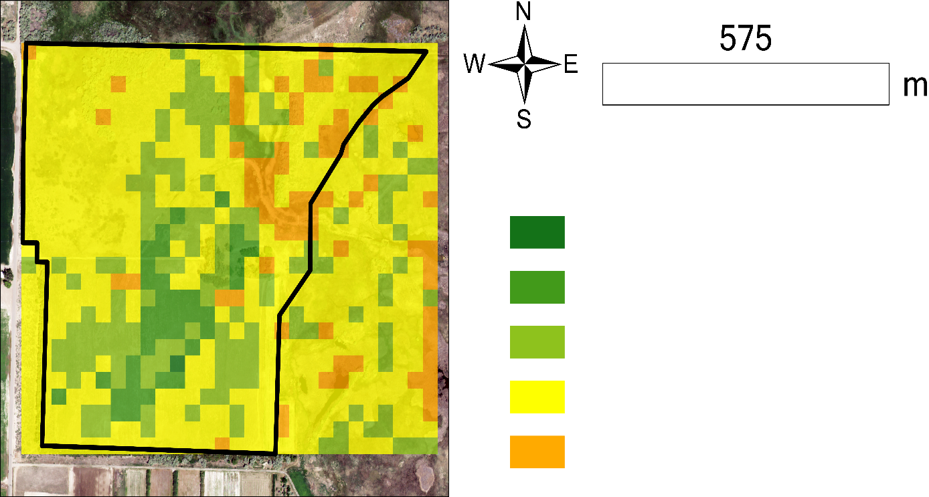
Results: Vegetation in Grazed Units
1000
575
m
m
> 0.3 Increased Vegetation
> 0.2 Increased Vegetation
> 0.3 Increased Vegetation
> 0.1 Increased Vegetation
> 0.2 Increased Vegetation
> 0 Increased Vegetation
= 0 No Change
> 0.1 Increased Vegetation
> 0 Decreased Vegetation
= 0 No Change
> 0.2 Decreased Vegetation
> 0.3 Decreased Vegetation
> 0 Decreased Vegetation
American Game Unit
Thompson Unit
Notes:
These images were generated by comparing our forecasted NDVI map for 2022 to the actual NDVI for 2022.
Green pixels: Forecast NDVI < Actual NDVI (derived from Landsat-8 GEE)
Yellow pixels: No change
Orange and light orange pixels: Forecast NDVI > Actual NDVI (derived from Landsat-8 GEE)
This indicates that there has been a decrease in vegetation within the grazing units in 2022.
The area within the red box (not under SWMA) also shows decreased vegetation. This is private land where grazing occurs summer through fall and, hence, is in alignment with the decreased vegetation shown within the grazed SWMA units.

Slide 12
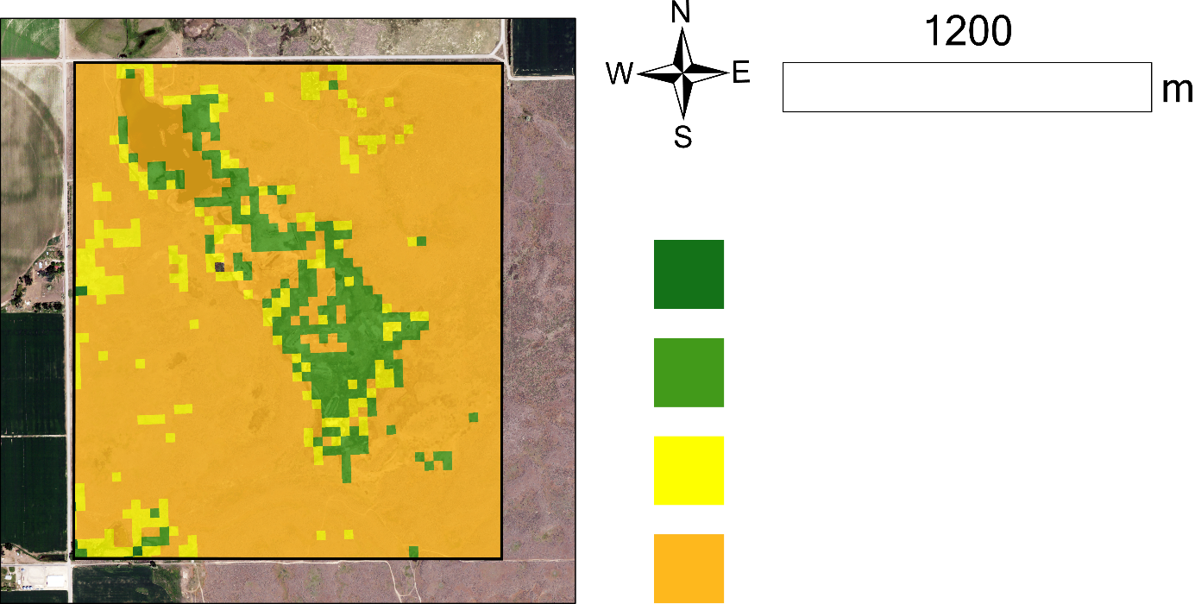
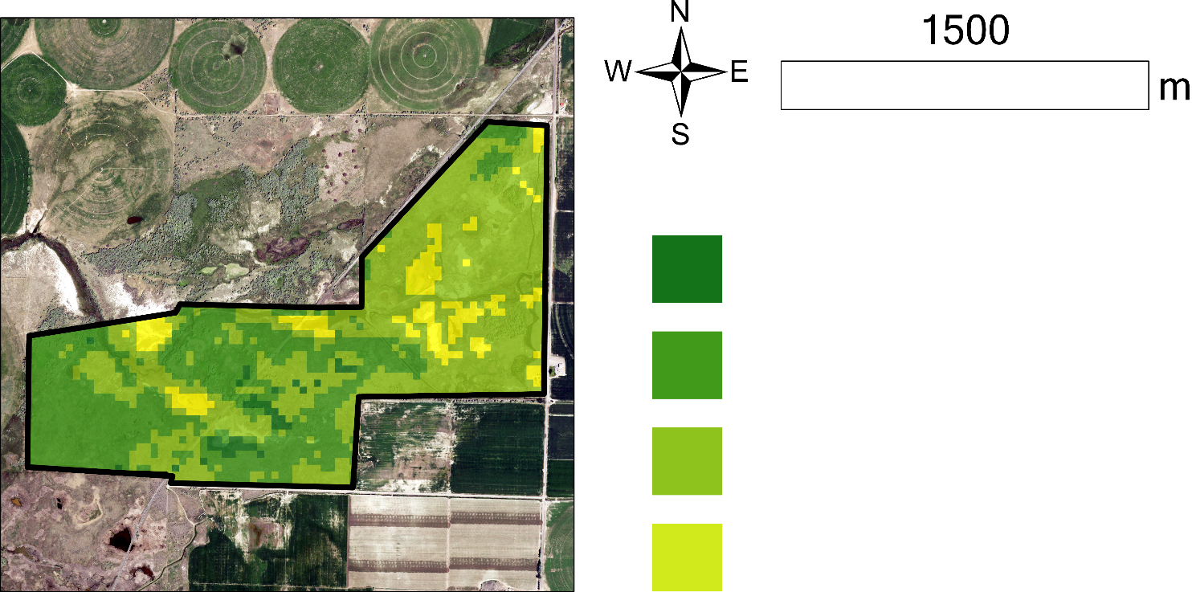
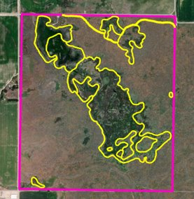
Results: Vegetation in the Control Units
1200
m
1500
> 0.2 Increased Vegetation
m
> 0.1 Increased Vegetation
= 0 No Change
> 0.4 Increased Vegetation
> 0.1 Decreased Vegetation
> 0.3 Increased Vegetation
> 0.2 Increased Vegetation
Johnson Unit boundary
Wetlands layer
> 0.1 Increased Vegetation
Control: Orth Unit
Control: Johnson Unit
Notes:
The Orth and Johnson units are the control units where grazing treatment was not performed. Results show an increase in biomass in 2022 within the Orth unit. Within the Johnson unit, some variations within the area can be seen. Vegetation increase is observed within the wetland areas. Outside of the wetlands, show decreased vegetation. Two possible reasons for this (1) Growth and transition of sage brush and (2) Different arid ecological community.

Slide 13
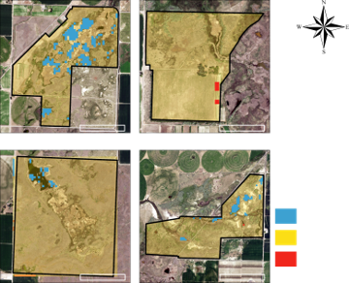
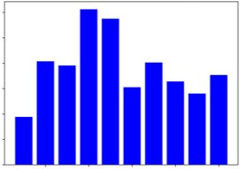
Results: Surface Water Cover
Cumulative precipitation across the study period
12
10
8
Cumulative precipitation (inches)
6
4
2
Increase
2014
2016
2018
2020
2022
No Change
Decrease
Notes:
We used the Normalized Difference Water Index to assess the change between pre- and post-grazing in surface water cover. The images on the left show areas where the surface water area has changed between 2020 & 2022 for the two grazed units on top and the two non-grazed units on the bottom. This shows surface water area change regardless of whether the area had been grazed or not, suggesting that there are other factors driving surface water change. The bar chart on bottom shows the cumulative annual precipitation across our study period, 2013-2022, and the chart on top quantifies the change in water area for each unit. Note that the biggest change observed were in the American Game unit, which has been grazed the longest, and a control unit which has not been grazed.

Slide 14
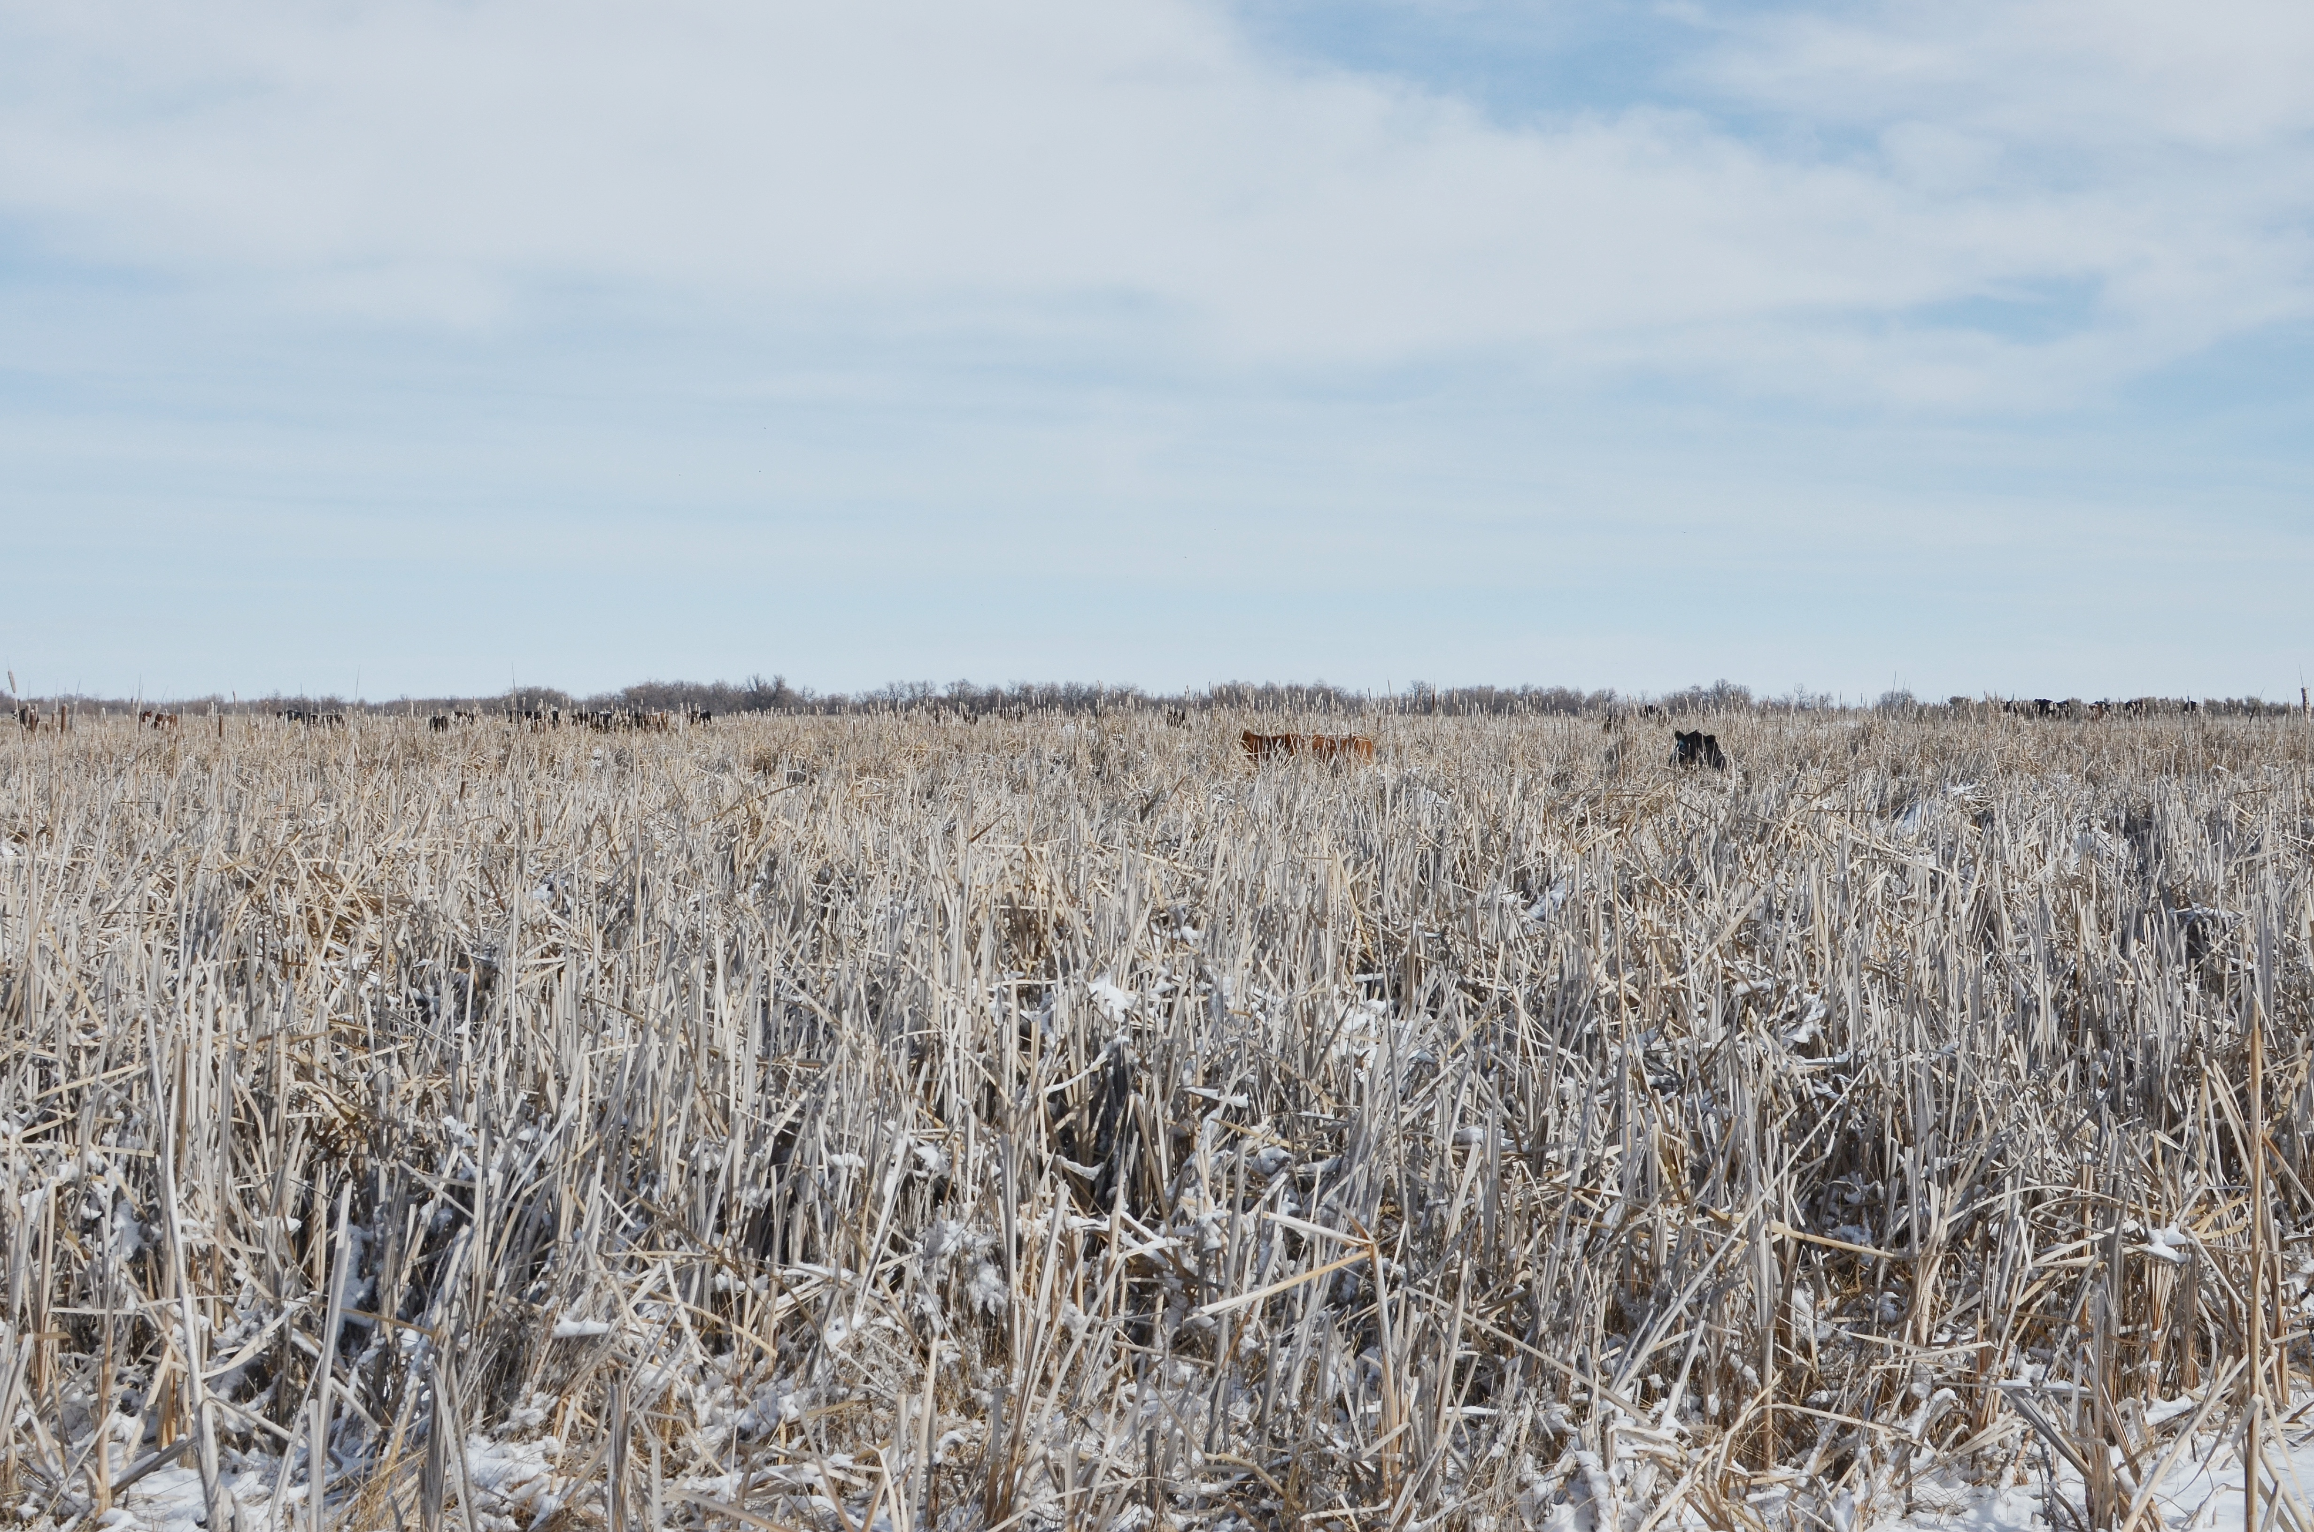
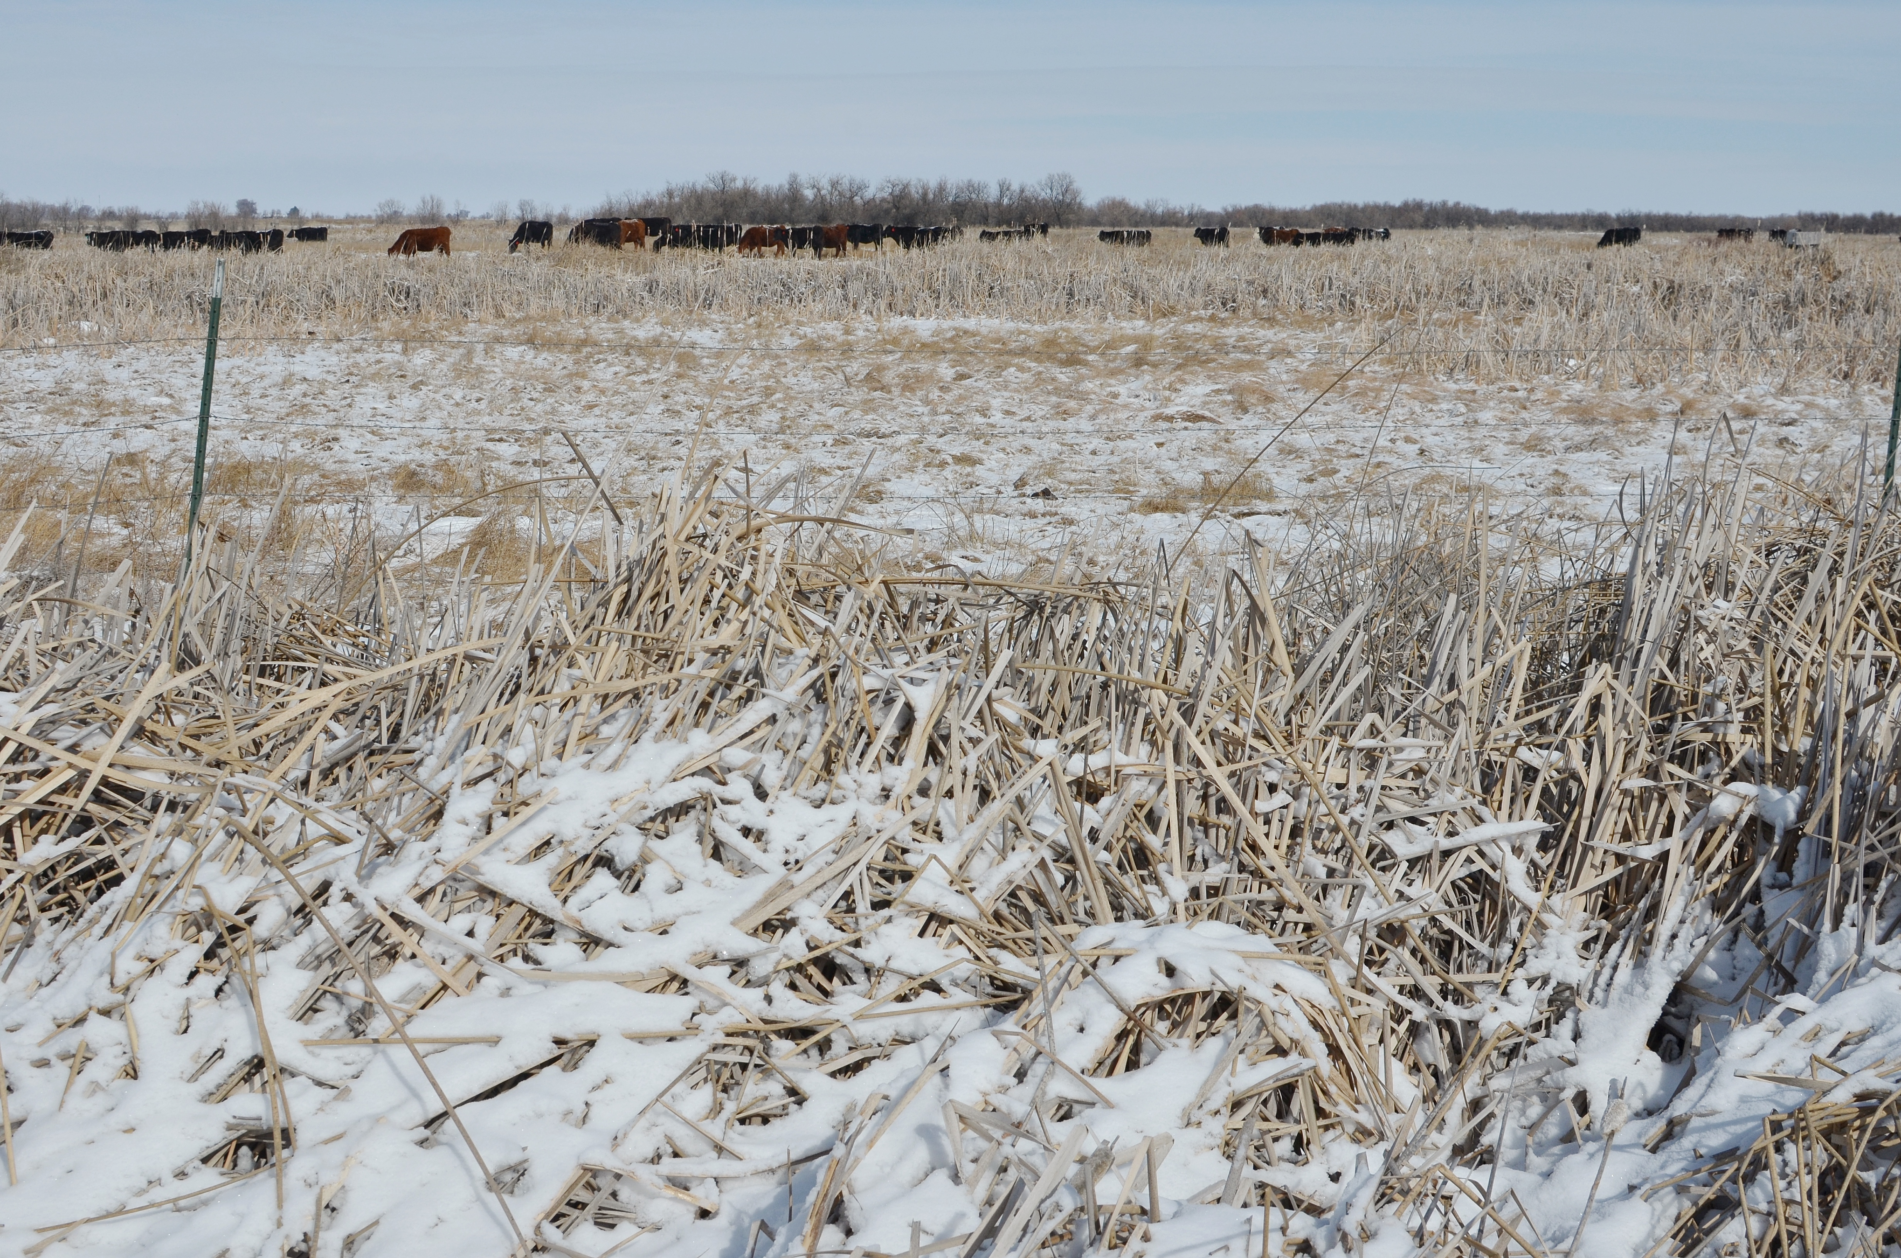
Conclusion
Given that NDVI decreased in the grazed units and surface water cover increased post-grazing, there are indications that targeted grazing on the Sterling Wildlife Management Area is increasing suitability for wetland wildlife
wildlife by reducing dense vegetation and increasing surface water cover
Image Credits: Ryan Healey
Notes:
The purpose of this study was to investigate the impacts of targeted grazing in the Sterling Wildlife Management Area. We accomplished this by investigating vegetation between 2018 & 2022 and surface water cover between 2020 & 2022. We used Land Change Modeler in IDRISI TerrSet to generate forecasted NDVI maps for 2022 and compared it to the actual NDVI for 2022. Results indicate that NDVI in 2022 decreased in the grazed units and increased in the non-grazed units and surface water cover increased between 2020 & 2022, which suggests that the targeted grazing is having the desired effect on the vegetation.
--------Image Information Below ------------------------------
Images credit: Ryan Healey
Images source: Provided by Fellow, Ryan Healey with permission

Slide 15
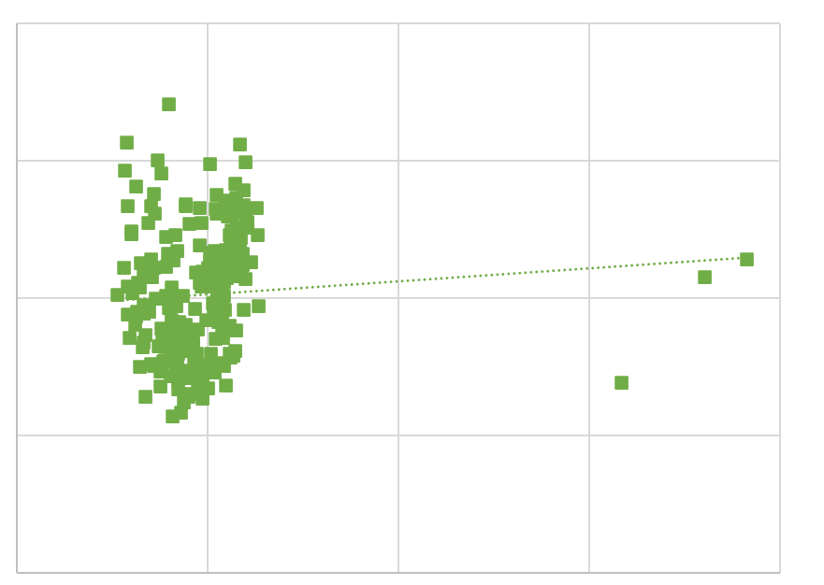
Study Limitations And Uncertainties
Limited grazing data available
Although high spatial resolution PlanetScope data was available, the NDVI imagery between PlanetScope data and Landsat data showed a very low correlation
Comparison of PlanetScope SuperDove (resampled to 30 m) NDVI and Landsat 8 (30 m)
0.45
Y = -0.96𝑥^2+ 0.55x + 0.19
𝑅^2=0.013
0.35
0.25
NDVI Derived from Landsat 8
0.15
0.05
0.05
0.15
0.25
0.35
0.45
NDVI derived from PlanetScope
Notes:
This study was constrained by the limited amount of post-grazing data available. Targeted cattle grazing is a recent development on the Sterling Wildlife Management Area and there was only one unit where there was two years of post-grazing data to analyze which is insufficient to make a full determination of the impact of grazing.
Additionally, using a vegetation index from PlanetScope, which is at a higher resolution than Landsat (3m vs. 30m), could possibly be considered for future monitoring; however, it would need to be reevaluated due to the low correlation with Landsat.

Slide 16
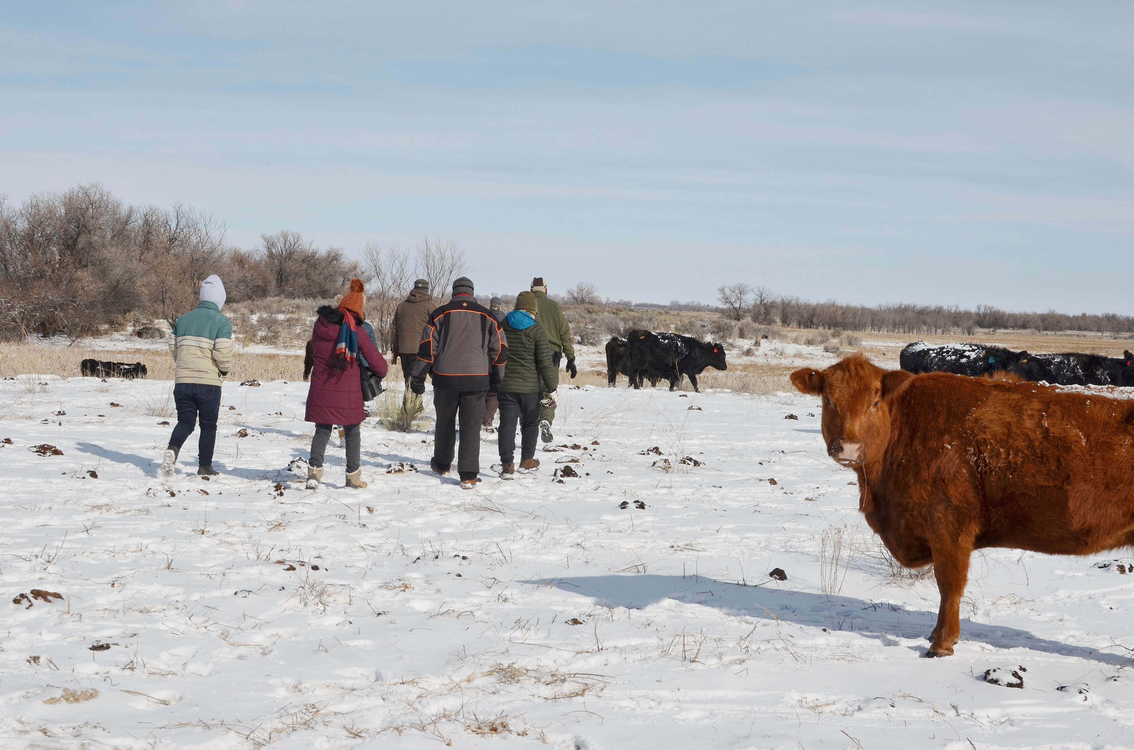
Future Work/Considerations
Working with this methodology in the future, more grazing data will increase the confidence of the analysis
Incorporating alternative indices and variables of interest
Image Credit: Ryan Healey
Notes:
Targeted cattle grazing is a recent development on the Sterling Wildlife Management Area. An increase in the sample size of units and years would give a better picture into the impact. Additionally, using a vegetation index from PlanetScope, which is at a higher resolution than Landsat (3m vs. 30m), could possibly be considered for future monitoring; however, it would need to be reevaluated due to the low correlation with Landsat.
------------------------------Image Information Below ------------------------------
Image credit: Ryan Healey
Image source: Provided by Fellow, Ryan Healey with permission

Slide 17
Fellow
Ryan Healey
Others
Chase and Dallin Carter
GIS Training and Research Center
Science Advisor
Keith Weber
Partners
Idaho Department of Fish and Game
Maria Pacioretty
Jeff May
Image Credit: Ryan Healey
This study utilized PlanetScope data made available through the NASA Commercial Smallsat Data Acquisition (CSDA) Program.
Includes copyrighted material of Planet Labs PBC. All rights reserved.
Notes:
We would like to extend our deepest gratitude to our fantastic fellow, Ryan Healey, our wonderful science advisor, Keith Weber, and our exceptional partners from the Idaho Department of Fish and Game, Maria Pacioretty and Jeff May, for all of their support, encouragement, and guidance during the past 10 weeks. Additionally, we would like to give a big shoutout to the cattle ranchers, Chase and Dallin Carter, as well as to all of the staff and student interns at Idaho State University's GIS Training and Research Center.
------------------------------Image Information Below ------------------------------
Image credit: Ryan Healey
Image source: Provided by Fellow, Ryan Healey with permission

Slide 18
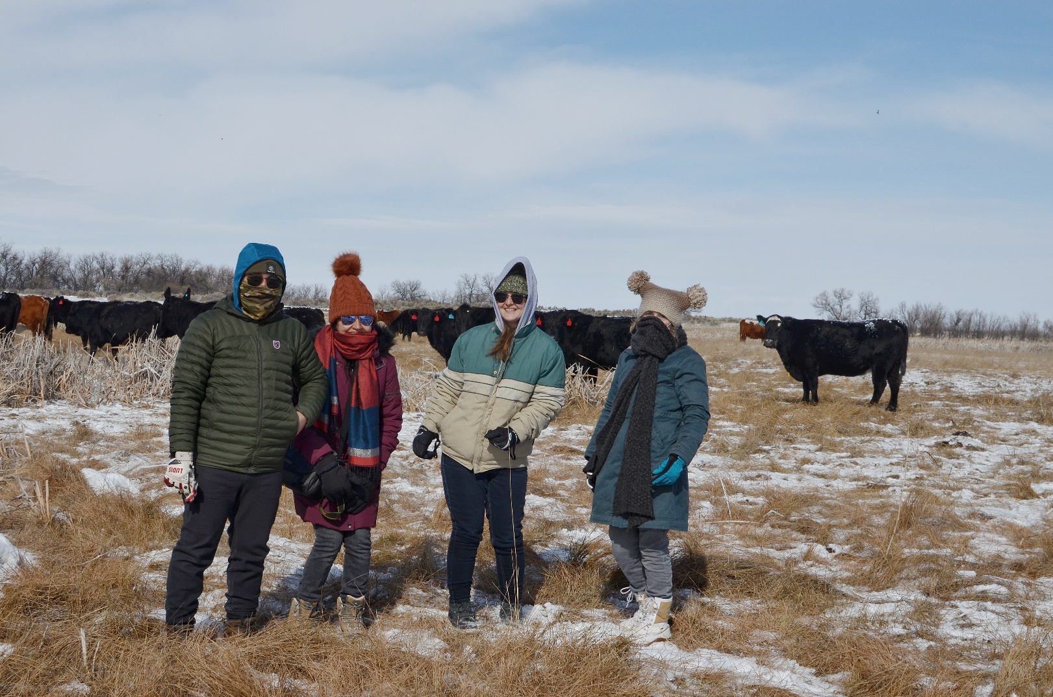
Questions?
Southern Idaho Ecological Conservation Team:
Preethi Malur Balaji
Talissa Cota
Kangsan Lee
Melissa McNally
Field image (placeholder)
Image Credit: Ryan Healey
Notes:
------------------------------Image Information Below ------------------------------
Image credit: Ryan Healey
Image source: Provided by Fellow, Ryan Healey with permission

