Slide 1
MAINE
Ecological Forecasting II
Identifying Forest Cover and Assessing Federally Endangered Atlantic Salmon Habitat in Maine Using Earth Observations
Tony Bowman
Jonathan Falciani
Christopher Matechik
Kelsey Preslar
Maryland – Goddard
Notes:
Tony
Greetings;
We are the NASA DEVELOP Spring 2022 Maine Ecological Forecasting II Team. We will be discussing the methodology and results of our project Identifying Forest Cover and Assessing Federally Endangered Atlantic Salmon Habitat in Maine Using Earth Observations
Now, I'd like to start off by giving a little bit of background about Atlantic salmon and the status of its populations in Maine

Slide 2
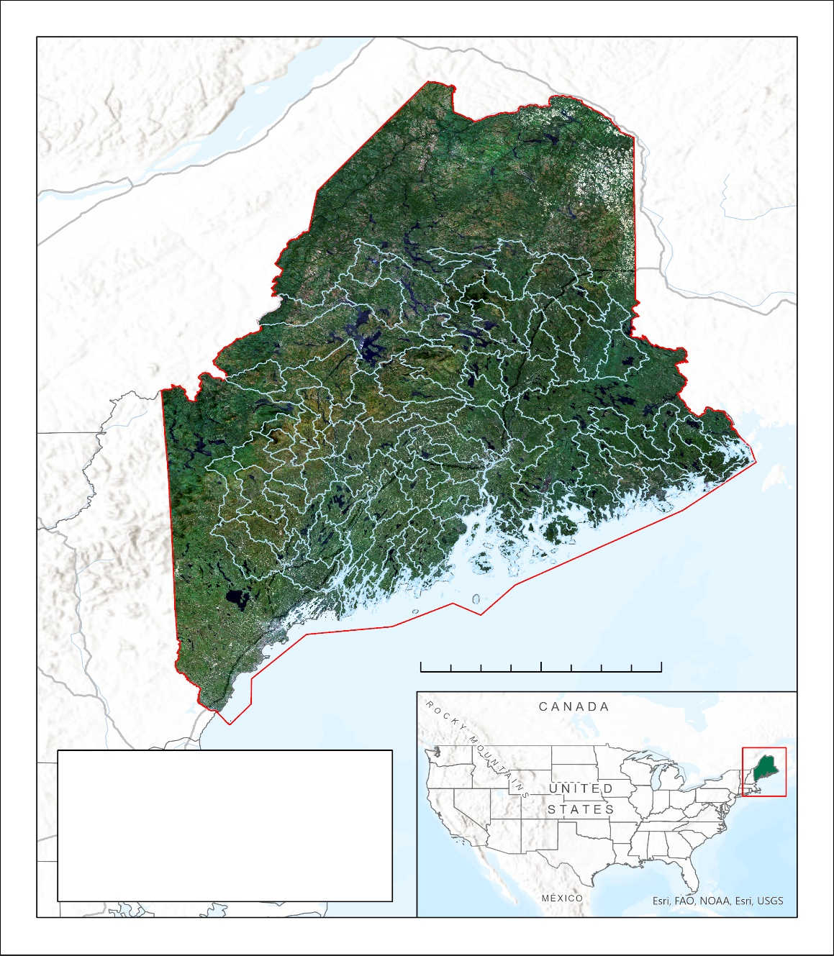
Gulf of Maine Distinct Population Segment (DPS)
Placeholder
Maine harbors the last wild population of Atlantic salmon (Salmo salar) in the U.S.
Federally endangered since 2000
Once native throughout New England
Salmon Habitat Recovery Units (SHRUs)
Penobscot Bay
Merrymeeting Bay
Downeast Region
N
0 50 100 miles
Study Area
Salmon Recovery Habitat
Image Credit: Maine Ecological Forecasting II, Esri
Notes:
Tony
Historically abundant throughout New England watersheds, Atlantic salmon populations have steadily declined over the past two centuries due to a variety of threats such as overfishing, dam construction, and habitat degradation.
Now, the range of Atlantic salmon distribution within the United States is limited to certain watersheds in Maine, establishing the Gulf of Maine Distinct Population Segment (or DPS) as the last remaining population of the species within the United States.
The extent of population declines in the Northeast U.S. provided the basis for the species' Endangered designation under the Endangered Species Act in 2000.
Outlined here in light blue are the watersheds that encompass the three SHRUs where recovery efforts are focused.
Though due to habitat fragmentation and climate change some of these watersheds are currently uninhabited, through the Maine Ecological Forecasting multi-term project, we hope to inform the efforts working to change this.
Now I'll pass it over to Chris to discuss more about the ecological issues and community concerns surrounding this species.
------------------------------Image Information Below ------------------------------
Image Credit: Maine Ecological Forecasting II Team
Image Source: Created by DEVELOPer
Image Credit (Basemap): Esri Terrain
Image Source: ArcGIS Pro

Slide 3
COMMUNITY CONCERNS
Population: Endangered
Designated as Endangered by United States Fish & Wildlife Service in 2000
Ecological & Cultural Loss
Water quality and historic fisheries
Habitat Degradation & Loss
Dams, pollution, and habitat connectivity
Changing Climate
Dependent on cool water
Image Credits: DSF, DMR
Notes:
Chris
Salmon are culturally and ecologically important to Maine.
Salmon not only supported subsistence, commercial, and recreational fisheries, but also distributed nutrients between marine and terrestrial systems.
The loss of salmon represents the loss of ecological services and the loss of a cultural feature.
Salmon face a multitude of threats too numerous to describe in detail here, but I will review a few that are relevant to our community partners and this project.
Dams, constructed for hydropower, limited salmon's upstream passage and also affected the hydrology of streams. They reduce habitat quality, but also limit the habitat available for salmon.
Forest and wetland habitats adjacent to streams have been converted to agricultural land and developed areas. These Land Use and Land Cover changes alter hydrology, increase siltation, increase nutrient inputs, and increase temperatures. Juvenile salmon require cool water, so increasing temperatures can affect juvenile survival in natal streams, restricting suitable habitat.
Our team focused on these temperature changes to see how they were related to land use and land cover classes.
More recently, climate change has created new threats and exasperated existing threats. For example, changes in weather patterns can cause anomalously warm temperatures which can add to the increasing temperatures resulting from LULC changes.
------------------------------Image Information Below ------------------------------
Image Credit (Left): State of Maine Department of Marine Resources. (2022). NG Trap [Photograph (JPG)]. Personal Communication.
Image Source: DMR (provided by partner with permission to use)
Image Credit (Top): Downeast Salmon Federation. (2022). Whiting Dam [Photograph (JPG)]. Personal Communication
Image Source: DSF (provided by partner with permission to use)
Image Credit: (Bottom): Downeast Salmon Federation. (2022). Little Narraguagus [Photograph (JPG)]. Personal Communication
Image Source: DSF (provided by partner with permission to use)

Slide 4
PARTNERSHIPS
Downeast Salmon Federation
NGO that focuses on salmon research and conservation within Downeast Maine
Department of Marine Resources
Sponsors & conducts salmon research to establish environmental regulations for Maine's fisheries
Image Credits: DSF, DMR
Notes:
Kelsey
- The Maine Ecological Forecasting II team partnered with the Maine Department of Marine Resources (DMR) and the Downeast Salmon Federation (DSF) to assess changes in LULC and temperatures across salmon habitat in Maine.
(Other bullets DMR) Protects cold water habitat
Establishes riparian buffers
Removes and restructures dams
Assesses hydrology, temperature, and population performance
Cooperative hatchery and stocking initiatives
Recommends policy
- Both the DMR and DSF are involved in Atlantic salmon habitat restoration and population recovery initiatives in Maine.
- The DMR aids in stream restoration efforts by identifying areas of thermal refuge and adding stream buffers in areas of degrading salmon habitat.
- The DSF is instrumental in maintaining Maine’s Distinct Population Segment (DPS) of Atlantic salmon through conservation hatcheries as well as habitat quality and salmon population surveys which inform habitat restoration efforts throughout the DPS critical habitat extent.
- Both the DSF and DMR aim to increase juvenile survival and adult salmon spawning in Maine’s rivers and improve the chances of successful oceanic migration and return to rearing streams.
------------------------------Image Information Below ------------------------------
Image Credits (Left): Department of Marine Resources (2022) Little Falls juvenile smolt screw trap [Photograph (JPG)]
Image Source: DMR (provided by partner with permission to use)
Image Credits (Right): Downeast Salmon Federation (2022) East Machias Hatchery [Photograph (JPG)] Personal Communication
Image Source: DSF (provided by partner with permission to use)

Slide 5
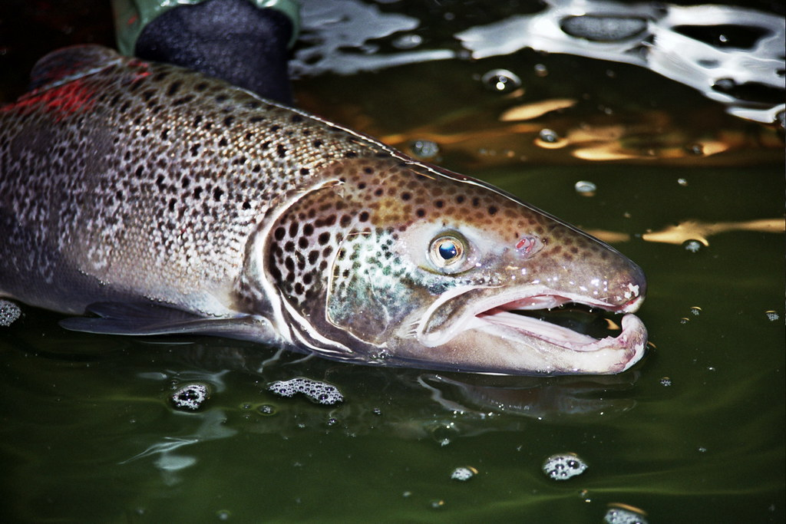
OBJECTIVES
Land Use / Land Cover Maps (LULC)
Refine LULC maps (1985, 2003, 2021)
Delineate forest types
Land Surface Temperature (LST)
Map average LST per HUC-12 watershed
Map average anomalies in LST
LULC & LST
Assess trends in LST trends within specific LULC types
LULC Study Period: 1985 – 2021
LST Study Period: 2000 – 2021
Image Credit: U.S. Fish and Wildlife Service – Northeast Region
Notes:
Tony
Land Use/ Land Cover (LULC)
For our assessment of the relationship between LULC and temperature, we began by setting out to refine LULC maps created during the first term of this project to further delineate an all-encompassing forest class into upland and wetland forest types.
We aimed to use these refined LULC maps to generate Forest cover maps of the state of Maine which will inform our partners' identification of streams with unfavorable riparian conditions.
Land Surface Temperature (LST)
To explore the possibility of using MODIS LST as a proxy for stream temperature, we aimed to compare in-situ stream temperature and MODIS LST data in select watersheds across Maine.
To bring it all together, our team also set out to generate LST maps based on forest cover type to explore how specific forest communities vary in their effects on stream temperature and overall Atlantic salmon habitat suitability.
Now that we've talked a little bit about our objectives, I'll pass it along to Jon to discuss the data and Earth observations we used to complete these goals.
------------------------------Image Information Below ------------------------------
Image Credit: Atlantic Salmon Male, U.S. Fish and Wildlife Service Northeast Region
Image Source: Atlantic Salmon | Openverse (wordpress.org). Public Domain

Slide 6
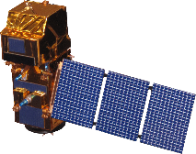
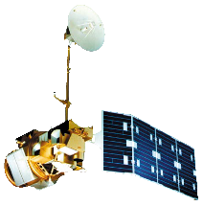
METHODS: Data Acquisition
Land Use / Land Cover (LULC)
Landsat 5 TM: 1985, 2003
Landsat 8 OLI: 2021
Summer & Winter; median composites
Sentinel-2 MSI: 2021 (validation)
Land Surface Temperature (LST)
Terra MODIS: 2000 – 2020
Timeline (1985 – 2021)
Sentinel-2 MSI
2021
Terra MODIS
2000
2021
Landsat 5 TM
Landsat 8 OLI
1985
2003
2021
Image Credit: NASA, ESA
Notes:
Jon
We addressed our objectives using NASA and ESA satellites.
The Landsat satellites allowed us to collect Maine imagery from 1985 through 2021 in 18-year intervals so that we could investigate Land Use / Land Cover (LULC) and determine forest types. The continuity of the program meant we had to use Landsat 5 for 1985 and 2003, and Landsat 8 for 2021. Image collections from summer and winter date ranges for 1985, 2003, and 2021 were composited using the median pixel value method and exported from Google Earth Engine for processing and classification in ArcGIS Pro. We used ESA's Sentinel-2 to validate the 2021 map to ensure the methodology applied to 1985 and 2003 was adequate.
For LULC, we assessed imagery between May and July, except for data used to derive winter NDVI. This allowed us to determine the difference between leaf cover to see where coniferous forest is distributed through the state.
Land surface temperature (LST) was collected using the Terra MODIS satellite launched in 1999. Although its resolution is relatively coarse in relation to the Landsat satellites, it resamples areas very frequently. As such, it is less susceptible to temporary temperature variations. We determined LST for each month between 2000 and 2020.
------------------------------Image Information Below ------------------------------
Image Credit: NASA
Image Source: https://www.devpedia.developexchange.com/dp/images/6/69/01_Landsat5.png
Image Credit: NASA
Image Source: https://www.devpedia.developexchange.com/dp/images/c/c2/03_Landsat8.png
Image Credit: NASA
Image Source: https://www.devpedia.developexchange.com/dp/images/9/91/05_Terra.png
Image Credit: ESA/NASA
Image Source: https://www.devpedia.developexchange.com/dp/images/d/dd/24_Sentinel2.png

Slide 7
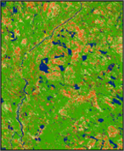
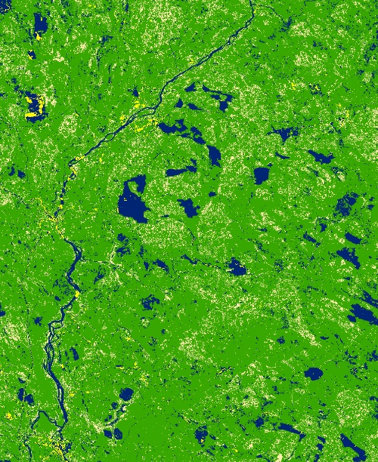
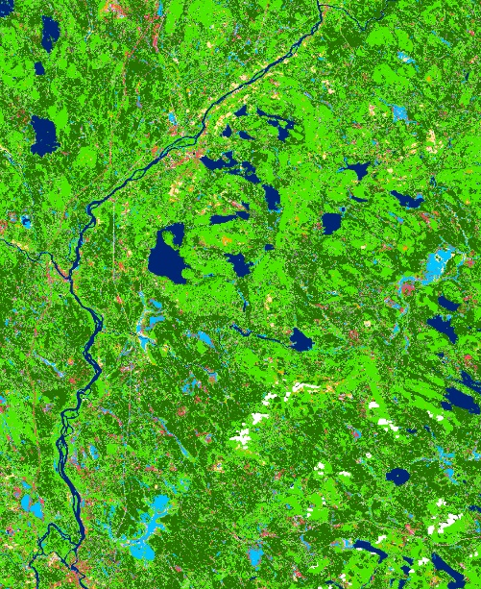
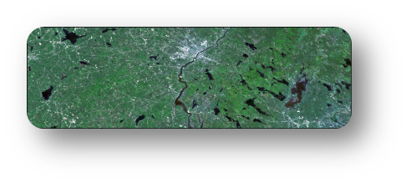
METHODS: LULC Processing & Analysis
Landsat 5 TM
1985, 2003
Initial cluster classifications
Final classification & validation
Cluster-busting
Landsat 8 OLI
2021
summer and winter imagery
Calculate trends over time
Image Credit: NASA
Notes:
Chris
Land Use and Land Cover Maps for three years, 1985, 2003, 2021, were created by classifying Landsat data and their derivatives (e.g., NDVI) using a hierarchal, unsupervised iso-clustering method...or cluster busting.
The layers of data, called stacks, were statistically grouped based on similarity using the image classification wizard, an automated process in ArcGIS Pro. The team then visually compared these groups to the Landsat images, ESRI World Imagery, and NAIP imagery, to assign these groups to our classes of interest. After the initial round of classification, most classes still had considerable overlap with other classes. For example, developed areas and agricultural areas were often confused. The confused classes were isolated and then classified again, with different stacks to remove the class confusion. We found that winter and summer NDVI's, SWIR, and NIR were useful for distinguishing the vegetative classes while a modified bare index (Nguyen 2022) was useful for differentiating the confused non-vegetative classes such as agriculture, developed, and barren. After cluster busting, the refined classifications were all merged back into one raster, and were more accurate than if we had only performed the initial classification.
Next, a stratified random sampling process in ArcGIS Pro selected accuracy assessment points throughout our study area. The points were compared to orthoimagery (1985, 2003) and Sentinel-2 MSI high-resolution composites to determine error rates between all possible pairs of classes, producing a confusion matrix that displayed the overall accuracy of class assignments and the error rates between classes.
EXTRA INFO FOR RESPONDING TO QUESTIONS
SR data were cloud and snow masked.
Winter dates: Dec 1 (previous year) – Mar 8
Summer Dates: May 1 – July 31
Initial Stack
Summer
Landsat 8 Bands 1-7 or Landsat 5 Bands 1-5, 7
NDVI
NDBI
MBI
Winter
Landsat 8 Bands 1-7 or Landsat 5 Bands 1-5, 7
NDVI
------------------------------Image Information Below ------------------------------
Image Credit: NASA
Image Source: https://www.devpedia.developexchange.com/dp/images/6/69/01_Landsat5.png
Image Credit: NASA
Image Source: https://www.devpedia.developexchange.com/dp/images/c/c2/03_Landsat8.png

Slide 8
RESULTS: Trends in LULC Change
Net Change In LULC From 1985 – 2021 In Acres
Wetlands
-35,951
Planted/Cultivated
+228,253
Shrubland/Herbaceous
+167,681
Mixed Forest
-712,616
Coniferous Forest -662,263
Deciduous Forest +806,031
Barren -248,993
Developed +478,736
Water -20,879
+800,000
-400,000
0
+400,000
+800,000
Notes:
Kelsey
- Above you can see a bar chart representing net change in LULC classes from 1985 to 2021
- Deciduous and Developed received the largest net growth
- While Mixed Forest and Coniferous received the greatest net loss
It is of particular interest that coniferous forest is experiencing such great loss, as coniferous forests provide shaded relief and cooler temperatures year-round for salmon habitat.

Slide 9
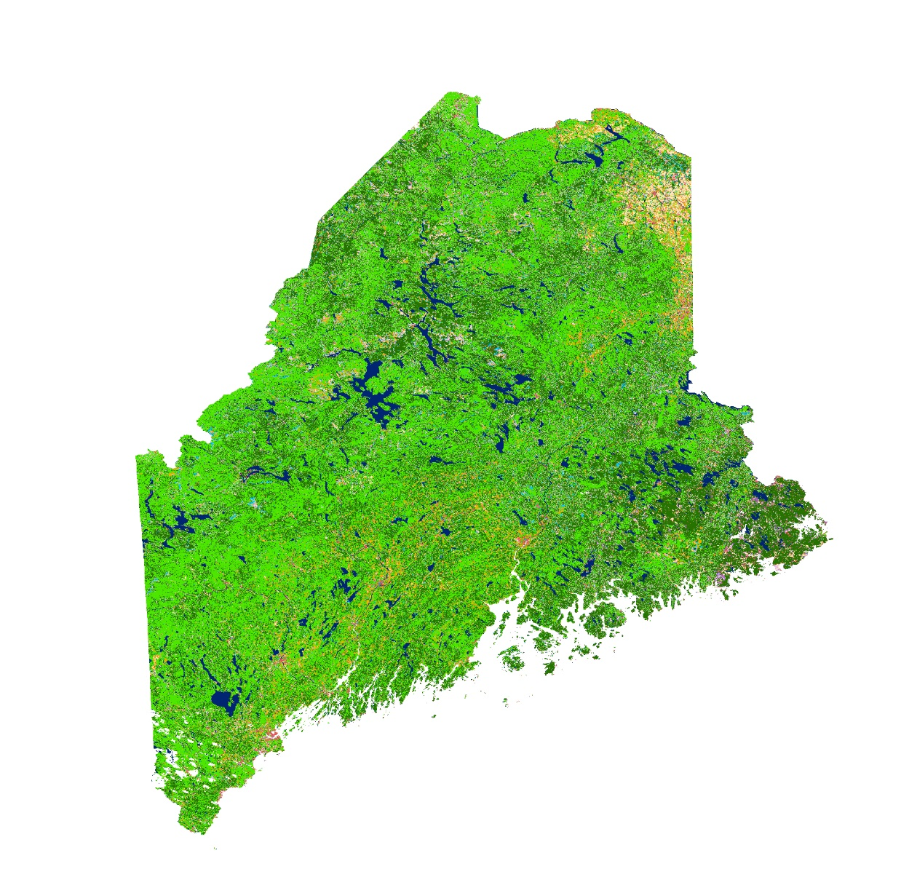
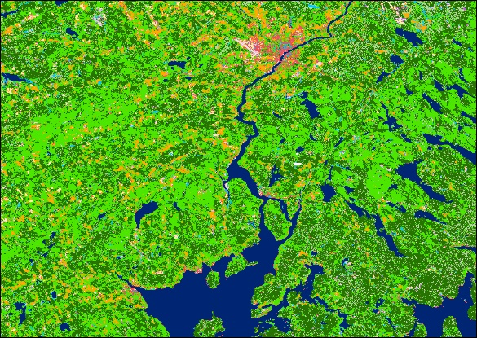
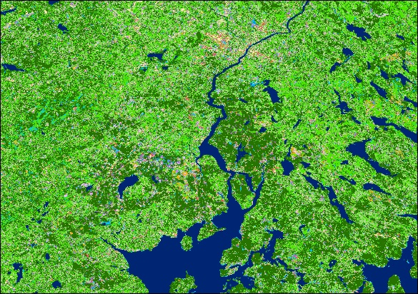
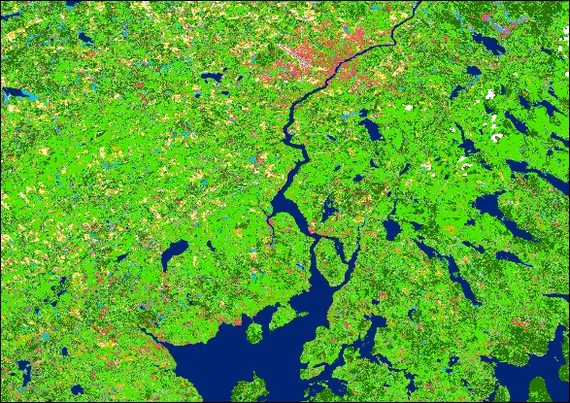
RESULTS: Trends in LULC Change
Classification Accuracy (User's)
1985: 90%
2003: 81%
2021: 82%
1985
1985
Water
Barren
2003
Developed
Deciduous Forest
Evergreen
Mixed Forest
Shrublands
Herbaceous
Wetlands
Cloud Mask
2021
Notes:
Chris
Overall accuracy for the three LULC classifications presented some interesting results:
1985: High accuracy in classifying continuous coniferous stands influenced the overall accuracy in this map.
2003: Our classification for 2003 was affected by a greater proportion of cloud and snow masked areas within the imagery compared to the two other years.
2021: Our accuracy was decreased in 2021 due to high spectral similarity between forest stands, and clear-cutting of coniferous forests between the summer and winter images introduced confusion to the classifier.
The preliminary LULC map shown here was further classified during the term to include upland and wetland evergreen forests in order to compare varying forest cover types to temperature trends across Maine.

Slide 10
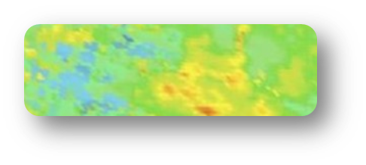
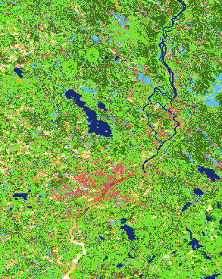
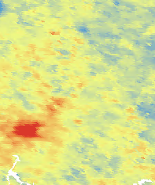
METHODS: LST Analysis
Terra MODIS
2000 – 2021
By HUC-12 watershed
By HUC-12 watershed
By HUC-12 watershed
LULC maps
2003, 2021
Average LST maps
Average LST anomaly maps
Linear Regression
LST ~ LULC
Image Credit: NASA
Notes:
Jon
Another goal of this DEVELOP project was to make conclusions about the effect of land use on temperature to identify what uses may impact salmon survivorship in Maine's streams. To analyze land surface temperature (LST), we gathered daily temperature data analyzed by Terra MODIS since its launch in 2000 until 2021. We collated the daily LST readings into monthly averages, allowing us to see what areas were warm and what areas were cool through time. For example, notice in the center averaged LST map, the hottest, red area corresponds to where you can see Bangor in the leftmost LULC map, giving us a glimpse at how development affects local temperature. To measure how land use may affect warming trends through time, we needed to get a sense of where unusual "anomalous" temperatures were found, as seen on the right. In the interest of capturing the warmest temperatures that could stress cold-water fish like salmon, we found the median summer temperature everywhere in Maine from 2000 until 2010. Then we compared this 2000-until-2010 baseline to each summer average from 2011-until-2021. Areas that got warmer glowed red, and the areas that cooled became blue.
Then to compare LULC in 2003 and 2021 to the respective LST maps, we averaged LST and anomalies within the boundaries of local "HUC-12" watersheds. We also found the area occupied by each land use in each local HUC-12 watershed. In this way, we could compare how land use affects both surface temperature and anomalous temperatures on a local, salmon-focused level using a linear model.
------------------------------Image Information Below ------------------------------
Image Credit: NASA
Image Source: https://www.devpedia.developexchange.com/dp/images/9/91/05_Terra.png

Slide 11
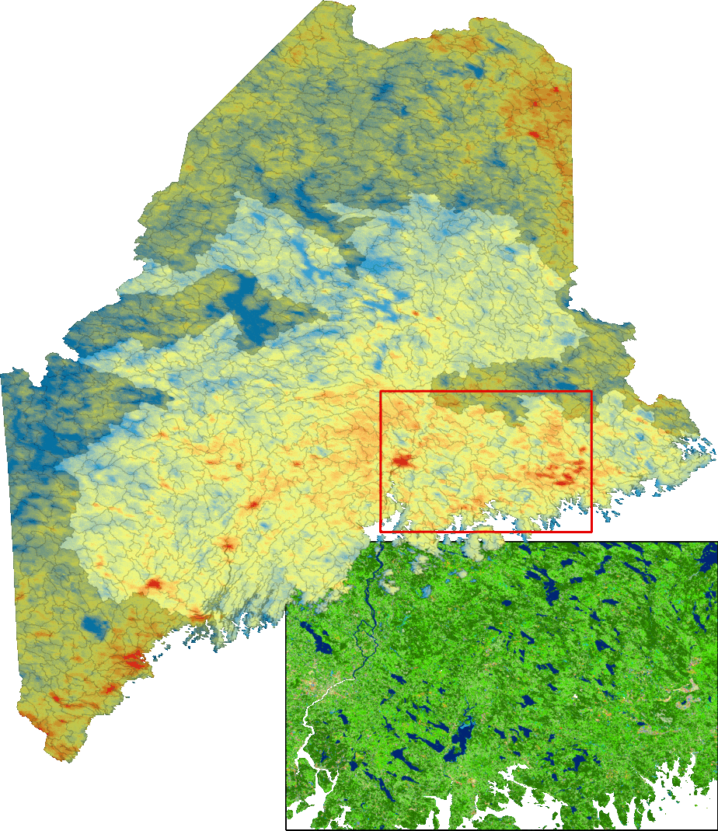
RESULTS: LST and Forest Cover
LST 2000 – 2021
80°F
Temperature (°F) Change per 10,000 Acres
(2021)
60°F
Developed
critical salmon habitat
Barren
×
Planted/Cultivated
Deciduous Forest
Coniferous Forest
×
Mixed Forest
Shrublands/Herbaceous
Wetlands
×
Water
×
-0.4 °F
0
+0.4 °F
Summer LST
R² = 0.51
LULC 2003, 2021
Anomalies
R² = 0.13
× insignificant effect on temperature
Notes:
Jon
The results tend to show coniferous forest, in particular, has a cooling effect on the watershed! This supports our partners' observations that areas shaded by coniferous forests hold onto their ice for longer periods, buffering salmon from Maine's warming trends, as seen in this animation.
The animation displays summer land surface temperature (LST) every 3 years from 2000 until 2021 (the animation holds onto 2021 for a few seconds longer before restarting). Maine, on average, has warmed from the start until the end of this period, although you may notice early years, like 2003 and 2006, experience widespread heat spikes. The salmon restoration units are highlighted, and the watersheds are outlined. The study area bounded by the red box shows some interesting relationships that reinforce the bar chart on the left. Namely, developed areas like Bangor are warmer, and low-lying mixed forest areas are warmer. In the top right of the bounding box is the coolest in the region, corresponding to where we see coniferous forests!
The bar chart on the left shows how much warming would occur if each land use were to grow by 10,000 acres in each watershed. Land use explains about 50% of the LST variation. However, land use only explains 13% of the anomalous temperatures, which may be more influenced by global climatic effects. Expanding developed and cultivated areas have exacerbated warming, by nearly half a degree Fahrenheit in developed areas, while experiencing more anomalous temperatures. Coniferous areas, which we have found has diminished since 1985, cool local watersheds.

Slide 12
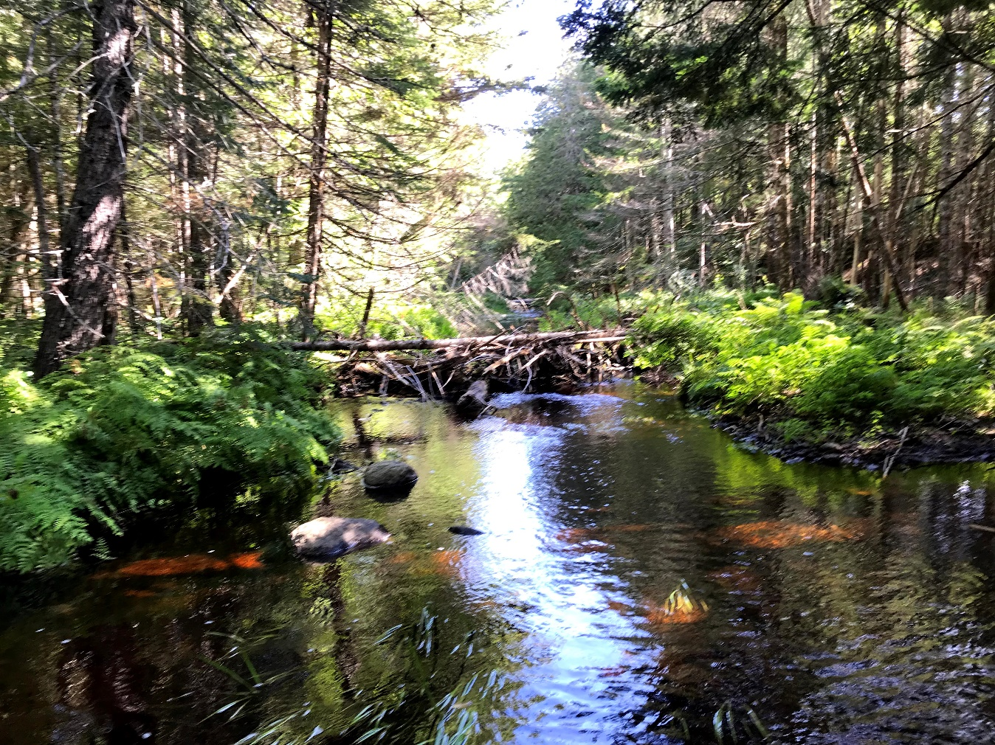
CONCLUSIONS
Maine has seen an overall loss in evergreen forest over the last 30 years
Development, mixed forests, and agriculture can influence LST trends
Declines in wetland coniferous forested areas could impact water quality and habitat suitability
Results can inform targeted recovery efforts to restore riparian buffers
Image Credit: DMR
Notes:
Tony
Maine has seen a shift in community types from predominantly evergreen to predominantly deciduous
The increase in developed areas and agriculture likely influence water quality and flow in areas that are historically affected by habitat disconnection due to dams, which further exacerbates the need for riparian habitat restoration efforts
Our results show that mixed and deciduous forest stands, compared to coniferous stands, have an overall warming effect on land surface temperature which necessitates further investigation to understand why these stands exhibit temperature trends distinct from what we traditionally expect when considering land cover types and temperature trends
The maps created by the team over the term allow our partners and associated agencies to compare land use land cover trends across time
Directly compare these LULC changes with surface temperature trends over the last 20 years. This will give our partners a good understanding of the overall net landscape characteristics and their associated contributions to temperature. From this, our partners will be able to address case-by-case studies of streams or rivers targeted for restoration efforts by mapping land use land cover and restoring riparian areas with cover types known to exhibit warmer temperatures.
------------------------------Image Information Below ------------------------------
Image Credit: Maine Department of Marine Resources (2022). [Photograph (JPG)]
Image Source: DMR (provided by partner with permission to use)

Slide 13
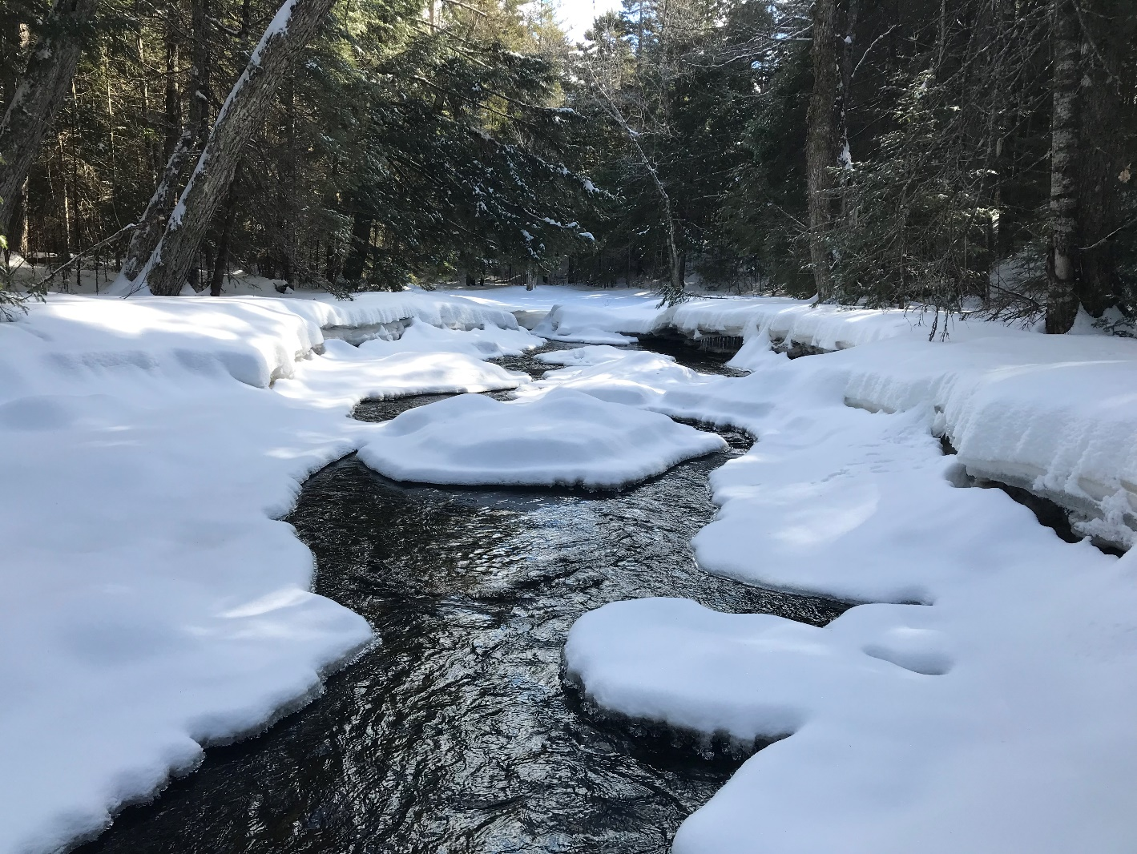
FUTURE WORK
Assess key threats at estuarine level
Utilize MODIS data to highlight coastal areas with cooler or warmer temperatures
Employ SAR data to delineate specific wetland forest types
Organize and deploy a workshop on the methods and data used to generate salmon habitat monitoring products
Image Credit: DMR
Notes:
Kelsey
- Looking at inland salmon habitat is only half of the picture, as salmon spend years of the life out at sea. Future work could incorporate this holistic approach by looking at estuaries and coastal areas.
- In addition, forest type could be further broken down into coniferous wetlands to see if these areas hold cooler temperatures year round versus upland wetlands.
- As for DEVELOP, future work should use end products from term 1 and term 2, including refined and forecasted LULC maps, LST anomaly maps and plots, and precipitation data, for further analysis. This could include further analysis of forest cover type maps in relation to anomalous land surface temperature and precipitation change maps coupled with partner-provided fish presence datasets. These end products and methods can be directly applied to the final DEVELOP Team’s workshop development that will give the partners tools to integrate with Earth observations and related data processing methods into their future projects.
------------------------------Image Information Below ------------------------------
Image Credit: State of Maine Department of Marine Resources. (2022). Untitled [Photograph (JPG)]. Personal Communication.
Image Source: DMR (provided by partner with permission to use)

Slide 14
Partners
Dwayne Shaw (Downeast Salmon Federation)
Ernie Atkinson (Maine Department of Marine Resources)
Science Advisors
Sean McCartney (NASA Goddard Space Flight Center, Science Systems & Applications, Inc.)
Dr. Bridget Seegers (NASA Goddard Space Flight Center, Morgan State University)
Joseph Spruce (Science Systems & Applications, Inc.)
Past Contributors
Michael Corley
Philip Casey
Olivia Landry
Lily Oliver
Brian Varley
Special Thanks
Dr. Nicole Ramberg-Pihl (NASA DEVELOP Fellow — Goddard Space Flight Center)
Additional Support
Dr. John Bolten (NASA Goddard Space Flight Center)
Maps throughout this work were created using ArcGIS® software by Esri. ArcGIS® and ArcMap™ are the intellectual property of Esri and are used herein under license. Copyright © Esri. All rights reserved. For more information about Esri® software, please visit www.esri.com.
Notes:
Tony
The Maine Ecological Forecasting II Team would like to extend our appreciation to our Partners: Dwayne Shaw of the Downeast Salmon Federation and Ernie Atkinson of the Maine Department of Marine Resources
As well as our science advisors, Dr. John Bolten, Sean McCartney, Dr. Bridget Seegers, and Joseph Spruce for always providing sound advice, troubleshooting help, and encouragement as we journeyed through this term.
We would also like to extend our thanks to the Maine Ecological Forecasting I team for setting the foundation for the work completed here.
Last but certainly not least the team wants to extend our immense appreciation to our NASA DEVELOP Fellow, Dr. Nicole Ramberg-Pihl.
I want to thank you all for joining us today to learn a little bit about our project and with that I will pass it over to the floor for some questions!

