Slide 1
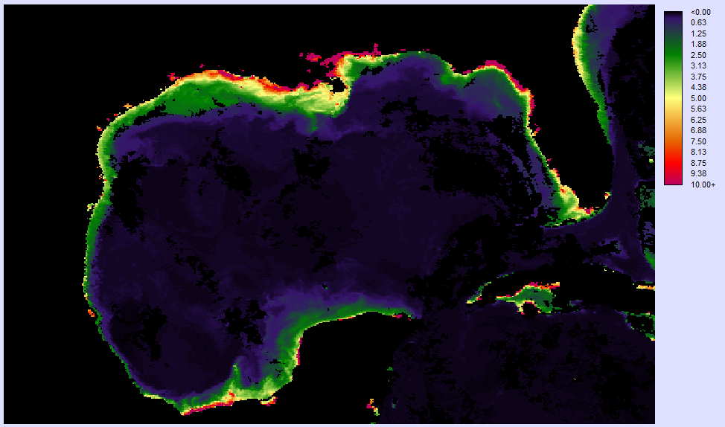
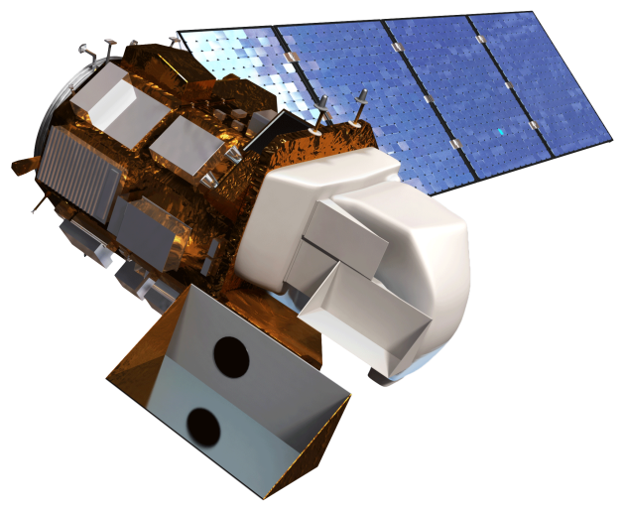
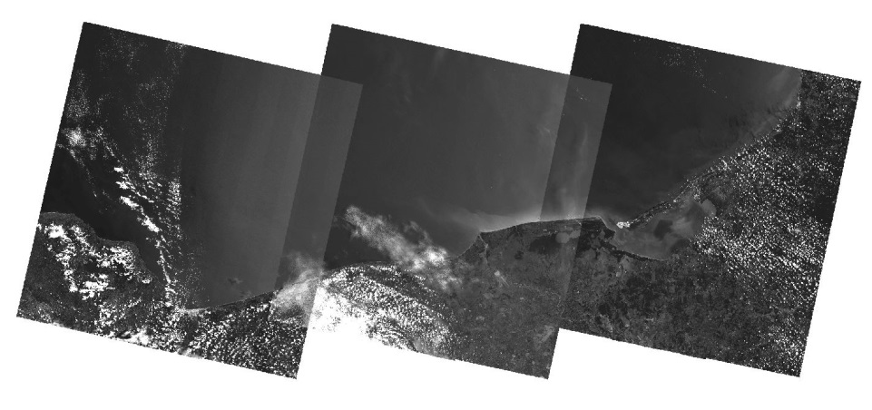
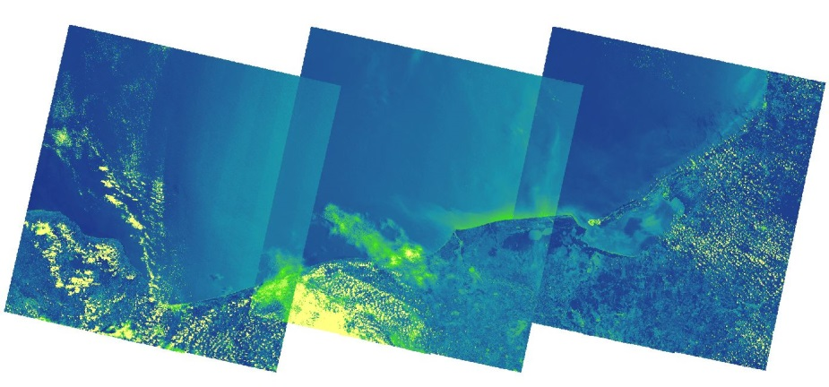
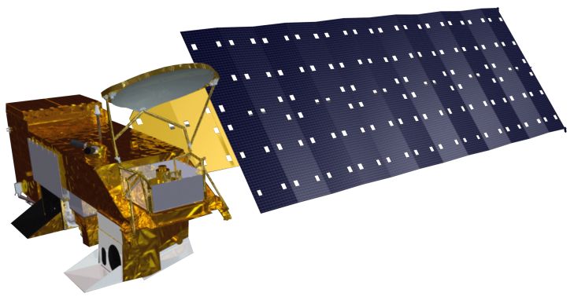
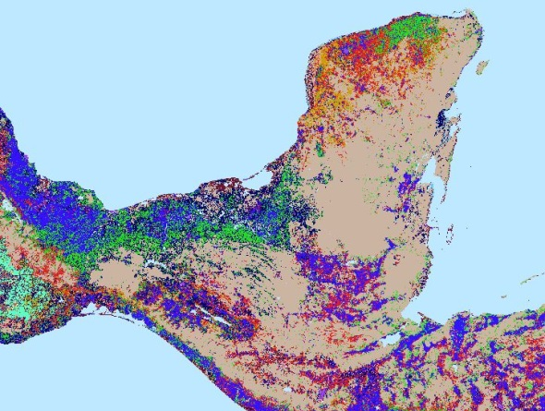
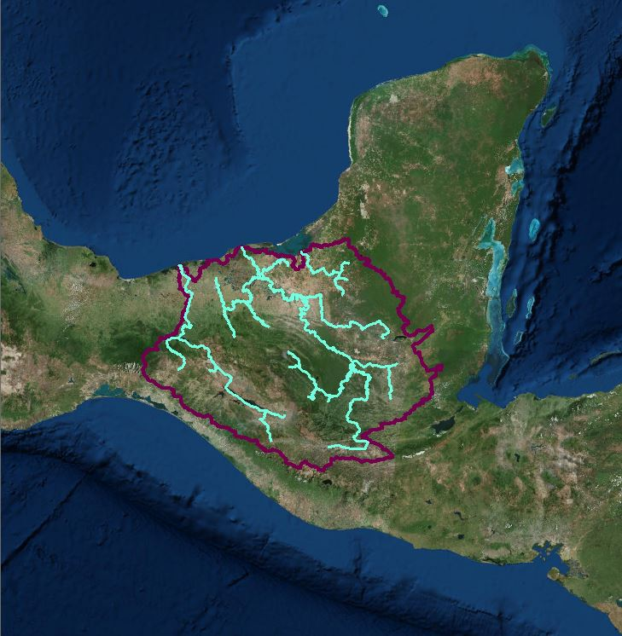
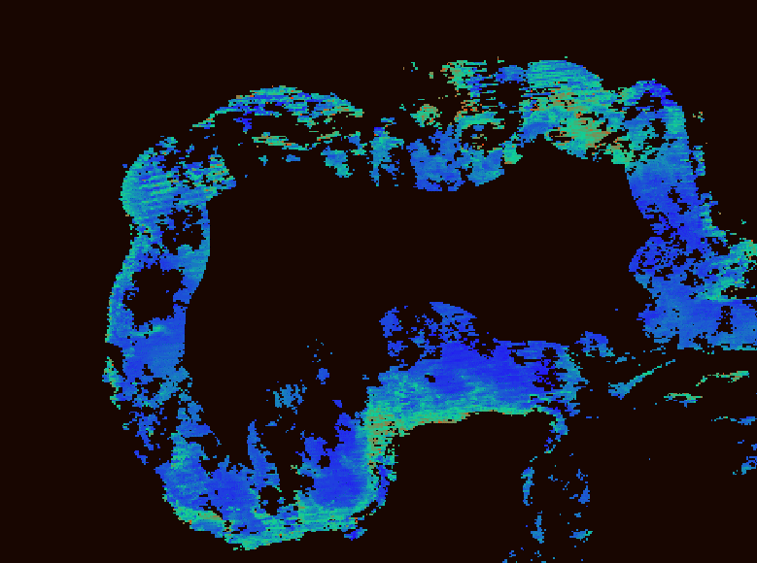
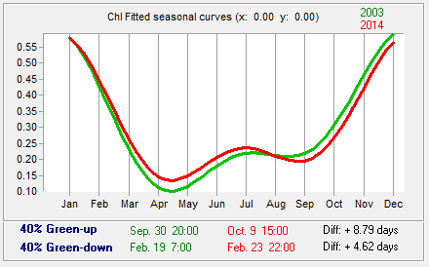
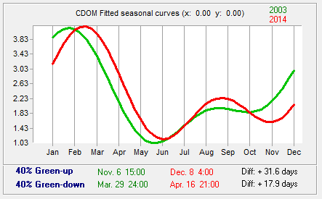
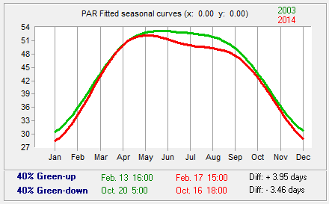
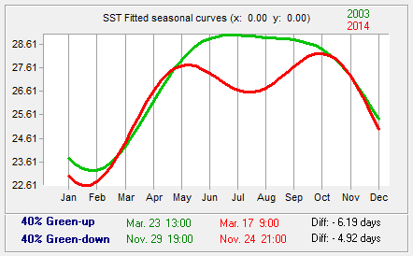
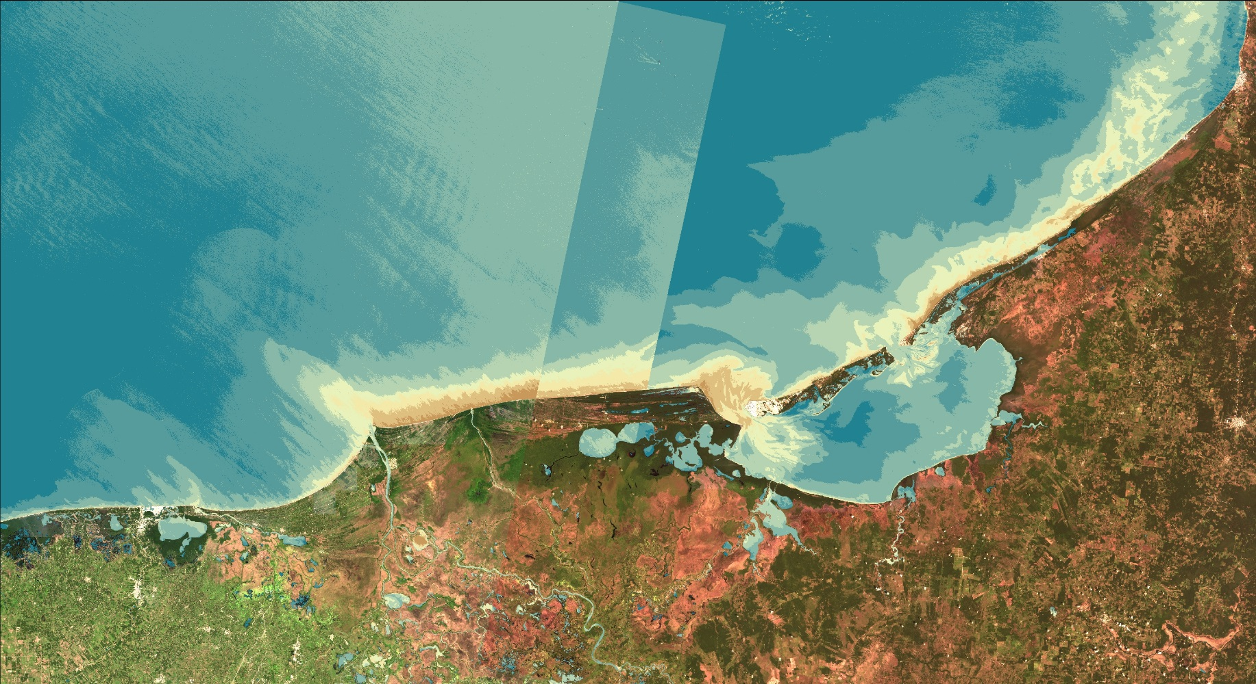
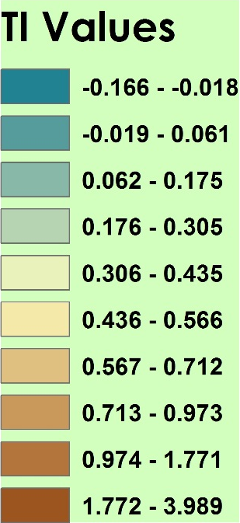
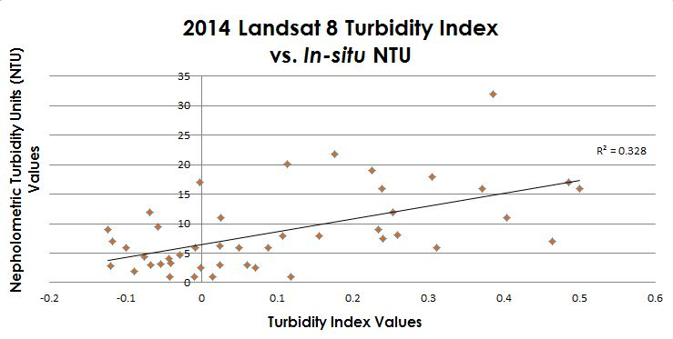
Gulf of Mexico Water Resources
Utilizing NASA Earth Observations to Detect Factors Contributing to Hypoxic Events in the Southern Gulf of Mexico
Rebecca Chapman(Project Lead)¹, Irma Caraballo Álvarez¹, Alannah Johansen¹, Åse Mitchell¹, Bridget Smith¹, Mackenzie Taggart¹
¹ NASA Ames DEVELOP Program
Abstract
Study Areas
Monitoring and analyzing harmful algal blooms (HABs) and hypoxic events in the southern coastal areas of the Gulf of Mexico (GoM) is important for watershed management and mitigation of environmental degradation. This study uncovered trends and dynamic characteristics of chlorophyll a (Chl) concentration, sea surface temperature (SST), colored dissolved organic matter index (CDOM), and photosynthetically available radiation (PAR); as evident in 8-day standard mapped image (SMI) products from the MODIS instrument on the Aqua platform from 2002-2015 using Clark Labs TerrSet Earth Trends Modeler (ETM). Additionally, sediment and nutrient loading values of the Grijalva-Usumacinta watershed were modeled using the ArcGIS Soil and Water Assessment Tool (SWAT). A Turbidity Index was generated using Landsat 8 Operational Land Imager (OLI) scenes for 2013-2014. Results will assist local fisheries and environmental, tourism, and health authorities in revising water quality standards and mitigating the impacts of future HABs and hypoxic events in the region.
Methodology
Objectives
Earth
Observations
Run TerrSet Earth
Trends Modeler
Chl
SST
CDOM
PAR
Utilize NASA Earth observations to identify indicators of hypoxic events and HABs in the southern Gulf of Mexico and connect their occurrences to nutrient and sediment loading from the Grijalva – Usumacinta River Basin.
Conduct time series analysis on MODIS Level III 8-day SMI products of Chl, SST, CDOM, and PAR.
Apply the Turbidity Index to Landsat 8 OLI data.
Run the Soil Water Assessment Tool (SWAT) to model nutrient and sediment loading for the entire Grijalava-Usumacinta river basin.
Landsat 8 OLI
Aqua MODIS
1) Download Aqua Modis Data: 2002 - 2015
Output:
Time Series Analysis
Apply
Turbidity Index
Analyze Trends
2) Download Landsat 8 OLI Data: 2013 - 2014
Project Partners
Inputs: DEM, Soil, Weather & Land Use data
Run SWAT
Outputs: Nutrient &
Sediment loading
Consorcio de Instituciones de Investigación Marina del Golfo de México y del Caribe (CiiMar-GoMC)
Centro del Cambio Global y la Sustentabilidad en el Sureste (CCGSS)
Comisión Nacional para el Conocimiento y Uso de la Biodiversidad (CONABIO)
The Federal Ministry of Health
Centro Nacional de Datos Oceanográficos (CENDO)
Universidad Autónoma de Baja California (UABC)
Universidad Juárez Autónoma De Tabasco (UJAT)
Secretaría de Marina (SEMAR)
3) Acquire SWAT input data
Results
Conclusions
Predicted DO
(mg/m3)
The models, tools, and indices used in this project will be beneficial for local agencies and partner organizations to assess the current environmental health of the region and mitigate future water quality degradation.
The analyses of Chl, CDOM, PAR, and SST can be used for forecasting the timing of hypoxic events and HABs.
The turbidity index can be continually performed as a method of remote water quality monitoring.
Once in-situ data becomes available, the SWAT model will be used to revise regulatory water quality standards.
Supplementing environmental monitoring efforts with analyses of Earth observations is especially important in regions where little to no in-situ data exists.
Figure 1: Map of predicted dissolved oxygen values for June 10 – 17, 2014 in the GoM generated from TerrSet’s Multi-Layer Perceptron (MLP) Classifier using in-situ dissolved oxygen from the northern GoM as the dependent variable and MODIS derived L3, 8-day SMI Chl, CDOM, SST, and PAR products as the independent variables.
Figures 2-6: Fitted seasonal curves for MODIS derived L3, 8-day SMI Chl, CDOM, PAR, and SST products generated from amplitude trend composites for the Bay of Campeche using TerrSet ETM Seasonal Trend Analysis (STA). Green curves represent the first 6 years and red curves represent the last 6 years of each time series. For each parameter, green-up and green-down refer to the dates corresponding to the maximum rates of increase and decrease, respectively.
Team Members
Table 1: SWAT model outputs delineating average annual values for influx of sediment, organic nitrogen, and organic phosphorous from the Grijalva-Usumacinta River Basin into the Bay of Campeche from 2000-2014.
Watershed Area (km2) | 153516.7
Number of Sub-basins | 45
Total Sediment Loading (T/Ha) | 88.9
Organic N (kg/Ha) | 13.7
Organic P (kg/Ha) | 2.1
Left to Right: Mackenzie Taggart Irma Caraballo Álvarez Bridget Smith Alannah Johansen Rebecca Chapman Åse Mitchell
Acknowledgements
Figure 7: Linear regression analyzing the correlation between in-situ nepholometric turbidity unit values and Landsat OLI derived turbidity index values for the northern Gulf of Mexico in 2014 (R² = 0.328).
Special thanks to our science advisors Dr. Juan L. Torres-Pérez, Dr. Sherry L. Palacios, and Chase Mueller from the Bay Area Environmental Research Institute. The authors also wish to thank the NASA Ames DEVELOP management team for their overall support and help with this project.
Figure 6: Turbidity index generated from Landsat 8 OLI scenes in the Bay of Campeche.
NASA Ames Research Center

