Slide 1
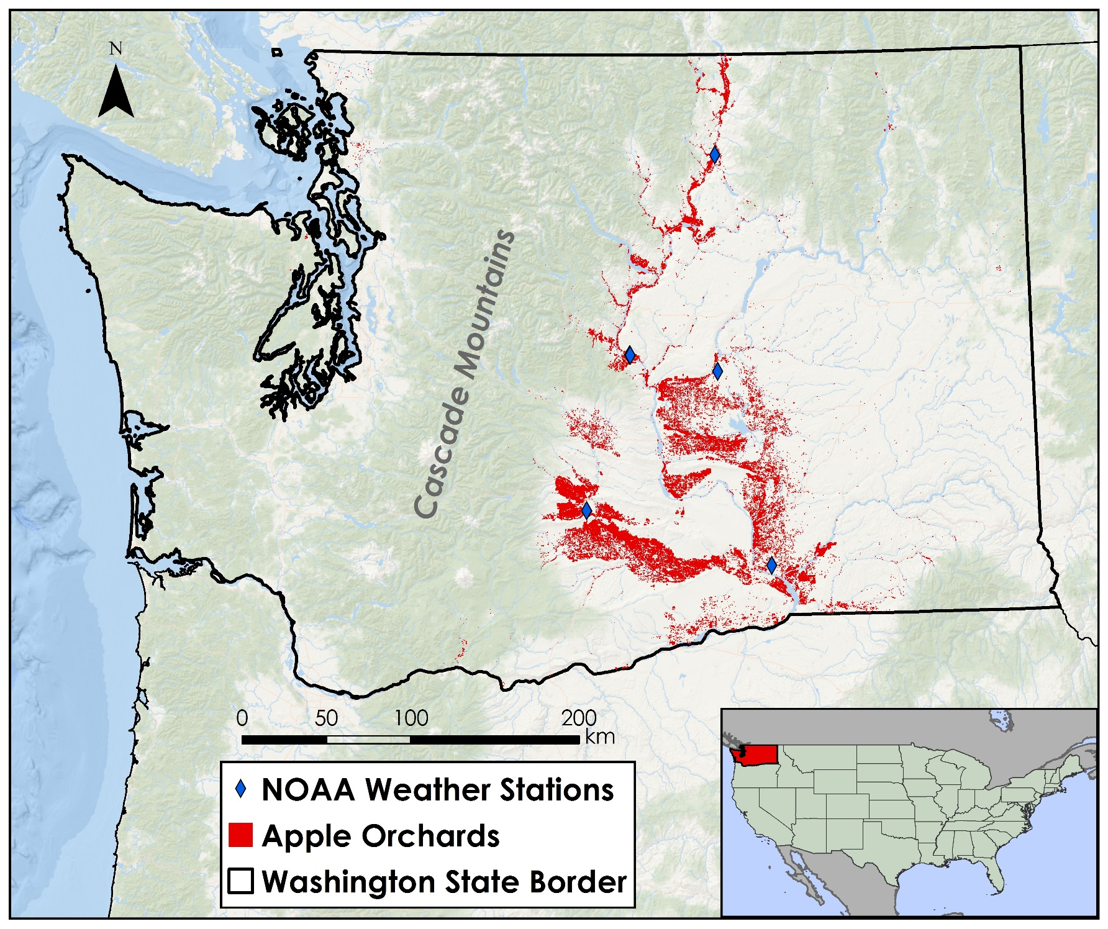
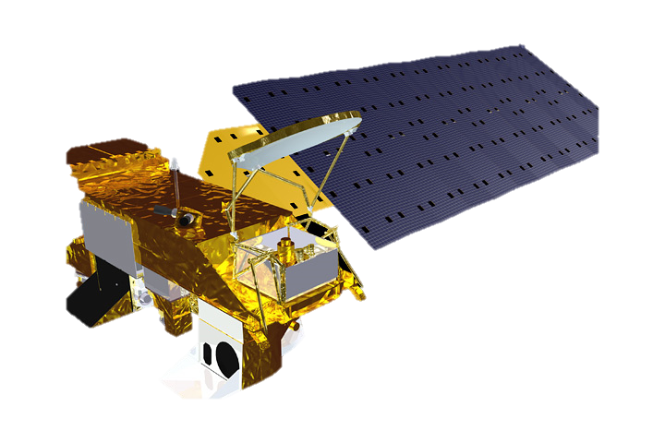
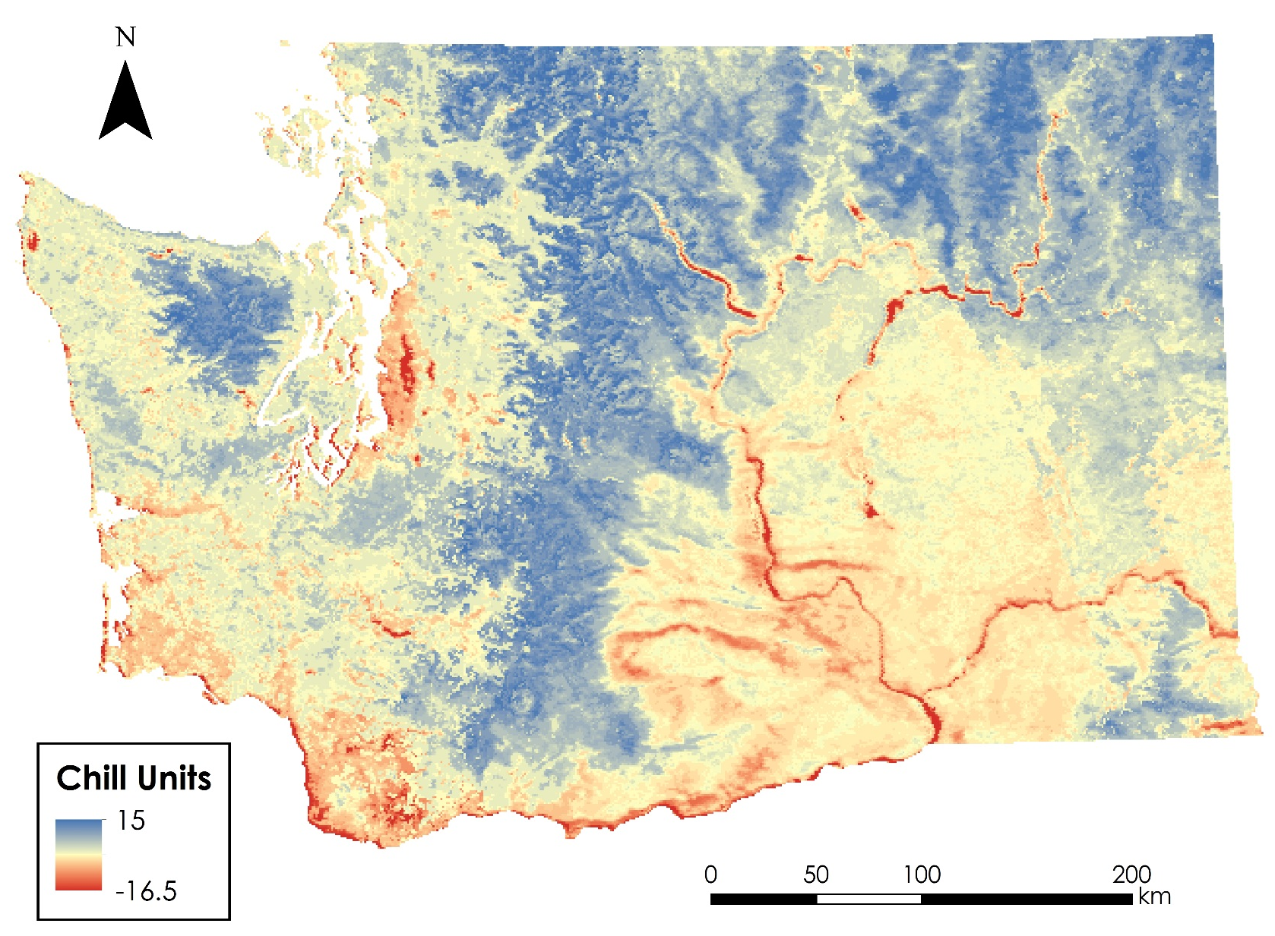
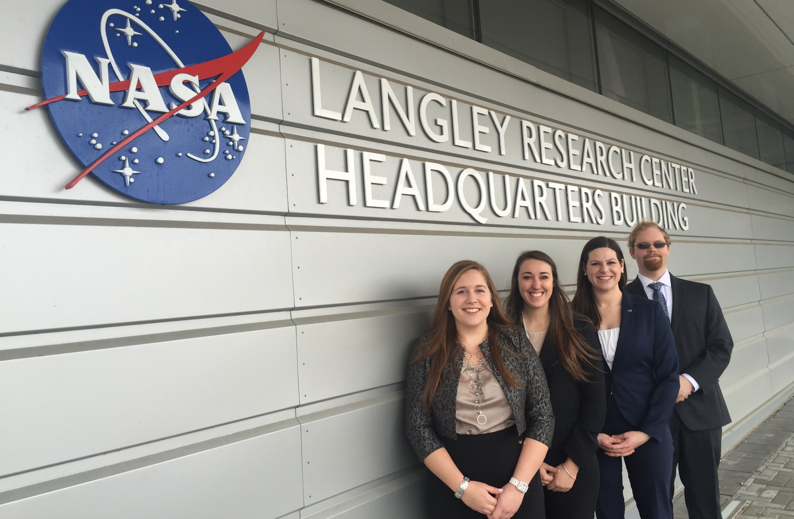
Northwest United States Agriculture
Evaluating Suitability for Apple Cultivation Based on Accumulated Chill Hours in Washington State from 2003 – 2013
Lydia Cuker (Team Lead), Laura Lykens, Alyssa Walzak, Timothy Stelter
NASA Langley Research Center
Washington, the top apple producing state in the United States, contributes over half of the nation’s apples. The climate of eastern Washington is ideal for apple growth, but as climate fluctuates, concerns are rising over the continued suitability of the region for apple cultivation. Apple trees require 500 – 1000 hours between 1.4 – 12.4° C, known as chill units, to break dormancy and homogenously bloom in the spring. Accumulated chill hours was identified as a key factor contributing to the success of apples, which may change due to climate fluctuations. Thus, understanding how climate change may affect chill hours will provide growers with insight as to how their orchards may eventually be affected. Connections to the apple growers in Washington were established through a partnership with the United States Department of Agriculture - Agriculture Research Service (USDA-ARS). Hourly temperature data for 2003 – 2013 were acquired from NOAA ASOS weather stations and used to determine an averaged normalized diurnal temperature curve for the region. NASA Earth observations data measured by Aqua Moderate Resolution Imaging Spectroradiometer (MODIS) as the Land Surface Temperature (LST) product were acquired for 2003 – 2013. The process for calculating accumulated chill hours using the averaged normalized diurnal temperature curve applied to MODIS LST was demonstrated for a 24 hour period. Maps of current accumulated chill hours may benefit orchard managers by detailing regions that are currently optimal for apple production and maps of forecasted accumulated chill hours may show how those regions will shift with forecasted changes in climate.
Incorporate temperature forecasts into methods of assessing possible climate shifts in ideal apple growing locations in the state of Washington.
Map accumulated chill unit results to help orchard growers make decisions regarding adaption of their apple growing processes to climate fluctuations.
Data Acquisition
Data Processing
Data Analysis
Hourly Temperature
NOAA ASOS
Weather Stations
2003 – 2013
Normalized hourly temperature
Utah Model
Averaged normalized diurnal temperature curve
Current Accumulated
Chill Units
Land Surface
Temperature (LST)
MODIS
2003 – 2013
Converted to T_{air}
Apply averaged normalized diurnal temperature curve to daily T_{max} and T_{min}
Utah Model
Current Accumulated
Chill Units for 24 hours
Hourly temperature for 24 hour period
Aqua
Averaged Normalized Diurnal Temperature Curve
24 Hour Accumulated Chill Units Map
Deriving the averaged normalized diurnal temperature curve for the apple cultivating region of Washington allows for the application of MODIS LST data for calculating accumulated chill units.
Further work is needed to calculate accumulated chill units for a typical year under current conditions so that current the trend may be compared to forecasted accumulated chill units.
Incorporation of CMIP5 climate model temperature forecasts can enable the forecast of accumulated chill units in years 2045 and 2065
Dr. Michael Glenn
Appalachian Fruit Research Station
USDA- Agriculture Research Service
Dr. Kenton Ross
NASA DEVELOP National Program
Science Advisor
Dr. Noel Baker
NASA Postdoctoral Program Fellow
Nathan Owen
NASA DEVELOP – Langley Center Lead
Jeffry Ely
NASA DEVELOP Geoinformation Scientist
Chad Smith
NASA DEVELOP – Langley Assistant Center Lead
L to R: Alyssa Walzak, Laura Lykens, Lydia Cuker, Tim Stelter

