Slide 1
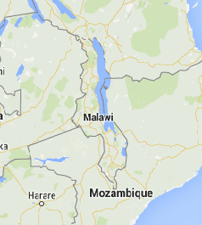
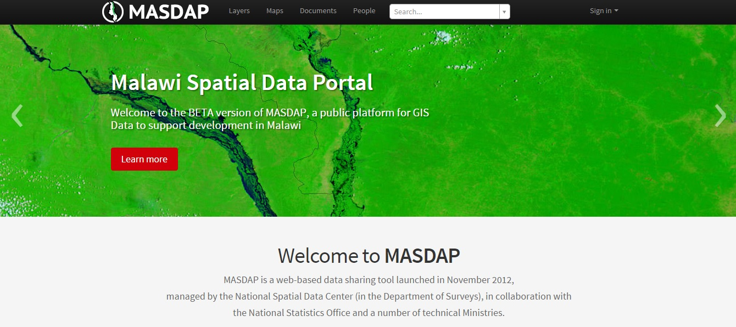
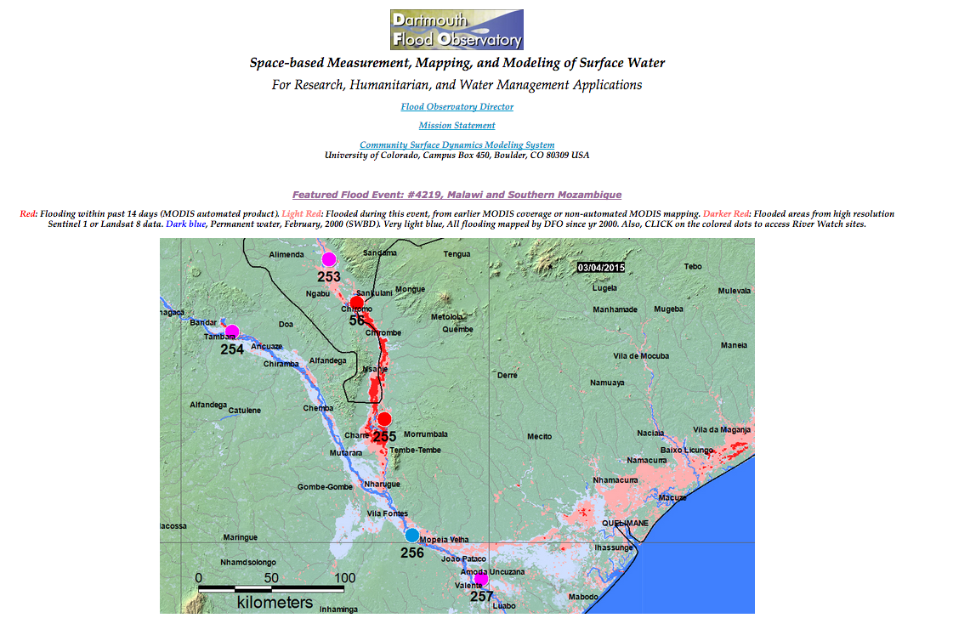
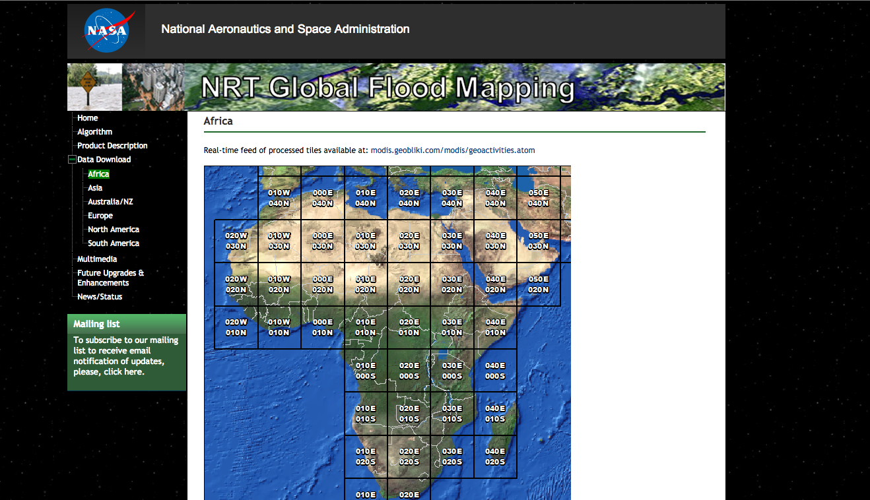
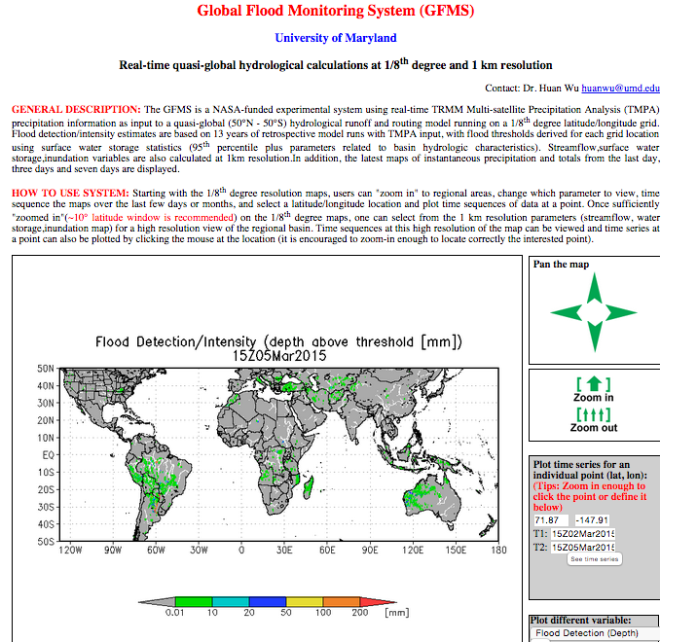
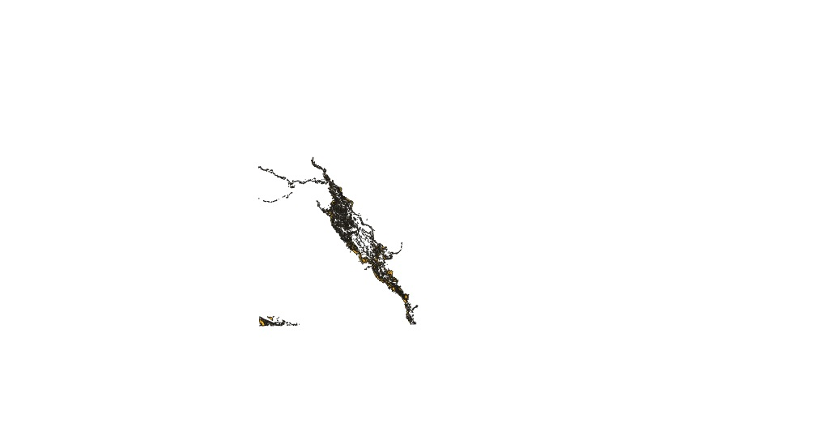
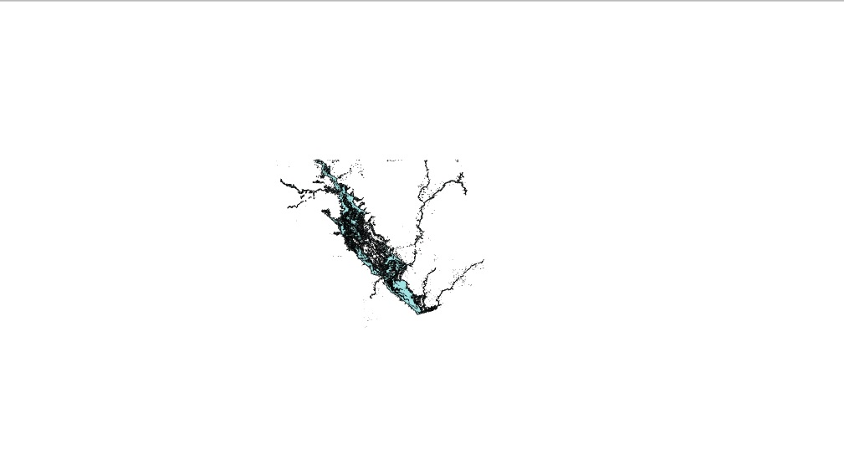
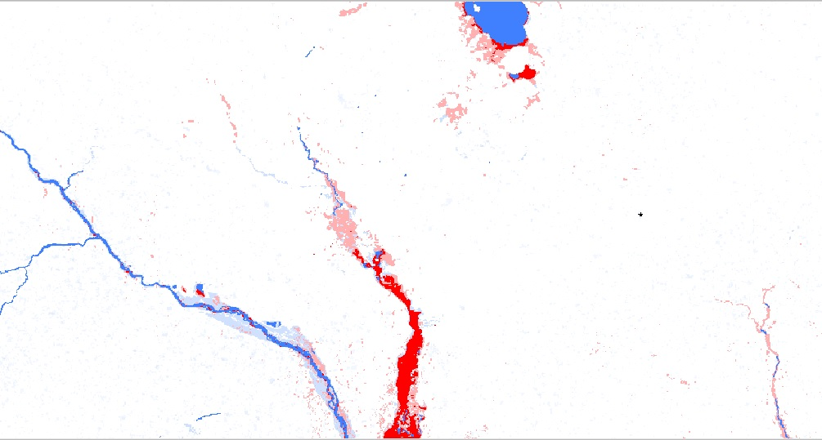
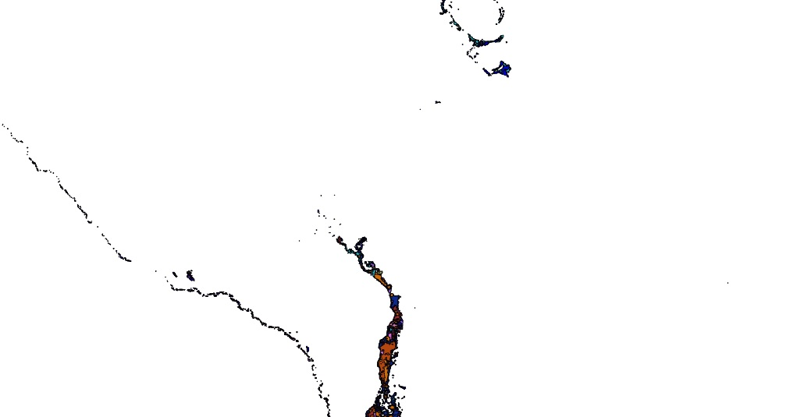
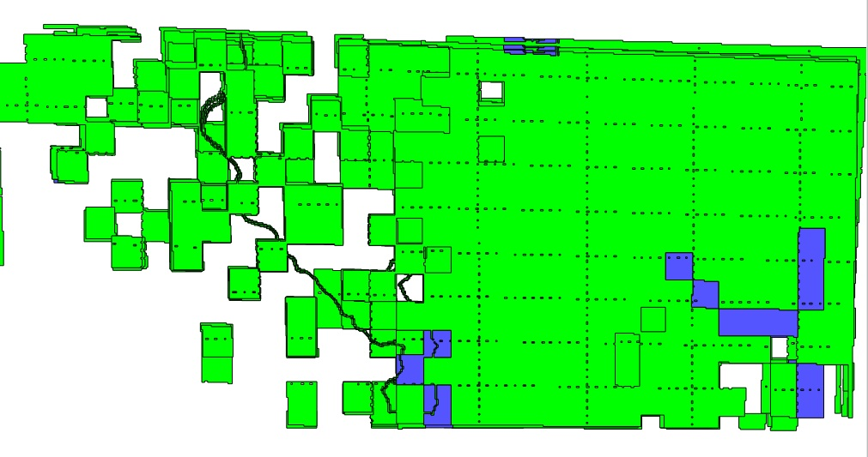
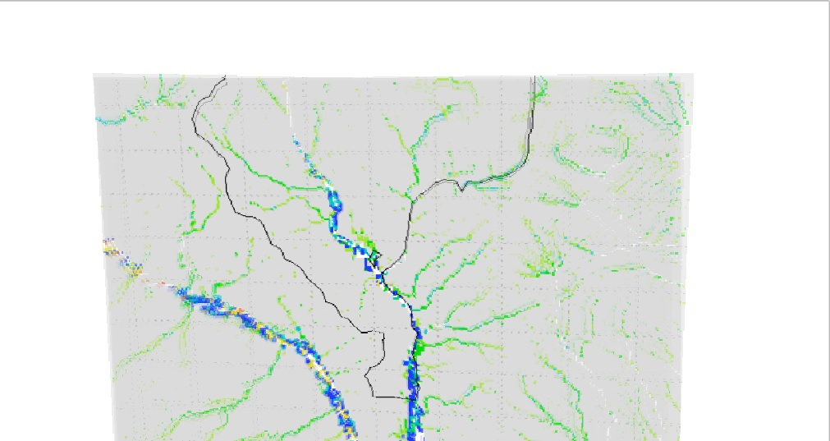
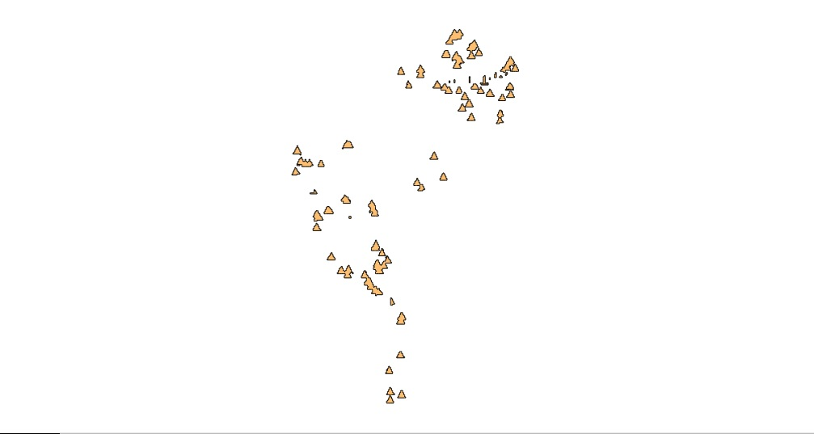
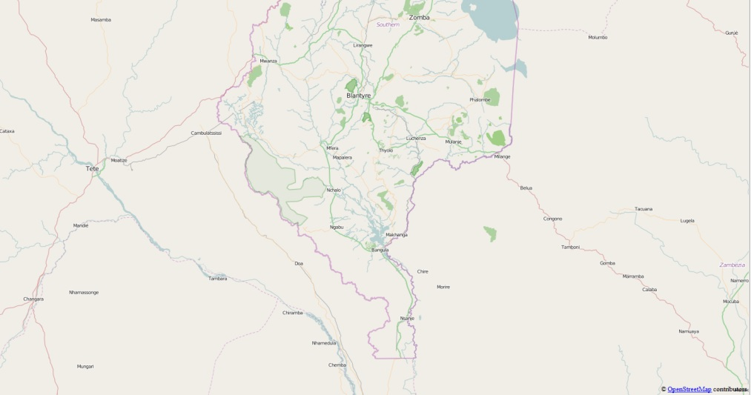
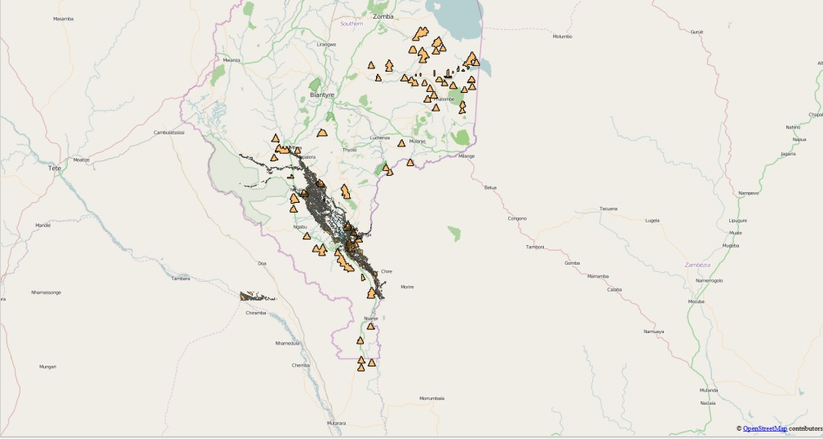
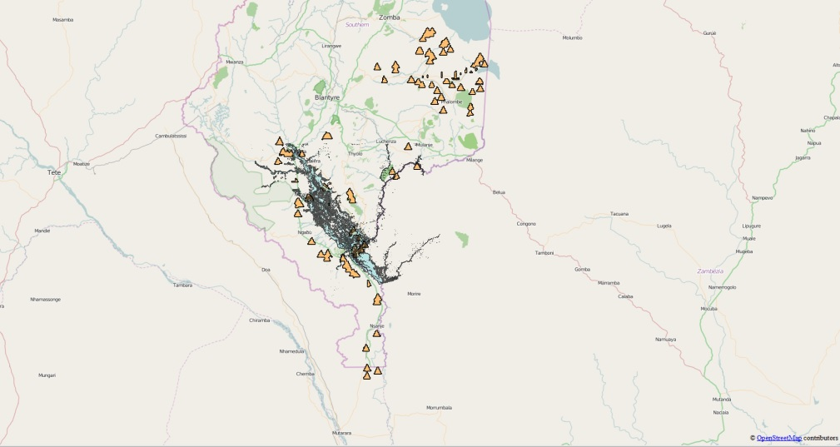
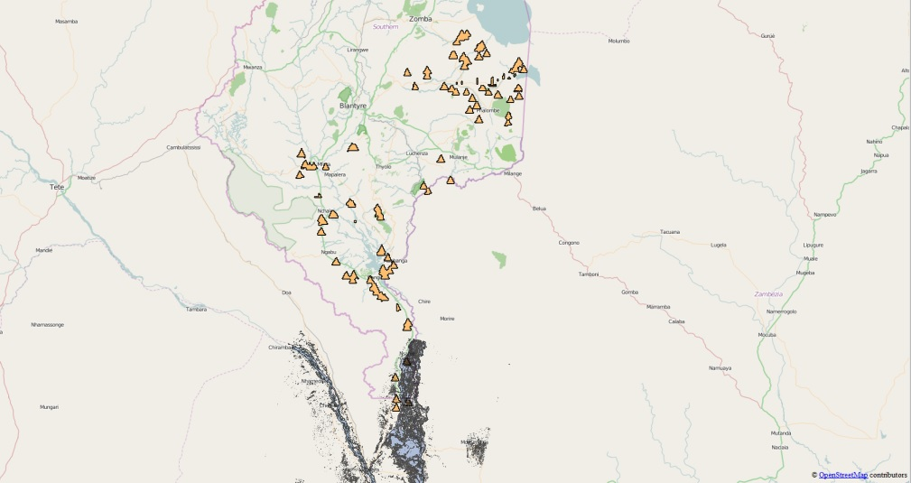
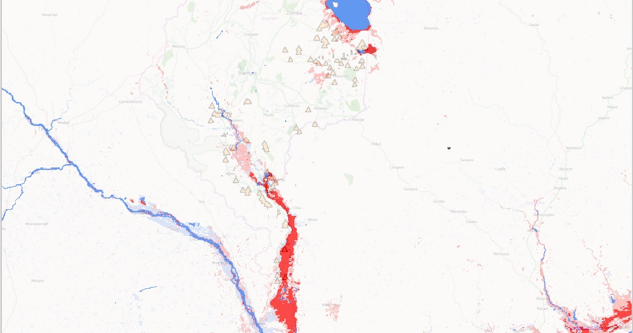
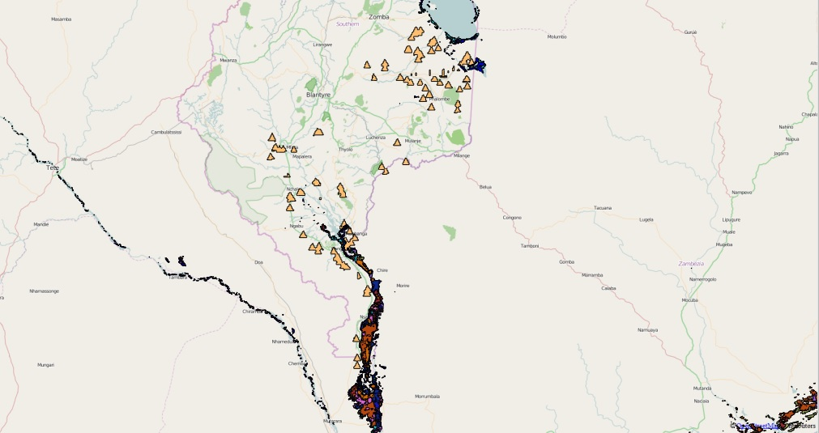
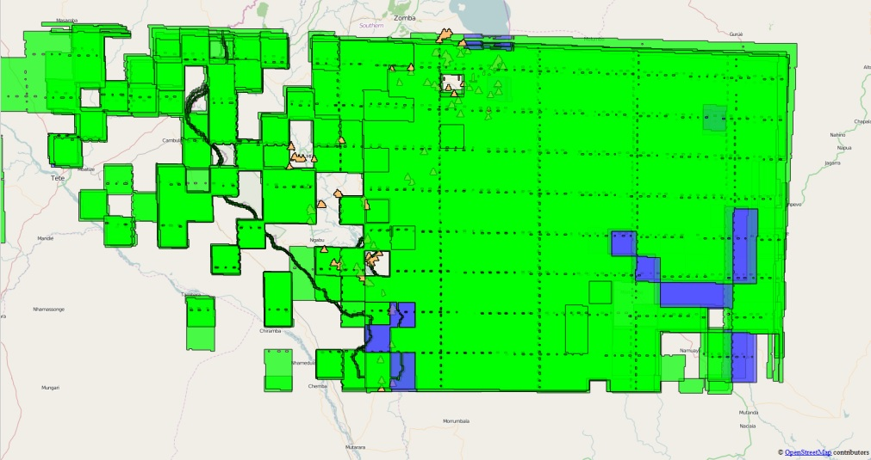
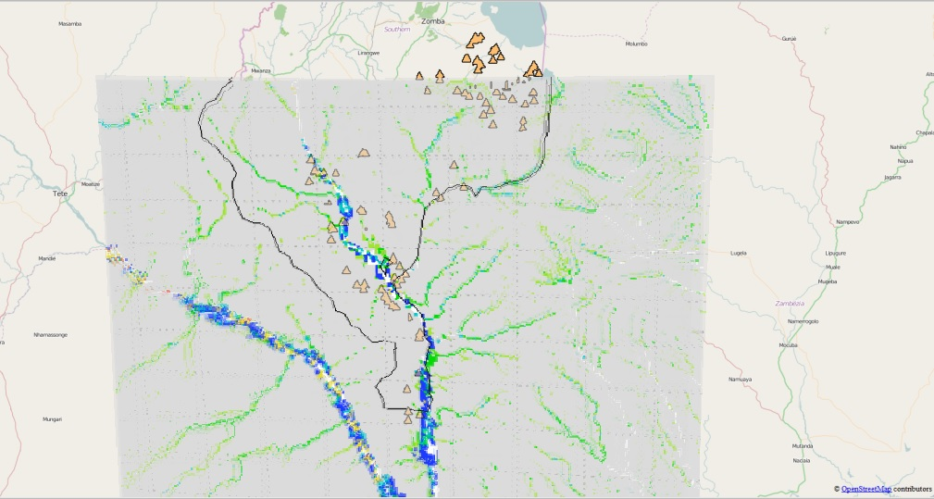
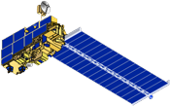
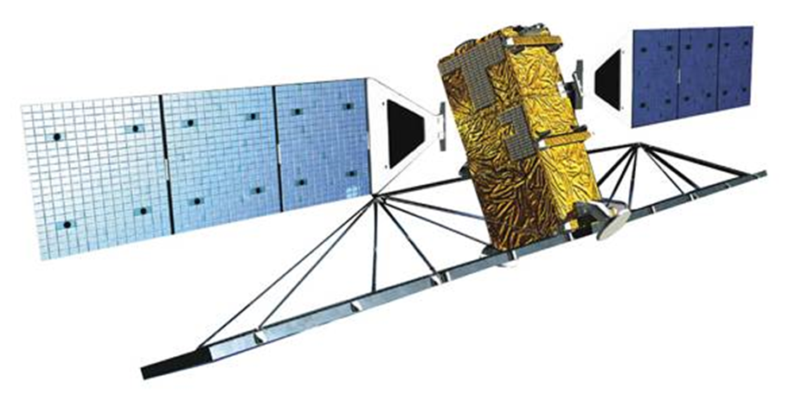
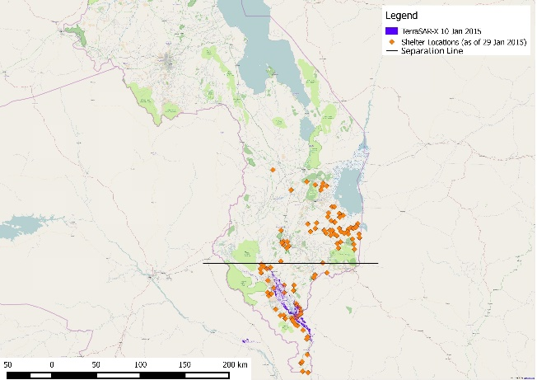
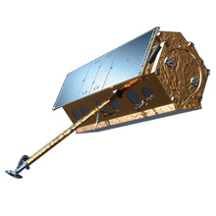
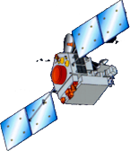
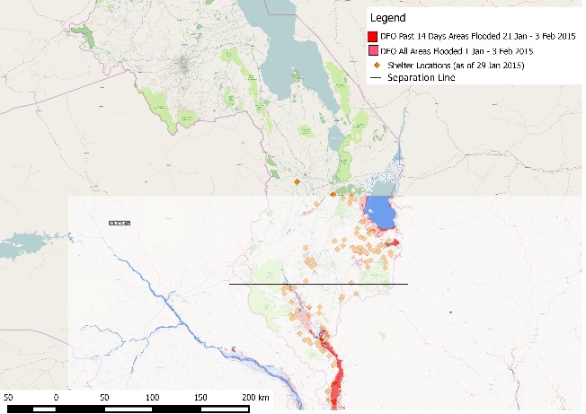
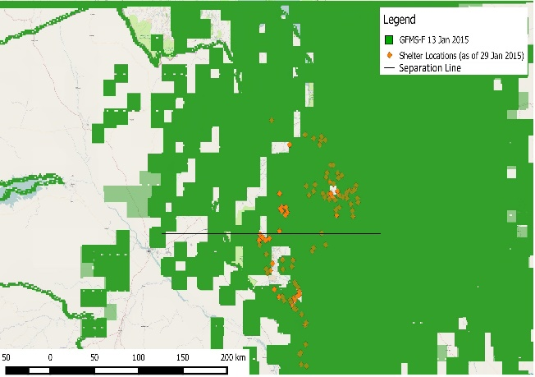
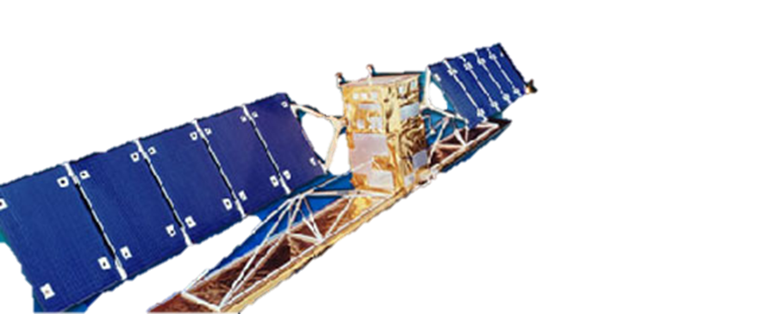
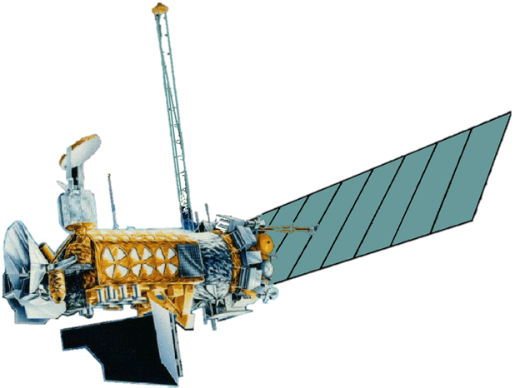
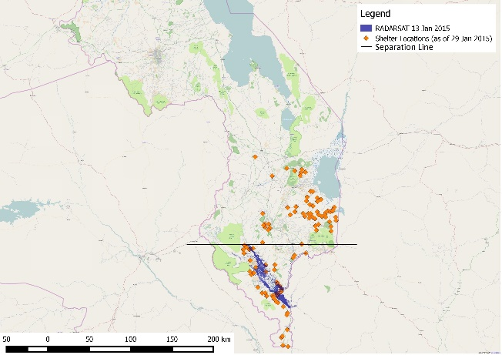
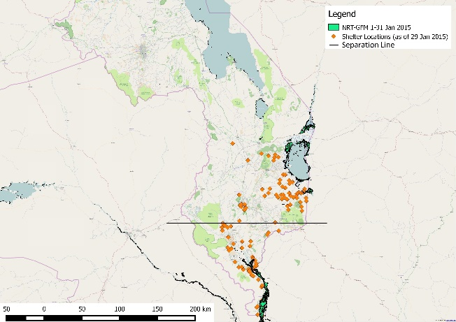
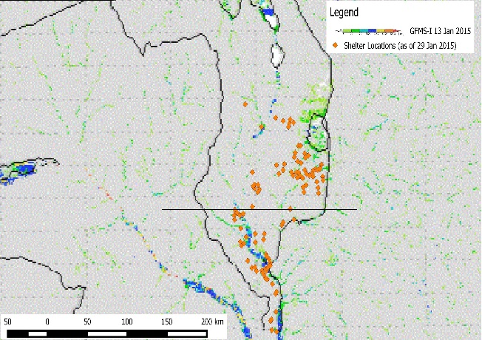
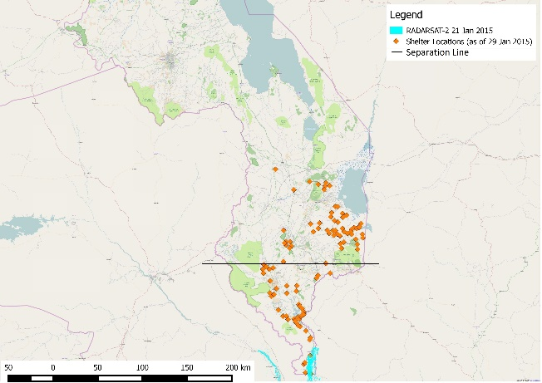
Malawi Disaster
Comparing Techniques of Inundation Detection for the January 2015 Malawi floods Using NASA Earth Observations
Andrew Kruczkiewicz (Project Lead), Helen Cen
International Research Institute for Climate and Society (IRI)
Malawi is prone to floods especially during its rainy season from October to April. In January 2015, Malawi experienced a series of flooding which resulted in 179 deaths, 153 missing, and over 175,000 people displaced. The series of floods consisted of flash floods and riverine floods. Due to differences in temporal and spatial limitations of various flood detecting methodologies, some are more likely to be sensitive to certain types of flooding. As such, the possibility exists that floods maps may introduce a bias into flood monitoring and assessment, especially in flooding events that consist of 2 or more types of events. A comparative analysis using shelter locations to explore the relationship spatial coverage of the January 2015 Malawi floods was conducted using Dartmouth Flood Observatory (DFO) flood map, NASA Goddard Space Flight Center Moderate Resolution Imaging Spectroradiometer Near Real-Time Global Flood Mapping Project (NRT-GFM), TerraSAR-X (German satellite) inundation map, RADARSAT (Canadian satellite) inundation map, RADARSAT-2 (Canadian satellite) inundation map, the University of Maryland Global Flood Monitoring System Flood Detection (GFMS-FD) product and GFMS Inundation 1KM (GFMS-I) product. It is expected that the results of this study will increase the ability to monitor flood events, which will benefit organizations involved with disaster relief efforts in Malawi; potentially increasing the accuracy in flood map production by differentiating between flood type, which may possibly lead to better definition of the spatial and temporal limits of flood impacts.
Use recent floods in Malawi to compare various inundation detection tools
Validate flood maps with ground data provided by the Malawi Red Cross
Malawi
Study Period:
January 2015
Step 1: Acquire Flood Product
Step 2: Acquire & Process Shelter Data
Step 3: Process & Group Flood Products
Group 1: SAR Products
Group 2: Near real time products
Group 3: University of Maryland Global Monitoring System products
Step 4:
Group 3 Comparison
(GFMS-FD Vs. GFMS-I)
Group 1 Comparison: (SAR) Products
(TerraSAR-X Vs. RADARSAT Vs. RADARSAT-2)
Group 2 Comparison
(DFO Vs. NRT-GFM)
TerraSAR-X
RADARSAT
RADARSAT-2
DFO
NRT-GFM
GFMS-FD
GFMS-I
Shelter Sites
Shelter Sites
Shelter Sites
Shelter Sites
Shelter Sites
Shelter Sites
Shelter Sites
OpenStreet Map
OpenStreet Map
OpenStreet Map
OpenStreet Map
OpenStreet Map
OpenStreet Map
OpenStreet Map
Visual Comparison
Visual Comparison
Visual Comparison
Group 1 Spatial Analysis Group 2 Spatial Analysis Group 3 Spatial Analysis
TerraSAR-X
Aqua
Terra
RADARSAT-2
DFO
GFMS-FD
TerraSAR-X
TRMM
RADARSAT
DMSP
RADARSAT
TerraSAR-X and RADARSAT in Group 1, DFO and NRT-GFM in Group 2 along with GFMS-I in Group 3 can better detect riverine floods at high resolution, which can better assist disaster managers for decision making.
DFO and GFMS-I showed flooding near shelters in flash flood prone regions, yet ground truth data is needed for verification.
NRT-GFM
GFMS-I
RADARSAT-2
Andrew Kruczkiewicz & Helen Cen
Red Cross/Red Crescent Climate Centre:
Erin Coughlan
Malawi Red Cross Society:
Hastings Kandaya
Dr. Pietro Ceccato
Lead Environmental Monitoring Program, IRI (Science Advisor)

