Slide 1
Best Practices & Tips: Project Summary
Fall 2016
Notes:
Welcome to Project Summary Best Practices & Tips!

Slide 2
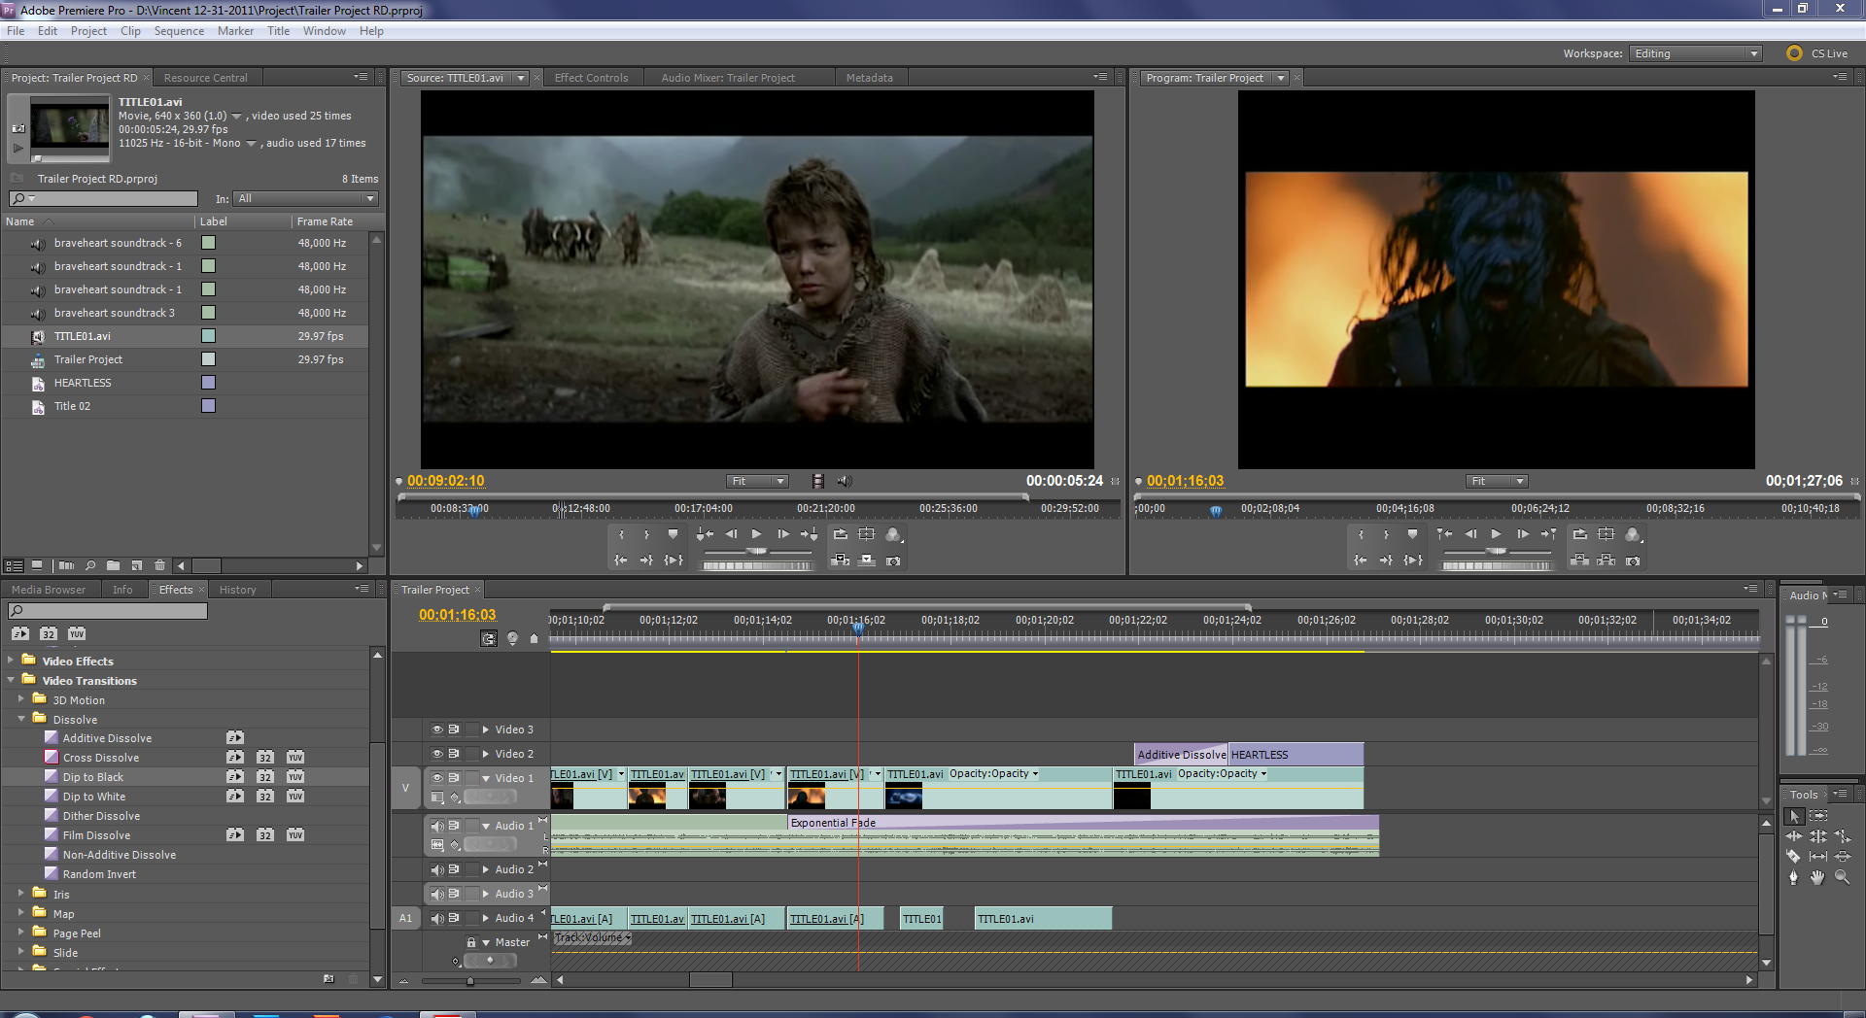
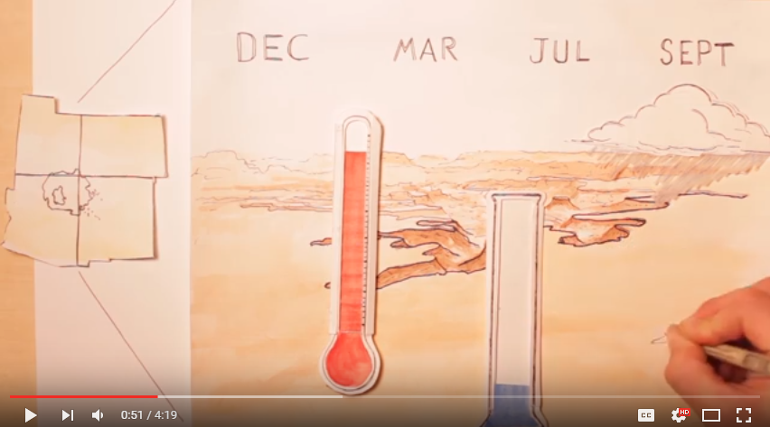
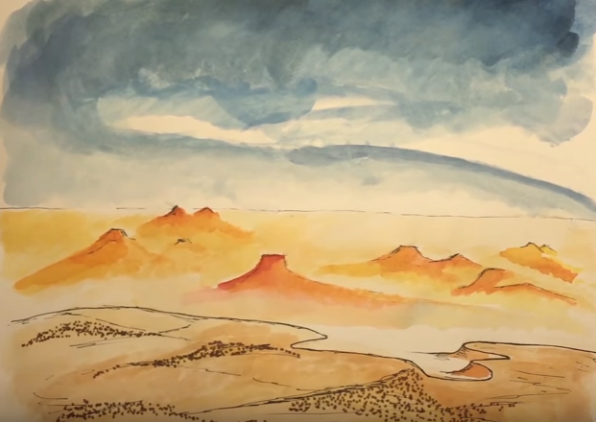
What is the purpose of a Project Summary?
Ensures project goals are understood
Impact Tracking
Start thinking about the VPS
Abstract Rough Draft
Notes:
So, why do we need a project summary? Well, not only will it help you start figuring out your project’s goals, but is also a first look to see if your projects are on the right track.
The Project Summary is also what NPO uses for impact tracking and analysis.
This deliverable is due first to get the ball rolling on ideas, concepts, and best practices for all future deliverables.
Make sure that you follow the instructions with word counts and creating a quality abstract.

Slide 3
Abstract Tips
Easy for reader to answer the question “So What?”
Uses 1 or more unified, coherent, concise, paragraphs that can stand alone
Uses an intro-body-conclusion structure:
1) Purpose 2) Findings 3) Analysis 4) Conclusions
Provides logical connections between material included
Adds no new information, but simply summarizes the report
Is intelligible to a wide audience
Write out all acronyms
Note: This will be the only time NPO will edit your abstract until the Project Summary Final Draft
Notes:
The Abstract is often the only thing people read and allows readers to decide whether they want to continue to read the full report. Therefore your mission, if you choose to accept it, is to produce the best abstract possible for your project so that people will want to read all of the hard work and amazing science that you have accomplished in less than 10 weeks!
As you probably already know, you want to make it clear for the reader why your research is important. They should be able to answer the “so what?” question. You’ll want to end with a paragraph or two that can stand alone with the intro-body-conclusion structure. It should provide a logical connection to the actual report, not adding any new information, but rather highlighting the essential points and is understandable to the average reader.
Other qualities that we look for in an abstract will be writing out all acronyms. Right now you will not have fully developed your methodology and probably aren’t nearly as close to your final results yet. This is alright. Your final abstract will probably look much different than this first draft, so for now focus on the structure of the abstract and maybe ask yourself: Will my mom or dad be able to understand the main points behind my research?
If you take anything away from this slide, please note that if you include your abstract in any other deliverable rough drafts, such as the Tech Paper next week, NPO will not be providing any further review or edits of your abstract until the final draft of the Project Summary.

Slide 4
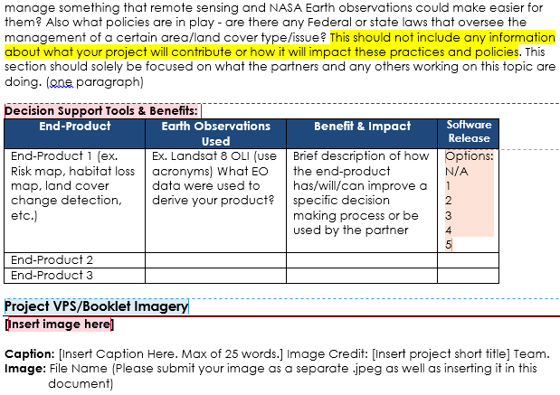
Software Release
NASA Export Control: Categories 3 & 4
Description of categories on DEVELOPedia’s Software Release page
Teams fill out:
Category for each end-product
If you need Export Control
DON’T PANIC
Notes:
One item on the project summary that you may not have seen before is software release, which classifies end-products by their use of codes and/or scripts. Due to NASA security restrictions, any computer code, script, etc. that is sent to a person or organization outside of NASA must first undergo Export Control. This can take about six weeks, and since you don’t want your partners to wait that long to receive your end-products, DEVELOP likes to begin the export control process around week 3 or 4, so it’s finished by the end of the term. We determine which end-products need export control using Software Release categories, which are on a scale of 1 to 5. Categories 3 and 4 need export control.
Software release categories are given for each end-product in a table at the bottom of the project summary. If you don’t know which category your end-product falls under, there is a Software Release page on DEVELOPedia with a chart describing the different categories. You can navigate to this page from the deliverables menu [which is on the right of the slide].
If you have a Category 3 or 4 project, and need to undergo export control, IT’S OKAY!

Slide 5
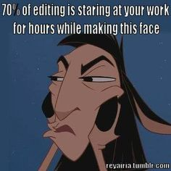
What to submit to NPO
Consider this as a final draft of the rough draft
Comments and edits removed
Best version
Consistency
Email the project coordination team if you need to submit a deliverable late.
Notes:
Once you’ve finished your project summary, there are some things to note before you send that e-mail to NPO:
First, delete all comment bubbles and all tracked changes from the summary. NPO needs a clean and professional version
You want to give us the best rough draft you can, so make sure that there is more than one person who reviews the final RD as things can be easily missed by the person who wrote it.
Also, try not to leave any blank sections. If you don’t have anything concrete at this point, give us an outline of where you are heading so we have something to comment on and possibly brainstorm with you.
If you can’t make the deadline, that’s alright (try not to make a habit of it). Just be sure to email the Project coordination team with an estimate of when your deliverable will be submitted.

Slide 6
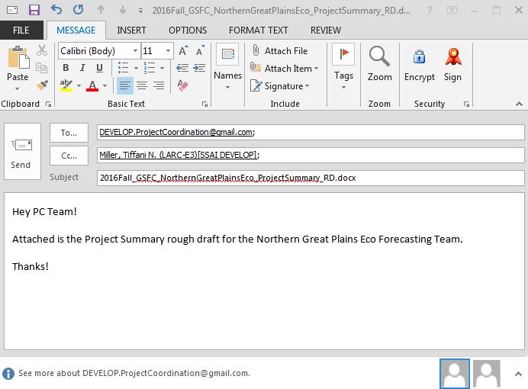
How to submit to NPO
E-mail to Tiffani AND DEVELOP PC:
Tiffani.N.Miller@nasa.gov
DEVELOP.ProjectCoordination@gmail.com
E-mail Subject:
Node, Project, Deliverable
Proper file name:
2016Fall_NODE_ShortTitle_ProjectSummary_RD
DEVELOPedia templates:
Deliverables home page ->
Project Summary page
Notes:
All deliverables are emailed to PC Senior Fellow Tiffani Miller AND the Project Coordination gmail account, whose email is on the slide in green. Refer to this example when you write any e-mail to NPO. Make sure you include who you are, the team and node, and follow this subject line example.
Step by step instructions for submitting a deliverable may be found on DEVELOPedia’s deliverables homepage.

Slide 7
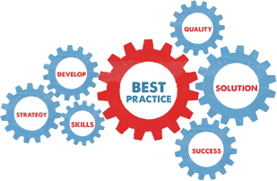
Common Errors
Check the Deliverables Checklist for a complete list
Plural vs. Singular (i.e. National Applications Addressed: Climate)
Google Docs
EOS vs. EOs
in situ NOT in-situ
Nomenclature
Passive voice
Too many “voices” (styles of writing)
For example:
The watershed was contaminated by the agricultural runoff (passive).
Agricultural runoff contaminated the watershed (active).
Notes:
As you have probably already taken a look at the template, some of you will only have one partner organization or one advisor/mentor or perhaps only one national application area addressed. In this case you will need to edit the heading from a plural to singular.
Google Docs: A reminder, although google docs is great when collaborating on a shared document, before you submit your paper to NPO be sure to download it and check through each section for text size and style as it often changes.
NASA’s Earth Observing System vs. NASA Earth observations (o is lowercase)
Nomenclature: please check out the correct nomenclature before delivering anything to NPO. If you do not see your software, partner, etc. listed, please e-mail the PC team so we can update it for you.
Stay consistent
Verb tense (present or past)
“We”, “the project”, “the team”
Things To Watch Out For:
Where you place the subject (actor) if the sentence describes an action. Is he/she/it at the front or at the end (or missing entirely)?
For example:
The watershed was contaminated by the agricultural runoff (passive).
Agricultural runoff contaminated the watershed (active).
Too many voices: When you have 2 or more people contributing to the writing of any paper, you may begin to hear two very different voices or styles of writing, which can be distracting for the reader. Make sure that before submitting, one person is chosen to re-read the paper and mold it into one that flows well with one voice.

Slide 8
Common Errors Continued
Subtitles
Include “utilizing (or other active verb) NASA Earth observations to…”
Not just research oriented, but also application oriented
Try to include/answer:
What impact is this research going to make?
What will the results be used for?
How will it affect a policy or decision?
Not just “studying drought”, but rather how studying drought will help your partner make an informed decision
Notes:
When using subtitles, it should include something like, “utilizing NASA Earth observations to…”
Not just research oriented, but making sure that you bring back the application area.
Remember to include or focus on what the research is going to be used for, what impacts this research is going to make, and how it is going to affect a policy or decision?
So we are not just studying drought, but how studying drought will help their partner make a better decision

Slide 9
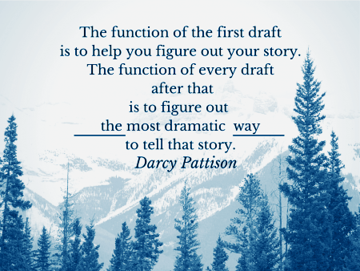
Questions?
Notes:
Remember, this is not a creative writing class. Since this is scientific writing, we want to encourage you to be creative, but these deliverables should written in a more scientific manner, that is not necessarily dramatic, but still interesting.

