Slide 1
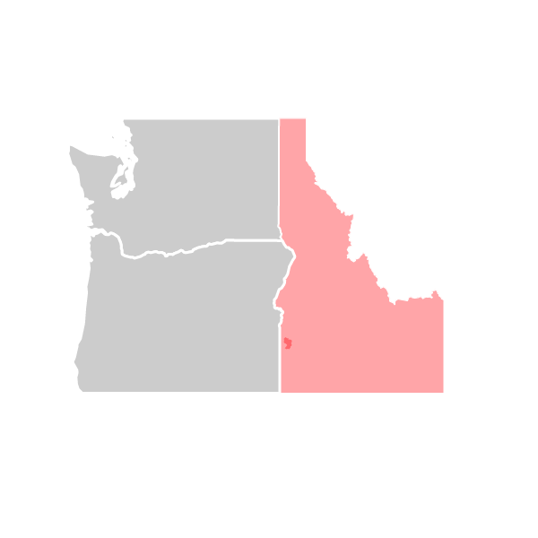
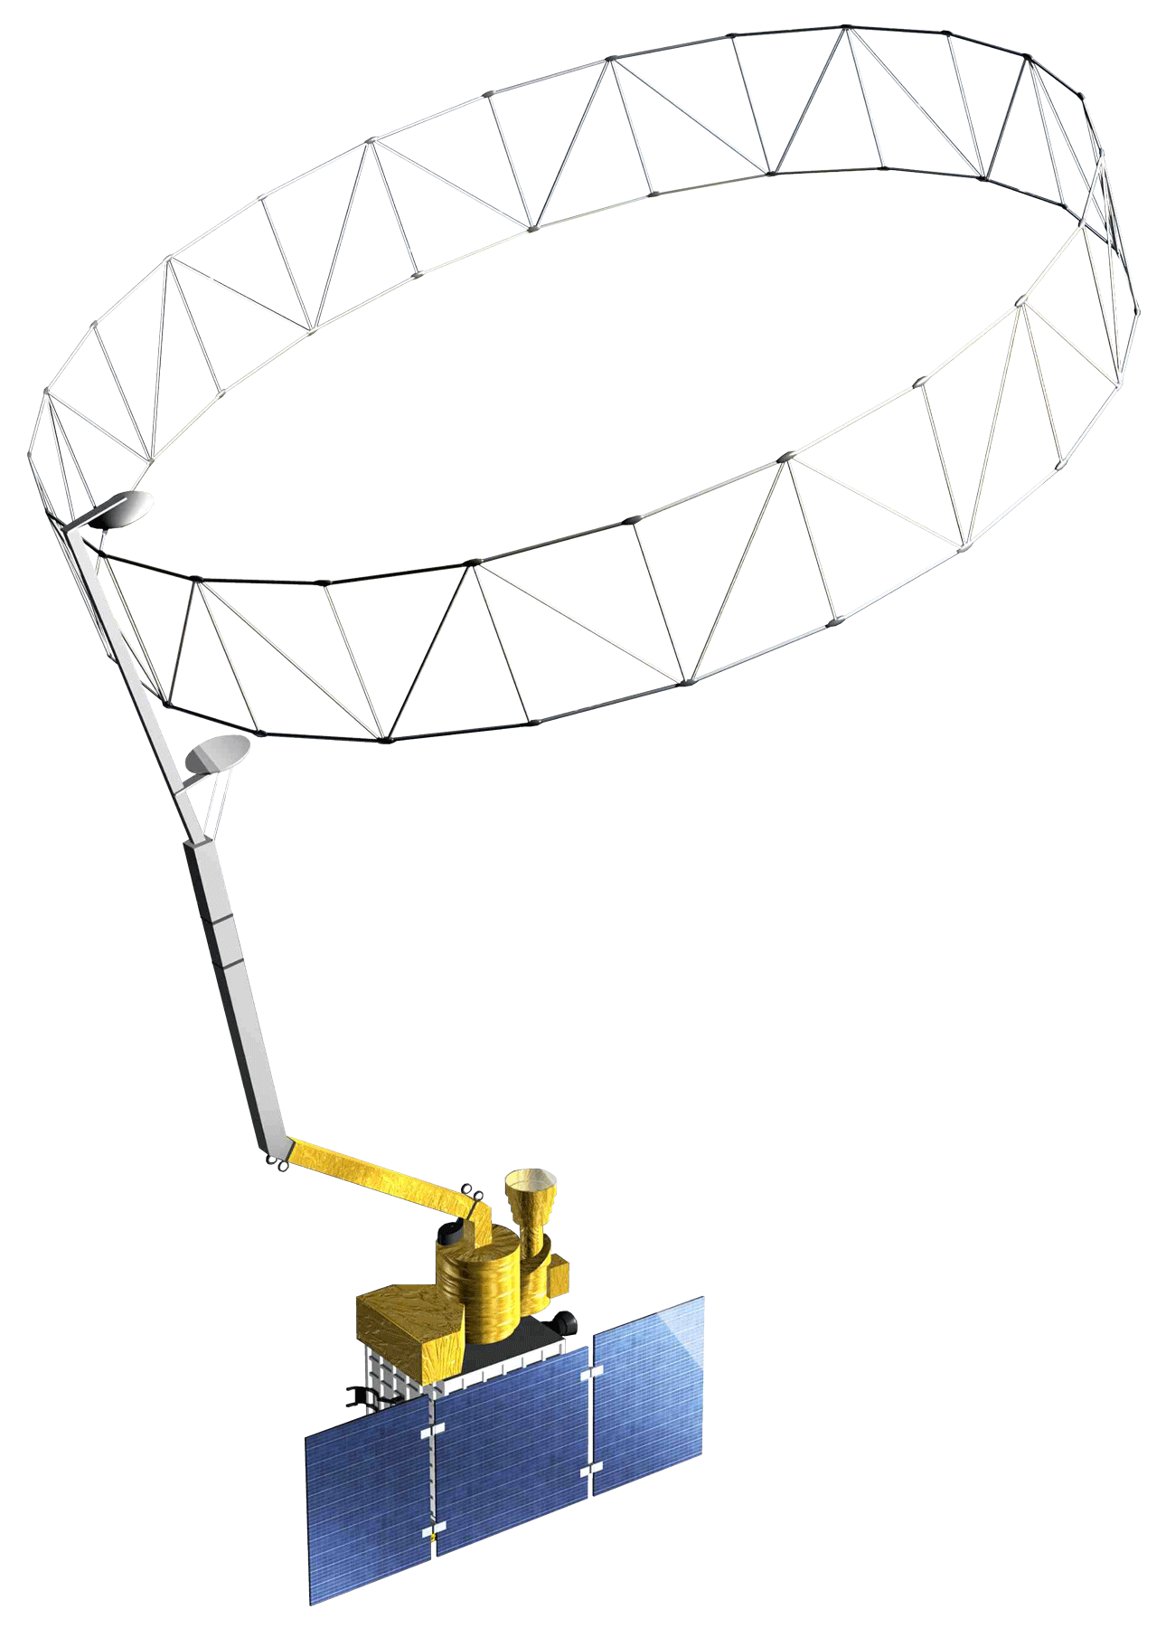
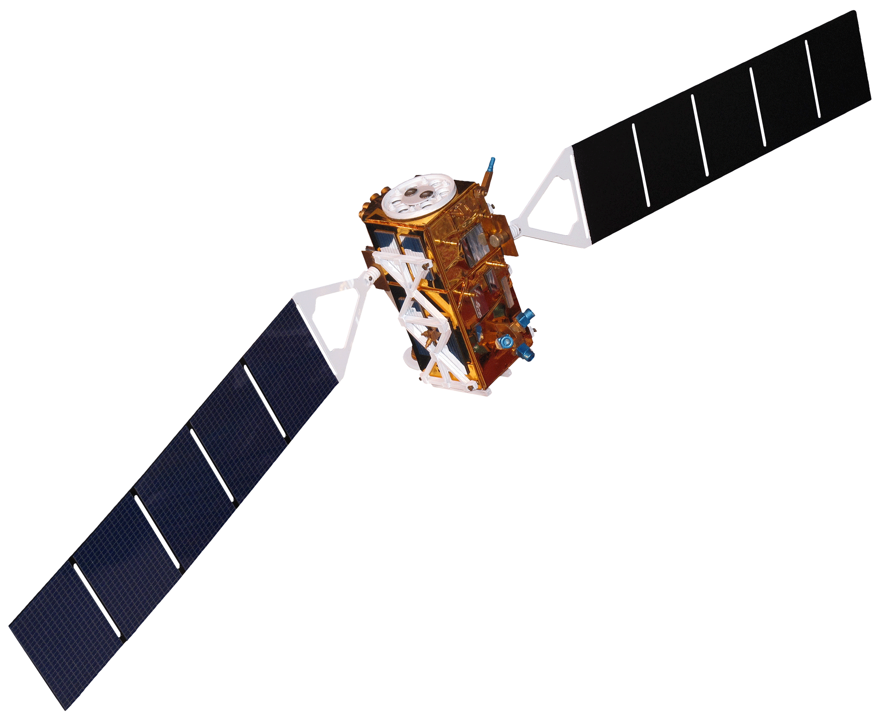
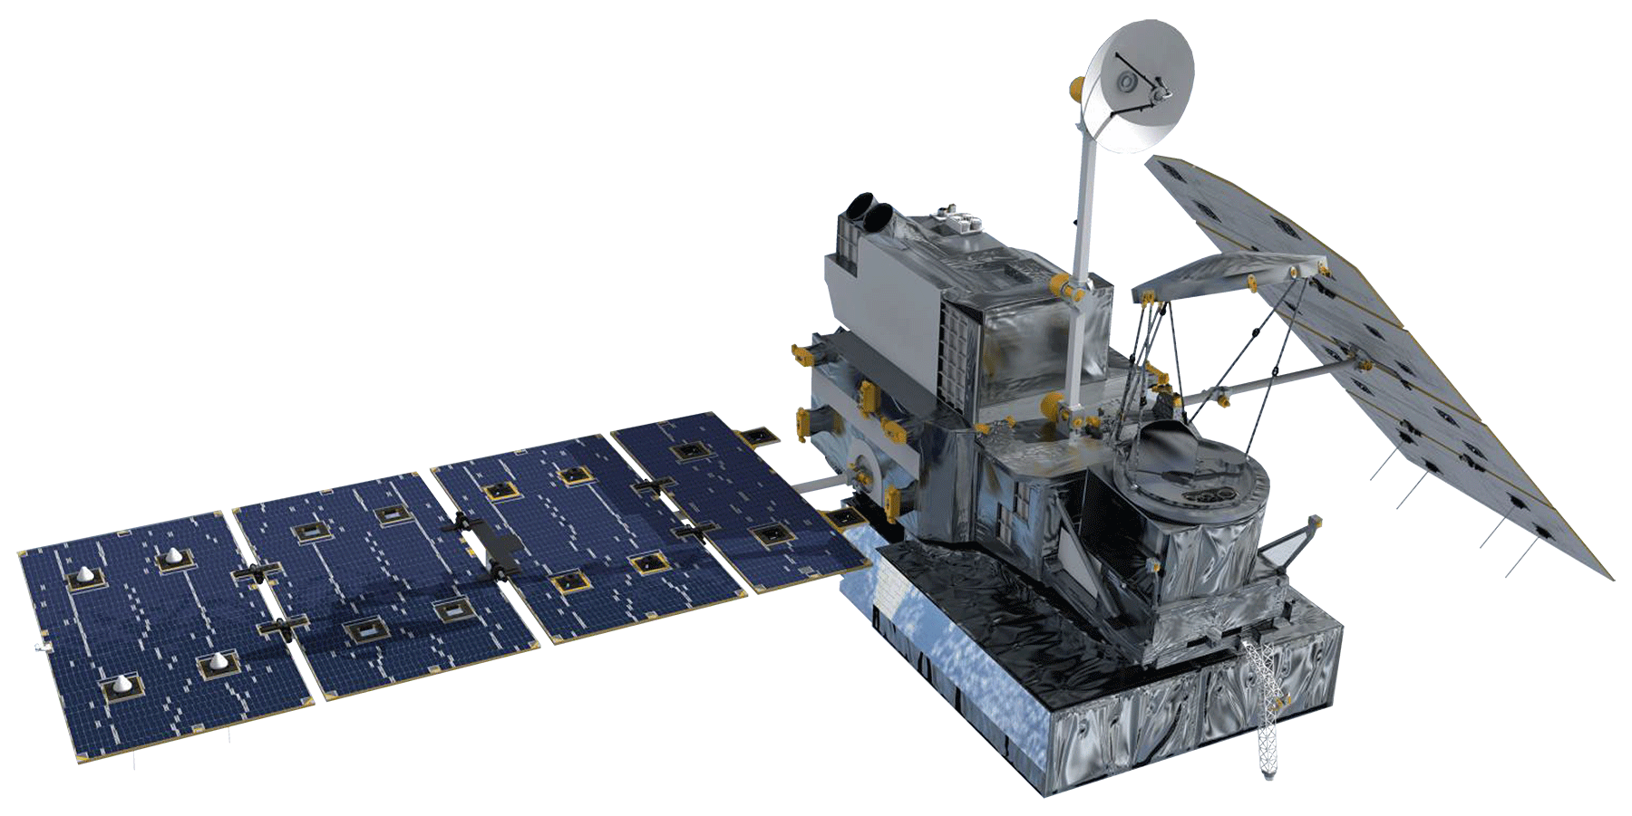
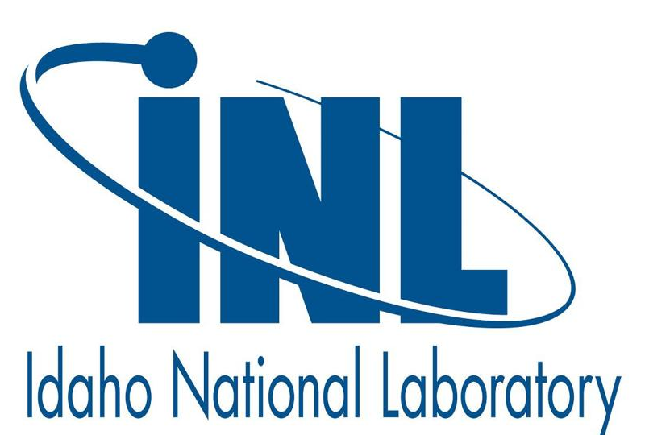
Estimating Soil Moisture in Semiarid Sagebrush Steppe Utilizing NASA Earth Observations
Abstract
Study Area
Soil moisture is a critical component of ecosystem health, particularly in semi-arid landscapes where seasonal and infrequent precipitation is one of the primary controls on vegetative health. Current land management practices of soil moisture data collection rely on costly and time-consuming field sampling or on extensive modeling. The introduction of remotely sensed soil moisture measurements from NASA Earth observations (EO) will provide low-effort, high spatio-temporal coverage datasets for management agencies such as our primary partners at the US Fish and Wildlife Service (USFWS). Validating remotely-sensed data with field observations from Reynolds Critical Experimental Watershed (RCEW) in Idaho will increase the confidence in remotely sensed soil moisture data. This project evaluated methods for monitoring soil moisture in semi-arid ecosystems using data from NASA Soil Moisture Active Passive (SMAP) sharpened with European Space Agency (ESA) Sentinel-1 C-Band Synthetic Aperture Radar (C-SAR) backscatter, Global Precipitation Measurement (GPM), Terra Moderate Resolution Imaging Spectroradiometer (MODIS) derived Normalized Difference Vegetation Index (NDVI), and modeled soil moisture from TopoFire for the period between December 2016 to July 2018. The Idaho NASA DEVELOP team created useful maps and established a workflow to allow land managers to easily access and visualize soil moisture in their area of interest. Linear regression analysis was used to quantify correlations between soil moisture, precipitation, and vegetation health. Preliminary correlation between SMAP and in situ soil moisture were positive at all sites, but results fell into three categories: 60% had a moderate correlation at good confidence, 25% had a high correlation at high confidence, and 15% had a low correlation at low confidence.
Objectives
Earth Observations
Evaluate the application of enhanced SMAP soil moisture estimates for semi-arid sagebrush steppe in the Intermountain West
Validate Sentinel-1 enhanced SMAP maps against in situ soil moisture measurements, precipitation maps, and vegetation indices
Develop a replicable workflow/methodology to access SMAP measurements, perform comparisons to other indices, and output useful maps and statistics
SMAP
Terra MODIS
GPM
0
5
10
15
20
Kilometers
Sentinel-1
Soil Moisture Validation Sites
Stream Network
Reynolds Creek Experimental Watershed
Methodology
In situ soil moisture,
GPM, NDVI
Google Earth Engine:
Combine GEE and in situ data; extract values at RCEW sites
Compare in situ soil moisture and precipitation, NDVI, and GPM precipitation to SMAP soil moisture estimates
Produce soil moisture maps
and correlation plots
SMAP/Sentinel-1
Soil Moisture
ArcPro:
Clip to study area, extract point data for RCEW sites
Results
Flats Weir (Site 057) 2017-2018
PRECIPITATION INTENSITY
Very Light
Light
Moderate
Heavy
Very Heavy
km
Soil Moisture Probe
2
5
SOIL MOISTURE
(cm³ / cm³ )
0.6
NDVI
R²
P-value
0
-1
Soil Moisture Probe
km
1
2
5
Soil Moisture Probe
km
Conclusions
2
5
Team Members
Overall, the combined SMAP and Sentinel-1 1km soil moisture data products correlate well with in situ soil moisture measurements at high confidence levels.
The sample sites with high uncertainty (P-values above 0.05; representing 15% of all observations) may be due to intrapixel variability, slope and elevational differences, or other regional variations.
Future studies can use these methods and incorporate evapotranspiration estimates for improved hydrologic modelling.
Partners & Acknowledgements
Ian Lauer
Project Lead
Dane Coats
Leah Kucera
Zach Sforzo
Madison Broddle
The Idaho Water Resources team would like to thank our partners, advisors, collaborators, and contributors for their help: Keith Weber (GIS Training and Research Center at ISU); Evan Ohr, Lisa Dlugolecki, and Matt Bringhurst (US Fish and Wildlife Service); Dr. Scott Bergen (Idaho Department of Fish and Game); Nate Matlack and Trudy Pink (USDA Natural Resource Conservation Service); Dr. Patrick Clark and Mark Seyfried (USDA Agricultural Research Service); Tammie Borders and Trent Armstrong (Idaho National Laboratory); and former Center Lead Brandon Crawford (Los Alamos National Laboratory)
Idaho Water Resources
Idaho – Pocatello | 2018

