Slide 1
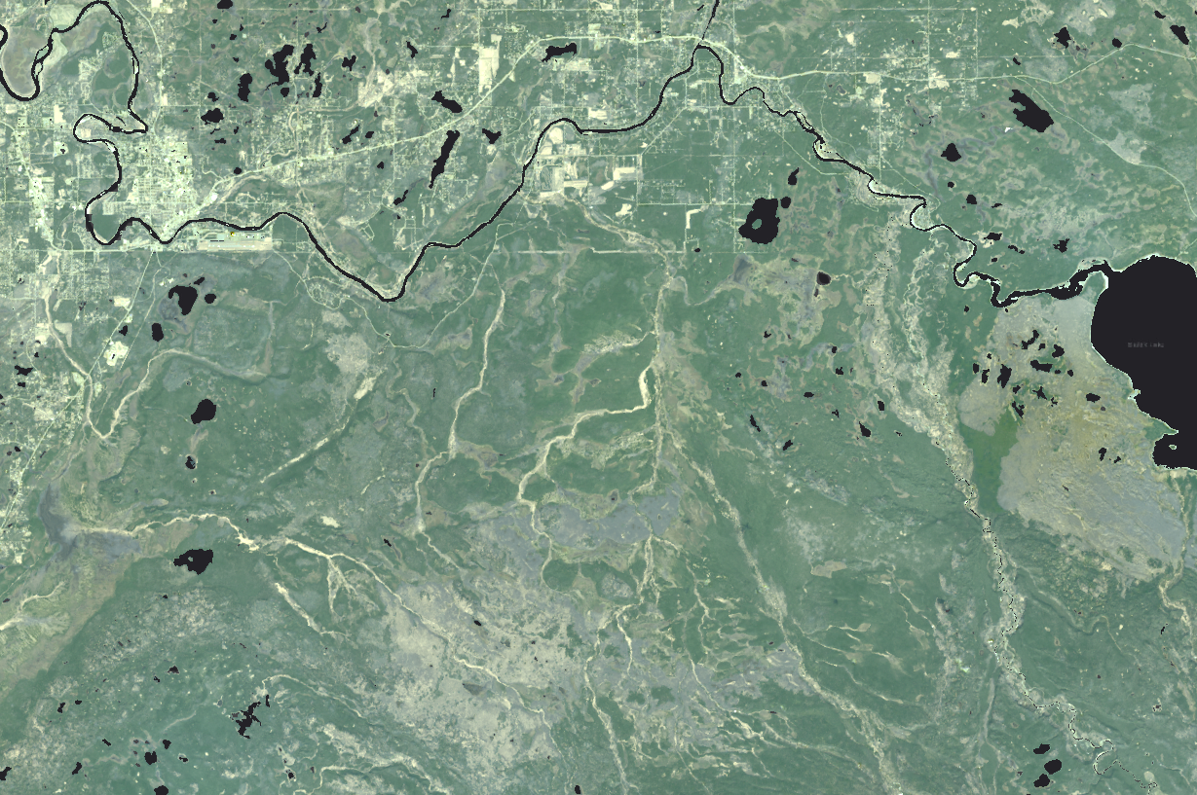
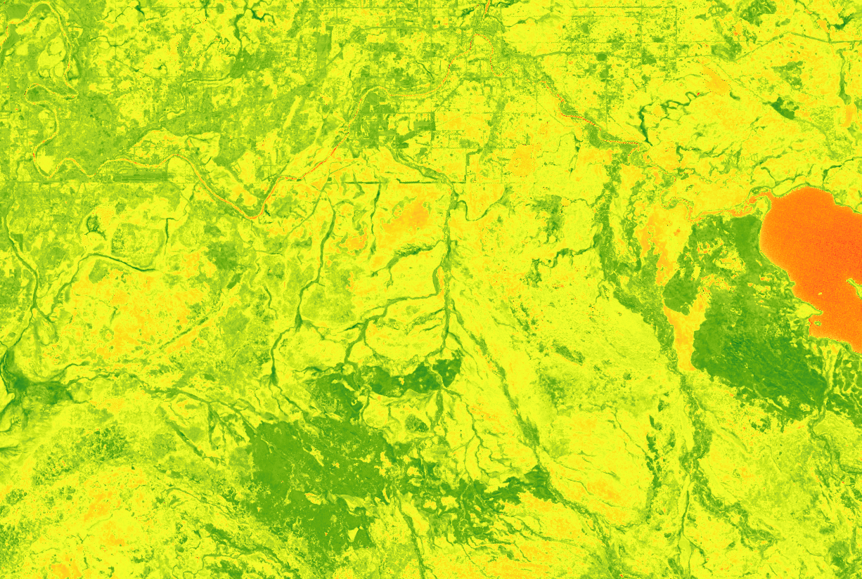
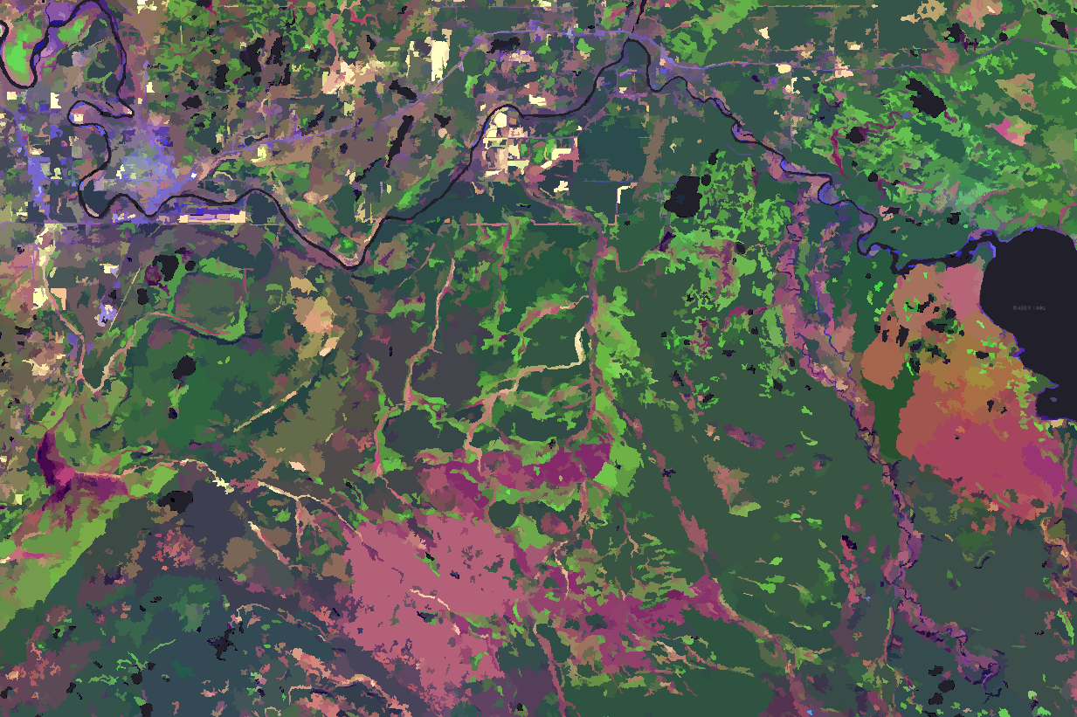
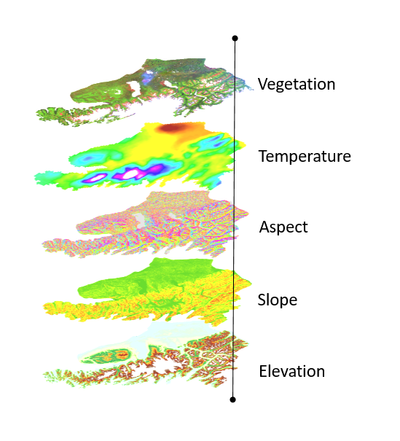
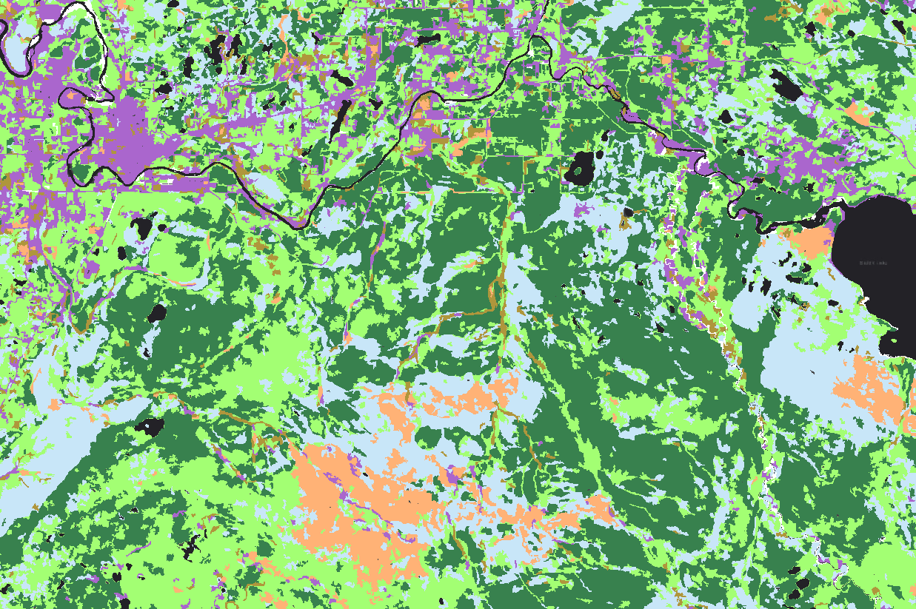
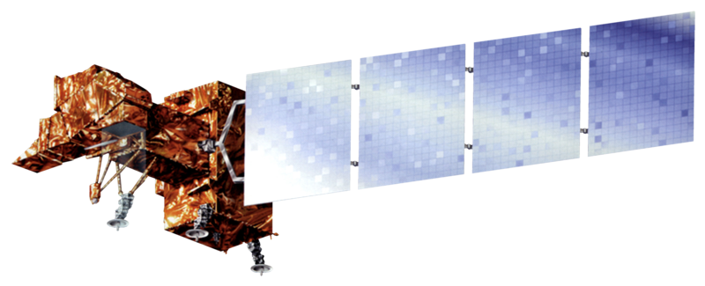
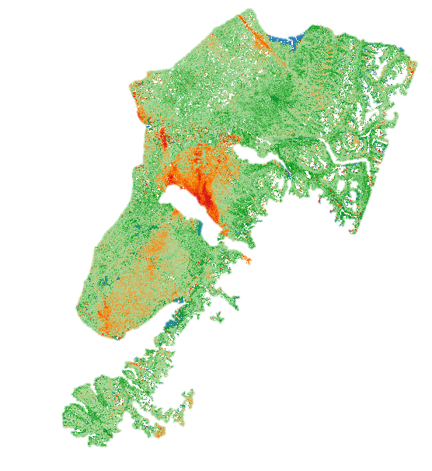
Evaluating Grassland Conversion and the Related Likelihood of Fire Disturbance to Enhance Fire Monitoring and Management in the Kenai Peninsula, Alaska
Abstract
Project Partner
Spruce beetle-induced (Dendroctonus rufipennis (Kirby)) mortality on the Kenai Peninsula has heightened local wildfire risk as canopy loss facilitates the conversion from forest to fire-prone grassland. We collected images from NASA Earth observations to visualize land cover succession at roughly five-year intervals following a severe, mid-1990’s beetle infestation to the present. Using ArcGIS Pro, we classified these data by vegetation cover type to quantify grassland encroachment patterns over time. We used the raster calculator in ArcGIS Pro to conduct a change detection analysis on the land cover classifications. The resulting change image will give the Kenai National Wildlife Refuge (KENWR) ecologists a better understanding of where forests have converted to grassland since the 1990s. These classifications provided a foundation for us to integrate digital elevation models (DEMs) and geospatial temperature and precipitation data into a model using R for assessing and mapping changes in wildfire risk. Spatial representations of this risk will contribute to a better understanding of ecological trajectories of beetle-affected landscapes, thereby informing management decisions at KENWR.
US Fish & Wildlife Service, Kenai National Wildlife Refuge
Methodology
Landsat Reflectance Bands
Model Training:
NDVI
Historic Fire Pixels
(MODIS)
Segmented Image
+
Objectives
Vegetation
Classification
Vegetation
Develop a land cover classification system for locating areas of grassland conversion
Detect and quantify land cover change stemming from fire and beetle disturbances from 1989 to the present
Map and assess emergent wildfire risk due to this conversion across the peninsula
Temperature
Aspect
Study Area
Slope
FP(Fire Probability)
Algorithm:
Elevation
Anchorage
Results
Alaska
Kenai Peninsula
40
80 Miles
Kenai National Wildlife Refuge
Earth Observations
Fire Risk Probability
0 < 20%
20 - 40%
40 - 60%
Landsat 4/5 TM
Landsat 7 ETM+
Landsat 8 OLI
60 - 80%
80 - 100%
Aqua MODIS
Terra MODIS
Team Members
Land Cover Type
Shrubland
% Change in NDVI,
1985-2016
Black Spruce Forest
Mixed Forest
-50
Kate Hess
Project Lead
Jeanette Cobian
Jake Ramthun
Developed
-20
Herbaceous
0
Wetlands
20
Cheila Avalon Cullen, PhD
Victor Lenske
Barren
50
Acknowledgements
Conclusions
Dr. Dawn Magness, U.S. Fish and Wildlife Service, Kenai National Wildlife Refuge
Dr. John D. Bolten, NASA Goddard Space Flight Center Dr. Adrianna Foster, Universities Space Research Association, NASA Goddard Space Flight Center Dr. Joseph Spruce, Science Systems and Applications, Inc., NASA Stennis Space Center
Conversion of spruce forest to grassland increases the prevalence of changing fire regimes in the KENWR
Spruce forests in the Caribou Hills that were severely damaged by spruce beetles exhibit significantly higher fire risks in our model, therefore we predict similar outcomes across comparable landscapes.
Kenai Disasters
Maryland – Goddard | Summer 2018

