Slide 1
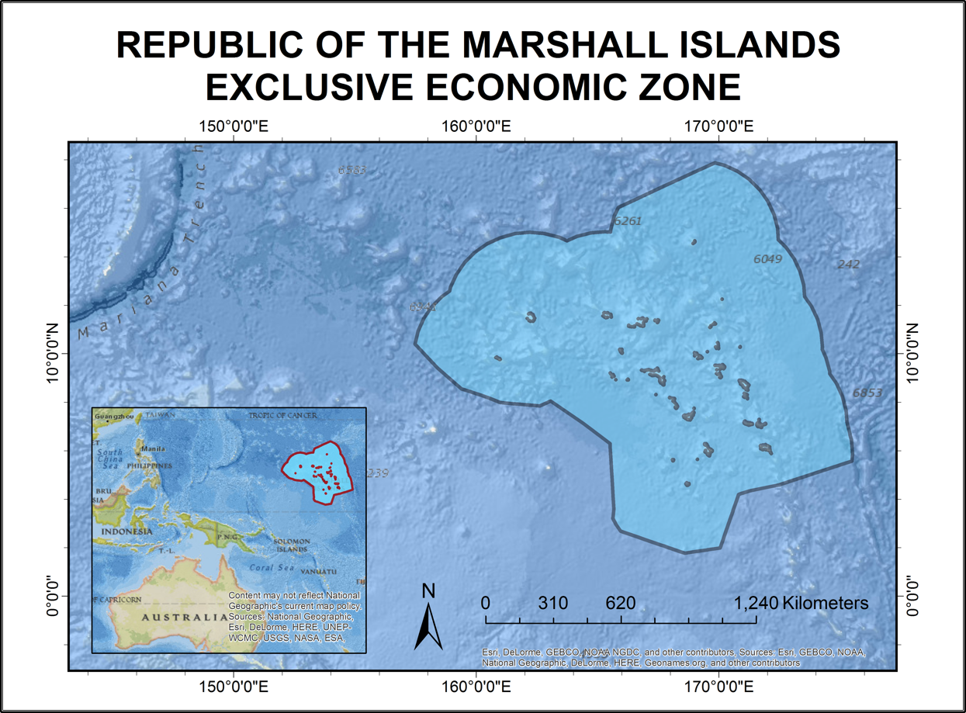
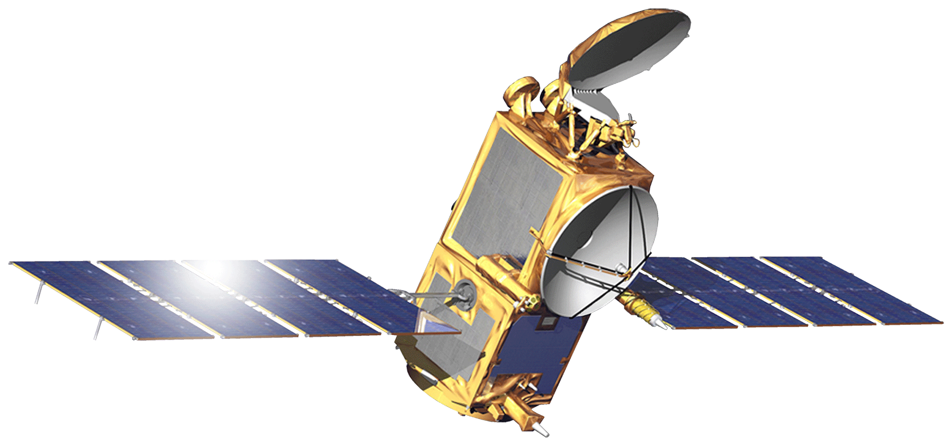
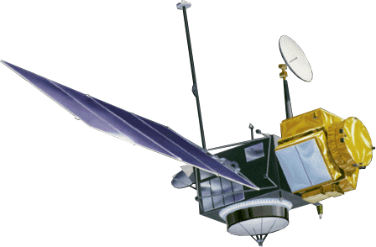
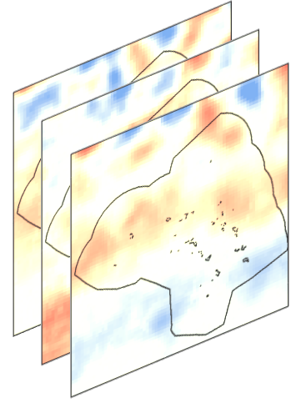
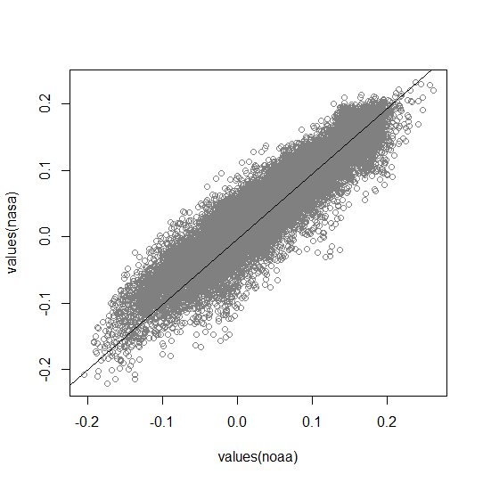
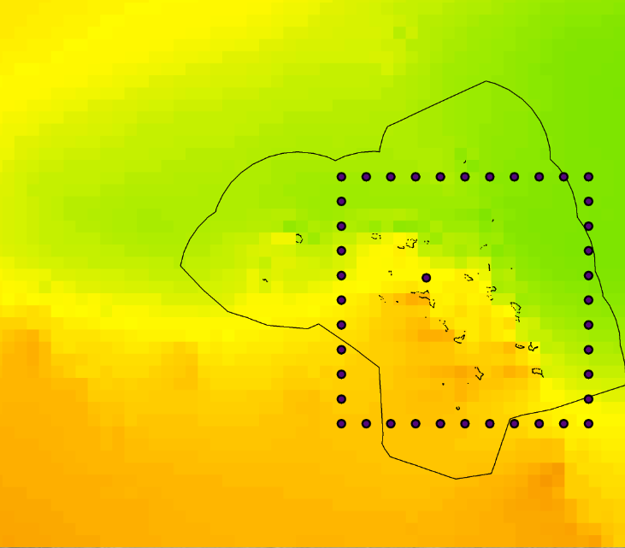

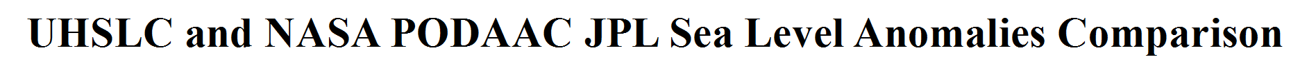
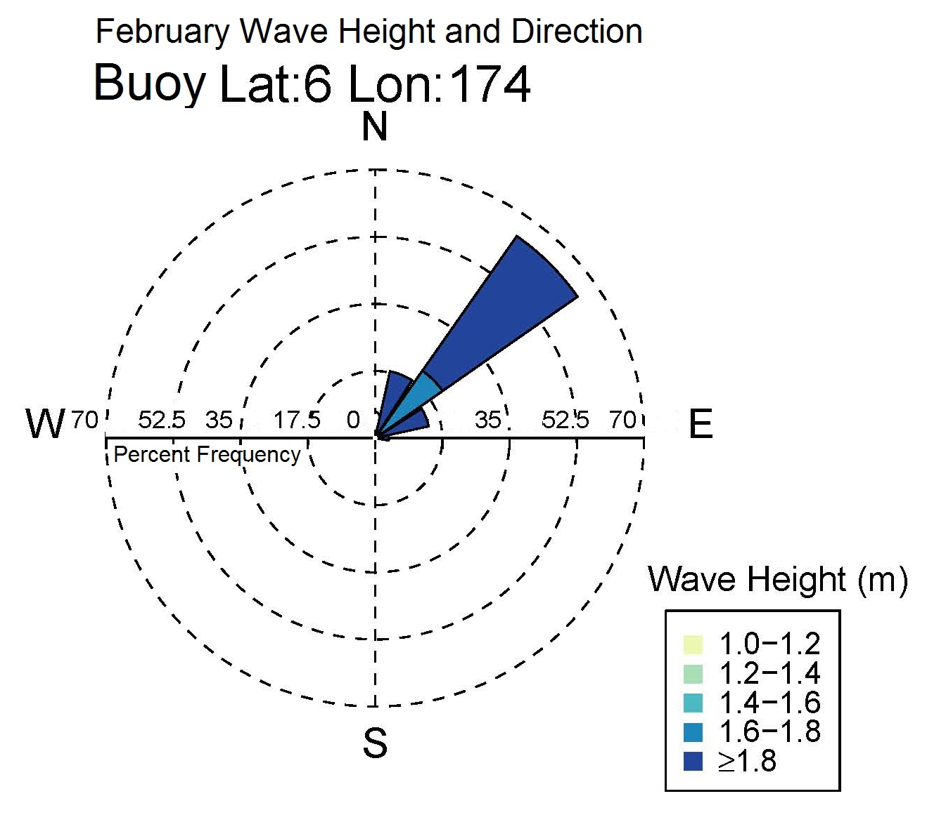
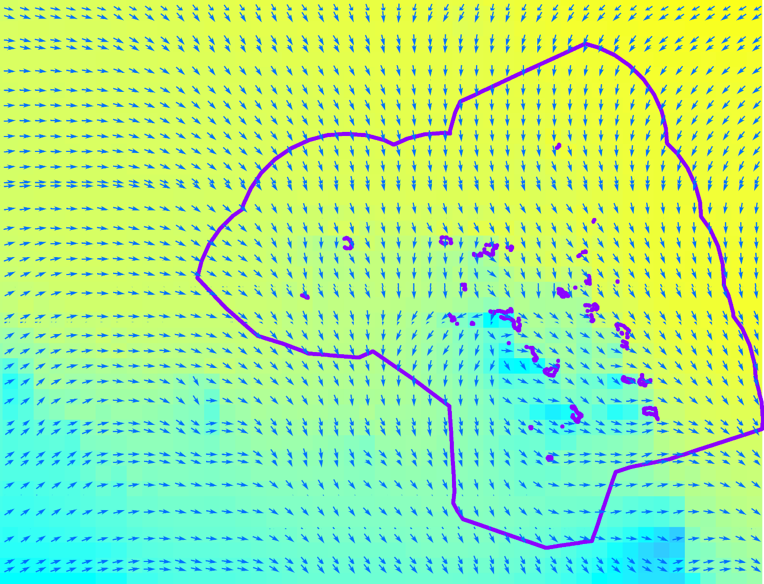
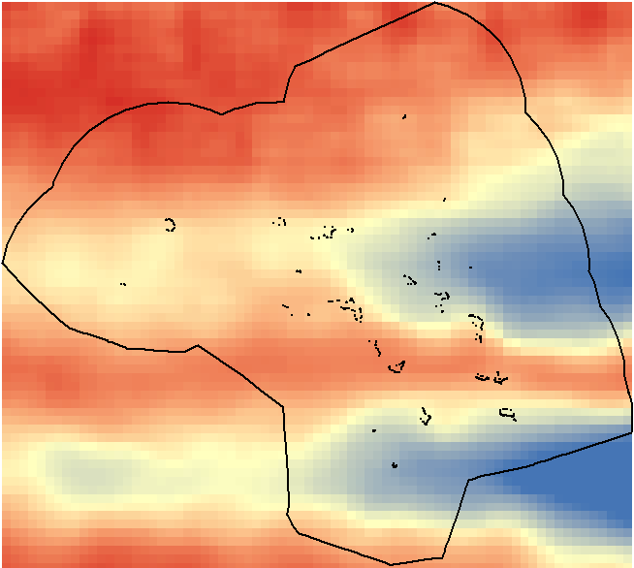

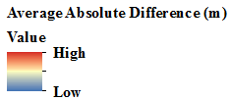
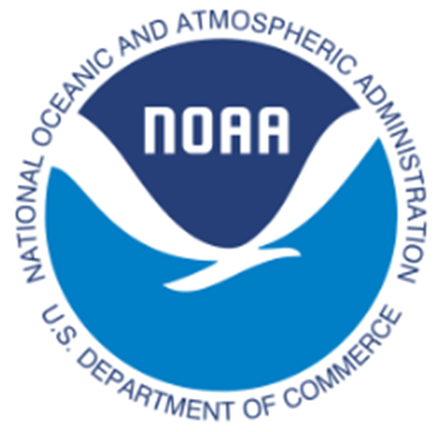





Utilizing the NASA and NOAA Joint Ocean Surface Topography Mission and Modeled Wave Data to Assess Patterns and Trends in Sea-surface Height in the U.S. Affiliated Pacific Islands
Abstract
Objectives
Within the NOAA National Centers for Environmental Information (NCEI), near-real time spatial and temporal patterns and trends in sea-surface height (SSH) were analyzed around the U.S. Affiliated Pacific Islands (USAPI). Ocean Surface Topography Mission data and current tidal data from in-situ measurements were used in conjunction with in situ and satellite data from buoys, tide gauges, NASA’s Sea Surface Height TOPEX/Poseidon mission and Ocean Surface Topography Mission data from Jason-2 and Jason-3 satellites, and a blend of satellites for NOAA’s CoastWatch and OceanWatch. The team produced a significant wave height climatology, wave direction climatology, a 1 week to 3 week outlook, and a categorical risk metric to assess potential island inundation. End users will apply the risk metric tool set climatologies and distribute this information to coastal hazard and climate adaptation decision-makers in the USAPI.
Create climatologies for significant wave height (SWH) and wave direction in the Republic of the Marshall Islands
Calculate frequency distribution of wave heights for each month
Integrate SWH and wave direction with sea level anomalies (SLA) and tides to create an optimized coastal-inundation risk metric
Study Area
Earth Observations
JASON
Radar altimeter
Spatial Resolution: ¼ degree
Temporal Resolution: 10 days
Include a map that has easily readable text and a legend. Including the study period is optional.
For ALL images – make sure all text is legible and add legends separately (so they can be moved or resized). If text is not editable, a team member must be available to make changes with a very short turn-around time (hours, not days) after submission.
TOPEX/POSEIDON
Radar altimeter
Spatial resolution: 1 degree
Temporal resolution 10 days
Methodology
Data Collection
Processing
Analysis & Validation
End Products
WaveWatch III Hindcast
NOAA OceanWatch
NASA PODAAC
NOAA NDBC
UHSLC tide data
Resample
Aggregate
Clip
Compile into time series
Climatology
Mean average difference (MAD) and correlation
Distribution frequency
Wave climatology atlas at 41 virtual buoy stations for every 1º around RMI
Risk protocol
Imagery Comparison
US Pacific Islands Oceans
Results
Imagery Comparison
Wave Rose
Inundation Risk Protocol
Project Partners
Conclusions
NOAA, Regional Climate Services, Pacific Region
University of Hawaii Sea Level Center
NOAA, Center for Satellite Applications and Research, Satellite Oceanography & Climatology Division
NOAA OceanWatch/CoastWAtch SLA improves current regional outlooks and warnings
Wave atlas informs RMI decision makers in planning and mitigation efforts
Risk Assessment Protocol helps create more robust inundation outlooks and warnings in the region
Team Members
Acknowledgements
We would like to thank our science advisor Michael Kruk, as well as our project partners: John Marra, Matthew Widlansky, Philip Thompson, and Eric Leuliette for their expert guidance and commitment to our project. We would also like to acknowledge: Jonathan Brannock, Kate Johnston, Eric Freeman, Ryan Smith, Jake Crouch, and Warren Scott.
India Young
Team Lead
Alec Courtright
Kaitlin Walker
Saraneh Fitzgerald
NOAA National Centers for Environmental Information – 2017 Summer

