Slide 1
Wise County Disasters
Using NASA Earth Observations to Identify the Historic and Future Extent of Flooding Throughout Wise County, Virginia.
Kimberly Berry (Project Lead)
Zachary Tate
Abhijeet Singh Baghel
Grant Bloomer

Slide 2
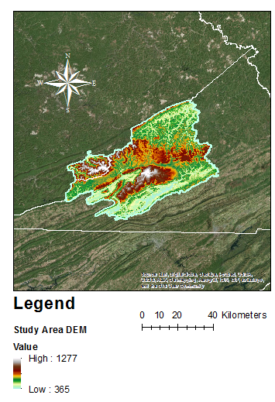
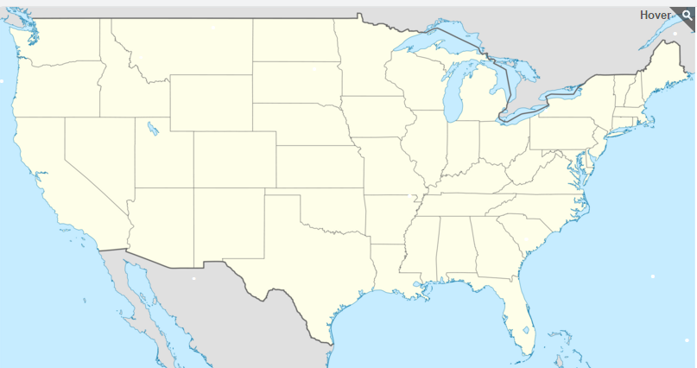
Study Area
West Virginia
Mountainous Terrain
Micro Climate
Stormy Summers and Snowy Winters
Kentucky
Virginia
Tennessee
Notes:
Storms in Wise County have contributed to millions of dollars in damages . Some of the factors that potentially contribute to high flooding in this area include low capacity thresholds of the many stream networks, and the intensity of rainfall with powerful storms that drop a large quantity of water within a relatively short period of time. This project determined areas that are more susceptible to flooding using ArcGIS and CREST model.

Slide 3
Current Management & Policies
Current Flash flood warnings come from the National Weather Service to the Wise County Emergency Management Office
Notes:
Wise county currently used the National Weather Service because that is the only service they have.

Slide 4
CREST Model
Temporal and Spatial variation of land surface
Coupling between the runoff generation and routing mechanisms
Cell to cell routing scheme
F
A
F
A
A
B
A
A
B
B
Ponding and Flow Analysis
Digital Elevation Model
Soil Data
Precipitation Data
Notes:
The CREST stands for Coupled Routing and Excess Storage Distributed Hydrologic Model. Routing refers to the Surface and Sub surface runoff modelling. Excess Storage refers to surface water storage and underground water storage after the routing phase. CREST uses a Variable Infiltration Curve, denoted using R which determines where water goes next. The water can be infiltrated to the next soil layers or routed to the overland reservoir.

Slide 5
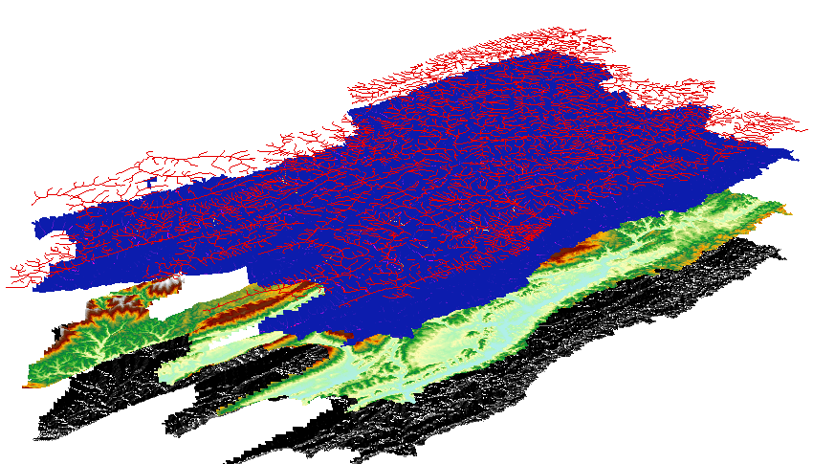
Data Inputs
Precipitation: TRMM and GPM
Elevation: STRM
Soil: gSSURGO soil dataset
Stream:
Flow: USGS

Slide 6
Examples of Model Running
WIP

Slide 7
Sample outputs
WIP

Slide 8
Analysis
WIP

Slide 9
Impacts
WIP

Slide 10
SURELY THERE IS MORE?
RIGHT? WIP?

Slide 11
Advisors
Dr. Kenton Ross (NASA DEVELOP National Program)
Dr. DeWayne Cecil (Global Science & Technology [GST] National Centers for Environmental Information [NCEI])
Bob VanGundy (University of Virginia’s College at Wise)
Partners
Wise County Board of Supervisors (End-user),
Boundary Organization, POC: Bob Adkins ;
Boundary Organization (Director of Emergency Management)
Others

