Slide 1
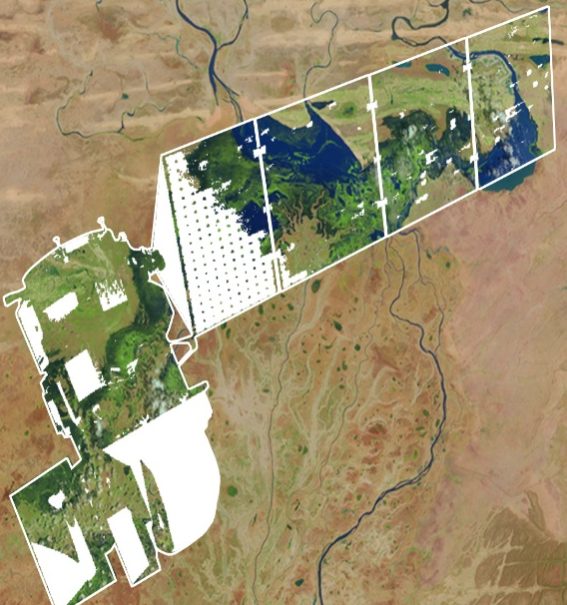
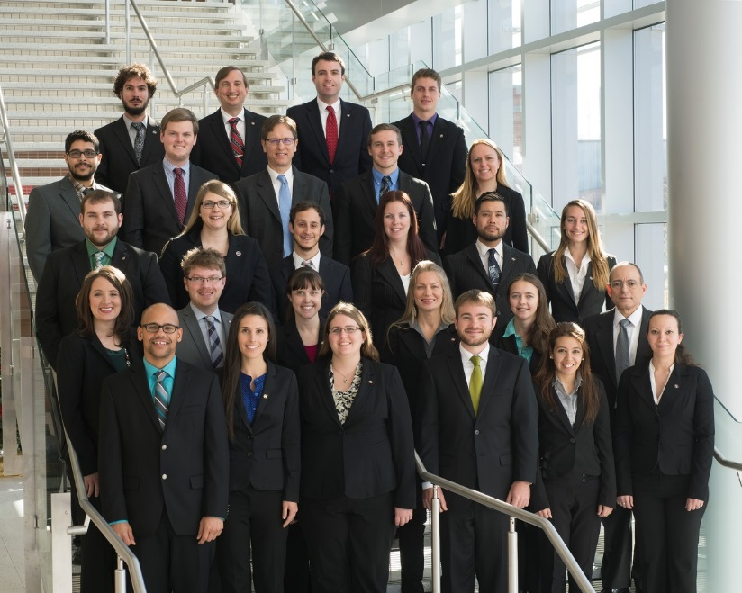
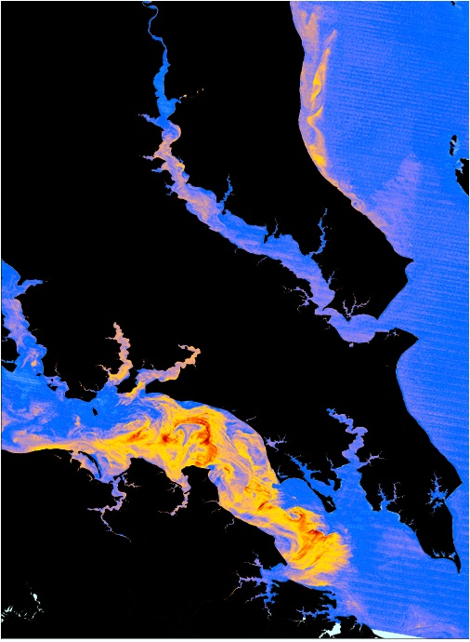
DEVELOP National Program
DEVELOP Projects & Partners:
Project Execution, Partner Engagement, Performance Metrics, Communicating results

Slide 2
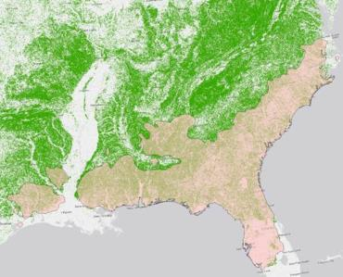
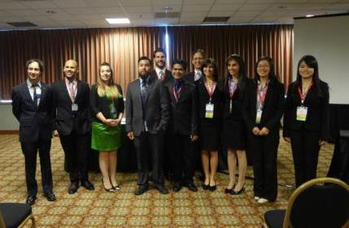
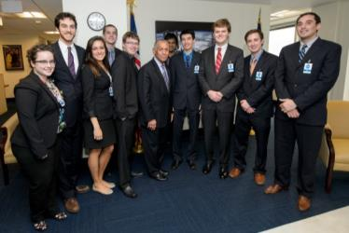
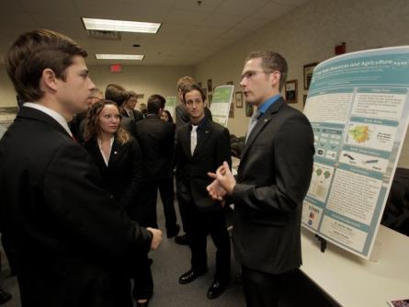
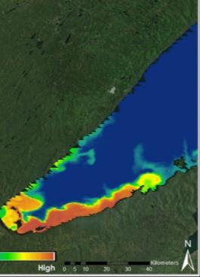
FY2015 Project Stats
Fall 2014
117 Participants working on
25 Projects with
57 Partners & End-Users
Spring 2015
115 Participants working on
29 Projects with
64 Partners & End-Users
Summer 2015
169 Participants working on
38 Projects with
84 Partners & End-Users

Slide 3
Project Lifecycle
Science
National Science Objectives
Program Managers
Science Advisors
Decadal Survey
Partners / End-Users
Community Demand
Local Policy Makers
State Governments
Federal Agencies
Applied Sciences Program
Project Execution
Partner with stakeholder
Support from science advisors
Data acquisition, processing, analysis
Creation of deliverables
Outreach
Present at Science & Policy conferences
Virtual Poster Session (VPS)
Recruiting events
Publications
Capacity Built:
Future Workforce
Capacity Built:
Partner Organizations
Capacity Built:
State/Local/Federal
Governments
Capacity Built:
General Public

Slide 4
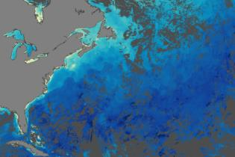

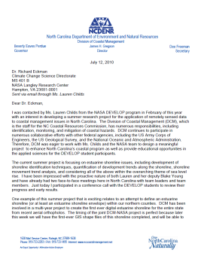
Project Characteristics
80+ projects take place each year - at their core they share these characteristics:
Highlight the applications and capabilities of NASA Earth observations
Address community concerns relating to decision-making for real-world environmental issues
Partner with organizations who can benefit from using NASA Earth observations to enhance decision making by providing decision support tools
Align with at least one of the nine NASA Applied Sciences Program’s National Application Areas
Research is conducted by teams with diverse backgrounds under the scientific guidance of Science Advisors and mentors from NASA and partner organizations

Slide 5







2015 Summer Portfolio
Alaska Disasters (LaRC)
California Disasters II (JPL)
East Africa Disasters (MSFC)
Georgia Disasters (UGA)
Himalaya Disasters II (GSFC)
Idaho Disasters II (BLM-ISU)
Indonesia Disasters (IRI)
Malawi Disasters II (IRI)
Peru Disasters II (WC)
Southern California Disasters II (SSC)
Southwest US Disasters (NCEI)
Texas Disasters (SSC)
Thailand Disasters (GSFC)
US Disasters II (JPL)
Ethiopia Eco Forecasting (FC)
Maryland Eco Forecasting (GSFC)
Mississippi Eco Forecasting (SSC)
North Carolina Eco Forecasting (LaRC)
Ocmulgee Eco Forecasting II (UGA)
Southeast US Eco Forecasting (UGA)
Texas-Arizona Eco Forecasting (MSFC)
Colorado Ag II (FC)
Northwest US Ag III (LaRC)
Thailand Ag (MSGC/WC)
Navajo Nation Climate II (ARC)
Arizona Health AQ (LaRC)
Brazil-Venezuela Health AQ (GSFC/MSFC/WC)
Los Angeles Health AQ (JPL)
Coastal Texas Water (MCHD)
Colorado Water II (LaRC)
Costa Rica Water II (UGA)
Mexico Water (ARC)
New Mexico Water (JPL)
Pacific Water (NCEI)
Sierra Nevada Water (ARC)
Texas Water (LaRC)
Virginia Water (PHB)
CALIPSO Cross-Cutting II (LaRC)

Slide 6
Project Team Responsibilities
Set goals and work towards them.
Complete all mandatory deliverables and weekly updates, as well as any optional deliverables the team decides.
Please respect the chain of command within the team - project team members report to Project Leads, who report to Center Leads, who report to NPO. However, don’t feel bogged down by the chain of command - DEVELOP fosters open communication between all levels!
Leave organized documentation of all research and contacts so the project and/or communication with end-users may be continued in following terms.
Cleanup team rooms and office space daily (common areas, etc.) – respect your office mates and stay orderly.
Look at what else needs to be done when you have completed the tasks your Project Lead(s) and Center Lead(s) have assigned. Take initiative!
Have an open mind & learn from each other!

Slide 7
Deliverable Descriptions and Uses
Project Summary
Compiles project information for reporting and outreach materials, such as project booklets, annual reports, close out presentations, quarterly program reviews, monthly status reports, and also the virtual poster session. This content will be what feeds the DEVELOPedia page and is what future DEVELOP teams will use to reference and understand your project.
Sub-deliverables:
Abstract Update – This is a mid-term follow up with teams regarding abstract edits ahead of submission in the final project summary. This allows for updates based on project activities and for final feedback ahead of the VPS. Once the feedback/final version is sent from NPO to teams it should be inserted into all final deliverables.
DEVELOPedia Page – Take the content from the final summary returned by NPO and use it to populate your team’s DEVELOPedia page in week 9.
Poster
Provides understanding of the project and its results in one overview. Content is often the same/similar to the presentation content. Posters are presented in close-out sessions and at conferences. Creating a successful poster to demonstrate results is great skill and a standard practice in science. All teams will submit a HQ final draft, and a final draft at the end of the term can include more results/outcomes or a team can submit the HQ poster as the final poster draft again.
Presentation
A visually appealing means of telling the story of the project and the flow should carry the viewer from the community concern to the conclusions. The page structure in the template is a guide, feel free to amend it to fit your project. It must include full speaker notes. Typical length is 6-20 slides, depending on the presentation venue. Often used to report to project partners, NASA HQ and at conferences.

Slide 8
Deliverable Descriptions and Uses
Tech Paper
Provides a synopsis of the project with technical details for partners and future DEVELOP teams to replicate and understand. Methods should be the focus. It should be no longer than 12 pages and use the template unless permission is previously granted to use a different style. Any distribution or publications of this work must go through NASA Export Control.
VPS: Video & Transcript
The VPS deliverable consists of the video and full transcription of audio in the video. The transcript is mandatory, as the video must be compliant with Section 508 of the US Rehabilitation Act. Videos must not be longer than 4 minutes, 15 seconds, include the mandatory DEVELOP beginning and ending clips, and provide a good overview of the project. Creativity is appreciated, however “goofy” is not. A good rule of thumb is to ask yourself if you would feel comfortable sending the video to your project partners. Keep in mind that you are representing NASA.
Optional Deliverables
Tutorial: Description of methodologies for data acquisition, processing and analysis; useful for hand-offs to partners/end-users and future DEVELOP teams. These are being collected for inclusion in DEVELOPedia and made available to future teams.
Brochure: Useful for hand-offs and close out presentations.
AGOL Map: Useful for sharing w/partners/end-users, share maps with general public. Experience w/AGOL is a good resume builder.
Final Imagery: Used for brochures, close out print material, presentations, posters, social media, etc. Serves as a one stop shop for imagery found in the presentation, tech paper, video and poster.

Slide 9
Deliverable Submission
1. Template
Make sure you are using the right template and the template font and formatting is intact (especially if your team used Google Docs to collaborate on the text)!
2. Nomenclature
YearTerm_Node_Team_Deliverable_Draft
Use this for EVERYTHING! (all deliverables and any separate attachments - images, etc.)
Examples: 2015Sum_LaRC_NorthCarolinaWater_Poster_FD
2015Sum_LaRC_NorthCarolinaWater_Imagery_legend.PDF
3. Center Lead & Science Advisor Review
Center Leads and Science Advisors should review and approve prior to submitting to NPO
Work in time for this! They are busy people!
4. Submit:
Submit through your project team’s DEVELOPedia page [there is a 60MB limit]
  There is a 60MB limit, so do not submit videos through DEVELOPedia – use NASA Large File Transfer System or Google to share those with the Project Coordination Team
If there are any issues or delays, email DEVELOP.ProjectCoordination@gmail.com
5. Archive on the Exchange: http://files.developexchange.com/
All teams should keep a second copy of all submitted final deliverables in their folder on the Exchange.

Slide 10
Project Summary | Tech Paper | Poster | Presentation | Video & Transcript | Optional Deliverables
Week 1
Week 2
Week 3
Week 4
Week 5
Week 6
Week 7
Week 8
Week 9
Week 10
Rough Draft
Rough Draft
AGOL Interest Form
Abstract Only
Rough Draft
Rough Draft
Final Draft w/Image
HQ Final Draft
HQ Final Draft
Video & Transcript
AGOL HQ Final Draft
DEVELOPedia Page
HQ Close Out
HQ Close Out
VPS Launch
Final Draft
Final Draft
Final Draft
Brochure, Imagery, AGOL Map, Tutorial

Slide 11
2015 Summer Deliverable Deadlines
June
Week 1 (6/5): Handbook Forms
Week 3 (6/18): Project Summary Rough Draft
Week 3 (6/19): HQ Travel & Highlight Request (submitted by CL only)
Week 4 (6/22-26): Focus – Tech Paper, Video Planning
Week 4 (6/25): Tech Paper Rough Draft
July
Week 5 (6/30): Abstract Update
Week 5 (7/2): Poster Rough Draft, Presentation Rough Draft
Week 5 (7/3): Offices Closed for Independence Day
Week 6 (7/9): Project Summary Final Draft (includes final image)
Week 8 (7/20-24): Focus – Video, Transcript, HQ Poster/Talks
Week 8 (7/20): VPS (Video & Transcript)
Week 8 (7/22): HQ Poster Final Draft, HQ Presentation Final Draft & HQ AGOL Map Content
Week 9 (7/27-31): Focus – HQ Showcase, Travel, VPS Launch
Week 9 (7/30): HQ Showcase
Week 9 (7/31): VPS Launch, DEVELOPedia Page
August
Week 10 (8/3-7): Focus – VPS Blogging, Node Close Outs & Partner Hand-Offs
Week 10 (8/6): Technical Paper Final Draft, Final Poster & PPT
Week 10 (8/7): Optional Deliverables

Slide 12
Questions?
1. Check Out the Project Coordination Team DEVELOPedia Page
http://www.devpedia.developexchange.com/dv/index.php?title=Project_Coordination
This the hub of all things project-related. Guides, videos, templates, etc. Check it out!
2. Watch Deliverable How-To Videos
Each deliverable has a short narrated demonstration of how to successfully go about completing the deliverable. These are available on DEVELOPedia.
3. Join the Project Coordination Team Open Doors
The day before each deliverable deadline, the Project Coordination Team will host an “open door” session where anyone from any team can join and ask questions. The PCT will be in touch with exact day/times.
4. Email the Project Coordination Team
DEVELOP.ProjectCoordination@gmail.com
Don’t hesitate to email questions!
5. Call the Project Coordination Team
Fellows:
Amberle – 208.530.0866
Peter – 706.338.4020
Christine – 818.621.9790
Senior Fellows:
Beth – 757.864.4496
Tiffani – 757.864.3762
NPO:
Lauren – 757.864.4204
Jamie – 804.692.0136

Slide 13

Scientific Integrity
“The iconic success of NASA is planted firmly on three foundational elements: innovation, inspiration, and integrity. While innovation and inspiration are visible through our endeavors and successes, it is our integrity – how we work, and our commitment to excellence and openness – that earns us the trust of the public and ensures our continued ability to inspire and innovate. Integrity is woven throughout the fabric of NASA. It has always been there. And each and every day, we recommit ourselves to keeping it there.”
Dr. Waleed Abdalati
Former NASA
Chief Scientist
NASA SI Policy: http://www.nasa.gov/pdf/611201main_NASA_SI_Policy_12_15_11.pdf

Slide 14
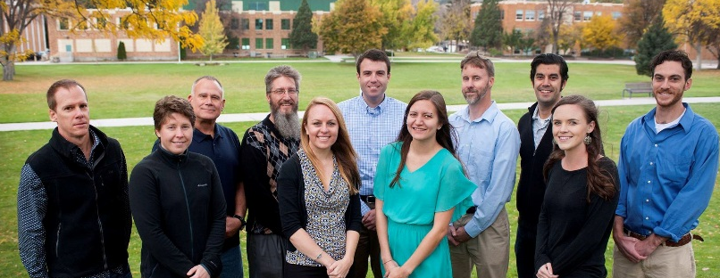
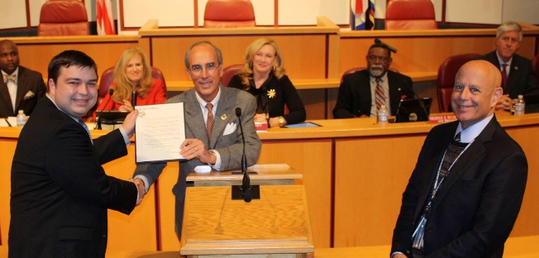
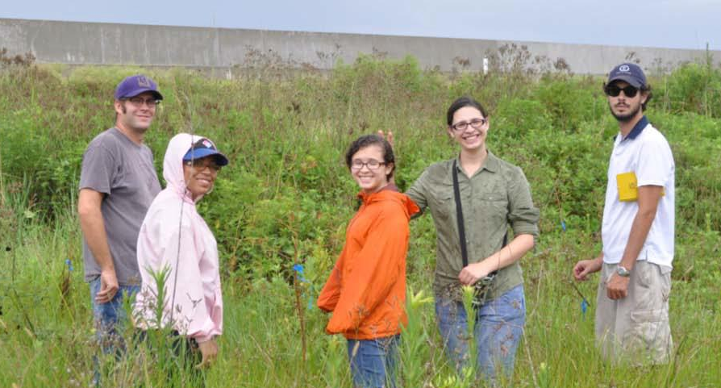
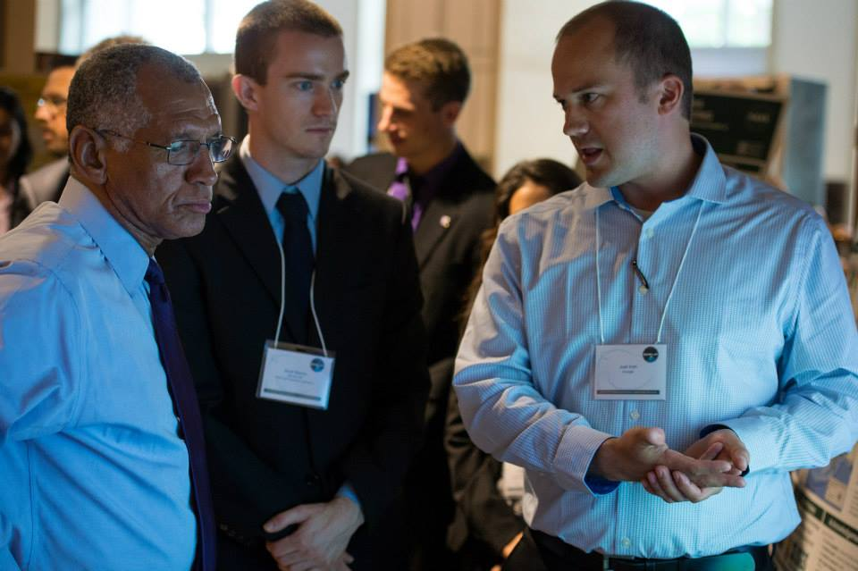
Partner Types: Definitions
Often, DEVELOP teams use the terms ‘partner’ and ‘end-user’ interchangeably. However, there are some distinct differences relating to these terms, and thus the standardized definitions of typical DEVELOP partners are provided.

Slide 15
Partner Types: Definitions
Partner: Umbrella term for any outside organization DEVELOP engages with through projects, nodes, or other activities
  Types of Partners
  End-User: Organization or individual that receives results and methodologies from DEVELOP (either directly from a DEVELOP project team or through a collaborator/boundary organization) and can use the project’s products or methodologies to make a decision or policy. They may also provide some kind of resources (advising, data, model, software, funding, etc.), but it is not required. Ex. The Texas Forest Service’s Predictive Services that can use the products/methodologies from the DEVELOP project in their risk mapping creation.
  Collaborator: Organization or individual that works directly with a DEVELOP project team and provides some kind of leveraged resource (advising, data, model, software, funding, etc.), but are not actually using the project’s products or methodologies to make a decision or policy. Ex. A researcher from a university who provides a team with an ancillary dataset to validate their results.
  Boundary Organization: Organization or individual that disseminates the project’s results to other end-users, decision makers, policy-makers, etc. The Applied Sciences Program defines a boundary organization as “an organization outside of your own that broadens your reach across the boundary into the operational domain (i.e. policymakers, decision makers, and other key stakeholders).” Ex. The Smithsonian Conservation Biology Institute works with local groups in Myanmar and helped DEVELOP disseminate results from the Myanmar Ecological Forecasting project to those in-country groups.

Slide 16
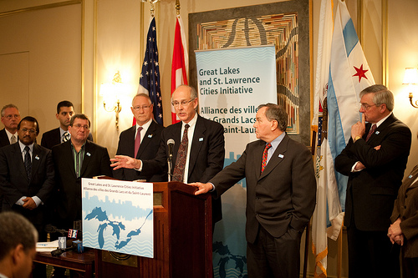
Partner Engagement & Communication
A cornerstone of DEVELOP projects is the engagement of management and policy makers who can benefit from the integration of NASA Earth observations in their decision making process. All DEVELOP projects strive to engage at least one decision-making organization to hand off project results and methodologies to.
The FY15 Project Coordination Fellows are creating a DEVELOP Partner Engagement Manual to further bolster this process.
Communication Strategies Commonly Employed:
Open communication lines with your partners, see what their needs and meeting abilities are, devise a plan, then be flexible!
Team-Partner greeting telecon during the first or second week
Weekly or bi-weekly telecons & emails with status updates
Hand-off event at the end of the term

Slide 17
Checklist: Working with Partners
Ensure professionalism in all interactions - you are representing yourself, your team, your advisors, your node, DEVELOP, Applied Sciences, and NASA!
Have a plan and schedule.
Be realistic in what you promise and the expectations of the partner, in fact don’t “promise” anything, but ensure the plan you are working to is clear and that there is a healthy understanding of challenges and potential obstacles/risks.
Keep in mind the limitations of resolution (spatial and temporal) of NASA data and work within them.
Understand the partner’s needs - what kind of data/tools are useful, what software do they have access to, what tutorials or products would be helpful?
Keep communication lines open and ensure the team follows through. Generally speaking, the Project Lead should be the POC for communicating with a partner unless it is specifically delegated to another team member.
All emails to partners should be approved by the Center Lead and you should cc the Center Lead always.
Include your project’s Science Advisor in partner communication as much as is possible per your advisor’s availability

Slide 18
Pre- and Post-Project Partner Forms
A Pre-Project Partner Form was sent out before the term to gather information about partner needs and expectations. A Post-Project Partner Form will follow the completion of the term to collect information regarding the perceptions of success of collaborating with DEVELOP.
  Were the project results and methodologies useful?
  Was the experience a good one?
  Is the partner using the results or methodologies in their decision-making process?
Timeline: Center Leads sent out the Pre-Project survey link a couple weeks before the beginning of the term. The Post-Project survey link will be sent to partners at the end of the term. In case of a project that has multiple terms, the survey goes out following the project’s final term.
Please communicate to your partners that DEVELOP will stay in touch and send a brief survey at the end of the project’s final term.

Slide 19
Understanding Partner Needs
Prepare for your first team communication with your partner by compiling questions relating to the following areas. Discuss this with CLs, look at responses to the pre-project form, and build off previous conversations with the partner. The following questions can guide you in understanding your partner’s needs:
Community Concern or Policy
Background, current policies, and upcoming/ongoing decisions relating to the issue at hand
Economic impact (ex. cost of fighting a wildfire or drought impacts to crops in a region)
Technology
Do they currently use GIS and/or remote sensing?
What data types are they familiar with?
Do they have access to Arc/ENVI/Matlab/etc. or whatever software you will use? If not, would they be able to purchase it? (this can guide the team’s use of open source software)
Partnership and Transition
Clarify expected level of involvement - how much can the partner interact with the team?
What organizations do they partner with?
What tutorials would be of use? What format should end-products be in to be useful?
What is the best transition approach? Email, telecon, videocon, in-person (consider distance for this one - if you’re 3000 miles apart choose a different option unless the partner can fund)

Slide 20
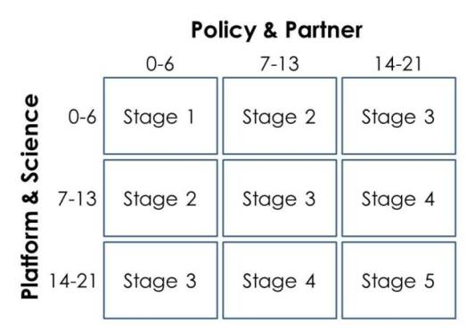
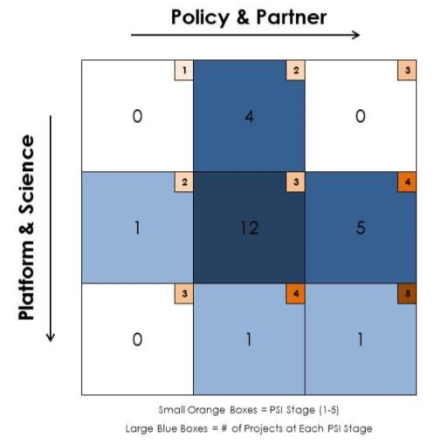
DEVELOP Project Strength Index (PSI)
DEVELOP projects have consistently improved and matured over the Program’s last 15+ years. A means of assessing project progression and comparing project success has, to date, been subjective. This project strength index provides DEVELOP a means of objectively evaluating projects and tracking progress.
A series of questions are answered earning a total of 21 points in two sections: 1. Policy & Partner and 2. Platform & Science. The score for each category is then placed on the index to receive the project’s current stage (1 to 5).
Stage 1: Basic Research
Stage 2: Application Concept Complete
Stage 3: Application Demonstration Successful
Stage 4: Application Verified / End-User Engaged
Stage 5: Transition to End-User / Decision Enhanced

Slide 21
Presenting & Publishing DEVELOP Work
For purposes of ensuring appropriate export control review, performance metric tracking, and reporting to NASA HQ, any and all presentations or publications related to DEVELOP (projects or the program in general) must be communicated to, and content shared with, the NPO before the presentation/publication.
Submitting work for presentation or publication is encouraged; however, ALL research is the property of NASA and therefore, you must have permission prior to submitting your research anywhere. Also, to minimize duplication of effort, the NPO oversees all publications and presentations.
Coordinate with your Center Lead and if approved at your node, a simple email with your ideas before the presentation or publication to Karen.N.Allsbrook@nasa.gov and Lauren.M.Childs@nasa.gov with the following information will suffice:
Description of the activity - conference, presentation to a class, publication, etc.
Timeline for the activity - when the event is or deadline for publication, etc.
A copy of the material/content (because often presentations can be large, a PDF is good enough for a quick review)
Thank you for your consideration and help with this!

Slide 22
NASA’s Export Control
What is a Export Control?
The NASA Export Control Program is based on the philosophy: “We want to maximize the benefits of our international efforts while ensuring that we comply with U.S. export control laws and regulations”. This is the personal responsibility of each employee or contractor to pursue appropriate international activities involving transfers of technologies, software, and commodities. The Agency’s Export Control Program is the mechanism that provides checks and safeguards at key steps to help manage international activities and ensures that NASA works within Export Administration Regulations (Department of Commerce) and the International Traffic in Arms Regulations (Department of State), which could result in criminal, civil, or administrative enforcement actions against NASA, individual employees, and/or private contractors.
NASA Administrator’s Export Control Policy:
"As a U.S. Government Agency on the forefront of technological development and international cooperation in the fields of space, aeronautics, and science, the National Aeronautics and Space Administration will strive to fulfill its mission for cooperative international research and civil space development in harmony with the export control laws and regulations of the United States. Due to heightened proliferation challenges facing the United States and the world, including risks posed by the spread of missile technologies and weapons of mass destruction, and in view of the significant criminal, civil, and administrative penalties that may affect the Agency and its employees as a result of a failure to comply with U.S. export control laws and regulations, it is the responsibility of every NASA official and employee to ensure that the export control policies of the United States, including nonproliferation objectives, are fully observed in the pursuit of NASA's international mission."

Slide 23
Export Control & Designated Countries
What is a Designated Country?
This list of “Designated Countries” is a compilation of 41 countries with which the United States has no diplomatic relations, countries determined by Department of State to support terrorism, countries under Sanction or Embargo by the United States, and countries of Missile Technology Concern.
What does this mean to me?
It means that for any project deliverables, products, decision support tools, etc. to be transferred to any partner (domestic or international) a review must take place first. The NPO ensures that DEVELOP works within NASA Export Control guidelines. The NPO must be made aware of any presentations, publications, or information transfer that take place before they occur. A transfer can be an email, publication, presentation, telecon, webinar, etc. Communication with partners in designated countries has restrictions, so coordinate with NPO ahead of opening communication lines.
But my partner is domestic/not in a designated country?
While your project partner may be in the United States or not on the designated country list, the assumption is that anything that leaves the Agency/DEVELOP could be in turn transferred to any individual or organization anywhere and thus we must ensure that all material is appropriate for a global audience.
Questions? Contact Lauren.M.Childs@nasa.gov
NASA Export Control: http://oiir.hq.nasa.gov/nasaecp/index.html

Slide 24

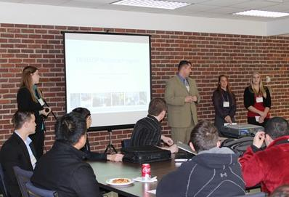
Hand-Offs
Hand-offs are an important step in transitioning results and methodologies to end-users, and working towards the goal of the end-user integrating NASA Earth observations in their decision making process.
Commonly Used Hand-off Styles
Email of deliverables (tech paper, tutorials, presentation, etc.)
Teleconference or videoconference presenting the results and methodologies
In-person presentation of results and methodologies
Get creative in how and what you hand-off. Interesting idea? Speak to your Center Lead about it!

Slide 25
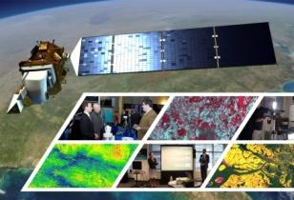
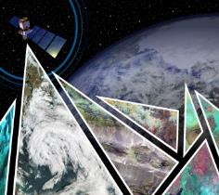

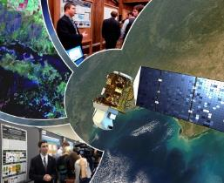
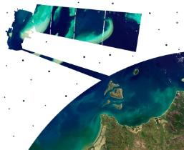
Virtual Poster Sessions
What is a Virtual Poster Session?
Since 2011, DEVELOP has regularly collaborated with IEEE’s Earthzine to showcase the work of participants through a series of ‘virtual poster sessions’ or VPS. Each VPS includes an impressive array of abstracts, videos, and other material on each DEVELOP project. A blogging period with question-and-answer discussion allows the teams to interact with the global community and share their work.
Thousands of people from around the world participate in the VPS – For example, the 2015 Spring VPS had visitors from 87 different counties with 3500 video views!
Key Dates:
VPS Video and Transcript – due July 20 (Week 8)
VPS Launch – July 31 (Week 9)
Bonus: The winning team receives a prize package from VPS sponsors (geospatial software)
DEVELOP VPS Archive: www.earthzine.org/vps-archive/

Slide 26
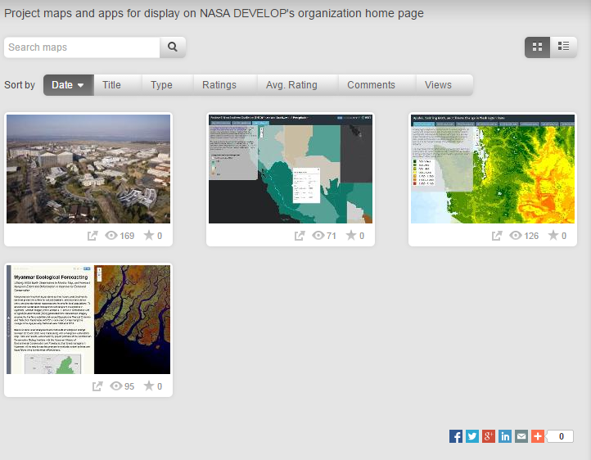
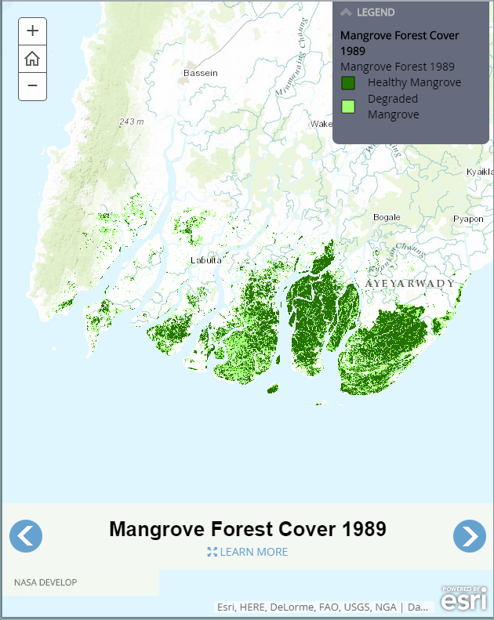
ArcGIS Online (AGOL)
Newly available to participants this term!
Tell the story of your project with a publicly viewable app.
Easy to get started
Attend the interest meeting to learn more.
DEVELOP AGOL Project Gallery: http://goo.gl/gSH0TK

Slide 27

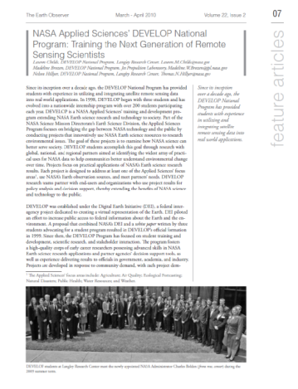
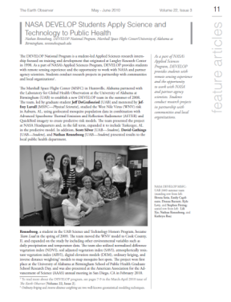
Publications
Publications are a huge avenue for getting the word out about the great research you are a part of with DEVELOP!
DEVELOP has a handful of peer-reviewed publications to date.
Currently, DEVELOP publishes frequently in Earthzine, Directions Magazine, and The Earth Observer
Water for Agriculture is Earthzine’s new quarterly theme, and we are looking to submit a few summer projects.
If you are interested in working your project toward a potential publication, contact your Center Lead and Tiffani Miller.
Reminder: All publications must be approved by NPO and NASA’s Export Control process before submission!

Slide 28
DEVELOPedia
DEVELOPedia is an internal wiki intended to serve three purposes:
  Enhance project workflow
  Capture lessons learned and make them available to future project teams
  Record data required for operational metrics
DEVELOPedia is a collaborative effort whose utility is directly related to the efforts of previous DEVELOP participants.
DEVELOPedia is a living document, constantly adapting to meet the needs of the NASA DEVELOP National Program and the people that make the program great. (That’s you!)
http://www.devpedia.developexchange.com
Notes:
Initial program release for Summer Term 2015
Historical content still being added

Slide 29
Resources
DEVELOP Handbook: Given to each participant at start of term, also on DEVELOPedia
DEVELOPedia: http://www.devpedia.developexchange.com/
You should have received information about your account just before the beginning of the term.
DEVELOP Exchange: http://developexchange.com/
Username: develop_user & Password: DEVELOPers2014!
Filezilla: Server file exchanging program to connect to the DEVELOP Exchange. Very easy to use, and free.
DEVELOP Website: http://develop.larc.nasa.gov/
DEVELOP’s Anonymous Dropbox: http://developexchange.com/dropbox.html
Need Help?
Geospatial help - email Geoinformatics Team: DEVELOP.Programming14@gmail.com
Deliverable help - email Project Coordination Team: DEVELOP.ProjectCoordination@gmail.com
NPO-level questions - refer to the questions page in the About DEVELOP section and email the appropriate contact, unsure who? Ask your Center Lead.

Slide 30
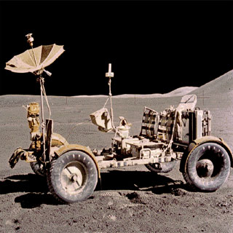
THANK YOU!
A lot goes into every DEVELOP project. What will your project’s legacy be?

